Slide 1
Review of TCLM studies
G. Cattenoz, L. Puddu
WP5.2 – Technical meeting
2025-03-24

Slide 2
Outline
Introduction
Thermal cycles to be done at CERN
First proposal for thermal isolations for TT at CERN
Results from simulations
  TCLM4 outgoing
  TCLM5/6 + TCLM4 incoming
Next step: experimental test with prototypes
Conclusions

Slide 3
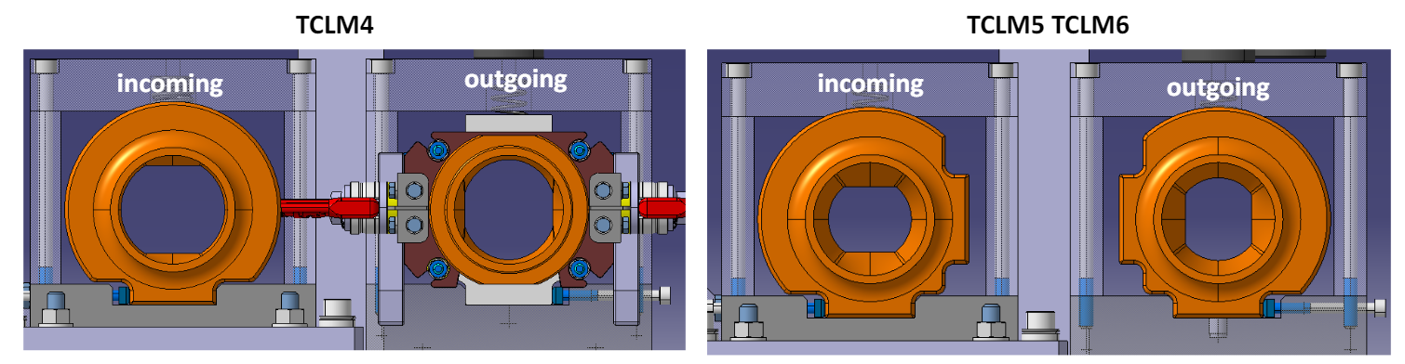
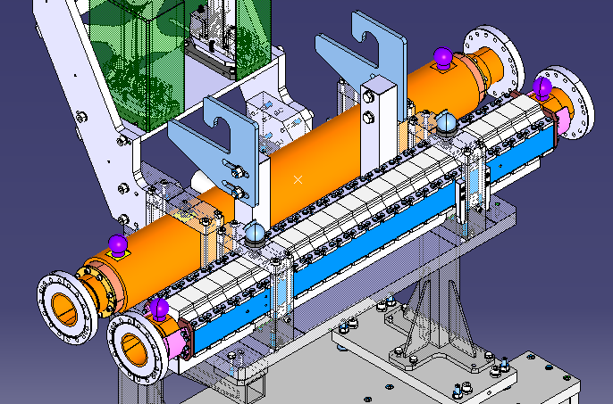
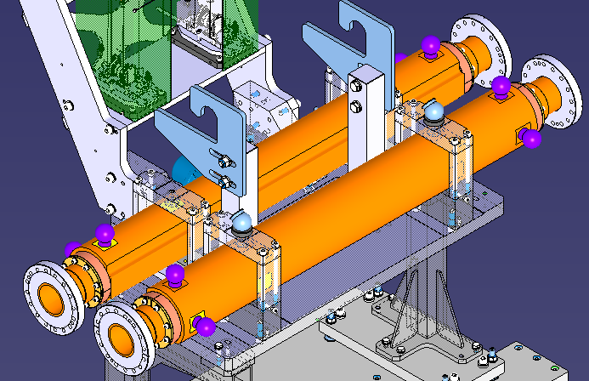
Introduction
Different design:
TCLM4 outgoing:
  Most loaded
  Made of copper and inermet
TCLM5/6 + TCLM4 incoming:
  Less loaded
  Made of copper only
  Easier design

Slide 4
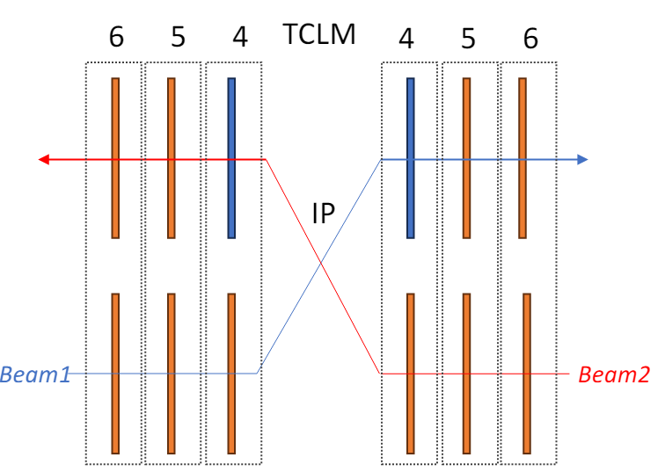
Introduction
New TCLM masks design analyzed (EDMS n. 3221866, 3221867)
Scenarios simulated:
  Bake out (250 °C)
  Operational conditions
Load from Fluka simulations [Watt] | Incoming | Outgoing
TCLM4 | 1 | 40
TCLM5 | 2.4 | 8.6
TCLM6 | 0.12 | 1.6
+ 3 Watt (impedance)

Slide 5
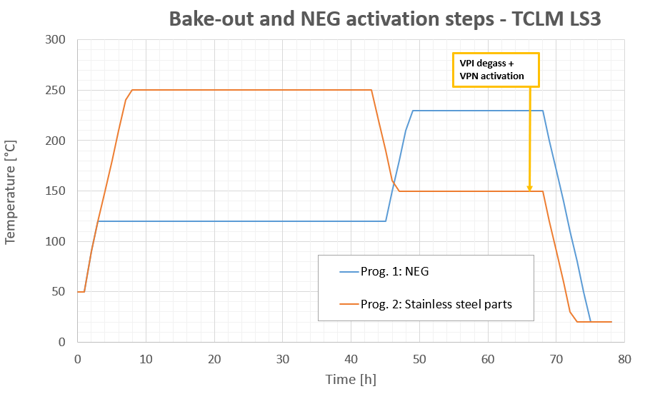
Thermal cycles to be done at CERN
Cycles for NEG and SS parts:
1st step:
    Bakeout of Stainless-Steel parts at 250°C
    NEG part (TCLM) remains at 120°C, for 48h00
2nd step:
  SS parts are cooled to 150°C
  NEG part (TCLM) is increased to NEG activation temp (230°C), for 24h00
3rd step:
  cool down to RT
During the TCLM prototype UHV test we will verify that we can reached the 230°C or not.

Slide 6
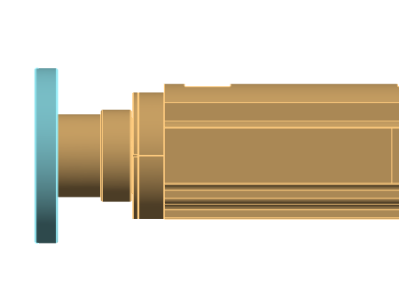
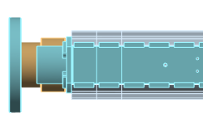
1st proposal for TT at CERN
air convection
TCLM5 and 6
Heating tape in direct contact (wrapped) on the external surface (tape length 3 or 4 m)
Insulation cover as close as possible to the flanges and all over the tape.
Glass fibres, 10 mm thick (1 layer) attached with aluminium tape): until 2.5 cm from the end flanges
Flanges covered with heating collars (which don’t really have insulation properties)
Threads for lifting, survey target interface with the mask and supports of the masks below remain accessible.
TCLM 4
Same as TCLM5/6
Alternative: bakeout jackets like collimator

Slide 7
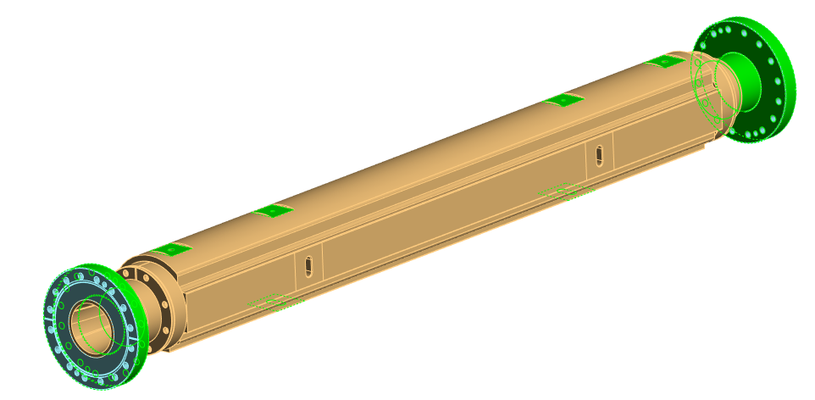
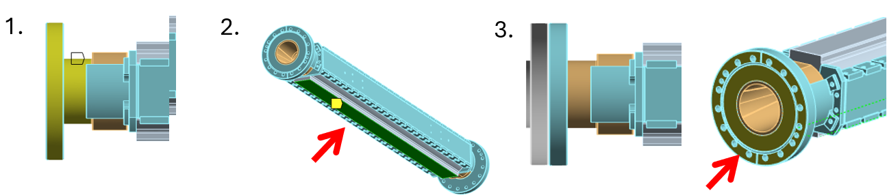
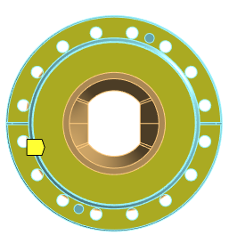
1st proposal for TT at CERN
Themo-mechanical simulations in ANSYS: BC
Air convection (extremities): 5 W/m²/K
Contact with the beam + supports at the bottom: 2 W/m²/K
At the extremities, the contribution of the thermal resistance given by the contact with the second flange (16xM8)+, by the flange itself and the air: 4.5 W/m²/K
TCLM5/6
TCLM4
1.
2.
3.

Slide 8
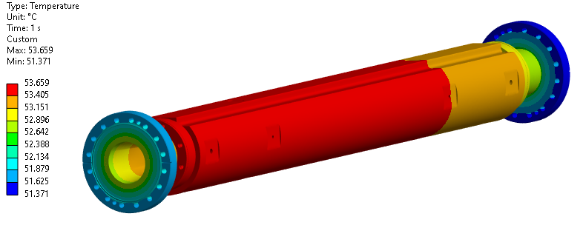
Results from simulations
TCLM5/6 – operational scenario
TCLM | Power [Watt] | Tmax [°C] | Taverage [°C]
5OUT | 11.3 | 53.7 | 52.8
5IN | 5.4 | 37.3 | 36.9

Slide 9
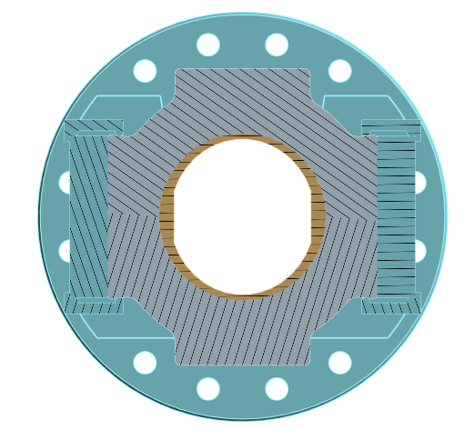
Results from simulations
TCLM4 – operational scenario
Power [Watt] | In-Cu thermal contact | Entire model |  | Copper
 |  | Taverage [°C] | Tmax [°C] | Taverage [°C] | Tmax [°C]
43 | No | 115.4 | 121.8 | 115.8 | 120.2
 | Perfect | 114.9 | 120.6 | 115.8 | 120.6
Inermet-Cu interface:
Perfect contact
or no contact
120 °C doesn’t represent a problem from the structural point of view (bake-out is more critical), but it can be a problem for degassing

Slide 10
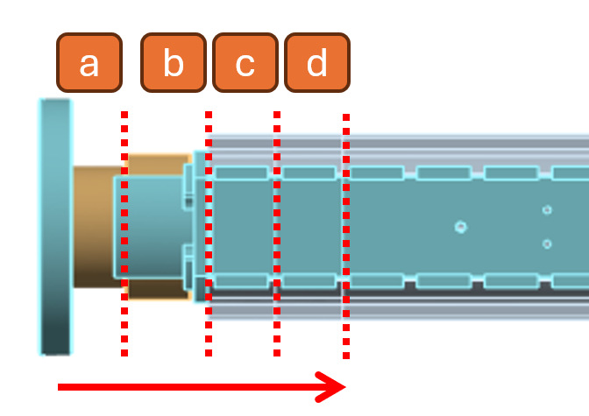
Results from simulations
TCLM4 – operational scenario
Surface with free air convection | In-Cu thermal contact | Entire model |  | Copper
 |  | Taverage [°C] | Tmax [°C] | Taverage [°C] | Tmax [°C]
a | No | 115.4 | 121.8 | 115.8 | 120.2
 | Perfect | 114.9 | 120.6 | 115.8 | 120.6
b | No | 81.3 | 87.4 | 81.3 | 85.5
 | Perfect | 80.8 | 86.2 | 81.6 | 86.2
c | No | 70.5 | 76.1 | 70.7 | 74.8
 | Perfect | 70.3 | 75.4 | 70.9 | 75.4
d | No | 62.9 | 68.1 | 63.4 | 67.5
 | Perfect | 62.8 | 67.7 | 63.4 | 67.7

Slide 11
Results from simulations
TCLM4: T<70°C if first 2 clamps are not covered
  First proposal (A): not acceptable
  Problem:
      Can we reach the temperature required during bake out with configuration D?
        Other simulations
TCLM5/6: max temperature slightly higher than 50°C

Slide 12
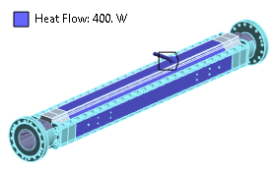
Results from simulations
TCLM4 – Bake out scenario
What power do we need to keep the bake out temperature in the entire model?
Steady state thermal simulations:
Input: 250 °C
How much time do we need to reach bake out temperature in the copper pipe?
Transient thermal simulations:
Input: 400W
Surface with free air convection (up to) | Power [Watt]
A | 107.7
B | 171.2
C | 209.1
D | 247.3
Surface with free air convection (up to) | Time
 | Perfect contact | No contact
B | 4.6 h | 5 h
D | 5.6 h | 7.7 h
Notes:
250 everywhere

Slide 13
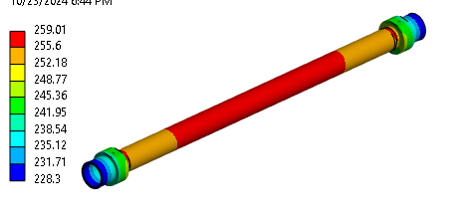
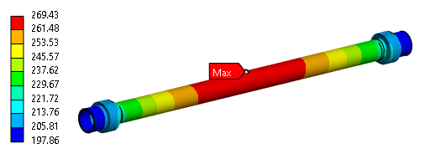
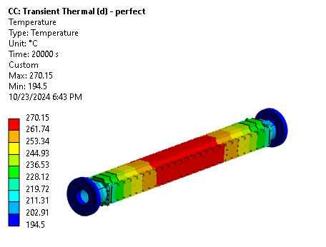
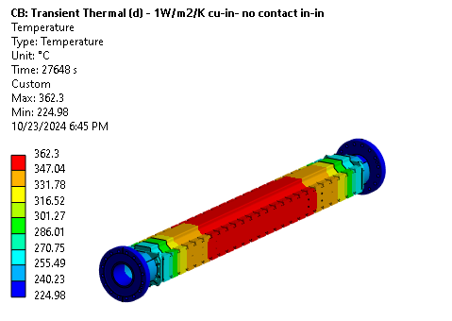
Results from simulations
TCLM4 – Bake out scenario
Temperature distribution – Case D
Input: 400 Watt
No contact
Perfect contact
After 7.7 h
After 5.6 h
From a structural point of view, the bake-out is a very critical condition and the design validation is based on certain assumptions, including 250°C being uniform in both copper and Inermet (if Inermet is at higher temperature, that would be even better)

Slide 14
Next step
Experimental set-up for bake out once we have the prototypes at CERN
When: May 2025
  TCLM5/6:
    we do not expect problems: completely covered
  TCLM4:
    Plan A: thermal isolation on TCLM4 from the center up to the second clamping system (configuration D)
    Alternatives (to be discussed)
    Plan B: active cooling system
    Plan C: thermal jackets to be removed after bake out like for collimators

Slide 15
Conclusions
The results from the simulations show different scenarios for:
  TCLM5/6 + TCLM4 incoming: masks in copper
  TCLM4 outgoing: masks in inermet and copper
The first proposed thermal insulation during the operational scenario cannot be implemented for TCLM4 outgoing masks (T>120 °C)
Several solutions have been investigated though FEA that must be tested while the prototype will be available at CERN
  2 alternatives have been already identified

