Slide 1
CuBe RF springs insertion
Remi VISCARDI
24-03-2025

Slide 2
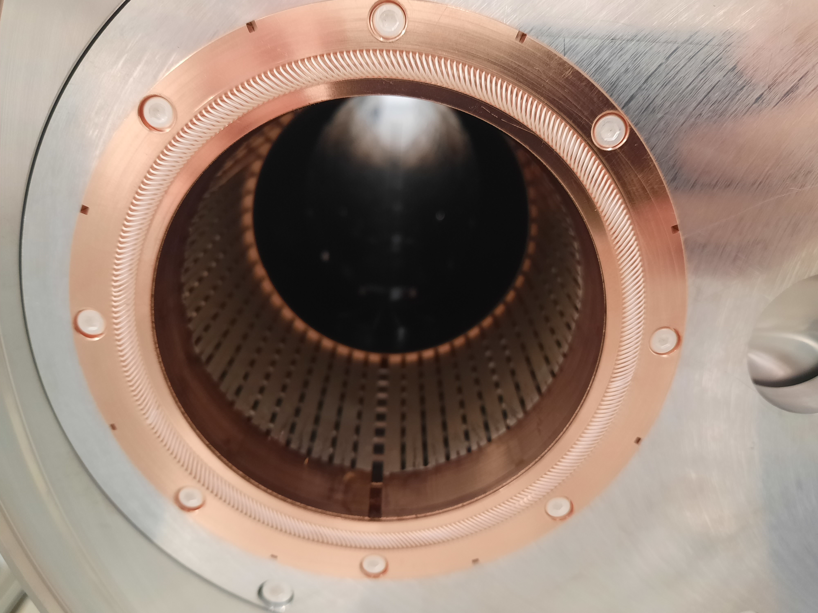
Context
We had noticed a fault with the springs. After closing and reopening the flanges, the springs flattened without returning, which posed a problem for the reliability of the electrical contact. In addition, there could be a problem during installation.
And the shape of the springs didn't really correspond to what was expected

Slide 3
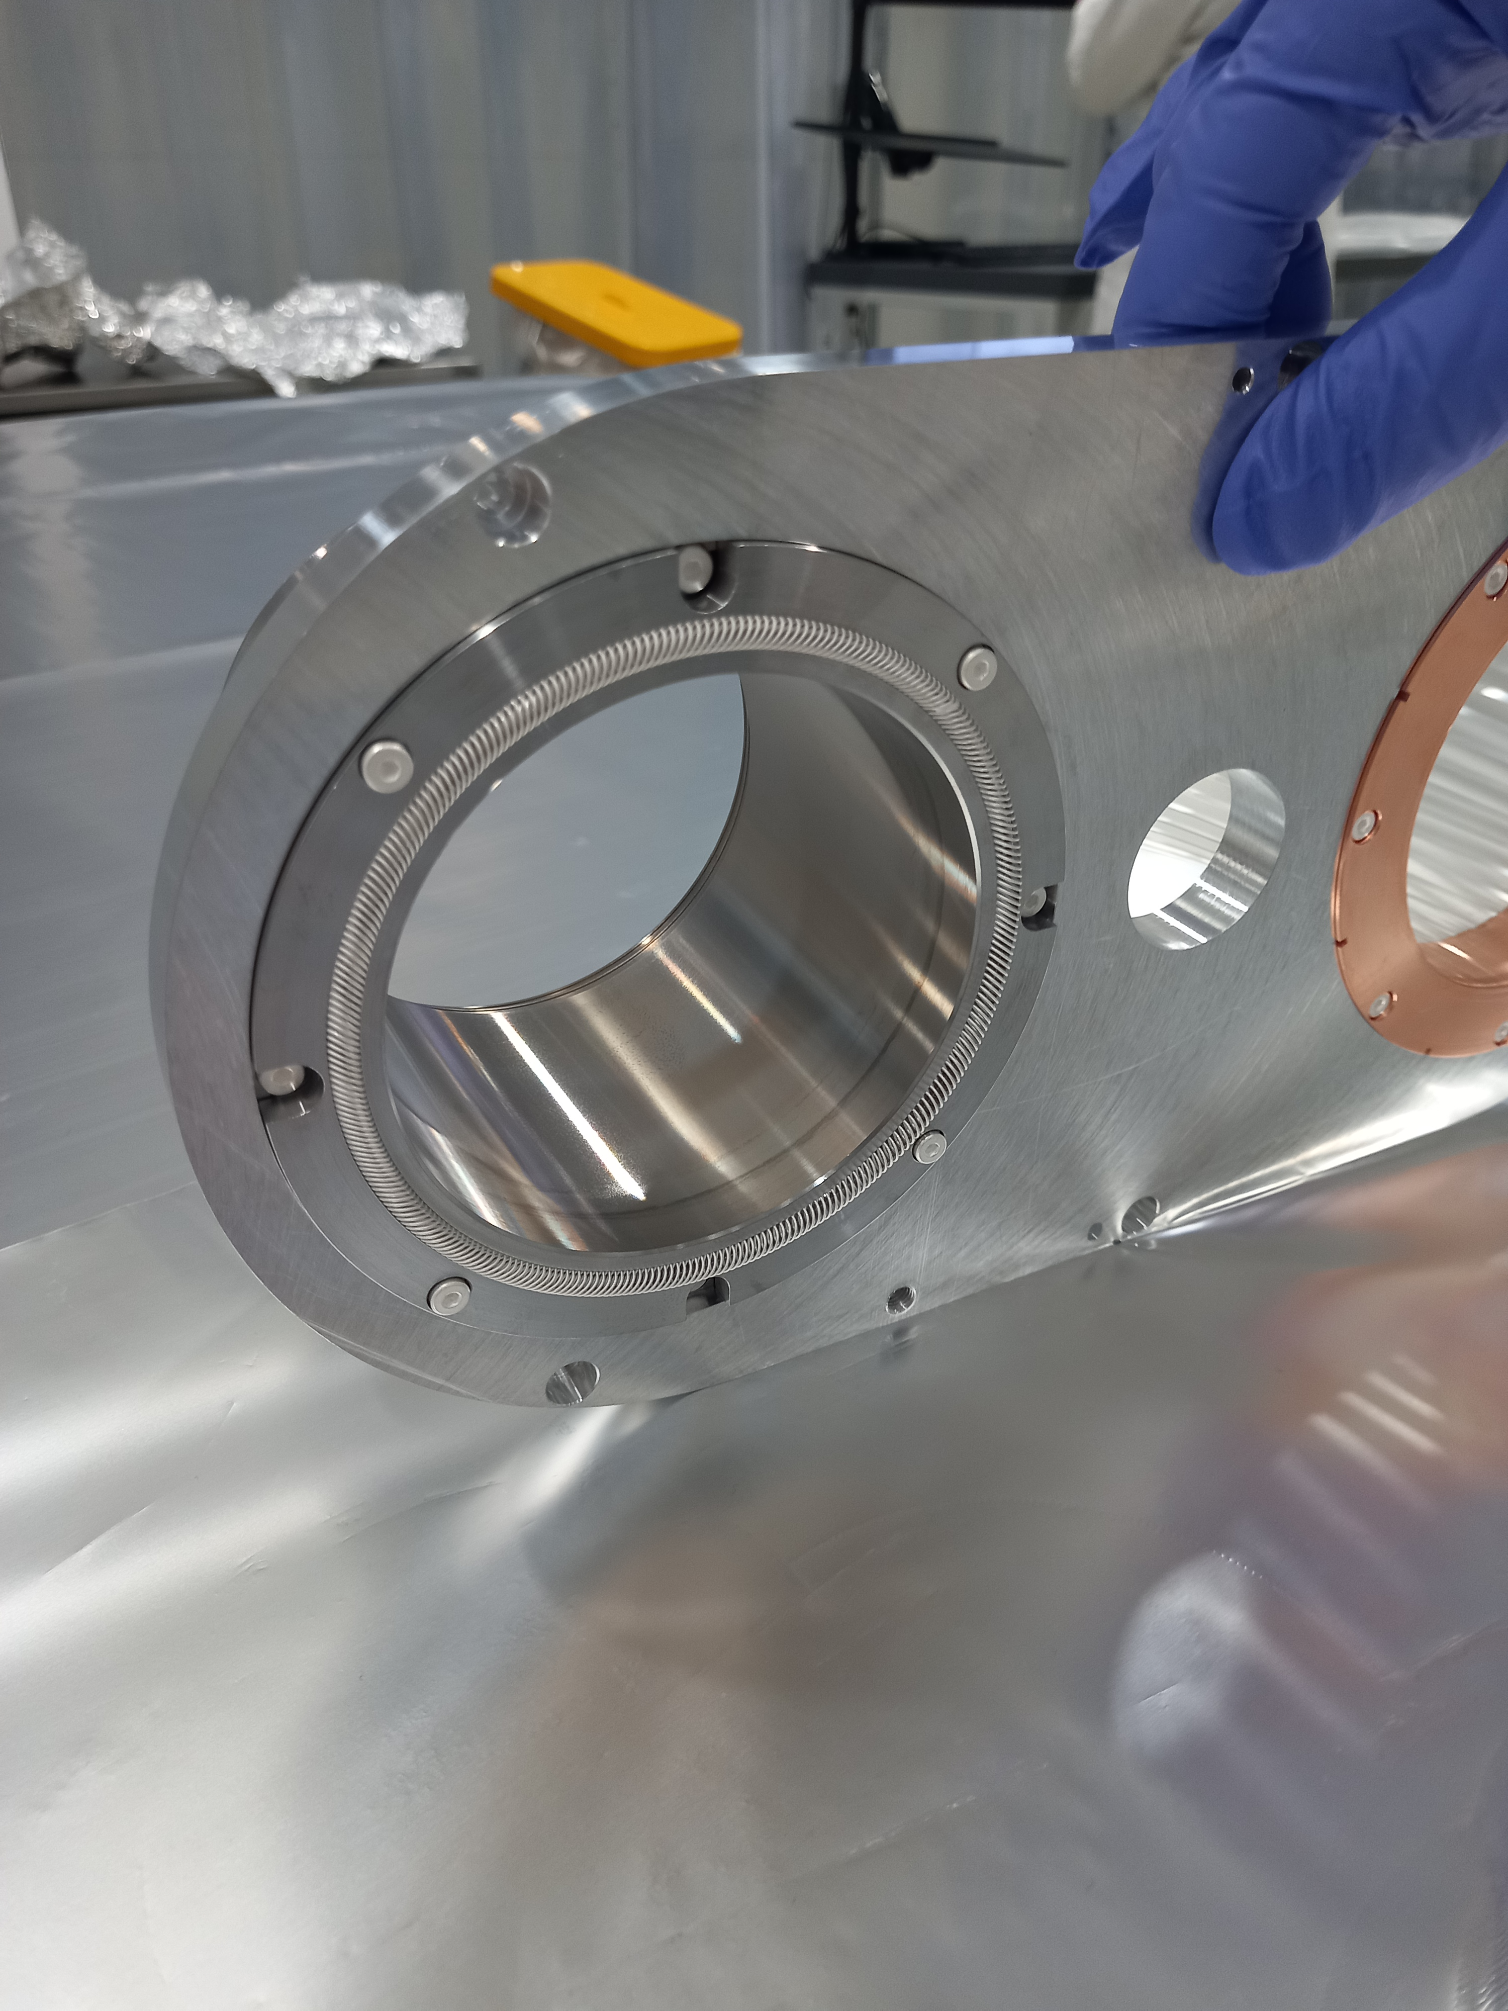
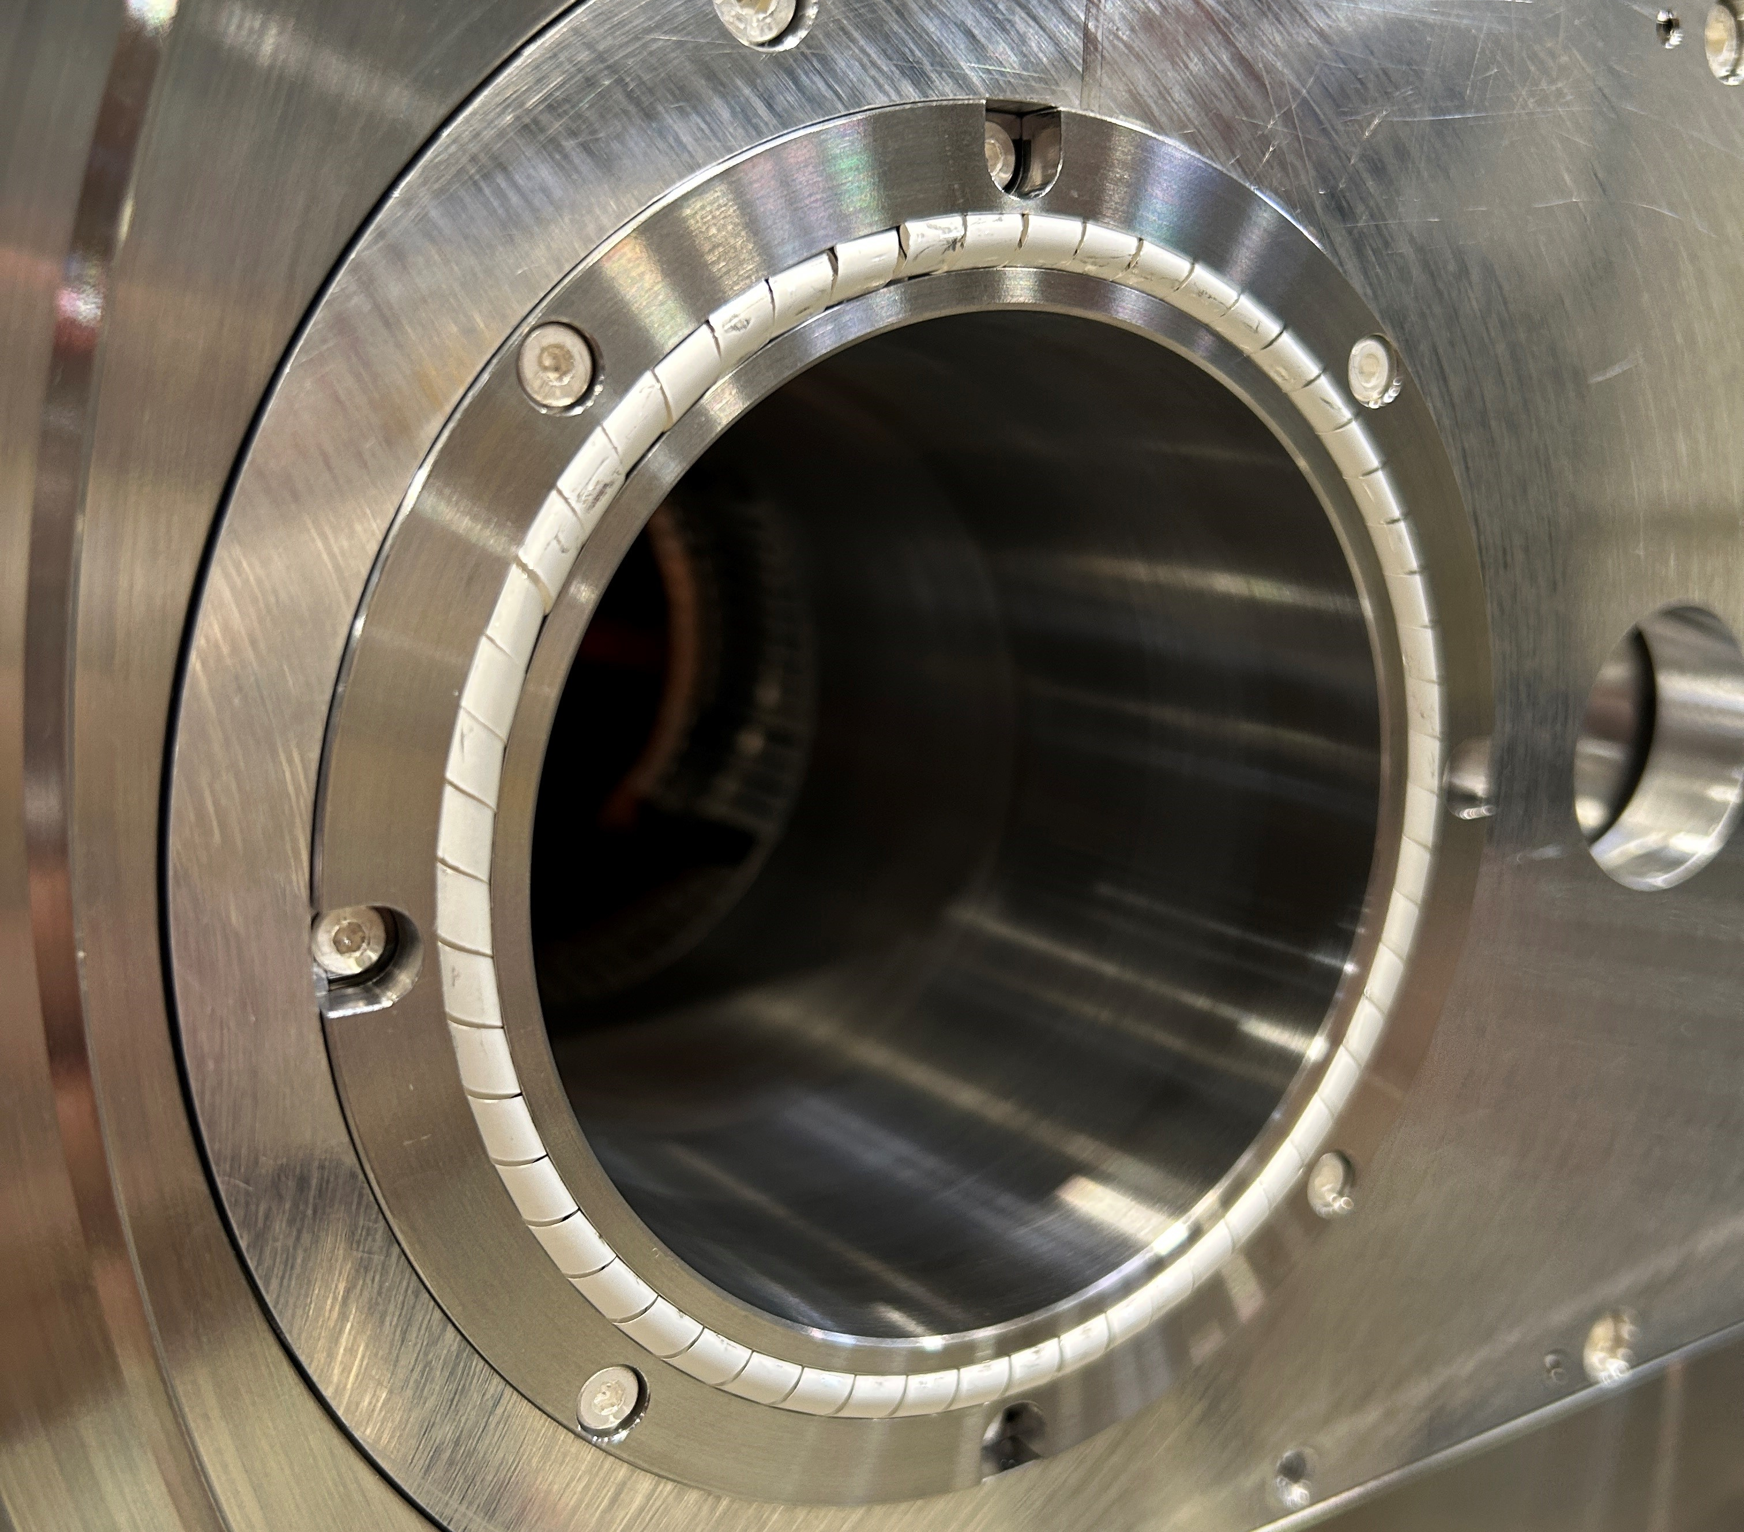
Change the springs for test

Slide 4
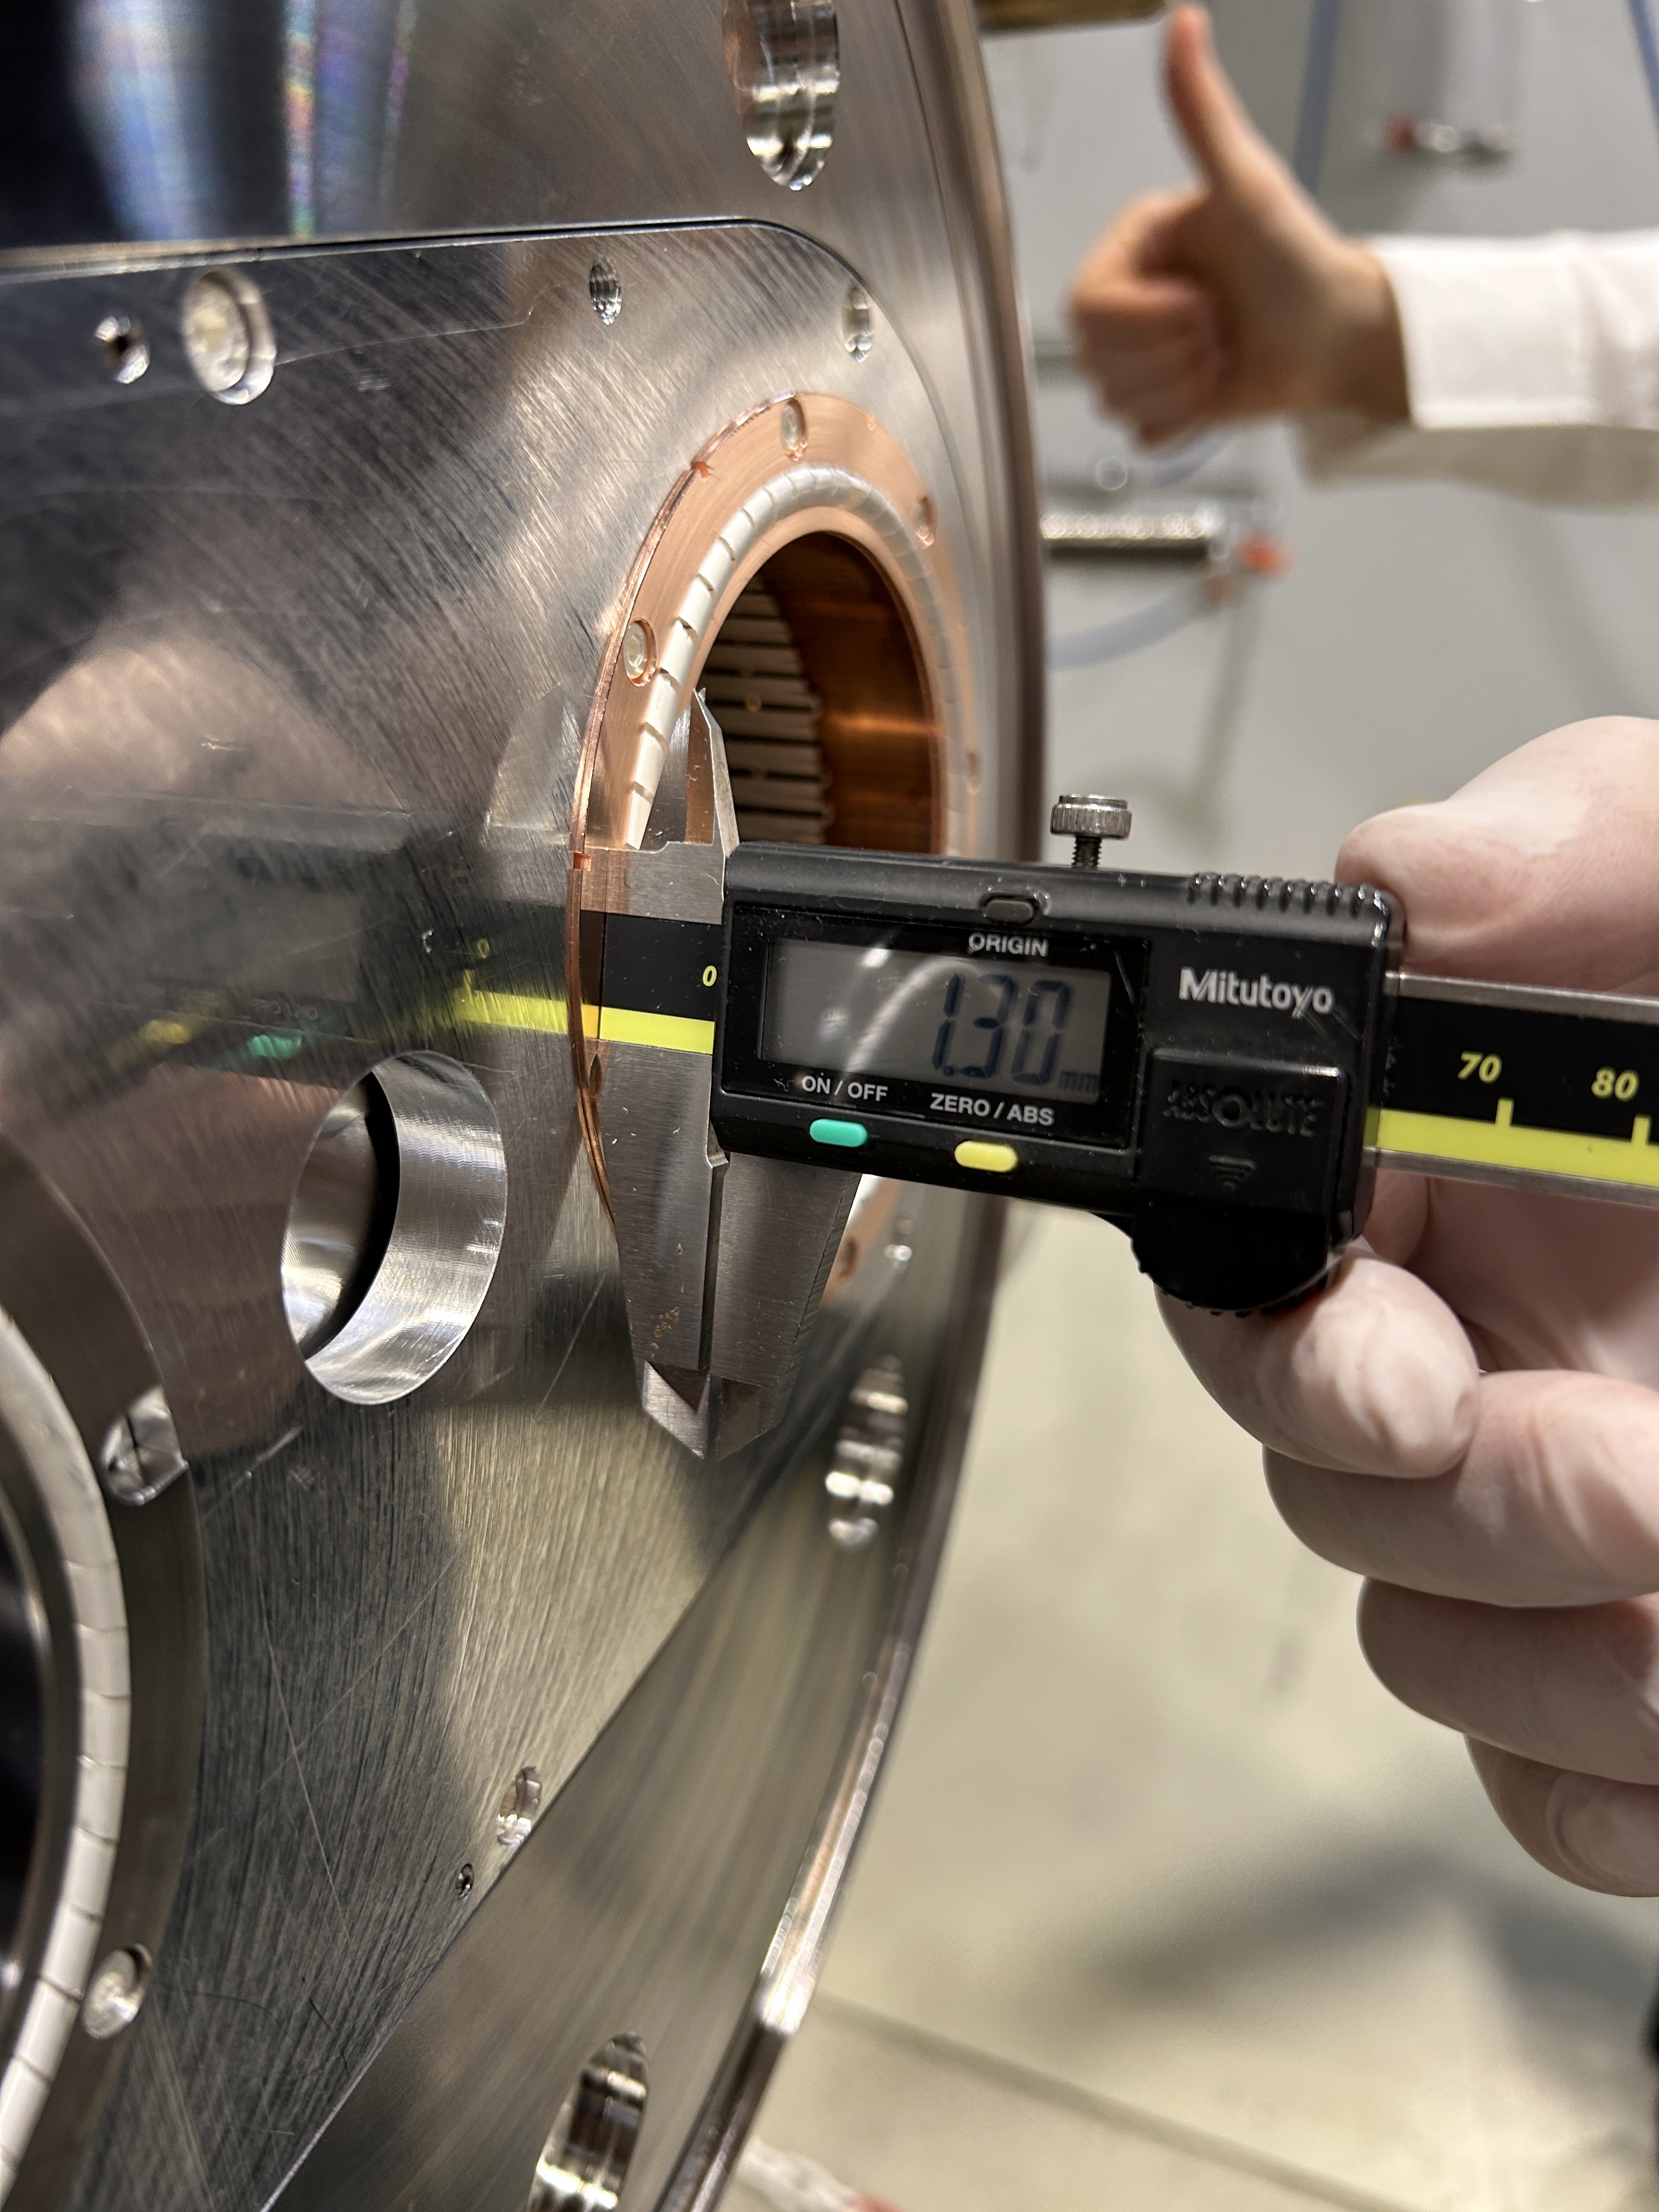
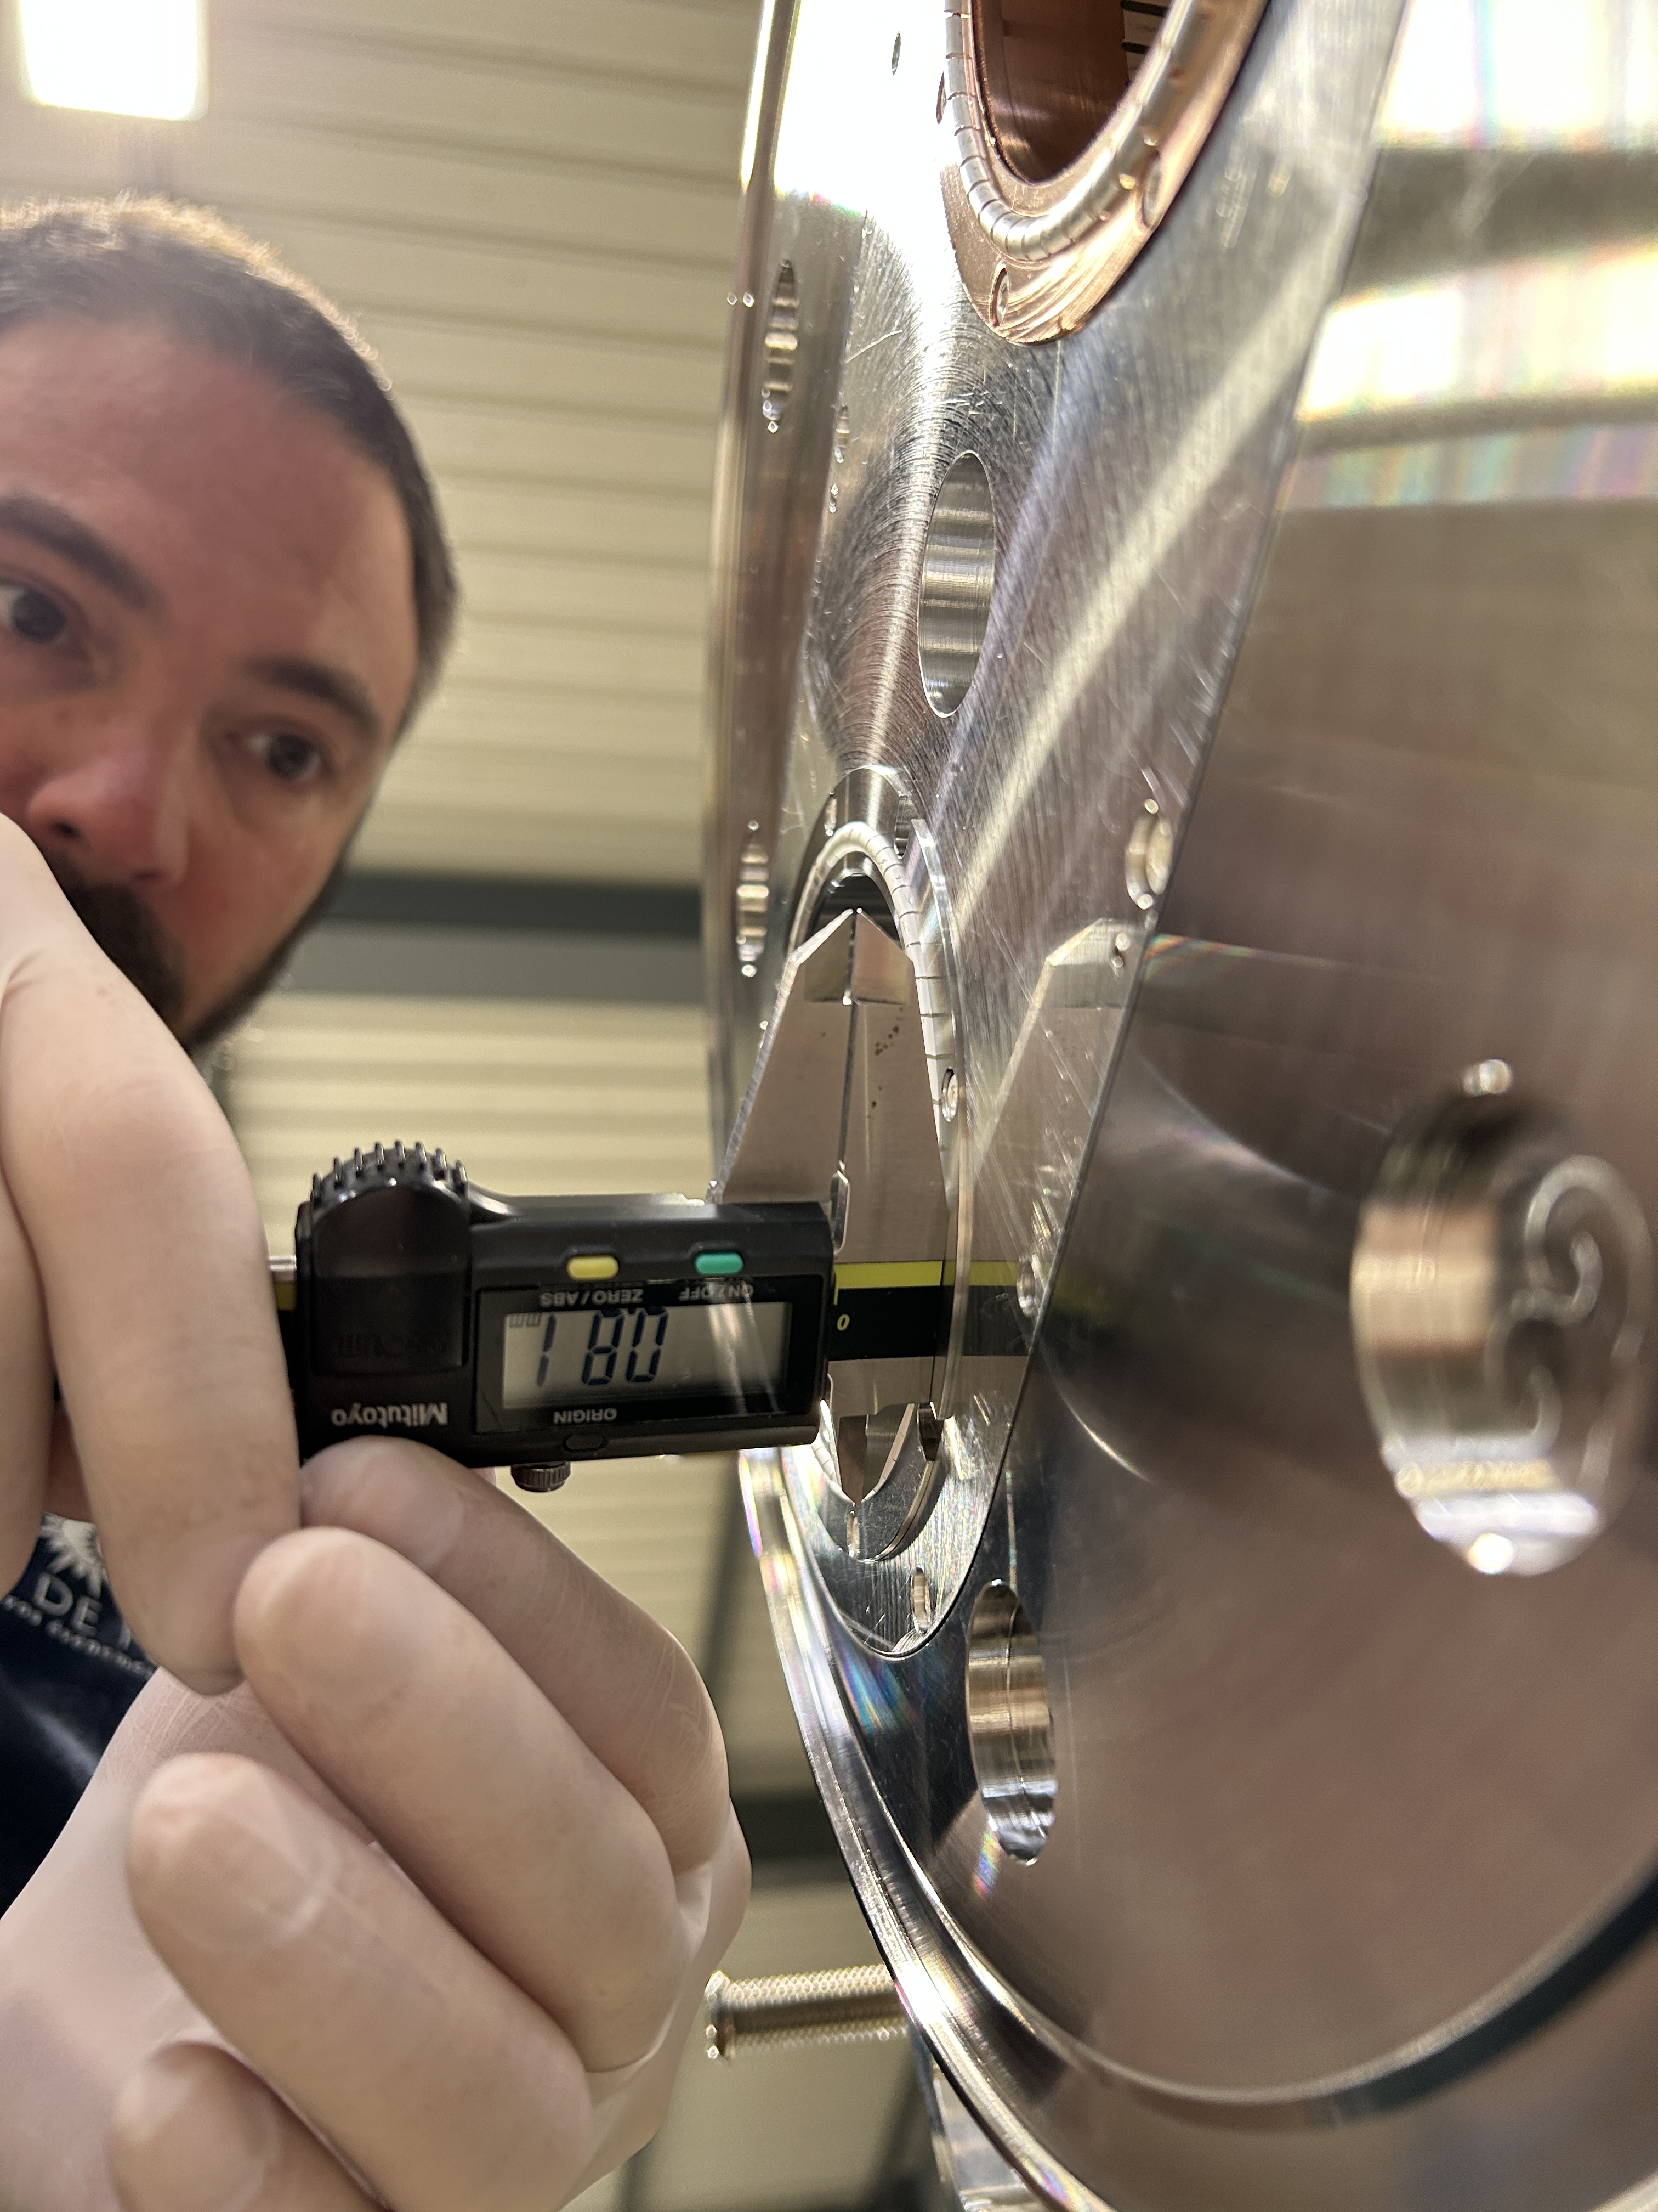
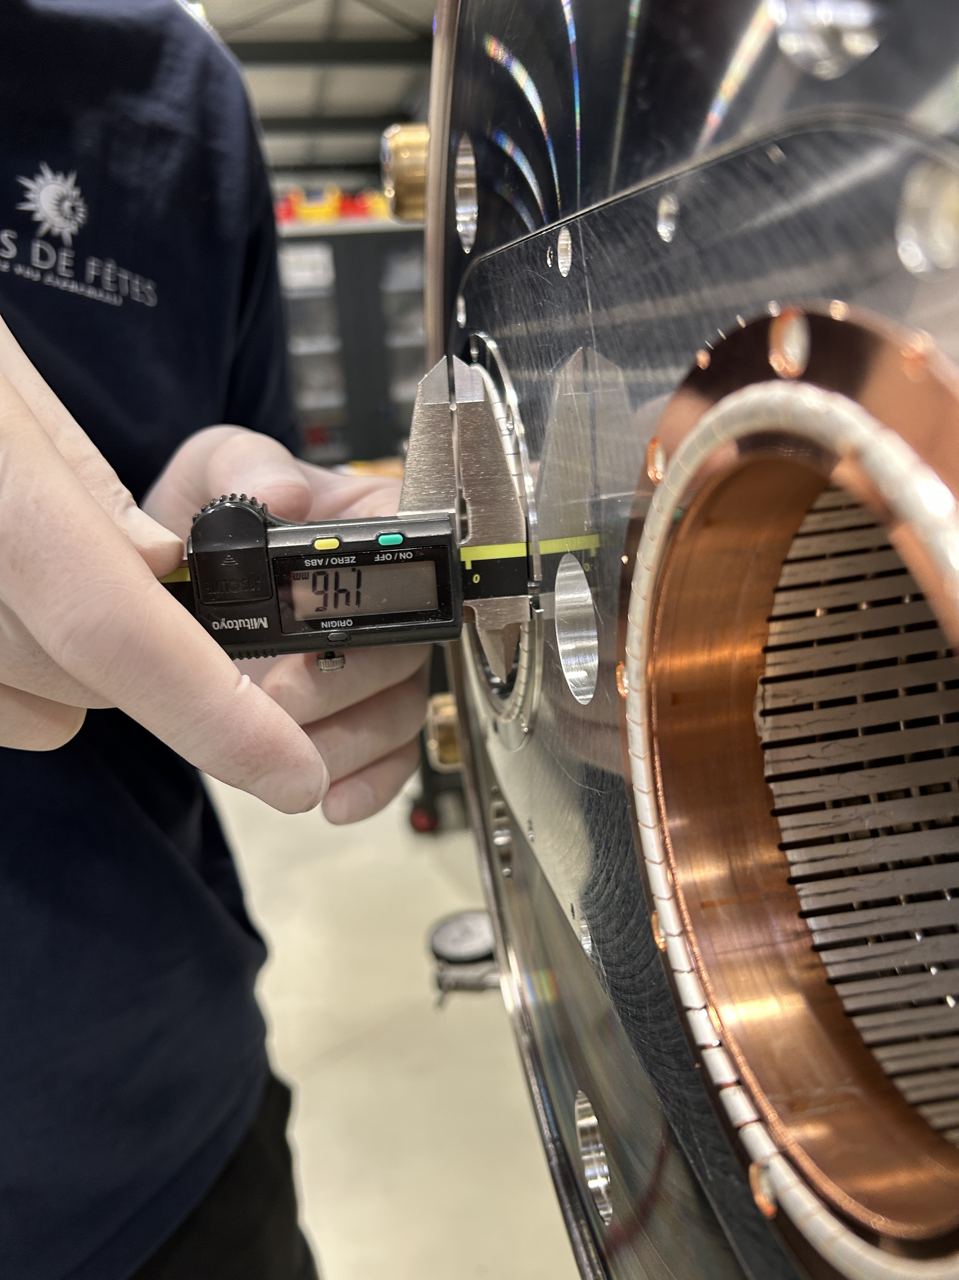
Thank you, Carla, for your approval
We need 0.6mm for the contact with flange

Slide 5
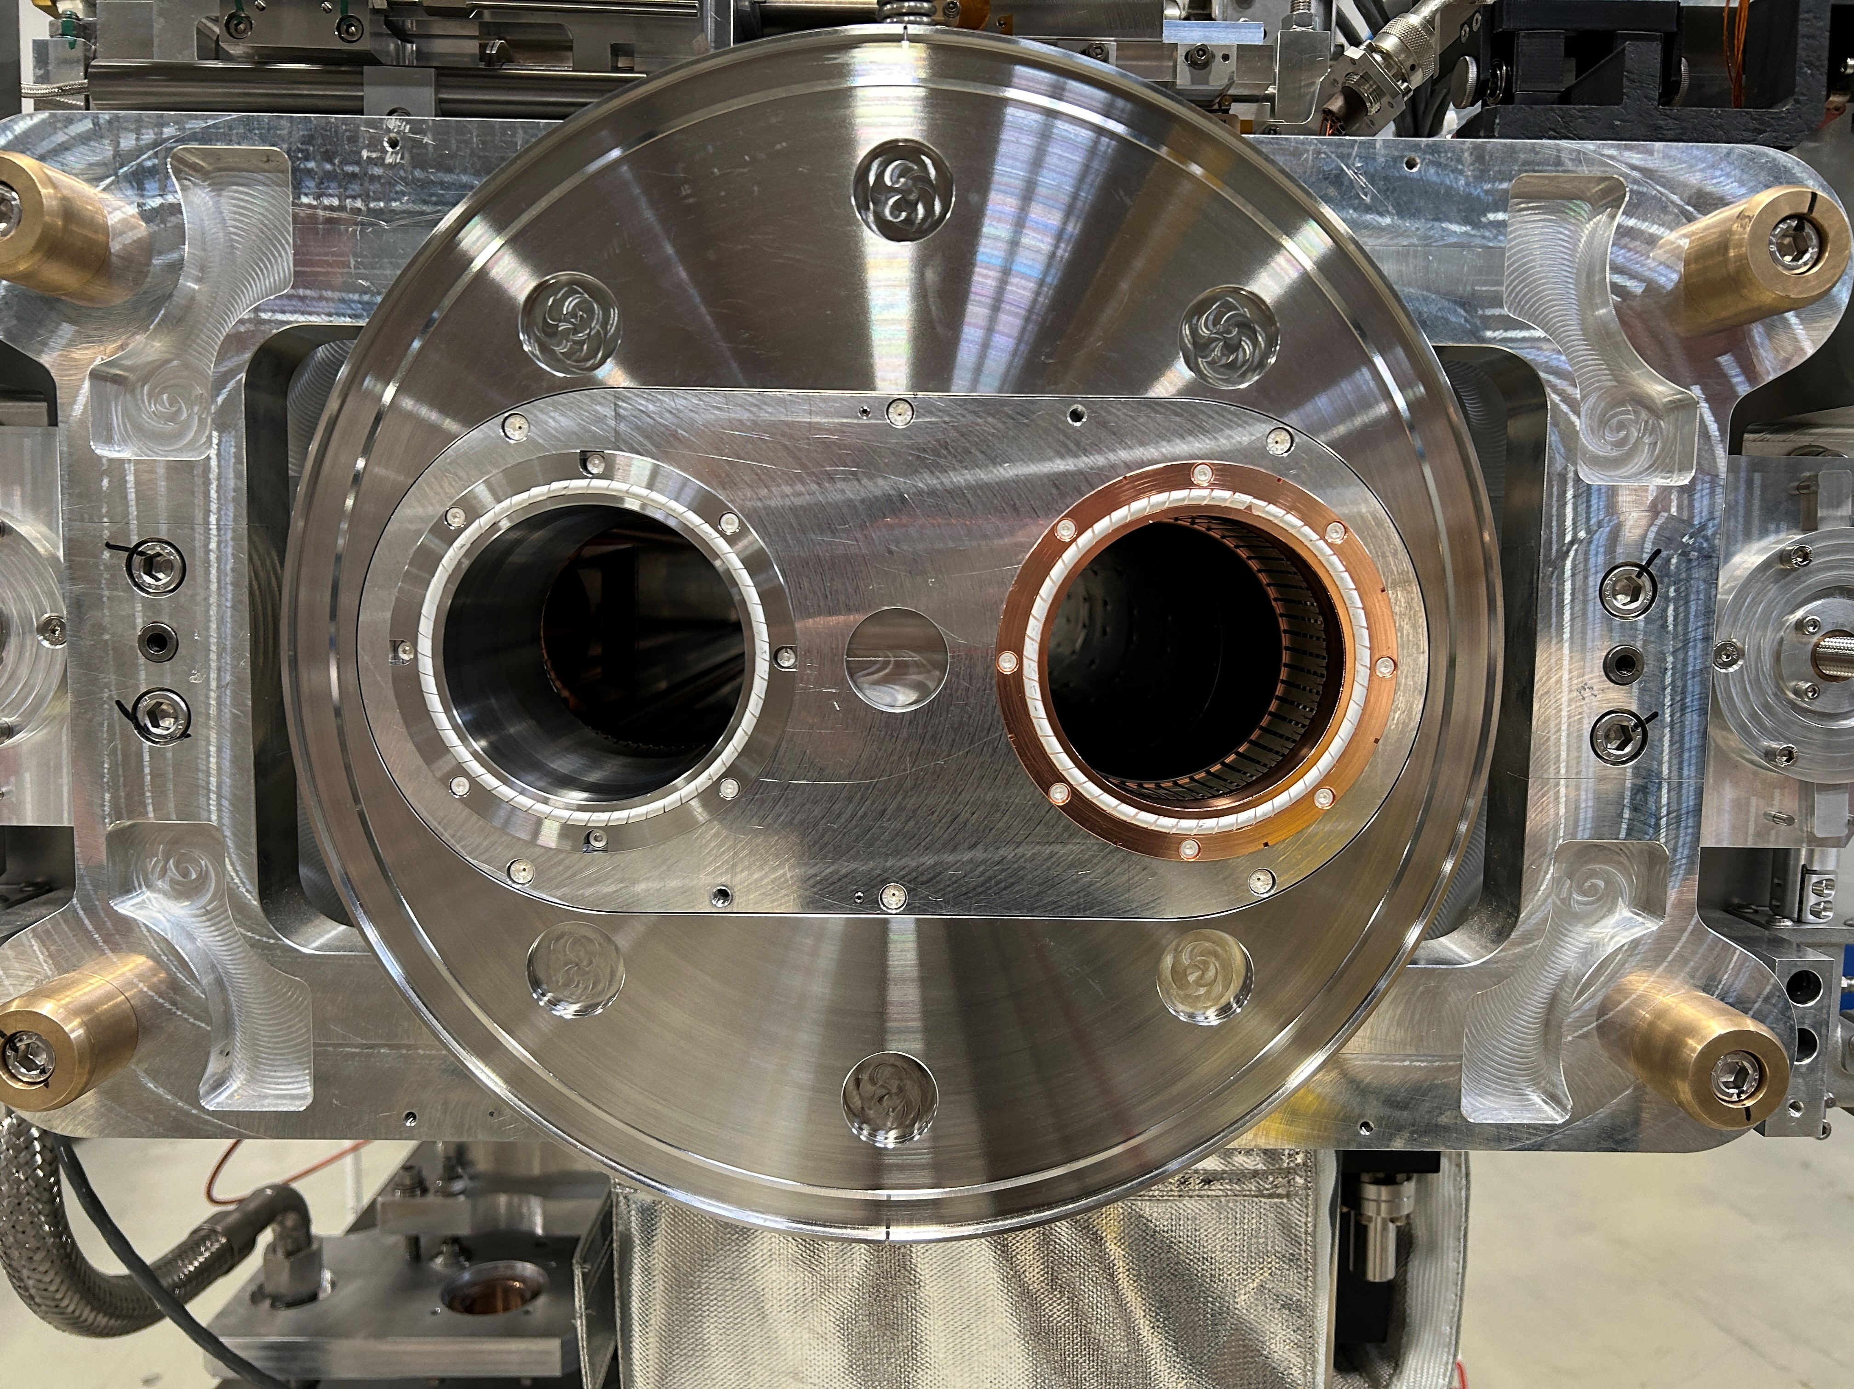
Confirmation the new springs and conclusion

Slide 6
Any questions ?

