Slide 1
Follow-up of the TCLPX jaw sag after thermal test
07/04/2025
Thibaut Parmentier

Slide 2
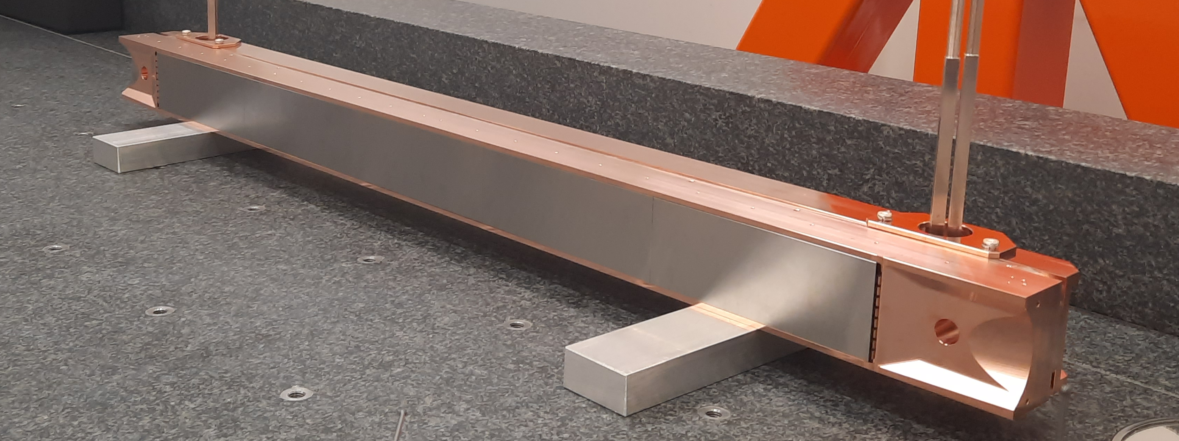
Recap of the situation
HCTCLPX__320-CZ000001 jaw assembly 25/03, tightening with 5 Nm
Thermal test, 6 cycles: results accepted
Metrology, flatness of the active plane, tolerance 100 µm
  Active surface facing down: flatness 150 µm, convex parabolic shape.
  Active surface facing to the side: flatness 120 µm, convex parabolic shape
Loosening and tightening the blocks in situ at 5 Nm with the active surface facing to the side.
Metrology, active surface facing to the side, flatness 54 µm
Thermal test, 6 cycles

Slide 3
Visit to Cinel
Wednesday 02/04/2025 14:00 to Friday 04/04/2025 18:00
Main objective: solve the TCLPX sag issue
Participants:
  CERN: Francois-Xavier
  Régis
  Rémi
  Thibaut
  Cinel: Roberto (Technical expertise)
  Guiseppe (Quality assurance)
  Matteo (Metrology)
  Christian (Mechanical assembly)
  Joshue (Mechanical assembly)

Slide 4
LHCTCLPX__0320 Timeline
Metrology, active surface facing to the side, flatness 120 µm (identical results as before)
Loosening and tightening the blocks in situ at 4 Nm with the active surface facing to the side.
Metrology, active surface facing to the side, flatness 76 µm
Re-assembly with the blocks on a marble, tightening with 4 Nm
Metrology, active surface facing to the side, flatness 47 µm
Bakeout proposed by CERN (in correspondence with the prototype production)

Slide 5
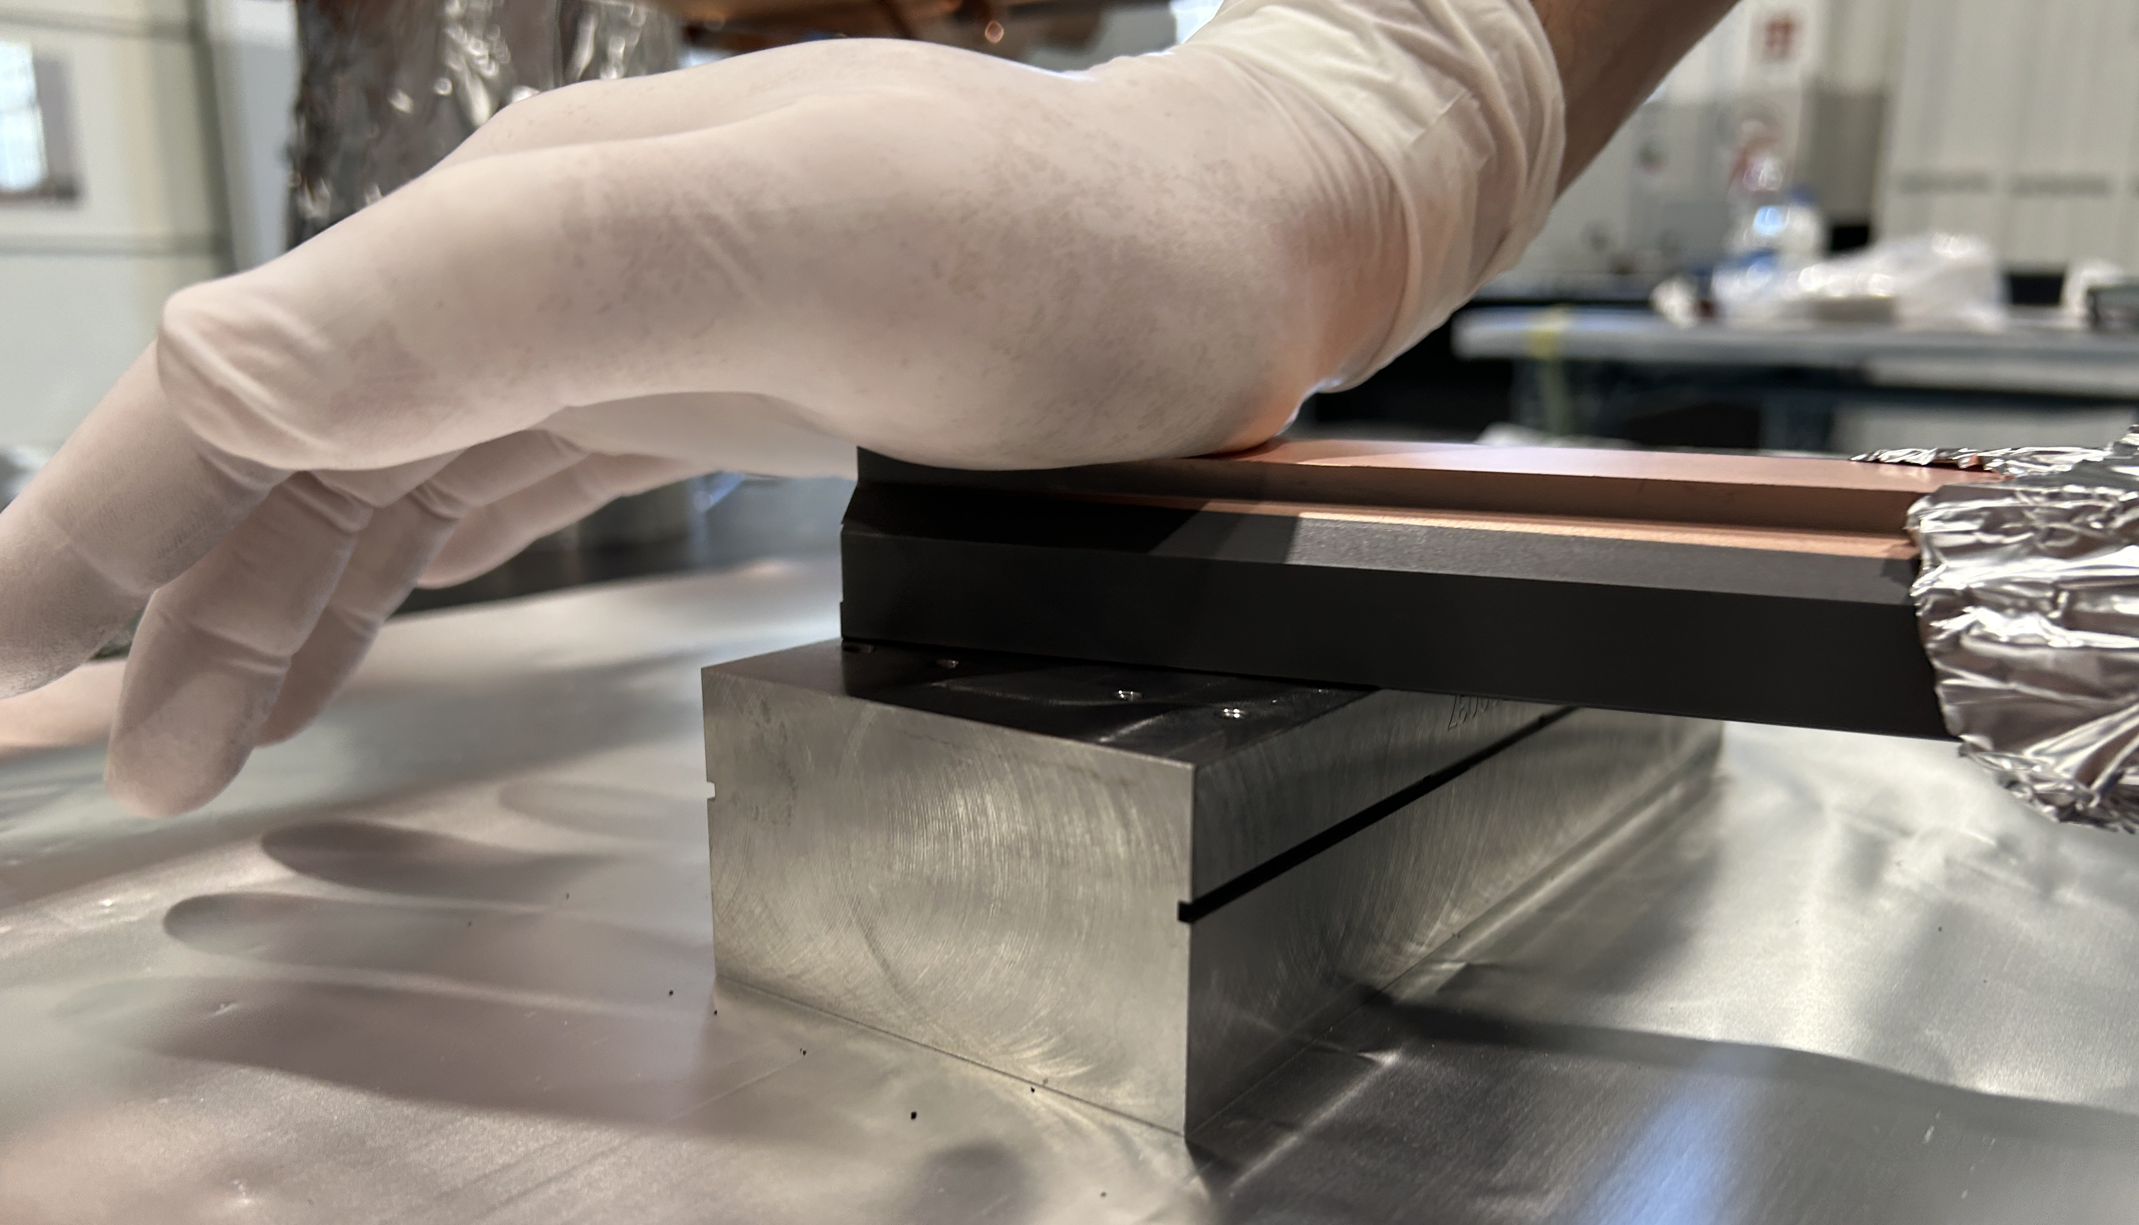
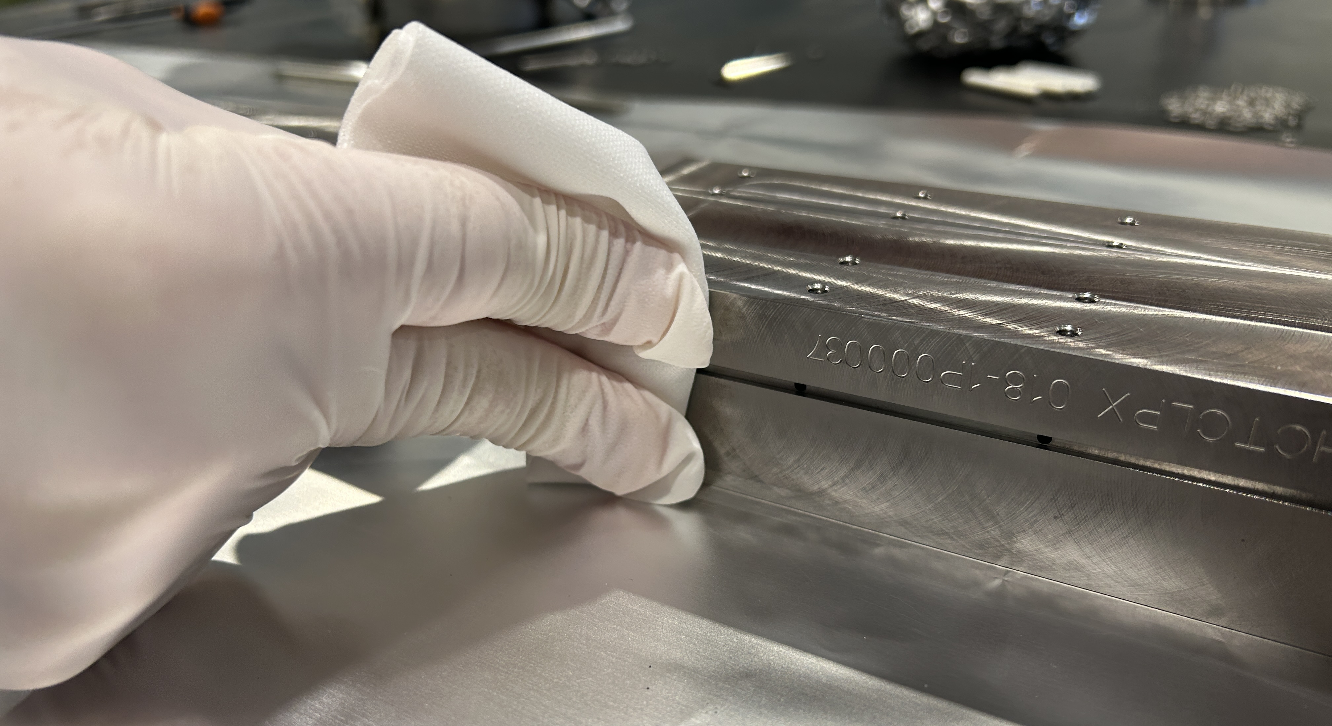
LHCTCLPX__0319 Timeline
HCTCLPX__319-CZ000001 jaw assembly 01/04,wrong washers' type, tightening with 4 Nm
Thermal test, 6 cycles: results accepted
Metrology, active surface facing to the side, flatness 120 µm (identical results as for HCTCLPX__320-CZ000001)
Disassembly on a marble, applying graphite coating to the backside of the Inermet blocks with discarded TCSPM block and cleaning the dust
Reassembly with correct washers and tightening with 4 Nm

Slide 6
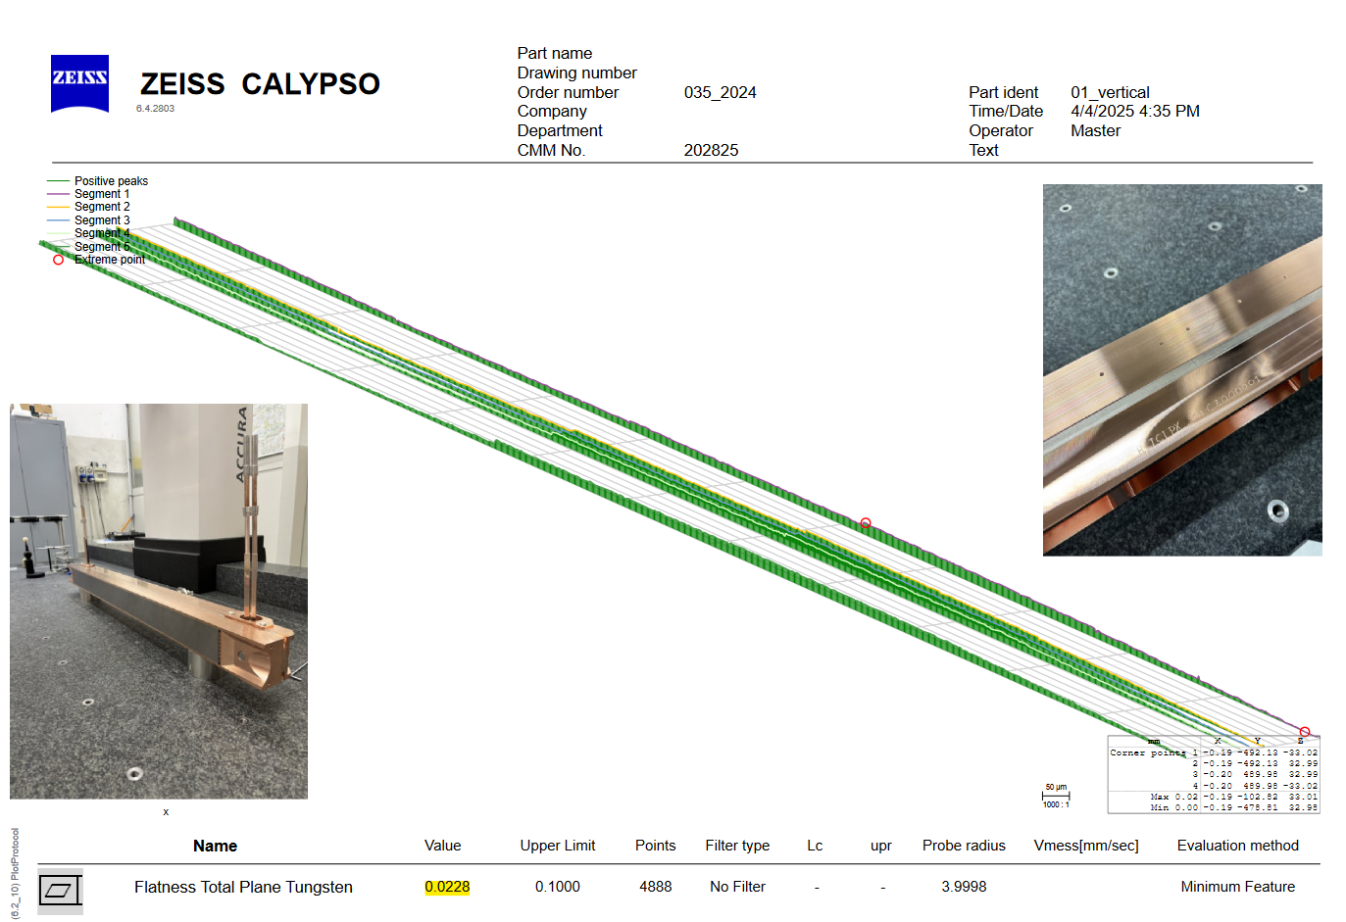
LHCTCLPX__0319 Timeline
Thermal test, 6 cycles: 2 seconds slower, but still accepted
Metrology, active surface facing to the side, flatness 23 µm

Slide 7
LHCTCLPX Summary
HCTCLPX__320-CZ000001 | Flatness
5 Nm, Thermal test | 120 µm
5 Nm, Re-tightening in-situ | 54 µm
5 Nm, Thermal test | 120 µm
4 Nm, Re-tightening in-situ | 76 µm
4 Nm, Reassembly on a marble | 47 µm
4 Nm, Bakeout | Pending
HCTCLPX__319-CZ000001 | Flatness
4 Nm, Thermal test | 120 µm
4 Nm, Graphite lubrification, Thermal test | 23 µm

Slide 8
LHCTCLPX Next steps
HCTCLPX__320-CZ000001
  If bakeout has been started: follow up with thermal test and metrology. Next, harmonize with HCTCLPX__319-CZ000001: Disassembly, graphite coating, thermal test and metrology to confirm the lubrification solution
  OR If bakeout has not been started: cancel the bakeout step and harmonize with HCTCLPX__319-CZ000001
  Guiding plates adjustment and counter-drilling
  Complete metrology, pressure test, pictures of the active plane, acceptance & shipping to CERN
HCTCLPX__319-CZ000001
  Guiding plates adjustment and counter-drilling
  Complete metrology, pressure test, pictures of the active plane, acceptance & shipping to CERN

Slide 9
Discussion

