Slide 1
FAT Pre-Series Meeting
Vacuum Connection Tools
03.04.2025 – Microlan Aerospace, Pamplona
WP5.2 Meeting
April 7th, 2025
^{Laura Helene Hannemann}
^{L. Hermida Pena}

Slide 2
Objectives
Discussion Points:
✅Pre-Series FAT
✅Metrology Reports
✅Documentation
✅Timeline for Pre-Series and Series

Slide 3
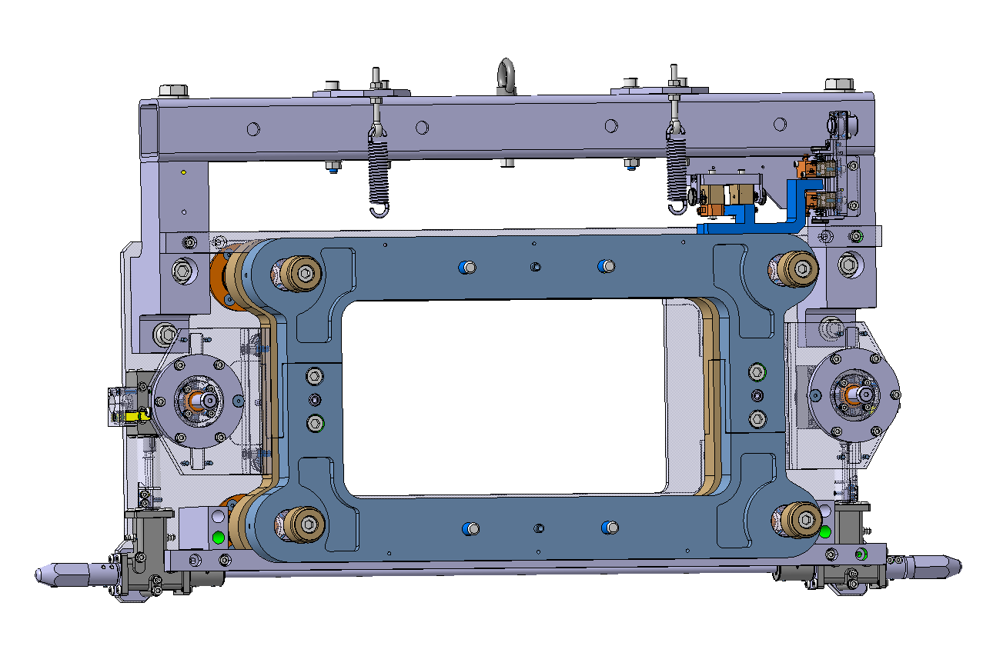
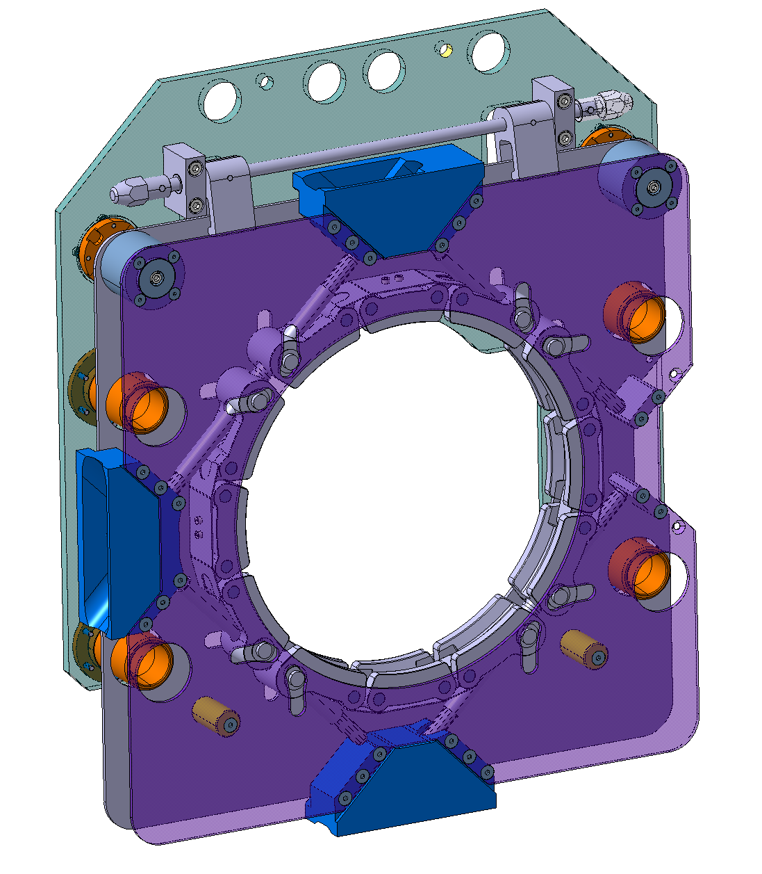
Project Overview & Objectives
Quantities
 | Manufacturing Drawings | Versions | Quantities
 |  |  | Pre-series | Series | Total
Type 1 | LHCVLTTBC0076 ind. AD | Left version | 0 | 8 | 8
 |  | Right version | 1 | 7 | 8
 | LHCVLTTBC0120 ind. AB | Left version | 0 | 2 | 2
 |  | Right version | 0 | 3 | 3
Type 2 | LHCVLTTCQ0034 ind. AD | RETRACTION TARGET ASSEMBLY | 1 | 10 | 11
 | LHCVLTTCQ0036 ind. AB | INVERTED RETRACTION TARGET ASSEMBLY | 2 | 10 | 12
Pre-series are part of the full production and are not prototypes. The Contractor shall produce pre-series before the series to demonstrate compliance with the technical requirements.
21 units of the Type 1 Vacuum Connection Tool
23 units of the Type 2 Vacuum Connection Tool
Total of 44 Tools

Slide 4
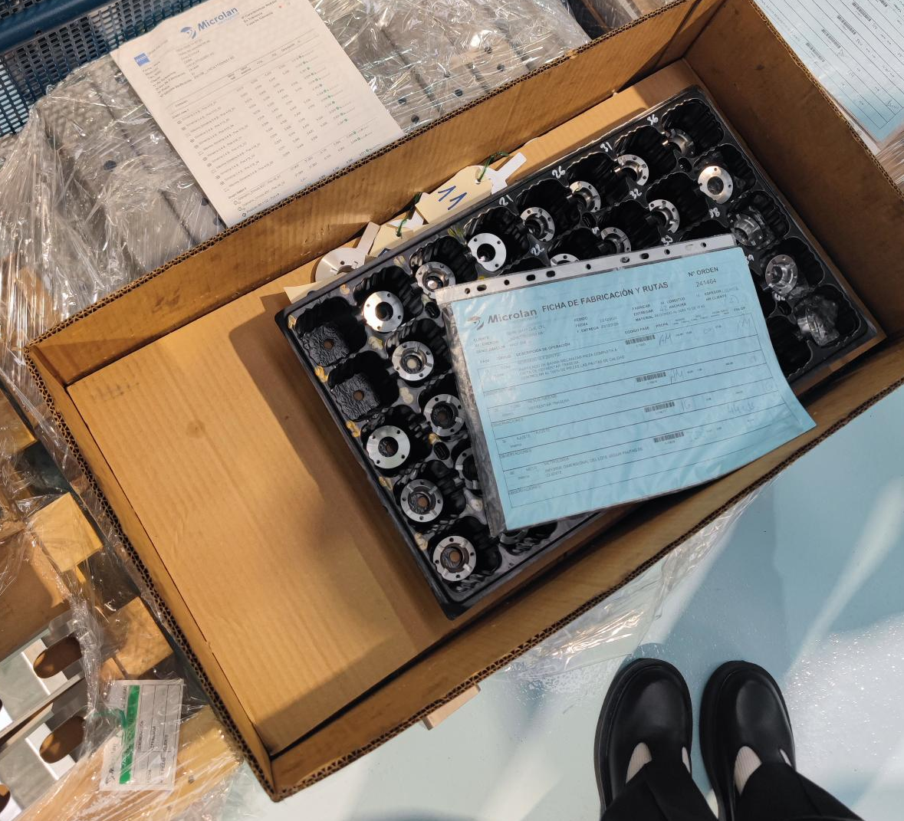
Status of the Production
Pre-Series production finished:
  1 tool LHCVLTTBC0076 ind. AD right version
  1 tool LHCVLTTCQ0034 ind. AD
  2 tools LHCVLTTCQ0036 ind. AB
Production of most individual parts finished

Slide 5
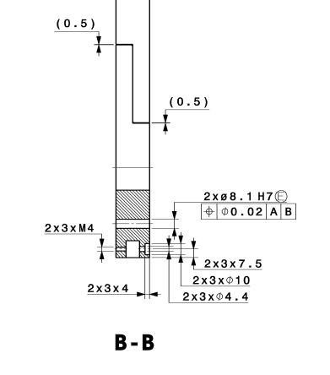
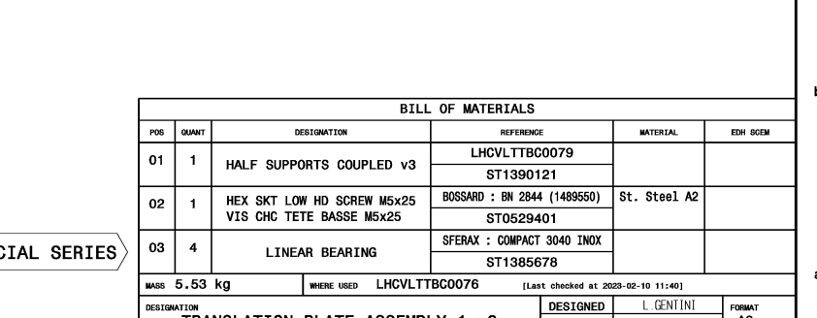
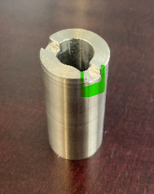
Encountered Issues
LHCVLTTBC0079 AD M4 holes and M5 screws in the BOM of the assembly LHCVLTTBC008. Solution: Keep an M4 screw for the pre-series and adapt to M5 for the series.
The square bar LHCVLTTBC0010 AA has a weld that hinders the insertion of the shims LHCVLLTTBC0124. Solution Machine a groove in the shim.

Slide 6
Technical Review
Factory Acceptance Test
Functional and verification tests shall be performed after assembly at the contractor’s premises.
The tests include:
Visual Inspection
Labelling verification test: Check labels on each assembly of the two tool types
Retraction Targets Assembly: Chain sliding tests; CERN will provide the chains for these tests.
Retraction Flange Tooling: Torque verification on linear mechanism.

Slide 7
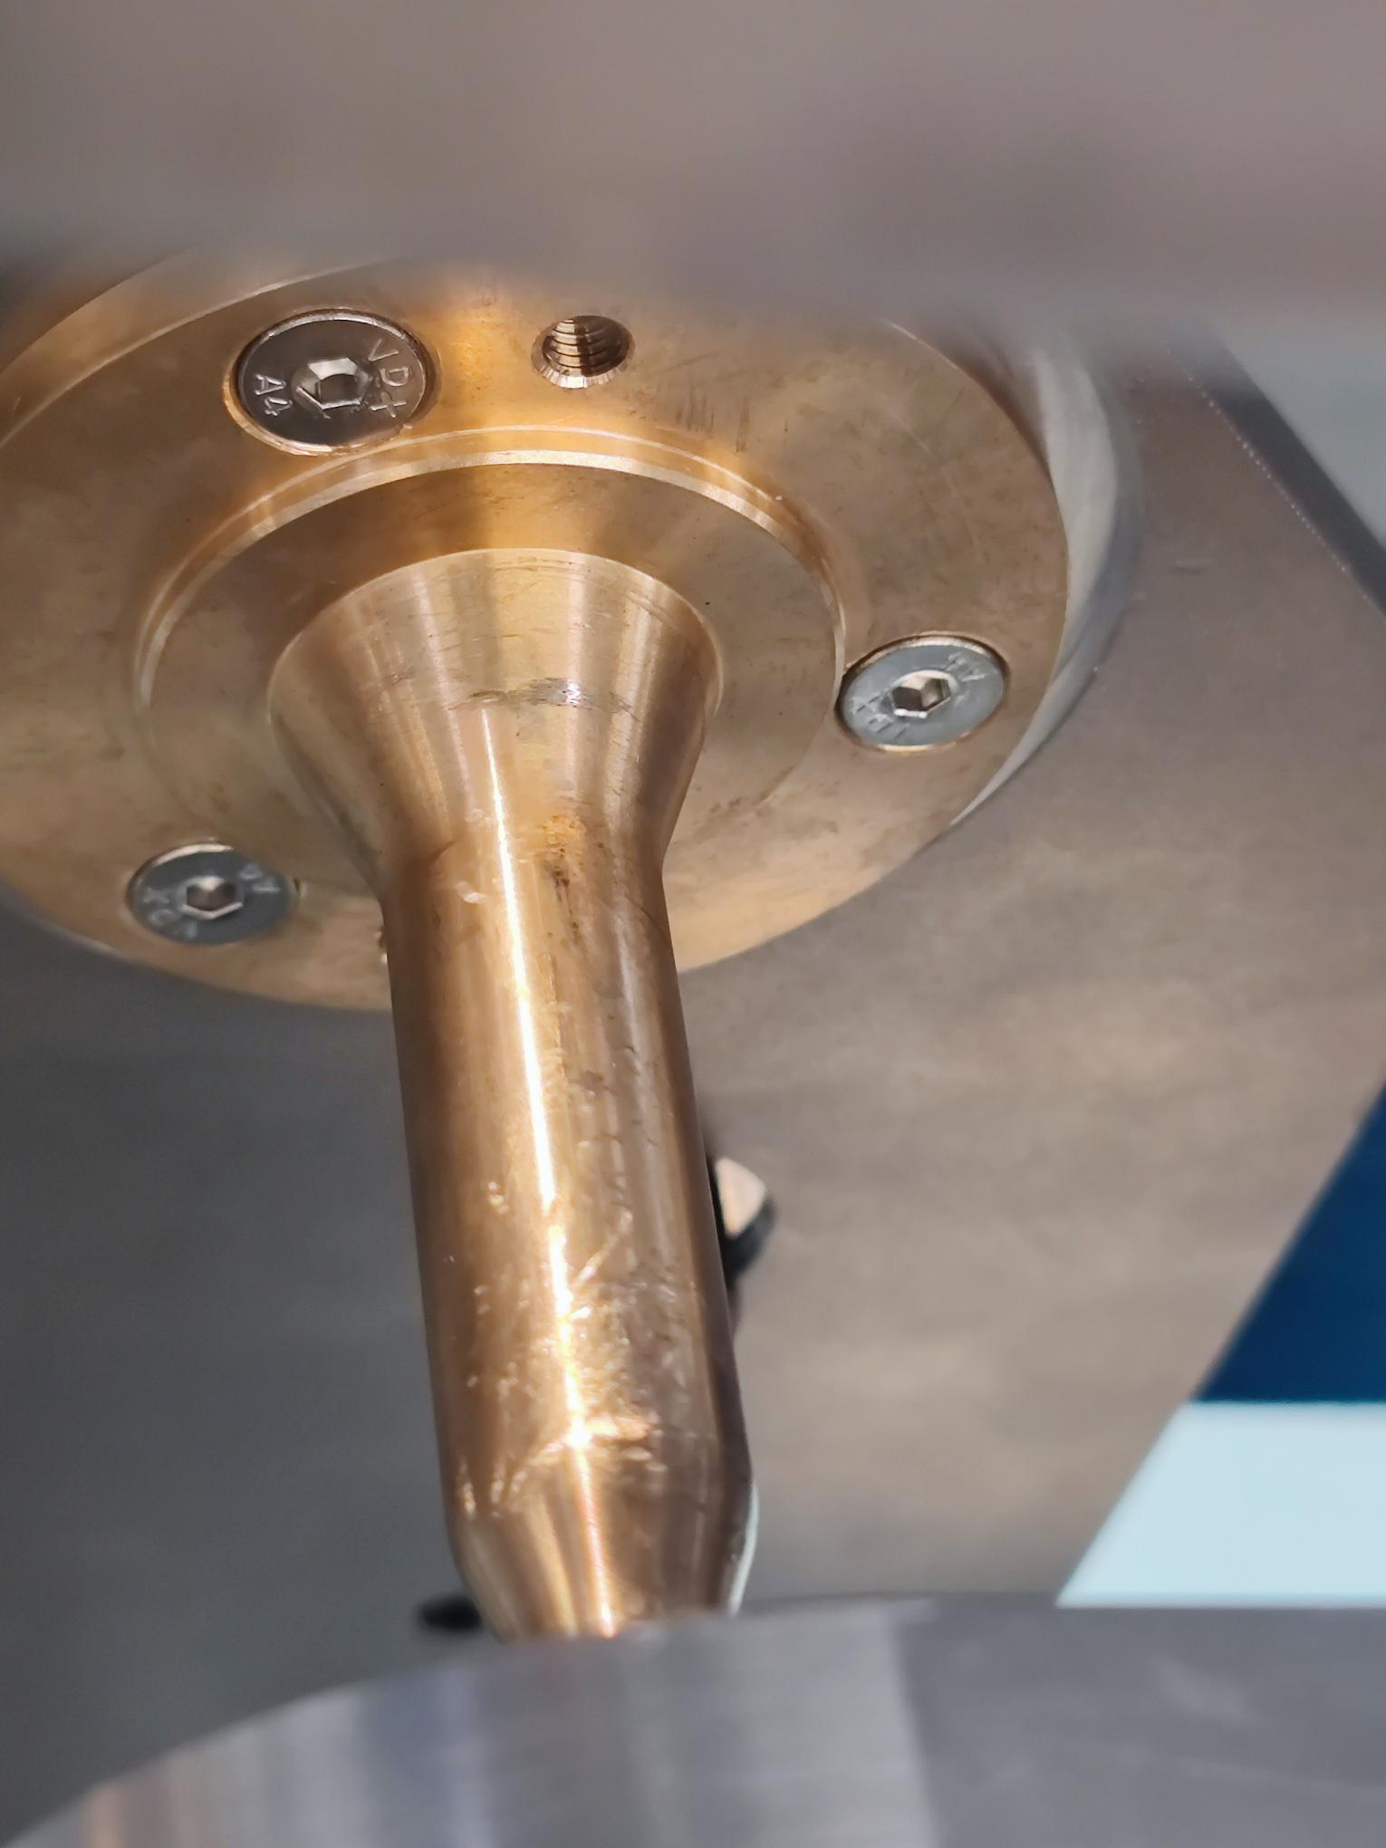
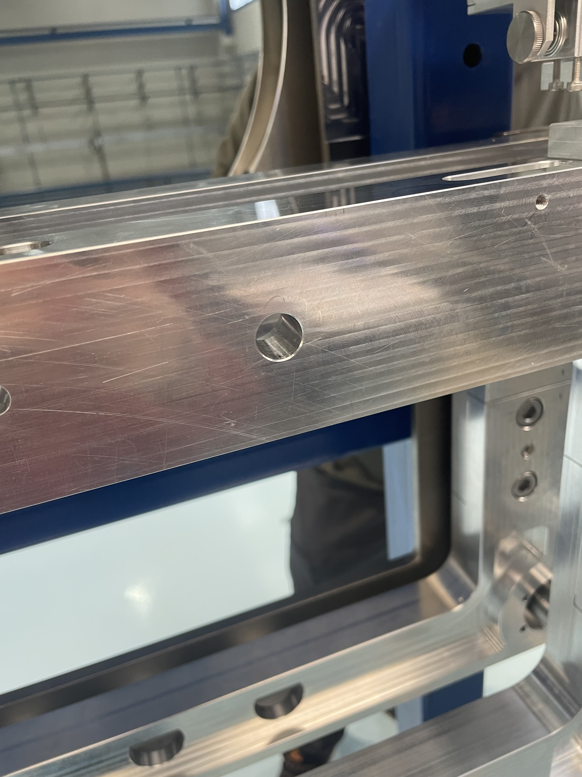
Retraction Flange Tool
Visual Inspection
Superficial Scratches: Scratch depth seems to be low and within roughness tolerances. Option: polish surface.

Slide 8
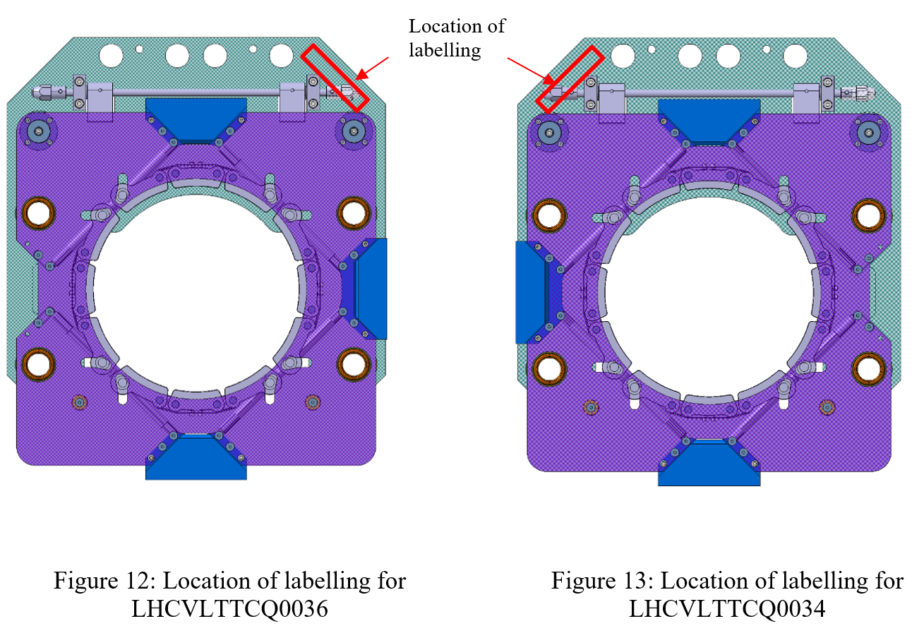
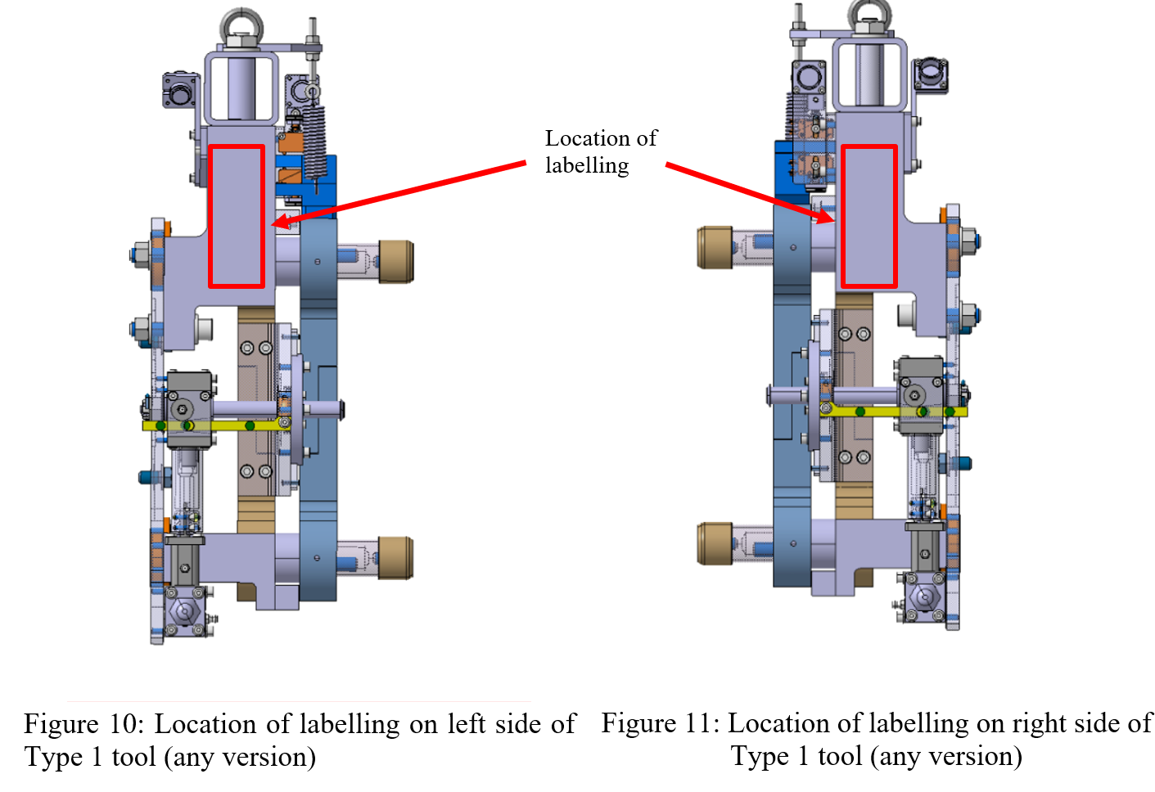
Technical Review
Labelling to be done by the Contractor
The identification ID shall be applied to both sides of each assembly as shown in Figures 10, 11, 12, 13.
Labelling Verification (pictures proving that all assemblies are labelled)
Labelling not done yet

Slide 9
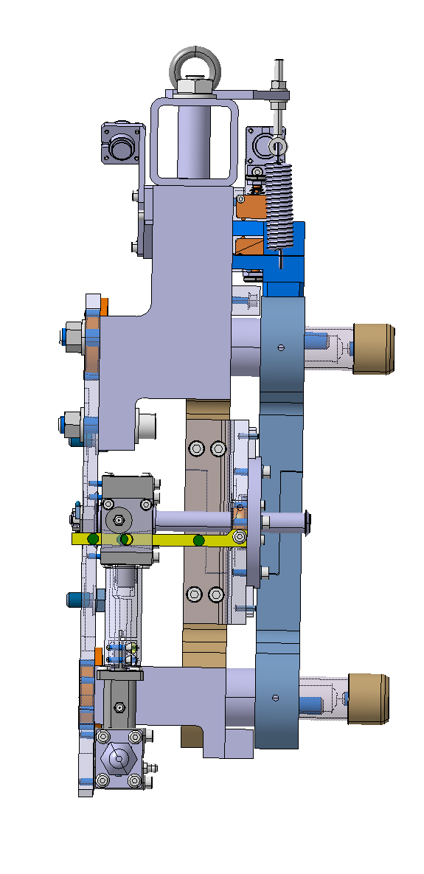
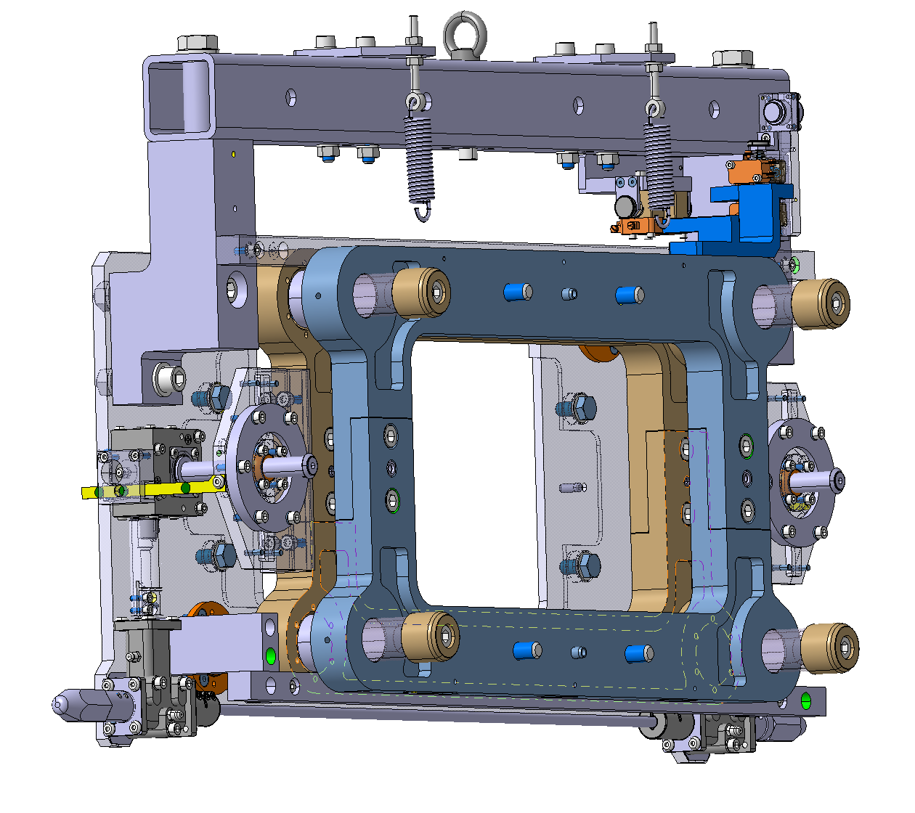
Technical Review
Factory Acceptance Test
Retraction Flange Tooling
Factory Acceptance Tests carried at the Contractor’s premises on all assemblies. The screw must be greased before the first use.
  Attach tool in upright position.
  Rotate the nut to move the tool from position 1 to position 3 and vice versa.
  Measure the torque required to move the tool from position 1 to 3 and 3 to 1. The torque should be below 0.4 Nm.
  Details are given in Annex 5
1
2
3

Slide 10
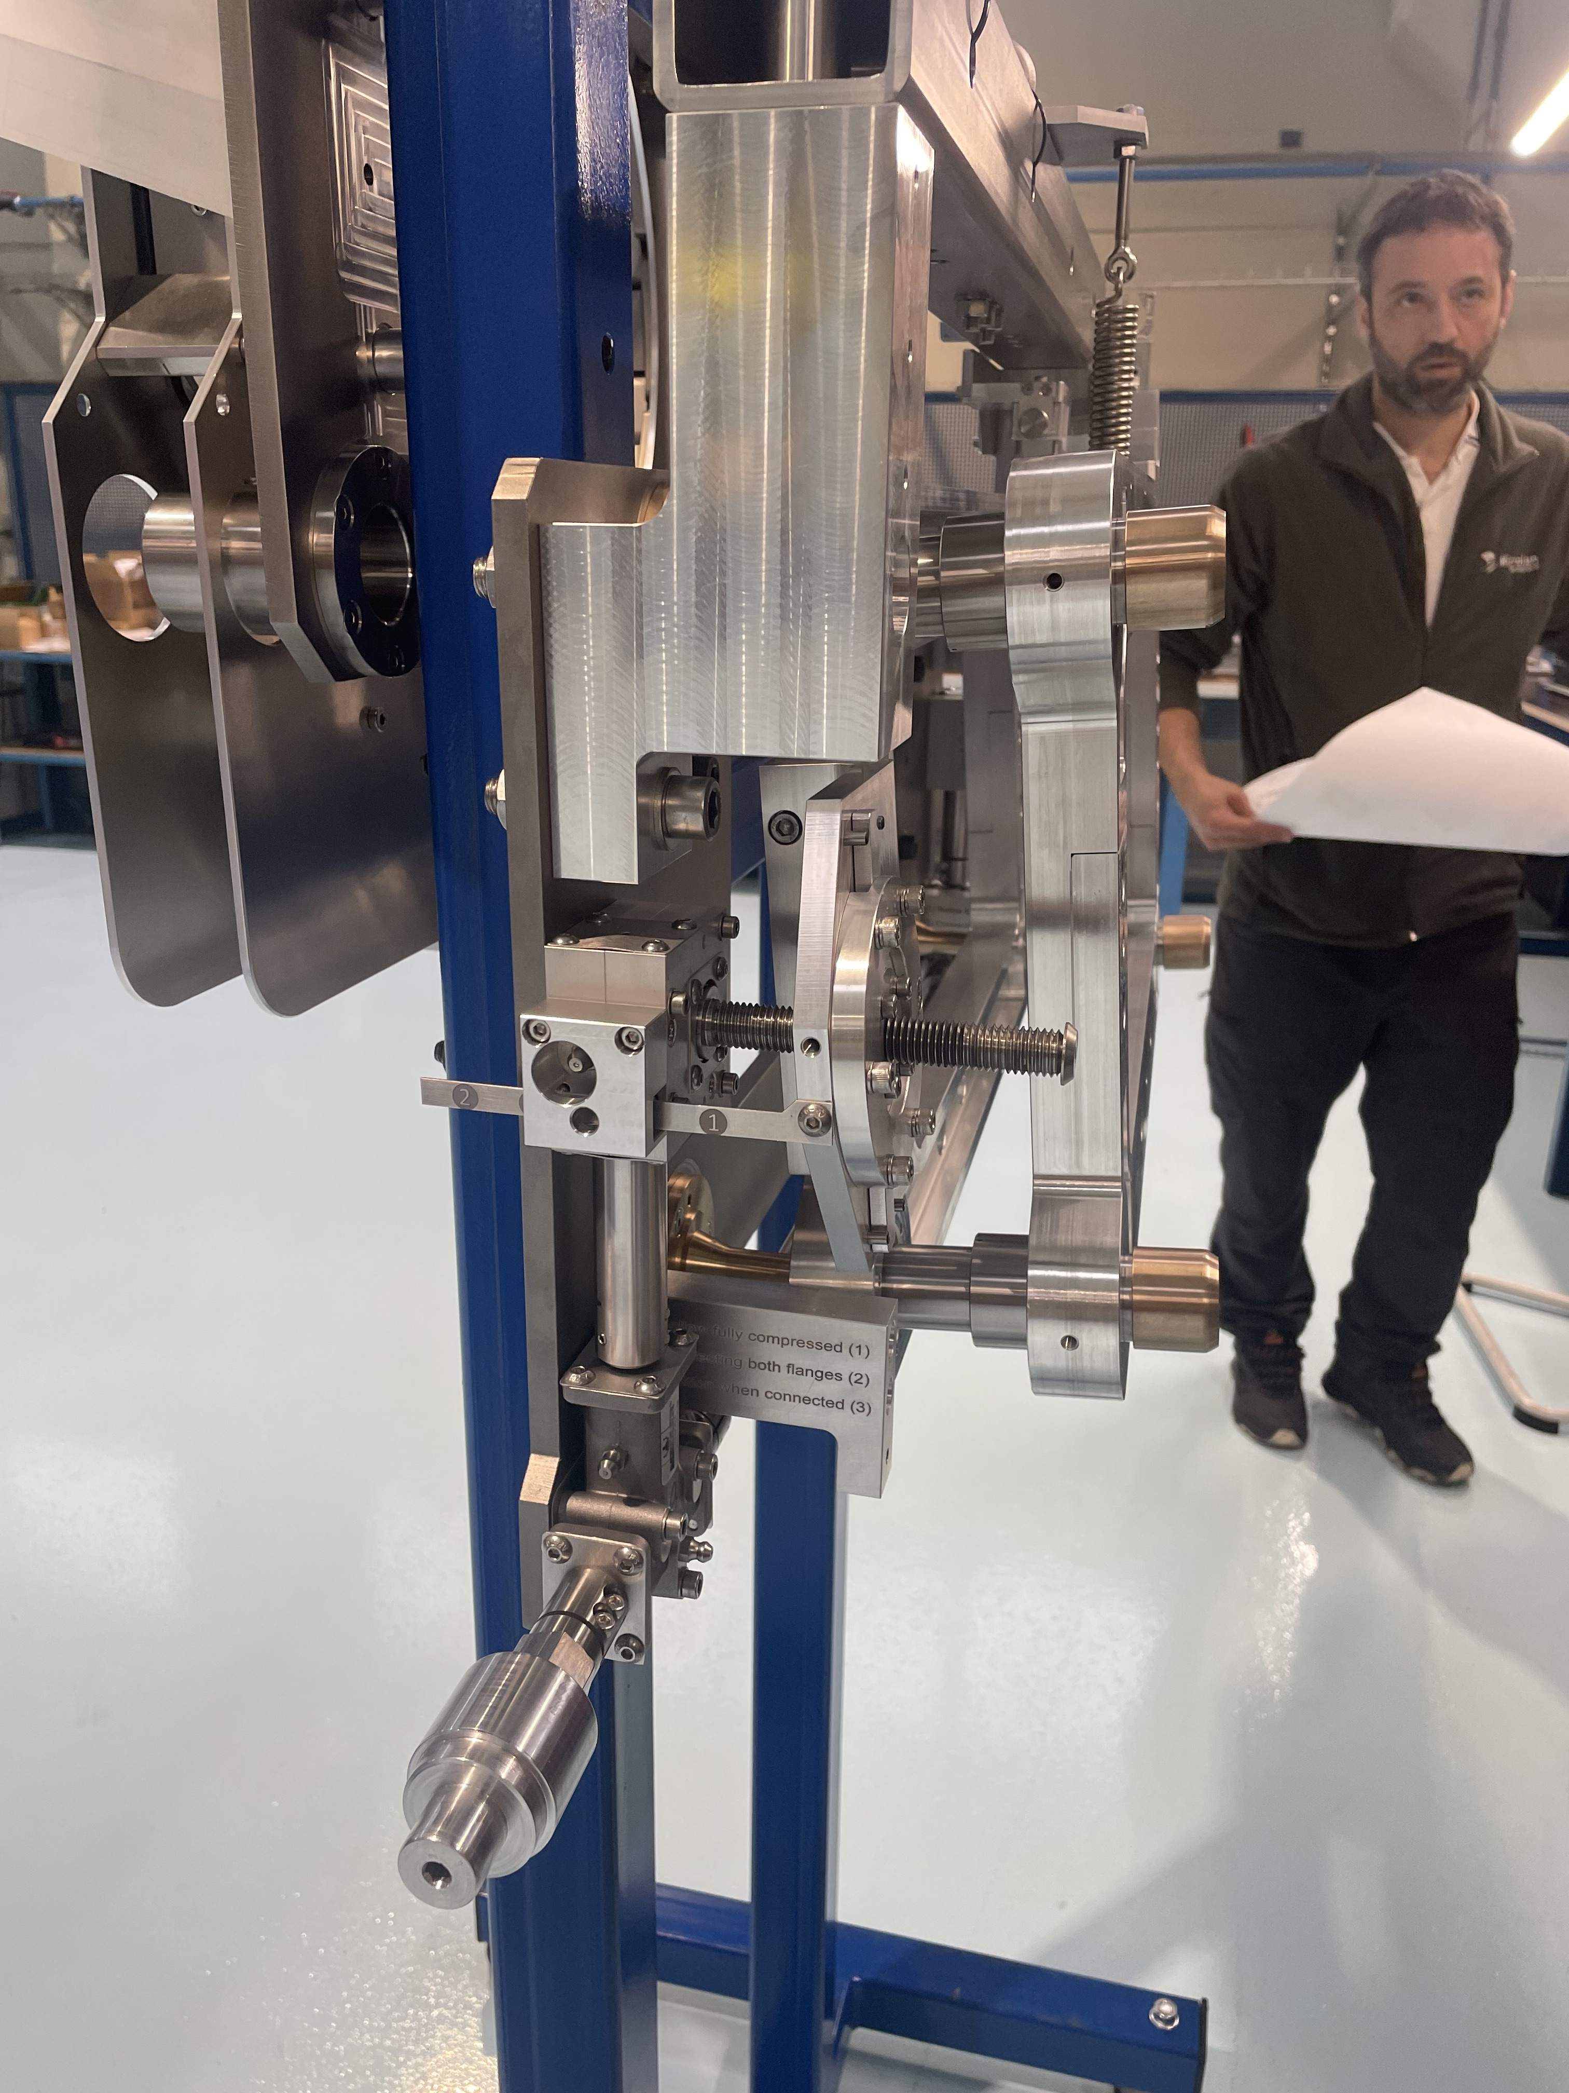
Retraction Flange Tool
Torque Test
Torque between 0.1Nm and 0.4Nm in the 3 different positions o the tool
Observation: spring force quite high and pulling the frame up.

Slide 11
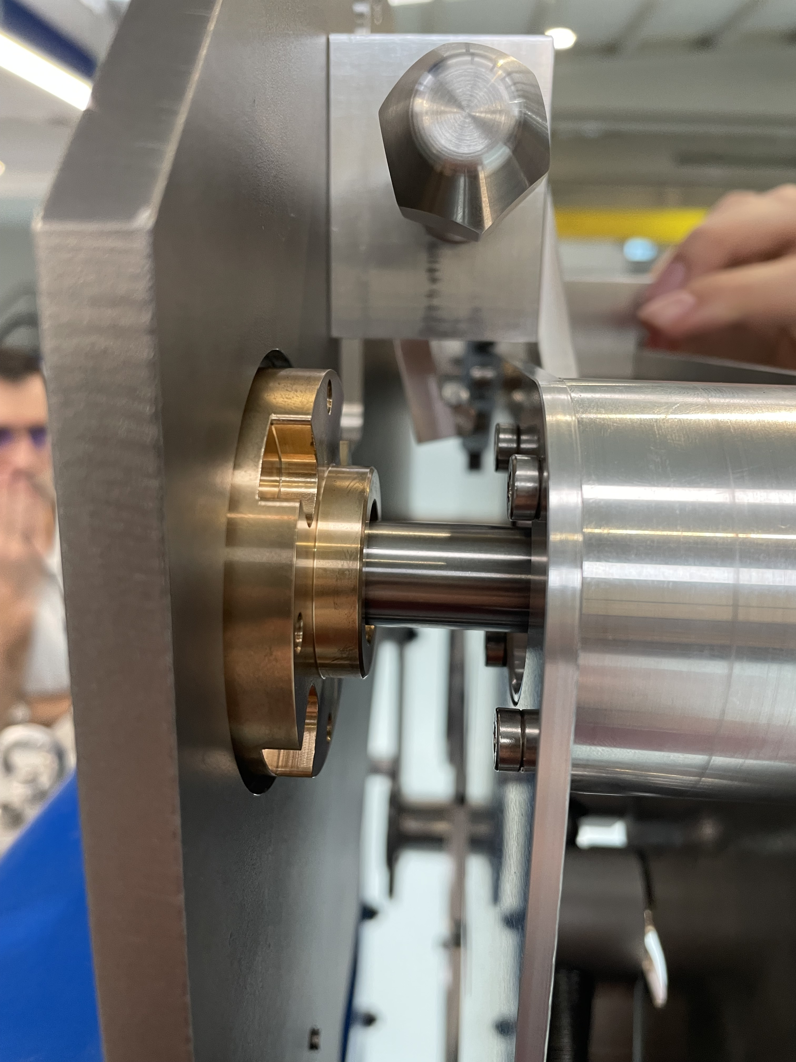
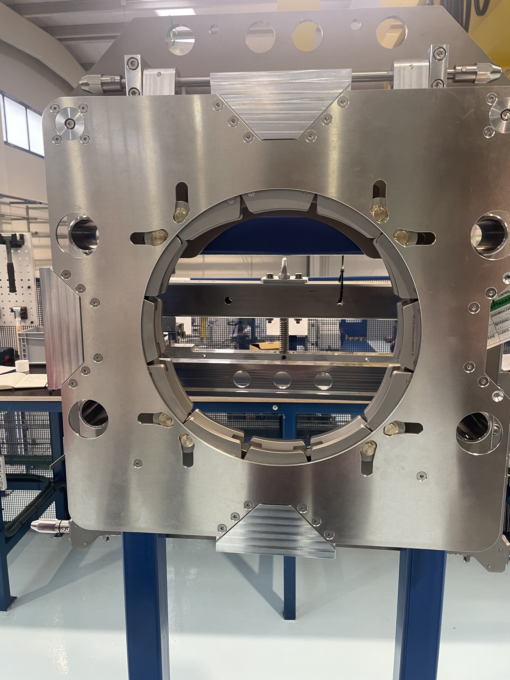
Retraction Target Assembly
Visual Inspection
Slight scratches on axles from linear bearings
Overall good state of the tools

Slide 12
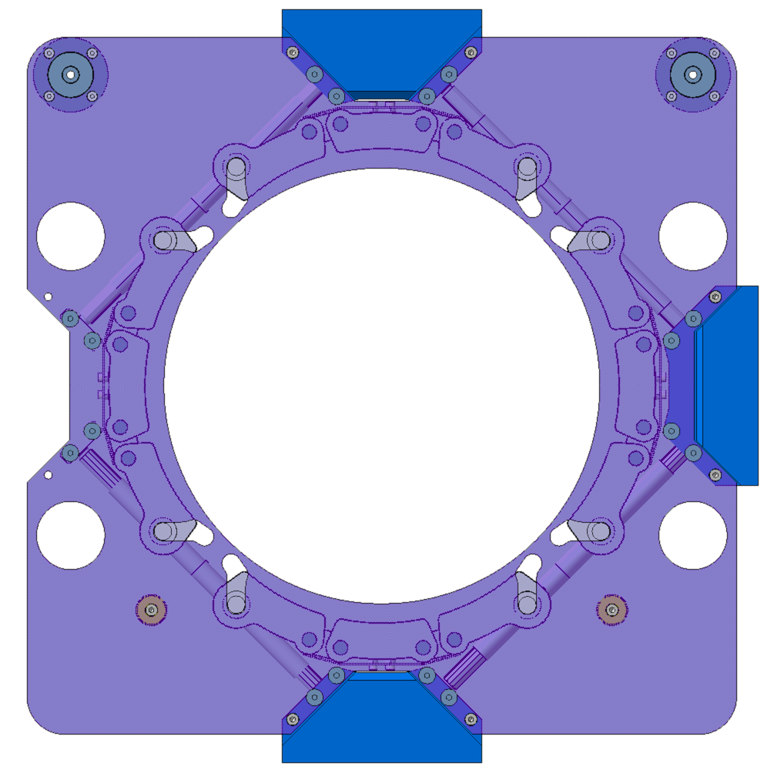
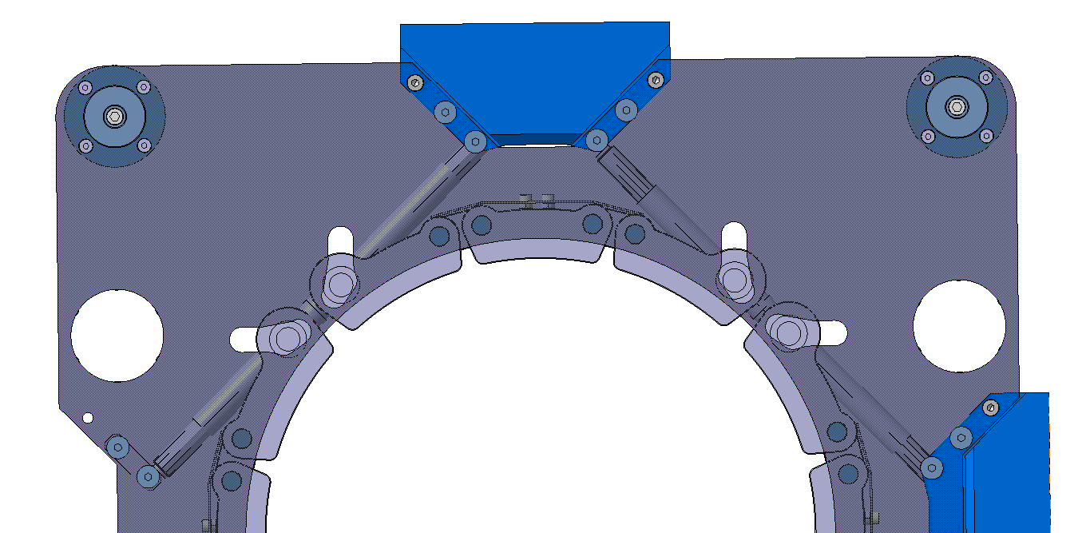
Technical Review
Factory Acceptance Test
Retraction Target Assembly
Factory Acceptance Tests carried at the Contractor’s premises on all assemblies
  Functionality test: Integration test of Type 2 tools with the chain.
    Check if all screws of the chains are rotatable by hand.
    Tightening the four chain screws in sequential order to bring the chain pins from open position to closed position and vise versa.
Details are given in Annex 6.
Chain in open position
Chain in closed position

Slide 13
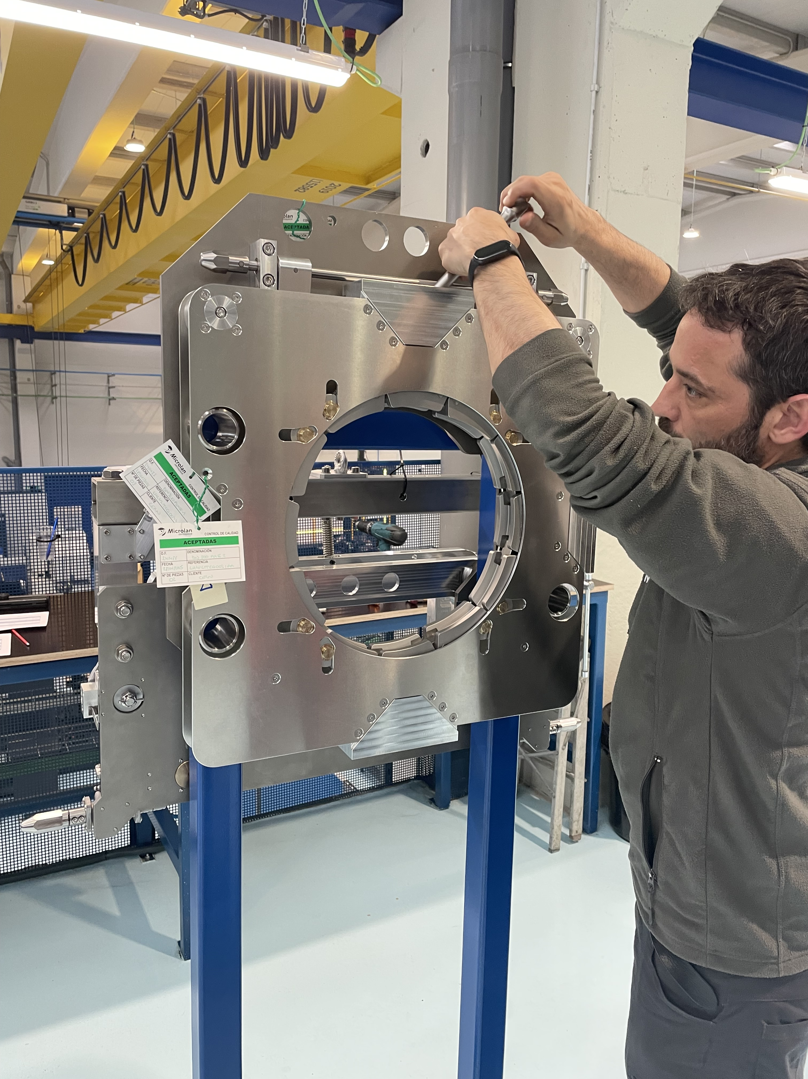
Retraction Target Assmebly
Chain Sliding Test
Chains can be rotated by hand

Slide 14
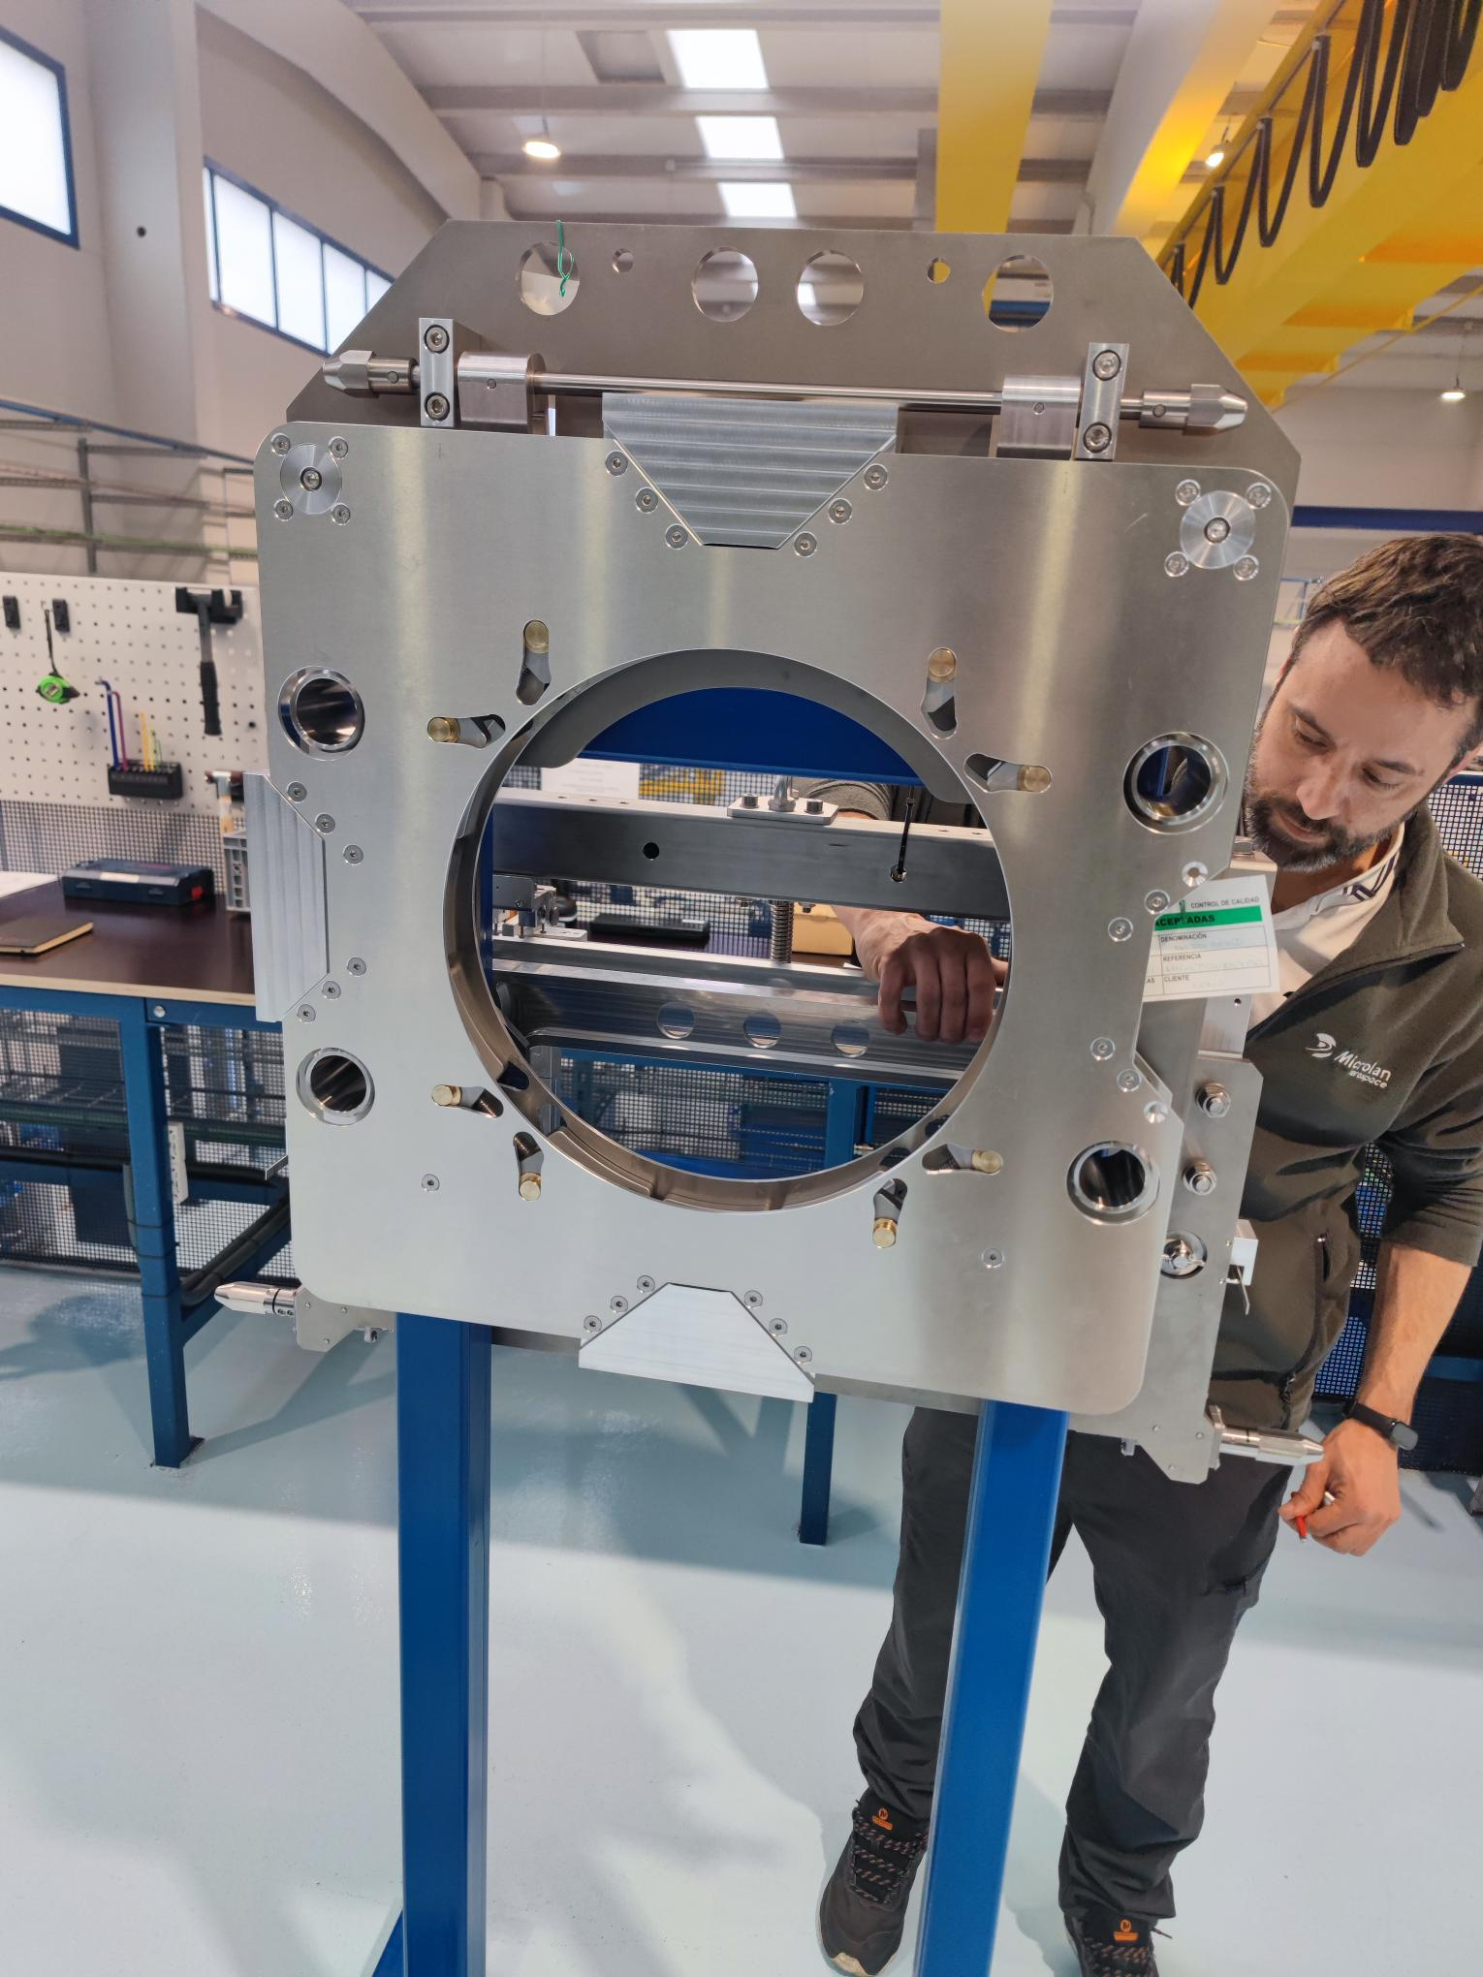
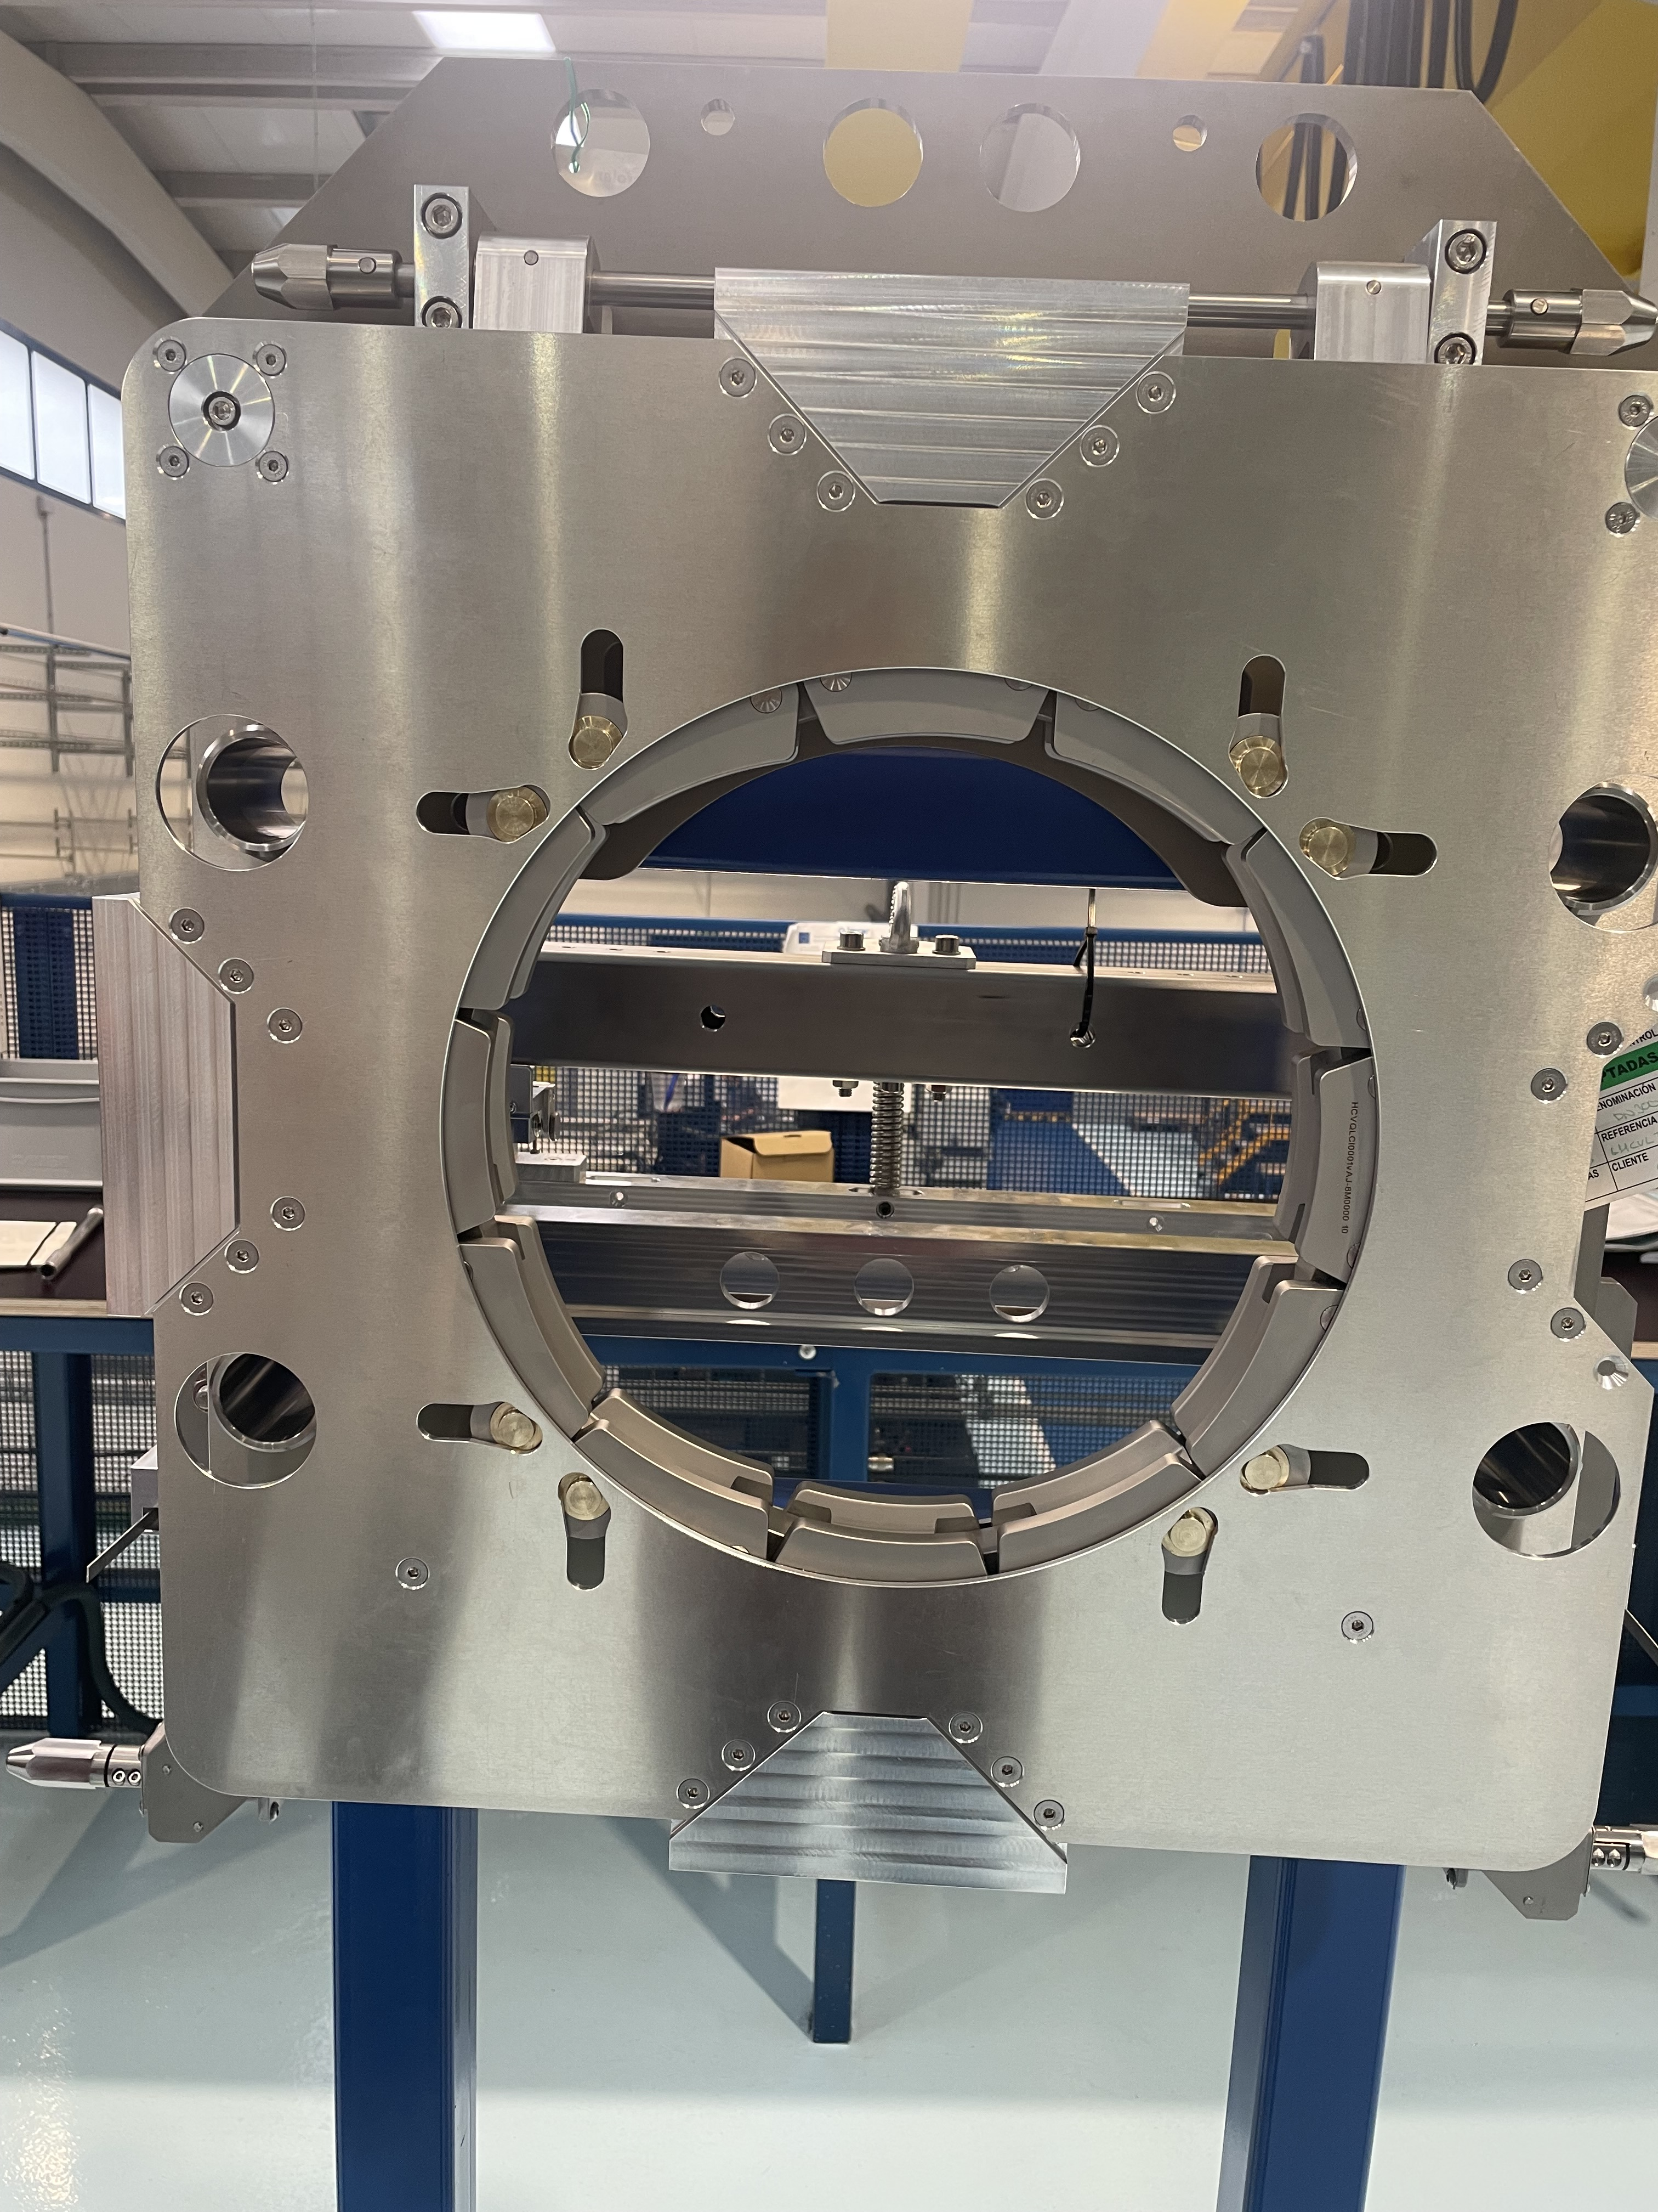
Retraction Target Assembly
Chain Sliding Test Results
Chain in open Position
Chain in Closed position

Slide 15
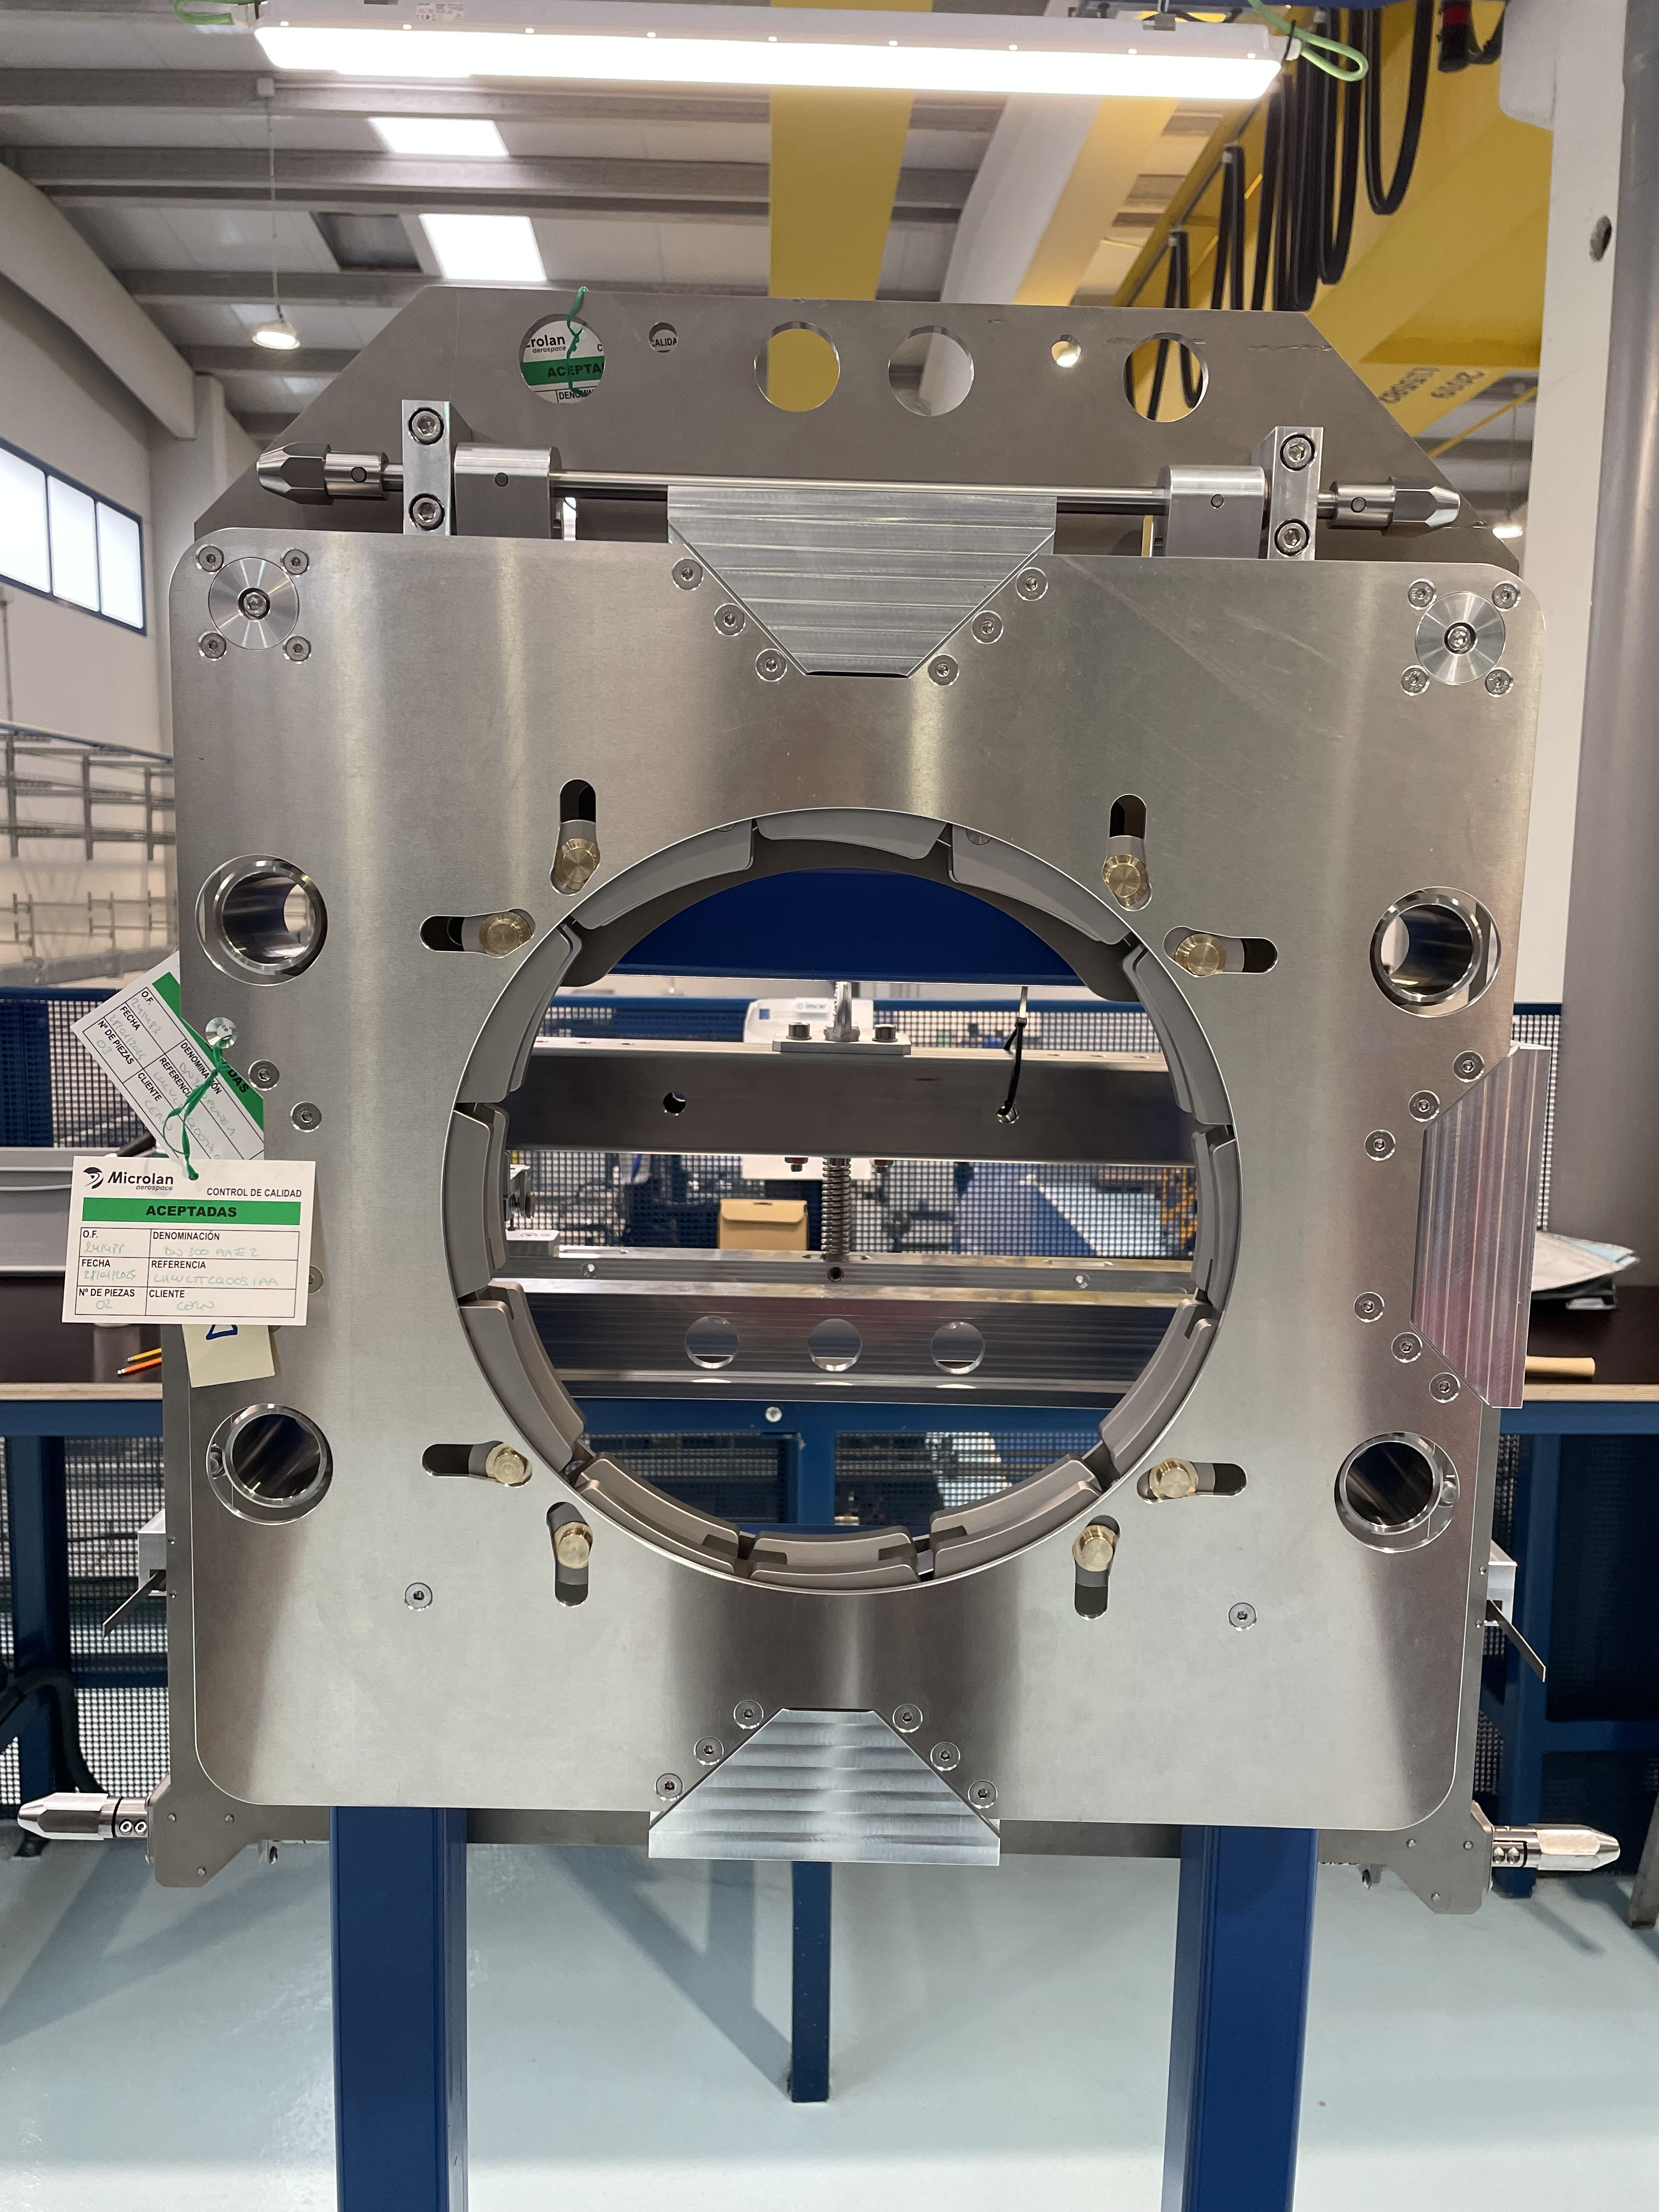
Retraction Target Assembly
Observations:
Chain pins not symmetrical in one assembly.
Possible cause:
  Not step wise tightening of the chain screws -→ insisting on the procedure
  Chains no well adjusted.

Slide 16
Current Status and Ongoing Tasks
Finishing the metrology reports. Uploaded results are compliant
Applying labelling on the tools
Uploading FAT reports
Designing transportation frame. Tools will be transported in upright position whilst protecting critical surfaces with protective foils.

Slide 17
Contract Milestones for Pre-Series
Task | Timeline
Pre-Series
Uploading of metrology and FAT reports | End of week 15
Acceptance of Documentation (Metrology and hardness test, FAT) | As soon as possible if compliant
Delivery of pre-series units | Possibly by week 17
Acceptance of pre-series units (SAT) | Week 19
Series
Machining of missing parts | Week 21
Assembly of 4 tools | Week 22
Documentation Acceptance | Week 23
Delivery of units | Week 24
Acceptance of 4 tools | Week 25
…
Delivery of last 4 units | Around week 30

Slide 18
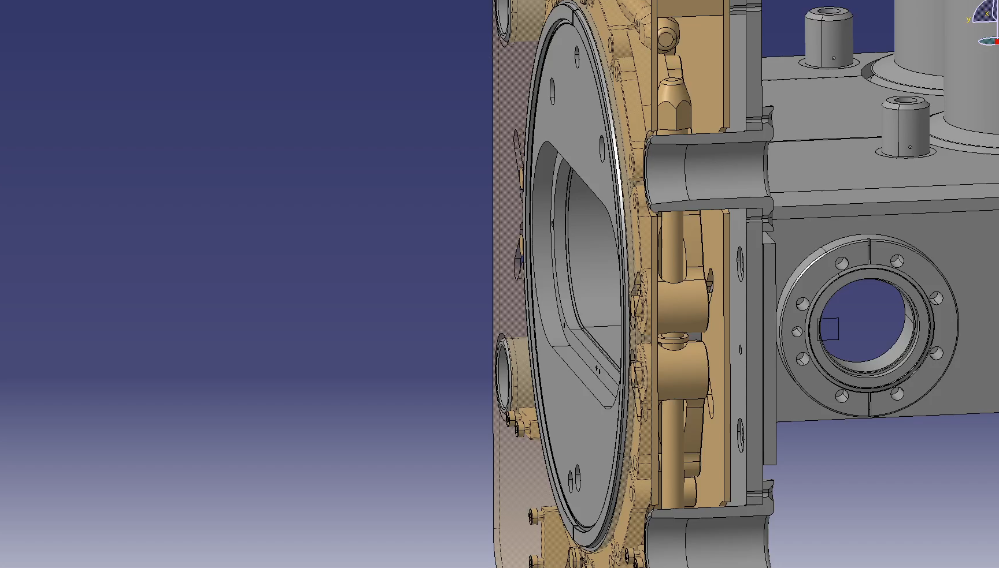
Animation of both Connection Tools Installed in the Collimator

Slide 19
Thank you!

