Slide 1
927 workshop setup for series collimation production.
Presenter Name
Date

Slide 2
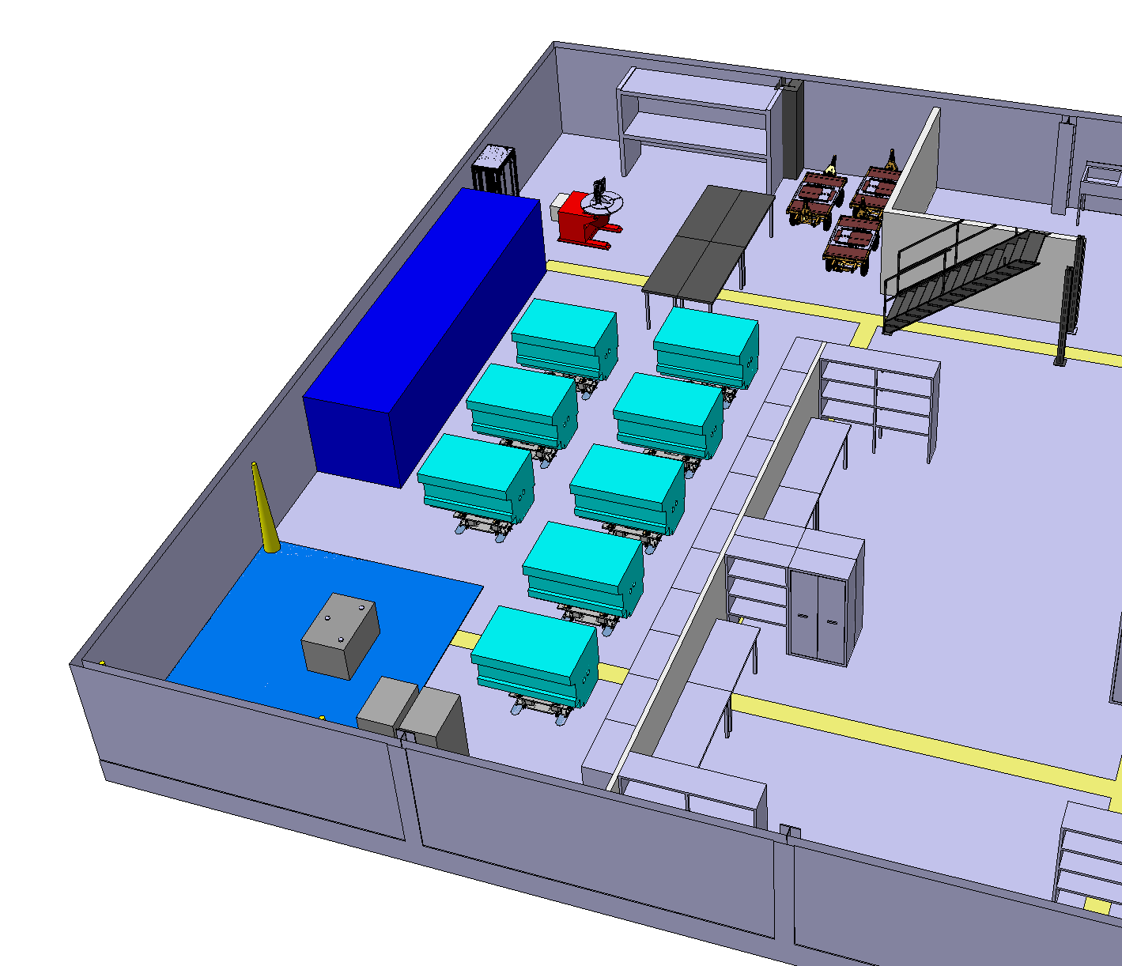
927 baseline.
IN/OUT Area
Orientation tooling
Mockup volume
Space for 8 Collimators with different support state.
Area dedicated to GM alignment + fidu
CEM Control Racks (moveable)
ST1A34603_01

Slide 3




927 Collimators supports flexibility.
 | Support Type |  | Total available
Slot 1-4 | Single beam Base Compatible single Beam & Dual Beam |  | 8 Pc Total
GM Slot | Rigid support for alignment and Fidu, 2 Types of spheres adaptor plate: single Beam & dual Beam |  | 1 Slot
Slots 5-8 | Supports adapted to the ongoing production single or dual beam collimators equipped plugins. |  | 4 Dual beam 4 Single beam 4 CEM Cabling support for Dual beam 4 CEM Cabling support for Single beam

Slide 4
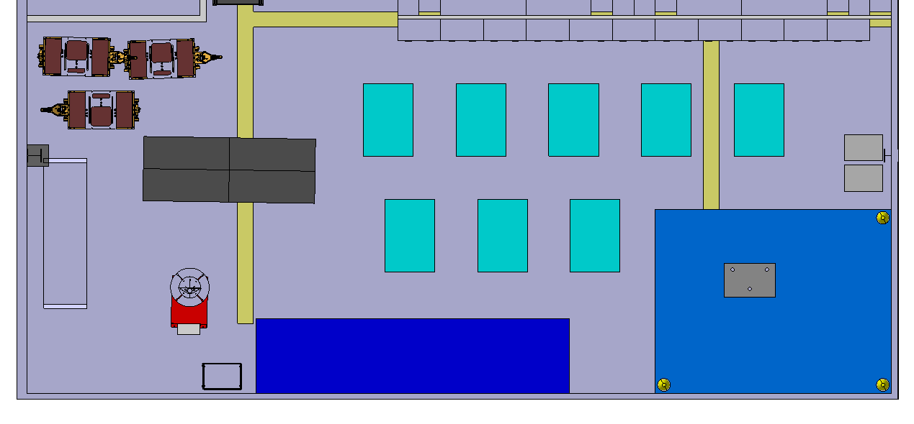
927 baseline.

Slide 5
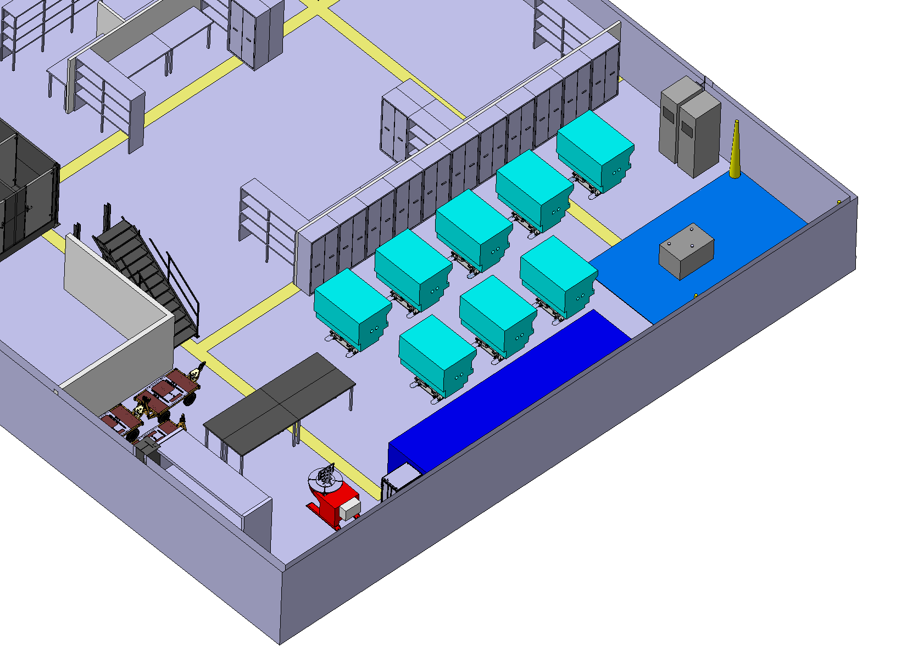
927 baseline.

Slide 6
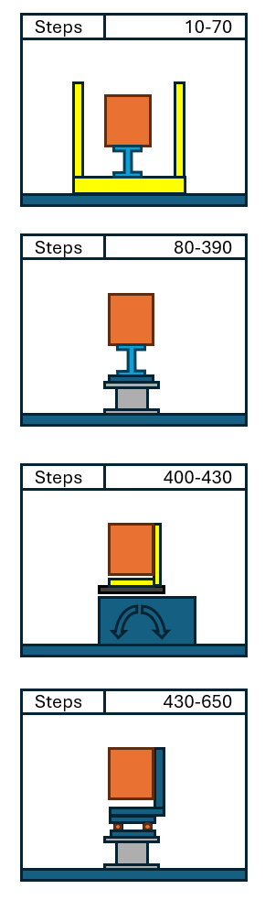
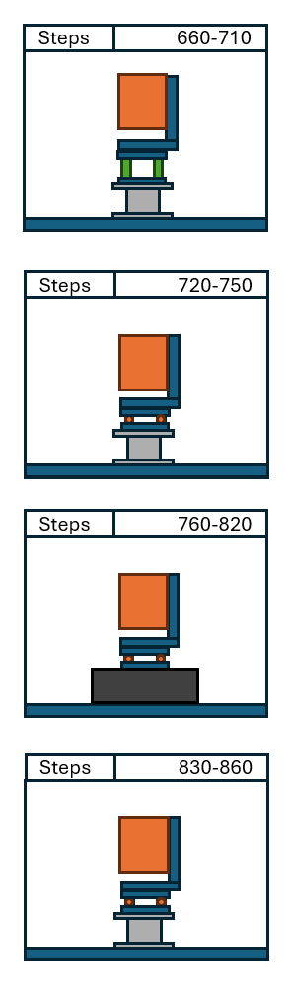
Reminder: Manutentions steps.
Remove collimator from delivery box to the support.
Elevated position for CEM hypertac installation
Collimator orientation.
Collimator alignment + fidu
Collimator and frame assembly.
Collimator final testing before UHV.

Slide 7
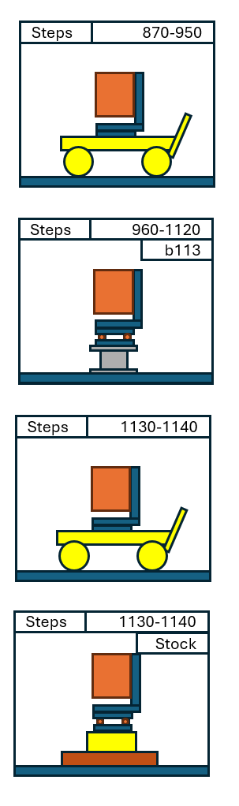
Reminder: Manutentions steps.
On the trolley for transport to VSC b113,
On VSC UHV acceptance test bench.
On the trolley for transport to storage building.
On pallet for storage.

Slide 8
“Subtitle and comparison” slide
Charts

Slide 9
“Two pieces of content” slide

Slide 10
Table
 | Column 1 | Column 2 | Column 3 | Column 4
Row 1
Row 2
Row 3
Row 4

Slide 11
“Big picture” slide

Slide 12
“Full-page picture” slide [28pt]
When you use this slide, please create a background in CERN blue or one of the other colours of this template with transparency set to 20%.

Slide 13
“Text and picture” slide

Slide 14
“Text and two pictures: horizontal” slide

Slide 15
“Subtitle and two pictures” slide

Slide 16
“Text and four pictures” slide

Slide 17
“Subtitle and three pictures” slide

Slide 18
“Horizontal picture and text” slide

Slide 19
“Chapter” slide [50pt Bold]

Slide 20
Fonts
Arial
AaBbCcDdEeFfGgHhIiJjKkLlMmNnOoPpQqRr
SsTtUuVvWwXxYyZz1234567890
Arial Bold
AaBbCcDdEeFfGgHhIiJjKkLlMmNnOoPpQqRr
SsTtUuVvWwXxYyZz1234567890
The font in this template is Arial. Please only use Arial and Arial Bold, as these are installed on all computers.
  Use bold selectively to emphasise information
  or titles.

Slide 21
Colours
The colour palette in this template is the following:
These colour combinations work well. Please use it when you need any extra colours, especially when making charts or other SmartArt graphics.

