Slide 1
Description of the Leak Tests Performed on EWBs at CERN
L. Hermida Pena (SY-STI-TCD)
14/07/25

Slide 2
Outline
Introduction
Leak tests performed at CERN
Status of the Tests & Results
Conclusions

Slide 3
Outline
Introduction
Leak tests performed at CERN
Status of the Tests & Results
Conclusions

Slide 4
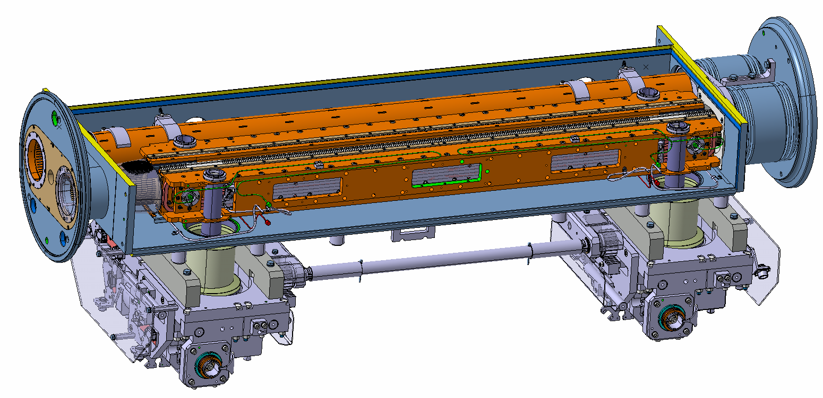
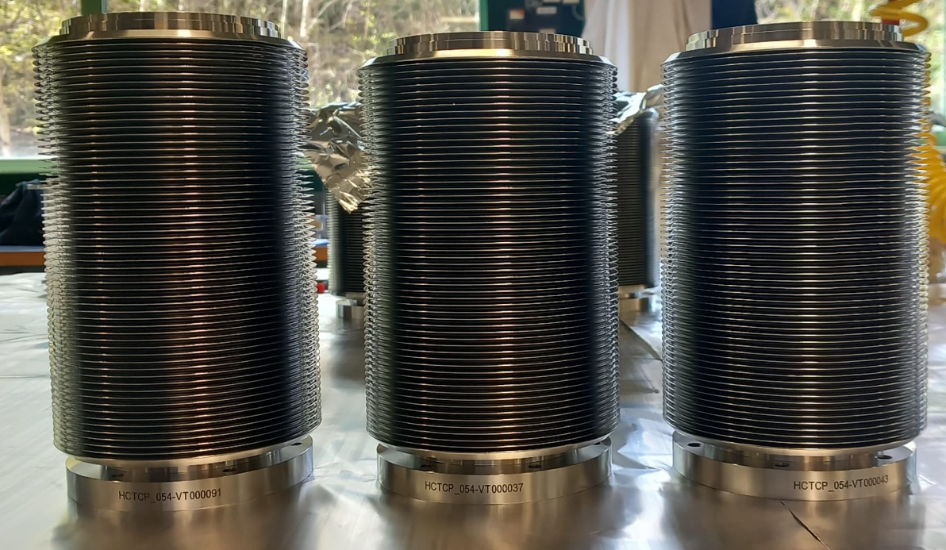
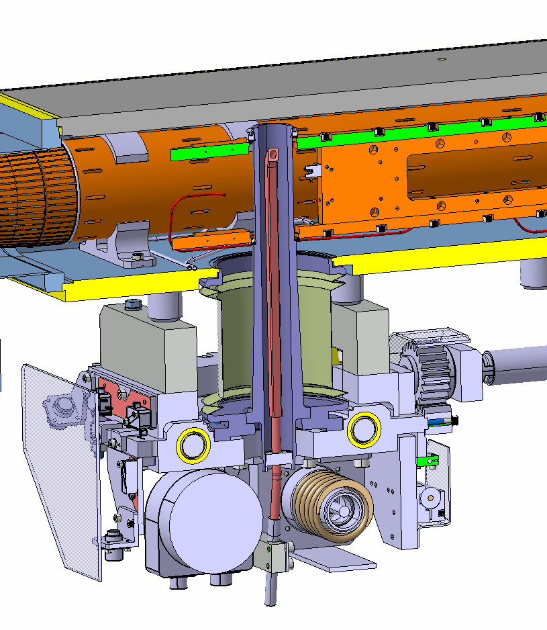
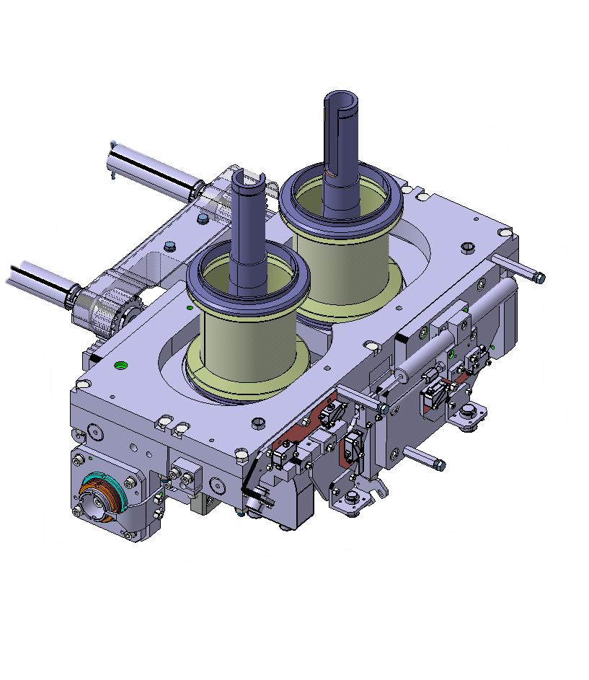
Introduction
The Edge Welded Bellows are critical components of the collimators. They allow for the displacement of the shaft and create an interface between Vacuum and the atmospheric pressure.
Cooling pipe
Mobile table
Courtesy of: C. Piccinni
Jaw
Shaft

Slide 5
New Production 2025
A new production was launched in January 2025 due to poor cycling behaviour with the following configuration:
Bellow type | Final Configuration | Series Quantity | Test bellows
LHCTCTP_0054 Index AG | 70 convolutions (vs prod. 2024: 58) | 101 | 8
LHCTCLPX__0160 Index AC | 82 convolutions (vs prod. 2024: 61) | 67 | 8
As of 14/07/2025:
LHCTCTP_0054: Fully delivered on the 05/06/2025
LHCTCLPX__0160: Fully delivered

Slide 6
SAT
As stated in DO-33714/SY/HL-LHC, the received bellows are undergoing the following Site Acceptance Tests:
Leak Test
Cycling test
Metrology

Slide 7
Outline
Introduction
Leak tests performed at CERN
Status of the Tests & Results
Conclusions

Slide 8
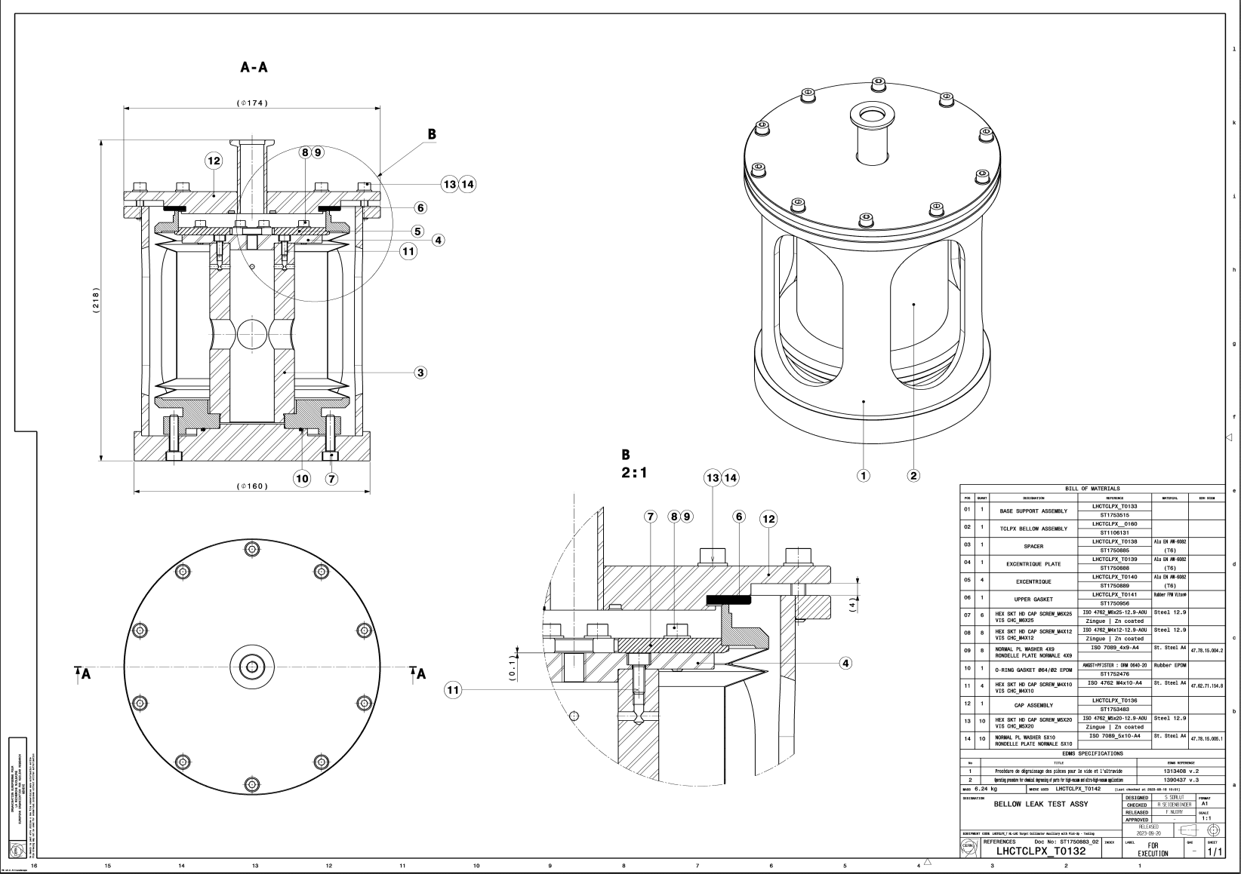
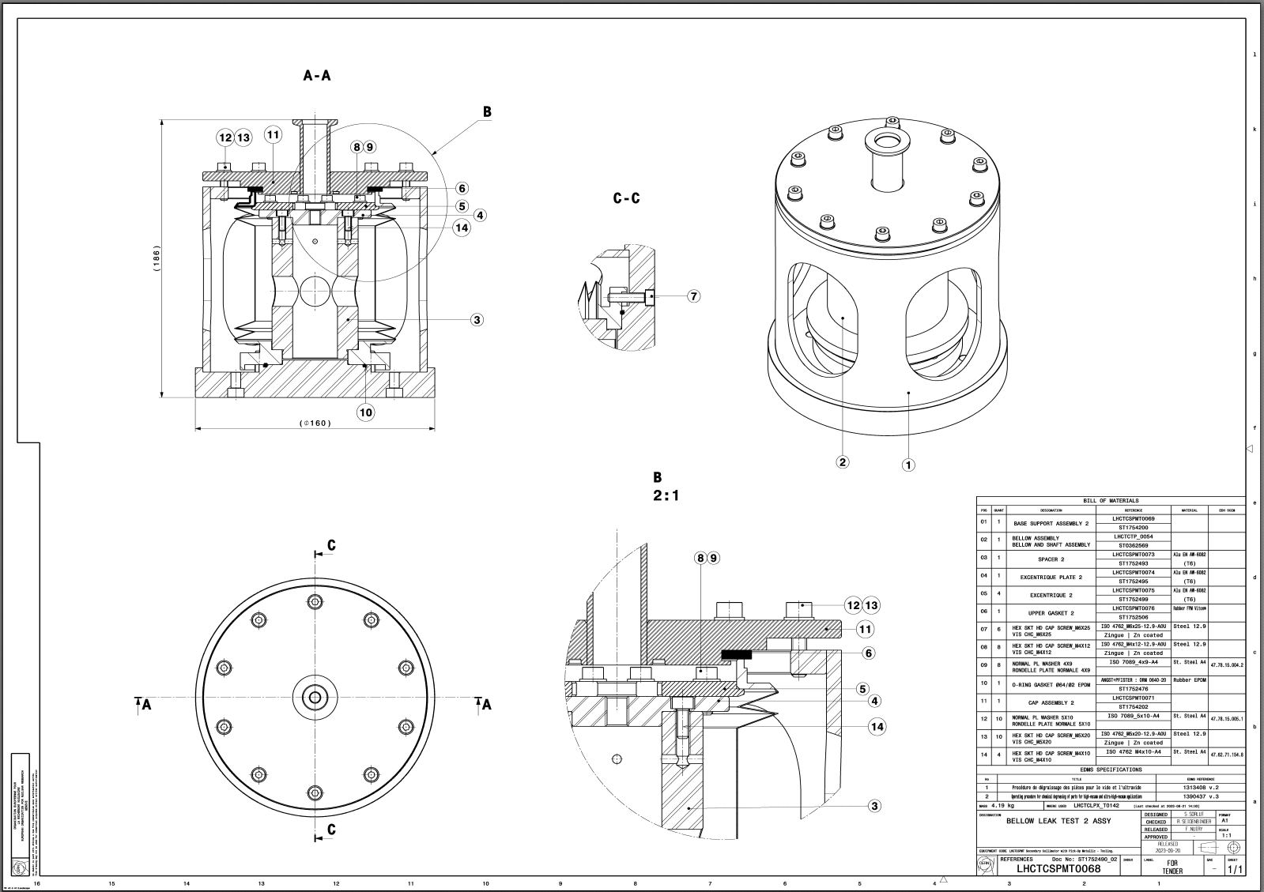
Leak Tests Performed at CERN
LHCTCLPX_T0132
Double-Beam
LHCTCSPMT0068
Single-Beam

Slide 9
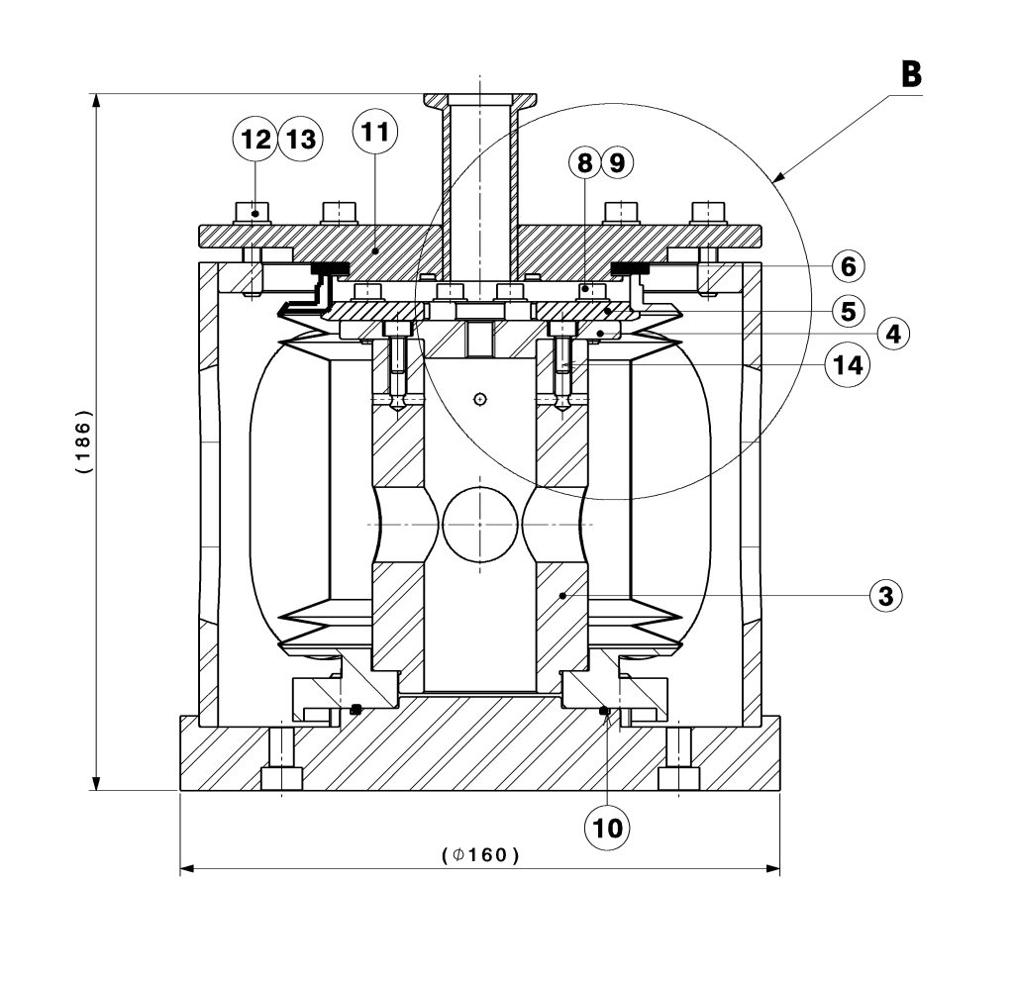
Leak Tests Performed at CERN
LHCTCLPX_T0132
Cover
Shaft
Seals
Support

Slide 10
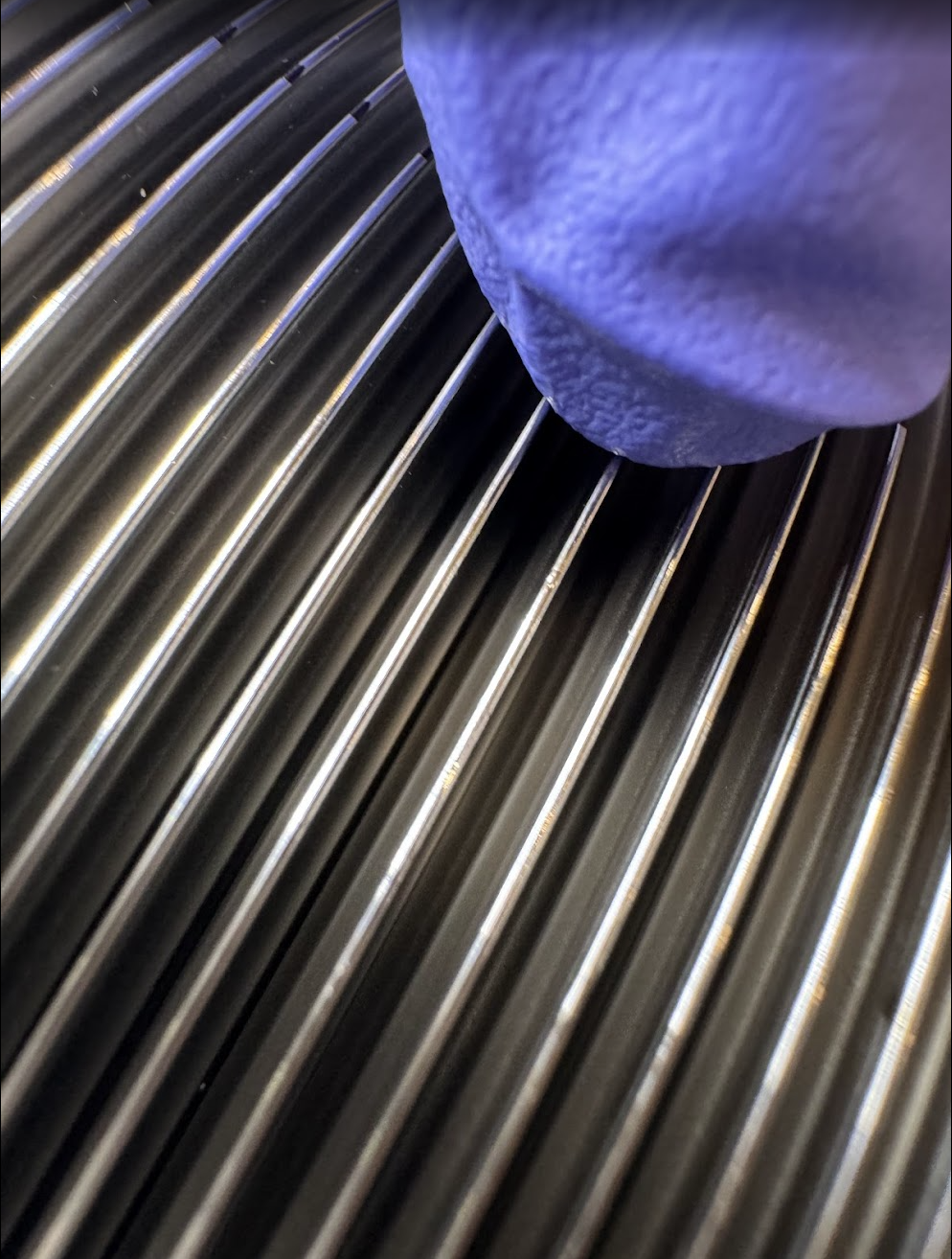
Leak Tests Performed at CERN in July 2025
Visual Inspection
Installation on the Tooling
Gas evacuation
Helium mass spectroscopy
Every bellow is inspected visually to check for unconformities.

Slide 11
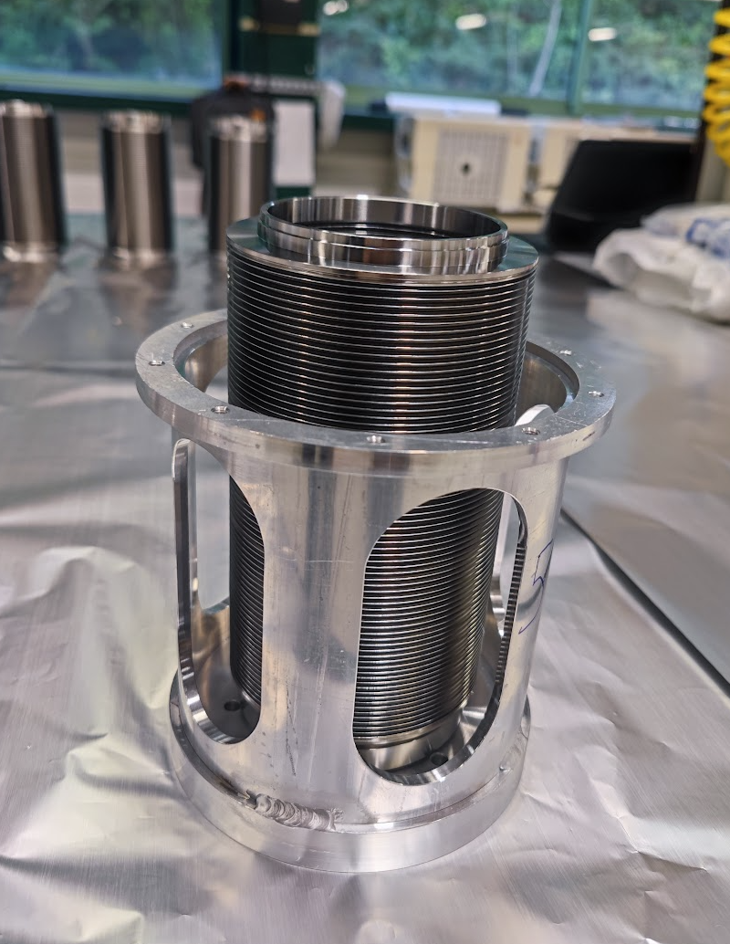
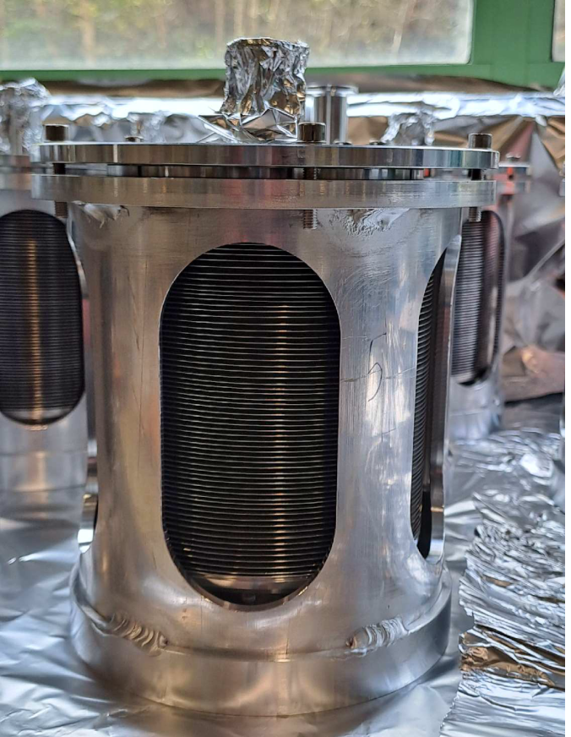
Leak Tests Performed at CERN in July 2025
Visual Inspection
Installation on the Tooling
Gas evacuation
Helium mass spectroscopy
The bellows are installed in the tooling.

Slide 12
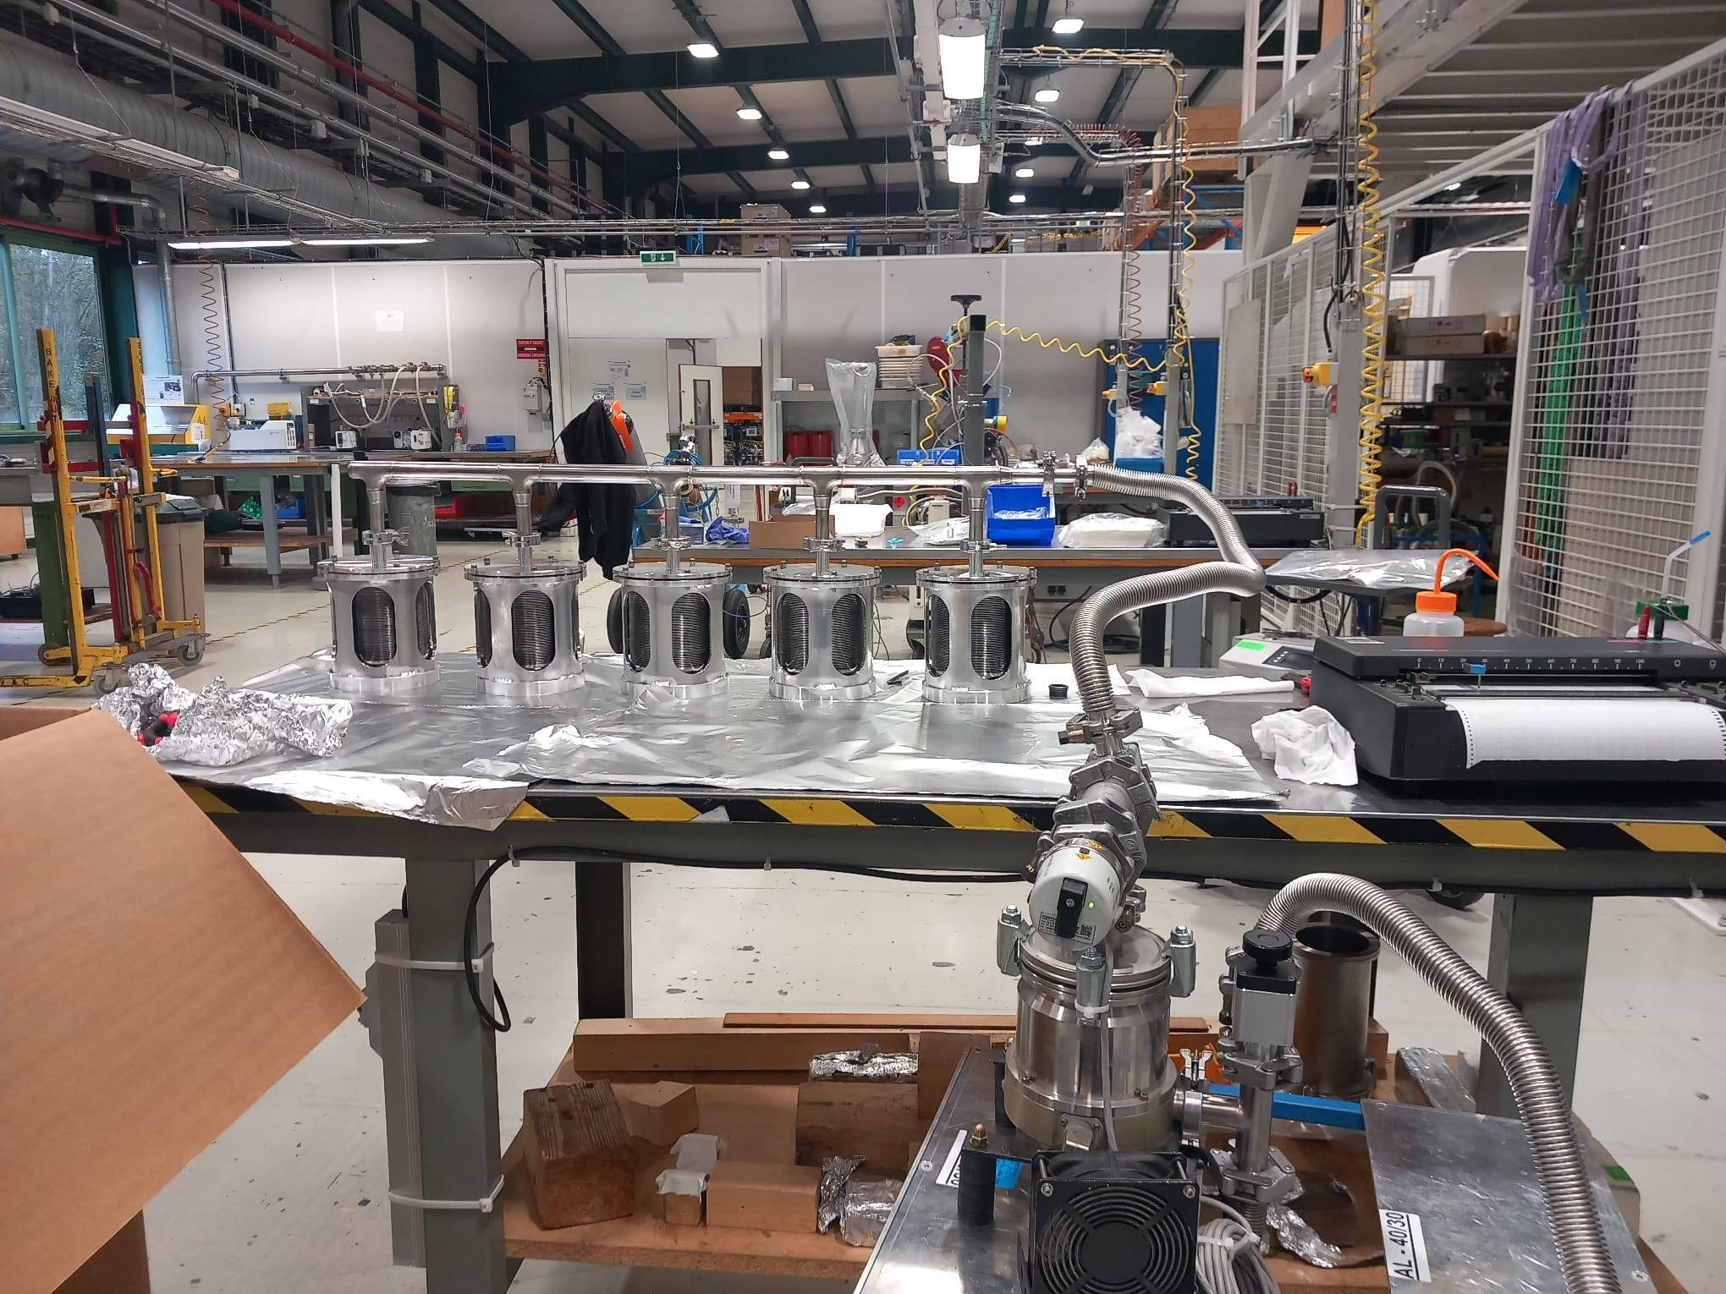
Leak Tests Performed at CERN in July 2025
Visual Inspection
Installation on the Tooling
Gas evacuation
Helium mass spectroscopy
The bellows are pumped down. The helium leak test sensitivity achieved is 2.00E-10 mbar.l/s.

Slide 13
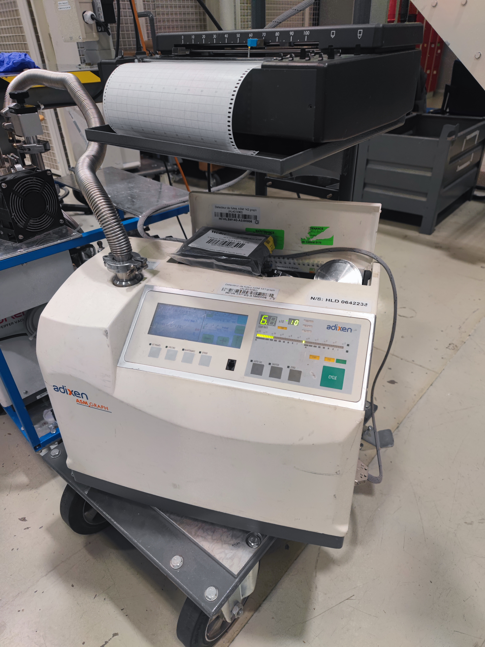
Leak Tests Performed at CERN in July 2025
Visual Inspection
Installation on the Tooling
Gas evacuation
Helium mass spectroscopy
Helium is sprayed on the outside of the bellow, and a mass spectrometer inside the vacuum system detects if helium gets in.

Slide 14
Outline
Introduction
Leak tests performed at CERN
Status of the Tests & Results
Conclusions

Slide 15
Status of the SAT & Results
2 leaky bellows have been detected
Bellow Reference | Date of arrival at CERN | Date of He leak test | Leak Rate
HCTCP_054-VT000015 | 05/06/2025 | 4/07/2025 | 3.5E-5 mbar.L.s-1
HCTCLPX_160-VT000002 | 25/06/2025 | 7/07/2025 | 3.1E-6 mbar.L.s-1

Slide 16
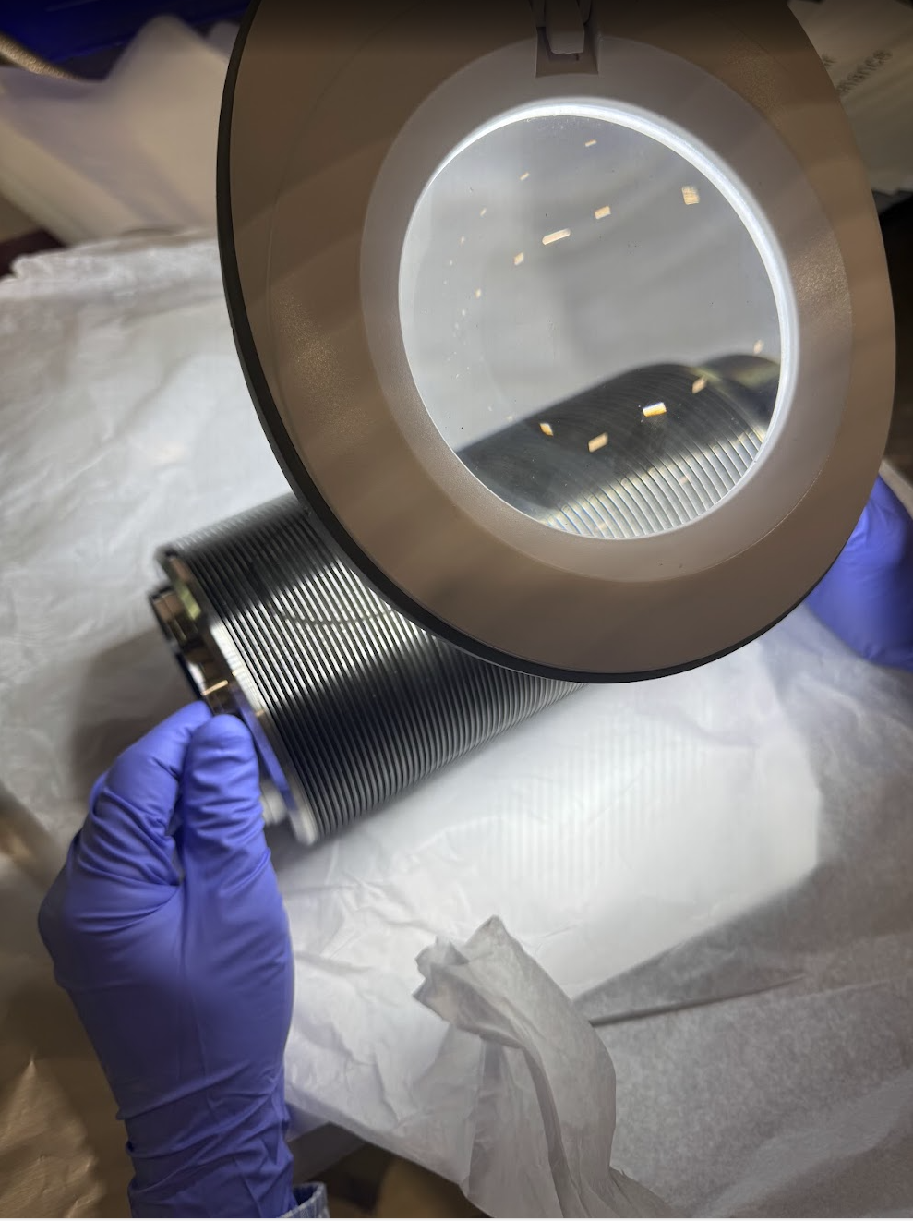
HCTCLPX_160-VT00015
Pictures taken on the weld number 35 from the big flange.

Slide 17
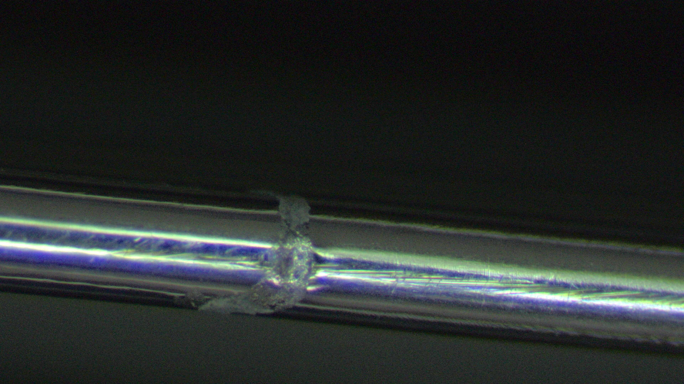
HCTCLPX_160-VT00015
Pictures taken on the weld number 35 from the big flange.

Slide 18
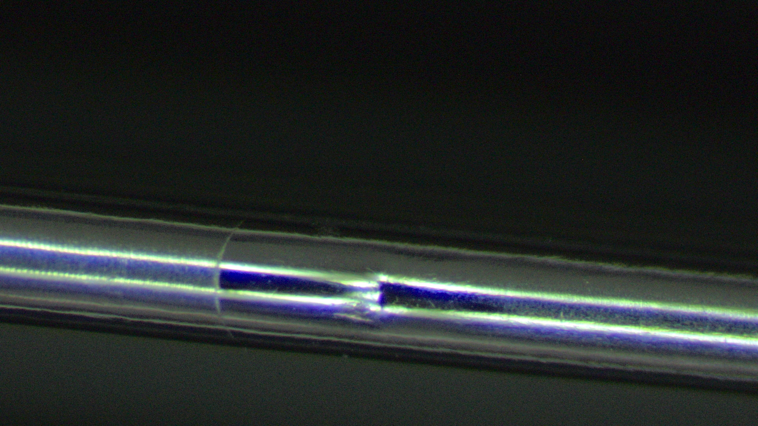
HCTCLPX_160-VT00015
Pictures taken on the weld number 35 from the big flange.

Slide 19
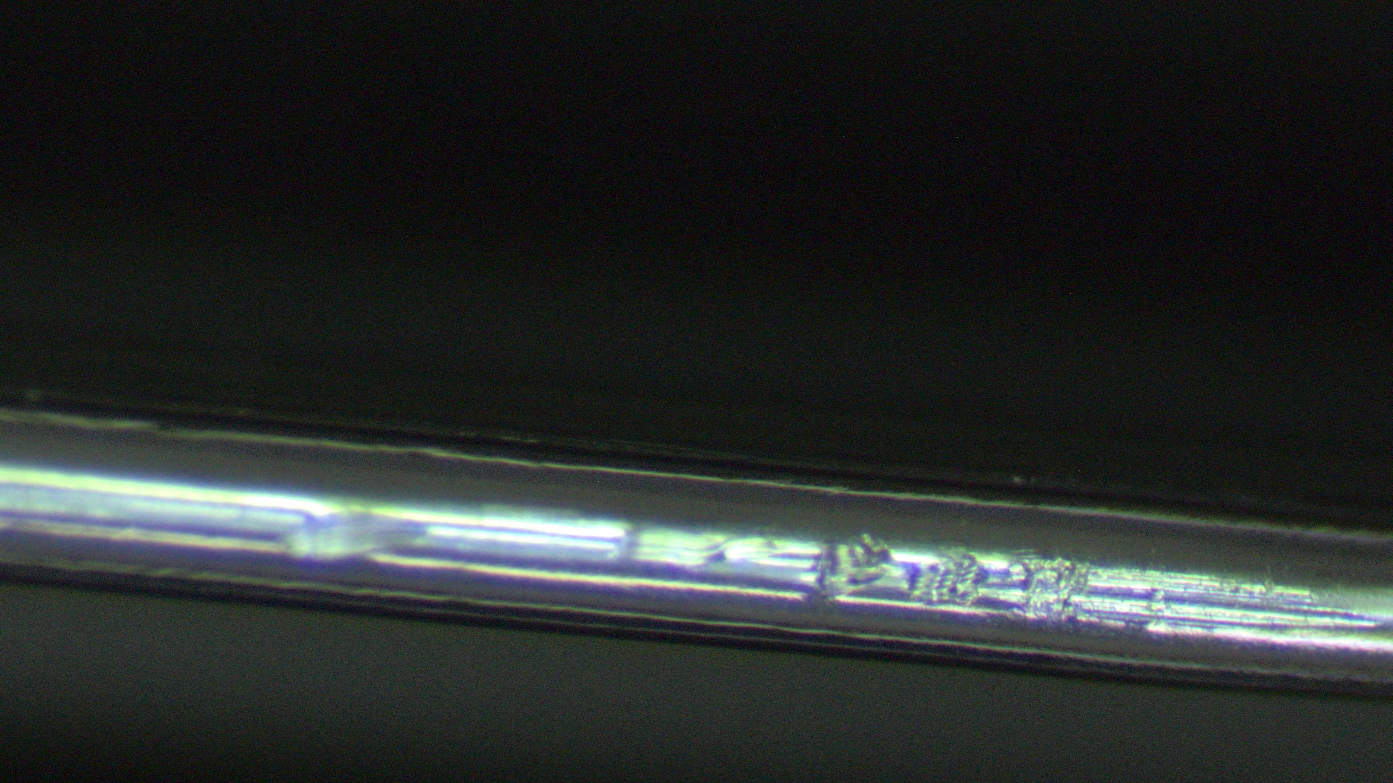
HCTCLPX_160-VT00015
Pictures taken on the weld number 35 from the big flange.

Slide 20
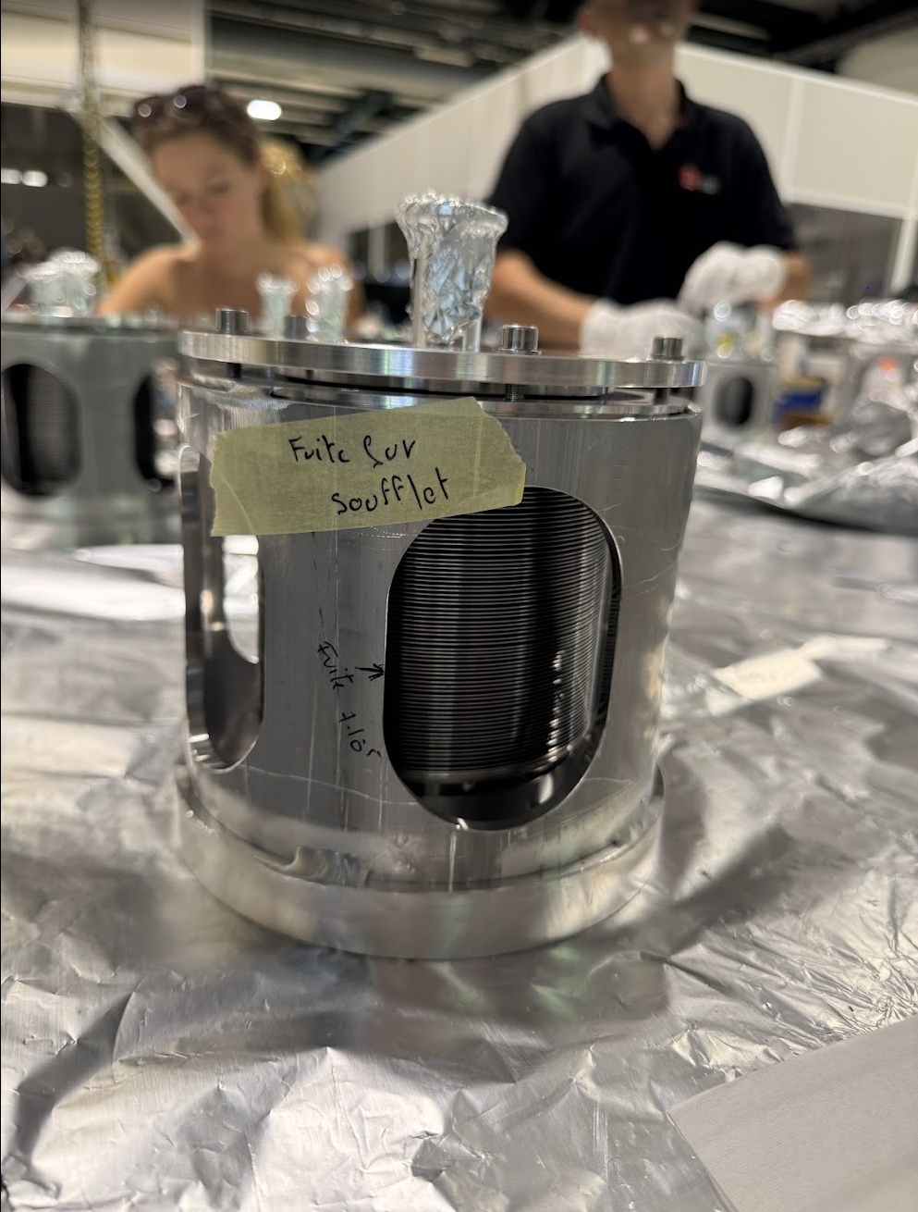
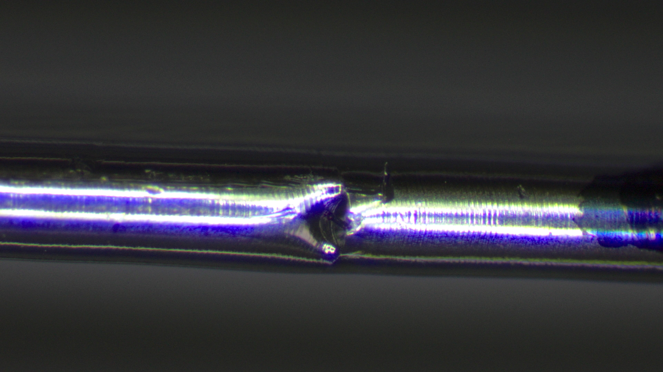
HCTCTP_054-VT000015

Slide 21
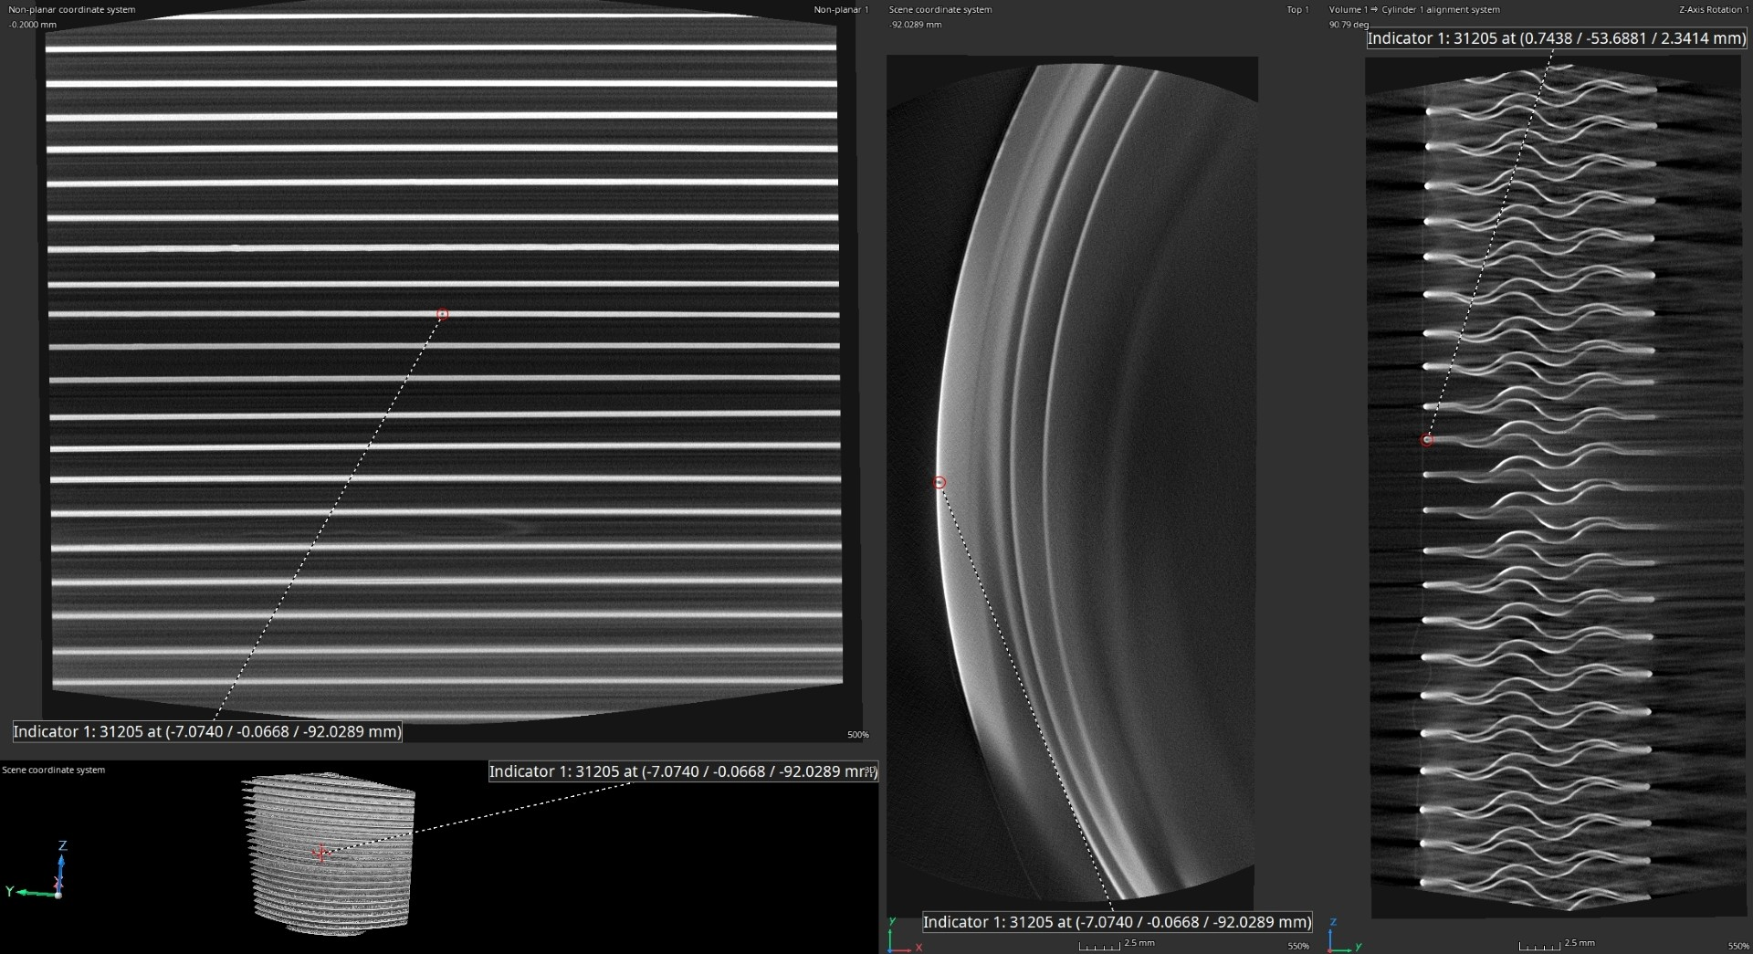
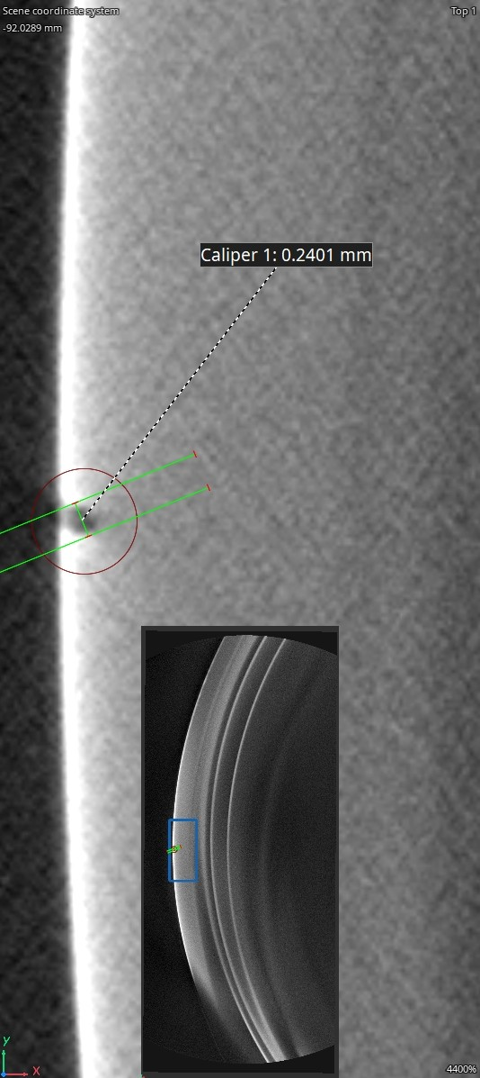
HCTCTP_054-VT000015 Tomography

Slide 22
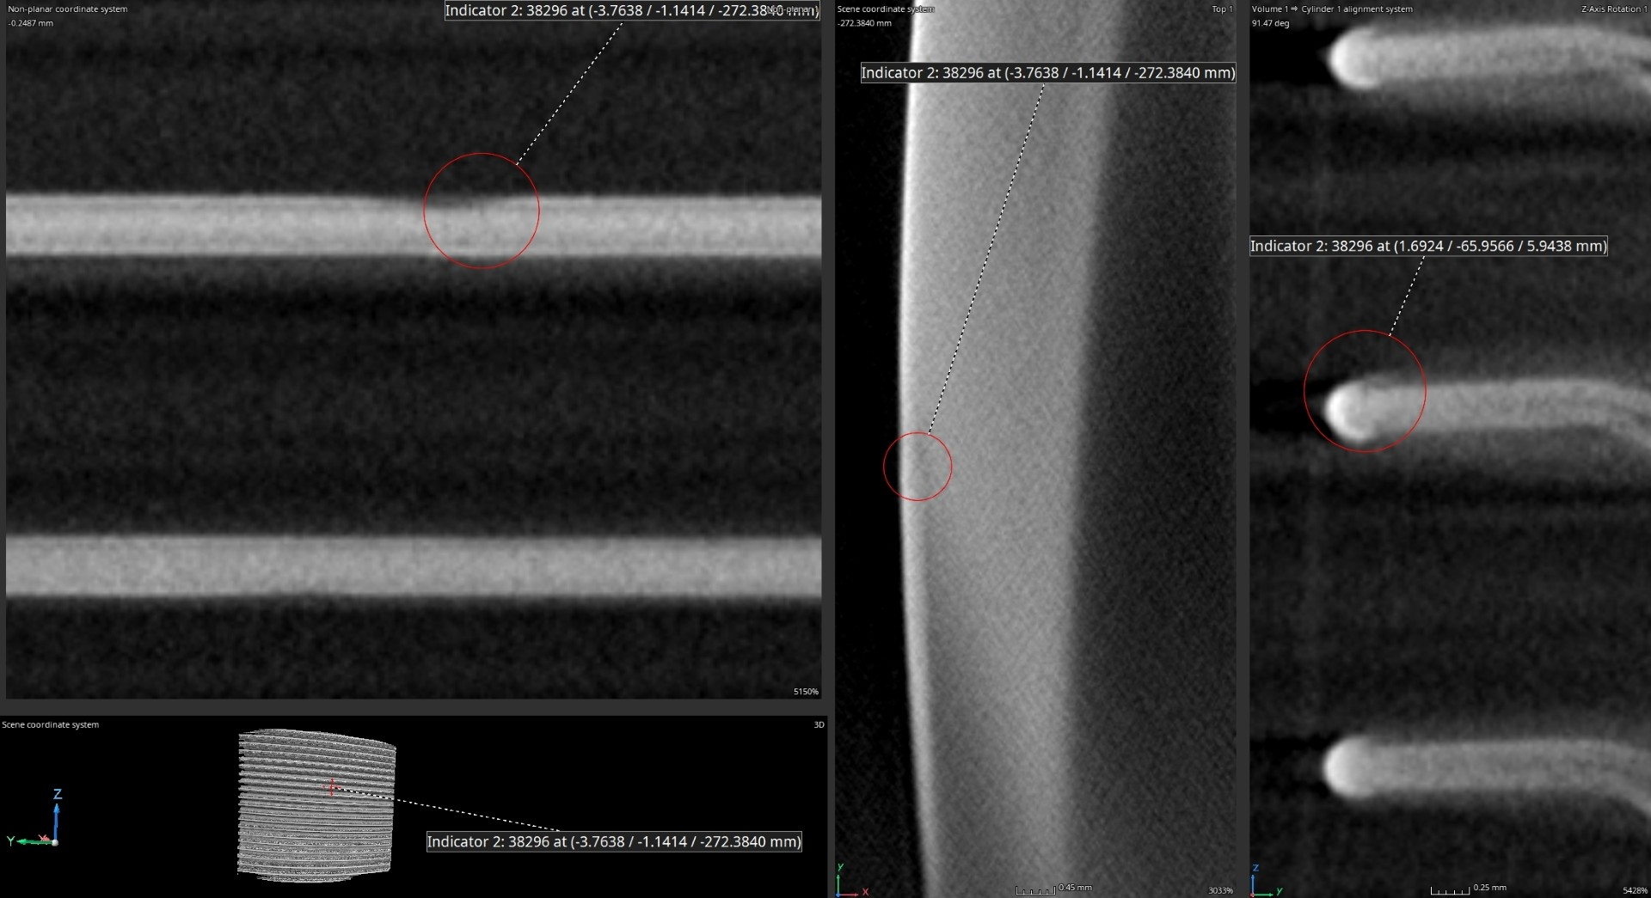
HCTCLPX_160-VT00002 Tomography

Slide 23
Status of the SAT & Results
LHCTCTP_0054: full series received on CW 23
Test | # bellows | Outcome
Leak tightness | 80/101 | OK
Metrology | 12 CMM + 2 Tomography | OK
UHV cleanliness | To be performed as last SAT step | N/A
Destructive cycling | 8 | See tables below
Cycling interrupted before leak appearance
As of 30/06 morning, 9.30 am; no leak. Cycling still ongoing.
Cycling outcomes (@ stroke ± 20 mm; 7 s/Cy):
Bellow S/N | # cycles
HCTCTP_0054vAG-VT100012 | 190 736
HCTCTP_0054vAG-VT100013 | 190 736
HCTCTP_0054vAG-VT100090 | 190 736
HCTCTP_0054vAG-VT100108 | 190 736
Bellow S/N | # cycles
HCTCTP_0054vAG-VT100010 | 45 880
HCTCTP_0054vAG-VT100008 | 45 880
HCTCTP_0054vAG-VT100003 | 45 880
HCTCTP_0054vAG-VT100001 | 45 880
Courtesy of: C. Piccinni

Slide 24
Status of the SAT & Results
LHCTCLPX_0160: full series received on CW 23
Test | # bellows | Outcome
Leak tightness | 19/75 | OK
Metrology | 12 CMM + 2 Tomography | TBD CMM, Tomo OK
UHV cleanliness | To be performed as last SAT step | N/A
Destructive cycling | 4 | See tables below
Cycling outcomes (@ stroke ± 20 mm; 7 s/Cy):
Bellow S/N | # cycles
HCTCLPX_160-VT000039 | Ongoing
HCTCLPX_160-VT000014 | Ongoing
HCTCLPX_160-VT000016 | Ongoing
HCTCLPX_160-VT000017 | Ongoing
Courtesy of: C. Piccinni

Slide 25
Outline
Introduction
Leak tests performed at CERN
Status of the Tests & Results
Conclusions

Slide 26
Conclusions
2 bellows have leaked:
HCTCP_054-VT000015
HCTCLPX_160-VT000002
This is a critical problem, as all bellows have to be leak tight, and this should have been detected before delivery.
CERN will continue to perform the leak tests on the whole production.
The rest of the SAT so far are ok.

Slide 27
Thank you for your attention

