Slide 1
Graphite Procurement Status
July 2025
CERN, Geneva
July 14th, 2025

Slide 2
Recap: Graphite Procurement Status
Original Order:
DAI 9841837(July 2023)
60 graphite blocks (48 for series production, 12 spares)
60 graphite taperings ( 48 for series, 12 spares)
Damage Overview:
15 blocks non-conform due to substantial copper coating damage
→ Up to 13 pairs (26 blocks) excluded
2 additional blocks damaged during handling at CINEL
→ 4 more blocks rejected
Recovery Measures:
Rematching efforts based on block height similarity
→ 4 block pairs successfully rematched
→ 2 pairs already installed in pre-series jaws
Reorder:
28 new blocks ordered from SGL (DAI 10688341)

Slide 3
Changes Applied in Handling Procedues
Foam padding added for packaging — working well, as many edge defects were likely caused by blocks rolling on hard surfaces
A dedicated person is now assigned in each team for graphite handling
Handling procedure is now attached to each graphite box
A visible note added: "Fragile – Handle with care“
Edges are wiped down before coating (reported moderate effectiveness according to Wil)

Slide 4
Changes Applied in Handling Procedures
Change Applied | Purpose | Effectiveness
Foam padding on top during packaging | Prevent edge damage from impact/rolling | High
Assign dedicated handler per team | Avoid miscommunication and inconsistent handling | Medium
Handling procedure added to graphite box | Ensure proper protocol is always followed | Medium-High
"Fragile" warning label added | Raise awareness of sensitivity | Medium
Edge wipe-down before coating | Improve coating quality, reduce residue | Medium

Slide 5

Flow Chart of Treatments of Additional Blocks
Visual Inspection
https://edms.cern.ch/document/3019660/1
Metrology
https://edms.cern.ch/document/3285352/1
Cleaning
Vacuum Firing
UHV Test pre-coating
Copper Coating
https://edms.cern.ch/document/3319210/1
UHV Test post-coating

Slide 6
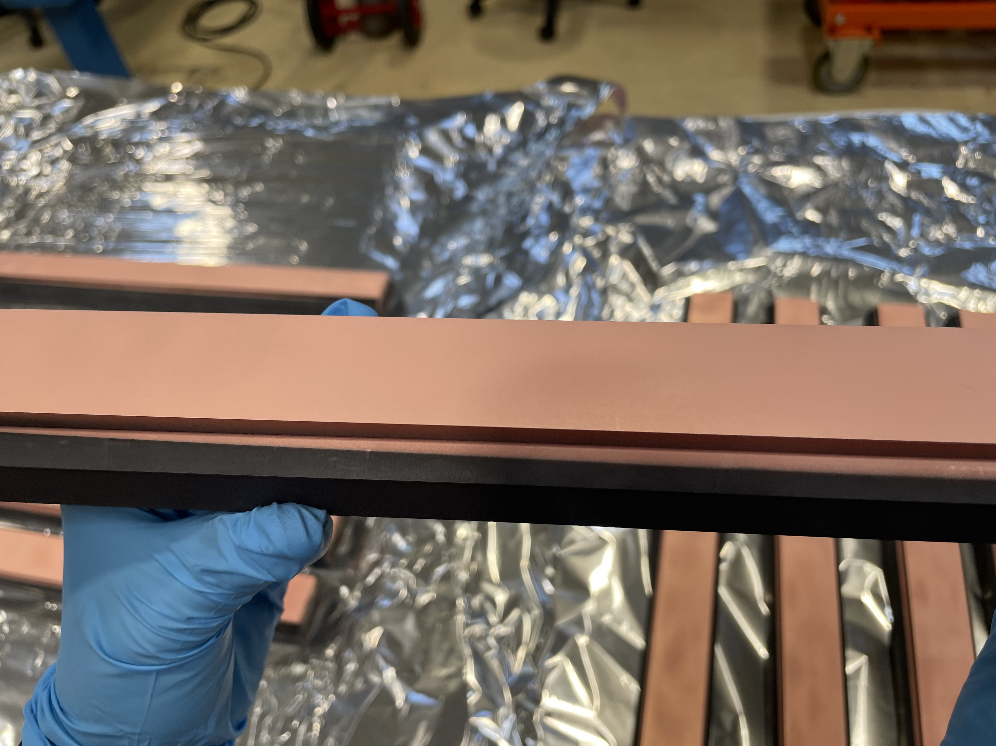
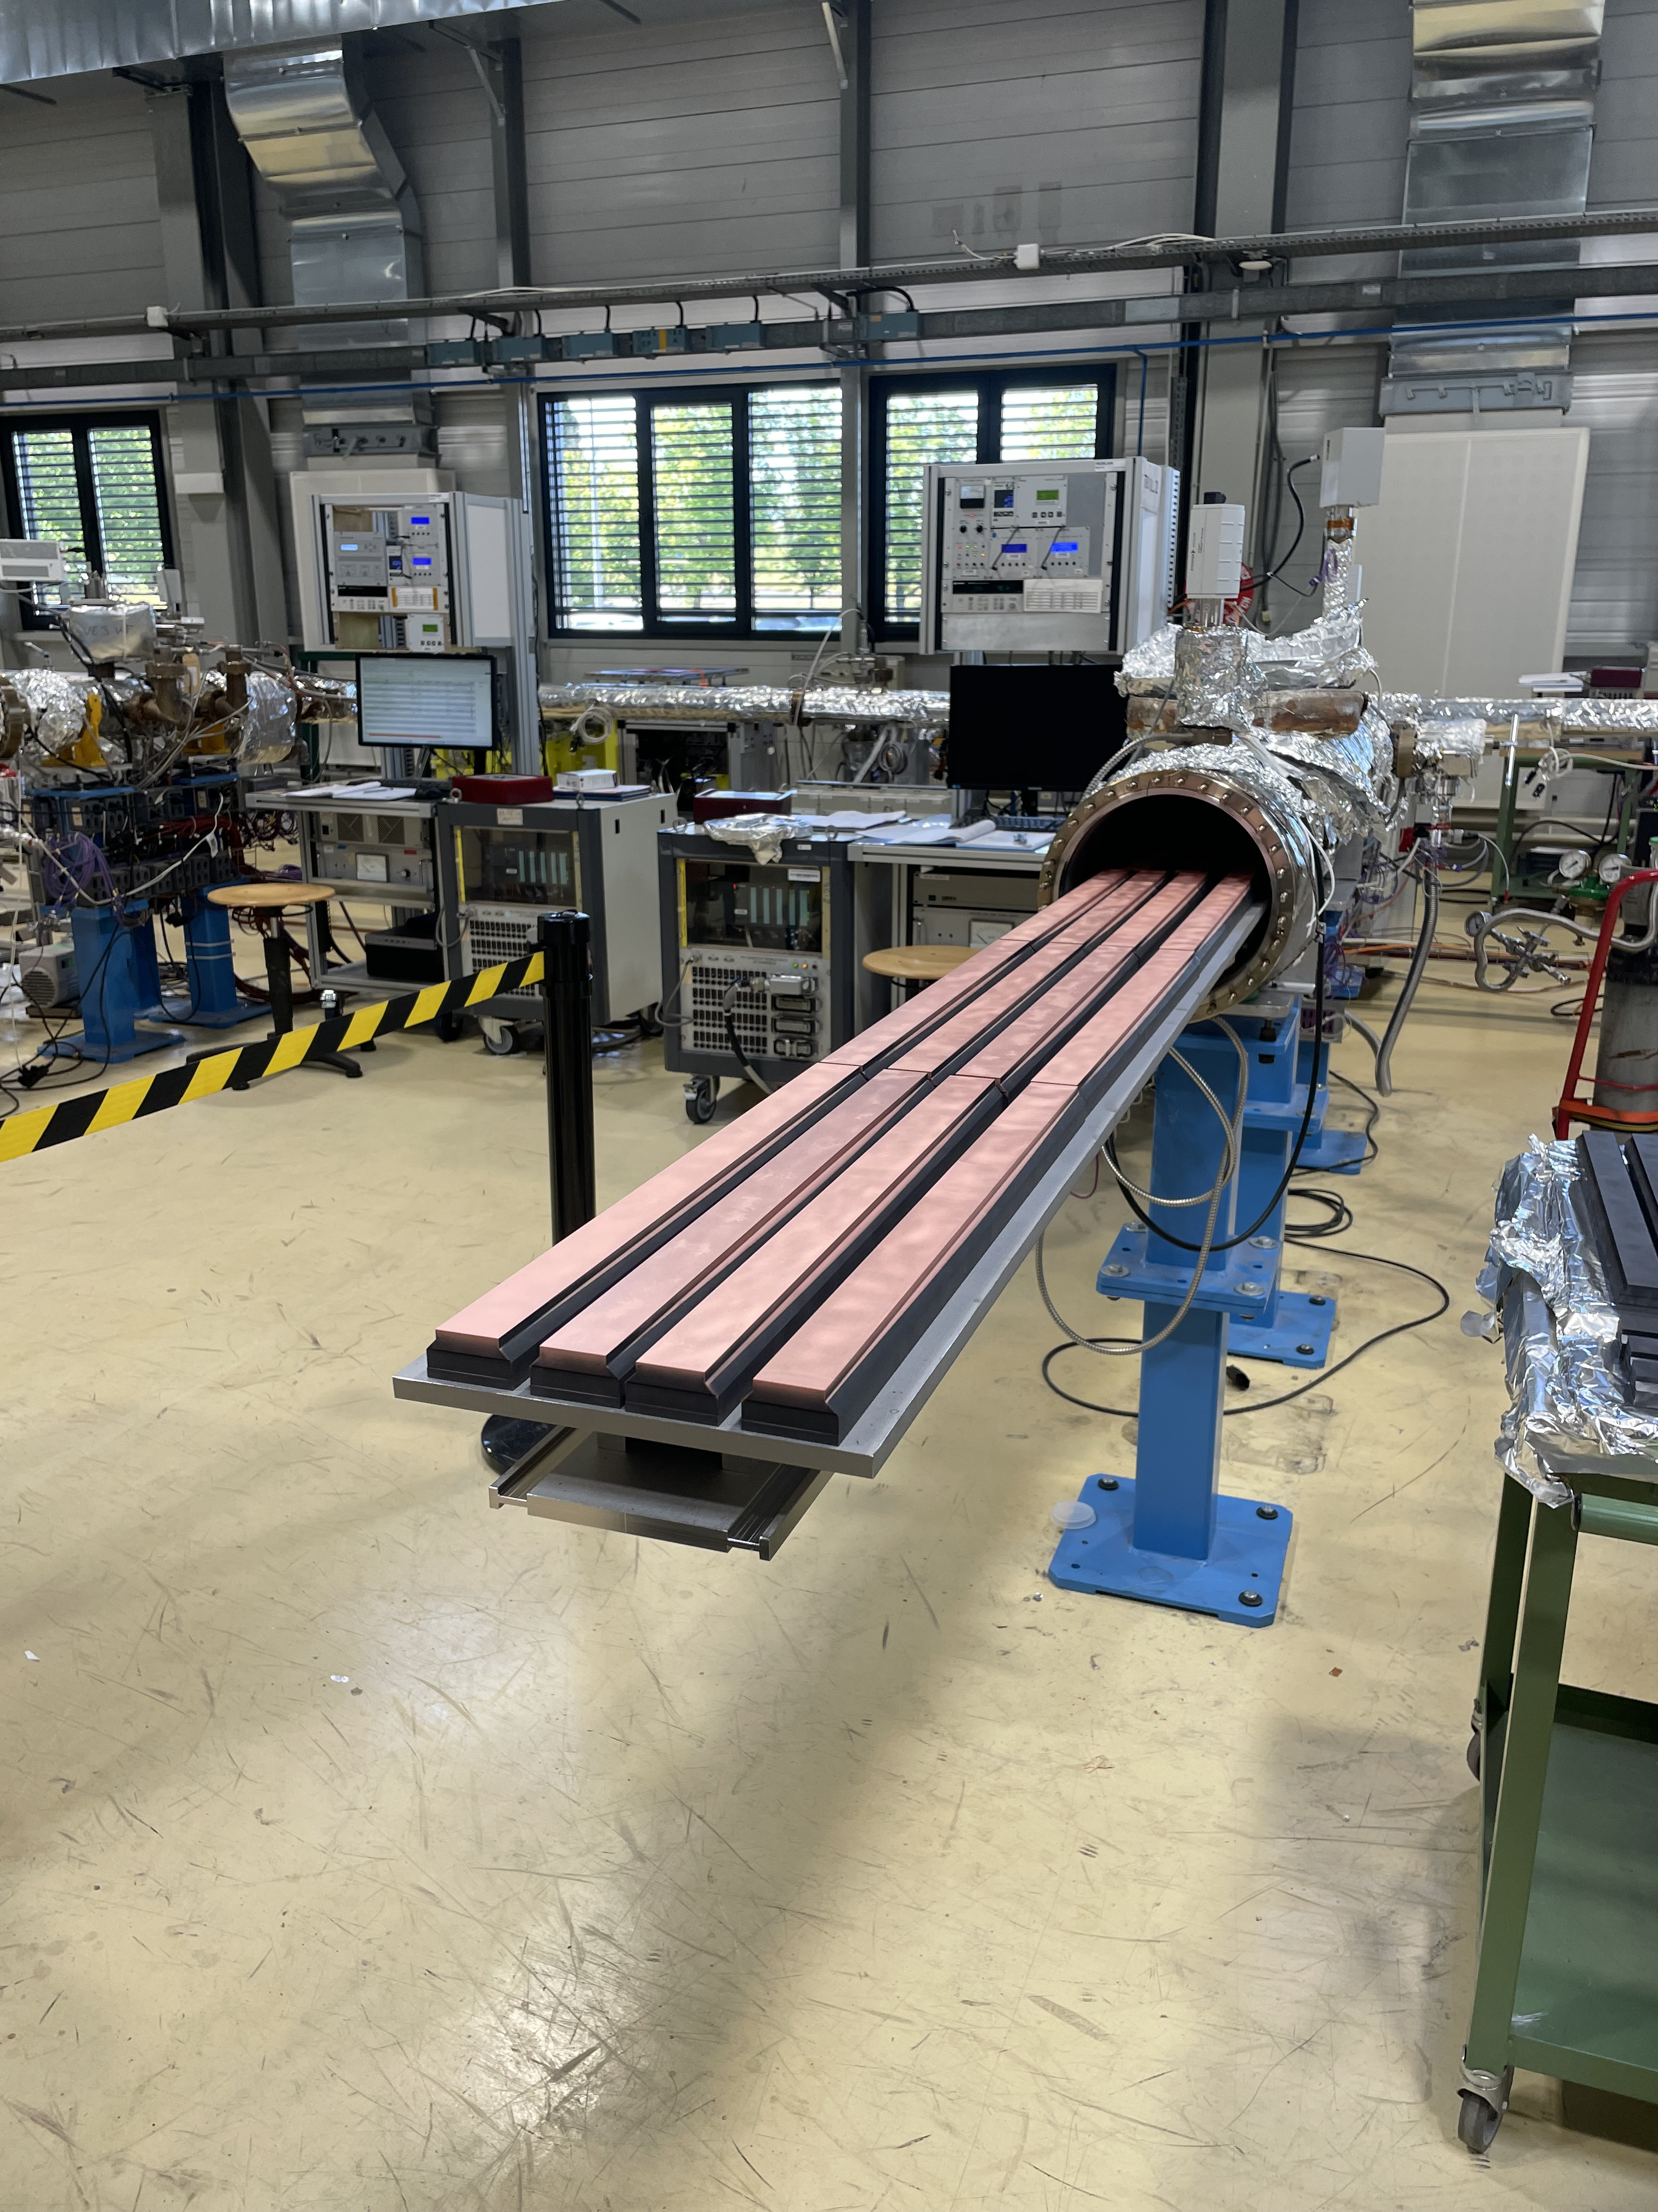
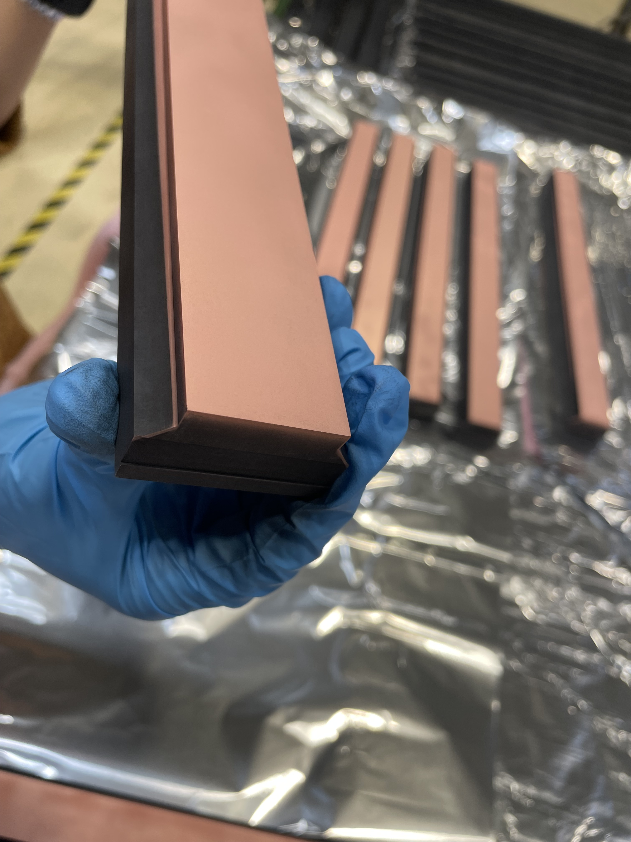
Coating Status Additional Blocks
15 blocks are in post-coating UHV testing
Edge quality confirmed to be good
13 blocks undergoing coating in two badges

Slide 7
Summary
Non-conformities stem from coating damages during handling
Recovery via rematching partially successful
Replacement blocks will be available in mid-August
Treatment steps are being closely monitored
Handling procedures have been refined to minimize future damage
Status (as of 14.07.2025) | Quantity
Operational blocks (incl. 4 in pre-series jaws) | 38
Non-conform (NC) blocks | 22
Blocks Currently in treatment (available mid-August) | 28
Blocks at CERN, ready for installation | 30

Slide 8
Thank you!

