Slide 1
Ongoing surface mock-up activities
Remi VISCARDI
06/10/2025

Slide 2
Summary
1 - Manufacture and adaptation
2 - Installation and alignment
3 - Modification of the false V
4 - Next step

Slide 3
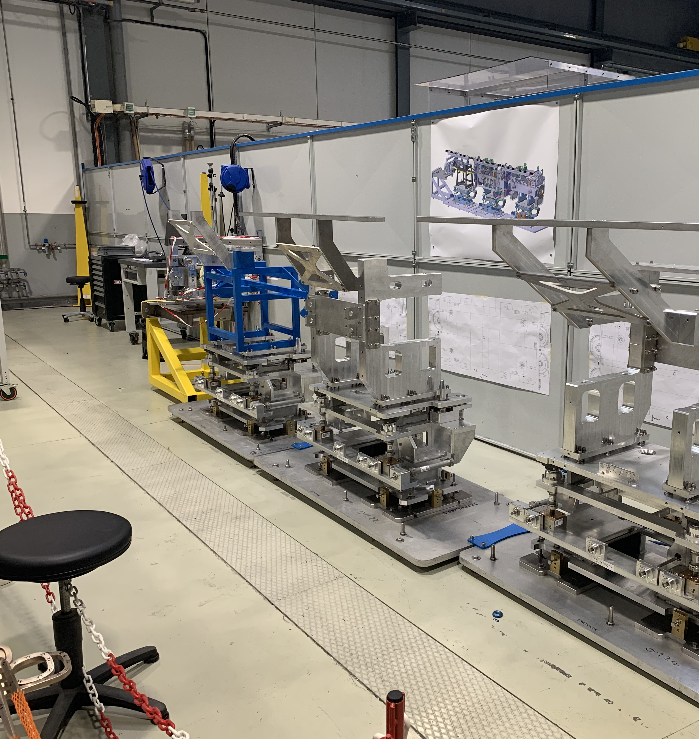
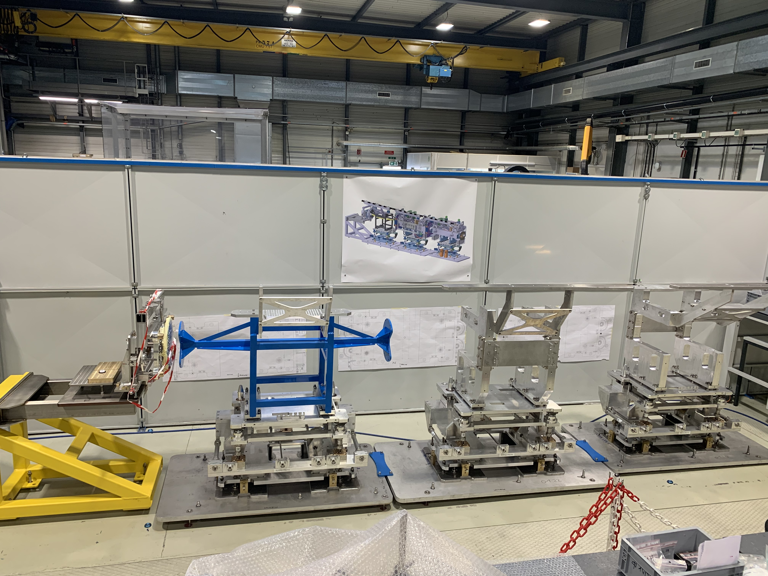
A touch of nostalgia
Photo taken on 22/03/2023

Slide 4
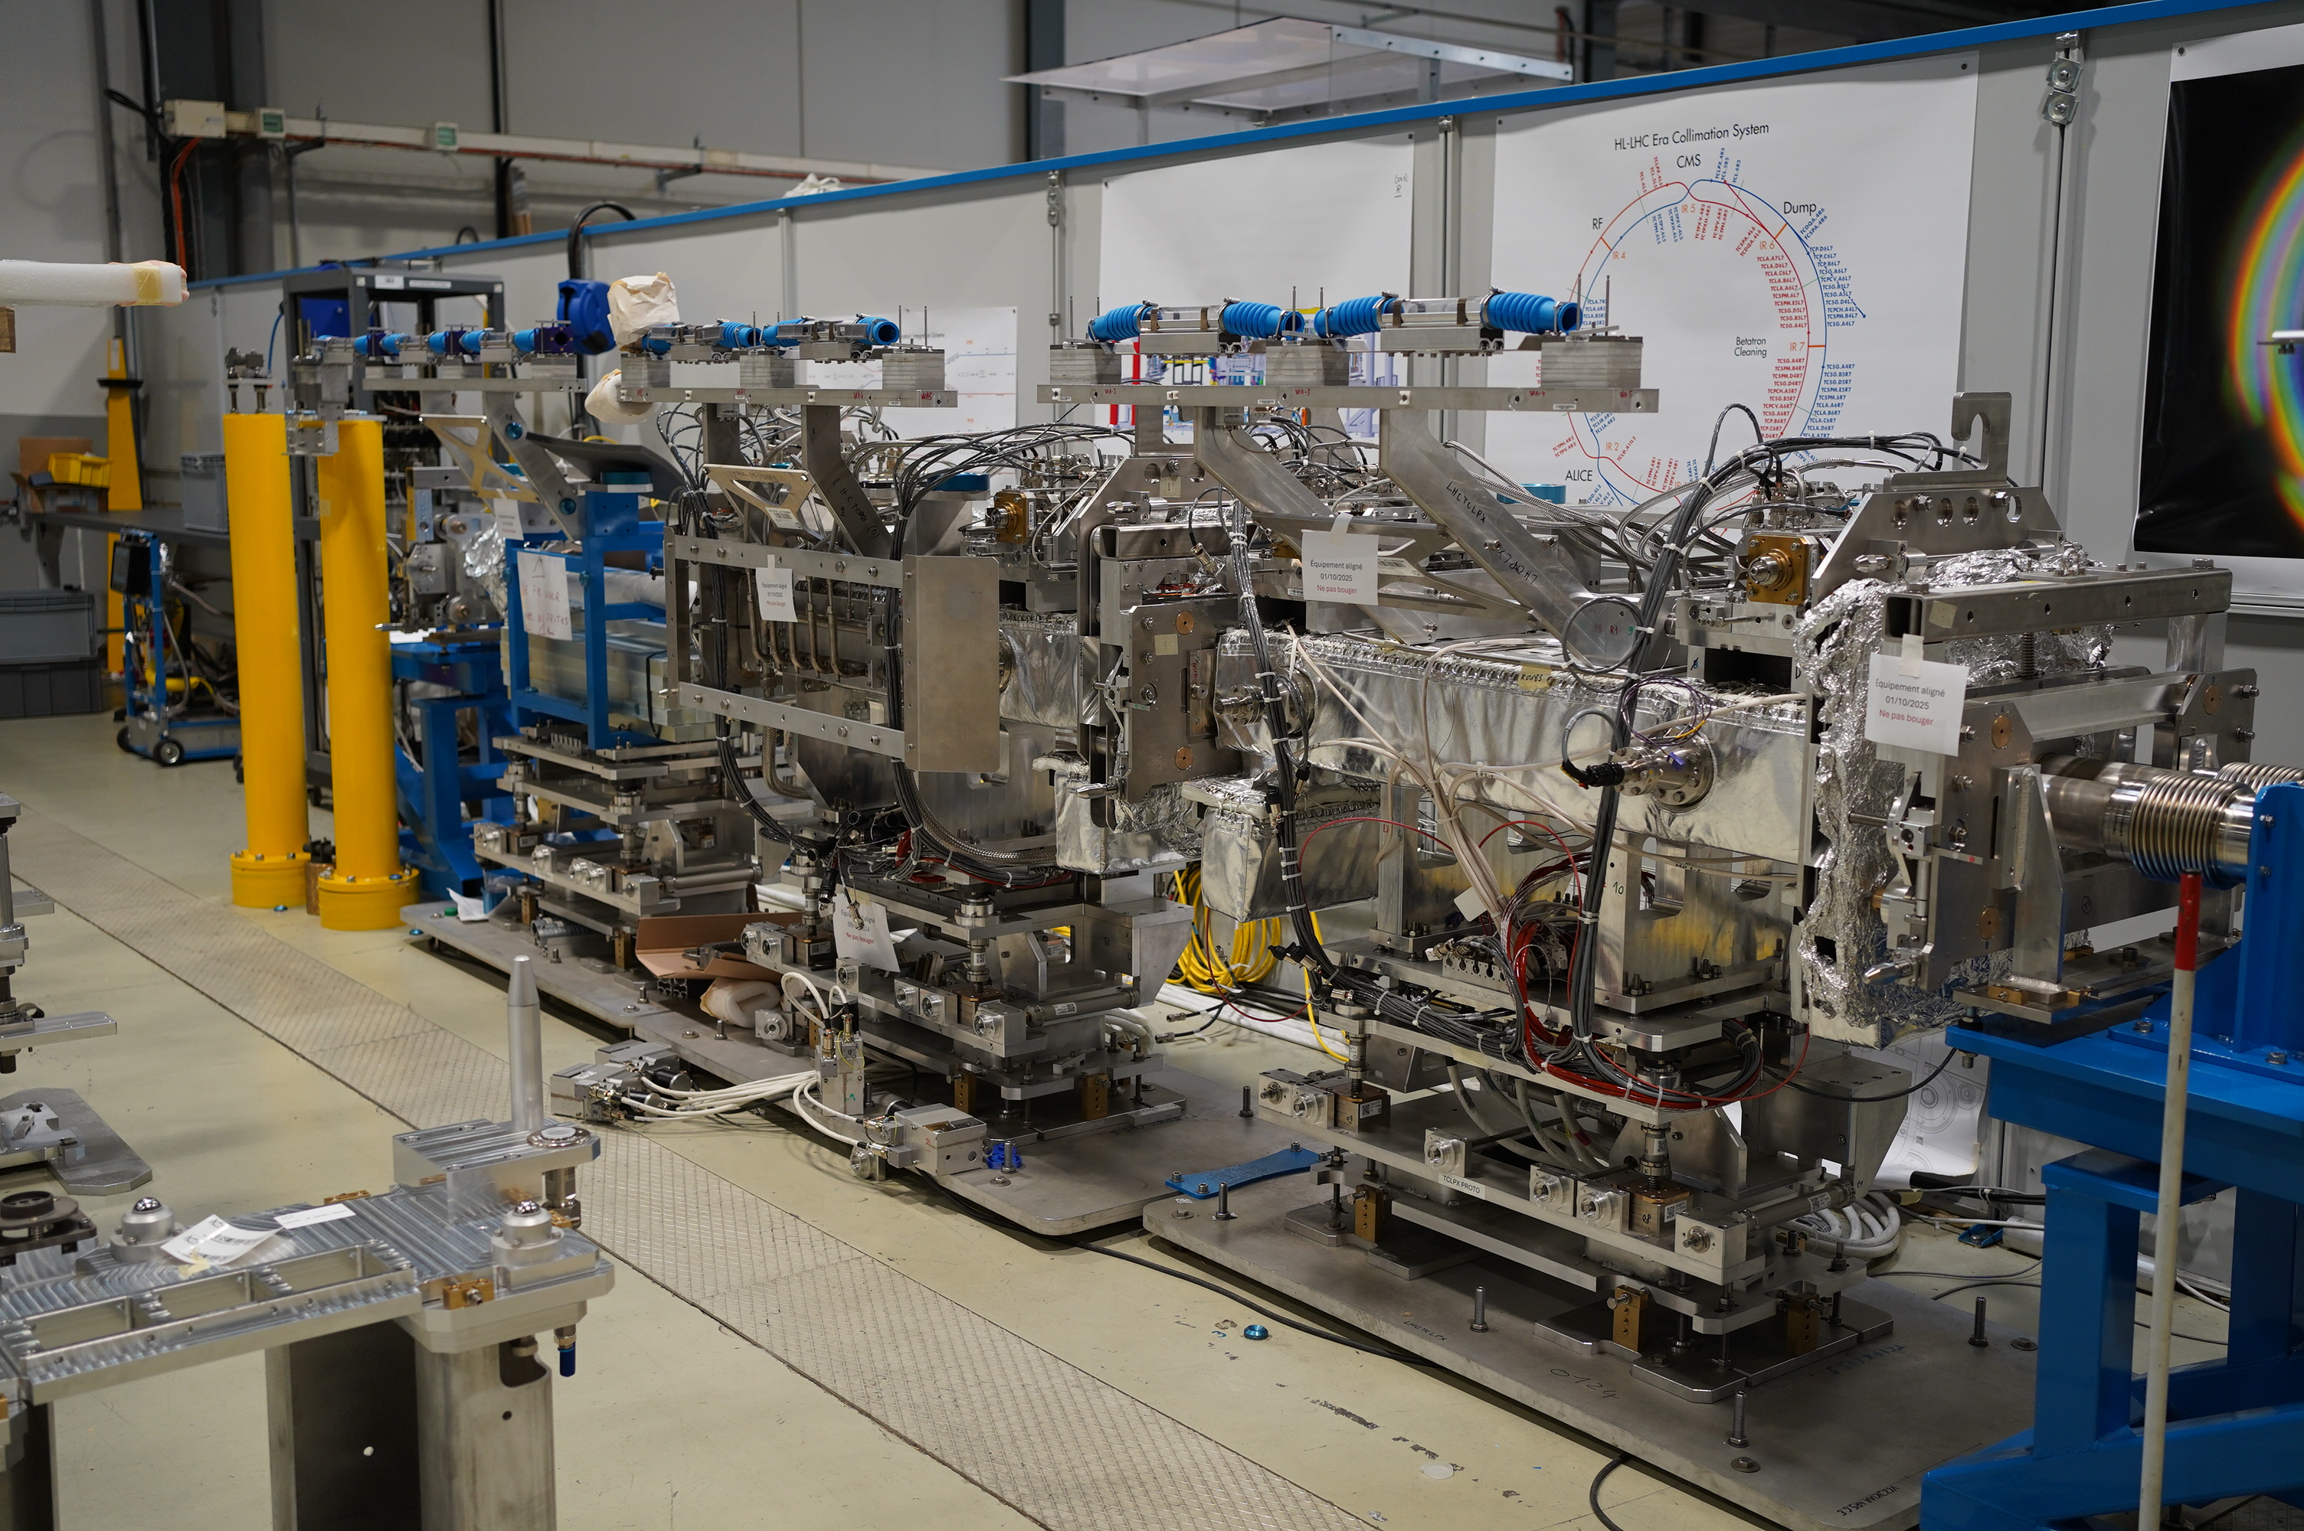
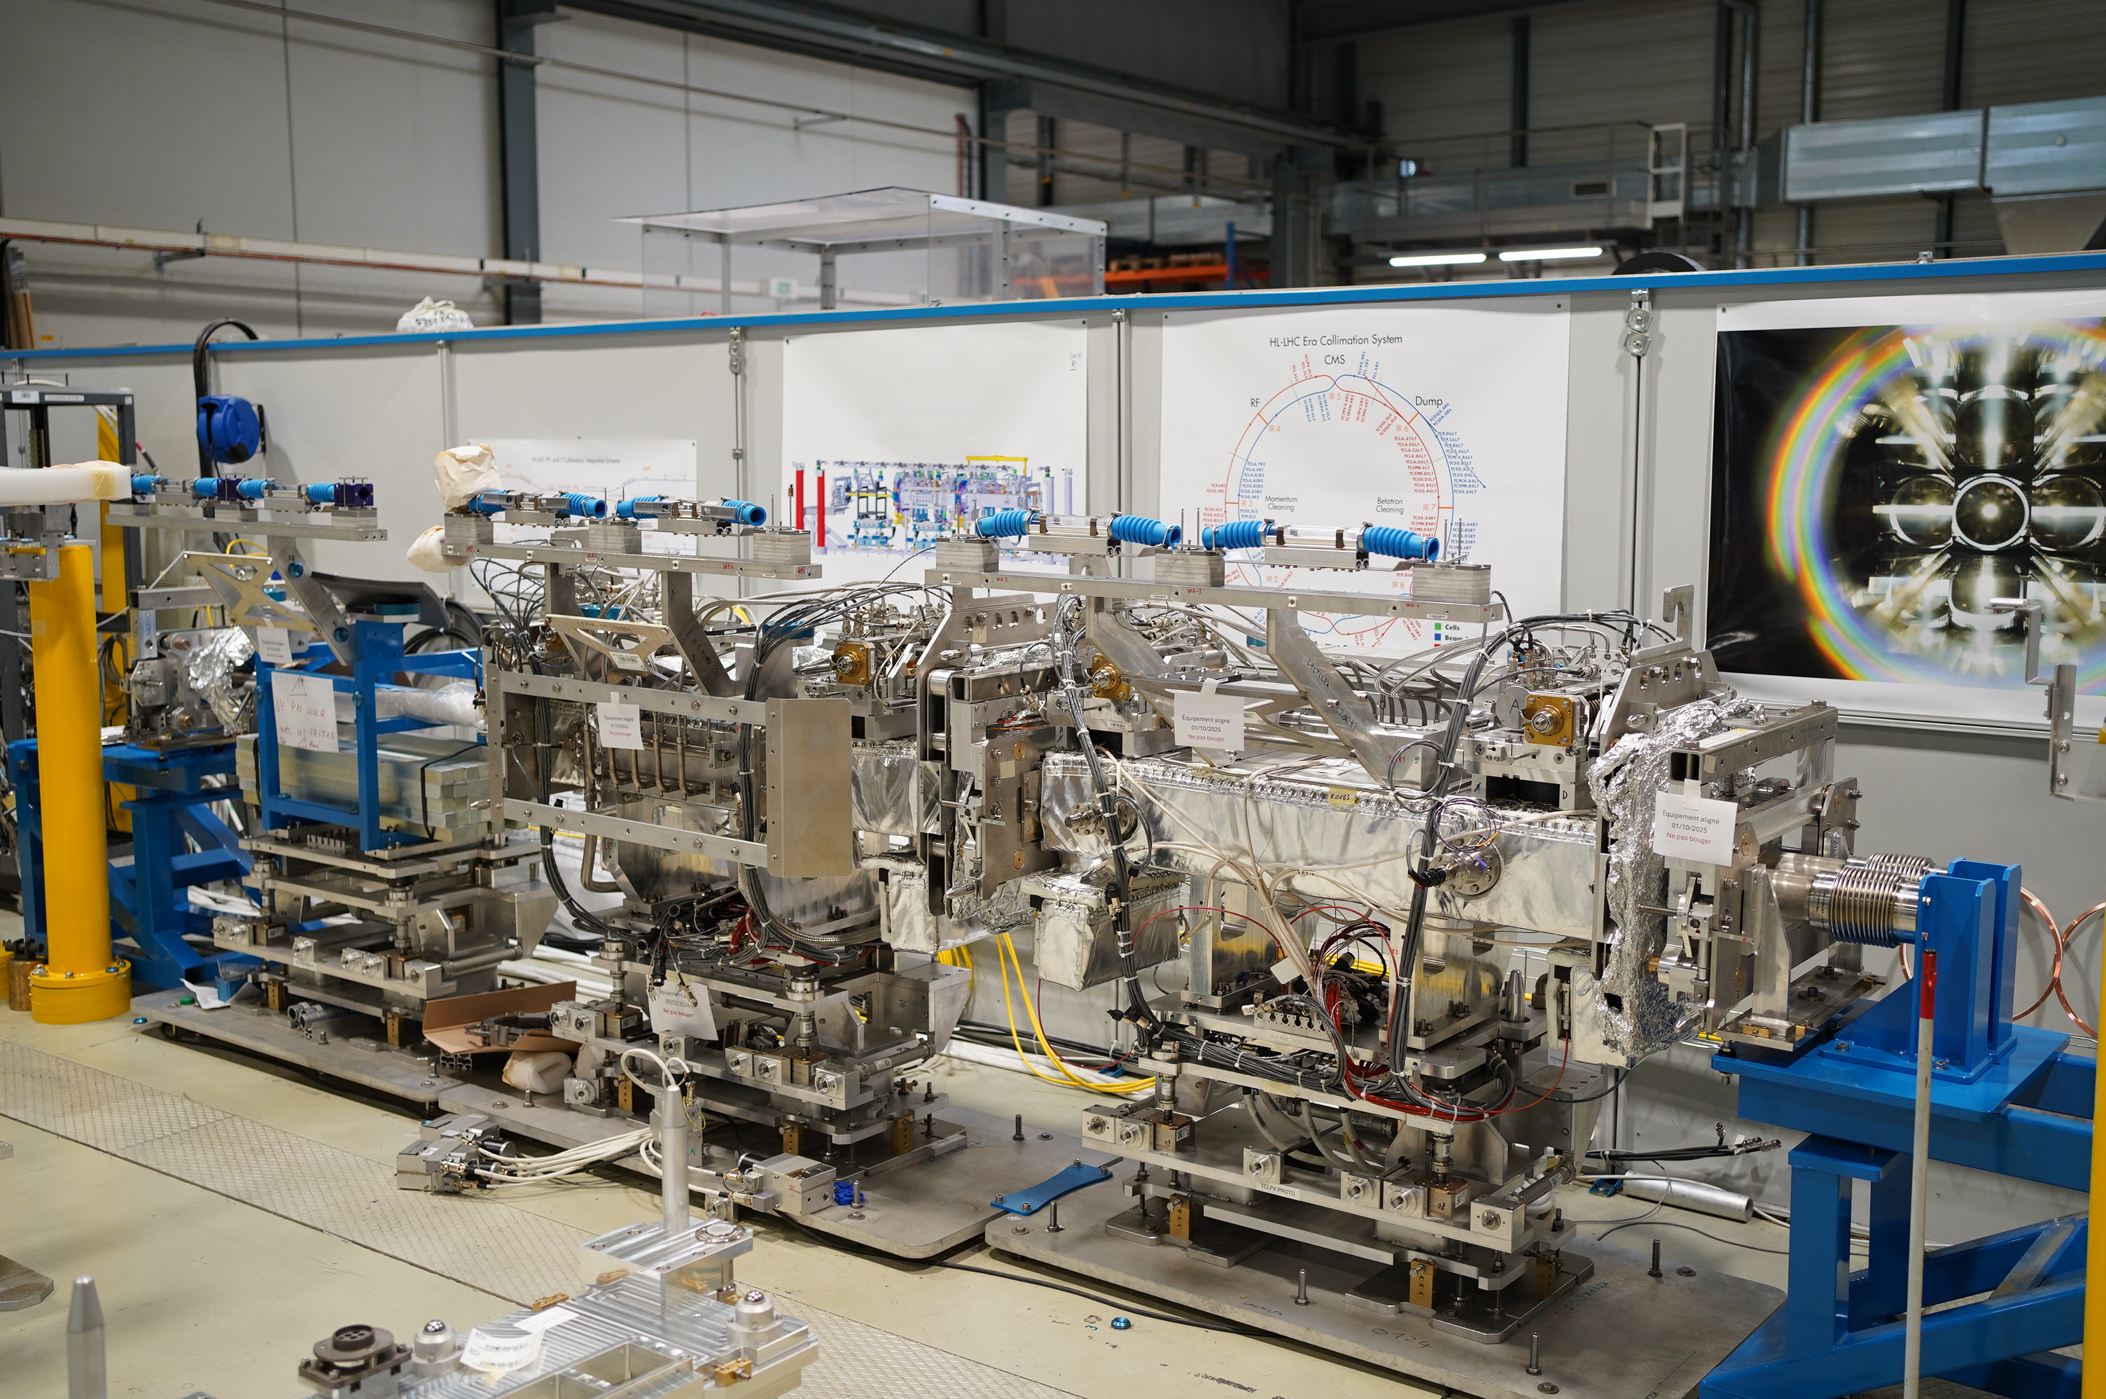
Today

Slide 5
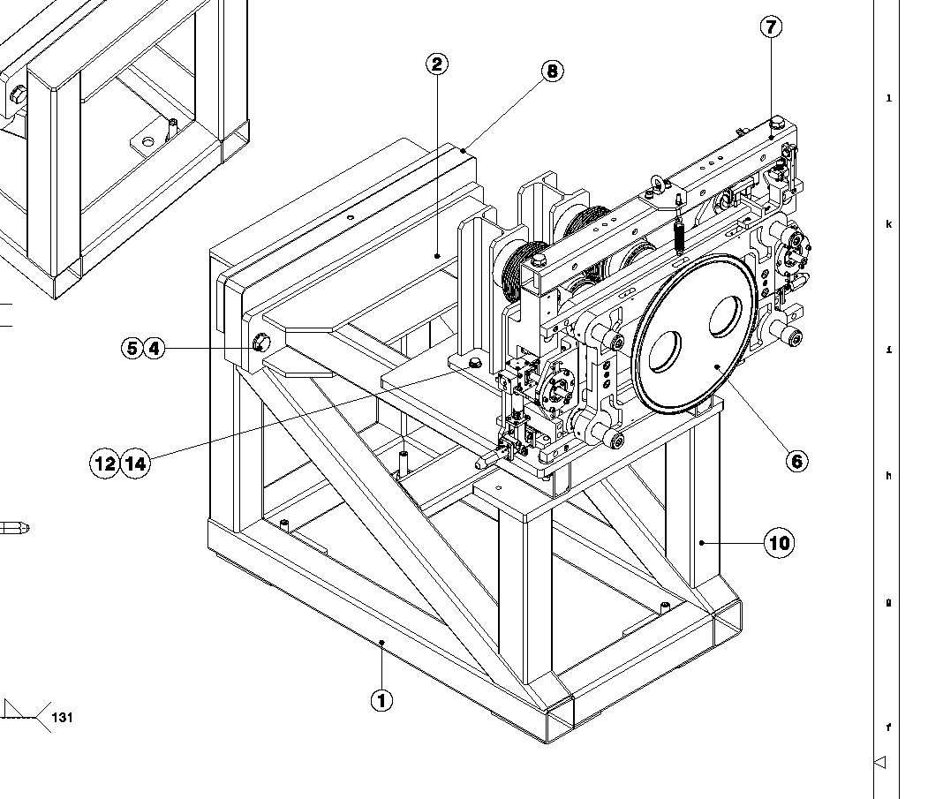
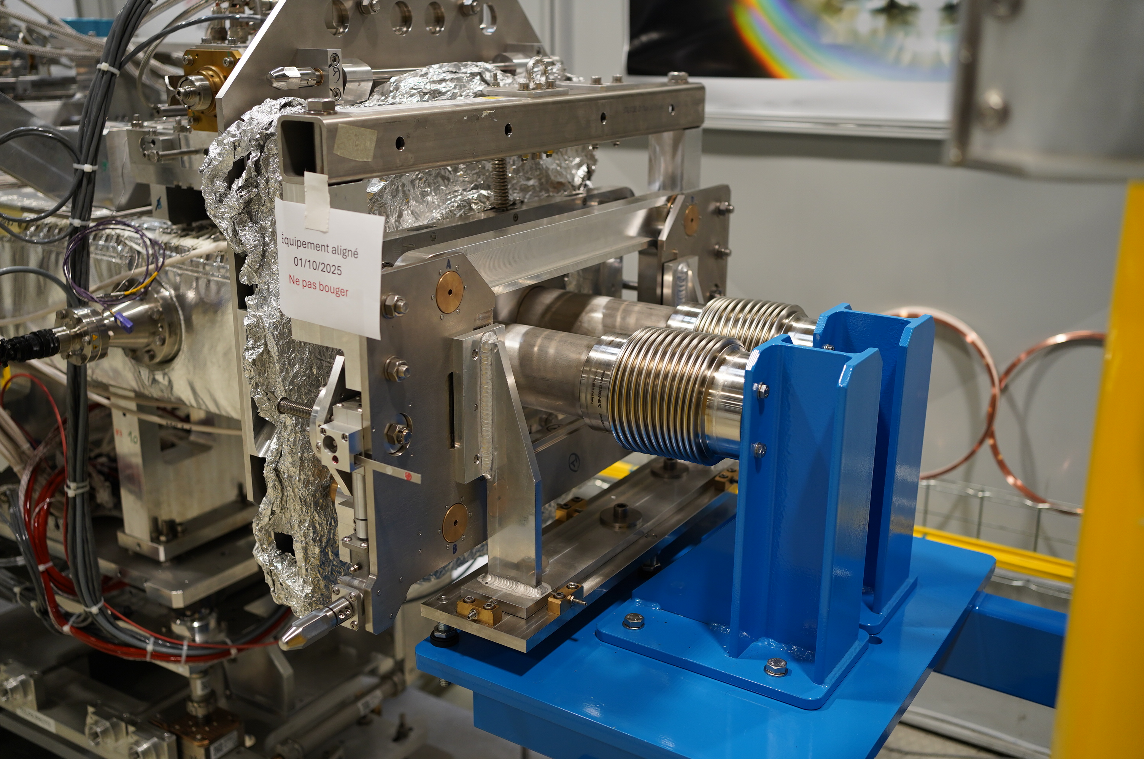
Manufacture and adaptation
Production and improvement of two chassis replacing the D2 equipment and the Taxn.

Slide 6
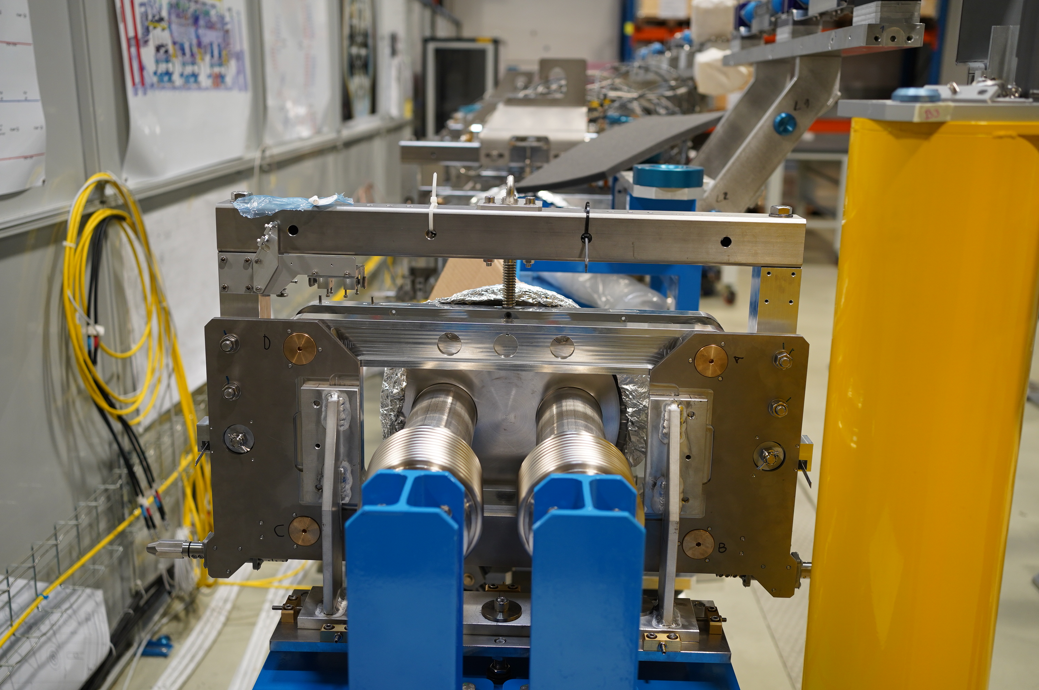
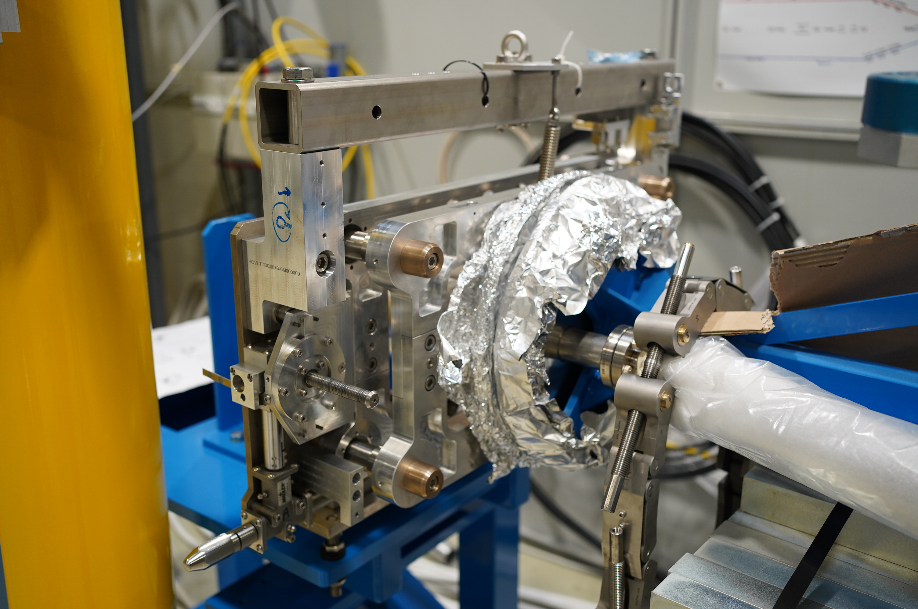
Installation and alignment
Setting up the frames, Alban and Kacper came to align the entire model.

Slide 7
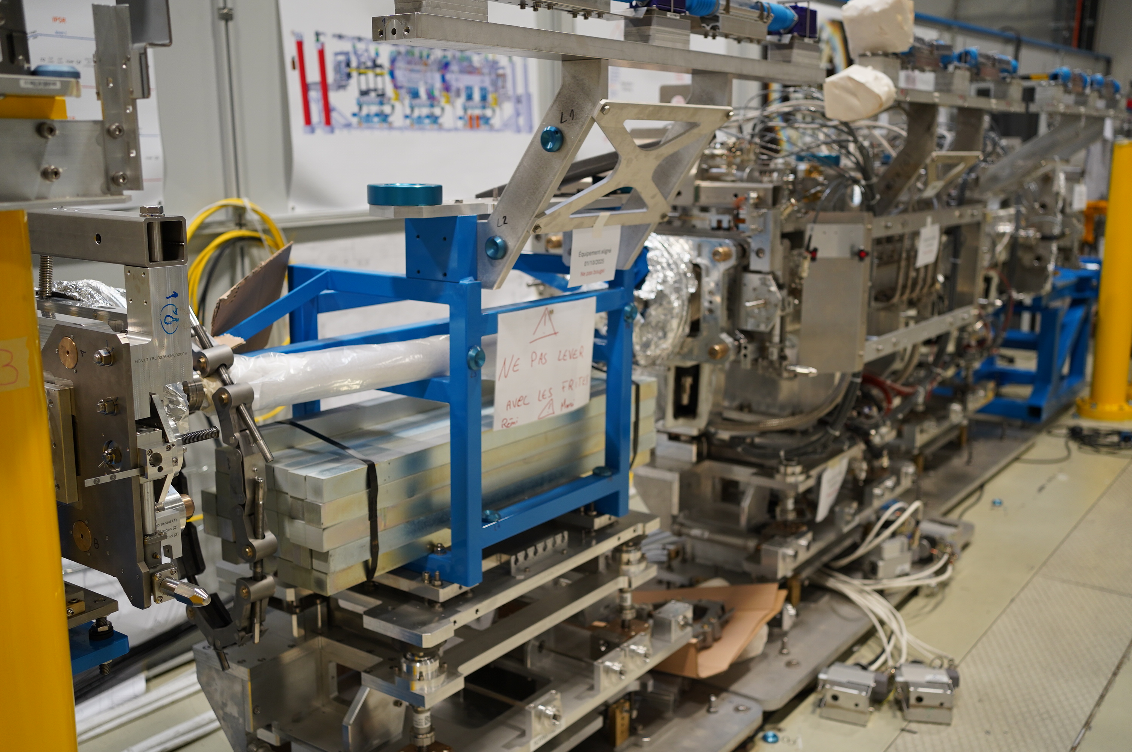
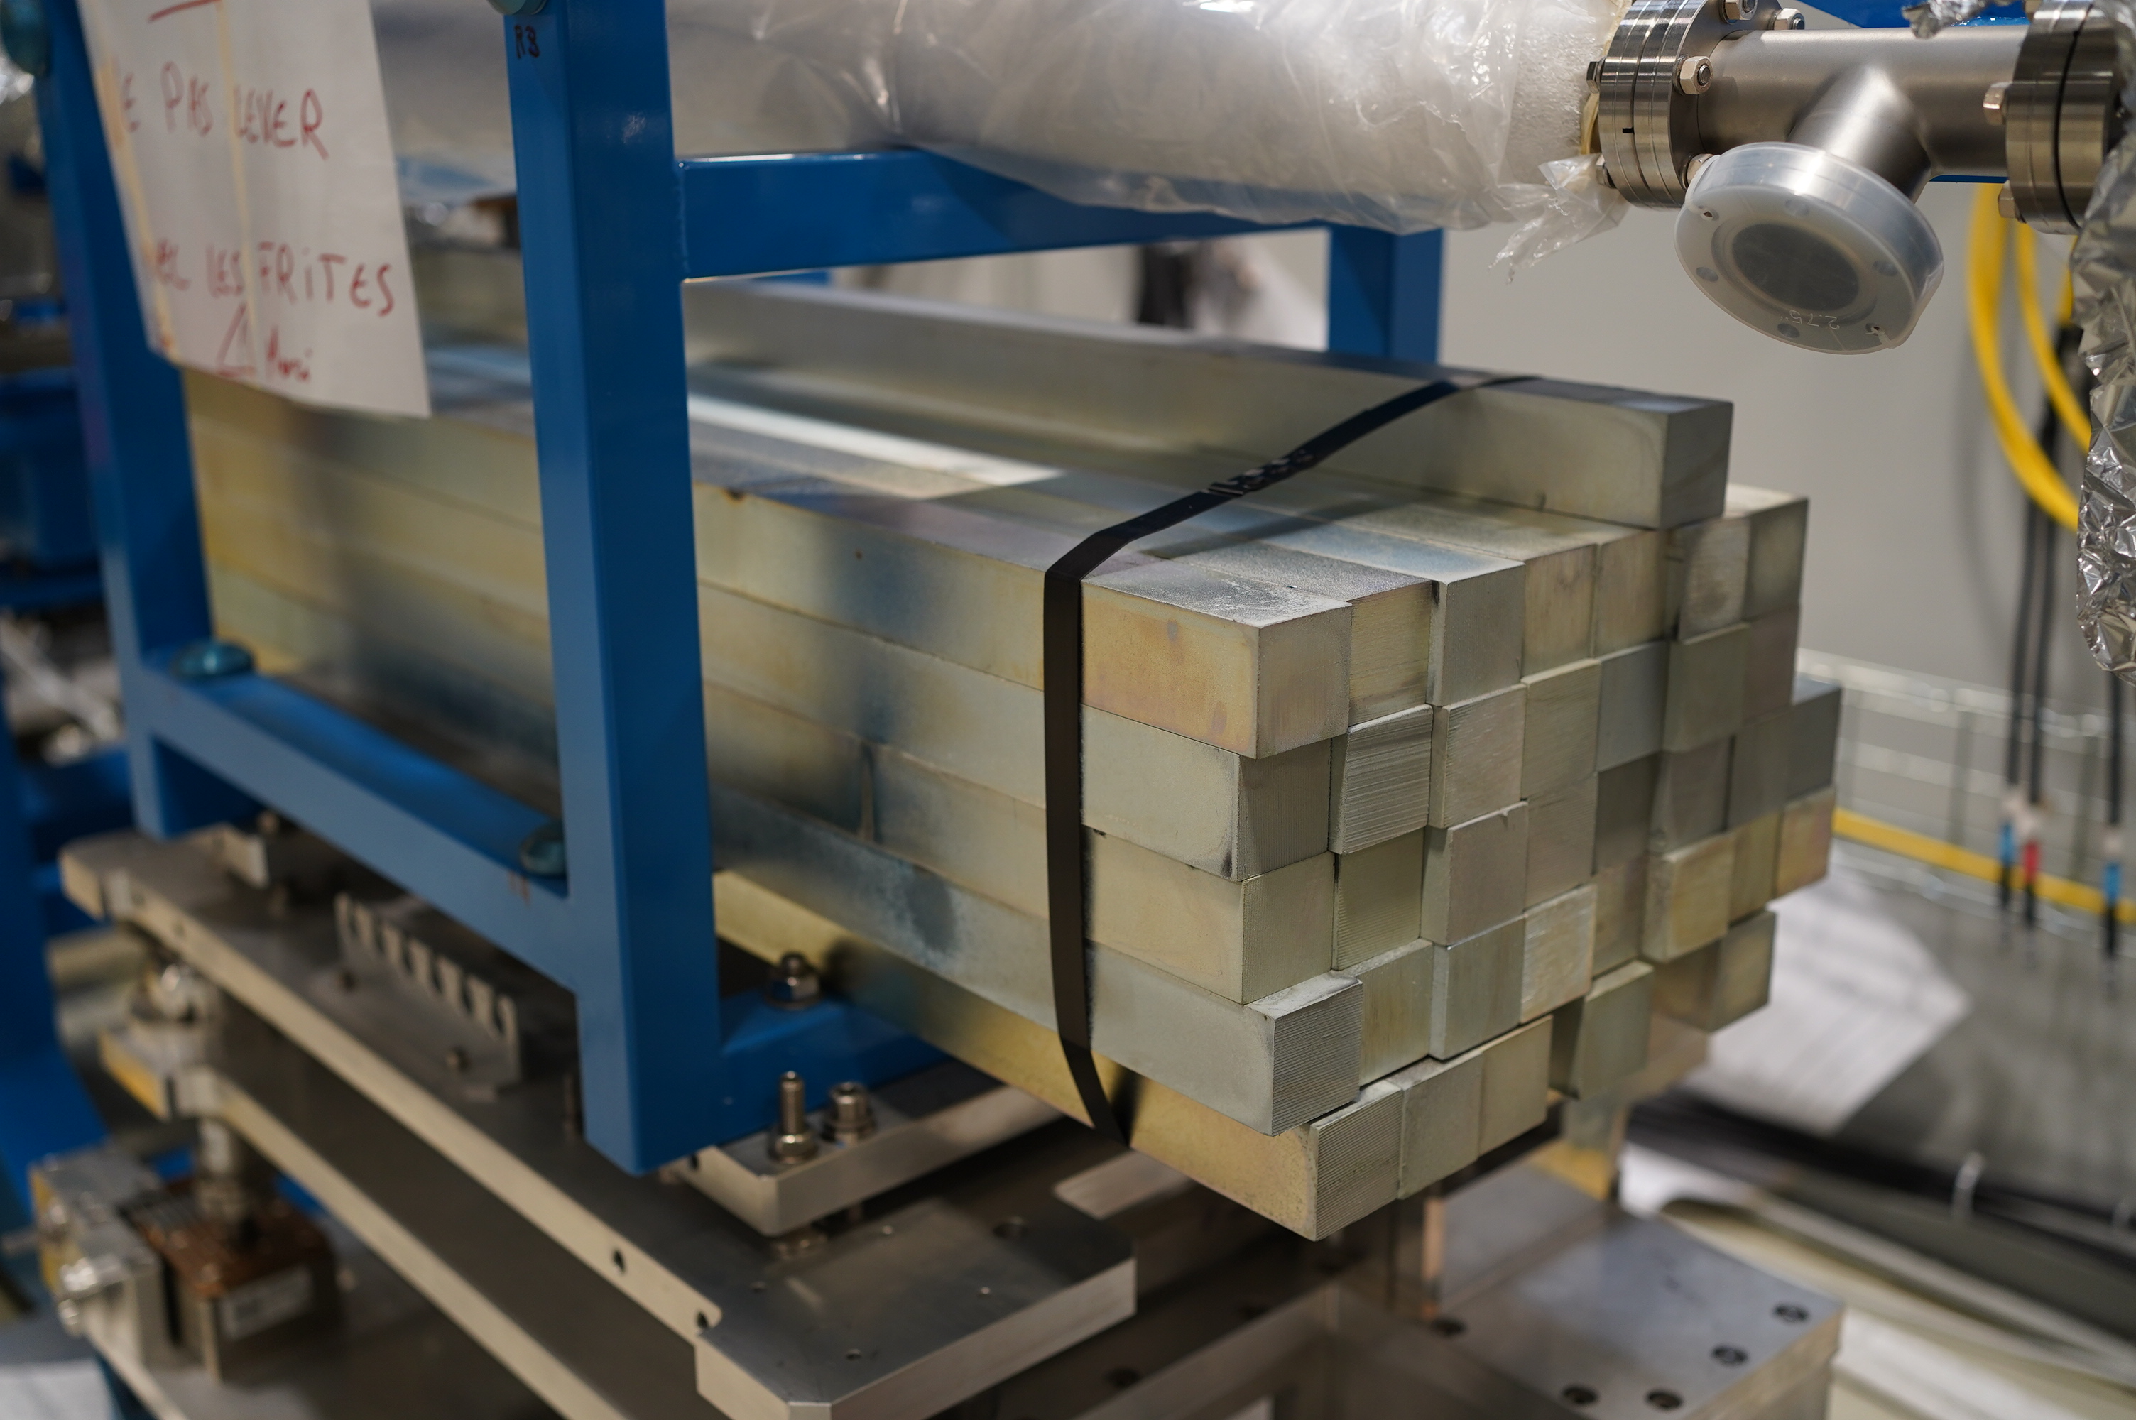
Modification of the false V

Slide 8
Next steps
Connection of equipment (scheduled for tomorrow morning)
Pump drying and vacuuming by Gregory (Wednesday/Thursday)
Vacuum packing and, if possible, leak testing (Thursday/Friday)
UAP test on the model

Slide 9
Thank you for your attention

