Slide 1

WP5.2 – Updates on Transport Simulation
L. Hannemann
01.12.2025

Slide 2
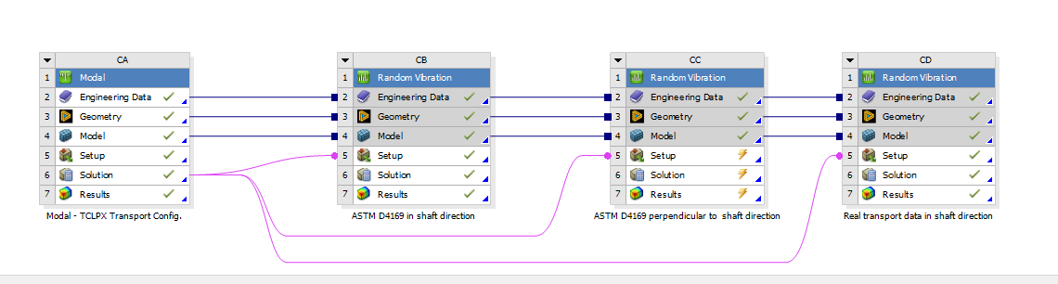
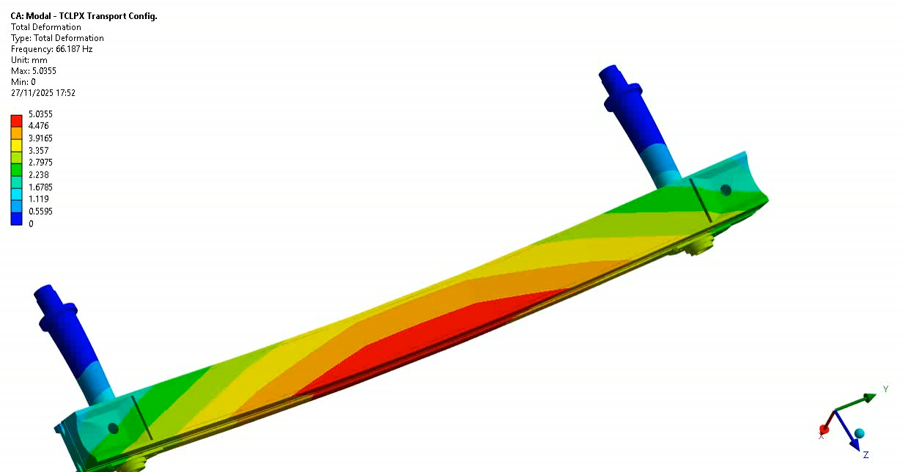
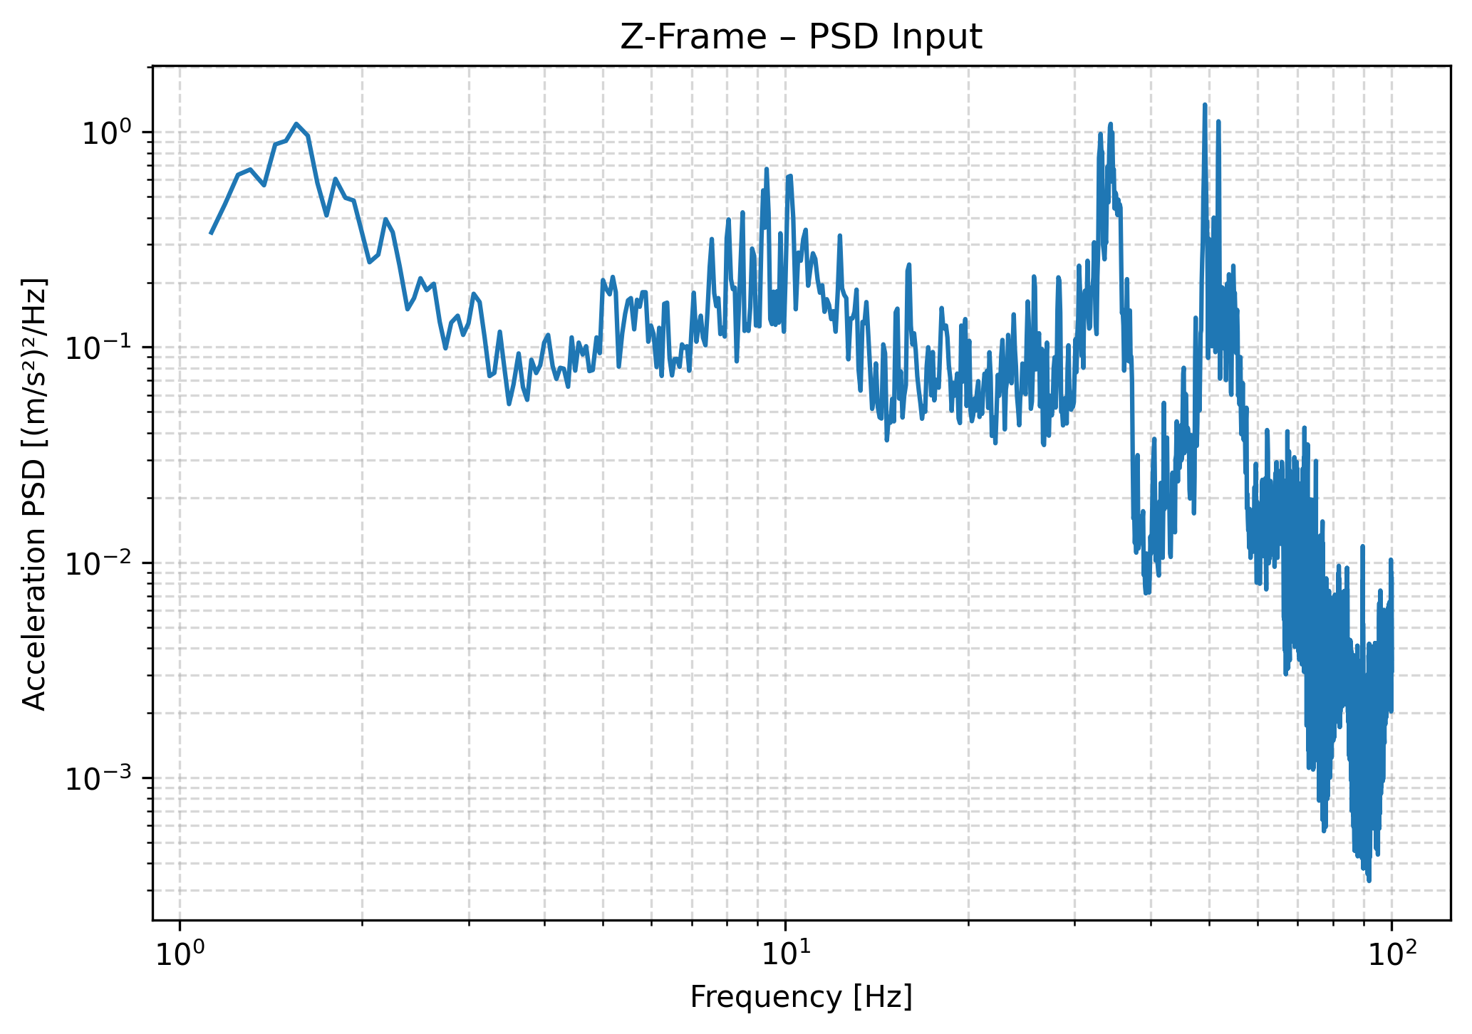
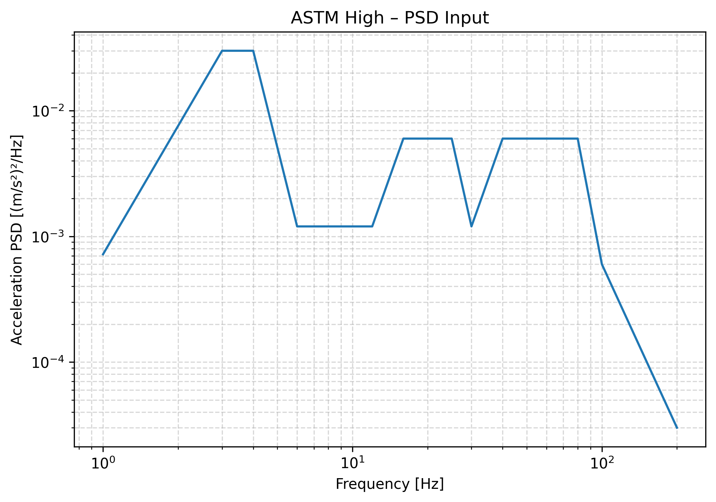
Procedure Recap

Slide 3
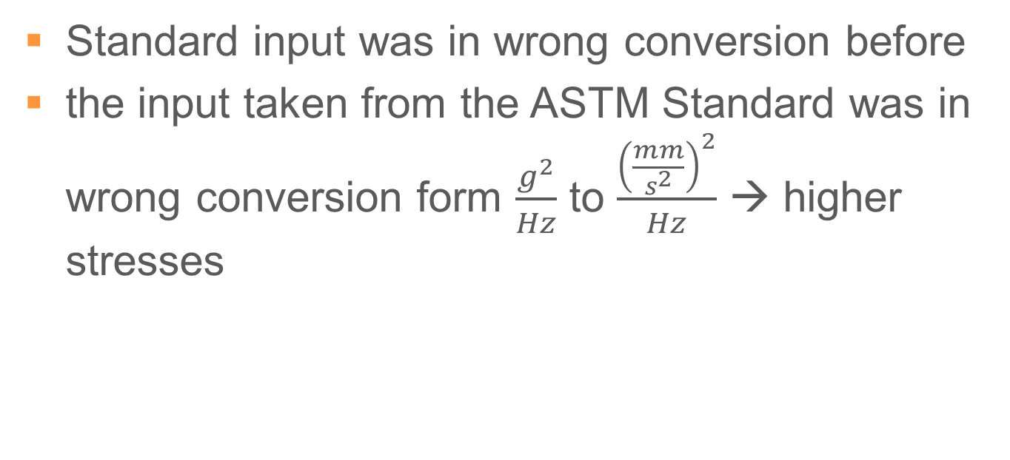
Update
Standard input was in wrong conversion before
the input taken from the ASTM Standard was in wrong conversion form $\frac{g^{2}}{Hz}$ to $\frac{{\left(\frac{mm}{s^{2}}\right)}^{2}}{Hz}$ → higher stresses

Slide 4
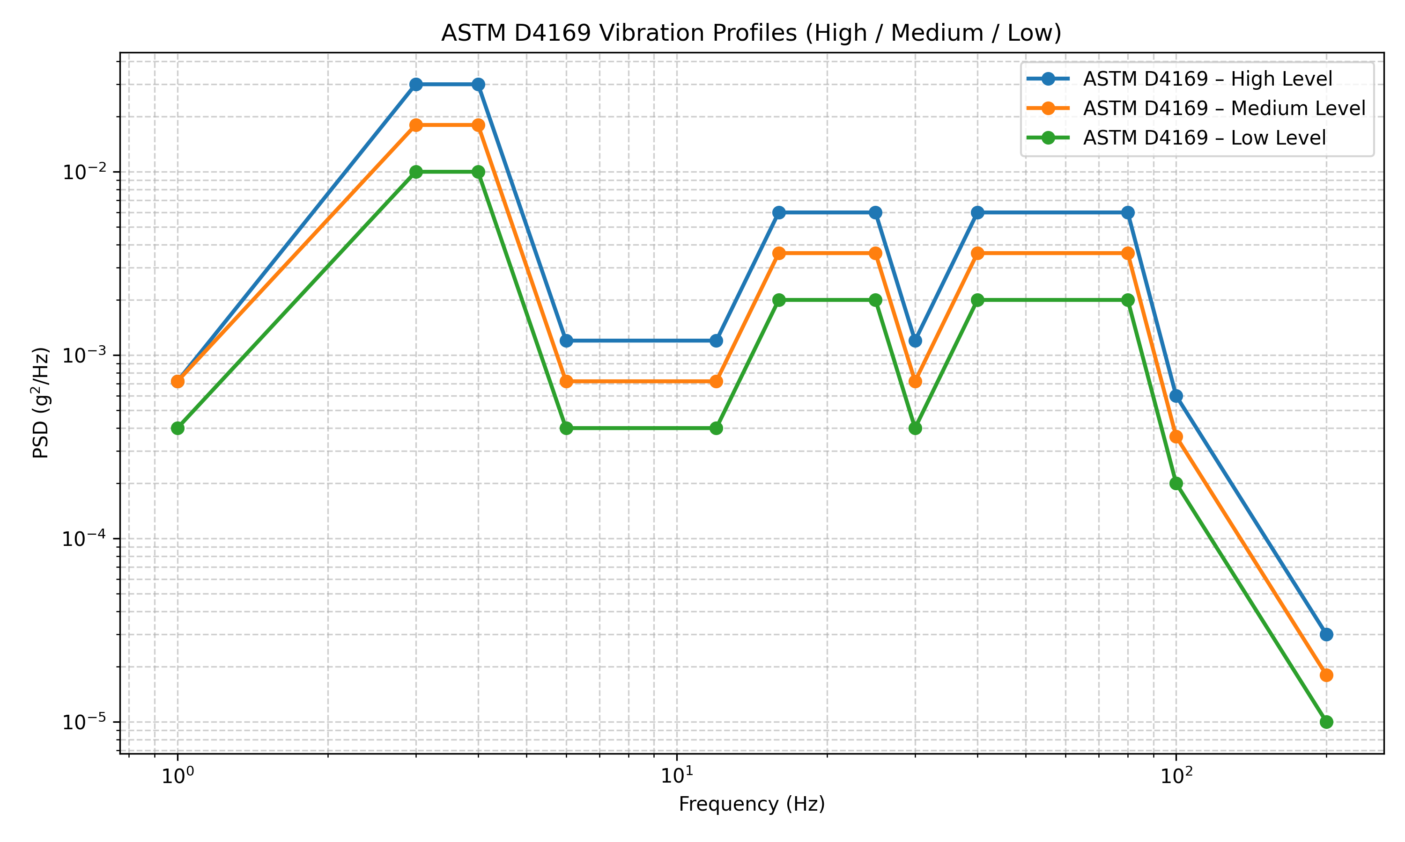
Road Transport Standard: ASTM D4169
Used for the analysis

Slide 5
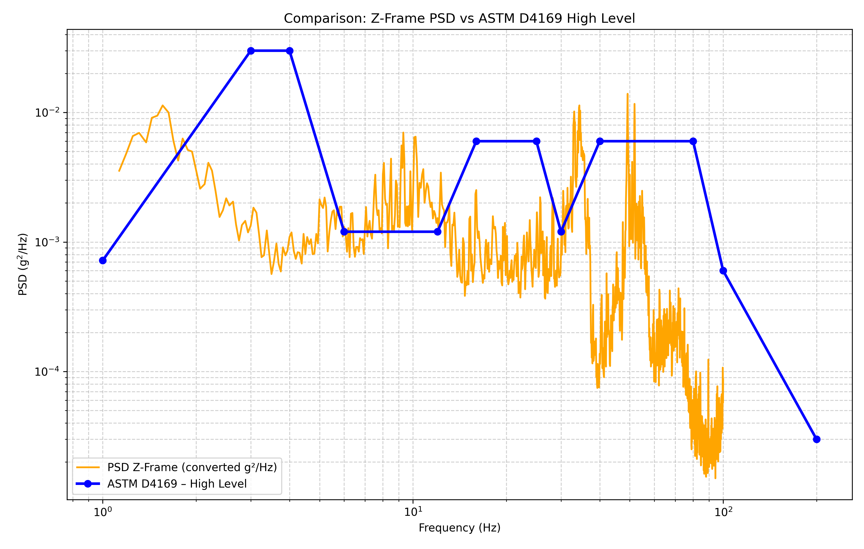
Comparison ASTM and Real Data

Slide 6
Jaw Type PSD Comparison
Jaw Type | PSD Input | Max von Mises Stress [MPa] – 3 sigma | Material Limit [MPa] | Max Deflection [mm] | Status
TCTPXV | ASTM D-4169 | 20 | 206 (316 Stainless Steel) | 0.19 | Safe
TCTPXV | Z-Frame (Crab Cavity) | 3 | 206 | 0.011 | Safe
TCLPX | ASTM D-4169 | 86 | 206 | 0.36 | Safe
TCLPX | Z-Frame (Crab Cavity) | 17 | 206 | 0.05 | Safe
TCSPM | ASTM D-4169 | 17 | 206 | 0.044 | Safe
TCSPM | Z-Frame (Crab Cavity) | 4 | 206 | 0.005 | Safe

Slide 7
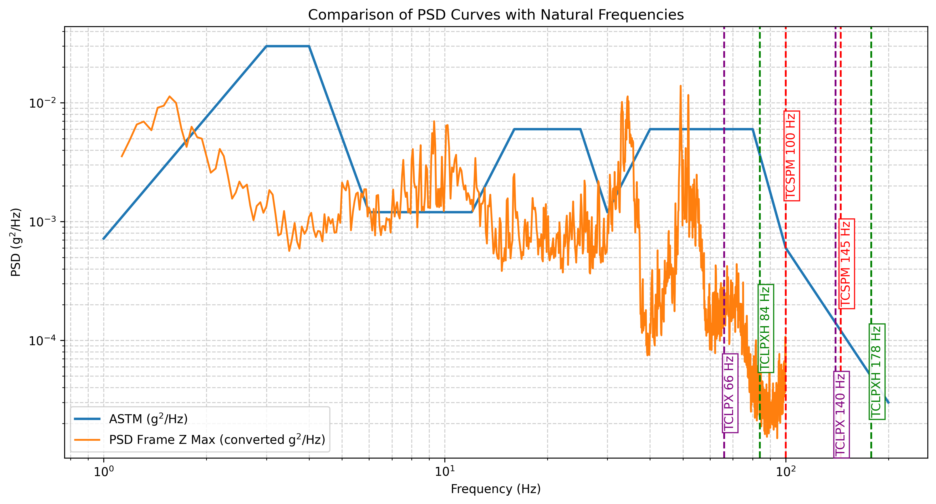
Natural Frequencies vs Input PSD

Slide 8
Conclusion
When using the correct Standard input (High level – worst case), higher stresses observed due to increased vibration energy
All stresses remain safely below the yield limits of the materials
Analysis represents a conservative worst-case scenario with direct excitation applied to the jaw
In real conditions, additional damping between the truck and the collimator jaw further reduces transmitted loads

Slide 9
Materials
Material | Density [kg/m³] | Young’s Modulus [GPa] | Yield / Strength [MPa] | Poisson’s Ratio [–]
Inermet 180 (W-alloy) | 18 000 | 360 | 613 | 0.28
CuCr1Zr | 8 900 | 130 | 293 | 0.34
CuNi 90/10 | 8 900 | 142 | 109 | 0.34
316L Stainless Steel | 8 000 | 190 | 205 | 0.30
304L Stainless Steel | 8 000 | 200 | 210 | 0.30
Graphite (CFC / Isotropic equivalent) | 1 830 | 11.5 | – (Flexural ≈ 60 MPa) | 0.10

Slide 10
Thank you for your attention

