Slide 1
ALICE Resources: 2012 Construction draft Budgets and 2012 Maintenance & Operation draft Budgets and estimates for 2013-2015
C. Decosse
31st meeting of the ALICE RRB
CERN-RRB-11-084 & CERN-RRB-11-086
19 October 2011

Slide 2
Summary of the presentation
2012 CORE draft budget
Status of the Common Fund
Maintenance and Operation cat A incomes
M&O-A current situation
2012 M&O-A draft budget and estimates for the period 2013-2015
2012 sharing of the M&O-A draft budget
M&O-C CERN investments at ALICE-P2
2012 M&O-B draft budget and estimates for the period 2013-2015
2012 sharing of the M&O-B draft budget

Slide 3
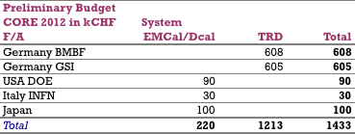
2012 CORE Draft Budget
Construction still continues for EMCal/Dcal and TRD sub-projects.
TRD: 10 super modules have been installed and 8 modules are under construction with the goal to install available modules during 2011/2012 technical stop and finish the installation during the 2013 long shutdown.
DCal modules: production continues for installation during the 2013 shutdown.

Slide 4
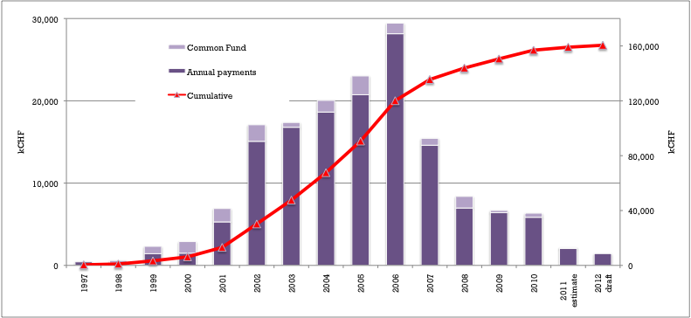
CORE expenditure 1997-2010 estimate 2011 and draft 2012

Slide 5
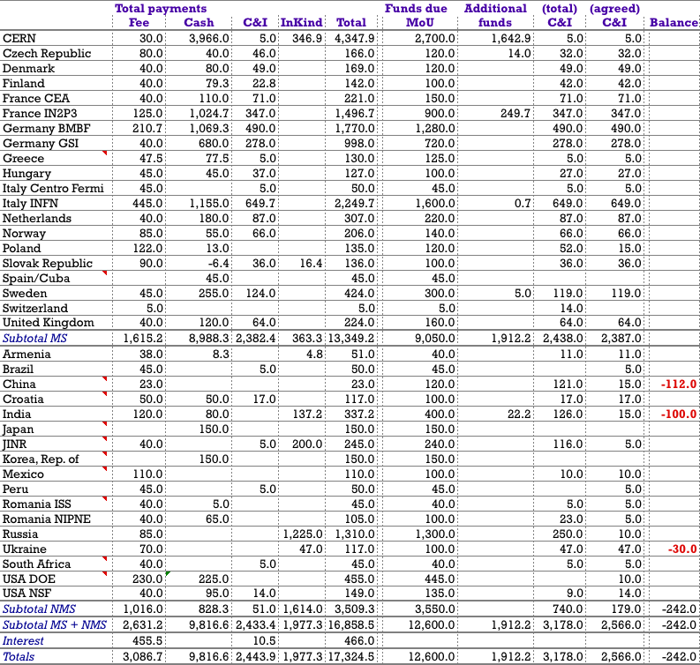
Common Fund and C&I contributions 1997-2011 in kCHF
⬅ 2 new institutes recently joined the
Collaboration, fees will be paid at the latest in Spring.

Slide 6
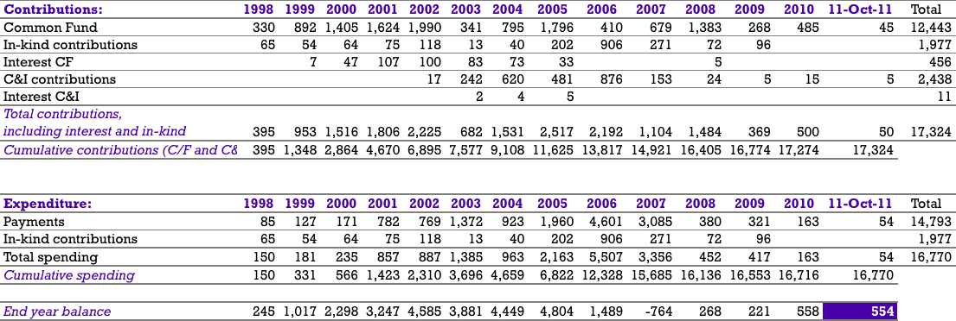
Common Fund 1998-Oct. 2011
In kCHF

Slide 7
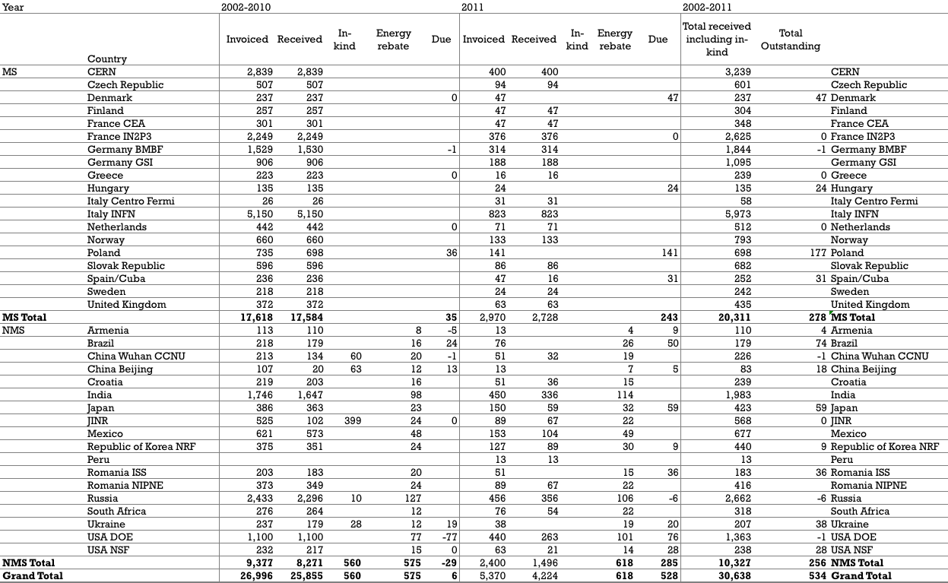
M&O Cat. A contributions 2002-2011
In kCHF

Slide 8
Rules on outstanding contributions
If on 1st of September the outstanding amount is less than, or equal to, the current year’s contribution -> CERN finance department sends a standard reminder to the Funding Agency requesting the payment within one month.
If on 1st of September the outstanding amount is larger than the current year’s contribution -> The ALICE Management sends a letter to the Funding Agency announcing that, unless payment is made before the end of the year, the right to sign papers will be withdrawn as of December 31st.
Letter already sent a few weeks ago to Prof. X. Li from CIAE Beijing for outstanding invoices.

Slide 9
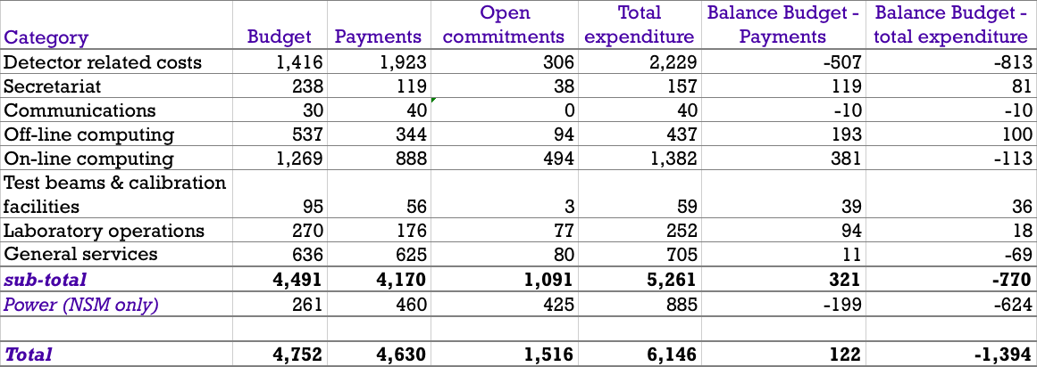
M&O-A 2011 current situation
In kCHF
We foresee an overspending the budget of ~ 1.5 MCHF at the end of 2011. This is mainly due to an increase of the gas consumption, the modification of the beampipe in the ZDC area, UPS, higher costs due to tight planning and intensive works done and to be done during the technical stops (2010-2011 and 2011-2012).
431 kCHF have been paid in 2011 from commitments taken in 2010. We still have ~ 80 kCHF of open commitments from 2010 which are included in the total open commitments.
Current cash balance 2,553 kCHF (still 534 kCHF of missing contributions).

Slide 10
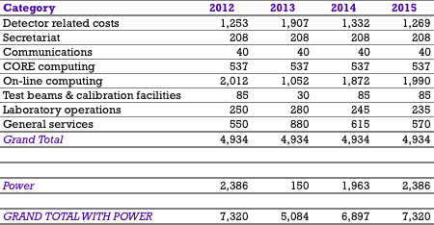
M&O-A budget 2012-2015
In kCHF
Our operating model follows the LHC operating model with a schedule consisting of a 2-months Technical Stop (Jan-Feb 2012) followed by a 9-months Running (Mar-Nov 2012) and a 17‑months Shutdown (Dec 2012-Apr 2014).

Slide 11
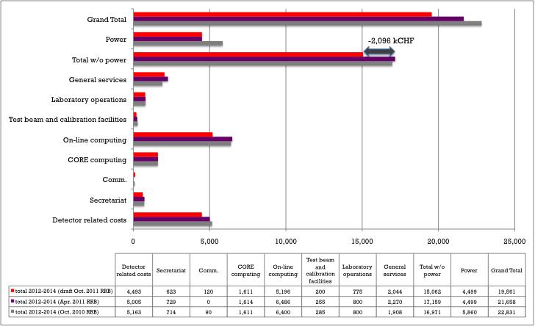
Reduction of the M&O-A budget request for the period 2012-2014

Slide 12
Reduction of the M&O-A budget request (cont.)
New model for the replacement of the Online computers. Dataflow and control and monitoring nodes replaced on a 4-year cycle rather than 3 years used previously
1 MCHF will be taken out from the accumulated cash and will be put on a special account to exclusively purchase Online computers, processors and LANs. Accordingly the online budget request has been reduced by 250 kCH/year for the next 4 years.
A list of long-term consolidation projects has been agreed with the SG and will be financed from the accumulated cash surplus for a total amount of 785 kCHF over the next 4 years (consolidation of cooling systems, DSS nitrogen extinguish system, CO2 racks extinguish system, flooding system, UPS and L3 magnet ventilation).
Budget requests for secretariat, test beam, laboratory operations and general services have been also reduced according to our needs.

Slide 13
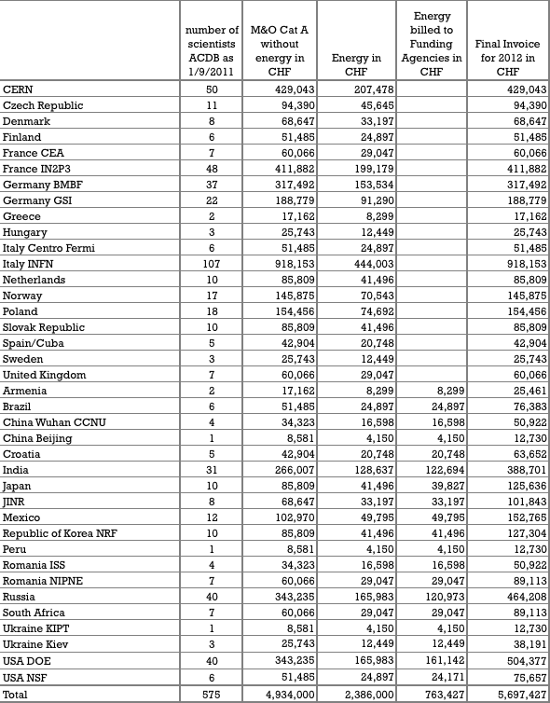
Sharing of the 2012 M&O-A budget in CHF
8.5 kchf/person
10 kchf/person including energy for NMS

Slide 14
M&O-C: CERN Investments on ALICE P2 infrastructure
We face ageing infrastructures at LHC-P2 formerly L3-LEP-P2 and CERN as host laboratory continues investing.
~ 1 MCHF for the large cranes in building SXL2 and SX2
~ 450 kCHF for the entrance door of the SXL2 hall
The building 3294 will have an addition floor for a cost of
~ 400 kCHF.

Slide 15
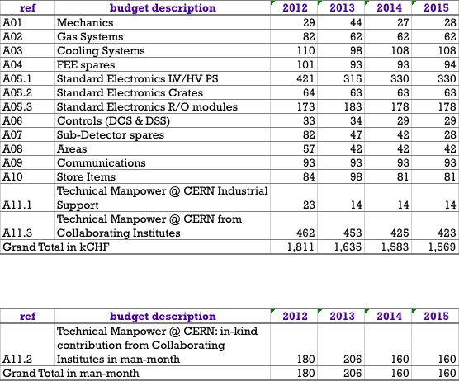
Maintenance & Operations Cat. B 2012 draft budget and estimates 2013-2015

Slide 16
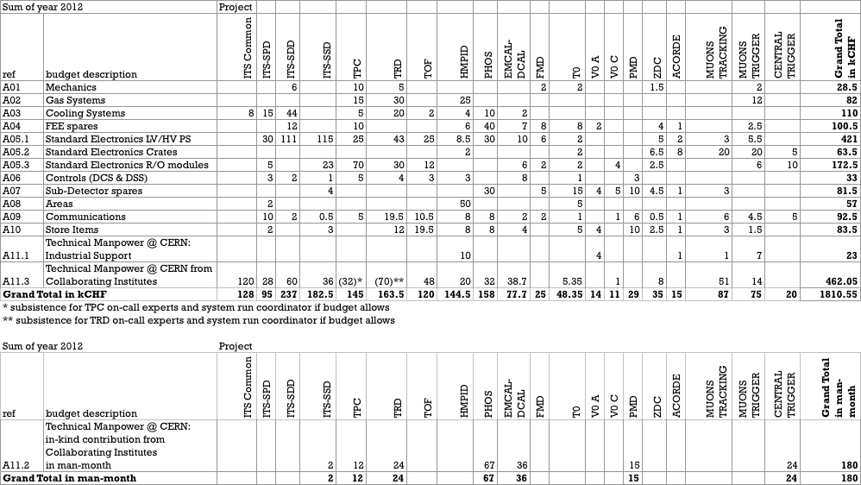
2012 M&O-B draft budget by sub-projects

Slide 17
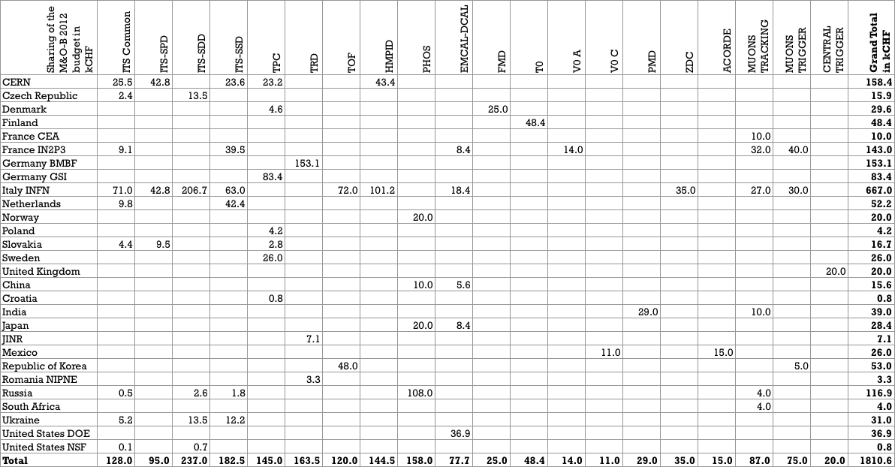
Sharing of the 2012 M&O-B draft budget by funding agencies and projects
In kCHF

Slide 18
Status of Memorandum of Understanding (MoU)
South Africa signed the MoU in March 2011
Still pending: Brazil and China
Under preparation addendum for two Indian Institutes: Bose Institute in Kolkata and Gauhati University in Guwahati

