Slide 1
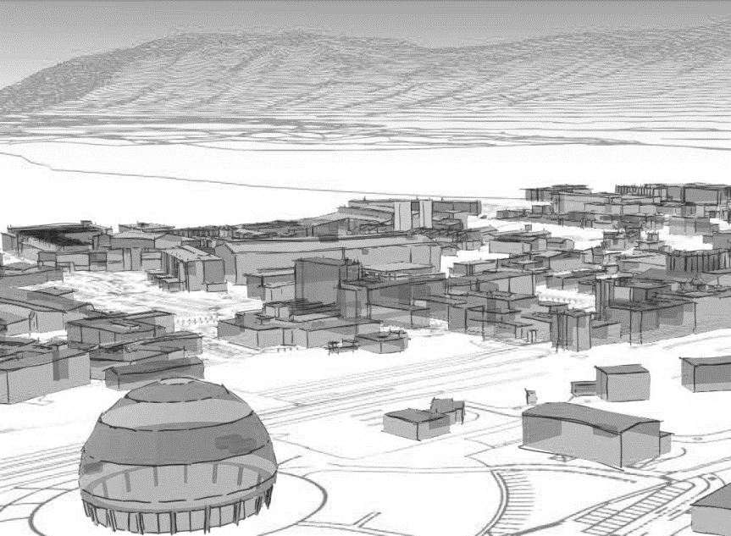

S e c t i o n m e e t i n g
S C E SAM CE
May 23th, 2025

Slide 2

2025 Structure
Civil Engineering
[SAM-CE]
SL: Alejandro Martínez
DSL: Christophe Biot
Interior works
Team referee:
Jean-Jerome Espuche
Boris Cabaud
Nicolas Duval
Sabine Roulet
Paulo Fonseca
Projects
Team referee:
Adem Kaymak
Faustine Cesca
Mehdi Lamrani
Ellie Ingram
Denis Pazem
Florent Legay
External works
Team referee:
Mathieu Fontaine
Olivier Maquenhen
Mathis Rinaldi
Structure and envelope
Team referee:
Christophe Biot
Severin D’Armancourt
Aurelien Dodard
Duncan Tarry
SERCO team
Jean Michel Ecuvillon
Gael Antoniazzi
Frederic Coupe
Philippe Sagnes & team

Slide 3
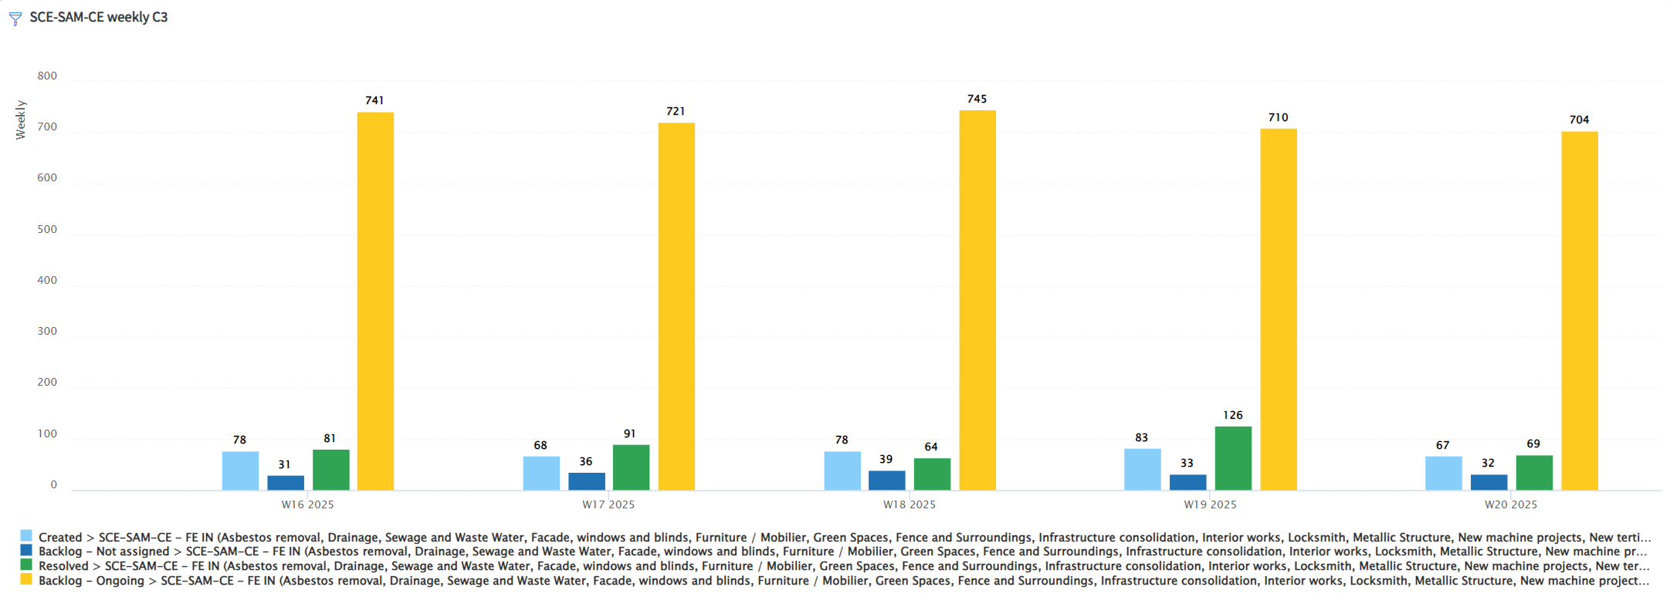
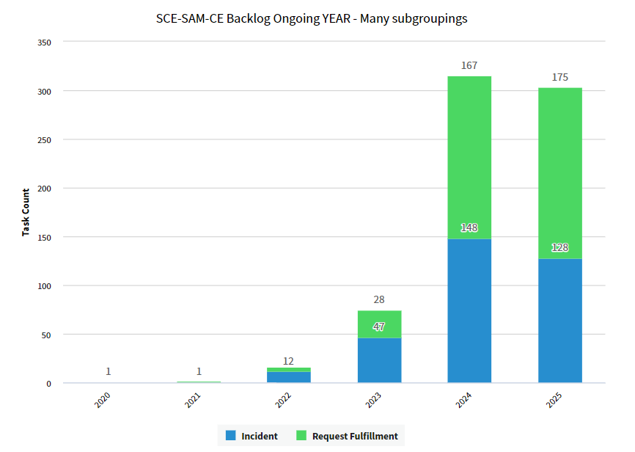
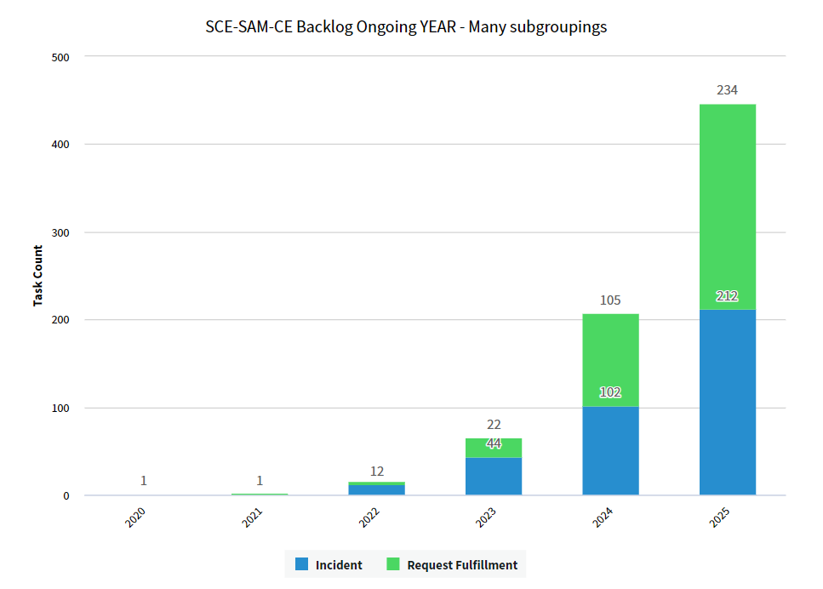

Tickets backlog
11 tickets created in 2023 or before resolved since last meeting

Slide 4
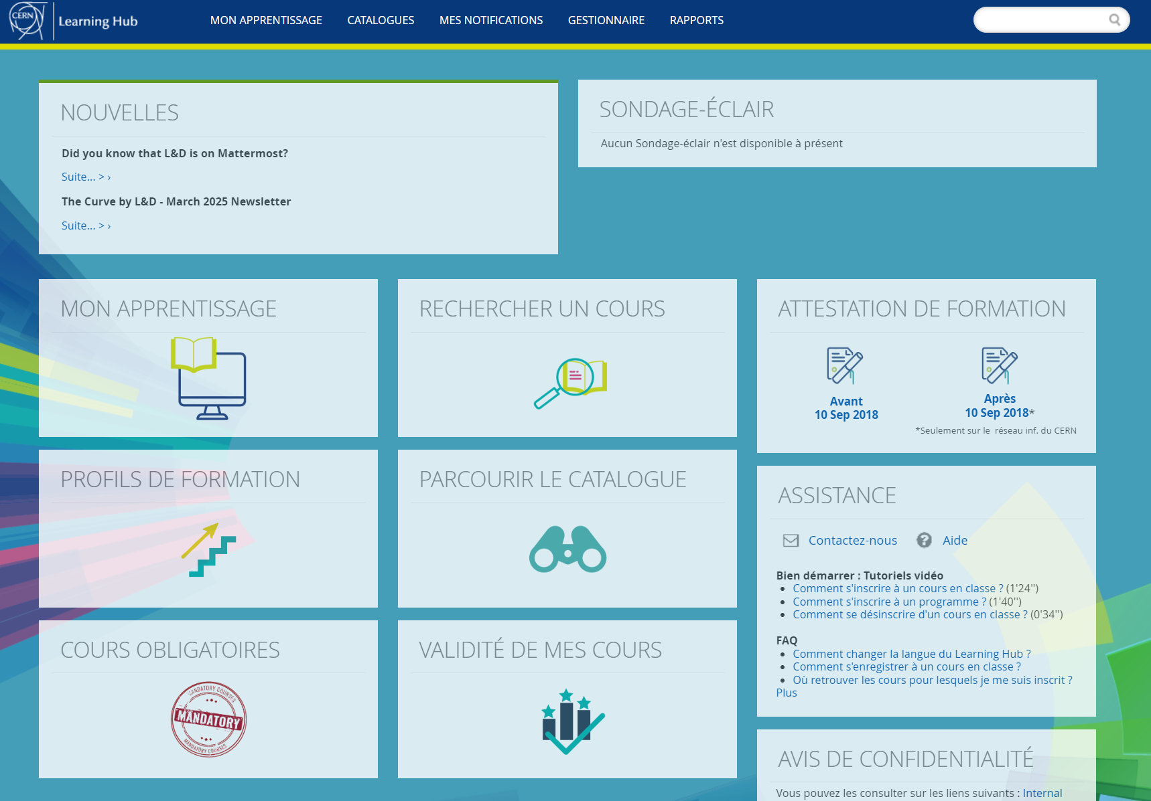
Other subjects
Formations obligatoires (reminder)
Un des objectifs du département pour 2025 est de compléter les formations obligatoires de tous les membres SCE.
Merci de vous inscrire aux formations obligatoires
LD publié pour technicien Génie civil:
CERN Civil Engineering Technician (SCE-SAM-CE-2025-48-LD) | SmartRecruiters
Conscious hiring
Video interviews analysis on-going
QUEST/ORIGIN to be published in the coming days
OSVC:
Pay attention to Technical responsible when creating OSVC directly from the INFOR ODM
A solution has been found and is being implemented. The TECH1 of the contract will be inserted automatically in the OSVC. Patience till implementation done
Frame contracts:
ALTRAD will possibly abandon the new contract. No more orders for ALTRAD
MARTI french side fully committed. Waiting for FC approval for enveloppe increase
REMINDER:
Samuel Adam pour pilotage renouvellement Contrats Cadre
Samuel Adam pour relecture DO/IT autres contrats avant diffusion a IPT
C. Biot comme réfèrent support pour toutes les DO/IT
Earthworks :
All modifications wrt VIC (or technical visits) agreements must be communicated beforehand to the owners of the networks (EN/EL, EN/CV, Fiber optics, etc…)
Do not forget HAP diags before any road works
PdP : Please make sure that all your PdP are up to date !

Slide 5
SITE-CONS budget follow-up
Responsible | Budget Code | Plan correspondance | Charged (CHF) | Committed (CHF) | Sum Pipeline (CHF) | Budget (CHF) | Sum of Difference
Adem Kaymak | 76366 | {B864/865 parking consolidation} | 35,281 | 484,123 |  | 511,000 | 26,877
 | 76365 | {0033-Upgrade fire safety} | 356 | 10,830 |  | 8,000 | -2,830
 | 76363 | {CERN Welcome Centre} | - | 11,128 |  | 8,000 | -3,128
 | 76353 | {0377-378-Facade} | 705 | 113,260 |  | 184,000 | 70,740
 | 76334 | {0057-Toilet Block} |  |  |  | 50,000 | 50,000
 |  | {0272-Toilet Block} |  |  |  | 75,000 | 75,000
 |  | {0287-Toilet Block} |  |  |  | 30,000 | 30,000
 |  | {0298-Toilet Block} |  |  |  | 140,000 | 140,000
 |  | {0917-Toilet Block} |  |  |  | 42,000 | 42,000
Aurélien Dodard | 76360 | {0030-Roof} |  |  |  | 150,000 | 150,000
 |  | {0052-Roof (500 m2)} | 2,257 | 2,257 |  | 9,000 | 6,743
 |  | {0167-Roof} | -106,552 | 98,231 |  | 97,000 | -1,231
 |  | {0501-Roof} |  |  |  | 50,000 | 50,000
 |  | {0872-Roof} |  | 131,009 |  | 120,000 | -11,009
Jerome Espuche | 76361 | {0050-Windows and blinds East facade} |  | 49,966 |  | 85,000 | 35,034
 |  | {0054-Windows replacement (staircase)} | 28,602 | 29,212 |  | 52,000 | 22,788
Denis Pazem | 76365 | {Asbestos removal (Safety)} | 48,130 | 81,349 |  | 259,000 | 177,651
Ellen Ingram | 76365 | {0504-Upgrade fire safety} |  | 11,662 | 3,685 | 60,000 | 44,653
Mehdi Lamrani | 76360 | {0033-Glass dome} | 4,964 | 21,330 |  | 15,000 | -6,330
Faustine Cesca | 76354 | {0200-201 envelope (facade + roof 300m2)} | 22,382 | 36,376 |  | 8,000 | -28,376
Florent Legay | 76368 | {0184-Facade} |  | 36,171 |  | 210,000 | 173,829
 |  | {0184-Roof} |  |  |  | 100,000 | 100,000
 |  | {ISR-Carbonation} |  | 66,445 |  | 100,000 | 33,555
 | 76361 | {0101-Facade} | -58,965 | 905,413 | 13,614 | 954,000 | 34,973
 | 76351 | {0133-Roof} | 23,519 | 30,626 |  | 450,000 | 419,374
Mathieu Fontaine | 76362 | {LHC2-Parking} |  | 2,897 |  | 100,000 | 97,103
Nicolas Duval | 76334 | {0032-Toilet Block} | 53,469 | 310,487 |  | 313,000 | 2,513
Olivier Maquenhen | 76362 | {Mobility center-Foul water consolidation} |  | 77,955 |  | 77,000 | -955
 | 76334 | {0108-Toilet Block} |  | 14,720 |  | 13,000 | -1,720
Severin D'armancourt | 76365 | {0227-Water tower (stairs)} |  | 200,799 |  | 268,000 | 67,201
 |  | {0285-Facade} | 7,768 | 123,671 | 2,800 | 92,000 | -34,471
 | 76360 | {Roofs securing} |  | 38,961 |  | 74,000 | 35,039
Grand Total |  |  | 61,916 | 2,888,878 | 20,099 | 4,704,000 | 1,795,023

Slide 6
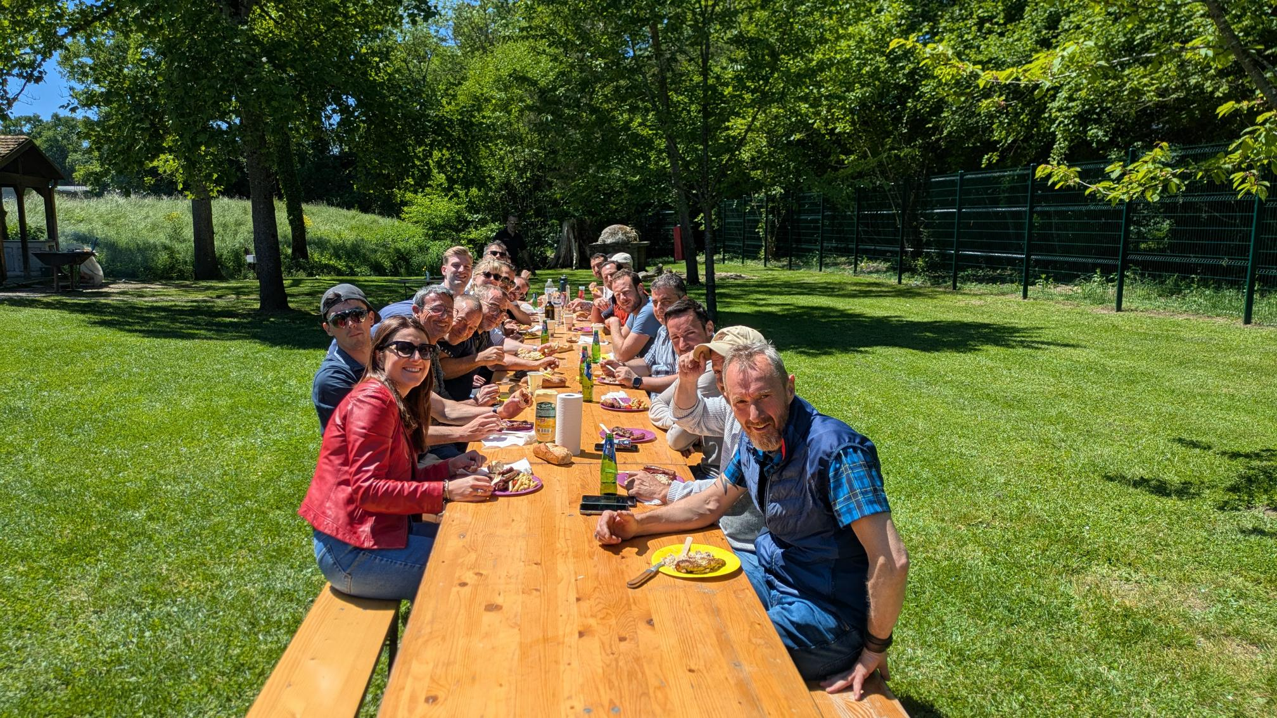
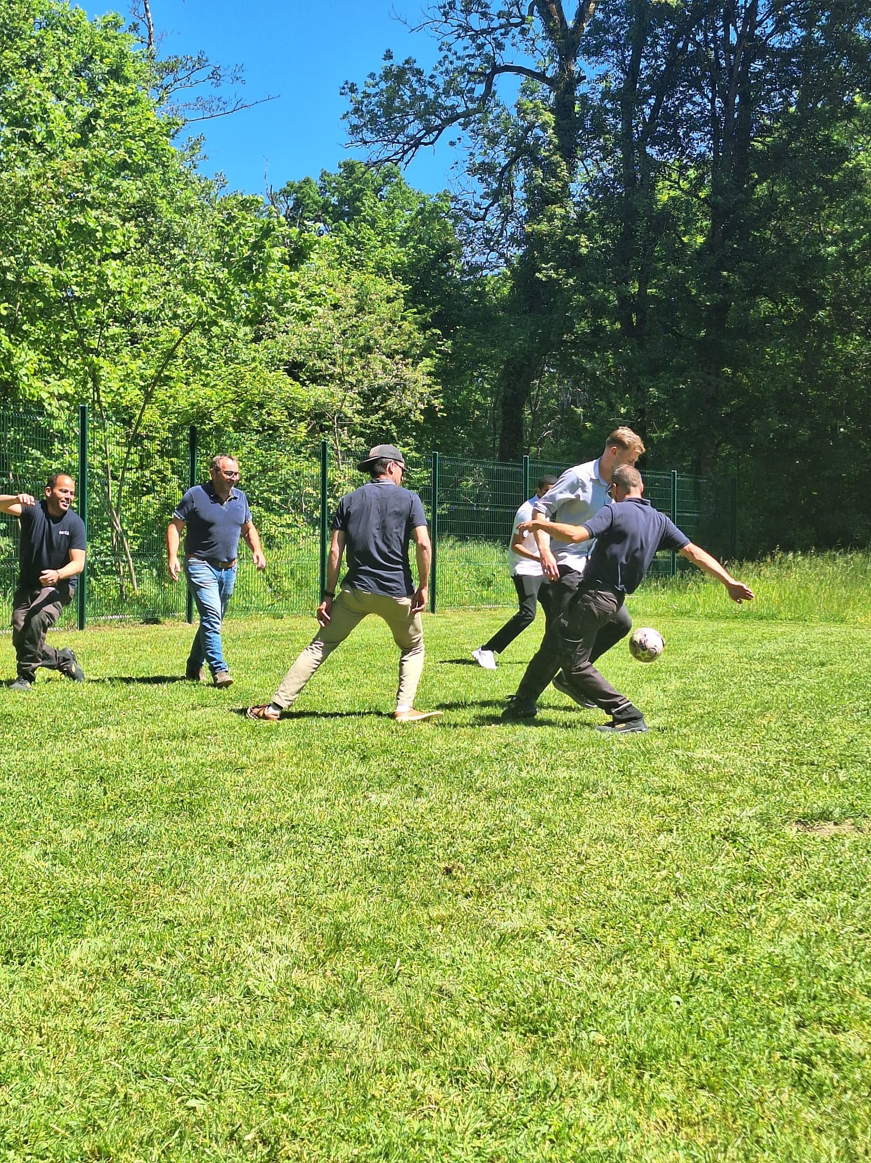
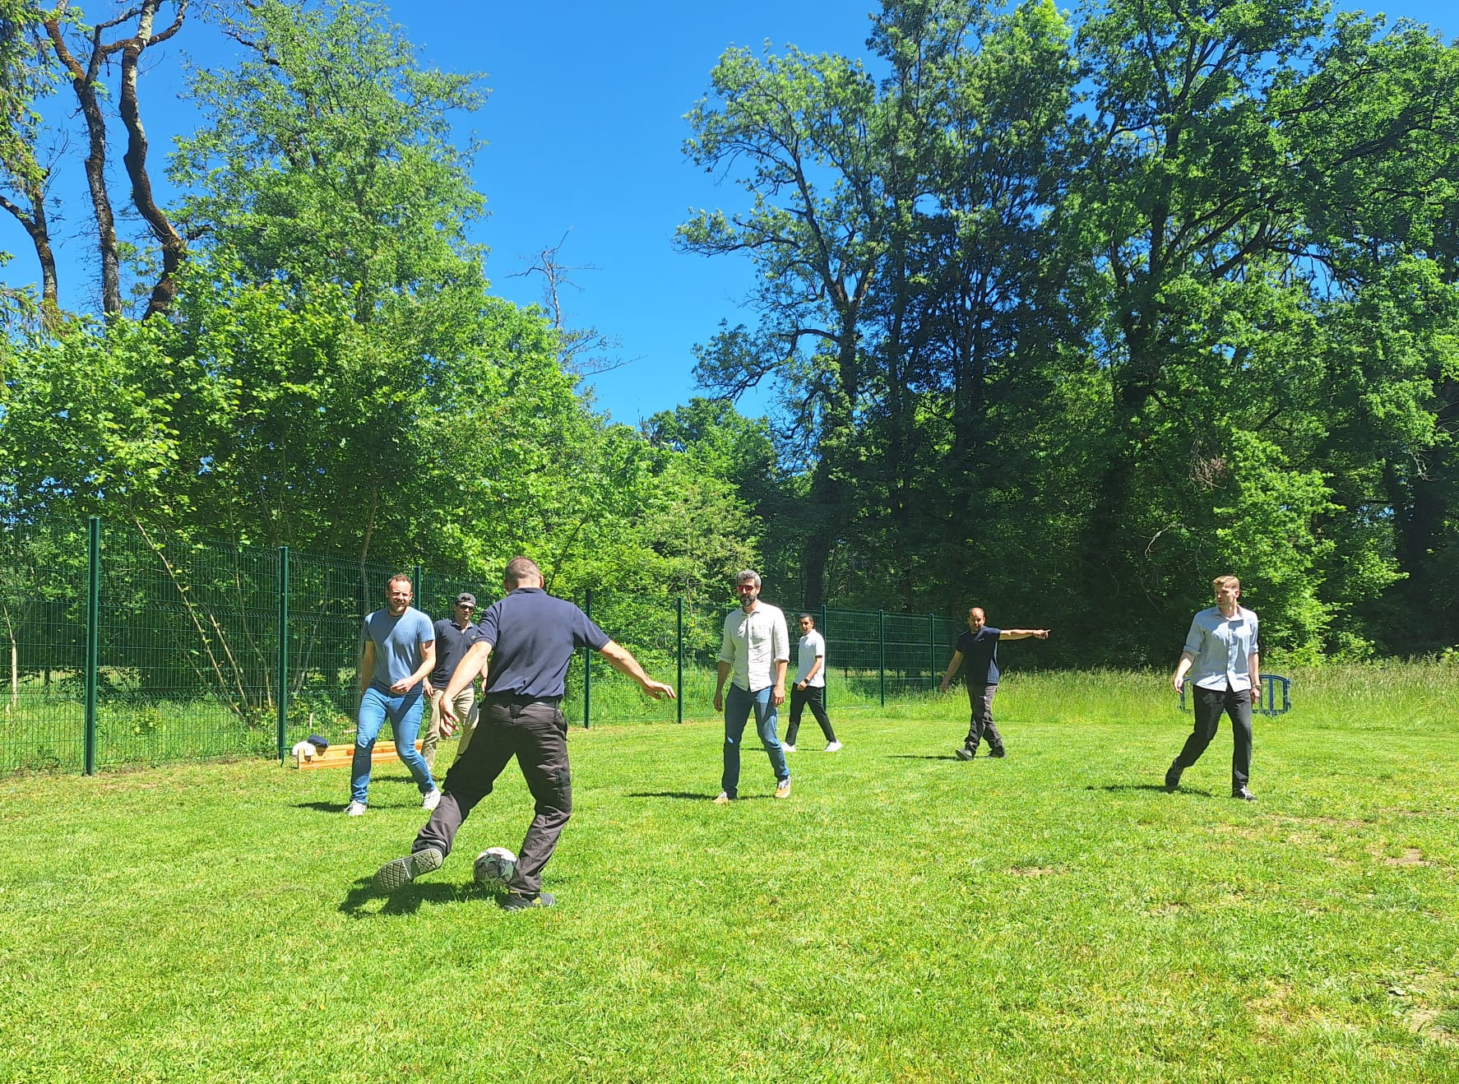
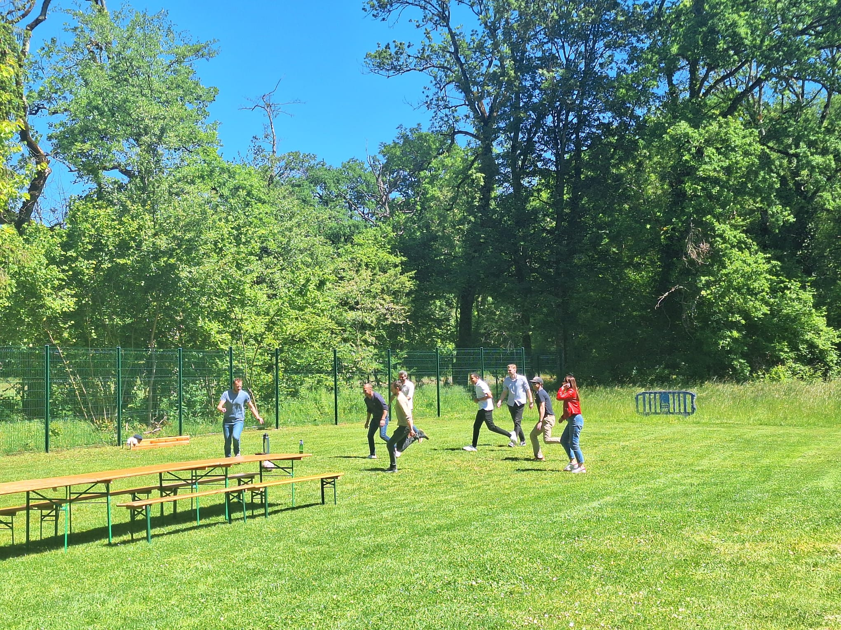
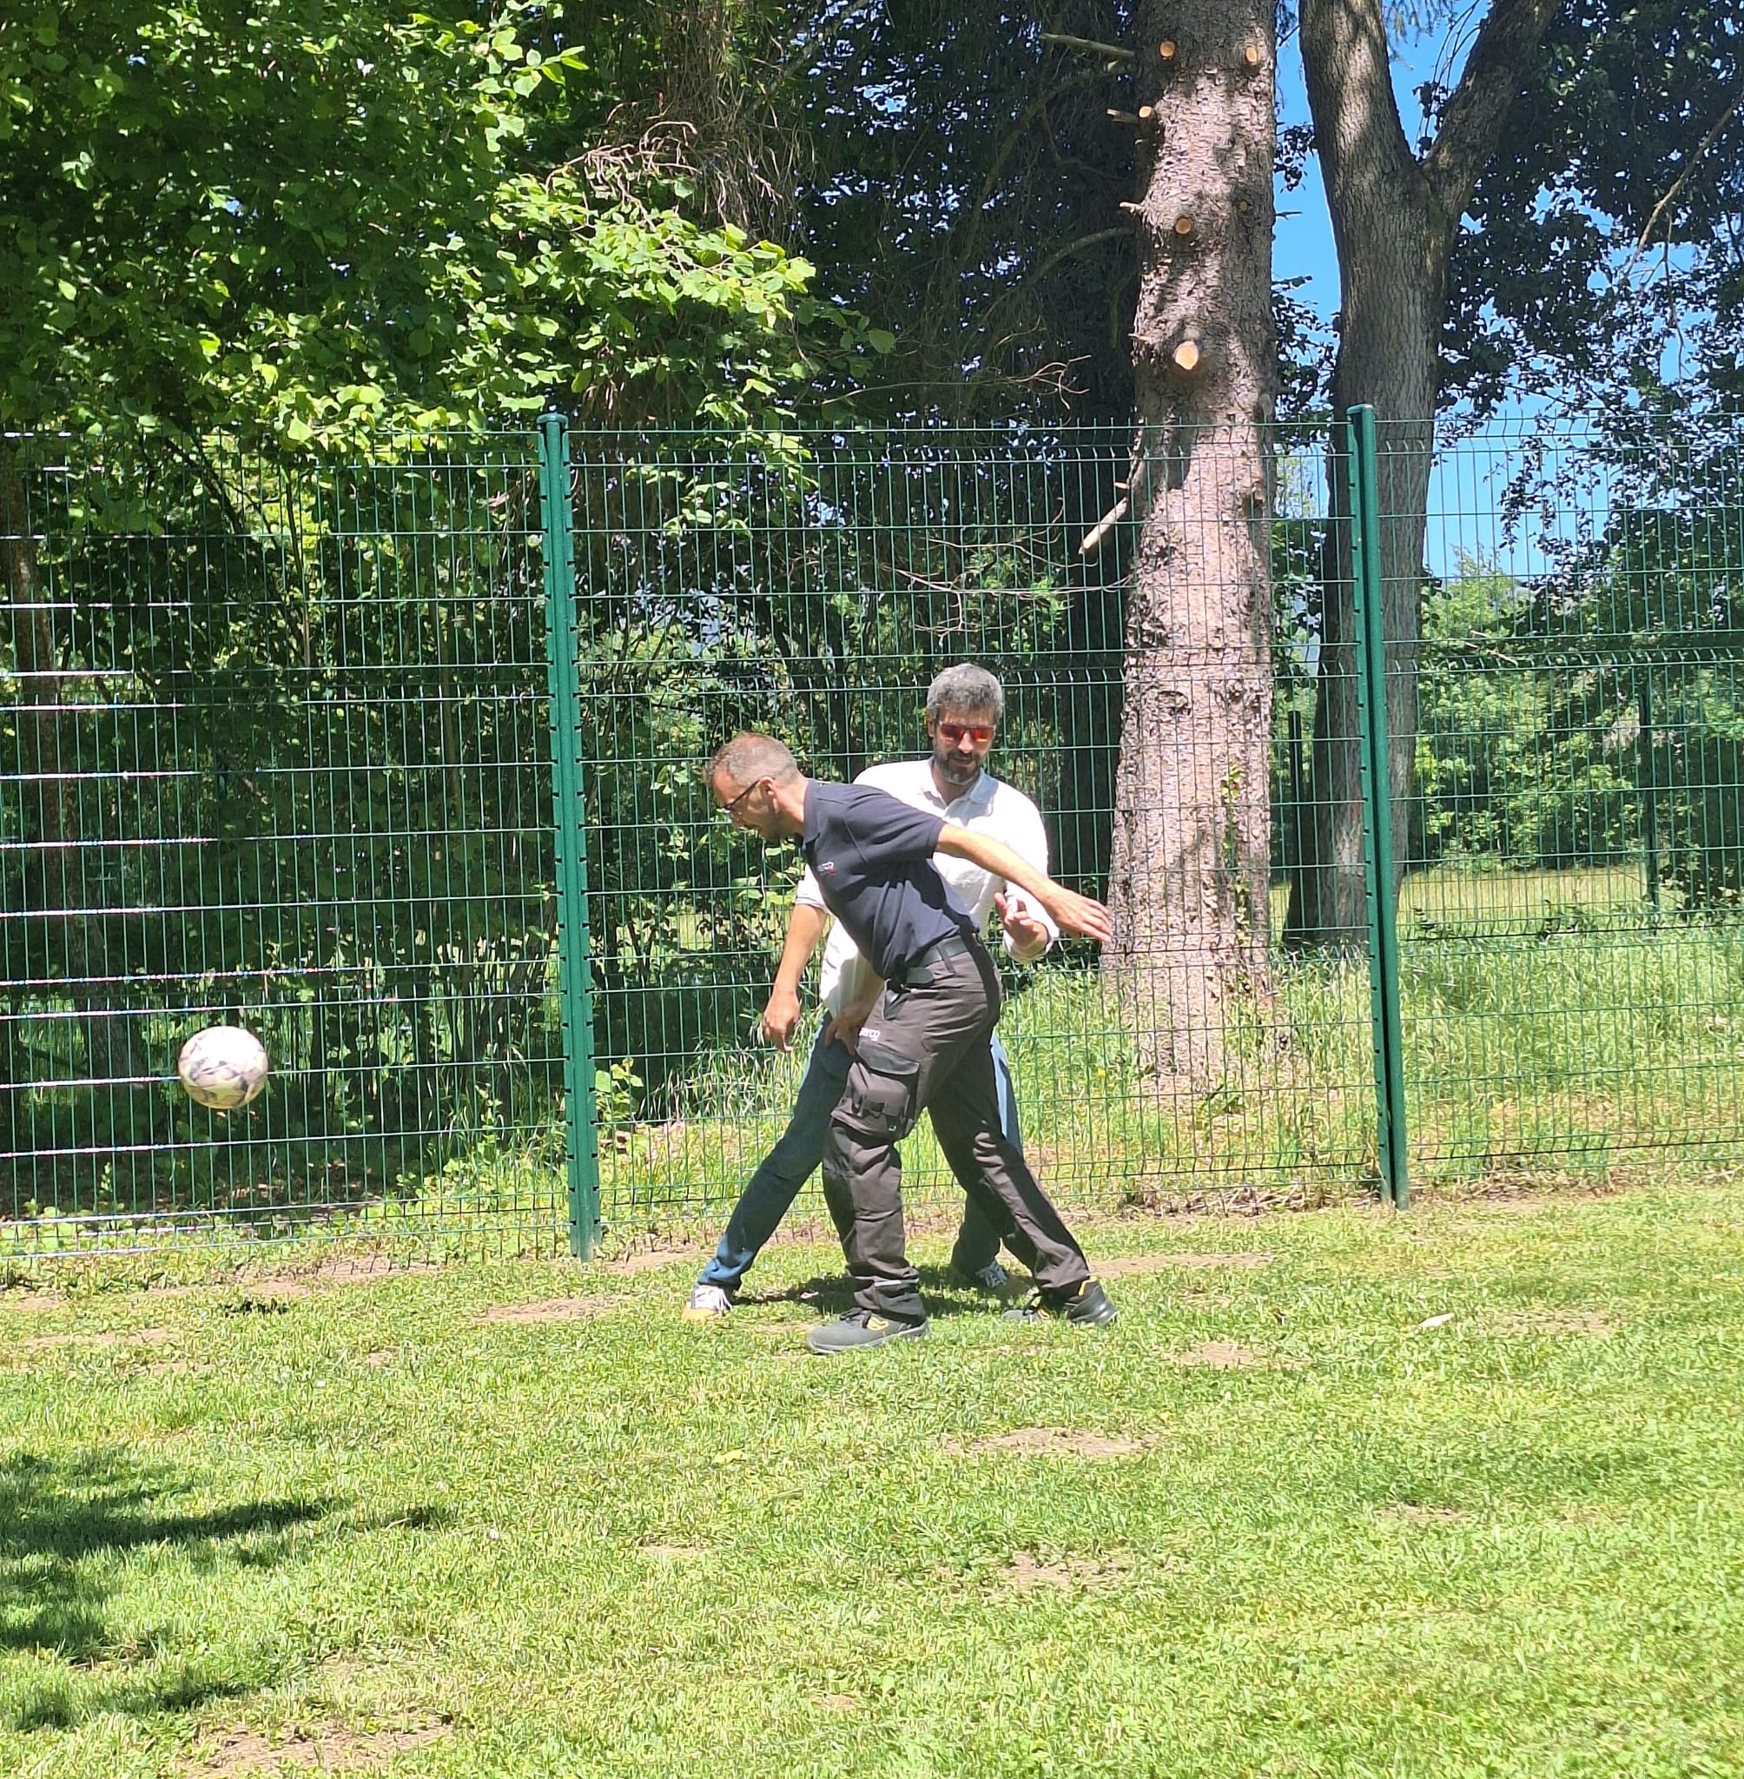
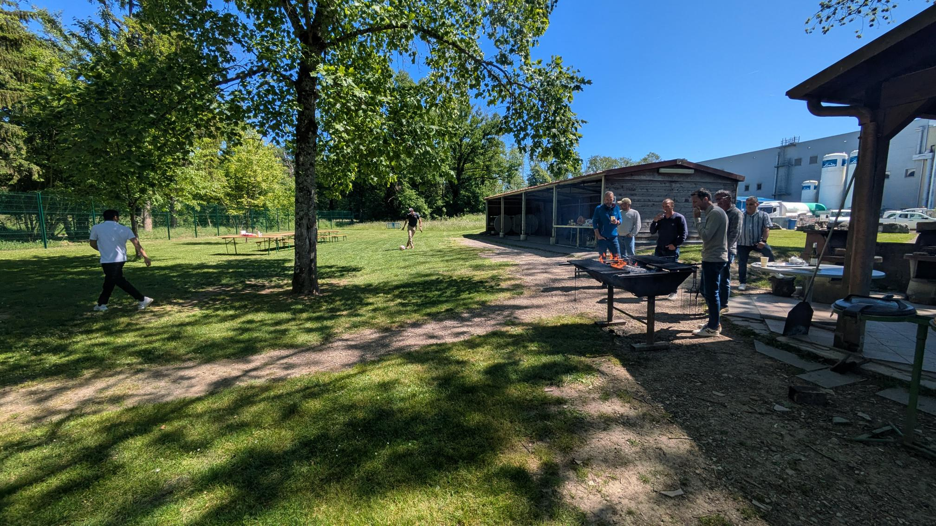
BBQ SAM-CE

Slide 7

TIME
FOR
TOUR DE TABLE

