Slide 1
HOM-based
Beam Position Monitoring
Nicoleta Baboi¹, Pei Zhang^{1,4},
Nathan Eddy², Hans-Walter Glock³,
Thomas Flisgen³, Roger Jones⁴, Ian Shinton⁴
¹ DESY; ² FNAL; ³ Rostock University;
⁴ Cockcroft Institute/Manchester University
HOM issues in the ESS SC linac

Slide 2
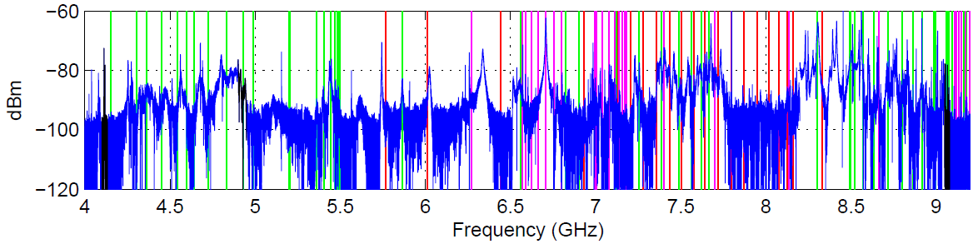
Higher Order Modes (HOM)
HOMs = fields excited by the beam in accelerating cavities
  Bad effect on beam, but also
  Can be used for beam (and cavity) diagnostics
    Properties depend on accelerating cavity and beam properties
        e.g.: beam-excited spectrum in a 3.9GHz cavity
  Spectrum includes monopole, dipole, quadrupole etc. modes

Slide 3
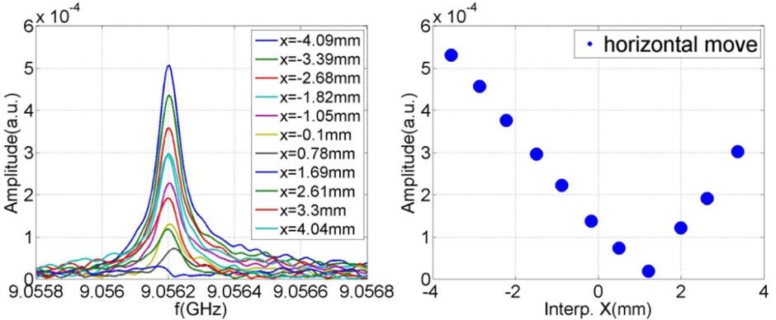
Principle of HOM-BPMs
Dipole modes have linear dependence on beam offset and charge
⇒ Idea: Use HOMs for beam position diagnostics (HOM-BPMs)
  Center beam (reduce wakes)
  Measure cavity misalignment

Slide 4
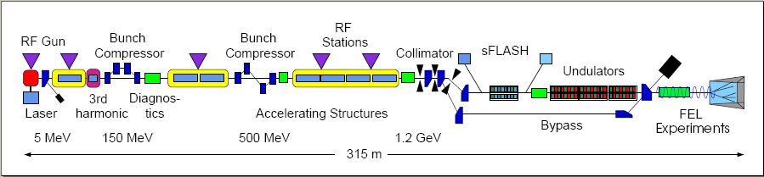
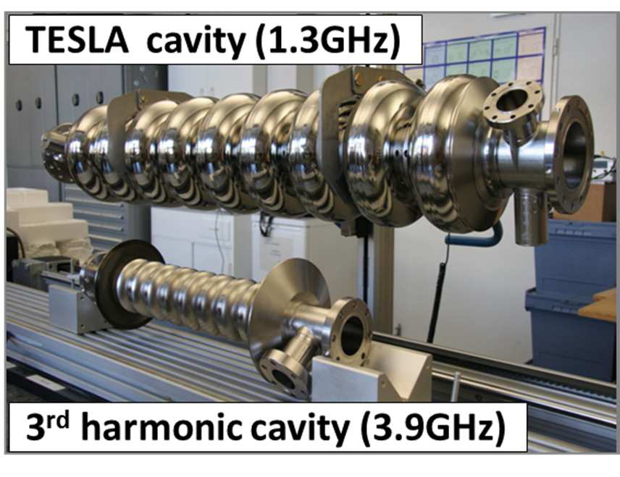
FLASH
TESLA cavities
  1.3 GHz
  8 cavities / module
  2 HOM couplers
3rd harmonics cavities
  3.9 GHz
  Flattens RF field
  4 cavities / module
  Built at Fermilab

Slide 5
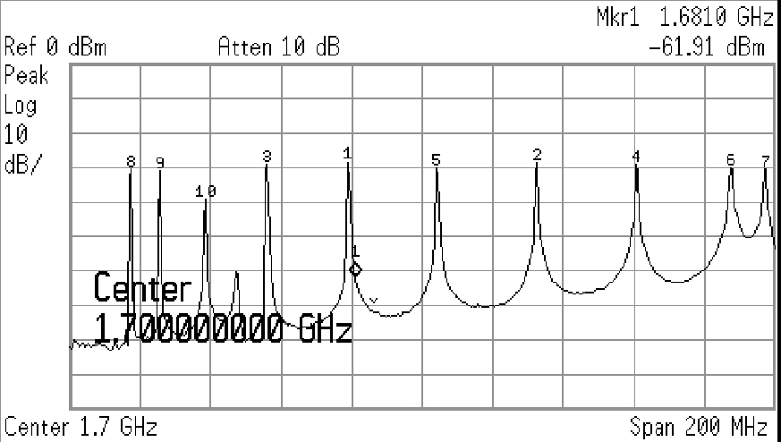
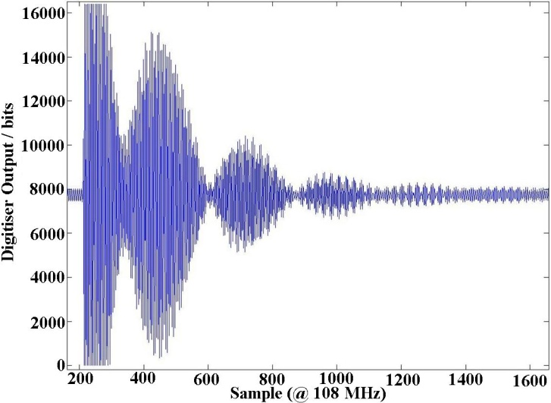
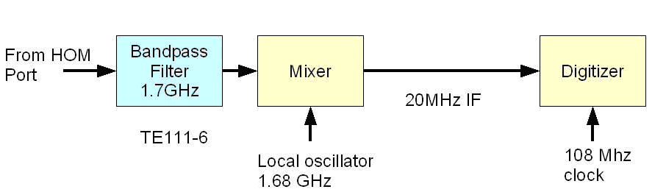
Previous work:
HOM-BPMs at TESLA cavities
  Electronics built by SLAC

Slide 6
Previous work:
HOM-BPMs at TESLA cavities (cont.)
Use SVD to process data
Evaluate resolution by comparing to adjacent cavities
  5-10 μm rms
  Problem with calibration
  stability
Raw signals
  Used during commissioning
  periods to center the beam
    S. Molloy et al., PRST-AB 9, 112802 (2006)
    J. Frisch et al., EPAC 2006, TUYPA02, Edinburgh, Scottland

Slide 7
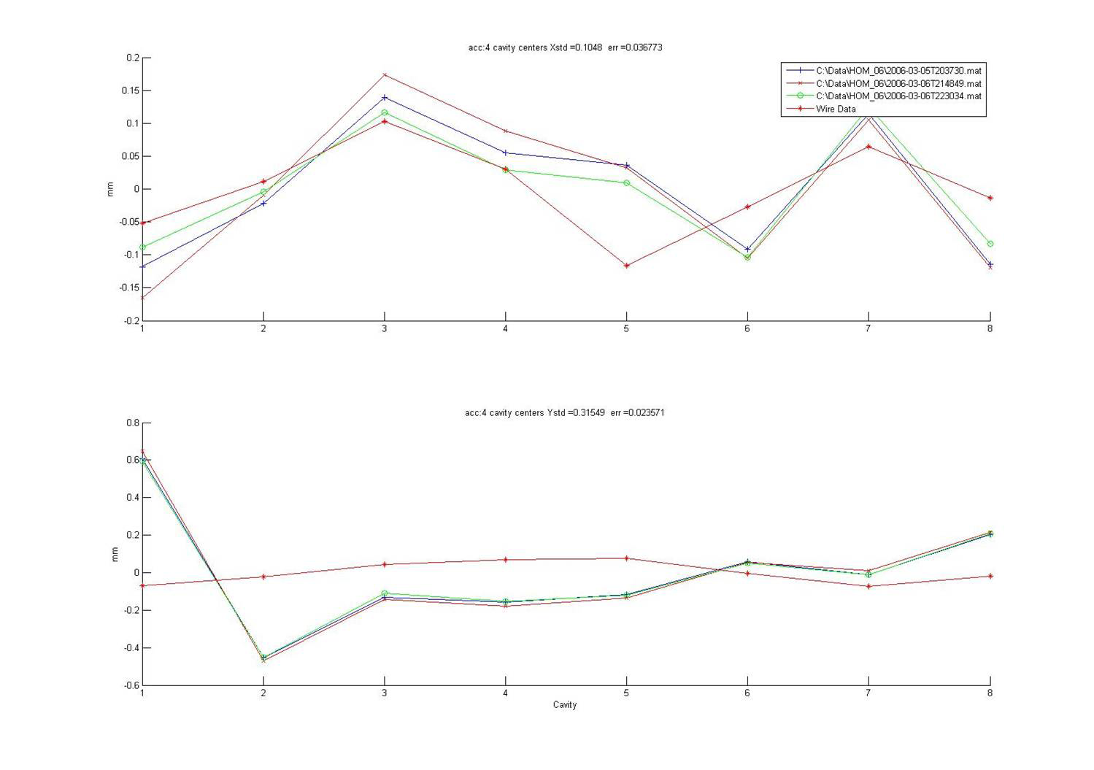
Previous Work: Cavity Alignment

Slide 8
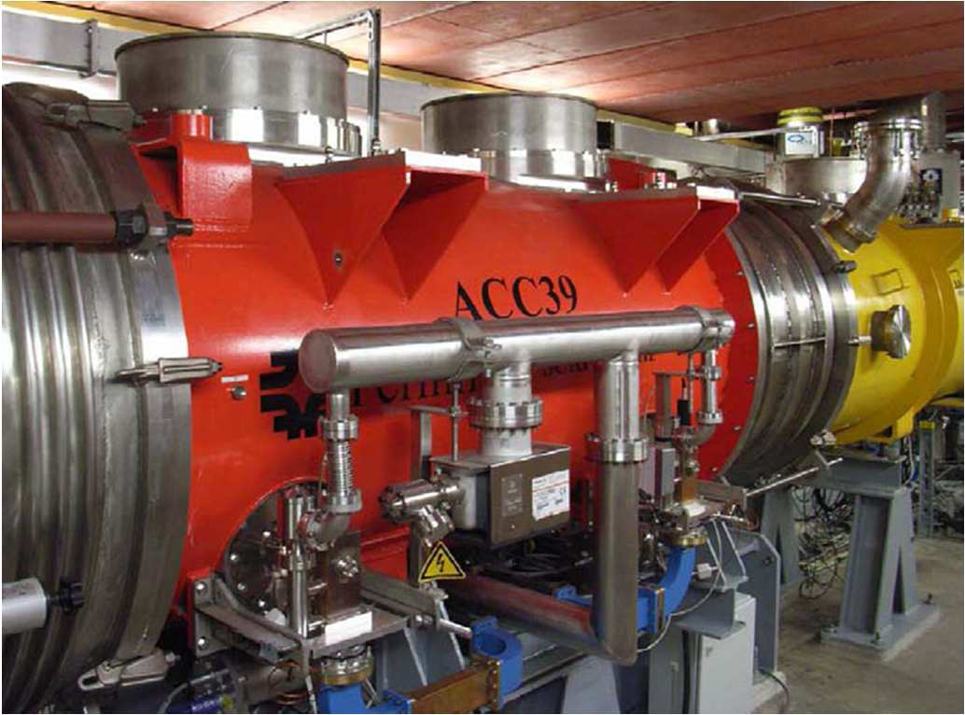
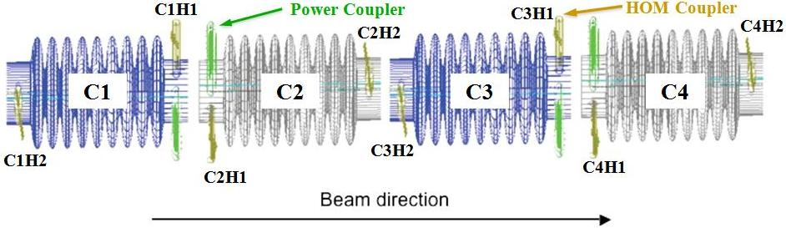
HOM-BPMs for 3rd Harmonic Cavities

Slide 9






EuCARD WP 10 “Supercodnucting RF,”
Task 5 “HOM Distributions”
Partially supporting our work
Sub-tasks
  1: HOMBPMs
  2: HOMCD (HOM Cavity Diagnostics)
  3: HOMGD (HOM Distributions and Geometrical Dependencies)
Fermilab

Slide 10
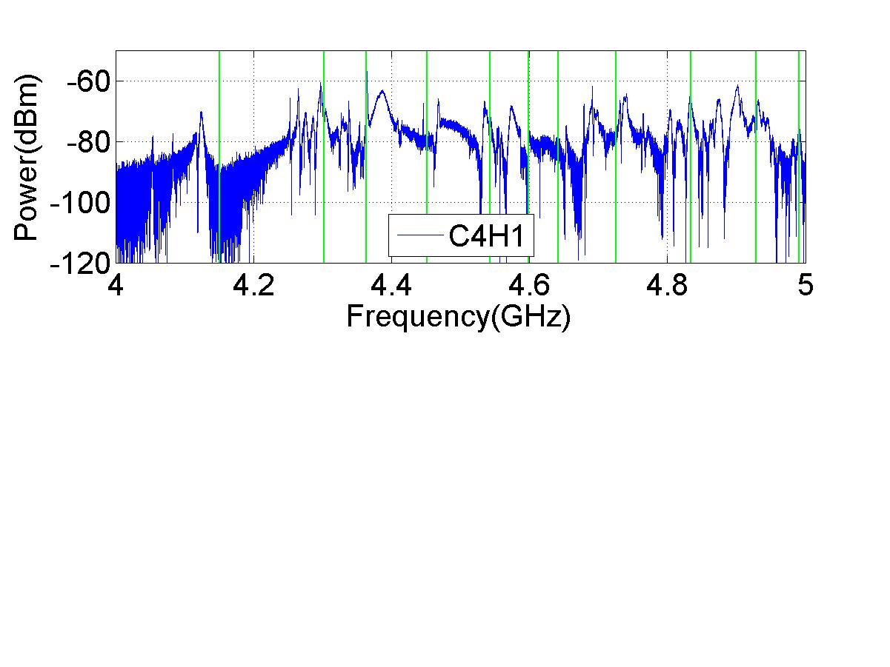
1st Dipole Band in one 3rd Harmonic Cavity
Practically all cavity modes above cut-off
  Crowded spectrum
  Modes: not possible to identify
  Idea: cut one portion of spectrum (several modes)
Alternatives:
  Beam-pipe dipole modes
  Trapped modes in 5th dipole passband
1st dipole band
Compare to TESLA cavity:

Slide 11
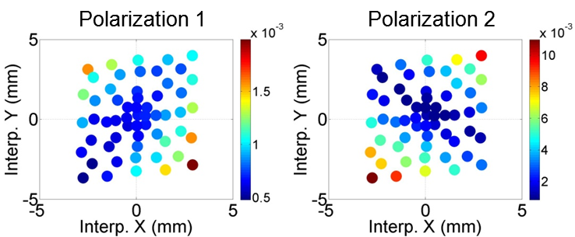
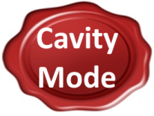
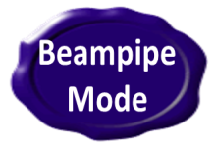



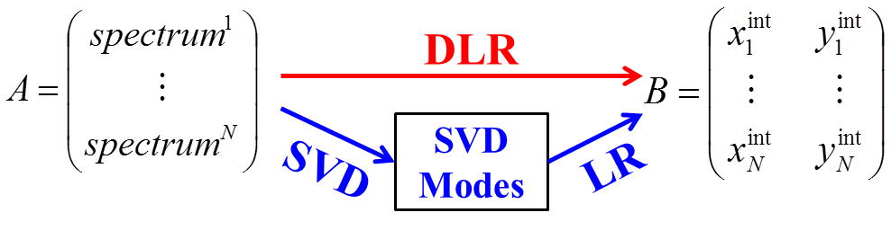


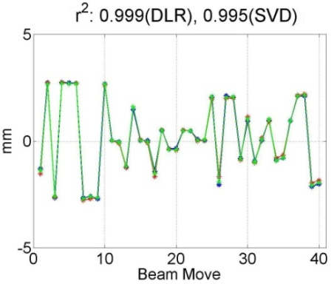
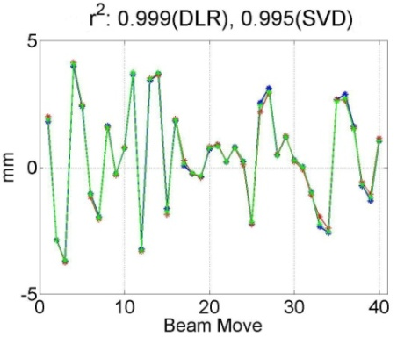
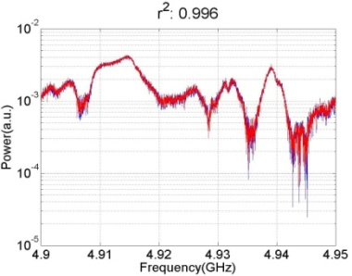
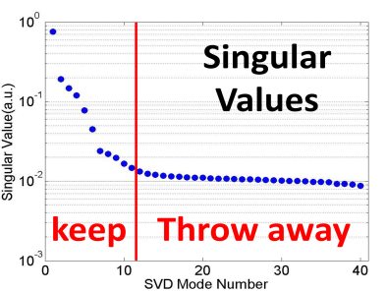
3 Options for Modes to be used as BPM
Localized vs. Propagating

Slide 12
3 Options (cont.)
Dipole passband | Frequency [GHz] (theor.) | R/Q [W/cm²] | Pros/Cons
Beam pipe | 4.1486 | 0.24 | Localized
 | 4.1487 | 1.31 | Low R/Q ⇒ low BPM resolution Not in cavity
Cavity 1st band | 4.723 | 10.37
 | 4.831 | 50.20 | High R/Q
 | 4.926 | 30.38 | ⇒ high BPM resolution
Cavity 2nd band | 5.444 | 20.88 | Propagate in whole module
 | 5.470 | 16.07
Cavity 5th band | 9.057 | 0.05 | Localized
 | 9.059 | 0.07 | Cavity-based
 | 9.062 | 2.17 | Low R/Q
 | 9.070 | 4.04 | ⇒ low BPM resolution

Slide 13
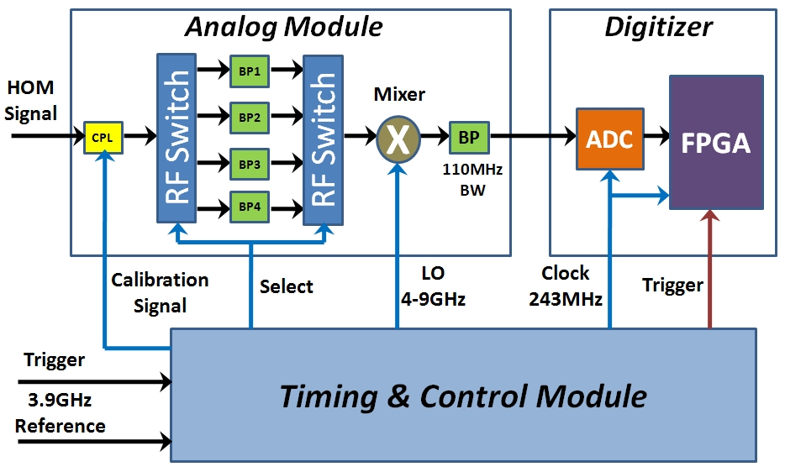
Electronics
Built by Fermilab
“Play”-electronics will be tested early next year
  N. Baboi et al., SRF 2011, MOPO060, Chicago, IL, U.S.A.
preliminary

Slide 14
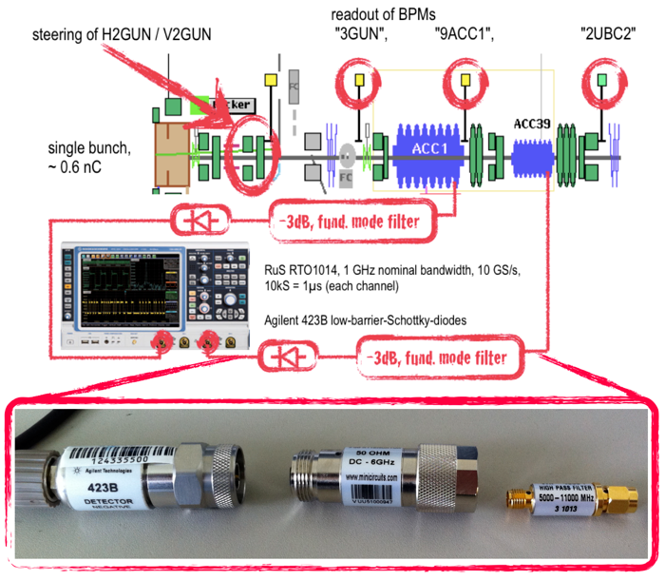
Diode Based Signal Capturing
Alternative electronics
  Already tested
Simple setup:
Broad-band filter
  to suppress strong 3.9GHz
+RF detector diode
Signal-output ~ total HOM power
H.W. Glock, DIPAC2011, MOPD25

Slide 15
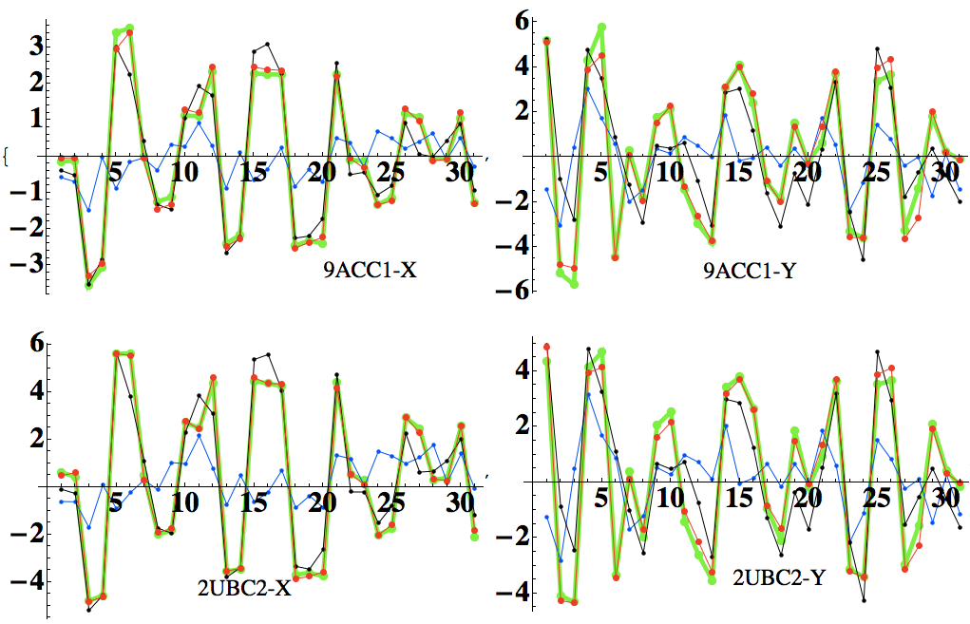
Diode Based Signal Capturing (cont.)
Complicated analysis, SVD based
  But it works

Slide 16
Comments and Outlook
Did not mention simulations
  Important for understanding the HOM behavior
  Not discussed here (see talk by R.M. Jones)
  Cockcroft Inst. / Univ. Manchester and the
  Univ. Rostock
Will test options (localized, propagating) with electronics at the beginning of 2012
  Then decide which modes to use for final electronics
HOMBPMs for the European XFEL
Replace/fix current HOMBPMs for the TESLA cavities at FLASH

