Slide 1

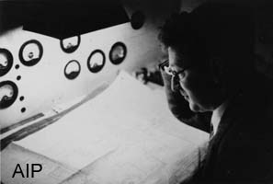

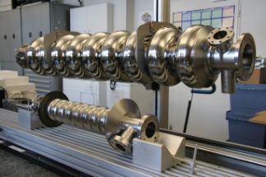
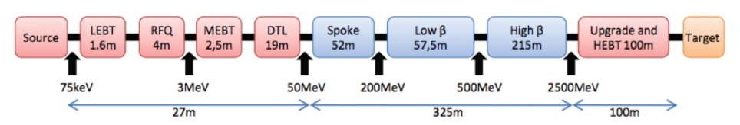
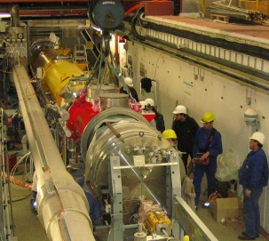
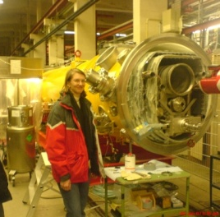
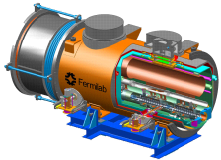
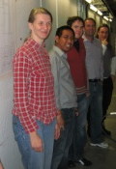

HOMs in ESS Cavities:
Spoke and Elliptical Work Proposed
Roger M. Jones, Univ. Manchester/Cockcroft Inst.
Wakefields and HOM beam dynamics for ILC and XFEL:
SC cavity high gradient optimisation
Main linac e.m. field and beam electrodynamics
HOM measurements/diagnostics at FLASH (FP7)
2. HIE-ISOLDE –Collaboration with CERN colleagues on LINAC component of upgrade to REX-ISOLDE
3. Application to ESS cavities

Slide 2

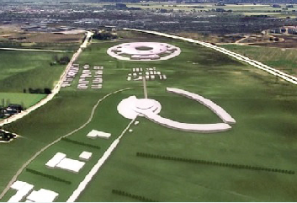
UK Membership
The United Kingdom will be the 17th country to join the European Spallation Source project. The UK was welcomed today at a meeting in Bilbao, Spain, by representatives from the current 16 Partner Countries.
I am particularly happy that the UK now joins the project. The UK has a large and strong neutron research community, that will now be able to benefit from the opportunities that ESS can give, says Colin Carlile, the ESS Director-General. There is a vast knowledge of the necessary technology for building a spallation neutron source from the ion source to the instruments in the UK and there will be mutual benefits.
(source ESS news 15th April 2011)

Slide 3
Overview
Focus of μ
group is on SC and NC cavities -with some other activities.
(Microwave Electrodynamics and Wakefields)
SC cavities, frequency range ~ 1.3 GHz (XFEL/ILC) ,
3.9 GHz (FLASH), 101 MHz (HIE-ISOLDE).
ESS spoke and 704 MHz elliptical cavities
We investigate wakefields/impedances, HOM damping, maximising gradient, computational methods.

Slide 4
Personnel
PDRAs: Ian Shinton (Univ. Manchester), Alessandro D’Elia (Univ. Manchester/CERN), Inna Nesmiyan, TBH
Ph.D. Students: Chris Glasman, Nawin Juntong, Lee Carver, Narong Chanlek, Matthew Fraser, Hugo Day , N. Shipman
Graduated PhD students: Vasim Khan (now CERN Fellow)
Graduated MSc students: Narong Chanlek, Chris Glasman (Univ. Manchester)
Collaborators: Walter Wuensch, Alexei Grudiev, Riccardo Zennaro, Germana Riddone (CERN), Nicoleta Baboi (DESY), Ulla van Rienen (Univ. Rostock), Mats Lindroos, Steve Peggs, Steve Molloy (ESS), Toshiyasu Higo, (KEK), Graham Burt, Amos Dexter, Richard Carter (Univ. Lancaster), Valery Dolgashev (SLAC)

Slide 5

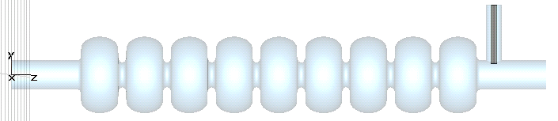

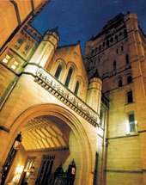
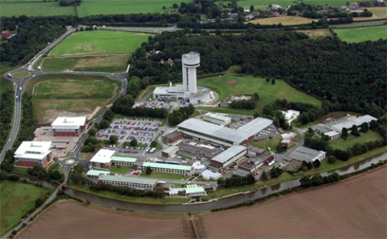
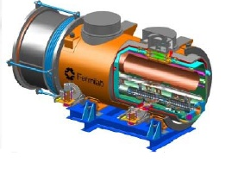
1. ILC High Gradient Cavities and FLASH/XFEL Third Harmonic Cavities
Roger M. Jones
Cockcroft Institute and
The University of Manchester

Slide 6
LC + XFEL SC Linac -Staff
Roger M. Jones (Univ. of Manchester faculty)
Ian Shinton (Univ. of Manchester PDRA based at Cockcroft –April 2009, 100%)
Nawin Juntong (Ph.D. student, 100%)
Chris Glasman (Ph.D. student, 100%)
Part of EuCard ( European Coordination Task Leader for Accelerator Research and Development) FP7 SCLinac Task 10.5. Three associated sub-tasks.
EuCARD FP7 WP 10.5 Members:
R.M. Jones, N. Baboi (DESY), U. Van Rienen (Univ. Rostock)
CI/Univ. of Manchester PDRA I. Shinton (left) and Ph.D. student
N. Juntong (right; supported by the Royal Thai Government and Thai Synchrotron Light Source)

Slide 7
Overview
Two Main Parts:
1.0 Introduction to Globalised Scattering Techniques
1.1 ILC High Gradient Cavities * : New Low Surface Field Design
-exploration of large parameter space
1.2 Third Harmonic Cavities at FLASH/XFEL –entails intensive simulations and construction of HOM diagnostics
*Detailed beam dynamics simulations by Glasman et al. on several alternative high gradient designs have also been conducted, but skipped here due to time constraints!
Refs:
1. Juntong et al, PAC09, SRF2009
2. Shinton et al, SRF 2009

Slide 8
1.0 Introduction to Globalised Scattering Techniques
Simulation of Higher Order Modes (HOMs) in high gradient cavities
Utilise 3D codes: GdfidL, HFSS, ACE3P suite
Use 2D codes, ABCI, Echo2D for bulk of cavity structures.
Develop interface that cascades given sections to make more efficient calculations of overall fields.
Focus on:
Re-entrant -Cornell Univ. design
Low-loss (Ichiro variant) –KEK design.
Z. Li’s redesign

Slide 9
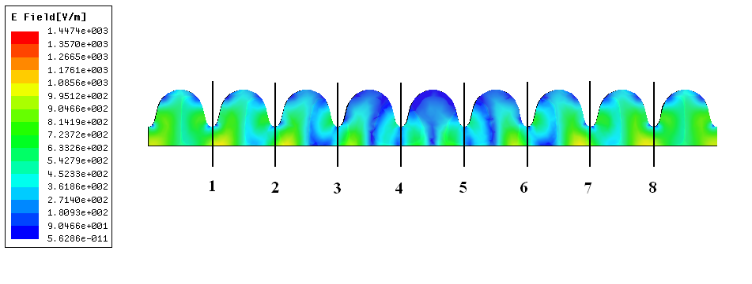
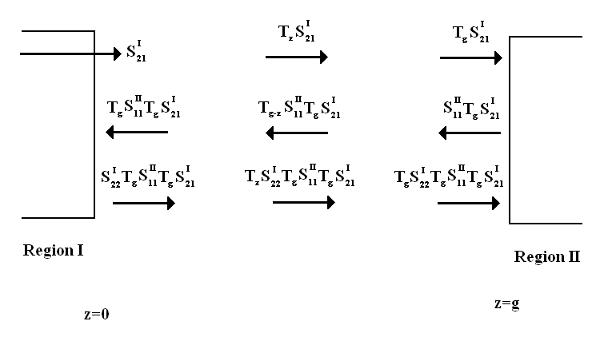
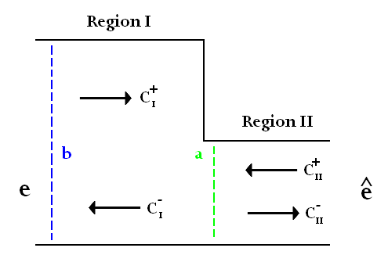
0 Cascaded Computation of EM Fields and Dispersion Relations
Field Calc. from S-Matrix
HFSS 9-Cell Simulation
Field distribution at interface enables rapid determination of fields and potentially trapped modes
Fields obtained from HFSS single cells cascaded
Cascaded Single-Cell E_{z}
Dispersion Calculations via GSM enables efficient characterisation of cavities
Bethe hole perturbation coupling formulation investigated for X-band structures. Good agreement for a limited cells (thin iris approx)
See Shinton and Jones,
LINAC08.

Slide 10
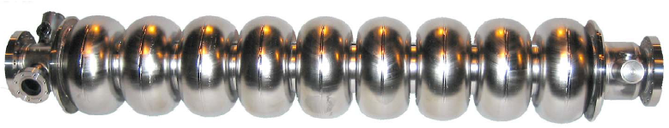
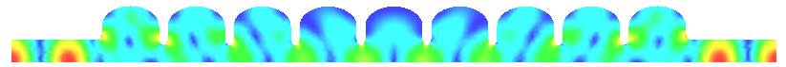
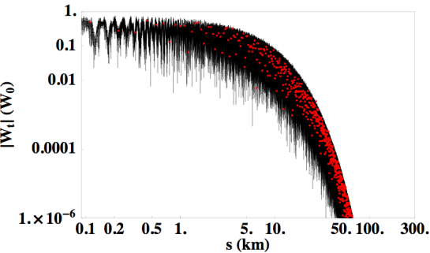
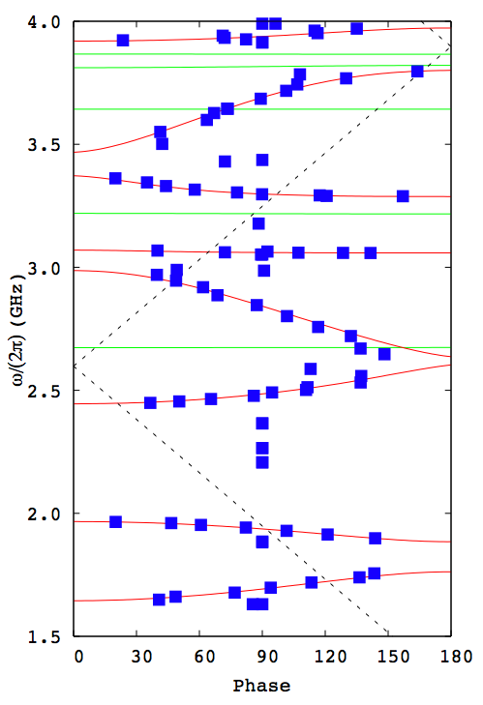
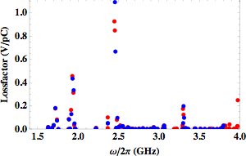
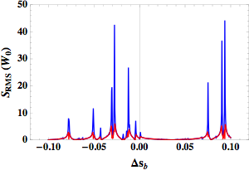
1.0 HOMs studies for ILC ACD
Ichiro Cavity
fabricated at KEK
Trapped mode ~2.4498GHz
Multi-cavity mode ~2.6420GHz
Simulations of E-field of the 3rd band modes in Ichiro cavities
Envelope of long-range wake-field
Comparison of Loss factors calculated with GdfidL (red) and MAFIA 2D (blue)
Detailed studies conducted on HOMS in Ichiro cavity. Sensitivity to systematic changes in frequency investigated. Detailed comparison of codes –MAFIA,HFSS, GdfidL, Analyst.
Dispersion curves of first 8 dipole and 5 sextupole bands
Sensitivity of RMS wake to small changes in bunch spacing
See Glasman, Jones et al.
EPAC08 &LINAC08.

Slide 11
1.1 NLSF Design
Red- Bs/Ea, Blue- Es/Ea, Black- k_{c}
Red- Bs/Ea, Blue- Es/Ea
Explore parameter regions for NLSF cavity with an iris range of 30 to 33 mm (whilst the iris thickness is varied).
The parameter regions for an iris of 32 mm is shown.
Red- Bs/Ea
NLSF shape
1. Surface Magnetic Field Contours
2. Surface Electric Field Contours
3. Cell coupling k_{c} (% bandwidth)

Slide 12
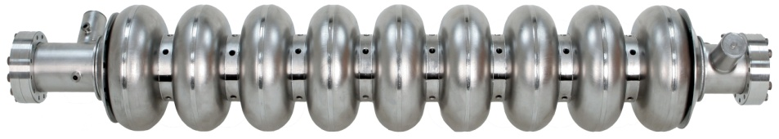
1.1 NLSF Design - Bandwidth
1. Fundamental mode
2. Nearest mode (f_{8π/9}) closely separated:

Slide 13
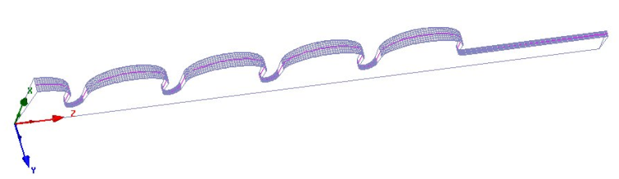
1 NLSF Design
–Overall Surface Fields
Earlier alternate designs were limited by field emission which occurred in the end cells.
HFSS simulations indicate that NLSF cavity does not suffer from this problem.
Surface Magnetic Field/Accel. Field
Surface Electric Field/Accel. Field

Slide 14
1.1 HOM Properties of NLSF Cavity
Higher order multipoles investigated for full 9-cell cavity
Dipoles modes will dominate emittance dilution
Corresponding transverse momentum kicks studied by calculating R/Qs.
Similar, although redistributed R/Qs as TESLA shape
Modify HOM couplers (no problems anticipated!)

Slide 15
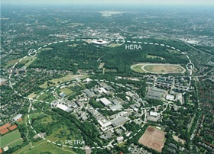




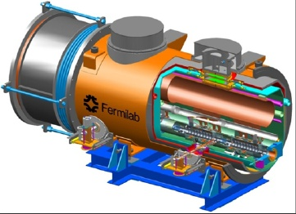
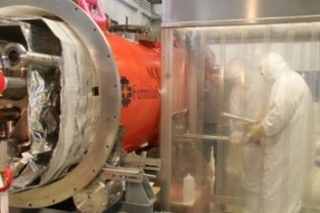
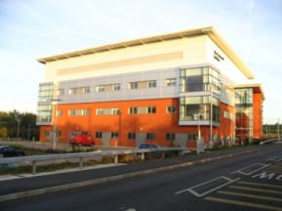
1.2 HOM DIAGNOSTICS IN
THIRD HARMONIC CAVITIES AT FLASH
Roger M. Jones
University of Manchester/ Cockcroft Inst.

Slide 16
1.2 Task 10.5 HOM Diagnostic in 3rd Harmonic Cavities at FLASH
TASK 10.5 | HOM Distribution | R.M. Jones
Sub-Task | Name | Coordinating Institute/Univ.
10.5.1 | HOMBPM | DESY
10.5.2 | HOMCD | Cockcroft/Univ. Manchester
10.5.3 | HOMGD | Univ. Rostock
TASK 10.5 | HOM Distribution | R.M. Jones
10.5.1 HOM based Beam Position Monitors (HOMBPM)
10.5.2 HOM based Cavity Diagnostics (HOMCD)
10.5.3 HOM based Geometrical Dependancy (HOMGD)
All pool together to ensure success of instrumentation of diagnostics for FLASH cavities.

Slide 17
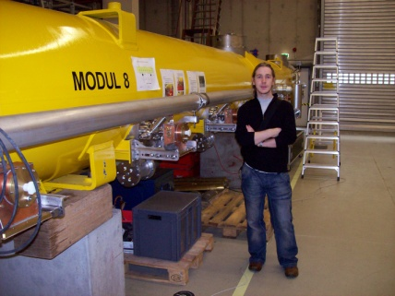
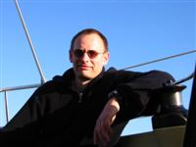
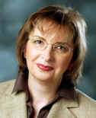
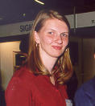


1.2 HOM Diagnostic in 3rd Harmonic Cavities at FLASH -Staff
Sub-task leaders: Nicoleta Baboi (DESY), Ursula van Rienen (Univ. Rostock), Roger M. Jones (CI/Univ. Manchester).
PDRAs: Hans-Walter Glock (Univ. Rostock), Ian Shinton (CI/Univ. of Manchester)
Ph.Ds: Nawin Juntong (CI/Univ. Manchester), Pei Zhang (DESY/Univ. Manchester/CI), Thomas Flisgen (Univ. Rostock)
WP 10.5.2
WP 10.5.3
WP 10.5.1
H-W Glock, Univ. of Rostock, PDRA
C. Glasman, CI/Univ. of Manchester PhD student
(PT on FP7)
U. Van Rienen,
Univ. of Rostock
N. Baboi, DESY
I. Shinton, CI/Univ. of Manchester PDRA
N. Juntong, CI/Univ. of Manchester PhD student
(PT on FP7)
T. Flisgen ,Univ. of Rostock
P. Zhang, DESY/Univ. Of Manchester

Slide 18
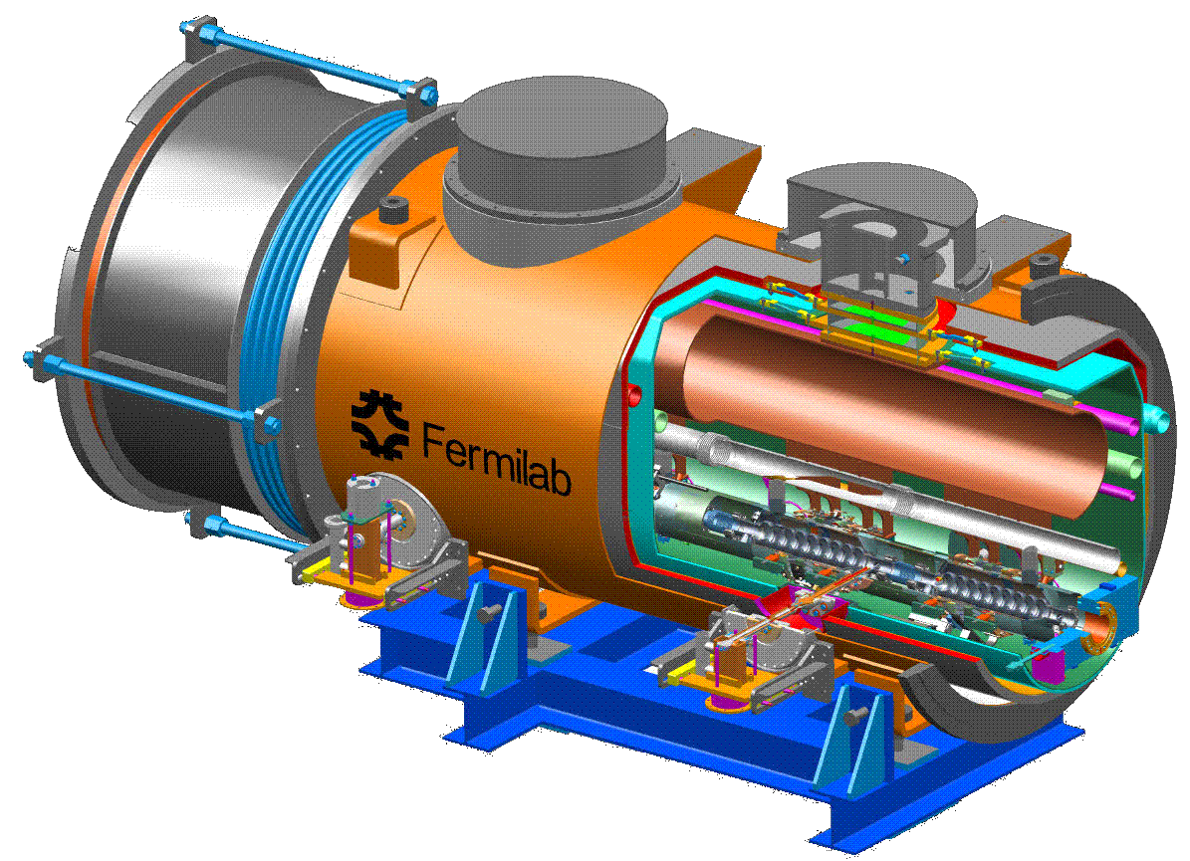

1.2 3.9 GHz Module Installed at FLASH
TESLA Cryo-Module (ACC1)
8 x 9-Cell 1.3 GHz Cavities
photo &
drawing
courtesy
E. Vogel &
FNAL
ACC39 FNAL Cryo-Module
4 x 9-Cell 3.9 GHz Cavities

Slide 19
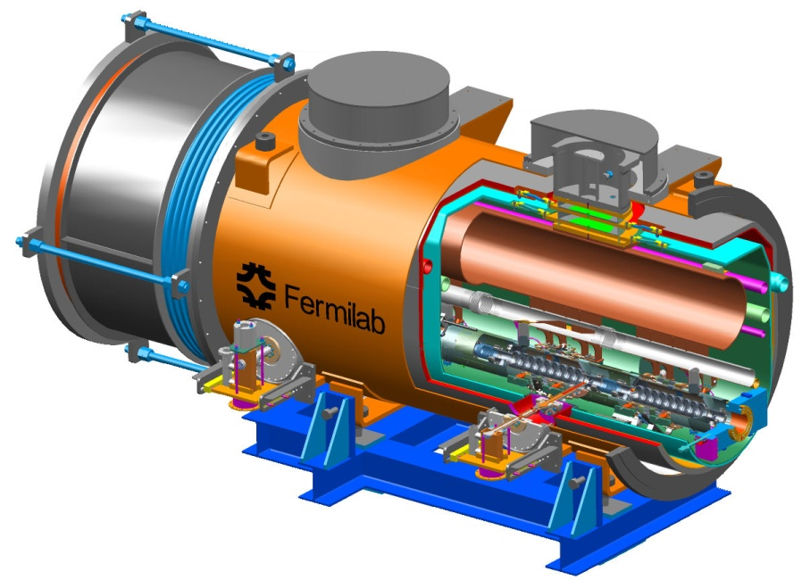
1.2 HOM Diagnostic in 3rd Harmonic Cavities at FLASH
Fermilab has constructed a third harmonic accelerating (3.9GHz) superconducting module and cryostat for a new generation high brightness photo-injector.
This system compensates the nonlinear distortion of the longitudinal phase space due to the RF curvature of the 1.3 GHz TESLA cavities prior to bunch compression.
The cryomodule, consisting of four 3.9GHz cavities, have been installed in the FLASH photoinjector downstream, of the first 1.3 GHz cryomodule (consisting of 8 cavities).
Four 3.9 GHz cavities provide the energy modulation, ~20 MV, needed for compensation.

Slide 20
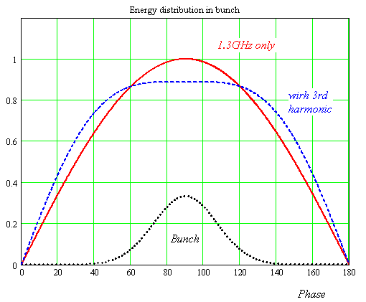
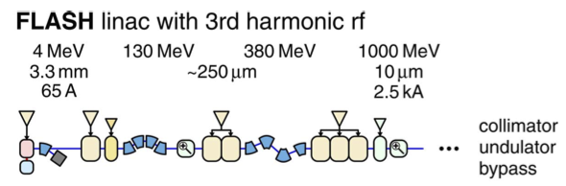

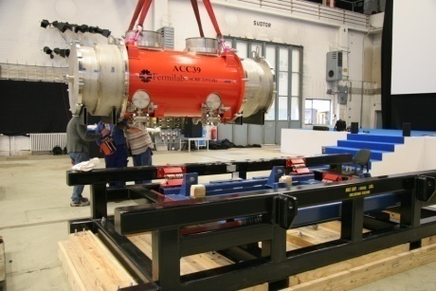
1.2 Third Harmonic Parameters
Illustrative energy (not to scale)
Number of Cavities | 4
Active Length | 0.346 meter
Gradient | 14 MV/m
Phase | -179º
R/Q [=U²/(wW)] | 750 Ω
E_{peak}/E_{acc} | 2.26
B_{peak} (E_{acc} = 14 MV/m) | 68 mT
Q_{ext} | 1.3 X 10⁶
BBU Limit for HOM, Q | <1 X 10⁵
Total Energy | 20 MeV
Beam Current | 9 mA
Forward Power, per cavity | 9 kW
Coupler Power, per coupler | 45 kW
Adding harmonic ensures the 2nd derivative at the max is zero for total field (could use any of the harmonics in the expansion, but using the lowest freq. ensures the transverse wakefields ~ ω³ are minimised).
The third harmonic system (3.9GHz) will compensate the nonlinear distortion of the longitudinal phase space due to cosine-like voltage curvature of 1.3 GHz cavities.
It linearises the energy distribution upstream of the bunch compressor thus facilitating a small normalized emittance ~1.10⁻⁶ m*rad.

Slide 21
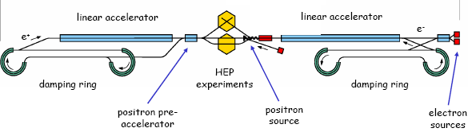

1.2 HOMs in SCRF Cavities
Schematic of International Linear Collider (ILC)
~11km
~11km
http://www.linearcollider.org
Used at XFEL and FLASH. Baseline design for main accelerators in ILC.
TESLA cavity (1.3 GHz)
FPC Coupler
~1m
Used at XFEL and FLASH in order to flatten the field profile and reduce energy spread.
HOM Coupler
3rd harmonic cavity (3.9 GHz)

Slide 22
1.2 Minimising Emittance Dilution and HOMBPMs
Source of Emittance Dilution
W_{t} , transverse wakefields (W_{t} ~ a⁻³ –a iris aperture)
Much stronger in 3.9 GHz than in 1.3 GHz cavities (each iris is r ~ 15 mm compared to 35 mm for TESLA).
Utilise Wakefields as Diagnostic
Sample HOMs to ascertain beam position (HOMBPM).
Move beam to minimise impact on itself and to align to electrical axis.
  Can also be used for measuring beam charge, phase etc.

Slide 23
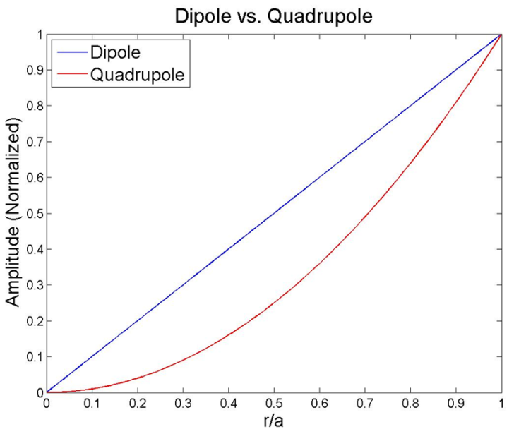
1.2 HOMs in SCRF Cavities
Higher order modes (HOMs) are excited by charge particles in cavity
‐ influence the beam both longitudinally and transversely
‐ non‐monopole modes excited by off‐axis particles effect bunch itself (intra) and subsequent (inter) bunches
Dipole modes dominate transverse wake potentials
Use HOMs (non‐monopole modes) to
‐ align the beam to the electric center
‐ monitor beam position (HOM‐BPM)
r: beam offset
a: iris radius
m=1, dipole; m=2, quadrupole
Region of
interest
Earlier work on 1.3 GHz demonstrated the principle
[1] G. Devanz et al., EPAC2002, WEAGB003
[2] N. Baboi et al., LINAC2004, MOP3

Slide 24
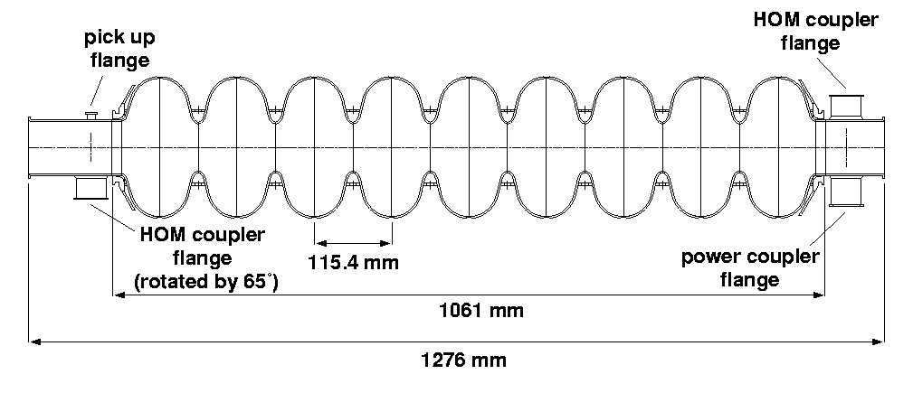
1.2 HOMs in SCRF Cavities
Task:
  Develop, build, test electronics for 3.9 GHz cavities
  Interpret signals and integrate in control system
  Measure cavity alignment
HOM-couplers
  At end of each cavity
  Enable monitoring the
  HOMs excited by beam
HOM-couplers (pick-ups)
TESLA cavity Illustrated
(similar features present in 3.9 GHz cavity)

Slide 25

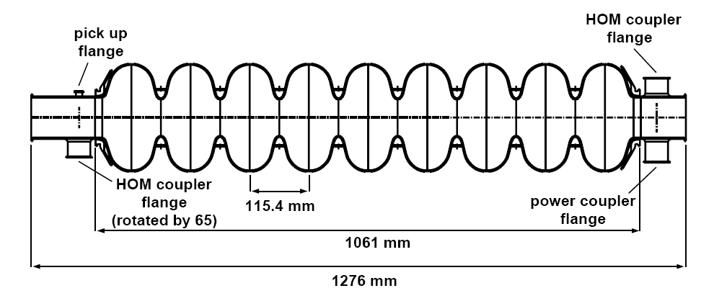
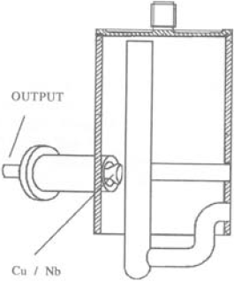
bunch compressors
bypass line
gun
undulators
FEL beam
ACC39
4 cavities within
3.9GHz Module
collimator section
dump
5 accelerating modules
with 8 cavities each
1.3GHz SC, typically 450-700MeV, 1 nC charge for FLASH/XFEL
HOMs generated in accelerating cavities must be damped.
Monitored HOMs facilitate beam/cavity info
Forty cavities exist at FLASH.
-Couplers/cables already exist.
-Electronics enable monitoring of HOMs (wideband and narrowband response).
Based on 1.3 GHz (CEA/SLAC/FNAL/DESY) Diagnostics –redesigned for ACC39 as part of EuCARD

Slide 26
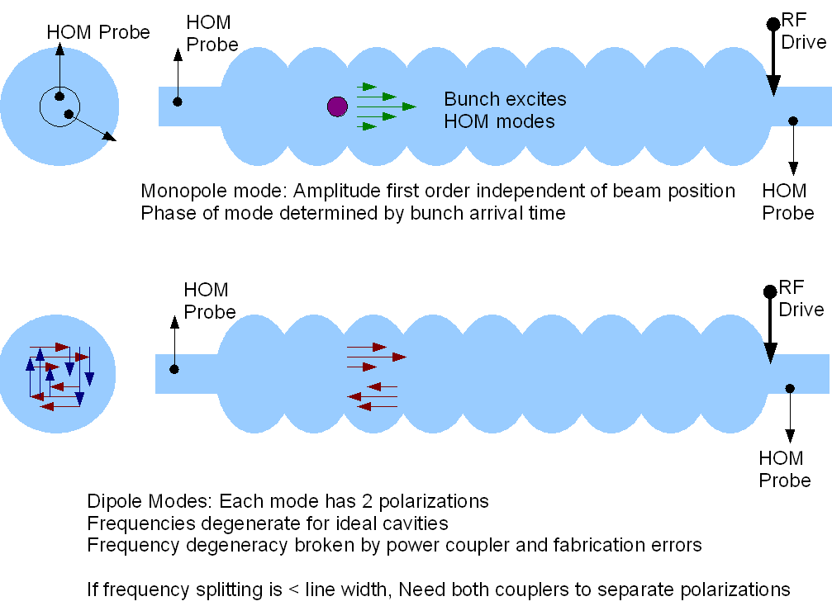
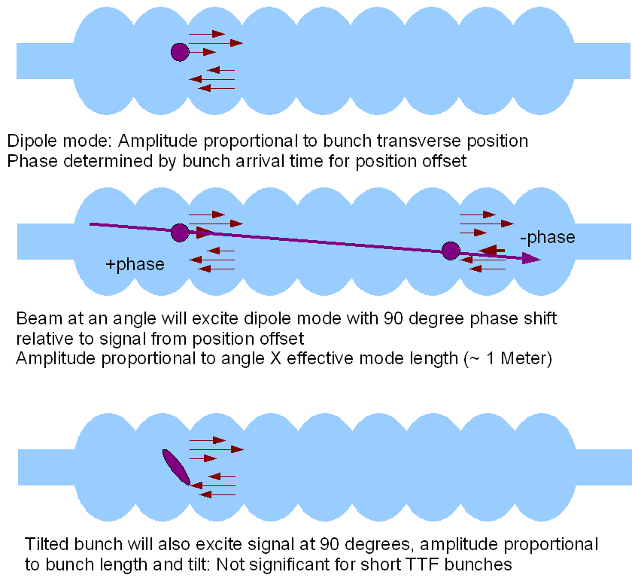
1.2 Response of HOM to Beam

Slide 27
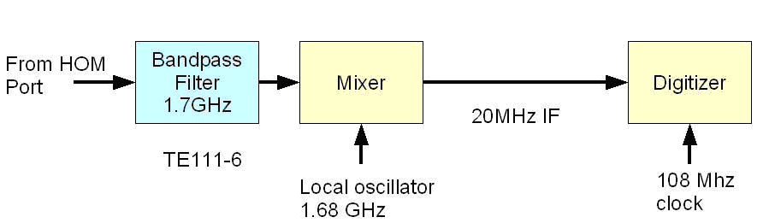
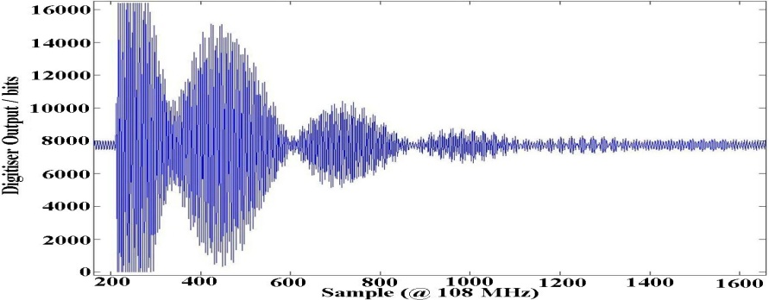
1.2 Extant Work at 1.3 GHz:
HOM-BPMs in TESLA Cavities
HOM-BPMs at 1.3GHz cavities
  Use dipole mode at 1.7 GHz
  Installed in 5 accelerating
  modules (40 cavities)
  Calibration: with SVD technique
    problem: unstable in time
Beam Alignment in Modules
  Now routinely used in FLASH
Other studies
  Cavity alignment in cryo-module
  Beam phase measurement with monopole modes at ~2.4GHz
XFEL Plans:
  Install in some 1.3 GHz and in all 3.9 GHz cavities

Slide 28
1.2 Analysis of Narrowband Signals –
Beam Position (Previous 1.3 GHz Study)
Resolution of position measurement.
  Predict the position at cavity 5 from the measurements at cavities 4 and 6.
  Compare with the measured value.
X resolution
  ~9 μm
Y resolution
  ~4 μm

Slide 29
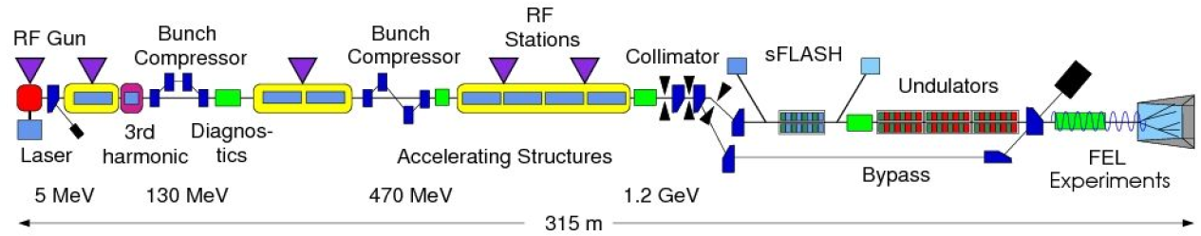
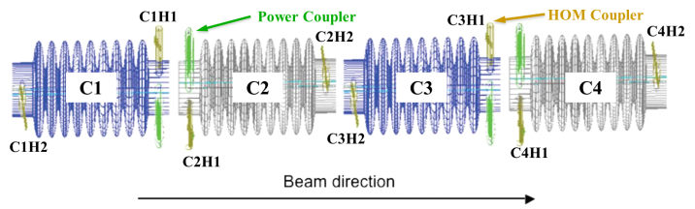
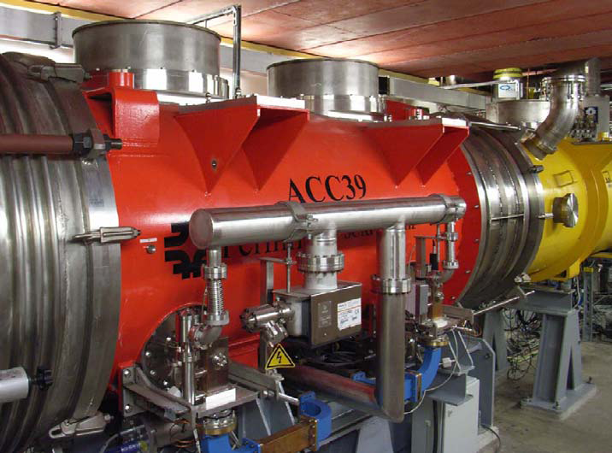
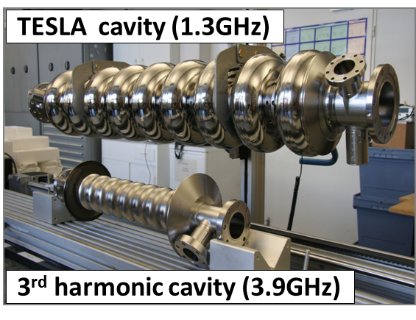
1.2 FLASH and ACC39
Free-electron LASer in Hamburg (FLASH)
Photo courtesy E. Vogel & DESY
Page 29

Slide 30
1.2 Selected Highlights
S-matrix measurements and comparison with simulations.
Transmission measurements.
Multi-cavity modes.
Beam-based mode characterisation.
HOM pickup vs beam offset for trapped/isolated modes
Comparison of analysis of data
Direct Linear Regression (DLR) vs Singular Value Decomposition (SVD)

Slide 31
1.2 Measurement Programme
(since last SRF WP10 review meeting)
Data | Measurement info | Beam info
Apr. 2010 | Transmission measurement | w/o beam
Jul. 2010 | 1st parasitic measurement | w/ beam
Nov. 2010 | 2nd parasitic measurement | w/ beam
Jan. 2011 | 1st dedicated measurement | w/ beam
Feb. 2011 | Multi-bunch measurement | w/ beam
Mar. 2011 | 2nd dedicated measurement | w/ beam
Apr. 2011 | Transmission measurement | w/o beam
May 2011 | Mini measurement | w/ beam

Slide 32
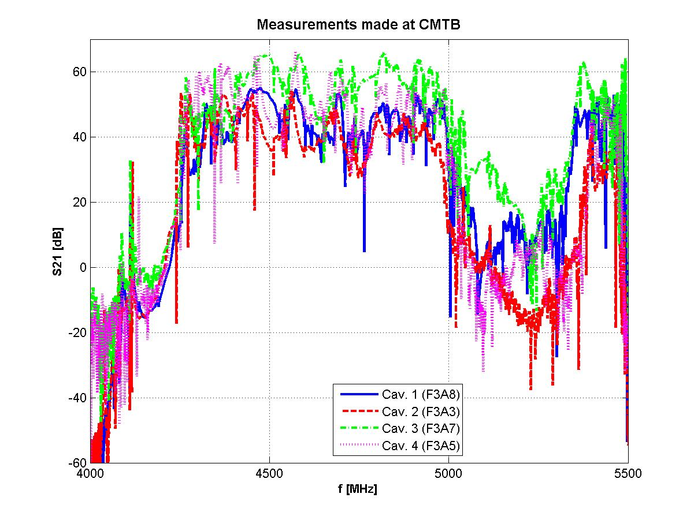

1.2 ACC39 Spectra Measured in CMTB:
Focused on Dipole and Other Bands
For comparison: dipole band in TESLA cavity
Transmission matrix measurements made on all 4 cavities within ACC39.

Slide 33



1.2 Band Structure
5th dipole band
Potential HOM Diagnostic Candidates
From transmission measurement done in CMTB
Page 33

Slide 34


1.2 S₂₁ Exp vs Simulations
Transmission through single cavity in chain.
Transmission through complete chain.

Slide 35




1.2 Beam-Based HOM Measurements
*Not to scale
Steer the beam in various ways

Slide 36

HOM Signal (1st and 2nd Dipole Bands)
1.2 HOM Signal (1st Two Dipole Bands)
Time Domain HOM pickup
Comparison of FFT of HOM pickup vs RSA

Slide 37







1.2 1st Dipole Beampipe Modes
Lorentzian fit to get mode amplitude

Slide 38






5th Dipole Cavity Band
1.2 5th Dipole Cavity Band
localized!
hor. move
hor. move
vert. move
vert. move
† I.R.R. Shinton, et al., “Mode Distribution …”, CI Internal Note

Slide 39


1.2 Comparison of DLR vs SVD
2nd dipole cavity band
Direct Linear Regression (DLR)
Singular Value Decomposition (SVD)

Slide 40



Direct Linear Regression
1.2 Direct Linear Regression
RSA
2nd dipole cavity band
Direct Linear Regression (DLR)
A: spectra matrix
B: beam position matrix

Slide 41




1.2 Singular Value Decompostion
RSA
Calib.
2nd dipole cavity band
Two steps
Valid.

Slide 42
1.2 Concluding Remarks on HOM Third Harmonic Cavities
ACC39, has been received by DESY, characterised at the CMTF, and subsequently installed at FLASH.
Beam tubes connecting cavities are above cut-off and allows for strong coupling between all 4 cavities –suite of simulations being used to characterise the coupling and sensitivity to geometrical perturbations.
Experiments indicate trapped modes in 5th band (~ 9GHz) and expected linear dependence. Mode candidate for diagnostics? First systematic comparison of DLR vs SVD indicates consistent behaviour. (other candidates are based on modes which exist in the beampipe and stretch over the complete module)
HOM electronics will be tested for 3.9 GHZ cavities in 2012.
Good overall progress!

Slide 43
Acknowledgements
I wish to express thanks for the organising committee for giving me this opportunity to report on the work of this task.
I acknowledge materials supplied, and/or many useful discussions with: N. Baboi, E. Vogel (DESY), P. Zhang (University of Manchester/Cockcroft Inst./DESY) , I.R.R. Shinton (University of Manchester/Cockcroft Inst.), U. Van Rienen, H.-W. Glock, T. Flisgen (University of Rostock), S. Molloy (RHUL/ESS), N. Eddy, T.N. Khabiboulline (FNAL).
Publications
Higher Order Modes In Third Harmonic Cavities at FLASH, I.R.R. Shinton, N. Baboi, T. Flisgen, H.W. Glock, R.M. Jones, U van Rienen, P. Zhang, Proc. Of Linac 2010
First Beam Spectra of SC Third Harmonic Cavity at FLASH, P. Zhang, N. Baboi, T. Flisgen, H.W. Glock, R.M. Jones, B. Lorbeer, U van Rienen, I.R.R. Shinton, Proc. Of Linac 2010.
SCRF Third Harmonic Cavity HOM Diagnostics and the Quest for High Gradient Cavities for XFEL and ILC,
By MEW Collaboration (R.M. Jones for the collaboration). 2010. 4pp.
Published in ICFA Beam Dyn.Newslett.51:182-185,2010
Higher Order Modes in Third Harmonic Cavities for XFEL/FLASH, I.R.R. Shinton, N. Baboi, N. Eddy, T. Flisgen, H.W. Glock, R.M. Jones, N. Juntong, T.N. Khabiboulline, U van Rienen, P. Zhang, FERMILAB-CONF-10-302-TD.
Third Harmonic Cavity Modal Analysis, B. Szczesny, I.R.R. Shinton, R.M. Jones, Proc. Of SRF 2009.

Slide 44
1.2 HOMs in SC Accelerator Cavities
Experience gained on FLASH measurements will be invaluable.
HOMs in ALICE TESLA cavities will provide information on:
1. Beam position (effectively a built-in BPM)
2. Alignment of cells (and groups thereof).
Schematic illustrating ALICE*
CI/Univ. of Manchester PDRA I. Shinton (left) and Ph.D. student N. Juntong (right; supported by the Thai Government) participated in ALICE commissioning in Dec 2008

Slide 45
1.2 Acknowledgements
I wish to express thanks for the materials supplied, and/or many useful discussions with: N. Baboi, E. Vogel (DESY), P. Zhang (University of Manchester/Cockcroft Inst./DESY) , I.R.R. Shinton (University of Manchester/Cockcroft Inst.), U. Van Rienen, H.-W. Glock, T. Flisgen (University of Rostock), S. Molloy (RHUL), N. Eddy, T.N. Khabiboulline (FNAL).
1.2 Publications
Higher Order Modes In Third Harmonic Cavities at FLASH, I.R.R. Shinton, N. Baboi, T. Flisgen, H.W. Glock, R.M. Jones, U van Rienen, P. Zhang, Proc. Of Linac 2010
First Beam Spectra of SC Third Harmonic Cavity at FLASH, P. Zhang, N. Baboi, T. Flisgen, H.W. Glock, R.M. Jones, B. Lorbeer, U van Rienen, I.R.R. Shinton, Proc. Of Linac 2010.
SCRF Third Harmonic Cavity HOM Diagnostics and the Quest for High Gradient Cavities for XFEL and ILC,
By MEW Collaboration (R.M. Jones for the collaboration). 2010. 4pp.
Published in ICFA Beam Dyn.Newslett.51:182-185,2010
Higher Order Modes in Third Harmonic Cavities for XFEL/FLASH, I.R.R. Shinton, N. Baboi, N. Eddy, T. Flisgen, H.W. Glock, R.M. Jones, N. Juntong, T.N. Khabiboulline, U van Rienen, P. Zhang, FERMILAB-CONF-10-302-TD.
Third Harmonic Cavity Modal Analysis, B. Szczesny, I.R.R. Shinton, R.M. Jones, Proc. Of SRF 2009.

Slide 46
Concluding Remarks on SCRF
New Low Surface Field (NLSF) Design has the potential to reach in excess of 50 MV/m –all three parameters optimised!
Third harmonic cavities received by DESY, characterised at the CMTF, beam-based tests ongoing.
Strong coupling of cavity modes within module ACC39 –suite of simulations in progress to assess mode for electronics diagnostics.
HOM electronics will be built designed and tested for 3.9 GHZ cavities in 2012.
HOM simulations on cavity alignment/beam based alignment in progress for third harmonic cavities.

Slide 47
2. HIE-ISOLDE
High Intensity and Energy at ISOLDE
Isotope Separation
On-Line (ISOL)
M. Fraser, Univ. Manchester/Cockcroft Inst. PhD student, Leads Beam Dynamics Work
Alessandro D’Elia, Univ. Manchester/Cockcroft Inst. , Leads RF Cavity Design

Slide 48


2. HIE-LINAC
HIE-LINAC Upgrade
Existing REX-LINAC
Energy – provided by the HIE-LINAC (superconducting machine providing full energy variability from 1.2 Mev/u to over 10 MeV/u)
HIE-ISOLDE project aim:
To upgrade the current ISOLDE nuclear research facility in three key ways, with a focus on post-accelerated radioactive ion beams (RIB):
  1. Intensity (upgrade of proton driver to 10 kW through linac4) – R&D is required for the production target.
  2. Quality (improved isotope selection using laser ionisation, improved charge breeding, cooling and accumulation stages prior to post-acceleration).
Cryo-Module Schematic
Focussed on the cavity rf and beam dynamics design for the HIE-LINAC including:
  A first-order beam dynamics study of the whole linac.
  A realistic field beam dynamics study of the high-energy section of the HIE-LINAC.
  Single particle dynamics study in QWR to investigate the effects of beam steering and transverse field asymmetry intrinsic to the cavity.
  Compensation of field asymmetry by geometric modifications to the cavity.
  Error and misalignment study.

Slide 49





High-β cavity RF Design
2. HIE-LINAC
WP3: Cavity RF and Beam Dynamics
Transit Factor
f (MHz) | 101.28
Inner Cond. Diam (mm) | 90
Outer Cond Diam (mm) | 300
Mechanical Length (mm) | 320
Gap length (mm) | 85
Beam Apert. Diam. (mm) | 20
U/Ea² (mJ/(MV/m))² | 207
Ep/Ea | 5.6
Hp/Ea (Oe/MV/m) | 100.7
Rsh/Q (Ohm) | 548
Q0 min for 6 MV/m at 7W | 5x10⁸
TTF max | 0.9
β₀ | 10.3%
Design Gradient E_{acc} (MV/m) | 6
Number of cavities | 20
Low-β
High-β
Notes:
49

Slide 50
2. HIE-LINAC
Summary
SC cavities will facilitate the provision of variable-energy beams of exotic ions with concomitant improvement in beam quality.
Nb sputtered onto Cu quarter-wave cavities have the potential to radically reduce costs and serve as a technological base for future accelerators. Prototype high-β cavity built and sputtered, tested at TRIUMF. Re-sputtered and in tests at CERN
RF cavity and beam dynamics studies to both design the overall system and to perform “cradle to grave” simulations –improvements beam port designs completed
Influence of transverse kicks to the beam has been investigated utilising state-of-the art beam dynamics RF computer codes (LANA and others).

Slide 51


3. HOM Studies on ESS Cavities
Schematic of ESS
Initially focus on the low β end of ESS, which has ~15 modules with 4 cavities per module. After HOM studies on this section have been made investigation of the high β end of ESS will be made, followed by a concatenation of the results.
ESS cavity geometry unavailable – conduct some preliminary studies with dimensions taken from different cavity (2001 ASH cells). Objective: HOM’s in a high intensity proton machine
Focused on looking at low beta ASH (Superconducting Accelerator for Hybrid) cell geometry [J–L Biarrotte et al.,” 704 MHz superconducting cavities for a high intensity proton accelerator”, Proc. of SRF99, Santa-Fe, NM, 1999. ], as a precursor investigating ESS cavities.
I.R.R. Shinton

Slide 52


3. HOM Studies on ESS Cavities
Major difference between electron and low to medium β cavity is of course the charged particles are not ultra-relativistic (v<c)
The major consequence of this is the usual modal formula –summation over discrete modes –needs modification to take into account the velocity variation and to make use of the characteristic pancake shape of the transverse field. The wakefield peers ahead, as well as behind, the bunches
Needs to be incorporated into beam dynamics studies
Envelope of Transverse Wakefield

Slide 53




3. HOM Characterisation
of 704 MHz Cavities
Initial results will involve simulations with HFSS of an idealised cavity, this results will give an overview for any potentially harmful HOMs
I.R.R. Shinton
Slice used to simulate monopole modes
Quarter cell used
to simulate dipole modes
Monopole
Dipole and Sextupole
Simulations capitalise scalable properties of Omega3P (part of ACE3P suite) to simulate a series of cavity strings will be used to investigate the effects of HOM’s including trapped modes and multi-cavity modes (above the beam-pipe cut-off) that propagate throughout the entire structure (work in progress!)

Slide 54















3. HOM Characterisation of 704 MHz Cavities
 | F:MHz | Band
 | 696.4 | 1
 | 698.9 | 1
 | 701.7 | 1
 | 703.9 | 1
 | 704.8 | 1
 | F:GHz | Band
 | 2.250 | 3
 | 2.260 | 3
 | 2.270 | 3
 | 2.282 | 3
 | 2.294 | 3
 | F:GHz | Band
 | 1.540 | 2
 | 1.548 | 2
 | 2.250 | 2
 | 2.258 | 2
 | 2.270 | 2
All monopole bands below 2nd are below cut-off of the power coupler beam-pipe
Simulations performed with eigenmode module of HFSS
Monopole bands
I.R.R. Shinton

Slide 55

















3. HOM Characterisation of 704 MHz Cavities
 | F:GHz | Band
 | 1.025 | 1
 | 1.032 | 1
 | 1.040 | 1
 | 1.047 | 1
 | F:GHz | Band
 | 1.868 | 4
 | 1.871 | 4
 | 1.875 | 4
 | 1.883 | 4
The first dipole band is localised within the cavity
All dipole bands above 2nd are above cut-off of the power coupler beam-pipe
 | F:GHz | Band
 | 1.546 | 2
 | 1.570 | 2
 | 1.628 | 2
 | 1.702 | 2
 | 1.765 | 2
 | F:GHz | Band
 | 2.292 | 5
 | 2.302 | 5
 | 2.324 | 5
 | 2.334 | 5
Selected Dipole Bands

Slide 56


3. HOM Characterisation of 704 MHz Cavities
Preliminary study of multi-cavity modes using the Omega3P frequency domain solver of the ACE3P suite
Additional full module simulations and strings of modules in progress (in NERSC job queue!)
I.R.R. Shinton
Example of a diple mode at ~1.76378GHz in the second dipole band
Frequency shift from idealised single cavity values due to propagation through power coupler beam-pipe
Simulations of Coupled Four-Cavity Module with OMEGA3P (part of ACE3P Suite)

Slide 57
Summary
1. HOM characterisation of cavity wake-fields and beam dynamics for ILC/XFEL. Globalised scattering technique provides a unique method to enable trapped modes in modules to be probed.
1. HOMs as BPM diagnostic for ILC/XFEL: FP7 as part of DESY/Cockcroft/Univs Manchester & Rostock collaboration. Participating in exp program at FLASH/DESY. EuCARD FP7, R.M. Jones, Task Leader
2. HIE-ISOLDE energy upgrade ongoing. Protoype quarter wave cavity built (inc. tuners). Well-reviewed by recent intl. committee. Ph.D. student –beam dynamics simulations, PDRA –cavity/coupler/tuner design. Sputtered cavity tested at TRIUMF,VA. Re-sputtered being tested at CERN.
3. HOMs in spoke and elliptical cavities will be analysed and means to provide sufficient Q damping suggested.
Both isolated and multi-cavity modes will be simulated and analysed.
HOM as diagnostic BPMs could be advantageous in these cavities also.
Anticipate exchange of information, on both sets of cavity structures, from our European and international collaborators!

Slide 58
ESS HOMs -Summary Cont.
Wakefield is distributed among the HOMs generated. Main issue is how much transverse momentum is distributed to the beam –or how large are the kick factors?
Beam dynamics simulations will indicate how much (if any?!) suppression of modes is necessary.
Experience with SNS indicated that the couplers may not be necessary (and indeed introduced a major headache due to multipacting)
Project X is investigating whether or not HOM damping/couplers are necessary -influence of (inevitable during fabrication) random errors reduces the overall average kick to the beam!
Overall conclusion :
Full analysis of coupled multi-cavity modes needed and the largest ones isolated . If there are trapped modes –do they matter (inconsequential R/Q)?
Beam dynamics study incorporating these modes (including realistic sources of errors).

Slide 59

Thank you for your attention!

Slide 60
Additional Slides

Slide 61
2009/2010 Publications of μ Group
Journal Pubs.
R. M. Jones, Wake field Suppression in High gradient linacs for lepton linear colliders, Phys. Rev. ST Accel. Beams 12, 104801, 2009, 14pp.
R. M. Jones, V. A. Dolgashev, and J. W. Wang, Dispersion and energy compensation in high-gradient linacs for lepton colliders, Phys. Rev. ST Accel. Beams 12, 051001 2009, 11pp.
R.M. Jones, C.E. Adolphsen, R.H. Miller, J.W. Wang , T. Higo, Influence of fabrication errors on wake function suppression in NC X-band accelerating structures for linear colliders, New J. Phys.11:033013,2009, 13pp.
W. Salah, R.M. Jones, J.L. Coacolo, Analysis of space charge fields using lienard-wiechert potentials and the method of images in the RF-free electron laser photoinjectors, doi:10.1016/j.nima.2009.05.188 .
W. Salah, R.M. Jones, J.L. Coacolo, Analysis of the transverse kick to beams in low-frequency photoinjectors due to wakefield effects, Nuclear Instruments and Methods in Physics Research Section A: Accelerators, Spectrometers, Detectors and Associated Equipment, Volume 601, Issue 3, 1 April 2009, Pages 264-269
Conf. Pubs.
In 2009 (2010) we published ~10 (12) conference proceedings pubs

Slide 62



RFQ
IH-Structure
Acceleration: 2-gap superconducting QWRs.
  Low-energy section: β_{g} = 6.3 %
  High-energy section: β_{g} = 10.3 %
Each cavity independently powered allowing for a flexible velocity profile: 2.5 < A/q < 4.5.
Focusing: superconducting solenoids.
Dedicated lattices for low and high-energy:
  Strong RF defocusing at low-energy so 2 solenoids per cryomodule are used.
  First low-β cavity separated to operate as a buncher.

