Slide 1
Time Structure of the
ESS Proton Beam
Håkan Danared
European Spallation Source
ESS, 22 September 2011

Slide 2
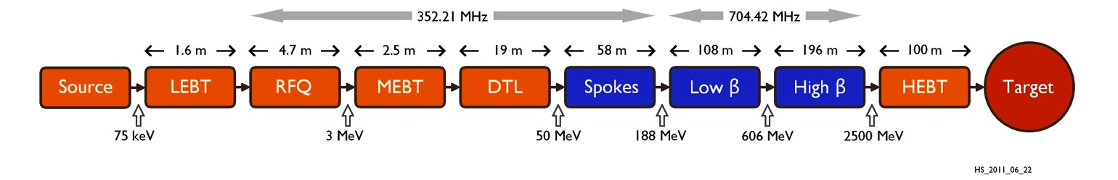
Main Parameters of ESS Proton Linac
Top-Level Parameters | Unit | Value
Average beam power | MW | 5
Proton kinetic energy | GeV | 2.5
Average macro-pulse current | mA | 50
Macro-pulse length | ms | 2.86
Pulse-repetition rate | Hz | 14
Maximum cavity surface field | MV/m | 40
Maximum linac length | m | 392
Section | Lab | Energy_{out} | Beta_{out} | Length | Temp | Freq
Ion source | Catania | 75 keV | 0.01 | 2.5 m | 300 K | -
RFQ | Saclay | 3 MeV | 0.08 | 4.7 m | 300 K | 352 MHz
MEBT | Bilbao | 3 MeV | 0.08 | 2.5 m | 300 K | 352 MHz
DTL | Legnaro | 50 MeV | 0.31 | 19 m | 300 K | 352 MHz
Spokes, β_{opt} = 0.50 | Orsay | 188 MeV | 0.55 | 58 m | 2 K | 352 MHz
Ellipticals, β_{g} = 0.70 | Saclay | 606 MeV | 0.79 | 108 m | 2 K | 704 MHz
Ellipticals, β_{g} = 0.90 | Saclay | 2500 MeV | 0.96 | 196 m | 2 K | 704 MHz
HEBT | Århus | 2500 MeV | 0.96 | 100 m hor | 300 K | -

Slide 3
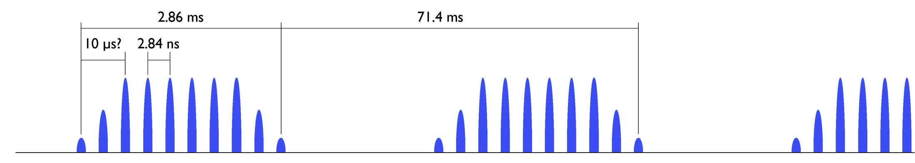
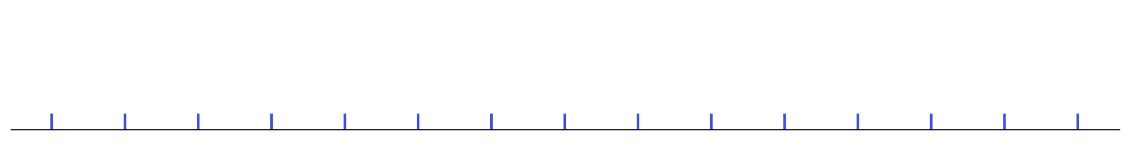
Proton Pulse Structure - Basic
Basic time structure is given by
Pulse repetition frequency 14 Hz
Pulse length 2.86 ms (=20/14×2 ms)
Bunch frequency 352 MHz (RF frequency 352 and 704 MHz)
Rise and fall times of power supplies etc.

Slide 4
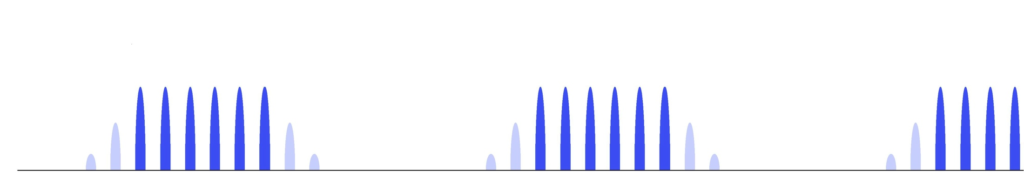
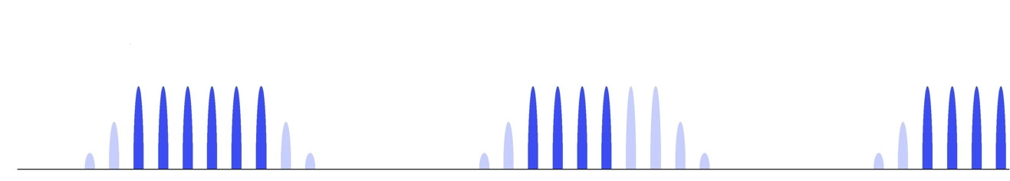
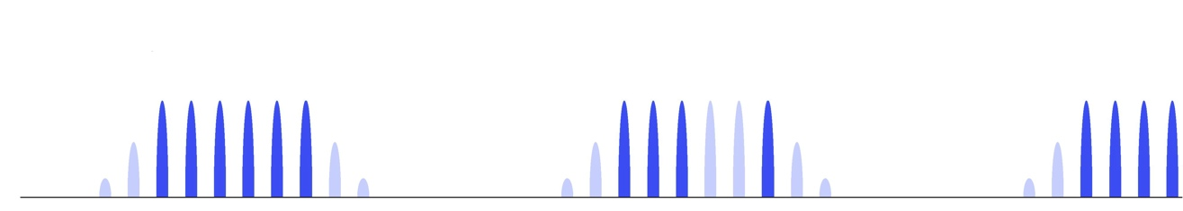
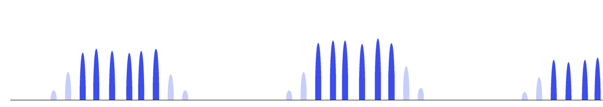
Proton Pulse Structure - Variations
Original (not to scale!)
Chopped flanks, 0.1-1 µs?
Beam to parasitic experiment at end of pulse
Beam to parasitic experiment in middle of pulse
Intensity and timing fluctuations from ion source, RF and other devices

Slide 5
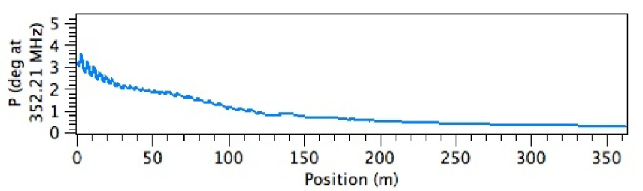
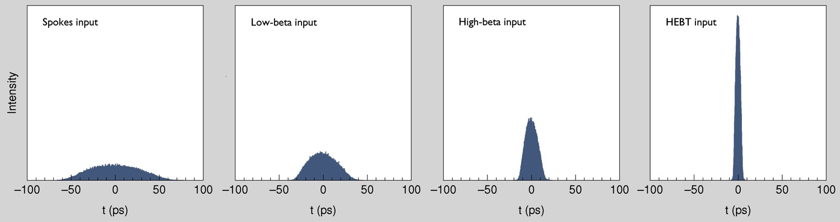
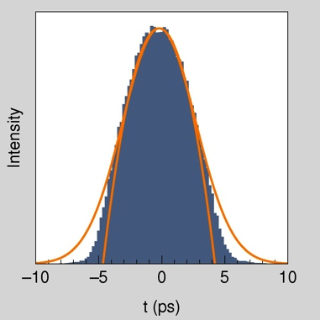
Bunch Profiles
Bunch length through super-conducting linac, 1degree at 352 MHz corresponds to 8 ps.
M. Eshraqi, HS_2011_06_22
Bunch profiles at spokes, low-beta, high-beta input and SC linac output.
Bunch profile at SC linac output, compared to Gaussian and parabolic.

