Slide 1
Experimental Measurements of Electron Capture and Loss Cross Sections of Ions with Gaseous Targets
Fenna Ukena
21 January 2025

Slide 2

Accelerators at CERN
Image source: Lopienska, E. (2022), The CERN accelerator complex, Layout in 2022.

Slide 3
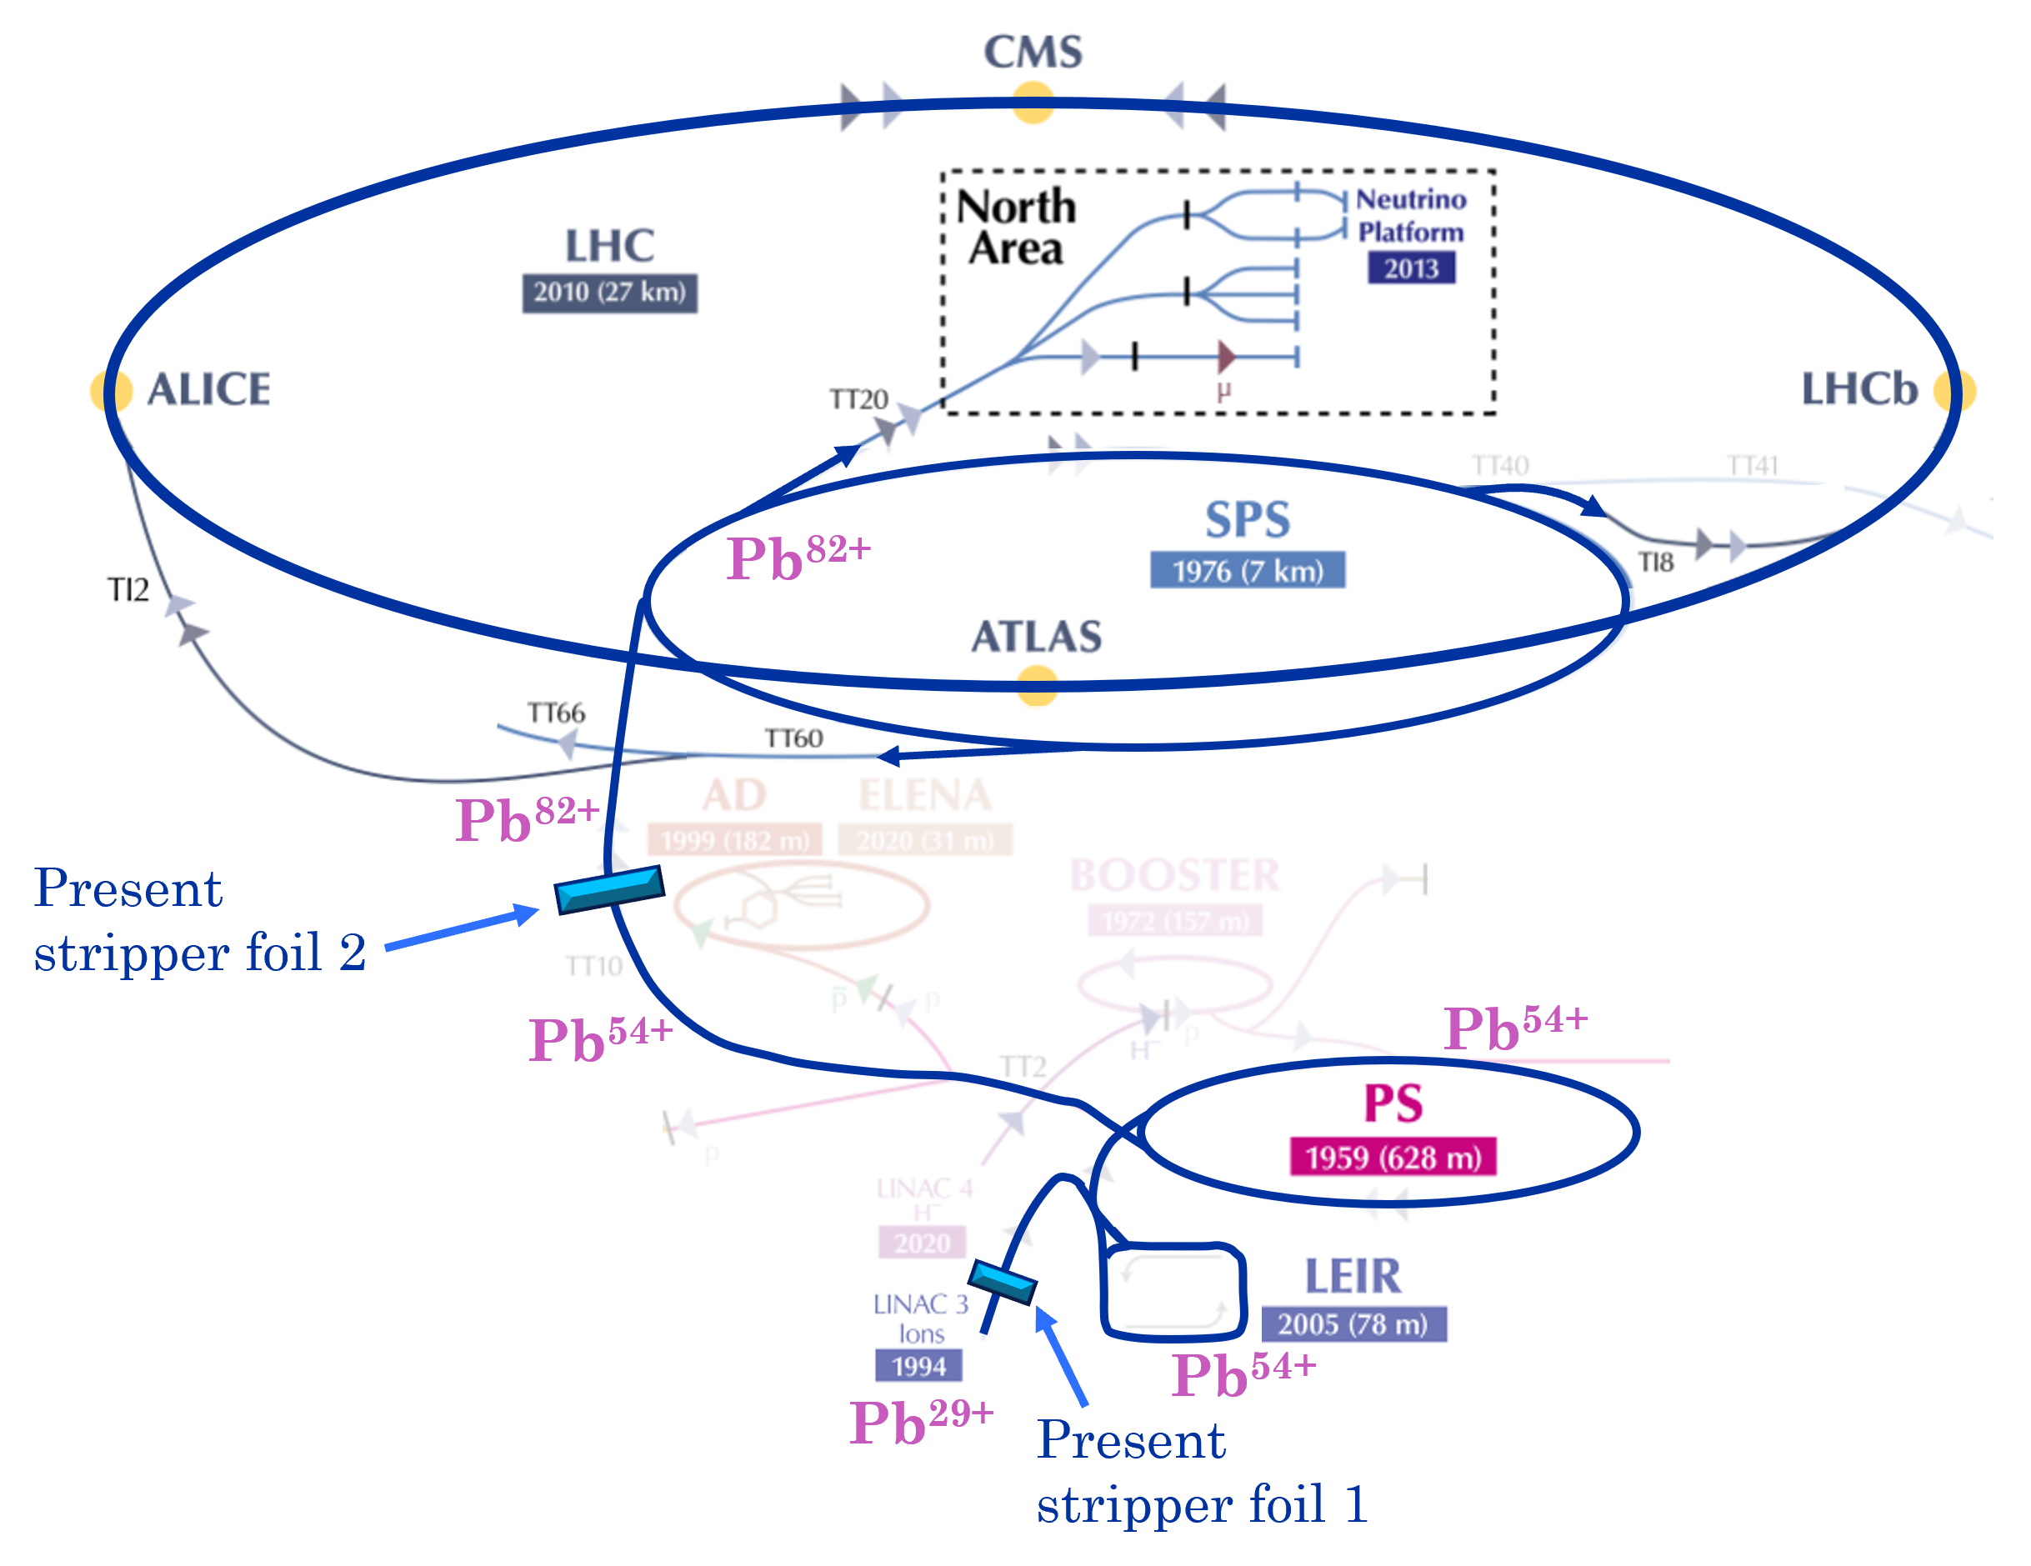
Ion Injector Chain at CERN
177 GeV/u
5.9 GeV/u
4.2 MeV/u
72 MeV/u
Image source: Lopienska, E. (2022), The CERN accelerator complex, Layout in 2022.

Slide 4
Ion Injector Chain at CERN
177 GeV/u
Pb⁵⁴⁺ ions are not fully stripped of electrons
susceptible to charge-changing processes
beam intensity losses
Aim: Measure cross sections for these processes and validate predictive models for future ion projects
5.9 GeV/u
4.2 MeV/u
72 MeV/u
Image source: Lopienska, E. (2022), The CERN accelerator complex, Layout in 2022.

Slide 5
Structure
Beam-Gas Interactions
Cross Section and Lifetime
Concept
Experimental Setup
Steps of Analysis
    3D Model
    Simulation
    Lifetime from Experiment in the PS
Results
Conclusion
Outlook

Slide 6



Beam-Gas Interactions
Residual Gas
Beam
Electron Capture
Electron Loss
$$B^{q+}+G → B^{(q−k)+}+G^{k+} ,k≥1$$
$e^{−}$transfer from residual gas to beam ions
$B^{q+}+G → B^{(q+m)+}+{ΣG}^{ }+ me^{−}$, $m≥1$
$e^{−}$transfer from beam ions to residual gas
Gas can be exited or ionized
$$k e^{−}$$
$$m e^{−}$$
→ Charge-change of beam ions → Loss of beam intensity

Slide 7
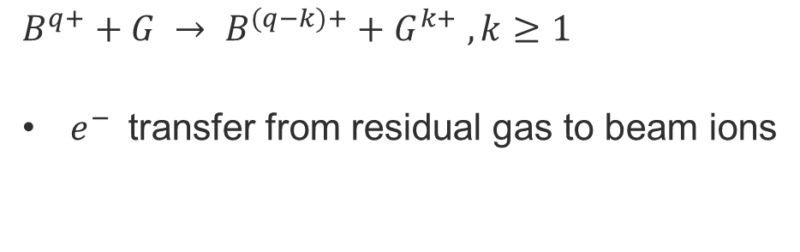
Beam-Gas Interactions
Residual Gas
Beam
Electron Capture
Electron Loss
$$B^{q+}+G → B^{(q−k)+}+G^{k+} ,k≥1$$
$e^{−}$transfer from residual gas to beam ions ions
$B^{q+}+G → B^{(q+m)+}+{ΣG}^{ }+ me^{−}$, $m≥1$
$e^{−}$transfer from beam ions to residual gas
Gas can be exited or ionized
$$k e^{−}$$
$$m e^{−}$$
→ Charge-change of beam ions → Loss of beam intensity

Slide 8
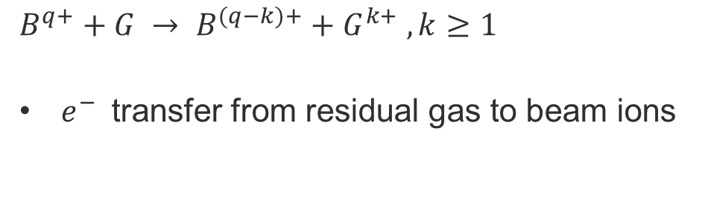
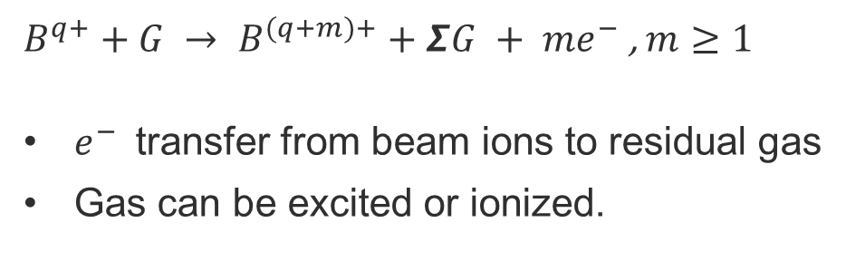
Beam-Gas Interactions
Residual Gas
Beam
Electron Capture
Electron Loss
$$B^{q+}+G → B^{(q−k)+}+G^{k+} ,k≥1$$
$e^{−}$transfer from residual gas to beam ions
$B^{q+}+G → B^{(q+m)+}+{ΣG}^{ }+ me^{−}$, $m≥1$
$e^{−}$transfer from beam ions to residual gas
Gas can be excited or ionized.
$$k e^{−}$$
$$m e^{−}$$
→ Charge-change of beam ions → Loss of beam intensity

Slide 9

Beam-Gas Interactions
Residual Gas
Beam
Electron Capture
Electron Loss
$$B^{q+}+G → B^{(q−k)+}+G^{k+} ,k≥1$$
$e^{−}$transfer from residual gas to beam ions
$B^{q+}+G → B^{(q+m)+}+{ΣG}^{ }+ me^{−}$, $m≥1$
$e^{−}$transfer from beam ions to residual gas
Gas can be excited or ionized
$$k e^{−}$$
$$m e^{−}$$
→ Charge-change of beam ions → Loss of beam intensity

Slide 10

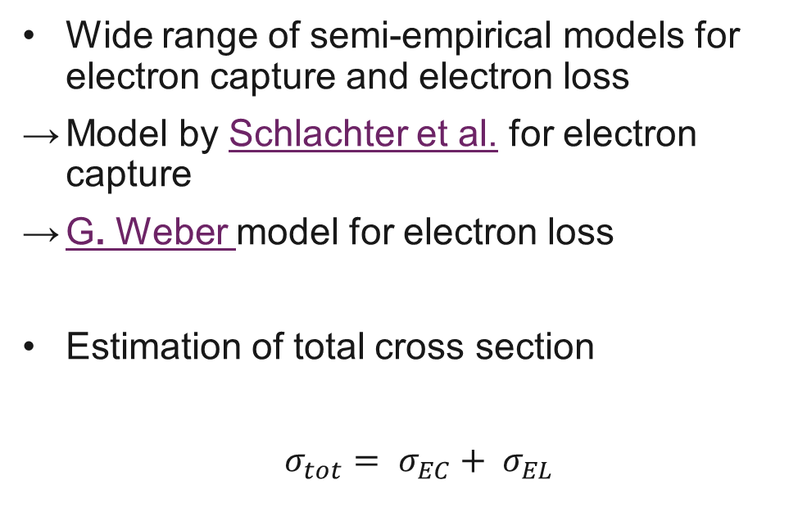
Cross Section and Lifetime
Theory
Experiment
Wide range of semi-empirical models for electron capture and electron loss
Model by Schlachter et al. for electron capture
G. Weber model for electron loss
Estimation of total cross section
$σ_{tot}= σ_{EC}+ σ_{EL}$
Calculation of lifetime using the experimental beam data of intensity loss
$$I\left(t\right)=I\left(t_{0}\right){∙ e}^{− \frac{t}{τ}}$$
Calculation of lifetime with total cross-section and molecular density
$$τ=\frac{1}{σnβc}$$

Slide 11
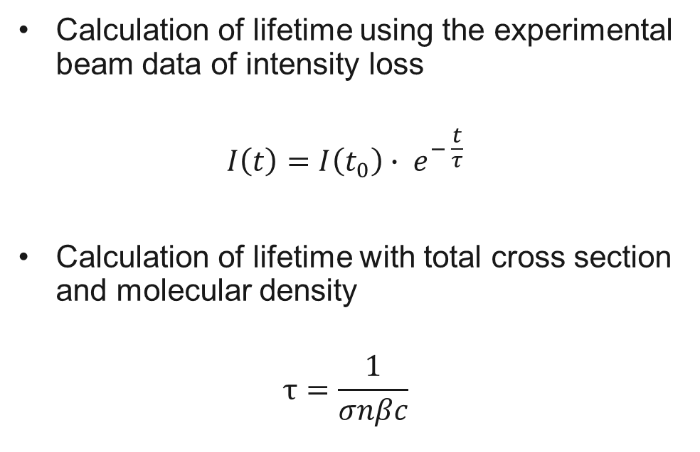
Cross Section and Lifetime
Theory
Experiment
Wide range of semi-empirical models for electron capture and electron loss
Model by Schlachter et al. for electron capture
G. Weber model for electron loss
Estimation of total cross section
$σ_{tot}= σ_{EC}+ σ_{EL}$
Calculation of lifetime using the experimental beam data of intensity loss
$$I\left(t\right)=I\left(t_{0}\right){∙ e}^{− \frac{t}{τ}}$$
Calculation of lifetime with total cross section and molecular density
$$τ=\frac{1}{σnβc}$$

Slide 12
Concept
Goals:
Experimentally measure effects of electron loss and electron capture processes in the PS
Comparison of experimental data and prediction of models for different ion species and gas types
Validate semi-empirical models → lifetime predictions of future ion species
Three Experiments:
Pb⁵⁴⁺ with Ar
Pb⁵⁴⁺ with He Measurements and Calculation of Cross Sections
Mg⁷⁺ with Ar
Problem: How do we isolate electron loss and electron capture losses from other losses in the PS to compare them to the models?

Slide 13
Concept
Goals:
Experimentally measure effects of electron loss and electron capture processes in the PS
Comparison of experimental data and prediction of models for different ion species and gas types
Validate semi-empirical models → lifetime predictions of future ion species
Three Experiments:
Pb⁵⁴⁺ with Ar
Pb⁵⁴⁺ with He Measurements and Calculation of Cross Sections
Mg⁷⁺ with Ar
Problem: How do we isolate electron loss and electron capture losses from other losses in the PS to compare them to the models?

Slide 14
Concept
Goals:
Experimentally measure effects of electron loss and electron capture processes in the PS
Comparison of experimental data and prediction of models for different ion species and gas types
Validate semi-empirical models → lifetime predictions of future ion species
Three Experiments:
Pb⁵⁴⁺ with Ar
Pb⁵⁴⁺ with He Measurements and Calculation of Cross Sections
Mg⁷⁺ with Ar
Problem: How do we isolate electron loss and electron capture losses from other losses in the PS to compare them to the models?

Slide 15
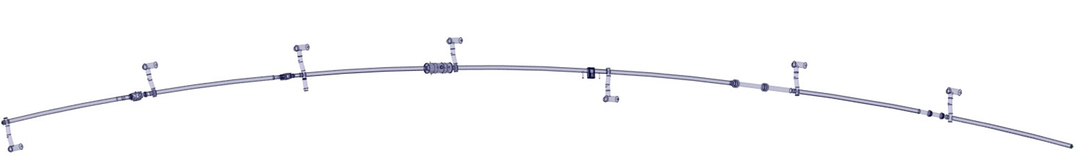
Experimental Setup
Beam Gas Ionization (BGI) monitor at the PS
  Injects gas (normally argon), which is ionized by the passing beam to measure the transverse beam size
→ By utilizing the BGI injection system, we can inject gas around BGI location
    Injection of argon or helium
    Many magnitudes higher than the residual gas
Injection of Pb⁵⁴⁺ and Mg⁷⁺ beams at energies of 72 MeV/u and 90 MeV/u
  Measurement of beam intensity decay for different pressures
  Fit of data to estimate beam lifetime and calculate cross sections
Injection of Ar
or He
(BGI)

Slide 16

Steps of the Analysis
Building a 3D model of significant Sections of the PS
Simulation of the injected Ar and He gas and gas distribution along the PS beamline to generate a pressure profile for each injection, and calculation of the total average pressure in the PS
Calculation of lifetime and cross section in the PS using the experimental data
$$I\left(t\right)=I\left(t_{0}\right){∙ e}^{− \frac{t}{τ}}$$
$σ=\frac{1}{τ n β c}$
Calculating the theoretical cross section using the different models for electron loss and capture
Analysis of the gas distribution
Calculation of the cross section

Slide 17
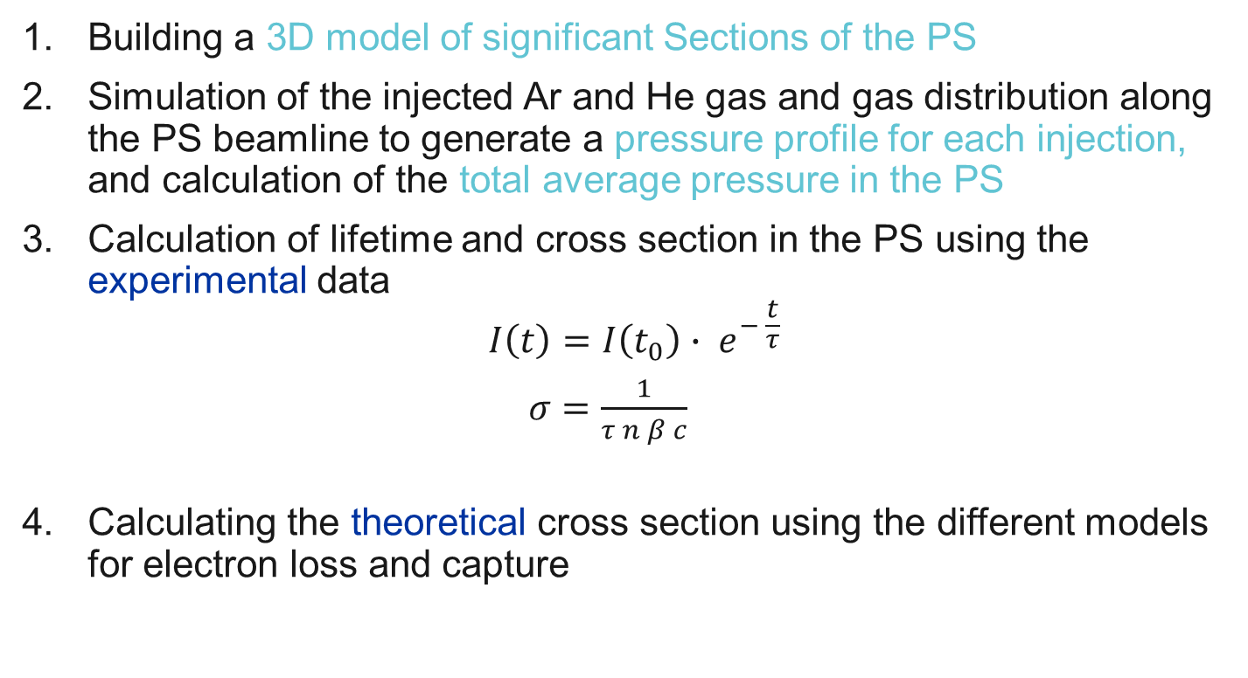
Steps of the Analysis
Building a 3D model of significant Sections of the PS
Simulation of the injected Ar and He gas and gas distribution along the PS beamline to generate a pressure profile for each injection, and calculation of the total average pressure in the PS
Calculation of lifetime and cross section in the PS using the experimental data
$$I\left(t\right)=I\left(t_{0}\right){∙ e}^{− \frac{t}{τ}}$$
$σ=\frac{1}{τ n β c}$
Calculating the theoretical cross section using the different models for electron loss and capture
Analysis of the gas distribution
Calculation of the cross section

Slide 18
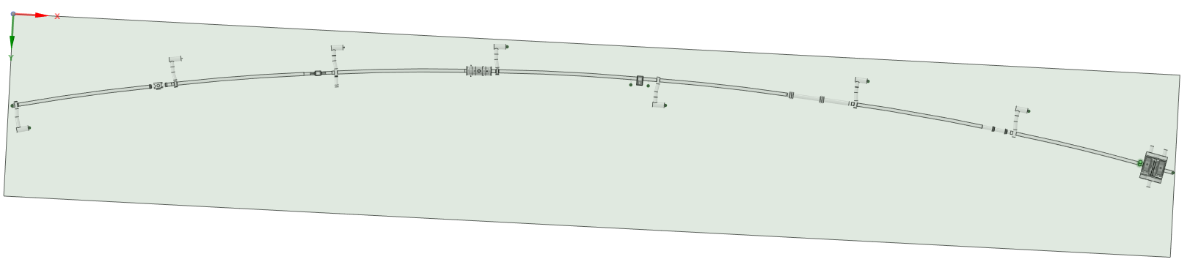
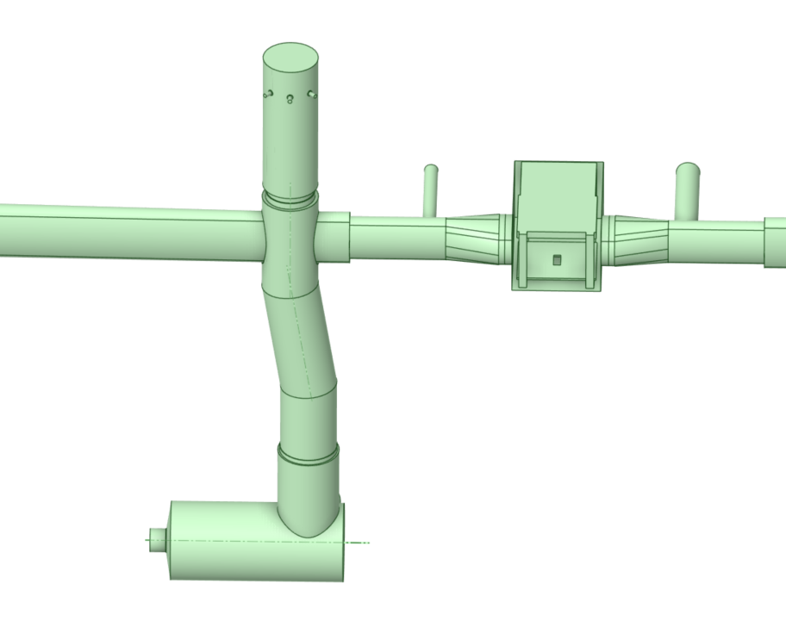
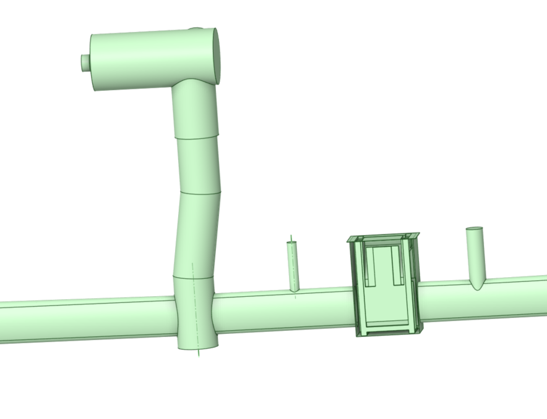
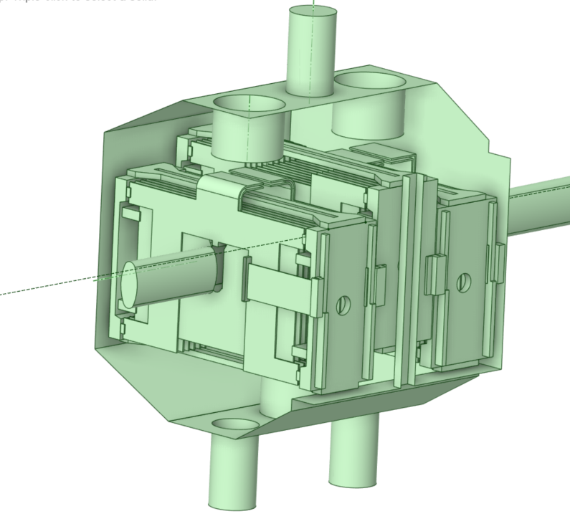
1. 3D model of the PS using SpaceClaim
Injection of Ar and He
(BGI)

Slide 19
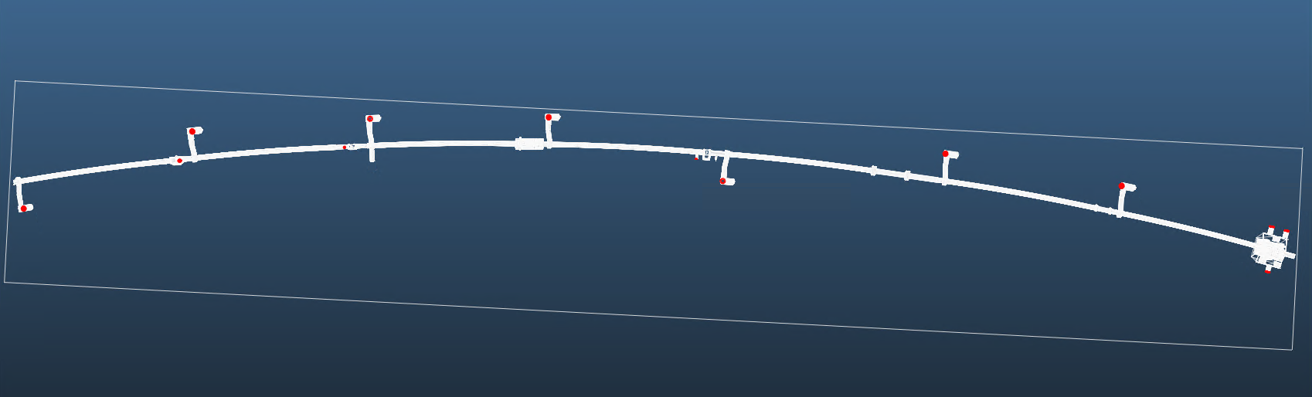
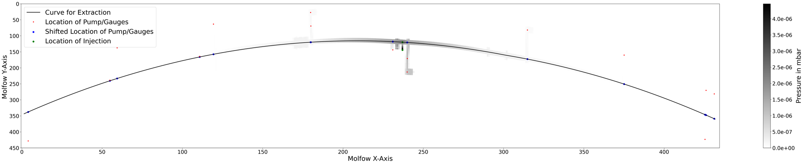
2. Simulation of the injected gas using Molflow
Heading
  Software: Molflow
Heading
  ….

Slide 20
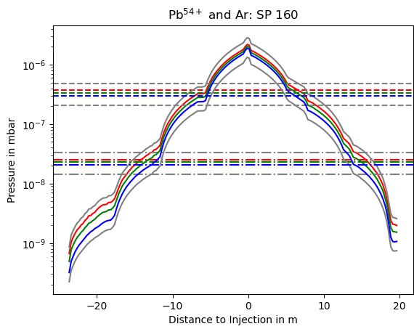
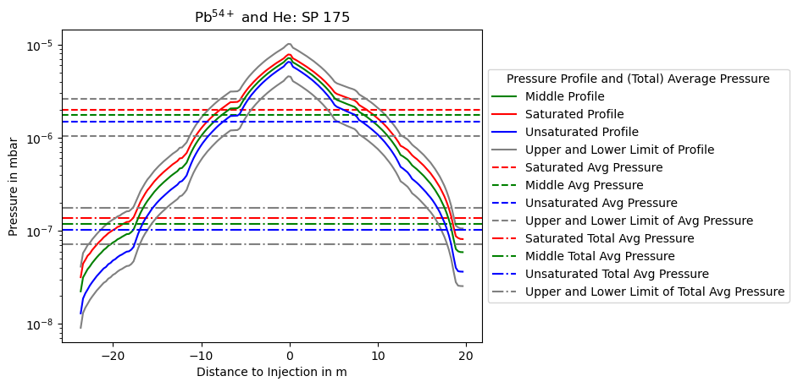
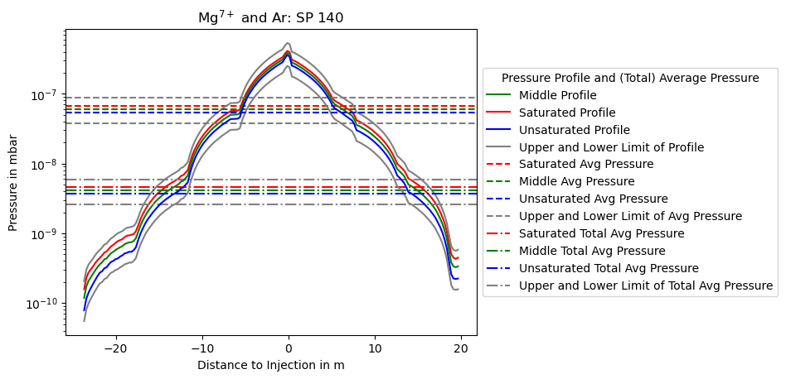
2. Simulation of the injected gas: Pressure Profile
Setpoints (SP) correspond to the amount of gas injected
Pumping speed estimation dependent on the pressure
Saturation of the pumps represented via different profiles

Slide 21
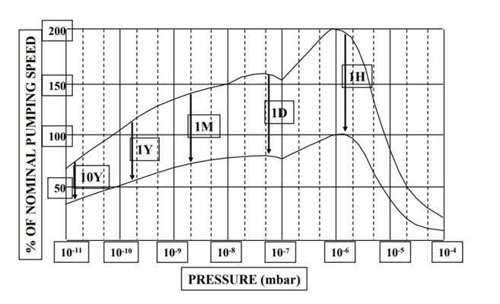
2. Simulation of the injected gas: Pressure Profile
Image source: Audi, M. (2006), CERN Accelerator School
unsaturated
Setpoints (SP) correspond to the amount of gas injected
Pumping speed estimation dependent on the pressure
Saturation of the pumps represented via different profiles
saturated

Slide 22
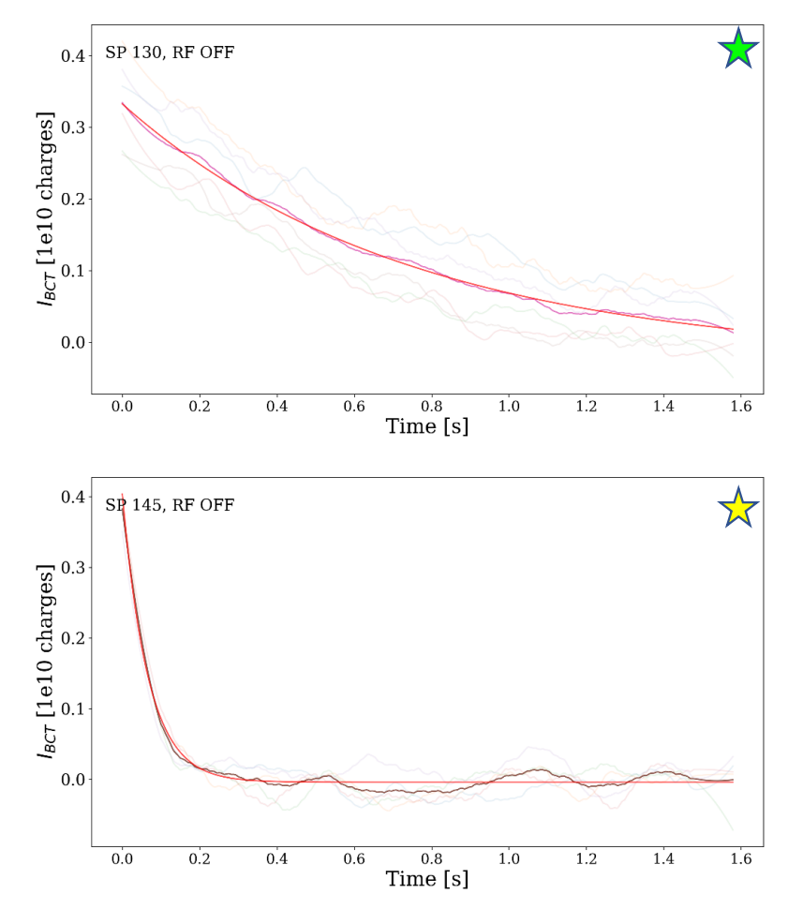
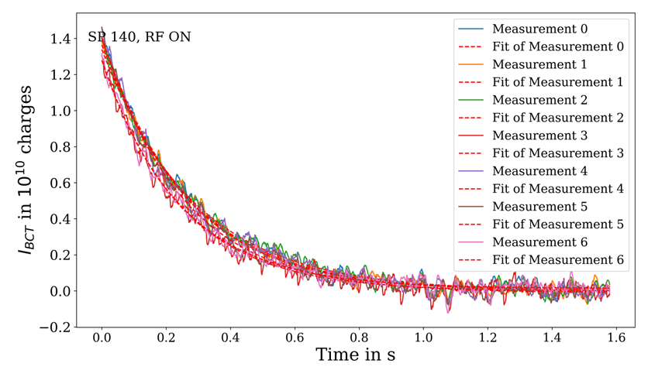
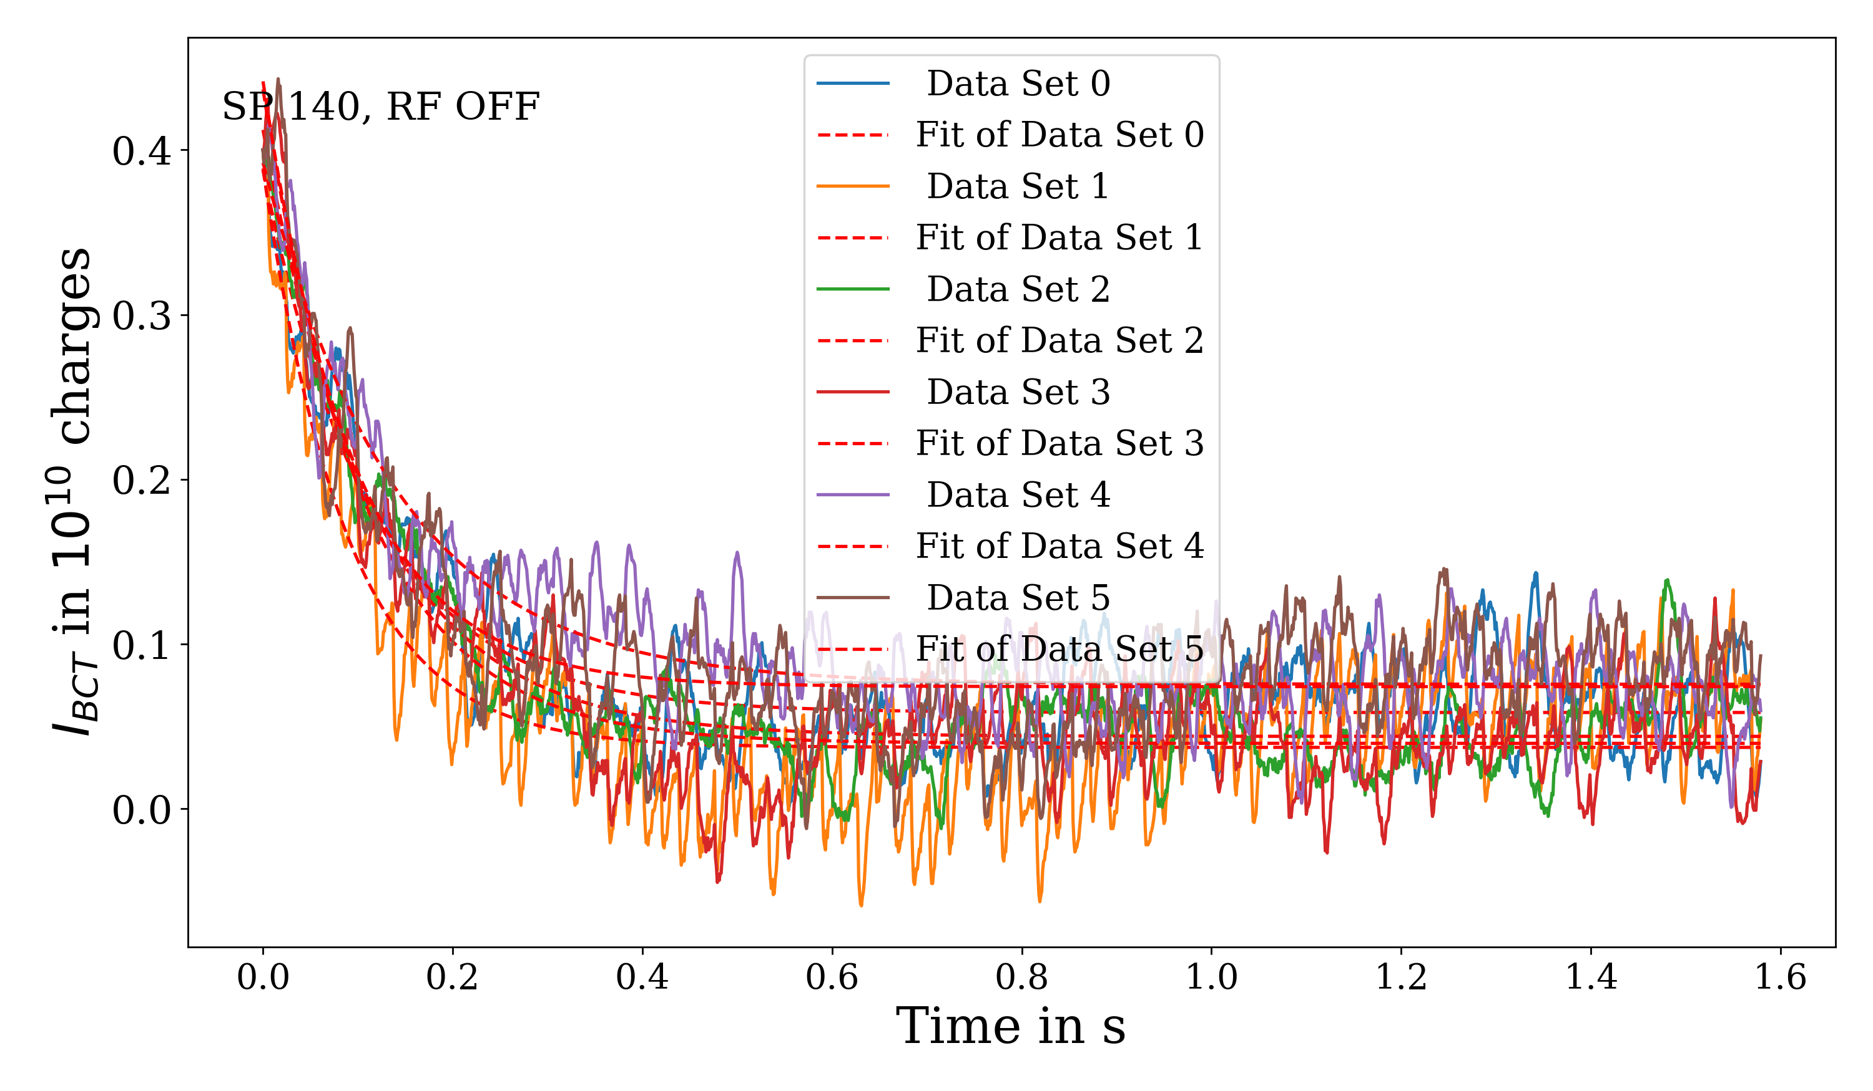
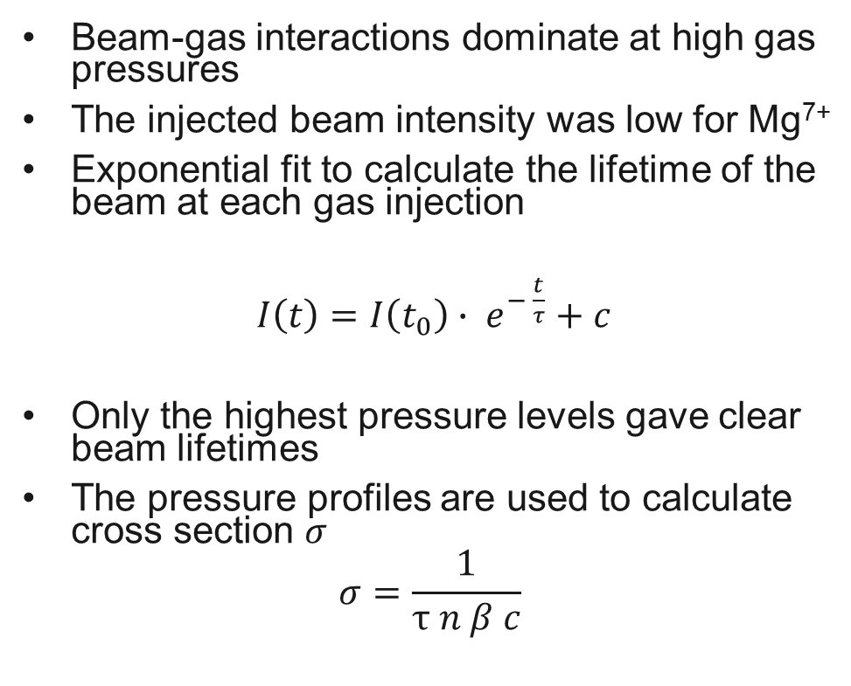
3. Lifetime from Experiment in the PS
Beam-gas interactions dominate at high gas pressures
The injected beam intensity was low for Mg⁷⁺
Exponential fit to calculate the lifetime of the beam at each gas injection
$I\left(t\right)=I\left(t_{0}\right){∙ e}^{− \frac{t}{τ}}$ $+ c$
Only the highest pressure levels gave clear beam lifetimes
The pressure profiles are used to calculate cross section $σ$
$$σ=\frac{1}{τ n β c}$$

Slide 23
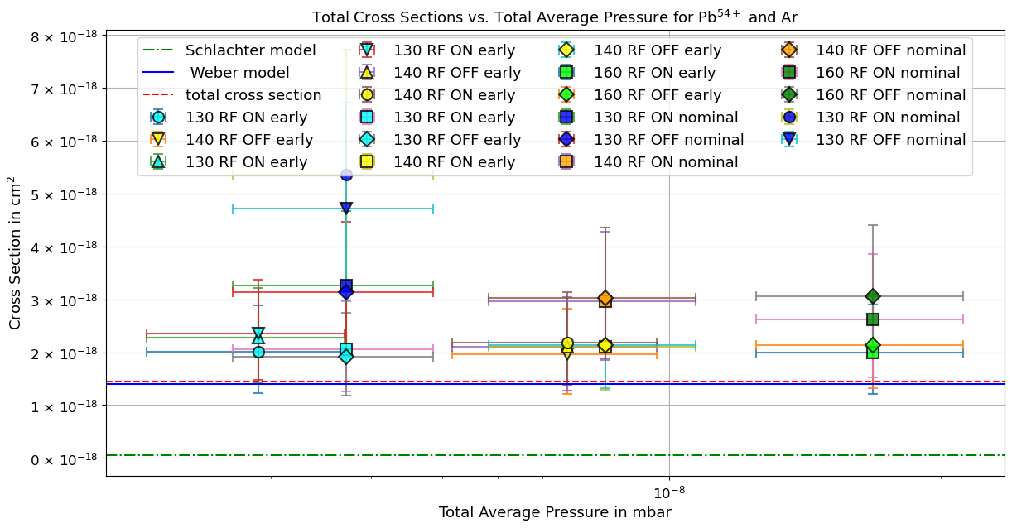
Results: Pb⁵⁴⁺ with Ar gas
Close agreement between the experimental values and the model predictions
The measured cross section is higher than the predicted lifetime of the semi-empirical formula
  EARLY beam: factor of 1.32 – 1.63 (avg: 1.46)
  NOMINAL beam: factor of 1.81 – 3.71 (avg: 2.44)
Time difference between the measurements of the EARLY beam and the NOMINAL beam

Slide 24
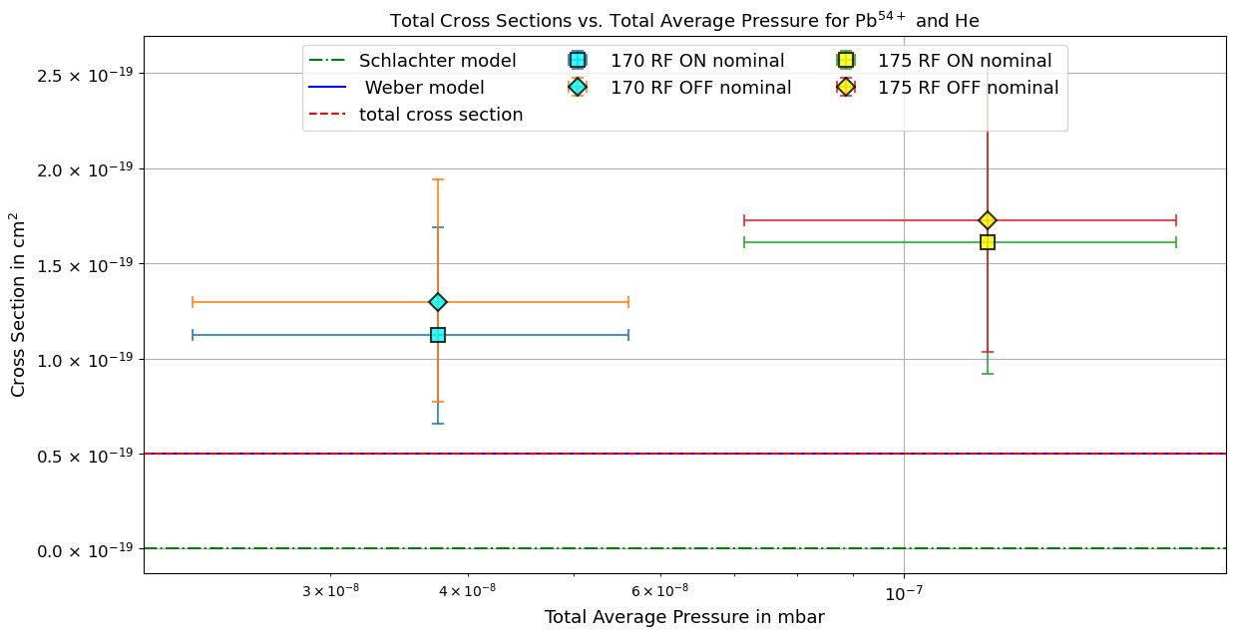
Results: Pb⁵⁴⁺ with He gas
Higher deviations compared to the experiment with Ar gas
The measured cross section is a factor of 2.25 - 3.45 (avg: 2.88) higher than the predicted lifetime of semi-empirical formula
Electron capture contribution: 0.01%

Slide 25
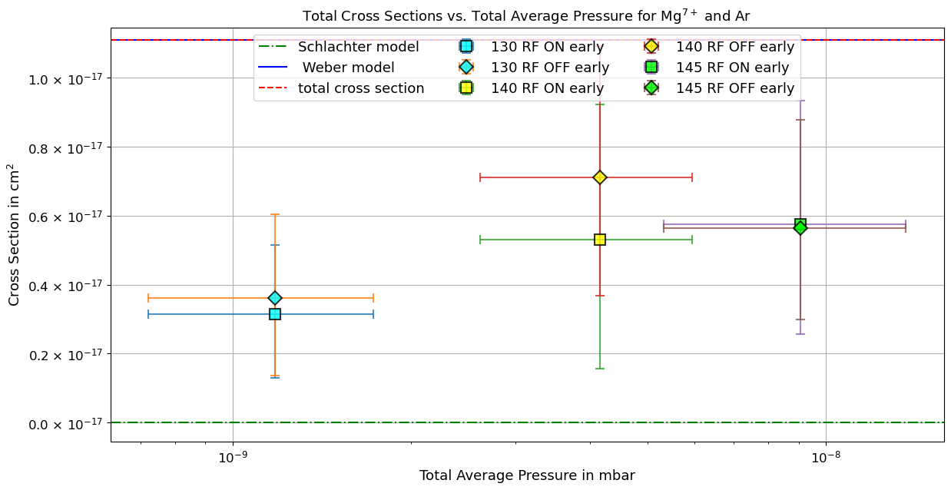
Results: Mg⁷⁺ with Ar gas
The measured cross section is a factor of 1.93 - 3.53 (avg: 2.36) times lower than the predicted lifetime of the semi-empirical formula
The measured cross section of Pb⁵⁴⁺ is higher than predicted, while for Mg⁷⁺ it is the opposite
Predictions of the models result in higher losses than those measured
Ongoing checks of formula validity for loosely bound projectile electrons and high-Z targets

Slide 26
Conclusion
Ion cross section experiments with Pb⁵⁴⁺ and Mg⁷⁺ beams in the CERN PS, using different levels of injected Ar and He gas with the BGI injection system
  Exponential intensity decay was observed for high pressure injections, and beam lifetimes was extracted
  Pressure analysis resulted in a more accurate representation of the gas distribution
  Calculations of ion beam cross section as a function of pressure were performed
New experimental methodology has been proven to give reasonable results
Measured cross sections were compared with the predictions of the semi-empirical models
  Close agreement, with a factor of 1.4 – 3.7, between the prediction models and the measurements
  Comparison showed potential improvements in the experiment and/or models
  Models are valuable tool for the estimation of cross sections to evaluate future ion species

Slide 27
Conclusion
Ion cross section experiments with Pb⁵⁴⁺ and Mg⁷⁺ beams in the CERN PS, using different levels of injected Ar and He gas with the BGI injection system
  Exponential intensity decay was observed for high pressure injections, and beam lifetimes was extracted
  Pressure analysis resulted in a more accurate representation of the gas distribution
  Calculations of ion beam cross section as a function of pressure were performed
New experimental methodology has been proven to give reasonable results
Measured cross sections were compared with the predictions of the semi-empirical models
  Close agreement, with a factor of 1.4 – 3.7, between the prediction models and the measurements
  Comparison showed potential improvements in the experiment and/or models
  Models are valuable tool for the estimation of cross sections to evaluate future ion species

Slide 28
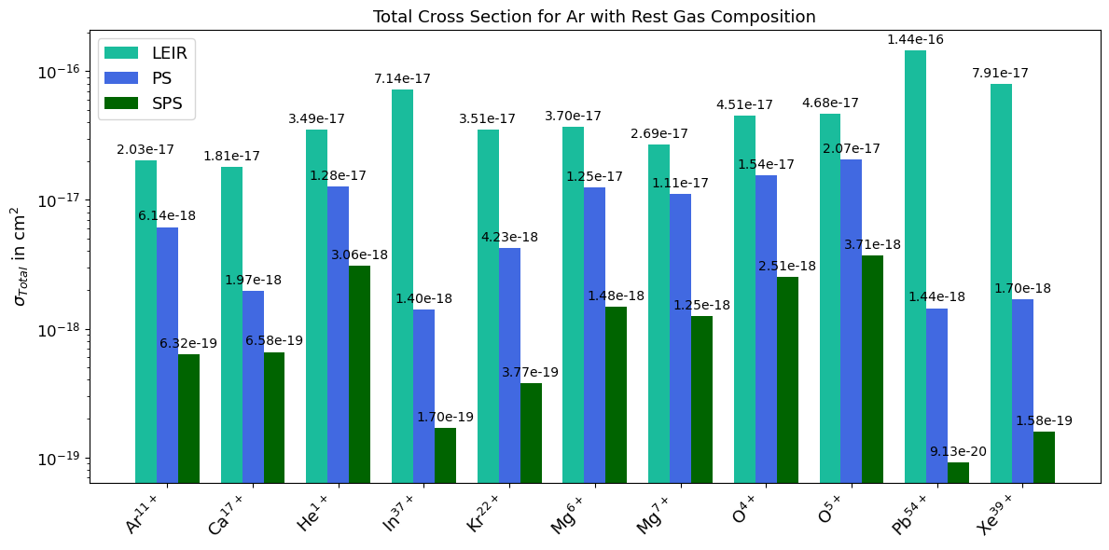
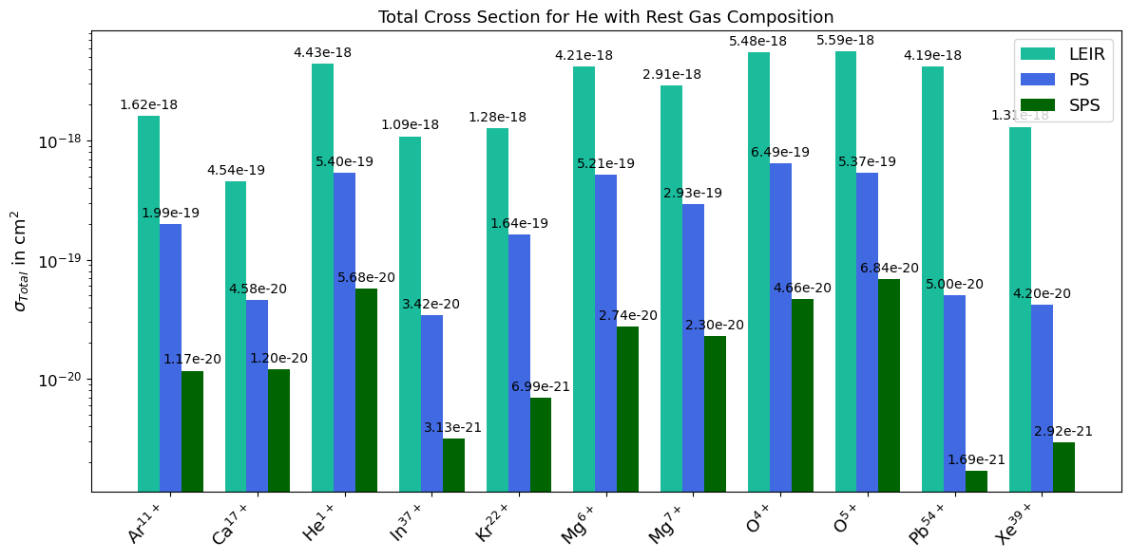
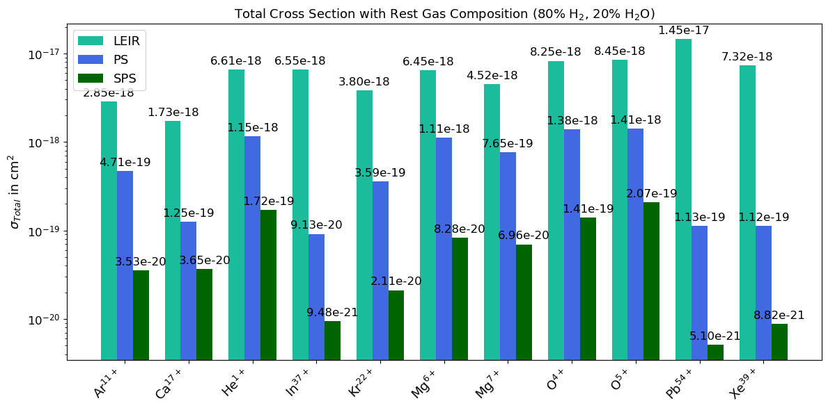
Outlook
Ion lifetime experiments with an O⁴⁺ beam in the CERN PS will take place in June/July 2025, using different levels of injected Ar and He gas
  New experimental setup will include the use of two injection systems, enabling more measurements

Slide 29
Thank you!!

Slide 30
References
Lopienska, E. (2022). The CERN accelerator complex, layout in 2022. General Photo. Retrieved from https://cds.cern.ch/record/2800984
Waagaard, Elias Walter (2024). Image modified from Lopienska, E. (2022).
Audi, M. (2006). An Introduction to Ion Pumps. CERN Accelerator School, May 2006. Varian Vacuum Technologies. Retrieved from https://cas.web.cern.ch/sites/default/files/lectures/platjadaro-2006/audi.pdf
Waagaard, E. W. (2024). VGP82 pressure over time. Personal communication.
GSI. (n.d.). Gas jet. Retrieved from https://web-docs.gsi.de/~stoe_exp/laboratory/environment/gasjet/gasjet.php

Slide 31
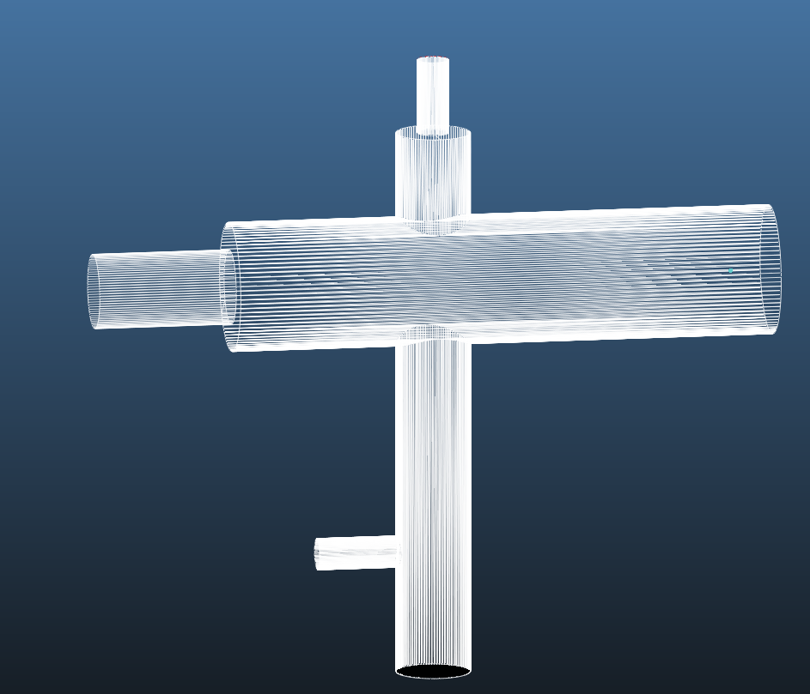
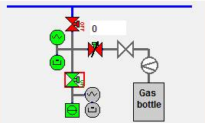

Flow
Series of simulations to estimate effective pumping speed $S_{eff}$
Error of gauge: 30%
$$Q=S_{eff}P$$
gas
connected to pump

