Slide 1
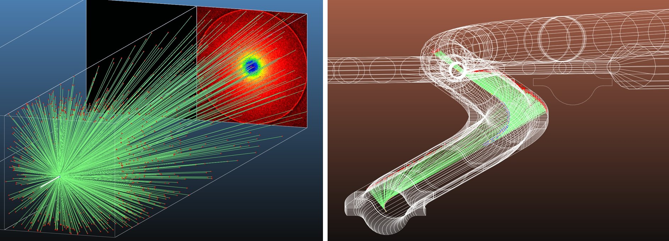
MolFlow and SynRad development update
2025-02-25 TE-VSC seminar
Márton Ady, Petar Trifunović

Slide 2
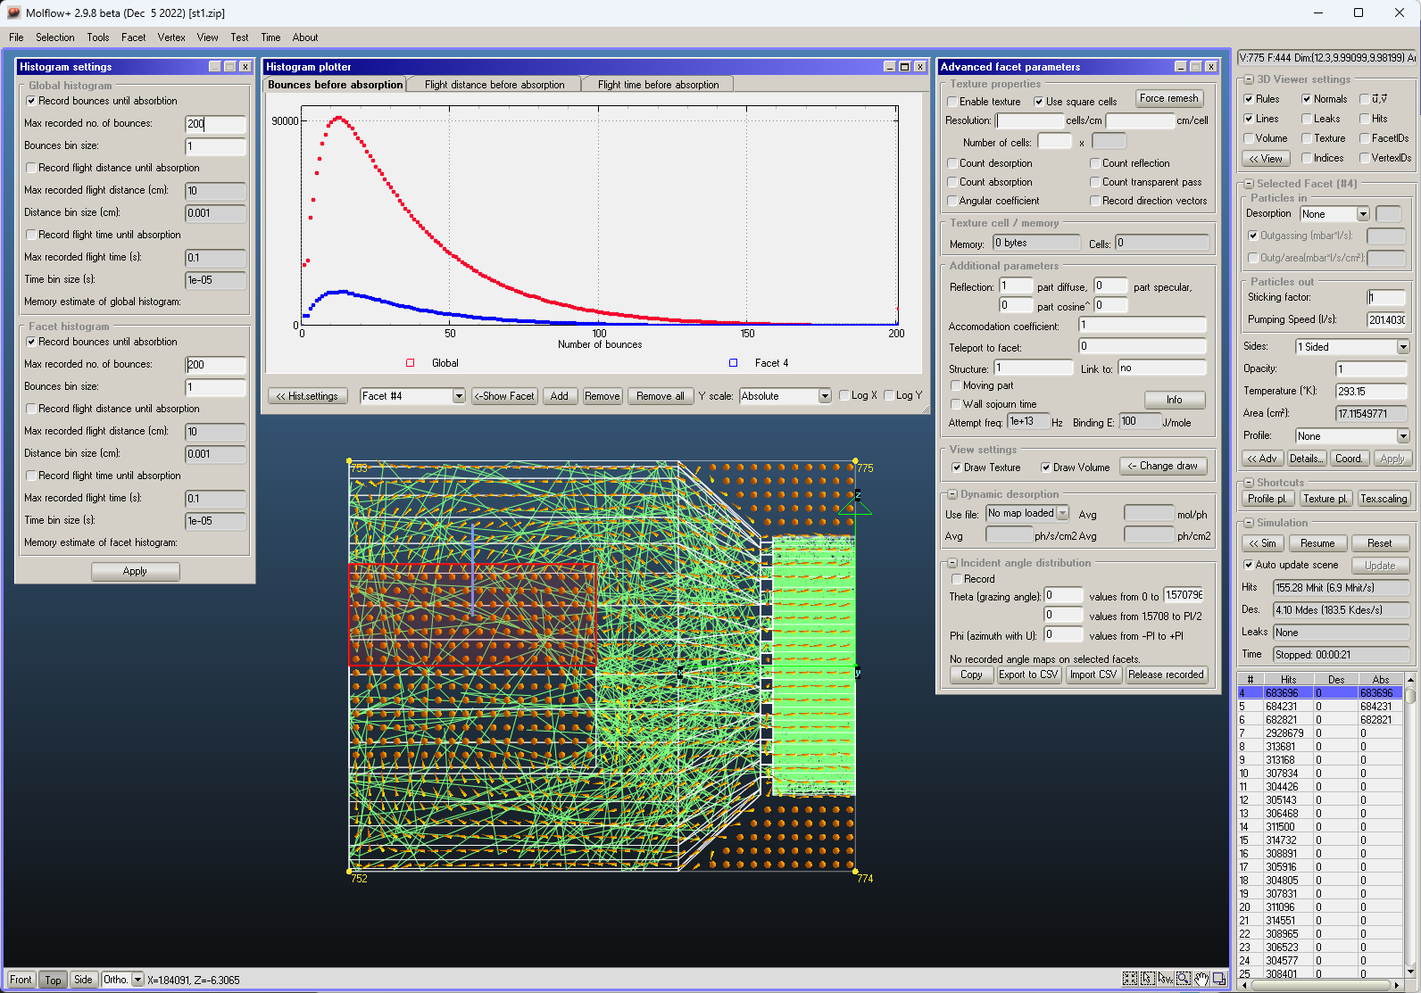
MolFlow in one slide
Test-particle vacuum simulator
Uses Monte Carlo test particles
Assumes molecular flow
Written by Roberto Kersevan in 1990s
Modernized at ESRF in 2008
Developed at TE-VSC since 2012
Approx. 1000 users

Slide 3
Today: 5 new functions
Physics
Visualization
Contamination
Geometry edit
Data extraction
2024
2025

Slide 4
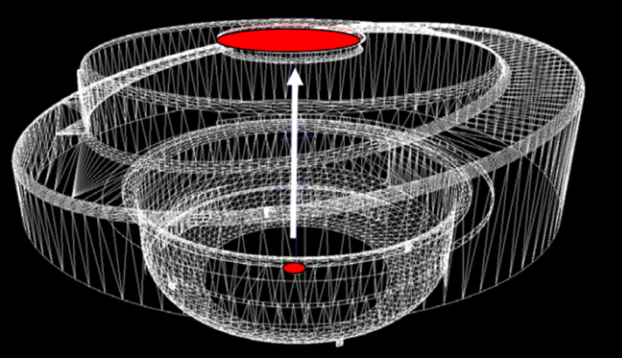
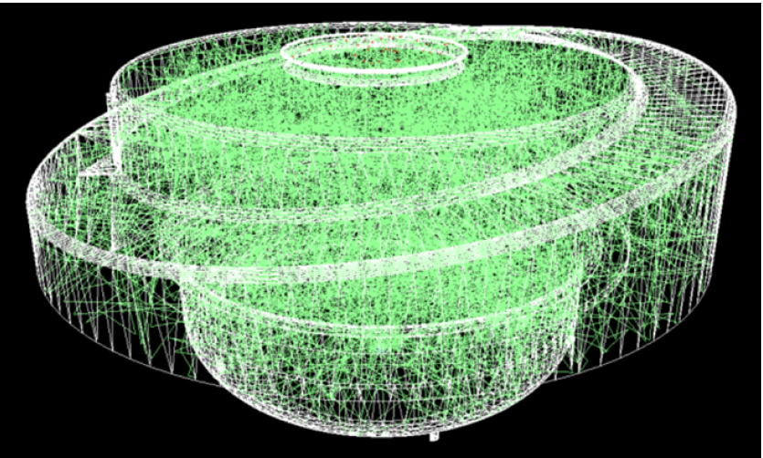
A Monte Carlo simulation: Transmission probability
Entrance
Exit

Slide 5
MolFlow for sputtering simulations
Simple sputtering simulation
With background gas
C
C

Slide 6
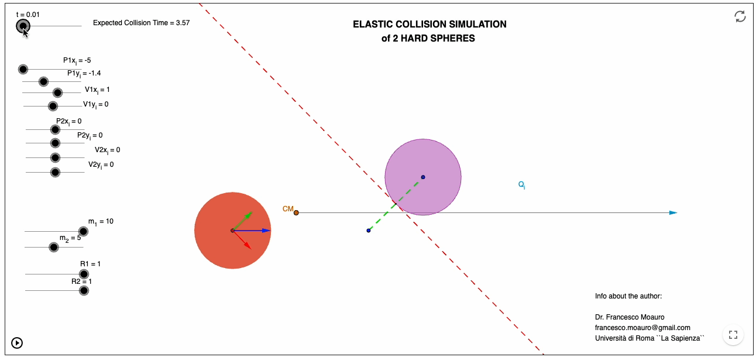
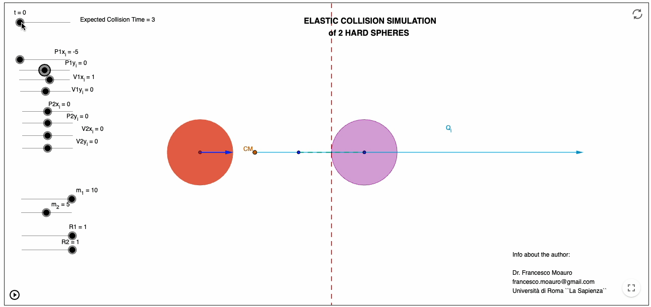
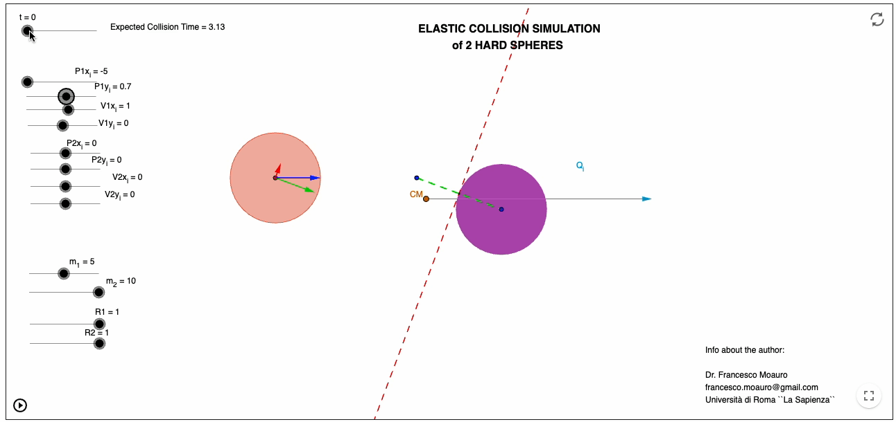
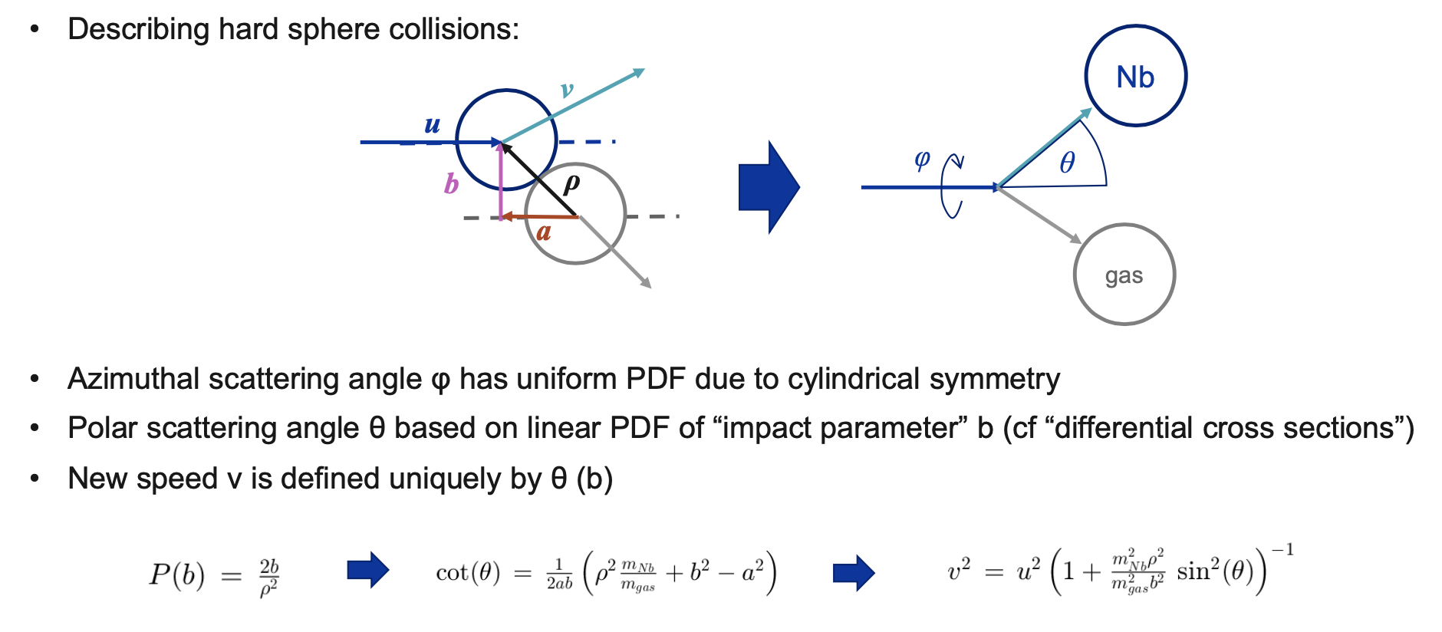
Collision between two particles
From Fabian Manke

Slide 7
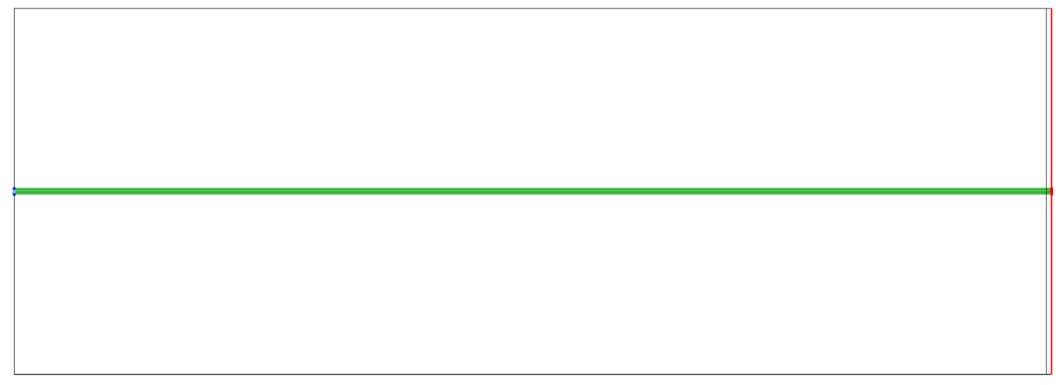
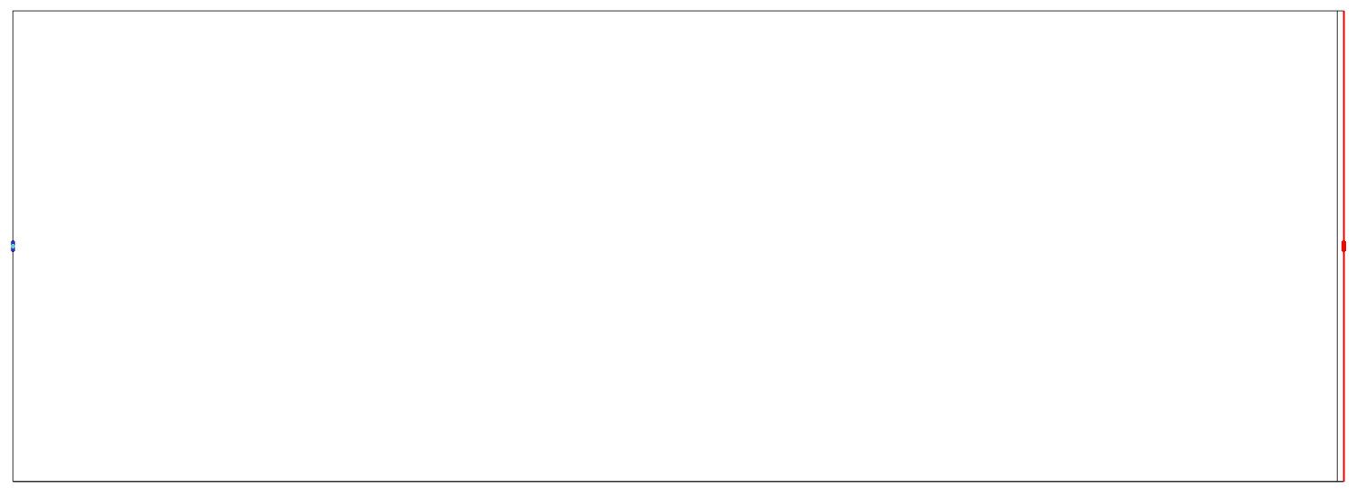
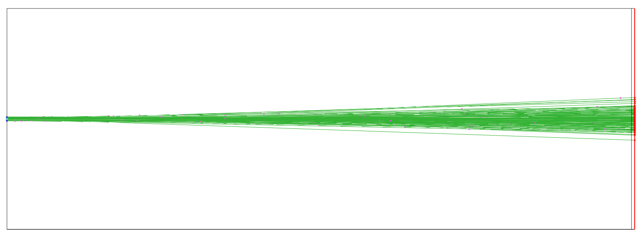
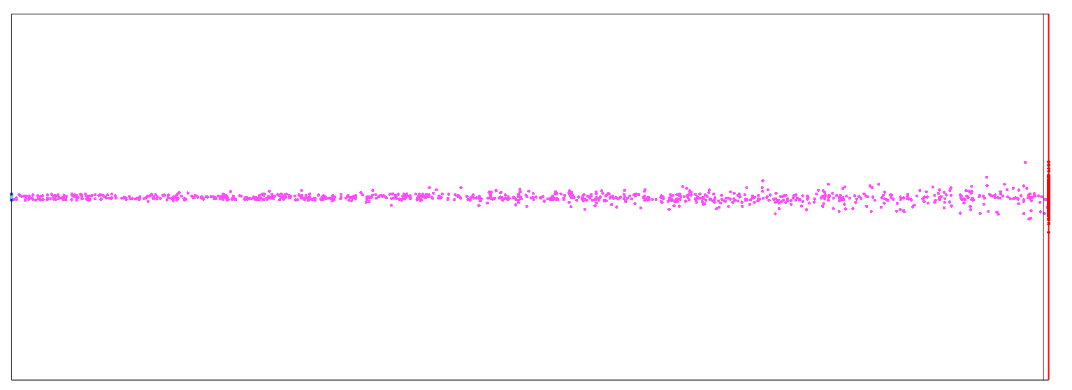
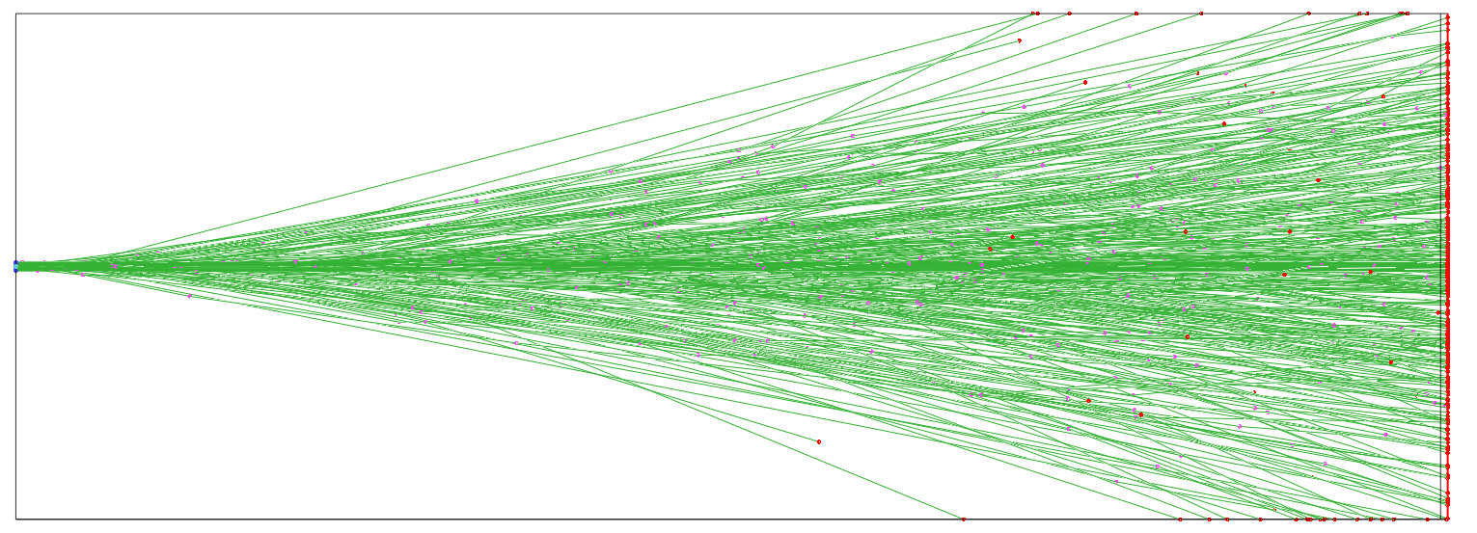
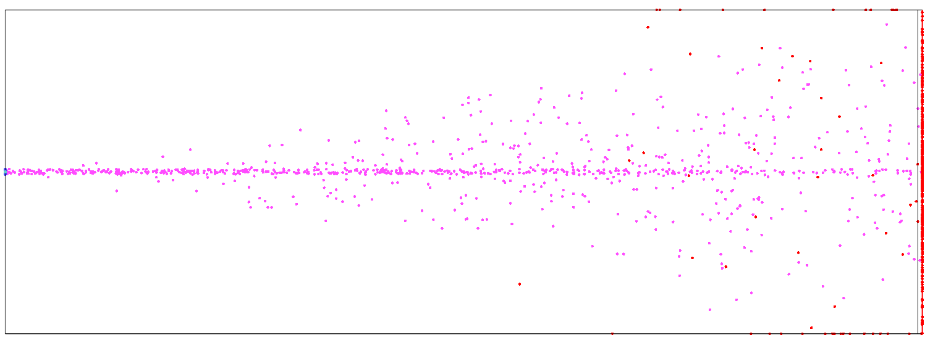
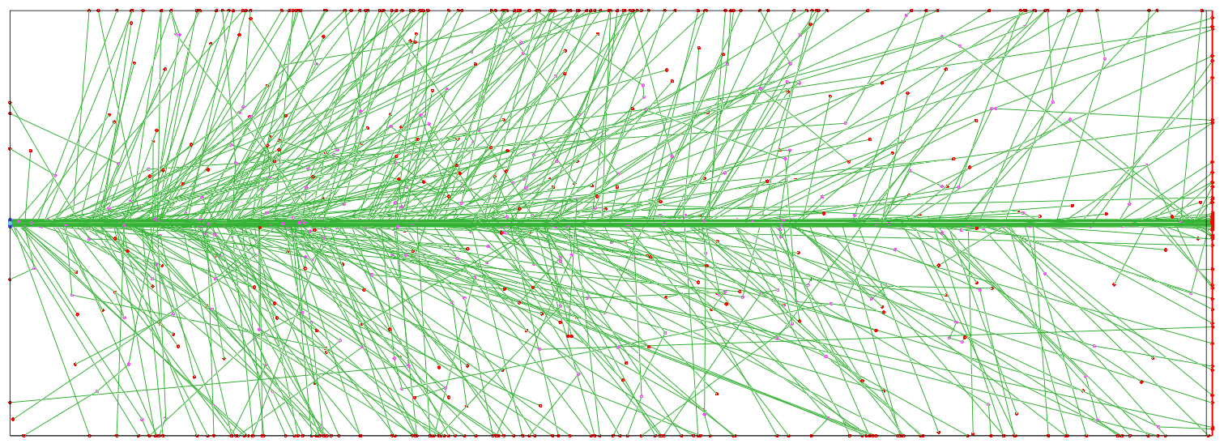
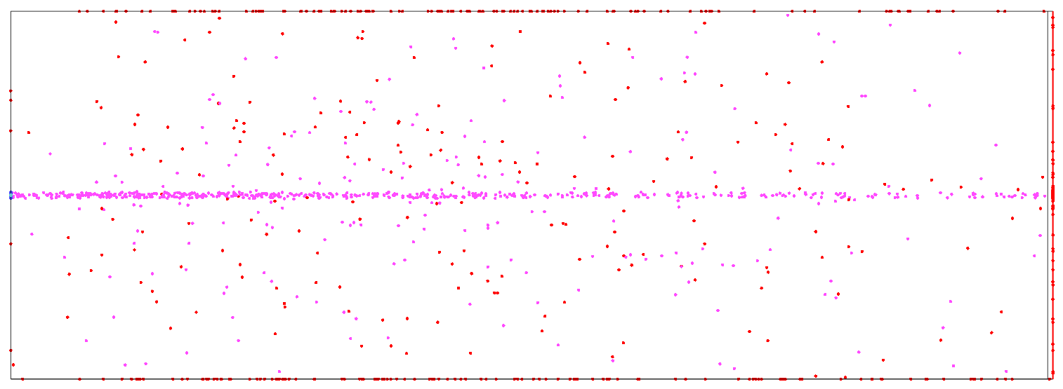
green lines: particle trajectories
purple dots: collision locations
red dots: absorption locations on walls
collisions off
mass ratio = 50
mass ratio = 5
mass ratio = 0.5

Slide 8

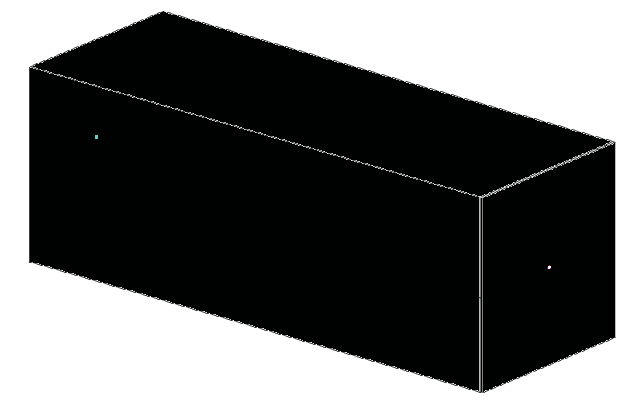
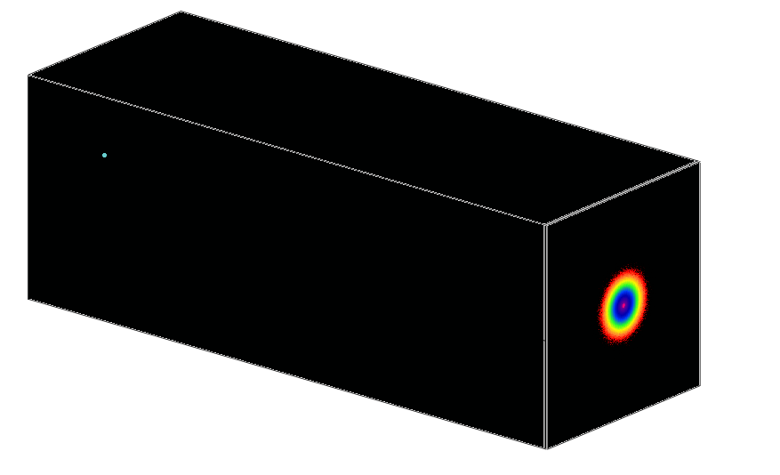
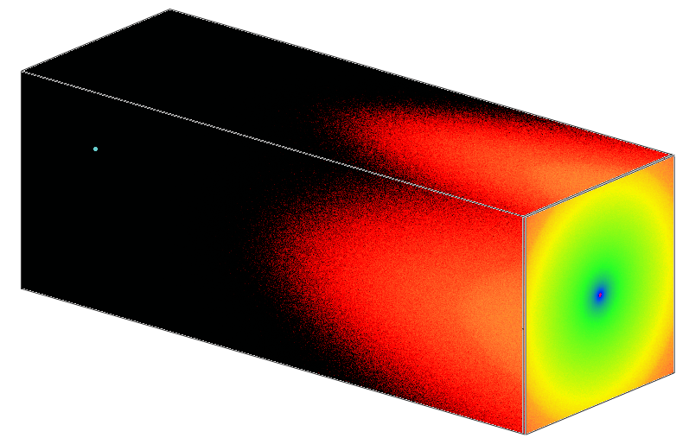
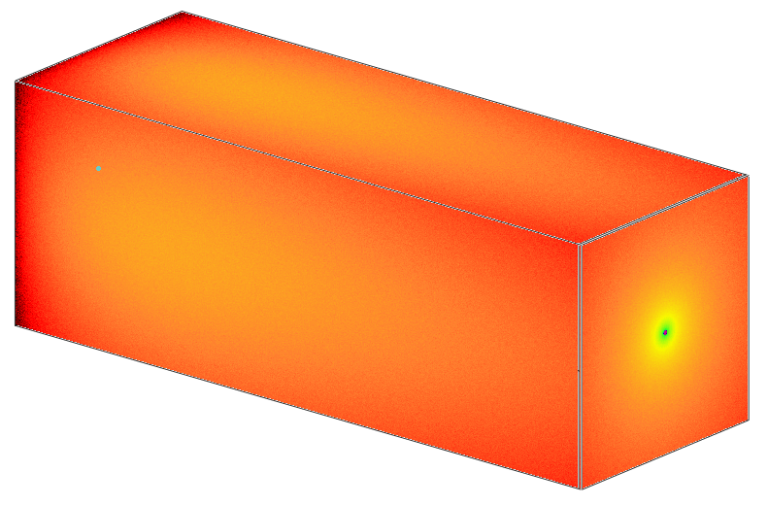
collisions off
mass ratio = 50
mass ratio = 5
mass ratio = 0.5

Slide 9
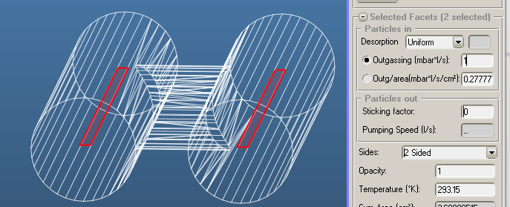
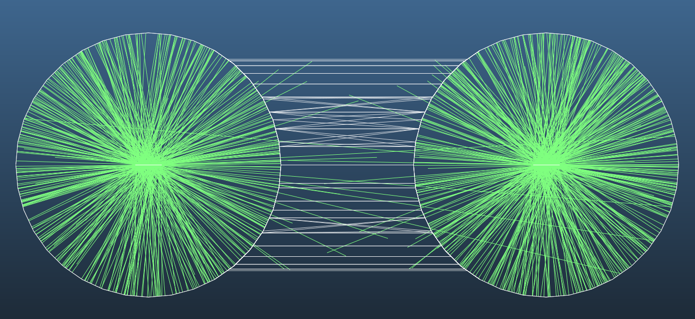
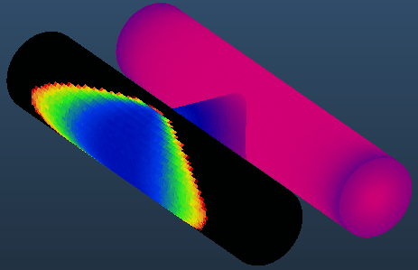
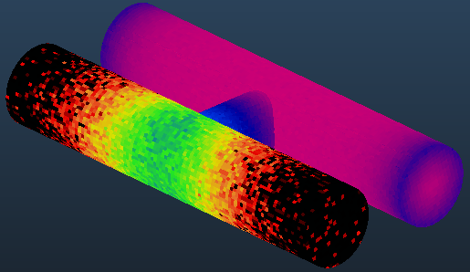
Sputtering seminar for SCC section
reference – no background
with background gas

Slide 10
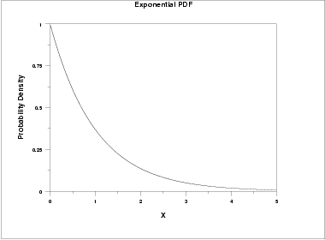
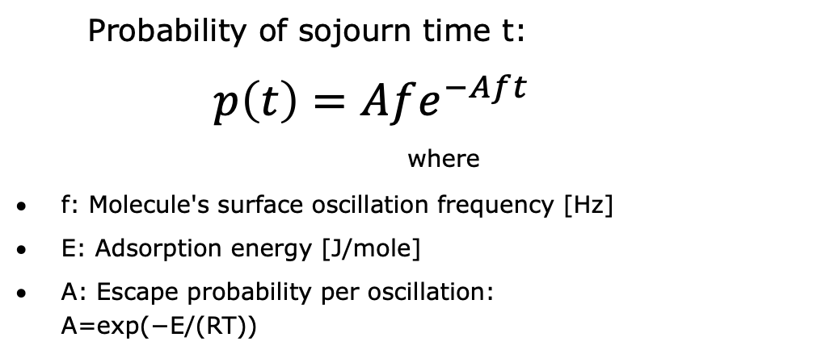
Water vapor sticking
Surface
Probability of sojourn time t:
$$p\left(t\right)=Afe^{−Aft}$$
where
f: Molecule's surface oscillation frequency [Hz]
E: Adsorption energy [J/mole]
A: Escape probability per oscillation:
A=exp(−E/(RT))

Slide 11
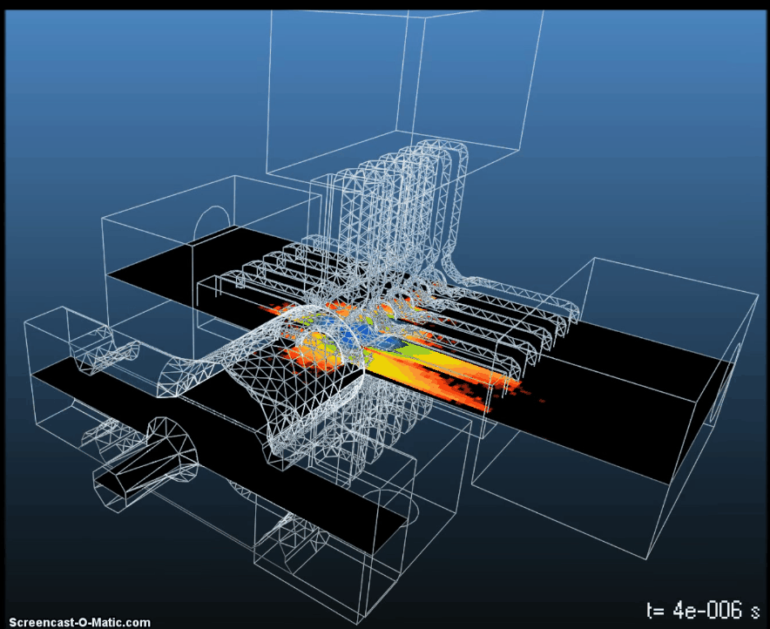
Time-dependent mode in MolFlow
CLIC cavity geometry: Cedric Garion
Problem: No connection between independent time moments

Slide 12
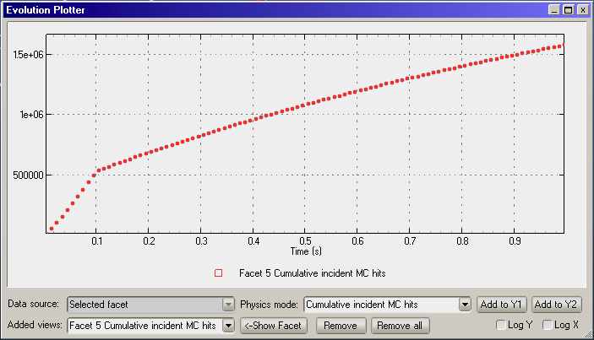
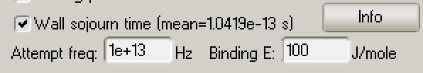
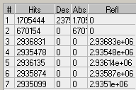
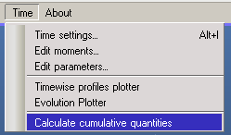
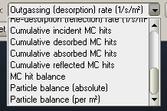
New features
New plotter window
Add temperature-dependent residence time
Add reflection counters
Integrate over time

Slide 13
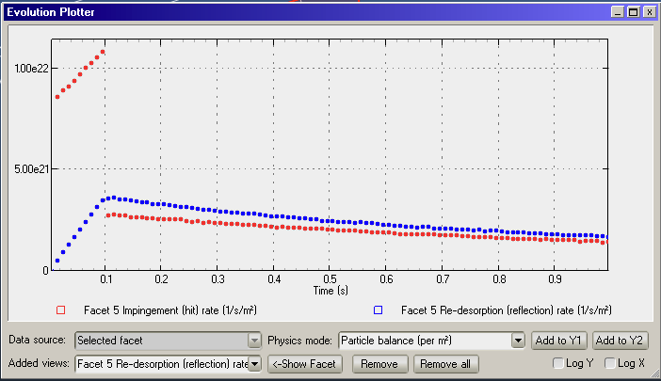
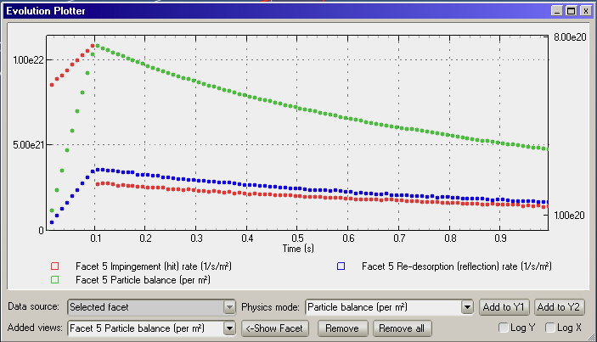
Particle balance example
Mean residence time: 0.2s
Outgassing: from 0 to 0.1s

Slide 14
Automation with MolFlow
Change physics or geometry
Run MolFlow programmatically
Extract results
Python XML interface
Python XML interface
Parameter sweep
Iterative simulations
Result-based optimization
molflowCLI
molflowCLI.exe --file inputFile.xml -t 3600 -o ./outputFile.xml

Slide 15
Python XML interface
Python is an easy to learn, popular programming language
XML is a file format – both machine and human-readable
  Looks like a tree
  Non-linear, can be searched
MolFlow file
Input
Results
Geometry
Physics
Pressure
Particle balance
Facets
Vertices
Gas mass
Time

Slide 16
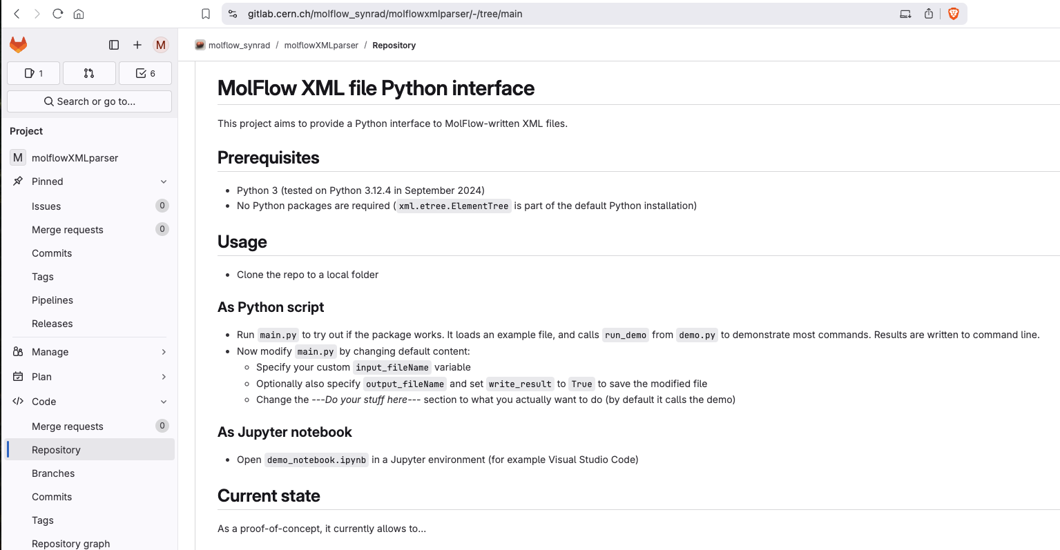
Published as Python module or Jupyter notebook

Slide 17
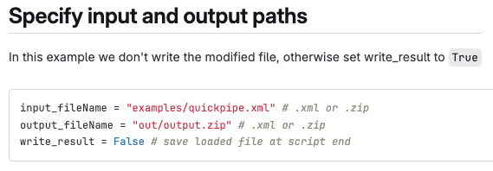
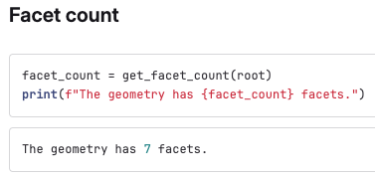
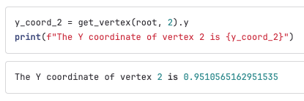
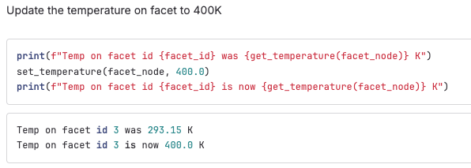
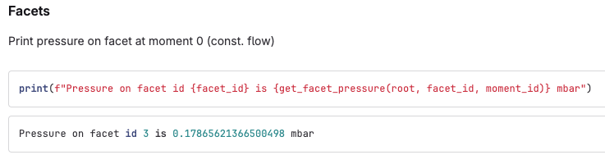
Examples
Set what to work on:
Read geometry:
Change physics:
Get results:

Slide 18
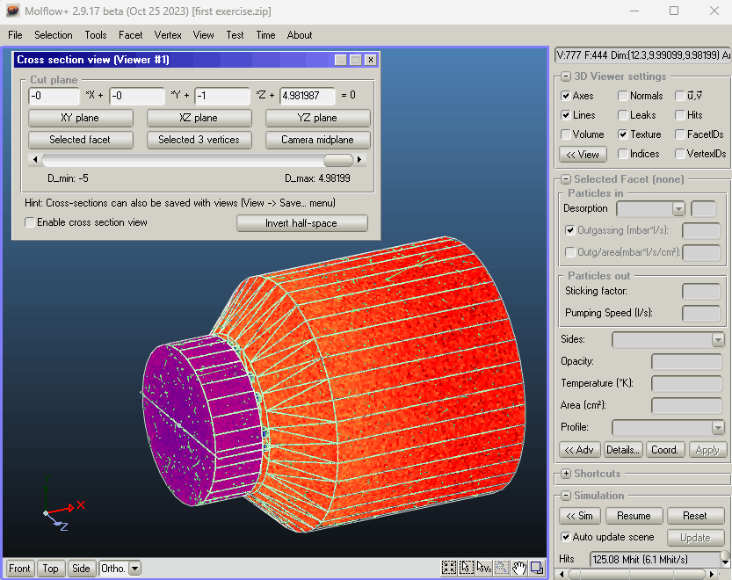
Cross-section viewer

Slide 19
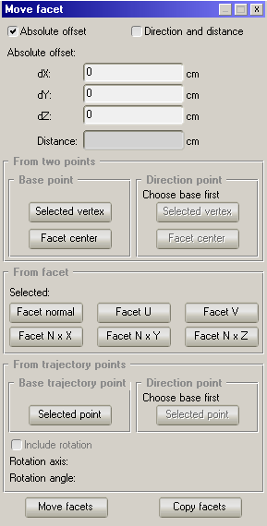
Rich facet and vertex movement
SynRad movement using beam trajectory points
  Two points of a trajectory define the movement parameters:
    Direction,
    Distance,
    Rotation.

Slide 20
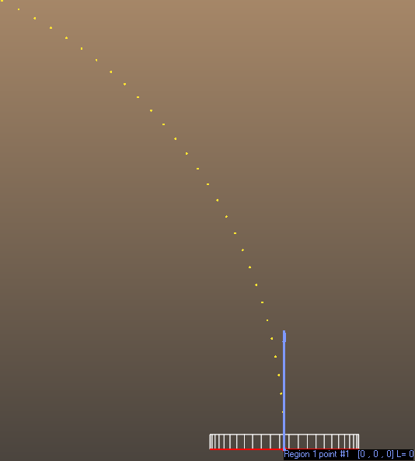
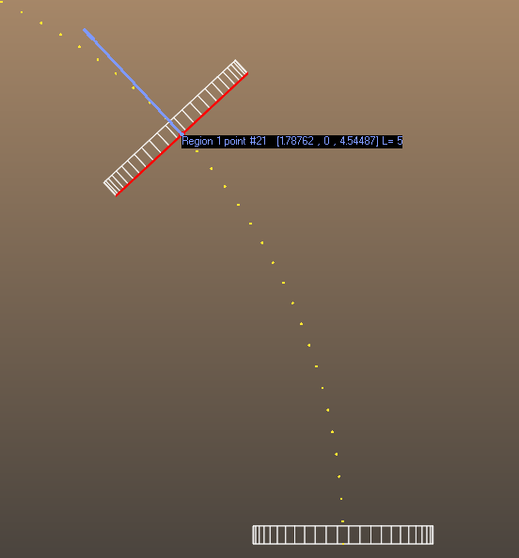
Rich facet and vertex movement
SynRad movement using beam trajectory points
  Two points of a trajectory define the movement parameters:
    Direction,
    Distance,
    Rotation.
Example (top view):

Slide 21
Rich facet and vertex movement
SynRad movement using beam trajectory points:
  Why add this feature?
Problem:
  Moving or duplicating smaller pieces of geometry along longer pipes.
  Long pipes usually contain beams whose trajectory is aligned with the pipe.
The old “solution”:
  Using the Move and Rotate options separately, manually calculating the rotation.
The new solution:
  Selecting the appropriate trajectory points while SynRad does the rest.

Slide 22
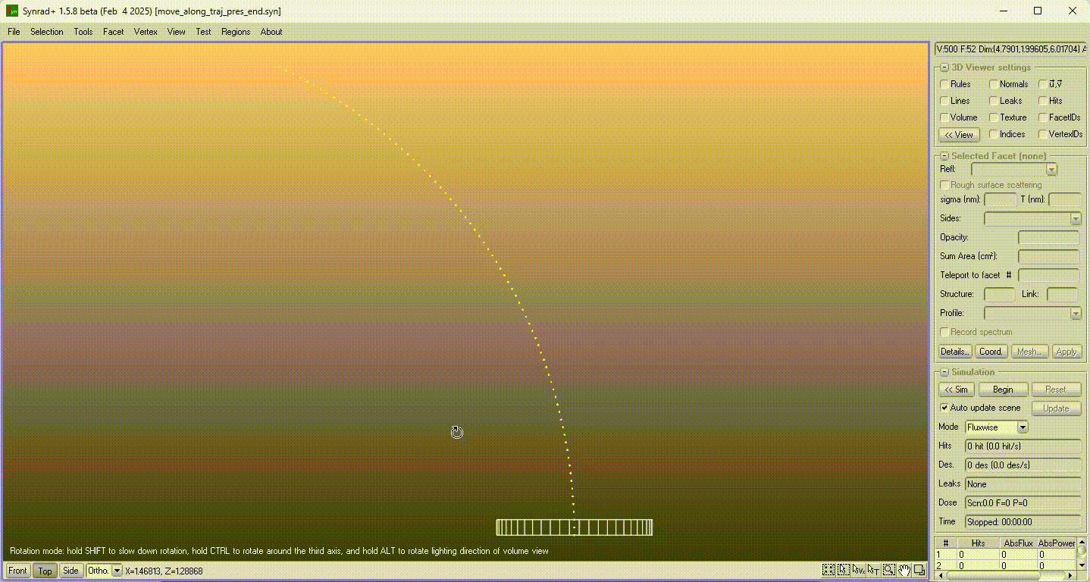
Rich facet and vertex movement – a simple demo

Slide 23
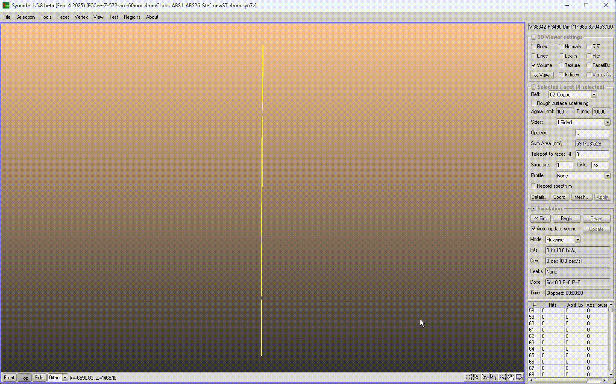
Rich facet and vertex movement – FCCee demo

Slide 24
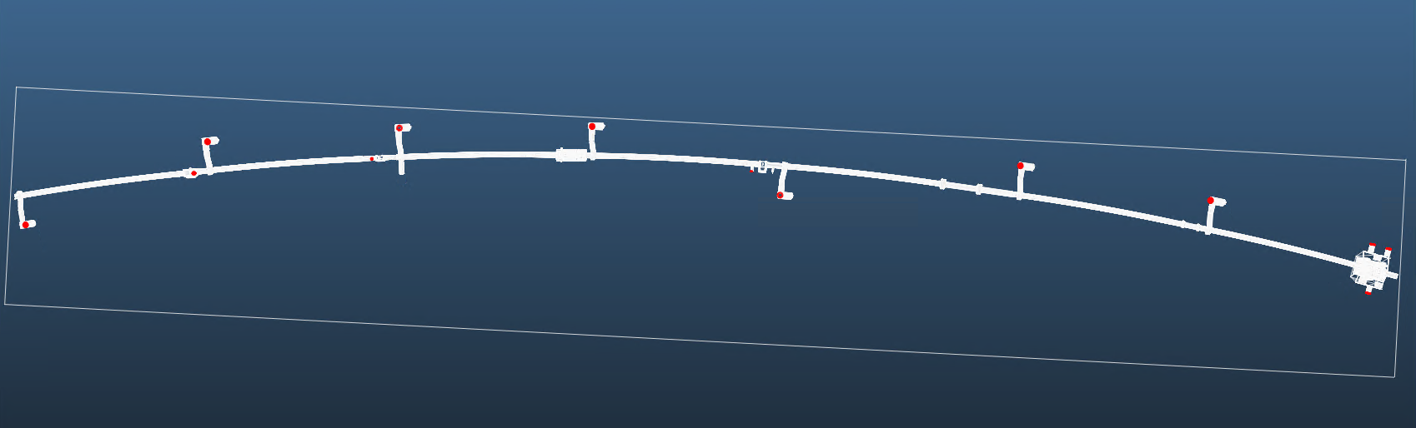
New feature – extracting data along a path
Problem:
  It is often required to extract simulation results (e.g. pressure, impingement rate…) along a certain path in the geometry.
The old solution:
  For straight paths, it could be sufficient to add a transparent facet that stretches along the desired path and “records” results.
  For curved paths, this can be hard:
Fenna Ukena, Experimental Measurements of Electron Capture and Loss Cross Sections of Ions with Gaseous Targets, CERN VSC group seminar, 21 January 2025

Slide 25
New feature – extracting data along a path
Problem:
  It is often required to extract simulation results (e.g. pressure, impingement rate…) along a certain path in the geometry.
The old solution:
  For straight paths, it could be sufficient to add a transparent facet that stretches along the desired path and “records” results.
  For curved paths, this can be hard.
The new solution:
  Allow the user to define a data extraction path by specifying the points in space it consists of.
  Read simulation results from the surrounding facets.

Slide 26
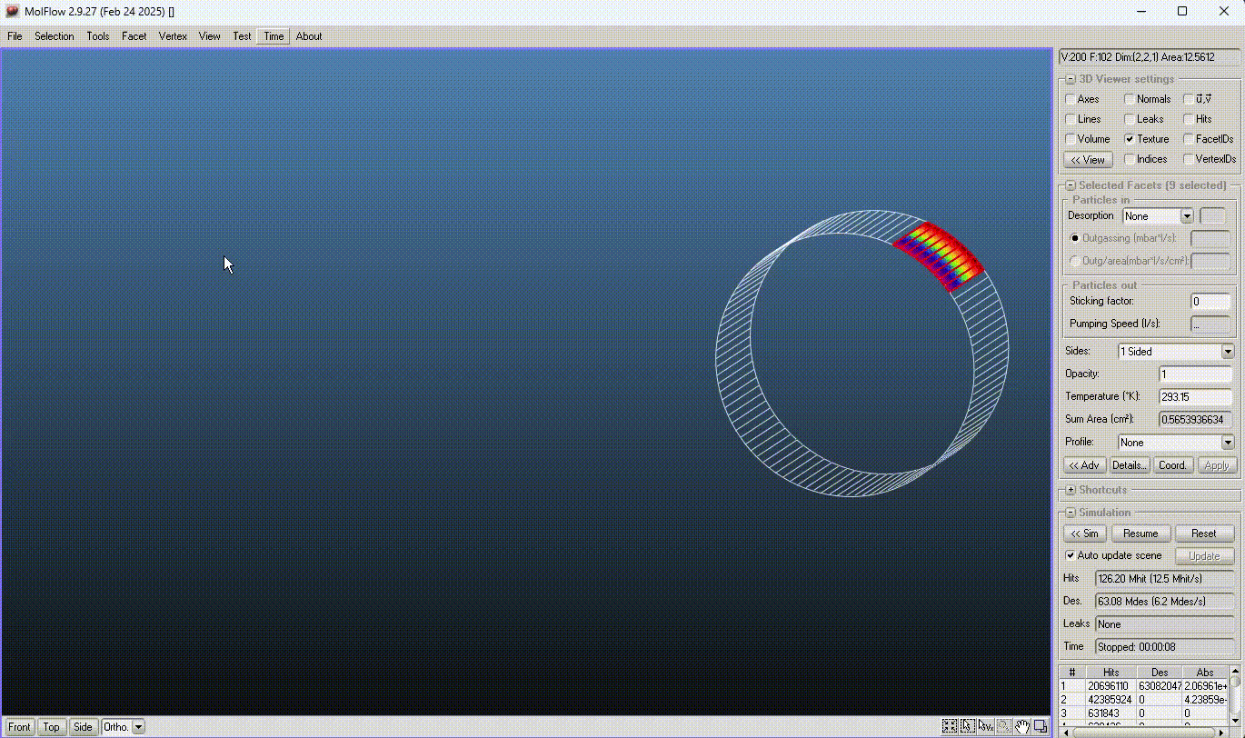
Extracting data along a path – a preview

Slide 27
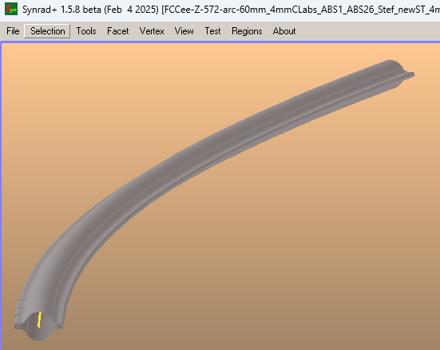
Extracting data along a path – an important use case
FCC-ee:
  Using curved geometries at CERN is a very common practice.
  The new feature will be useful for simulations for the FCC-ee.
  The SynRad version will include data extraction along trajectory points

