Slide 1
Water outgassing rate* & adsorption isotherms
Carlo Scarcia
25.02.2025
*for a metallic surface

Slide 2
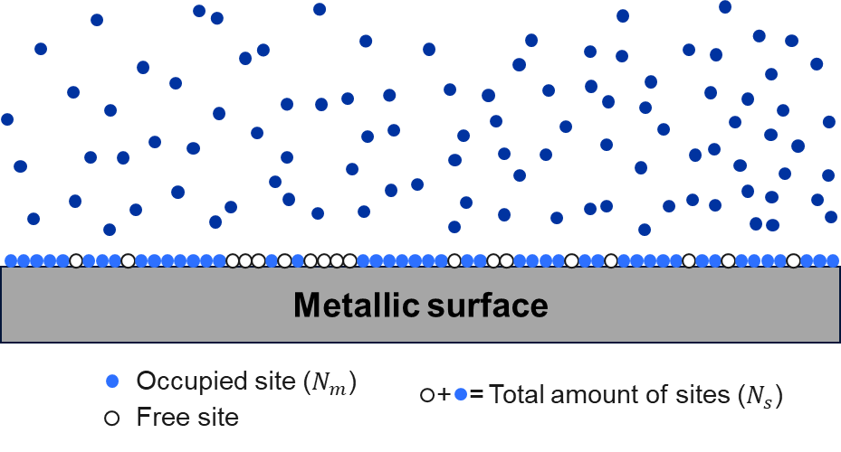
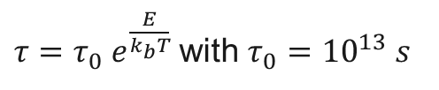
Glossary
Coverage ($θ$): Ratio between occupied sites ($N_{m}$) and total amount of sites ($N_{s}$) available on a surface.
$0 ≤θ≤1$
(empty surface)
(full surface)
Sticking coefficient ($s$): probability of the surface to capture an impinging molecule (0 $≤s≤$ 1).
Binding energy ($E$): energy of the bond between the water vapour molecule and the surface.
Sojourn time ($τ$): time spent by a molecule on a surface with a binding energy $E$ at temperature $T.$
$τ={τ_{0} e}^{\frac{E}{k_{b}T}}$ with $τ_{0}={10}^{13} s$
Adsorption isotherm: is a mathematical function that defines the relationship between the concentration of solute (water vapour) molecules in two phases (gas and solid) at the interface of the phases (surface), at constant temperature.

Slide 3
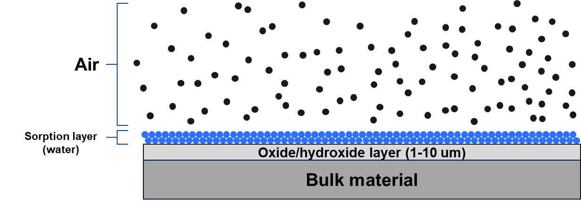
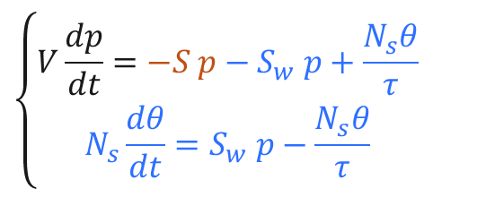
Vacuum system pumpdown: the mathematical approach
Mass balance equation ^{[1,5]}
$$\left\{\begin{aligned}V\frac{dp}{dt}=−S p−S_{w} p+\frac{N_{s}θ}{τ} \\ N_{s}\frac{dθ}{dt}=S_{w} p−\frac{N_{s}θ}{τ}\end{aligned}\right.$$

Slide 4
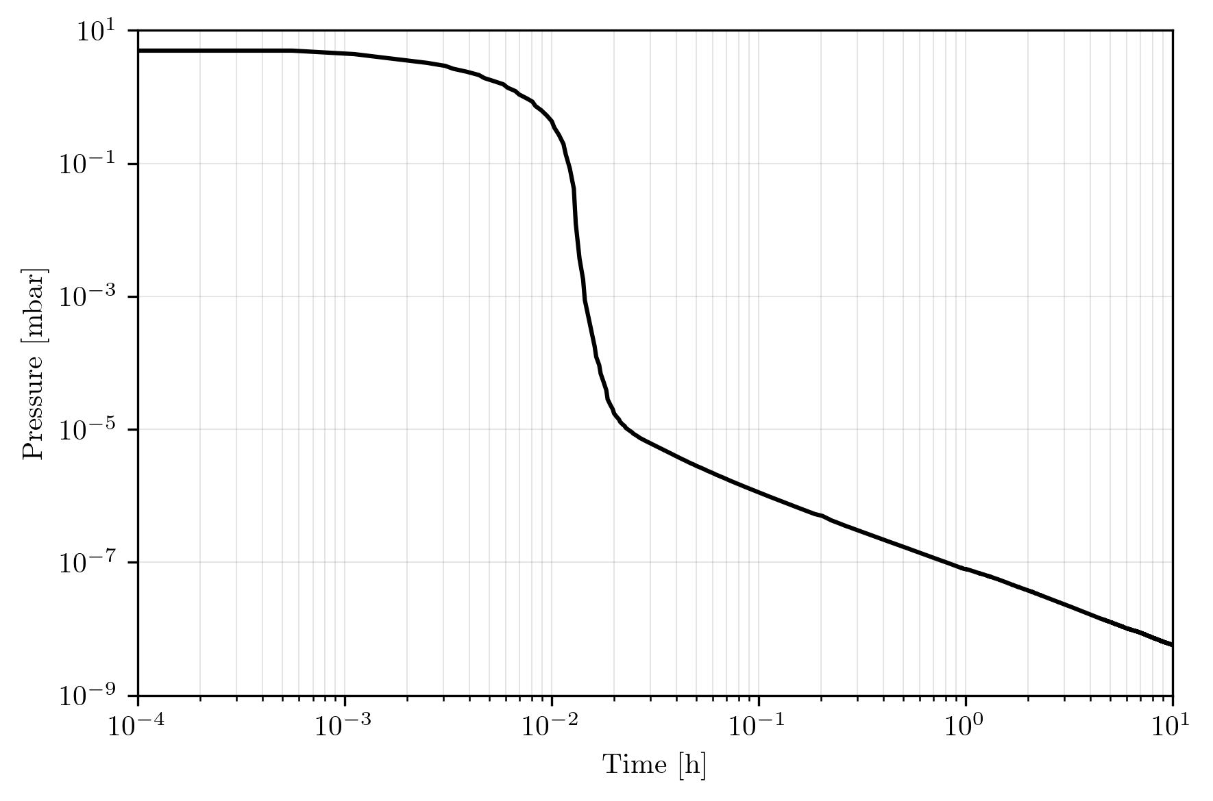
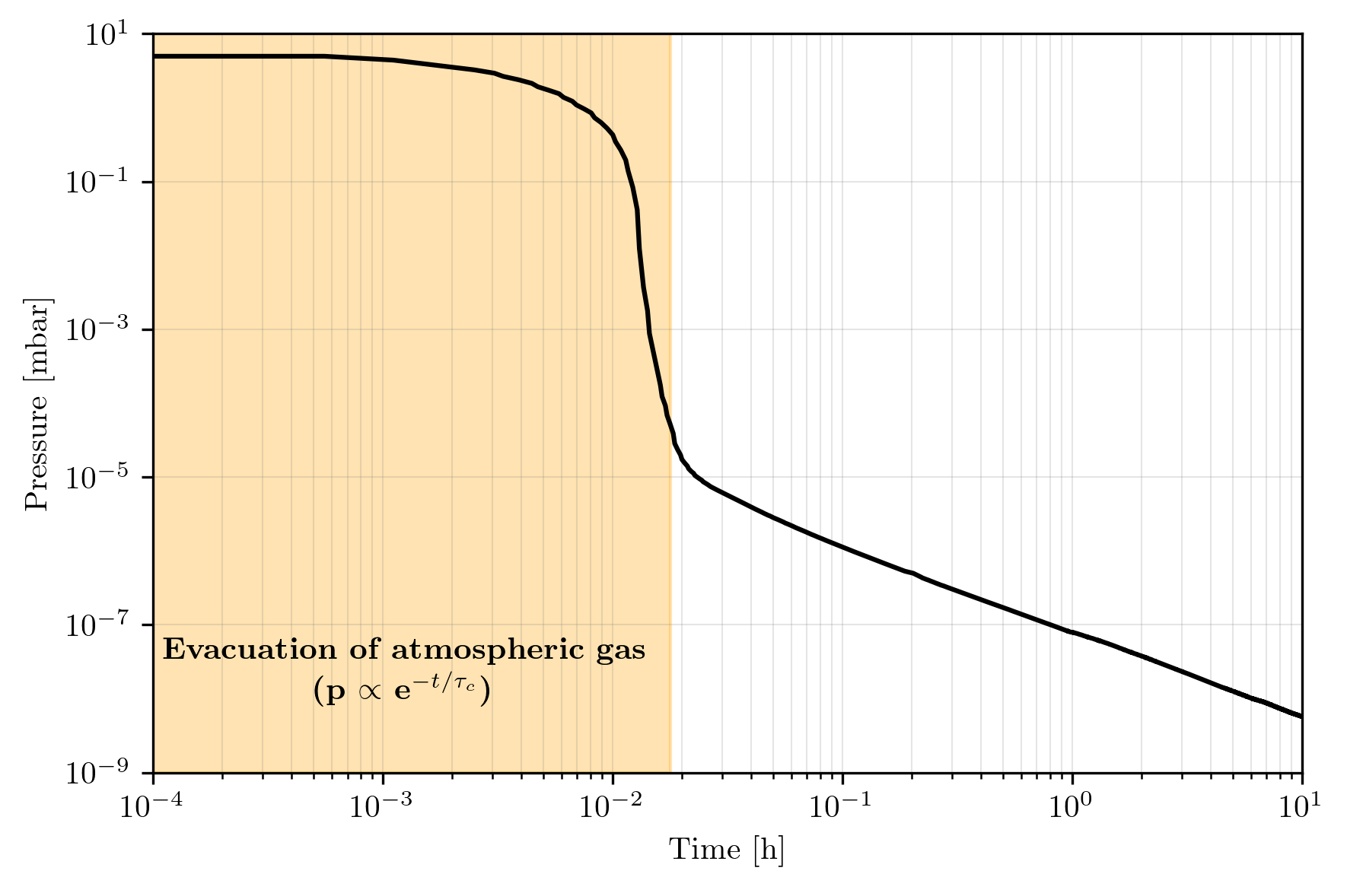
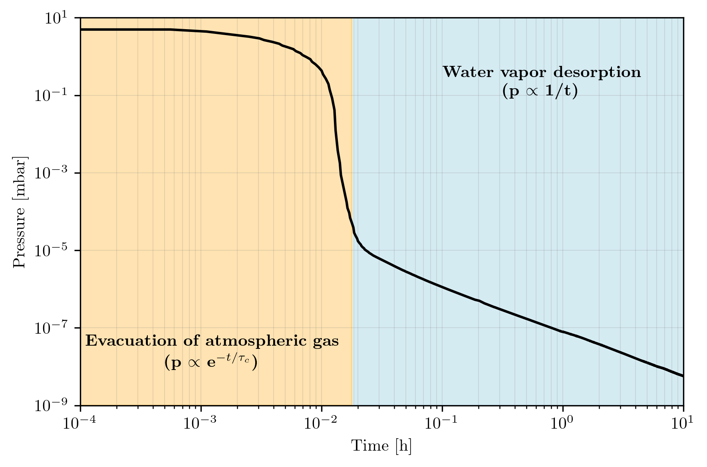
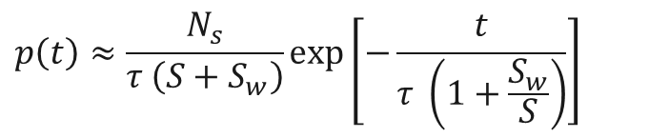


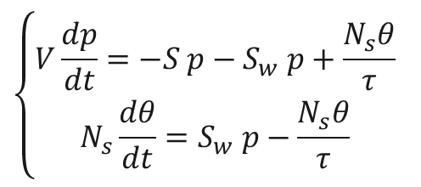
Vacuum system pumpdown: the mathematical approach
Mass balance equation ^{[1,5]}
$$\left\{\begin{aligned}V\frac{dp}{dt}=−S p−S_{w} p+\frac{N_{s}θ}{τ} \\ N_{s}\frac{dθ}{dt}=S_{w} p−\frac{N_{s}θ}{τ}\end{aligned}\right.$$
Beginning of the pumpdown $\left\{\frac{dθ}{dt}≈0\right\}$:
$$p\left(t\right)=p_{0 }e^{−\frac{t}{τ_{c}}}$$
with $τ_{c}= \frac{V}{S}$ characteristic pumping time
Desorption dominated pumpdown $\left\{\frac{dp}{dt}≈0, τ_{c}<τ\text{, }S≪S_{w} \right\}$:
Pumpdown of an AISI 304L chamber at 294 K.
$$p\left(t\right)≈\frac{N_{s}}{τ \left(S+S_{w}\right)}\exp\left[−\frac{t}{τ \left(1+\frac{S_{w}}{S}\right)}\right]$$
Average time spent of a water molecule before leaving the system

Slide 5
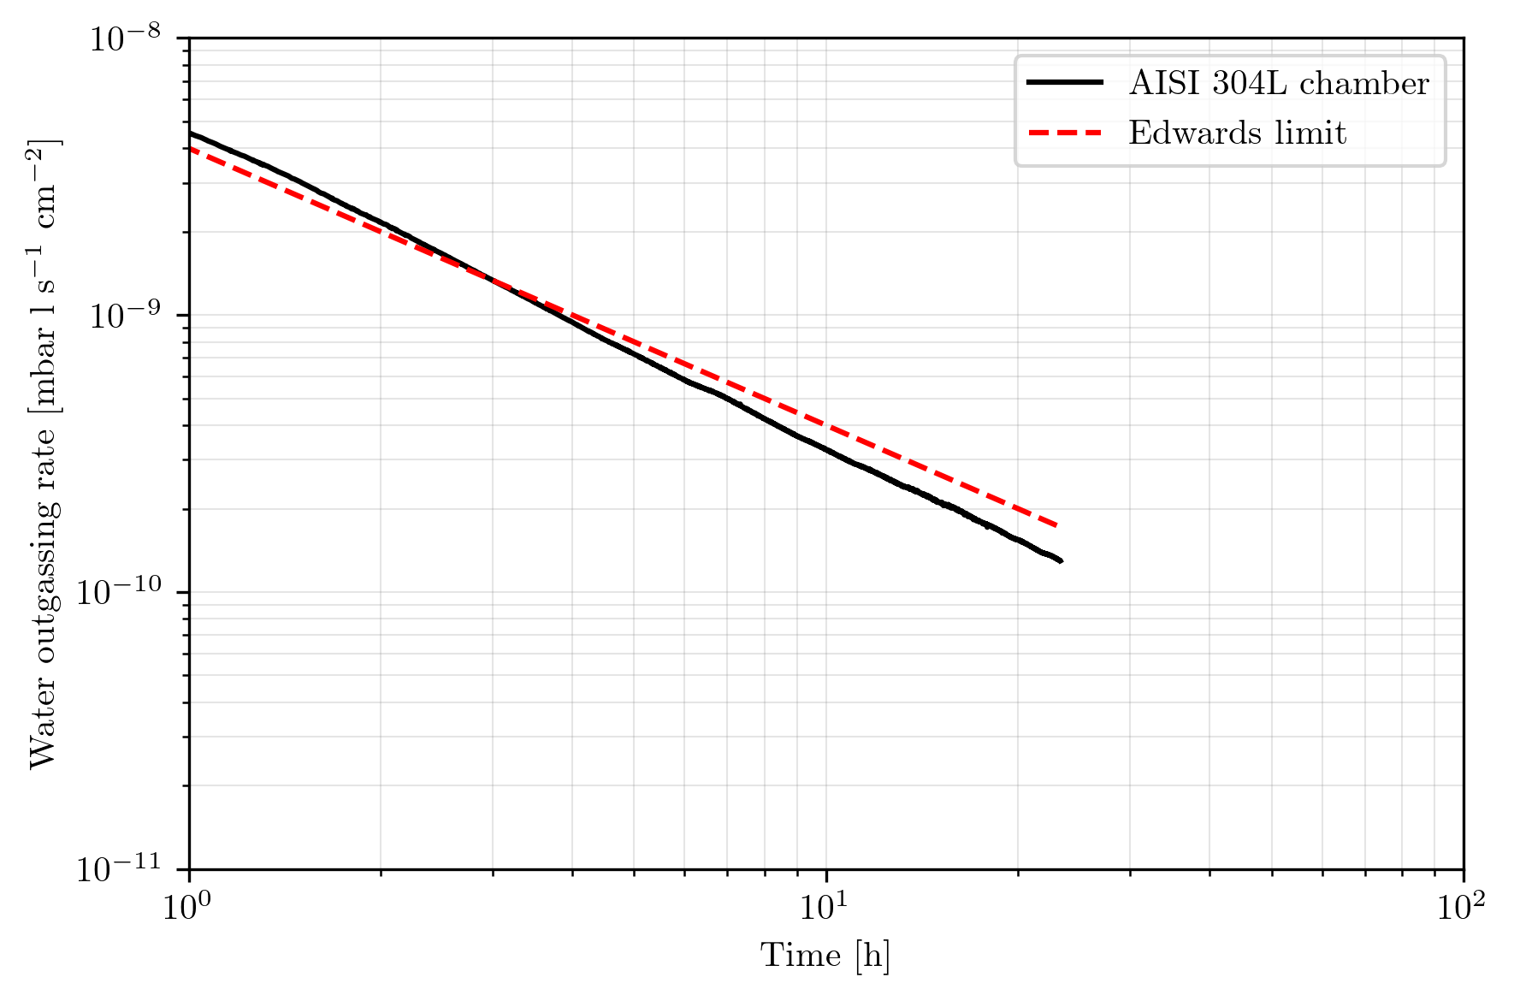

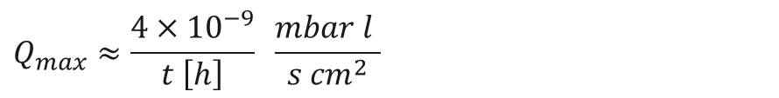
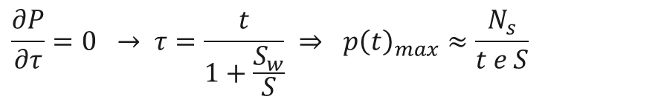
Vacuum system pumpdown: the mathematical approach
The Edwards limit ^{[1,2]}
Desorption dominated pumpdown $\left\{\frac{dp}{dt}≈0, τ_{c}<τ\text{, }S≪S_{w} \right\}$:
$$p\left(t\right)≈\frac{N_{s}}{τ \left(S+S_{w}\right)}\exp\left[−\frac{t}{τ \left(1+\frac{S_{w}}{S}\right)}\right]$$
Maximum pressure during pumpdown:
$$\frac{∂P}{∂τ}=0 → τ=\frac{t}{1+\frac{S_{w}}{S}} ⇒ {p\left(t\right)}_{max}≈\frac{N_{s}}{t e S}$$
Let's assume $n_{m}=1 ML ≈{10}^{15}\frac{molecules}{{cm}^{2}} ≈4{×10}^{−5}\frac{mbar l}{{cm}^{2}} \left(@ 293K\right)$^{[3,4]}:
Pumpdown of an AISI 304L chamber at 294 K.
$$Q_{max}≈\frac{4×{10}^{−9}}{t \left[h\right]} \frac{mbar l }{s {cm}^{2}}$$

Slide 6

0D modelling and limitations
For most of the situations we encounter daily, we can approach with a 0D problem and apply a quasi-static equilibrium (Horikoshi-Kanazawa-Redhead condition^{[6-8]}):
$$\left|\frac{dp}{dt}\right|≪\frac{S_{w}}{V}=\frac{s A p \overline{v}}{4}\frac{1}{V}$$
The inequality is valid upon the satisfaction of two additional conditions:
A surface site can be occupied by one and only one molecule at a time without dissociation.
$s=const$ and equally probable for all the sites.
$$θ⟹θ\left(p,T\right) fully reversible$$
It’s a quasi-static equilibrium! Does not model very well dynamic effects (i.e. changes of pumping speed).
For that, an energy distribution model as to be applied.

Slide 7
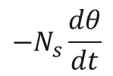


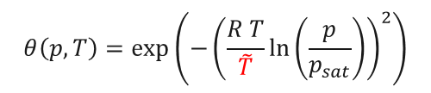
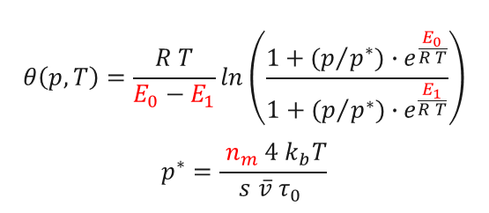
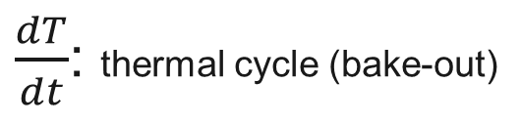
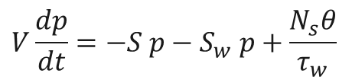
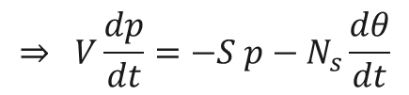
New formulation and possible ads. isotherms
$$V\frac{dp}{dt}=−S p−S_{w} p+\frac{N_{s}θ}{τ_{w}}$$
$$⇒ V\frac{dp}{dt}=−S p−N_{s}\frac{dθ}{dt}$$
$$\underset{⇒}{chain rule} V\frac{dp}{dt}=−S p−N_{s}\left(\frac{dθ}{dp} \frac{dp}{dt}+\frac{dθ}{dT} \frac{dT}{dt}\right)$$
$$−N_{s}\frac{dθ}{dt}$$
$$\frac{dp}{dt}=\frac{−S p−N_{s}\frac{dθ}{dT} \frac{dT}{dt}}{V+N_{s}\frac{dθ}{dp}}$$
$\frac{dT}{dt}$: thermal cycle (bake-out)
Some adsorption isotherms that could be used:
Temkin
Dubinin-Radushkevich
$$θ\left(p,T\right)=\frac{R T}{E_{0}−E_{1}}ln\left(\frac{1+{(p}/{p^{∗})}{∙e}^{\frac{E_{0}}{R T}}}{1+{(p}/{p^{∗})∙}e^{\frac{E_{1}}{R T}}}\right)$$
$$p^{∗}=\frac{ n_{m} 4 k_{b}T}{s \overline{v} τ_{0} }$$
$$θ\left(p,T\right)=\exp\left(−{\left(\frac{R T}{\tilde{T}}\ln\left(\frac{p}{p_{sat}}\right)\right)}^{2}\right)$$
Many others (Sips, Freudlich, ..)

Slide 8
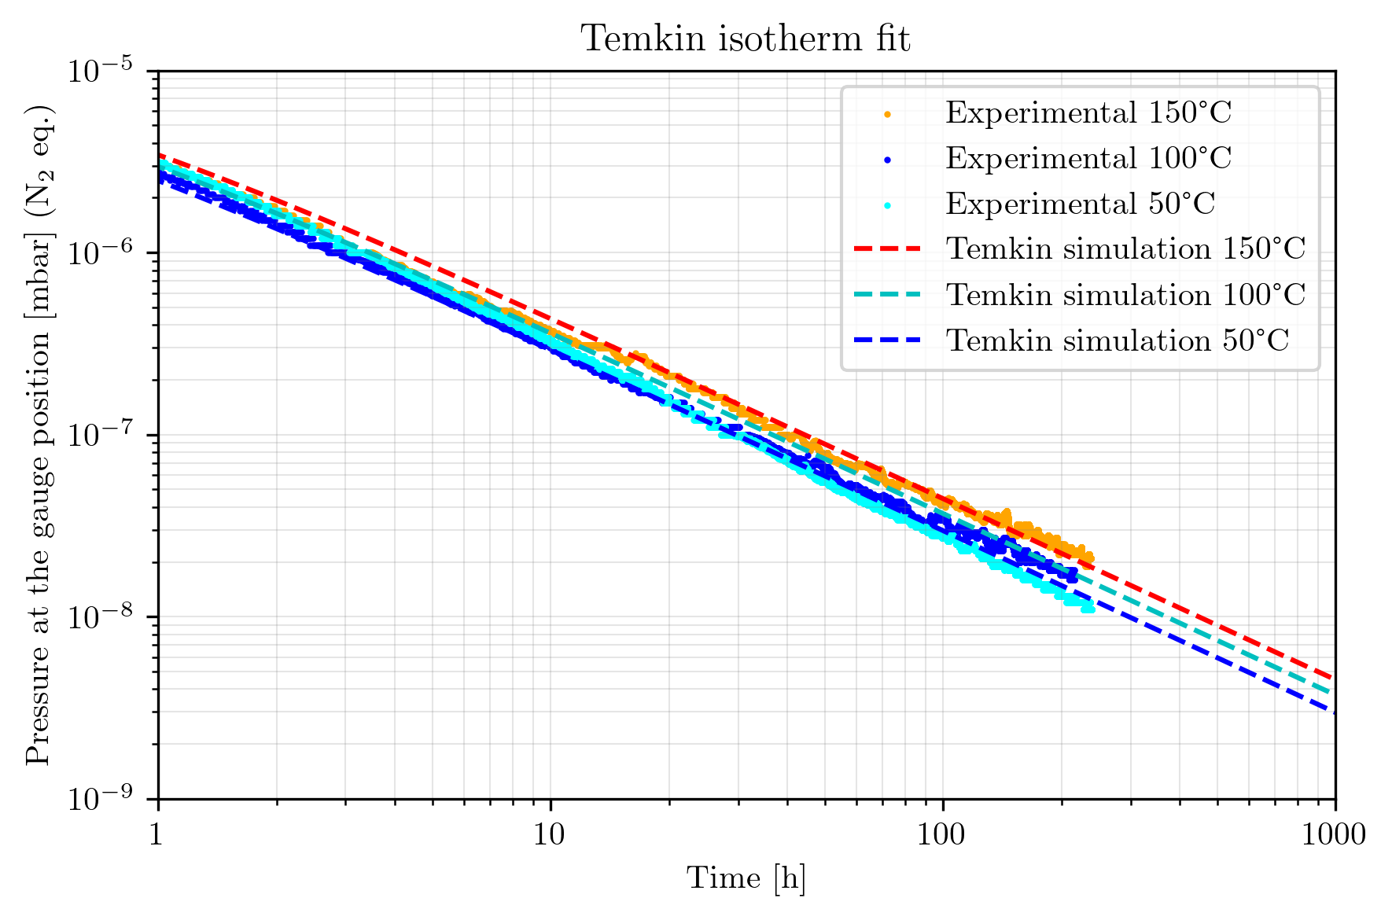
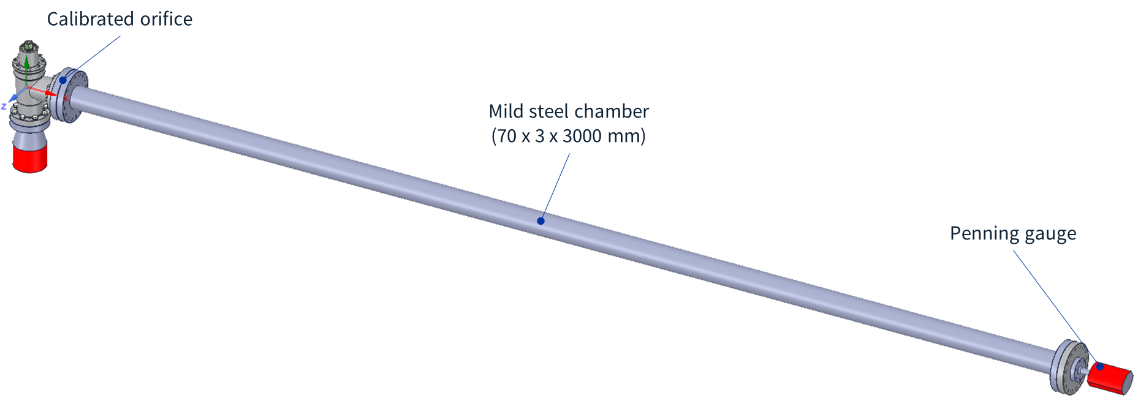



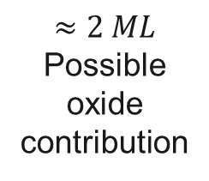
Experimental parameters extraction
Simplest approach:
Series of pumpdown at different temperatures to extract (and adjust) the isotherm parameters ($N_{m}/n_{m}$, $E$, etc.)
Parameters extracted
$$n_{m}:9.8× {10}^{15} molecules/{cm}^{2}$$
$$≈2 ML$$
Possible oxide contribution
$$E_{0}:1.5 eV$$
$$E_{1}:0.3 eV$$
Mild steel chamber baked at 50, 100 and 150⁰C.
(vented to lab conditions for 24h after each pumpdown)

Slide 9
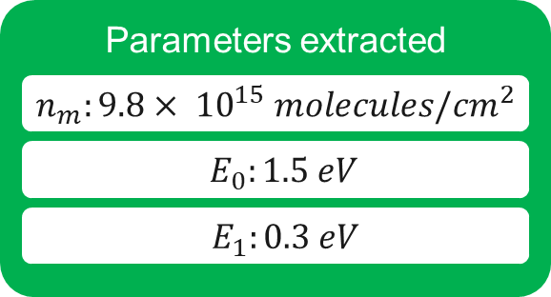
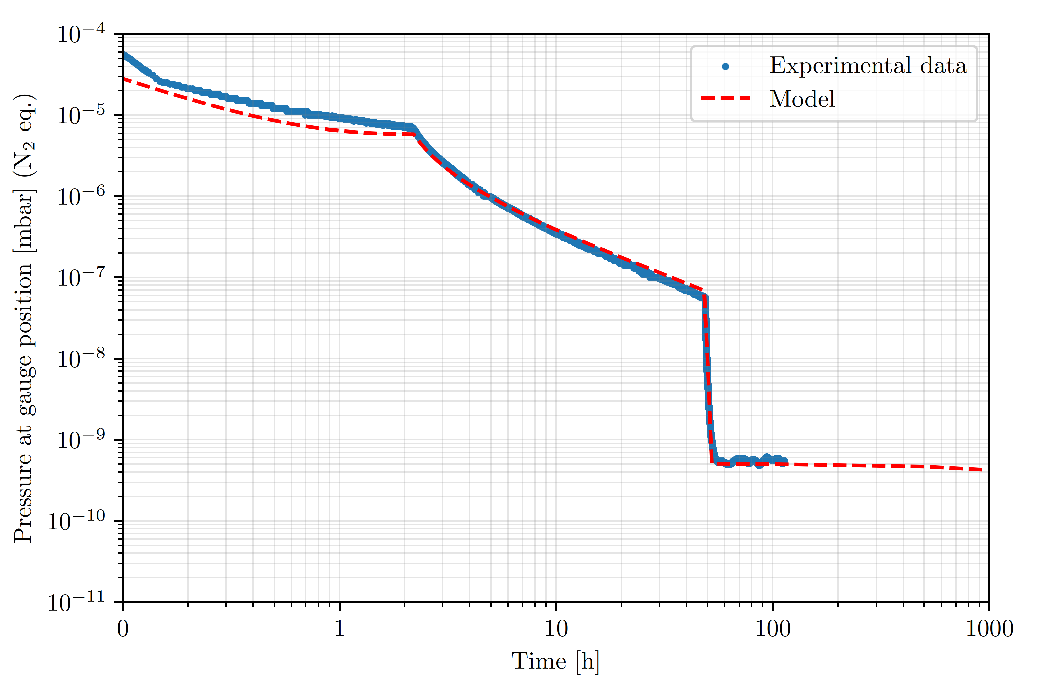
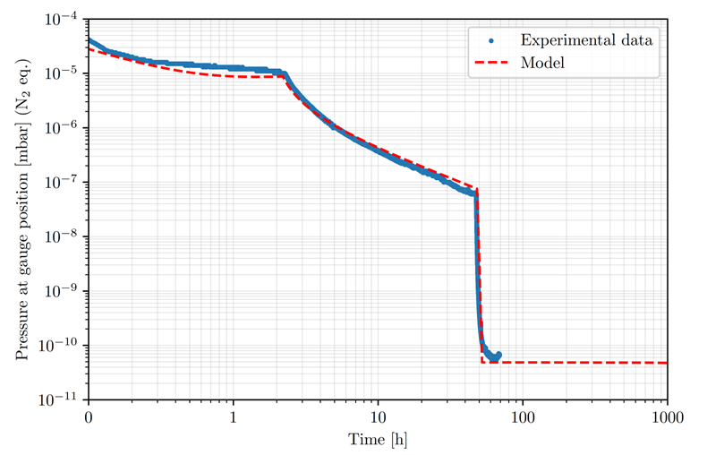
Bake-out simulation
60⁰C, 48 h
80⁰C, 48 h

Slide 10
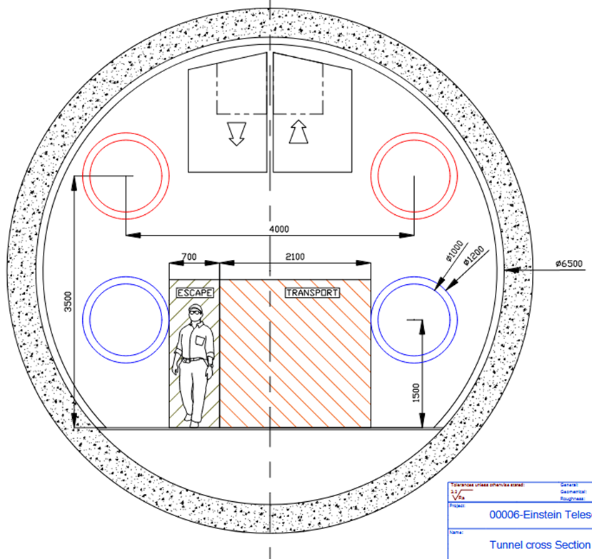
Example of application: the ET beam pipe vacuum design
Dimensions
Beampipe internal diameter: 1 m
Total beampipe length: 120 km
Partial pressure requirements
P (H₂O) ≈ 10⁻¹¹ mbar
Other requirements/characteristics
Bakeout via direct joule effect
Max bakeouts: 1 every 50 years [req.]
Max bakeout temperature: 150⁰C [~req.]
Minimum sector length: 5 km
Source: ET design report update 2020 and XIII ET symposium (2023)
Material: Ferritic stainless steel (AISI 441)

Slide 11
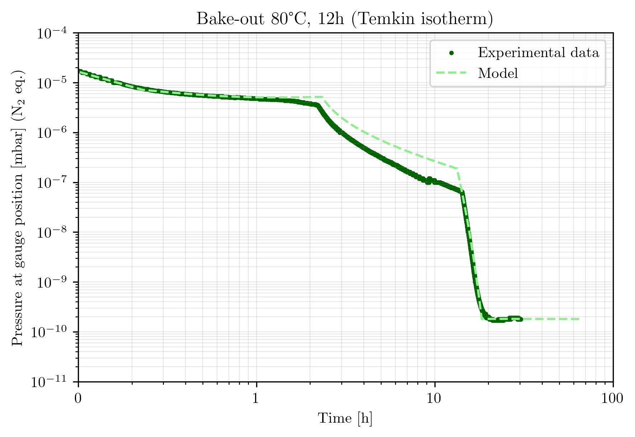
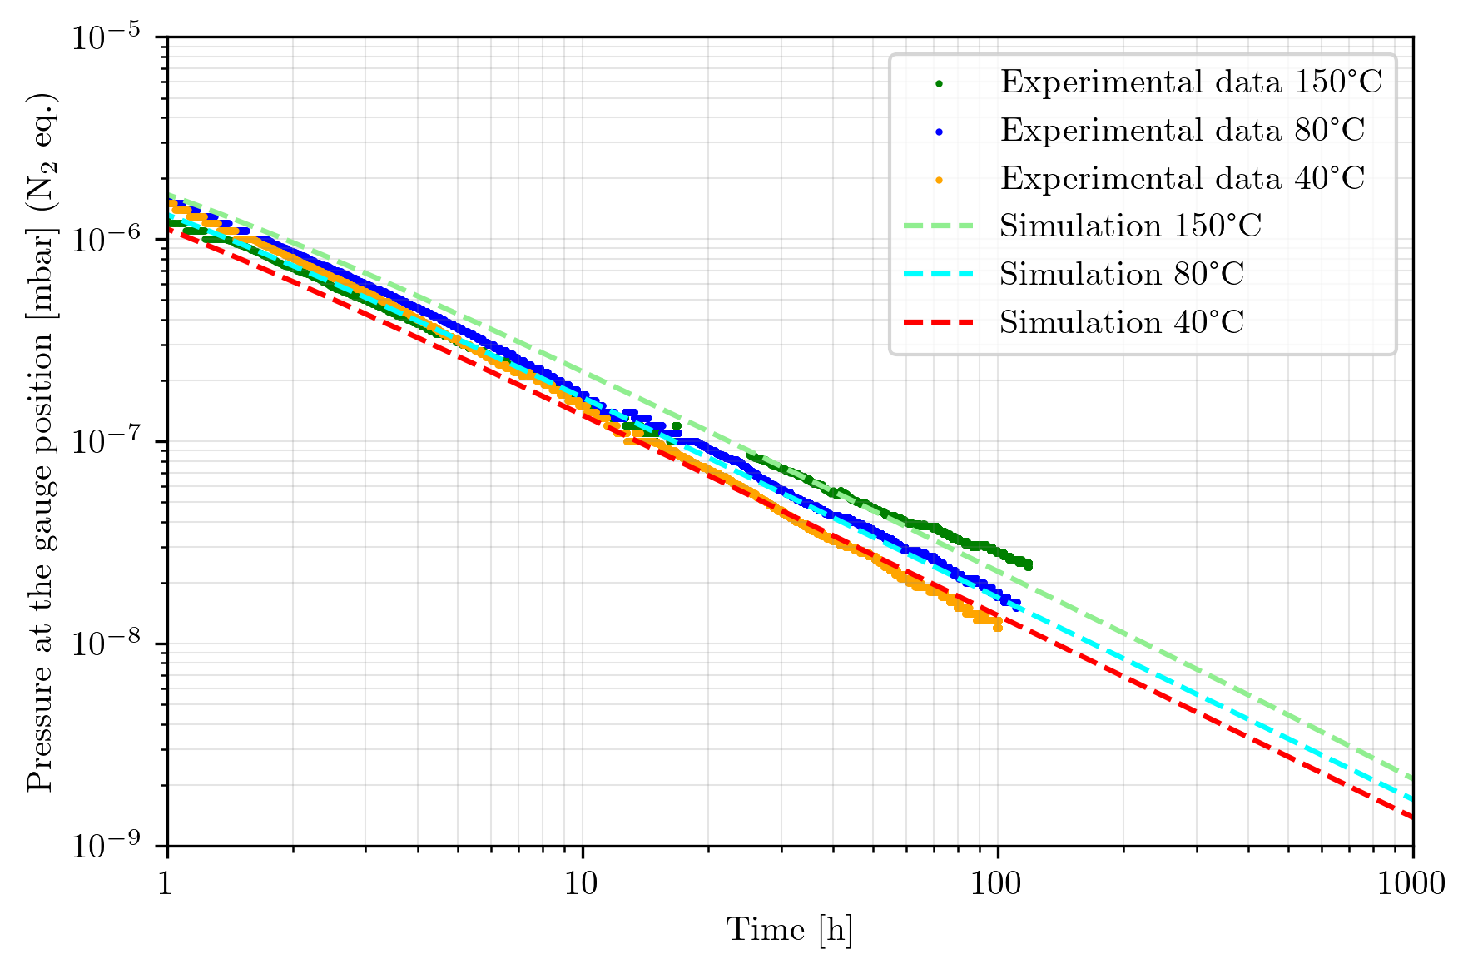
Example of application: the ET beam pipe vacuum design
AISI 441 H₂O partial pressure modelling with Temkin isotherm
H₂O binding energy
&
coverage

Slide 12
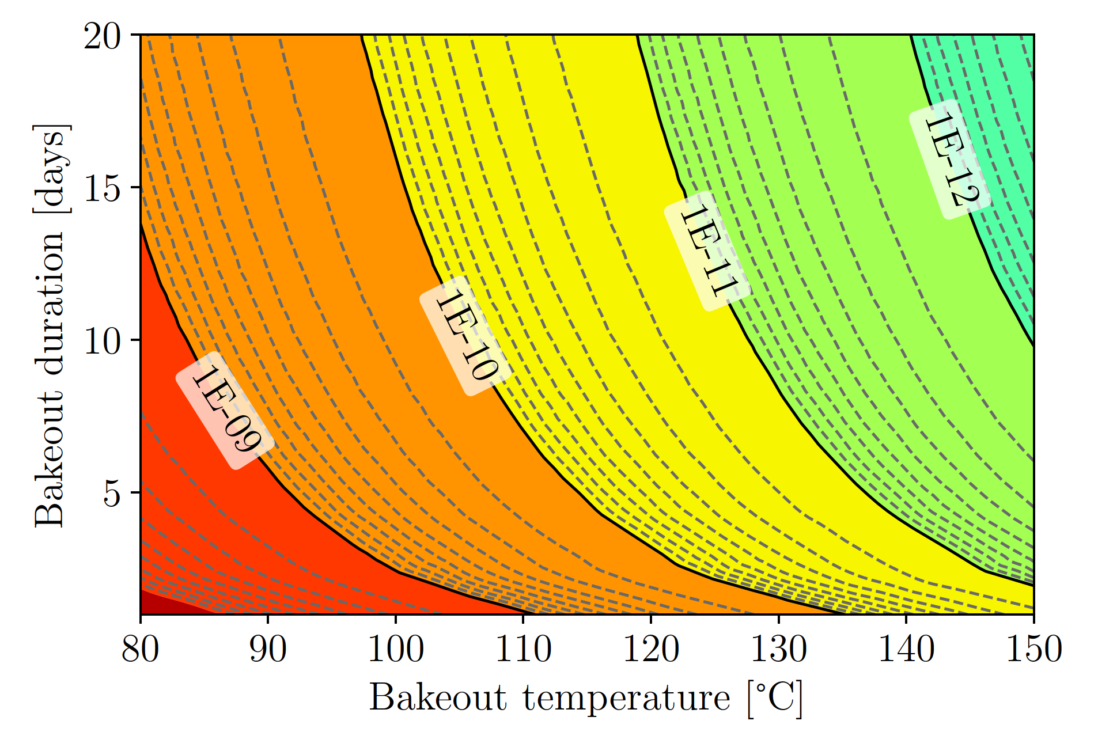
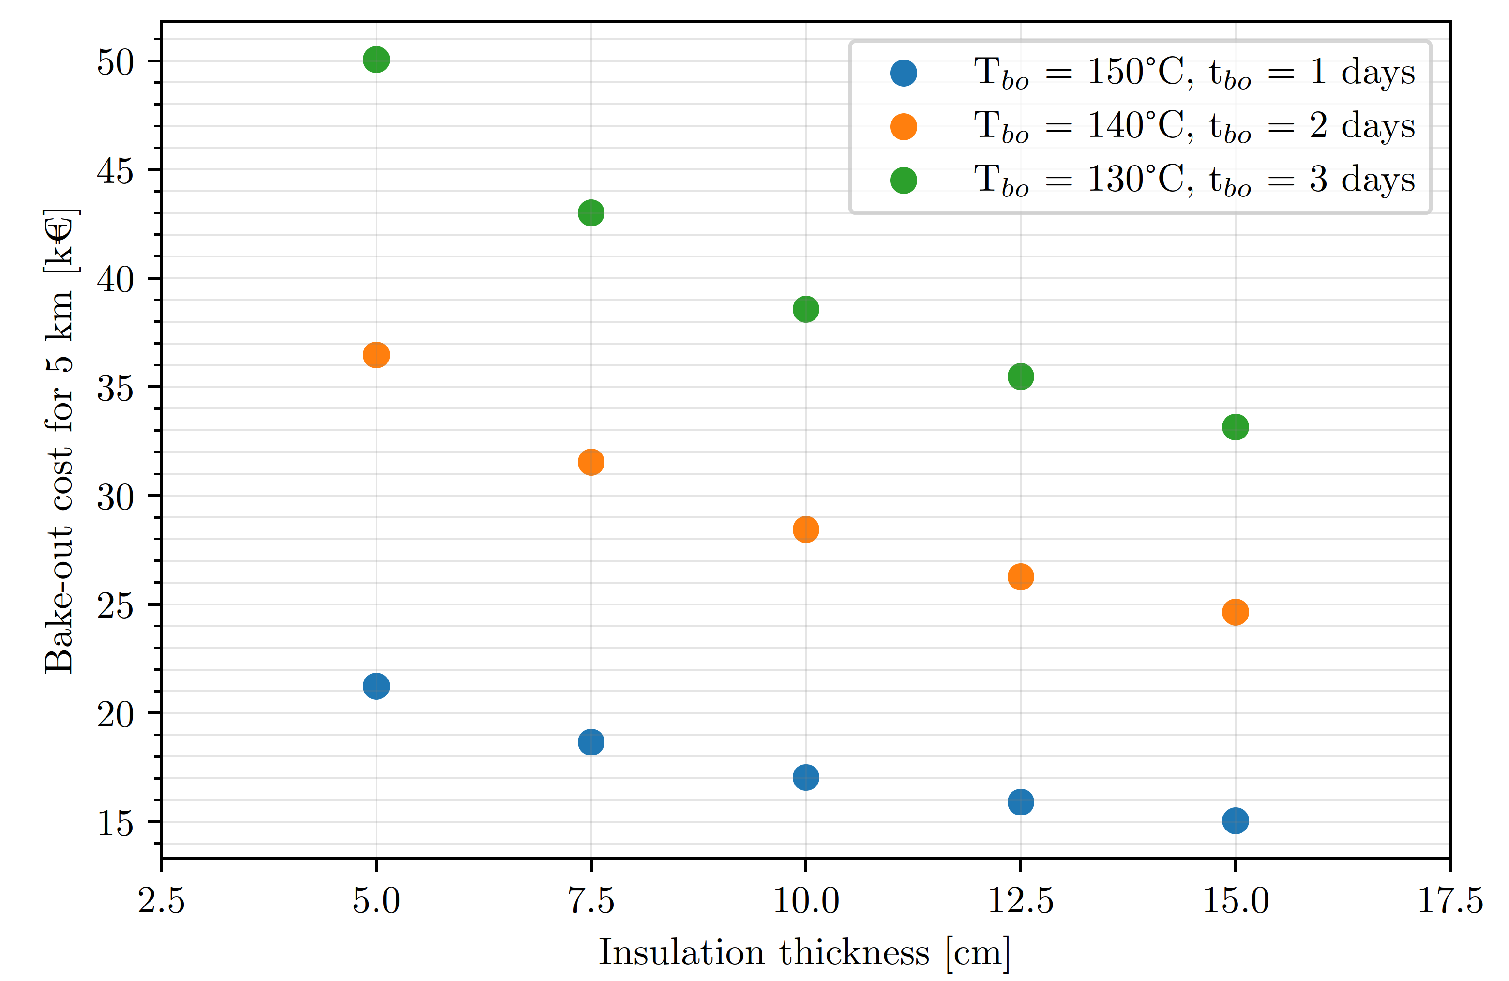
Example of application: the ET beam pipe vacuum design
Simulation of H₂O partial pressure after bakeout and insulation optimisation
H₂O pressure after bakeout between two pumps
Electricity cost per 5 km sector in function of T, duration and insulation thickness (mineral wool)
Pumps distribution:1 Turbomolecular pump (700 l/s nominal) every 2000 m

Slide 13
Conclusions and considerations
Simple first principles can get very close prediction of the water outgassing rate evolution.
With a simple 0D quasi-equilibrium modelling we can model water outgassing behaviour of materials and vacuum systems at room temperature and during bakeout.
The discussed approach can be extended to 1D, 2D and 3D cases. For other applications, cryo-sorption (ice formation) and dynamic vacuum (change in pumping speed, vacuum accumulation) a more refined approach must be used for a better modelling.
NOTE: the adsorption isotherms are a sandbox, their use without a proper experimental confirmation and reasoned evaluation might be highly misleading. Please use them wisely.

Slide 14
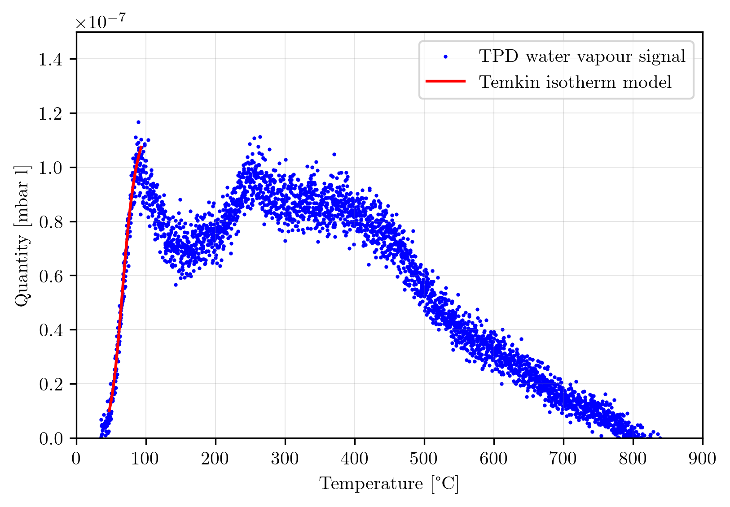
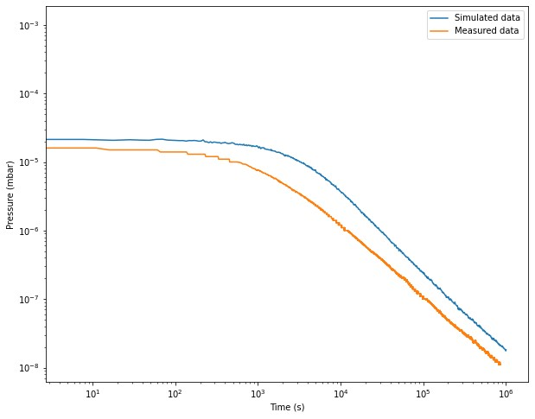
Future developments (?)
H₂O binding energy &
coverage extraction from small samples via TPD
(useful for coatings characterisations)
Molflow+ / COST implemented isotherm to simulate water outgassing in Molflow+
(Lindquist Henriksen – Ady – Kersevan - Scarcia)

Slide 15
Thank you for you attention
A special thanks goes to Jose Antonio Ferreira Somoza for the instructive talks and having introduced me to the topic

Slide 16
References
[1] Jr. D. Edwards,J. Vac. Sci. Technol. 14 (1977) 606–610.
[2] D. Edwards Jr., J. Vac. Sci. Technol. 14 (1977) 1030–1032.
[3] L. Ter Minassian-Saraga, Pure and Applied Chemistry 66.8 (1994),1667–1738.
[4] M. Li and H. F. Dylla, J. Vac. Sci. Tech. A 11 (1993), 1702–1707.
[6] G. Horikoshi, J. Vac. Sci. Technol. A 5 (1987) 2501–2506.
[7] K. Kanazawa, J. Vac. Sci. Technol. A 7 (1989) 3361–3370.
[8] P.A. Redhead, J. Vac. Sci. Technol. Vac. Surf. Films 13 (1995) 467.

