Slide 2
Status of LIU proton beams
F. Asvesta, Hannes Bartosik, E. de la Fuente, I. Karpov, S. Kostoglou, K. Li, I. Mases, L. Mether,
G. Papotti, K. Paraschou, G. Rumolo, B. Salvant, M. Schenk, F.M. Velotti, C. Zannini

Slide 3
Outline
Operational BCMS beam in 2024
  Optimizations applied
  Performance evolution along the year
  Beam degradation on SPS and LHC injection plateaus
Status of LIU performance ramp-up
  Intensity ramp-up
  LIU BCMS beam
  Other beams: standard, 8b4e, hybrid
Summary and outlook

Slide 4
Outline
Operational BCMS beam in 2024
  Optimizations applied
  Performance evolution along the year
  Beam degradation on SPS and LHC injection plateaus
Status of LIU performance ramp-up
  Intensity ramp-up
  LIU BCMS beam
  Other beams: standard, 8b4e, hybrid
Summary and outlook

Slide 5
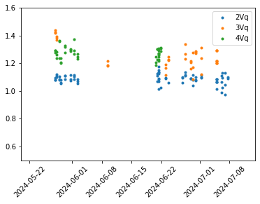
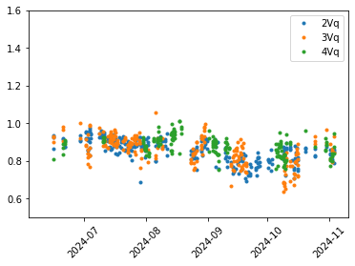
Optimization of BCMS beam in the PSB
Effort mostly concentrated on tail reduction
  V1: BCMS on LIU target: brightness margin was used for tails reduction (ε~1μm/q~1.3 in vertical)
  V2: Introduced scraping at low energy could give Gaussian profiles, propagated to operation (ε ~1μm /q~1 in vertical)
V2: tails
V1: tails

Slide 6
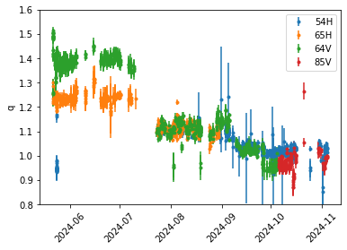
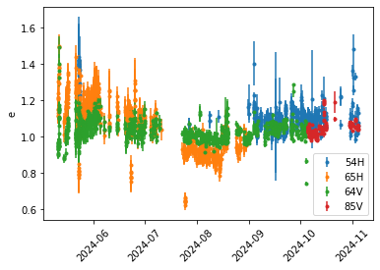
Optimization of BCMS beam in the PS
Effort mostly concentrated on tail reduction
  V1: close to LIU target & WP adjustments at transition for tail reduction (ε~1.1μm /q~1.35)
  V2: Further optimization of WP around transition (ε~1.1μm /q~1.15)
  V3: Further optimization of WP around transition & Chroma correction (ε ~1.1μm /q~1)
  V4?: Improvement couldn’t be traced down to any particular setting or observable …
V3
V3
V1
V2
V1
V2
V4?
V4?

Slide 7
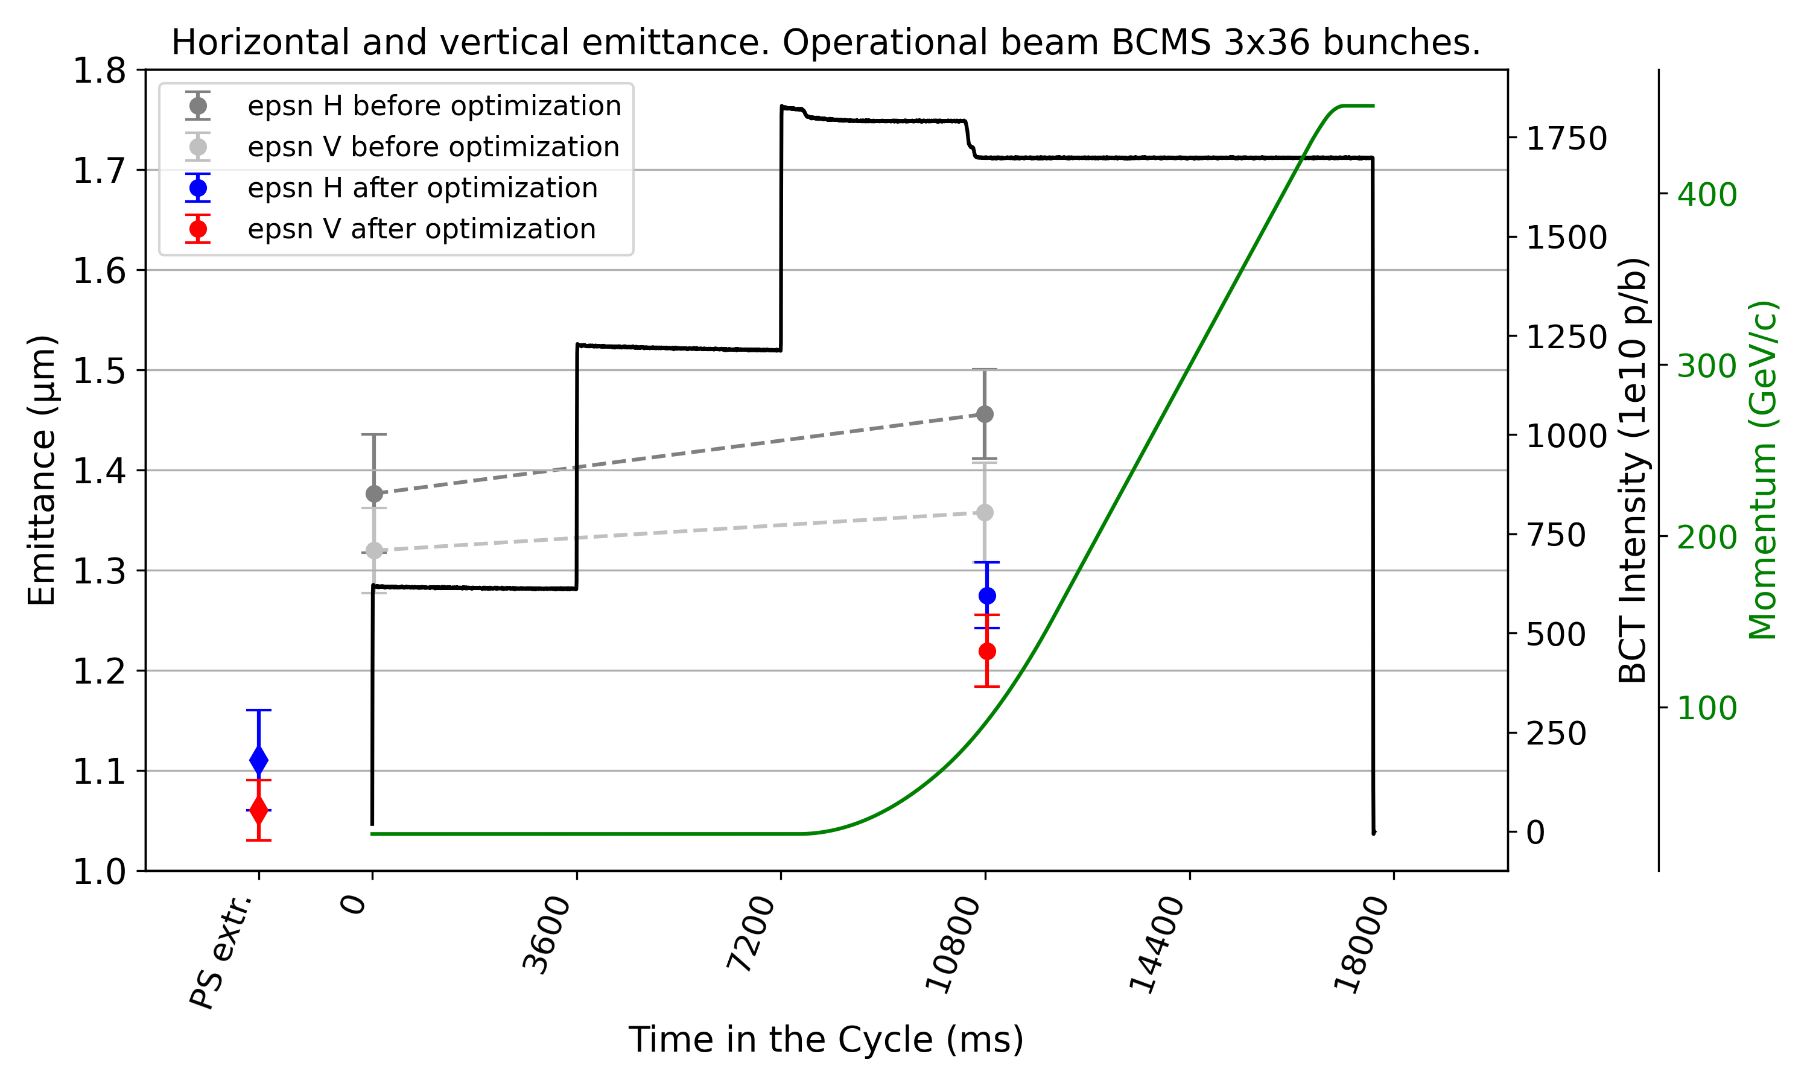
Optimization of BCMS beam in SPS
Working point optimization to reduce emittance blow-up (23.05.2024)
  Keeping the incoherent tunes
  constant along injection plateau
  (instead of coherent tunes
  as done in the past) to minimize
  blow-up from space charge

Slide 8
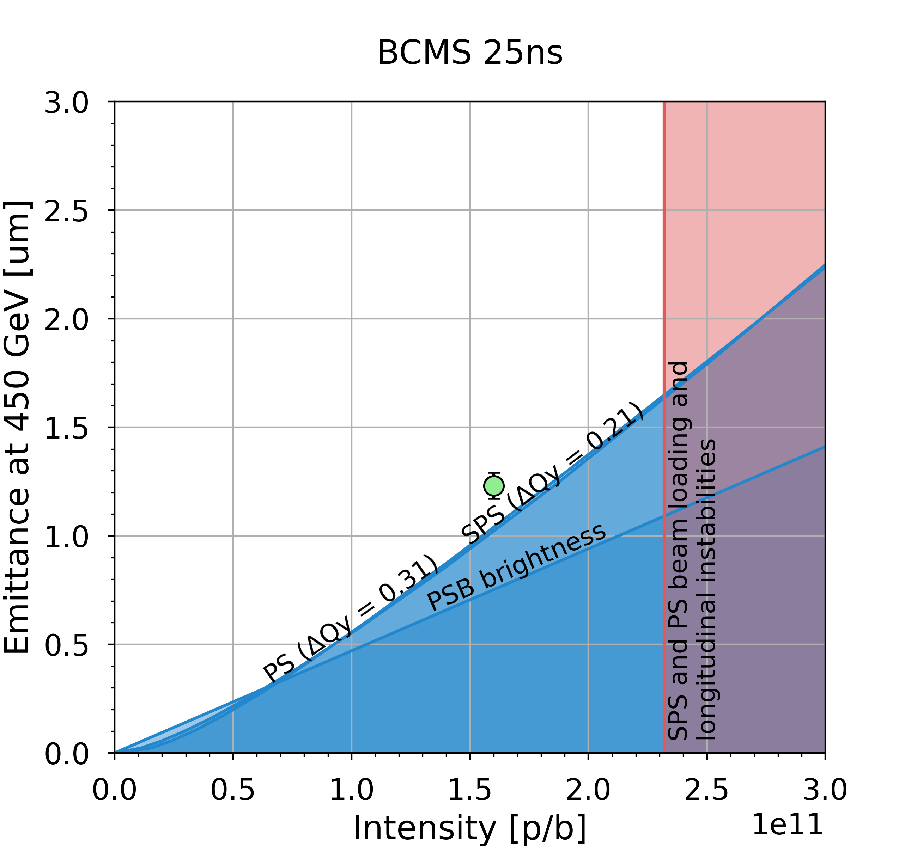
Optimization of BCMS beam in SPS
Working point optimization to reduce emittance blow-up (23.05.2024)
  Keeping the incoherent tunes
  constant along injection plateau
  (instead of coherent tunes
  as done in the past) to minimize
  blow-up from space charge
  Within 15% of LIU brightness target
  Further optimization of beam from
  pre-injectors along the year followed
  (mostly focused on tails)

Slide 9
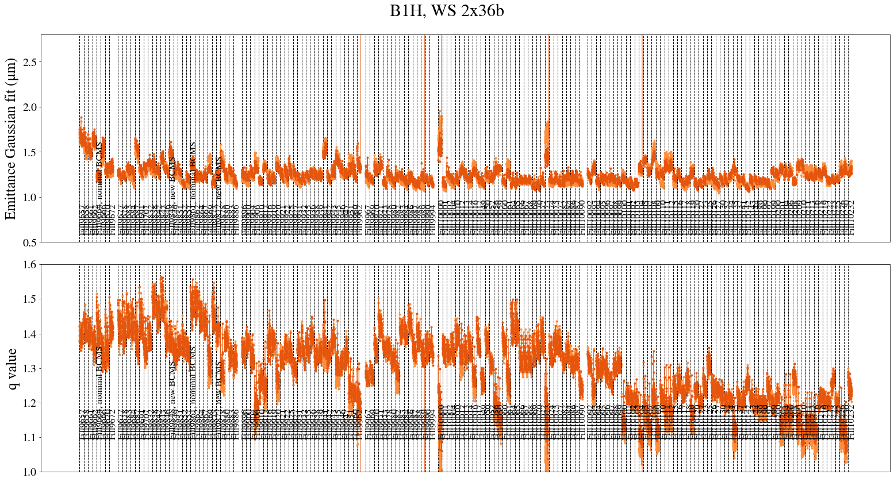
Evolution of emittances / tails at LHC injection
Clear reduction of tails

Slide 10
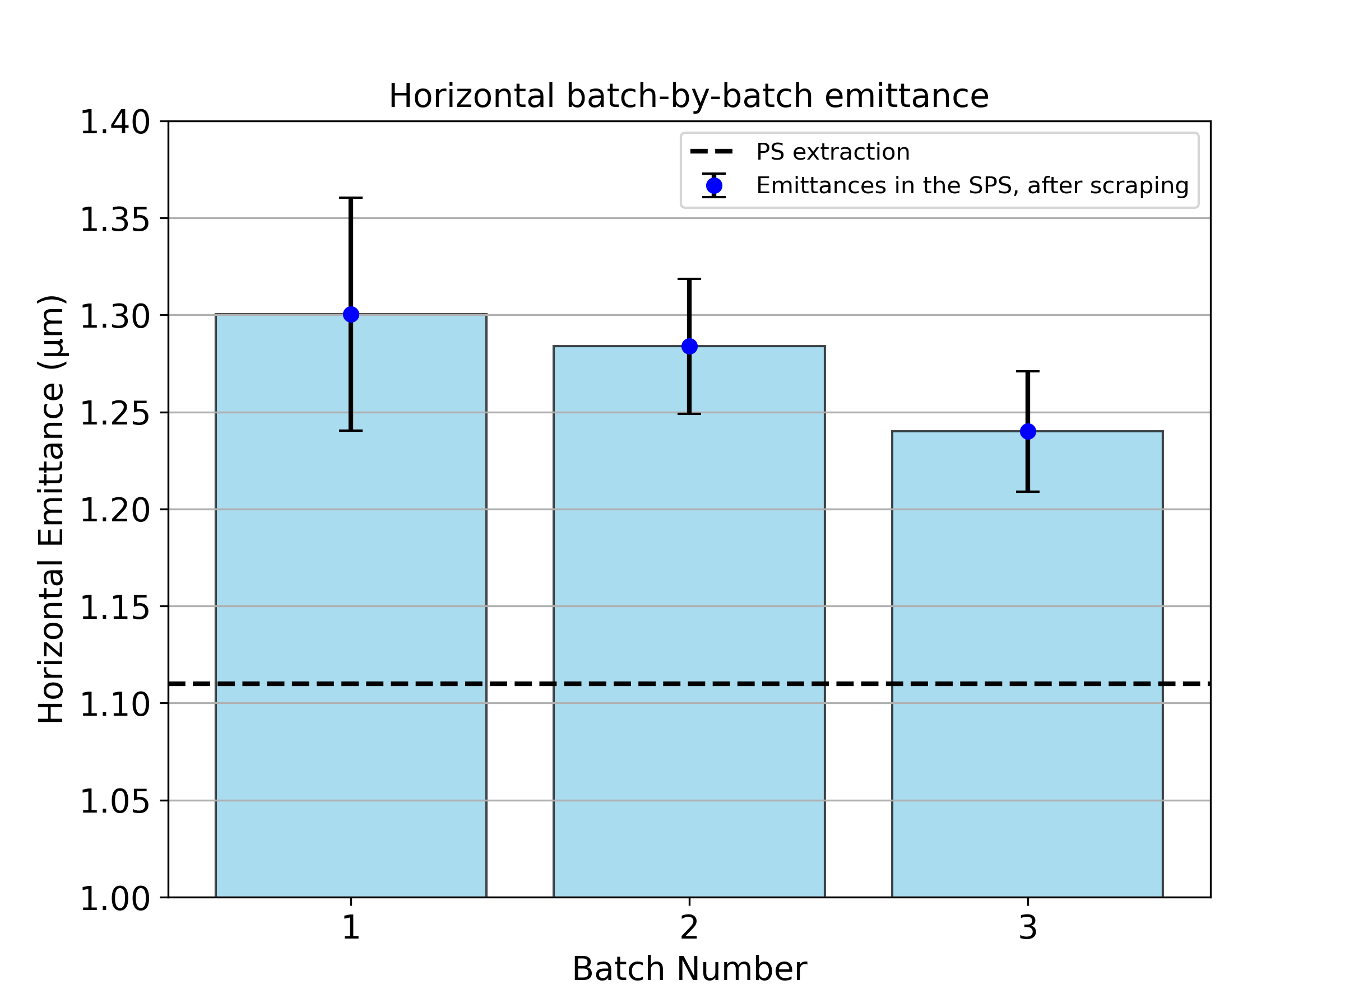
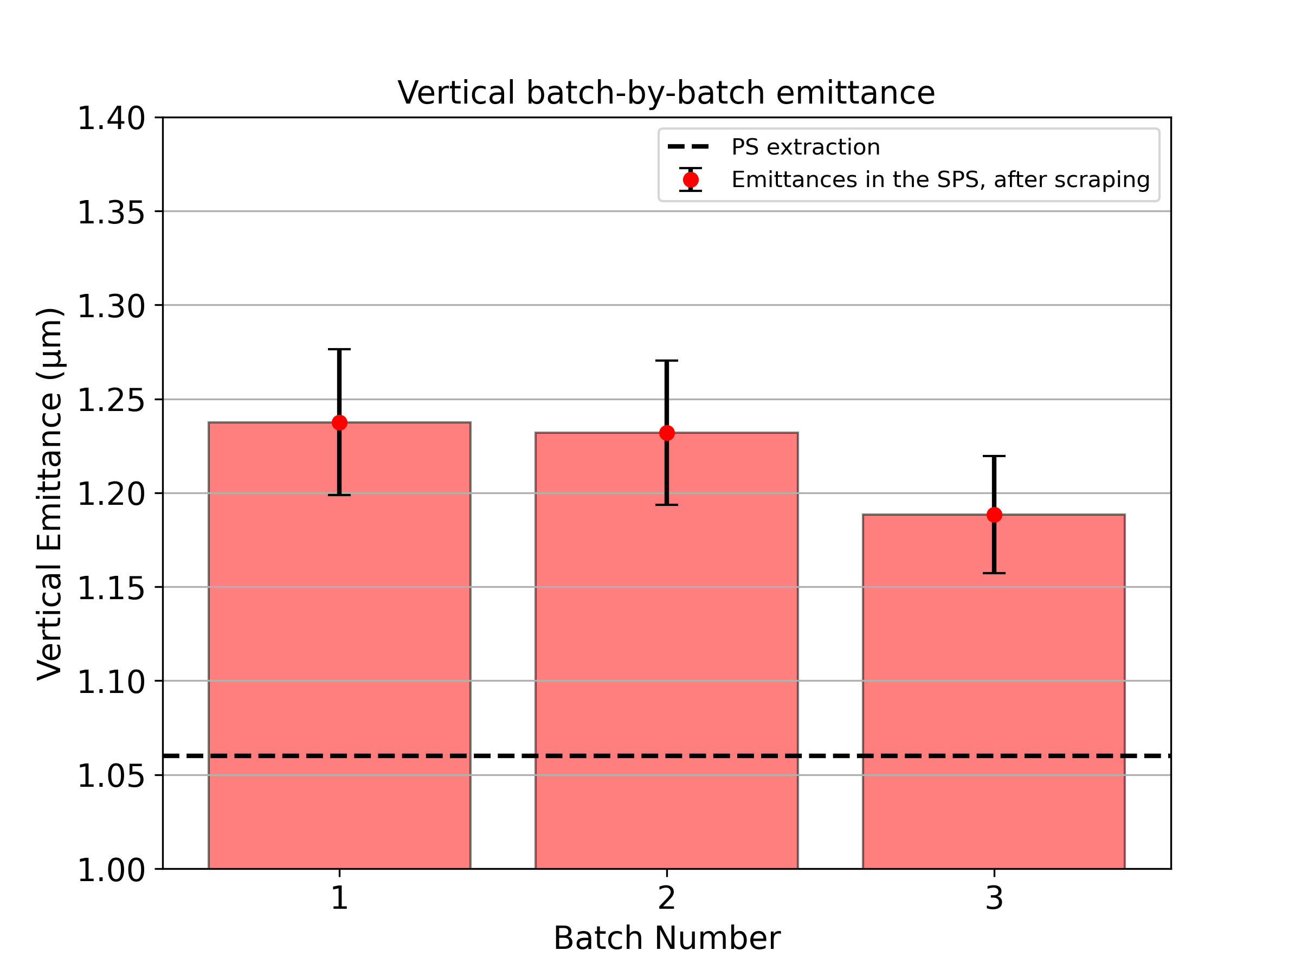
Beam quality degradation – to be improved
Emittance growth (and tail generation) on SPS injection plateau
  Around 10% emittance growth from PS-to-SPS, and around 10% in SPS

Slide 11
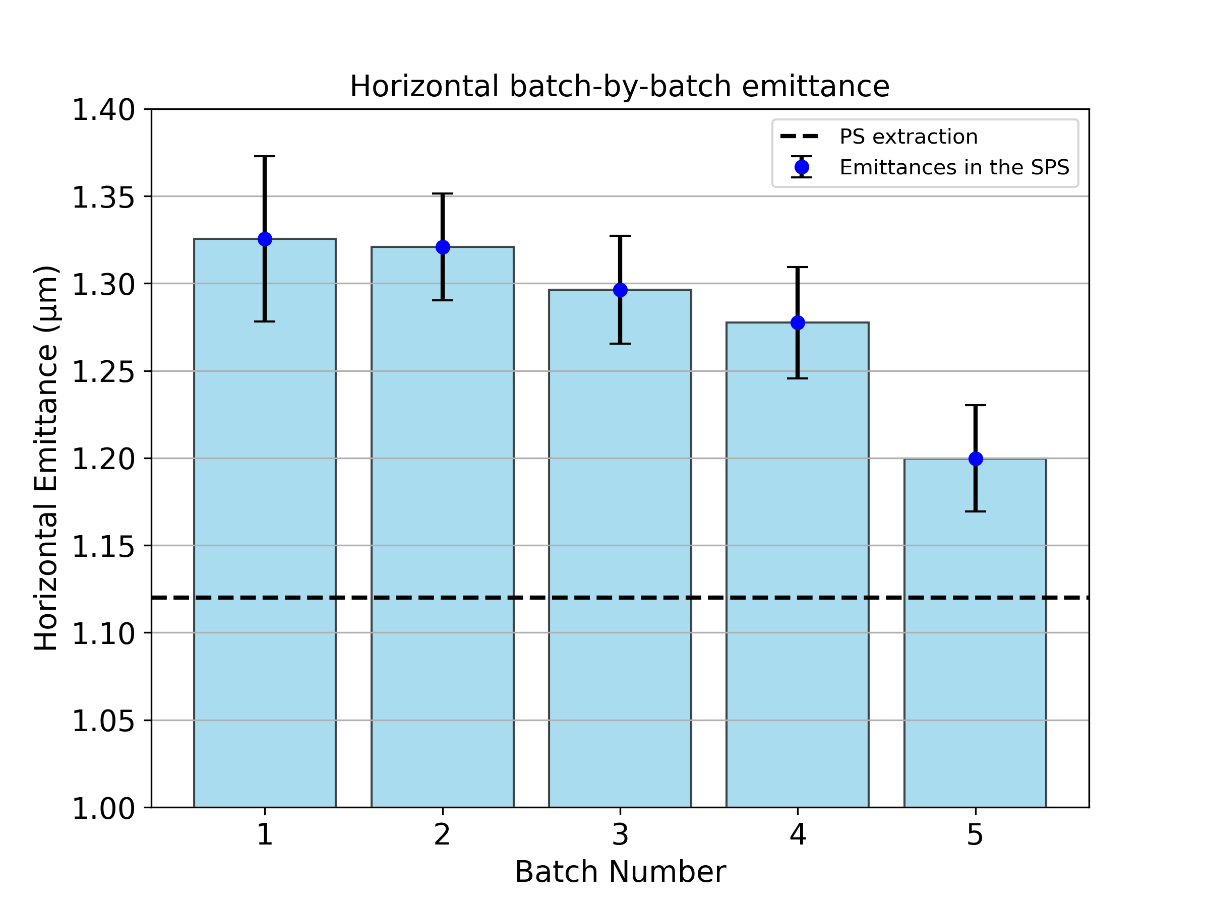
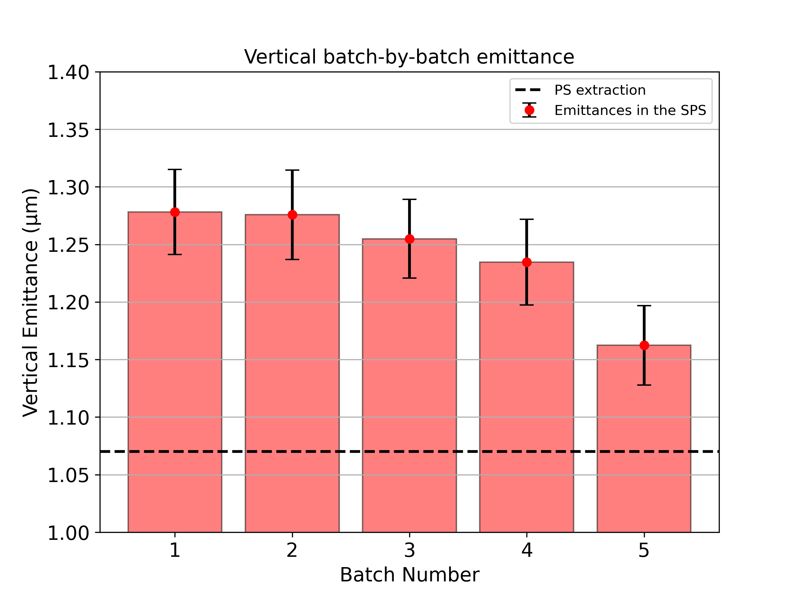
Beam quality degradation – to be improved
Emittance growth (and tail generation) on SPS injection plateau
  Around 10% emittance growth from PS-to-SPS, and around 10% in SPS
Measurement of 5x36 in preparation of 2025 operation
Measurement of 5x36 in preparation of 2025 operation

Slide 12
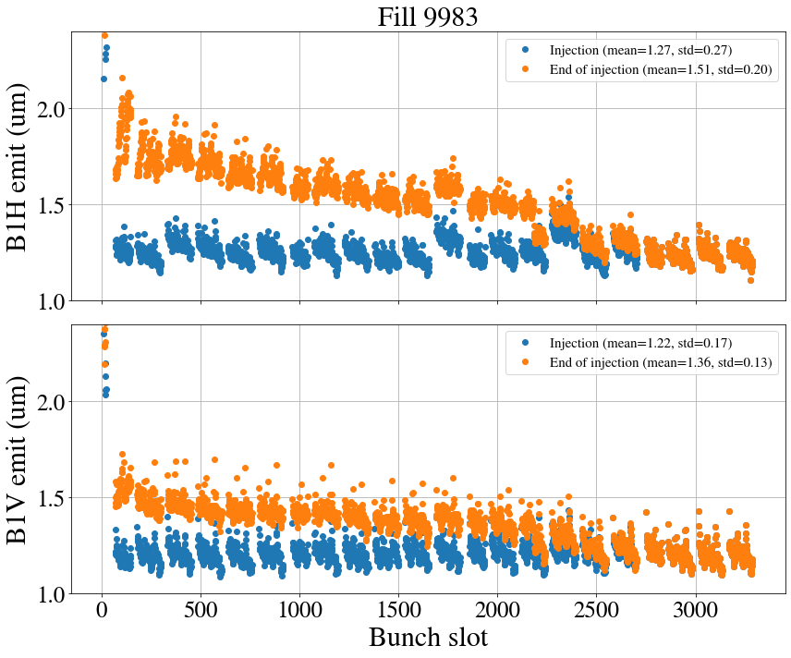
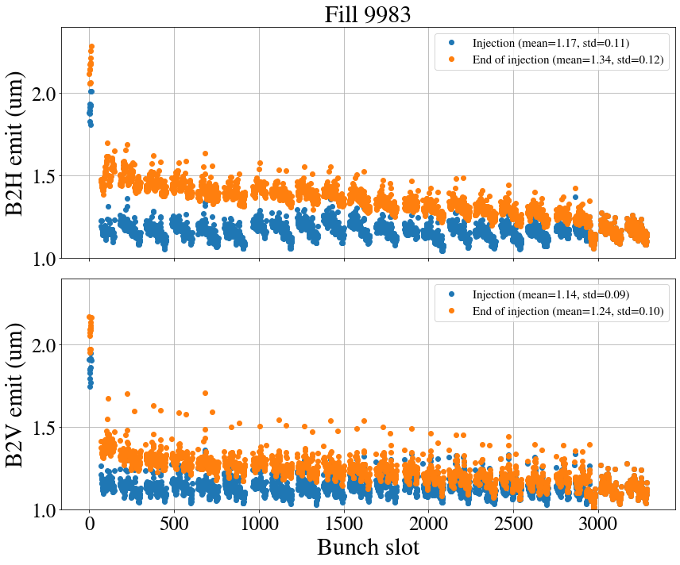
Beam quality degradation – to be improved
Emittance growth (and tail generation) on SPS injection plateau
Emittance growth on LHC injection plateau

Slide 13
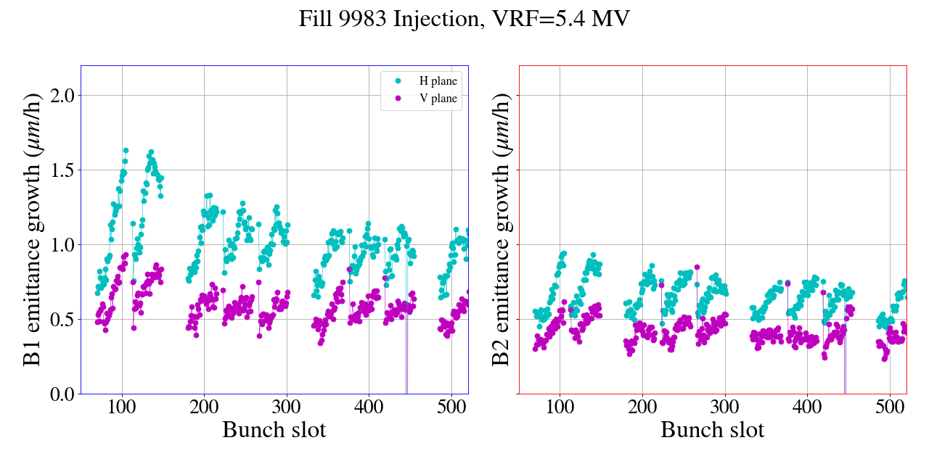
Beam quality degradation – to be improved
Emittance growth (and tail generation) on SPS injection plateau
Emittance growth on LHC injection plateau
  About 0.4 μm / hour (only partially explained by IBS) + e-cloud effects (B1H worse)

Slide 14
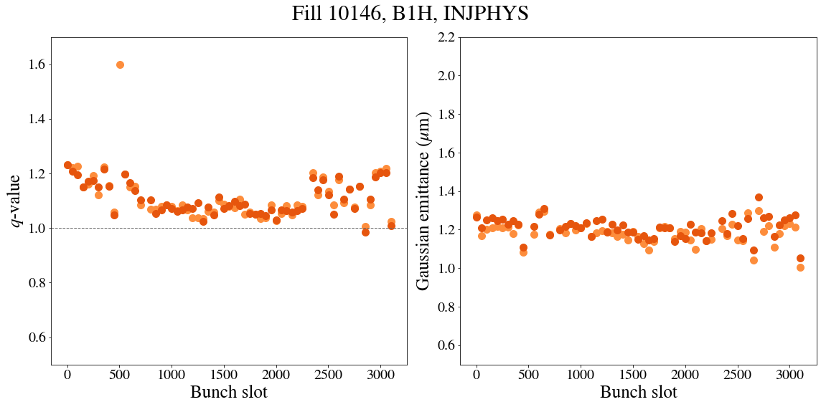
Beam quality degradation – to be improved
Emittance growth (and tail generation) on SPS injection plateau
Emittance growth on LHC injection plateau
Tail generation for B1H at SPS-to-LHC transfer
  Known error in quadrupole transfer function – will be corrected for 2025
B1H
New TF

Slide 15
Outline
Operational BCMS beam in 2024
  Optimizations applied
  Performance evolution along the year
  Beam degradation on SPS and LHC injection plateaus
Status of LIU performance ramp-up
  Intensity ramp-up
  LIU BCMS beam
  Other beams: standard, 8b4e, hybrid
Summary and outlook

Slide 16
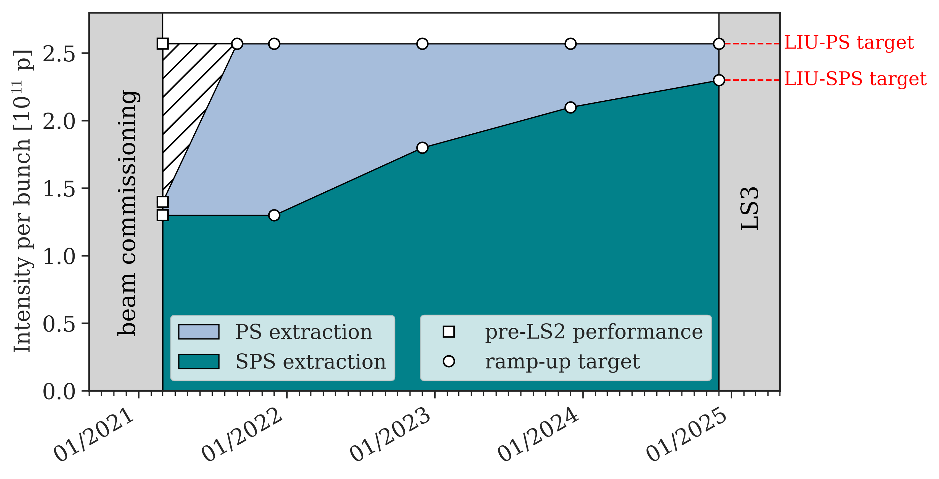
LIU beam commissioning in Run 3: ramp-up plan
Defined at the LIU Montreux workshop in 2020
  Year-by-year intensity goals
  LIU intensity demonstrated in 2024 with 4x72 bunches at 450 GeV
A. Huschauer et al., LIU workshop 2020
4x72 @450 GeV
2x48 @450 GeV

Slide 17
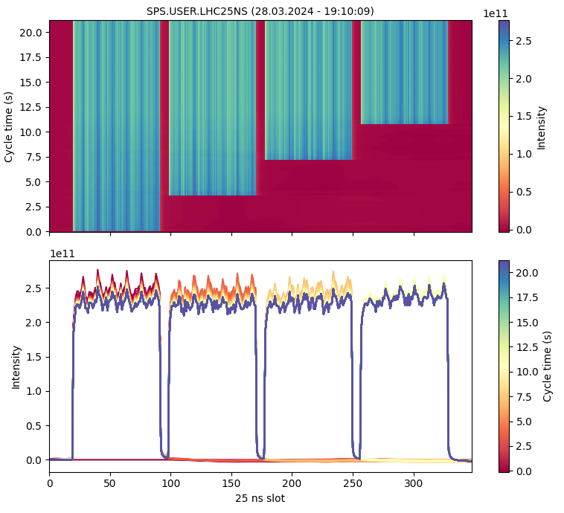
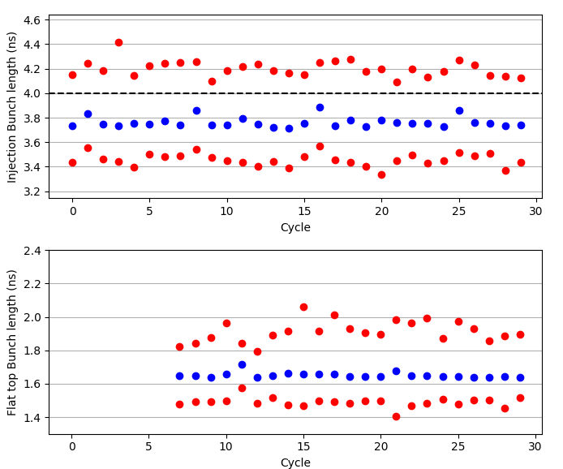
LIU intensity at 450 GeV demonstrated in 2024
Scrubbing run: reached with 4x72 bunches with nominal bunch length
  Transverse emittances not yet optimized for standard beam at LIU intensity
  Further studies limited by RF (vacuum spikes, RF modules breaking) → work is ongoing during the YETS24/25 to make the RF system ready for LIU intensity (improved modules)
Nominal bunch length (1.65 ns) reproducibly achieved

Slide 18
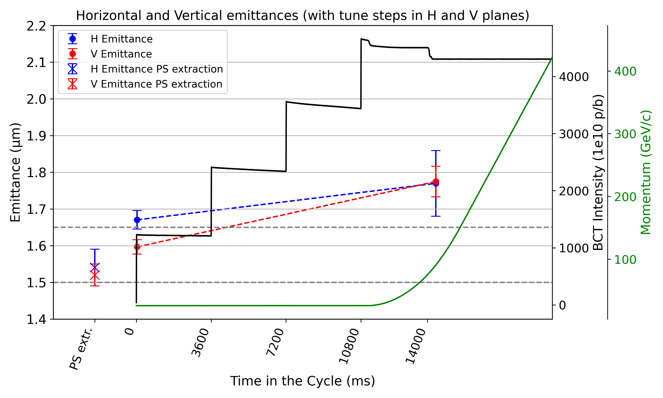
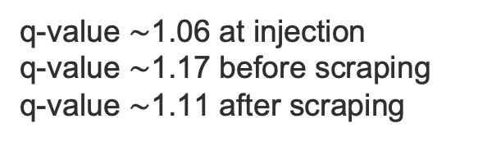
Emittances of BCMS beam at ~LIU intensity
(2024.10.03)
4x48 bunches,
2.6e11 p/b injected intensity
Measurements at
PS extraction.
Measurements at SPS:
Injection (35 ms after inj.)
After scraping
LIU target SPS extraction
LIU target PS extraction
q-value $\sim$1.06 at injection
q-value $\sim$1.17 before scraping
q-value $\sim$1.11 after scraping

Slide 19
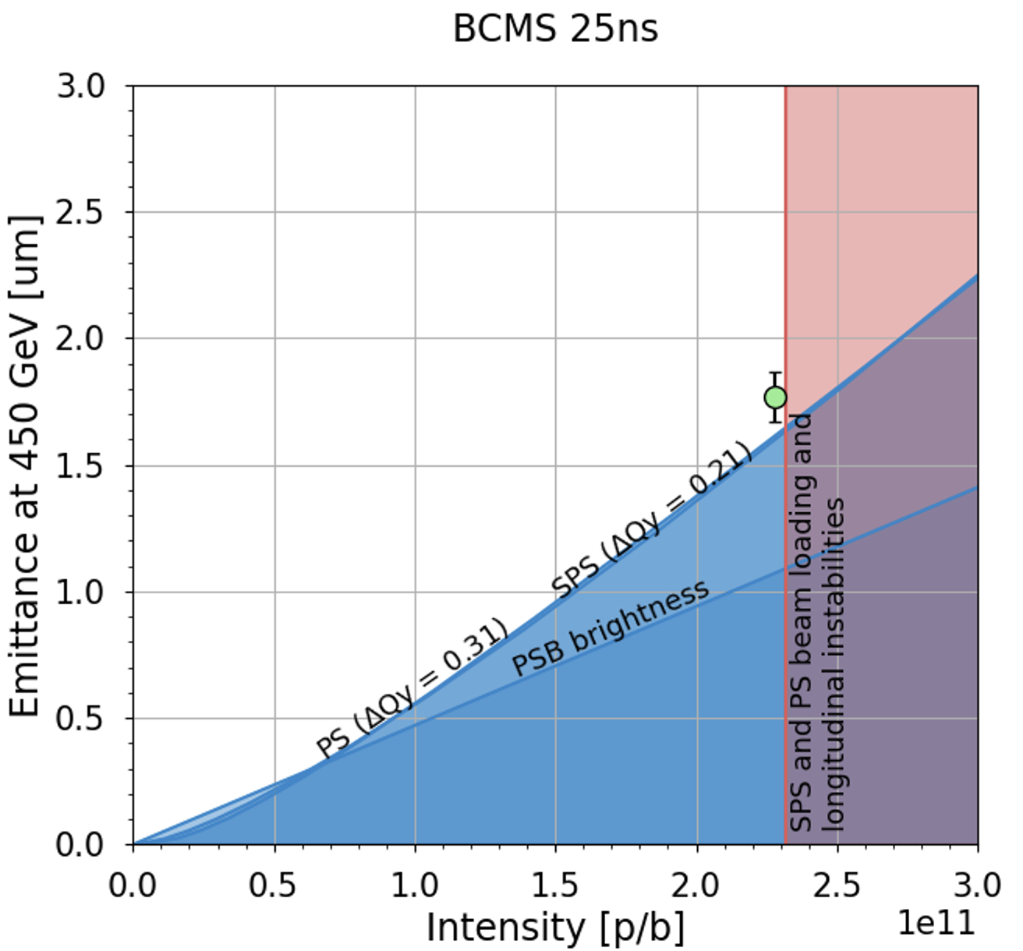
Emittances of BCMS beam at ~LIU intensity
(2024.10.03)
4x48 bunches,
2.6e11 p/b injected intensity
Measurements at
PS extraction.
Measurements at SPS:
Injection (35 ms after inj.)
After scraping
After scraping
q-value $\sim$1.06 at injection
q-value $\sim$1.17 before scraping
q-value $\sim$1.11 after scraping

Slide 20
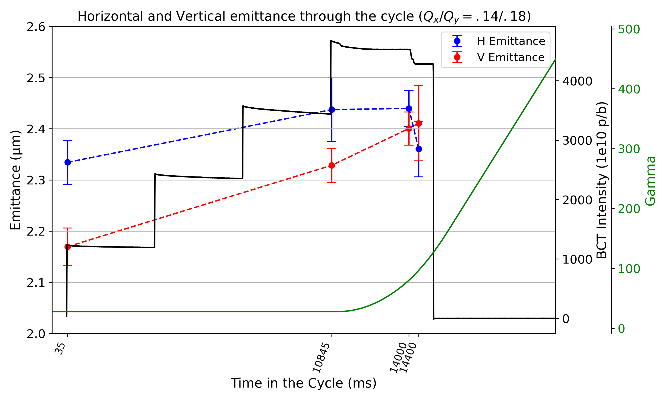
Other beams
Standard beam at ~LIU intensity (4x48 due to limited RF power in 2024)
  Emittances of about 2.4 μm after scraping (LIU target is 2.1 μm)
  Tails are larger than for BCMS beam

Slide 21
Other beams
Standard beam at ~LIU intensity (4x48 due to limited RF power in 2024)
  Emittances of about 2.4 μm after scraping (LIU target is 2.1 μm)
  Tails are larger than for BCMS beam
8b4e
  Maximum intensity reached so far: 2.15e11 p/b at extraction of 4x56 bunches with nominal bunch length (1.65 ns)
  Was not a priority in 2024
Hybrid beam
  Not worked on in 2024

Slide 22
Outline
Operational BCMS beam in 2024
  Optimizations applied
  Performance evolution along the year
  Beam degradation on SPS and LHC injection plateaus
Status of LIU performance ramp-up
  Intensity ramp-up
  LIU BCMS beam
  Other beams: standard, 8b4e, hybrid
Summary and outlook

Slide 23
Summary & Outlook
BCMS beam with improved beam quality (reduced tails) in 2024 operation → clear impact on LHC performance (operating close to burn-off limit)
LIU intensity demonstrated with 4x72 bunches and nominal bunch length
  Emittance and brightness (after scraping) achieved so far with 4x48 bunches
Outlook for 2025
  Continue optimization of BCMS beam (emittance, tails)
  Optimization of other beams depending on priority from HL-LHC (8b4e, standard, hybrid?)
4x48 bunches | Intensity | Emittance | Brightness | Target brightness
standard | 2.3e11 p/b | 2.40 μm | 0.95e11 p/b / μm | 1.1 p/b / μm
BCMS | 2.3e11 p/b | 1.75 μm | 1.3e11 p/b / μm | 1.4 p/b / μm

Slide 24
THANK YOU FOR YOUR ATTENTION

