Slide 1
Performance updates &
A first simple model for comparison between SPS flat bottom duration & LHC injection
Performance Results

Slide 2
Reference
Run | Year | Efficiency | Bunch intensity (1e11 ppb) | β//* (cm) | β_{x}* (cm) | CC | PU_{max} | Days Intensity ramp-up | Days Proton physics [2] | # colliding IP1/5 bunches [3] | # colliding IP8 bunches | Emit start of SB (μm) | IP1/5 crossing plane | IP1/5 φ/2 (μrad) | LHCb L_{peak} (1e33 Hz/cm²) [4] | Losses (mb) | Emittance growth (um/h)
4 | 2030 | 0.5 | 1.8 (1.6) | 30 | 30 | off | 101 | 20 | 6 [1] | 2748 | 2574 | 2.5 | H/V | 250 | 2 | 110 | Extra V 0.04
 | 2031 | 0.5 | 2.2 | 25 | 25 | on | 132 | 15 | 136 | 2748 | 2574 | 2.5 | H/V | 250 | 2 | 110 | Extra V 0.04 + CC noise
 | 2032 | 0.5 | 2.2 | 20 | 20 | on | 132 | 10 | 154 | 2748 | 2574 | 2.5 | H/V | 250 | 2 | 110 | Extra V 0.04 + CC noise
 | 2033 | 0.5 | 2.2 | 20 | 20 | on | 132 | 10 | 152 | 2748 | 2574 | 2.5 | H/V | 250 | 2 | 110 | Extra V 0.04 + CC noise
5 | 2036 | 0.5 | 2.2 | 15 | 15 | on | 132 | 15 | 152 | 2748 | 2574 | 2.5 | H/V | 250 | 2 | 110 | Extra V 0.04 + CC noise
 | 2037 | 0.5 | 2.2 | 15 | 15 | on | 132 | 10 | 195 | 2748 | 2574 | 2.5 | H/V | 250 | 2 | 110 | Extra V 0.04 + CC noise
 | 2038 | 0.5 | 2.2 | 15 | 15 | on | 132 | 10 | 198 | 2748 | 2574 | 2.5 | H/V | 250 | 2 | 110 | Extra V 0.04 + CC noise
 | 2039 | 0.5 | 2.2 | 15 | 15 | on | 132 | 10 | 198 | 2748 | 2574 | 2.5 | H/V | 250 | 2 | 110 | Extra V 0.04 + CC noise
 | 2040 | 0.5 | 2.2 | 15 | 15 | on | 132 | 15 | 165 | 2748 | 2574 | 2.5 | H/V | 250 | 2 | 110 | Extra V 0.04 + CC noise
 | 2041 | 0.5 | 2.2 | 15 | 15 | on | 132 | 10 | 203 | 2748 | 2574 | 2.5 | H/V | 250 | 2 | 110 | Extra V 0.04 + CC noise
[1]: Reaching 1.6e11 ppb and not 1.8e11 ppb at the end of 2030.
[2]: Same numbers of days as DMR M. Zerlauth, 29 days of ions per year in Run4 and 25 days/year in Run5.
[3]: 25ns_2760b_2748_2492_2574_288bpi_13inj_800ns_bs200ns
[4]: Not considering LHCb upgrade after LS4, up to 3% loss of integrated lumi for ATLAS/CMS.

Slide 3
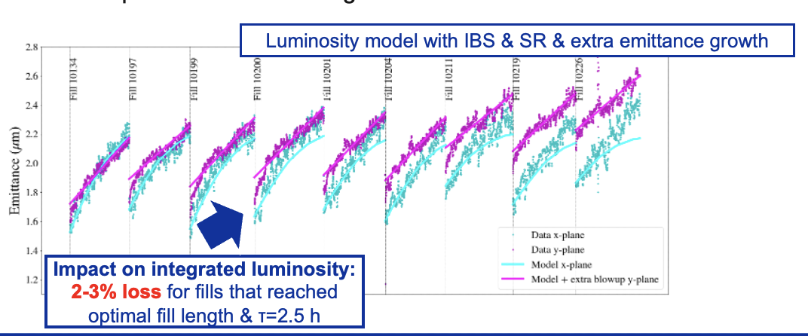
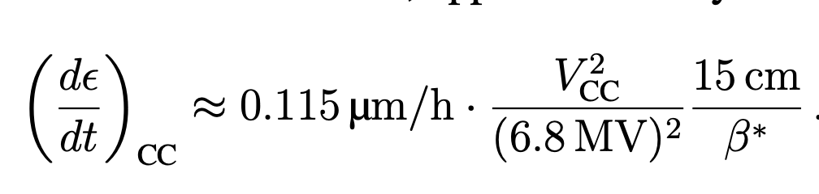
Reference
Run | Year | Efficiency | Bunch intensity (1e11 ppb) | β//* (cm) | β_{x}* (cm) | CC | PU_{max} | Days Intensity ramp-up | Days Proton physics [2] | # colliding IP1/5 bunches [3] | # colliding IP8 bunches | Emit start of SB (μm) | IP1/5 crossing plane | IP1/5 φ/2 (μrad) | LHCb L_{peak} (1e33 Hz/cm²) [4] | Losses (mb) | Emittance growth (um/h)
4 | 2030 | 0.5 | 1.8 (1.6) | 30 | 30 | off | 101 | 20 | 6 [1] | 2748 | 2574 | 2.5 | H/V | 250 | 2 | 110 | Extra V 0.04
 | 2031 | 0.5 | 2.2 | 25 | 25 | on | 132 | 15 | 136 | 2748 | 2574 | 2.5 | H/V | 250 | 2 | 110 | Extra V 0.04 + CC noise
 | 2032 | 0.5 | 2.2 | 20 | 20 | on | 132 | 10 | 154 | 2748 | 2574 | 2.5 | H/V | 250 | 2 | 110 | Extra V 0.04 + CC noise
 | 2033 | 0.5 | 2.2 | 20 | 20 | on | 132 | 10 | 152 | 2748 | 2574 | 2.5 | H/V | 250 | 2 | 110 | Extra V 0.04 + CC noise
5 | 2036 | 0.5 | 2.2 | 15 | 15 | on | 132 | 15 | 152 | 2748 | 2574 | 2.5 | H/V | 250 | 2 | 110 | Extra V 0.04 + CC noise
 | 2037 | 0.5 | 2.2 | 15 | 15 | on | 132 | 10 | 195 | 2748 | 2574 | 2.5 | H/V | 250 | 2 | 110 | Extra V 0.04 + CC noise
 | 2038 | 0.5 | 2.2 | 15 | 15 | on | 132 | 10 | 198 | 2748 | 2574 | 2.5 | H/V | 250 | 2 | 110 | Extra V 0.04 + CC noise
 | 2039 | 0.5 | 2.2 | 15 | 15 | on | 132 | 10 | 198 | 2748 | 2574 | 2.5 | H/V | 250 | 2 | 110 | Extra V 0.04 + CC noise
 | 2040 | 0.5 | 2.2 | 15 | 15 | on | 132 | 15 | 165 | 2748 | 2574 | 2.5 | H/V | 250 | 2 | 110 | Extra V 0.04 + CC noise
 | 2041 | 0.5 | 2.2 | 15 | 15 | on | 132 | 10 | 203 | 2748 | 2574 | 2.5 | H/V | 250 | 2 | 110 | Extra V 0.04 + CC noise
Emittance growth at collisions

Slide 4
Variations
Flat optics
Run | Year | Efficiency | Bunch intensity (1e11 ppb) | β//* (cm) | β_{x}* (cm) | CC | PU_{max} | Days Intensity ramp-up | Days Proton physics | # colliding IP1/5 bunches | # colliding IP8 bunches | Emit start of SB (μm) | IP1/5 crossing plane | IP1/5 φ/2 (μrad) | LHCb L_{peak} (1e33 Hz/cm²) | Losses (mb) | Emittance growth (um/h)
4 | 2030 | 0.5 | 1.8 | 30 | 30 | off | 101 | 20 | 6 | 2748 | 2574 | 2.5 | H/V→V/H | 250 | 2 | 110 | Extra V 0.04
 | 2031 | 0.5 | 2.2 | 25 | 25 | on | 132 | 15 | 136 | 2748 | 2574 | 2.5 | H/V→V/H | 250 | 2 | 110 | Extra V 0.04 + CC noise
 | 2032 | 0.5 | 2.2 | 20→8 | 20→18 | on | 132 | 10 | 154 | 2748 | 2574 | 2.5 | H/V→V/H | 250 | 2 | 110 | Extra V 0.04 + CC noise
 | 2033 | 0.5 | 2.2 | 20→8 | 20→18 | on | 132 | 10 | 152 | 2748 | 2574 | 2.5 | H/V→V/H | 250 | 2 | 110 | Extra V 0.04 + CC noise
5 | 2036 | 0.5 | 2.2 | 15→8 | 15→18 | on | 132 | 15 | 152 | 2748 | 2574 | 2.5 | H/V→V/H | 250 | 2 | 110 | Extra V 0.04 + CC noise
 | 2037 | 0.5 | 2.2 | 15→8 | 15→18 | on | 132 | 10 | 195 | 2748 | 2574 | 2.5 | H/V→V/H | 250 | 2 | 110 | Extra V 0.04 + CC noise
 | 2038 | 0.5 | 2.2 | 15→8 | 15→18 | on | 132 | 10 | 198 | 2748 | 2574 | 2.5 | H/V→V/H | 250 | 2 | 110 | Extra V 0.04 + CC noise
 | 2039 | 0.5 | 2.2 | 15→8 | 15→18 | on | 132 | 10 | 198 | 2748 | 2574 | 2.5 | H/V→V/H | 250 | 2 | 110 | Extra V 0.04 + CC noise
 | 2040 | 0.5 | 2.2 | 15→8 | 15→18 | on | 132 | 15 | 165 | 2748 | 2574 | 2.5 | H/V→V/H | 250 | 2 | 110 | Extra V 0.04 + CC noise
 | 2041 | 0.5 | 2.2 | 15→8 | 15→18 | on | 132 | 10 | 203 | 2748 | 2574 | 2.5 | H/V→V/H | 250 | 2 | 110 | Extra V 0.04 + CC noise

Slide 5
Variations
Smaller initial emittance at start of SB (~12%)
Run | Year | Efficiency | Bunch intensity (1e11 ppb) | β//* (cm) | β_{x}* (cm) | CC | PU_{max} | Days Intensity ramp-up | Days Proton physics | # colliding IP1/5 bunches | # colliding IP8 bunches | Emit start of SB (μm) | IP1/5 crossing plane | IP1/5 φ/2 (μrad) | LHCb L_{peak} (1e33 Hz/cm²) | Losses (mb) | Emittance growth (um/h)
4 | 2030 | 0.5 | 1.8 | 30 | 30 | off | 101 | 20 | 6 | 2748 | 2574 | 2.5→2.2 | H/V | 250 | 2 | 110 | Extra V 0.04
 | 2031 | 0.5 | 2.2 | 25 | 25 | on | 132 | 15 | 136 | 2748 | 2574 | 2.5→2.2 | H/V | 250 | 2 | 110 | Extra V 0.04 + CC noise
 | 2032 | 0.5 | 2.2 | 20 | 20 | on | 132 | 10 | 154 | 2748 | 2574 | 2.5→2.2 | H/V | 250 | 2 | 110 | Extra V 0.04 + CC noise
 | 2033 | 0.5 | 2.2 | 20 | 20 | on | 132 | 10 | 152 | 2748 | 2574 | 2.5→2.2 | H/V | 250 | 2 | 110 | Extra V 0.04 + CC noise
5 | 2036 | 0.5 | 2.2 | 15 | 15 | on | 132 | 15 | 152 | 2748 | 2574 | 2.5→2.2 | H/V | 250 | 2 | 110 | Extra V 0.04 + CC noise
 | 2037 | 0.5 | 2.2 | 15 | 15 | on | 132 | 10 | 195 | 2748 | 2574 | 2.5→2.2 | H/V | 250 | 2 | 110 | Extra V 0.04 + CC noise
 | 2038 | 0.5 | 2.2 | 15 | 15 | on | 132 | 10 | 198 | 2748 | 2574 | 2.5→2.2 | H/V | 250 | 2 | 110 | Extra V 0.04 + CC noise
 | 2039 | 0.5 | 2.2 | 15 | 15 | on | 132 | 10 | 198 | 2748 | 2574 | 2.5→2.2 | H/V | 250 | 2 | 110 | Extra V 0.04 + CC noise
 | 2040 | 0.5 | 2.2 | 15 | 15 | on | 132 | 15 | 165 | 2748 | 2574 | 2.5→2.2 | H/V | 250 | 2 | 110 | Extra V 0.04 + CC noise
 | 2041 | 0.5 | 2.2 | 15 | 15 | on | 132 | 10 | 203 | 2748 | 2574 | 2.5→2.2 | H/V | 250 | 2 | 110 | Extra V 0.04 + CC noise

Slide 6
Variations
Nominal BCMS
Run | Year | Efficiency | Bunch intensity (1e11 ppb) | β//* (cm) | β_{x}* (cm) | CC | PU_{max} | Days Intensity ramp-up | Days Proton physics | # colliding IP1/5 bunches | # colliding IP8 bunches | Emit start of SB (μm) | IP1/5 crossing plane | IP1/5 φ/2 (μrad) | LHCb L_{peak} (1e33 Hz/cm²) | Losses (mb) | Emittance growth (um/h)
4 | 2030 | 0.5 | 1.8 | 30 | 30 | off | 101 | 20 | 6 | 2748→ 2736 | 2574 → 2370 | 2.5→2.2 | H/V | 250 | 2 | 110 | Extra V 0.04
 | 2031 | 0.5 | 2.2 | 25 | 25 | on | 132 | 15 | 136 | 2748→ 2736 | 2574 → 2370 | 2.5→2.2 | H/V | 250 | 2 | 110 | Extra V 0.04 + CC noise
 | 2032 | 0.5 | 2.2 | 20 | 20 | on | 132 | 10 | 154 | 2748→ 2736 | 2574 → 2370 | 2.5→2.2 | H/V | 250 | 2 | 110 | Extra V 0.04 + CC noise
 | 2033 | 0.5 | 2.2 | 20 | 20 | on | 132 | 10 | 152 | 2748→ 2736 | 2574 → 2370 | 2.5→2.2 | H/V | 250 | 2 | 110 | Extra V 0.04 + CC noise
5 | 2036 | 0.5 | 2.2 | 15 | 15 | on | 132 | 15 | 152 | 2748→ 2736 | 2574 → 2370 | 2.5→2.2 | H/V | 250 | 2 | 110 | Extra V 0.04 + CC noise
 | 2037 | 0.5 | 2.2 | 15 | 15 | on | 132 | 10 | 195 | 2748→ 2736 | 2574 → 2370 | 2.5→2.2 | H/V | 250 | 2 | 110 | Extra V 0.04 + CC noise
 | 2038 | 0.5 | 2.2 | 15 | 15 | on | 132 | 10 | 198 | 2748→ 2736 | 2574 → 2370 | 2.5→2.2 | H/V | 250 | 2 | 110 | Extra V 0.04 + CC noise
 | 2039 | 0.5 | 2.2 | 15 | 15 | on | 132 | 10 | 198 | 2748→ 2736 | 2574 → 2370 | 2.5→2.2 | H/V | 250 | 2 | 110 | Extra V 0.04 + CC noise
 | 2040 | 0.5 | 2.2 | 15 | 15 | on | 132 | 15 | 165 | 2748→ 2736 | 2574 → 2370 | 2.5→2.2 | H/V | 250 | 2 | 110 | Extra V 0.04 + CC noise
 | 2041 | 0.5 | 2.2 | 15 | 15 | on | 132 | 10 | 203 | 2748→ 2736 | 2574 → 2370 | 2.5→2.2 | H/V | 250 | 2 | 110 | Extra V 0.04 + CC noise

Slide 7
Variations
Reduced losses
Run | Year | Efficiency | Bunch intensity (1e11 ppb) | β//* (cm) | β_{x}* (cm) | CC | PU_{max} | Days Intensity ramp-up | Days Proton physics | # colliding IP1/5 bunches | # colliding IP8 bunches | Emit start of SB (μm) | IP1/5 crossing plane | IP1/5 φ/2 (μrad) | LHCb L_{peak} (1e33 Hz/cm²) | Losses (mb) | Emittance growth (um/h)
4 | 2030 | 0.5 | 1.8 | 30 | 30 | off | 101 | 20 | 6 | 2748 | 2574 | 2.5 | H/V | 250 | 2 | 110→ 90 | Extra V 0.04
 | 2031 | 0.5 | 2.2 | 25 | 25 | on | 132 | 15 | 136 | 2748 | 2574 | 2.5 | H/V | 250 | 2 | 110→ 90 | Extra V 0.04 + CC noise
 | 2032 | 0.5 | 2.2 | 20 | 20 | on | 132 | 10 | 154 | 2748 | 2574 | 2.5 | H/V | 250 | 2 | 110→ 90 | Extra V 0.04 + CC noise
 | 2033 | 0.5 | 2.2 | 20 | 20 | on | 132 | 10 | 152 | 2748 | 2574 | 2.5 | H/V | 250 | 2 | 110→ 90 | Extra V 0.04 + CC noise
5 | 2036 | 0.5 | 2.2 | 15 | 15 | on | 132 | 15 | 152 | 2748 | 2574 | 2.5 | H/V | 250 | 2 | 110→ 90 | Extra V 0.04 + CC noise
 | 2037 | 0.5 | 2.2 | 15 | 15 | on | 132 | 10 | 195 | 2748 | 2574 | 2.5 | H/V | 250 | 2 | 110→ 90 | Extra V 0.04 + CC noise
 | 2038 | 0.5 | 2.2 | 15 | 15 | on | 132 | 10 | 198 | 2748 | 2574 | 2.5 | H/V | 250 | 2 | 110→ 90 | Extra V 0.04 + CC noise
 | 2039 | 0.5 | 2.2 | 15 | 15 | on | 132 | 10 | 198 | 2748 | 2574 | 2.5 | H/V | 250 | 2 | 110→ 90 | Extra V 0.04 + CC noise
 | 2040 | 0.5 | 2.2 | 15 | 15 | on | 132 | 15 | 165 | 2748 | 2574 | 2.5 | H/V | 250 | 2 | 110→ 90 | Extra V 0.04 + CC noise
 | 2041 | 0.5 | 2.2 | 15 | 15 | on | 132 | 10 | 203 | 2748 | 2574 | 2.5 | H/V | 250 | 2 | 110→ 90 | Extra V 0.04 + CC noise

Slide 8
Variations
“Low-tail” BCMS
Run | Year | Efficiency | Bunch intensity (1e11 ppb) | β//* (cm) | β_{x}* (cm) | CC | PU_{max} | Days Intensity ramp-up | Days Proton physics | # colliding IP1/5 bunches | # colliding IP8 bunches | Emit start of SB (μm) | IP1/5 crossing plane | IP1/5 φ/2 (μrad) | LHCb L_{peak} (1e33 Hz/cm²) | Losses (mb) | Emittance growth (um/h)
4 | 2030 | 0.5 | 1.8 | 30 | 30 | off | 101 | 20 | 6 | 2748→ 2736 | 2574 → 2370 | 2.5→2.2 | H/V | 250 | 2 | 110→ 90 | Extra V 0.04
 | 2031 | 0.5 | 2.2 | 25 | 25 | on | 132 | 15 | 136 | 2748→ 2736 | 2574 → 2370 | 2.5→2.2 | H/V | 250 | 2 | 110→ 90 | Extra V 0.04 + CC noise
 | 2032 | 0.5 | 2.2 | 20 | 20 | on | 132 | 10 | 154 | 2748→ 2736 | 2574 → 2370 | 2.5→2.2 | H/V | 250 | 2 | 110→ 90 | Extra V 0.04 + CC noise
 | 2033 | 0.5 | 2.2 | 20 | 20 | on | 132 | 10 | 152 | 2748→ 2736 | 2574 → 2370 | 2.5→2.2 | H/V | 250 | 2 | 110→ 90 | Extra V 0.04 + CC noise
5 | 2036 | 0.5 | 2.2 | 15 | 15 | on | 132 | 15 | 152 | 2748→ 2736 | 2574 → 2370 | 2.5→2.2 | H/V | 250 | 2 | 110→ 90 | Extra V 0.04 + CC noise
 | 2037 | 0.5 | 2.2 | 15 | 15 | on | 132 | 10 | 195 | 2748→ 2736 | 2574 → 2370 | 2.5→2.2 | H/V | 250 | 2 | 110→ 90 | Extra V 0.04 + CC noise
 | 2038 | 0.5 | 2.2 | 15 | 15 | on | 132 | 10 | 198 | 2748→ 2736 | 2574 → 2370 | 2.5→2.2 | H/V | 250 | 2 | 110→ 90 | Extra V 0.04 + CC noise
 | 2039 | 0.5 | 2.2 | 15 | 15 | on | 132 | 10 | 198 | 2748→ 2736 | 2574 → 2370 | 2.5→2.2 | H/V | 250 | 2 | 110→ 90 | Extra V 0.04 + CC noise
 | 2040 | 0.5 | 2.2 | 15 | 15 | on | 132 | 15 | 165 | 2748→ 2736 | 2574 → 2370 | 2.5→2.2 | H/V | 250 | 2 | 110→ 90 | Extra V 0.04 + CC noise
 | 2041 | 0.5 | 2.2 | 15 | 15 | on | 132 | 10 | 203 | 2748→ 2736 | 2574 → 2370 | 2.5→2.2 | H/V | 250 | 2 | 110→ 90 | Extra V 0.04 + CC noise

Slide 9
Variations
CC emittance growth fully mitigated
Run | Year | Efficiency | Bunch intensity (1e11 ppb) | β//* (cm) | β_{x}* (cm) | CC | PU_{max} | Days Intensity ramp-up | Days Proton physics | # colliding IP1/5 bunches | # colliding IP8 bunches | Emit start of SB (μm) | IP1/5 crossing plane | IP1/5 φ/2 (μrad) | LHCb L_{peak} (1e33 Hz/cm²) | Losses (mb) | Emittance growth (um/h)
4 | 2030 | 0.5 | 1.8 | 30 | 30 | off | 101 | 20 | 6 | 2748 | 2574 | 2.5 | H/V | 250 | 2 | 110 | Extra V 0.04
 | 2031 | 0.5 | 2.2 | 25 | 25 | on | 132 | 15 | 136 | 2748 | 2574 | 2.5 | H/V | 250 | 2 | 110 | Extra V 0.04
 | 2032 | 0.5 | 2.2 | 20 | 20 | on | 132 | 10 | 154 | 2748 | 2574 | 2.5 | H/V | 250 | 2 | 110 | Extra V 0.04
 | 2033 | 0.5 | 2.2 | 20 | 20 | on | 132 | 10 | 152 | 2748 | 2574 | 2.5 | H/V | 250 | 2 | 110 | Extra V 0.04
5 | 2036 | 0.5 | 2.2 | 15 | 15 | on | 132 | 15 | 152 | 2748 | 2574 | 2.5 | H/V | 250 | 2 | 110 | Extra V 0.04
 | 2037 | 0.5 | 2.2 | 15 | 15 | on | 132 | 10 | 195 | 2748 | 2574 | 2.5 | H/V | 250 | 2 | 110 | Extra V 0.04
 | 2038 | 0.5 | 2.2 | 15 | 15 | on | 132 | 10 | 198 | 2748 | 2574 | 2.5 | H/V | 250 | 2 | 110 | Extra V 0.04
 | 2039 | 0.5 | 2.2 | 15 | 15 | on | 132 | 10 | 198 | 2748 | 2574 | 2.5 | H/V | 250 | 2 | 110 | Extra V 0.04 +
 | 2040 | 0.5 | 2.2 | 15 | 15 | on | 132 | 15 | 165 | 2748 | 2574 | 2.5 | H/V | 250 | 2 | 110 | Extra V 0.04
 | 2041 | 0.5 | 2.2 | 15 | 15 | on | 132 | 10 | 203 | 2748 | 2574 | 2.5 | H/V | 250 | 2 | 110 | Extra V 0.04

Slide 10
Variations
V emittance growth fully mitigated
Run | Year | Efficiency | Bunch intensity (1e11 ppb) | β//* (cm) | β_{x}* (cm) | CC | PU_{max} | Days Intensity ramp-up | Days Proton physics | # colliding IP1/5 bunches | # colliding IP8 bunches | Emit start of SB (μm) | IP1/5 crossing plane | IP1/5 φ/2 (μrad) | LHCb L_{peak} (1e33 Hz/cm²) | Losses (mb) | Emittance growth (um/h)
4 | 2030 | 0.5 | 1.8 | 30 | 30 | off | 101 | 20 | 6 | 2748 | 2574 | 2.5 | H/V | 250 | 2 | 110 | -
 | 2031 | 0.5 | 2.2 | 25 | 25 | on | 132 | 15 | 136 | 2748 | 2574 | 2.5 | H/V | 250 | 2 | 110 | CC noise
 | 2032 | 0.5 | 2.2 | 20 | 20 | on | 132 | 10 | 154 | 2748 | 2574 | 2.5 | H/V | 250 | 2 | 110 | CC noise
 | 2033 | 0.5 | 2.2 | 20 | 20 | on | 132 | 10 | 152 | 2748 | 2574 | 2.5 | H/V | 250 | 2 | 110 | CC noise
5 | 2036 | 0.5 | 2.2 | 15 | 15 | on | 132 | 15 | 152 | 2748 | 2574 | 2.5 | H/V | 250 | 2 | 110 | CC noise
 | 2037 | 0.5 | 2.2 | 15 | 15 | on | 132 | 10 | 195 | 2748 | 2574 | 2.5 | H/V | 250 | 2 | 110 | CC noise
 | 2038 | 0.5 | 2.2 | 15 | 15 | on | 132 | 10 | 198 | 2748 | 2574 | 2.5 | H/V | 250 | 2 | 110 | CC noise
 | 2039 | 0.5 | 2.2 | 15 | 15 | on | 132 | 10 | 198 | 2748 | 2574 | 2.5 | H/V | 250 | 2 | 110 | CC noise
 | 2040 | 0.5 | 2.2 | 15 | 15 | on | 132 | 15 | 165 | 2748 | 2574 | 2.5 | H/V | 250 | 2 | 110 | CC noise
 | 2041 | 0.5 | 2.2 | 15 | 15 | on | 132 | 10 | 203 | 2748 | 2574 | 2.5 | H/V | 250 | 2 | 110 | CC noise

Slide 11
Variations
All sources of emittance growth at collisions fully mitigated, V emittance shrinking
Run | Year | Efficiency | Bunch intensity (1e11 ppb) | β//* (cm) | β_{x}* (cm) | CC | PU_{max} | Days Intensity ramp-up | Days Proton physics | # colliding IP1/5 bunches | # colliding IP8 bunches | Emit start of SB (μm) | IP1/5 crossing plane | IP1/5 φ/2 (μrad) | LHCb L_{peak} (1e33 Hz/cm²) | Losses (mb) | Emittance growth (um/h)
4 | 2030 | 0.5 | 1.8 | 30 | 30 | off | 101 | 20 | 6 | 2748 | 2574 | 2.5 | H/V | 250 | 2 | 110 | -
 | 2031 | 0.5 | 2.2 | 25 | 25 | on | 132 | 15 | 136 | 2748 | 2574 | 2.5 | H/V | 250 | 2 | 110 | -
 | 2032 | 0.5 | 2.2 | 20 | 20 | on | 132 | 10 | 154 | 2748 | 2574 | 2.5 | H/V | 250 | 2 | 110 | -
 | 2033 | 0.5 | 2.2 | 20 | 20 | on | 132 | 10 | 152 | 2748 | 2574 | 2.5 | H/V | 250 | 2 | 110 | -
5 | 2036 | 0.5 | 2.2 | 15 | 15 | on | 132 | 15 | 152 | 2748 | 2574 | 2.5 | H/V | 250 | 2 | 110 | -
 | 2037 | 0.5 | 2.2 | 15 | 15 | on | 132 | 10 | 195 | 2748 | 2574 | 2.5 | H/V | 250 | 2 | 110 | -
 | 2038 | 0.5 | 2.2 | 15 | 15 | on | 132 | 10 | 198 | 2748 | 2574 | 2.5 | H/V | 250 | 2 | 110 | -
 | 2039 | 0.5 | 2.2 | 15 | 15 | on | 132 | 10 | 198 | 2748 | 2574 | 2.5 | H/V | 250 | 2 | 110 | -
 | 2040 | 0.5 | 2.2 | 15 | 15 | on | 132 | 15 | 165 | 2748 | 2574 | 2.5 | H/V | 250 | 2 | 110 | -
 | 2041 | 0.5 | 2.2 | 15 | 15 | on | 132 | 10 | 203 | 2748 | 2574 | 2.5 | H/V | 250 | 2 | 110 | -
Variations:
  Flat optics
  Loss reduction to 90 mb
  2.2 μm initial emittance at SB
  CC noise fully mitigated
  V extra growth fully mitigated
  Nominal BCMS: smaller initial emittance, BCMS filling scheme
  “Low-tail” BCMS: smaller initial emittance, BCMS filling scheme, 90 mb
  All possible combinations
Reference:
Round optics, 110 mb losses, 2.5 μm initial emittance at SB, 4x72b standard, emittance growth from CC noise and extra in V of Run3 (0.04 μm/h)

Slide 12
Relative yearly & total integrated luminosity
Run | Year | Reference (fb-¹) | Flat optics | CC noise growth fully mitigated | V emittance growth fully mitigated | Smaller initial emittance at SB | Losses to 90 mb from 110 mb | Nominal BCMS | “Low-tail” BCMS | 1. “Low-tail” BCMS & 2. fully mitigated emittance growth at collisions & 3. Flat optics | 1. “Low-tail” BCMS & 2. Flat optics
4 | 2030 | 9.2 | 0% | 0% | 4.1% | 4.9% | 5% | 4.6% | 10% | 14.9% | 10%
 | 2031 | 204.9 | 0% | 1% | 1.5% | 1.8% | 5.2% | 1.5% | 6.7% | 9.4% | 6.4%
 | 2032 | 235.9 | 6.6% | 0.9% | 1.2% | 1.3% | 5% | 1.1% | 6% | 12.9% | 11.7%
 | 2033 | 232.9 | 6.6% | 0.9% | 1.2% | 1.3% | 5% | 1.1% | 6% | 12.9% | 11.7%
5 | 2036 | 211.9 | 2.9% | 0.8% | 0.9% | 1% | 4.7% | 0.8% | 5.5% | 9.2% | 7.9%
 | 2037 | 273 | 2.8% | 0.8% | 0.9% | 1% | 4.7% | 0.8% | 5.3% | 8.8% | 7.6%
 | 2038 | 277.6 | 2.7% | 0.8% | 0.9% | 1% | 4.7% | 0.8% | 5.3% | 8.8% | 7.6%
 | 2039 | 277.6 | 2.7% | 0.8% | 0.9% | 1% | 4.7% | 0.8% | 5.3% | 8.8% | 7.6%
 | 2040 | 229.1 | 2.9% | 0.8% | 0.9% | 1% | 4.7% | 0.8% | 5.4% | 9.1% | 7.9%
 | 2041 | 283.9 | 2.7% | 0.8% | 0.9% | 1% | 4.7% | 0.8% | 5.3% | 8.8% | 7.6%
 |  | 2236.2 | 3.3% | 0.8% | 1% | 1.1% | 4.8% | 0.9% | 5.6% | 9.8% | 8.4%

Slide 13
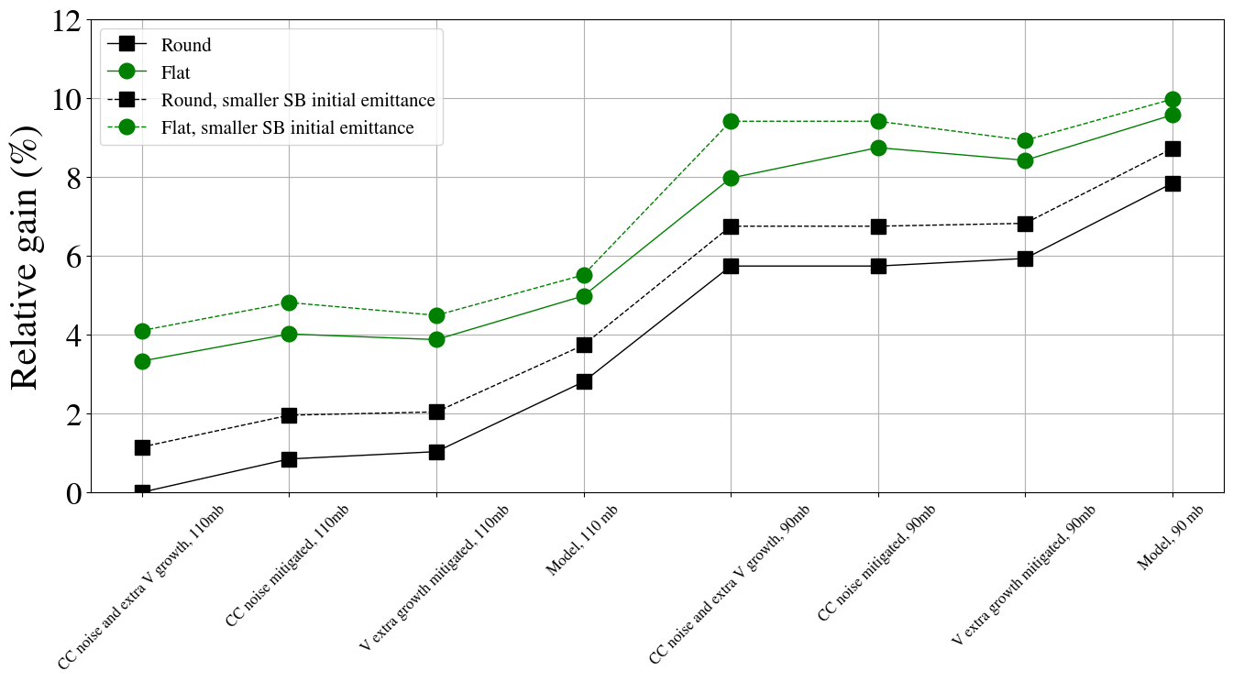
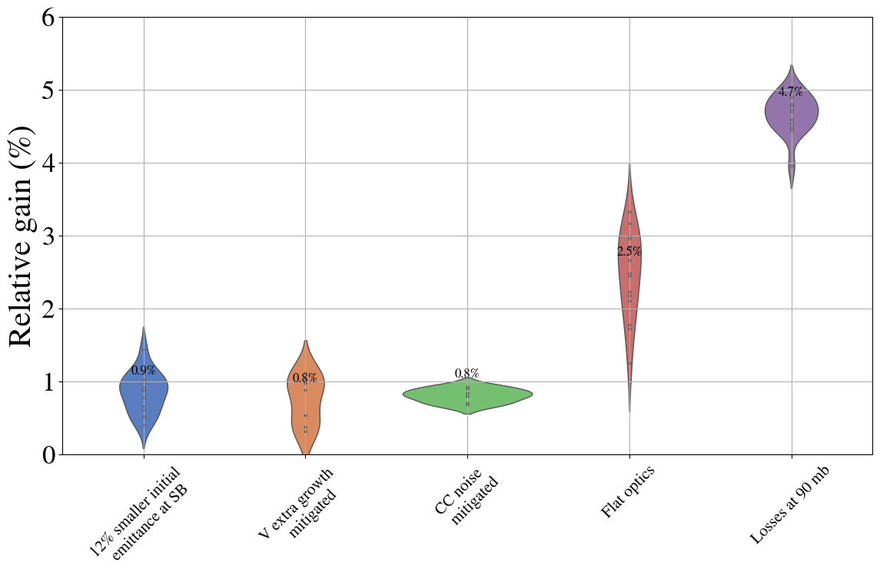
Relative gain in integrated luminosity

Slide 14
Simple model SPS FB vs LHC injection
 | 3x36 | 3x36 + dedicated filling (6s) | 3x36 + dedicated filling (9s) | 5x36 | 5x36 + dedicated filling (6s) | 5x36 + dedicated filling (9s) | 4x72b | 4x72b + dedicated filling (9s) | 4x72b + dedicated filling (6s)
Bunch intensity (1e11 ppb) | 1.6 | 1.6 | 1.6 | 1.6 | 1.6 | 1.6 | 2.3 | 2.3 | 2.3
SPS supercycle (s) | 36 | 30 | 27 | 43.2 | 37.2 | 34.2 | 39.6 | 33.6 | 30.6
Time between B1 injections (s) | 72 | 60 | 54 | 86.4 | 74.4 | 68.4 | 79.2 | 67.2 | 61.2
Number of injections for IP1/5 colliding bunches | 23 | 23 | 23 | 15 | 15 | 15 | 12 | 12 | 12
Emittance at start of LHC injection (μm) | 1.3 | 1.3 | 1.3 | 1.3 | 1.3 | 1.3 | 2.1 | 2.1 | 2.1
Minimum time spent at LHC injection for IP1/5 colliding bunches (mins) | 27.6 | 23 (-4.6 mins) | 20.7 (-6.9 mins) | 21.6 (-6 mins) | 18.6 (-9 min/-3 min) | 17.1 (-10.5 min/-4.5 min) | 15.84 | 13.44 (-2.4 mins) | 12.24 (-3.4 mins)
Emittance growth due to IBS and unknown blowup (μm/h) | ~0.7 | ~0.7 | ~0.7 | ~0.7 | ~0.7 | ~0.7 | ~0.7 | ~0.7 | ~0.7
Average/Max emittance at the end of LHC injection | 1.47/1.62 | 1.44/1.57 | 1.43/1.54 | 1.43/1.55 | 1.42/1.52 | 1.41 /1.5 | 2.2/2.28 | 2.18/2.26 | 2.18/2.24
Number of IP1/5 colliding bunches | 2340 | 2340 | 2340 | 2484 | 2484 | 2484 | 2748 | 2748 | 2748
Turn-around (h) | 2.5 | 2.42 | 2.385 | 2.5 | 2.45 | 2.425 | 2.5 | 2.46 | 2.44

Slide 15
Simple model SPS FB vs LHC injection
 | 3x36 | 3x36 + dedicated filling (6s) | 3x36 + dedicated filling (9s) | 5x36 | 5x36 + dedicated filling (6s) | 5x36 + dedicated filling (9s) | 4x72b | 4x72b + dedicated filling (9s) | 4x72b + dedicated filling (6s)
Bunch intensity (1e11 ppb) | 1.6 | 1.6 | 1.6 | 1.6 | 1.6 | 1.6 | 2.3 | 2.3 | 2.3
SPS supercycle (s) | 36 | 30 | 27 | 43.2 | 37.2 | 34.2 | 39.6 | 33.6 | 30.6
Time between B1 injections (s) | 72 | 60 | 54 | 86.4 | 74.4 | 68.4 | 79.2 | 67.2 | 61.2
Number of injections for IP1/5 colliding bunches | 23 | 23 | 23 | 15 | 15 | 15 | 12 | 12 | 12
Emittance at start of LHC injection (μm) | 1.3 | 1.3 | 1.3 | 1.3 | 1.3 | 1.3 | 2.1 | 2.1 | 2.1
Minimum time spent at LHC injection for IP1/5 colliding bunches (mins) | 27.6 | 23 (-4.6 mins) | 20.7 (-6.9 mins) | 21.6 (-6 mins) | 18.6 (-9 min/-3 min) | 17.1 (-10.5 min/-4.5 min) | 15.84 | 13.44 (-2.4 mins) | 12.24 (-3.4 mins)
Emittance growth due to IBS and unknown blowup (μm/h) | ~0.7 | ~0.7 | ~0.7 | ~0.7 | ~0.7 | ~0.7 | ~0.7 | ~0.7 | ~0.7
Average/Max emittance at the end of LHC injection | 1.47/1.62 | 1.44/1.57 | 1.43/1.54 | 1.43/1.55 | 1.42/1.52 | 1.41 /1.5 | 2.2/2.28 | 2.18/2.26 | 2.18/2.24
Number of IP1/5 colliding bunches | 2340 | 2340 | 2340 | 2484 | 2484 | 2484 | 2748 | 2748 | 2748
Turn-around (h) | 2.5 | 2.42 | 2.385 | 2.5 | 2.45 | 2.425 | 2.5 | 2.46 | 2.44
Measured by Ingrid

Slide 16
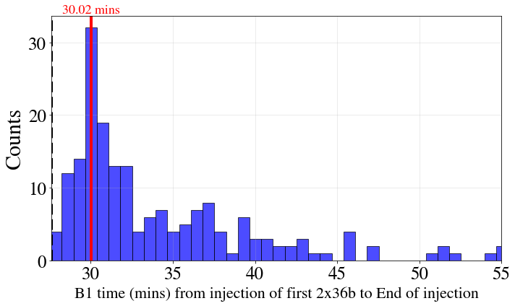
Simple model SPS FB vs LHC injection
 | 3x36 | 3x36 + dedicated filling (6s) | 3x36 + dedicated filling (9s) | 5x36 | 5x36 + dedicated filling (6s) | 5x36 + dedicated filling (9s) | 4x72b | 4x72b + dedicated filling (9s) | 4x72b + dedicated filling (6s)
Bunch intensity (1e11 ppb) | 1.6 | 1.6 | 1.6 | 1.6 | 1.6 | 1.6 | 2.3 | 2.3 | 2.3
SPS supercycle (s) | 36 | 30 | 27 | 43.2 | 37.2 | 34.2 | 39.6 | 33.6 | 30.6
Time between B1 injections (s) | 72 | 60 | 54 | 86.4 | 74.4 | 68.4 | 79.2 | 67.2 | 61.2
Number of injections for IP1/5 colliding bunches | 23 | 23 | 23 | 15 | 15 | 15 | 12 | 12 | 12
Emittance at start of LHC injection (μm) | 1.3 | 1.3 | 1.3 | 1.3 | 1.3 | 1.3 | 2.1 | 2.1 | 2.1
Minimum time spent at LHC injection for IP1/5 colliding bunches (mins) | 27.6 | 23 (-4.6 mins) | 20.7 (-6.9 mins) | 21.6 (-6 mins) | 18.6 (-9 min/-3 min) | 17.1 (-10.5 min/-4.5 min) | 15.84 | 13.44 (-2.4 mins) | 12.24 (-3.4 mins)
Emittance growth due to IBS and unknown blowup (μm/h) | ~0.7 | ~0.7 | ~0.7 | ~0.7 | ~0.7 | ~0.7 | ~0.7 | ~0.7 | ~0.7
Average/Max emittance at the end of LHC injection | 1.47/1.62 | 1.44/1.57 | 1.43/1.54 | 1.43/1.55 | 1.42/1.52 | 1.41 /1.5 | 2.2/2.28 | 2.18/2.26 | 2.18/2.24
Number of IP1/5 colliding bunches | 2340 | 2340 | 2340 | 2484 | 2484 | 2484 | 2748 | 2748 | 2748
Turn-around (h) | 2.5 | 2.42 | 2.385 | 2.5 | 2.45 | 2.425 | 2.5 | 2.46 | 2.44
Statistics from 2024, time between 2x36b injected and end of injection

Slide 17
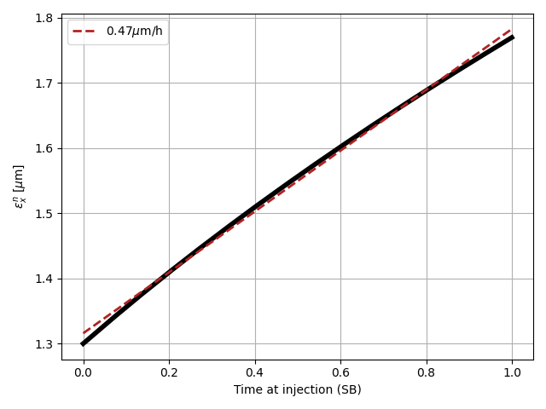
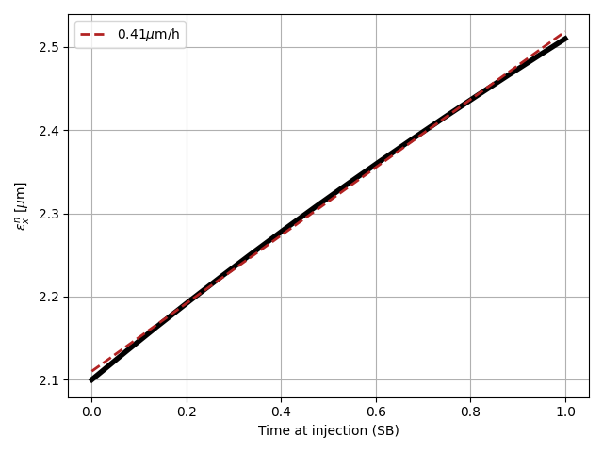
Simple model SPS FB vs LHC injection
 | 3x36 | 3x36 + dedicated filling (6s) | 3x36 + dedicated filling (9s) | 5x36 | 5x36 + dedicated filling (6s) | 5x36 + dedicated filling (9s) | 4x72b | 4x72b + dedicated filling (9s) | 4x72b + dedicated filling (6s)
Bunch intensity (1e11 ppb) | 1.6 | 1.6 | 1.6 | 1.6 | 1.6 | 1.6 | 2.3 | 2.3 | 2.3
SPS supercycle (s) | 36 | 30 | 27 | 43.2 | 37.2 | 34.2 | 39.6 | 33.6 | 30.6
Time between B1 injections (s) | 72 | 60 | 54 | 86.4 | 74.4 | 68.4 | 79.2 | 67.2 | 61.2
Number of injections for IP1/5 colliding bunches | 23 | 23 | 23 | 15 | 15 | 15 | 12 | 12 | 12
Emittance at start of LHC injection (μm) | 1.3 | 1.3 | 1.3 | 1.3 | 1.3 | 1.3 | 2.1 | 2.1 | 2.1
Minimum time spent at LHC injection for IP1/5 colliding bunches (mins) | 27.6 | 23 (-4.6 mins) | 20.7 (-6.9 mins) | 21.6 (-6 mins) | 18.6 (-9 min/-3 min) | 17.1 (-10.5 min/-4.5 min) | 15.84 | 13.44 (-2.4 mins) | 12.24 (-3.4 mins)
Emittance growth due to IBS and unknown blowup (μm/h) | ~0.7 | ~0.7 | ~0.7 | ~0.7 | ~0.7 | ~0.7 | ~0.7 | ~0.7 | ~0.7
Average/Max emittance at the end of LHC injection | 1.47/1.62 | 1.44/1.57 | 1.43/1.54 | 1.43/1.55 | 1.42/1.52 | 1.41 /1.5 | 2.2/2.28 | 2.18/2.26 | 2.18/2.24
Number of IP1/5 colliding bunches | 2340 | 2340 | 2340 | 2484 | 2484 | 2484 | 2748 | 2748 | 2748
Turn-around (h) | 2.5 | 2.42 | 2.385 | 2.5 | 2.45 | 2.425 | 2.5 | 2.46 | 2.44
1.6e11 ppb
2.3e11 ppb

Slide 18
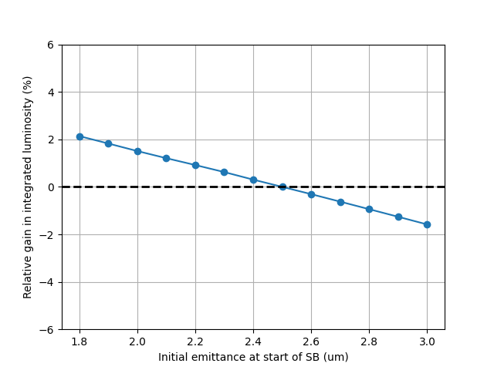
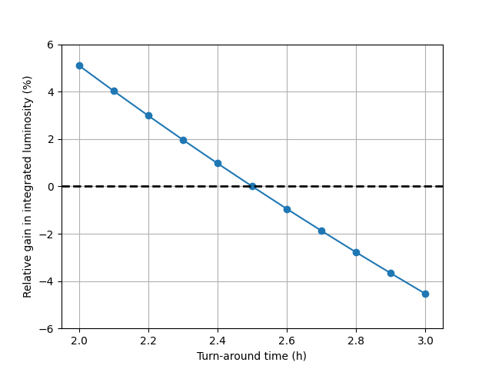
Simple model SPS FB vs LHC injection
 | 3x36 | 3x36 + dedicated filling (6s) | 3x36 + dedicated filling (9s) | 5x36 | 5x36 + dedicated filling (6s) | 5x36 + dedicated filling (9s) | 4x72b | 4x72b + dedicated filling (9s) | 4x72b + dedicated filling (6s)
Bunch intensity (1e11 ppb) | 1.6 | 1.6 | 1.6 | 1.6 | 1.6 | 1.6 | 2.3 | 2.3 | 2.3
SPS supercycle (s) | 36 | 30 | 27 | 43.2 | 37.2 | 34.2 | 39.6 | 33.6 | 30.6
Time between B1 injections (s) | 72 | 60 | 54 | 86.4 | 74.4 | 68.4 | 79.2 | 67.2 | 61.2
Number of injections for IP1/5 colliding bunches | 23 | 23 | 23 | 15 | 15 | 15 | 12 | 12 | 12
Emittance at start of LHC injection (μm) | 1.3 | 1.3 | 1.3 | 1.3 | 1.3 | 1.3 | 2.1 | 2.1 | 2.1
Minimum time spent at LHC injection for IP1/5 colliding bunches (mins) | 27.6 | 23 (-4.6 mins) | 20.7 (-6.9 mins) | 21.6 (-6 mins) | 18.6 (-9 min/-3 min) | 17.1 (-10.5 min/-4.5 min) | 15.84 | 13.44 (-2.4 mins) | 12.24 (-3.4 mins)
Emittance growth due to IBS and unknown blowup (μm/h) | ~0.7 | ~0.7 | ~0.7 | ~0.7 | ~0.7 | ~0.7 | ~0.7 | ~0.7 | ~0.7
Average/Max emittance at the end of LHC injection | 1.47/1.62 | 1.44/1.57 | 1.43/1.54 | 1.43/1.55 | 1.42/1.52 | 1.41 /1.5 | 2.2/2.28 | 2.18/2.26 | 2.18/2.24
Number of IP1/5 colliding bunches | 2340 | 2340 | 2340 | 2484 | 2484 | 2484 | 2748 | 2748 | 2748
Turn-around (h) | 2.5 | 2.42 | 2.385 | 2.5 | 2.45 | 2.425 | 2.5 | 2.46 | 2.44
~ 1% smaller emittance at end of injection

Slide 19
Backup

Slide 20
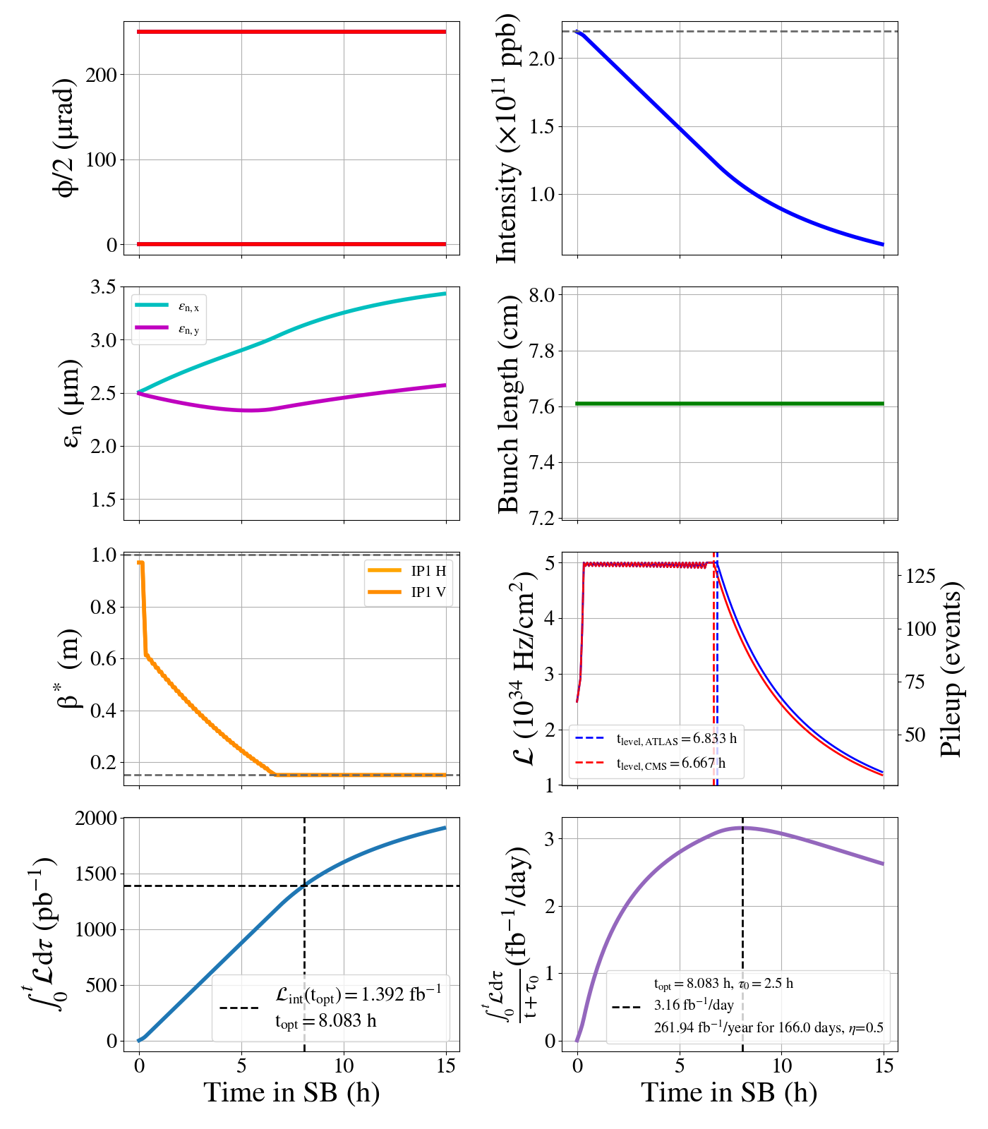
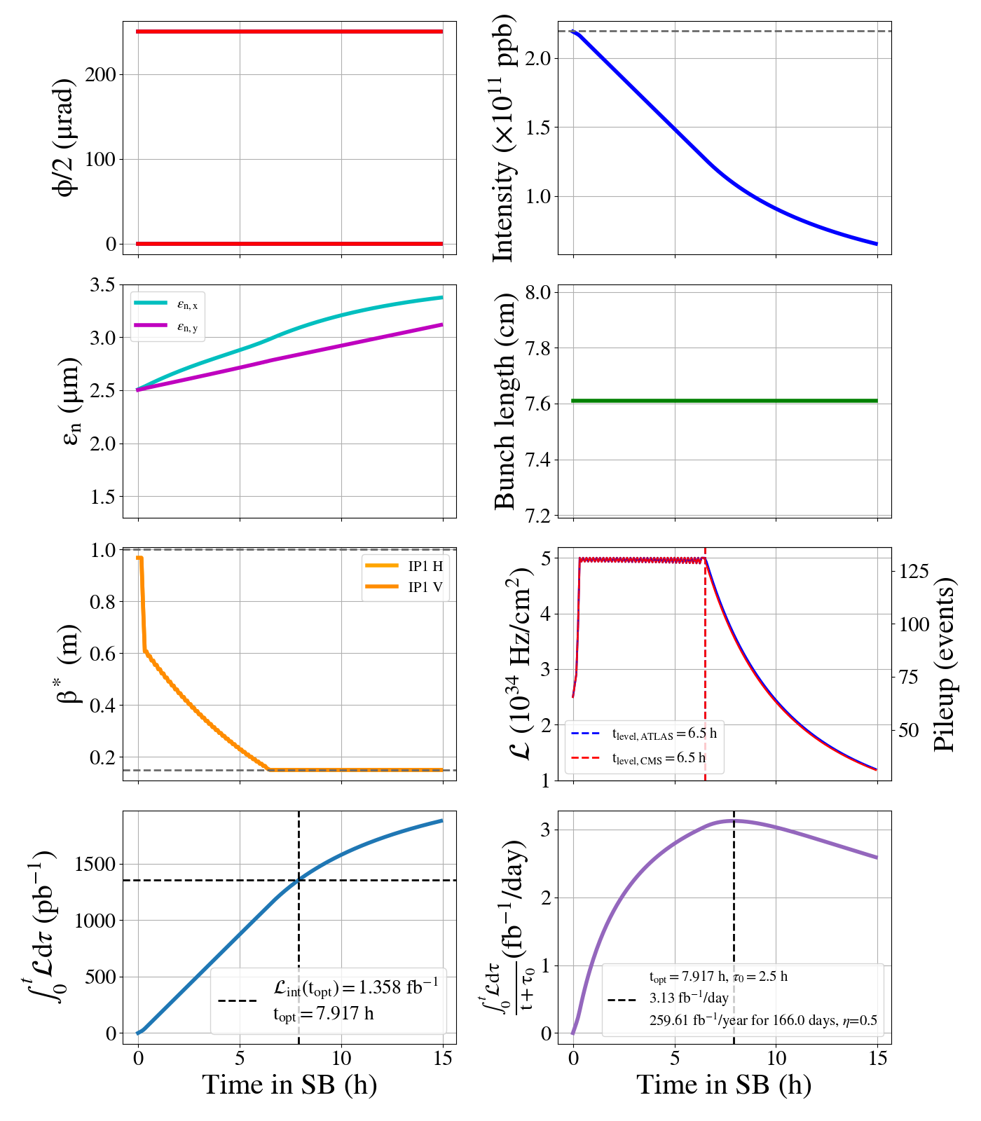
With CC noise
With CC noise & extra V

