Slide 1
HL-LHC Operational scenarios
R. De Maria, S. Kostoglou
Chamonix 2025

Slide 2
Chairs' questions
Discuss for HL-LHC:
beam parameters and configurations
optics options and related performance impact
impact of different beam production types
Impact of collimator settings
RF configurations
Slides in a very draft state!!!

Slide 3
Run 3 to Run 4 for ATLAS/CMS
Domain and teams | Constraints, limiting factors | Parameters | 2024 | 2025 | HL-LHC baseline | HL-LHC ultimate
Injectors, RF | Injector performances, bellows, RF power, surface treatments and cooling | Num. Colliding bunches | 2340 | 2340 (2484) | 2748 | 2748
 |  | Protons per bunch SB 10¹¹ | 1.6 | 1.6 (1.8) | 2.2 | 2.2
 |  | Emittance INJ | 1.3 | 1.3 | 2.1 | 2.1
Optics, incoherent effects | Aperture, magnet field quality, e-cloud | Beta* EOL [urad] | 30 | 60/18 | 15 | 15 (18/7.5)
 | Beam-beam effects | ½ Crossing angle EOL [urad] | 150 | 110 | 250-190(CC) | 220-190(CC)
Optics, coherent effects | Field quality, beam-beam effects, impedance, PC FB noise | Beam losses [mb] | 100 | 100 | 110 | 110
 |  | Emittance SB [um] | 1.8 | 1.8 | 2.5 | 2.5
 |  | Emittance EOL [um] | 2.2 | 2.2 | 2.9 | 2.9
 |  | Virtual luminosity [10³⁴ cm⁻²s⁻¹] | 3.7 | 4.3(5.3, ) | 16.9 | 16.9(20.7)
Experiment | Detector, cooling | Pile-up / Lev Lumi [10³⁴cm⁻²s⁻¹] | 65 / 2.2 | 65 / 2.2 | 132 / 5 | 200 / 7.5
Operation | Reliability, robustess | Turn around time [h] | 2.5 | 2.5 | 2.5 | 2.5
 |  | Operational efficiency [%] | 0.5 | 0.6 | 0.5 | 0.5
 |  | Days | ? | ? | 198 | 198
 |  | Lumi | 130? |  | 275 | 340(360)

Slide 4
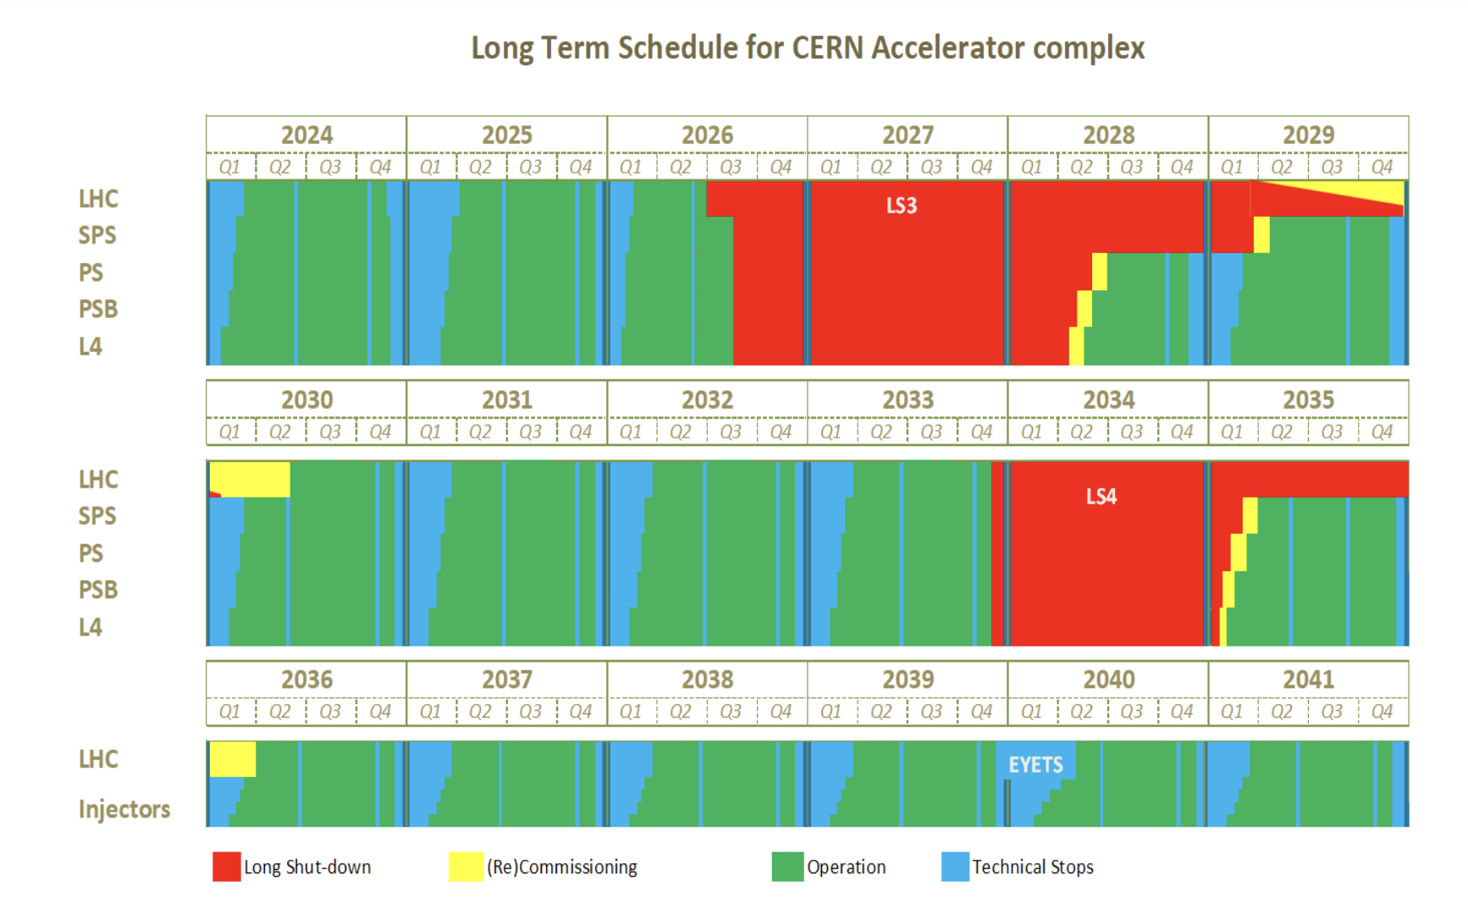
Schedule
Run | Year | Efficiency | Days Intensity ramp-up | Days Proton physics | Days Ion Physics
4 | 2030 | 0.5 | 20 | 35 | 0
 | 2031 | 0.5 | 15 | 136 | 29
 | 2032 | 0.5 | 10 | 154 | 29
 | 2033 | 0.5 | 10 | 152 | 29
5 | 2036 | 0.5 | 15 | 152 | 29
 | 2037 | 0.5 | 10 | 195 | 29
 | 2038 | 0.5 | 10 | 198 | 29
 | 2039 | 0.5 | 10 | 198 | 29
 | 2040 | 0.5 | 15 | 165 | 29
 | 2041 | 0.5 | 10 | 203 | 29
Ions operations in 2031-2041

Slide 5
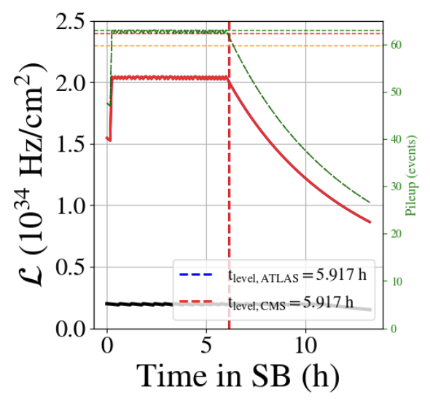
Luminosity and beam parameters
2024
Parameters | HL-LHC baseline | 2024
Num. Colliding bunches | 2748 | 2340
Protons per bunch SB 10¹¹ | 2.2 | 1.6
Emittance INJ | 2.1 | 1.3
Beta* EOL [cm] | 15 | 30
½ Crossing angle EOL [urad] | 250-190(CC) | 150
Beam losses [mb] | 110 | 100
Emittance SB [um] | 2.5 | 1.8
Emittance EOL [um] | 2.9 | 2.2
Virtual luminosity [10³⁴ cm⁻²s⁻¹] | 16.9 | 3.7
Pile-up / Lev Lumi [10³⁴cm⁻²s⁻¹] | 132 / 5 | 65 / 2.2
Turn around time [h] | 2.5 | 2.5
Operational efficiency [%] | 0.5 | 0.6
Daily Lumi

Slide 6
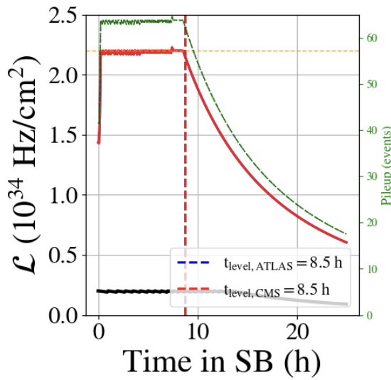
Luminosity and beam parameters
2025
Parameters | HL-LHC baseline | 2025
Num. Colliding bunches | 2748 | 2340-2484?
Protons per bunch SB 10¹¹ | 2.2 | 1.6-1.8?
Emittance INJ | 2.1 | 1.3
Beta* EOL [cm] | 15 | 60/18
½ Crossing angle EOL [urad] | 250-190(CC) | 110
Beam losses [mb] | 110 | 100
Emittance SB [um] | 2.5 | 1.8
Emittance EOL [um] | 2.9 | 2.2
Virtual luminosity [10³⁴ cm⁻²s⁻¹] | 16.9 | 4.3(5.3)
Pile-up / Lev Lumi [10³⁴cm⁻²s⁻¹] | 132 / 5 | 65 / 2.2
Turn around time [h] | 2.5 | 2.5
Operational efficiency [%] | 0.5 | 0.6
Daily Lumi

Slide 7
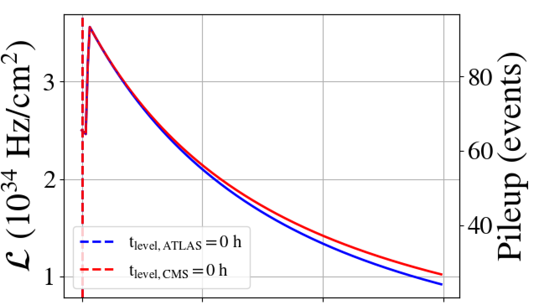
Luminosity and beam parameters
2030
Parameters | HL-LHC baseline | 2030
Num. Colliding bunches | 2748 | 2748
Protons per bunch SB 10¹¹ | 2.2 | 1.8 (1.6)
Emittance INJ | 2.1 | 2.1
Beta* EOL [cm] | 15 | 30 (60/18)
½ Crossing angle EOL [urad] | 250-190(CC) | 250
Beam losses [mb] | 110 | 110
Emittance SB [um] | 2.5 | 2.5
Emittance EOL [um] | 2.9 | 2.9
Virtual luminosity [10³⁴ cm⁻²s⁻¹] | 16.9 | 4.3 ()
Pile-up / Lev Lumi [10³⁴cm⁻²s⁻¹] | 132 / 5
Turn around time [h] | 2.5 | 2.5
Operational efficiency [%] | 0.5 | 0.6
Daily Lumi

Slide 8
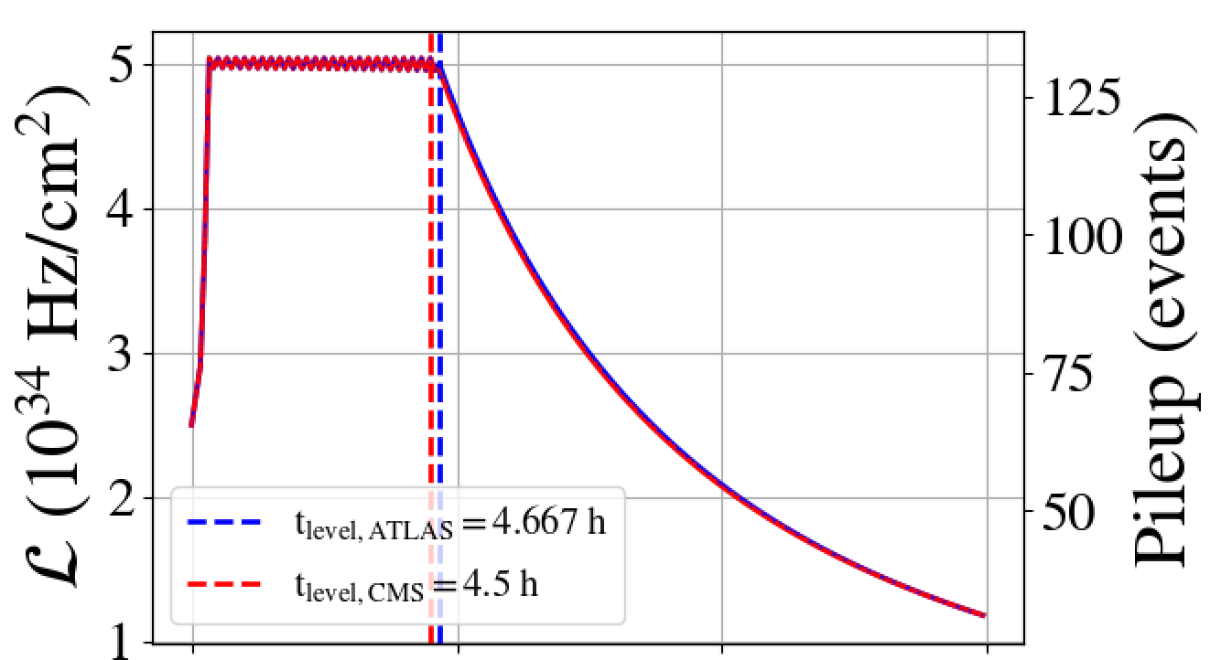
Luminosity and beam parameters
2031
Parameters | HL-LHC baseline | 2031
Num. Colliding bunches | 2748 | 2748
Protons per bunch SB 10¹¹ | 2.2 | 2.2
Emittance INJ | 2.1 | 2.1
Beta* EOL [cm] | 15 | 25
½ Crossing angle EOL [urad] | 250-190(CC) | 250 -190(CC)
Beam losses [mb] | 110 | 110
Emittance SB [um] | 2.5 | 2.5
Emittance EOL [um] | 2.9 | 2.9
Virtual luminosity [10³⁴ cm⁻²s⁻¹] | 16.9 | 4.3
Pile-up / Lev Lumi [10³⁴cm⁻²s⁻¹] | 132 / 5
Turn around time [h] | 2.5 | 2.5
Operational efficiency [%] | 0.5 | 0.6
Daily Lumi

Slide 9
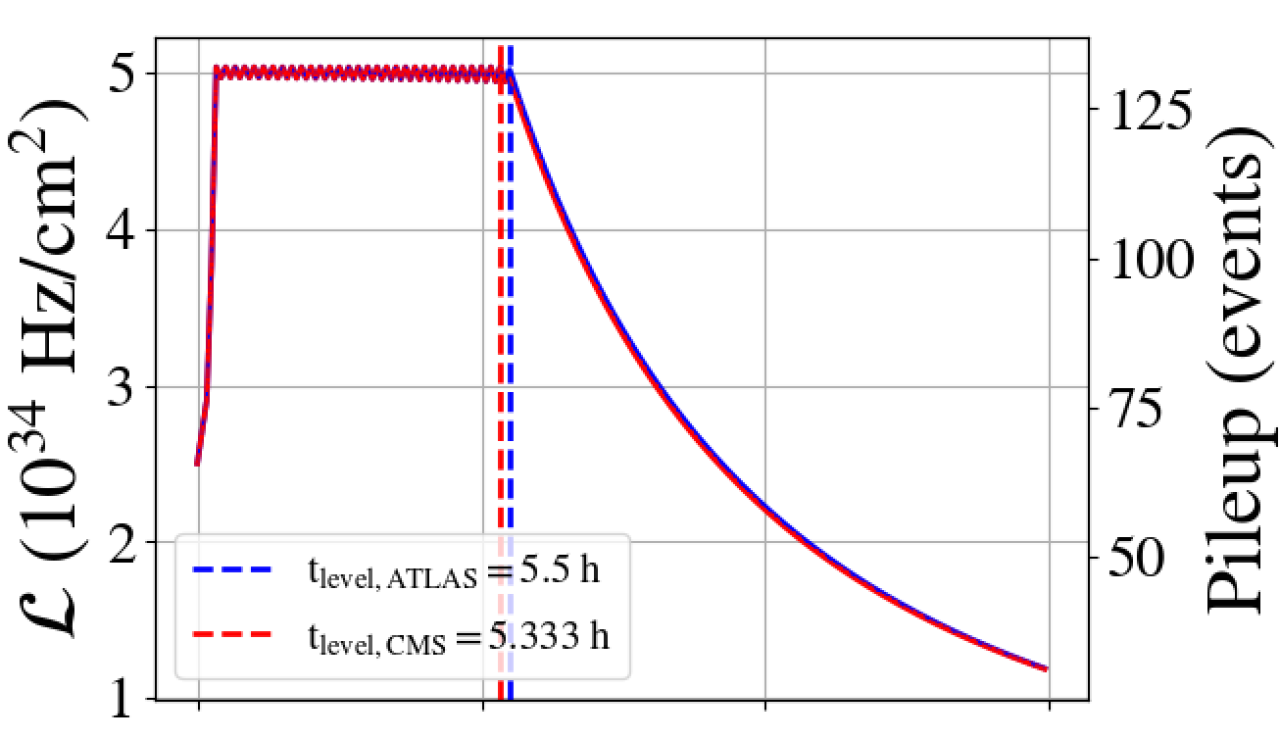
Luminosity and beam parameters
2032-3
Parameters | HL-LHC baseline | 2032-3
Num. Colliding bunches | 2748 | 2748
Protons per bunch SB 10¹¹ | 2.2 | 2.2
Emittance INJ | 2.1 | 2.1
Beta* EOL [cm] | 15 | 20
½ Crossing angle EOL [urad] | 250-190(CC) | 250 -190(CC)
Beam losses [mb] | 110 | 110
Emittance SB [um] | 2.5 | 2.5
Emittance EOL [um] | 2.9 | 2.9
Virtual luminosity [10³⁴ cm⁻²s⁻¹] | 16.9 | 4.3
Pile-up / Lev Lumi [10³⁴cm⁻²s⁻¹] | 132 / 5
Turn around time [h] | 2.5 | 2.5
Operational efficiency [%] | 0.5 | 0.6
Daily Lumi

Slide 10
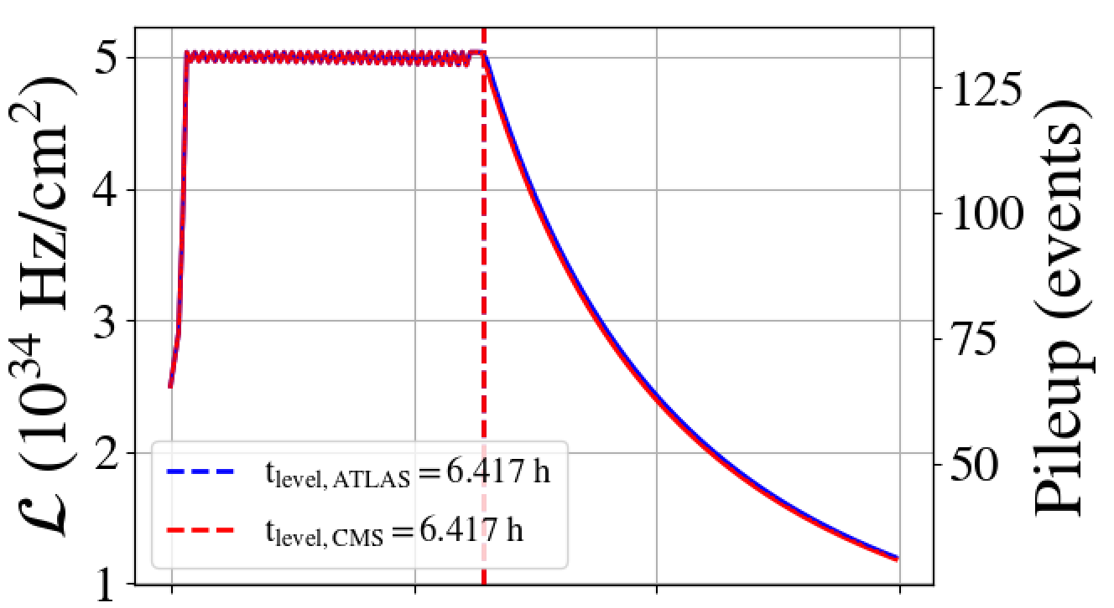
Luminosity and beam parameters
2036-41
Parameters | HL-LHC baseline | 2032
Num. Colliding bunches | 2748 | 2748
Protons per bunch SB 10¹¹ | 2.2 | 2.2
Emittance INJ | 2.1 | 2.1
Beta* EOL [cm] | 15 | 20
½ Crossing angle EOL [urad] | 250-190(CC) | 250 -190(CC)
Beam losses [mb] | 110 | 110
Emittance SB [um] | 2.5 | 2.5
Emittance EOL [um] | 2.9 | 2.9
Virtual luminosity [10³⁴ cm⁻²s⁻¹] | 16.9 | 4.3
Pile-up / Lev Lumi [10³⁴cm⁻²s⁻¹] | 132 / 5
Turn around time [h] | 2.5 | 2.5
Operational efficiency [%] | 0.5 | 0.6
Daily Lumi

Slide 11
Nominal performance
Run | Year | Efficiency | Bunch intensity (1e11 ppb) | β//* (cm) | β_{x}* (cm) | CC | PU_{max} | Days Intensity ramp-up | Days Proton physics | Emit start of SB (μm) | IP1/5 crossing plane | IP1/5 φ/2 (μrad) | LHCb L_{peak} (1e33 Hz/cm²) [4]
4 | 2030 | 0.5 | 1.8 (1.6) | 30 | 30 | off | 101 | 20 | 35 | 2.5 | H/V | 250 | 2
 | 2031 | 0.5 | 2.2 | 25 | 25 | on | 132 | 15 | 136 | 2.5 | H/V | 250 | 2
 | 2032 | 0.5 | 2.2 | 20 | 20 | on | 132 | 10 | 154 | 2.5 | H/V | 250 | 2
 | 2033 | 0.5 | 2.2 | 20 | 20 | on | 132 | 10 | 152 | 2.5 | H/V | 250 | 2
5 | 2036 | 0.5 | 2.2 | 15 | 15 | on | 132 | 15 | 152 | 2.5 | H/V | 250 | 2
 | 2037 | 0.5 | 2.2 | 15 | 15 | on | 132 | 10 | 195 | 2.5 | H/V | 250 | 2
 | 2038 | 0.5 | 2.2 | 15 | 15 | on | 132 | 10 | 198 | 2.5 | H/V | 250 | 2
 | 2039 | 0.5 | 2.2 | 15 | 15 | on | 132 | 10 | 198 | 2.5 | H/V | 250 | 2
 | 2040 | 0.5 | 2.2 | 15 | 15 | on | 132 | 15 | 165 | 2.5 | H/V | 250 | 2
 | 2041 | 0.5 | 2.2 | 15 | 15 | on | 132 | 10 | 203 | 2.5 | H/V | 250 | 2
Run | Year | Reference (fb-¹)
4 | 2030 | 31.99
 | 2031 | 205.54
 | 2032 | 236.85
 | 2033 | 233.82
5 | 2036 | 208.12
 | 2037 | 271
 | 2038 | 275.72
 | 2039 | 275.72
 | 2040 | 228.54
 | 2041 | 283.57
Run 4+5 |  | 2250.89
All | +520 | 2770.9

Slide 12
Filling schemes
Goal: largest number of colliding bunches at 2.3 10¹¹, while keeping small bunch-by-bunch variations, low tails, small emittance.
Type | # Inj. | # bunches | # collising bunches ATLAS/CMS Alice LHCb | E-cloud degradation
4x72 STD | 13 | 2760 | 2748 2492 2574
5x48 BCMS | 13 | 2748 | 2740 2250 2376
5x36 BCMS | 16 | 2484 | 2484 2121 2260
Hybrid | 13 | 2604 | 2592 2224 2313
Hybrid | 13 | ~2250 | ~2250
8b+4e | 12 | 1972 | 1960 1886 1178
Std 72b scheme more bunches, short injection time, better for luminosity compared to BCMS, at the same time
BCMS 48b scheme being better for e-cloud, emittance, tails, losses, was a more optimal choice so far.
Hybrid, gives more bunches compared to pure schemes in the presence of e-cloud issues, but due to complex operation, large bunch-by-bunch variations. Less effective unless severe e-cloud limitations.

Slide 13
Baseline optics cycle
2024
2025
HL Baseline
Main features established in 2010:
ATS paper
HL-LHCV1.0 layout and further
HL-LHC baseline further updated to
follow layout changes
study options and improvements
Injection
β* = 10 m
ATS = 1
β* = 6 m
ATS = 1
End of ramp
β* = 2 m
ATS = 0.5
β* = 1 m
ATS = 1
Collapse
β* = 1.2 m
ATS = 0.5
β* = 1 m
ATS = 1 (CC)
Start of levelling
β* = 1.2 m
ATS = 0.5
β* = 64 cm
ATS = 1 (CC)
Crab cavity voltage at 1MV dephased until adjust
End levelling
β* = 30 cm
ATS = 2
β* = 60/18 cm
ATS =1/3.3
β* = 15 cm
ATS = 3.3 (CC)
IR1/5 only: Q change, LHCb rotation not shown

Slide 14
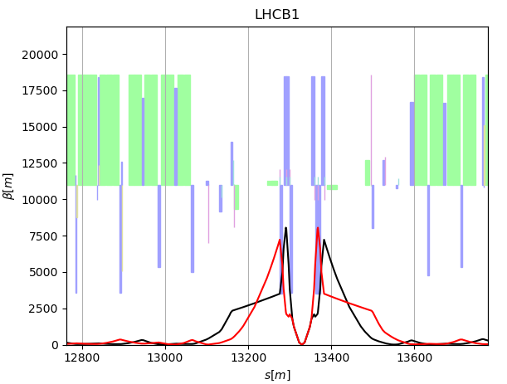
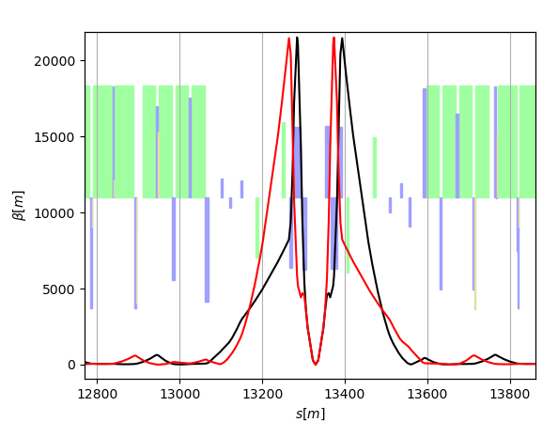
Run 3 -> HL-LHC Optics

Slide 15
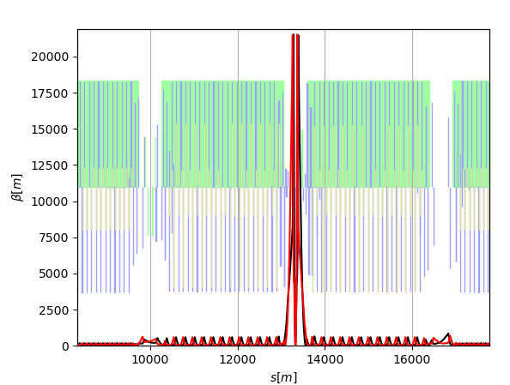
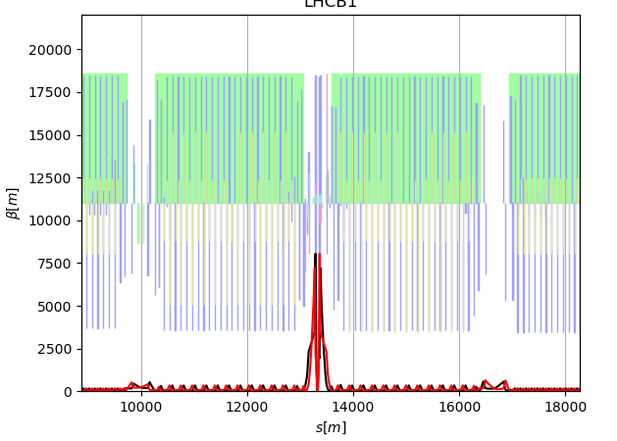
Run 3 -> HL-LHC Optics: Large ATS factor

Slide 16
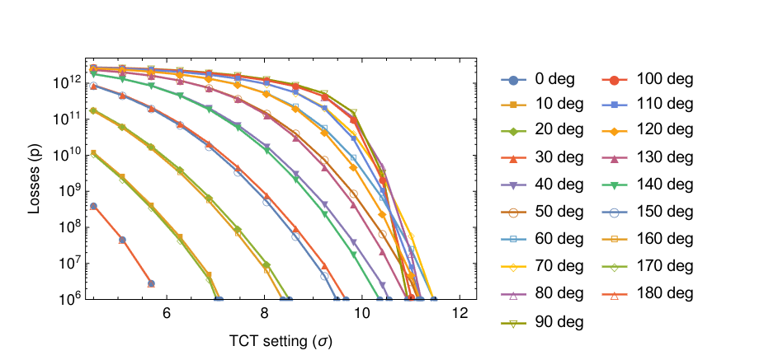
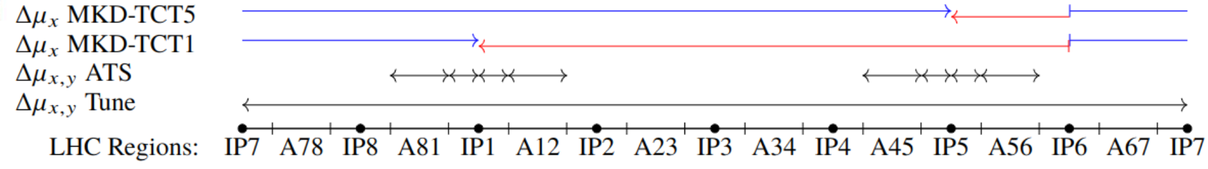
Protected aperture
Protected aperture depends on MKD-TCT phase advance at flat top in the horizontal plane.
MKD-TCT are difficult in P5 because very few quadrupoles available (due to ATS) and many constraints. BETS upgrade and optics developments to improve beta* reach!
Tight collimator settings have better cleaning and beta* reach.
Relaxed settings have less impedance and reduce sensitivity to MP issues, potentially improving intensity reach.
Trade off between cleaning and intensity to be found operationally.
References:
[1] R. Bruce et al. CERN-ACC-2017-0051
[2] R. Bruce ColUSM 115
[3] R. Tomas et al. CERN-ACC-2022-0001
Collimator [σ@2.5µm] | 2023 Injection | HL Injection | 2023 end-of-level settings | HL end-of-level tight settings [1] | HL end-of-level relaxed settings [3]
TCP IR7 | 6.7 | 6.7 | 5.9 | 6.7 | 8.5
TCS IR7 | 7.9 | 7.9 | 7.7 | 9.1 | 10.1
TCDQ IR6 | 9.5 | 9.5 | 8.6 | 10.1 | 11.1
TCT | 15.4 | 15.4 | 10.1 | 10.2-13.3* | 11.2-14.6*
TCL | parking | parking | 17 | [21.3 mm]⁺ | [21.3 mm]⁺
TCLA | 11.8 | 11.8 | 11.8 | 13.7 | 13.7
Aperture | 14.2 (meas) | 12.6 | 11.2(meas) | 11.2-14.3* | 12.2-15.6*

Slide 17
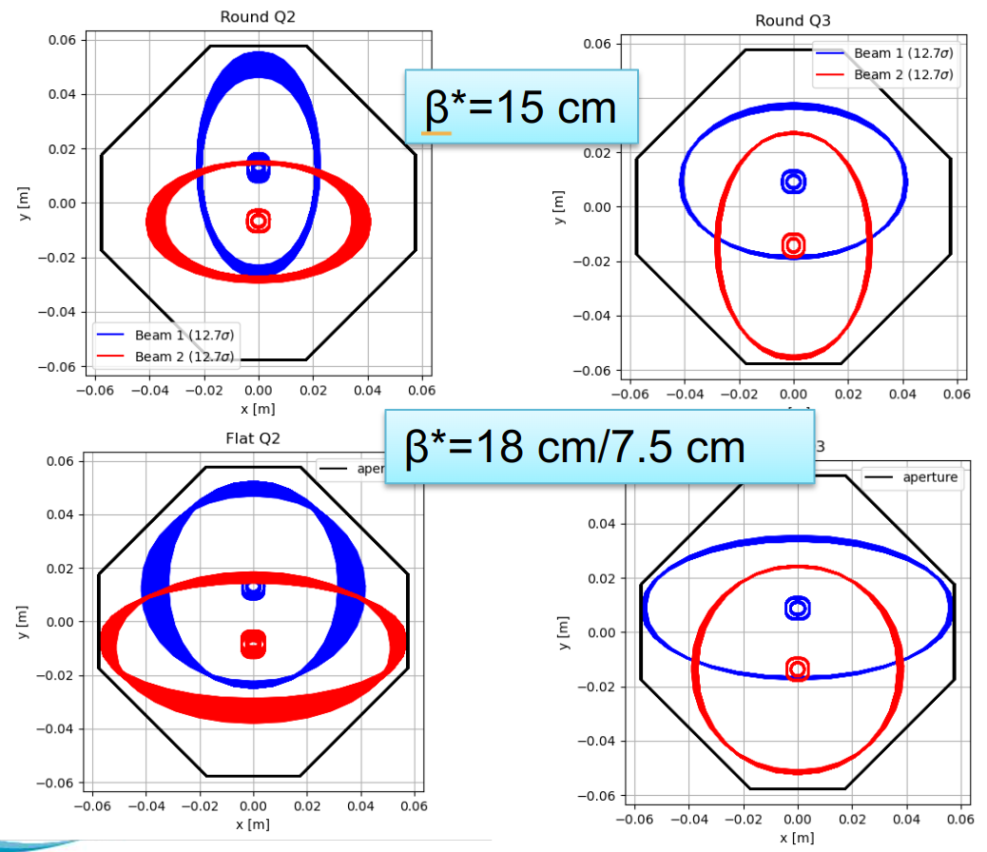
β* reach, flat optics and crossing planes
Flat and round have approximately the same beam size at the triplets.
β* reach depends on MKD-TCT phase advance and (new finding) TCL gaps. Crossing plane, triplet polarity, crabbing angle matters, IP1 or IP5!
MKD-TCT difficult to achieve when squeezing β*_{X} in IP5. Vertical crossing angle (that is small β*_{x} in P5) is the worst, well known, choice in this respect.
Present triplet polarity β_{X}>β_{Y} at the TCL: large gaps needed (good for PPS2), -> small H radius in pass-through pipe -> large power deposited in D2 and TCLMB for vertical crossing.
CLIQ system failure scenarios more critical compared to round optics. Phase advance mitigation under study.
Mitigations:
Exchange crab cavities for Run 5 (extend reach 5600 fb-1 lifetime)
Improve MKD-TCT also for V crossing in P5: relax dispersion or ATS matching.
RP optics could help on TCL settings, but not optimal on current design.

Slide 18
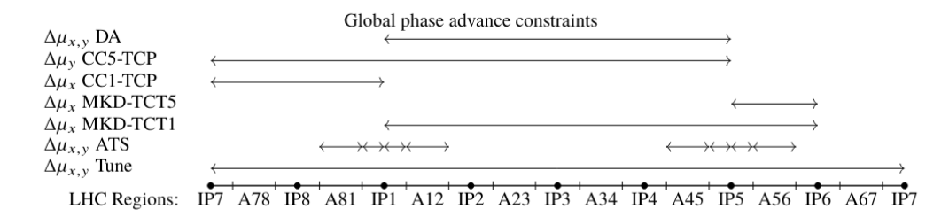
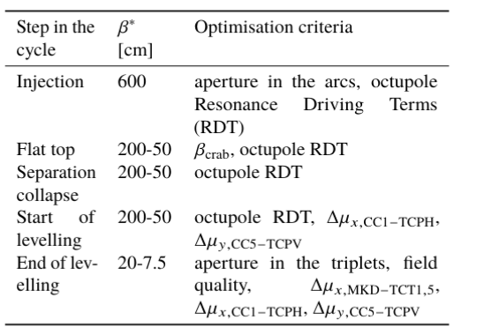
HL-LHC Optics Phase optimization
Phase advance optimization
Machine protection issue could limit intensity and beta* reach.
CC-TCP phase is important for crab and CLIQ failure scenarios.
TCP-TCT important for background.
IP1-IP5 phase important for DA.
Phase advances are also important for FA
HL-LHC optics are designed to find a global solutions.
Efforts to find a global optimum for the different phases of the cycle that have different compromises. Work ongoing, iterative work.

Slide 19
MKD-TCT optimizations
MKD-TCT are difficult in P5 because very few quadrupoles available (due to ATS) and many constraints
Horizontal matching more difficult because of the dispersion constraints. Options:
Relax dispersion matching -> dispersion beating in the arc 56 (next slide)
Relax ATS matching -> limit spurious dispersion correction and off-momentum beta-beating and Q’ (next step)

Slide 20
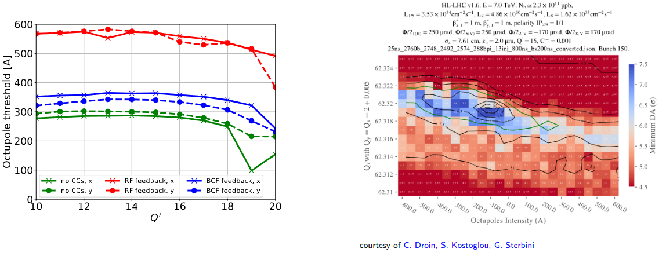
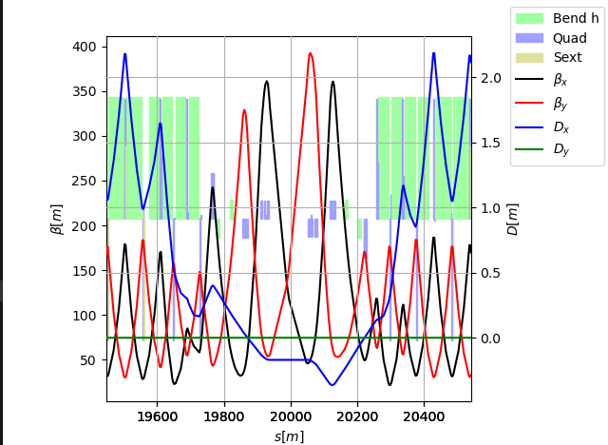
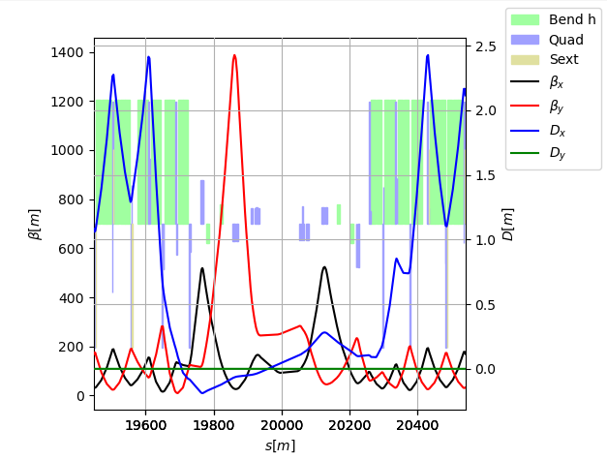
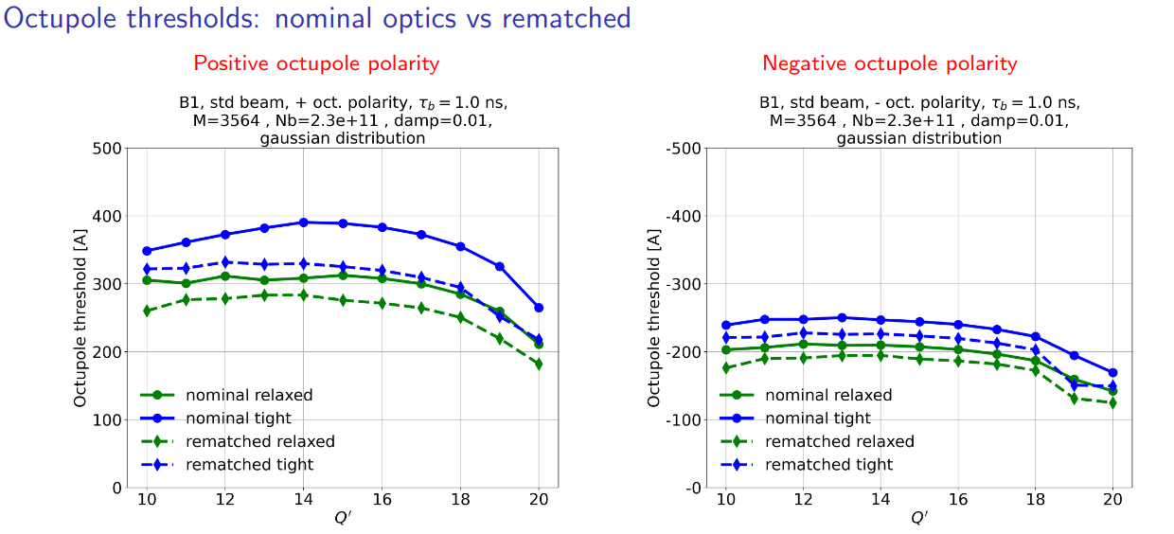
Beyond Nominal: Impedance mitigation
Impedance is stabilized by Landau octupole and chromaticity at the cost of beam lifetime, thus luminosity.
New IR7 and IR3 optics (on top of potential gains by collimators gap), as well as increasing cleaning efficiencies.
First test in MDs shows no issues, but high intensity needed for assessment.
IR7 injection
IR7 flat top
Ideally to be tested or put in operation in 2026 or to be assumed baseline from Run 4 and step back during intensity ramp-up in 2023 at marginal cost compared to be limited in high production years.

Slide 21
Optics options cycle
2024
2025
HL Baseline
Optics options
Injection
β* = 10 m
ATS = 1
β* = 6 m
ATS = 1
e-cloud phase
low impedance
IR7(3) ramp
Flat for CC impedance and noise mitigation
End of ramp
β* = 2 m
ATS = 0.5
β* = 1 m
ATS = 1
β* = 0.7/2.8 m
ATS = 1
Collapse
β* = 1.2 m
ATS = 0.5
β* = 1 m
ATS = 1
β* = 0.7/2.8 m
ATS = 1
Start of levelling
β* = 1.2 m
ATS = 0.5
β* = 64 cm
ATS = 1
β* = 60(30)/18(8) cm
ATS = 0.9/2.7
Flat with no CC for performance
End levelling
β* = 30 cm
ATS = 2
β* = 60/18 cm
ATS =1/3.3
β* = 15 cm
ATS = 3.3
β* = 18/8 m
ATS = 2.7/6.3
Flat with CC for performance
IR1/5 only: Q change, LHCb rotation not shown

Slide 22
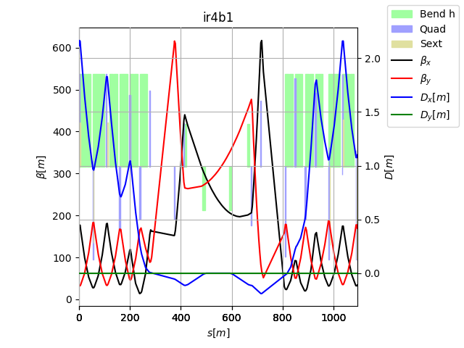
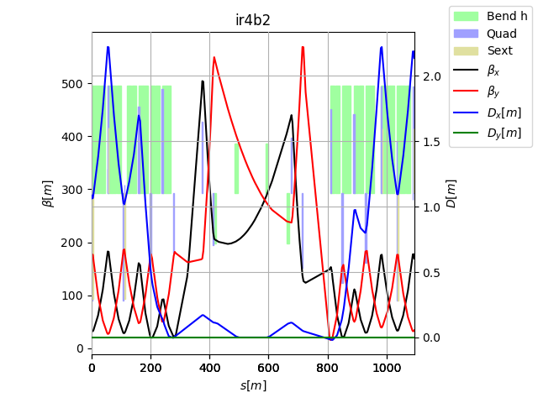
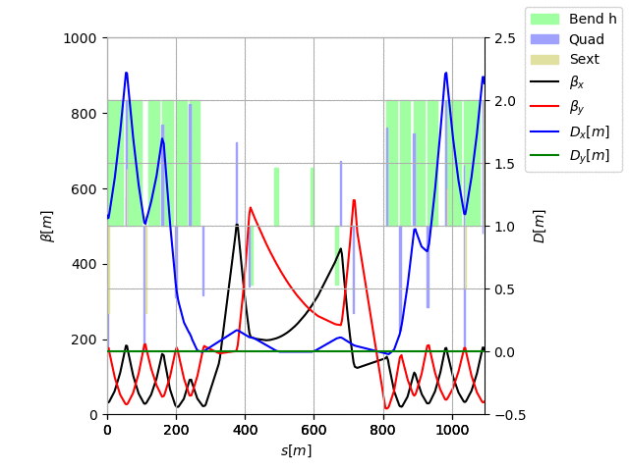
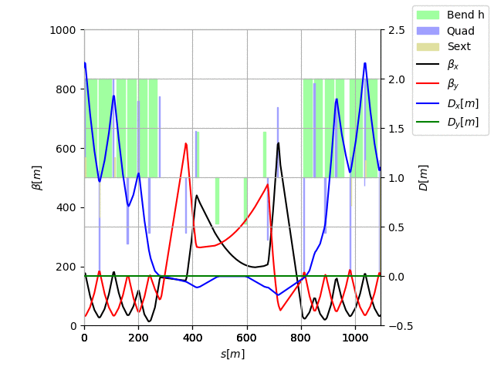
Beyond nominal: IR4 Optics
IR4 optics for HL was studied and optimized for e-lens and BI around 2019.
There is still additional optics flexibility.
Currently, is used to control the long-range phase advance constraints, in combinations with the MQTs in the arcs.
However, could also be used to further optimize the optics, in particular, if we allow changes of optics conditions at the IP to increase beta function at to improve SNR (e.g. BSRT, coronagraph)
e-lens
Principle tested in MD in 2024 showed no issues.

Slide 23
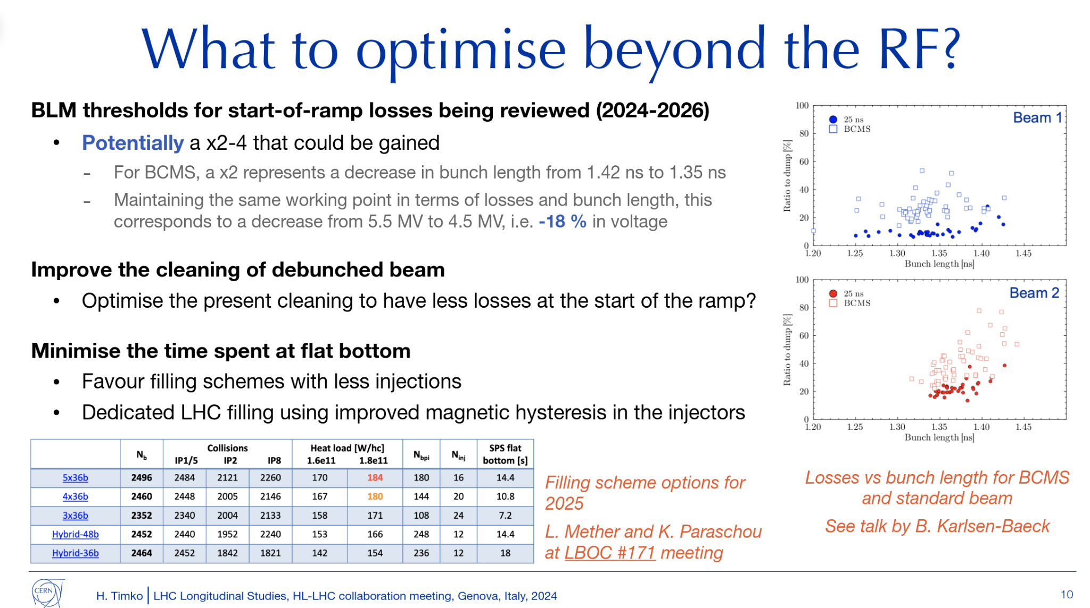

Slide 24
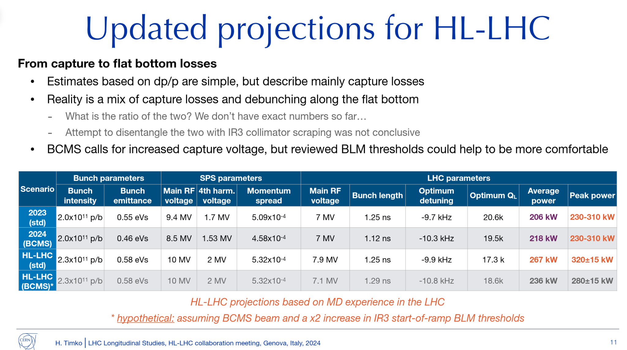

Slide 25
Conclusion
HL-LHC performance is enabled by increased level-luminosity, bunch population, larger beam density (beta*) and overlap (CC).
LHC has not yet demonstrated 2.2 1011 ppb with 2760 bunches: key to make steps to this parameters in 2024.

Slide 26
Back-up

Slide 27
Luminosity and beam parameters
2031
2032
2024
2025
2041

Slide 28
Protected aperture
Parameters | 7 TeV | 0.45 TeV
Min Ap. no TCT [σ] | 19.4 | 12.6
Min H. Ap. with TCT [σ] | 11.2-15.6 | 12.6
Min V. Ap. with TCT [σ] | 11.2-12.2 | 12.6
Δµ_{x} MKD-TCT [°] | H. Ap. W [1] [σ@2.5µm] | H. Ap. CuCD [2] [σ@2.5µm] | H. Ap. W Relaxed [σ@2.5µm]
0-20 | 11.2 | 11.2 | 12.2
30 | 11.9 | 11.2 | 12.9
40 | 12.9 | 11.9 | 13.9
50 | 13.8 | 12.8 | 14.8
60 | 14.5 | 13.6 | 15.5
70 | 14.6 | 14.0 | 15.6
80-90 | 14.6 | 14.3 | 15.6
Protected aperture depends on MKD-TCT phase advance at flat top in the horizontal plane.
Collimator [σ@2.5µm] | 2023 Injection | HL Injection | 2023 end-of-level settings | HL end-of-level tight settings [1] | HL end-of-level relaxed settings [3]
TCP IR7 | 6.7 | 6.7 | 5.9 | 6.7 | 8.5
TCS IR7 | 7.9 | 7.9 | 7.7 | 9.1 | 10.1
TCDQ IR6 | 9.5 | 9.5 | 8.6 | 10.1 | 11.1
TCT | 15.4 | 15.4 | 10.1 | 10.2-13.3* | 11.2-14.6*
TCL | parking | parking | 17 | [21.3 mm]⁺ | [21.3 mm]⁺
TCLA | 11.8 | 11.8 | 11.8 | 13.7 | 13.7
Aperture | 14.2 (meas) | 12.6 | 11.2(meas) | 11.2-14.3* | 12.2-15.6*
* Collimation settings and protected aperture need to be validated with collimation simulations of specific optics.
⁺ Minimum setting in mm validated by radiation simulations (38W in D2)
References:
[1] R. Bruce et al. CERN-ACC-2017-0051
[2] R. Bruce ColUSM 115
[3] R. Tomas et al. CERN-ACC-2022-0001

Slide 29
TCL, TCT settings estimates
 | MKD-TCT5 | IP5 |  |  | IP1
 |  | β* | TCTH⁽²⁾ | TCL⁽²⁾ | β* | TCTH⁽²⁾ | TCL⁽²⁾
Round | 30/31 | 15/15 | 10.9σ | 14.2σ 21.3 mm | 15/15 | 10.2σ | 14.2σ 21.3 mm
Flat HV | 40/45 | 9/18 | 12.3σ | 12.3σ 23.8 mm | 18/9 | 10.2σ⁽¹⁾ | 15.5σ 21.3 mm
Flat HV | 51/54 | 7.5/18 | 13.1σ | 13.1σ 27.8 mm | 18/7.5 | 10.2σ⁽¹⁾ | 15.5σ 21.3 mm
Flat VH | 27/25 | 18/7.5 | 11.7σ | 15.5σ 21.3 mm | 7.5/18 | 10.2σ | 10.2σ 21.6 mm
Assuming TCL can be as low as TCTs as they see the same MKD -TCT phase.
MKD-TCT is also responsible for limiting beta* reach due to power deposition in D2 and TCLMB
Reversing triplet polarity could help here! But, it requires a redesign of TCTPHX, TCLPX, reverse of MCBY orientation in Q4, demonstrate optics solutions in P1/5 for β* 0.5-30 m and crabbing angle >380 murad.
Switching crossing planes solves the problem should be the baseline for Run 5 and 6!
Exploring complications of improving MKD-TCT (next slide)
(1) achievable but not demonstrated yet, (2) tight collimator setting

Slide 30
RF

Slide 31
Cases for flat optics
There are 3 different cases for preferring flat optics that are logically separated and can be implemented independently.
At collapse: Reduce β function in the crossing plane at the crab cavities to reduce impedance. A reduction of β at the crab cavities can also be done for round optics (25% at β*=1.1m) or without ATS.
During luminosity levelling: Integrate more luminosity at reduced pile-up density. Increase allowed intensity of non-colliding bunches due to lower impedance at the cavities.
Towards the end of luminosity levelling: Increase levelling time and therefore increase luminosity. Sizeable gain when levelling time is in the order of 4-5 hours (e.g. 200 pile-up with 2.2 10¹¹ or 140 pile-up at 1.8 10¹¹ ). Still compelling gain 3-4% for nominal conditions.
β* | 1.1 m high | 1.1 low | 0.9/1.8 low no ats | 1.8/0.9 no ats
Avg beta crab | 680 | 466 | 327 | 280

Slide 32
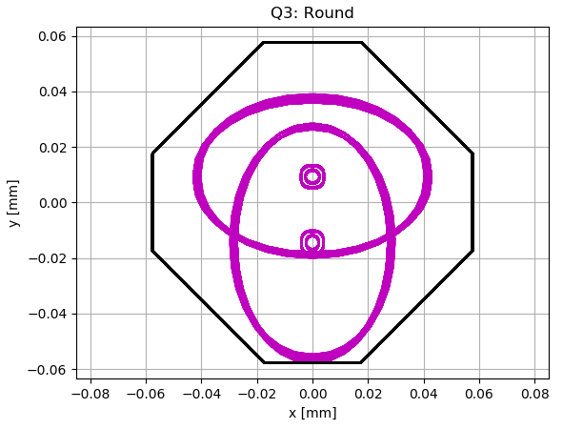
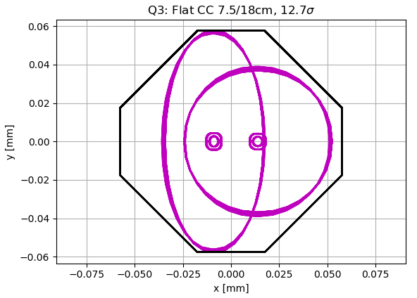
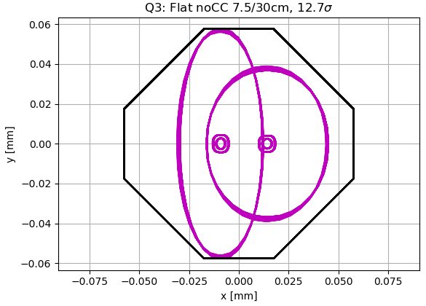
Flat optics opportunities
Flat optics: larger beta* in the crossing plane and lower beta* in the separation plane.
Flat optics at the end of the levelling increases virtual luminosity (for high pile-up, low ppb scenarios) for similar aperture in the triplets.
Flat optics throughout the cycle reduces emittance growth, impedance, failure induced losses from crab cavities.
Virtual lumi 2.2 10¹¹ ppb | Round β*=15 cm | Flat β*=8 cm X-plane
CC On | 16.9 10³⁴ cm⁻²s⁻¹ (250 μrad) | 20.6 10³⁴ cm⁻²s⁻¹ (18 cm //-plane, 250 urad)
CC Off | 8.31 10³⁴ cm⁻²s⁻¹ (250 μrad) | 16.5 10³⁴ cm⁻²s⁻¹ (40 cm //-plane, 200 urad)
Flat optics are more sensitive than round to non-linear imperfections. Simulations have shown that flat with CC is viable at low chromaticity and negative octupoles is still viable.
Experience expected in 2025 will provide insights on these scenarios.

Slide 33
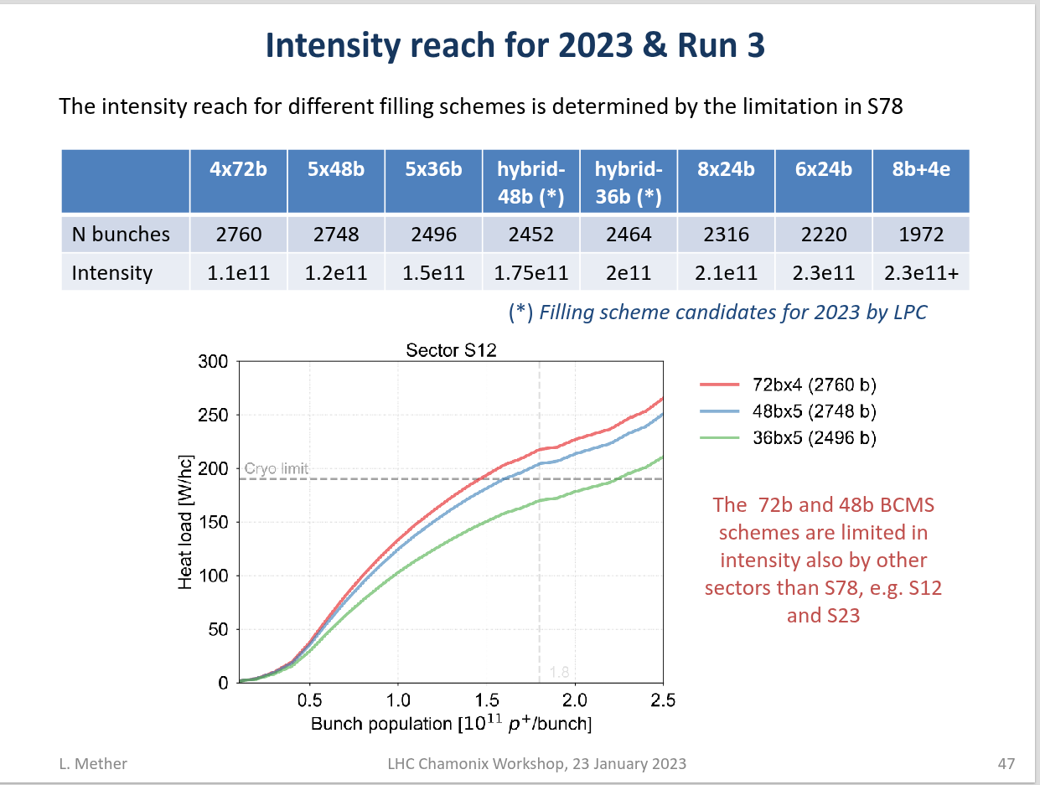

Slide 34
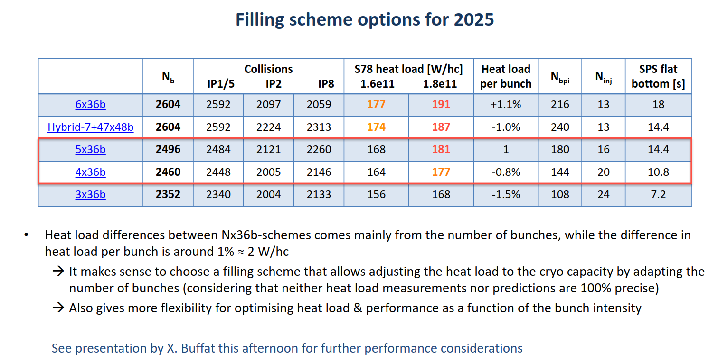

Slide 35

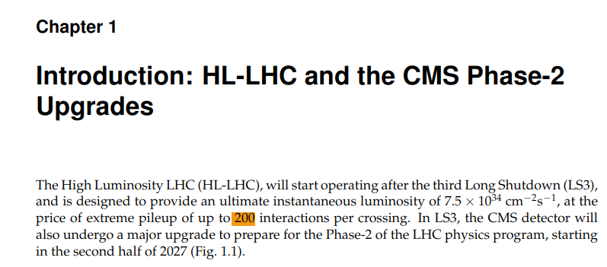

Slide 36
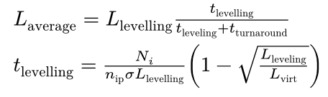
Performance reach
It is important for the discussion to appreciate some counterintuitive aspects of HL-LHC integrated luminosity estimates.
Increase L_levelling
Increase N_i and L_virt

Slide 37
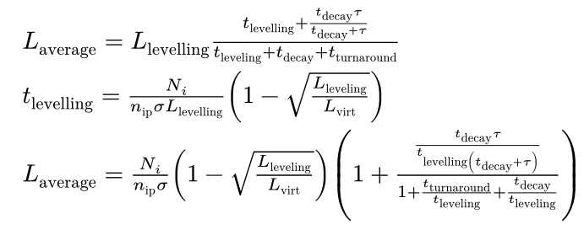
Performance reach
It is important for the discussion to appreciate some counterintuitive aspects of HL-LHC integrated luminosity estimates.

Slide 38
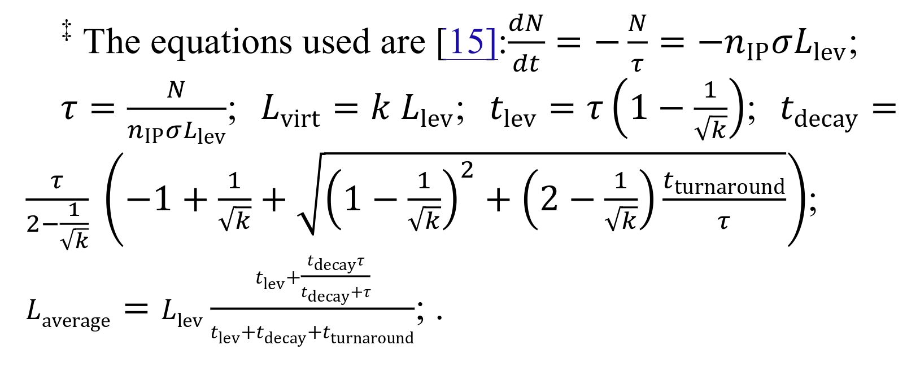

Slide 39
Reference
Run | Year | Efficiency | Bunch intensity (1e11 ppb) | β//* (cm) | β_{x}* (cm) | CC | PU_{max} | Days Intensity ramp-up | Days Proton physics [2] | # colliding IP1/5 bunches [3] | # colliding IP8 bunches | Emit start of SB (μm) | IP1/5 crossing plane | IP1/5 φ/2 (μrad) | LHCb L_{peak} (1e33 Hz/cm²) [4] | Losses (mb) | Emittance growth (um/h)
4 | 2030 | 0.5 | 1.8 (1.6) | 30 | 30 | off | 101 | 20 | 6 [1] | 2748 | 2574 | 2.5 | H/V | 250 | 2 | 110 | Extra V 0.04
 | 2031 | 0.5 | 2.2 | 25 | 25 | on | 132 | 15 | 136 | 2748 | 2574 | 2.5 | H/V | 250 | 2 | 110 | Extra V 0.04 + CC noise
 | 2032 | 0.5 | 2.2 | 20 | 20 | on | 132 | 10 | 154 | 2748 | 2574 | 2.5 | H/V | 250 | 2 | 110 | Extra V 0.04 + CC noise
 | 2033 | 0.5 | 2.2 | 20 | 20 | on | 132 | 10 | 152 | 2748 | 2574 | 2.5 | H/V | 250 | 2 | 110 | Extra V 0.04 + CC noise
5 | 2036 | 0.5 | 2.2 | 15 | 15 | on | 132 | 15 | 152 | 2748 | 2574 | 2.5 | H/V | 250 | 2 | 110 | Extra V 0.04 + CC noise
 | 2037 | 0.5 | 2.2 | 15 | 15 | on | 132 | 10 | 195 | 2748 | 2574 | 2.5 | H/V | 250 | 2 | 110 | Extra V 0.04 + CC noise
 | 2038 | 0.5 | 2.2 | 15 | 15 | on | 132 | 10 | 198 | 2748 | 2574 | 2.5 | H/V | 250 | 2 | 110 | Extra V 0.04 + CC noise
 | 2039 | 0.5 | 2.2 | 15 | 15 | on | 132 | 10 | 198 | 2748 | 2574 | 2.5 | H/V | 250 | 2 | 110 | Extra V 0.04 + CC noise
 | 2040 | 0.5 | 2.2 | 15 | 15 | on | 132 | 15 | 165 | 2748 | 2574 | 2.5 | H/V | 250 | 2 | 110 | Extra V 0.04 + CC noise
 | 2041 | 0.5 | 2.2 | 15 | 15 | on | 132 | 10 | 203 | 2748 | 2574 | 2.5 | H/V | 250 | 2 | 110 | Extra V 0.04 + CC noise
[1]: Reaching 1.6e11 ppb and not 1.8e11 ppb at the end of 2030.
[2]: Same numbers of days as DMR M. Zerlauth, 29 days of ions per year in Run4 and 25 days/year in Run5.
[3]: 25ns_2760b_2748_2492_2574_288bpi_13inj_800ns_bs200ns
[4]: Not considering LHCb upgrade after LS4, up to 3% loss of integrated lumi for ATLAS/CMS.

Slide 40
Relative yearly & total integrated luminosity
Run | Year | Reference (fb-¹) | Round, 90 mb | Flat optics | Flat optics, 200 urad | Flat optics, 90 mb | Reference, 200 PU | Round, 90 mb, 200 PU | Flat optics, 200 PU | Flat optics, 90 mb, 200 PU
4 | 2030 | 31.99 | 33.7 | 35.33 | 38.24 | 37.31 | 31.99 | 33.71 | 35.33 | 37.31
 | 2031 | 205.54 | 216.38 | 210.85 | 214.89 | 221.8 | 237.35 | 253.13 | 247.72 | 264.29
 | 2032 | 236.85 | 248.73 | 252.76 | 256.5 | 263.97 | 283 | 301.39 | 318.88 | 338.27
 | 2033 | 233.82 | 245.55 | 249.54 | 253.23 | 260.61 | 279.4 | 297.52 | 314.8 | 333.95
5 | 2036 | 208.12 | 218 | 214.33 | 217.68 | 223.93 | 256.37 | 272.5 | 269.8 | 286.36
 | 2037 | 271 | 283.75 | 278.55 | 282.64 | 290.88 | 334.56 | 355.51 | 351.53 | 372.9
 | 2038 | 275.72 | 288.68 | 283.38 | 287.54 | 295.92 | 340.39 | 361.71 | 357.65 | 379.39
 | 2039 | 275.72 | 288.68 | 283.38 | 287.54 | 295.92 | 340.39 | 361.71 | 357.65 | 379.39
 | 2040 | 228.54 | 239.37 | 235.28 | 238.92 | 245.8 | 281.67 | 299.38 | 296.38 | 314.49
 | 2041 | 283.57 | 296.9 | 291.44 | 295.71 | 304.34 | 350.13 | 372.1 | 367.86 | 390.21
 |  | 2250.89 | 2359.77 | 2334.86 | 2372.88 | 2440.5 | 2735.3 | 2908.62 | 2917.64 | 3096.54
 | + 520 | 2770.9 | 2879.8 | 2854.9 | 2892.9 | 2960.5 | 3255.3 | 3482.6 | 3437.6 | 3616.5
Flat means 18/60 cm for 2030, 14/40 cm for 2031 and 8/18 for the rest
2030 leveling time is 0 with round, but there is some leveling time (0.8 h) with flat
200 PU means 101 max PU for 2030 and 200 for the rest
4. Flat and 200 urad means that crossing angle is reduced to 200, based on DA this is extreme, only 220 possible.

Slide 41
Relative yearly & total integrated luminosity
Run | Year | Reference (fb-¹) | Round, 90 mb | Flat optics | Flat optics, 200 urad | Flat optics, 90 mb | Reference, 200 PU | Round, 90 mb, 200 PU | Flat optics, 200 PU | Flat optics, 90 mb, 200 PU
4 | 2030 | 31.99 | 5.4 | 10.4 | 19.5 | 16.6 | 0 | 5.4 | 10.4 | 16.6
 | 2031 | 205.54 | 5.3 | 2.6 | 4.6 | 7.9 | 15.5 | 23.2 | 20.5 | 28.6
 | 2032 | 236.85 | 5 | 6.7 | 8.3 | 11.5 | 19.5 | 27.2 | 34.6 | 42.8
 | 2033 | 233.82 | 5 | 6.7 | 8.3 | 11.5 | 19.5 | 27.2 | 34.6 | 42.8
5 | 2036 | 208.12 | 4.8 | 3 | 4.3 | 7.6 | 23.2 | 31 | 29.7 | 37.6
 | 2037 | 271 | 4.7 | 2.8 | 4.3 | 7.3 | 23.4 | 31.12 | 29.7 | 37.6
 | 2038 | 275.72 | 4.7 | 2.8 | 4.3 | 7.3 | 23.5 | 31.12 | 29.7 | 37.6
 | 2039 | 275.72 | 4.7 | 2.8 | 4.3 | 7.3 | 23.5 | 31.2 | 29.7 | 37.6
 | 2040 | 228.54 | 4.7 | 2.9 | 4.5 | 7.5 | 23.2 | 31 | 29.7 | 37.6
 | 2041 | 283.57 | 4.7 | 2.8 | 4.3 | 7.3 | 23.5 | 31.2 | 29.7 | 37.6
 |  | 2250.89 | 4.8 | 3.7 | 5.4 | 8.4 | 21.5 | 29.2 | 29.6 | 37.6

