Slide 1
Performance updates &
A first simple model for comparison between SPS flat bottom duration & LHC injection
Updated tables

Slide 2
Relative yearly & total integrated luminosity
Run | Year | Reference (fb-¹) | Without ion run beyond Run4 | Round, 90 mb | Flat optics | Flat optics, 200 urad | Flat optics, 90 mb | Reference, 200 PU | Round, 90 mb, 200 PU | Flat optics, 200 PU | Flat optics, 90 mb, 200 PU
4 | 2030 | 31.99 | 31.99 | 33.7 | 35.33 | 38.24 | 37.31 | 31.99 | 33.71 | 35.33 | 37.31
 | 2031 | 205.54 | 205.54 | 216.38 | 210.85 | 214.89 | 221.8 | 237.35 | 253.13 | 247.72 | 264.29
 | 2032 | 236.85 | 236.85 | 248.73 | 252.76 | 256.5 | 263.97 | 283 | 301.39 | 318.88 | 338.27
 | 2033 | 233.82 | 233.82 | 245.55 | 249.54 | 253.23 | 260.61 | 279.4 | 297.52 | 314.8 | 333.95
5 | 2036 | 208.12 | 247.39 | 218 | 214.33 | 217.68 | 223.93 | 256.37 | 272.5 | 269.8 | 286.36
 | 2037 | 271 | 310.28 | 283.75 | 278.55 | 282.64 | 290.88 | 334.56 | 355.51 | 351.53 | 372.9
 | 2038 | 275.72 | 314.99 | 288.68 | 283.38 | 287.54 | 295.92 | 340.39 | 361.71 | 357.65 | 379.39
 | 2039 | 275.72 | 314.99 | 288.68 | 283.38 | 287.54 | 295.92 | 340.39 | 361.71 | 357.65 | 379.39
 | 2040 | 228.54 | 267.82 | 239.37 | 235.28 | 238.92 | 245.8 | 281.67 | 299.38 | 296.38 | 314.49
 | 2041 | 283.57 | 322.85 | 296.9 | 291.44 | 295.71 | 304.34 | 350.13 | 372.1 | 367.86 | 390.21
 |  | 2250.89 | 2486.53 | 2359.77 | 2334.86 | 2372.88 | 2440.5 | 2735.3 | 2908.62 | 2917.64 | 3096.54
 | + 520 | 2770.9 | 3006.53 | 2879.8 | 2854.9 | 2892.9 | 2960.5 | 3255.3 | 3482.6 | 3437.6 | 3616.5
Flat means 18/60 cm for 2030, 14/40 cm for 2031 and 8/18 for the rest
2030 leveling time is 0 with round, but there is some leveling time (0.8 h) with flat
200 PU means 101 max PU for 2030 and 200 for the rest
4. Flat and 200 urad means that crossing angle is reduced to 200, based on DA this is extreme, only 220 possible.

Slide 3
Relative yearly & total integrated luminosity
Run | Year | Reference (fb-¹) | Without ion run beyond Run4 (%) | Round, 90 mb (%) | Flat optics (%) | Flat optics, 200 urad (%) | Flat optics, 90 mb (%) | Reference, 200 PU (%) | Round, 90 mb, 200 PU (%) | Flat optics, 200 PU (%) | Flat optics, 90 mb, 200 PU (%)
4 | 2030 | 31.99 | 0 | 5.4 | 10.4 | 19.5 | 16.6 | 0 | 5.4 | 10.4 | 16.6
 | 2031 | 205.54 | 0 | 5.3 | 2.6 | 4.6 | 7.9 | 15.5 | 23.2 | 20.5 | 28.6
 | 2032 | 236.85 | 0 | 5 | 6.7 | 8.3 | 11.5 | 19.5 | 27.2 | 34.6 | 42.8
 | 2033 | 233.82 | 0 | 5 | 6.7 | 8.3 | 11.5 | 19.5 | 27.2 | 34.6 | 42.8
5 | 2036 | 208.12 | 18.9 | 4.8 | 3 | 4.3 | 7.6 | 23.2 | 31 | 29.7 | 37.6
 | 2037 | 271 | 14.5 | 4.7 | 2.8 | 4.3 | 7.3 | 23.4 | 31.12 | 29.7 | 37.6
 | 2038 | 275.72 | 14.2 | 4.7 | 2.8 | 4.3 | 7.3 | 23.5 | 31.12 | 29.7 | 37.6
 | 2039 | 275.72 | 14.2 | 4.7 | 2.8 | 4.3 | 7.3 | 23.5 | 31.2 | 29.7 | 37.6
 | 2040 | 228.54 | 17.2 | 4.7 | 2.9 | 4.5 | 7.5 | 23.2 | 31 | 29.7 | 37.6
 | 2041 | 283.57 | 13.9 | 4.7 | 2.8 | 4.3 | 7.3 | 23.5 | 31.2 | 29.7 | 37.6
 |  | 2250.89 | 10.5 | 4.8 | 3.7 | 5.4 | 8.4 | 21.5 | 29.2 | 29.6 | 37.6

Slide 4
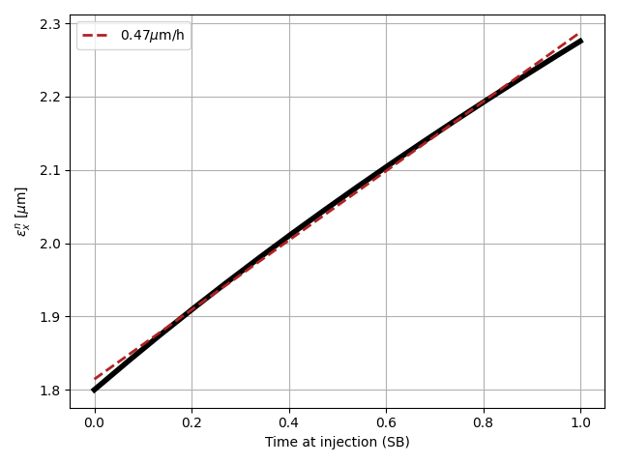
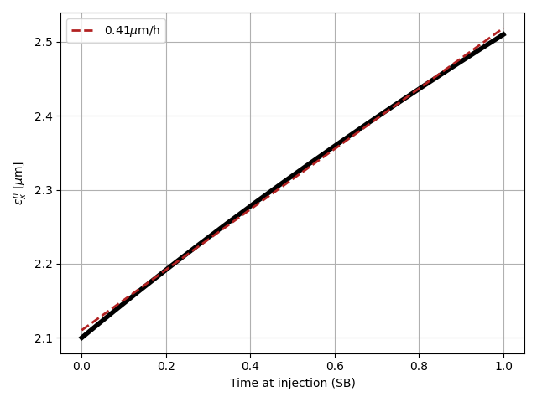
Simple model SPS FB vs LHC injection
2.3e11 ppb
Ideal filling, HL standard
Missing injections, HL standard
 | 4x72b | 4x72b + dedicated filling (6s) | 4x72b | 4x72b + dedicated filling (6s)
Bunch intensity (1e11 ppb) | 2.3 | 2.3 | 2.3 | 2.3
SPS supercycle (s) | 39.6 | 33.6 | 39.6 | 33.6
Time between B1 injections (s) | 79.2 | 67.2 | 79.2 | 67.2
Number of injections for IP1/5 colliding bunches | 12 | 12 | 12 | 12
Number of missed injectons | 0 | 0 | 12 | 12
Emittance at start of LHC injection (μm) | 2.1 | 2.1 | 2.1 | 2.1
Minimum time spent at LHC injection for IP1/5 colliding bunches (mins) | 15.84 | 13.44 (-2.4 mins) | 31.7 | 26.9 (-4.8 mins)
Emittance growth due to IBS and unknown blowup (μm/h) | ~0.6 | ~0.6 | ~0.6 | ~0.6
Average/Max emittance at the end of LHC injection | 2.19/2.26 | 2.17/2.23 | 2.27/2.42 | 2.25/2.37
Number of IP1/5 colliding bunches | 2748 | 2748 | 2748 | 2748
Turn-around (h) | 2.24 | 2.2 | 2.5 | 2.42
Integrated luminosity per day (fb-1) | 3.24 | 3.25 | 3.15 | 3.18
IBS um/h with standard vs BCMS

Slide 5
Simple model SPS FB vs LHC injection
2.86 minutes longer injection than with standard
for same injection efficiency
Ideal filling, HL BCMS
Missing injections, HL BCMS
 | 5x48b | 5x48b + dedicated filling (6s) | 5x48b | 5x48b + dedicated filling (6s)
Bunch intensity (1e11 ppb) | 2.3 | 2.3 | 2.3 | 2.3
SPS supercycle (s) | 43.2 | 37.2 | 43.2 | 37.2
Time between B1 injections (s) | 86.4 | 74.4 | 86.4 | 74.4
Number of injections for IP1/5 colliding bunches | 12 | 12 | 12 | 12
Number of missed injectons | 0 | 0 | 12 | 12
Emittance at start of LHC injection (μm) | 1.8 | 1.8 | 1.8 | 1.8
Minimum time spent at LHC injection for IP1/5 colliding bunches (mins) | 17.28 | 14.88 (-2.4 mins) | 34.56 | 29.76 (-4.8 mins)
Emittance growth due to IBS and unknown blowup (μm/h) | ~0.7 | ~0.7 | ~0.7 | ~0.7
Average/Max emittance at the end of LHC injection | 1.91/2 | 1.89/1.97 | 2.02/2.2 | 1.99/2.15
Number of IP1/5 colliding bunches | 2736 | 2736 | 2736 | 2736
Turn-around (h) | 2.26 | 2.22 | 2.55 | 2.47
Integrated luminosty (fb-1) | 3.25 | 3.27 | 3.15 | 3.18

Slide 6
Ideal filling, Run3 BCMS 3x36 or 5x36
Missing injections, Run3 BCMS 5x36
 | 3x36 | 3x36 + dedicated filling (6s) | 5x36 | 5x36 + dedicated filling (6s)
Bunch intensity (1e11 ppb) | 1.6 | 1.6 | 1.6 | 1.6
SPS supercycle (s) | 36 | 30 | 43.2 | 37.2
Time between B1 injections (s) | 72 | 60 | 86.4 | 74.4
Number of injections for IP1/5 colliding bunches | 23 | 23 | 15 | 15
Number of missed injections | 0 | 0 | 0 | 0
Emittance at start of LHC injection (μm) | 1.3 | 1.3 | 1.3 | 1.3
Minimum time spent at LHC injection for IP1/5 colliding bunches (mins) | 27.6 | 23 (-4.6 mins) | 21.6 (-6 mins) | 18.6 (-9 min/-3 min)
Emittance growth due to IBS and unknown blowup (μm/h) | ~0.7 | ~0.7 | ~0.7 | ~0.7
Average/Max emittance at the end of LHC injection | 1.47/1.62 | 1.44/1.57 | 1.43/1.55 | 1.42/1.52
Number of IP1/5 colliding bunches | 2340 | 2340 | 2484 | 2484
Turn-around (h) | 2.5 | 2.42 | 2.4 | 2.35
Integrated luminosity per day (fb-1) | 1.47 | 1.48 | 1.49 | 1..49
 | 5x36 | 5x36 + dedicated filling (6s)
Bunch intensity (1e11 ppb) | 1.6 | 1.6
SPS supercycle (s) | 43.2 | 37.2
Time between B1 injections (s) | 86.4 | 74.4
Number of injections for IP1/5 colliding bunches | 15 | 15
Number of missed injections | 15 | 15
Emittance at start of LHC injection (μm) | 1.3 | 1.3
Minimum time spent at LHC injection for IP1/5 colliding bunches (mins) | 43.2 | 37.2 (-6 minutes)
Emittance growth due to IBS and unknown blowup (μm/h) | ~0.7 | ~0.7
Average/Max emittance at the end of LHC injection | 1.57/1.8 | 1.53/1.73
Number of IP1/5 colliding bunches | 2484 | 2484
Turn-around (h) | 2.76 | 2.66
Integrated luminosity per day (fb-1) | 1.43 | 1.45

