Slide 1
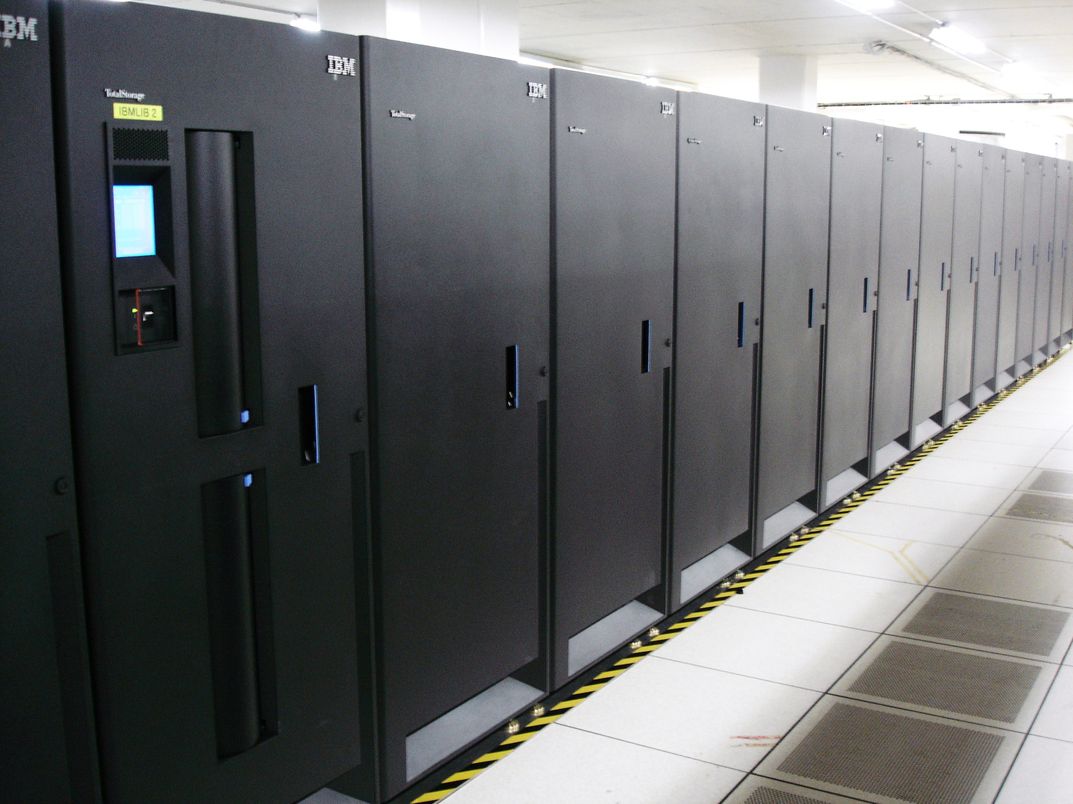
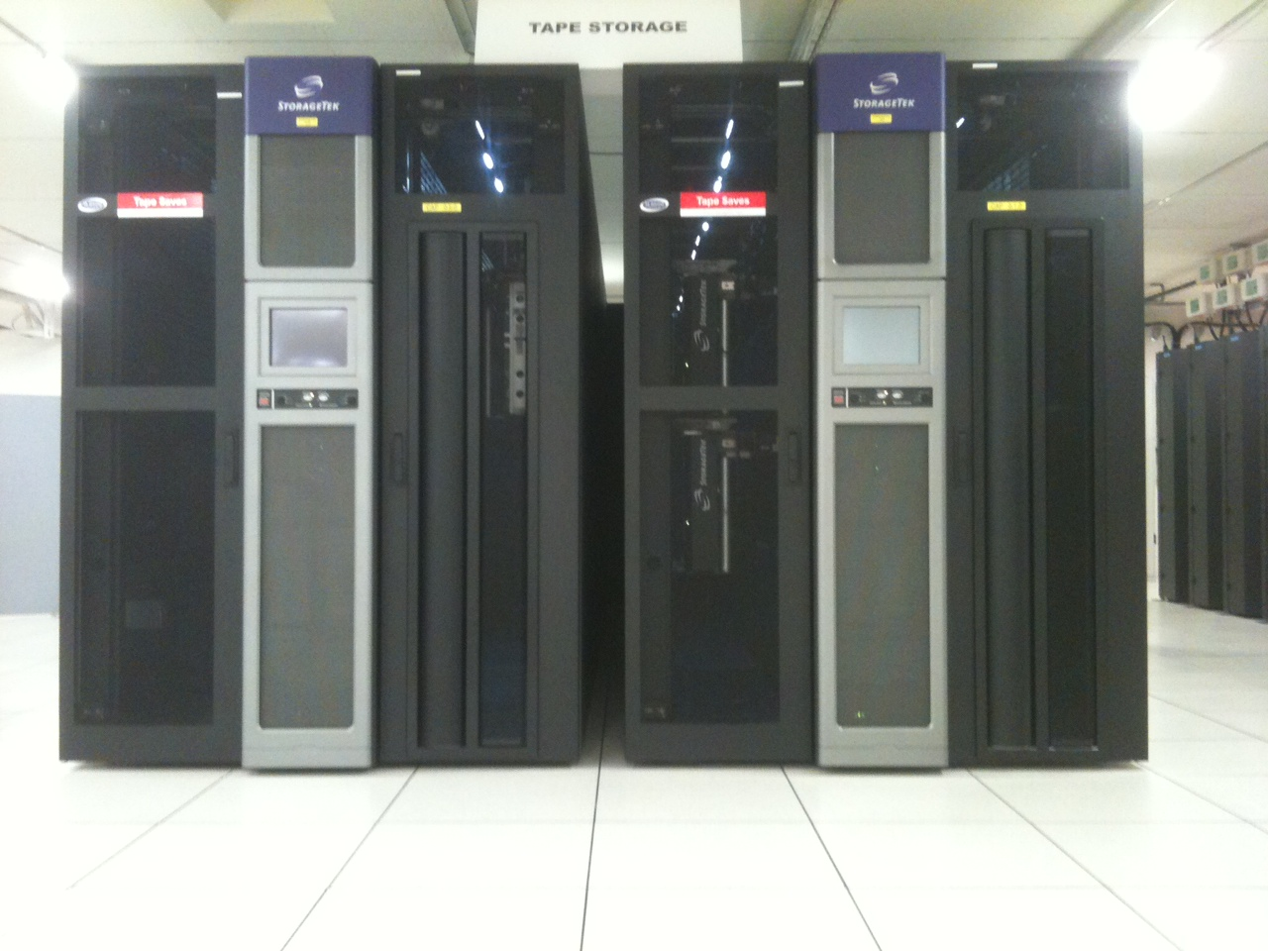
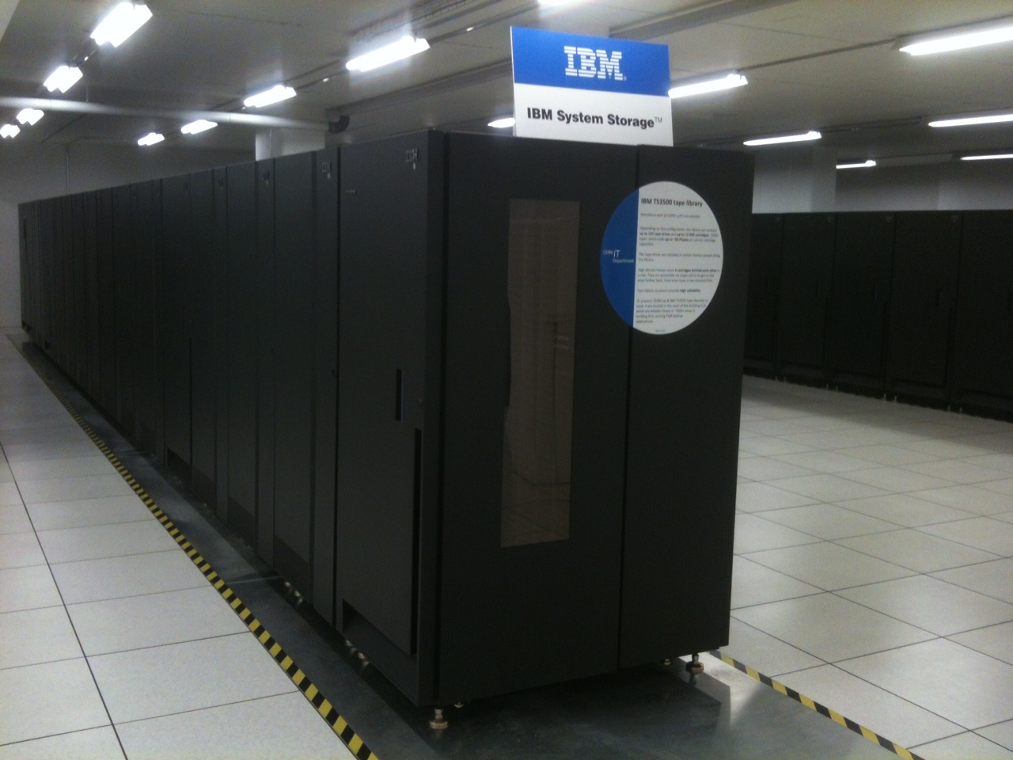
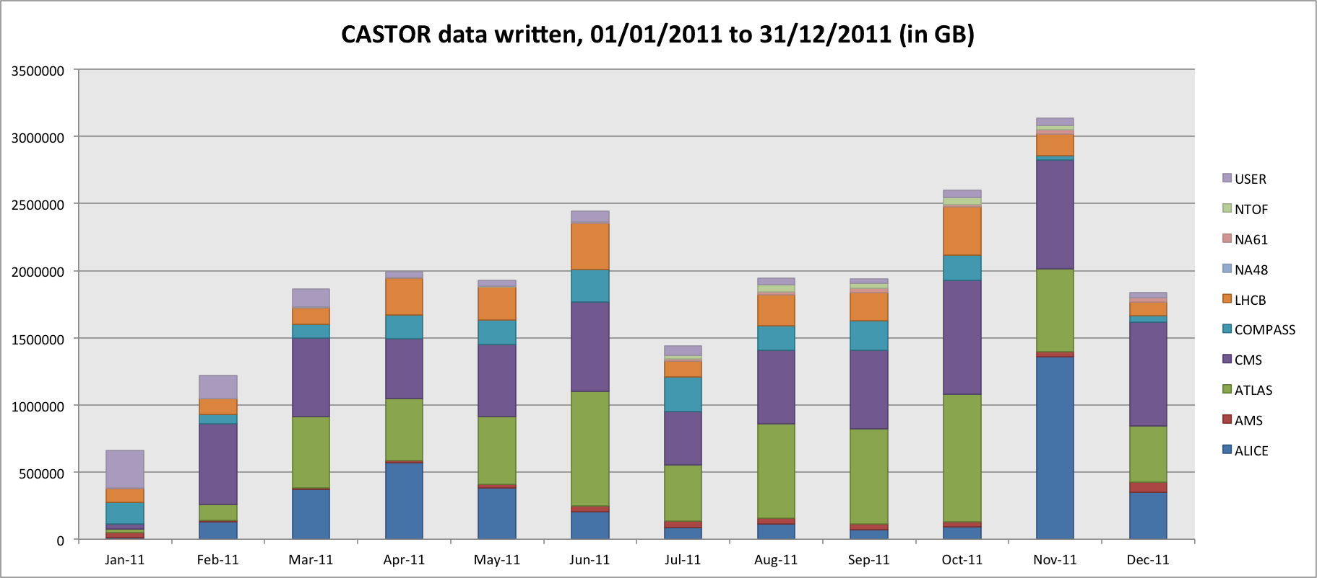
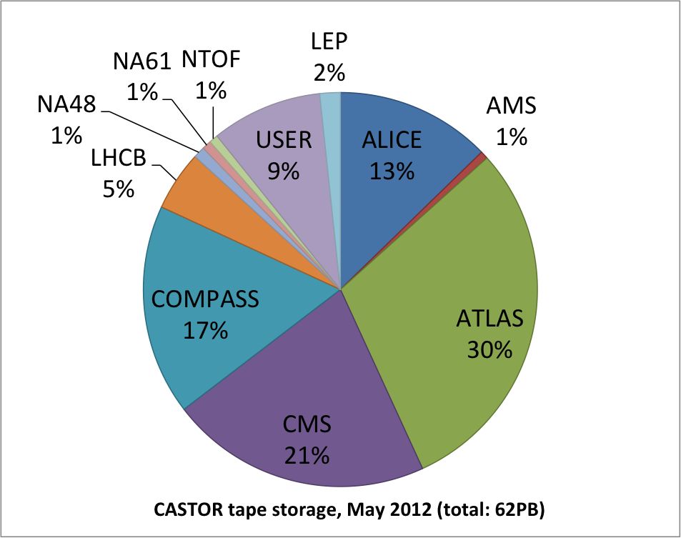
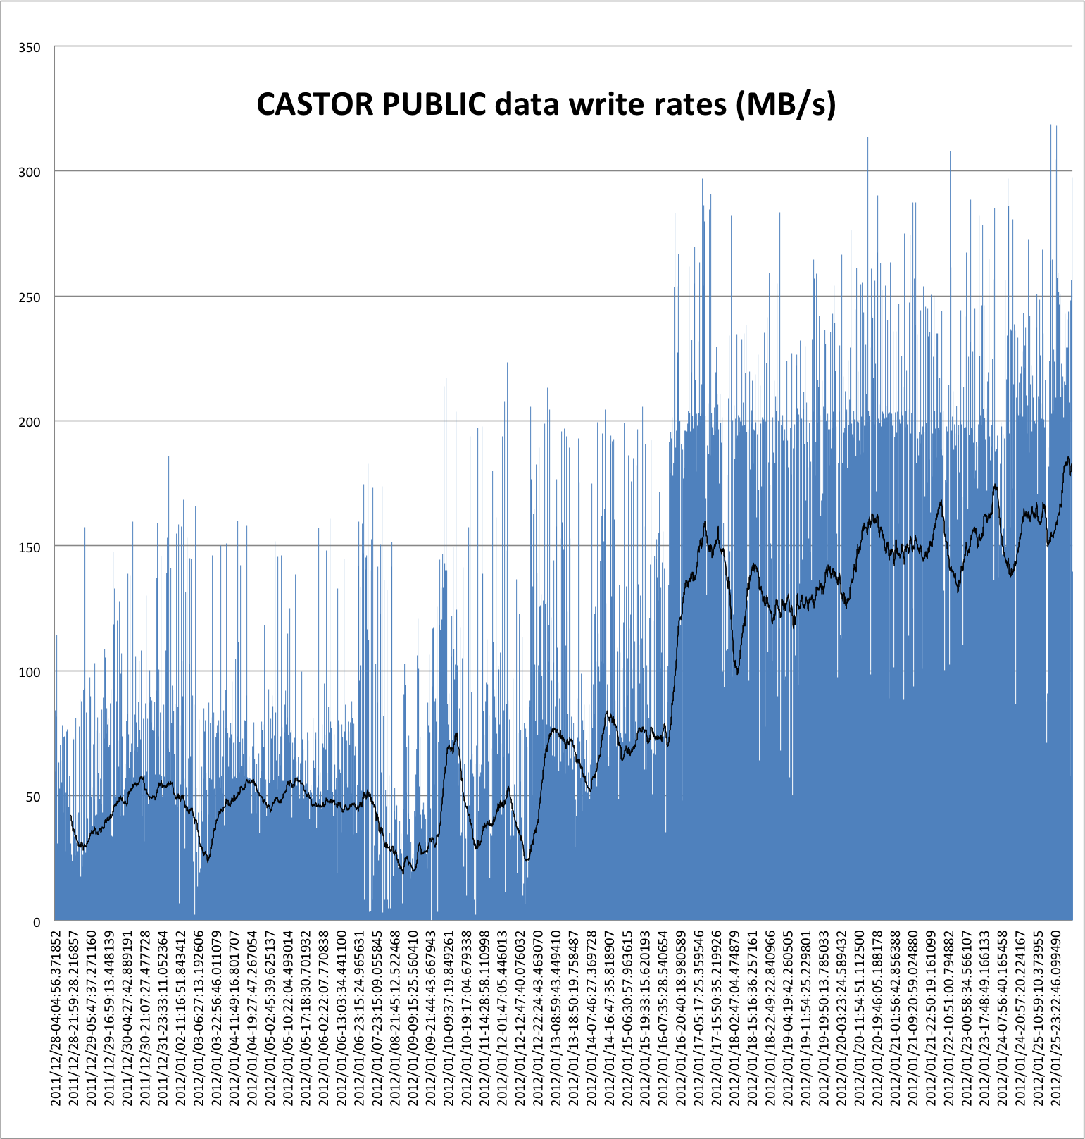
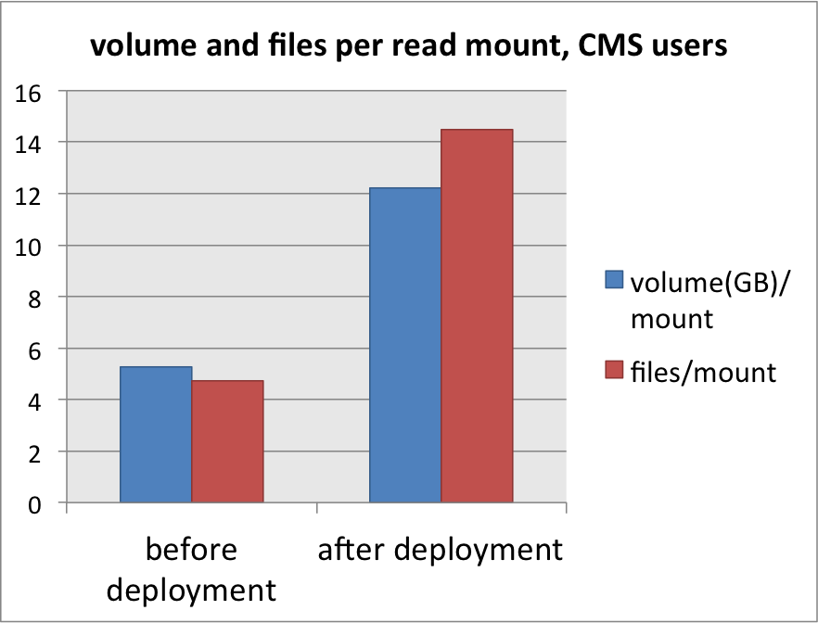
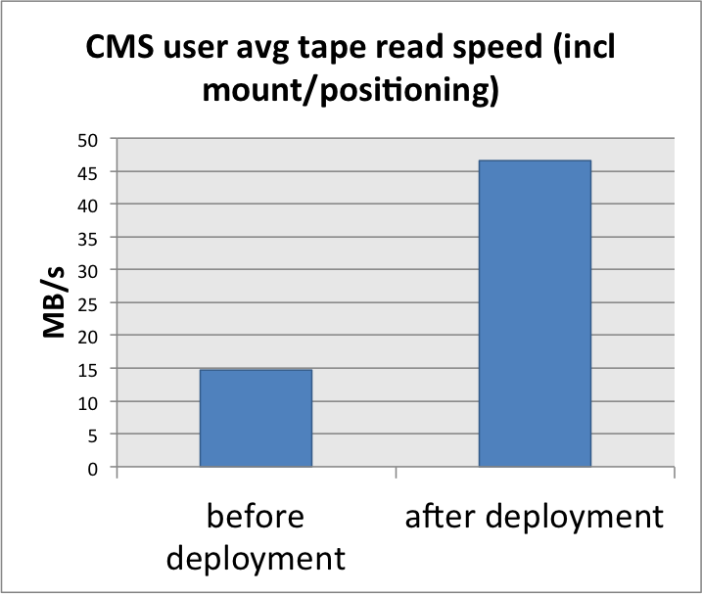
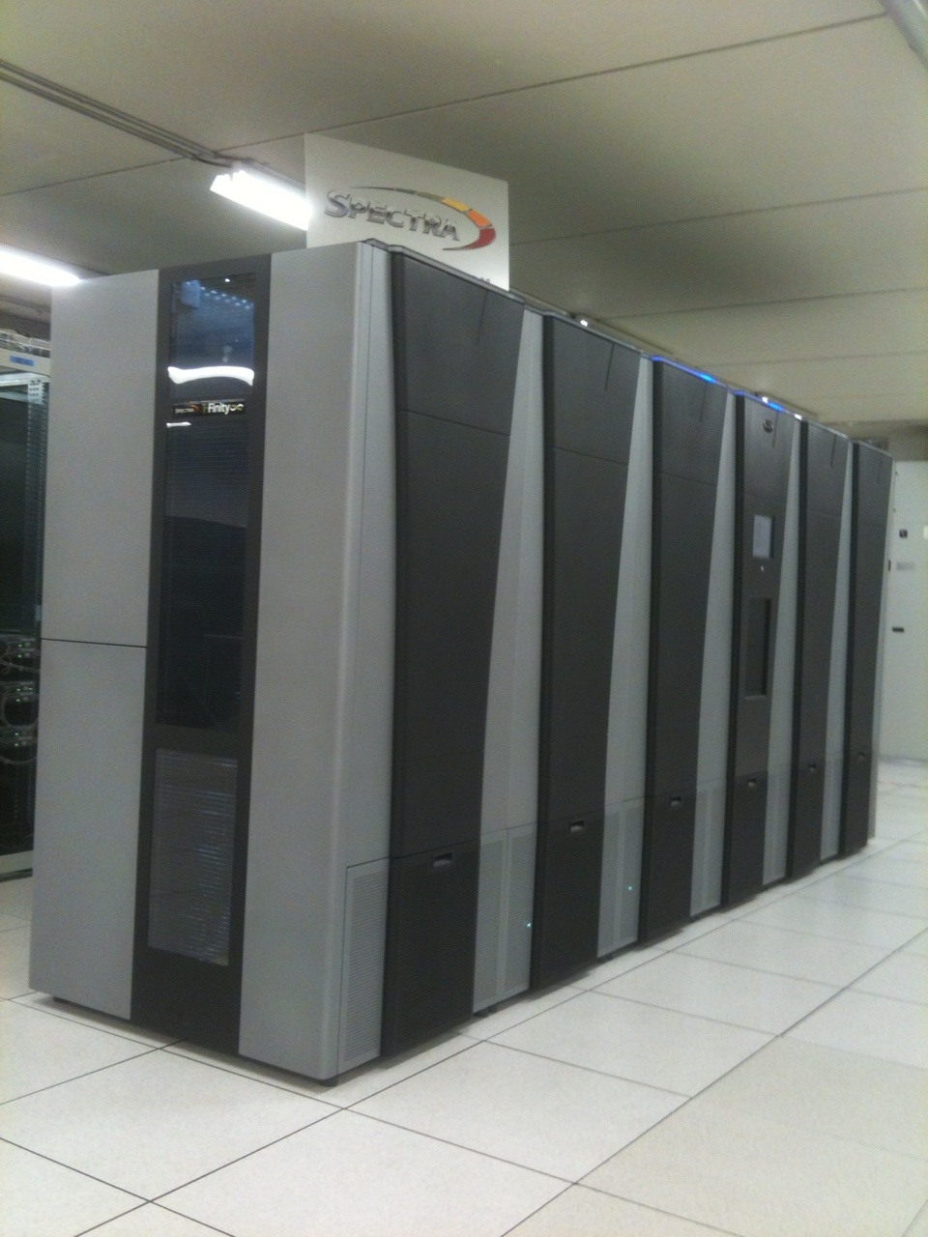
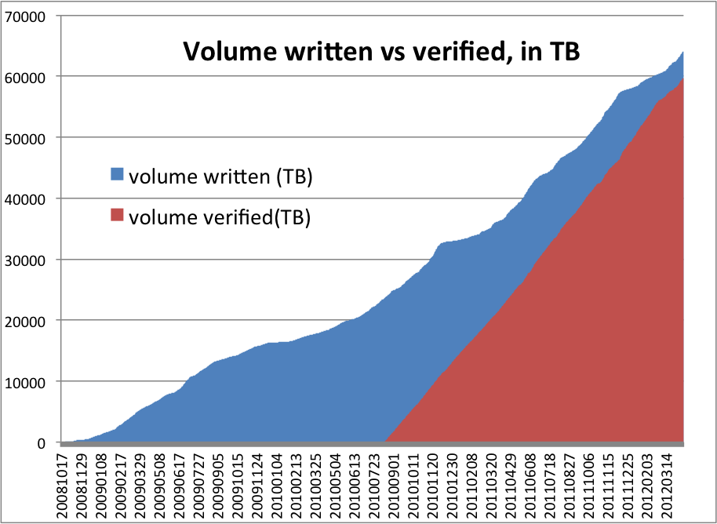

DSS
Tape status and strategy at CERN
CERN
IT
Data Storage
Services
Germán Cancio, Vladimír Bahyl, Eric Cano, Steve Murray, Daniele Kruse - CERN
Department
62PB data in 208M files and 52K tapes
1.5 .. 3PB new data per month
Up to 6.9GB/s to tape during HI period
Setup and numbers
4x Oracle SL8500
40x T10KC drives
+legacy T10KBs
5x IBM TS3500
40x TS1140 drives
+ legacy TS1130s
From nearline to archiving…
Tape technology is evolving…
Increased per-tape capacity and transfer speed
Large-scale archive market building up (legal, media, cloud providers)
… but library and drive mount/positioning times not improving!
Speed up streaming access and
minimise file/user based HSM
a) boost write streaming
b) optimise data retrieval
Full deployment of ‘buffered’ tape marks (cf. poster 415, S. Murray)
Early 2011, reduced sync tape marks from 3 to 1 per CASTOR file
speed increase from ~15MB/s to ~40MB/s
Achieve near-native drive speed by writing data in effective chunks of ~32GB
eliminates “backhitch” (tape repositioning) inefficiencies
Deployed “traffic lights” and “bus lanes” for prioritising bulk read requests
Access to robotics and drives is the bottleneck
  Define thresholds for tape mounts:
  minimum volume, max wait time, concurrent drive usage; group related tape requests
  Different thresholds + priorities for production coordinators and end users
  After: 146MB/s avg
  Before:49MB/s avg
3x files / volume per mount -> 3x increase in effective tape access speed
~50% less tape mounts (~7K to 3.5K mounts per day)
Additional ~30% less tape mounts expected when moving CMS end users to EOS
higher throughput and efficiency allowing substantial
decrease of production tape drives (from 120 to 80)
… now evaluating commodity tape
Tape usage at CERN was heavy-duty requiring enterprise-class tape equipment from IBM and Oracle
With far less demand in terms of small file writes and read mounts, “commodity” tape (LTO)
becomes a serious option, i.e. for “dusty” archived data which is infrequently accessed
Market share: LTO (~90%) vs. enterprise media (~2%)
Since Nov 2011, testing a SpectraLogic T-Finity library (max 120 drives, 30K slots)
  Test configuration: 5-10 LTO-5 drives, 1000 cartridges (1.5PB)
Necessary CASTOR adaptations coded and released
  Field test drives, library, and vendor support – storing 2nd copies of experiment data
  So far satisfactory results in general
Active monitoring and verification
Automated handling of tape, drive and library malfunction
User activity is monitored and unusual/inefficient usage
automatically reported
“bus lane” concept encourages users to pre-stage data
Archive verification:
re-read
all newly filled tapes
tapes not seen recently
turnaround time ~2 years
speed ~ 3PB / month
Top users causing tape mounts:
STAGER USER:GROUP #MOUNTS #TAPES RATIO Avg#FILES AvgFILESIZE(MB)
PUBLIC vkxxxxx:vy 2167 66 32.8 1.3 1047
ALICE alxxxxx:z2 834 85 9.8 1.7 4305
LHCb saxxxxxx:z5 285 5 57 1.4 160
CMS mpxxxxx:zh 119 2 59.5 1 202
Reliability (approximate!):
~0.0175% unavailable (under repair)
~0.000062% data loss (37.2GB)

