Slide 1
Applications of Advanced Data Analysis and Expert System Technologies in the ATLAS Trigger-DAQ Controls Framework
G. Avolio – University of California, Irvine

Slide 2
Outline
The ATLAS Trigger and Data Acquisition (TDAQ) system
  General schema
  Computing infrastructure
Intelligent systems and automation
  Why in TDAQ?
Error management in TDAQ
  Error Management System
    Online Recovery
    Diagnostic and Verification System (DVS)
  Complex Event Processing
    The “DAQ Assistant”
Conclusions

Slide 3
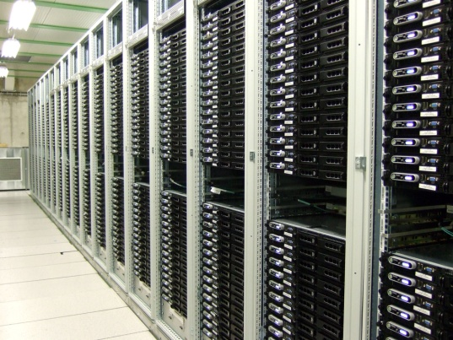

Trigger and Data Acquisition System
The Trigger and Data Acquisition (TDAQ) system is responsible for filtering and transferring data from the detector to the mass storage
  40 millions particle interactions per second
  More than 1.5 MB of data for each event
  Most of the generated events are totally uninteresting
    A filter mechanism is needed in order to select and collect the more interesting ones
From detector to data storage

Slide 4

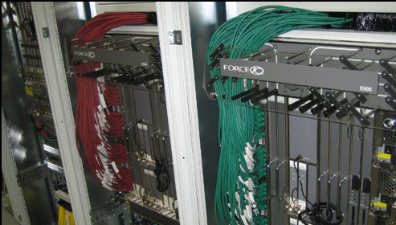
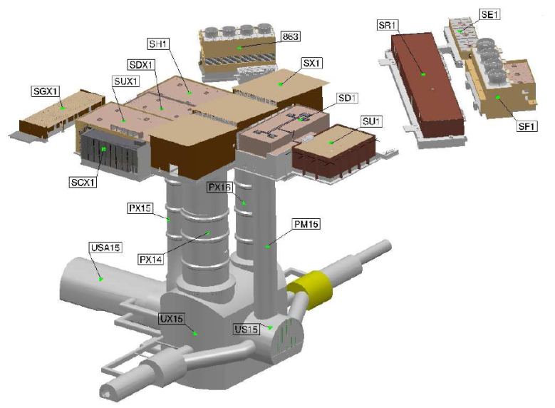
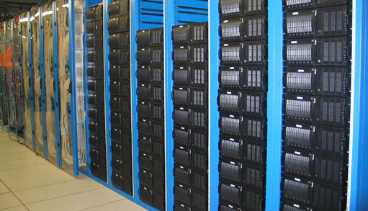
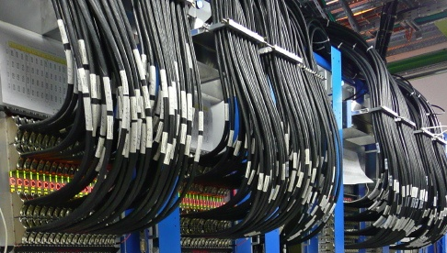
TDAQ Computing Infrastructure
More than 12k cores
and 20k applications
1600 point-to-point connections from detector to TDAQ
GbE network(s) with more than 10k channels

Slide 5
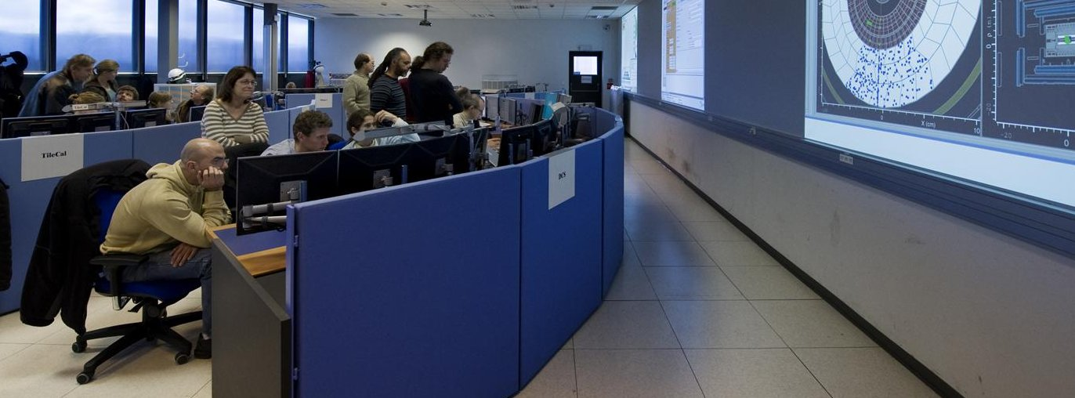
Why Intelligent Systems in TDAQ?
The main goal operating the system is to maximize the data taking efficiency
  Dealing fast and effectively with errors and failures
The system is operated by a non-expert shift crew assisted by experts providing knowledge for specific components
  Inefficiency may come from human interventions
Automating error detection, diagnosis and recovery is a key feature
  Effective analysis and monitoring system

Slide 6
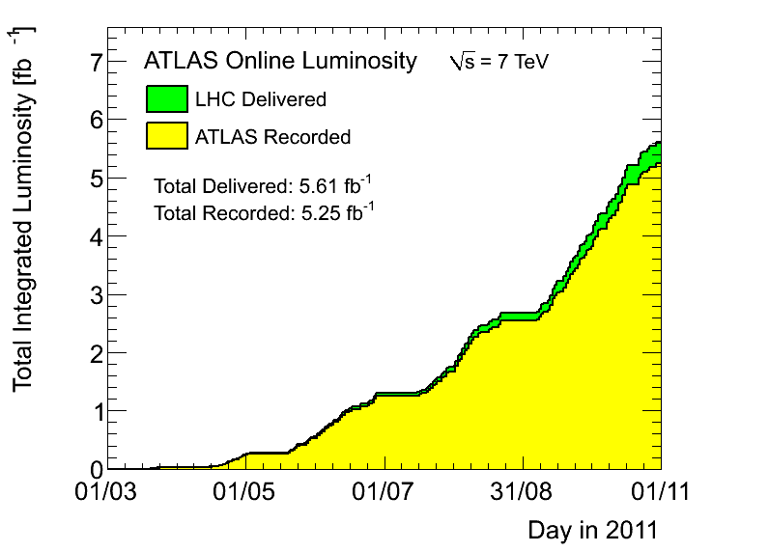
ATLAS Data Taking Efficiency in 2011
In 2011 ATLAS was able to record 93.5% of the total luminosity provided by the accelerator
Excellent result!
  But about 50% of the inefficiency due to situations involving the human intervention

Slide 7
Error Management in TDAQ
Error Management System
Rule-based (IF-THEN knowledge base)
Complex Event Processing (CEP) System
Meant to deal effectively with problems requiring the human intervention
CLIPS framework (Rete algorithm)
Actions triggered in case of predefined conditions
Meant to detect failures and able to perform automatic recovery procedures
Based on the ESPER CEP engine
Patterns detected among stream of events
Powerful Event Processing Language (EPL)
Online Recovery, DVS
DAQ Assistant

Slide 8
Online recovery & diagnostic and verification system (DVS)

Slide 9
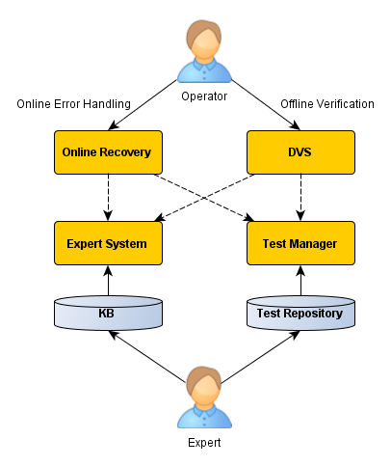
Online Recovery and DVS
Online Recovery
  Analyze and recover from errors during the data taking
    One global server dealing with system-wide errors and procedures
    Local units handling errors that can be dealt with at a sub-system level
Diagnostic and Verification System (DVS)
  Asses the correct functionality of the system
  Detect and diagnose eventual problems
Test Manager
  Framework allowing to develop and configure tests for any component in the system
Expert System
  Based on the CLIPS toolkit
  “if-then” rules

Slide 10
CLIPS
Originally developed by NASA
Available as open-source
Stand-alone application or embeddable as a library
Different programming paradigms
  IF-THEN rules and a forward-chaining inference engine
  Object oriented constructs
    “COOL” language
  Traditional algorithmic constructs
Rete algorithm

Slide 11
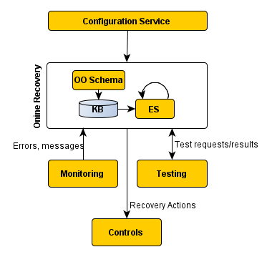
Online Recovery in Action
The system is described and configured via the Configuration Service
  Object-oriented schema
The set of objects for the actual configuration is loaded by the Expert System
  Using the COOL object-oriented language provided by CLIPS
The Expert System engine uses information coming from errors, messages and tests to match the loaded rules
The KB is parsed at run-time
  Easy customization of recovery procedures

Slide 12
DVS
The DVS is a framework that allows to
  Configure a test for any component in the system
  Have a graphical representation of the testable components and of the test results
    Via an user-friendly GUI
  Automate testing of the system
  Provide the operator with diagnosis and recovery advices in case of failures
  Add knowledge for testing sequences and error diagnostics

Slide 13
Recovery Scenarios
if
system state is running, and
application App1 status is absent, and
application App1 has supervisor S1, and
application App1 membership in
then
notify S1 ignore App1
set membership App1 out
Simple recovery action for a dead application
Recoveries cover a wide range of possible scenarios
  Simple local actions
    Restarting a dead application
    Ignore problems from non-critical applications
  System wide actions
    Disable (and eventually re-enable) a busy read-out channel without stopping the run
    Re-configure a sub-system during the data taking

Slide 14
The Daq assistant

Slide 15

The TDAQ Assistant
What
A tool meant at guiding the operator in his daily work
Diagnosing problematic situations and suggesting action to take
Aim
Reduce and simplify shifter tasks
Help shifters with more detailed and pertinent information
Objectives
Automate checks and controls in real-time
Process and analyze heterogeneous streams of information
Remind the operator he should (not) do something
Be more efficient, avoid repetition
Formalize knowledge from experts
Receive instructions from TDAQ experts on what to do and how to react
Promptly notify operators of problems and failures

Slide 16
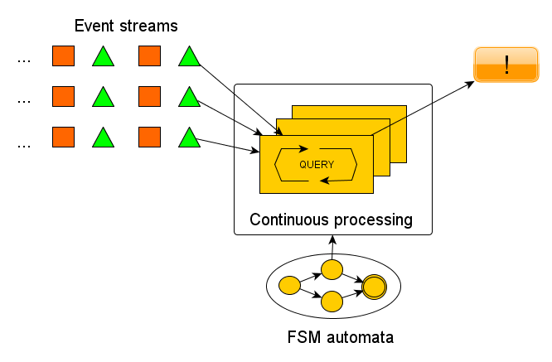
Complex Event Processing
A set of technologies to process events and discover complex patterns among streams of events
  Used in financial analysis, wireless sensor networks, business process management
A cross between Data Base Management System and Rule Engines
Main characteristics
  Continuous stream processing
  Support for time/size windows, aggregation and grouping events
  SQL-like pattern languages
    Augmented with constructs to express event relationships (time, cause and aggregation)
    Streams replacing tables in a continuous evaluation model

Slide 17
Challenges in TDAQ
Information gathering
Information processing
Present results
Many information sources
Several technologies
Dynamic system conditions
Heterogeneous data
Building Knowledge Base
Discover complex patterns
Several outputs: web pages, e-mails, SMS
… and all with thousands of information updates per second!

Slide 18
Directives and Alerts
Directives
Alerts
Define what to detect and how the system has to react (produce alerts, statistics,…)
Problem description, reaction, severity, domain, pattern details
Directives
  Encode the knowledge from experts
  XML structured KB
  Can be modified at run time via a web-based admin interface
Alerts
  Effective and timeliness notification
  Intelligent processing
    Thanks to CEP the number of false-positive situations is drastically reduced
  Carry all the information needed for debug and fault diagnosis

Slide 19
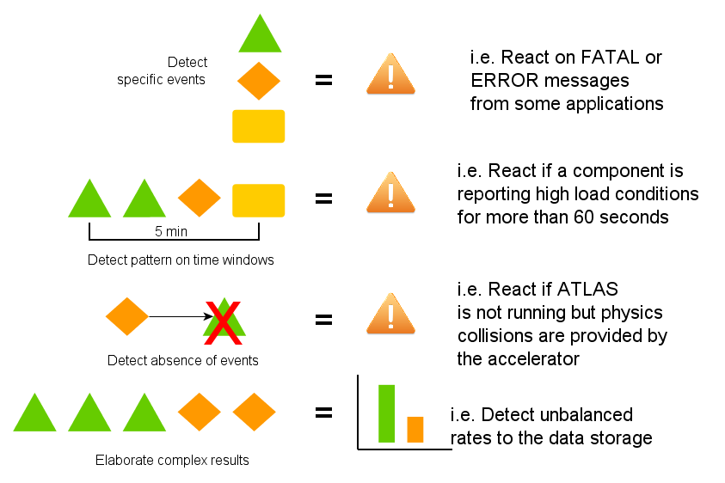
Detecting Patterns

Slide 20
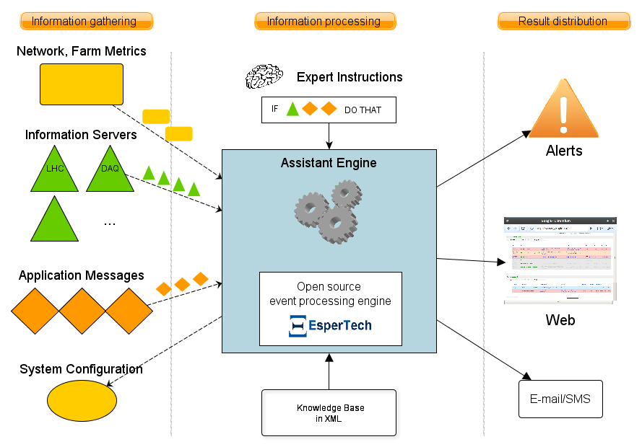
Architecture
Data gathered and feed into the engine
EPL statements (from directives) are evaluated against data (continuous query)
Generating alerts, notifications, statistics as soon as incoming events meet the constraints of the pattern

Slide 21
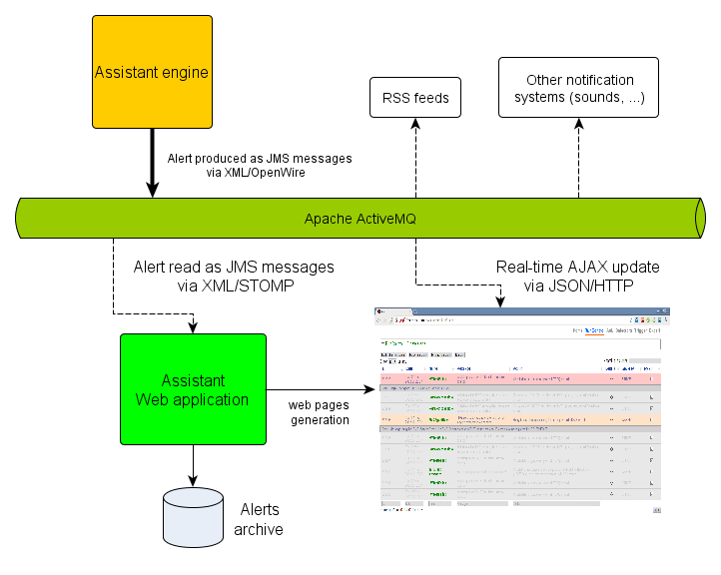
Web-Based Visualization
Message driven alert distribution
  Based on Apache ActiveMQ
Web page for interactive visualization of alerts
  Alerts grouped per categories/user preferences
  User interaction
    Mark alerts as read when the problem is solved
    Mask alerts
  Alert history
Django project with some SQLite and jQuery goodies

Slide 22
Conclusions
Effective monitoring, fault diagnosis and automation of recovery procedures have shown to really help improving the ATLAS data taking efficiency
The DAQ Assistant is in production since June 2011
  A message-driven architecture and CEP techniques allowed to build an intelligent and automated monitoring tool
  Used to assist the data acquisition operators
    From simple reminders to the detection of complex error conditions
    Shift crew reduced by one unit (DAQ shifter)
  Integrated with the EMS system in order to trigger automated recovery actions
Looking forward to a successful 2012 for ATLAS
  And the goal is to always improve the data taking efficiency

