Slide 1

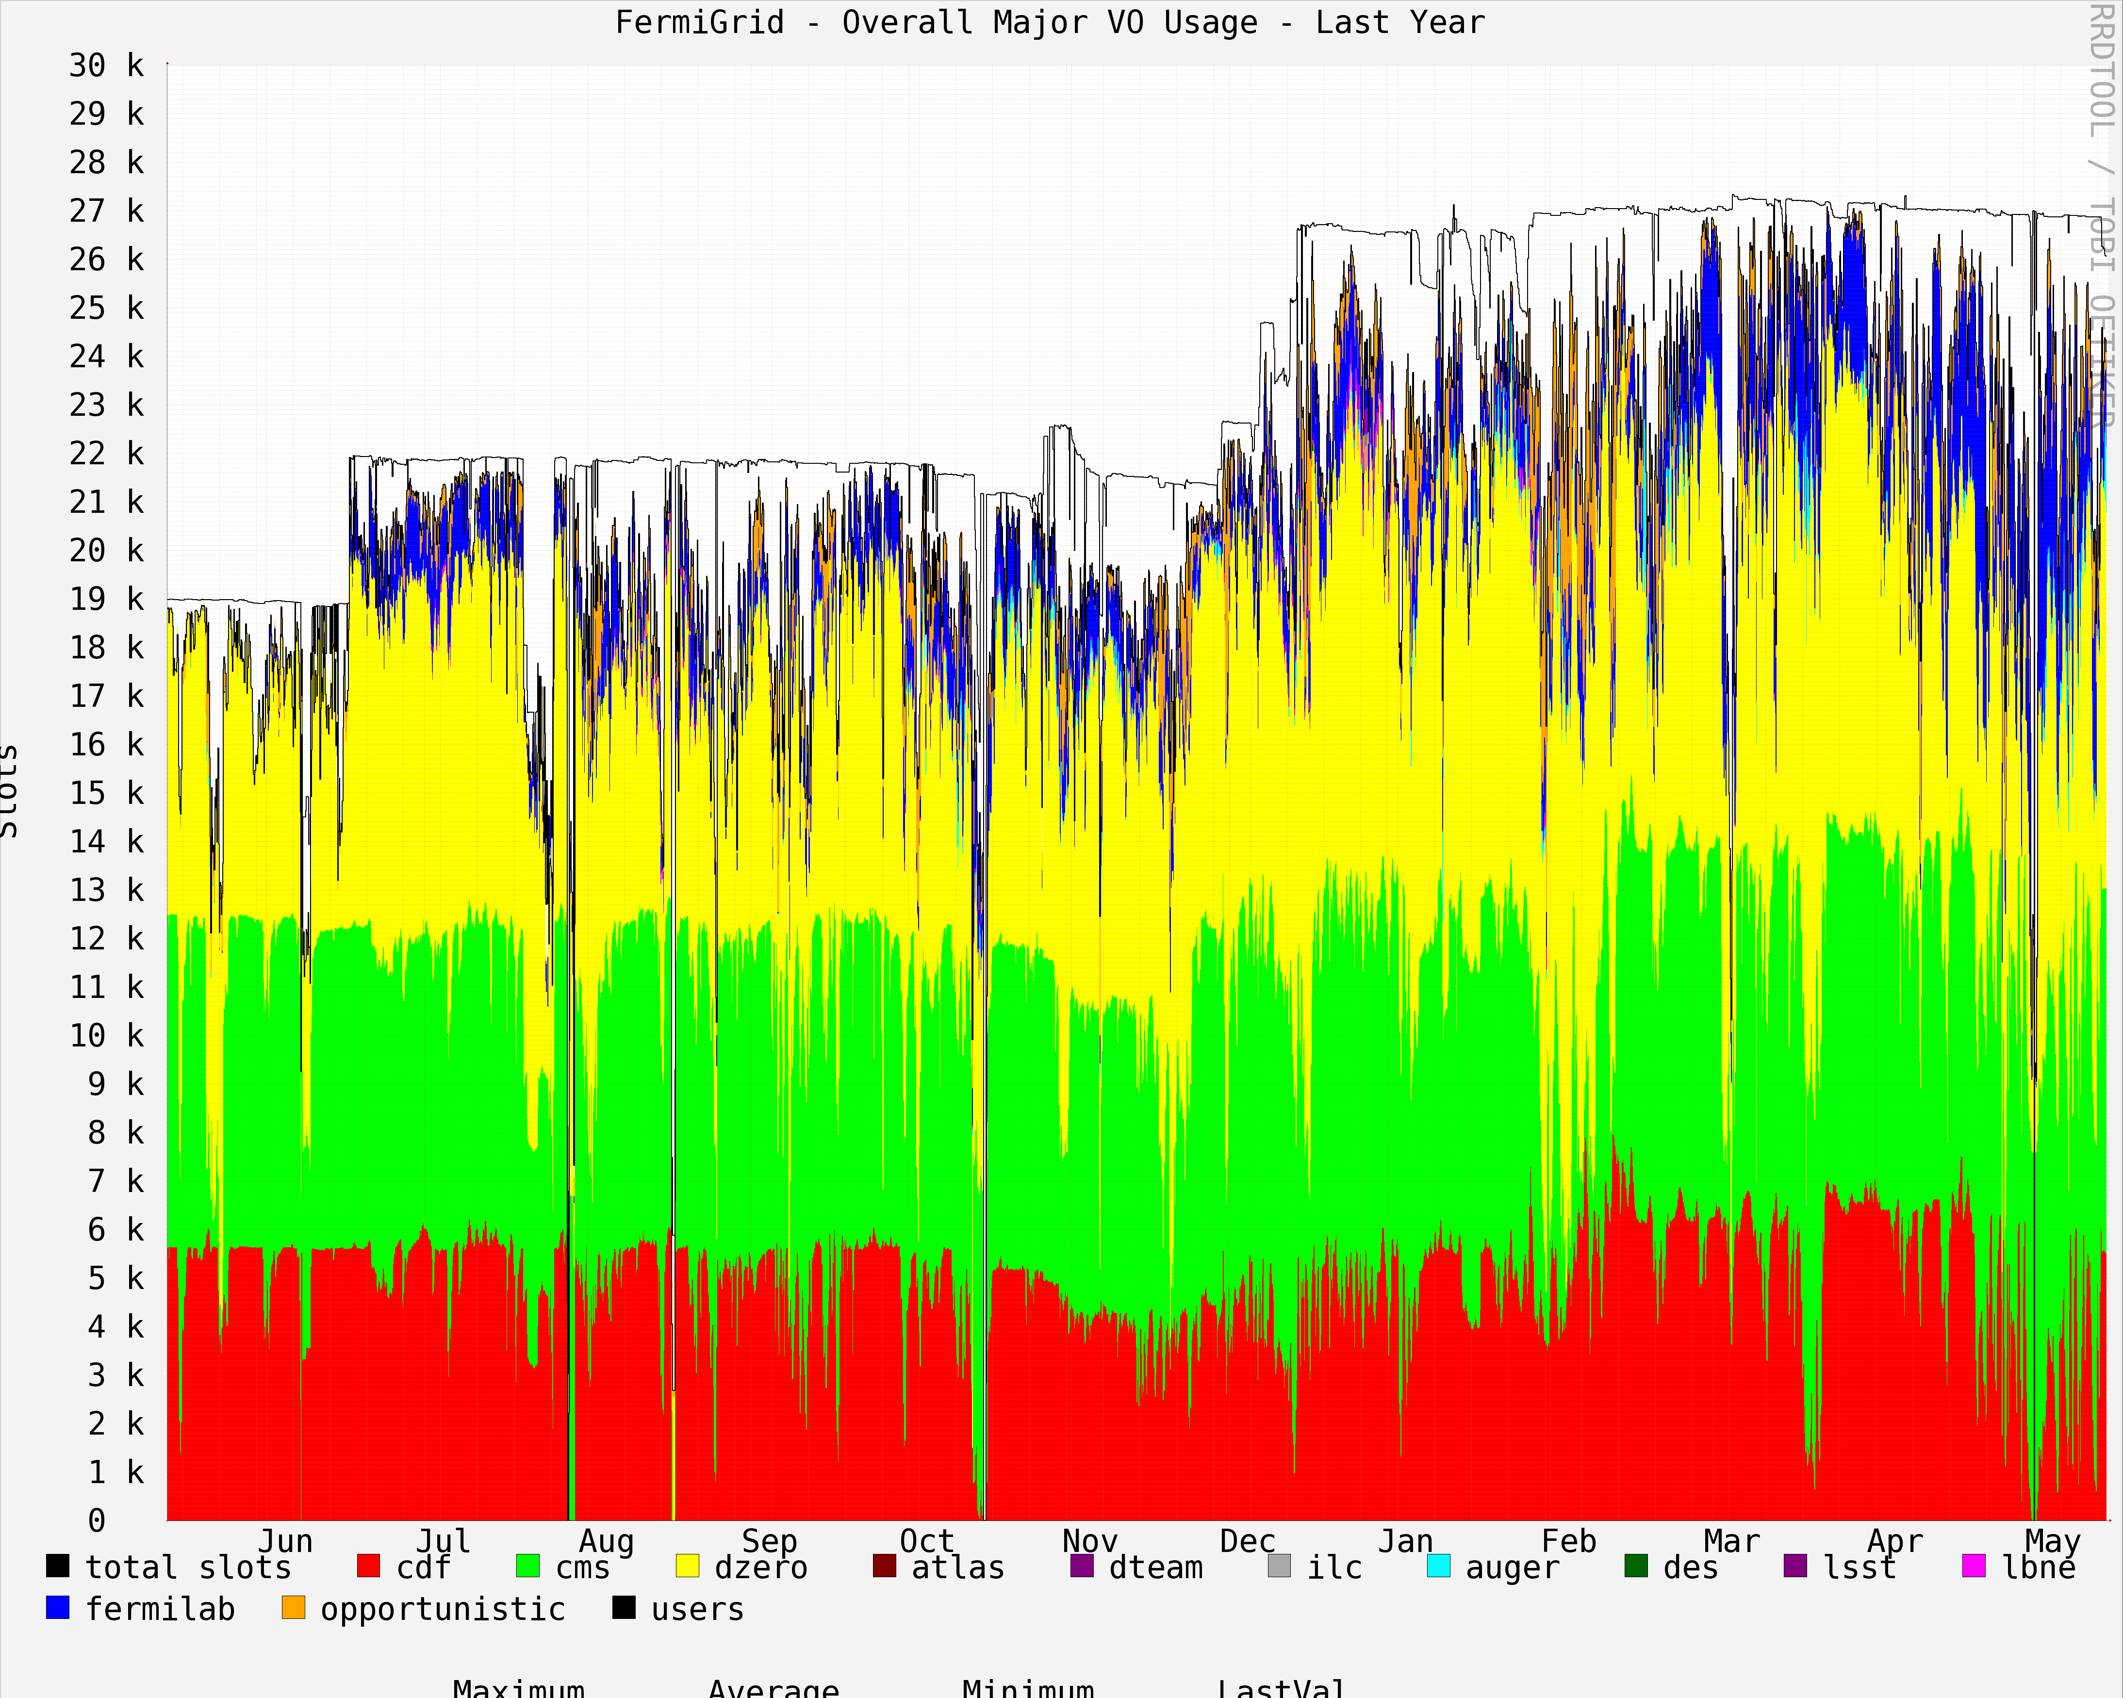
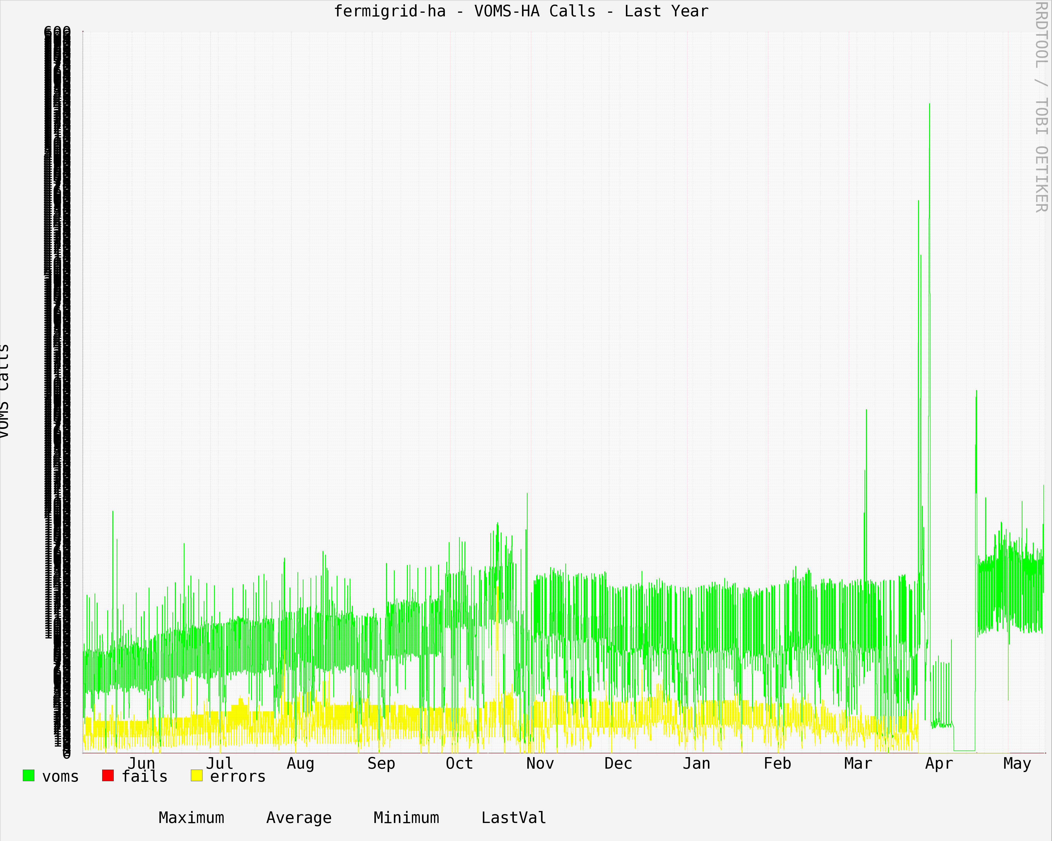
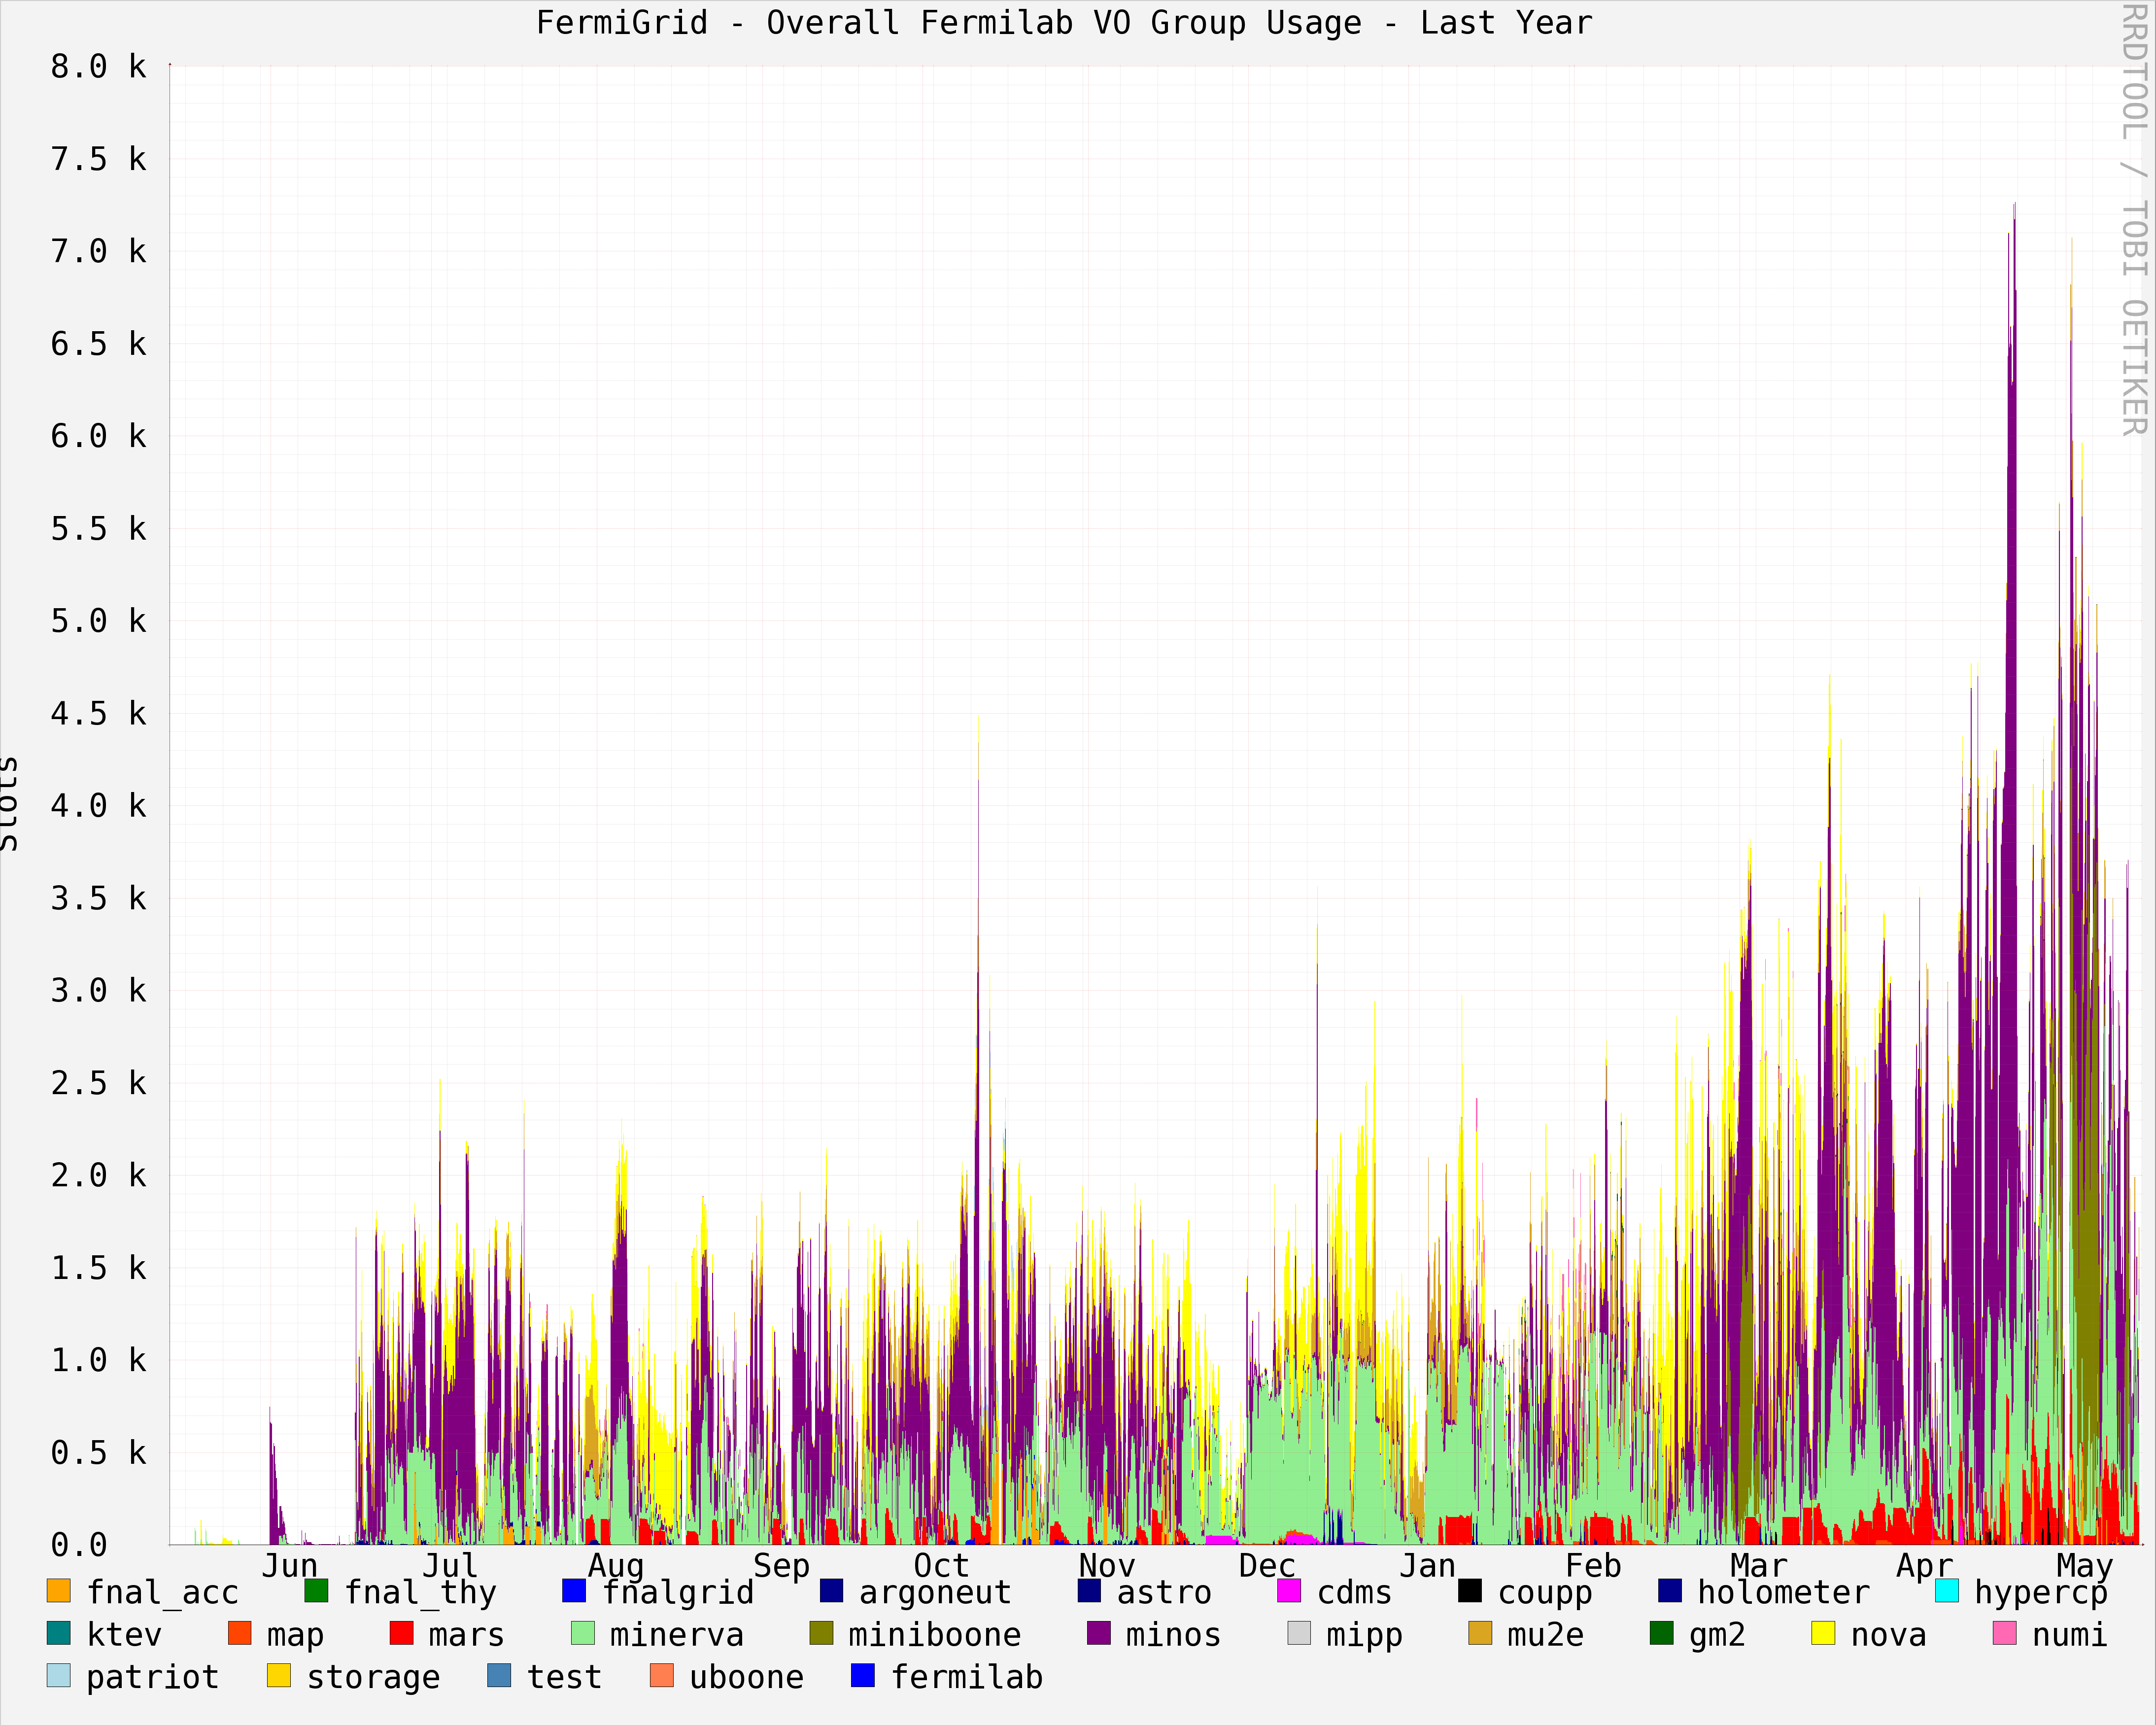
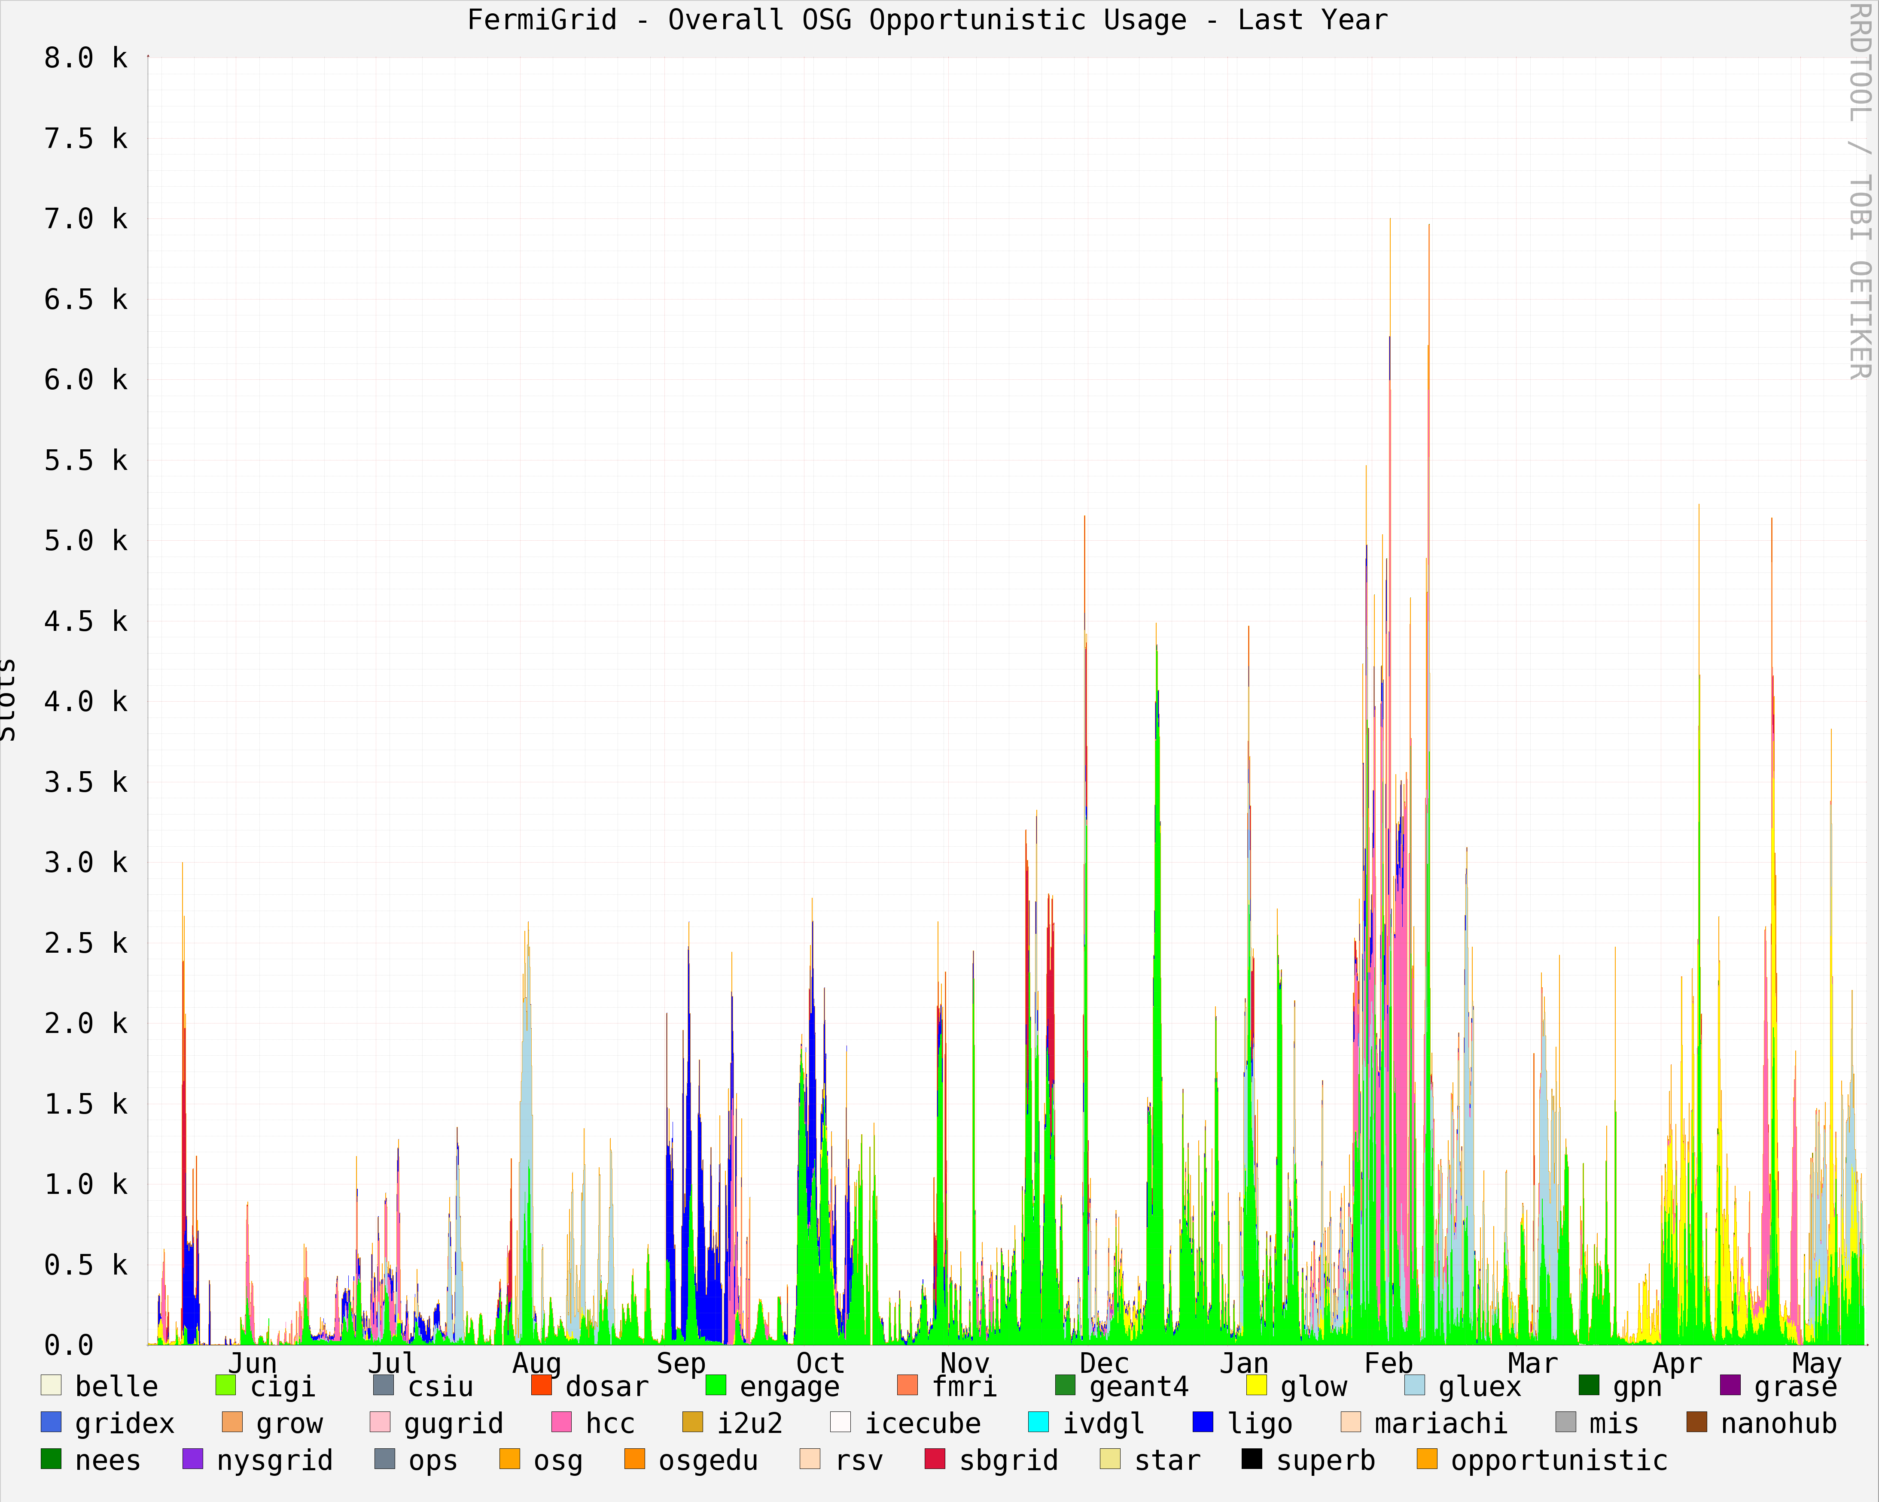
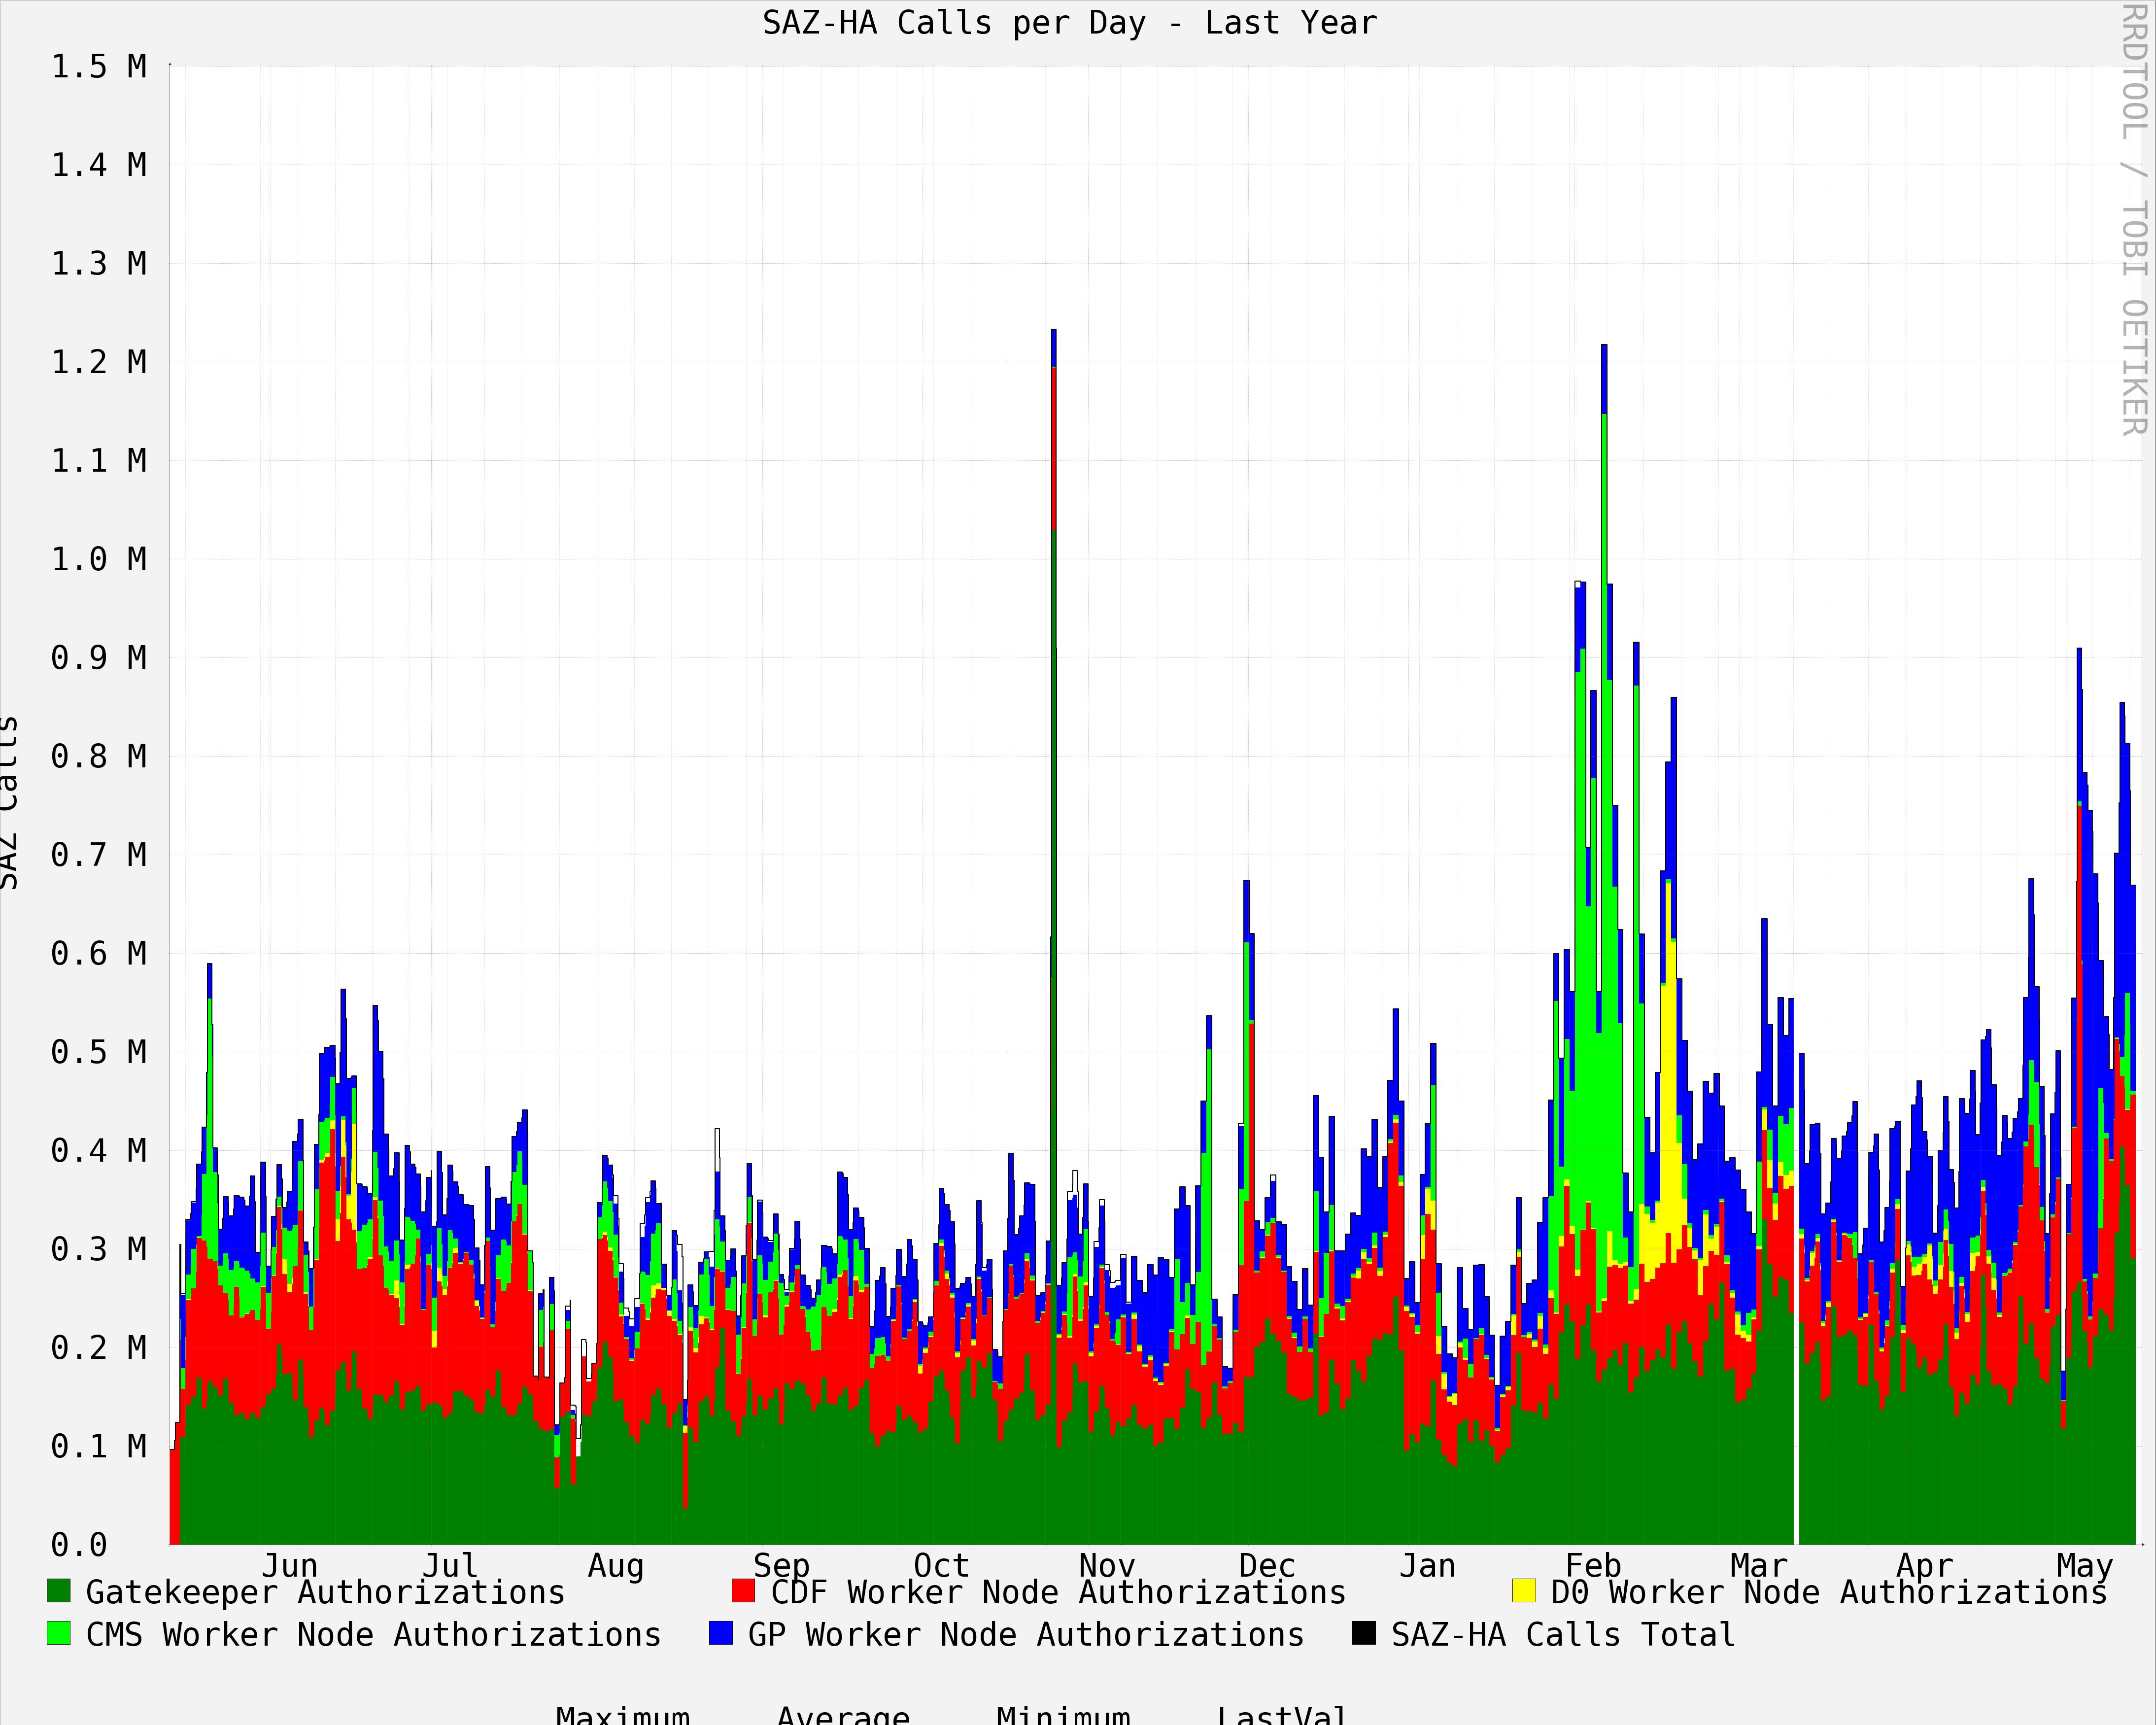
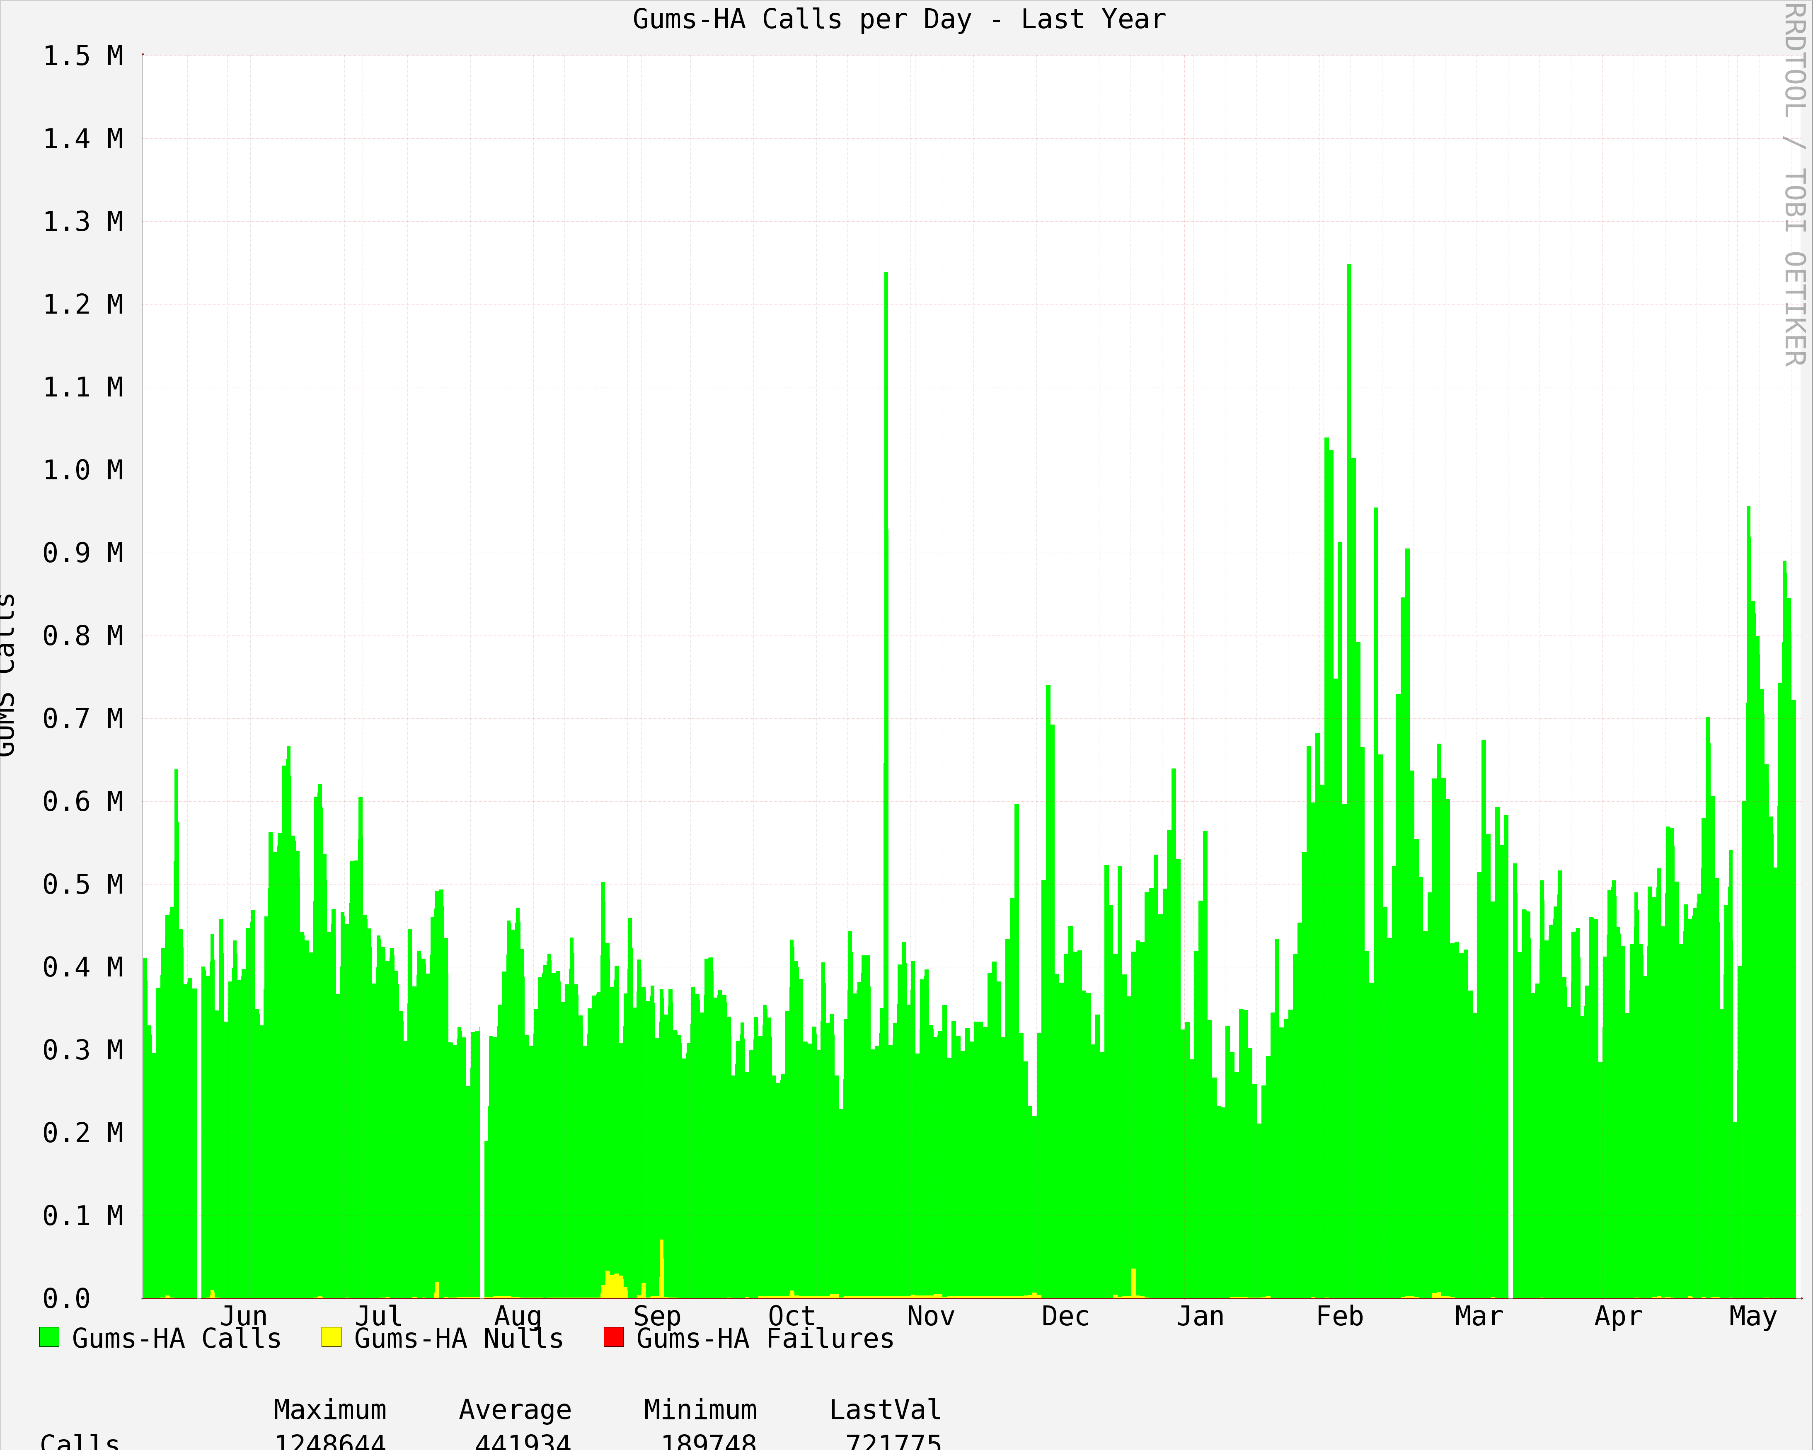
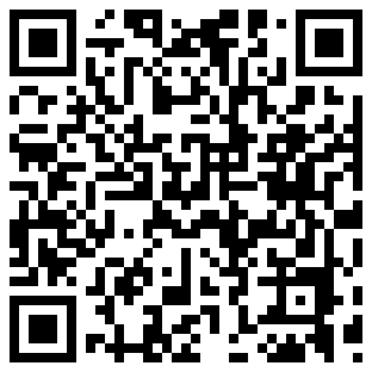



FermiGrid
A Campus Grid supporting local and remote users sharing resources across Fermilab and the Open Science Grid
S. Timm, K. Chadwick, N. Sharma, D. Yocum
Light Blue
RGB Color 26-134-187
HTML Color #1A86BB
FermiGrid Services | High Availability
Service Redundancy
Geographic Redundancy | Science Stakeholders
Service | Raw Availability | HA Configuration | Measured HA Availability | Minutes of Downtime
VOMS—VO Management Svc. | 99.813% | Active-Active | 99.908% | 480
GUMS– Grid User Mapping System | 99.668% | Active-Active | 100.000% | 0
SAZ—Site AuthoriZation | 99.988% | Active-Active | 100.000% | 0
Squid—Web Cache | 99.645% | Active-Active | 100.000% | 0
MyProxy—Grid Proxy service | 99.715% | Active-Standby | 99.715% | 1500
ReSS—Resource Selection Service | 99.634% | Active-Active | 100.000% | 0
Gratia—Fermilab and OSG Accounting | 99.162% | Active-Standby | 99.988% | 60
Database | 99.796% | Active-Active | 100.000% | 0
VOMS
Active
LVS
Active
VOMS
Active
LVS
Active
MySQL
Active
Red
RGB Color 217-34-41
Web Color #D92229
Heartbeat
GUMS
Active
Heartbeat
Replication
LVS
Standby
GUMS
Active
LVS
Standby
MySQL
Active
SAZ
Active
SAZ
Active
Data from May 13, 2011 to May 15, 2012
Energy Frontier:
CDF, D0, CMS
Intensity Frontier:
MINOS,MiniBooNE, NOvA,MINERvA,Mu2e, g-2, LBNE,ArgoNeuT,MicroBooNE
Cosmic Frontier:
DES,LSST,Holometer,COUPP, Auger,CDMS
Accelerator Design:
Muon Collider, Project X
Open Science Grid:
Green
RGB Color 102-183-99
Web Color #66B763
FCC2
VLAN
tunnel
GCC-B
Public LAN Switch
Public LAN Switch
LVS
(active)
Heartbeat
LVS
(standby)
Service
(active)
Service
(active)
Service
(active)
Service
(active)
Service
(active)
Service
(active)
Service
(active)
Service
(active)
Service
(active)
“Dark” Fiber
Service
(active)
Private LAN Switch
Private LAN Switch
Dark Blue
RGB Color 3-66-121
Web Color #034279
FermiGrid Performance
Major VO Utilization | VOMS Mapping
Fermilab VO | OSG Opportunistic
SAZ Authorization | GUMS Mapping
FermiGrid Architecture
User Login
& Job
Submission
Open Science
Grid
XSEDE
WLCG NDGF
FermiGrid
Authentication/Authorization
Services
FermiGrid
Site
Gateway
FermiGrid
Infra-
structure
Services
FermiGrid
Monitoring/Accounting
Services
GP Grid Cluster
4738 slots
D0 Grid Clusters
8086 slots
CDF Grid Clusters
5520 slots
CMS
T1 Grid Cluster
7560 slots
Work supported by the U.S. Department of Energy
under contract No. DE-AC02-07CH11359

