Slide 1
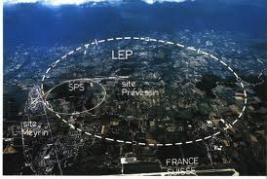


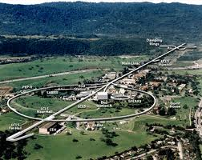
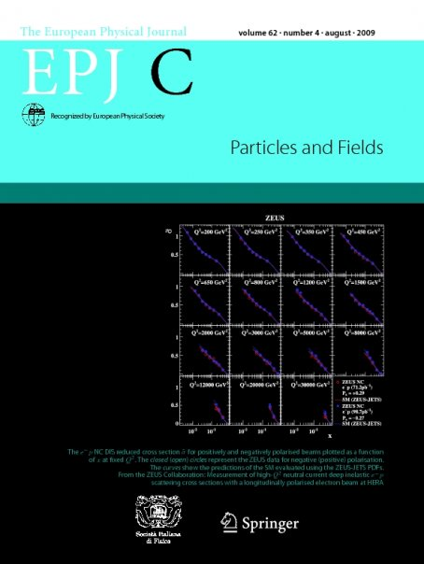




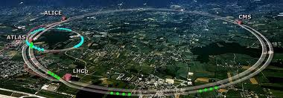

Publication patterns in HEP computing
M. G. Pia¹, T. Basaglia², Z. W. Bell³, P. V. Dressendorfer⁴
¹INFN Genova, Genova, Italy
²CERN, Geneva, Switzerland
³ORNL, Oak Ridge, TN, USA
⁴IEEE, Piscataway, NJ, USA
CHEP 2012, NYC

Slide 2
Analysis topics
What they publish
How much
Where
Citations
Technology vs physics
Software vs hardware
Software/DAQ-trigger
General tools
  Geant4
  ROOT
HEP experiments
  LEP
    ALEPH, DELPHI, L3, OPAL
  BaBar
  LHC
    ALICE, ATLAS, CMS, LHCb, TOTEM
Grid computing
  LCG
Representative
Not exhaustive

Slide 3
Data sources
Thomson-Reuters: ISI Web of Knowledge
  CERN subscription: since 1970, conference database not included
  Search by keywords, collaboration name
Journal web sites
  IEEE TNS
  NIM, Comp. Phys. Comm. (Elsevier)
  JINST (IOP/SISSA)
  Full-text searches
CERN databases
  CERN Document System
  Greybook
Years: 1982-2011 (LEP), 1992-2011 (BaBar, LHC)
  Reproducible sample

Slide 4
Data sample
Contamination
  Non-pertinent entries in the data sample
Omission
  Pertinent papers are not included in the data sample
Cross-checks
  WoS/CDS, WoS/publishers’ web sites
WoS inconsistencies and errors
  Total number of citations includes Conference database
  Proceedings papers: false classifications and omissions
  Manually corrected whenever possible
Automated analysis (whenever possible)
Manual evaluation: abstracts and full-text papers
  Some degree of subjectivity

Slide 5

2934 citations (14 May 2012)
S. Agostinelli et al.
Geant4: a simulation toolkit
NIM A, vol. 506, no. 3, pp. 250-303, 2003
2026 citations excluding proceedings
Most cited CERN publication in WoS
(excluding Rev. Part. Properties)
574 citations (14 May 2012)
J. Allison et al.
Geant4 Developments and Applications
IEEE Trans. Nucl. Sci., vol. 53, no. 1, pp. 270-278, 2006
381 citations excluding proceedings
Many papers cite the NIM paper, but they omit citing the TNS one, even though both are indicated in http://cern.ch/geant4
Many papers that use Geant4 do not cite either reference
Citation analysis: until 2011 (reproducibility)

Slide 6
Born from LHC experimental requirements
Multidisciplinary sources of citations
LHC
HEP
Other
75% citations
(plot)
16% citations (plot)
19% citations from collaborations

Slide 7

540 citations (14 May 2012)
R. Brun and F. Rademakers
ROOT - An object oriented data analysis framework NIM A, vol. 389, no. 1-2, pp. 81-86, 1997
347 citations excluding proceedings
AIHENP Workshop proceedings paper
27 citations (14 May 2012)
I. Antcheva et al.
ROOT - A C++ framework for petabyte data storage, statistical analysis and visualization
Comp. Phys Comm., vol. 180, no. 12, pp. 2499-2512, 2009
20 citations
excluding proceedings
Citation analysis: until 2011 (reproducibility)

Slide 8
75% citations
8% of all citations from collaborations
Field of citing journals
 | Geant4 % | ROOT %
Technology | 30.3 | 49.6
Physics | 29.9 | 18.2
BioMedical | 13.9 | 6.0

Slide 9
HEP experiments
LEP: 1989
BaBar: 1999
LHC: 2008
Start of run
LEP
  ALEPH
  DELPHI
  L3
  OPAL
BaBar
LHC
  ALICE
  ATLAS
  CMS
  LHCb
  TOTEM

Slide 10
Time distribution
LEP: 1989
BaBar: 1999
LHC: 2008
Run start
Publication year
Rescaled w.r.t. year of start run

Slide 11
Time distribution
LEP: 1989
BaBar: 1999
LHC: 2008
Run start
Same as previous slide, rescaled by the number of experiment members

Slide 12
Publications
Share of hardware, software and DAQ-trigger publications

Slide 13
Physics publications
LEP experiments completed their life-cycle
LHC experiments: at an early stage of their physics production

Slide 14
Technological publications
Roughly constant trends, once the number of publications is normalized to the number of collaborators

Slide 15
Software vs. hardware
Hardware publications: approximately 4 times more than software
DAQ-trigger publications: approximately 1.3 times more than software

Slide 16
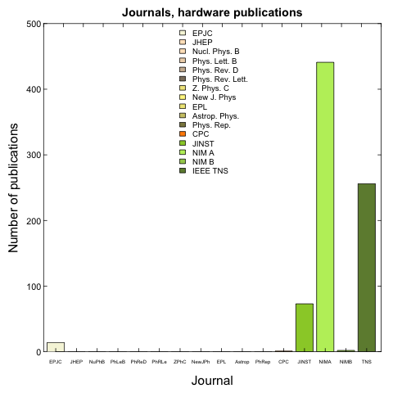
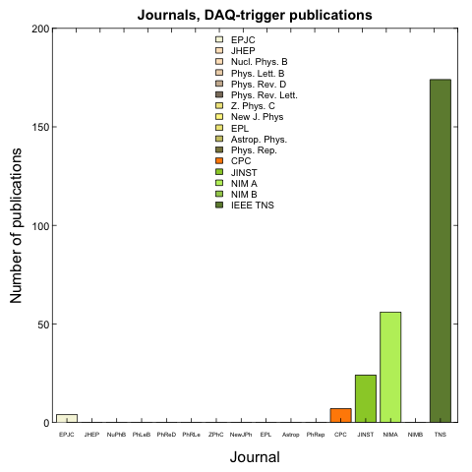
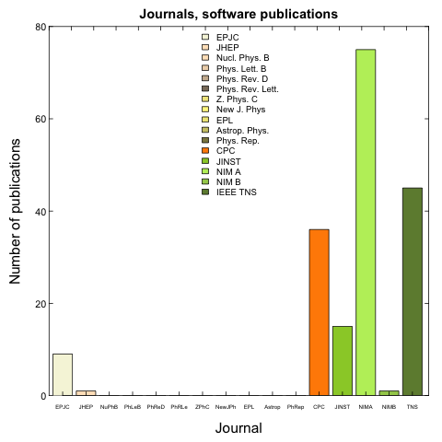
Journals
NIMA
hardware
TNS
JINST
DAQ-trigger
software

Slide 17
Journals: LEP and LHC
LEP
LHC
Dominated by physics publications
Still dominated by technological publications

Slide 18
Journals: pre- and post-2000
IEEE TNS is the most popular journal for HEP technological publications in recent years
Notes:
More balanced distribution of physics papers over various journals

Slide 19
Citations
0 citations: 4%
0 citations: 17%
The most cited papers are often the general reference papers about the detector published by each experiment
Citations of the most cited paper
ALEPH: 340
DELPHI: 309
L3: 509
OPAL: 473
BaBar: 859
ALICE: 116
CMS: 129
LHCb: 101
TOTEM: 35
0 citations: 27%
0 citations: 25%
ATLAS: ATLAS pixel detector electronics and sensors: 185

Slide 20
References
Physics papers cite more references than technological papers
More references
more citations
Bibliographical entries in software papers are often web sites

Slide 21
Pages
The number of pages of a paper depends on the format of the journal
  1 page_{TNS} ≈ 2.5 pages_{JINST}
Different journal formats in the same category
Evolutions of the format of some journals (e.g. NIM)

Slide 22
Sources of citations to physics papers
Samples in plots account for >90% of citations
LEP
Citations to HEP physics papers mostly come from journals specialized in HEP and a few related fields (astroparticle and nuclear physics)

Slide 23
Sources of citations to technological papers
LEP
LHC
Citations from HEP physics and technology journals

Slide 24
2008-2011
More refined analysis of technological papers published since start of LHC run

Slide 25
Citations 2008-2011
Self-citations
Outside citations
TNS
TNS
NIM A
NIM A

Slide 26
LCG – LHC Computing Grid
WoS
Sakamoto, H | Data grid deployment for high energy physics in Japan | CPC | 2007
Shiers, J | The Worldwide LHC Computing Grid (worldwide LCG) | CPC | 2007
Belov, S et al. | LCG MCDB - a knowledgebase of Monte-Carlo simulated events | CPC | 2008
Yin, Fet al. | Grid resource management policies for load-balancing and energy-saving by vacation queuing theory | CPC | 2009
Malawski, M et al. | Invocation of operations from script-based Grid applications | Fut. Gen. Comp. Syst. | 2010
Huedo, E et al. | A modular meta-scheduling architecture for interfacing with pre-WS and WS Grid resource management services | Fut. Gen. Comp. Syst. | 2007
Agarwal, A et al. | GridX1: A Canadian computational grid | Fut. Gen. Comp. Syst. | 2007
Chytracek, R et al. | POOL development status and production experience | TNS | 2005
Hatlo, M et al. | Developments of mathematical software libraries for the LHC experiments | TNS | 2005
Pfeiffer, A et al. | The LCG PI project: Using interfaces for physics data analysis | TNS | 2005
Munro, C et al. | Measurement of the LCG2 and gLite File Catalogue's performance | TNS | 2006
Li, H | Realistic Workload Modeling and Its Performance Impacts in Large-Scale eScience Grids | IEEE Trans. Par. Distr. Syst. | 2010
Andreeva, J et al. | High-Energy Physics on the Grid: the ATLAS and CMS Experience | J. Grid Comp. | 2008
Munoz, VM et al. | A Decentralized Deployment Strategy and Performance Evaluation of LCG File Catalog Service | J. Grid Comp. | 2011
Hou, S et al. | PacCAF: a Grid Portal in Pacific Asia for the CDF Experiment | J. Grid Comp. | 2009
Kim, BK et al. | A Composition of Monitoring Services for the LHC Computing Grid | J. Grid Comp. | 2009

Slide 27
LCG
Small sample of publications
Hard to perform any statistical analysis

Slide 28


Conclusions
Software is largely underrepresented in HEP scholarly literature w.r.t. hardware
Publication patterns appear similar in the LEP and LHC era
Citation patterns are different for publications by HEP experiments and about general software tools
Publish!
…and don’t forget to cite

