Slide 1



ALICE moves into warp drive
Vasco Barroso
on behalf of the ALICE Collaboration
CHEP 2012, New York, 21-25 May

Slide 2
Content
Introduction
ALICE operations
Data taking efficiency
In-run recovery procedures
EOR Reasons bookkeeping
Reporting
Future plans
Conclusion

Slide 3
Introduction

Slide 4
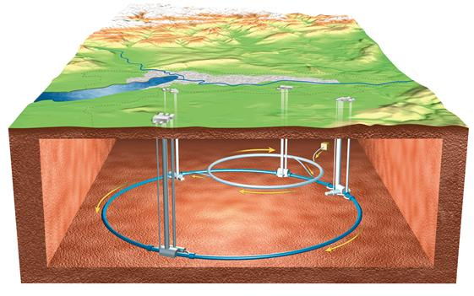
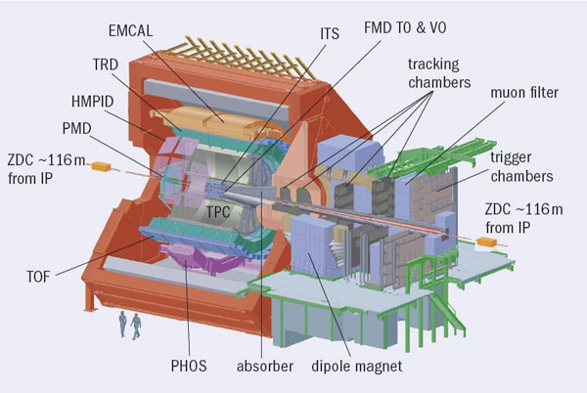
The ALICE experiment
A Large Ion Collider Experiment
  Focused on heavy-ion collisions to study QGP
  Central barrel + forward muon spectrometer
  17 installed sub-detectors
  5 online systems (DAQ, DCS, TRG, HLT, ECS)

Slide 5
ALICE data flow
TRG
Trigger system
3 levels
HLT
High Level Trigger
Data selection, compression
triggers detector readout
Detectors
485 x 2 Gbps optical links
Event fragments
LDCs
Readout
Sub-events
GDCs
Event Building
Events
TDS
PDS
Transient Data Storage
650 TB
4 x 10 Gbps links
Local Data Concentrators
Global Data Collectors
CERN CC
Files
3.5 GBps
4 GBps
8 GBps
3 GBps

Slide 6
ALICE operations

Slide 7
A typical LHC year
Jan | Feb | Mar |  | Apr | May | Jun | July | Aug | Sep | Oct | Nov |  | Dec
 | Shutdown for maintenance
 | proton-proton collisions
 | Heavy-ion collisions
Notes:
Unit is inverse, so less is more
Why 2010 and 2011 HI data are almost the same ? Trigger config, HLT compression

Slide 8
ALICE operations
A typical LHC fill in ALICE (0 - 30h)
Beam Injection
Stable beams
Beam dump
ALICE safe
Prepare
trigger
configuration
Detector calibration
Partial ALICE READY
Full ALICE READY
Data taking
Detector calibration
Ideally a single run
Notes:
Why calibrate at the beginning and at the end ? Because some calibration runs take too long to do at the beginning.
ALICE safe protects high voltage of gaseous detectors: reduced voltage. Super safe switches off

Slide 9
ALICE operations
Logbook
Bookkeeping
Data taking metadata
A typical ALICE run
Start-of-Run
Config detectors electronics
Data taking
Readout
End-of-Run
Start online systems
Export data taking conditions and calibration data to Offline
Stop online systems
Event building
Online data monitoring
Online calibration data
Store data taking conditions
Poster: “The ALICE DAQ Detector Algorithms framework”, Sylvain Chapeland, 24 May, 13:30 - 18:15
Notes:
DCS SOR example: storage of detector parameters for data analysis; reconfigure electronics
DCS EOR example: export configuration info to offline

Slide 10
Reality is hard...
17 sub-detectors + 5 online systems
  1 failure stops the run
Analysis of the ALICE Electronic Logbook metadata concluded:
  Better downtime/efficiency diagnosis tools needed
  Number of runs per fill is high
    ~ 11 runs per fill during 2011 p-p
  Starting/stopping runs is a costly operation
    SOR ~ 3 min
    EOR ~ 80 sec

Slide 11
Data taking efficiency

Slide 12

Data taking efficiency
Calculated per fill:
Stored in ALICE Electronic Logbook
Rd | run data taking duration
Rp | run pause duration (trigger disabled)
Fsb | fill stable beams duration
Fusb | fill unusable stable beams duration

Slide 13
Populating Logbook
LHC publishes operational parameters via the Data Interchange Protocol (DIP)
Dedicated ALICE software retrieves needed values and stores them in Logbook
Logbook Daemon
LHC
ALICE DIP Client
DIP
At SOR
Logbook DB
At start/end of Fill

Slide 14
In-run recovery procedures

Slide 15
In-run recovery procedures
To avoid stopping a run and lose beam time, thus increasing efficiency
Recover from sub-detector issues
2 in-run procedures introduced:
  via Detector Control System (DCS)
  via DAQ using Detector Data Link (DDL)

Slide 16
In-run recovery via DCS
A new state was introduced in the DCS logic:
  ERROR_RECOVER
Example: TPC high voltage trips
Detector in ERROR_RECOVER
ECS stops the trigger and waits
Detector is READY, restart trigger
Detector is not READY or timeout, stop run

Slide 17
In-run recovery via DDL
DDL is bi-directional, can be used to configure FEE
New procedure: Pause And Configure (PAC)
Example: Single Event Upset in detector FEE
Currently triggered manually by shifter
Shifter executes PAC
ECS stops the trigger
DAQ executes config commands using DDL
DAQ releases DDL
DAQ re-enables DDL for data taking
ECS starts the trigger

Slide 18
EOR Reasons bookkeeping

Slide 19
Typical EOR Reasons
Runs can stop for a multitude of reasons:
  Decision by shift crew (manual operation)
    Change trigger configuration
    Add/remove detector
  Problem with online systems
    Process no longer running
    Configuration error
  Problem with detectors
    High voltage trip
    Front End Electronics (FEE)
    Corrupted data

Slide 20
EOR Reasons bookkeeping
Up to mid-2011:
  Text based entry in Logbook
  Statistics done manually (time consuming, error prone)
  For abnormal stops, log search was needed
For the 2011 HI run:
  Structured data in Logbook
    Automatic stops: inserted by Experiment Control System
    Manual stops: prompt shifter

Slide 21
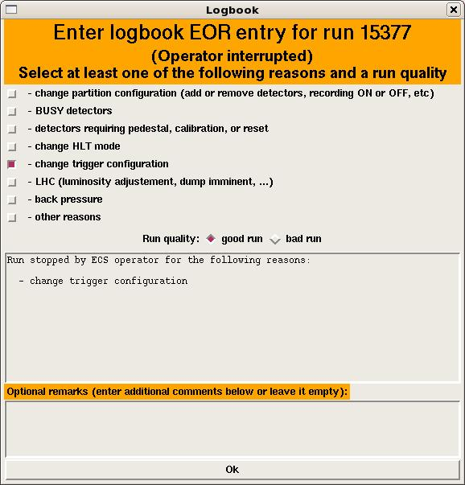
ECS End-of-Run panel
Whenever a shifter stops a run, he/she has to choose from a predefined list of EOR Reasons
Evolving list, changed when needed
Shifters training is important!

Slide 22
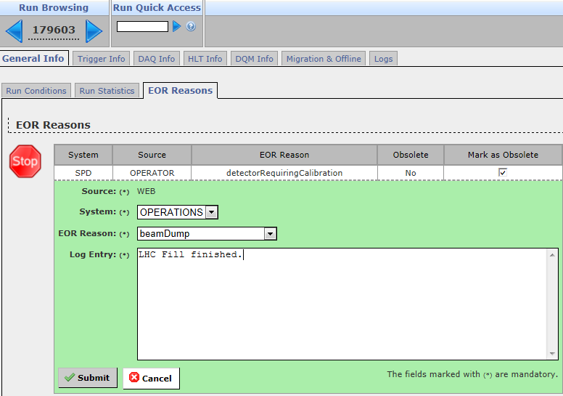
Changing EOR Reasons a posteriori
100 % accuracy is very difficult:
  Symptoms vs causes
  Shifters mistakes
Logbook GUI page to change EOR Reason

Slide 23
Reporting

Slide 24
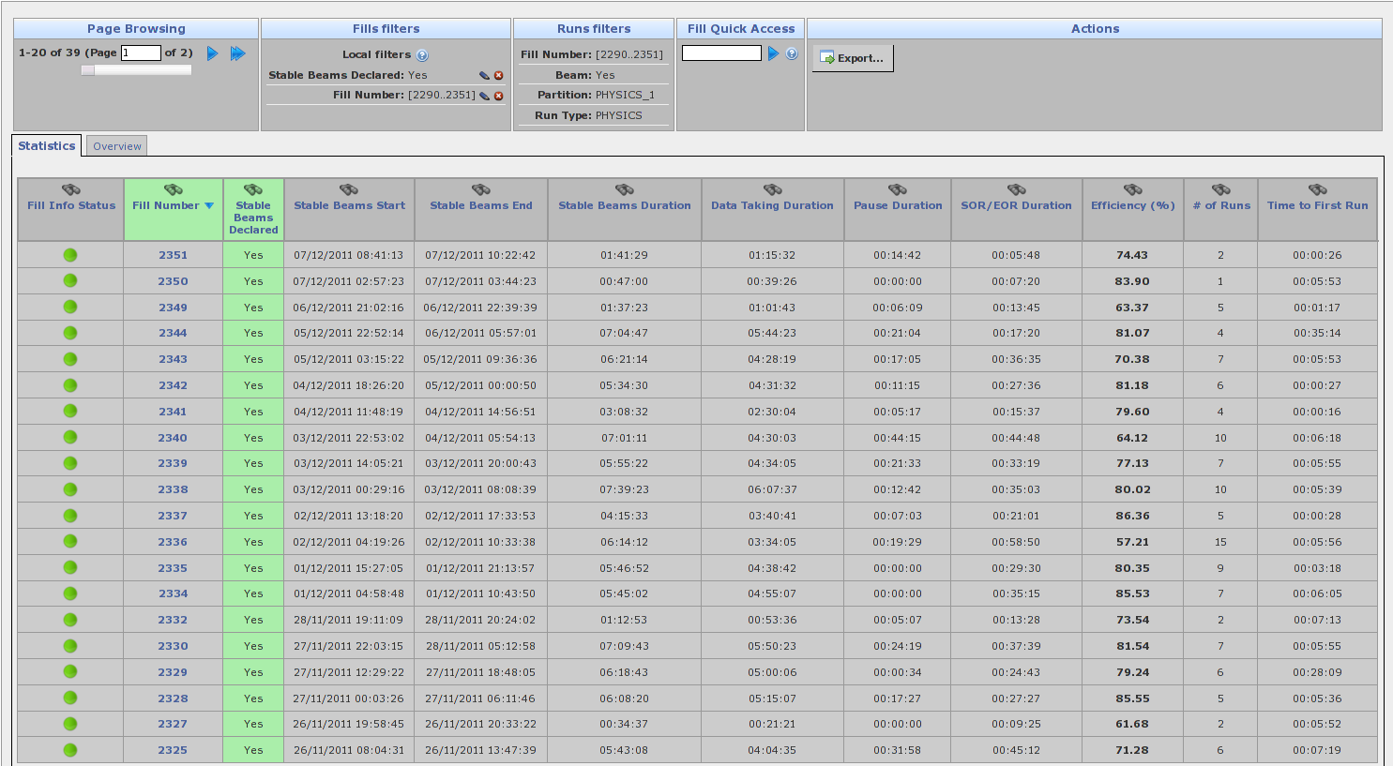
Online reports in Logbook
Fill Statistics

Slide 25
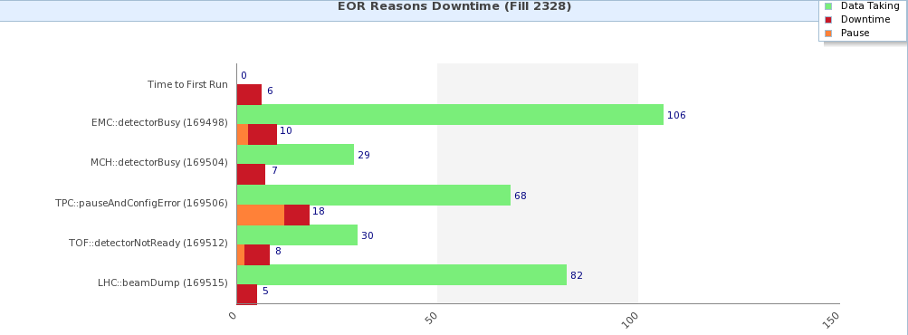
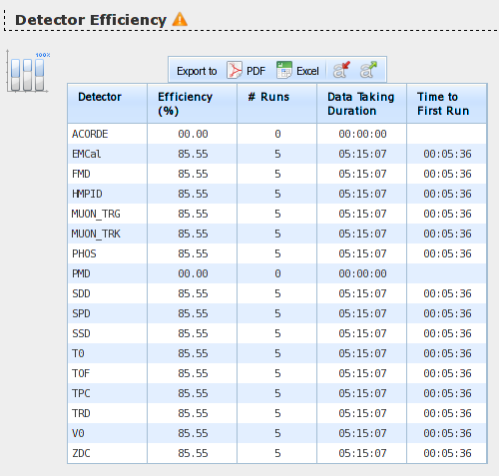
Online reports in Logbook
Fill Details

Slide 26
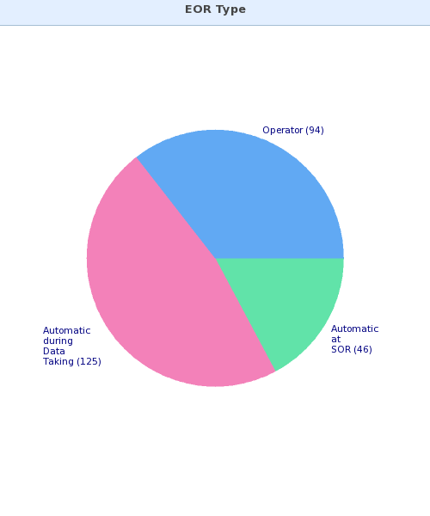
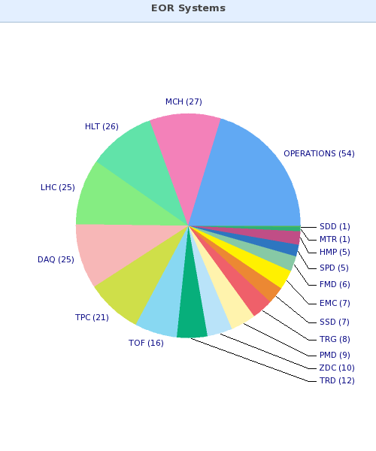
Online reports in Logbook
EOR Reasons

Slide 27
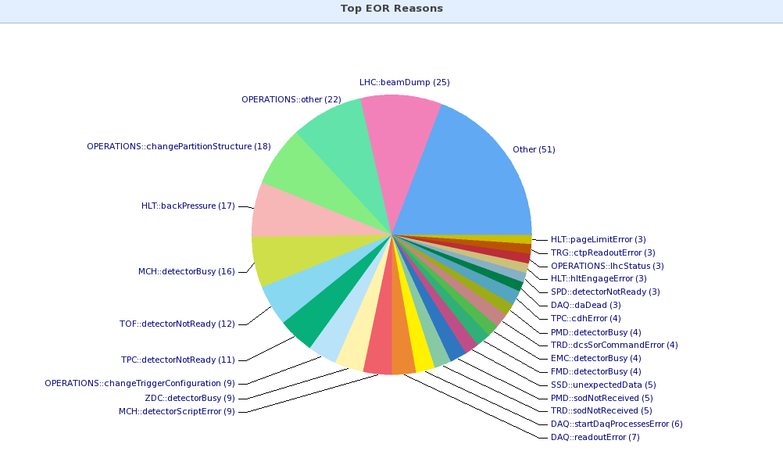
Online reports in Logbook
EOR Reasons

Slide 28
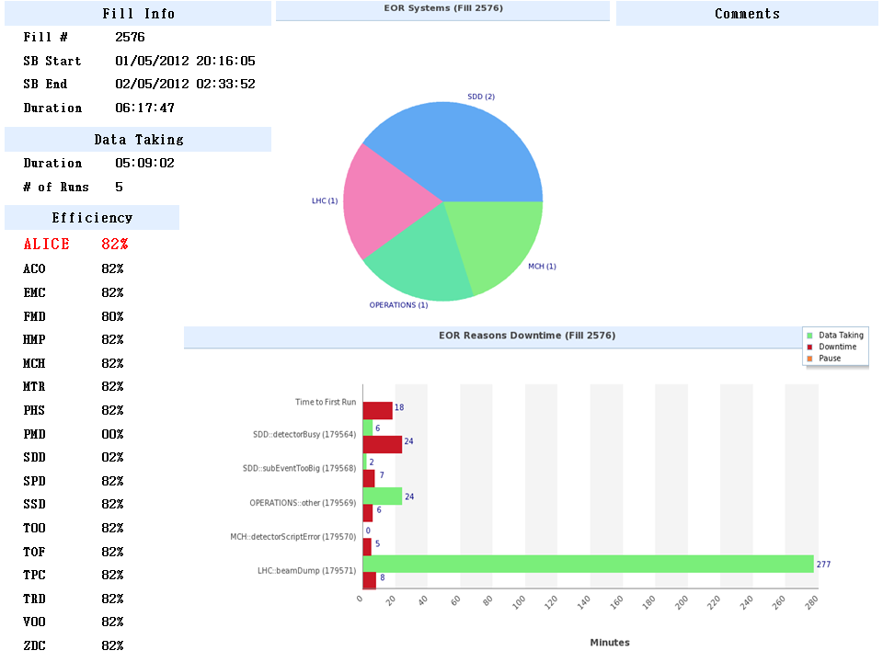
Fill Summary slides
A PPT slide with a summary of an LHC Fill
Automatically generated every day and sent via email

Slide 29
Future plans

Slide 30
Future plans
Integrate EOR Reasons with JIRA issue tracking system
  Logbook - JIRA interface being developed
Extend in-run recovery procedure via DDL
  Automatic detector request via bit in event header
  New SYNC event to synchronize data sources
Expert system for shifter support and automatic failure recovery
  Reduce load on on-call crew

Slide 31
Conclusion

Slide 32
Conclusion
2 years of successful operational experience
Big effort put in efficiency monitoring, EOR Reasons identification
Introduction of in-run recovery procedures reduced downtime thus increasing efficiency
Reports automation
  Saved time
  Increased visibility and “stimulated” issues resolution

Slide 33
Related presentations
Poster: “The ALICE DAQ Detector Algorithms framework”, Sylvain Chapeland, 24 May, 13:30 - 18:15
Poster: “Orthos, an alarm system for the ALICE DAQ operations”, Sylvain Chapeland, 24 May, 13:30 - 18:15
Poster: “Preparing the ALICE DAQ upgrade”, Pierre Vande Vyvre, 24 May, 13:30 - 18:15

Slide 34
ALICE presentations
“ALICE HLT TPC Tracking of Heavy-Ion Events on GPUs”, David Rohr, now
A review of data placement in WLCG
Data compression in ALICE by on-line track reconstruction and space-point analysis
The ALICE EMCal High Level Triggers
Automated Inventory and Monitoring of the ALICE HLT Cluster Resources with the SysMES Framework
Monitoring the data quality of the real-time event reconstruction in the ALICE High Level Trigger.
Operational Experience with the ALICE High Level Trigger
Flexible event reconstruction software chains with the ALICE High-Level Trigger
Dynamic parallel ROOT facility clusters on the Alice Environment
A new communication framework for the ALICE Grid
AliEn JobBrokering Extreme
Combining virtualization tools for a dynamic, distribution agnostic grid environment for ALICE grid jobs in Scandinavia
ALICE Grid Computing at the GridKa Tier-1 center
ALICE's detectors safety and efficiency optimization with automatic beam-driven operations
Managing operational documentation in the ALICE Detector Control System
An optimization of the ALICE XRootD storage cluster at the Tier-2 site in Czech Republic
Certified Grid Job Submission in the ALICE Grid Services
Rethinking particle transport in the many-core era
Grid Computing at GSI(ALICE/FAIR) - present and future
Employing peer-to-peer software distribution in ALICE Grid Services to enable opportunistic use of OSG resources

Slide 35
QUESTIONS ?

Slide 36
Extra Slides

Slide 37
ALICE timeline
First ideas HI@LHC
1990
1993
ALICE LoI
1997
ALICE is approved
Technical Proposal
1995
2000
Construction begins
First TDR
1998
Last TDR
2005
2006
Installation of services
2008
LHC first beam
Commissioning begins
2007
LHC first HI run
2010

Slide 38
ALICE operations
24/7 on-site shift crew
  Currently 4 shifters:
    Shift Leader
    DAQ + HLT + CTP (Central Trigger Processor)
    DQM (Data Quality Monitoring) +Offline
    DCS
  One of them is SLIMOS (Shift Leader in Matters of Safety)
24/7 on-call expert support for each subsystem

Slide 39
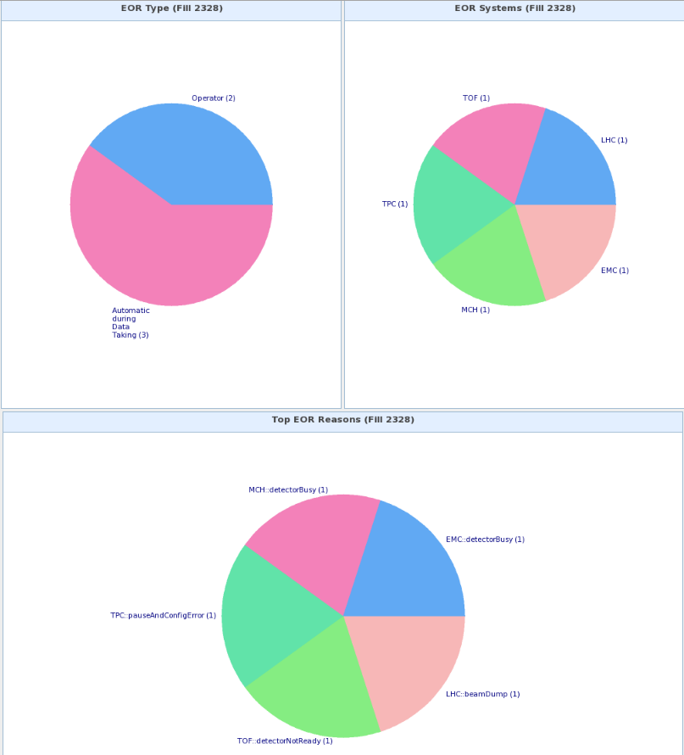
Online reports in Logbook
Fill Details

