Slide 1
The Common Solutions Strategy of the Experiment Support group at CERN for the LHC Experiments
Maria Girone, CERN
On behalf of the CERN IT-ES Group
CHEP, New York City, May 2012

Slide 2
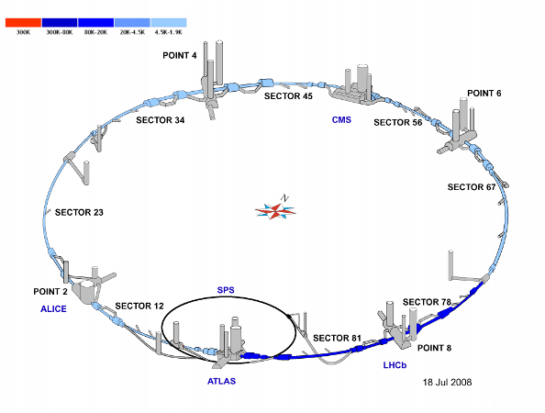




Motivation
Despite their differences as experiments at the LHC, from a computing perspective a lot of the workflows are similar and can be done with common services
While the collaborations are huge and highly distributed, effort available in ICT development is limited and decreasing
  Effort is focused on analysis and physics
Common solutions are a more efficient use of effort and more sustainable in the long run

Slide 3
Anatomy of Common Solution
Experiment Specific Elements
Most common solutions can be diagrammed as the interface layer between common infrastructure elements and the truly experiment specific components
  One of the successes of the grid deployment has been the use of common grid interfaces and local site service interfaces
  The experiments have a environments and techniques that are unique
  In common solutions we target the box in between. A lot of effort is spent in these layers and there are big savings of effort in commonality
    not necessarily implementation, but approach & architecture
  LHC schedule presents a good opportunity for technology changes
Higher Level Services that translate between
Common Infrastructure Components and Interfaces

Slide 4

The Group
IT-ES is a unique resource in WLCG
  The group is currently supported with substantial EGI-InSPIRE project effort
  Careful balance of effort embedded in the experiments & on common solutions
  Development of expertise in experiment systems & across experiment boundaries
  People uniquely qualified to identify and implement common solutions
    Matches well with the EGI-InSPIRE mandate of developing sustainable solutions
    A strong and enthusiastic team
EGI-InSPIRE INFSO-RI-261323

Slide 5
Activities
Monitoring and Experiment Dashboards
  Allows experiments and sites to monitor and track their production and analysis activities across the grid
    Including services for data popularity, data cleaning and data integrity and site test stressing
Distributed Production and Analysis
  Design and development for experiment workload management and analysis components
Data Management support
  Covers development and integration of the experiment specific and shared grid middleware
The LCG Persistency Framework
  Handles the event and detector conditions data from the experiments

Slide 6
Examples: Data Popularity
Experiment Booking Systems Mapping Files to Datasets
Experiments want to know which datasets are used, how much, and by whom
  Good chance of a common solution
Data popularity uses the fact that all experiments open files and access storage
The monitoring information can be accessed in a common way using generic and common plug-ins
The experiments have systems that identify how those files are mapped onto logical objects like datasets, reprocessing and simulation campaigns
Files accessed, users and CPU used
File Opens and Reads

Slide 7
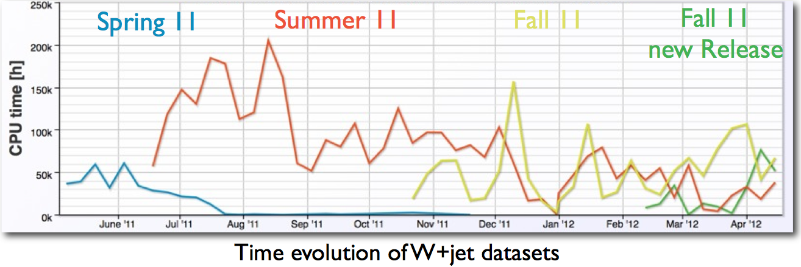
Popularity Service
Used by the experiments to assess the importance of computing processing work, and to decide when the number of replicas of a sample needs to be adjusted either up or down
See D. Giordano et al., [176] Implementing data placement strategies for the CMS experiment based on a popularity model

Slide 8
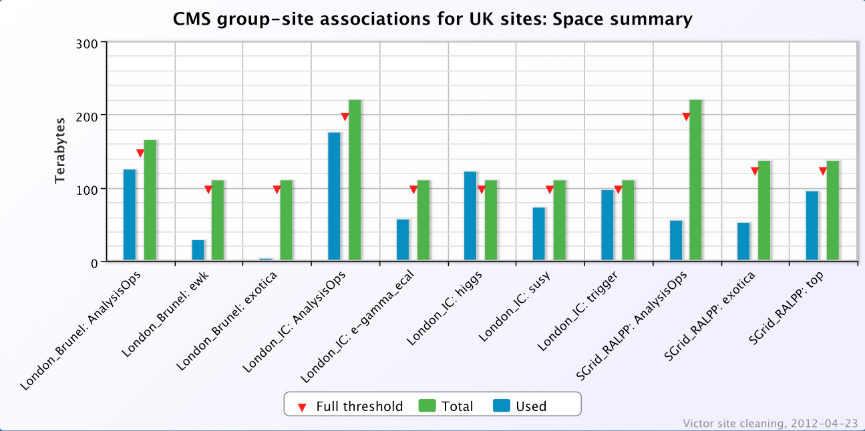
Cleaning Service
The Site Cleaning Agent is used to suggest obsolete or unused data that can be safely deleted without affecting analysis.
The information about space usage is taken from the experiment dedicated data management and transfer system

Slide 9

Dashboard Framework and Applications
Sites and activities
Dashboard is one of the original common services
  All experiments execute jobs and transfer data
  Dashboard services rely on experiment specific information for site names, activity mapping, error codes
  The job monitoring system collects centrally information from workflows about the job status and success
    Database, framework and visualization are common
Framework & visualization
Job submission &
data transfers
D. Tuckett et al., [300], Designing and developing portable large-scale JavaScript web applications within the Experiment Dashboard framework

Slide 10
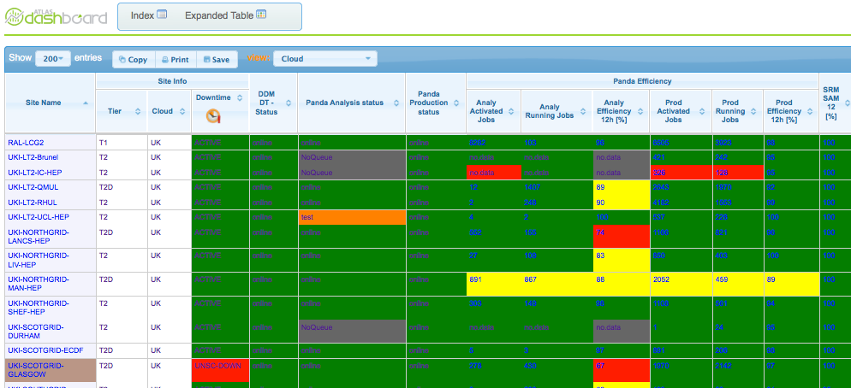
Site Status Board
Another example of a good common service
  Takes specific lower level checks on the health of common services
  Combines with some experiment specific workflow probes
  Includes links into the ticketing system
  Combines to a common view

Slide 11
HammerCloud
Distributed analysis Frameworks
HammerCloud is a common testing framework for ATLAS (PanDA), CMS (CRAB) and LHCb (Dirac)
Common layer for functional testing of CEs and SEs from a user perspective
Continuous testing and monitoring of site status and readiness. Automatic Site exclusion based on defined policies
Same development, same interface, same infrastructure → less workforce
Testing and Monitoring Framework
Computing & Storage Elements

Slide 12
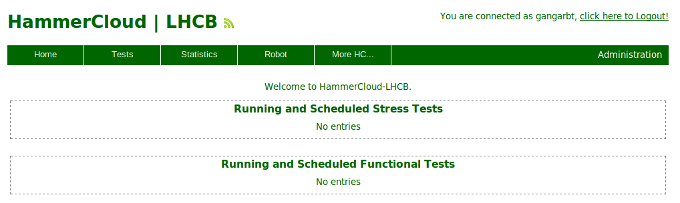
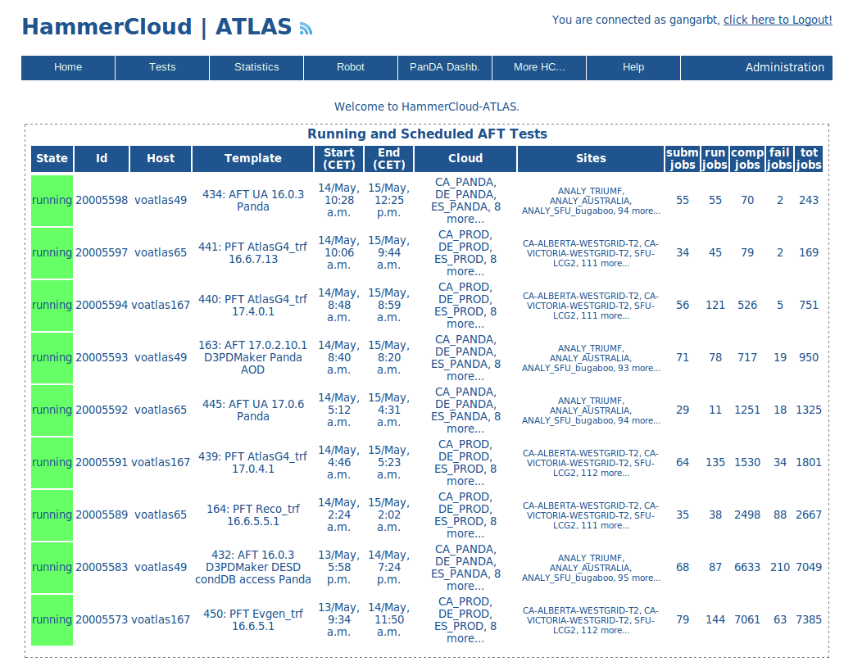
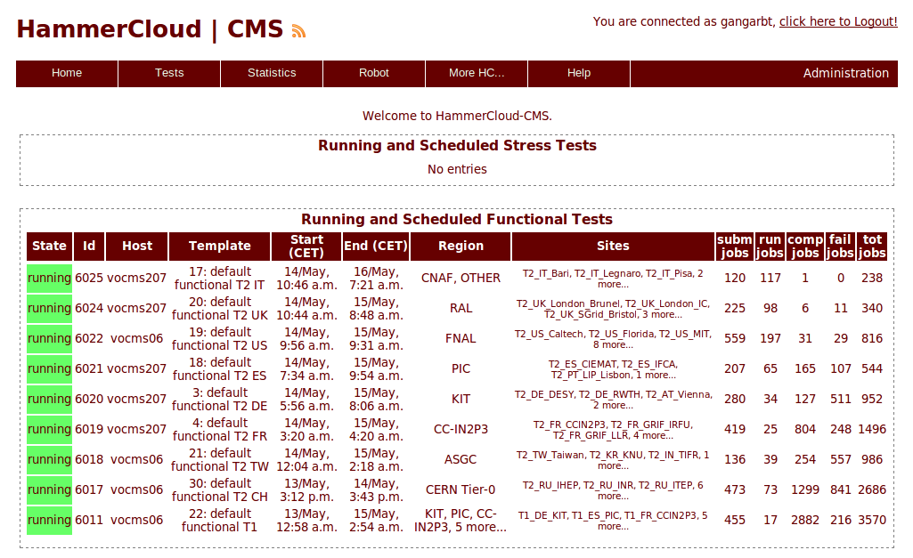
HammerCloud
D. van der Ster et al. [283], Experience in Grid Site Testing for ATLAS, CMS and LHCb with HammerCloud

Slide 13
New Activities – Analysis Workflow
Data discovery, environment configuration, and job splitting
Up to now services have generally focused on monitoring activities
  All of these are important and commonality saves effort
  Not normally in the core workflows of the experiment
Success with the self contained services has provided confidence moving into a core functionality
  Looking at the Analysis Workflow
    Feasibility Study for a Common Analysis Framework between ATLAS and CMS
Job Tracking, Resubmission, and scheduling
Job submission and Pilots

Slide 14
Analysis Workflow Progress
Data discovery, job splitting and packaging of user environment
Looking at ways to make the workflow engine common between the two experiments
  Improving the sustainability of the central components that interface to low-level services
    A thick layer that handles prioritization, job tracking and resubmission
  Maintaining experiment specific interfaces
    Job splitting, environment, and data discovery would continue to be experiment specific
Job Tracking, Resubmission, and scheduling
Job submission and Pilots

Slide 15
Proof of Concept Diagram
Feasibility Study proved that there are no show-stoppers to design a common analysis framework
Next step is a proof of concept

Slide 16
Even Further Ahead
Datasets to file mapping
As we move forward, we would also like to assess and document the process
  This should not be the only common project
The diagram for data management would look similar
  A thick layer between the experiment logical definitions of datasets and the service that moves files
    Deals with persistent location information and tracks files in progress and validates file consistency
Currently no plans for common services, but has the right properties
File locations and files in transfer
File Transfer Service (FTS)

Slide 17
Outlook
IT-ES has a good record of identifying and developing common solutions between the LHC experiments
  Setup and expertise of the group have helped
Several services focused primarily on monitoring have been developed and are in production use
As a result, more ambitious services that would be closer to the experiment core workflows are under investigation
  The first is a feasibility study and proof of concept of a common analysis framework between ATLAS and CMS
Both better and more sustainable solutions could result – with lower operational and maintenance costs

