Slide 1
VC in HEP
Status and Perspectives
Philippe Galvez, Caltech

Slide 2
Outlines
Challenge in VC, Real-time communication
The HEP Challenge
History of VC within HEP
Current State as of today
Perspectives for the future
EVO to SeeVogh

Slide 3
Challenges in VC
Anything can go wrong
The VC is in control of only 20% of the elements which are part of a collaborative session. Difficult to accept but no one can guarantee a successful session
WAN (National and International Network)
Firewall
LAN (Institute Network)
VC Application
Operating System
Computer
--- User ---
But we can architect a VC system that has some visibility and control over these unpredictable elements and take dynamic correctives actions to maximize the user’s collaborative experience

Slide 4


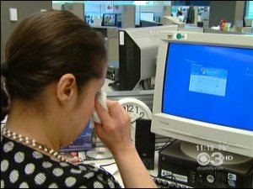
Challenges in VC
While a collaborative session is sharing with others, the user is always alone during a session and especially during issues.
…. It becomes very emotional … !
… And we tend to lose rationality when handling the situation
His/her failure should be everyone failure or…..
His/her success should be everyone success

Slide 5
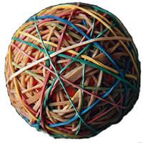
Challenges in VC for HEP
Experiments
(CMS, Atlas, Star,…)
Institutes
(CERN, BNL, ..)
Countries
(USA, Brazil, ..)
Op. Systems
(Win, Mac, ..)
VC Protocols
(Desktop, H.323/SIP,..)
Funding
(NSF, DOE, EU,..)
Mono dimensional way to deploy VC in traditional organizations
HEP is a multi-layer and multi-levels community
A top down solution is a non-solution

Slide 6
Some History
The HEP community has always been a pioneer and pushed the frontier of VC before anybody else.
(you should be proud of it)
Some key dates:
VRVS released in end-1996 (ended in 2006)
    Hosted more than 20 Millions of VC minutes for HEP
    Developed by the HEP community for the HEP community
Microsoft NetMeeting released in 1998
    First implementation of H.323
WebEx first release in 2000
    (still) using phone for audio communications
Skype released the first public beta in August 2003

Slide 7
More recent History
A lot of Web conferencing and video service are now available in the market place but no one emerged as well adapted for the HEP (as explained in previous slides)
Also some people are always expecting the killer video commercial application that will work perfectly in all situation for our research community. So far, no success yet despite large companies (> $B) financial support.
  Skype/Microsoft group video calling (10 max)
  Google Hangout (10 max)

Slide 8
Current VC Service used by HEP
Dedicated H.323 Services (Tandberg/Cisco, Polycom, Codian MCU,..) operated by:
  Most of the National Research Education Networks operate an H.323 service allowing between 20 to 150 concurrent ports connections
  Some Research Organizations such as ECS (ESnet), RMS (Renater/IN2P3/INRA/Inserm/CNRS).

Slide 9
Current VC Service used by HEP
Vidyo operated by CERN.
Starting in 2008, Vidyo was presented as a possible product to serve the LHC and CERN related experiments by CERN/IT who was mandated to look for commercial alternative to EVO.
As of today, it appears that the product is still missing some key functionalities to be a full release candidate.
Nevertheless, some research groups at CERN are starting to use the service.

Slide 10
Current VC Service used by HEP
EVO (Enabling Virtual Organization) released in 2007 and operated by Caltech and used by:
CMS, ATLAS, ALICE, LHCb, PHENIX, LIGO, STAR, Belle, CTA, D0, Double Chooz, EMI, HAWC, HERMES, IceCube, LBNE, LUX, Pierre Auger Observatory, SXS, T2K, ALPHA, Angra, APAG, APS, Astro-H, ATRAP, BABAR, Belle II, BESIII, CALICE, CBM, CDF, CEES, CI-TRAIN, CLEO, CTEQ, Daya Bay, DESY, CERN, COMBINE, COMET, CQUeST, CSIRO, CTA, EGI, EIC, ETSF, FERMI, FOPI, GlueX, GridPP, H1, HAWC, HADES, HESS, ILC, ISU, JCAP, JEM-EUSO, KAREN, KEK, KATRIN, LBNE, LMI-EFRC, LSST Camera, LTER Network, LUX, MAGIC, MINERvA, MPP Munich, NA49, NA61, NIMBios, NINJA, NOVA, Panda, PHENIX, Phyloseminar, PIENU, POLAR, SuperB, SuperCDMS, SXS Collaboration, SuperNEMO, Terascale, WLCG, XENON, XFEL, XDEDE, ZEUS…..
See next slides for more details

Slide 11
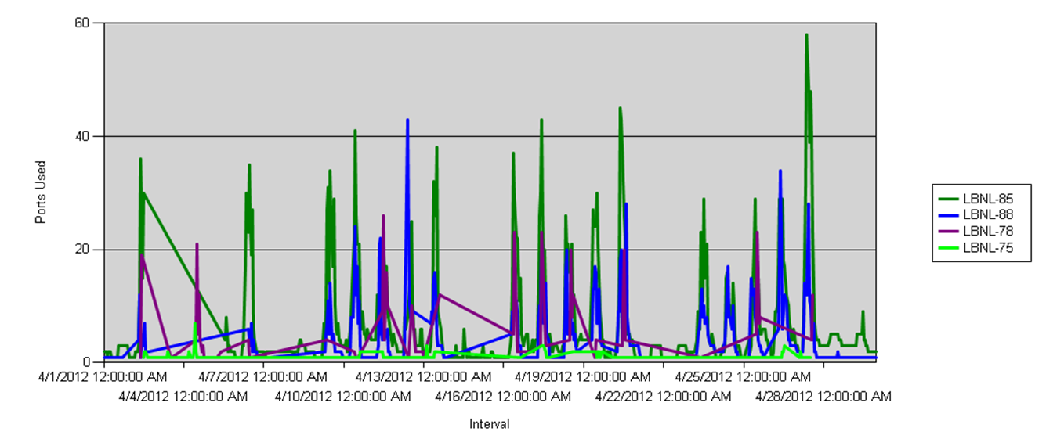
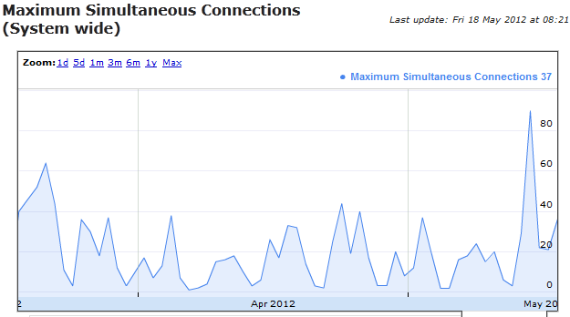
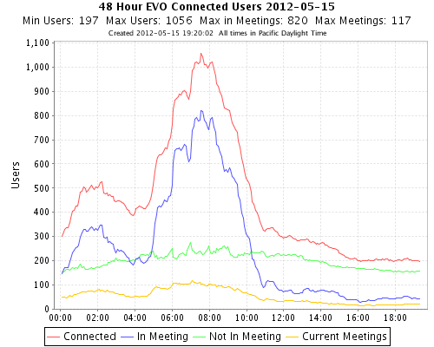
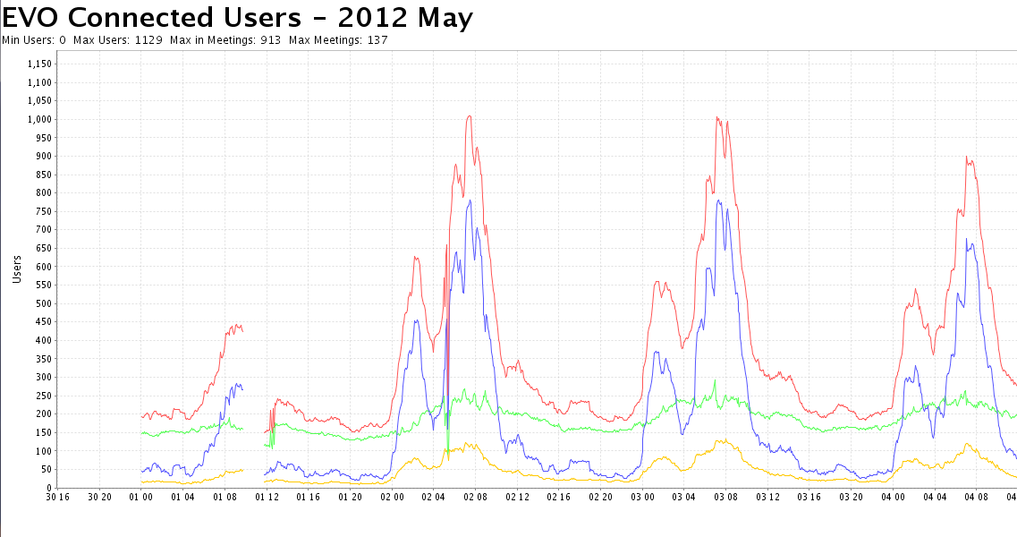
Current VC Service used HEP
ECS/Esnet: Peak average at 40 concurrent connections
Vidyo/CERN: Peak average at 40 concurrent connections
EVO: Peak average at 1,000 concurrent connections

Slide 12
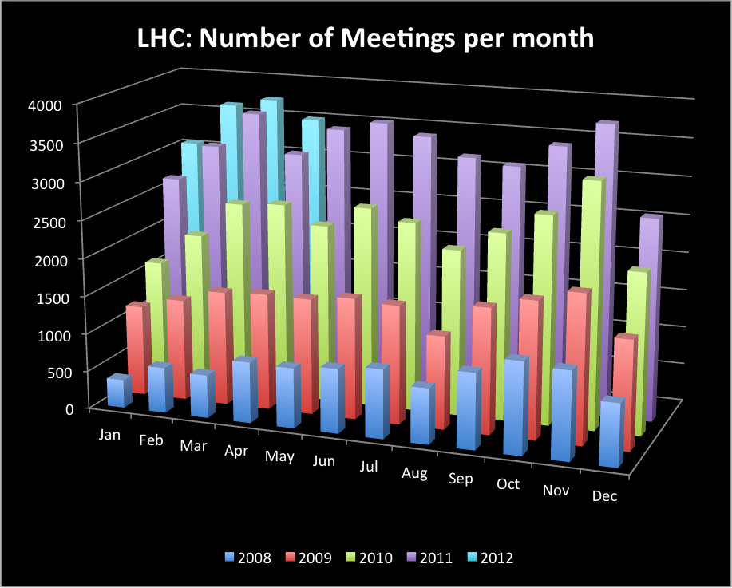
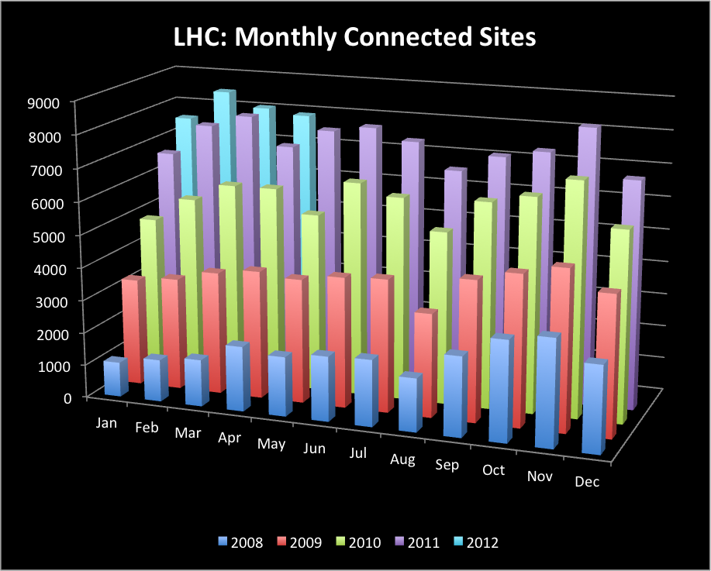
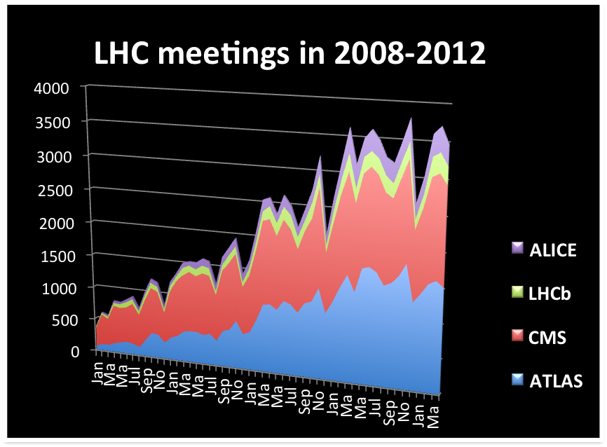
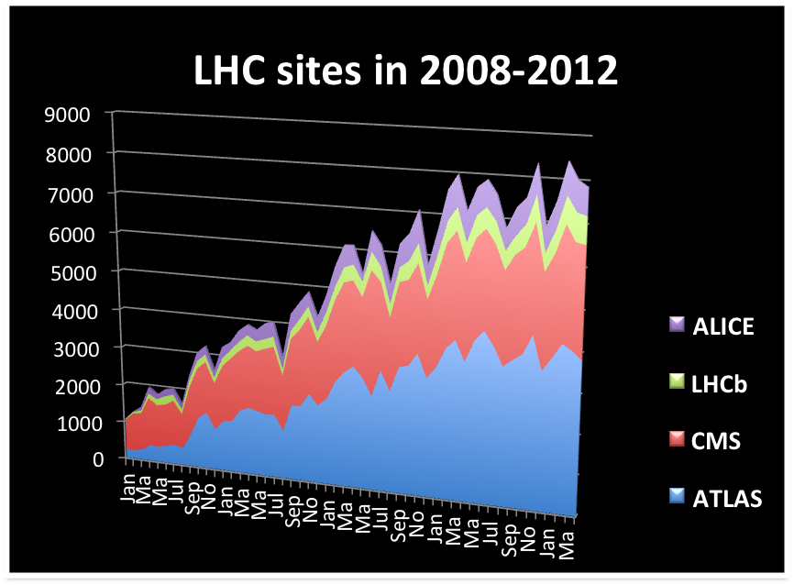
EVO LHC Usage

Slide 13

EVO VC Service in HEP
EVO usage for the month of April 2012
9,400 meetings
4,317 phone calls total 170 days (4,080 hours)
12,780 participants to meetings total 3,146 days (75,504 hours)
804 Skype connections total 28 days (672 hours)
Assuming a constant usage, we have an average of 60 Millions minutes / Year.
A cheap phone call $0.02/min
X 60M
$1.2M / Year
(~ $100/User/Year)

Slide 14
Architecture,
Features, Functionalities

Slide 15



EVO Architecture
Distributed
Clients
EVO Architecture
Controlled,
Administrated and Distributed
Infrastructure
Peer-to-Peer servers
H.323 or similar
Centralized Architecture
(old model)
Centralized

Slide 16
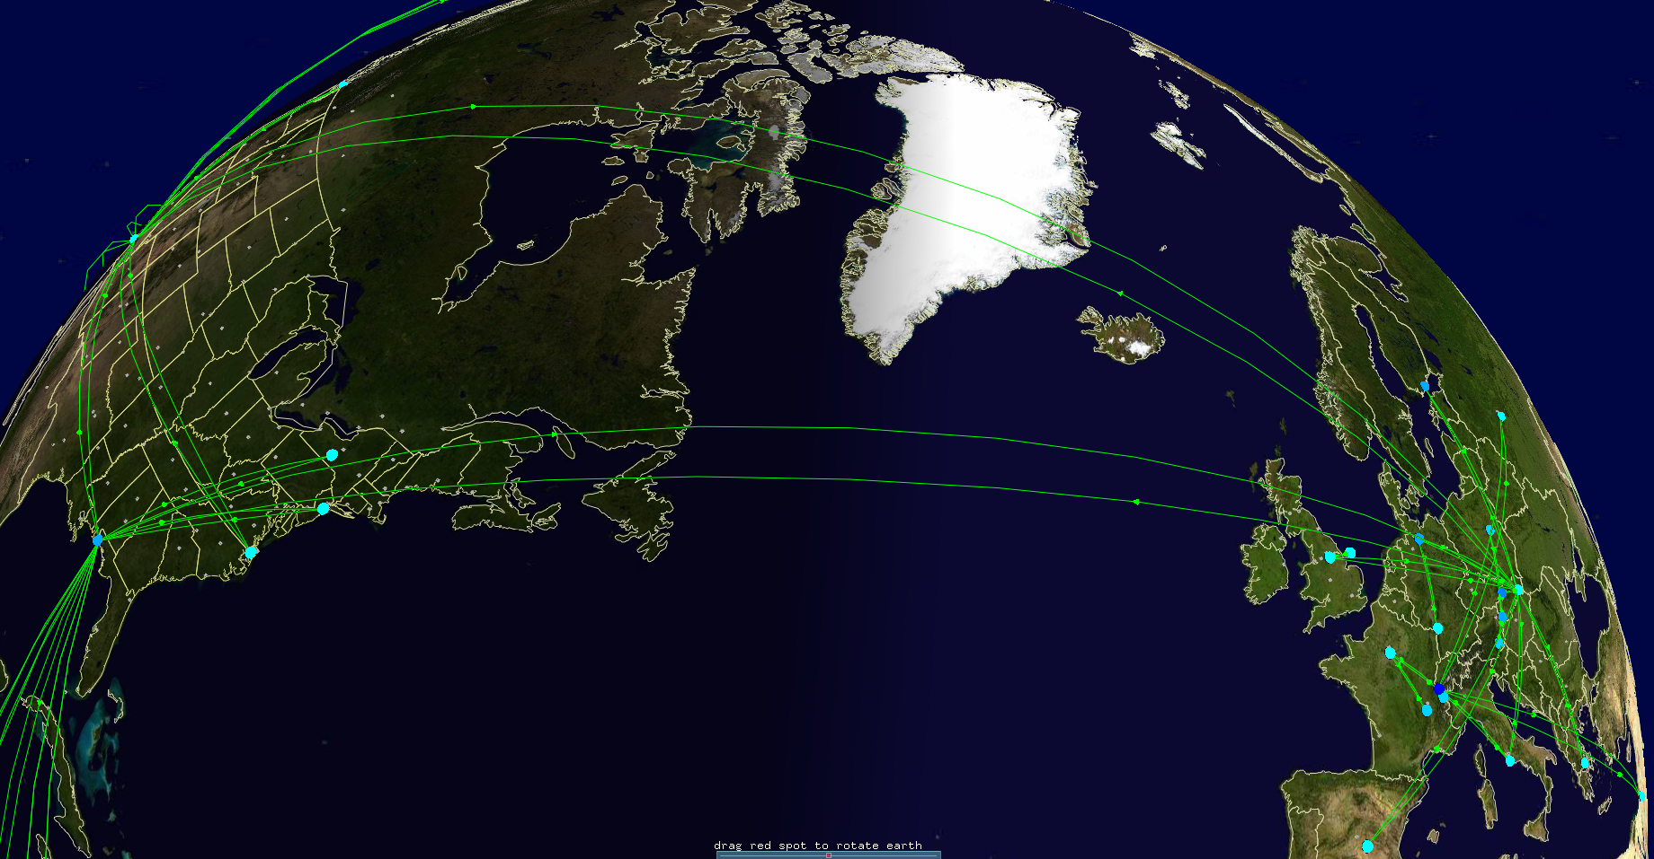
Self Managed Infrastructure
EVO uses MonALISA :
66 servers spread in 25 countries
Detects any network cut or peer down : Automatically reconnect the topology of servers to face the problem.
Reduce the support burden by a good order of magnitude
http://monalisa.caltech.edu
Notes:
EVO is of course depend of the quality of the network. Even if our model adapt the topology of the servers the users can suffer in some specific cases.

Slide 17
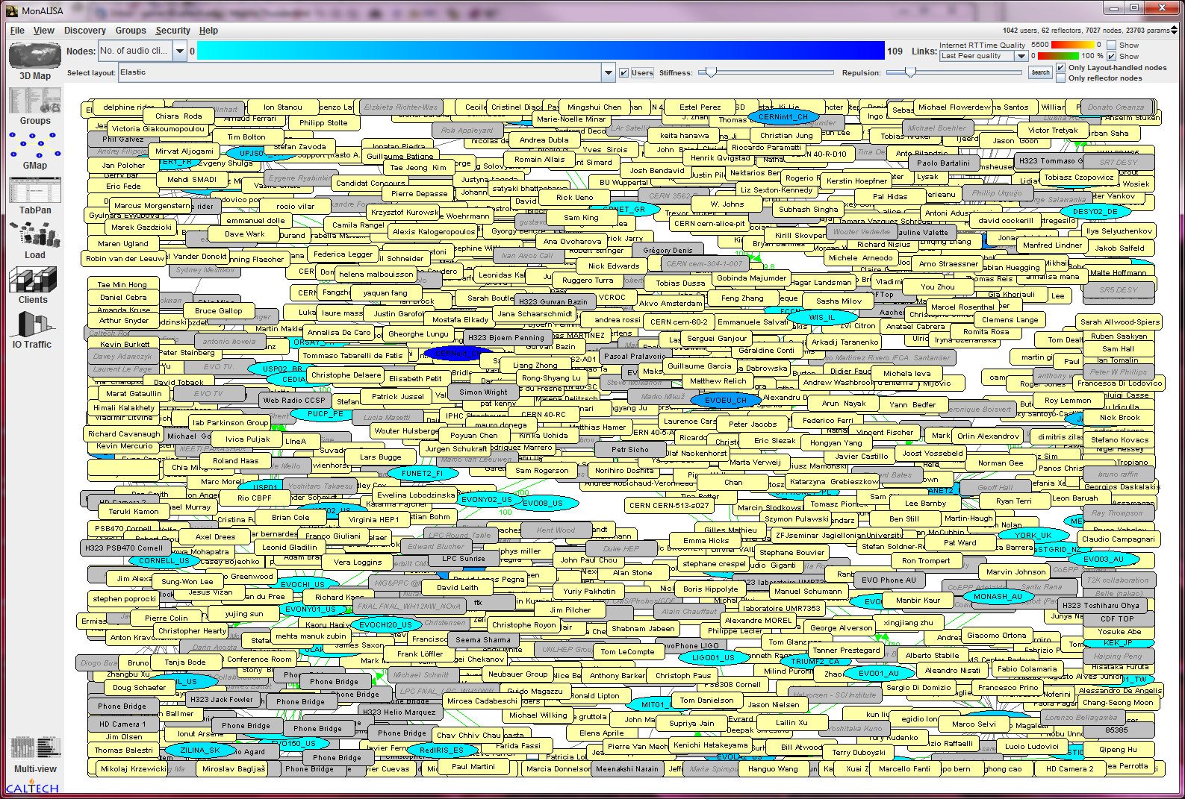
Self Managed Infrastructure
Average of 1,200 connected sites during peak time
Notes:
EVO is of course depend of the quality of the network. Even if our model adapt the topology of the servers the users can suffer in some specific cases.

Slide 18

Some EVO functionalities
Works on MS Windows, Mac OS X, Linux!
Connects to H.323 client, H.323 MCU, SIP client, SIP MCU, IP telephone, Standard Telephone
EVO is tunneling all communications into one Port and is firewall and NAT friendly
EVO GUI is available in 11 languages! and available in all time zones!
Support H.261, H.263 and H.264 video codecs up to 1080 HD resolution
integration: auto booking, auto-modification, auto-join meeting. (CERN, DESY, BNL).
LDAP/Shibboleth Integration

Slide 19
Perspectives for VC in HEP

Slide 20
Perspectives
When looking for VC solutions we have to investigate:
The Product and Technology
Who will deploy and operate the service
Who will provide end-user support for the service
Who can access the service

Slide 21
ECS (ESnet) and similar H.323 services
The Product and Technology
  H.323 (currently Tandberg/Cisco or Polycom)
Who will deploy and operate the service
  ESnet or similar organization
Who will provide end-user support for the service
  ESnet or similar organization
Who can access the service
  User must be affiliated with DOE Office of Science programs, projects and experiments

Slide 22
Vidyo (CERN)
The Product and Technology
  Vidyo
Who will deploy and operate the service
  CERN
Who will provide end-user support for the service
    CERN+Contractors
Who can access the service
  Need to have a valid CERN user account
  Possibility to have Guest access to join a meeting

Slide 23
EVO (Caltech)
The Product and Technology
  EVO Technology
Who will deploy and operate the service
  EVO Team
Who will provide end-user support for the service
    EVO Team
Who can access the service
  Primarily serving the LHC and LIGO collaborations
  Open to any research collaborations with limited usage

Slide 24
Current VC Service usage in HEP
ECS: Funded by DOE/ESnet
Vidyo Service: Funded by CERN
EVO: Funding Unknown after Dec 2012

Slide 25
From EVO to SeeVogh
In order to continue to expand and operate the current EVO service and provide enhancements, private funding is now needed.
Evogh, Inc. was formed
  Evogh, Inc. will take over all EVO activities and will be in charge of the operation and the development of the technology going forward.
  SeeVogh, a hybrid cloud video collaboration service (the 3rd generation of architecture, software based on EVO technology) will be offered by Evogh, Inc.

Slide 26
From EVO to SeeVogh
Internet2 NET+ Services expand to help universities address research, education, big data and innovation challenges
Arlington, VA—April 24, 2012—Internet2 and some of the nation's most prominent high-tech firms announced today partnerships that would expedite the delivery of cloud services to college campuses nationwide, and address research, big data and innovation challenges. Internet2, the world's most advanced networking consortium led by the U.S. research and education community, is pleased to be joined by Aastra; Adobe; Box; CENIC; Dell; Desire2Learn; Duo Security; DuraSpace; Evogh; HP; Level 3 Communications; Merit Network, Inc.; Microsoft; Savvis, a CenturyLink Company; SHI International; and The Solution Design Group in this initiative. The Internet2 NET+ Services' announcements were made at the Spring 2012 Internet2 Member Meeting.
http://internet2.edu/news/pr/2012.04.24.cloud-services-partnerships.html

Slide 27
From EVO to SeeVogh
What does it means for you ?
Transitioning from EVO to Evogh, Inc. with enhanced functionalities, with access to only authorized organizations/experiments from the research community
Service will be branded the SeeVogh Research Network and will be accessed through the commercial Web portal and supported through Evogh, Inc.
The SeeVogh Research Network will use the same network infrastructure already in place preserving our community's investment in Panda servers, phone bridges, scheduler interfaces, client systems, H.323 bridges and user adoption.
The user interface for meeting will provide the persistence services that everyone is familiar with including community meeting schedules, chat, among others, but will use the new SeeVogh client with simplified controls and on-going enhancements like mobile device support, H.323/SIP servers and much more in development.

Slide 28
From EVO to SeeVogh
What does it means for you ?
Pricing to access the SeeVogh Research Network will be highly affordable for every research experiments and projects.
All current EVO research communities will be entitled
  To subscribe to the SeeVogh Research Network
  To subscribe to the SeeVogh Hybrid Cloud offering if that fit better their needs
When ?
  The SeeVogh Hybrid Cloud offering is available now
  The SeeVogh Research Network will be available to interested research experiments this summer at no cost.
  The SeeVogh Research Network will be available only to paying customers by January 2013

Slide 29
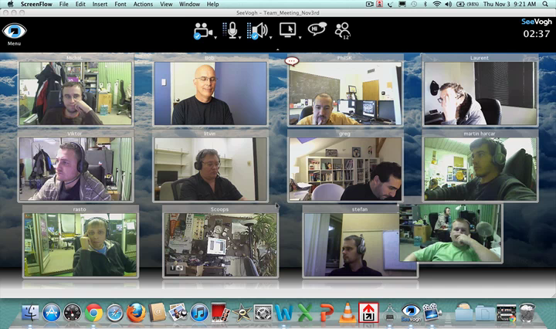
Simplified SeeVogh GUI
Simple Controls
Upper/Lower Display Area for configurable layout
Expandable, Detachable Video Tiles for viewing documents or people
Ideal for Large Meetings
Multiple Monitor Support

Slide 30
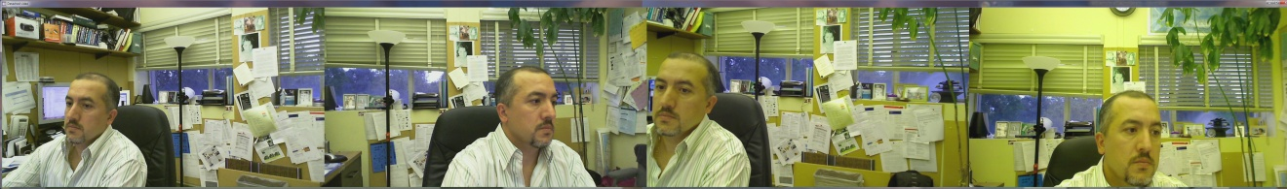
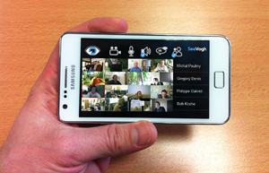
SeeVogh New Functionalities
H.323 and SIP video call-in and call-out capabilities to all SeeVogh meetings
International call-in Phone to SeeVogh meetings
Telepresence Capability
  Possibility to send and receive 3 or more 1080p video streams
  Build a SeeVogh telepresence system for less than $10k
  Support for TIP (Telepresence Interoperability Protocol) from Cisco Possibility to call a Cisco Telepresence room ( > $300k)
Android and IOS (iPad, iPhone) support

Slide 31
Conclusion (1)
The HEP community has unique collaborations requirements
The HEP community is composed of diverse groups, experiments and interests. A top down solution is a non solution
The VC client is important to provide the necessary features/functions
But much more important are the infrastructure and architecture that support the service:
    Should be highly scalable
    Should be cost effective to deploy and support
    Should allow ubiquitous connectivity (any devices)
    Should support any VC standard based clients (H.323, SIP, MCU)
    Should provide easy access for the end-user
There is no free service, but cost is minimal if the community comes together and share resources.

Slide 32
Conclusion (2)
Several VC services are currently offered to the community. Among them EVO being by far the service which as the broader reach among and across the experiments as well as the most used.
EVO is moving commercial and will transition to SeeVogh driven by high interest for the research community at large and in order to build a sustainable financial model going forward.
At the end what really matters is your experiment ?
Can you perform your research efficiently ? How reliable and easy can you collaborate with your remote colleagues and have productive meetings ? Which collaboration services and tools work best for you ?
Your experiment is the only decision maker so it is time to provide your feedback

Slide 33
Thank you
Questions ?
Notes:
Open GL version of video application has been released on Mac.
A new stand alone EVO recordings player has been released too.

Slide 34
Extra Slides

Slide 35
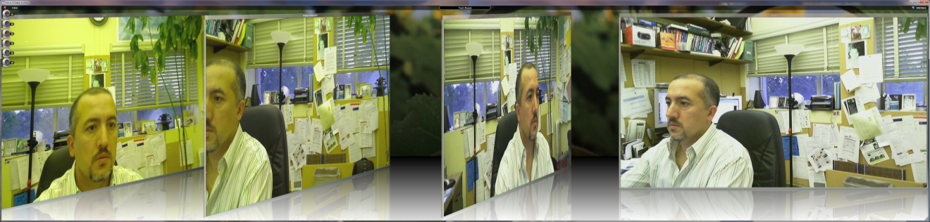
Multi-camera support

Slide 36
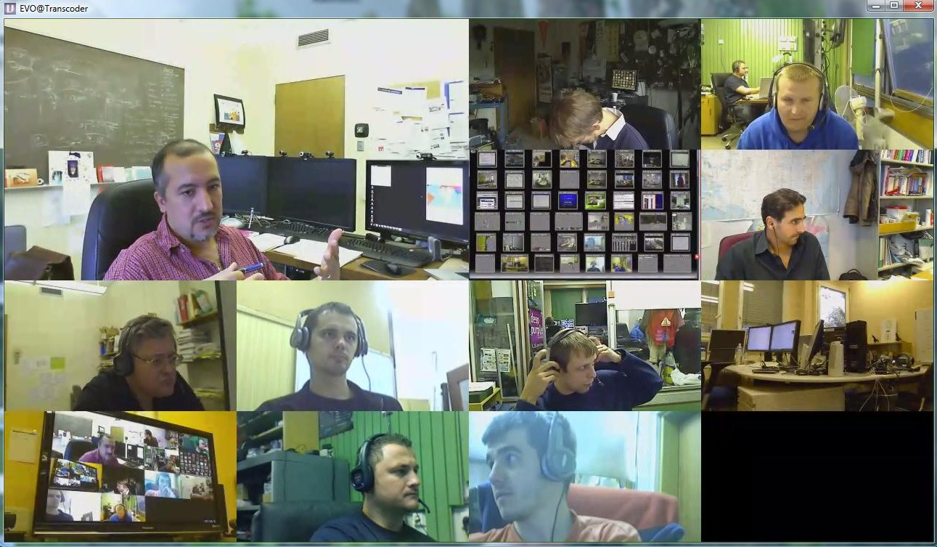
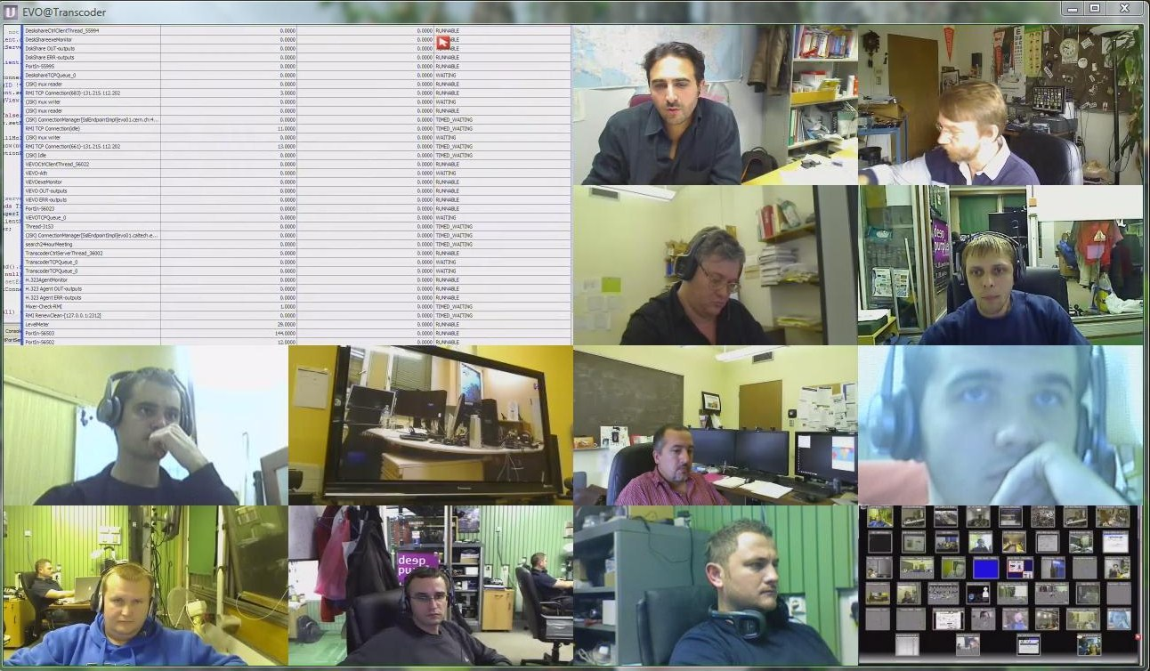
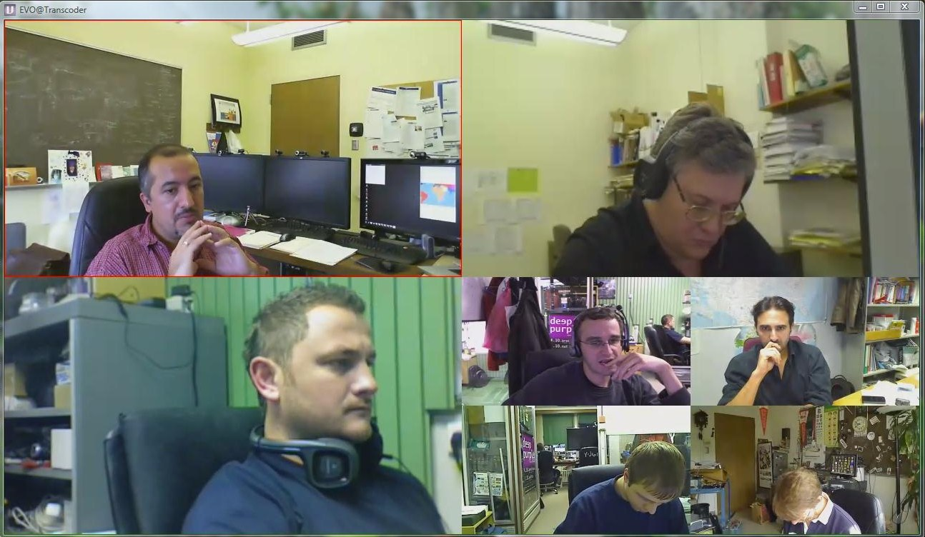
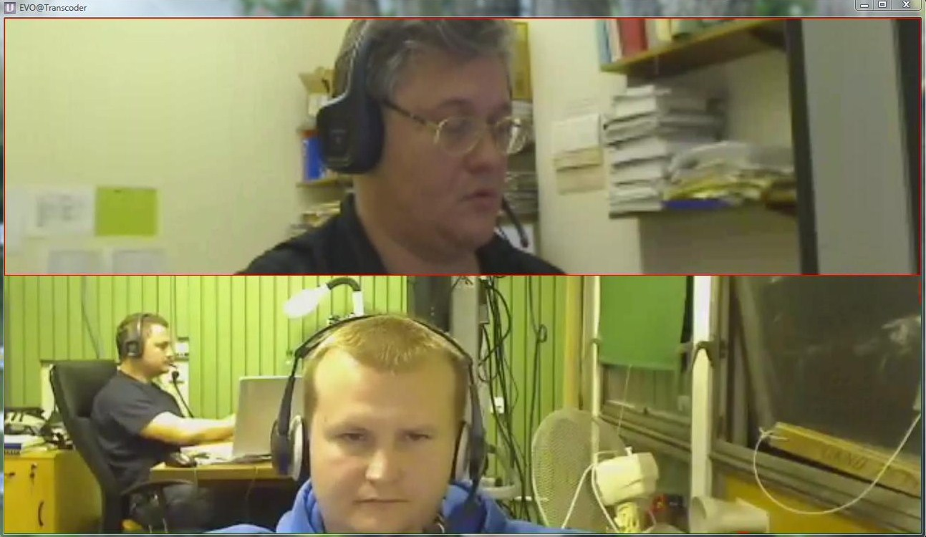
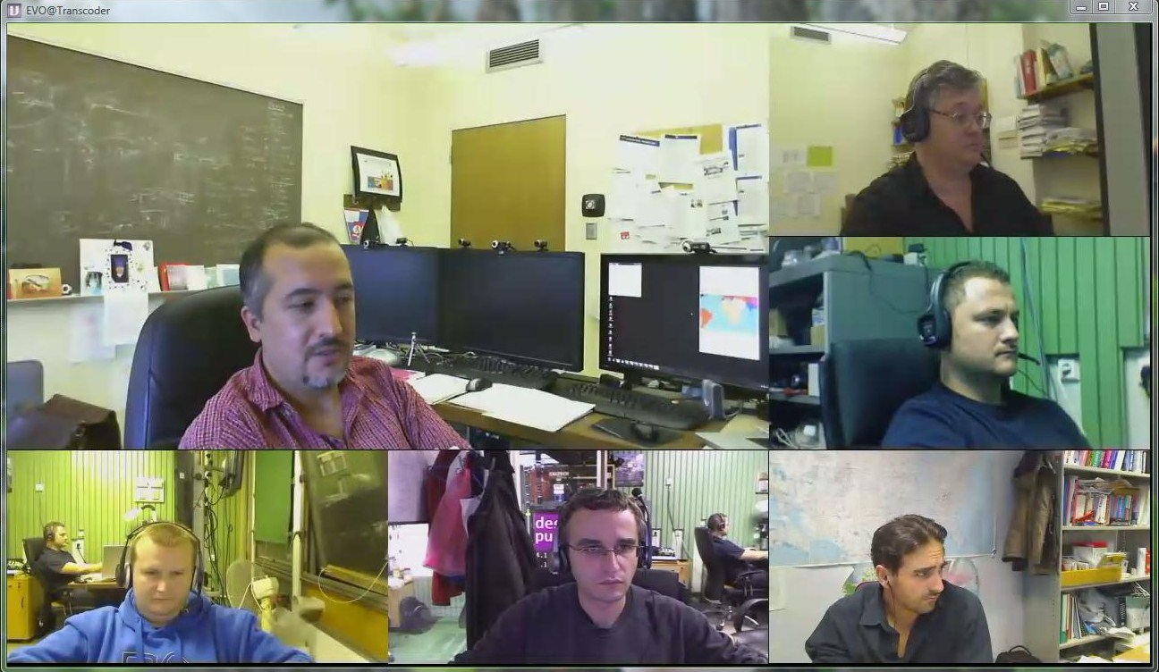
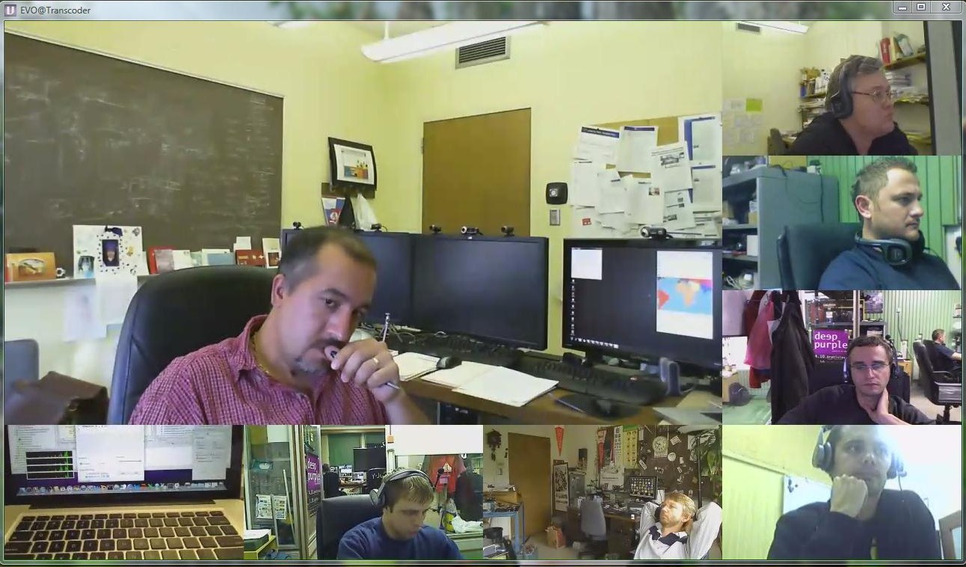

Slide 37


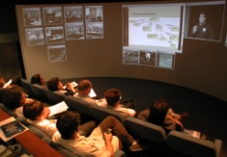
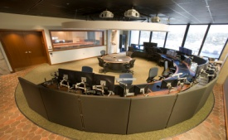


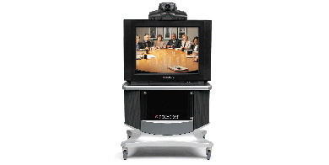
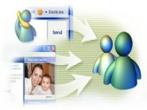
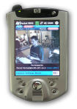



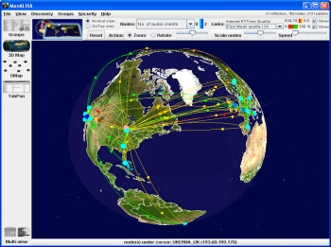

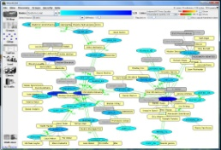

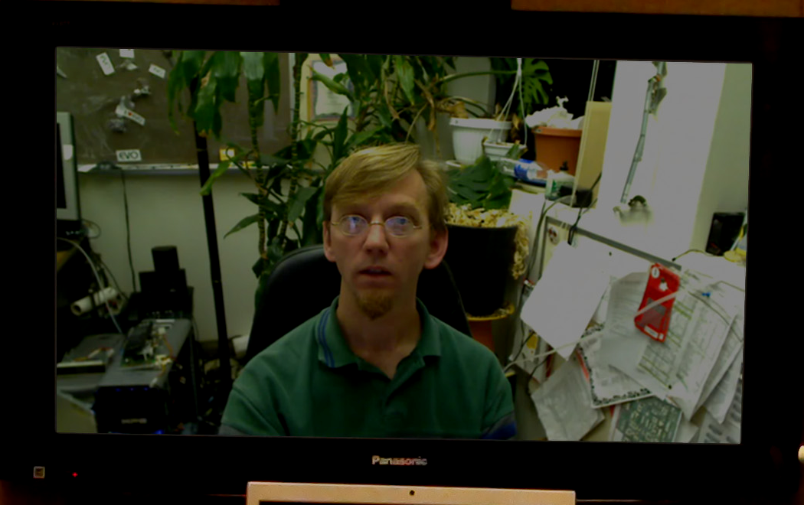

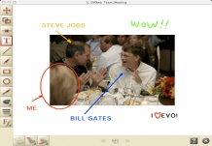
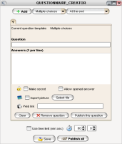

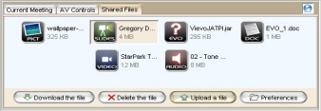
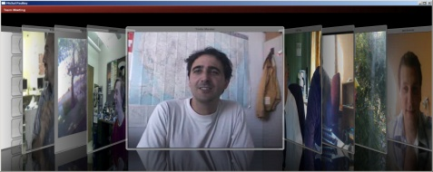
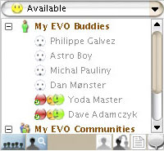
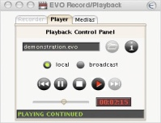
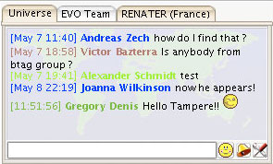
A Unique End-to-End Self Managed & Secure Infrastructure for Collaboration; Integrating all protocol and conferencing system
H.323
Phones
Multicast/AG
H.323 MCU
Physics Control Centers
Handheld
SIP
Monitoring/MonALISA
Desktops
Full HD
EVO
IPv6
Whiteboard/
Shared Files
APIs
Record/Playback
OpenGL Video
IM / Chat
Notes:
37

Slide 38

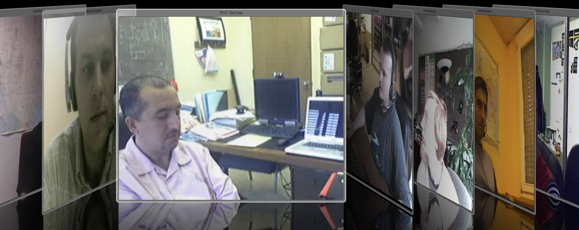
ViEVO features
All videos are shown in a single window
Use GPU (Graphical Processor Unit) instead of CPU
Real time:
  Transparency
  Text over video
  2D and 3D special effects (shadows, etc…)
  Title of the meeting
All resolutions from QCIF to HD 1080p
Codec: H.261, H.263 and H.264

Slide 39
Web Conferencing/Phone service
Subscribe to hosted web or phone conference service such as WebEx, Adobe Connect, GoToMeeting, etc…
While it could be appropriate for small groups, it will not fulfill the requirements for large scale international scientific experiments.
  Lack of scalability, interoperability, etc..
In addition to limited functionality and incompatibility with standards, the cost would be very high
(~ $500/person/year)

Slide 40
EVO Objectives
Provide a global-scale, robust, real-time, collaboration service to the LHC experiments and other major research and education programs
Support and foster much more effective collaboration, across the full range of working environments
from laptop to conference room to control room and auditorium
Build and operate a system that can support the entire research and education community, on a global scale
Design, build and evolve a system that can do all this, Operated by a Small team, with the required high level of functionality, and Low Cost
Notes:
40

Slide 41
Some EVO functionalities
Works on MS Windows, Mac OS X, Linux!
Connects to H.323 client, H.323 MCU, SIP client, SIP MCU, IP telephone, Standard Telephone
Works on Unicast and Multicast!
EVO is tunneling all communications into one Port and is firewall and NAT friendly
A/V Streams could be encrypted on the fly
EVO GUI is available in 11 languages! and available in all time zones!
Accepts CIF, VGA, 4CIF, 720p, 1080 resolutions!!
Support H.261, H.263 and H.264 video codecs

Slide 42


Strong Integration
Built-in powerful booking: meeting via invitation, Had-Hoc meeting, booked meeting, recurrent meetings, permanent meeting
integration: auto booking, auto-modification, auto-join meeting. (CERN, DESY, BNL).
LDAP/Shibboleth Integration
Conference room integration: special room account, special room setup, administration privileges

