Slide 1
Status of Activities at BNL
Alessandro Tricoli (BNL)
FNAL, February 24-25, 2025
US-Japan workshop for AC-LGAD and testbeam

Slide 2
Outline
Fabrication
Infrastructure
Measurements
Simulations
Plans
Details in G. Giacomini’s talk
Used in measurements
More measurements in A. Tricoli & G. D’Amen’s talk
Used in comparison with measurements
Input for discussion about future plans

Slide 3
Fabrication
On-going productions
  AC-LGAD strip and pixels for R&D EIC​
  Large-area single-channel AC-LGADs for calorimetry​: 20, 30, 50 𝜇m thick wafers​
  Trench-LGAD​​
  “Simplified” LGAD​: Gain buried by wafer-bonded wafer​
  Lower Gain AD for Pioneer​: Thick FZ n-type wafers​
See Gabriele’s presentation for details

Slide 4
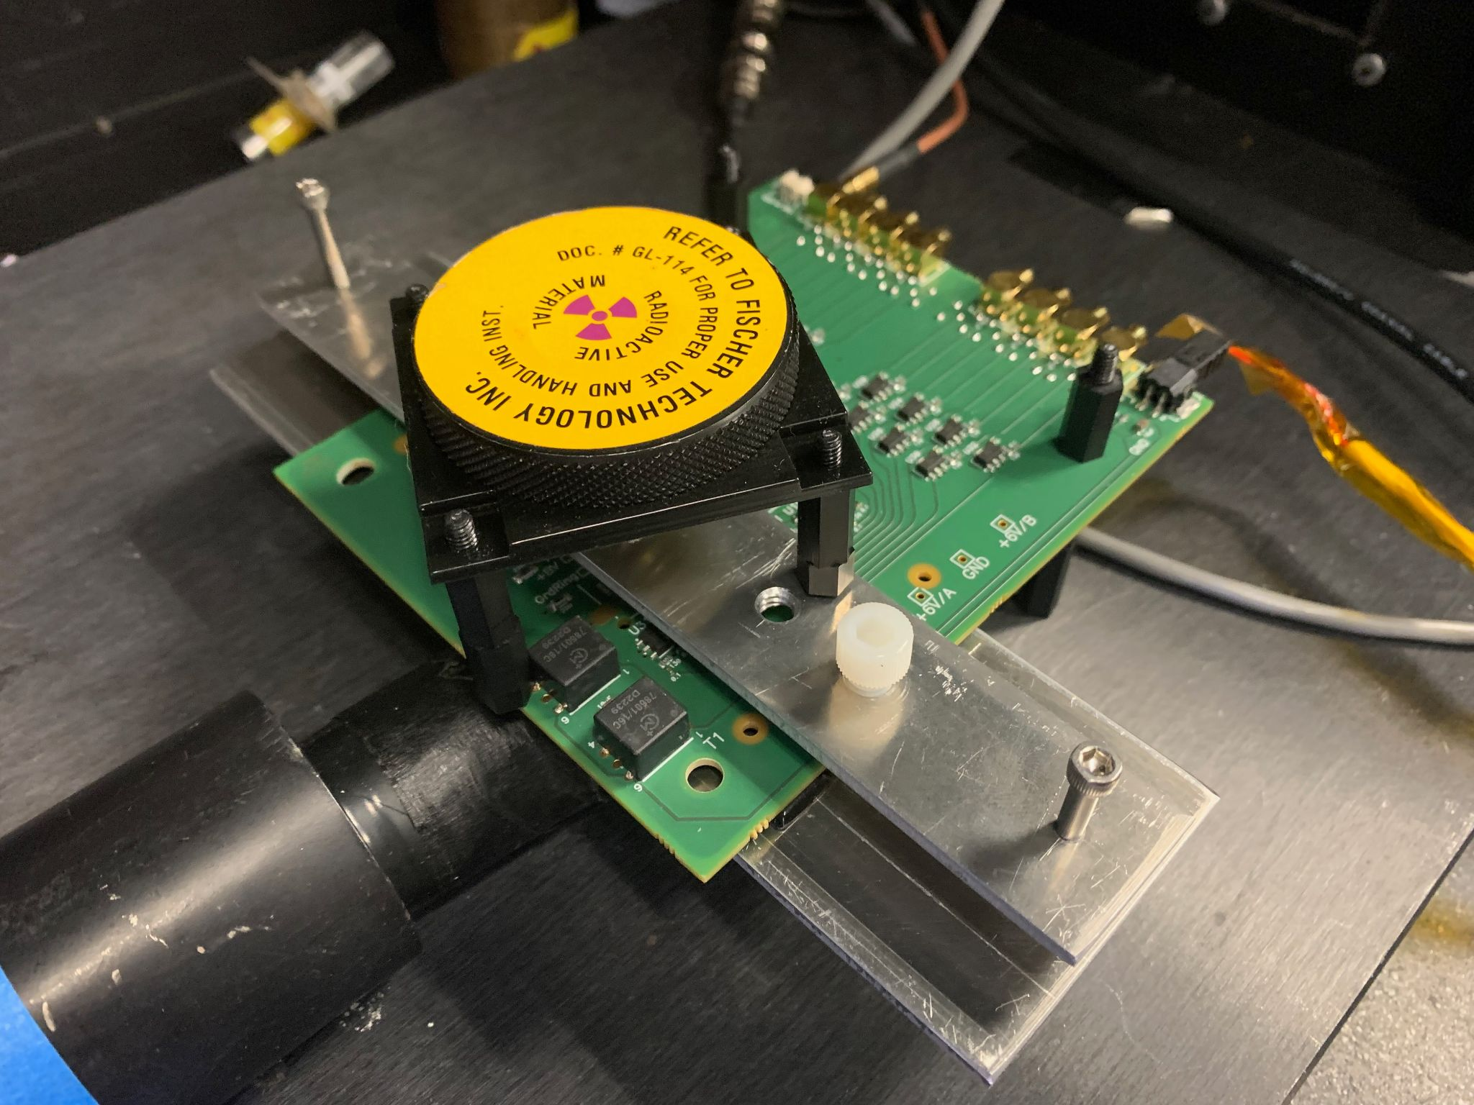
Infrastructure – Coincidence Setup
To improve measurements with betas from ⁹⁰Sr we are setting up a Coincidence Setup
  Allows to lower threshold on triggering
Currently 2x FNAL Boards placed close together:
  One with DUT (top board)
  One with Triggering device (bottom board)
    large area AC-LGAD strips with several strips bonded together
Also working on alternative setup with 1x FNAL Board with DUT + Scintillator
Aluminum layers as absorbers and collimators, with small pin holes
Requests:
  Can we develop a double sided FNAL board to maximise acceptance in coincidence?
    DUT and triggering devices on two surfaces of same board
      e.g. vias from bottom to top surfaces for input to amplifiers (which stays at top surface)
      e.g. additional pad for HV on bottom
  Add calibration channel for input test signal

Slide 5
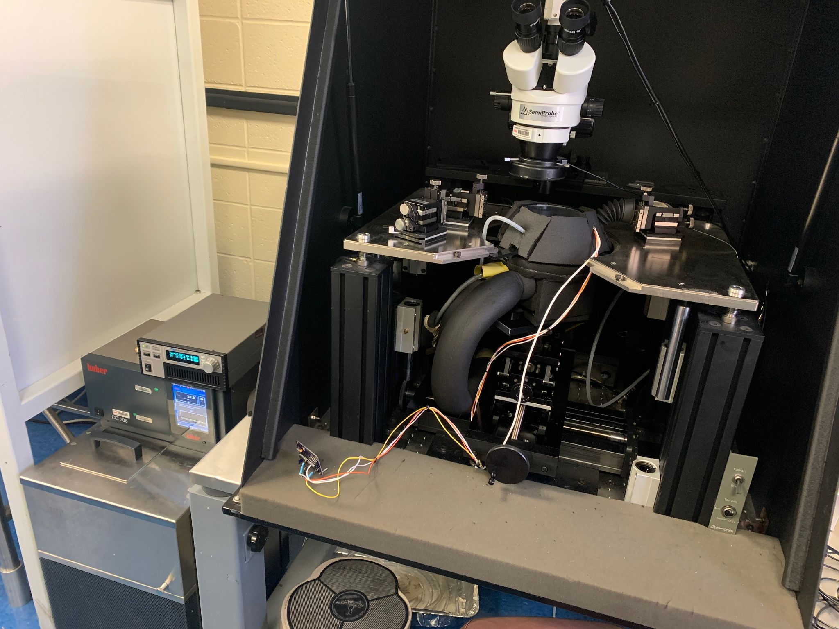
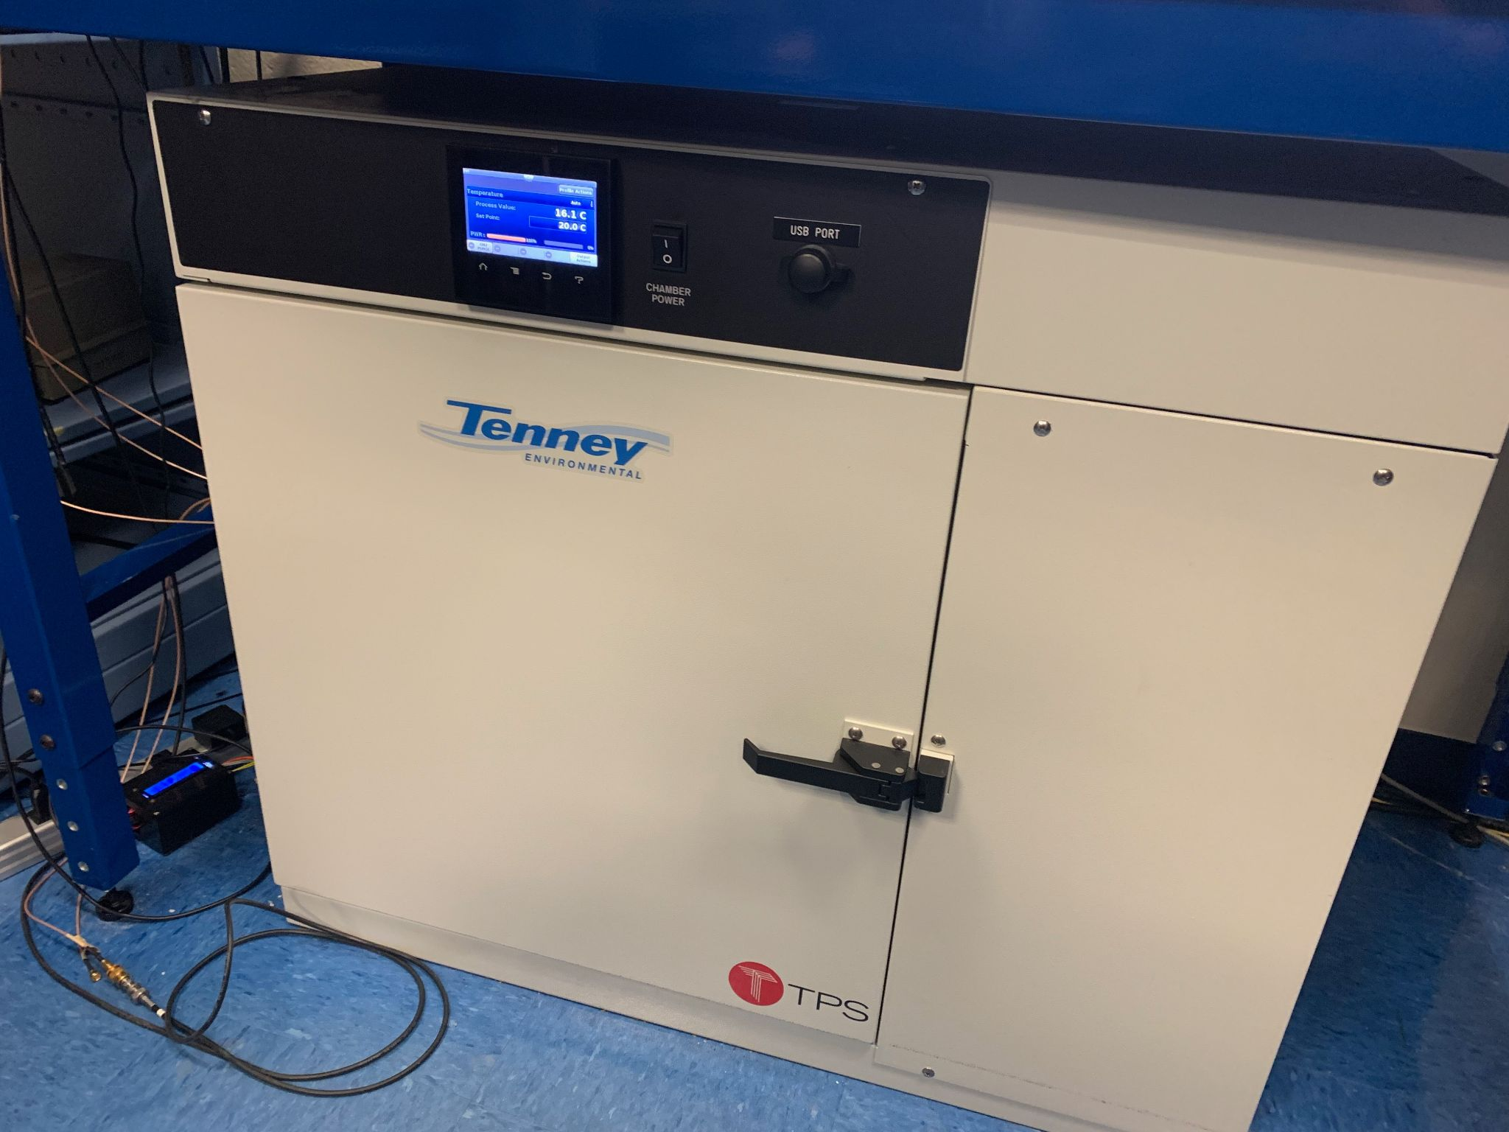
Infrastructure – IV, CV (cold/warm)
Cold Probe Station: -40 ℃ to Room Temp (plus)
Chiller + Peltier
Nitrogen flow
Humidity and temperature sensors
Dome with feedthroughs for manipulators
Scans: IV, CV
Plans: insert radioactive sources inside dome for readout studies
Ambient Chamber: -68 ℃ to 180 ℃
Nitrogen flow
Humidity and temperature sensors
Shared electronics with Cold Probe station
Scans: IV

Slide 6
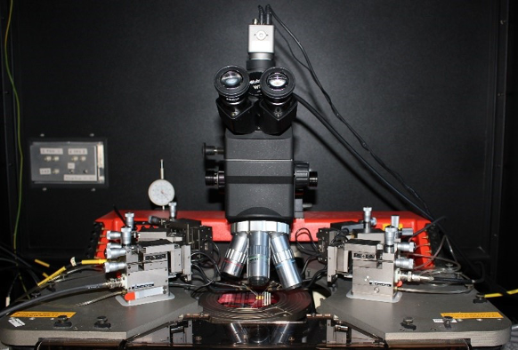
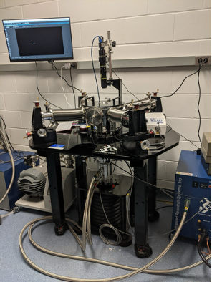
Infrastructure – IV, CV (cold/warm)
High performance probe station setup used for warm IV, CV
Karl Suss Probe Station for electrical characterization (I-V and C-V) at room temperature
Probe station setup used for very low temperature IV, CV
ARS closed-cycle cryogenic probe station for electrical characterization at low temperatures

Slide 7
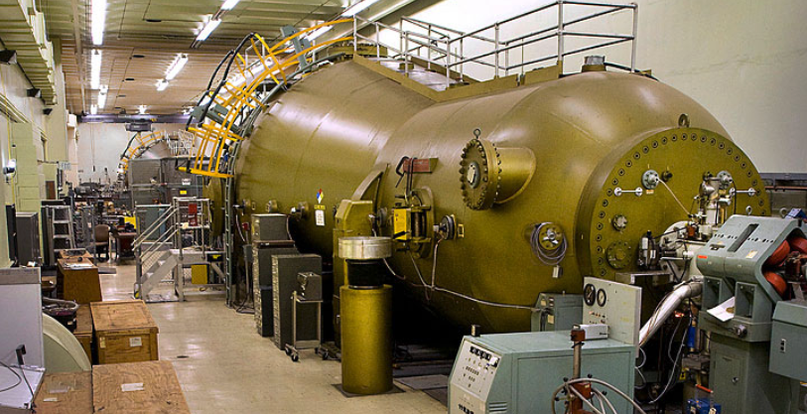
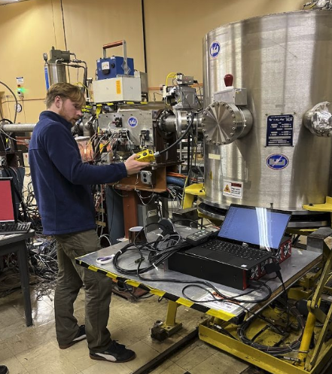
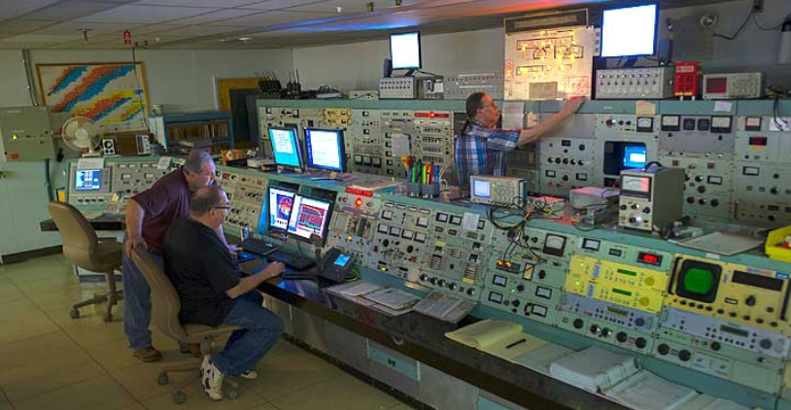
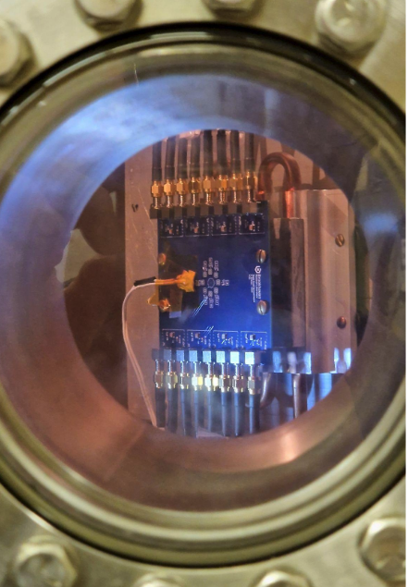
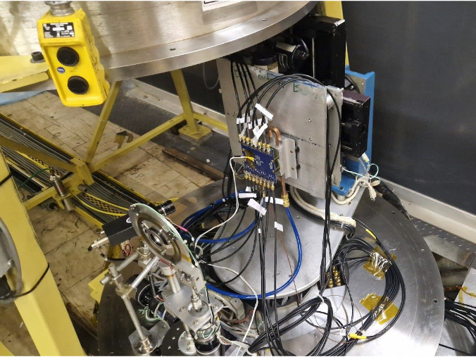
Infrastructure – Tandem van der Graaff
Tandem van der Graaf injects several ion species from protons to ¹⁹⁷Au
We use it for Irradiation, SEU, SEB, Testbeams

Slide 8
Measurements
BNL has carrying out several measurements on the following area
  (AC-)LGAD performance in different conditions
    Temperature, Humidity variations
    Response different particle beams
      MIP (90-Sr beta)
      non-MIP (28-MeV p, alpha)
      Photons: X-rays, IR laser
    Single Event Burnout (SEB)
    Charge carrier produced (No. e-h pairs)
  4D Readout electronics
    FNAL board performance (amplifier linearity, amplification)
    EICROC0 performance
See Next Talk by A. Tricoli
See Talk by G. D’Amen

Slide 9
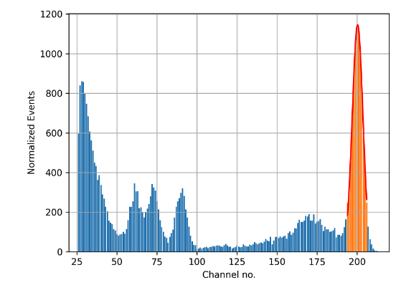
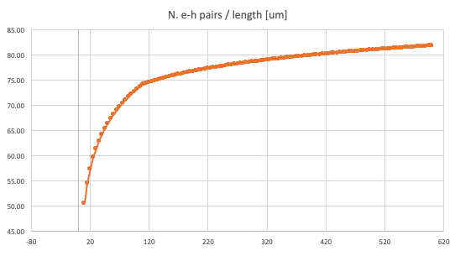
Measurements – No. e-h pairs per micron
Number of electron-hole pairs generated by a MIP in silicon measured using a Diode of 500 𝜇m thickness in a beam of beta-particles from a ⁹⁰Sr radioactive source
⇒ Extrapolation to 35 𝜇m
Calibration of readout channels:
59.5 keV spectrum line from ²⁴¹Am
Ch. 200 ≋ 146 keV
spectrum line
from ⁹⁰Sr
Readout CSA from PIX5 readout system
81.2 ± 0.16 e-h pairs / 𝜇m
(146 keV / 3.6 eV / 500 𝜇m)
146 keV line from ⁹⁰Sr
Extrapolation from 500 𝜇m to 35 𝜇m
No. e-h pairs / μm
No of e-h pairs generated by a MIP in silicon depends on thickness
⇒ Extrapolation using theory of energy loss in silicon
[“Straggling in thin silicon detectors” by Hans Bichset]
81.2 ± 0.16 @ 500 μm ⇒ 62.9 ± 3.77 @ 35 𝜇m
μm

Slide 10
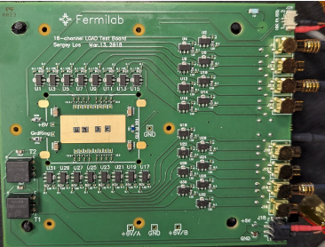
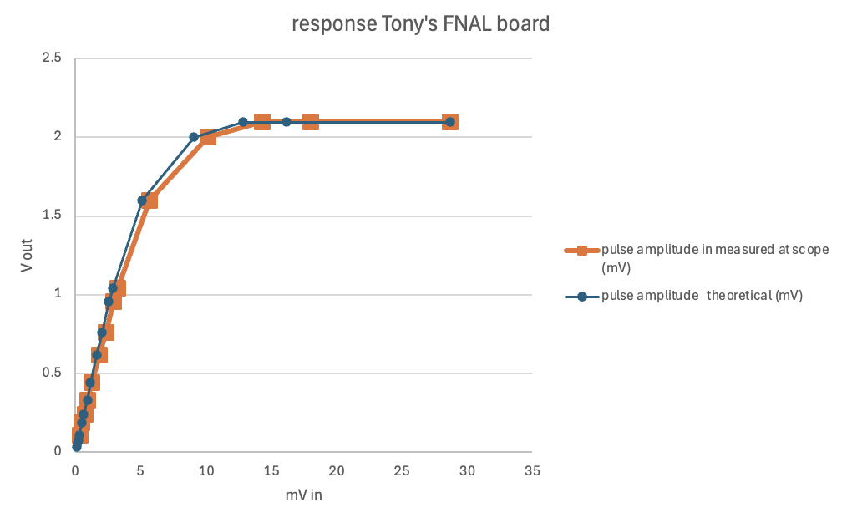
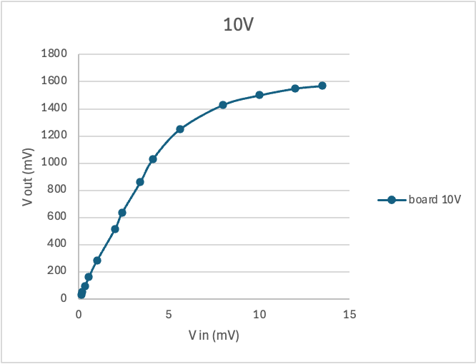
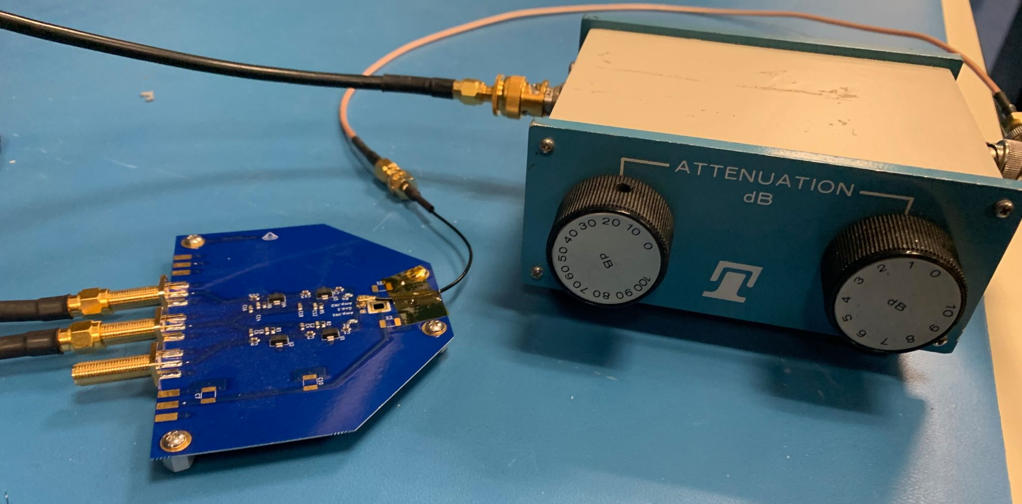
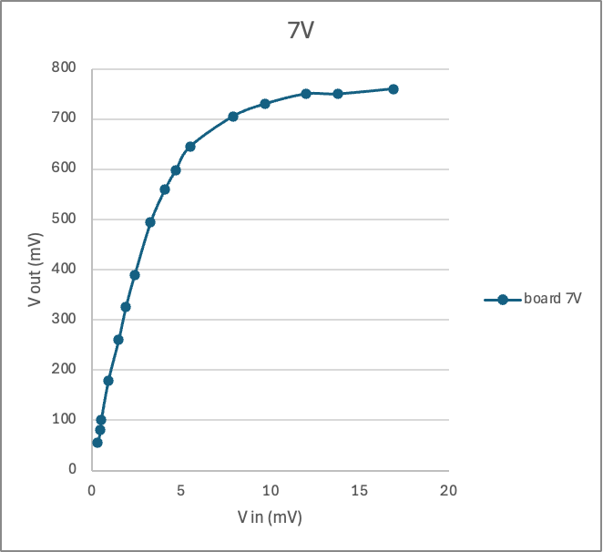
Measurements – FNAL Board Linearity
Determine the conditions at which the FNAL Board Amplifier's Gain deviates from a linear relationship with input voltage
  Dedicated Board (Tony’s Board) was developed with same amplifiers as in FNAL Board
FNAL Board
Amplifier at 12 V
Pulse Generator Berkeley Nucleonics 765:
  50mV amplitude, 3ns width, 1ms period
Oscilloscope:
  Waverunner 940M-MS 4 GHz, operated at 1 GHz
  Trigger on trigger signal by pulse generator
Amplifier: Mini-Circuits GALI66+
12 V
Very good linearity up to ~ 1 V
Tony’s Board
Attenuator
Boards with same
RF amplifiers as in FNAL Board

Slide 11

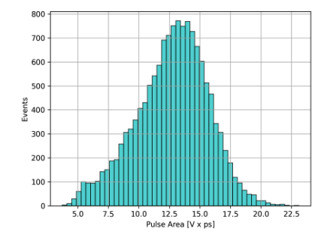




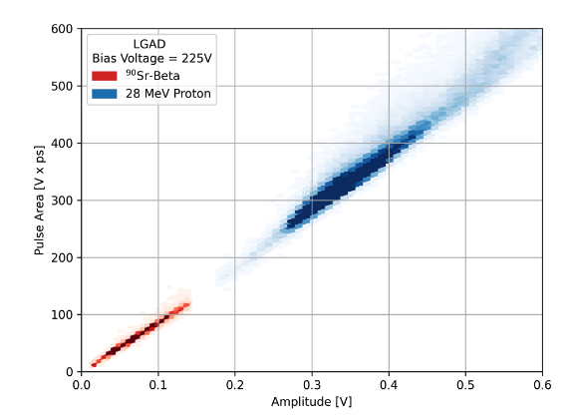

Measurements – FNAL Board Amplification
Diode fabricated by HPK with 35 𝜇m thickness, 1.3 x 1.3 mm² pad
X-rays from a ²⁴¹Am source
Amplification
(2-stage amplification)
Q_{signal} = 16,600
= 59.5 keV / 3.6 eV
X-ray emission from ²⁴¹Am
In agreement with Data sheet for Mini-Circuits GALI66+
0.68 ± 0.01 ns from X-rays from ²⁴¹Am
Area / Amplitude
Good agreement
0.66 ± 0.01 ns extrapolation from MIP from ⁹⁰Sr
(effective FWHM of pulse)
= 62.9 (e-h pairs in 35 um) x
50 Ohm x (9.95)²
= 1.75 Vps
extrapolating a linear fit to data
Amplitude = 2.73 ± 0.15 mV

Slide 12
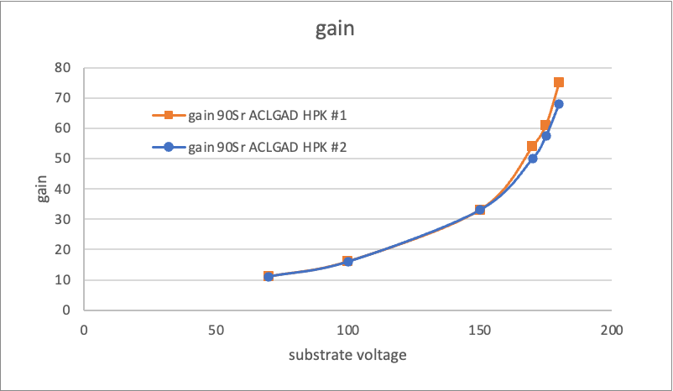
Measurements – HPK LGAD Gain
2x AC-LGADs fabricated by HPK with 50 𝜇m thickness
Used low-noise charge sensitive amplifier and PIX5 readout
⁹⁰Sr spectrum to extract gain
Gain reaches 80 on both sensors at high bias voltage

Slide 13
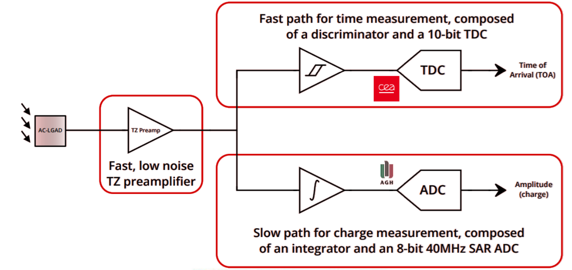
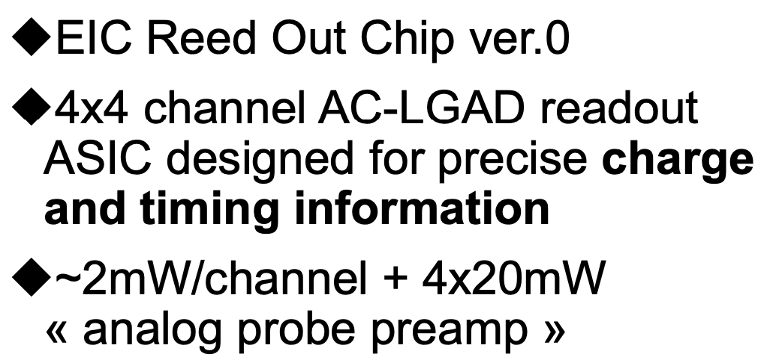
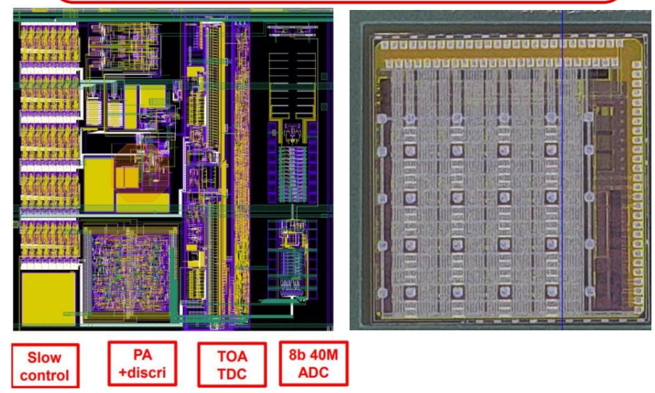
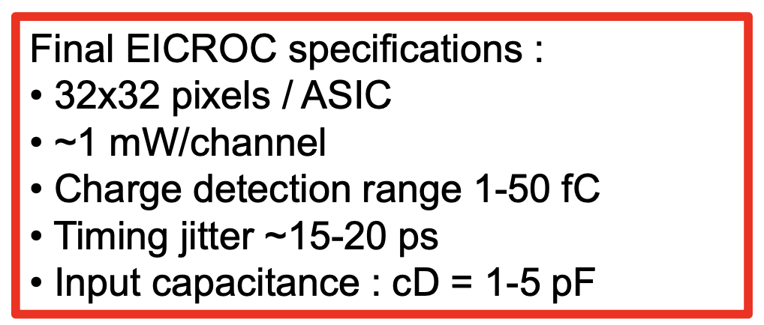
Measurements – EICROC0 (I)
EICROC: ASIC designed for EIC Roman Pots (500 x 500 μm² pitch)

Slide 14
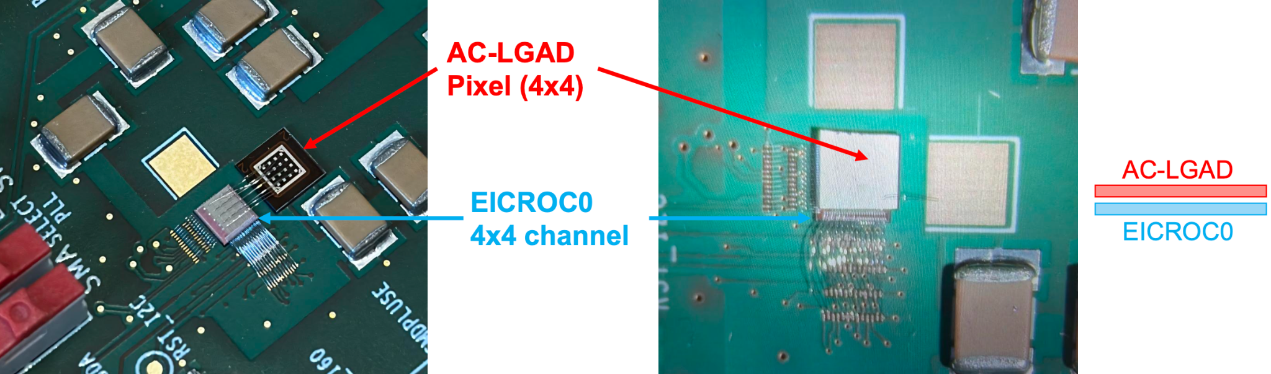
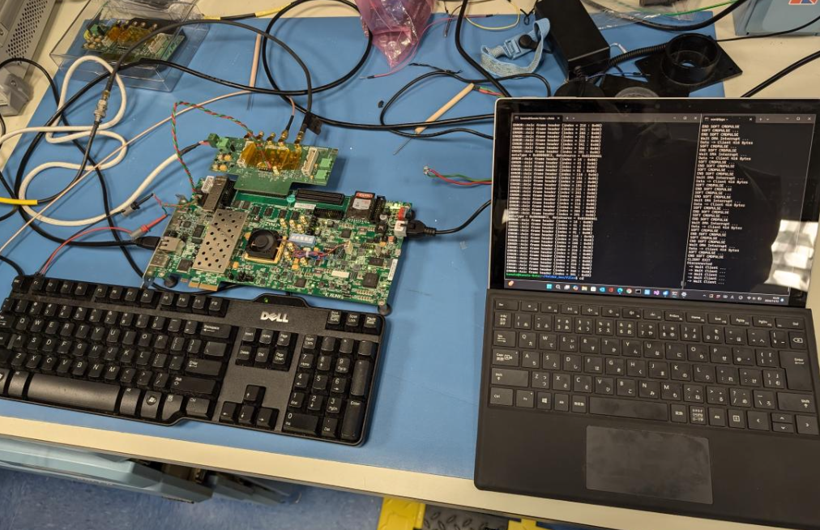
Measurements – EICROC0 (II)
Several EICROC+AC-LGAD flip chips were produced and distributed to EIC Coll.
Several EICROC were assembled on dedicated test-boards (some bump-bonded/wire-bonded to AC-LGADs some with ASIC only) and distributed to EIC Coll.
  At BNL we have been testing:
    A1 (ASIC wire-bonded to sensor)
    A2 (ASIC only)
    B1 (ASIC bump-bonded to sensor)
BNL Tests:
Charge injection to frontend
Beta from 90-Sr
TCT (IR laser)
Fruitful collaboration with Hiroshima Univ.
Testbench
A1
B1

Slide 15
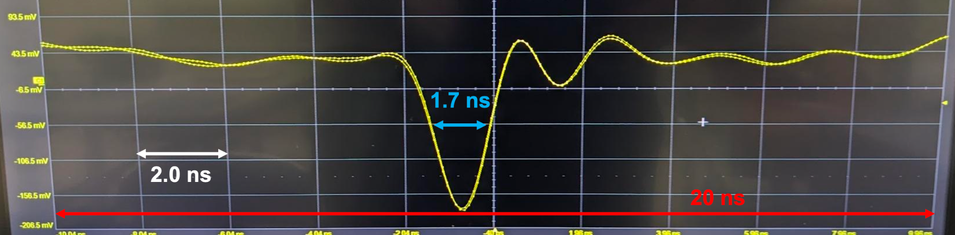
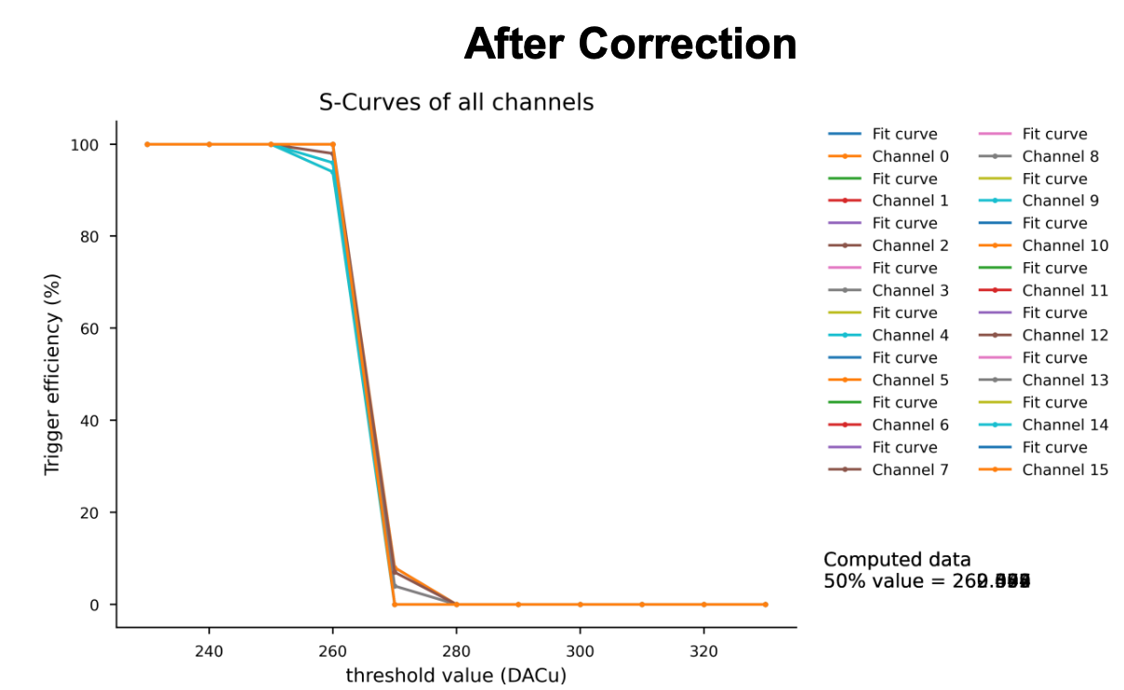
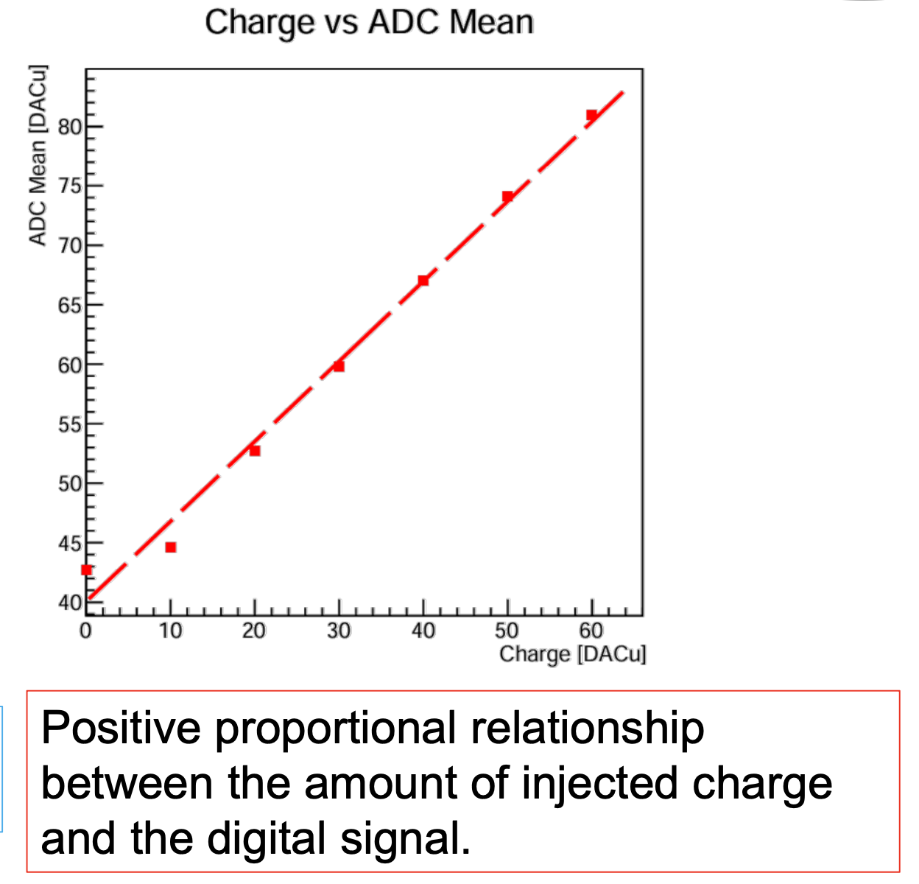
Measurements – EICROC0 (III)
Analog Signal
by Kanato Matsutani (Hiroshima U.)
Digital Signal
S-curve after channel-by-channel threshold trimming

Slide 16
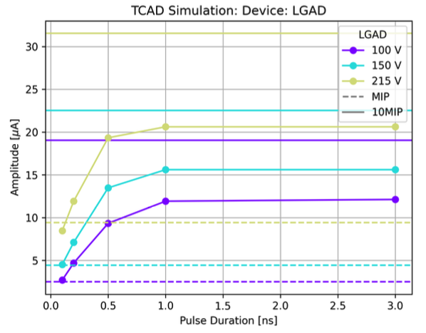
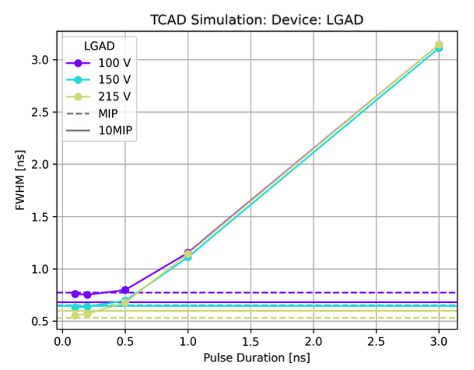
Simulation
Good experience with Weightfield2
Expertise in TCAD Silvaco
  Simulation of LGAD/Diode response to MIPs, non-MIPs, IR laser (different pulse duration)
IR laser
1x/10x MIP
Parametrizations of readout electronics effects
  Comparison of Weightfield2 with more formal parametrizations
Sensor
Amplifier
Oscilloscope

Slide 17
Plans (I)
Fabrication and Simulation
  AC-LGAD with 55x55 μm² and 100x100 μm² pixels
    US-Japan scope for assembly with readout electronics
  Attempt 8 m thick LGADs (wafers being purchased)
    US-Japan scope for faster timing and for microdosimetry for radiation therapy
  TCAD simulation of LGAD-based MAPS
    US-Japan scope for MAPS
  Prototyping of LGAD-based MAPS with deep wells but no electronics (proof of concept for signal collection)
    US-Japan scope for MAPS
Test-beams at Tandem van der Graaff in spring 2025
  Continue SEB studies with heavier ions (¹²C, ¹⁶O, ⁵⁶Fe, ¹⁹⁷Au) on LGADs and AC-LGADs
  LGAD response and gain suppression in ¹²C (100 MeV), p (14 MeV), ⁴He (43 MeV)
    20, 30 μm thick 1.3 x 1.3 mm² LGADs
    Collaboration with medical group at Miami U. for development of micro-dosimetry for radiation therapy, based on LGADs

Slide 18
Plans (II)
Continue testing of 4D ASICs (US-Japan scope)
  EICROC0 characterisation of analog and digital parts:
    with AC-LGAD pixels and try with strips too
    including tests with laser to determine time and space resolution
  EICROC1 when available (fall 2025)
  CaloROC/HGROC with AC-LGAD strips (designed for larger input capacitance)
Test LGAD and AC-LGAD signal response at different Temp. and Humidity
  Use cold probe station (-40 ℃ to 80 ℃) with ⁹⁰Sr source
Continue IV, CV scans to characterise our sensors

Slide 19
Backup Slides

