Slide 1
Recent Measurements
at BNL
Alessandro Tricoli (BNL)
FNAL, February 24-25, 2025
US-Japan workshop for AC-LGAD and testbeam

Slide 2
Outline
BNL’s recent measurements of (AC-)LGADs focused on
  1) QA tests in varying and extreme environmental conditions
      Temperature and Humidity variations
  2) Response to different particle beams
      MIPs, non-MIP,
      IR laser,
      X-rays, γ-rays, α
      SEB
See in D’Amen’s talk

Slide 3
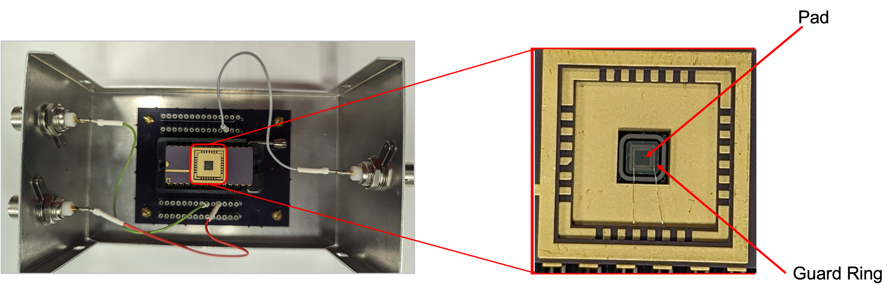
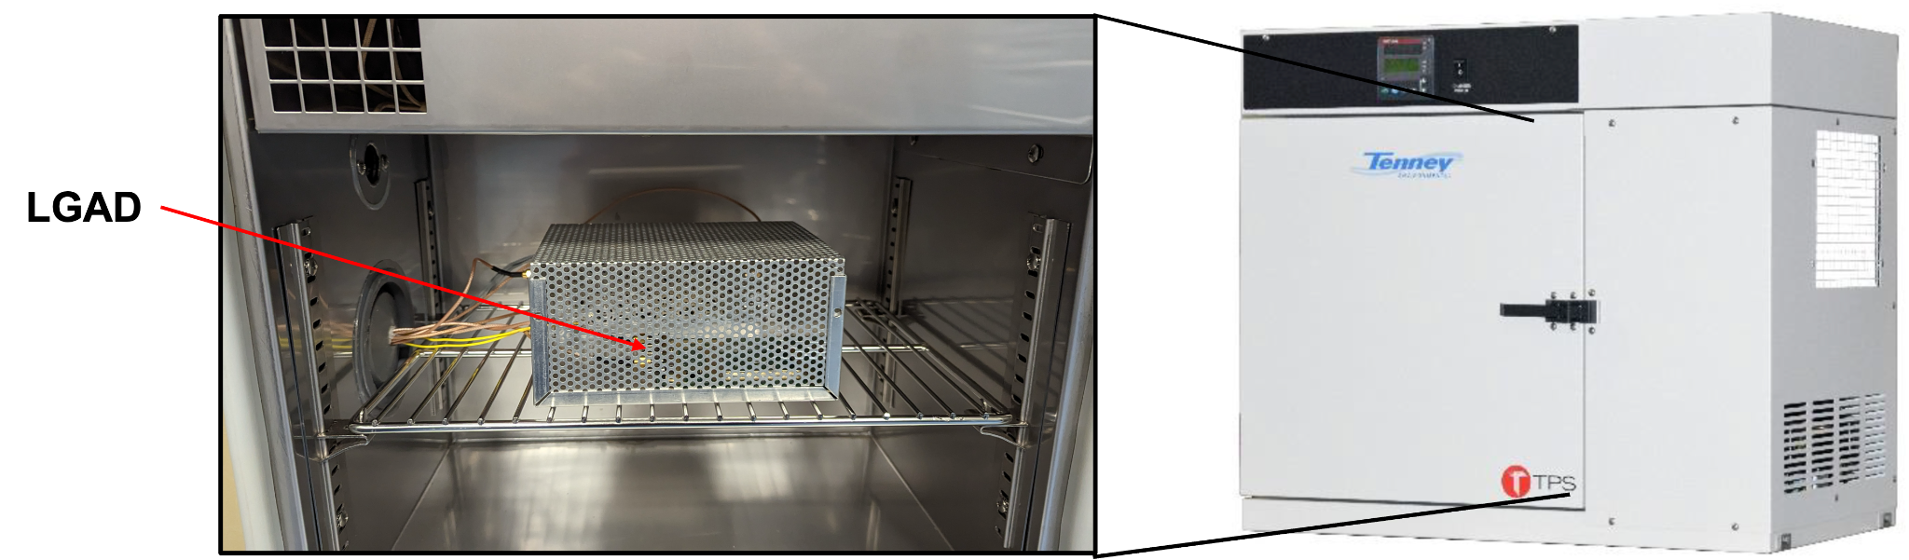
Tests in Varying Conditions – Temp. & Humidity
LGADs are considered for applications in environmental conditions are not guaranteed to be stable.
Space experiment is one such example where LGAD will be subjected to extreme conditions, which requires the study of LGAD behavior in a wide range of extreme environmental conditions mimic the conditions in space
This study aims to test LGAD with extreme temperature and different humidity levels to assess their operational conditions for such applications
BNL’s LGAD, 50 μm thickness
Biased with high voltage
Leakage currents from Pad and GR are measured
Sensor is enclosed in a mesh cover to allow air circulation and prevent electrical noise
Ambient chamber supplied by N₂

Slide 4
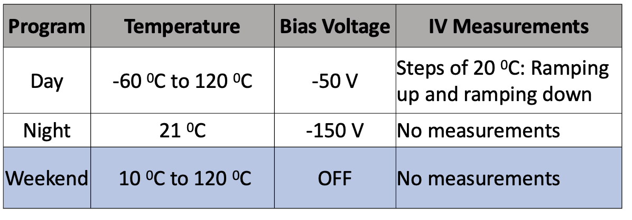
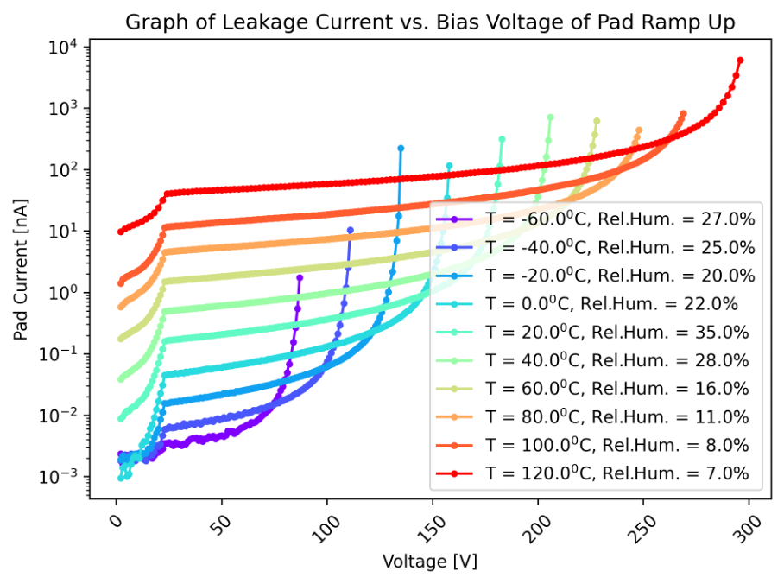
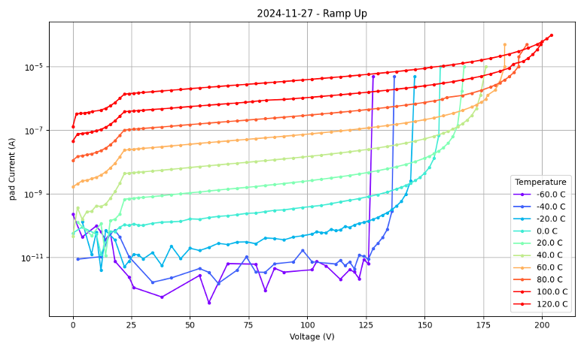
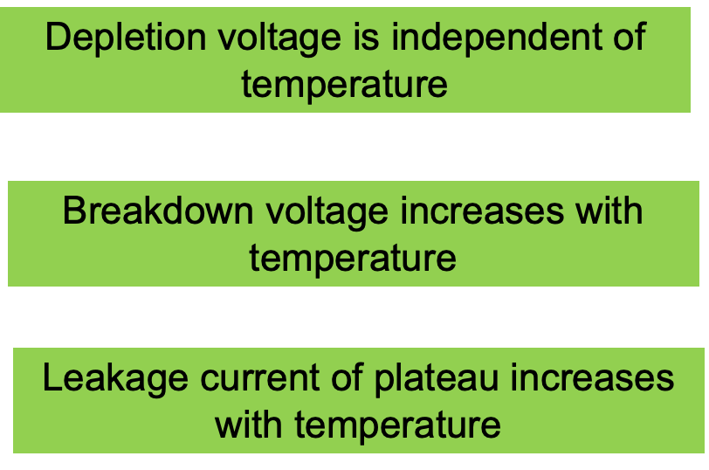
Tests in Varying Conditions – Temperature
Temperature is cycled at an average rate of 1.81℃/minute
Humidity is maintained in such manner that dew point is always 10℃ less than the operating temperature
AC-LGAD
LGAD
Similar results for AC-LGADs
Depletion Voltage
Breakdown Voltage

Slide 5
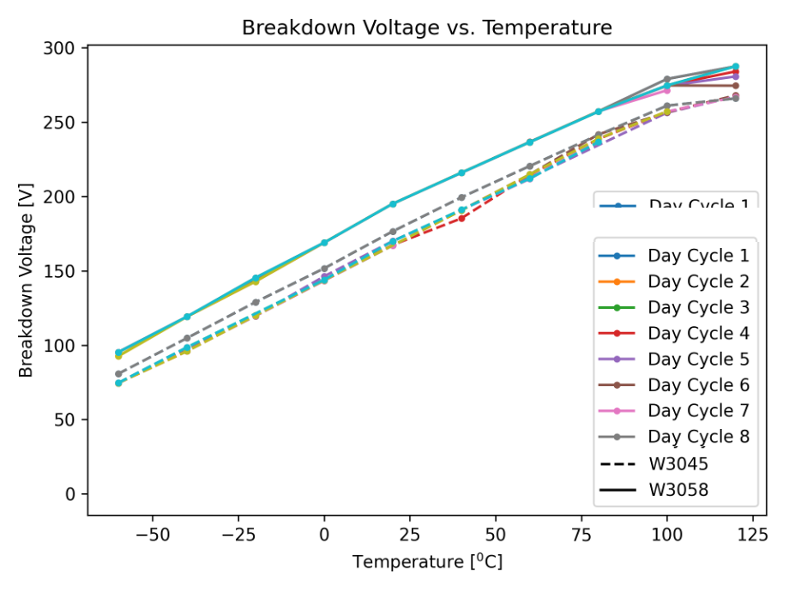
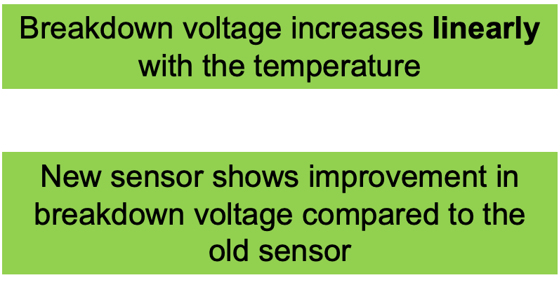
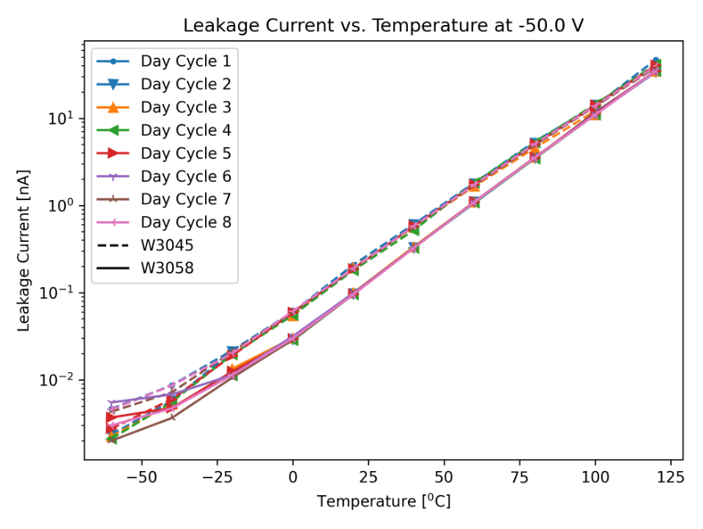
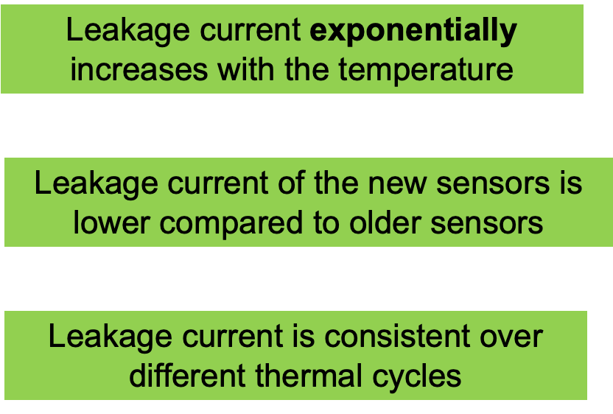
Tests in Varying Conditions – Temperature

Slide 6
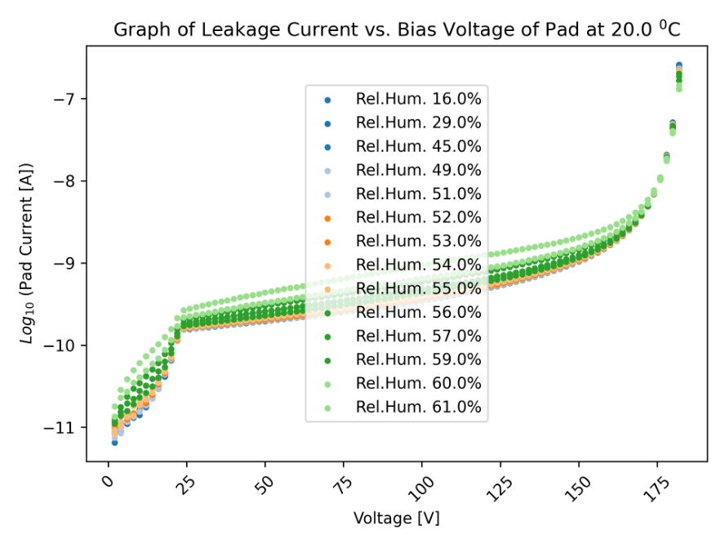
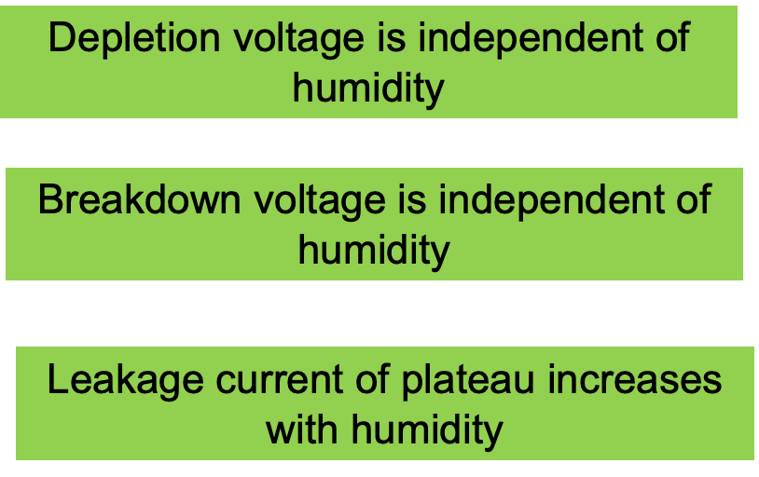
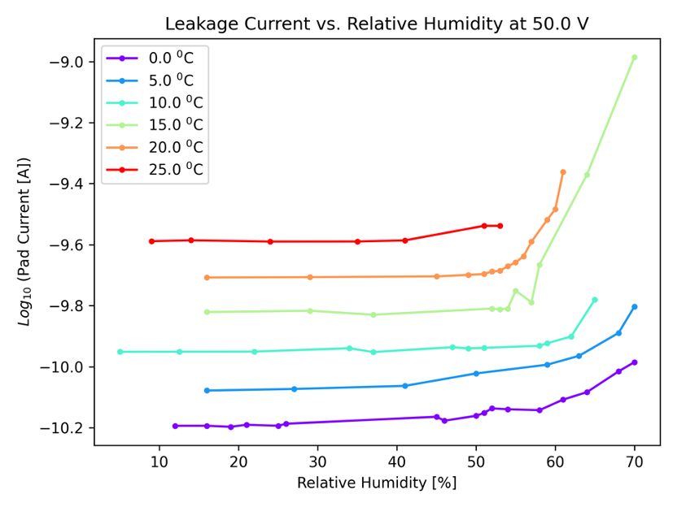
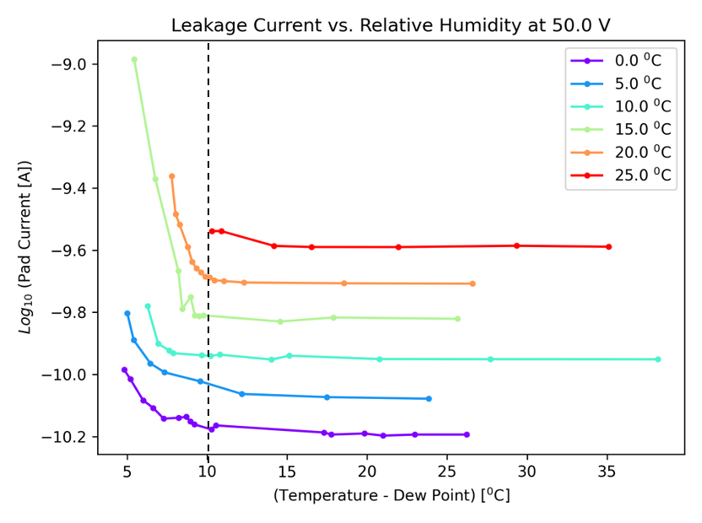
Tests in Varying Conditions – Humidity
Temperature constant at 20℃ and vary humidity
Breakdown Voltage
Depletion Voltage
We repeated measurements at different temperatures
When Dew-point 10℃ closer to Temp., leakage current increases rapidly

Slide 7
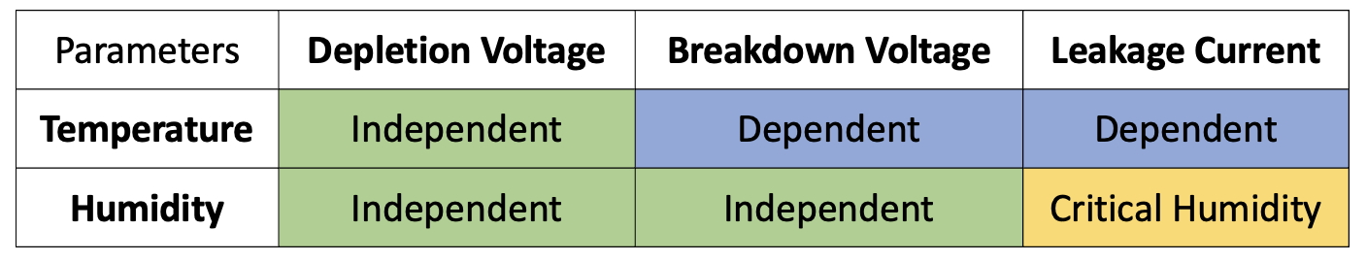
Tests in Varying Conditions – Temp & Humidity
Two different BNL-made LGAD sensors have been tested for weeks at extreme and rapidly changing temperature and humidity conditions.
The results from the two sensors show consistent response of leakage current, and depletion, breakdown and operating voltages as functions of temperature and humidity.
No deterioration of performance is seen in LGADs after weeks of thermal-cycling

Slide 8
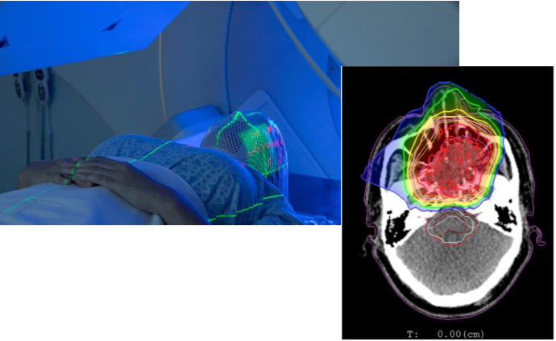
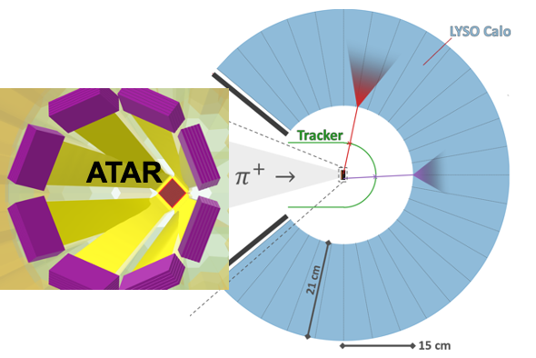
Response to different beams – MIPs / non-MIPS
LGAD performance has up till now focused primarily on the interaction of MIPs
This work expands the study to highly-ionizing particles (non-MIPs), which are relevant for several future scientific applications.
PIONEER experiment, Micro-Dosimetry for radiation therapy and high repetition rate experiments are examples of applications of LGADs in the non-MIP regime
PIONEER
Radiation Therapy:
  Several ion species and different
energy ranges used,
e.g. protons (0-200 MeV), ¹²C, ⁴He etc.
  Micro-dosimetry is important to study damage to healthy cells
  LGADs are considered to be used for micro-dosimeters

Slide 9
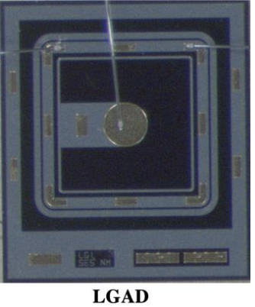
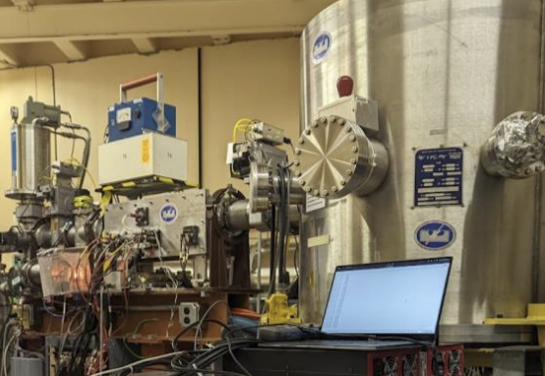
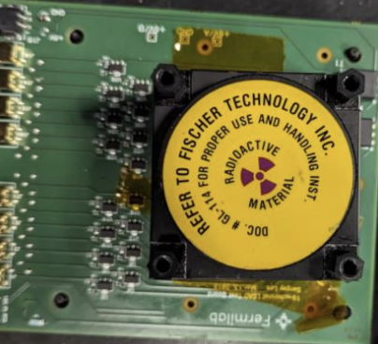
Response to different beams – MIPs / non-MIPS
Characterize LGAD Response and Gain vs bias voltage and injected charge
Sensors: 35 μm thick LGAD and Diodes by HPK were tested.
FNAL Readout board + Waverunner 9404M-MS 4 GHz Oscilloscope.
All tests were done at room temperature
non-MIP: 28 MeV protons from Tandem Van der Graaff
MIP: beta-particles from a ⁹⁰Sr-beta source

Slide 10
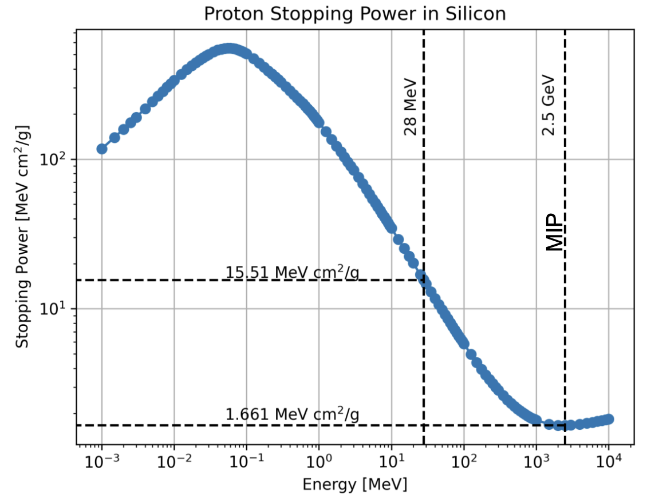
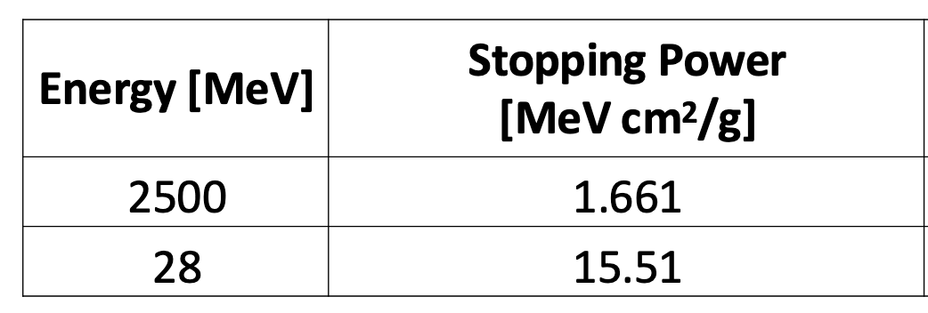
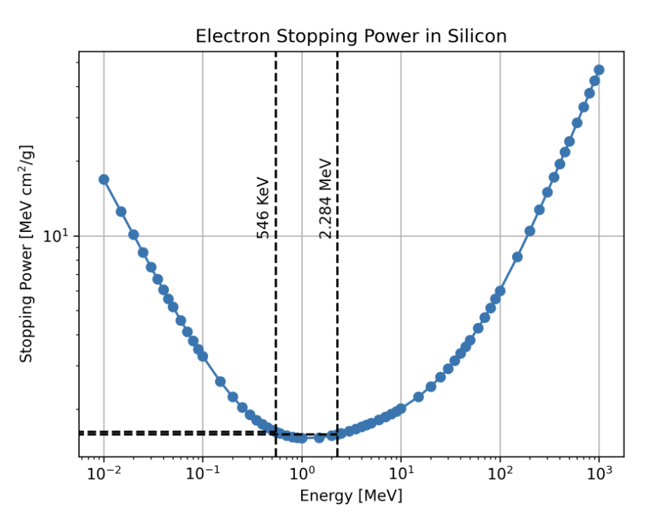
Response to different beams – MIPs / non-MIPS
28 MeV proton generates ~10 MIPs in Silicon
2 MeV 90Sr-beta generates a MIP in silicon
(1 mm absorber of Al was used to absorb low energy betas)

Slide 11
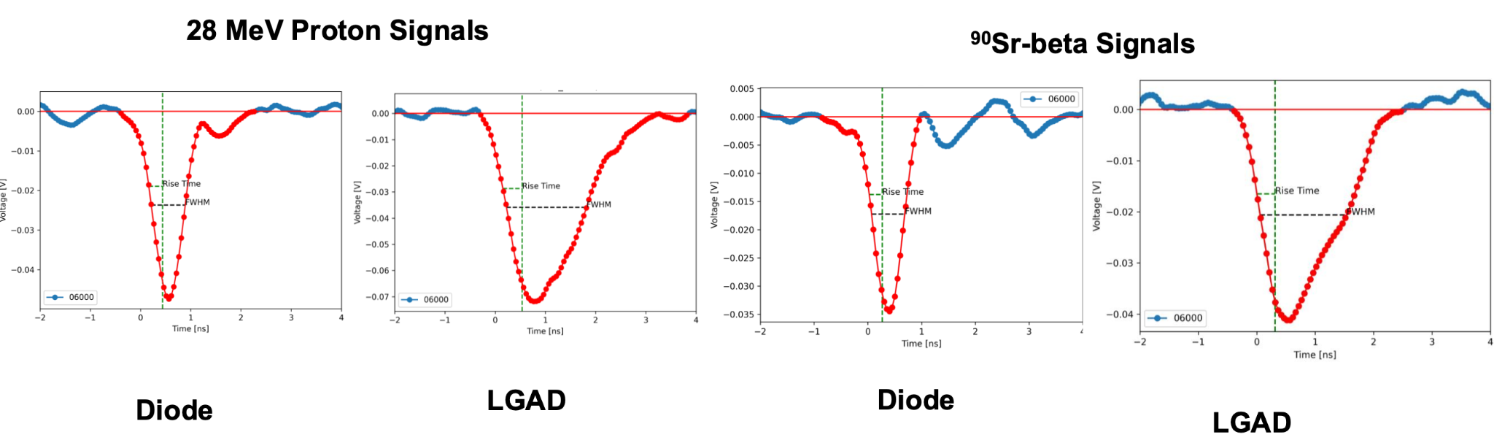
Response to different beams – MIPs / non-MIPS
Pulses in Diodes and LGAD
Signal parameters such as Amplitude (signal peak), Full Width at Half Maximum (FWHM), Rise Time and Pulse Area (collected-charge) were calculated for each pulse
  Rise Time was estimated between 40% - 90% of the maximum amplitude.

Slide 12
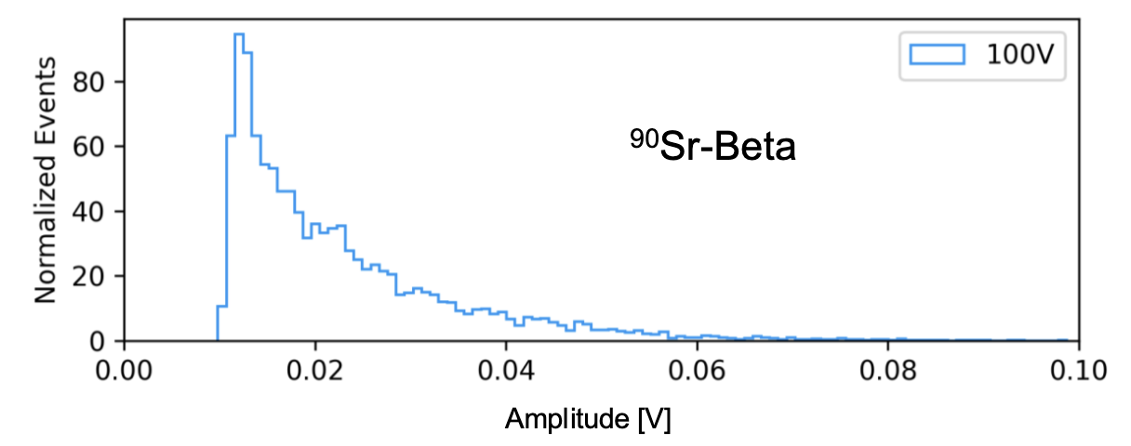
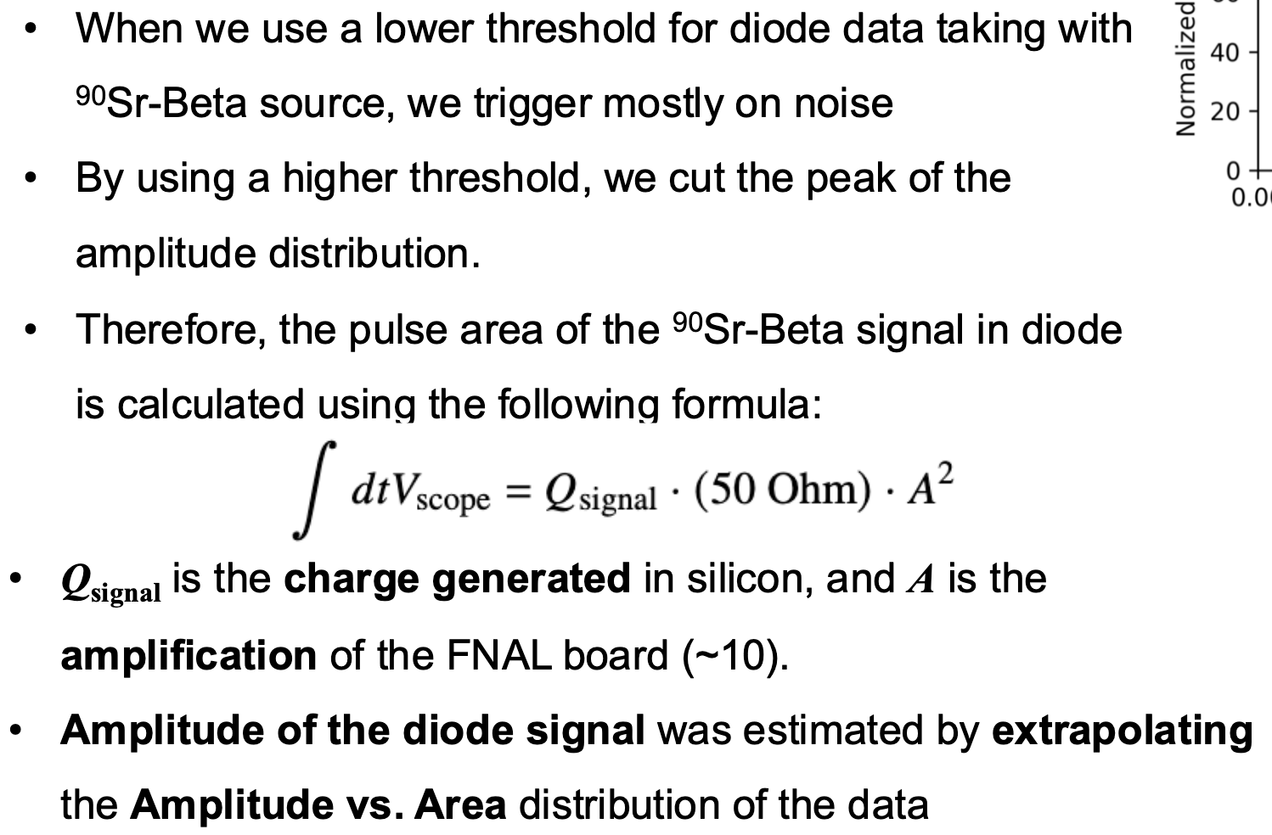
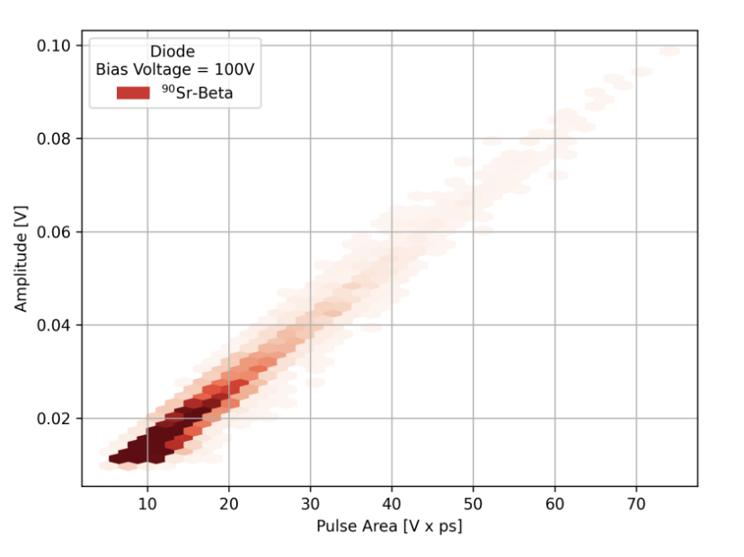
Response to different beams – MIPs / non-MIPS
Signal Properties in Diode with ⁹⁰Sr-Beta
Q = 62.9 ± 3.8
A = 9.95 ± 0.02
Area = 1.75 ± 0.11 V*ps
Area =
See previous talk
➔ Amplitude = 2.73 ± 0.15 mV

Slide 13
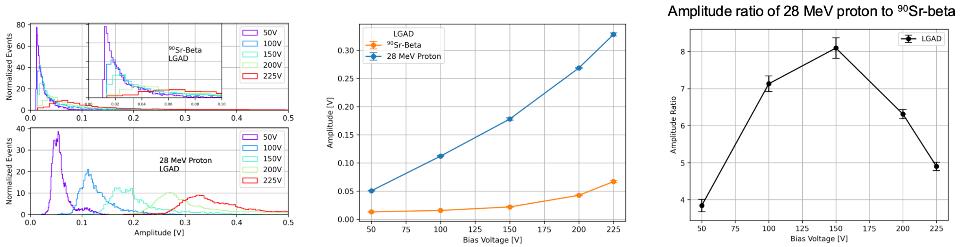
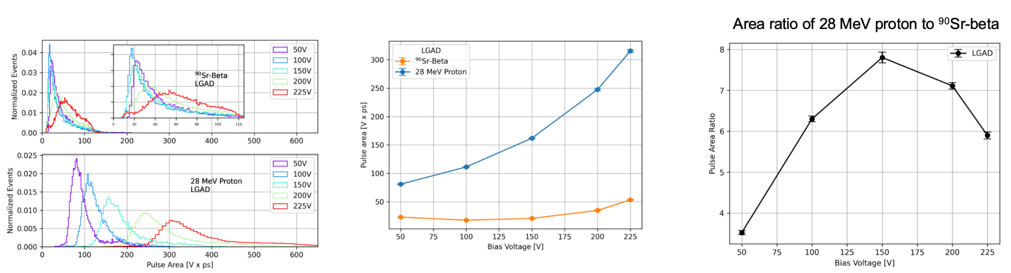
Response to different beams – MIPs / non-MIPS
Signal Properties in LGAD with 28-MeV protons vs ⁹⁰Sr betas
For both ⁹⁰Sr-beta and 28-MeV proton beams, Amplitude & Area increase with V_{bias}.
Amplitude & Area distributions exhibit long tails at high V_{bias}
MPVs of Amplitudes & Areas are up to 8 times higher for 28 MeV proton beam than 90Sr-beta
Amplitudes
Collected Charges (Areas)

Slide 14
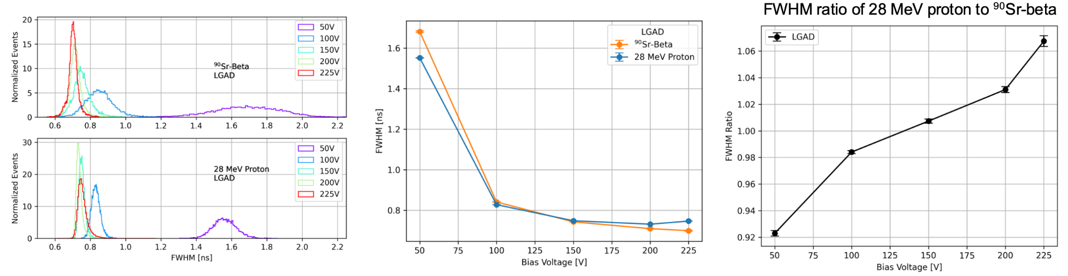
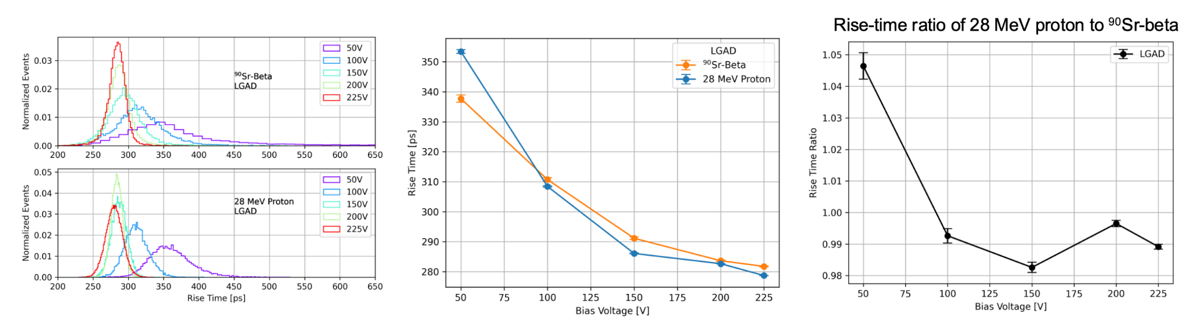
Response to different beams – MIPs / non-MIPS
Signal Properties in LGAD with 28-MeV protons vs ⁹⁰Sr betas
Broader & Slower pulses at low V_{bias}; Narrower & Faster at higher V_{bias} for both types of beams
For V_{bias} >100V, the FWHM is stable for both beam types.
The ratio of FWHM & Rise-time of 28 MeV protons to betas is ~ 1
FWHM
Rise-time

Slide 15
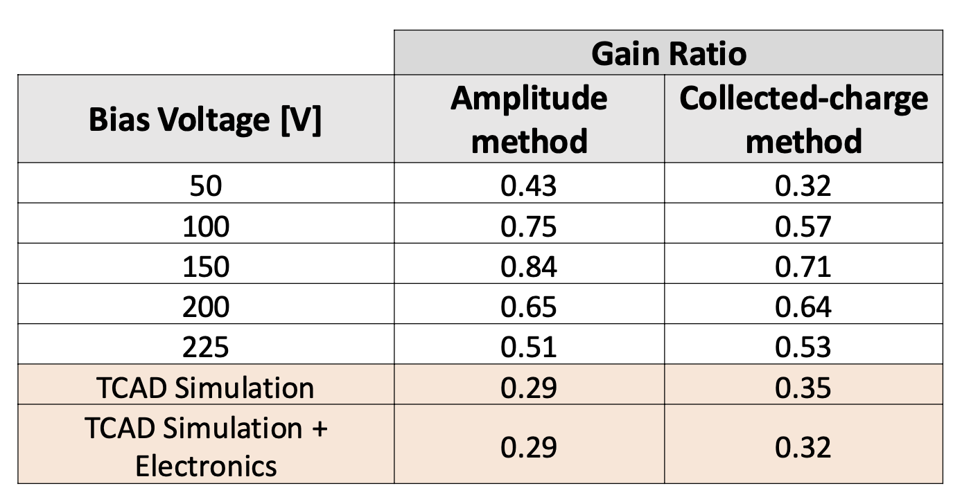
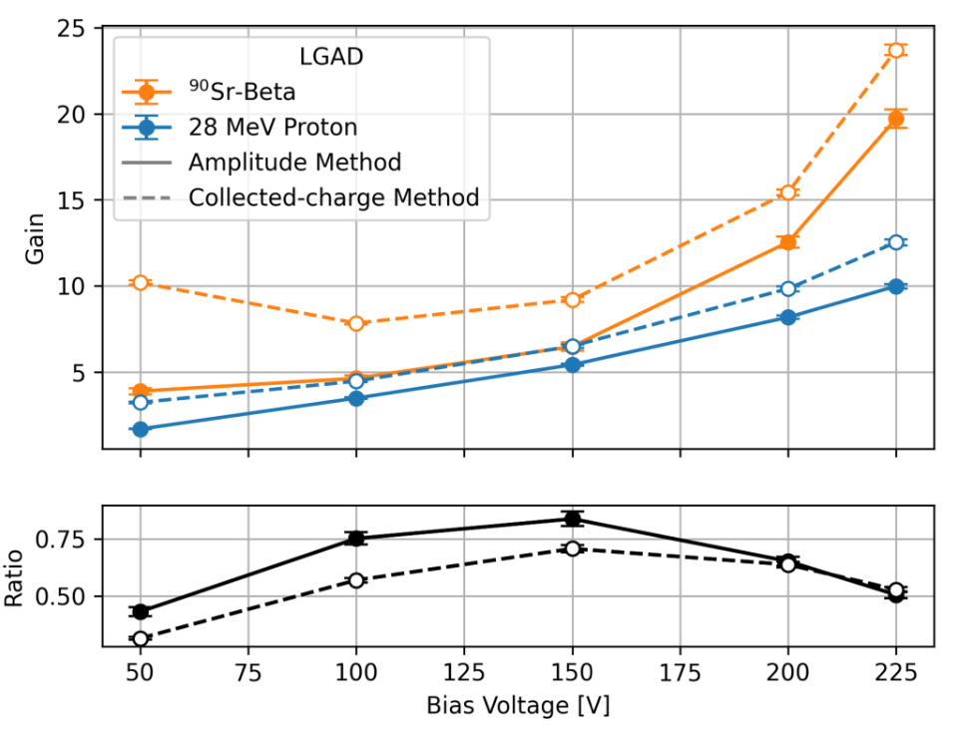
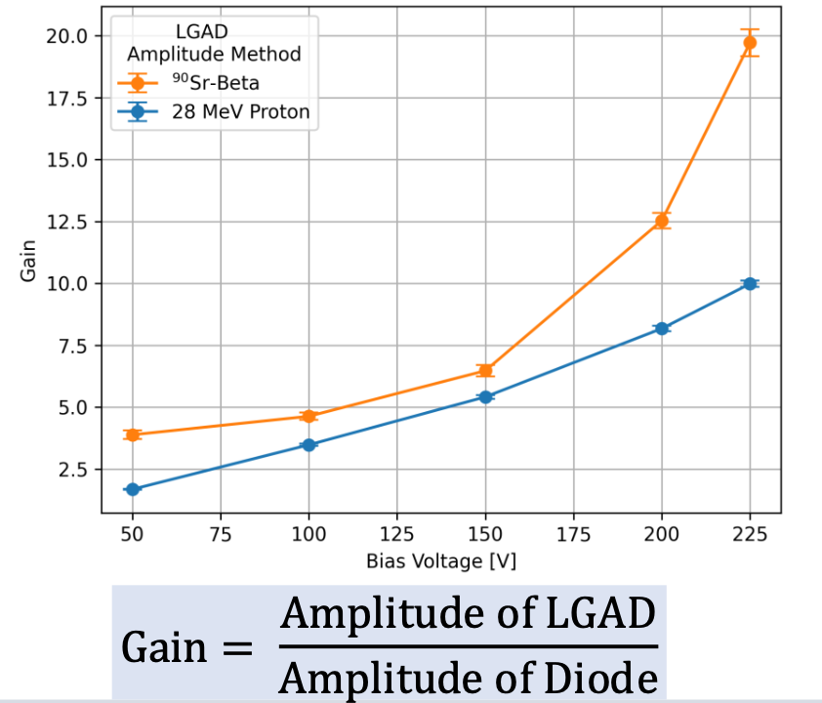
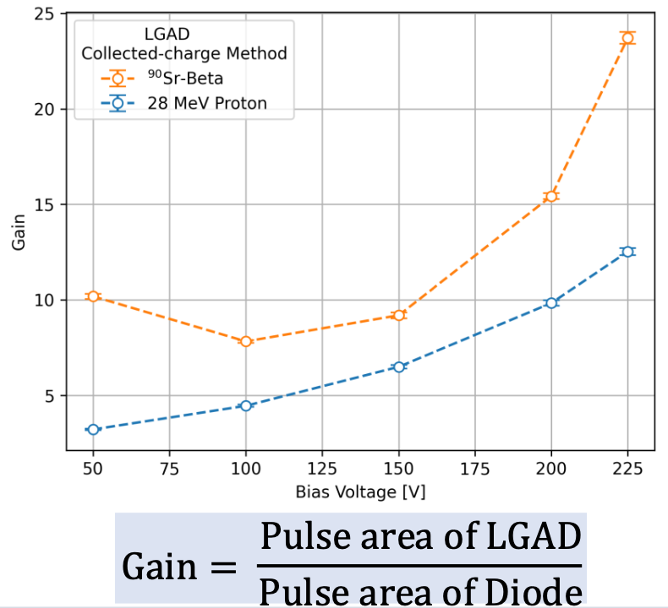
Response to different beams – MIPs / non-MIPS
LGAD Gains
Gain = ratio between MPVs of LGAD and Diode Amplitudes (Areas).
Gain increases with increasing V_{bias} for both beam types and for both gain methods.
Gain of LGAD with ⁹⁰Sr-Beta (MIPs) is higher compared to 28 MeV Protons (non-MIPs)
        ➔ Gain Suppression
        ➔ Confirmed qualitatively in TCAD Simulation

Slide 16
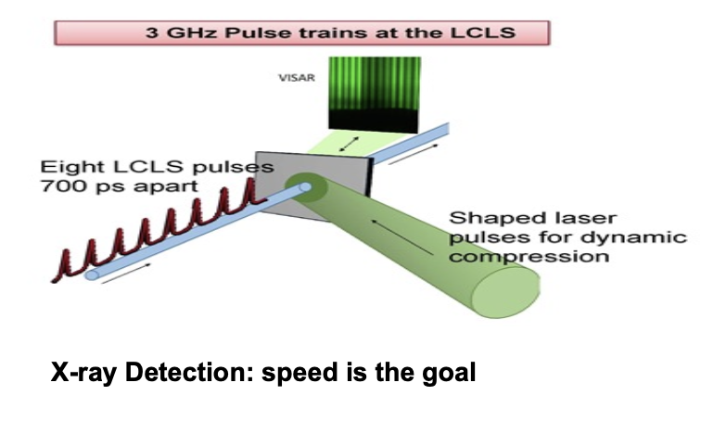
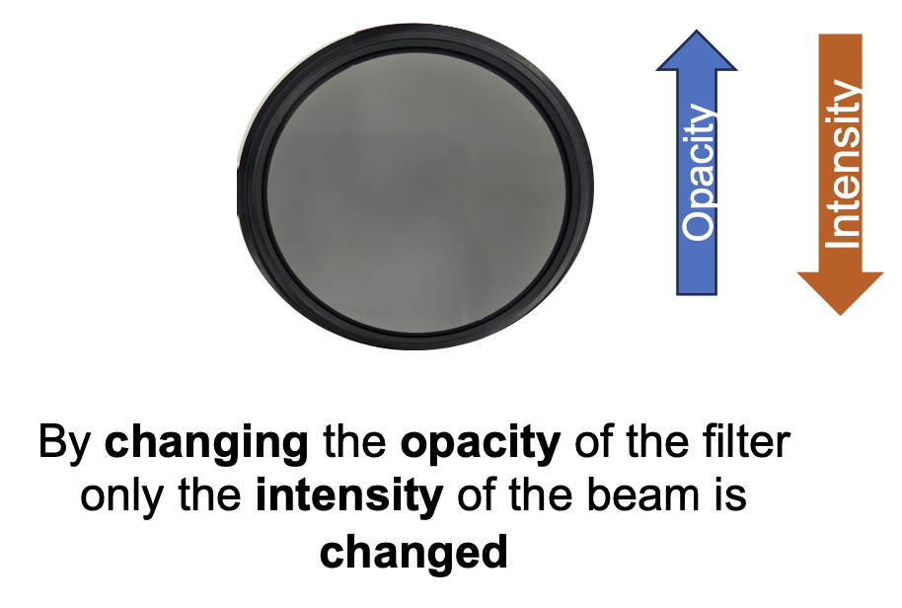
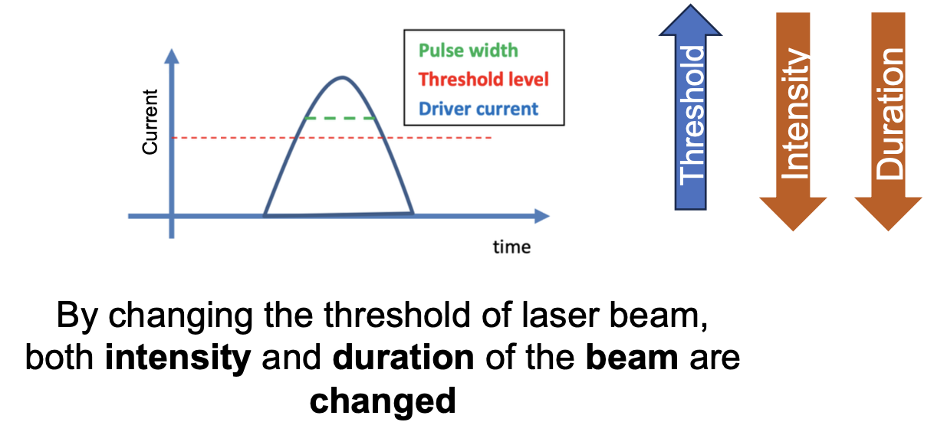
Response to different beams – MIPs / non-MIPS
LGAD Response to IR Laser
IR Laser is often used to emulate MIP signal on silicon devices ➔ how accurate is it?
    - High laser intensity and long laser pulses will divert from a MIP
High Repetition Rate experiments:
  - Sub-ns timing allows to study fast evolving samples
    - Light-sources may have high repetition rates, sub-ns
Change Beam Intensity
Add Filters with different Opacities

Slide 17
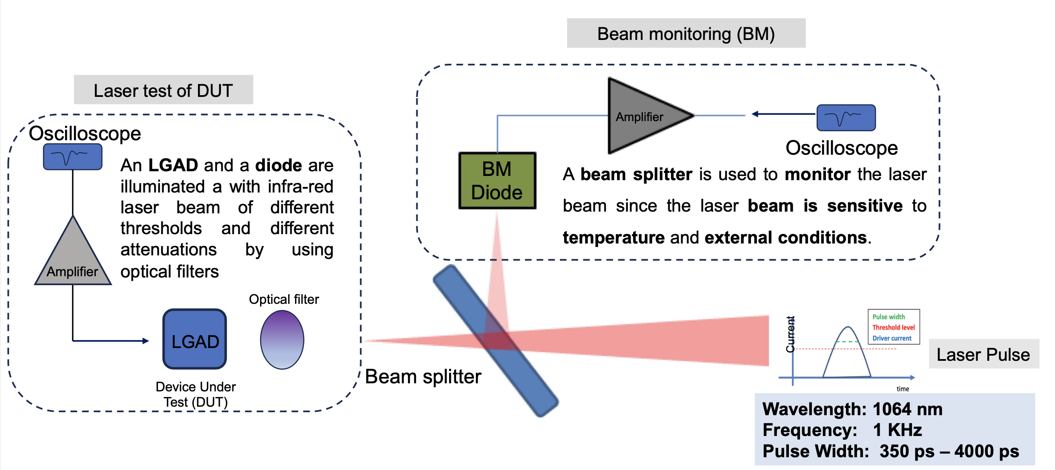
Response to different beams – MIPs / non-MIPS
LGAD Response to IR Laser

Slide 18
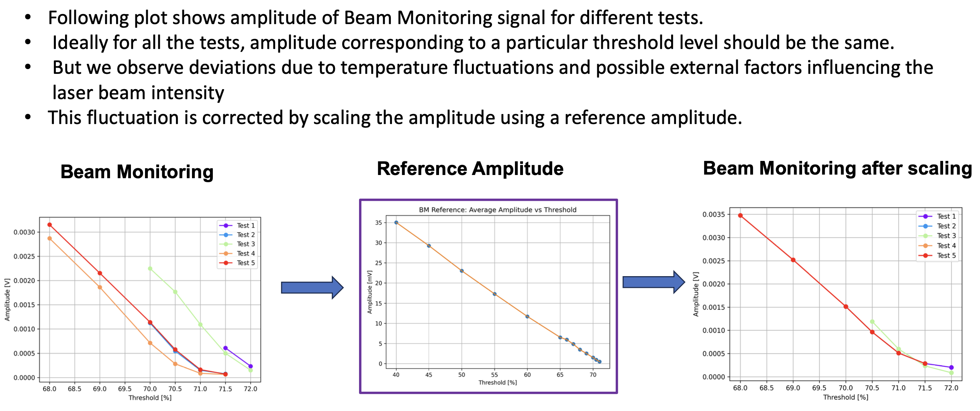
Response to different beams – MIPs / non-MIPS
LGAD Response to IR Laser - Calibration with Beam Monitoring
Laser Calibration with Beam Monitoring
Scale factors are applied in an event-by-event basis to the DUT pulse

Slide 19
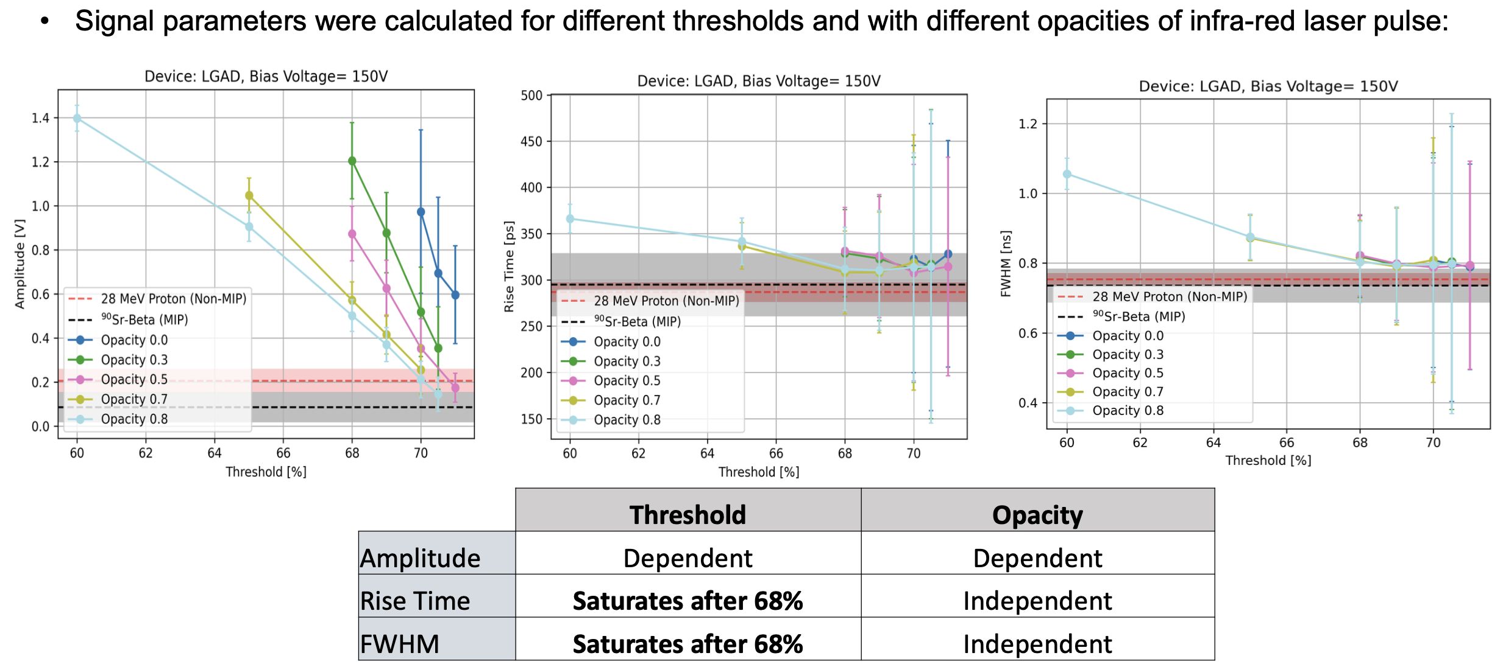
Response to different beams – MIPs / non-MIPS
LGAD Response to IR Laser

Slide 20
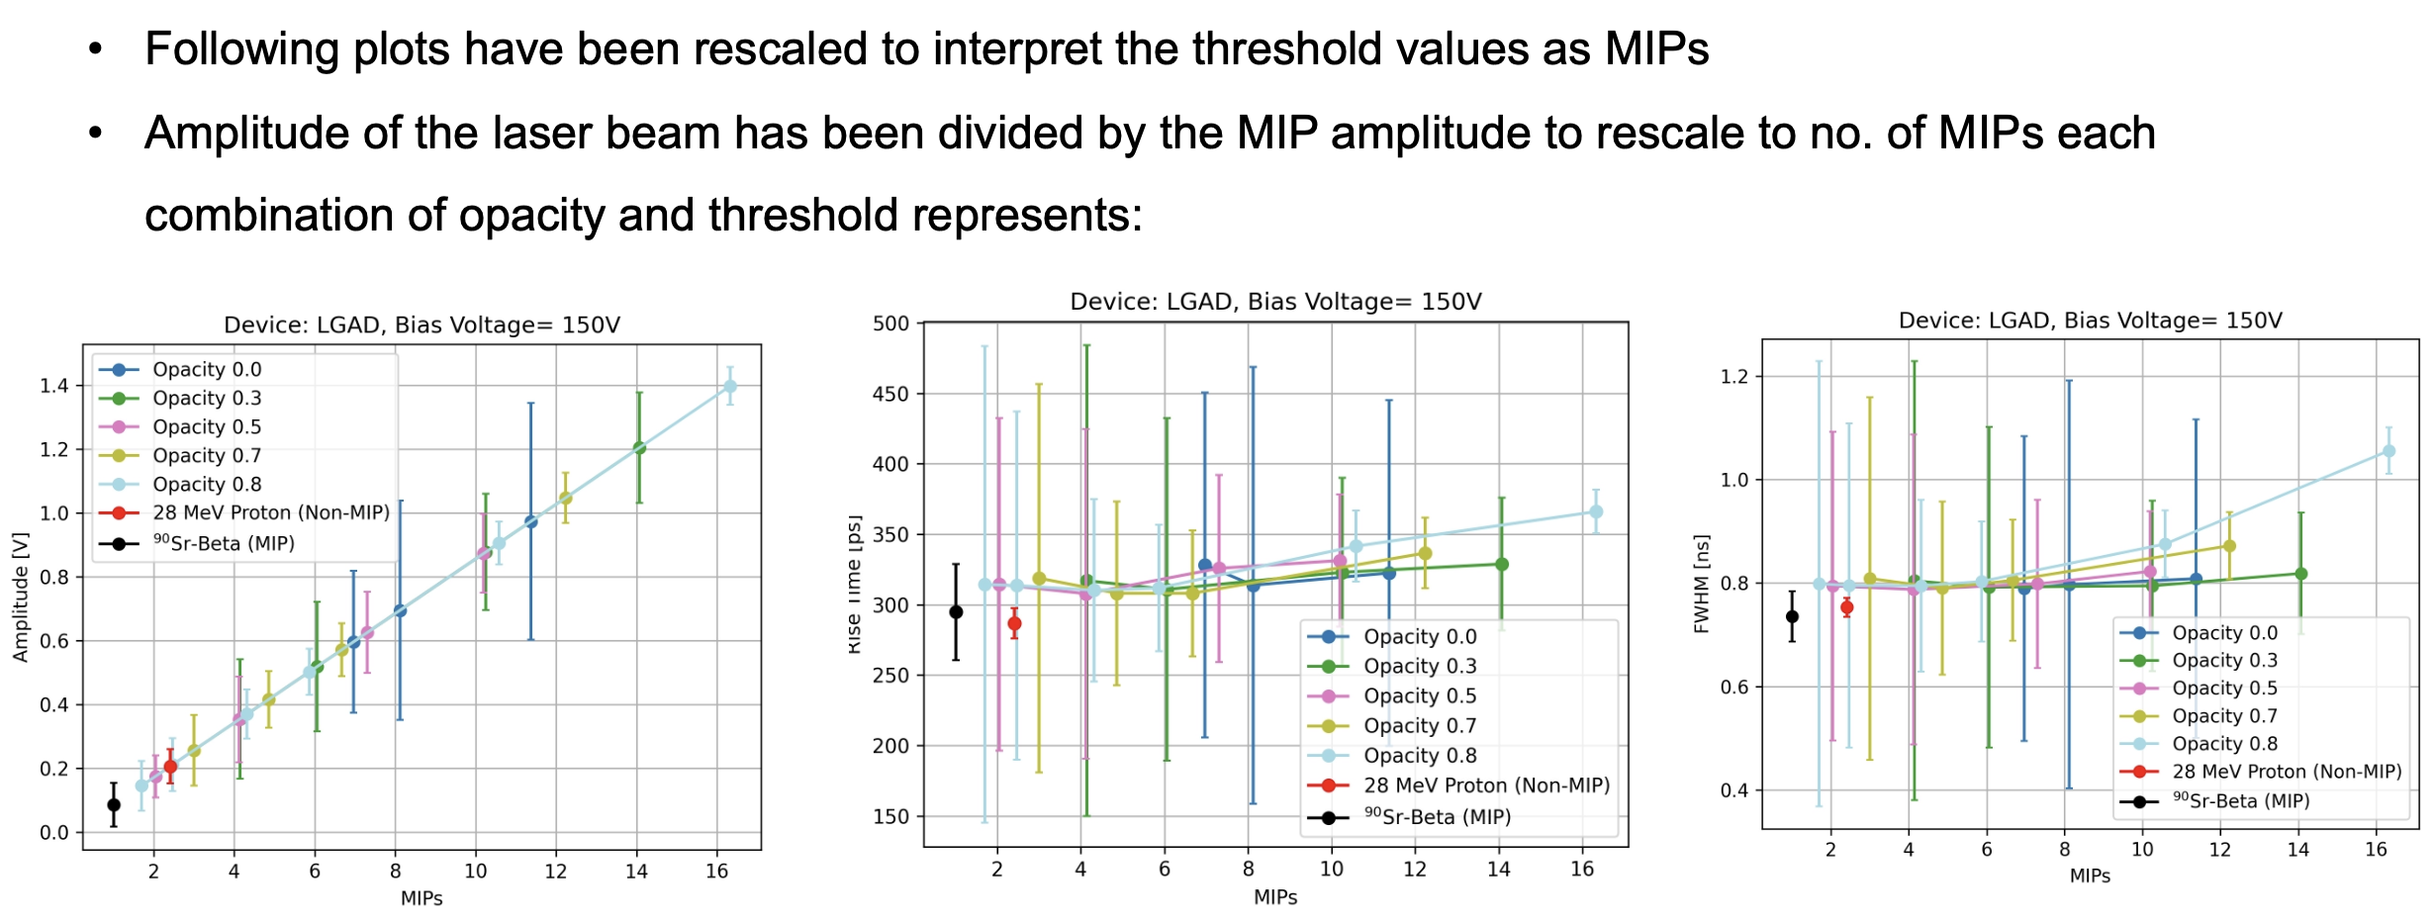
Response to different beams – MIPs / non-MIPS
LGAD Response to IR Laser, MIP and non-MIP
Good agreement between Laser, MIP and non-MIP data

Slide 21
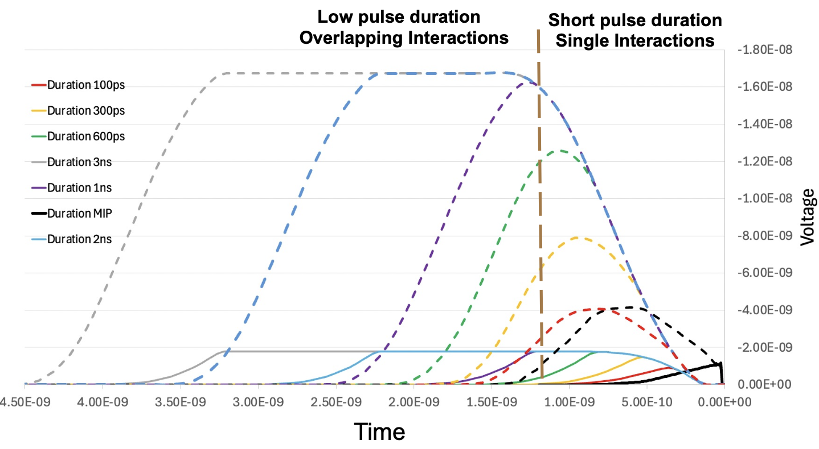
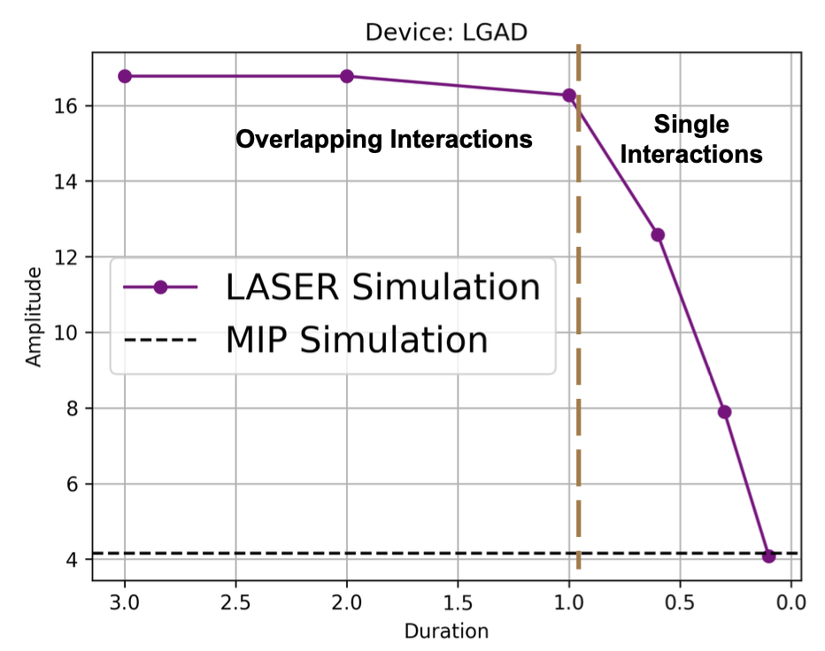
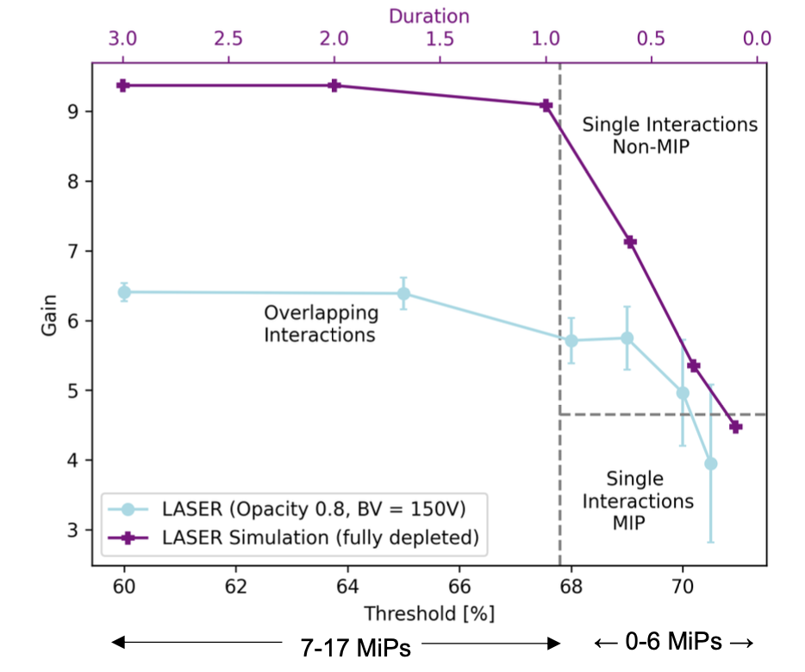
Response to different beams – MIPs / non-MIPS
LGAD Response to IR Laser - Laser Duration Simulation
TCAD was used to simulate fully depleted LGAD signals for different threshold levels of laser pulse.
Two distinct interaction regions can be demarcated:
  a) Overlapping Interaction
  b) Single Interaction
LGAD
Diode
High Threshold (>68%)
à Single Interactions
Low Threshold (<68%)
à Overlapping Interactions

Slide 22
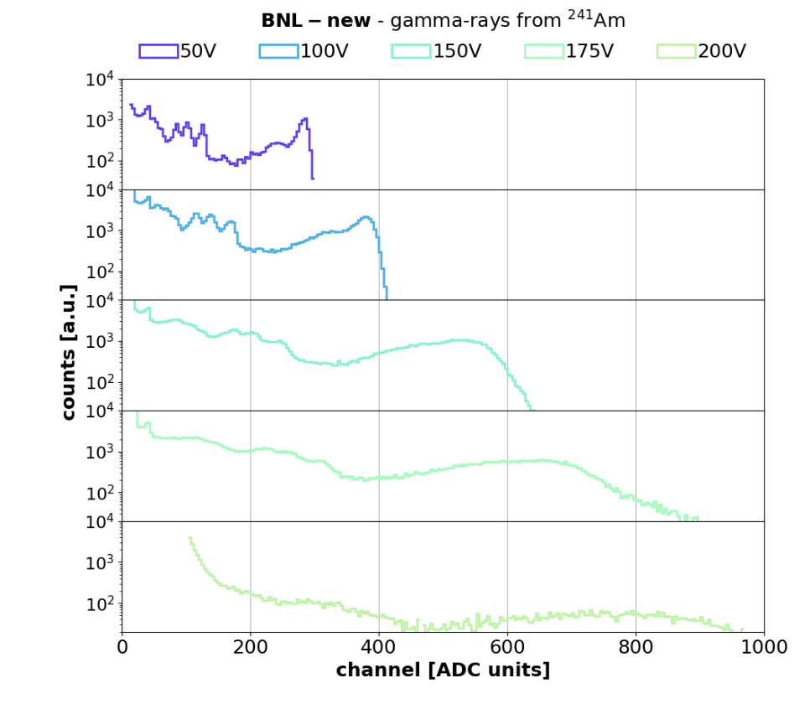
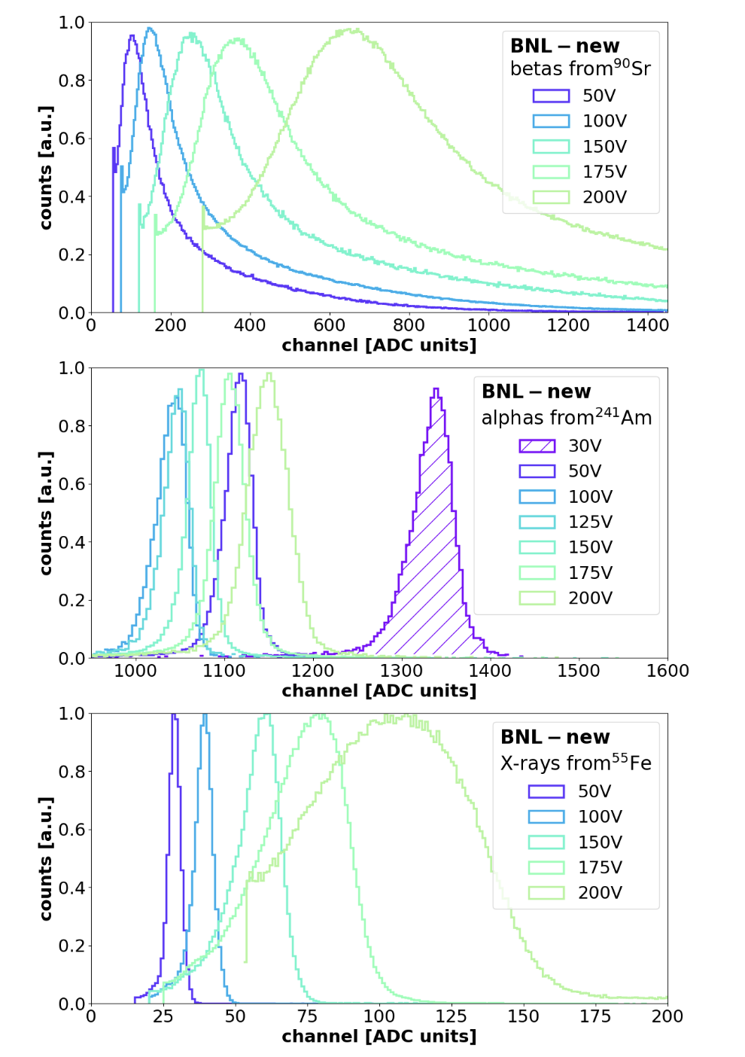
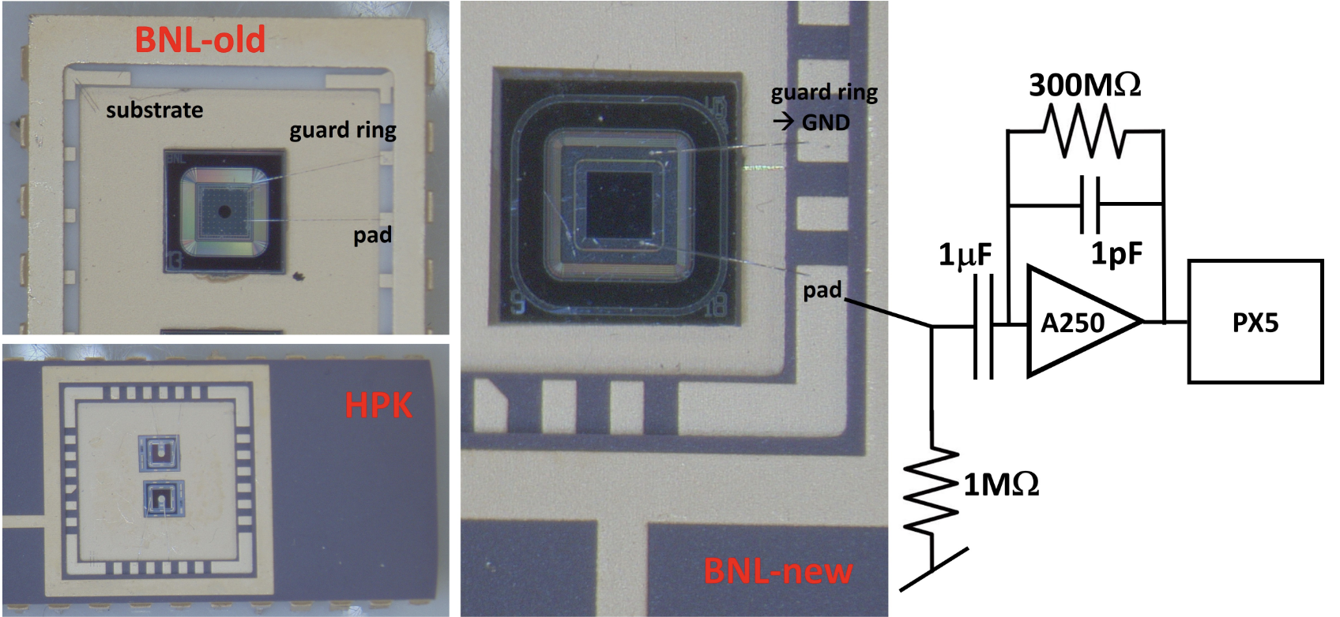
Response to different beams – X-rays, γ, α
Four different beams of particles from different radioactive sources:
    2.3 MeV Beta from ⁹⁰Sr
    5.9 keV X-rays from ⁵⁵Fe
    60 keV γ-rays from ²⁴¹Am
    5.46 MeV α from ²⁴¹Am
Measurements with
Low-noise Amptek CSA amplifier + PIX5
BNL New LGAD 50 μm thick, 2x2 mm² (2021)
BNL Old LGAD 50 μm thick, 1.3x1.3 mm² (2021)
HPK LGAD 35 μm thick, 1.3x1.3 mm²
arXiv:2402.04132

Slide 23
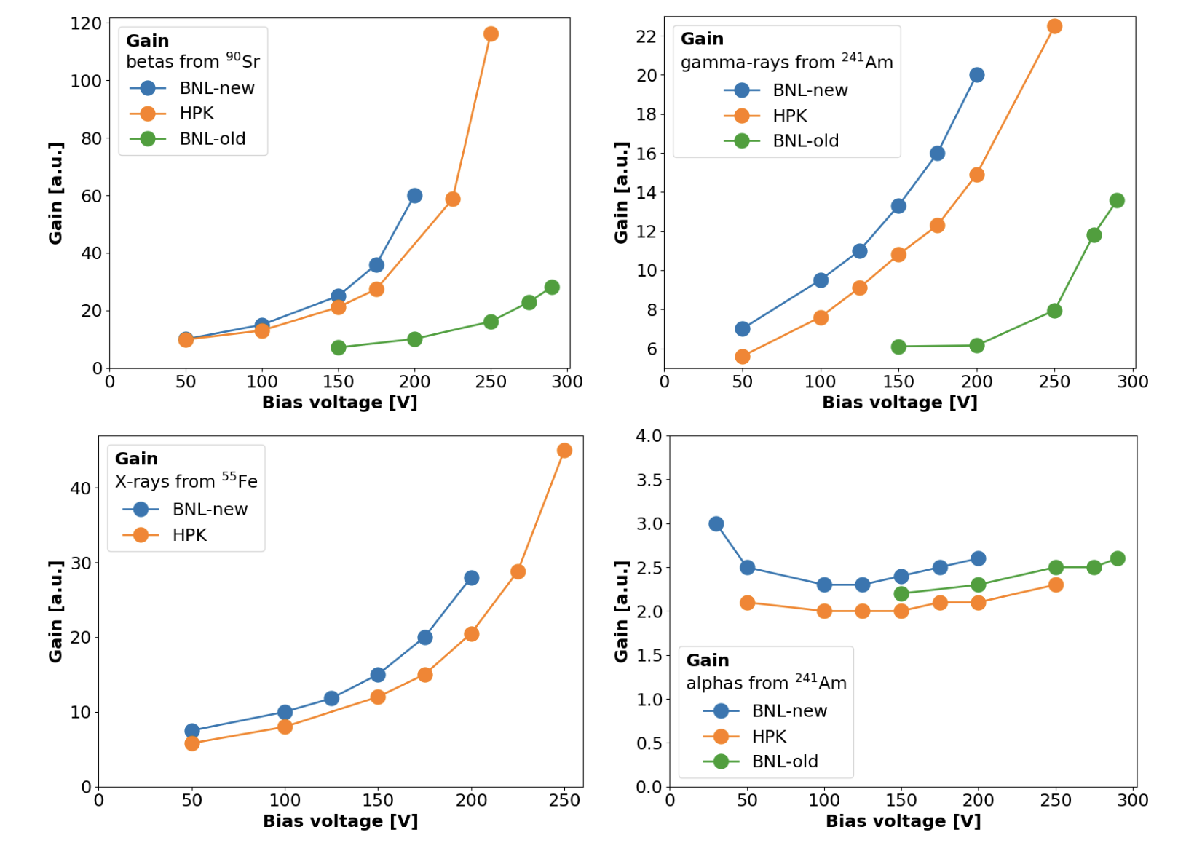
Response to different beams – X-rays, γ, α
Large difference b/w LGADs with beta is due to different gain depths
→ HPK has deepest gain layer
Largest gain with betas from ⁹⁰Sr
The lowest gain with alphas
  For alphas and X- or gamma-rays, inner carriers in the charge cloud are shielded from the external electric field by the outermost charges, which furthermore lowers the local magnitude of the electric field
  Electrons experience a limited multiplication
Non-monotonic trend with alpha is due to diffusion at low electric field
(self-screening effect is mitigated
by diffusion at low V_{bias})

Slide 24
Response to different beams
Gain suppression seen in highly-ionizing particles (28-MeV p) wrt MIP
IR Laser beam needs attenuation (High Threshold and > 0.8 Opacity Filter) to emulate a MIP
Amplitudes and Gain increase if the particle flux is sufficiently intense to cause overlapping particle interactions in silicon
28 MeV proton gain and 90Sr-beta gain correspond to single interaction region
LGAD amplitudes and gain depend on the particle beam and the interacting conditions
Simulation qualitatively agrees with data
X-rays, γ-rays and α show gain suppression wrt MIPs (i.e. beta from 90Sr):
  - Lowest gain for alpha
  - Diffusion of charge carriers plays a role at low electric fields
  Depth of gain layer is important: the deeper, the higher the gain

Slide 25
Backup Slides

Slide 26
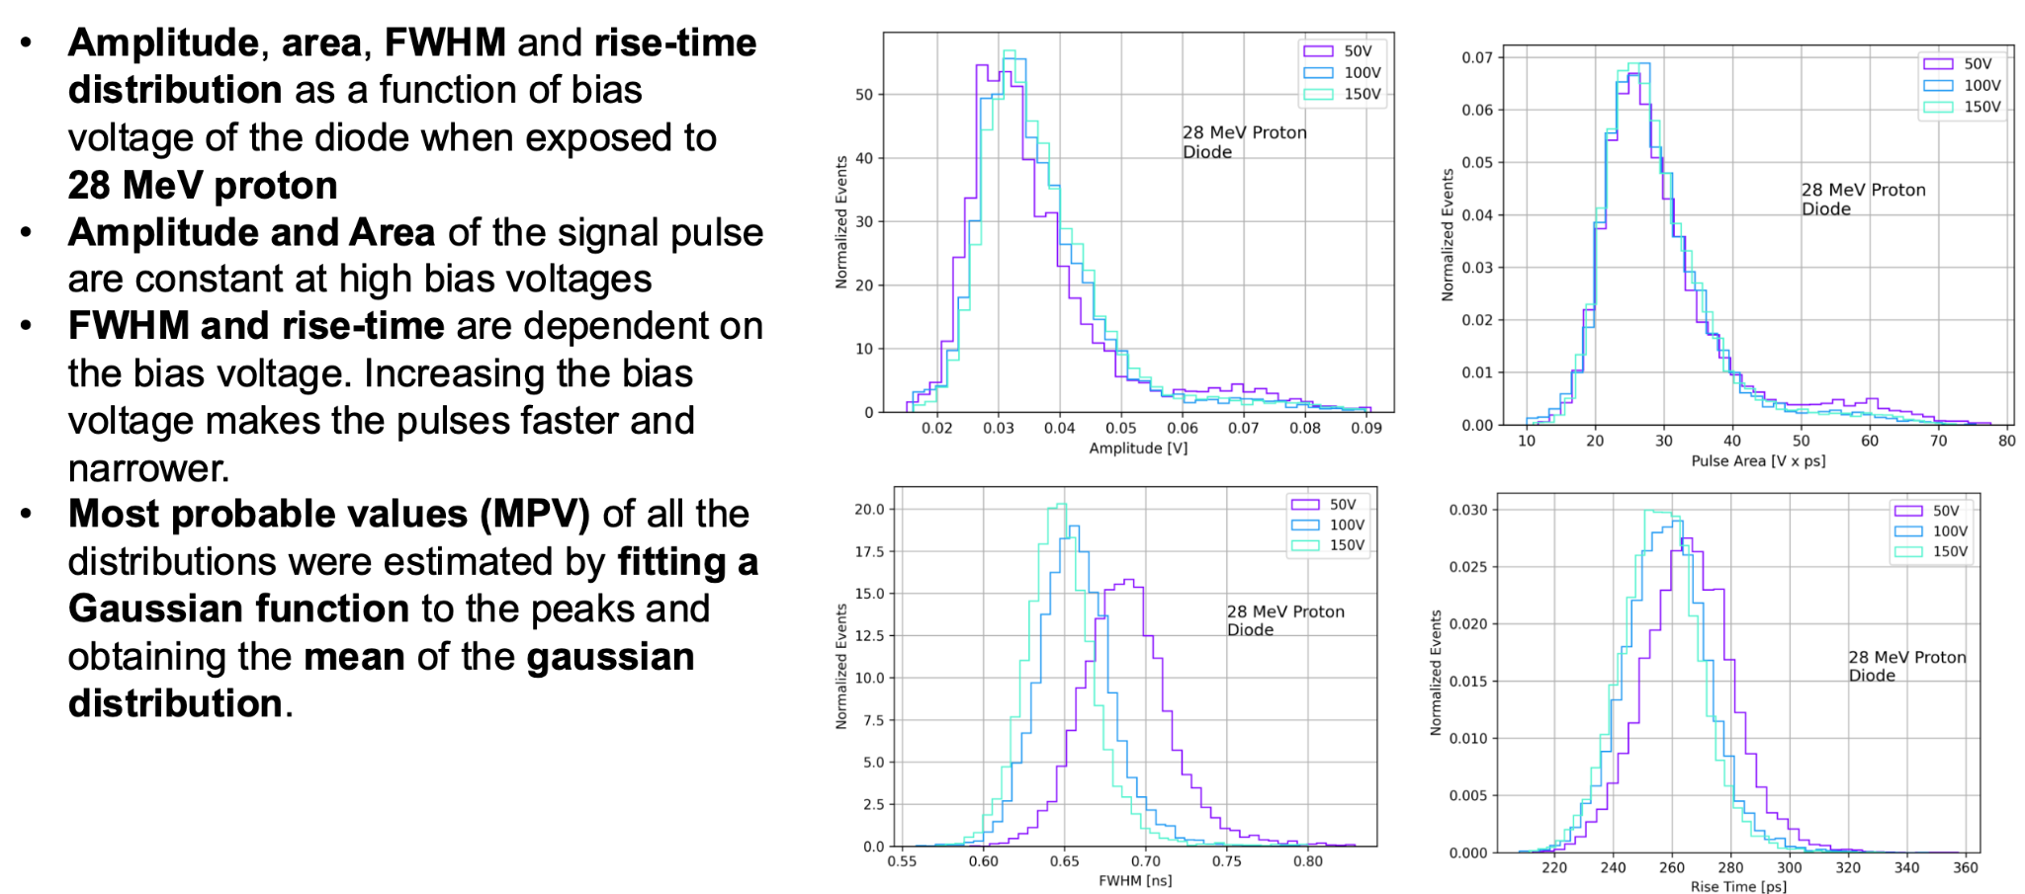
Response to different beams – MIPs / non-MIPS
Signal Properties in Diodes with 28-MeV protons

