Slide 1
On-going and planned fabrication at BNL
Gabriele Giacomini
February 24th 2025
US-Japan workshop for AC-LGAD and testbeam - FNAL

Slide 2

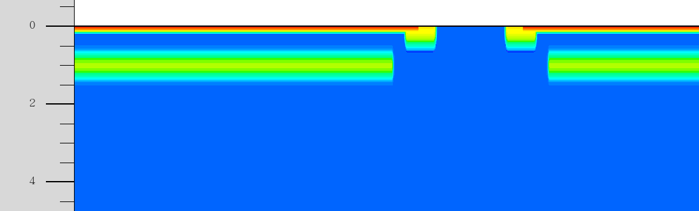
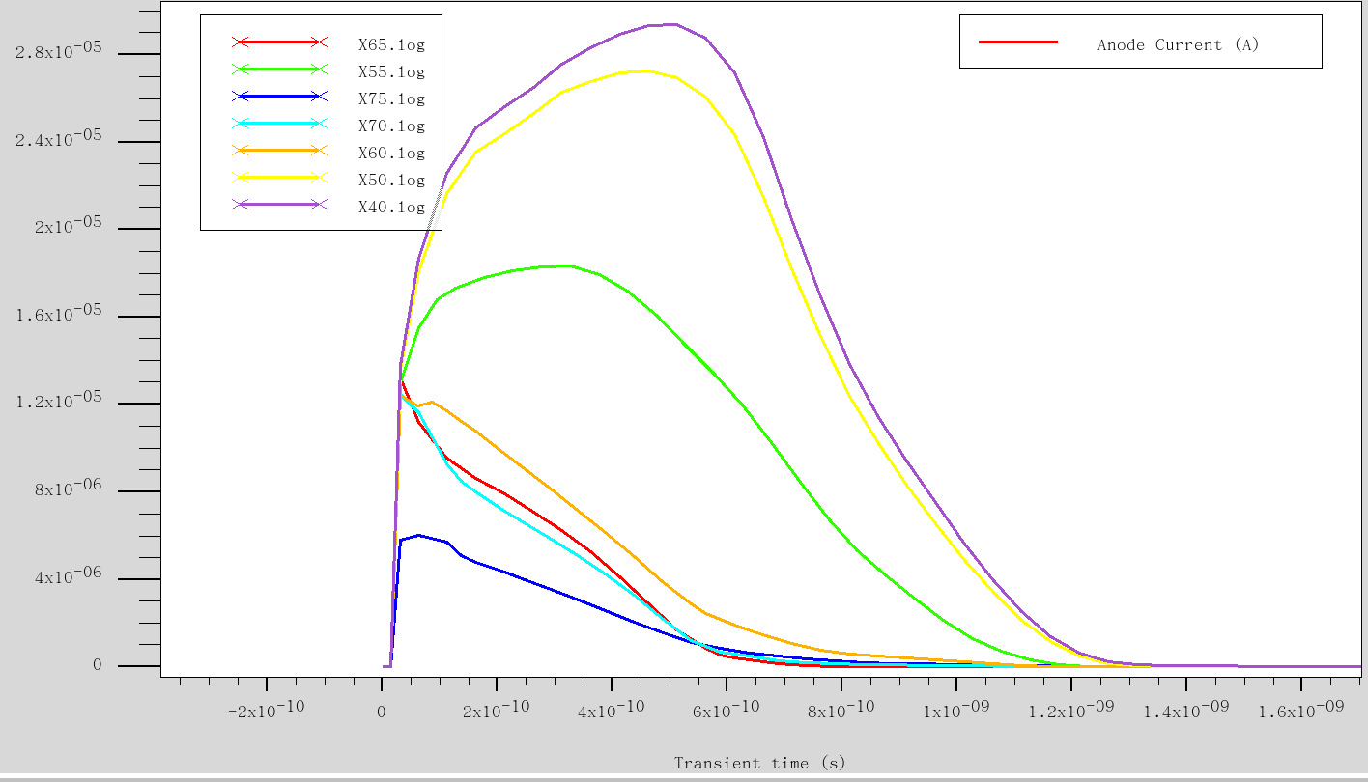
TCAD numerical simulations
Mip @ different X
Qualitatively assessment of LGAD/ACLGAD properties
Current pulses for different X
Switching to Victory, “legacy” package still available

Slide 3
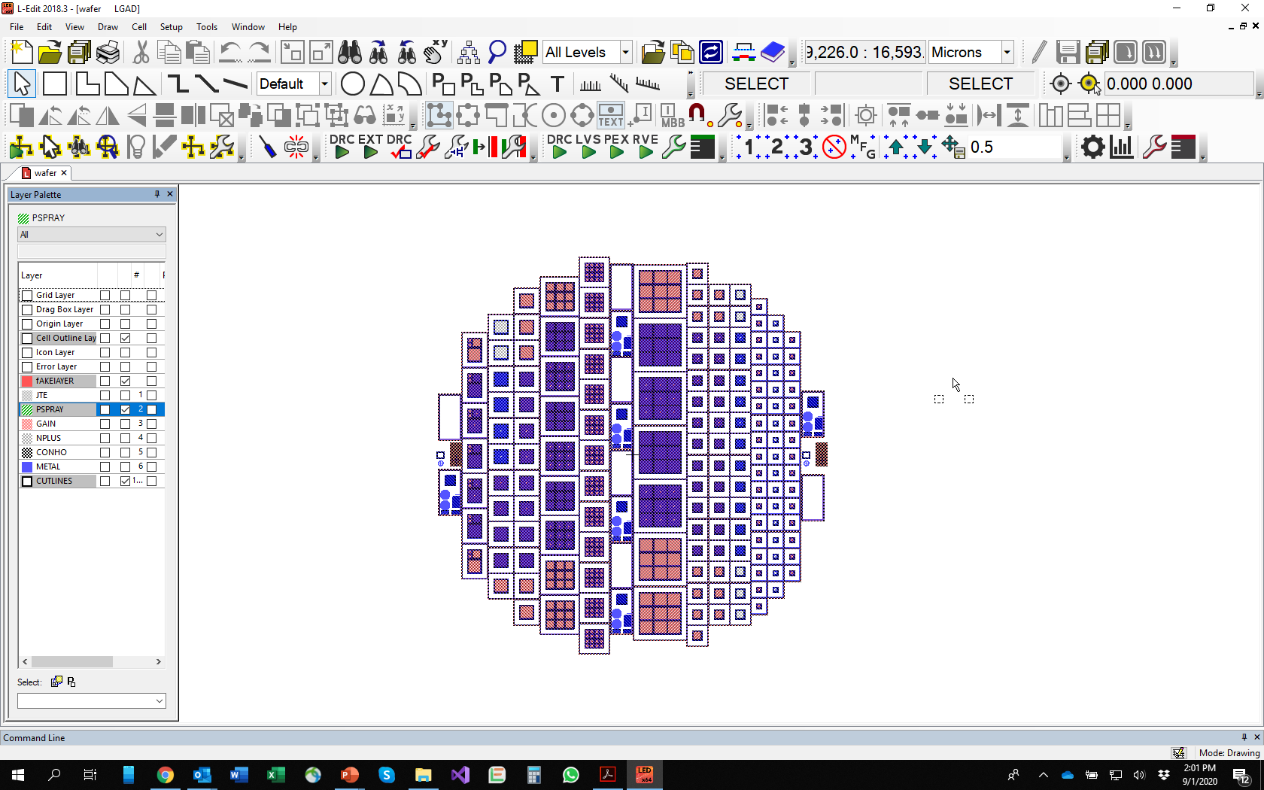
Layout Editor by L-Edit, photomasks fabrication by Photronics

Slide 4
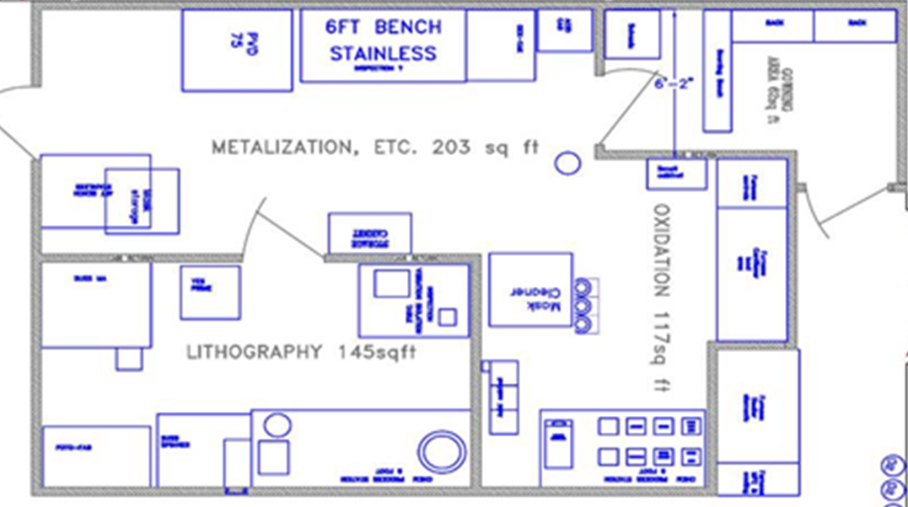
Class 100 Cleanroom ~ 500 sq ft
Dedicated to silicon (no transition metals)
corridor

Slide 5
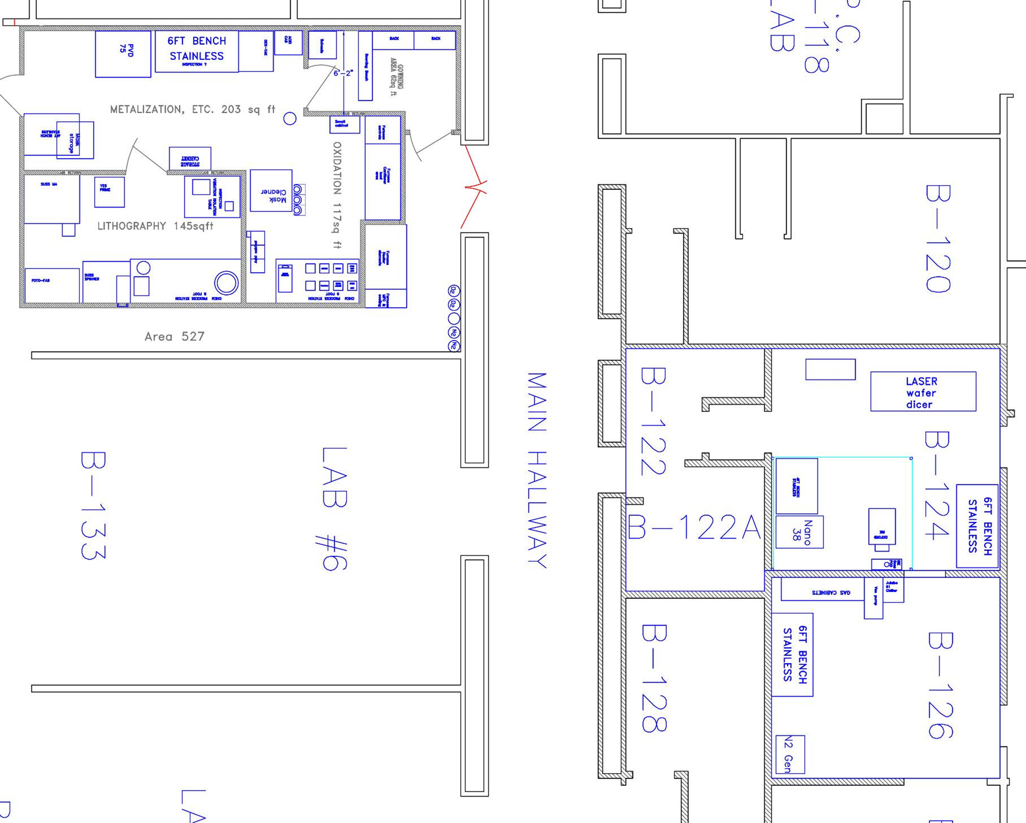
Other Facilities
PECVD Oxide & Si₃N_{4,} using another class1000 clean room @ BNL
External service for ion-implantation
Service at other facilities possible
Laser dicing
Dry etching
CMP

Slide 6
On-Going LGAD fabrication
All batches on 4” epi wafers, 20, 30, 50 μm thick
AC-LGAD strip for R&D EIC
  1 wafer with no gain for reference
  STD AC-LGAD strips
  RSD LGAD
  AC-LGAD with alumina as dielectric
Large-area single-channel AC-LGADs for calorimetry
  20, 30, 50 μm thick wafers
  380-keV vs 1-MeV gain implant
  300 μm thick diodes for reference
Trench-LGAD
  Optimization of LGAD/diode periphery
“Simplified” LGAD
  Gain buried by wafer-bonded wafer
Lower Gain AD for Pioneer
  Thick FZ n-type (!!) wafers

Slide 7
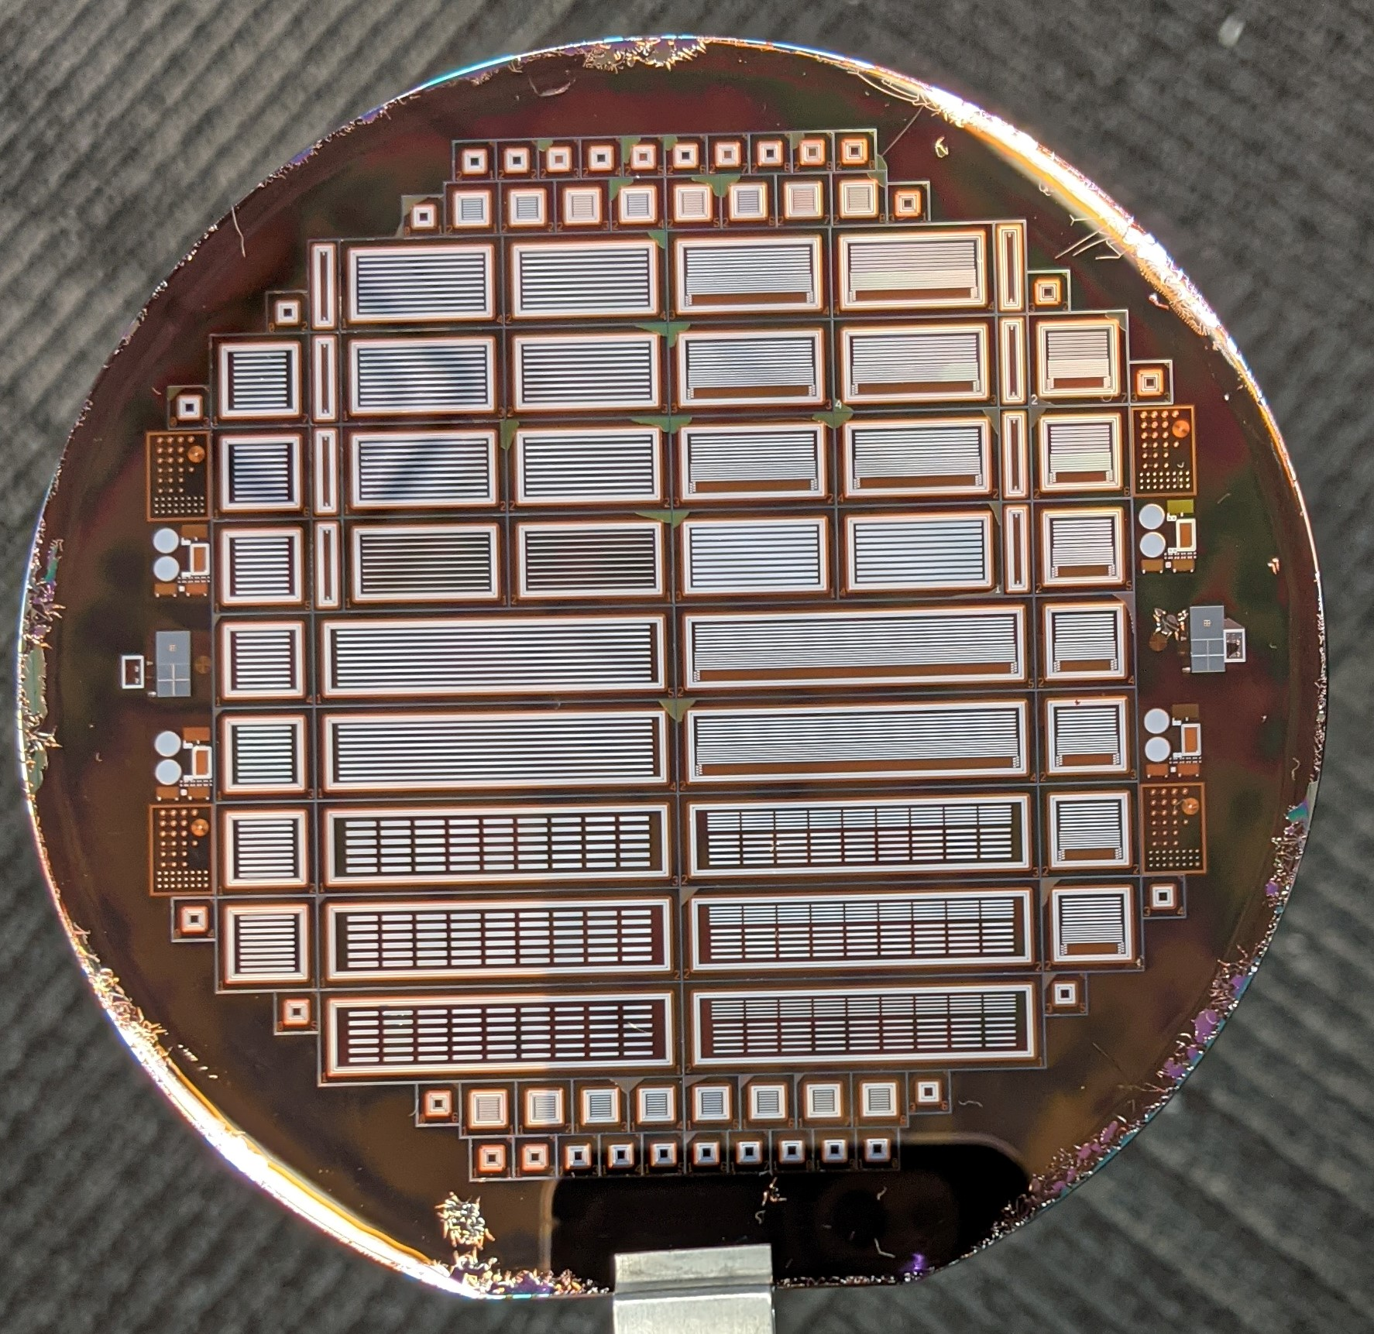
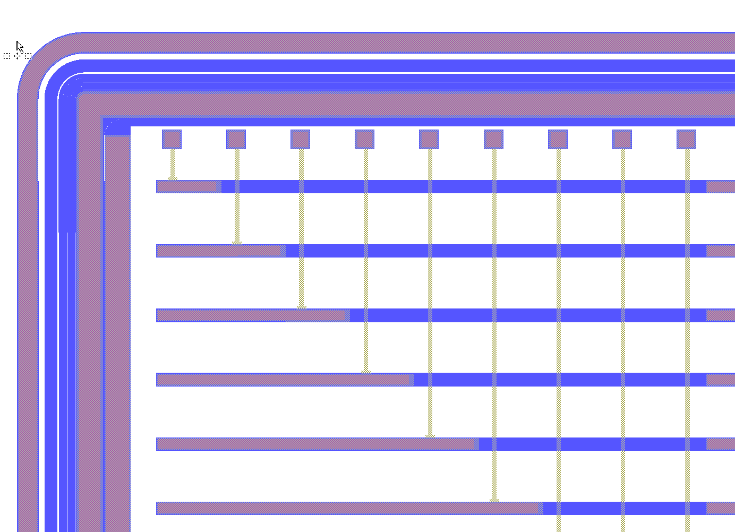
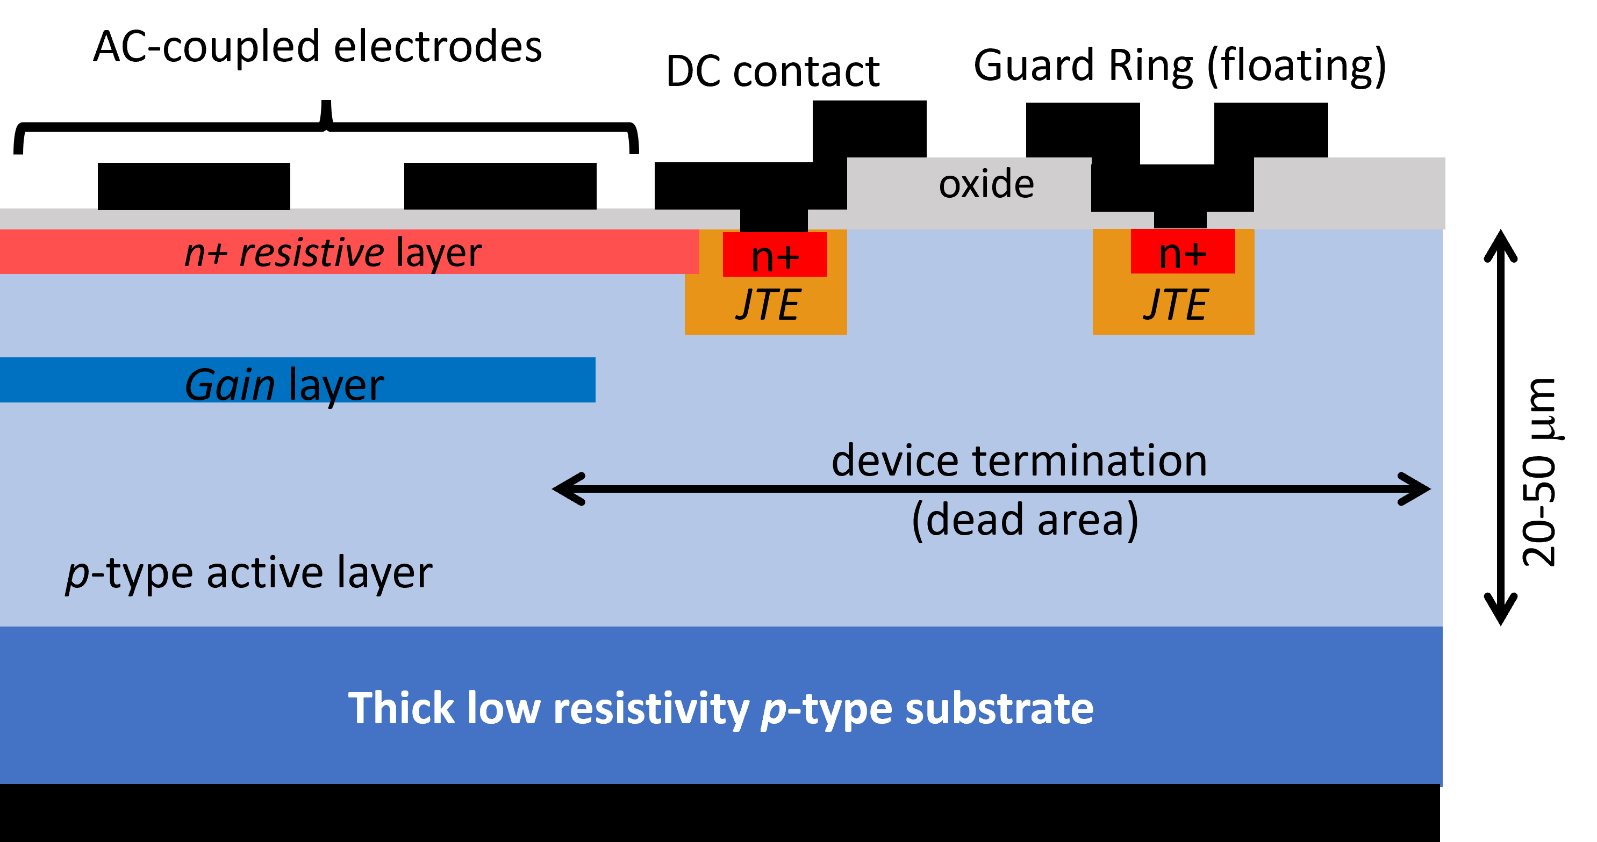
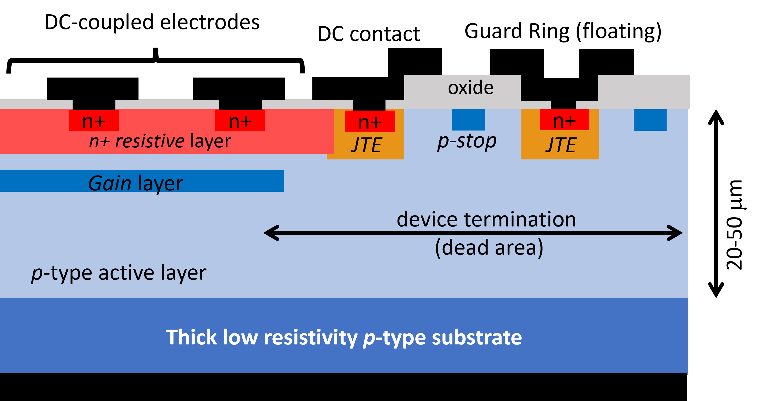
AC-LGAD strip for R&D EIC
(on-going)
Using some of the old masks: (JTE, n-resistive layer, [p-spray when required])
and adding p-plus at the border – which may change in the future
And re-designing: contacts, metal, passivation
1 MeV implant
1 wafer with no gain for reference
STD AC-LGAD strips
RSD LGAD
AC-LGAD with alumina as dielectric
Double metal to move the bonding pads on the long edge
AC-LGAD vs RSD: additional n+, new contacts, deeper n-res
AC-LGAD
RSD

Slide 8
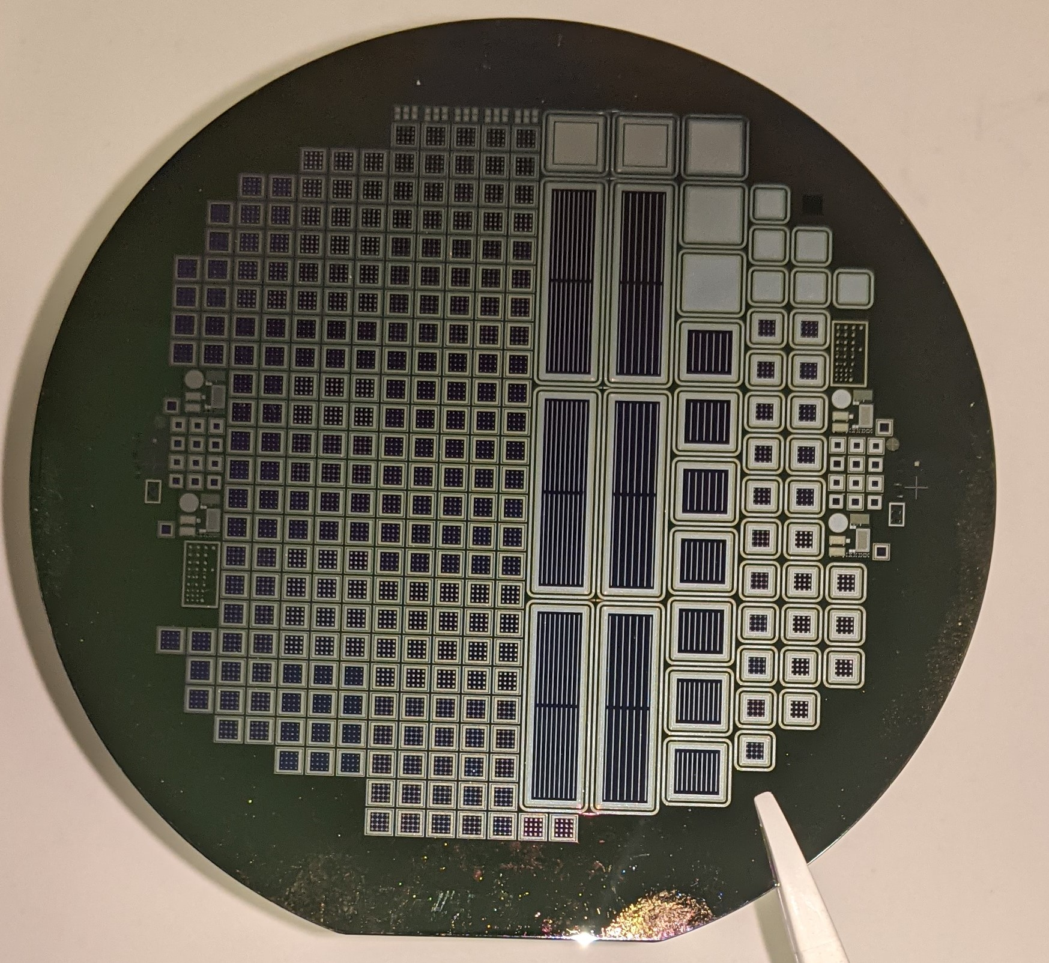
(on-going)
AC-LGAD pixel for R&D EIC
In parallel to AC-LGAD strip
1 wafer of EICROC pixels/strips

Slide 9
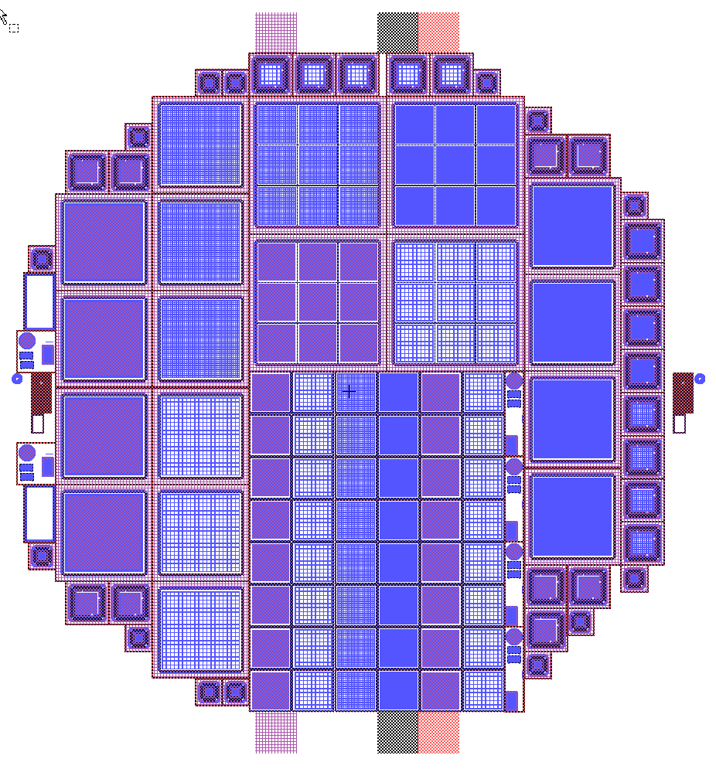
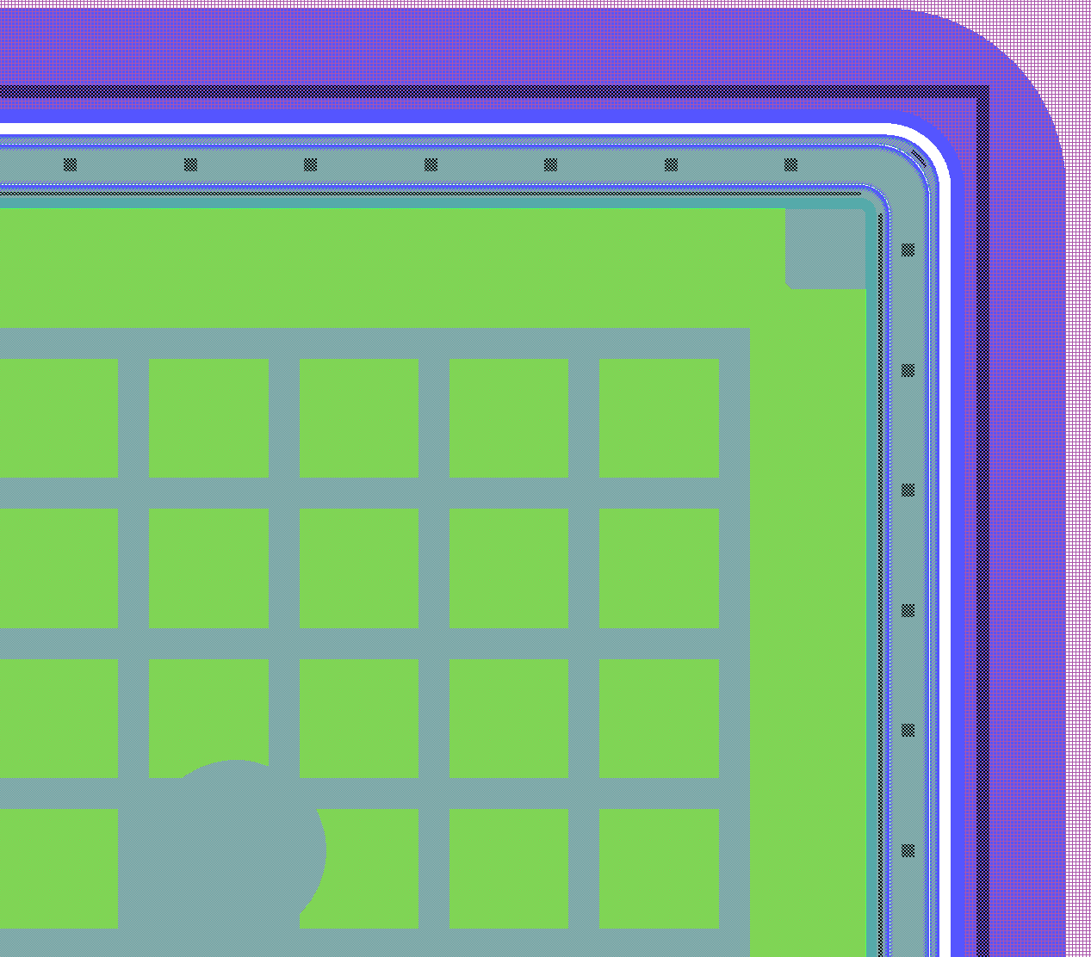
(on-going)
Large-area single-channel AC-LGADs for calorimetry
  20, 30, 50 μm thick wafers
  380-keV vs 1-MeV gain implant
  300 μm thick diodes for reference
P+ termination
AC metal grid

Slide 10
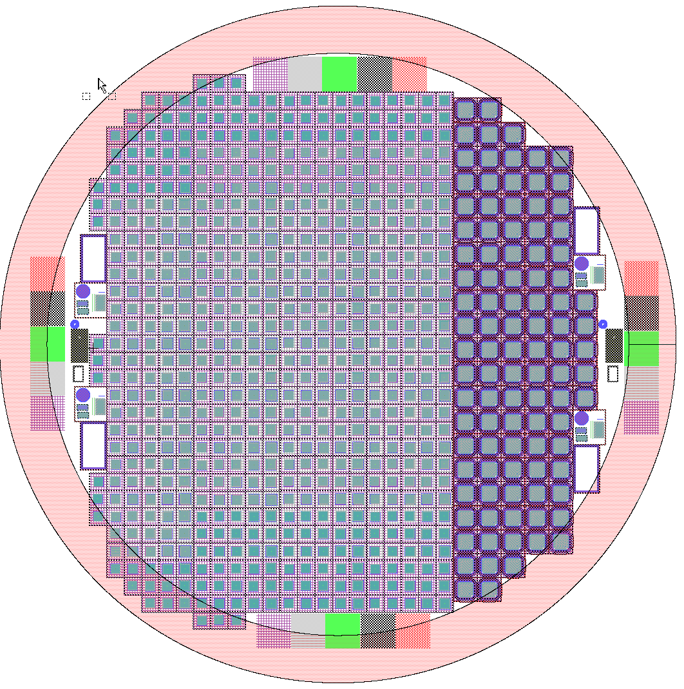
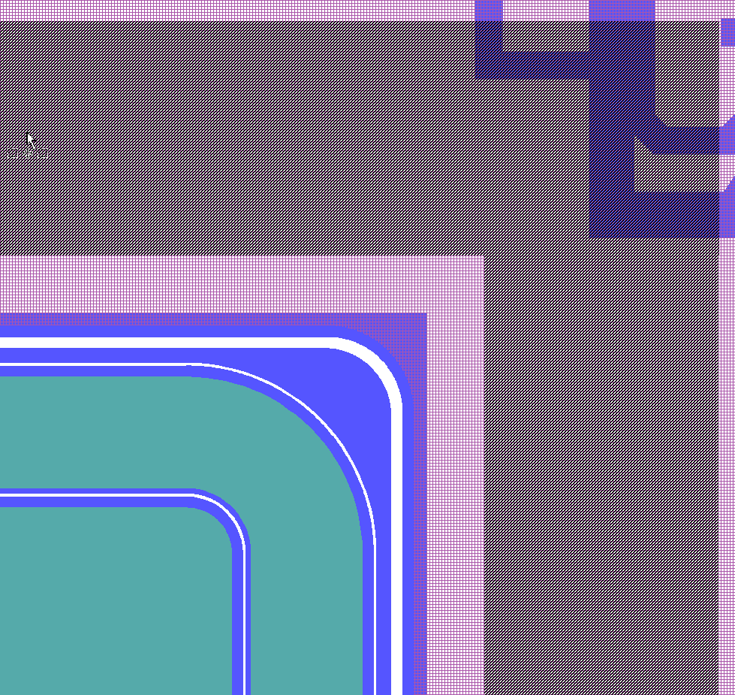
(on-going)
Trench-LGAD
Optimization of LGAD/diode periphery
Depletion region extends little in thin substrates;
Rule of thumb is: inactive border ~ 3x thickness ~ <200μm
New design, 1.3 mm x 1.3 mm single channel LGADs.
3 wafers with Diodes and 3 wafers with LGADs (1 MeV different doses to check the gain vs dose/bias)
N-type termination on one wafer to check functionality
(skipping the p-plus implant at the edge means one litho less, one implant less, less time and $$, higher yield)
trench
Different designs:
# of GRs
GND GR width
Distance GR p-plus
Distance trench-border
GR
pad

Slide 11
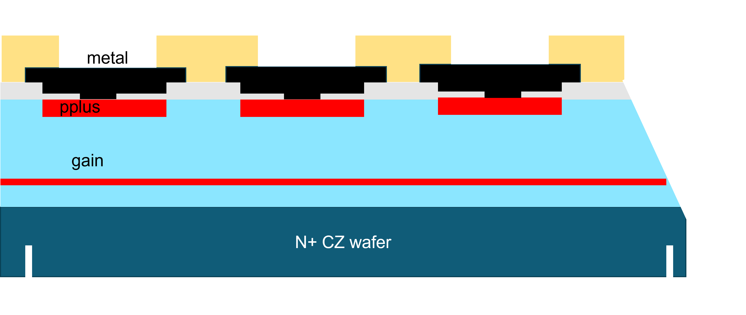
(on-going)
“Simplified” LGAD
  Gain buried by wafer-bonded wafer
Starting point n+ epitaxial wafer, ~ 3μm active thickness where gain layer is implanted.
Thick HR FZ wafer is wafer bonded on top, and then thinned down to ~ 50μm.
P-plus DC-electrodes follow, then trench
Wafer layout dedicated to the project, as usual several design splittings (where the gain ends, where the p+ ends…).
Problem in the first production, but wafer-bonding company kindly agreed to re-do them.
→ will go out for ion implantation as soon the PO is ready

Slide 12
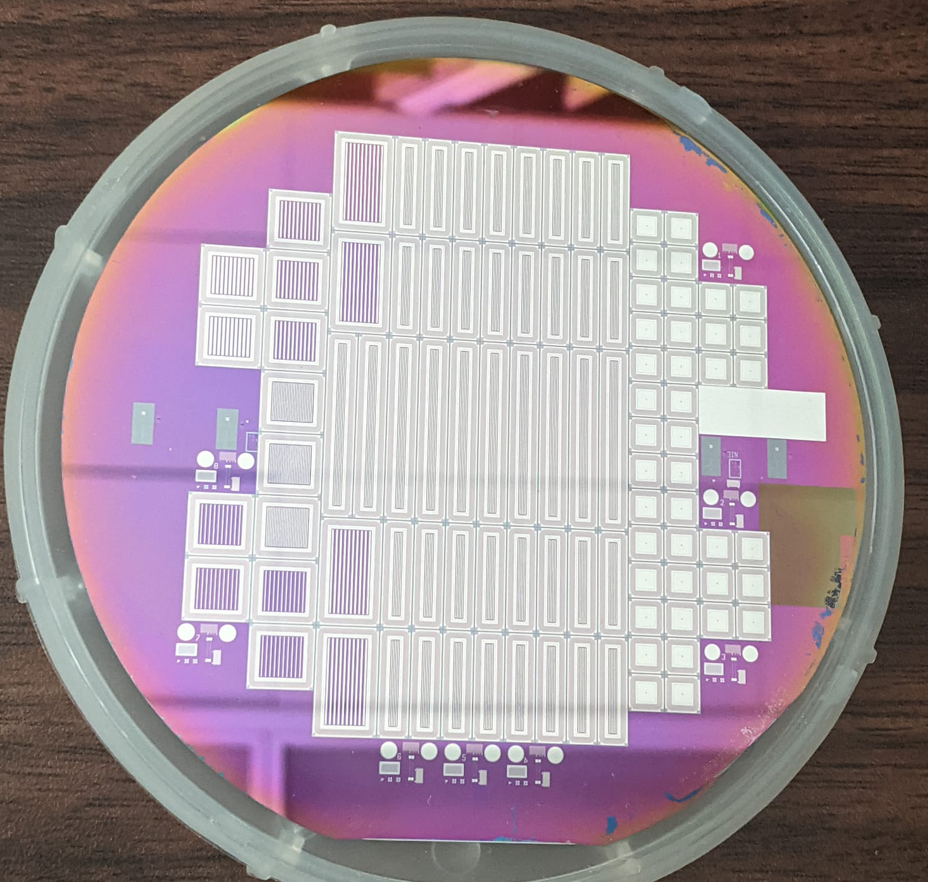
(completed)
L(er)GAD for Pioneer
  Thick FZ n-type (!!) wafers
Some applications require ultra low gain (~5)
  Measured a gain of ~ 10 for βs
FZ 200-μm thick wafer n-type!
AC-LGAD strip on front, DC strip on back
Diode
AC-LGAD

Slide 13
Planned LGAD fabrication
Dummy Monolithic AC-LGAD
  Passive device with ~CMOS wells
Large-Area AC-LGADs for TimePix
DC/AC LGAD with reduced thickness (8μm) for dosimetry
DC LGAD with 1.5 MeV gain implant
  Any benefit to go deeper?

