Slide 1
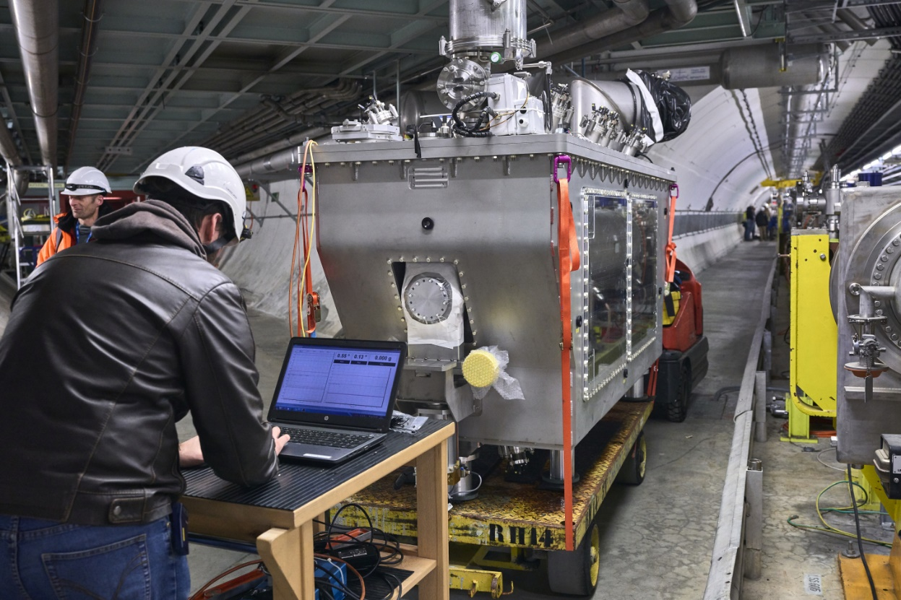
Optical Fibre Sensing
CRAB Cryomodule
Michael GUINCHARD on behalf of EN-MME-EDM
STFC Visit

Slide 2
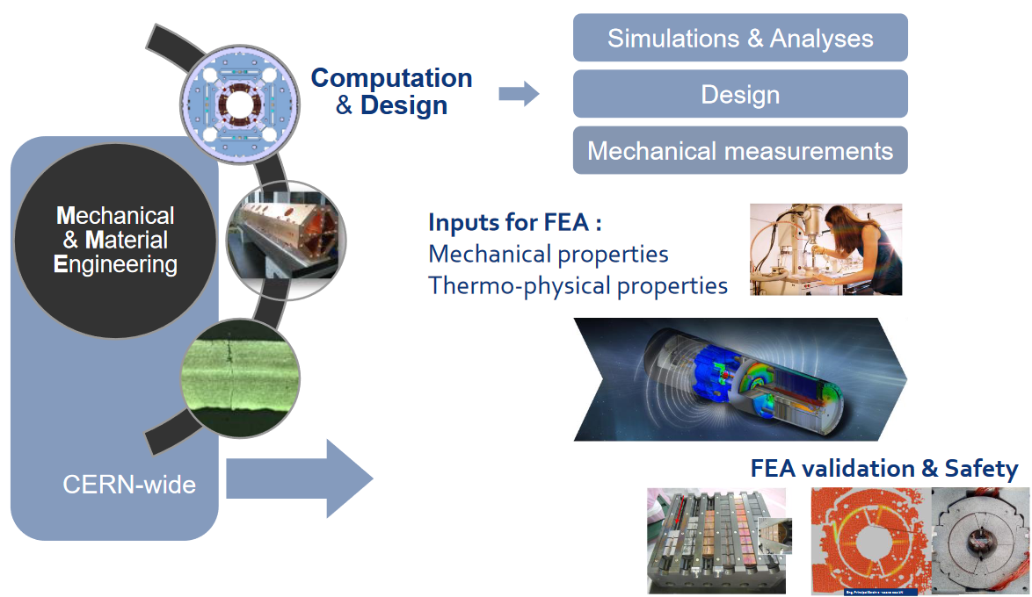

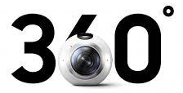




Introduction
  here

Slide 3
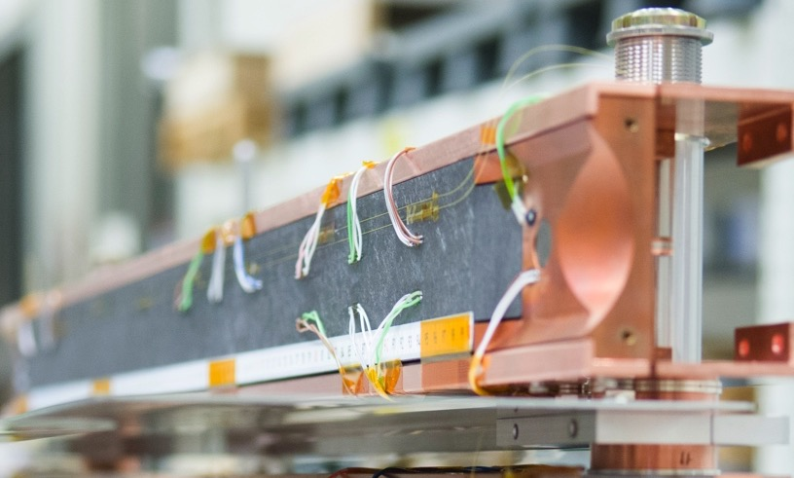
Introduction
Mechanical measurements are done on several types of components : superconducting magnets, dumps, RF cavity, detectors in different conditions as electro-magnetic field, vacuum, radiation, cryogenic, water, etc…

Slide 4
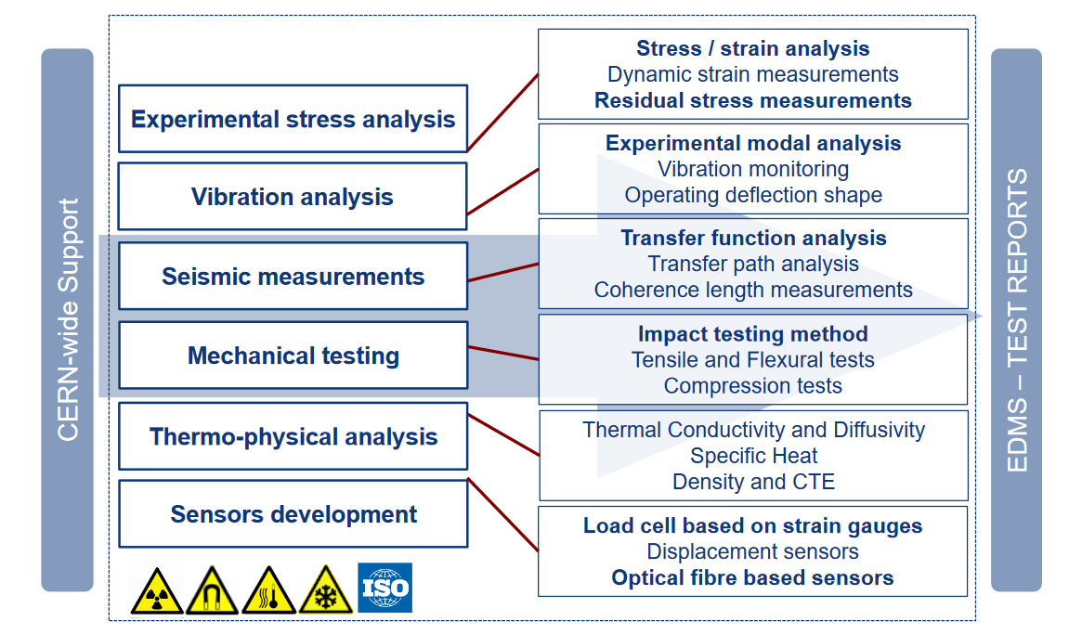
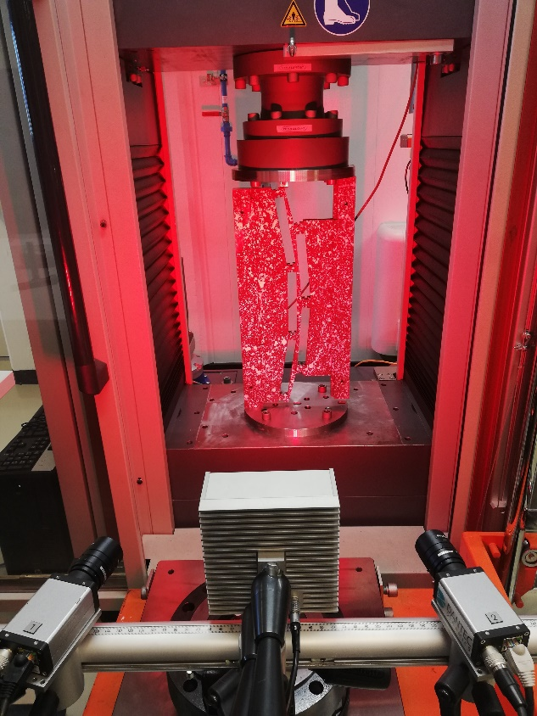
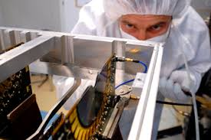
Introduction
STRAIN MEASUREMENTS IS A KEY TECHNIQUE !
Strong interest in optical strain measurement systems for harsh environmental conditions ;
Beginning of the study in 2011 with FBG technology;
Main requirements:
    Optical strain measurements
    1.9 K up to 400 K
    DAQ integrated system
As a measurement lab, we must perform a metrology qualification of new systems before field implementation.

Slide 5
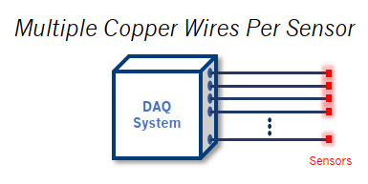
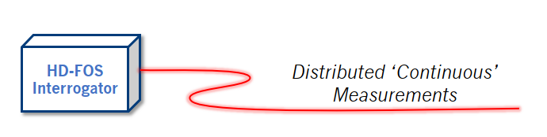
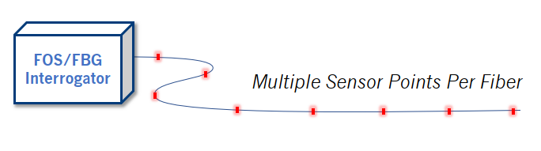
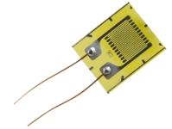
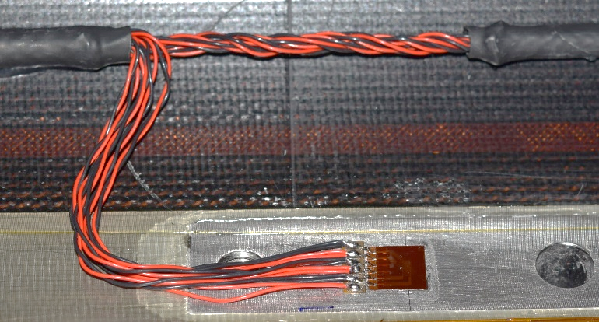
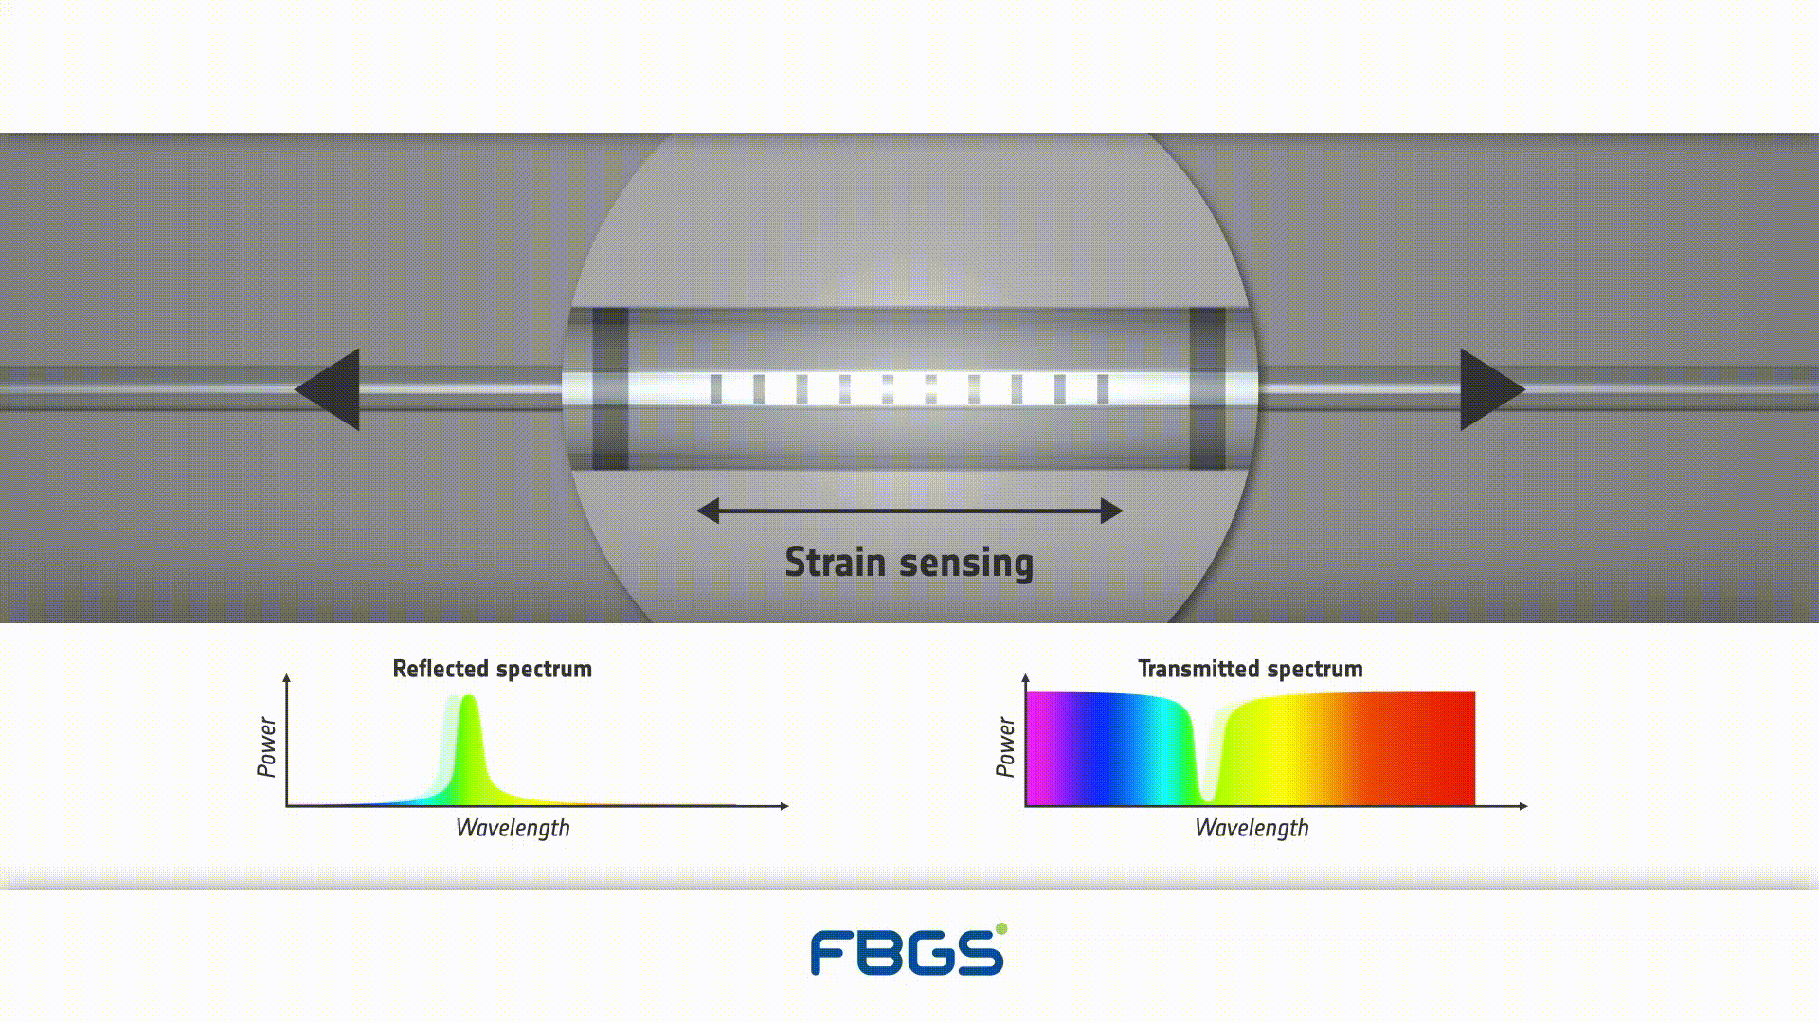

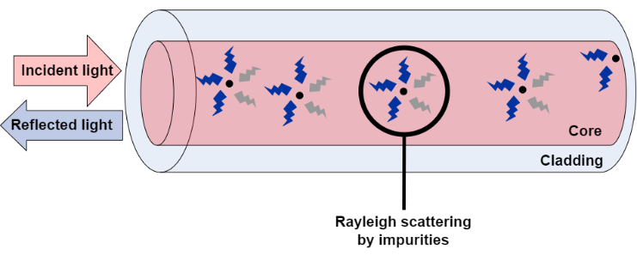

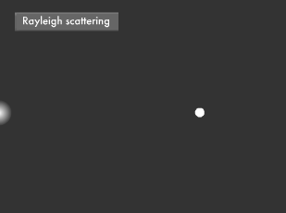
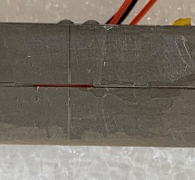

Strain Sensing Techniques at CERN
80’s
2011
2021
Electrical Strain Gauge (ESG)
Fiber Bragg Grating (FBG)
Rayleigh Backscattering (RBS)
Discrete
Distributed
Robust well proven technology
Bulky cabling
Single optical fiber
Challenging bonding process for
cryogenic temperatures
Single optical fiber
Sub mm spatial resolution
Challenging bonding process for cryogenic temperatures

Slide 6
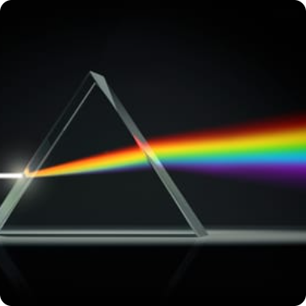
Principles of Optical Fibre Sensing (OFS)
Optical Fibres Sensing refers to the use of optical fibres to measure various physical parameters:
temperature, strain, pressure, chemical composition, vibrations, radiation, rotation, shape, EM field, etc.
The information is encoded in at least one property of the light travelling in the optical fibre:
intensity, phase, polarization, wavelength
Intrinsic sensors
Extrinsic sensors
When the OF itself is the sensing element
The physical measurand modulates one of the light properties.
When the OF is only used to transmit the light
The physical measurand modulates the light emission in an object external to the fibre.

Slide 7
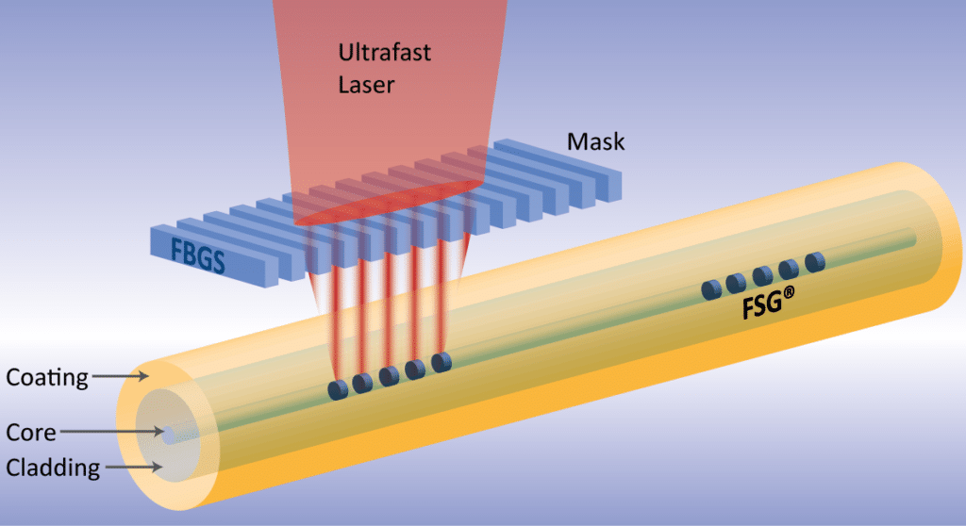
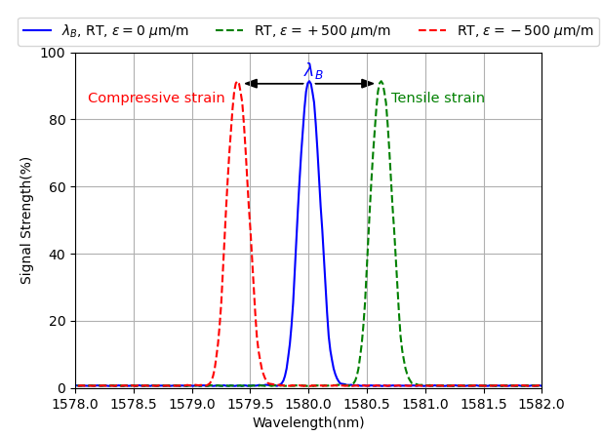
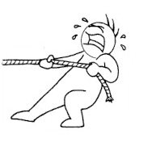
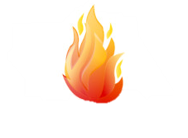


Working principle of the FBG
Through the coating inscription technique;
Fabricated with ultra short femtosecond laser pulses [7].
Through-coating FBG inscription process [4].
FBG interrogator
Optical fiber
Fiber Bragg grating
Reflection spectra of an FBG presenting the effect of tensile and compressive strains on the Bragg wavelength.
$Δλ_{B}=λ_{B}\left[\left(1−p_{e}\right)ε+\left(α+ξ\right)ΔT\right]$
[8]
Temperature sensing
Strain sensing

Slide 8
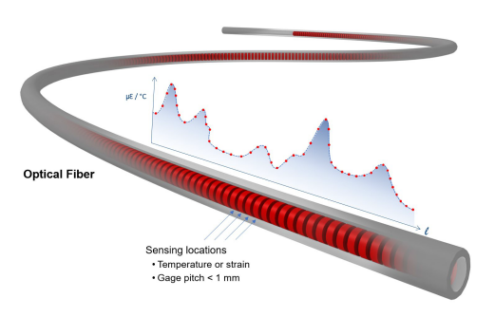

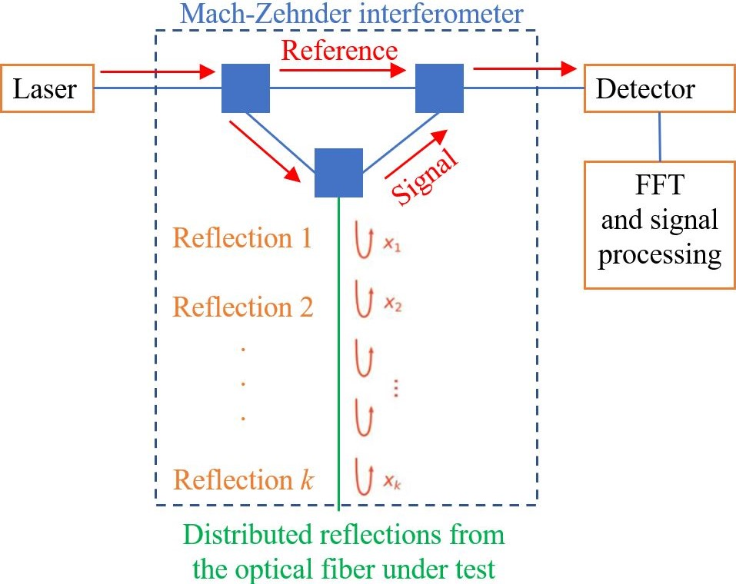
Working principle of the RBS
Rayleigh scattering [9].
Rayleigh scattering from air molecules [9].
Distributed sensing in optical fiber [10].
Rayleigh backscattering is caused by the random fluctuations in the index profile along the optical fiber.
Optical Frequency Domain Reflectometry (OFDR) technology in a single-mode optical fiber was reported in 1981 for the first time (Eickhoff and Ulrich, 1981) as a method to measure the spatial distribution of the Rayleigh scattering and optical losses along the optical fiber (0.5 m spatial resolution achieved) [6];
However, it has recently been investigated and commercialized for numerous monitoring applications (0.1 mm spatial resolution achieved) [11].
Diagram of the operating principle behind c-OFDR.

Slide 9
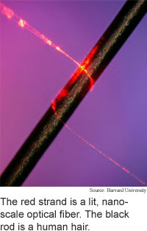
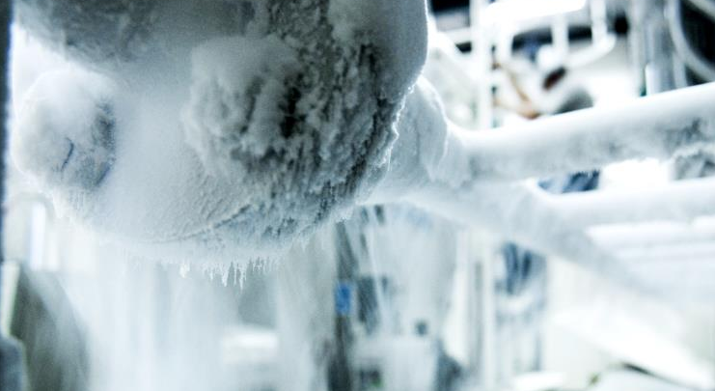
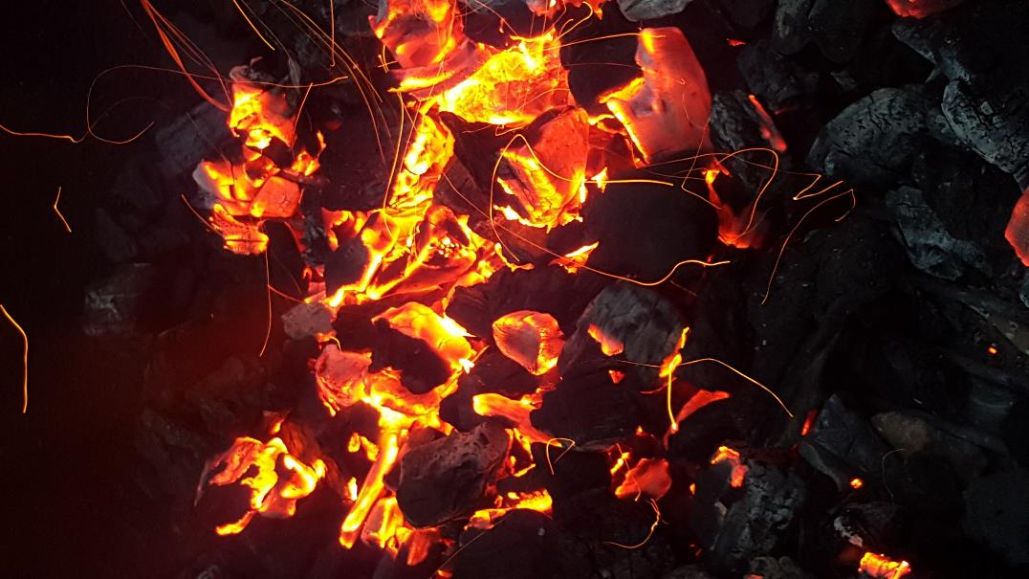
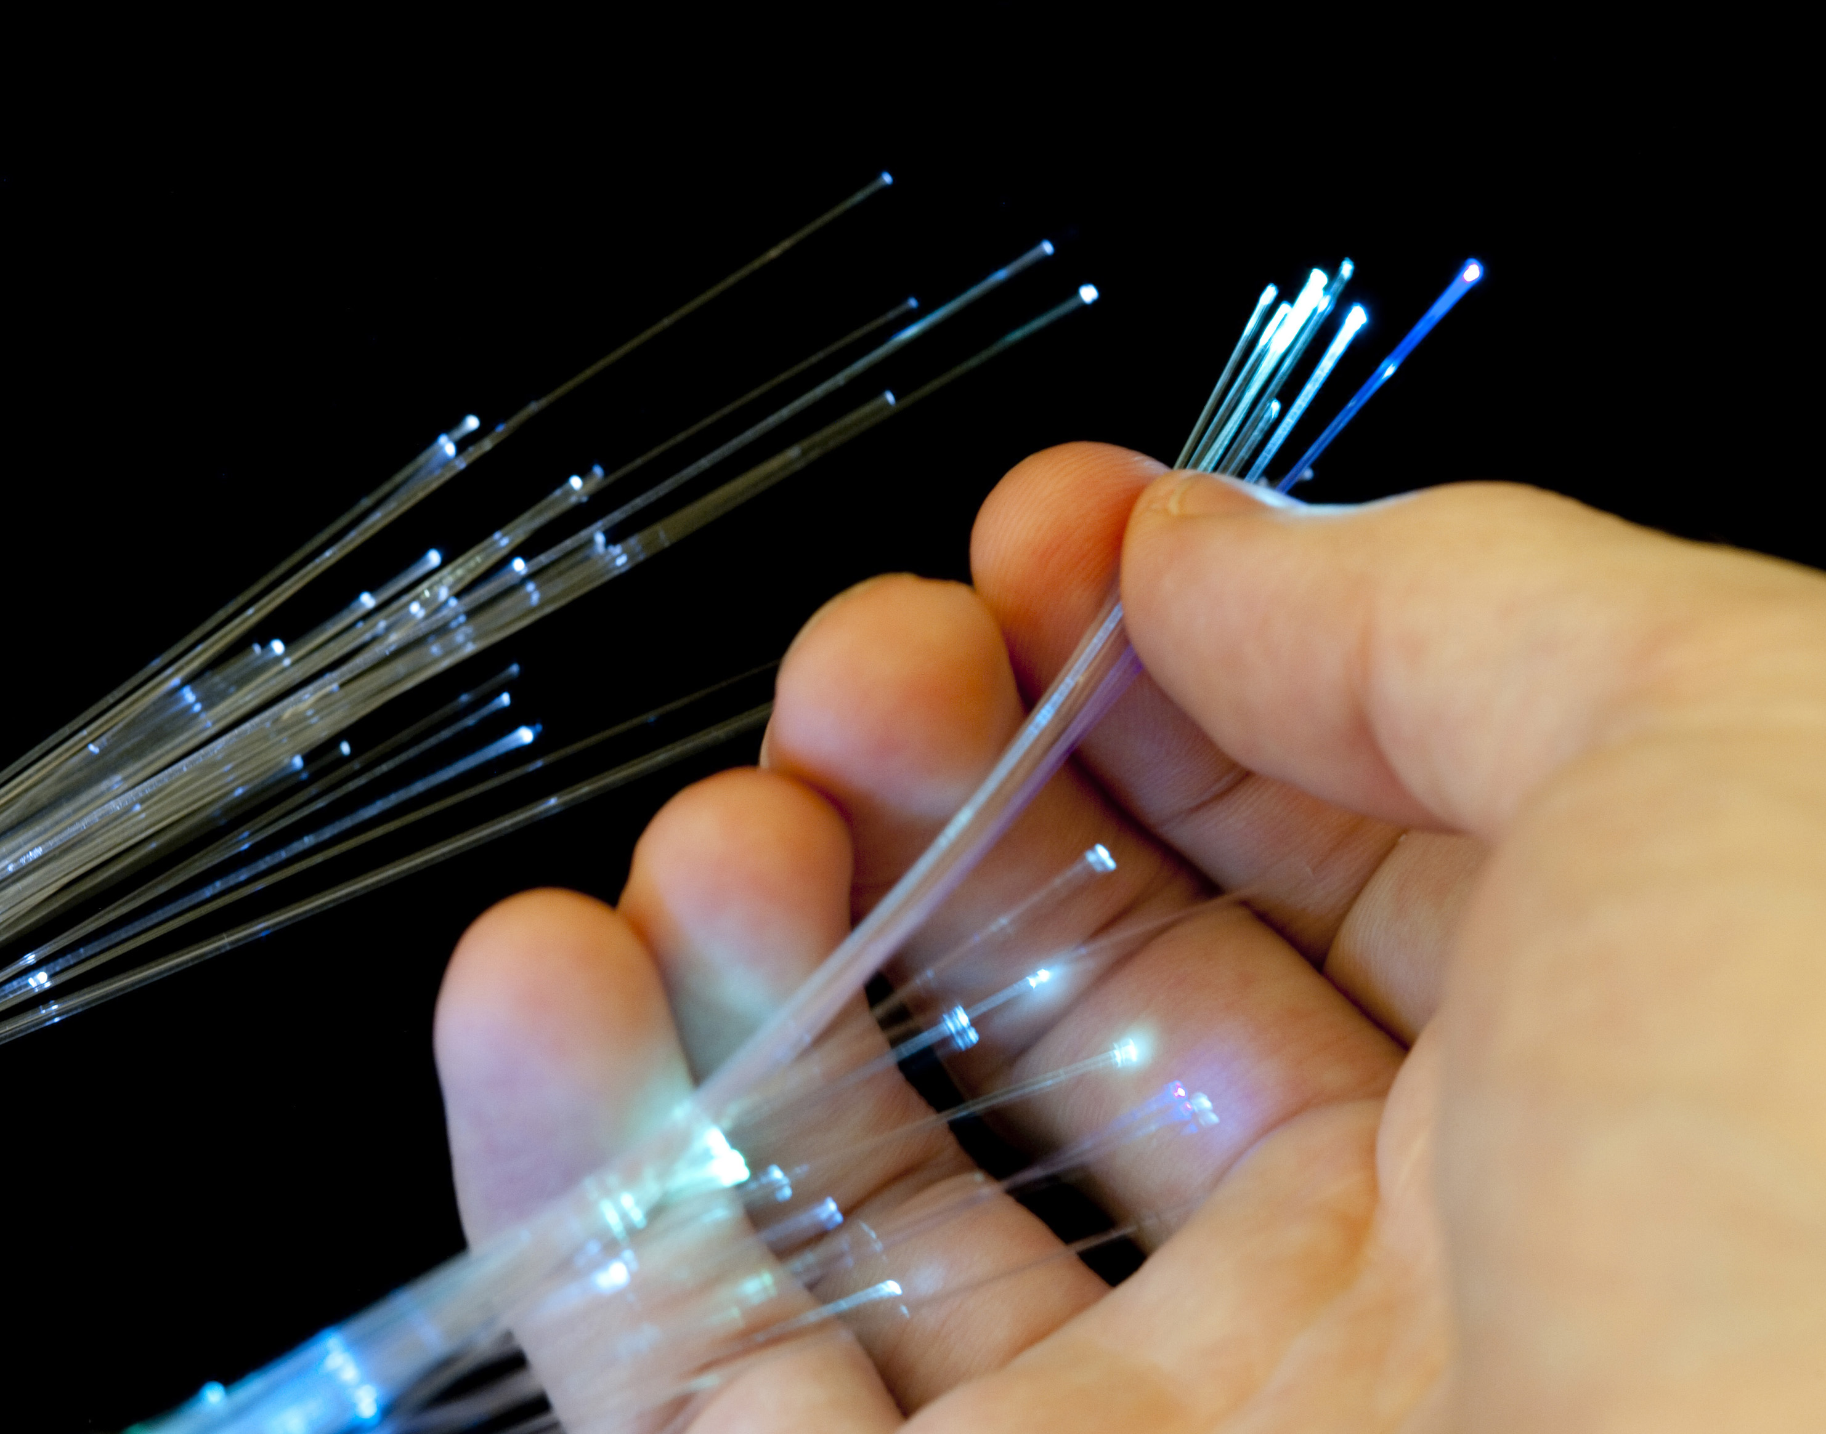
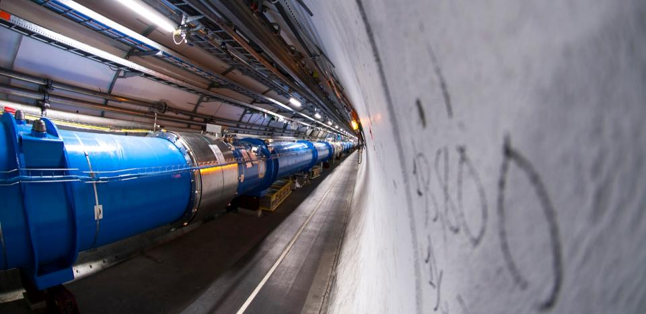
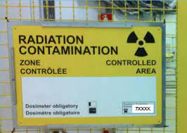
Advantages of the optical fiber strain sensors
Works in harshest environments
Flexibility
Applications at CERN
FBG technique
Real-time sensing up to 40 sensors per single optical fiber (depending on the optical interrogator performance);
Static and dynamic measurements up to 2000 Hz;
Better time resolution.
RBS technique
Ultra-high spatial resolution down to 0.65 mm;
Static and dynamic measurements up to 250 Hz;
Better spatial resolution.
Source: CERN
Immune to electromagnetic interference;
Chemically inert;
Different optical fiber types can be used depending on the need (radiation-hard; high-temperature, water-resistant, etc.).
Very small;
From 125 μm down to 40 μm cladding diameter;
Less invasive than ESG;
Lightweight.

Slide 10
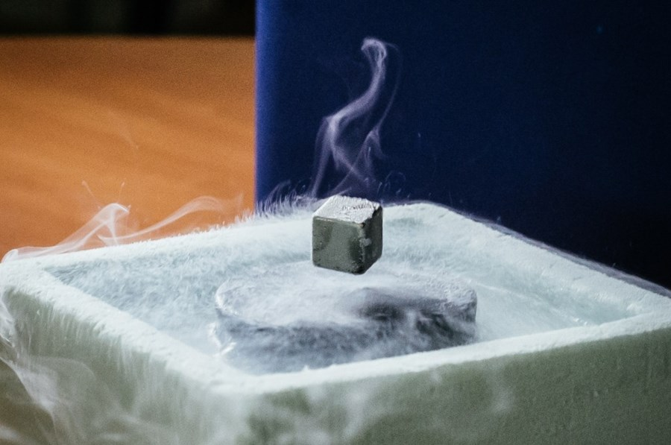
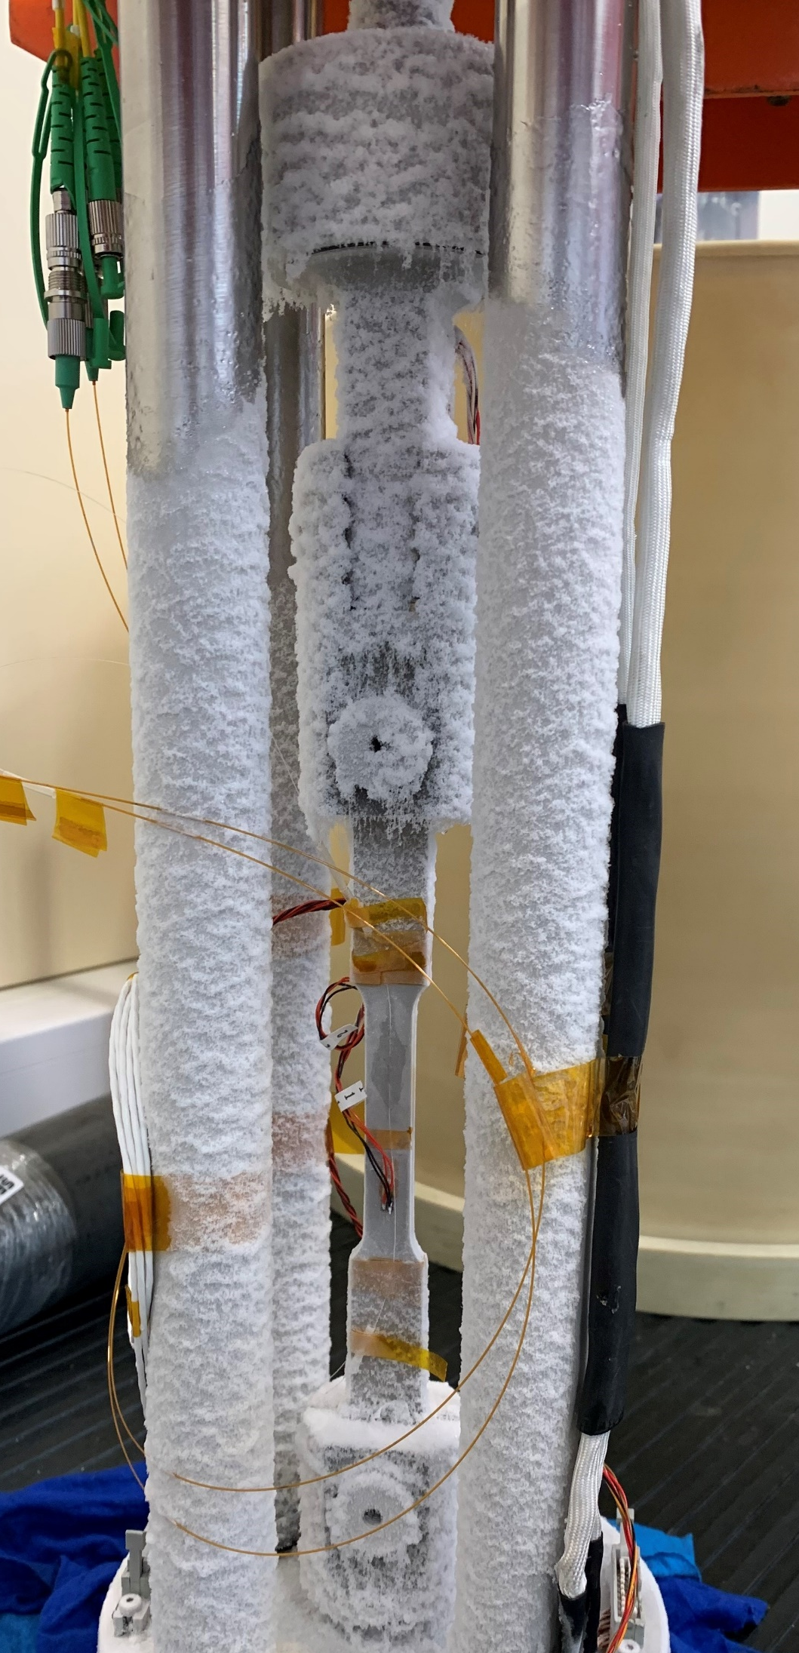
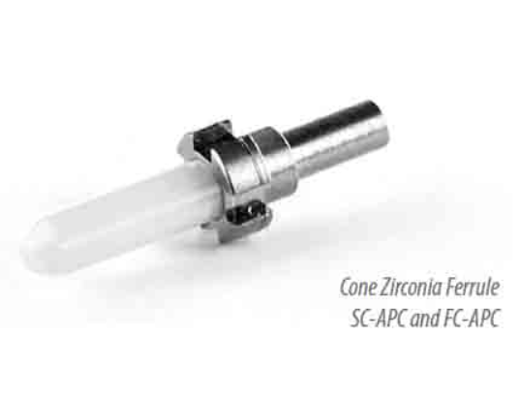
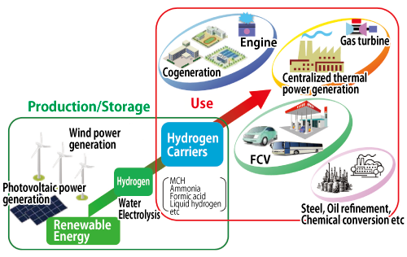
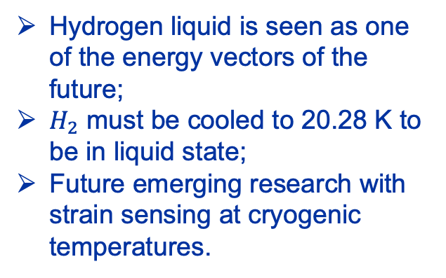
Strain sensing at cryogenic temperatures
A perhaps surprising property of optical fibers is that they remain flexible at cryogenic temperatures [12];
Zirconia ferrule has a very low thermal expansion coefficient, which reduces material stresses caused by temperature gradients; and is also very close to that of the fiber.
Hydrogen liquid is seen as one of the energy vectors of the future;
$H_{2}$ must be cooled to 20.28 K to be in liquid state;
Future emerging research with strain sensing at cryogenic temperatures.
Production and utilization of hydrogen from renewable energy [13].

Slide 11
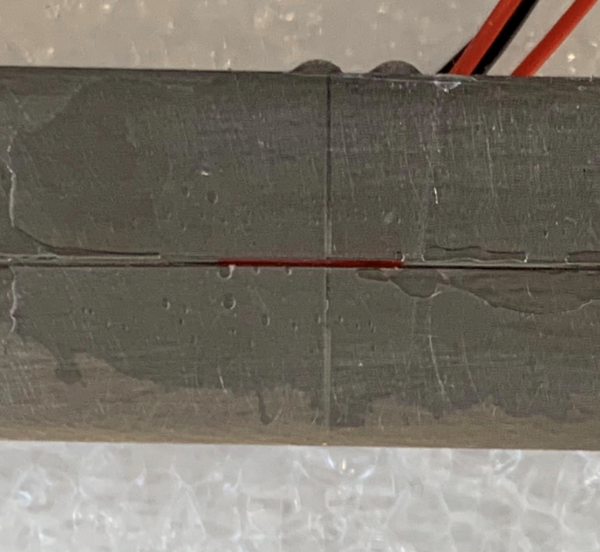
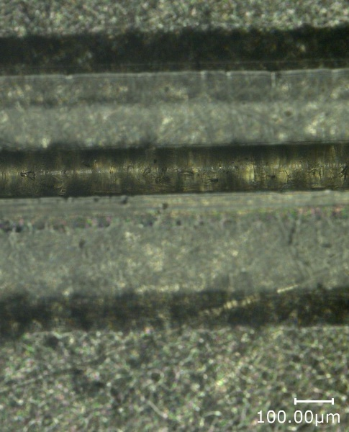
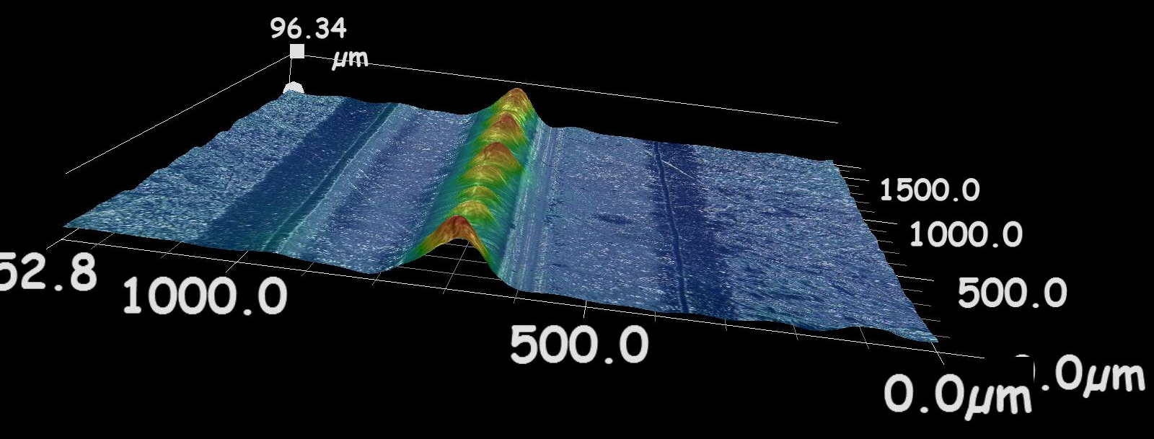
Technical Challenges
Adhesion technique is a crucial parameter as the deformations of the studied material need to be perfectly transferred to the sensor and need to be repeatable → Specific procedure
Adhesion technique developed internally at CERN for strain sensing experience in harsh environments such as cryogenic temperatures.
Courtesy of CERN EN-MME-MM

Slide 12
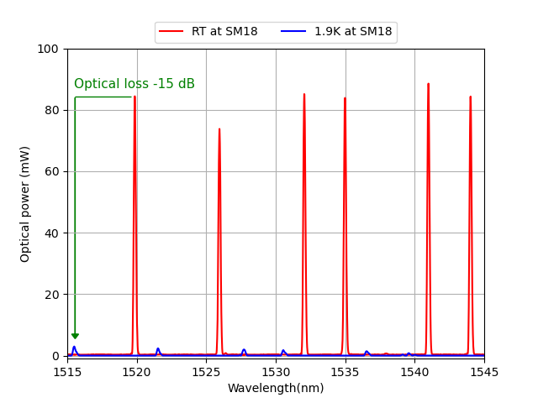
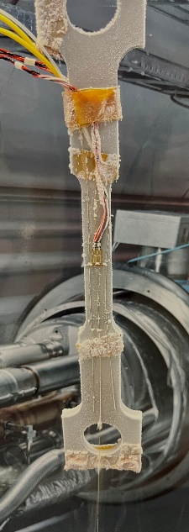
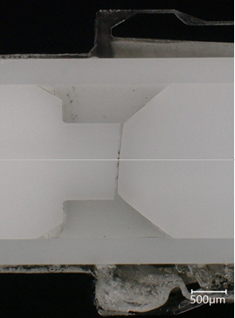
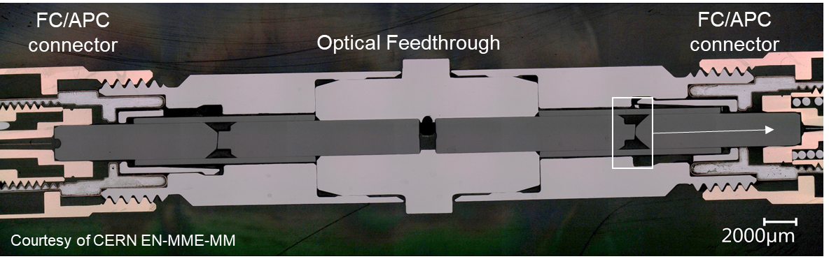
Technical Challenges
Main temperature effects on the optical fibers :
  Strong attenuation of the optical power due to the thermal contraction (- 15 dB) which can disturb the peak tracking (optical budget issue);
  High insertion losses observed at cryogenic temperatures on the optical fiber feedthroughs / connectors.

Slide 13
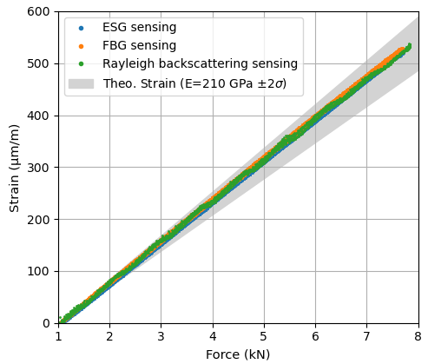
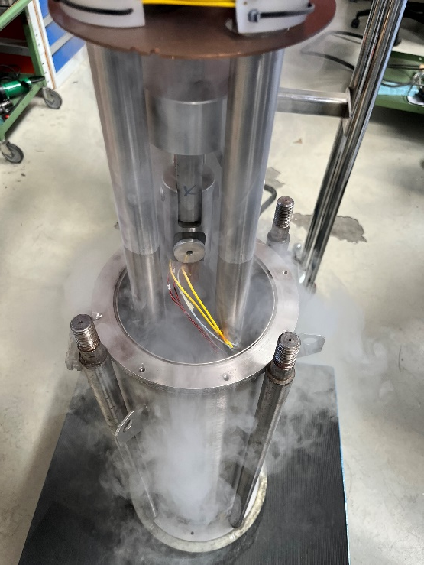
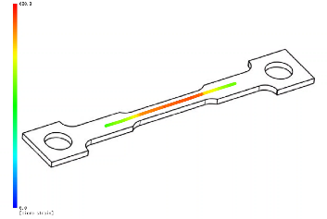
Validation Process
Optical strain gauges validation campaign down to cryogenic temperatures :
  Evaluating the repeatability and reproducibility down to 77 K;
  Evaluating the trueness of the three measuring systems down to 4.2 K according to ISO 5725.
 |  | ESG (1) | FBG (2) | RBS (3)
Apparent strain at 77 K | Mean Value (µm/m) (SS304L) | -3377 | -3924 | -3954
 | Repeatability (µm/m) | 9 | 63 | 120
 | Reproducibility (µm/m) | 32 | 78 | 122
 | Precision (%) | 1.2 % | 2.5 % | 4.3 %
Trueness at 4.2 K (%) |  | 4.3% | 3.5 % | 1.2 %
Accuracy at 4.2 K (%) |  | 4.4 % | 4.3 % | 4.5 %
LC11-3/350 – HBK®
High-reflectivity (>50%) femtosecond FBG in Polyimide coating – FBGS Technologies GmbH
Polyimide coating SM OF – Polytec GmbH

Slide 14
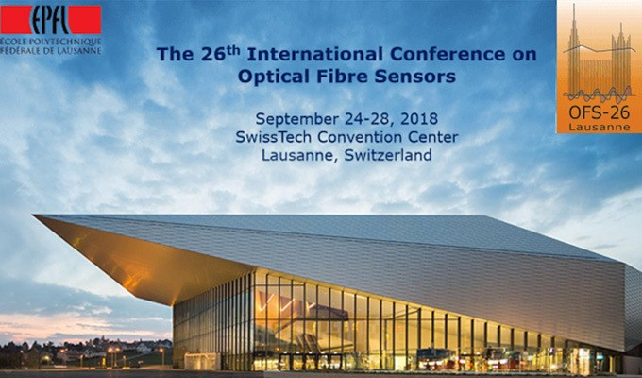
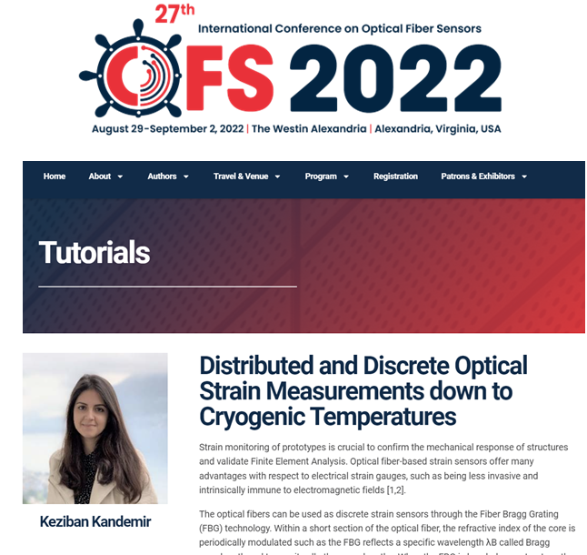
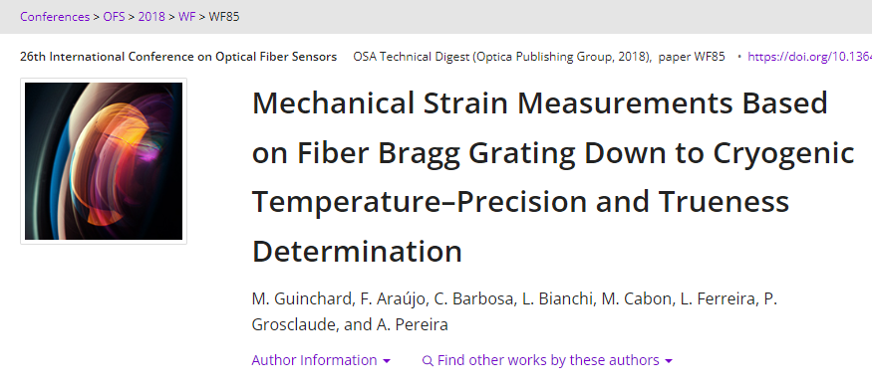

Validation Process
Optical and strain gauges validation campaign down to cryogenic temperatures

Slide 15
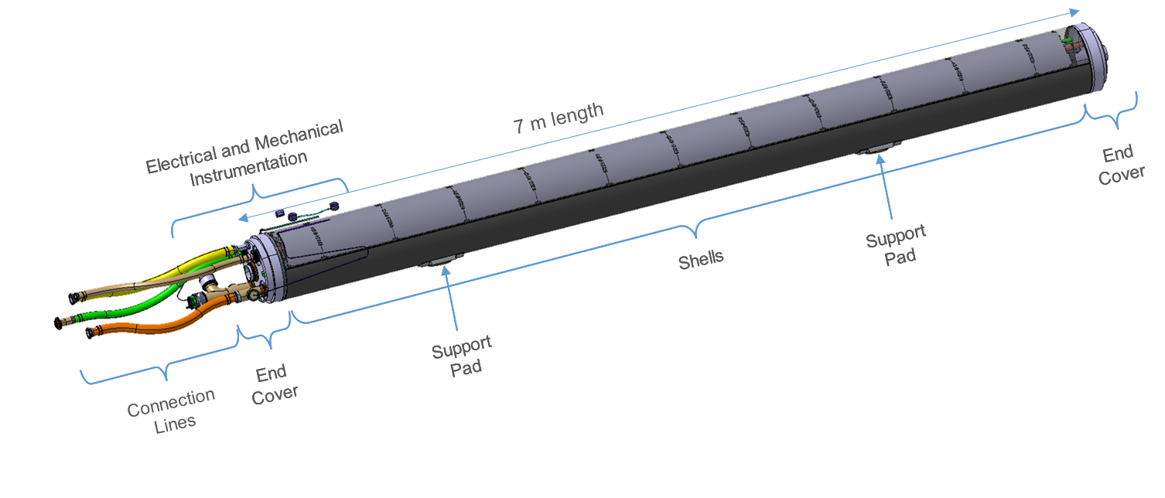
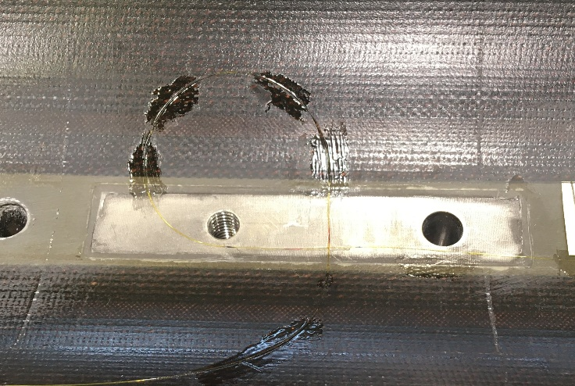
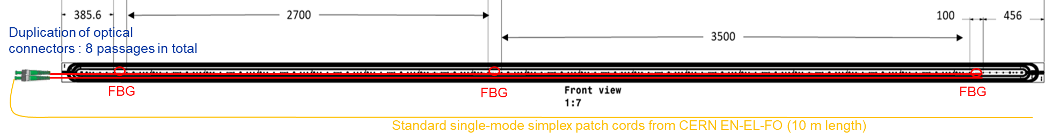
Applications
HL-LHC superconducting quadrupole magnets (MQXF) :
  7m length coils instrumented with OFS (FBG / discrete measurements) to assess the stress state (key parameter in the magnet performance);
  Stress monitoring performed during the loading, thermal cycles and powering processes.

Slide 16




Applications
HL-LHC superconducting quadrupole magnets (MQXF) :
  Aluminum outer shell instrumented with OFS (RBS / distributed measurements) to assess the stress state during loading operation;
Alignment pin
(optical fiber not glued)
Optical fiber glued around the perimeter
Azimuthal Strain (um/m) @ 200 bar
Start point
End point

Slide 17






Applications
HL-LHC superconducting quadrupole magnets (MQXF) :
  Real time data acquisition + Cloud data streaming → Grafana Dashboards

Slide 18








Applications
Embedded OFS in carbon fiber structure (EP-DT Collaboration)
Courtesy of CERN EN-MME-MM

Slide 19





Developments
Optical feedthrough development in the EN-MME (Design, FEA, Workshop) :
  Some issues to extract optical fiber signal from 1.9 K bath with commercial connectors ;
  Internal development to produce a brazed solution without connectors to improve the optical losses at cold.
Courtesy of CERN EN-MME-FW
Brazing methodology :
Single-mode pure-silica core optical fiber with 35 μm ± 5 % Cu-alloy thickness;
OFE copper inserts also brazed into the center of the AISI 316LN flange
Lab Cryocooler + LUNA OFDR

Slide 20



Developments
Optical feedthrough development in the EN-MME group :
Performance after 10 thermal cycles :
- Leak tight at 10-12 mbar.l/s;
- No optical losses visible at 77 K ;
- Next tests will be performed at 1.9 K.

Slide 21
Crab Cavity instrumentation
Design
Michael GUINCHARD on behalf of EN-MME-EDM
STFC Visit

Slide 22


Fiber Bragg grating based strain sensor
lhcacfis0037

Slide 23



Optical fiber bonding
Optical fiber bonding on the blades.

Slide 24



Fiber Bragg grating based strain sensor

Slide 25


Optical fiber bonding
Optical fiber bonding on the FPC tubes.

Slide 26



Optical fiber flange configuration
Evaluation of the strain along the blades and FPC:
Bending strain;
Traction stress.
Insulating vacuum
Outside environment
Atmospheric pressure
Receptacle R03 optical connector
Plug P01
optical connector
Flange
Crab cavity design

Slide 27





Optical fiber flange configuration
Evaluation of the strain along the blades and FPC:
Bending strain;
Traction stress.

Slide 28


Crab Cavity instrumentation
Results
Michael GUINCHARD on behalf of EN-MME-EDM
STFC Visit

Slide 29


Transport results – Optical measurement system
Stop Measurement during the night
Transport effects
Low frequency effects are related to temperature
Full transport data

Slide 30
Transport results – Optical measurement system
Typical response of the blade instrumentation during transport event
Strain (μm/m)

Slide 31


Transport results – Optical measurement system
Stop Measurement during the night
Full transport data

Slide 32


Transport results – Optical measurement system
 | 18th August 2023 | 17th October 2023 | 23th October 2023 | variation due to transport
 | Strain (µm/m) | Strain (µm/m) | Strain (µm/m) | Strain (µm/m)
CAV1_FPC_Secondary_Line | 29.12 | -13.4 | -23.8 | -10.4
CAV1_FPC_Short_Side | -29.91 | -43.41 | -59.47 | -16.06
CAV1_FPC_Long_Side | 17.97 | -76.33 | -99.1 | -22.77
CAV1_FPC_Cavity_Line | 104.7 | -24.16 | -46.58 | -22.42
CAV1_RightBlade_Cavity_Long Side | 299.1 | 281.62 | 262.4 | -19.22
CAV1_RightBlade_Secondary_Long Side | 22.24 | -43.96 | -52.49 | -8.53
CAV1_RightBlade_Secondary_Short Side | -268.3 | -418.47 | -447.9 | -29.43
CAV1_RightBlade_Cavity_Short Side | -388.7 | -489.43 | -519.1 | -29.67
CAV1_LeftBlade_Secondary_Long Side | 90.7 | 59.36 | 26.7 | -32.66
CAV1_LeftBlade_Cavity_Long Side | 6.579 | -47.39 | -41.57 | 5.82
CAV1_LeftBlade_Cavity_Short Side | -147.3 | -242.3 | -267.74 | -25.44
CAV1_LeftBlade_Secondary_Short Side | -103.3 | -146.14 | -161.43 | -15.29
CAV2_FPC_Secondary_Line | -73.02 | -129.23 | -141.69 | -12.46
CAV2_FPC_Short_Side | 41.06 | -19.99 | -29.3 | -9.31
CAV2_FPC_Long_Side | 168.6 | 64.92 | 53.54 | -11.38
CAV2_FPC_Cavity_Line | 48.74 | -44.96 | -58.38 | -13.42
CAV2_LeftBlade_Secondary_Long Side | -182.9 | -139.04 | -170.8 | -31.76
CAV2_LeftBlade_Cavity_Long Side | -34.94 | -153.79 | -169.67 | -15.88
CAV2_LeftBlade_Cavity_Short Side | -360.1 | -411.13 | -387.81 | 23.32
CAV2_LefttBlade_Secondary_Short Side | 48.44 | -23.51 | -42.46 | -18.95
CAV2_RightBlade_Cavity_Short Side | -44.86 | -97.98 | -118.8 | -20.82
CAV2_RightBlade_Secondary_Short Side | -184.1 | -321.01 | -354.98 | -33.97
CAV2_RigthBlade_Secondary_Long Side | 150.6 | 98.07 | 64.25 | -33.82
CAV2_RightBlade_Cavity_Long Side | 26.02 | -5.79 | -31.13 | -25.34

Slide 33






Transport Results – Worst case event
Blue frame
Sample rate = 1000 Hz
Sample rate = 4096 Hz
18/10/23 11h30 19/10/23_10h00 20/10/23 8h30
Sample rate = 1024 Hz
Sample rate = 1024 Hz
Sample rate = 1024 Hz

Slide 34

Transport Results – Worst case event
Blue frame
Sample rate = 1000 Hz
Sample rate = 4096 Hz
18/10/23 11h30 19/10/23_10h00 20/10/23 8h30
0.2 g @ 2 Hz

Slide 35

Repair of Cavity #1 FPC (Straightening)

Slide 36

Repair of Cavity #1 FPC (Straightening)

Slide 37
Crab Cavity instrumentation
What’s next ?
Michael GUINCHARD on behalf of EN-MME-EDM
STFC Visit

Slide 38
Expected instrumentation
Optical fiber lines will be installed at STFC by CERN
FPC instrumentation will be done at STFC by CERN
Bladdes instrumentation will be done at CERN before shipping

Slide 39

What do we expect from STFC team ?
Local experts must be identified and/or trained to support our activities remotely.
Internal instrumentation based on optical fibers is useful also during assembly operations → Optical instrumentation must be connected most of the time !

Slide 40
Discussions and Lab Visit

