Slide 1
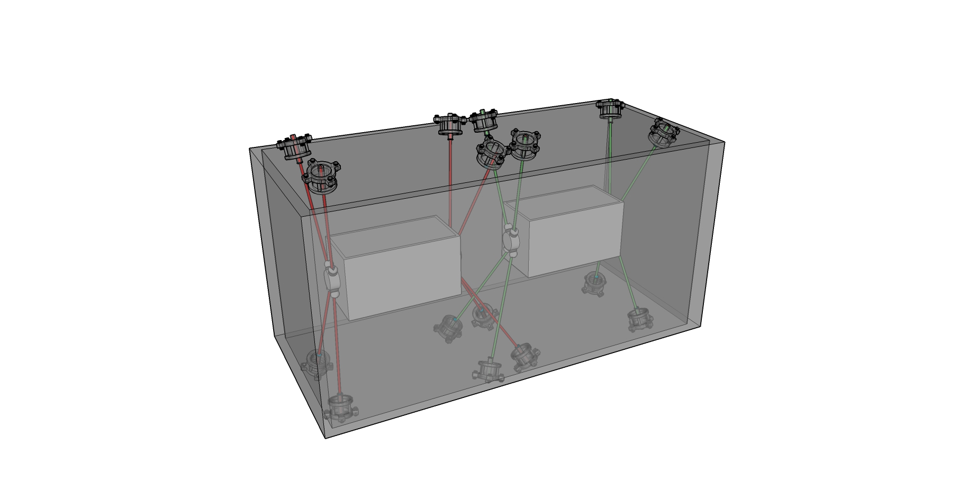
Internal monitoring for Crab-cavities
Vivien RUDE 2024-10-14
HL-LHC Collaboration Triumf-STFC-CERN

Slide 2
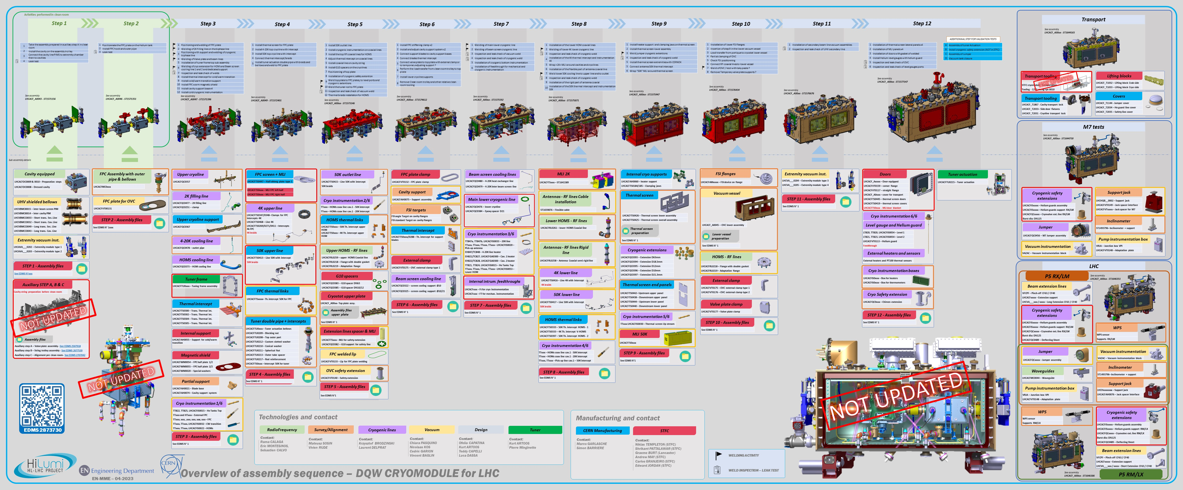
From Teddy Capelli

Slide 3
 | Step
Part 0 : CMM data | 0 | Validation of trolley
 |  | Position of the capacitive plates w.r.t. external references → CERN
 |  | Valve plate measurement
Part 1 : in clean room | 1-2 | Alignment in ISO5 (before connection in ISO4)
 |  | Alignment in ISO5 (after connection in ISO4)
Part 2 : before cryostating | 4-5 | Alignment of different equipment
 |  | Installation of FSI supports
 |  | Measurement of FSI supports
 |  | Installation FSI targets
Part 3 : cryostating (top plate) | 6 | Alignment of the cavities before cryostating
 |  | Measurement of the top plate cryomodule
 |  | Alignment trolley and top plate
Part 4 : cryostating (OVC cryomodule) | 10 | Measurement of the OVC cryomodule
 |  | Alignment top plate and OVC cryomodule
Part 5 : after cryostating | 10 | Installation of FSI heads on OVC and top plate
 |  | Measurement of FSI heads on OVC and top plate
 |  | FSI validation (comparison with a laser tracker)
 |  | Alignment with adjustment system
Part 6 : cold test at STFC or Triumf | 12 | Measurement ambient pressure
 |  | Measurement under vacuum
 |  | Measurement at cold
Part 7 : cold test at CERN |  | Measurement ambient pressure
 |  | Measurement under vacuum
 |  | Measurement at cold

Slide 4
General principle : 3 objects → 3 coordinate systems similar
Top plate
Y
Trolley
X
OVC
Z

Slide 5
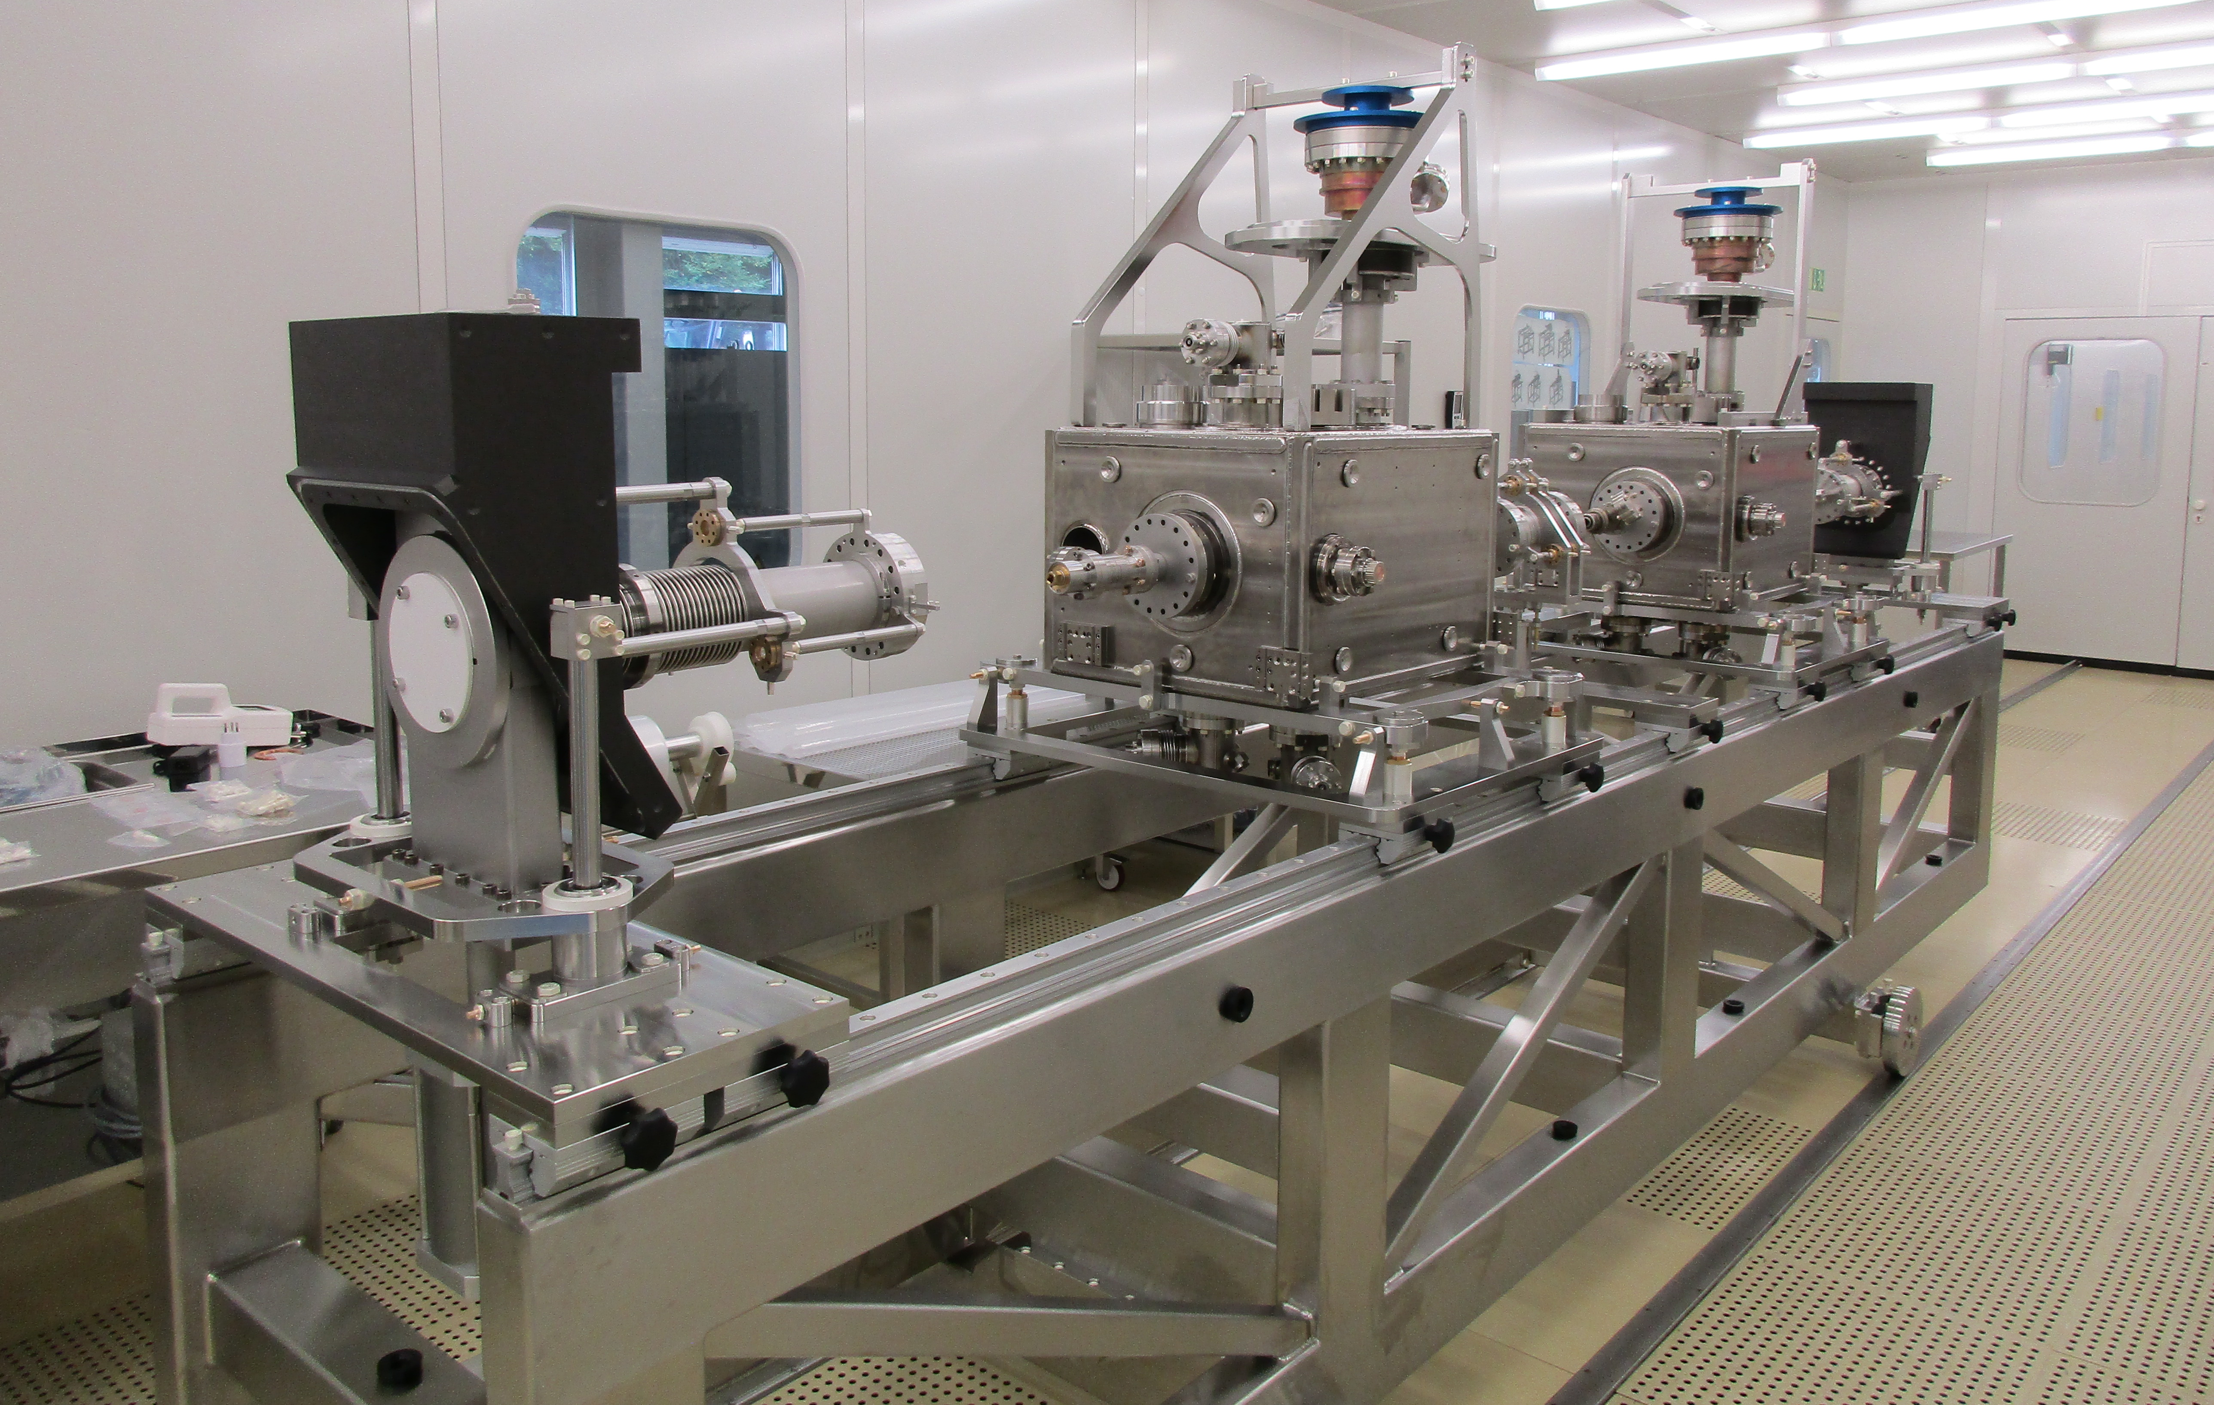
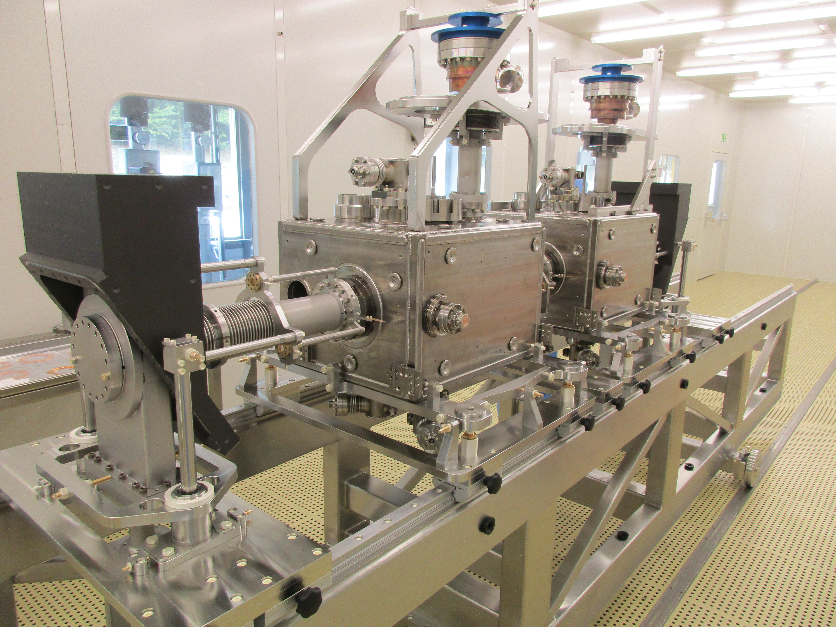
 | Step
Part 0 : CMM data | 0 | Validation of trolley
 |  | Position of the capacitive plates w.r.t. external references → CERN
 |  | Valve plate measurement

Slide 6
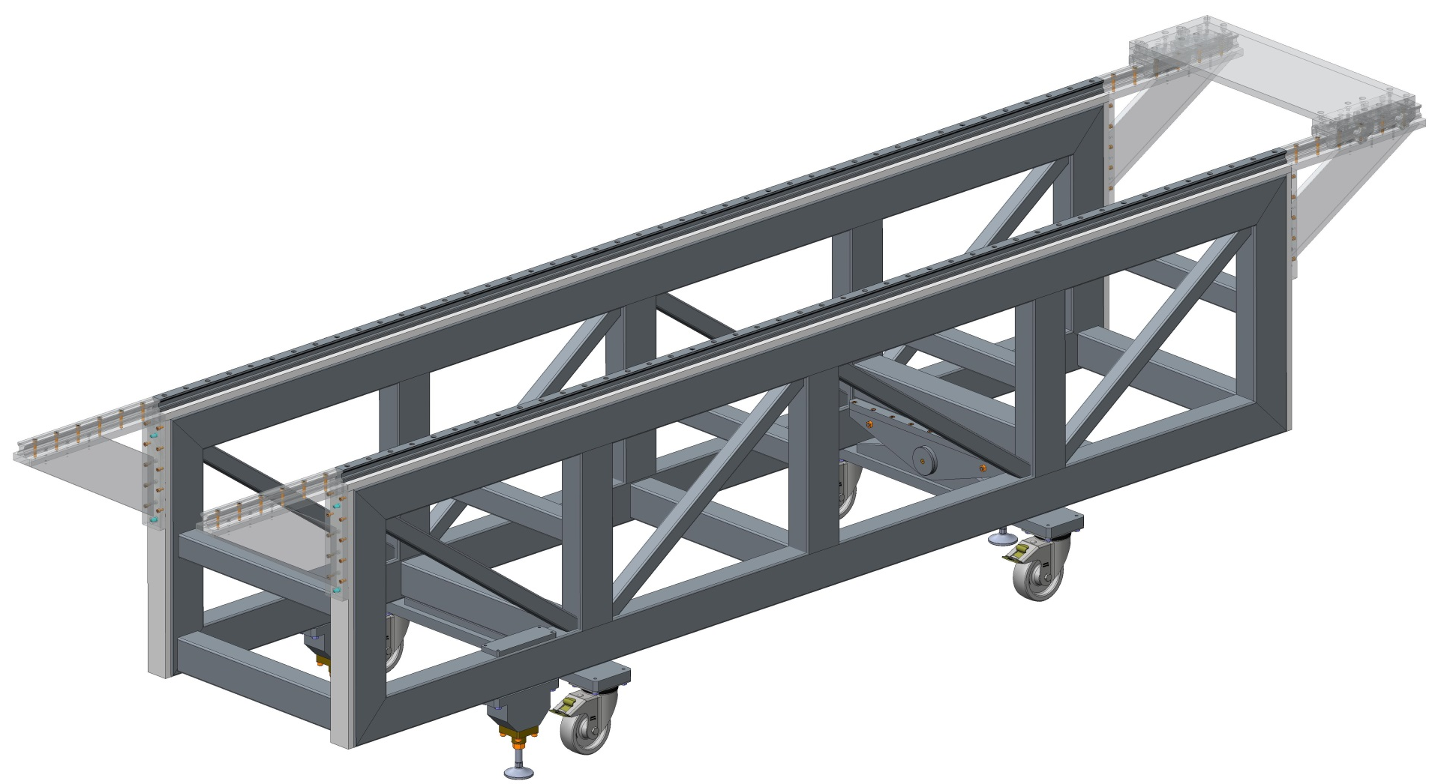
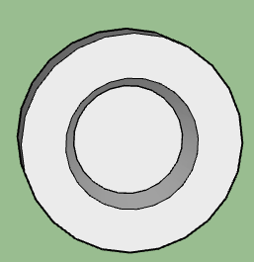
 | Step
Part 0 : CMM data | 0 | Validation of trolley
 |  | Position of the capacitive plates w.r.t. external references → CERN
 |  | Valve plate measurement
Y
X
IN
Z
Advice :
Install fiducial points on both sides of the trolley.
Test the trajectory of the component on the rails
Test the impact of load on the trolley
V3 mm
V2 mm
V1 mm
Coordinate frame :
Primary axis : Nominal axis (cavity line) → trajectory of the rails
Secondary axis : Normal vector to vertical plane of rails
Origin : Beginning of the rail

Slide 7
 | Step
Part 0 : CMM data | 0 | Validation of trolley
 |  | Position of the capacitive plates w.r.t. external references → CERN
 |  | Valve plate measurement

Slide 8
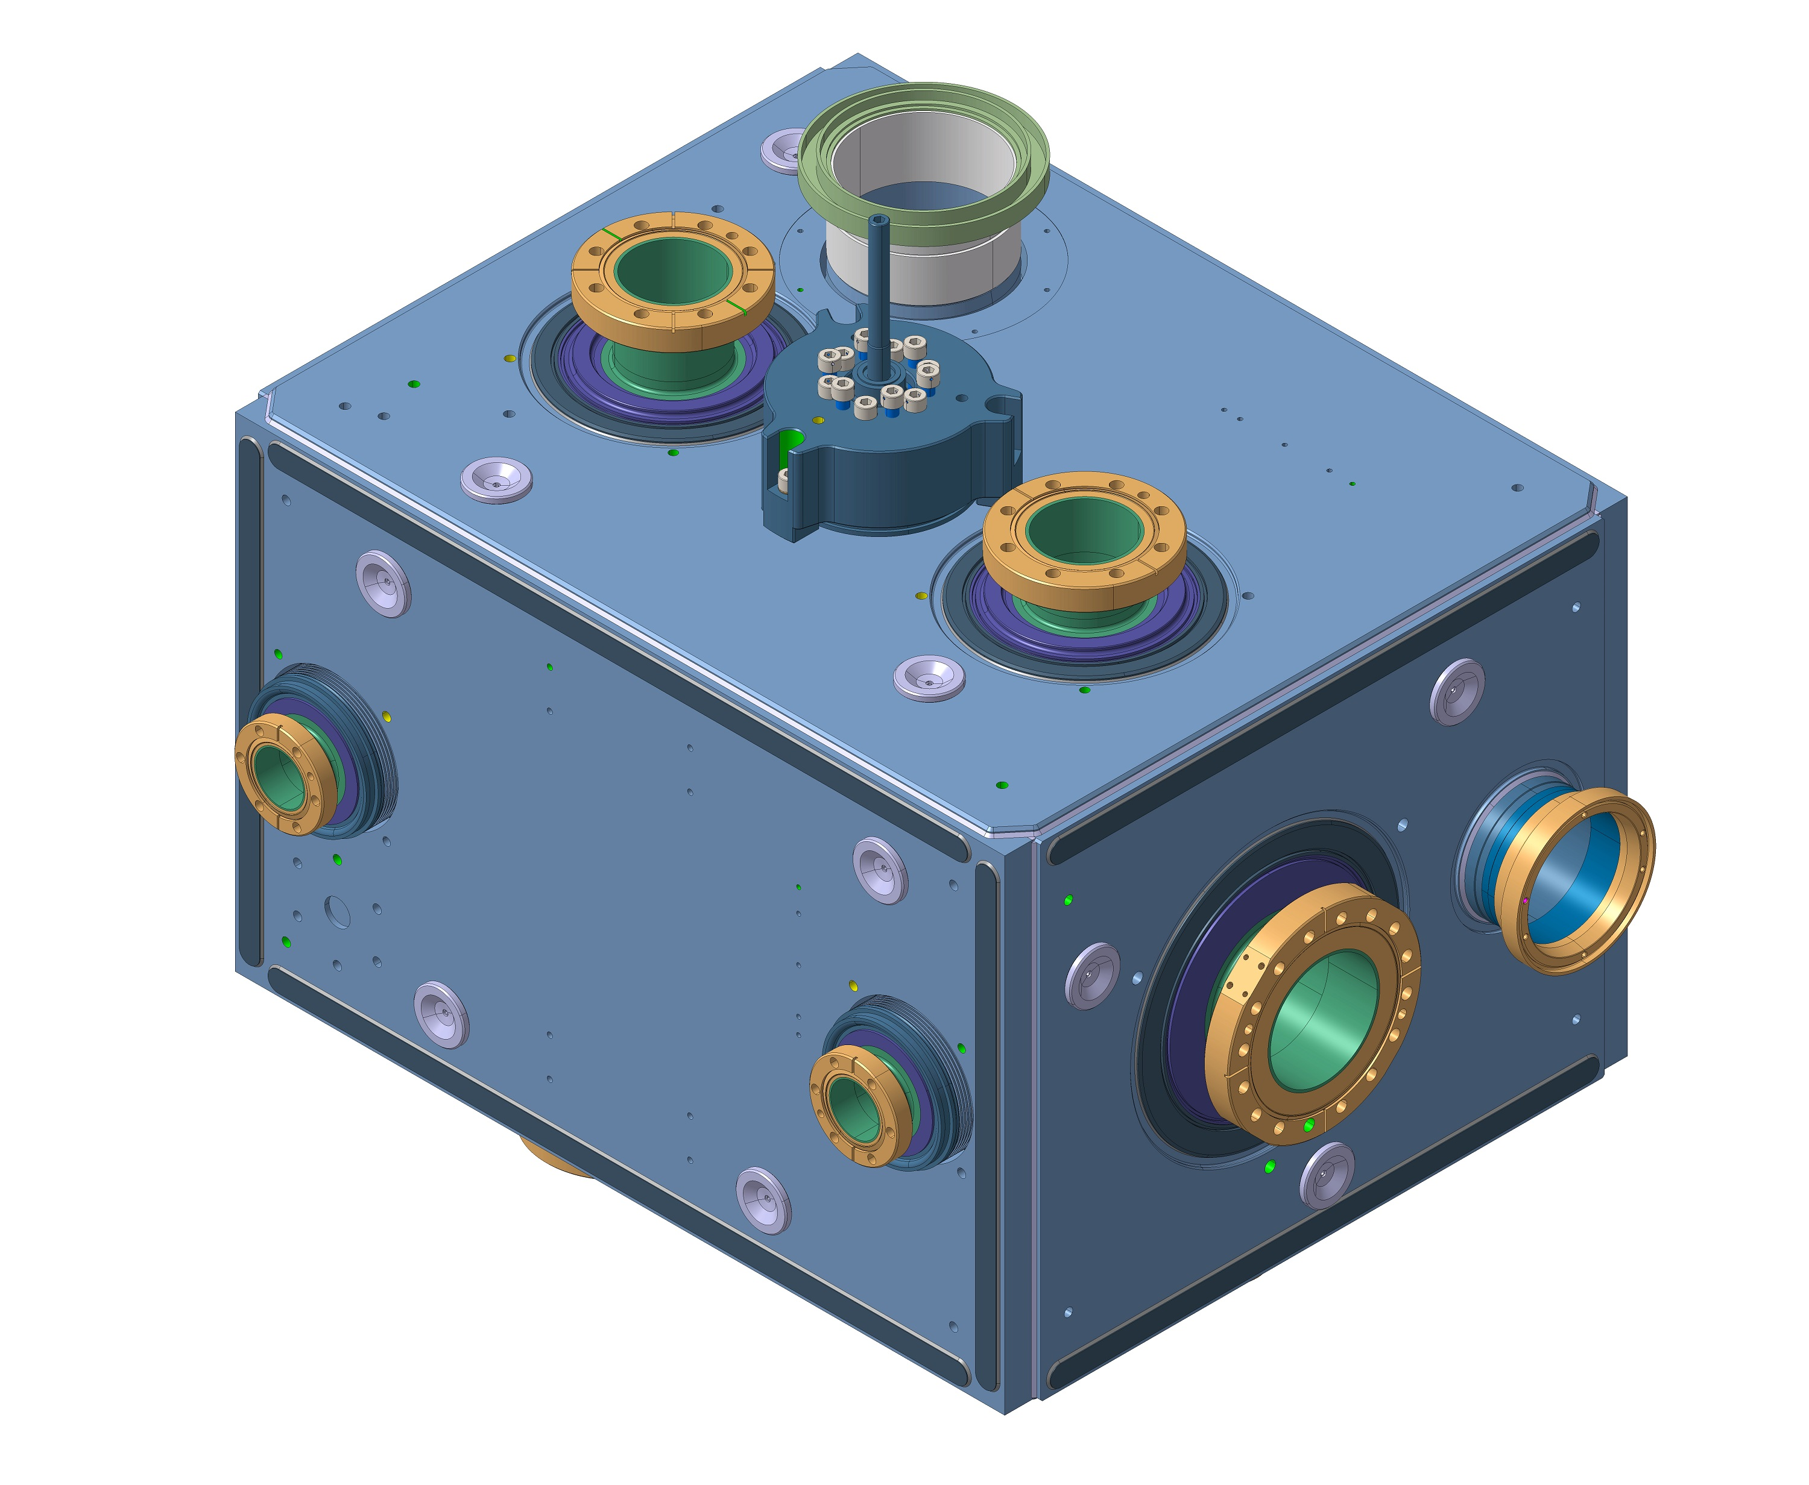
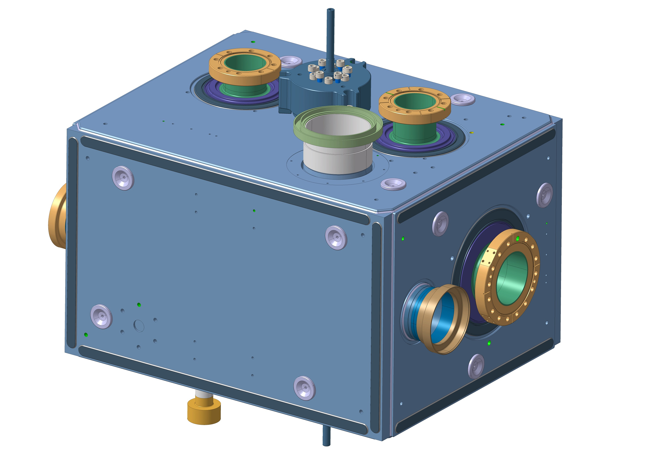
 | Step
Part 0 : CMM data | 0 | Validation of trolley
 |  | Position of the capacitive plates w.r.t. external references → CERN
 |  | Valve plate measurement
 | X (mm) | Y (mm) | Z (mm)
Flange_A_Inox | 0 | -500.857 | -0.039
Flange_B_Inox | 0 | 179.144 | -0.254
Flange_FPC_Inox | 0 | 0 | 234.834
Flange_HOM_A_Inox | 0.381 | -320.512 | 249.645
Flange_HOM_B_Inox | 89.659 | -274.265 | -250.260
Flange_HOM_C_Inox | -90.249 | -273.956 | -249.957
Flange_pick_up_A_Inox | 239.994 | -385.315 | -0.423
Flange_pick_up_B_Inox | 240.000 | 65.110 | -0.137
Line2 A | -194.522 | -508.330 | 0.298
Line2 B | -194.489 | 187.668 | 0.335
C1 | 121.217 | -0.148 | 214.856
C2 | 156.375 | -304.377 | 214.999
C3 | -184.520 | -410.281 | 215.239
C4 | 223.532 | -342.117 | 134.529
C5 | 223.371 | 47.401 | 134.695
C6 | 223.138 | -296.469 | -135.616
C7 | 223.011 | -43.997 | -135.468
C8 | 142.837 | 166.124 | 82.412
C9 | -41.267 | 166.172 | -144.759
C10 | -142.858 | 166.060 | 132.874
C11 | -305.115 | 30.952 | 135.617
C12 | -304.967 | -374.040 | 135.433
C13 | -305.525 | 69.491 | -109.469
C14 | -305.465 | -316.935 | -134.642
C15 | -41.117 | -486.970 | -145.082
C16 | -142.617 | -487.408 | 132.577
C17 | 143.050 | -487.184 | 82.045
Tunning_BOTTOM | -0.947 | -160.451 | -369.724
Tunning_TOP | 0.599 | -160.218 | 369.329
Capacitive_plate_CENTER | 0 | -160.238 | 0
Capacitive_plate_IN | 0 | -250.538 | 0
Capacitive_plate_OUT | 0 | -70.099 | 0
Origine | 0 | 0 | 0
Axe_X | 1000 | 0 | 0
Axe_Y | 0 | 1000 | 0
Axe_Z | 0 | 0 | 1000
IN | 0 | -500.857 | 0
OUT | 0 | 179.144 | 0
Final coordinate system (R-capacitive-plates):
Y-axis (primary axis): Defined by the capacitive plate axis
Z-axis (secondary axis): Defined from the projection of the center of circle FPC on line of the capacitive axis
Origin: projection of the center of circle FPC on line of the capacitive axis.
Z
Z
C3
HOM-A
C1
FPC
HOM-A
C2
FPC
Y
C2
C4
C17
C1
C10
C3
C11
C5
C12
C16
C8
Flange A
C6
Flange B
C13
Line2 A
C7
C9
C15
X
C14
Y

Slide 9
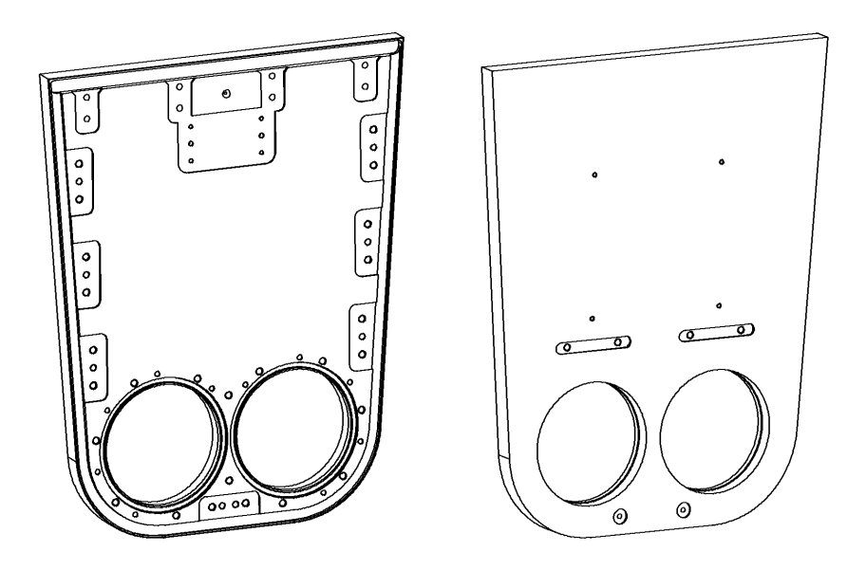
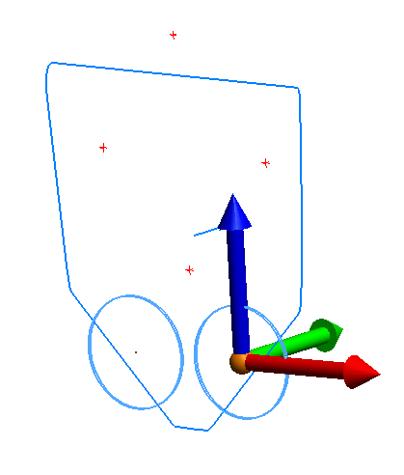
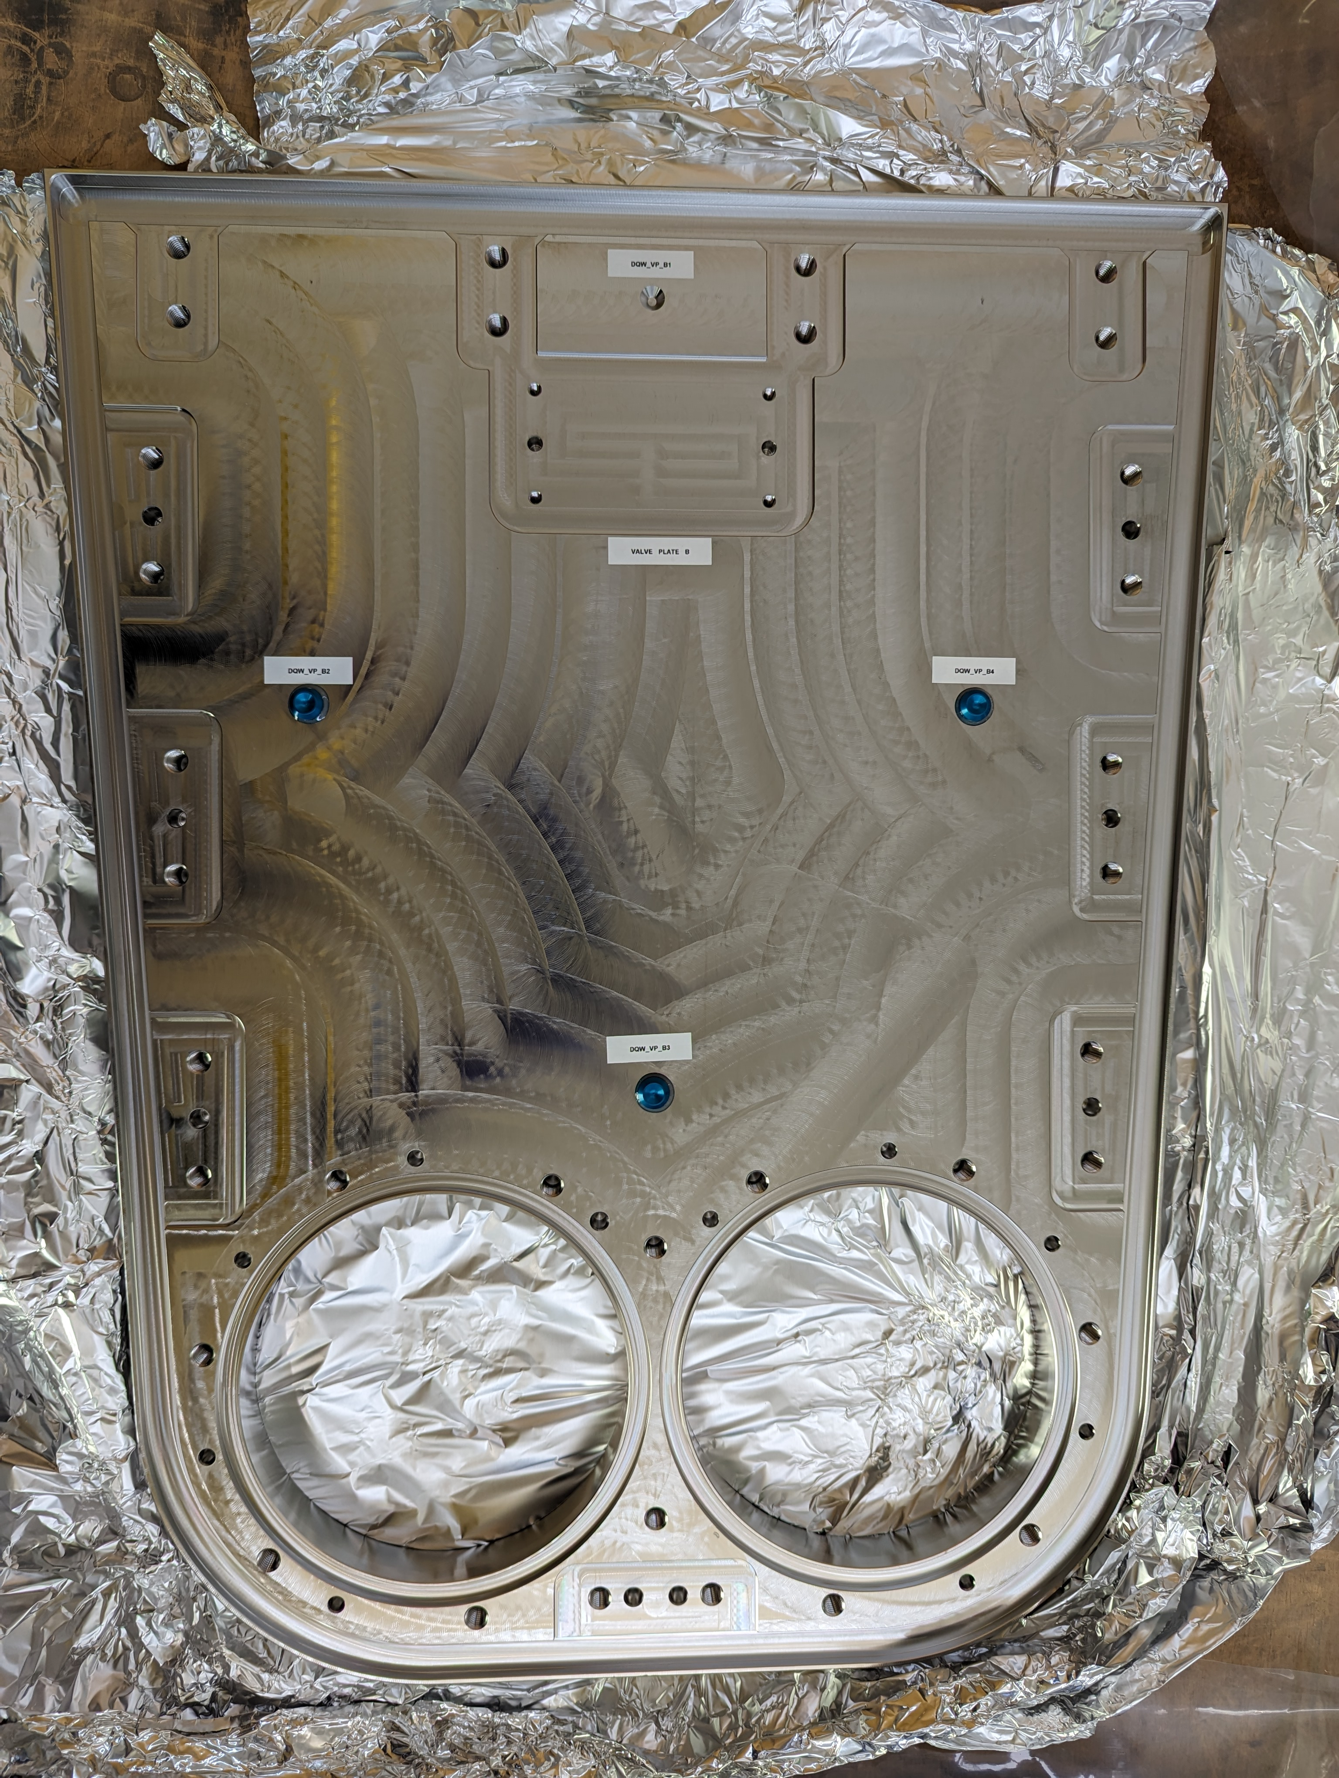
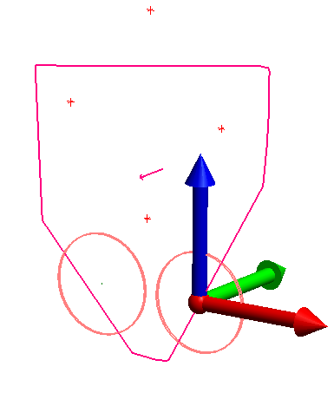
 | Step
Part 0 : CMM data | 0 | Validation of trolley
 |  | Position of the capacitive plates w.r.t. external references → CERN
 |  | Valve plate measurement
Coordinate system
For both Valve Plates,
X axis – along the line passing through the centres of the two cylinders (Secondary Axis)
Y axis – Normal to the measured 7 planes
Z axis – Perpendicular to XY Plane (Primary Axis)
Valve Plate B
DQW_VP_B1
Valve Plate A
DQW_VP_A1
DQW_VP_B2
DQW_VP_B4
Z
DQW_VP_B3
DQW_VP_A2
Y
DQW_VP_A3
Z
R_ValvePlate_B
X
DQW_VP_A4
Valve Plate A
Y
X
R_ValvePlate_A

Slide 10
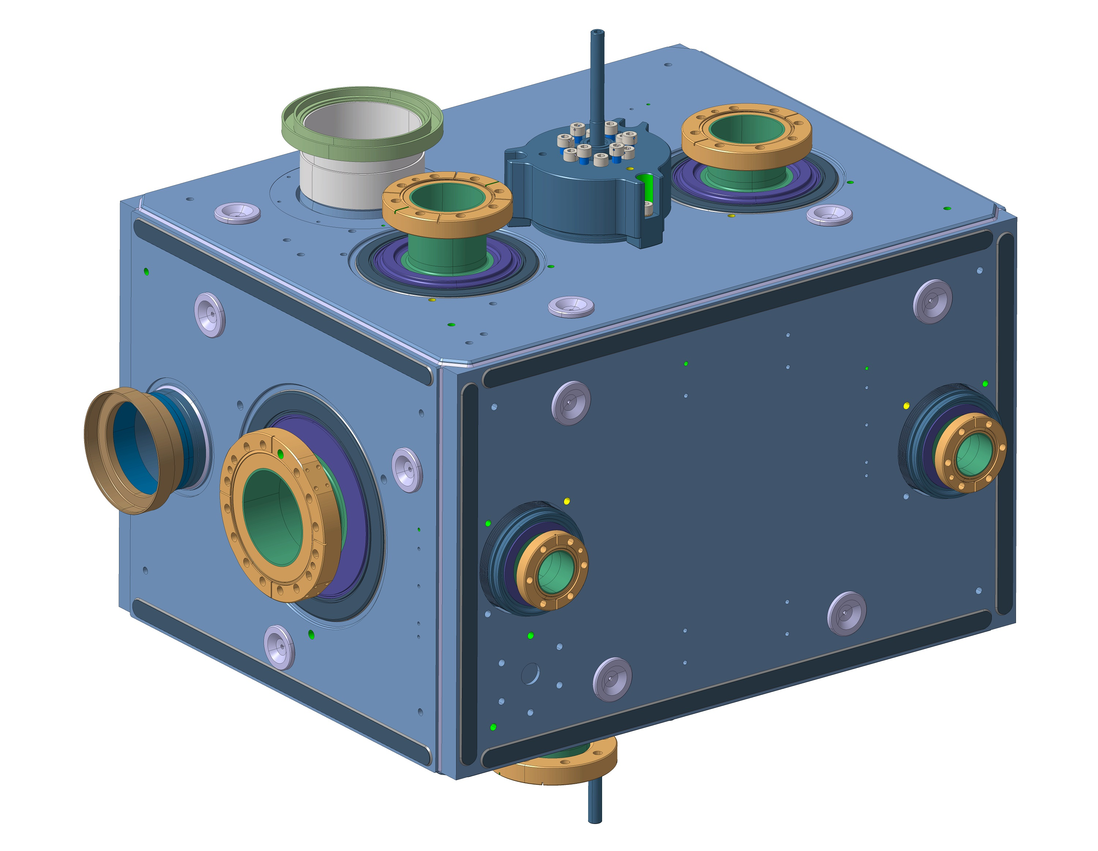
 | Step
Part 1 : in clean room | 1-2 | Alignment in ISO5 (before connection in ISO4)
 |  | Alignment in ISO5 (after connection in ISO4)
Valve plate B
Nb
Valve plate A
Cavity 2
FPC
Trolley axis
Cavity 1
B2
B1
FPC
Na
OUT
Please note:
No thermal contraction or movement due to vacuum is considered at this stage
(V. Rude, T. Capelli).
X
IN
Y
OUT
A2
A1
IN
 |  | X |  | Y |  | Z |  | Rx |  | Ry |  | Rz
Valve plate 1 | A1 | 0 | +/- 0.5 | -- | -- | 0 | +/- 0.5 | -- | -- | -- | -- | -- | --
 | A2 | -- | -- | -- | -- | 0 | +/- 0.5 | -- | -- | -- | -- | -- | --
 | Vect Na | -- | -- | N | N | -- | -- | 0 | +/-3.8 mrad | -- | -- | 0 | +/-2.5 mrad
Cav 1 | IN (Cap) | 0 | +/- 0.1 | -- | -- | 0 | +/- 0.1 | -- | -- | 0 | +/-1.2 mrad | -- | --
 | FPC | -- | -- | 1065.25 | +/- 2mm | -- | -- | -- | -- |  |  | -- | --
 | OUT (cap) | 0 | +/- 0.1 | -- | -- | 0 | +/- 0.1 | -- | -- |  |  | -- | --
Cav2 | IN (Cap) | 0 | +/- 0.1 | -- | -- | 0 | +/- 0.1 | -- | -- | 0 | +/-1.2 mrad | -- | --
 | FPC | -- | -- | 2027.74 | +/- | -- | -- | -- | -- |  |  | -- | --
 | OUT (cap) | 0 | +/- 0.1 | -- | -- | 0 | +/- 0.1 | -- | -- |  |  | -- | --
Valve plate 2 | B1 | 0 | +/- 0.5 | -- | -- | 0 | +/- 0.5 | -- | -- | -- | -- | -- | --
 | B2 | -- | -- | -- | -- | 0 | +/- 0.5 | -- | -- | -- | -- | -- | --
 | Vect Nb | -- | -- | 2504.5 | +/-5mm | -- | -- | 0 | +/-3.8 mrad | -- | -- | 0 | +/-2.5 mrad
Z
V3 mm
V2 mm
V1 mm

Slide 11
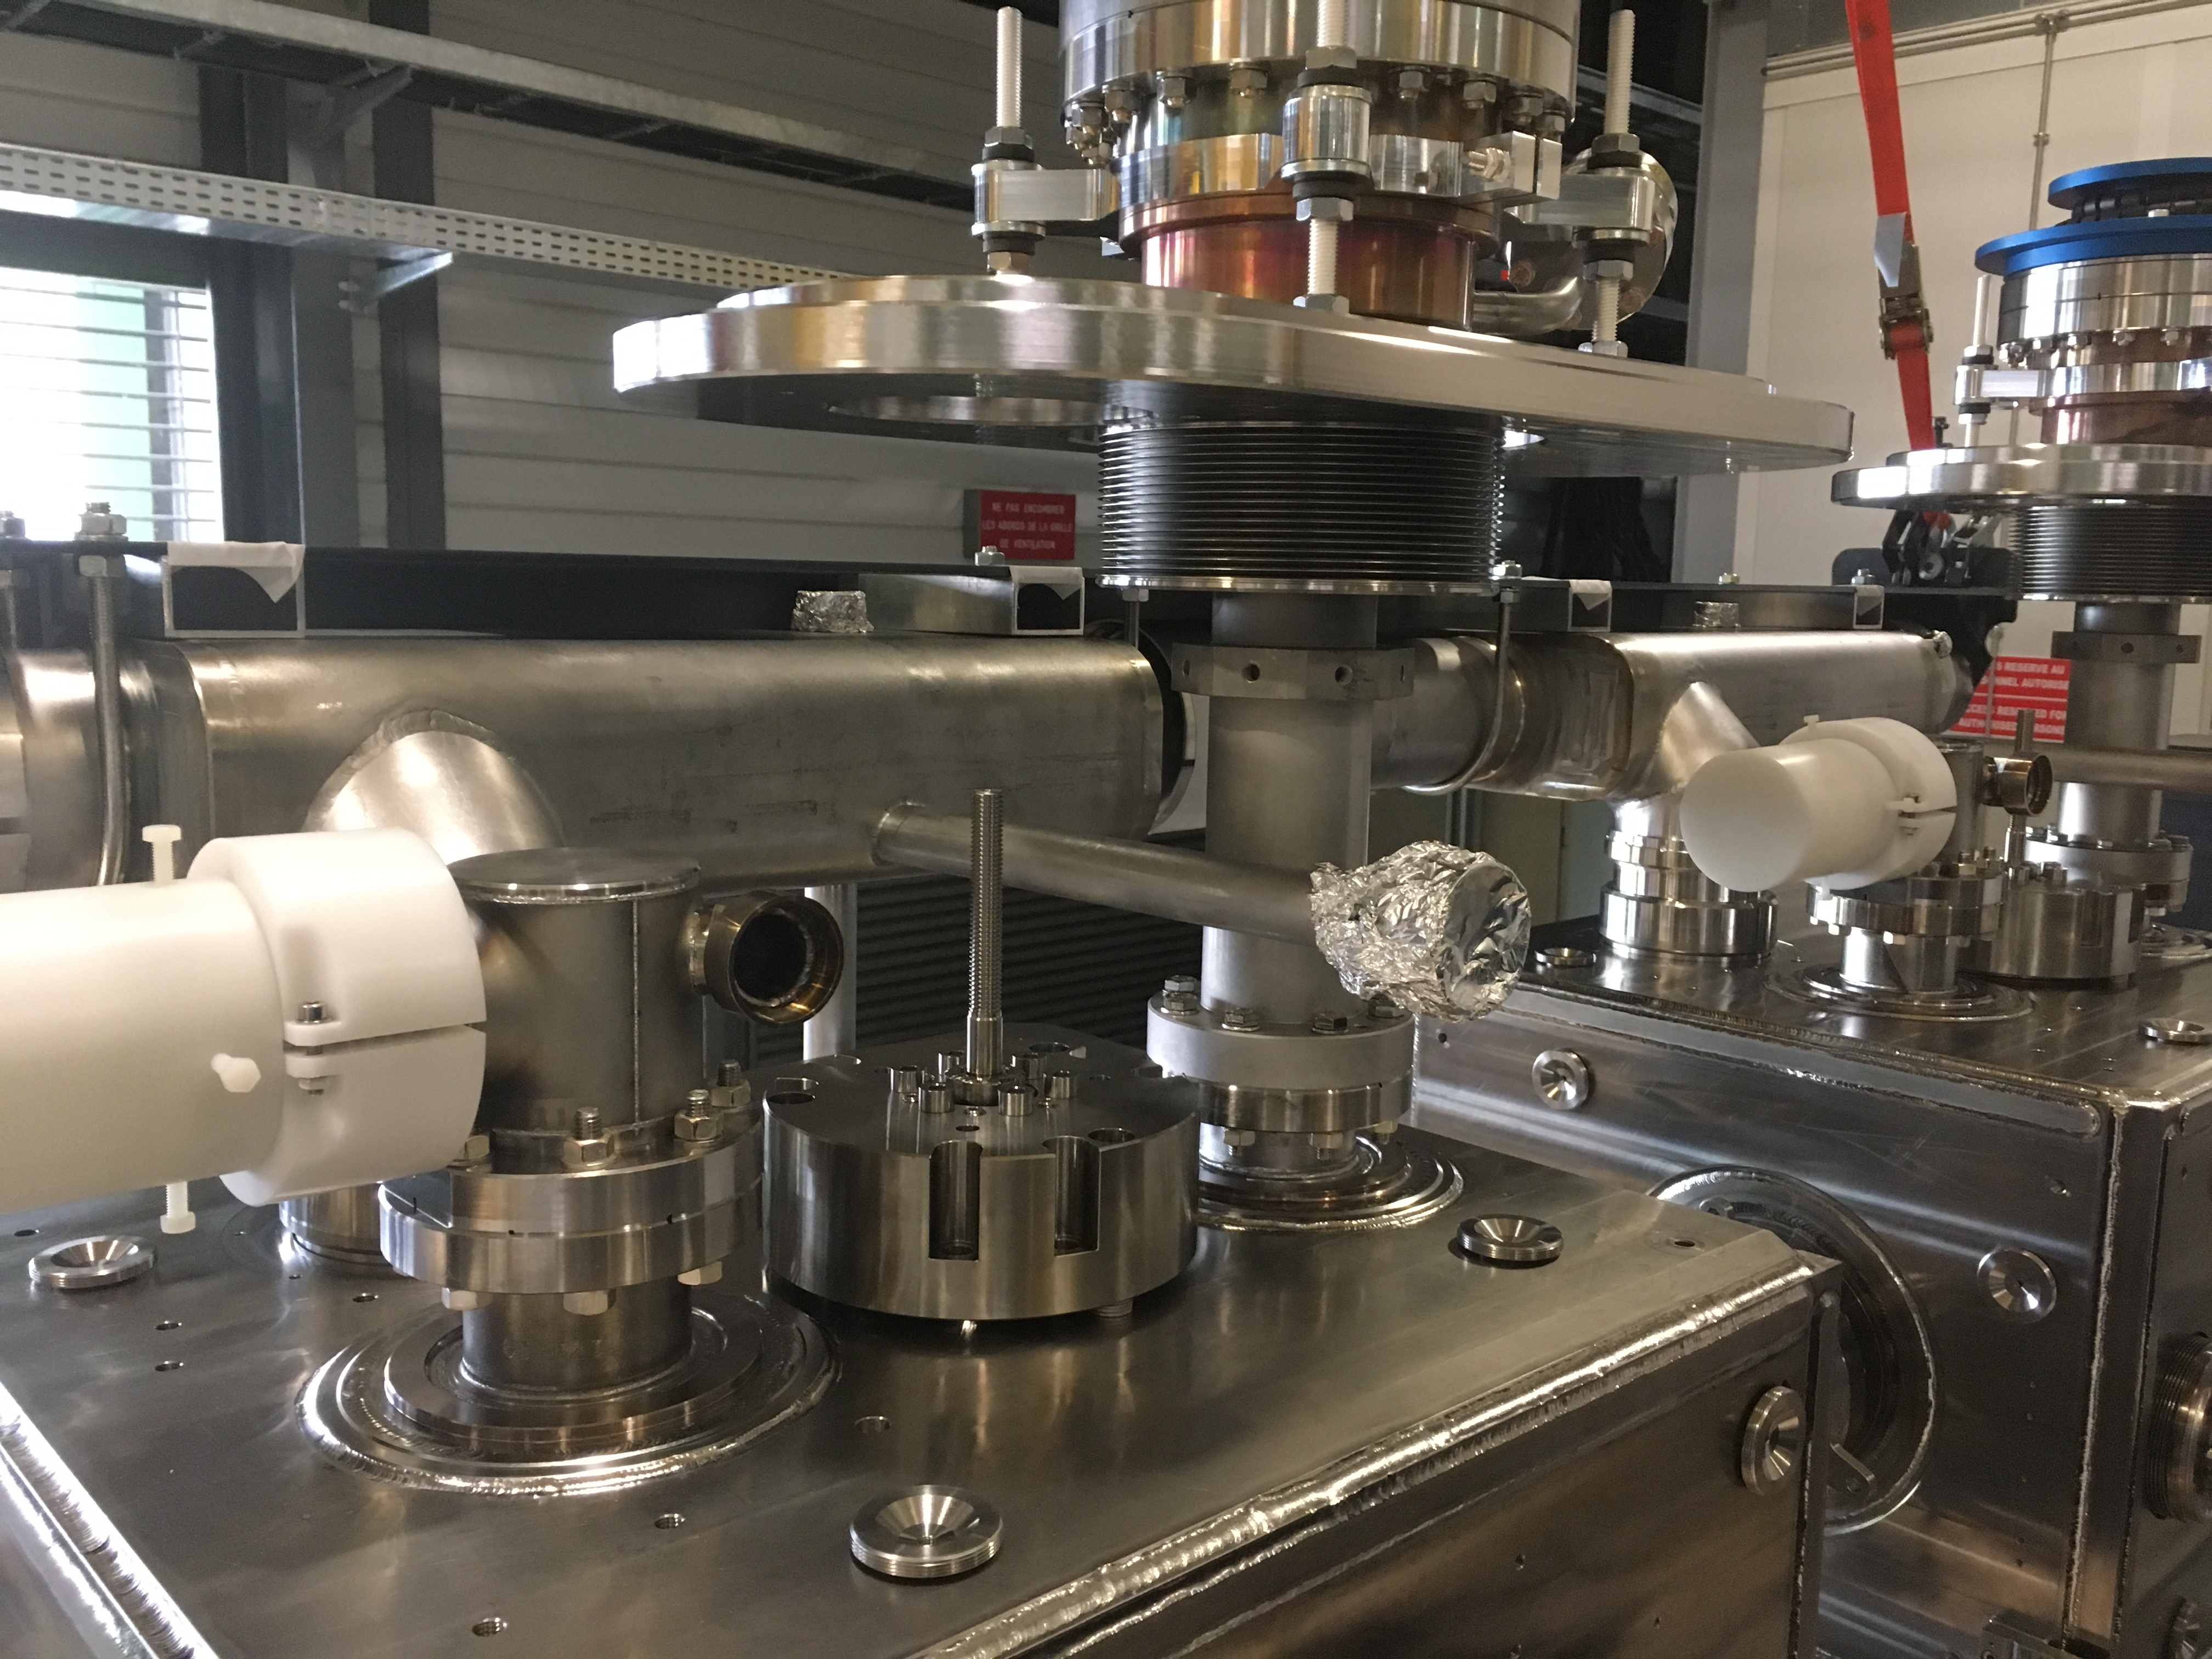
 | Step
Part 2 : before cryostating | 4-5 | Alignment of different equipment
 |  | Installation of FSI supports
 |  | Measurement of FSI supports
 |  | Installation FSI targets
Objective / Results :
Cryogenic line : at 1 mm
Oblong bellows plate : at 1 mm
…
Y= 899.85 [900]
X
Y=149.88 [150]
Y=150.01 [150]
X = 0.07 [0]
FPC
X = -0.08 [0]
FPC
Y
Z (top)
X = -137.46 [-137.5]
X = -137.55 [-137.5]
X = -137.42 [-137.5]
X = -137.6 [-137.5]
Y=-1317.86 [-1318.5]
Y=- 2217.84 [-2218.5]

Slide 12
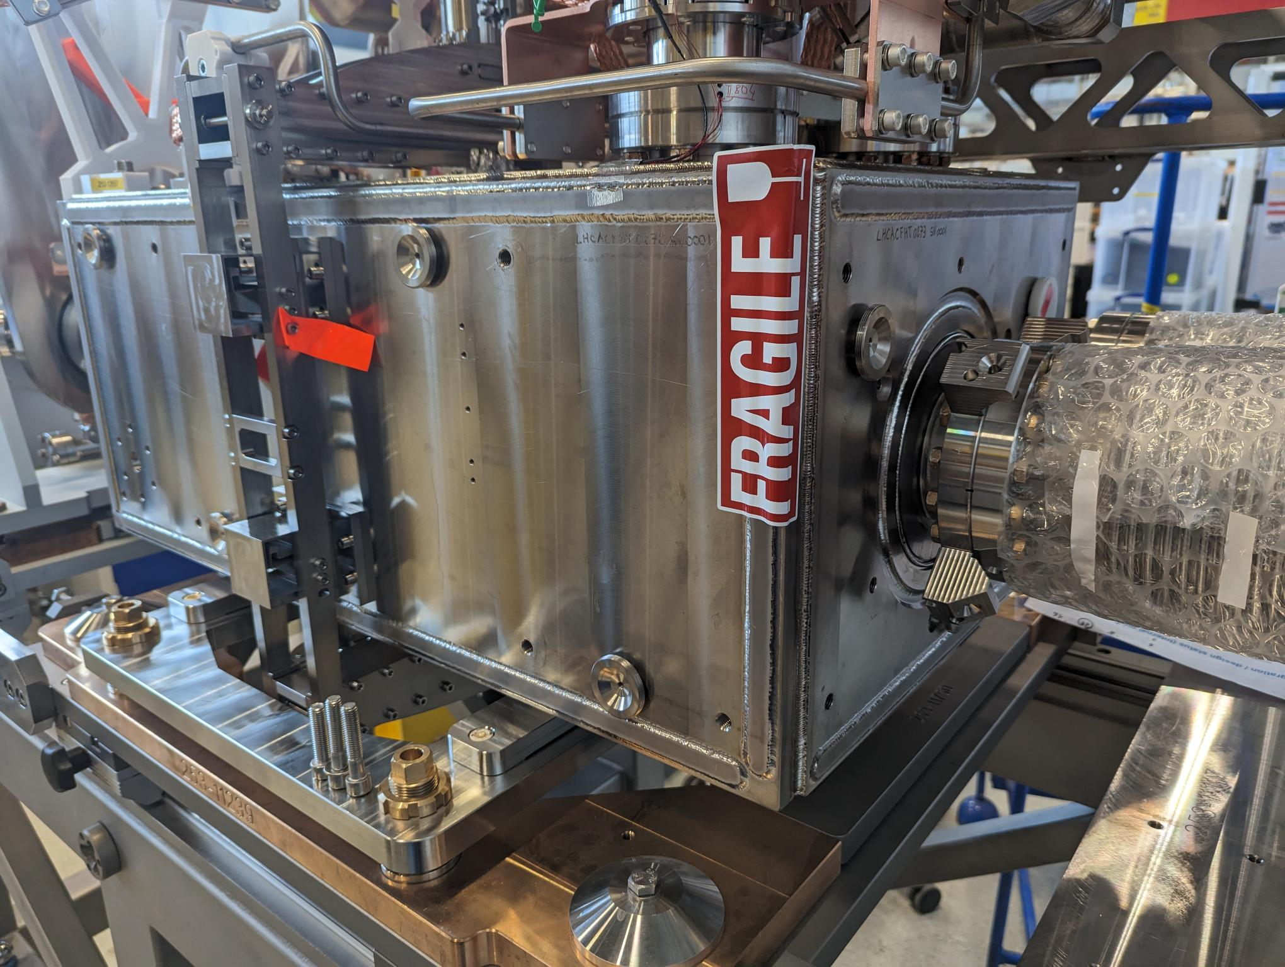
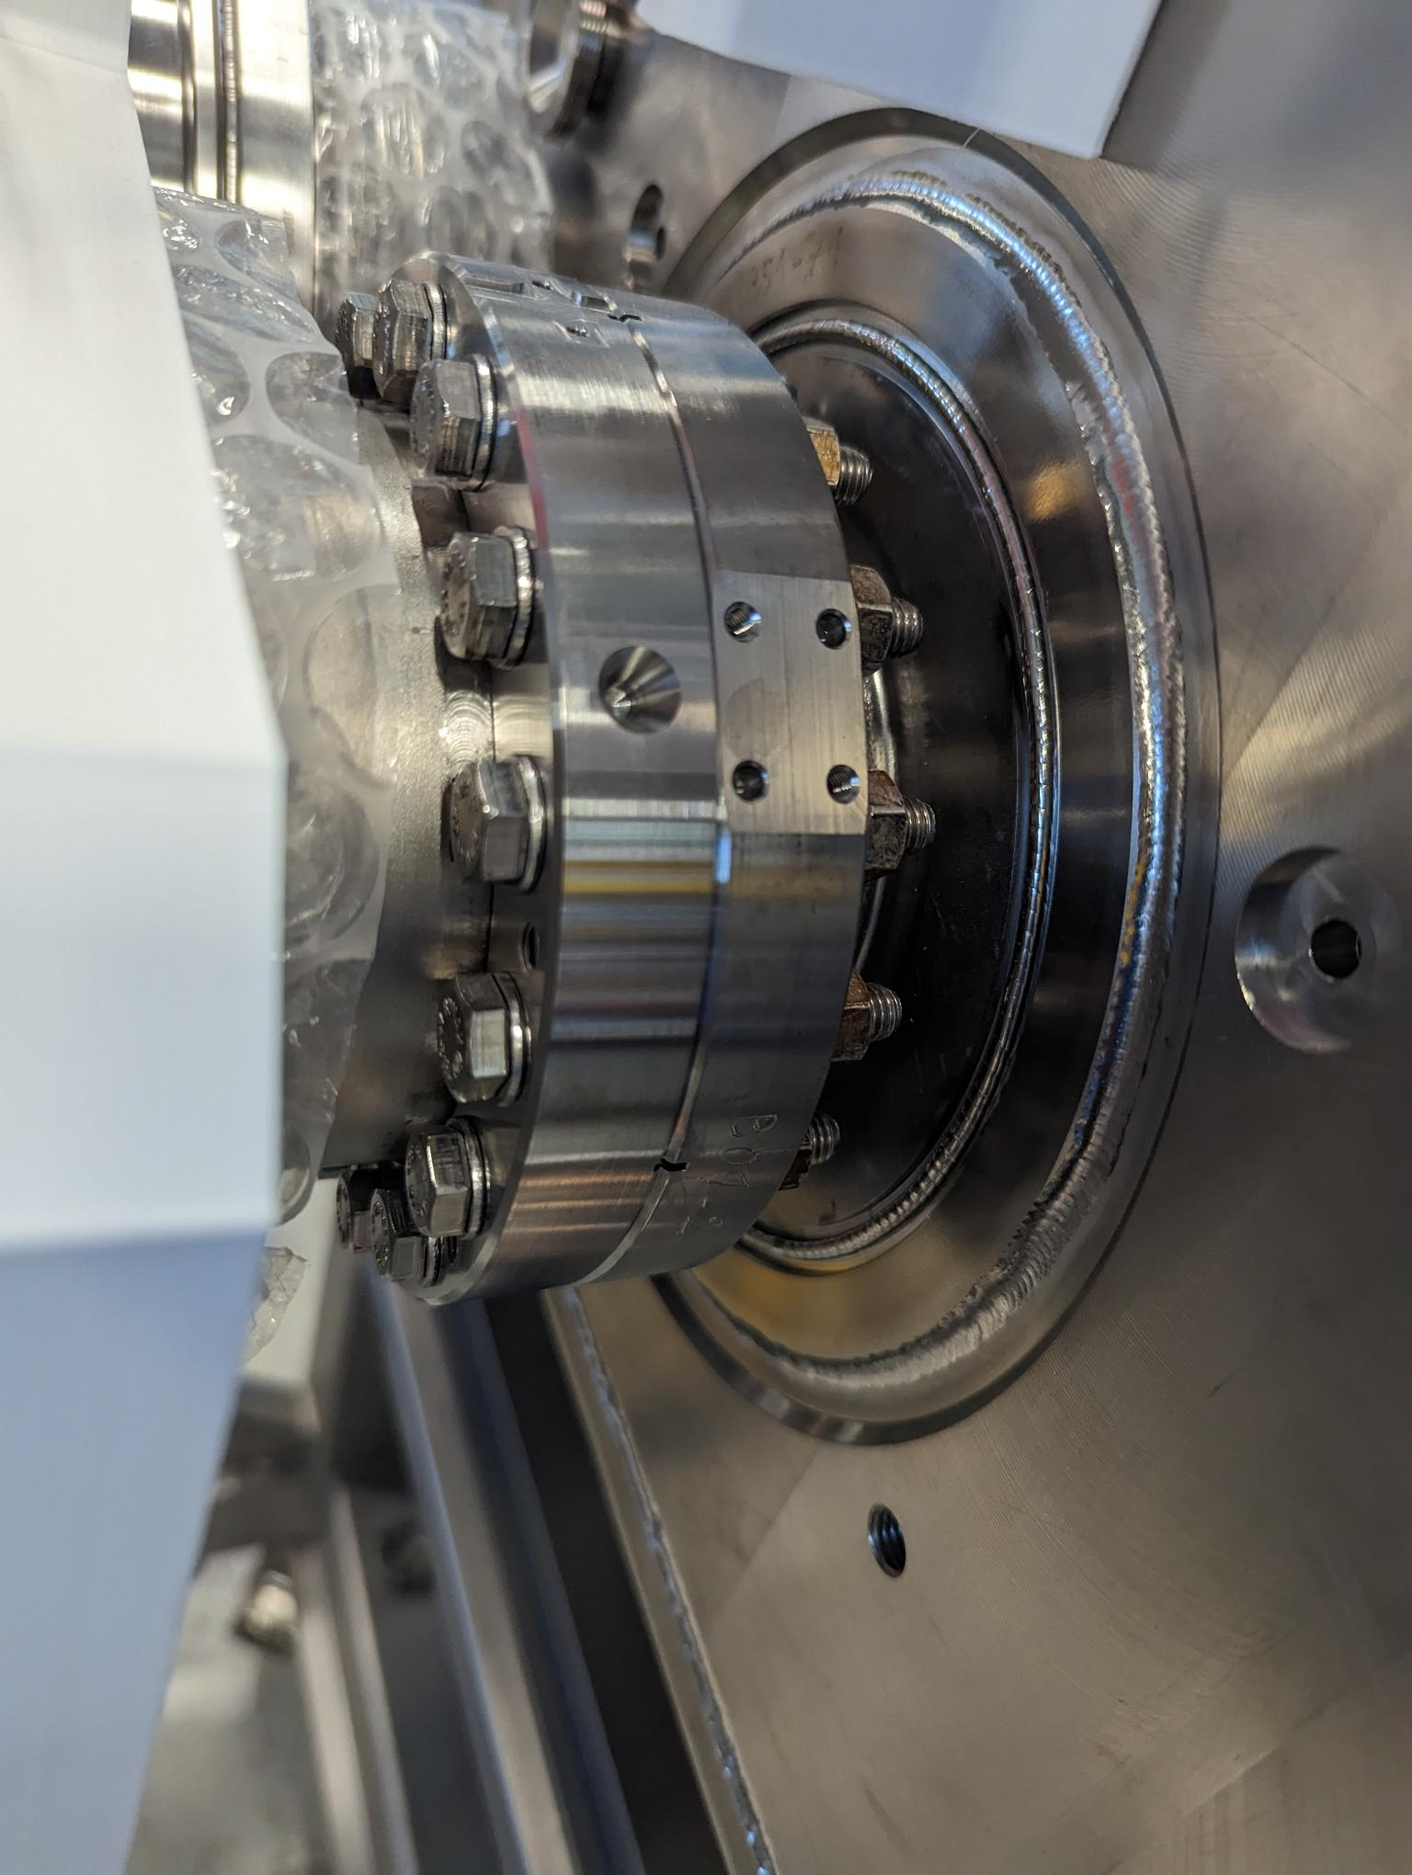
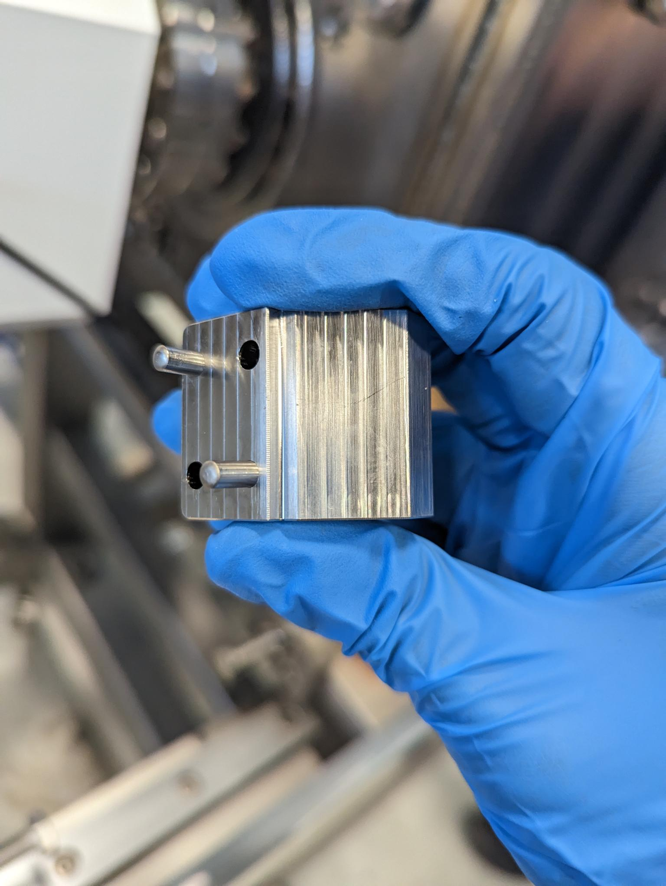
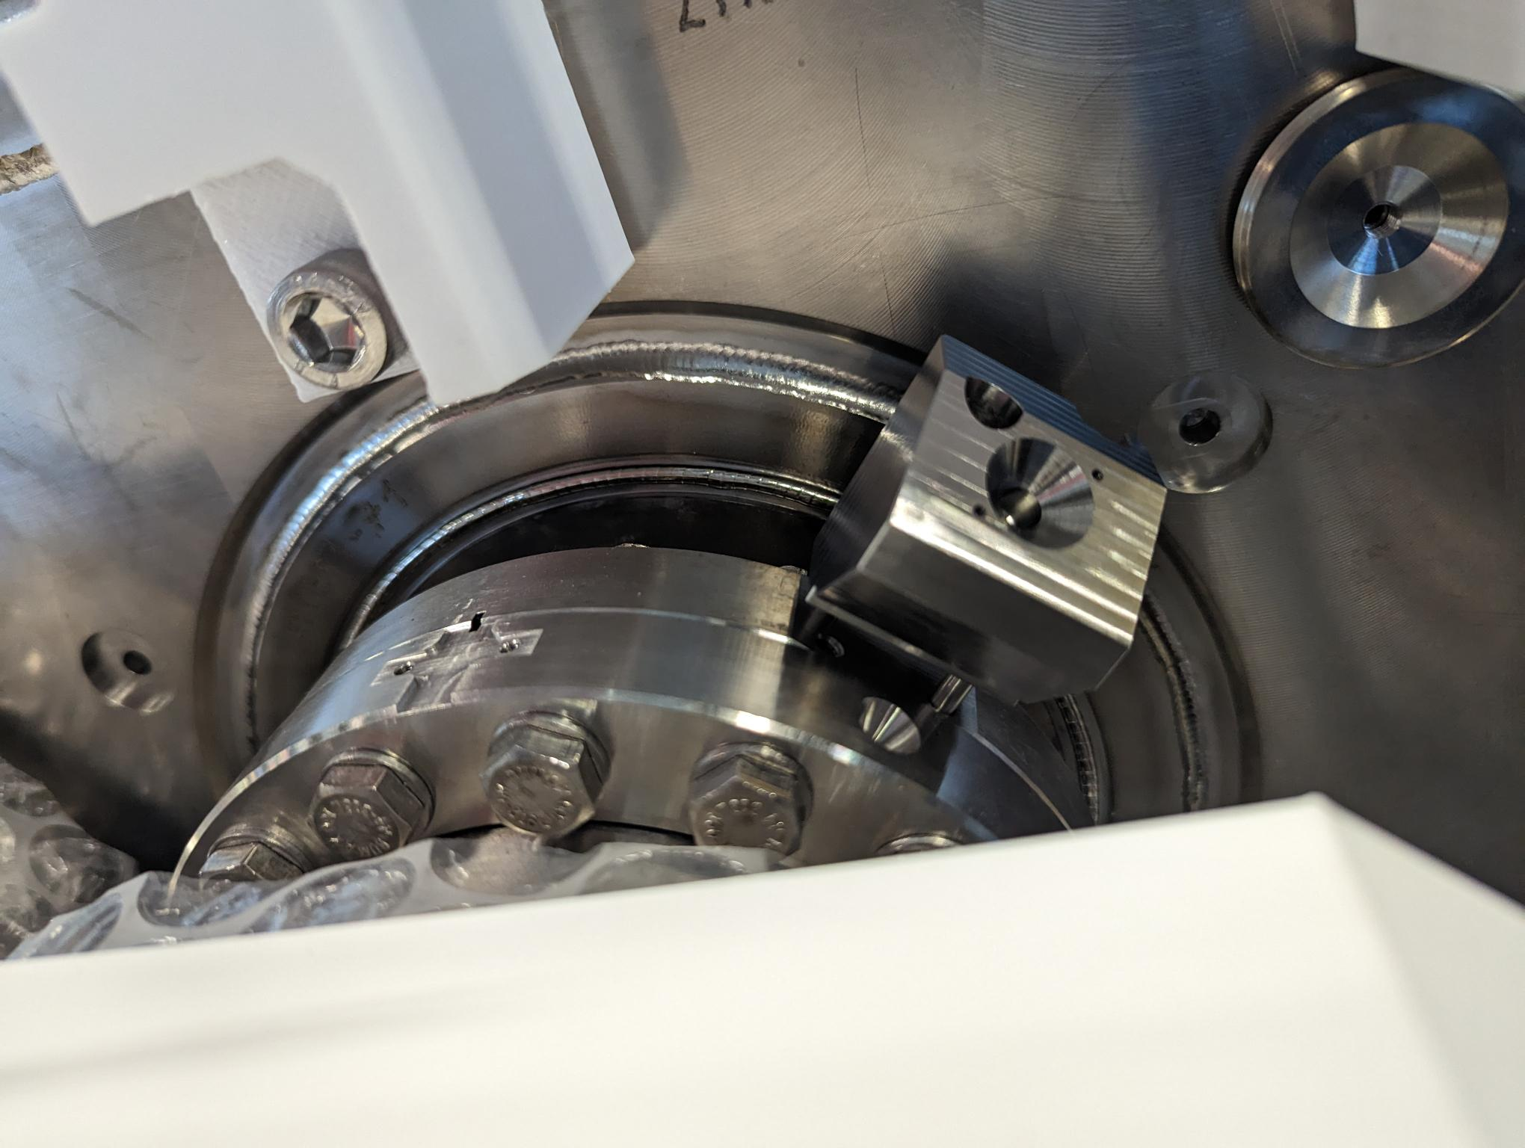
 | Step
Part 2 : before cryostating | 4-5 | Alignment of different equipment
 |  | Installation of FSI supports
 |  | Measurement of FSI supports
 |  | Installation FSI targets

Slide 13
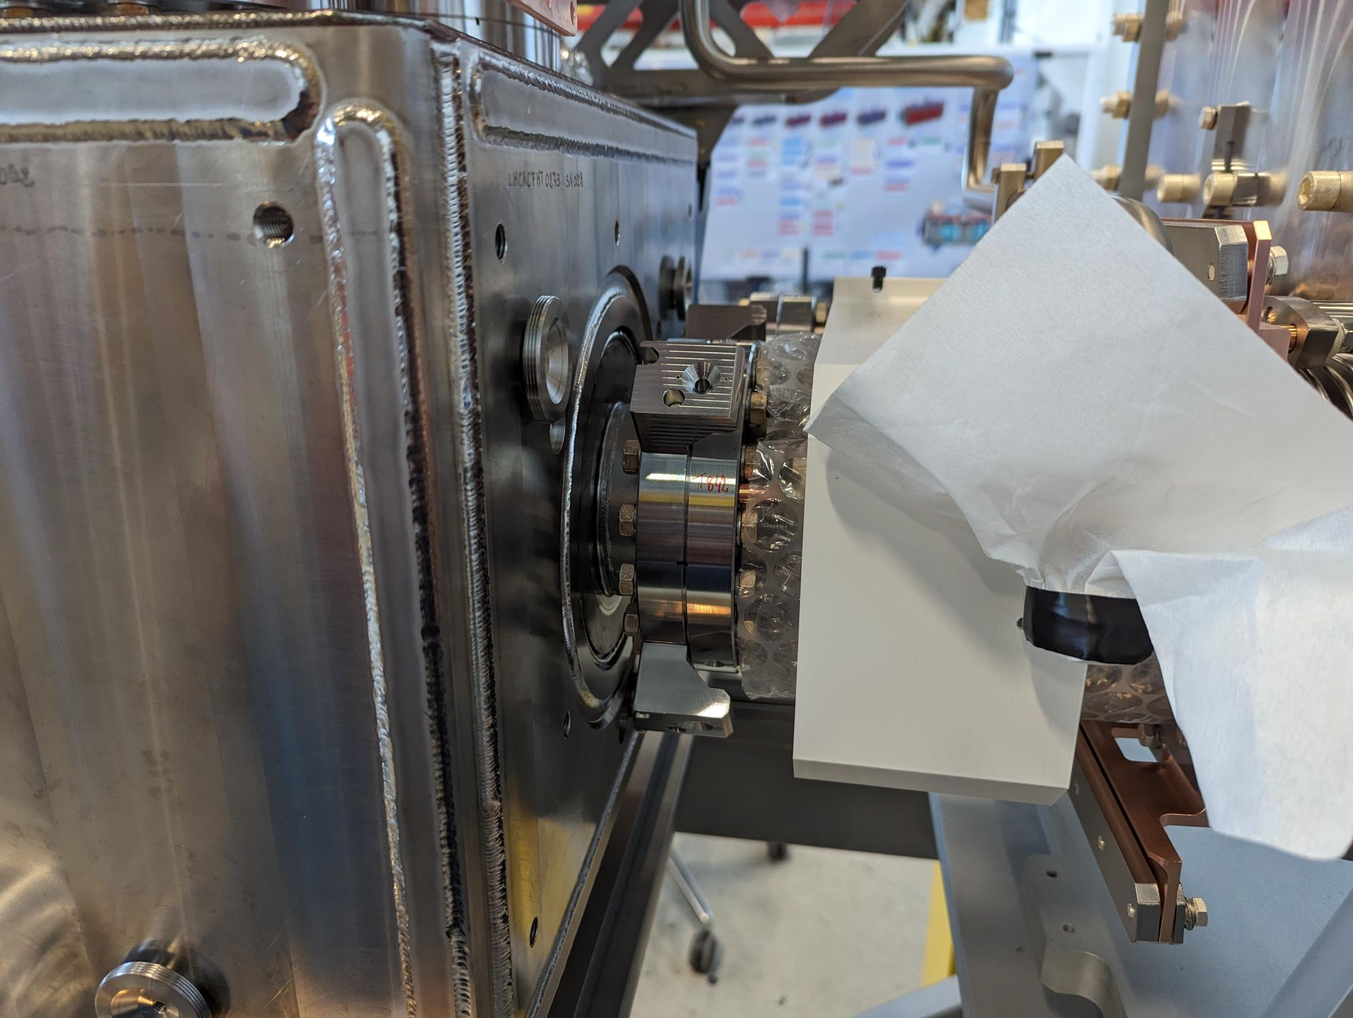
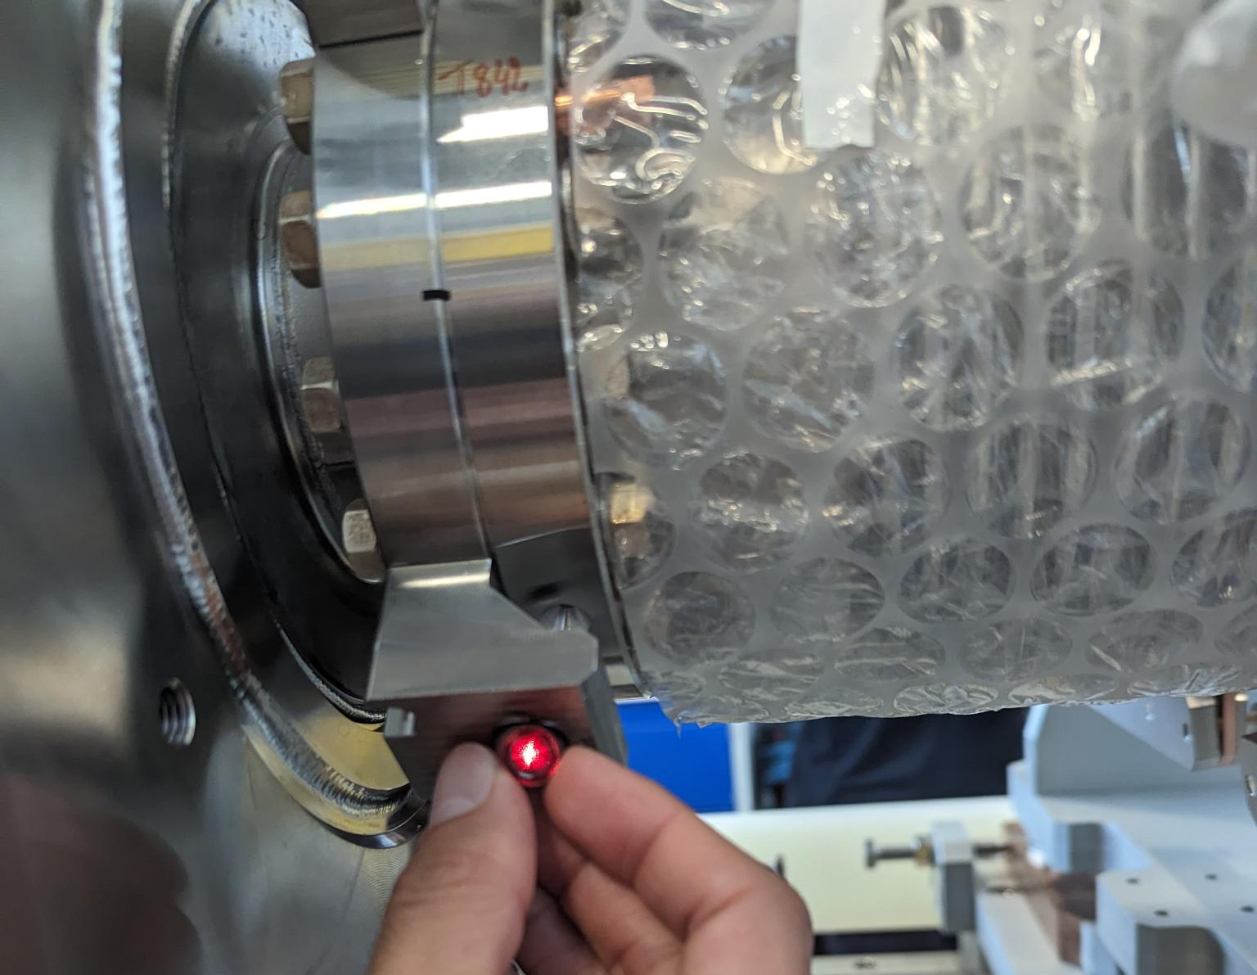
 | Step
Part 2 : before cryostating | 4-5 | Alignment of different equipment
 |  | Installation of FSI supports
 |  | Measurement of FSI supports
 |  | Installation FSI targets
ST5
ST6
ST4
ST3
TROLLEY
TANK1
TANK2
1-4
5-8
9-12
13-16
2-3
6-7
10-11
14-15
ST1
ST2
Each FSI supports should be measured 3 times
Max dispersion : 15 μm per axis

Slide 14
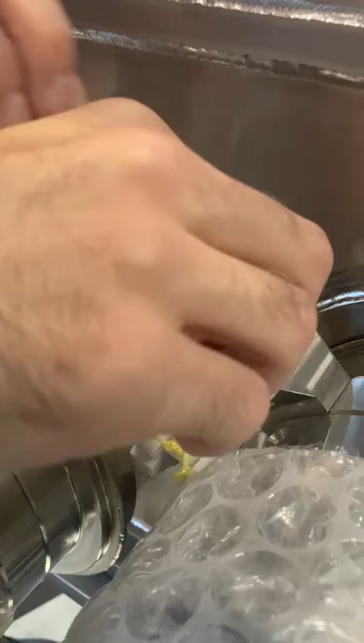
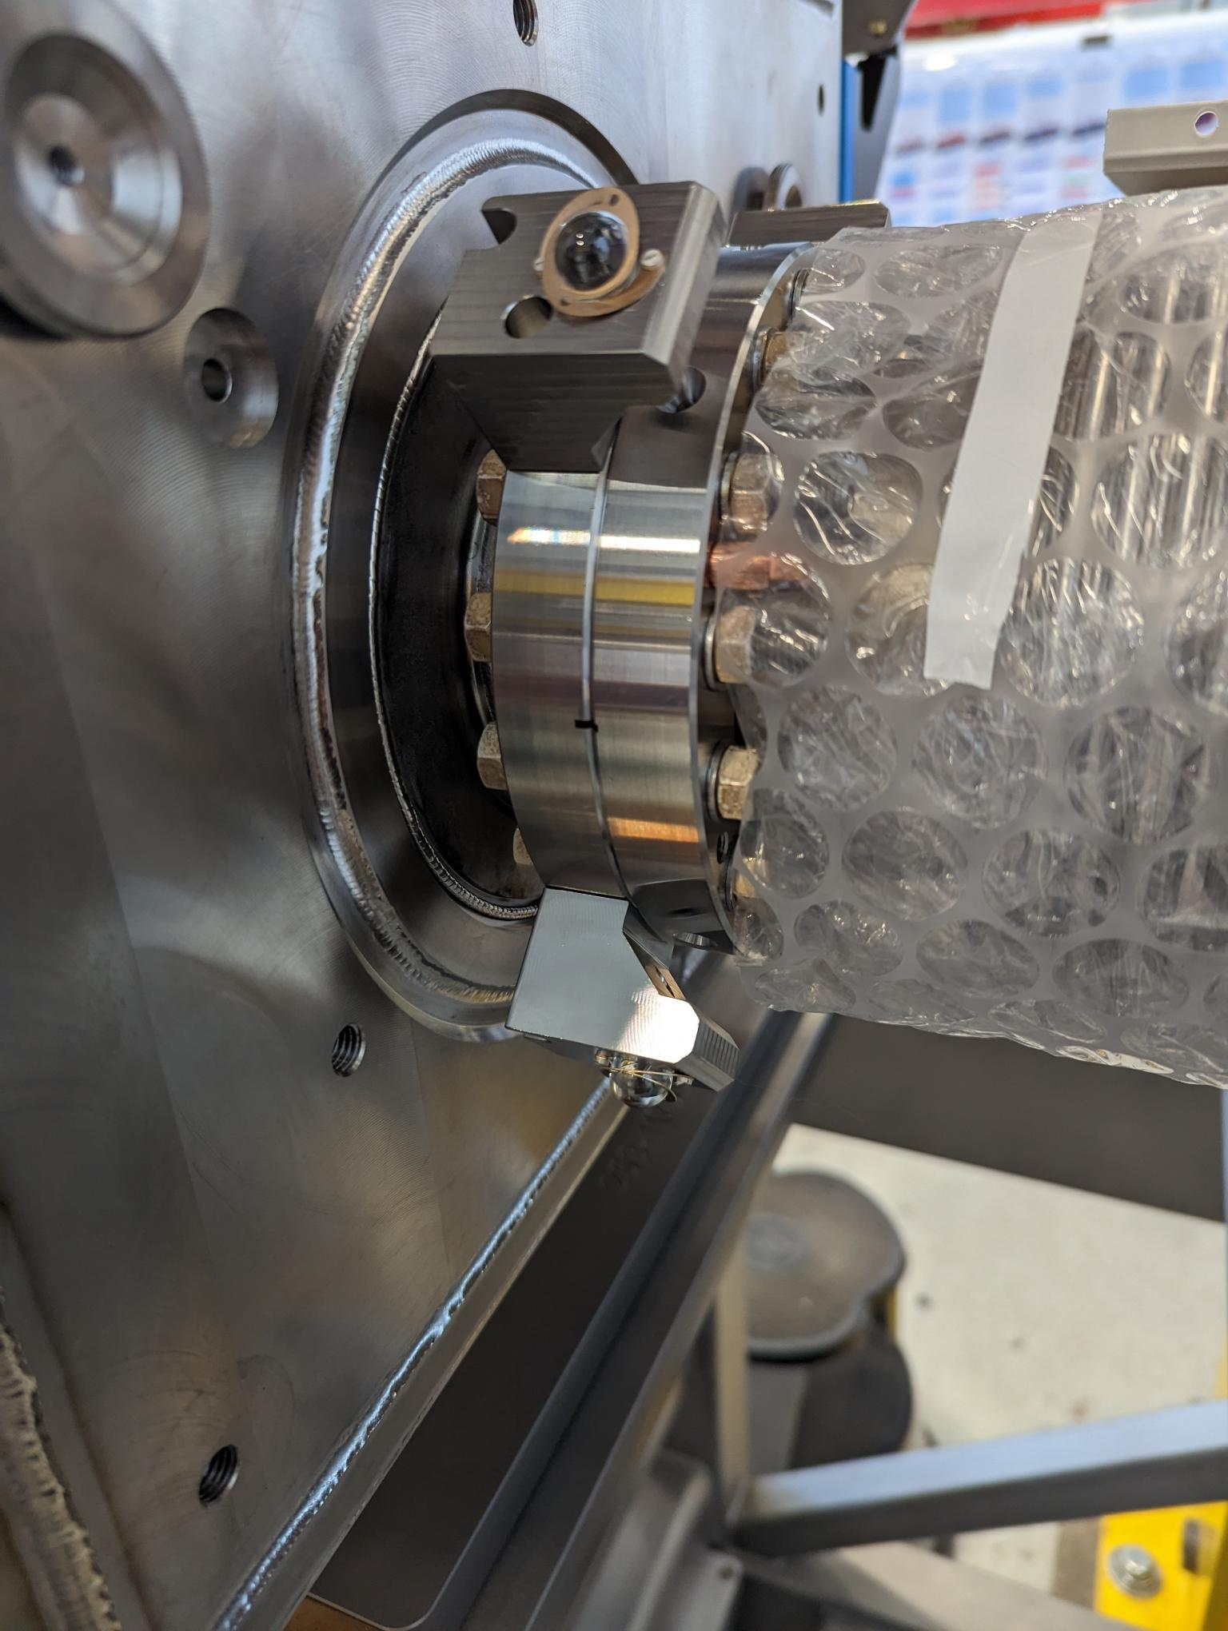
 | Step
Part 2 : before cryostating | 4-5 | Alignment of different equipment
 |  | Installation of FSI supports
 |  | Measurement of FSI supports
 |  | Installation FSI targets

Slide 15
 | Step
Part 3 : cryostating (top plate) | 6 | Alignment of the cavities before cryostating
 |  | Measurement of the top plate cryomodule
 |  | Alignment trolley and top plate
Into taking in account vacuum, cold and hanging motions
Nominal position
Position after alignment
TANK 1
TANK 2
Longitudinal axis (mm)
Longitudinal axis (mm)
TANK 1
TANK 2
Ry = -180 μrad [0]
Ry = -124 μrad [0]

Slide 16
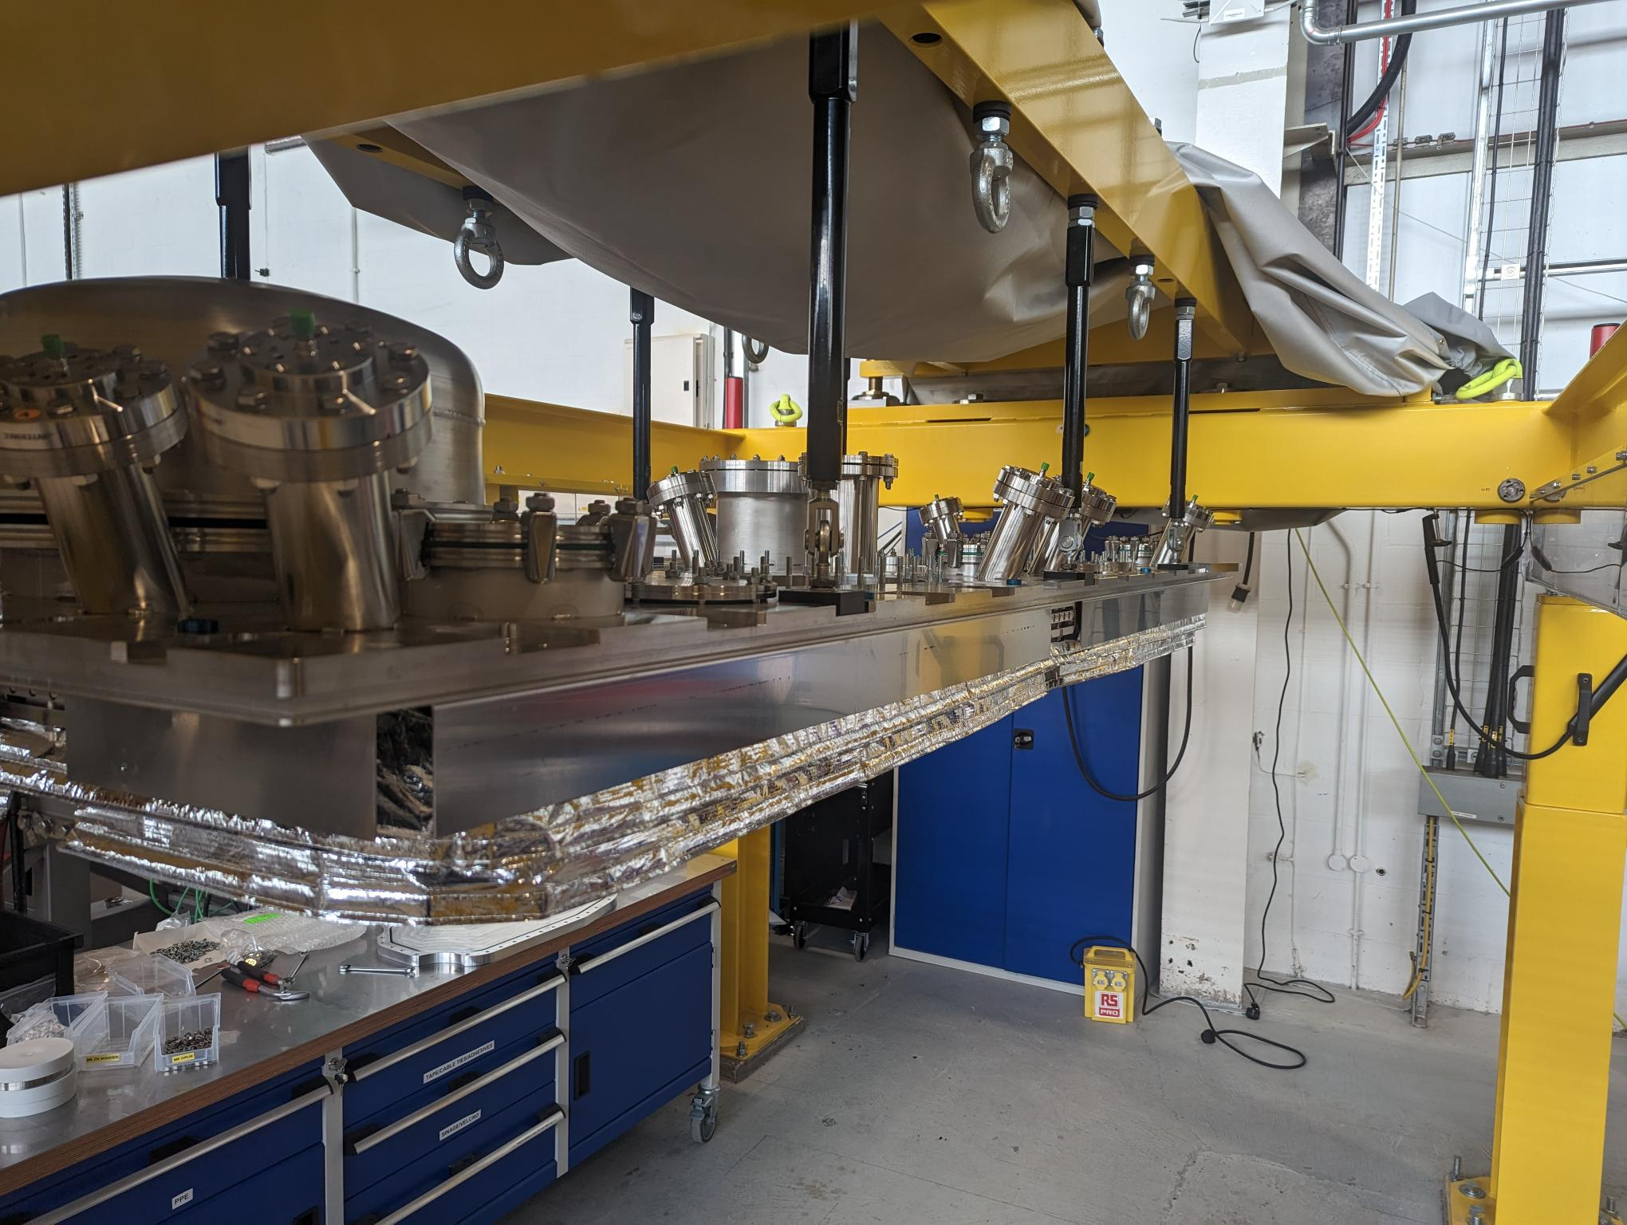
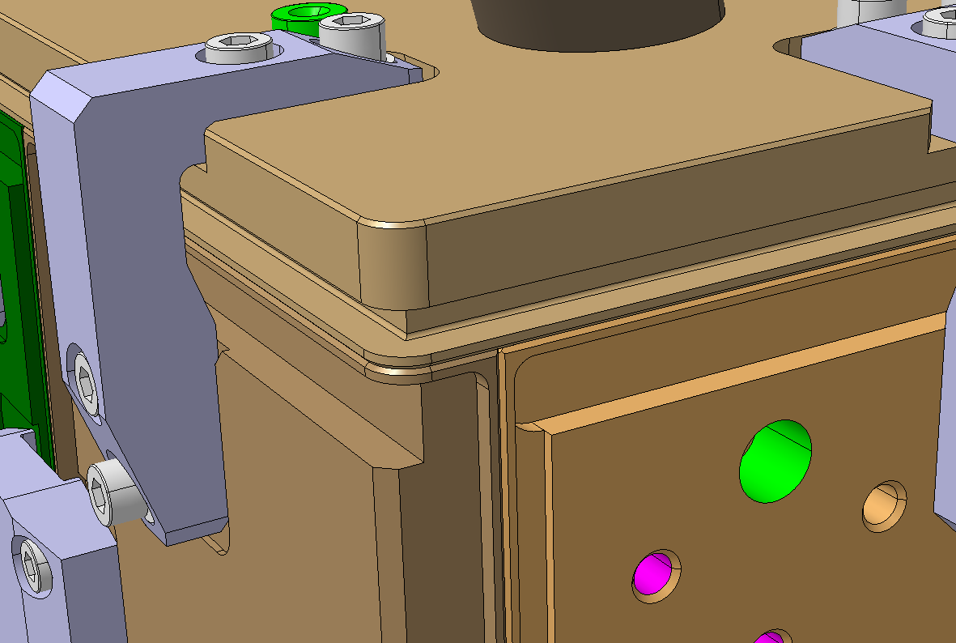
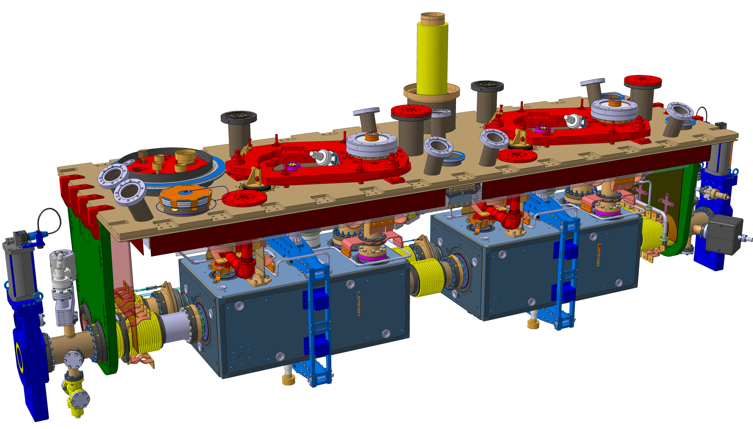
 | Step
Part 3 : cryostating (top plate) | 6 | Alignment of the cavities before cryostating
 |  | Measurement of the top plate cryomodule
 |  | Alignment trolley and top plate
Extremity face of the upper plate
Longitudinal reference
Top face of the upper plate
Vertical reference
Lateral face of the upper plate Transversal reference
R-top plate
Primary axis : Z : normal vector to top plate (on the edges)
Secondary axis : Y : normal vecor to lateral face
Origin : center of the 3 planes shifted of :
  X = 390 mm
  Y = 0 mm
  Z = 565 mm

Slide 17
 | Step
Part 3 : cryostating (top plate) | 6 | Alignment of the cavities before cryostating
 |  | Measurement of the top plate cryomodule
 |  | Alignment trolley and top plate
The 2 coordinate systems should be at the same position
Y
X
Z

Slide 18
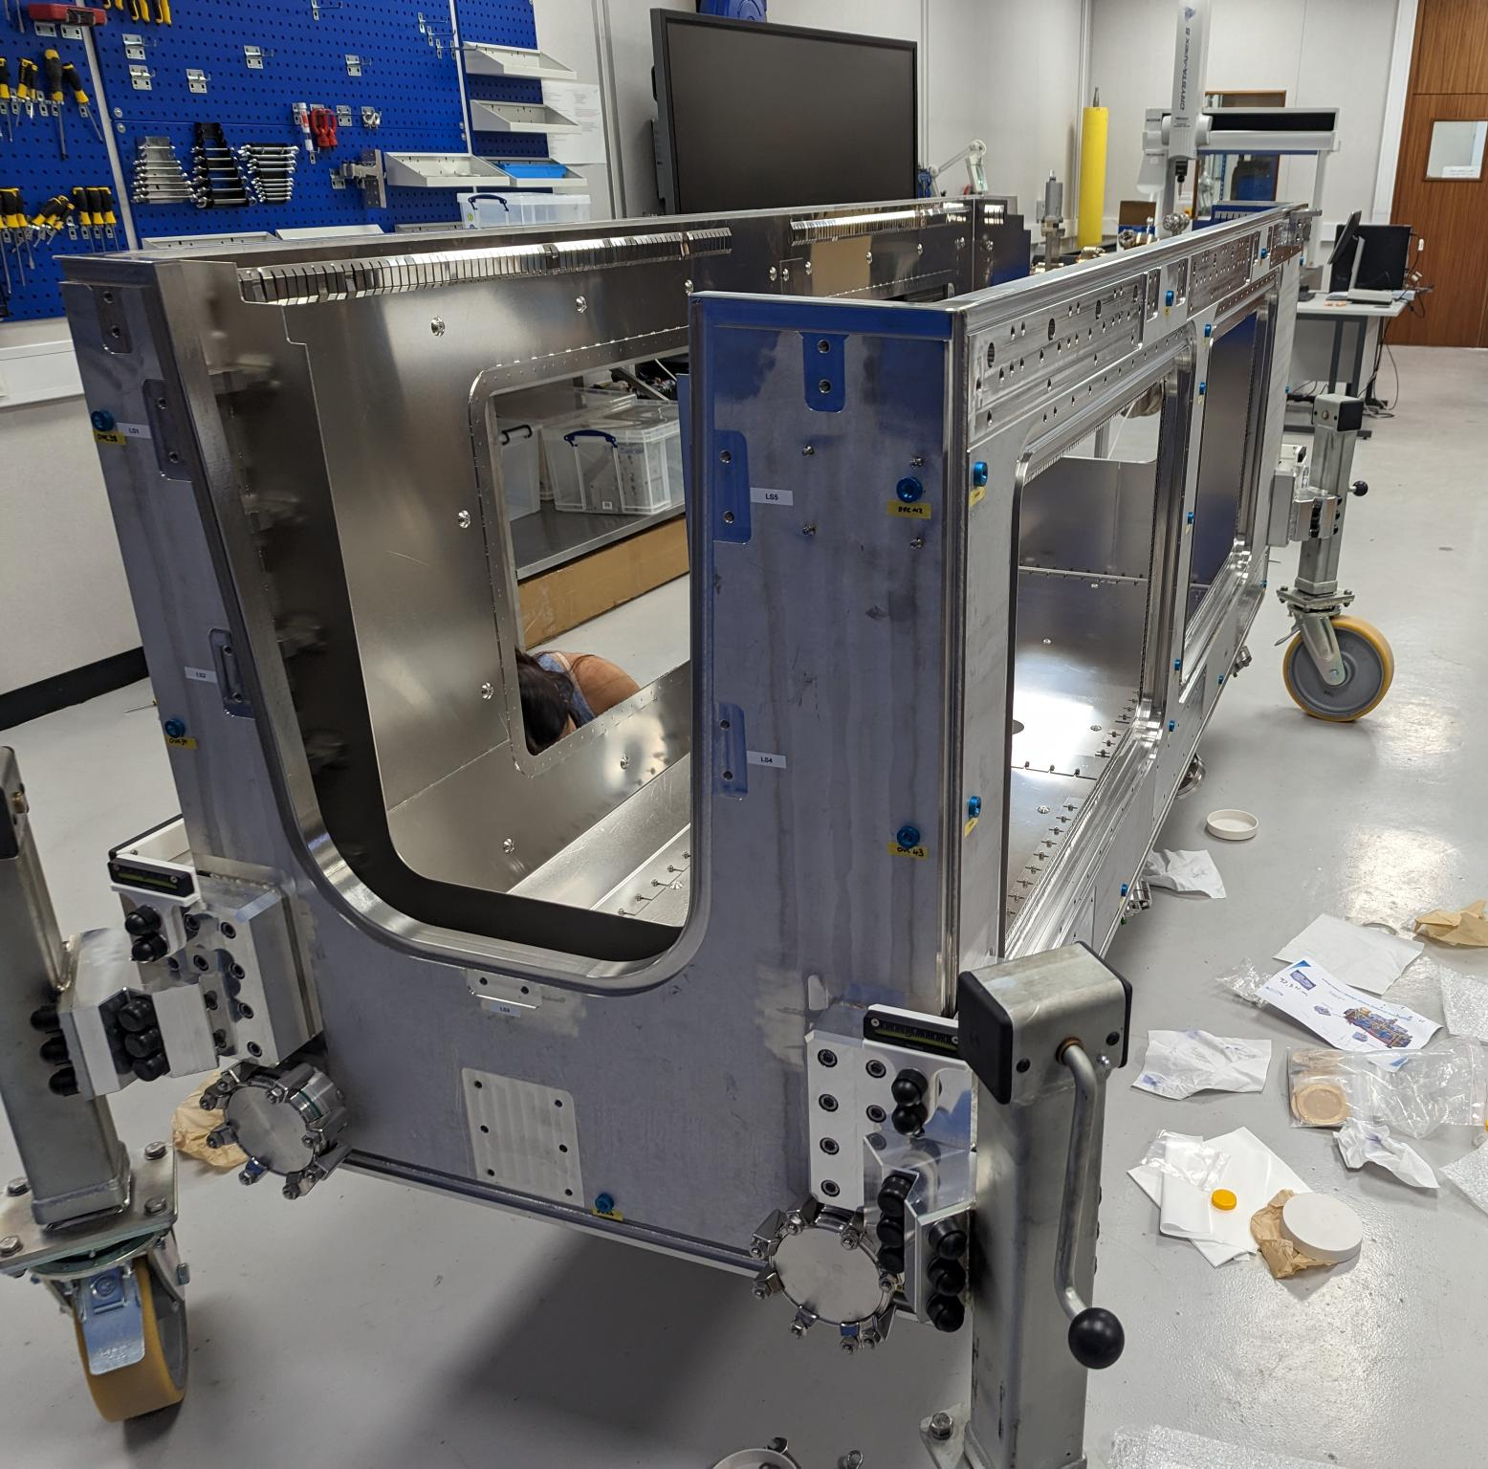
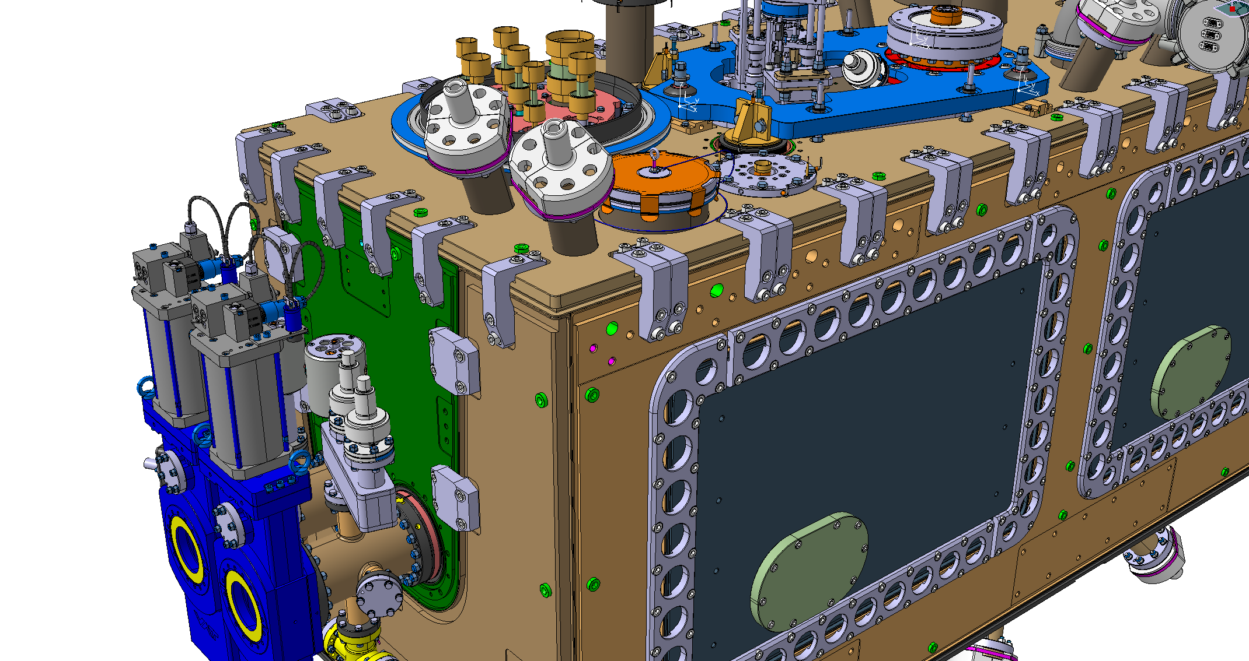
Advice :
Install top plate on the OVC.
The coordinate system of the top plate will be the coordinate system of the OVC
 | Step
Part 4 : cryostating (OVC cryomodule) | 10 | Measurement of the OVC cryomodule
 |  | Alignment top plate and OVC cryomodule
R-top plate = R OVC
Primary axis : Z : normal vector to top plate (on the edges)
Secondary axis : Y : normal vecor to lateral face
Origin : center of the 3 planes shifted of :
  X = 390 mm
  Y = 0 mm
  Z = 565 mm

Slide 19
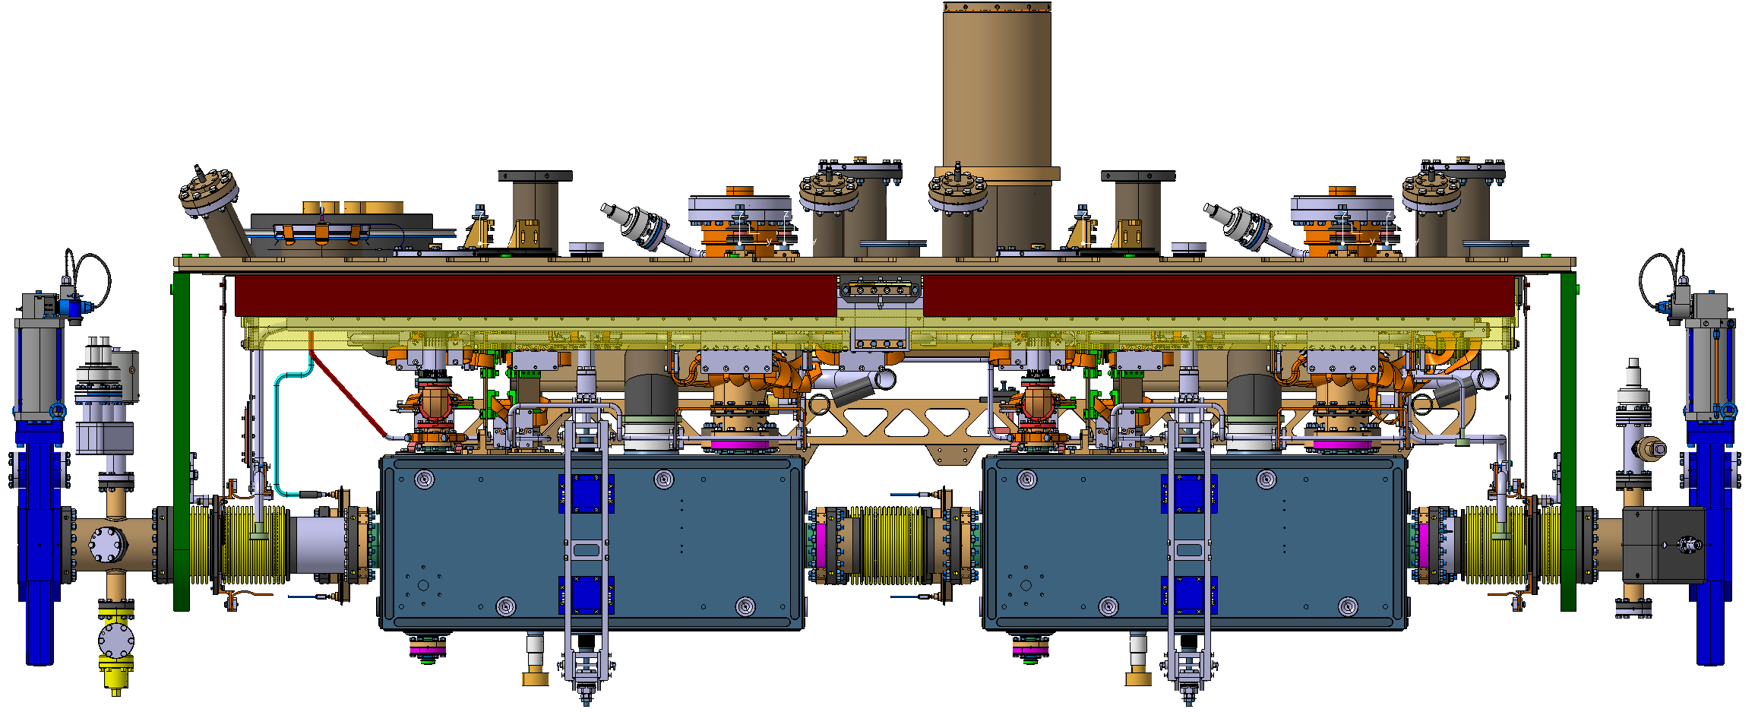
 | Step
Part 4 : cryostating (OVC cryomodule) | 10 | Measurement of the OVC cryomodule
 |  | Alignment top plate and OVC cryomodule
The 2 coordinate systems should be at the same position
OVC

Slide 20
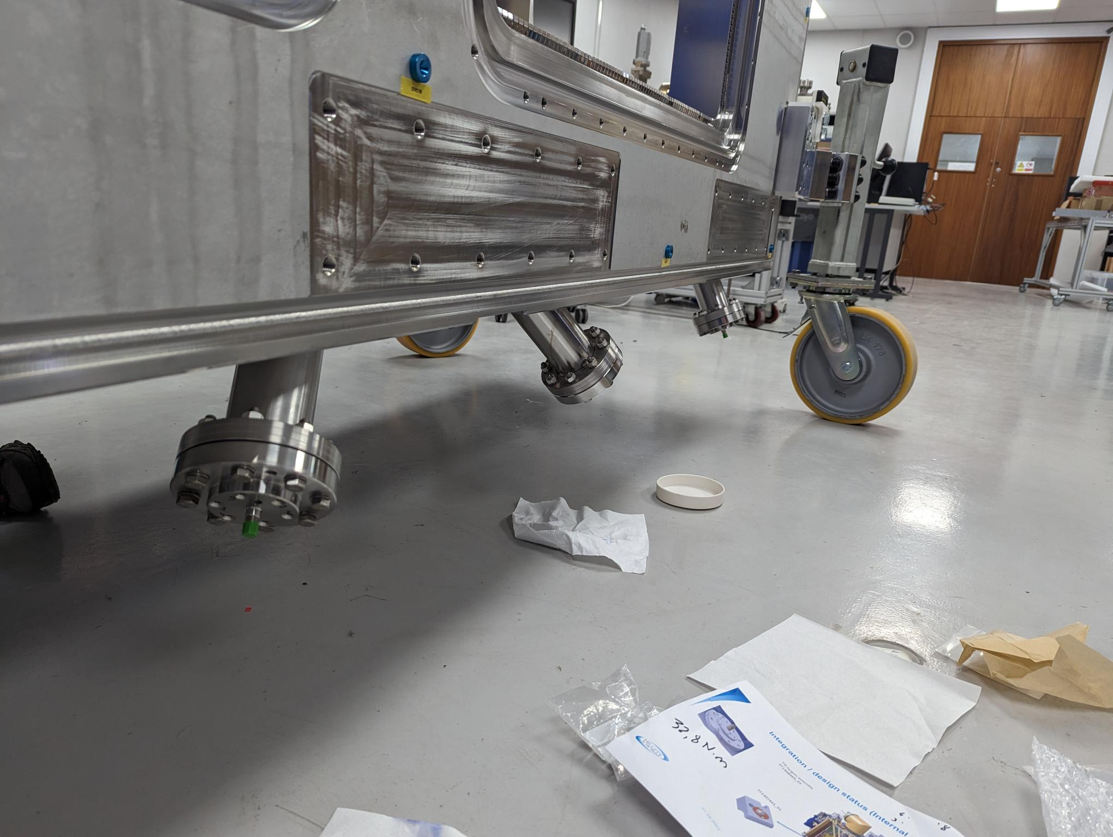
 | Step
Part 5 : after cryostating | 10 | Installation of FSI heads on OVC and top plate
 |  | Measurement of FSI heads on OVC and top plate
 |  | FSI validation (comparison with a laser tracker)
 |  | Alignment with adjustment system

Slide 21
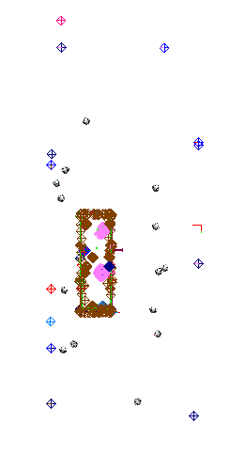
 | Step
Part 5 : after cryostating | 10 | Installation of FSI heads on OVC and top plate
 |  | Measurement of FSI heads on OVC and top plate + TANK position
 |  | FSI validation (comparison with a laser tracker)
 |  | Alignment with adjustment system
EDMS : 2996397
Legend
Station
Cryomodule

Slide 22
 | Step
Part 5 : after cryostating | 10 | Installation of FSI heads on OVC and top plate
 |  | Measurement of FSI heads on OVC and top plate
 |  | FSI validation (comparison with a laser tracker)
 |  | Alignment with adjustment system
Should be less inside :
[-0.040 mm : 0.040 mm]
 | Head | Target | FSI 3 D distance | Laser Tracker 3 D distance | Comparison
TANK 1 | 1 | 1
TANK 1 | 2 | 2
TANK 1 | 3 | 3
TANK 1 | 4 | 4
TANK 1 | 5 | 5
TANK 1 | 6 | 6
TANK 2 | 7 | 11
TANK 2 | 8 | 12
TANK 2 | 9 | 9
TANK 2 | 10 | 10
TANK 1 | 11 | 7
TANK 1 | 12 | 8
TANK 2 | 13 | 13
TANK 2 | 14 | 14
TANK 2 | 15 | 15
TANK 2 | 16 | 16

Slide 23
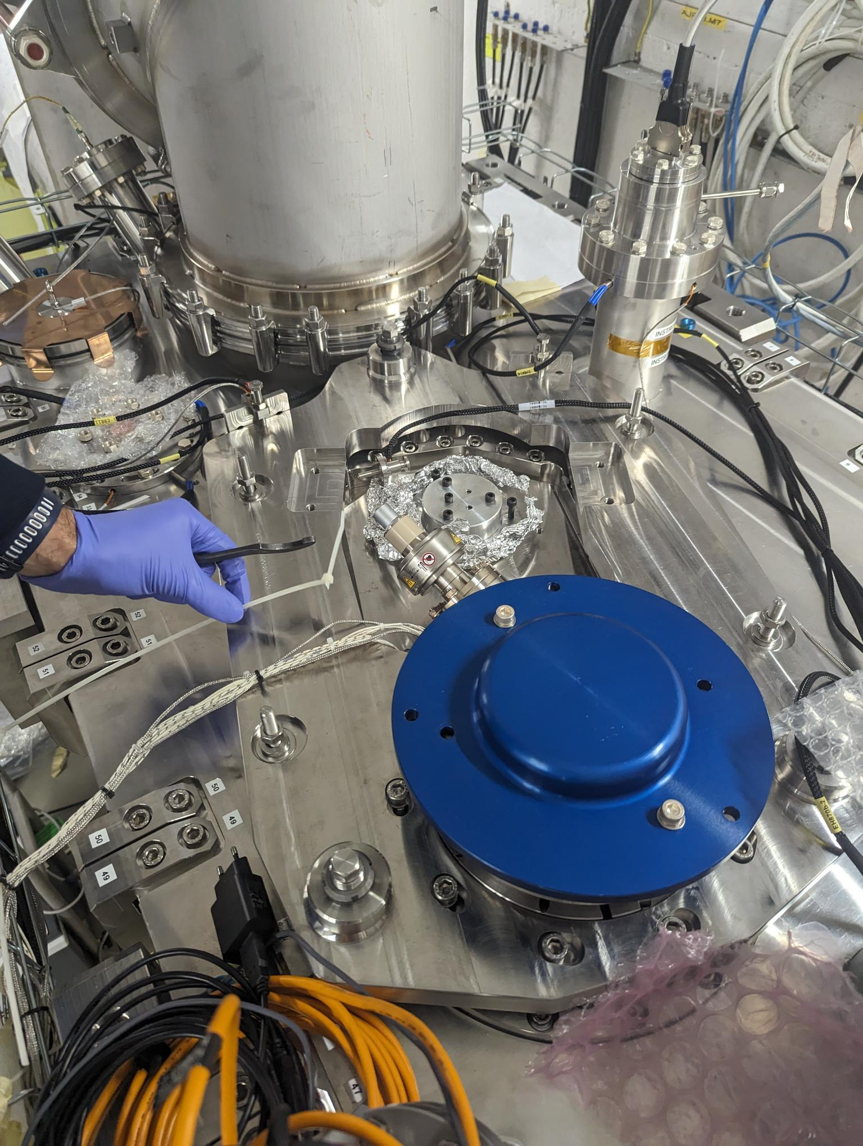
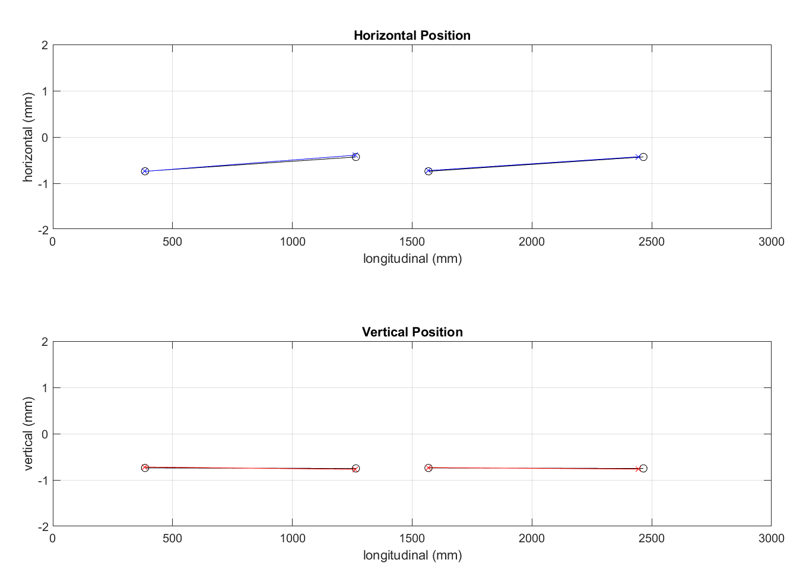
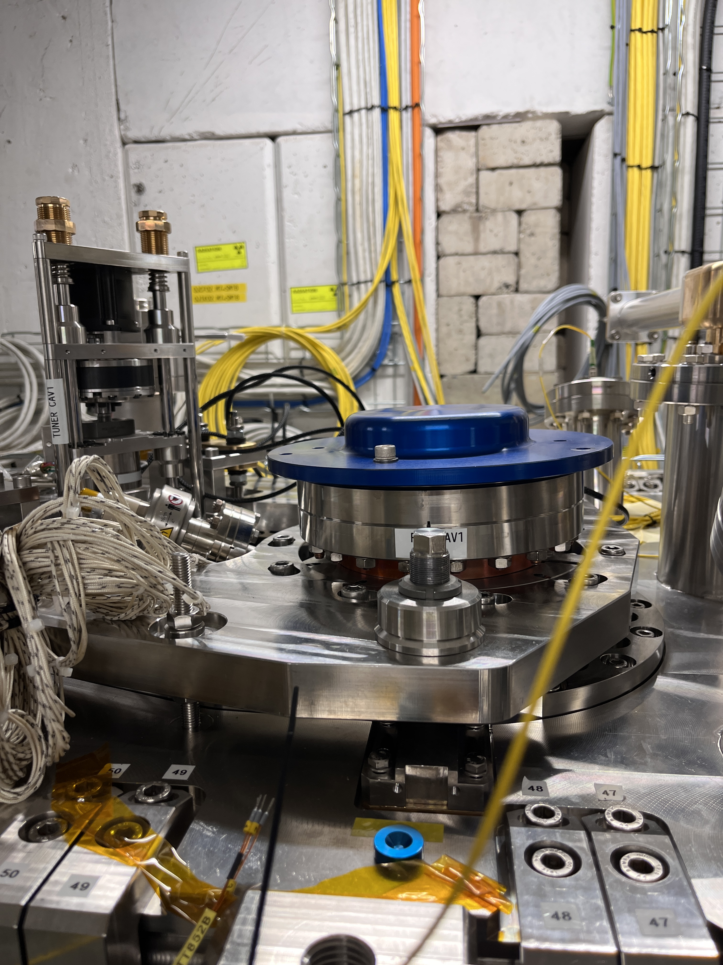
 | Step
Part 5 : after cryostating | 10 | Installation of FSI heads on OVC and top plate
 |  | Measurement of FSI heads on OVC and top plate
 |  | FSI validation (comparison with a laser tracker)
 |  | Alignment with adjustment system
EDMS : 3065249
Should be less inside :
[-0.040 mm : 0.040 mm]

Slide 24
 | Step
Part 6 : cold test at STFC or Triumf | 12 | Measurement ambient pressure
 |  | Measurement under vacuum
 |  | Measurement at cold
Legend
Station
Cryomodule

Slide 25
 | Step
Part 6 : cold test at STFC or Triumf | 12 | Measurement ambient pressure
 |  | Measurement under vacuum
 |  | Measurement at cold
Legend
Station
Cryomodule

Slide 26
 | Step
Part 6 : cold test at STFC or Triumf | 12 | Measurement ambient pressure
 |  | Measurement under vacuum
 |  | Measurement at cold
Legend
Station
Cryomodule

Slide 27
Thank you
for your attention

Slide 28
SPARE

Slide 29
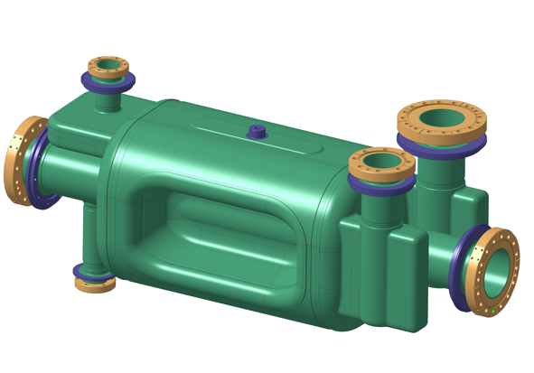
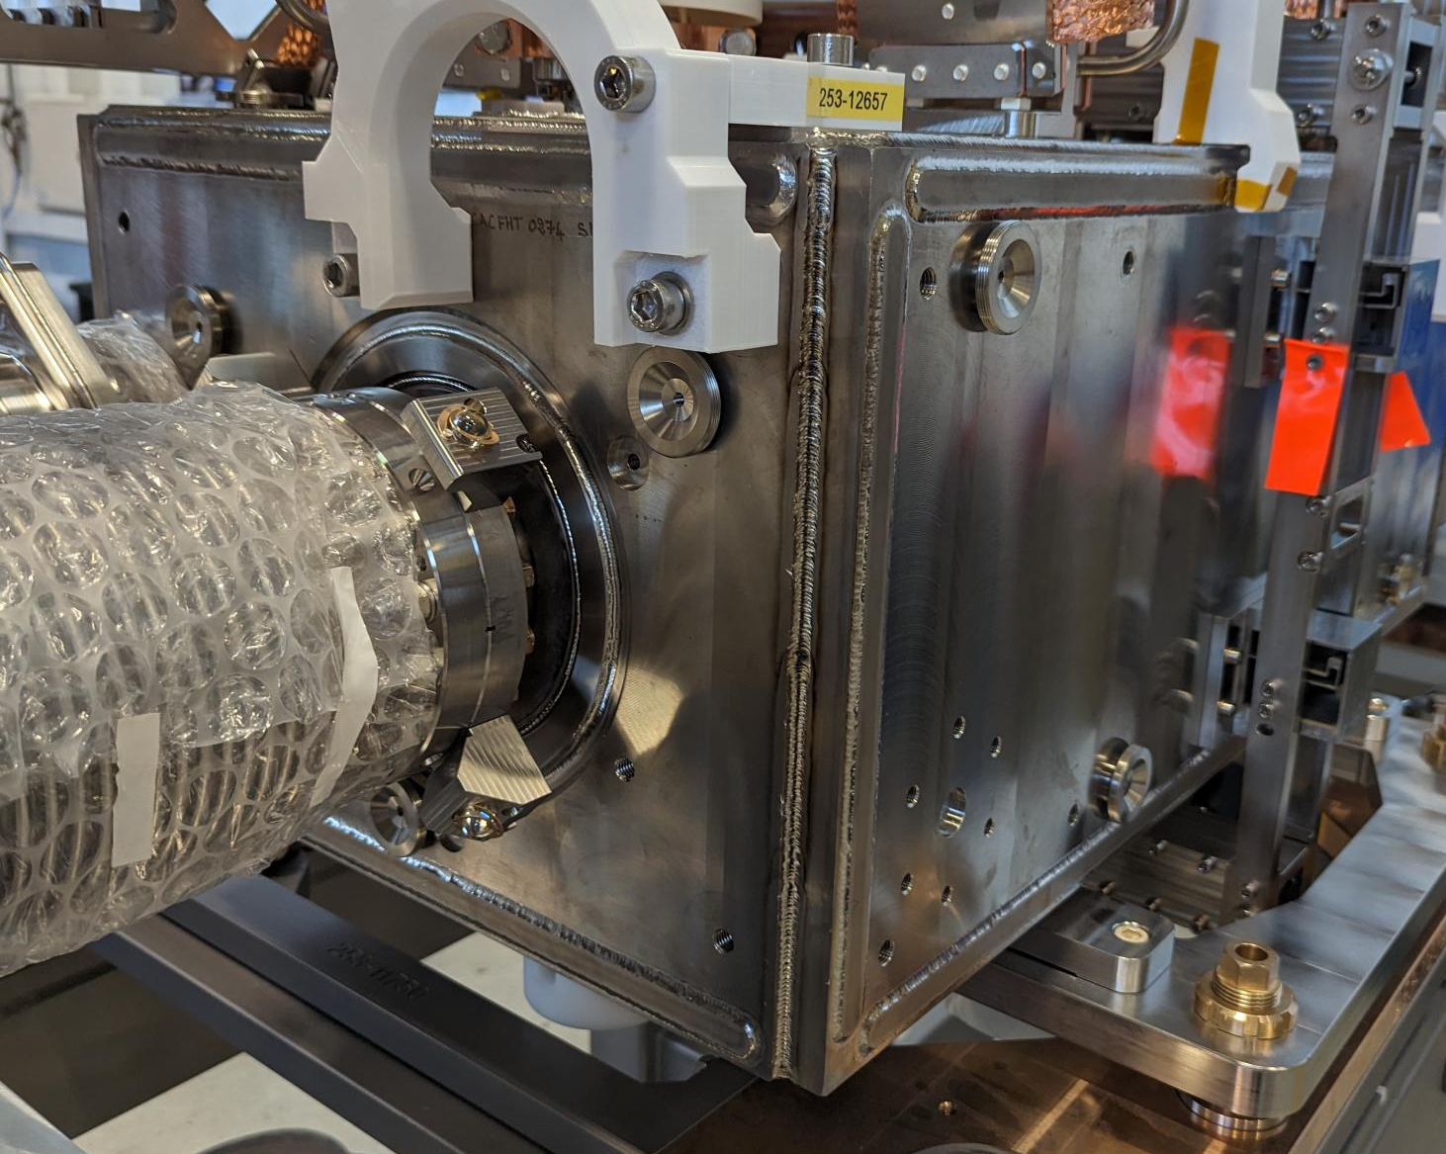
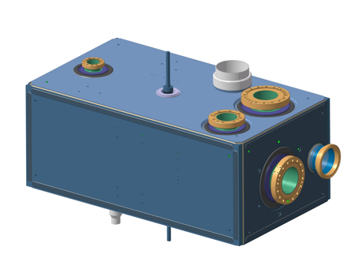
Alignment Objective n°1 : Fiducialisation
Cavity radio frequency axis → Approximated to mechanical axis of the capacitive plate
Bare Cavity
Axis of the
capacitive plate
Dressed Cavity
8 Alignment targets :
FSI targets
Axis of the
capacitive plate
Alignment requirement
Position : 50 μm (1σ)
Roll : 100 μrad (1σ)

Slide 30
Alignment Objective n°2 : Internal monitoring
Cryomodule
Alignment requirement
Position : < 100 μm (1σ)
Roll : < 400 μrad (1σ)
Cavities RF

Slide 31
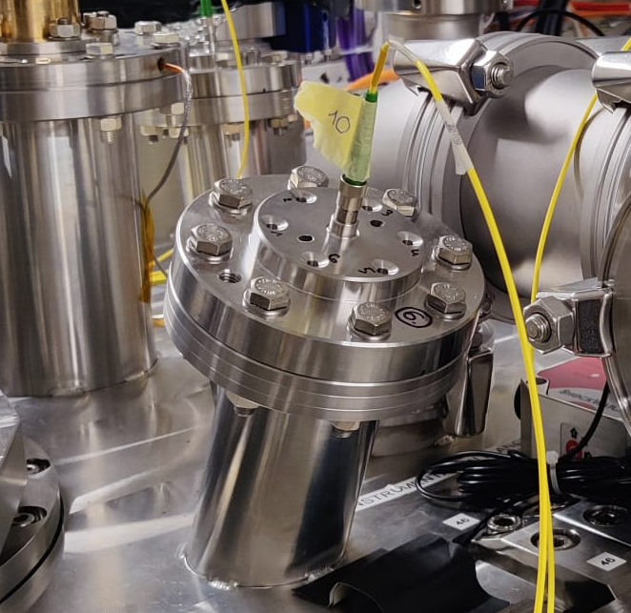
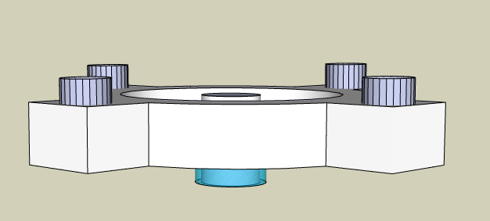
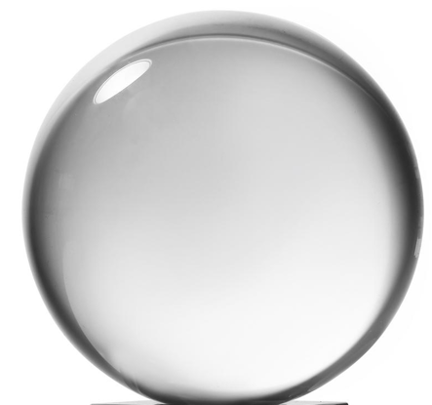
Internal monitoring : Configuration
Largest standard uncertainties | Uncertainty (1σ)
Position of the FSI Sensor in the framework of the cryomodule | 40 µm
Position of the FSI target in the framework of the crab-cavity | <15 µm
  FSI : Frequency Scanning interferometry
  → Absolute distance measuring interferometric technique
FSI Head (sensor)
on the Cryomodule
FSI Acquisition system
Optical fibre
Feedthrough
(FSI Head)
Fiber ferrule tip
8 FSI meas.
FSI target
on the flange of Helium TANK of the cavities
8 FSI meas.
Reflecting
glass sphere
(FSI target)
Total : 16 observations
(3D distances)
reflection
Support
FSI target
Flange of Helium Tank of RF Crab-cavities

Slide 32
Internal monitoring : Challenges and prerequisites
Ambient pressure
Measurement + Adjustment
Under vacuum
Anticipation
Cooling down
Anticipation
The position of the FSI sensors w.r.t. cryomodule must be measured with an accuracy of less than 40 microns.
Anticipation of the Deformation of the outer envelope with an accuracy of less than 40 microns
(deformation up to 1.2 mm)
Anticipation of the Movement of the cavities :
(Complex movement up to 0.4 mm
6 DOF)
Anticipation of the Deformation of the outer envelope with an accuracy of less than 40 microns
(deformation up to 0.1 mm)
Anticipation of the Movement of the cavities :
(Complex movement up to 1.2 mm
7 DOF)
The position of two cavities should be determined at cold at less than 0.1 mm (1sigma)
The position of two cavities at cold should be aligned at less than 0.1 mm (1sigma)
Two inner components
Non compensable misalignment
on the external envelope
No possibility to adjust
All adjustments should be carried out at ambient pressure.
ANTICIPATION : The position of the cavities should be at their nominal position at warm with an accuracy of less than 40 microns.
FSI Sensor
Cryomodule
Beam
RF cavity
RF cavity

Slide 33
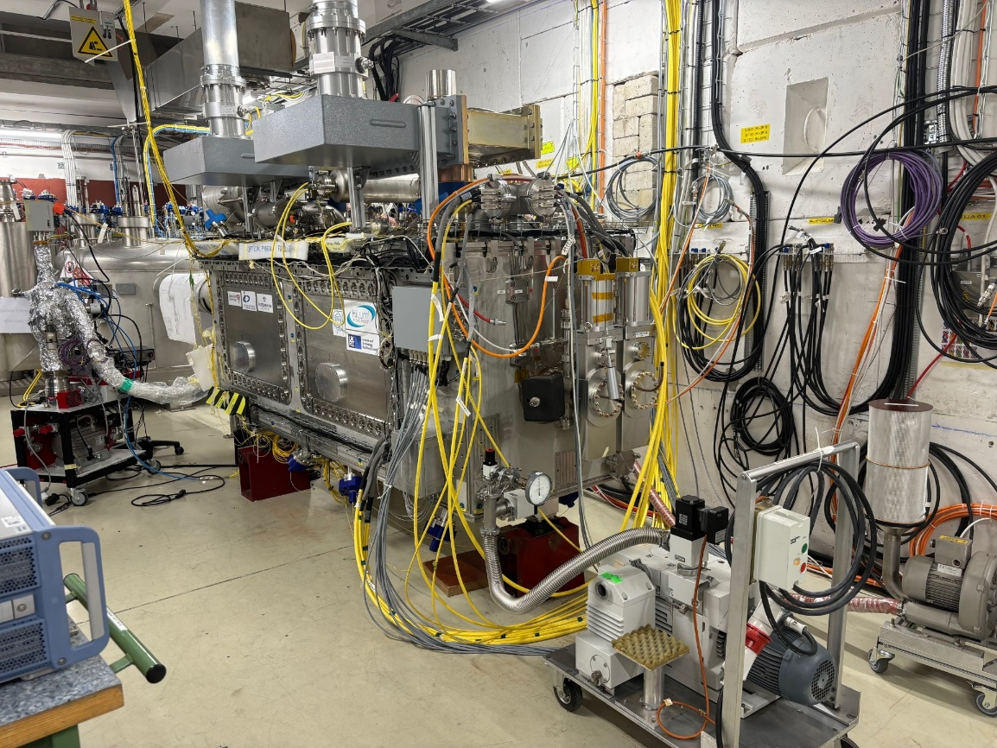
Alignment analysis of the RFD prototype
during cold test at CERN

Slide 34
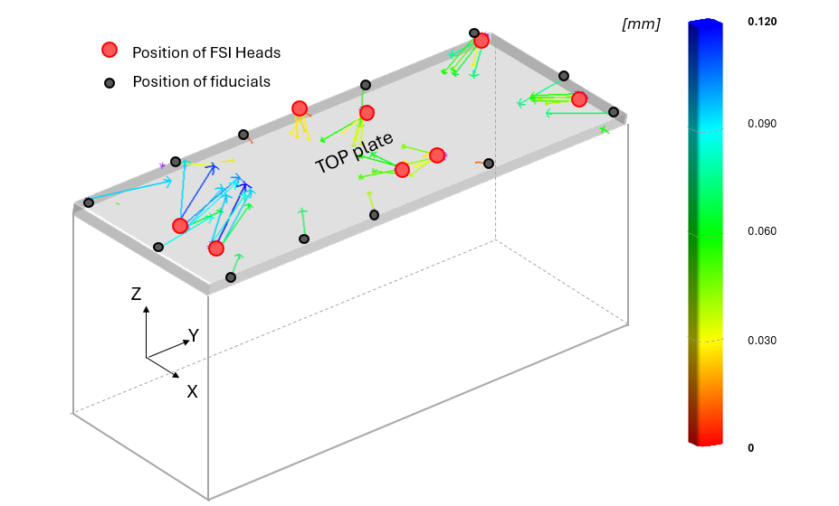
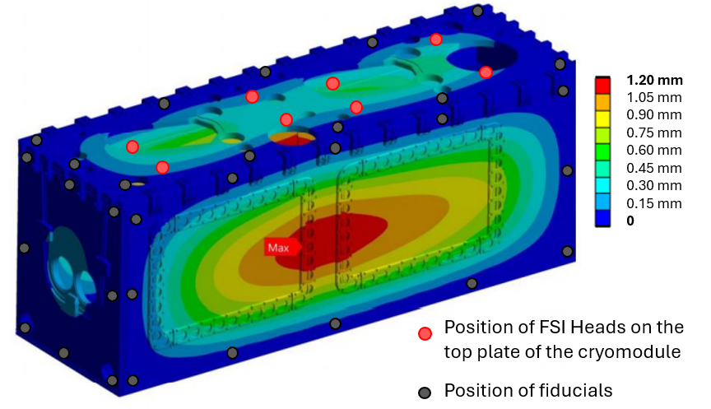
Deformations of the cryomodule (due to pumping and cooling down)
No deformation was observed on the edge of the top plate during pumping.
During cooldown, the top plate observed a thermal contraction due to thermal convection between the thermal screen and the top plate --> not expected but repeatable--> Can be anticipated
Ambient pressure
Max deformation :
1.20 mm
Under vacuum
Max deformation :
0.12 mm
Cold
Shape Repeatability
For 3 cycles :
Maximum dispersion : 67 μm
Average dispersion : 18 μm
Shape Repeatability
For 3 cycles :
Maximum dispersion : 57 μm
Average dispersion : 16 μm
Shape Repeatability
For 3 cycles :
Maximum dispersion : 68 μm
Average dispersion : 17 μm
Shape of the cryomodule at ambient pressure
Repeatable at +/- 0.040 mm (RMS)
Shape of the cryomodule under vacuum
Repeatable at +/- 0.040 mm (RMS)
Shape of the cryomodule at cold
Repeatable at +/- 0.040 mm (RMS)

Slide 35
Relative Motions of the cavities
due to vacuum and cooling down (cycle 3)
Step 3 : Cavity with
cryomodule at cold
875 mm
Step 3 : Cavity with
cryomodule at cold
IN
OUT
Step 2 : Cavity with
cryomodule under vacuum
Step 1 :
Cavity with cryomodule
at ambient pressure
Step 1 :
Cavity with cryomodule
at ambient pressure
Step 2 : Cavity with
cryomodule under vacuum

