Slide 1
PARALLEL-BAR
PROTOTYPING STATUS
LHC-CC 11, CERN
14-15 November 2011

Slide 2
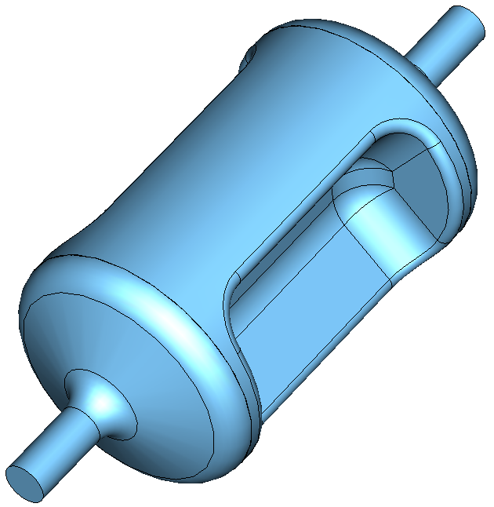
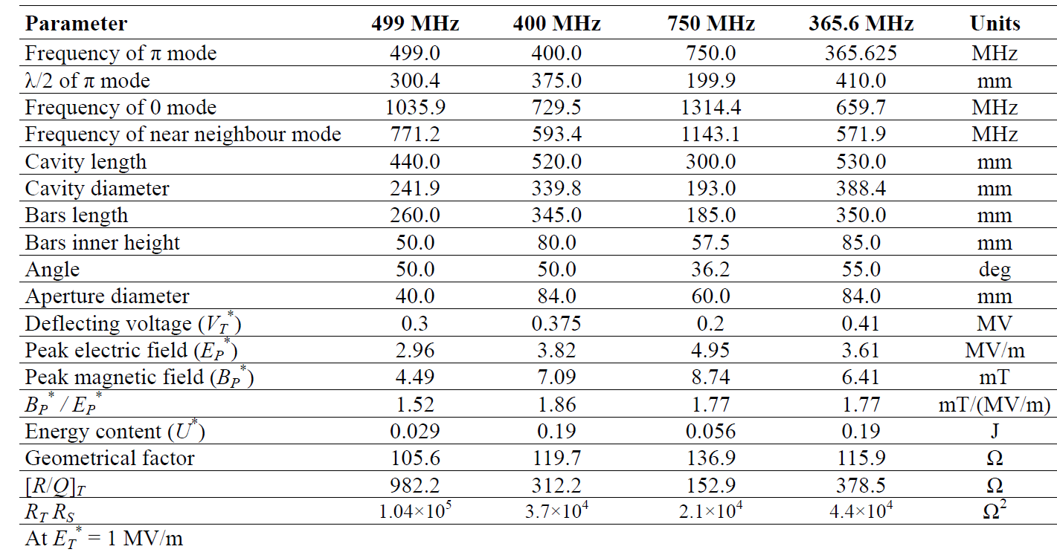
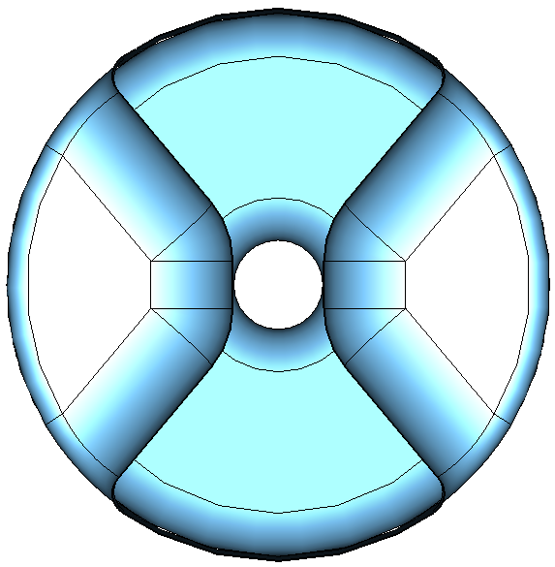
JLab 11 GeV Deflector

Slide 3
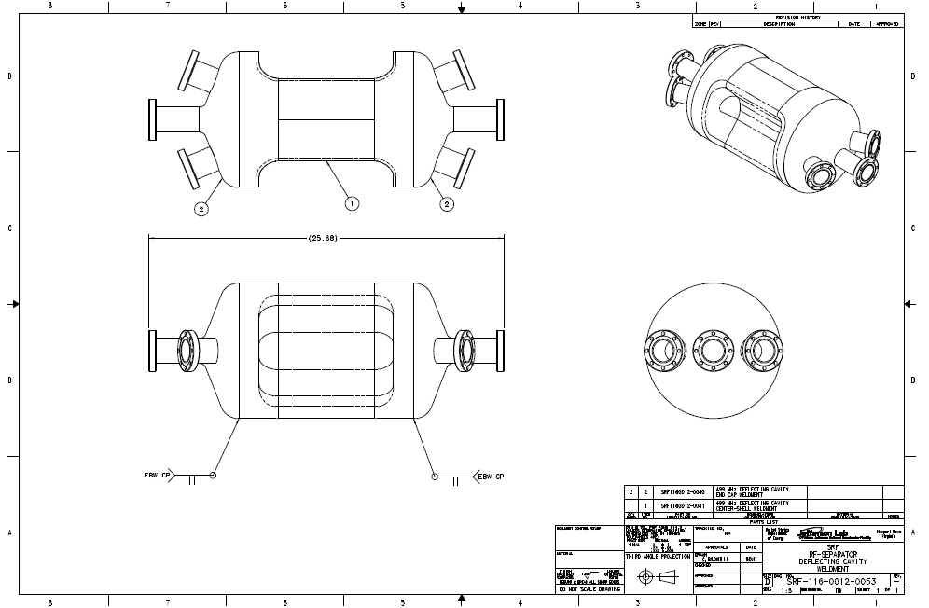
Cavity Drawing

Slide 4
FABRICATION OVERVIEW
Cavity Assembly
(Tuning before weld)
Body Weldment
Cavity Shoulders
End Cap Weldments
End Cap Forming/Machining
Beam Pipes/Ports
Beam Pipe Rolling/Machining
Flange Machining
Center Shell Weldment
Forming/Machining
Cavity shoulder machining

Slide 5
Fabrication Procedure
OFC copper unit will be fabricated before Niobium cavity.
Components forming and machining
Each components will have longitudinal margin for tuning and welding
Sub-assembly e-beam welding
All weld seams are full thickness butt weld, weld parameter study done
Warm tuning
Initial measurement of frequency before welding
Sub-assembly BCP
Currently BCP is preferred. JLAB BCP supports 80-100 mT gradient
Assembly welding
Frequency measurements before and after vacuum load
Stiffener welding
Frequency measurements before and after vacuum load
Final BCP and high pressure rinse
Electro polish is also considered

Slide 6
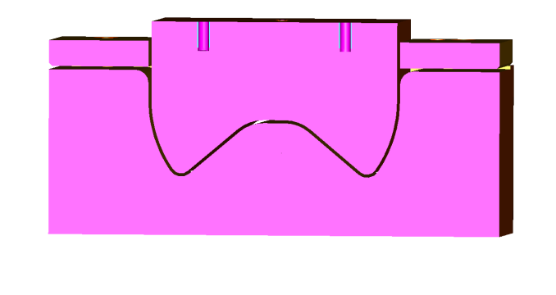
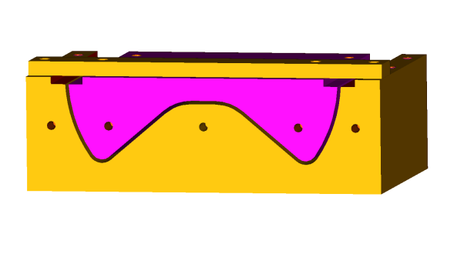
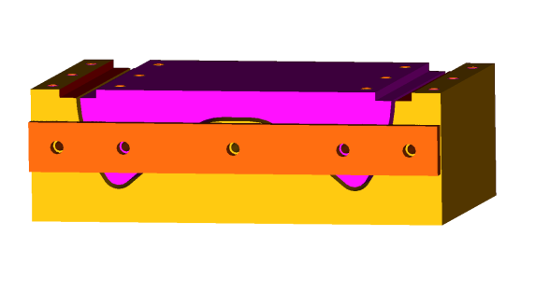
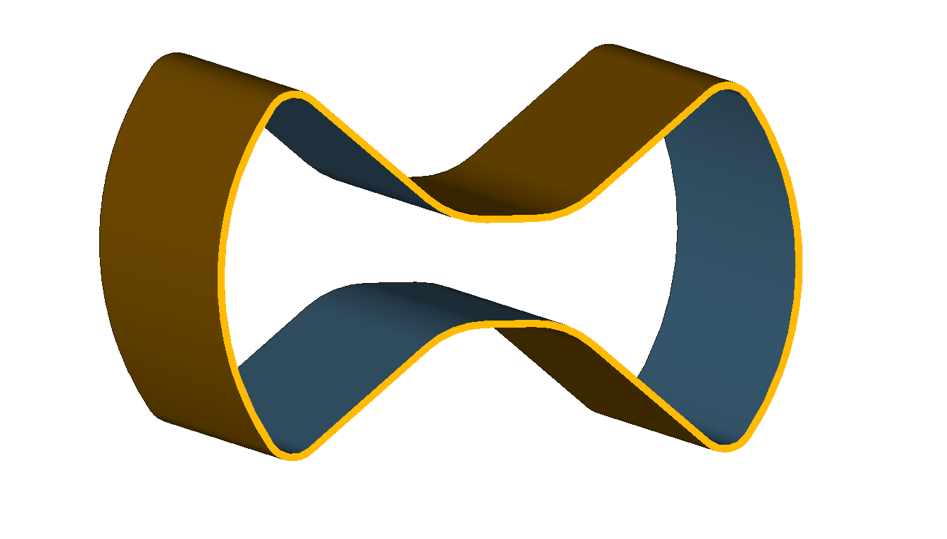
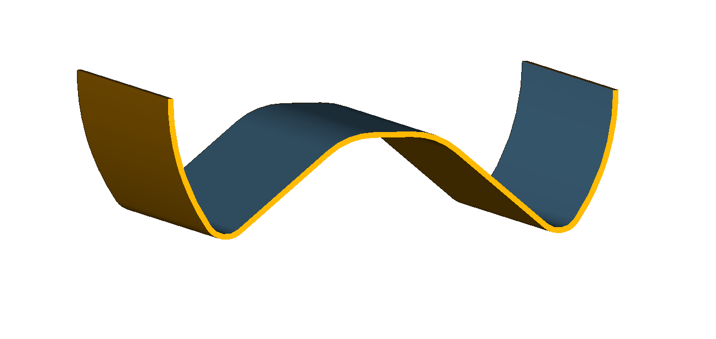
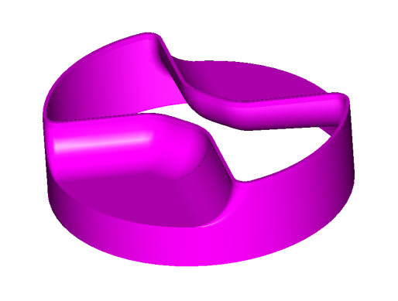
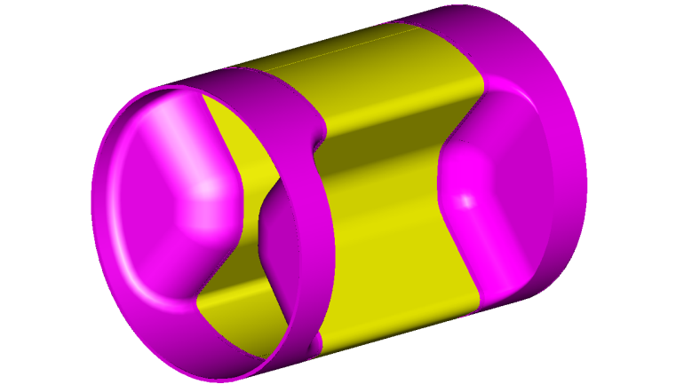
Body Weldment
Center shell machining
Weld margin included
Center shell forming
(Die cross section)
EBW seams: 40% pre-pass, 50kV 48mAmp 6 in/min beam speed
Welding will be both sides to ensure the smooth surface inside
Machined cavity shoulder
Welding cavity shoulder and center shell

Slide 7
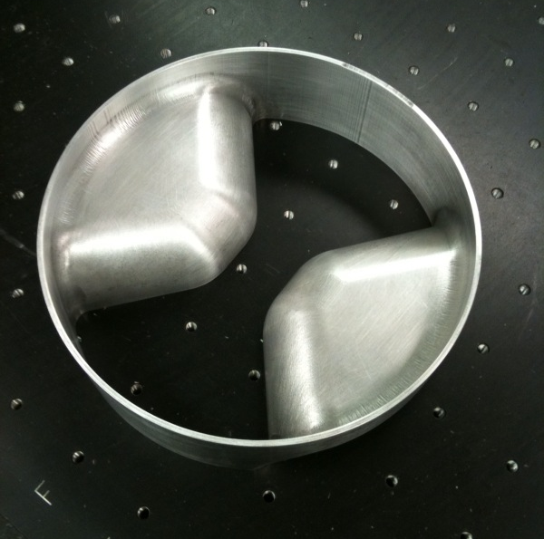
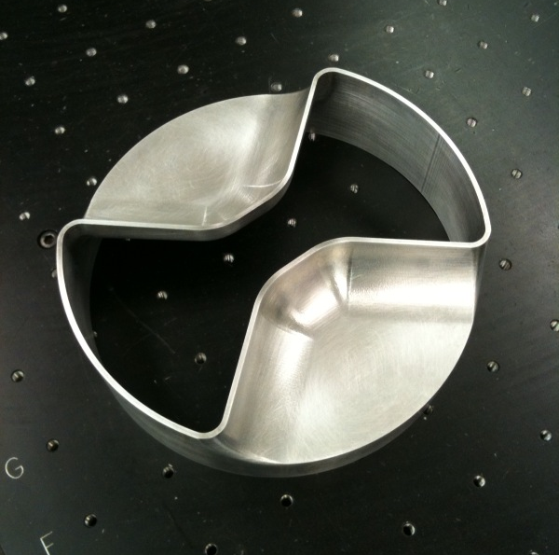
Transition block
Aluminum trial part shown
End cap side
Center shell side

Slide 8
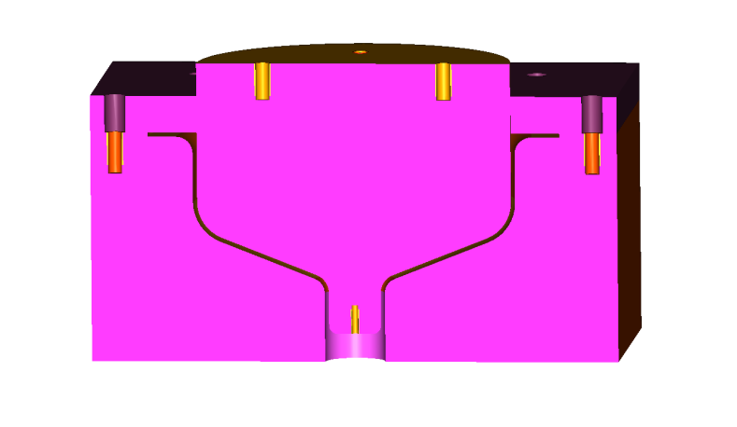
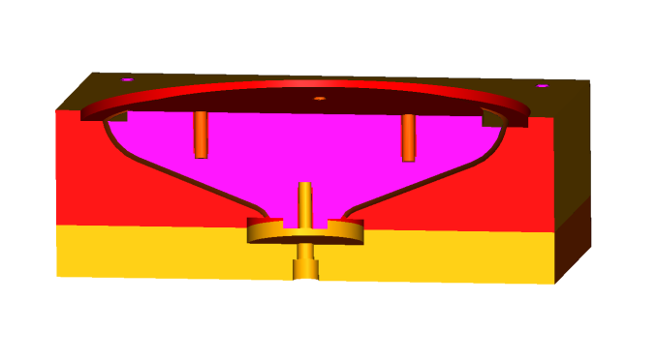
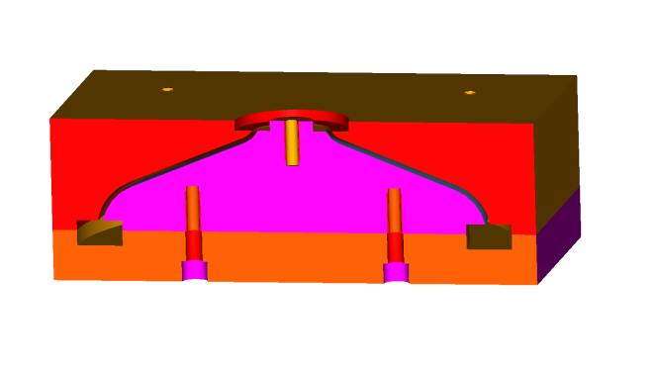
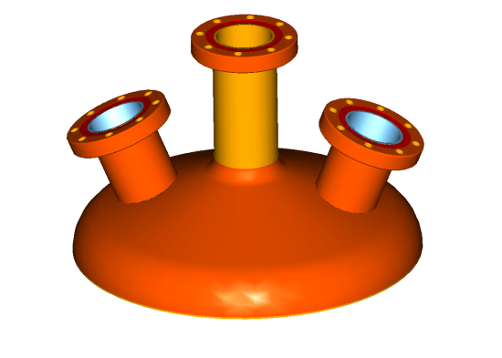
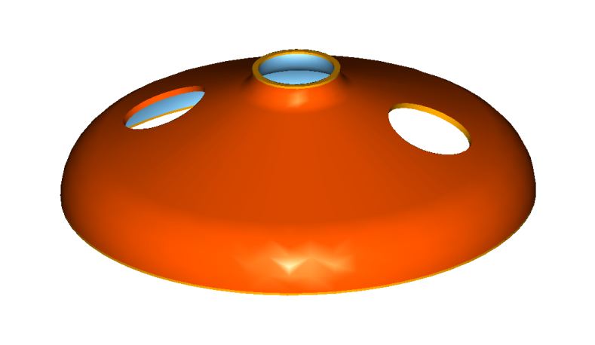
End Cap Weldment
Machining
(Weld and tuning margin included)
End cap forming
Machining port openings
Welding beam port and coupler ports

Slide 9
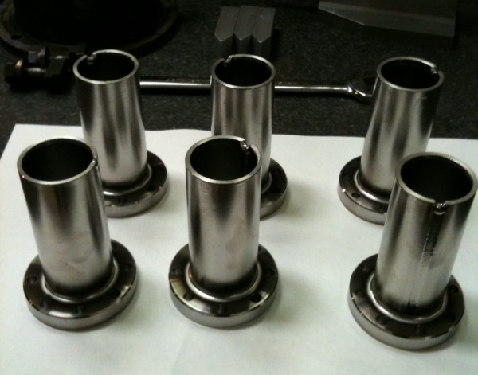
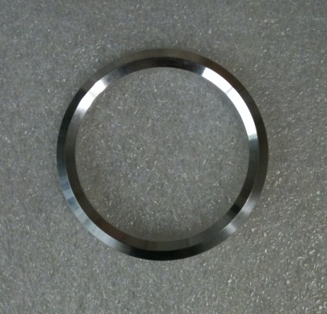
Niobium beam ports with Nb-Ti flanges
Al-Mg gaskets for final assembly.
For tunings and measurements Indium seal will be used.
Beam pipes and coupler ports are made.
Blank flanges are not shown.
Pipe ends need to be machined before welding.

Slide 10
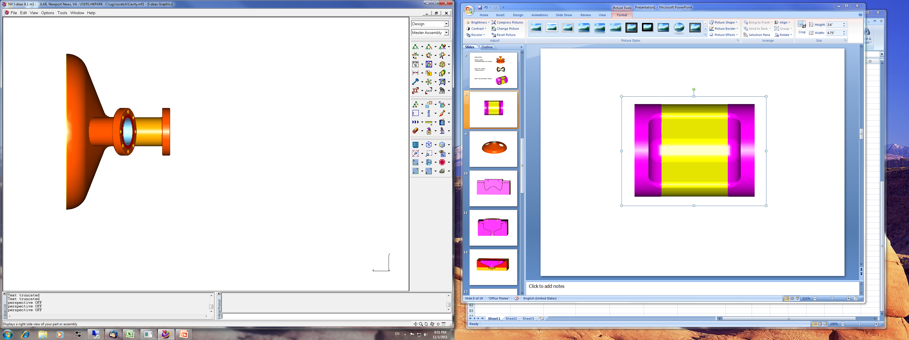
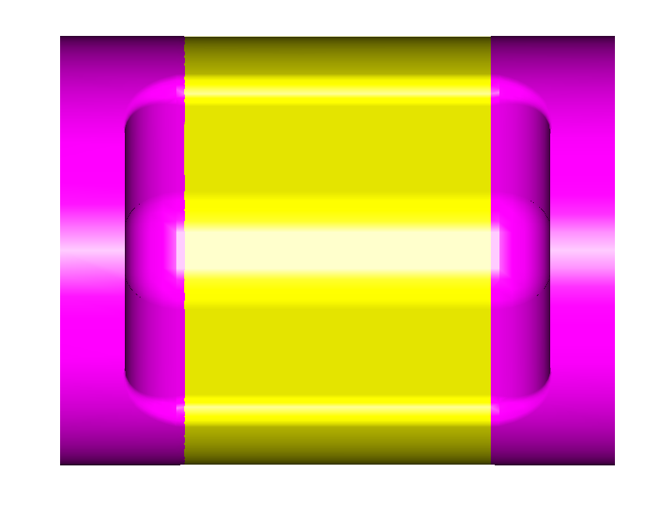
Frequency Measurements
Multi step frequency measurements to compare with the analyses
Warm Tuning before Final Weld
Frequency measurement after final weld
Evacuate and measure frequency
Weld stiffeners
Evacuate and measure frequency
Final BCP and high pressure rinse

Slide 11
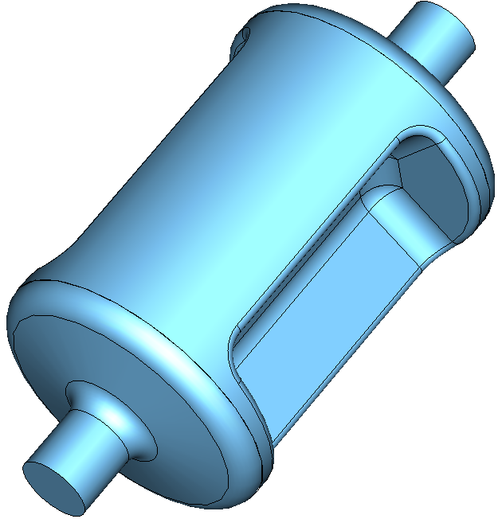
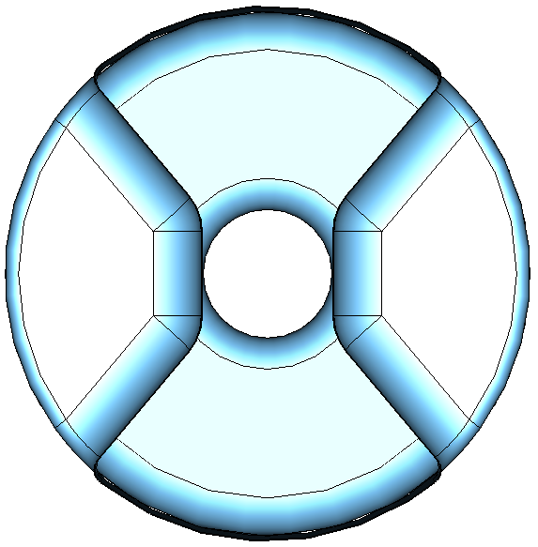
LHC Crab Cavity (ODU/Niowave)

Slide 12
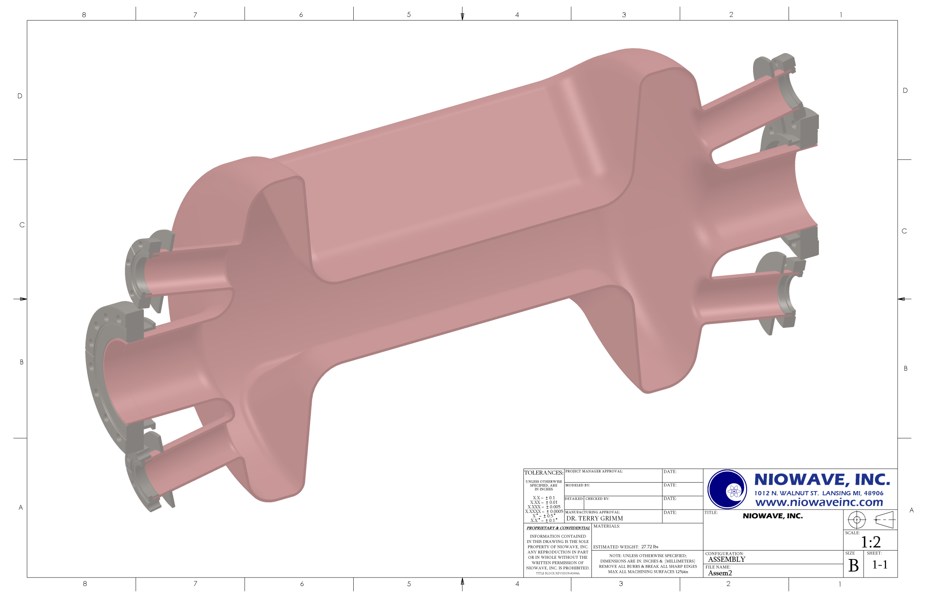
LHC Crab Cavity

Slide 13
Cavity Assembly

Slide 14
Cavity Parts
Mechanical design of the end plates with flanges is finished and the parts of this subassembly are manufactured
Outer conductor forming design is in progress

Slide 15
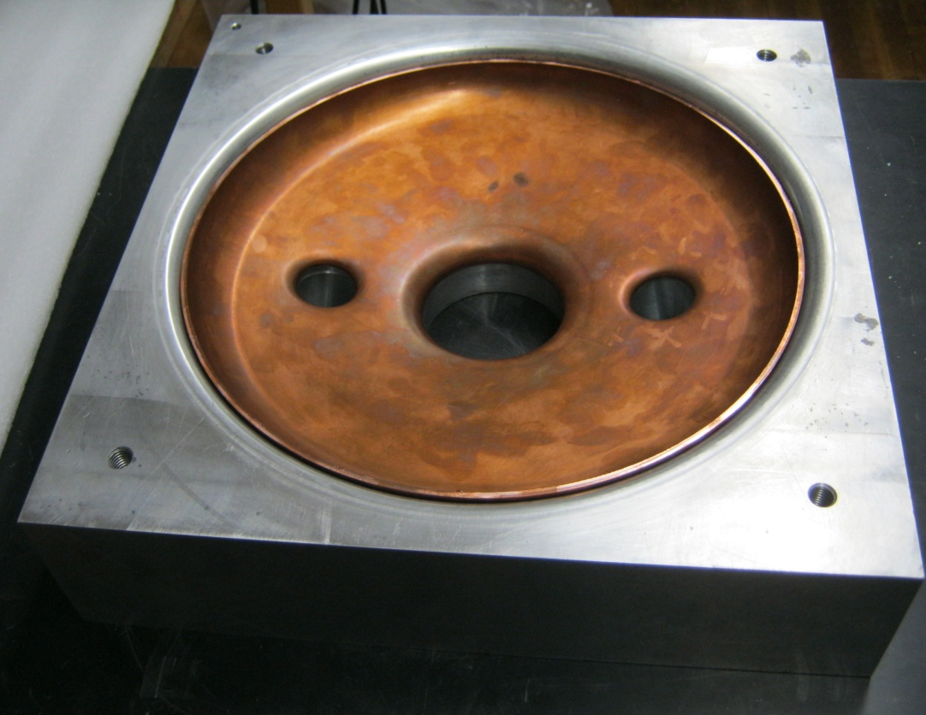
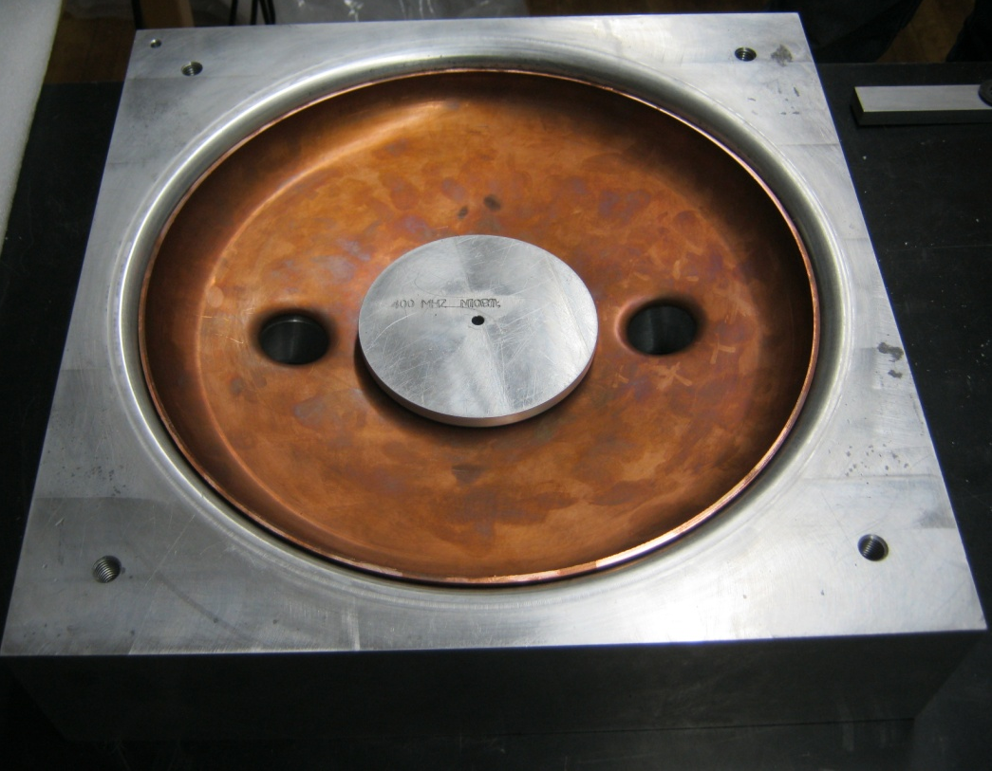
400 MHz LHC Crab Cavity Parts in Production (1)
Copper prototype of the end plates was stamped
And the nipples were pulled

Slide 16
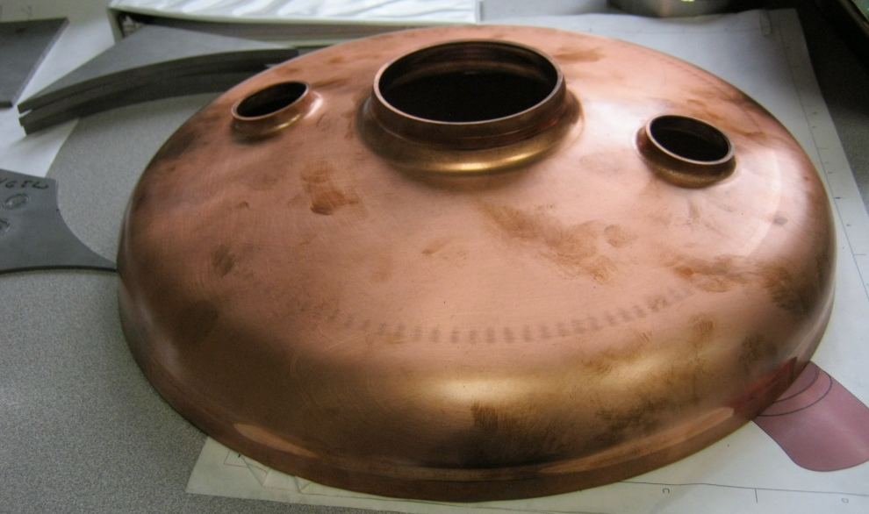
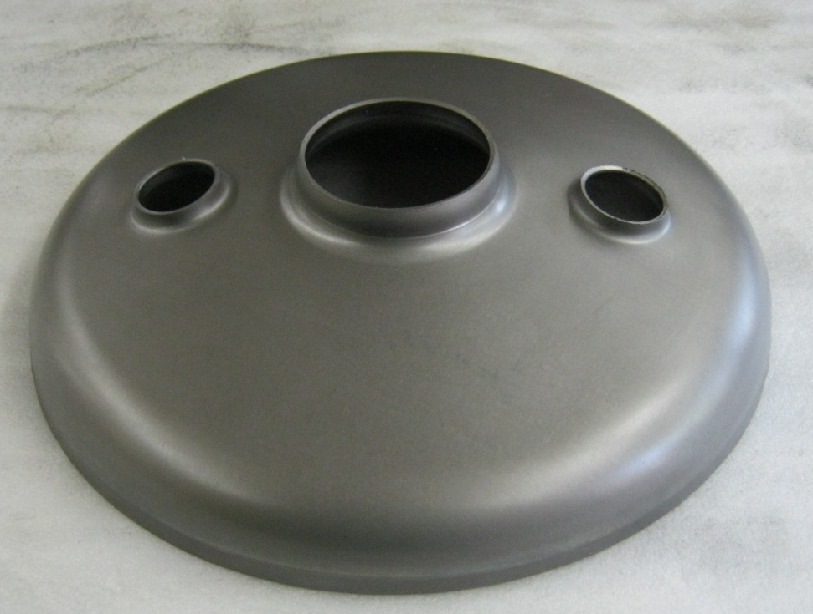
400 MHz LHC Crab Cavity
Parts in Production (2)
Beam and side port pipes are brazed with the stainless steel conflat flanges
Both of the Nb end plates were stamped and nipples were pulled
The preparation for the welding of the brazed beam pipes and side ports pipes is underway
The OC parts and dies are in production

Slide 17
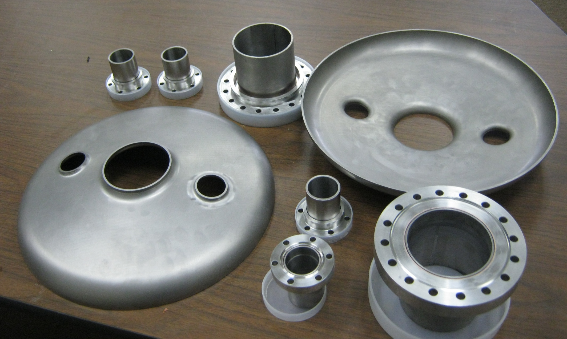
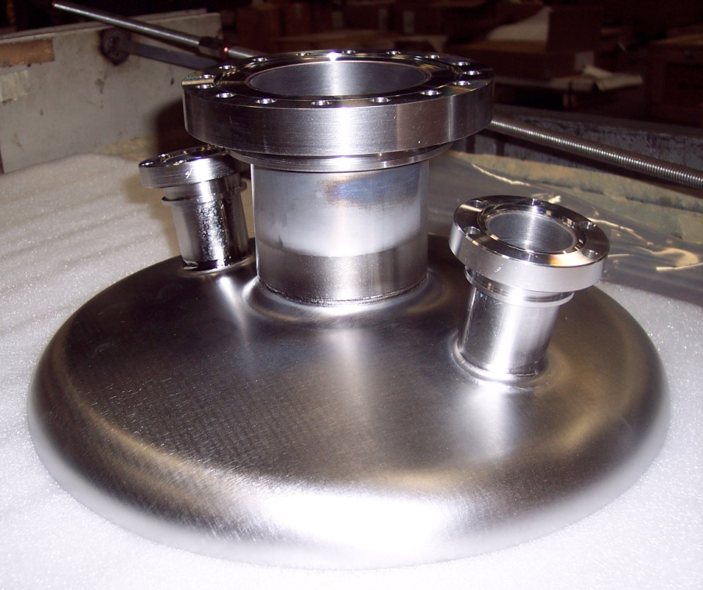
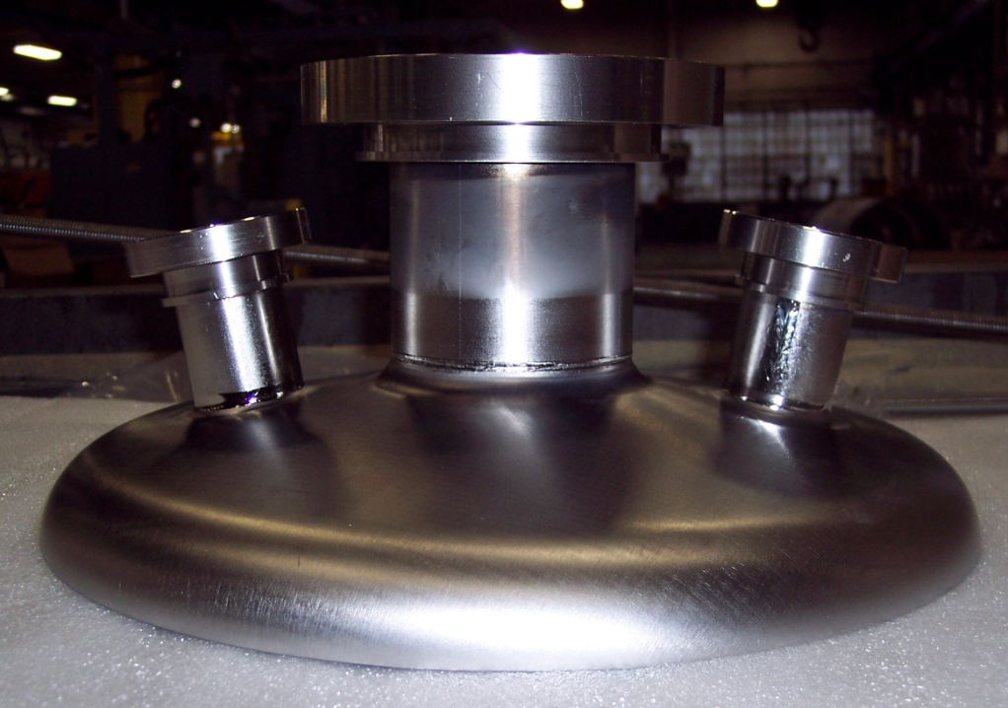
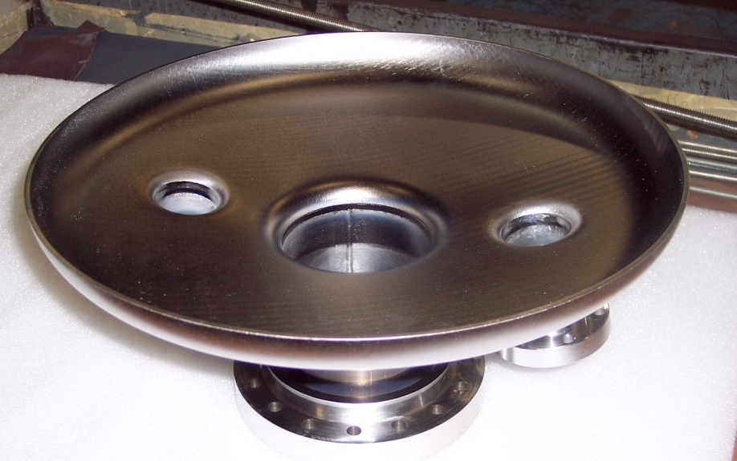
400 MHz LHC Crab Cavity
Parts in Production (3)

Slide 18
LHC Crab Cavity Schedule
Complete EB Welding of End Caps with beam ans side ports
  November 8th, 2011
Welding Fixture for the Outer Conductor manufacture
  November 21st, 2011
Complete OC fabrication
  November 28th, 2011
Complete Cavity Fabrication (Welding of End-plates with OC)
  December 12th, 2011
Welded Cavity leak checking and inspection
  December 19th, 2011
Flash Cavity Etch (~20 μm)
  December 21st, 2011
Stiffening Ribs design and fabrication
  January 31st, 2012

Slide 19
LHC Crab Cavity Schedule

