Slide 1




Efficient Multilevel Sampling of Lattice Field Theory Near Criticality
Ankur Singha, TU Berlin
Work in Collaboration with:
Elia Cellini, Kim A. Nicoli, Stefan Kuhn, Karl Jansen, and Shinichi Nakajima
Based on paper published ICLR 2025 : arXiv:2503.08918 [cs.LG]
ML4LATTICE Workshop 2025, ETH Zurich

Slide 2
Scope Clarification
This talk is not about gauge theories — we focus on sampling spin system and lattice scalar field theory.
We focus on systems where long-range correlations important,
such as in the critical region.
The goal is to build a generative model that can efficiently capture long-range correlations.
Multilevel sampling: ii) Autoregressive Model. (arXiv:2503.08918 [cs.LG])
ii) Normalizing Flow (preliminary)

Slide 3

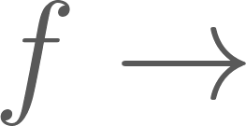
Critical Slowing Down/ Scaling Issue of Generative Models
Near criticality— fluctuations exist at many scales. A good sampler should captures long range correlations.
MCMC struggles: High autocorrelations; lots of effort goes in to the search for good algorithms.
Generative Model: e.g Flow model:
[Albergo et al., Phys. Rev. D (2019)]
CNN Layers
Receptive Field: Depth and kernel size of a CNN decide the kind of correlations it can capture.
Aggregation Style: CNNs aggregate information in a bottom-up, local-to-global manner.
Critical Systems: These require hierarchical, scale-separated representations — beyond local aggregation.
D. Bachtis et al., PRL (2022)
P. Białas et al., Comput. Phys. Commun. (2022)
R. Abbott et al., PoS LATTICE 2023
M. Bauer et al., SciPost Phys. (2025)
Urs Wenger,Kieran Holland,

Slide 4
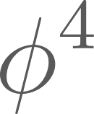
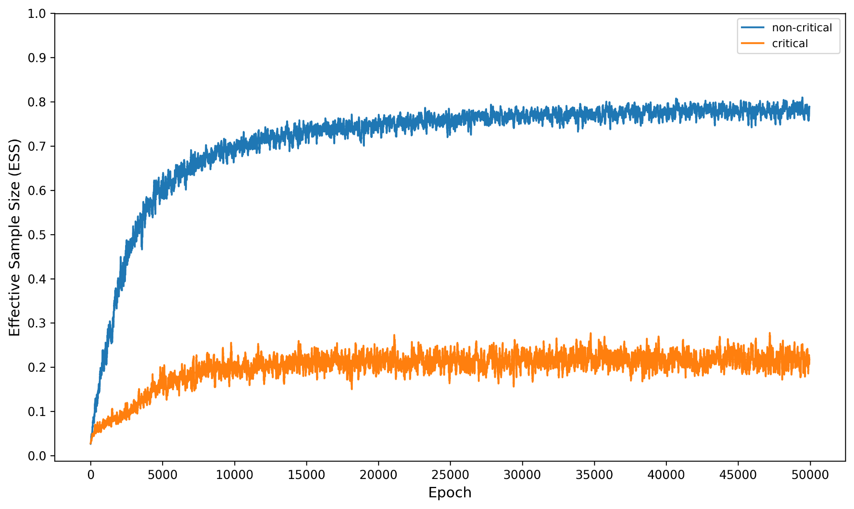
Generative Model struggles at Criticality
Example: 2D : Flow-based sampling at critical and non-critical.regions
Training ESS curve: Performance of flow model decreases near critical point
Similar parameters: Albergo et al., arXiv:2101.08176 [hep-lat] (2021)

Slide 5
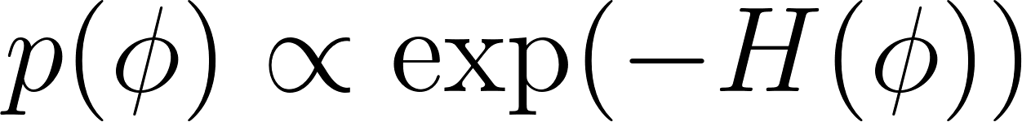
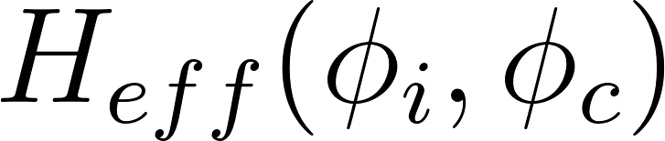
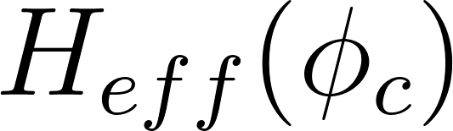
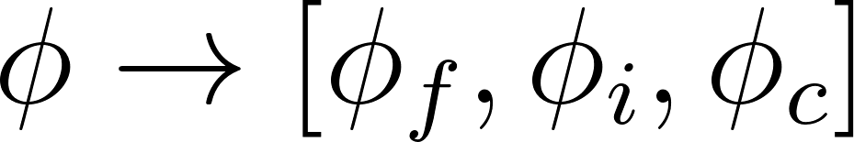
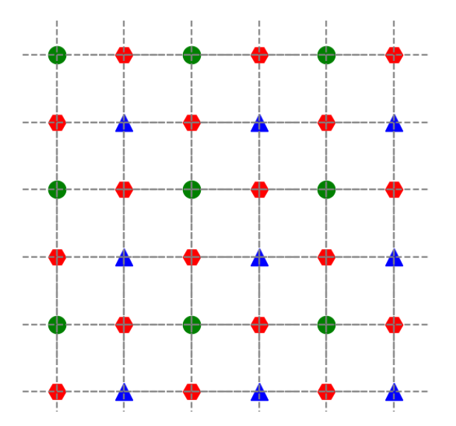
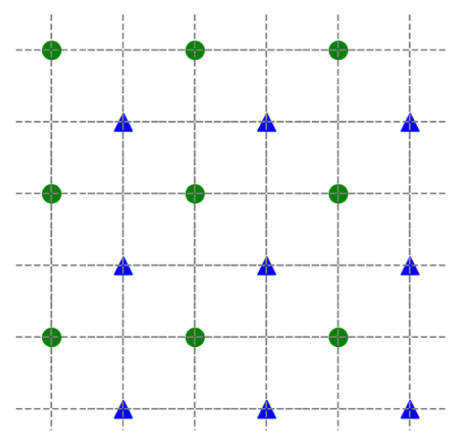
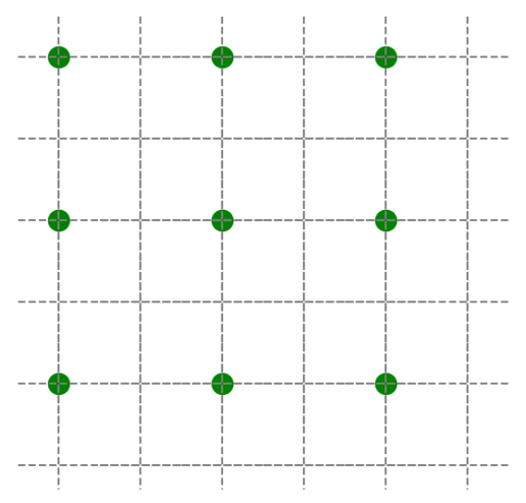
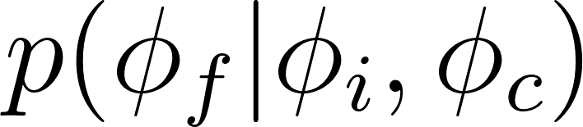
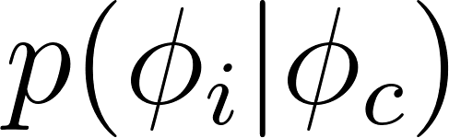
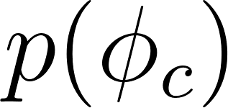
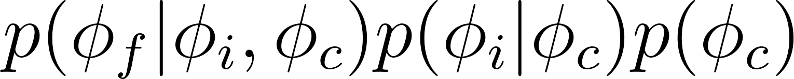
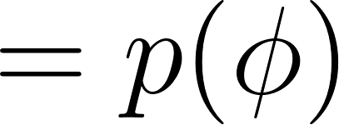
Introduction to Multilevel Sampling
Target Distribution
Schmidt K. E. et al., PRL. 51 (1983)
Jansen K. et al., Phys. Rev. D (2020).
RGT
RGT
cond.
sampling
cond. sampling

Slide 6
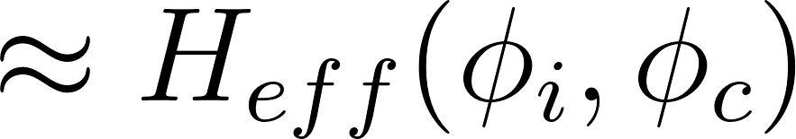
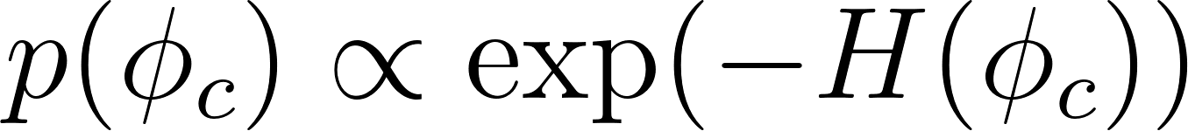
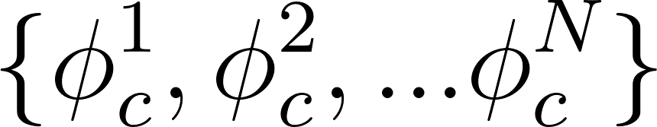
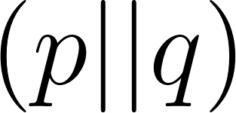
Multilevel Sampling: MCMC setting
Heatbath
update
Heatbath update
Coarse level
MCMC data
Metropolis-Hasting accept/reject
gives measure of efficient sampler

Slide 7
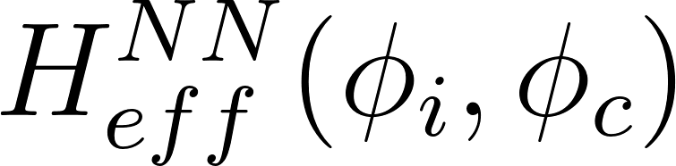
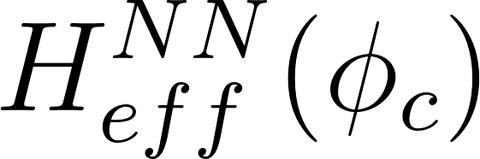
Example: Exact RGT
1D Ising:: Heatbath (HB) samples larger lattices conditioning new sites onto previously sampled nearest-neighbors (trivial, i.e., can be performed exactly).
Sampled site
Conditioning sites
Heatbath update

Slide 8
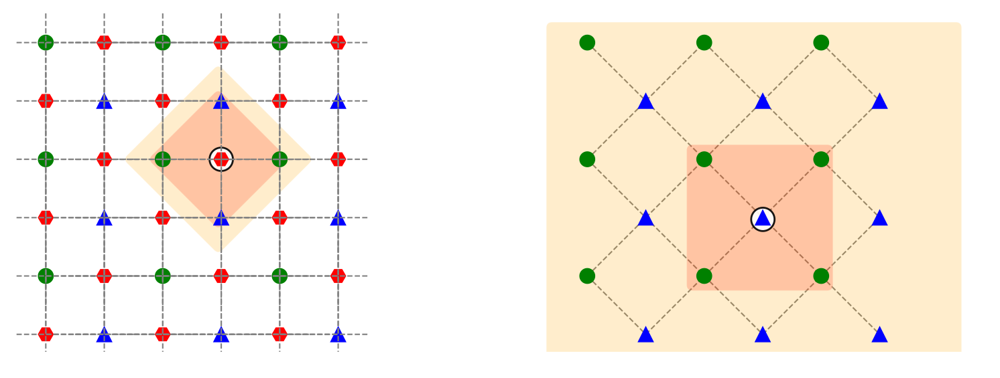
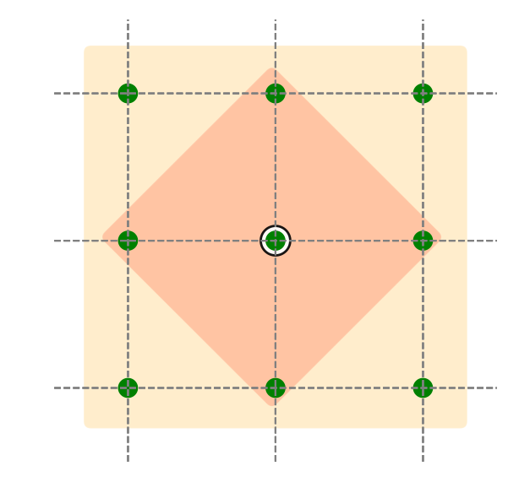
Example: Inexact RG
2D Ising: In two dimensions (and above) modelling higher-order interactions becomes difficult due to the true Markov Blanket extending beyond nearest neighbors.
1. Heatbath update is not suitable
2. Coarse distribution deviates from true marginal distribution
As levels increases these leads to a poor sampler

Slide 9
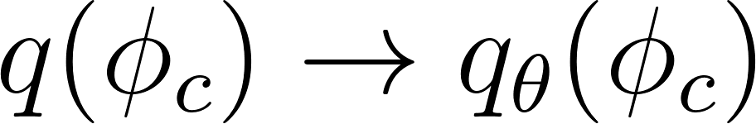
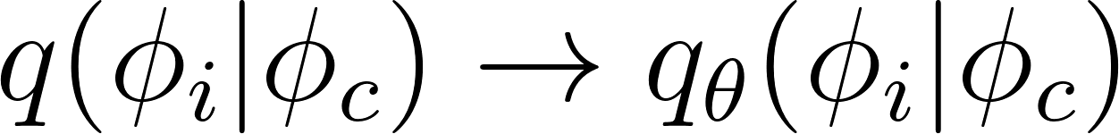
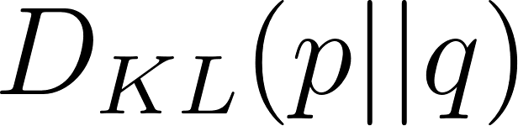
A Generative Model in Multilevel setting
Modelling for a factorized distribution at different scales.
Generative Model (GM)
Conditional GM
Minimize dist. between the distribution at finest level

Slide 10
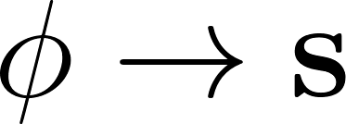
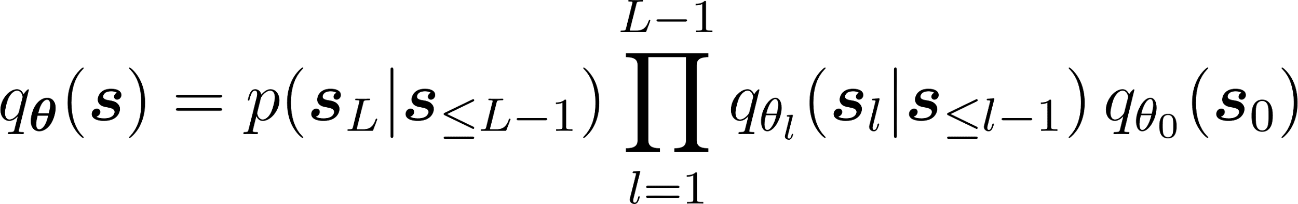
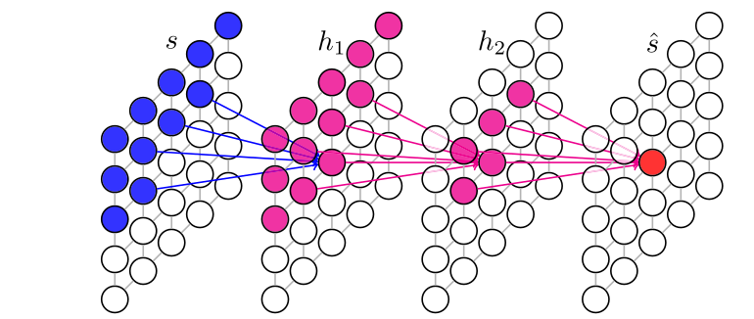
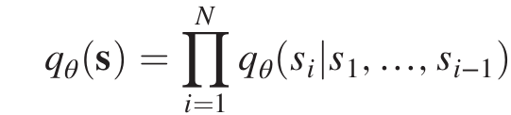

RiGCS: Renormalization-Informed Generative Critical Sampler
.
A. Singha et al., ICLR (2025)
RiGCS model
Heatbath (finer lattice)
Plain VAN (coarser lattice)
Conditional VANs (intermediate lattices)
Variational Autoregressive network:
D. Wu et al., PRL(2019)

Slide 11
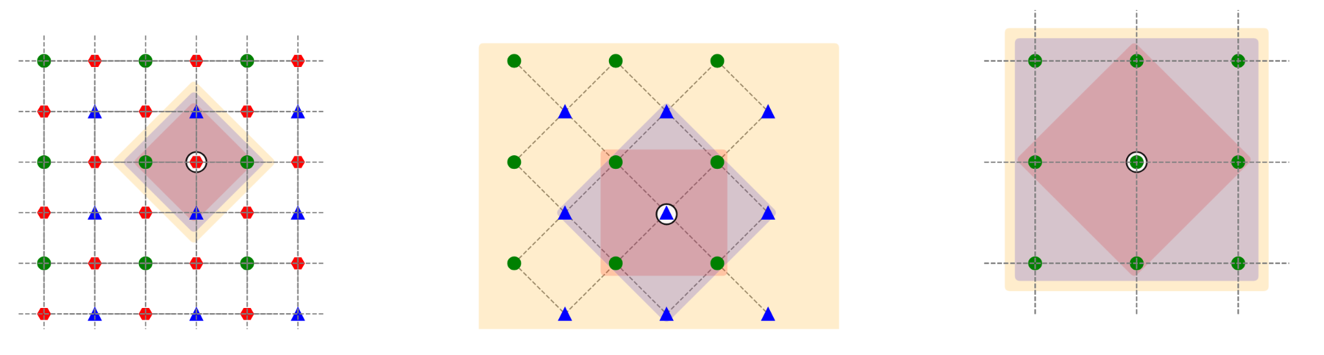
RiGCS: Renormalization-Informed Generative Critical Sampler
Cond. VANs: The Receptive Field in the conditional VAN is chosen such that it capture the higher order interactions.
HeatBath: At the finest level, leverage locality of interactions to sample using HB.

Slide 12
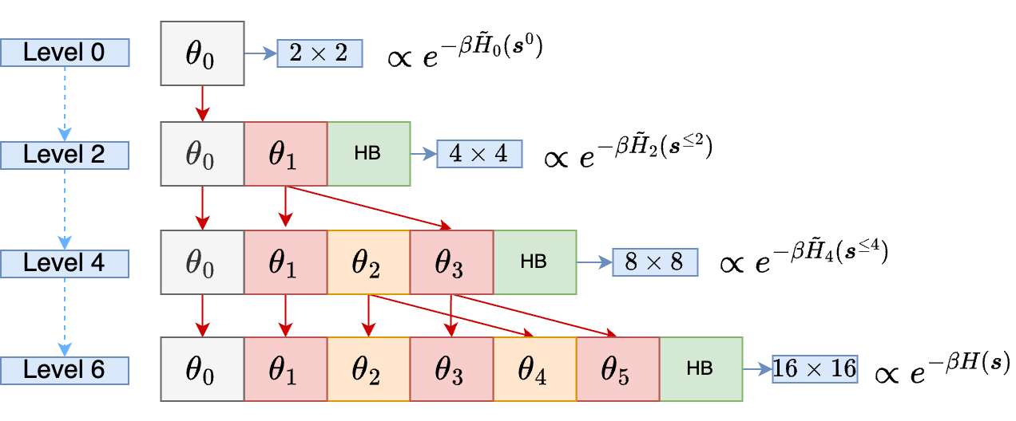
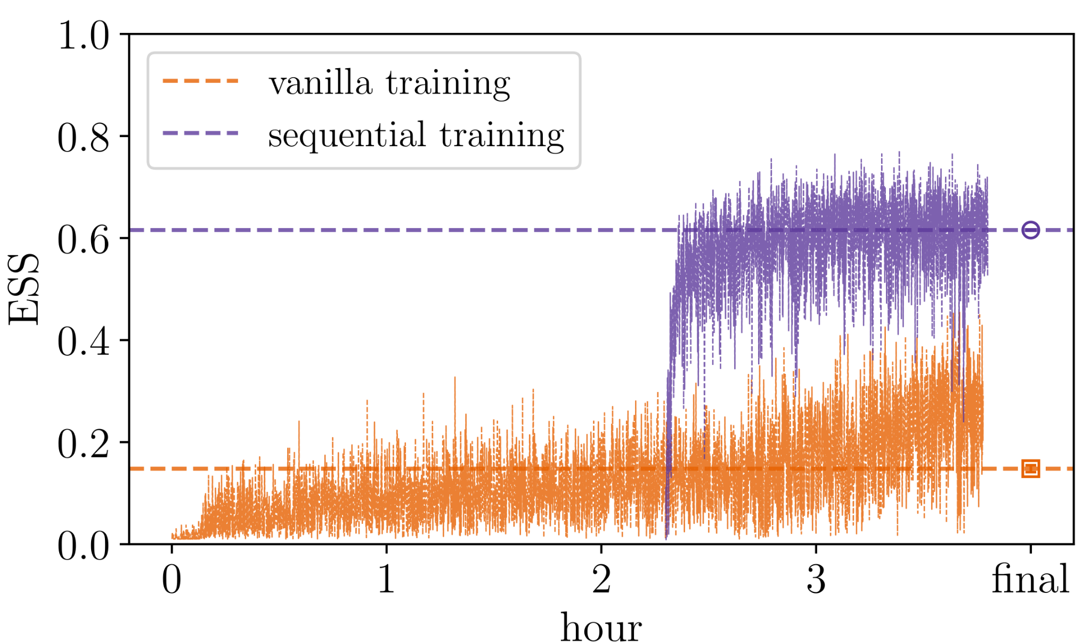
Sequential Training
Warm Start for Large Lattices:

Slide 13
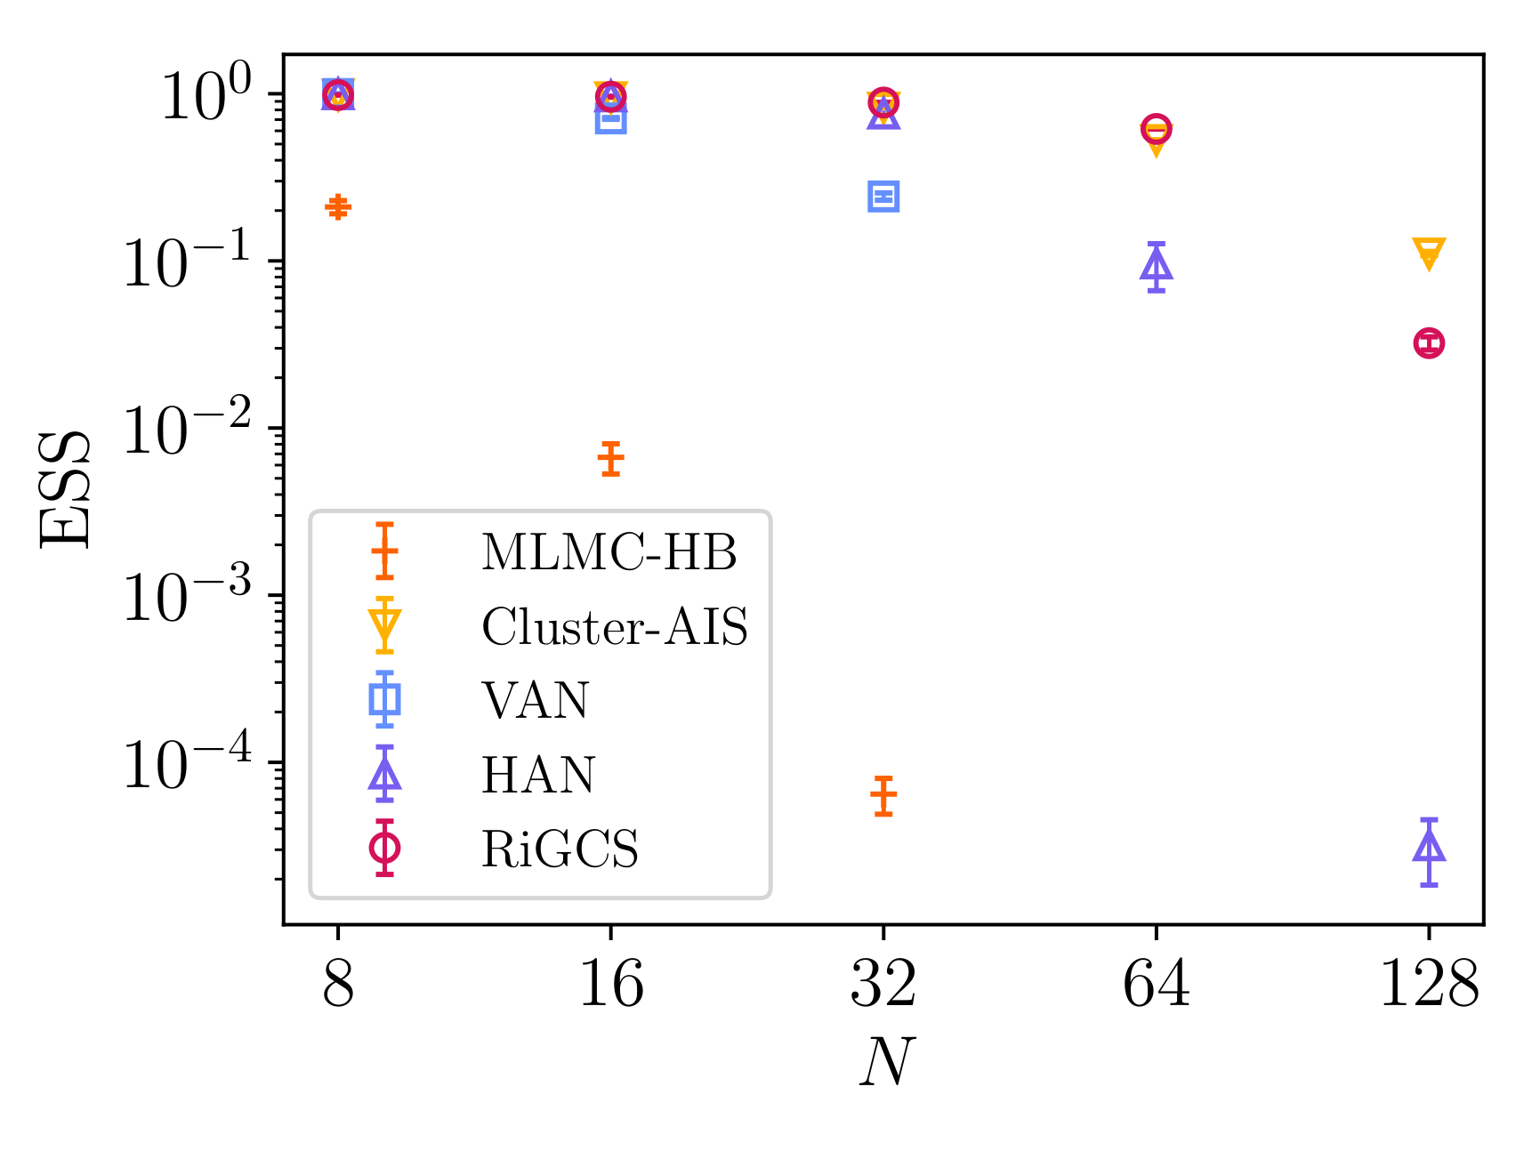
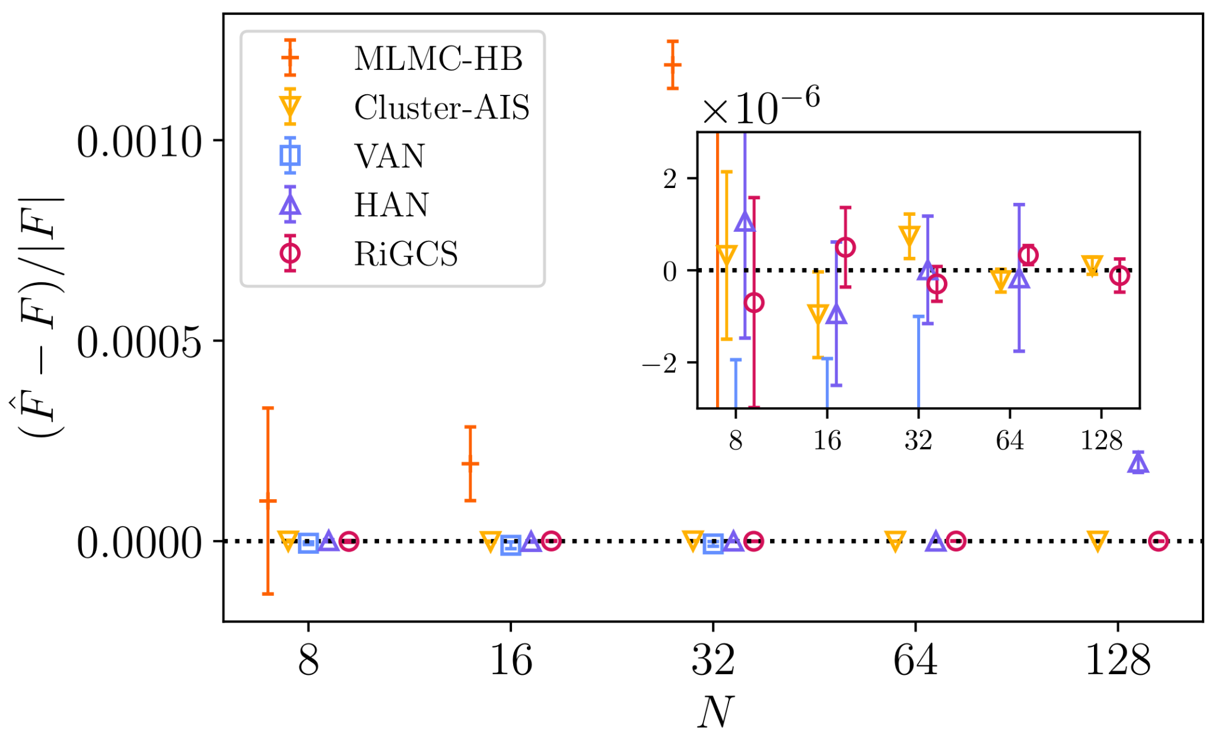
RIGCS Results
Spin System: Ising 2D
RiGCS achieves performance compatible to Cluster.
Is unbiased, even for largest lattices.
Outperforms both generative models and MLMC-HB.

Slide 14
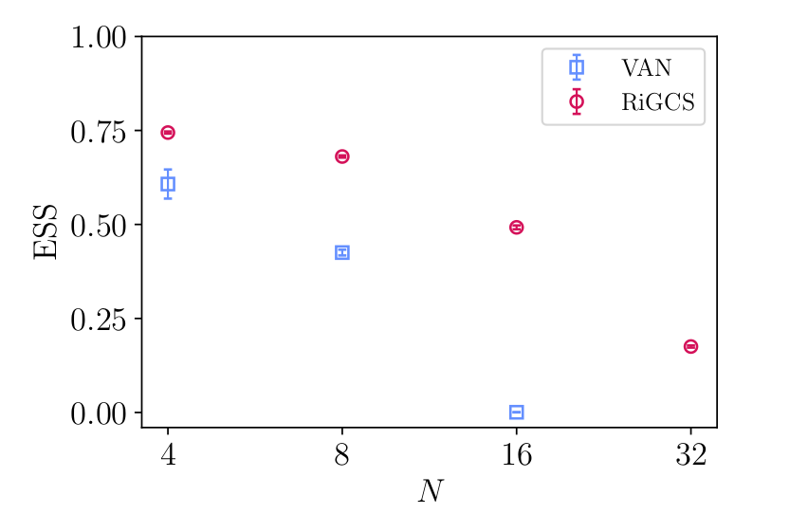
RiGCS for Phi4 with VAN
In Autoregressive setting, distributions are conditioned Gaussian Mixture Model (GMM)
Continuous case : Phi4 2D
Much Better performance than VAN.
Autoregressive model slower.
Normalizing Flow for multilevel modelling
R. Abbott et al., PoS LATTICE 2023 - Gauge Theory
M. Bauer et al., SciPost Phys.(2025)- Phi4 theory

Slide 15
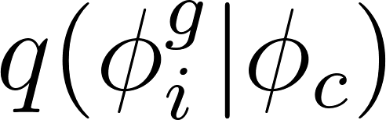
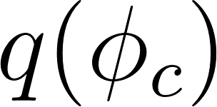
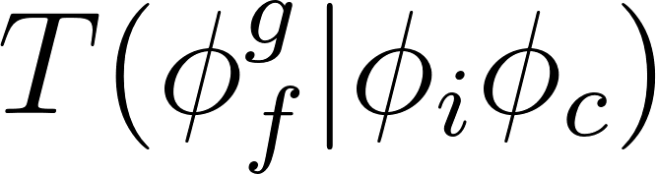
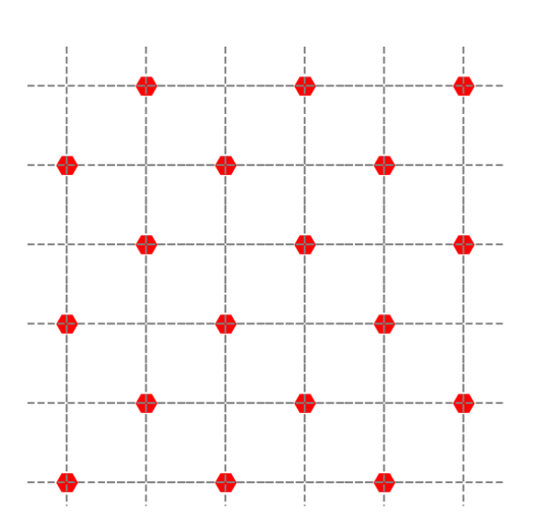
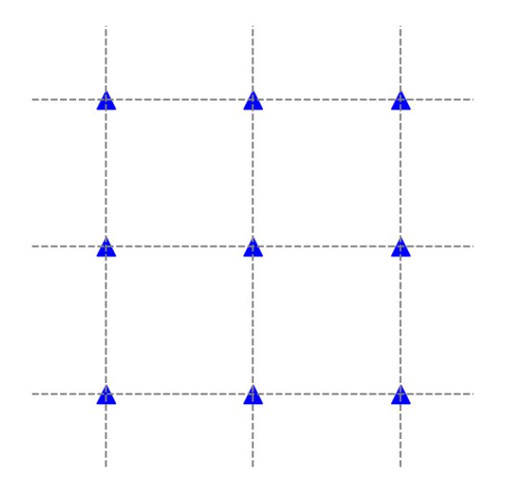
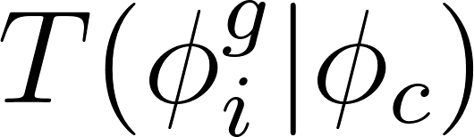
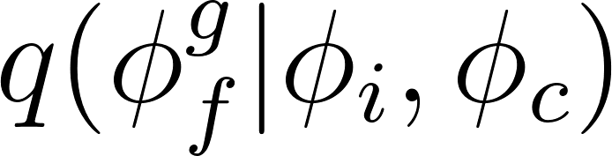
GMM and NF based Multilevel Method: Phi4
Target lattice
coarsest lattice
: GMM
prior
C. Flow
Normalizing Flow
C. Flow
: GMM

Slide 16
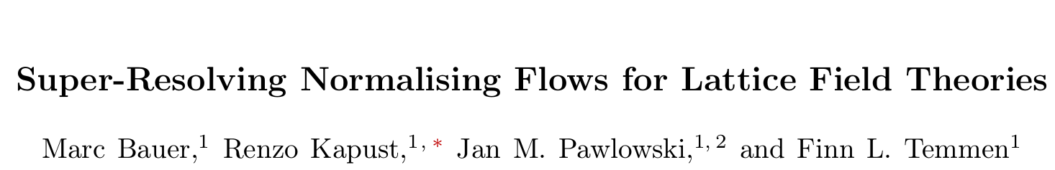
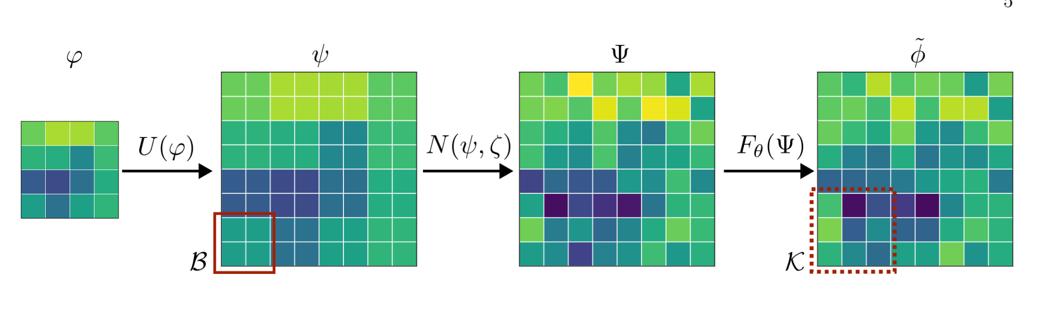
Baselines
R. Abbott et al., PoS LATTICE 2023 - Gauge Theory

Slide 17
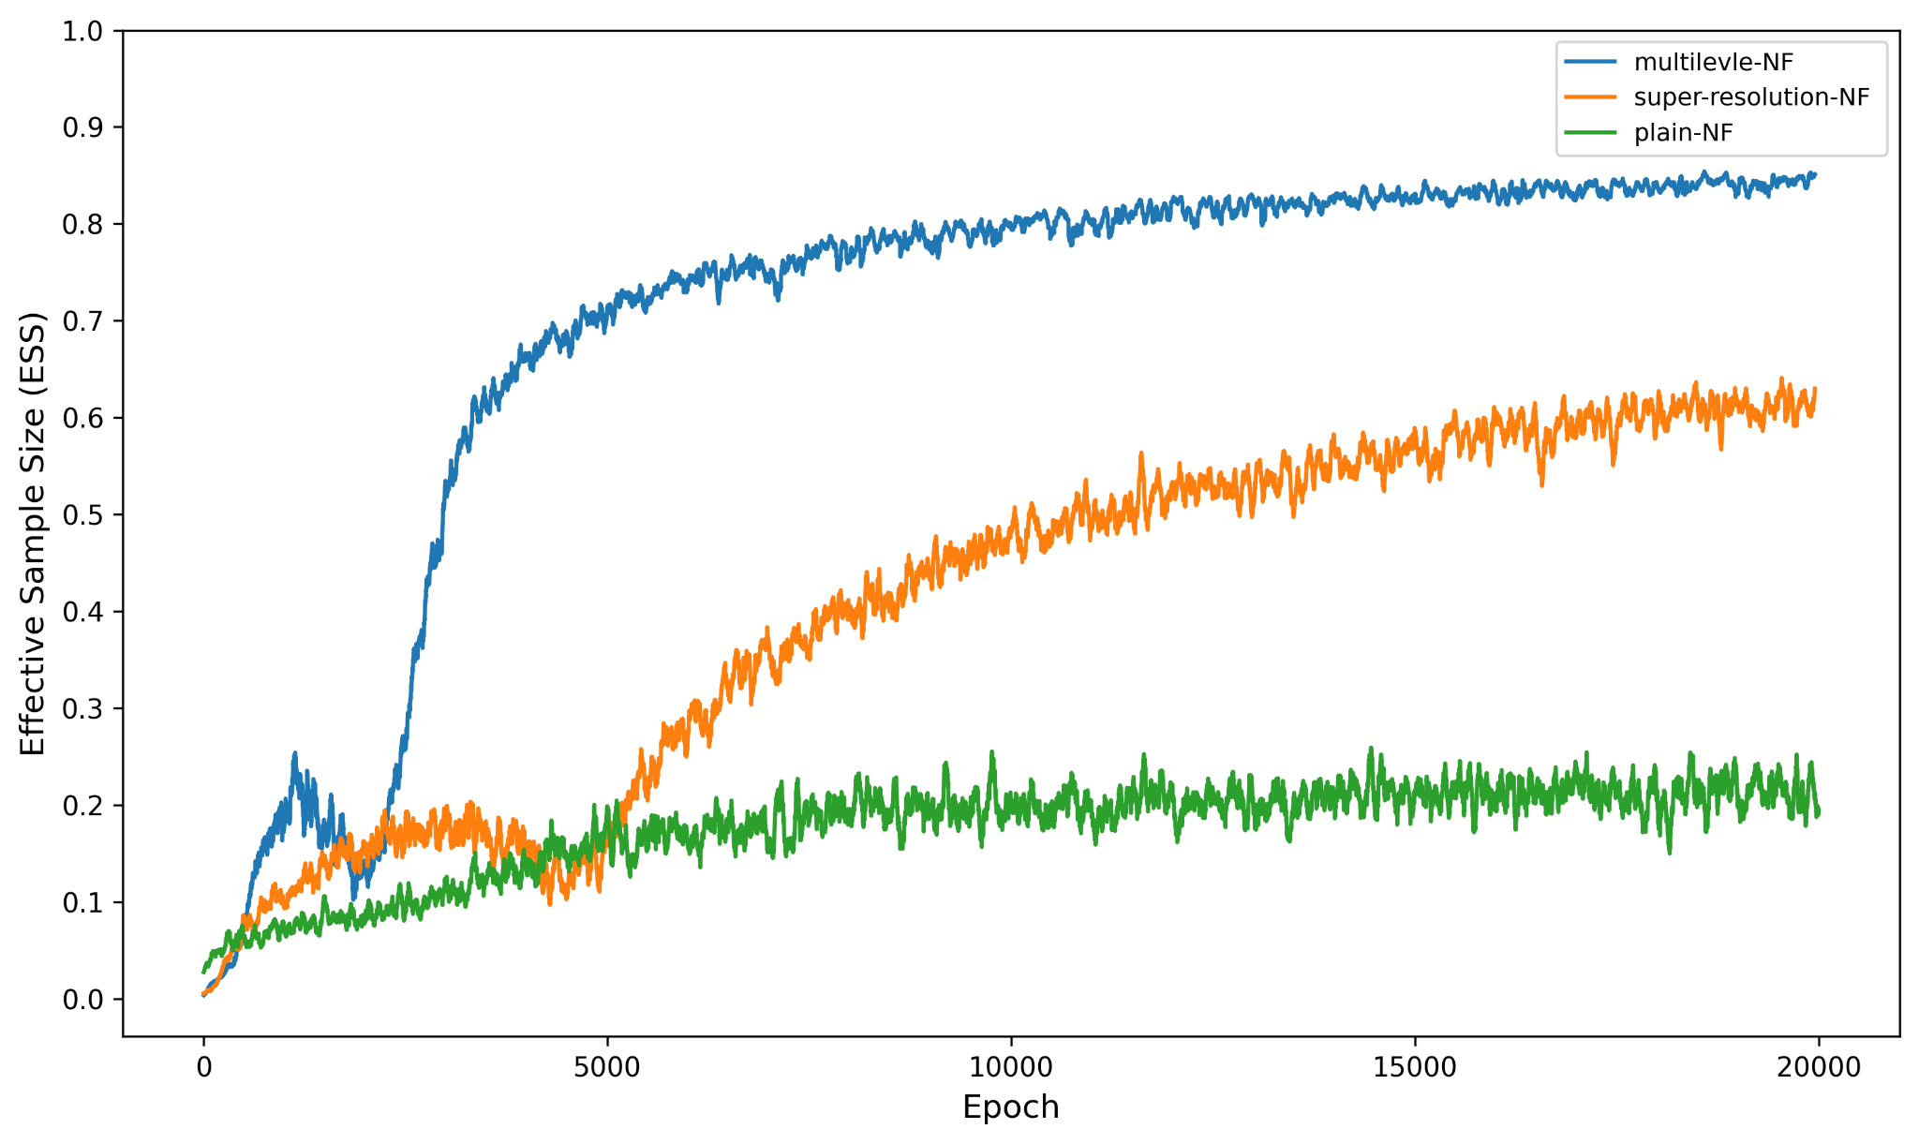
Preliminary Results
LxL=8x8, coupling layers: 4, kernel=5, hl= [32,32]

Slide 18
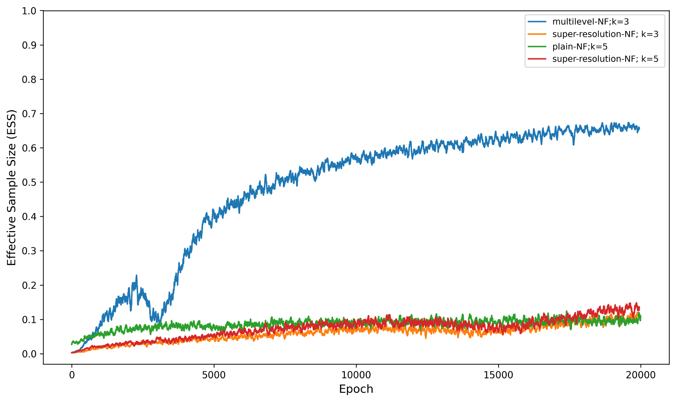
Preliminary Results:
LxL=16x16, coupling layers: 4, kernel=5, hl= [32,32]

Slide 19
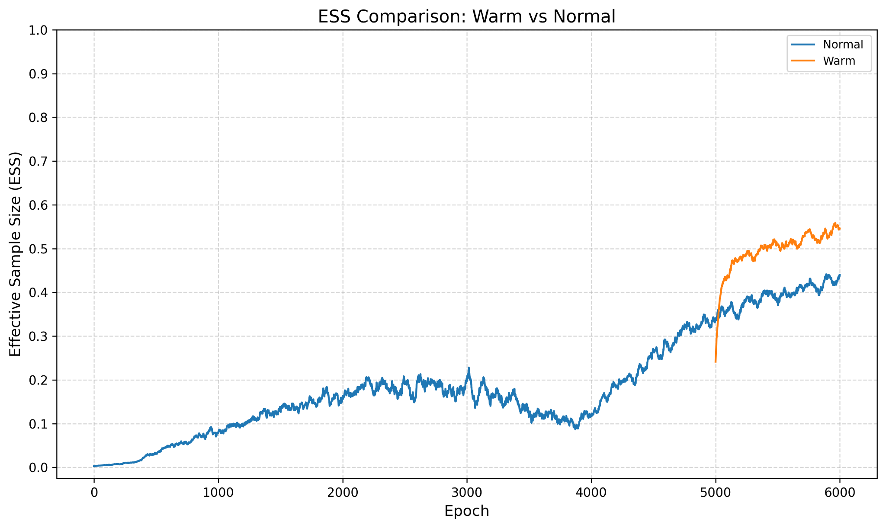
Preliminary Results:
Warm start: At 16x16
Pre-training time: 5000 epoch

Slide 20
Summary
Based on RG we build a Multiscale Autoregressive based sampler, RiGCS inspired by RG.
Based on scale invariance we developed a sequential training scheme.
Conditional-GMM for upsampling and NF to learn the remaining correlations.
Addressing scalability in Gauge Theory could be really exciting.
THANK YOU

Slide 21
THANK YOU

Slide 22
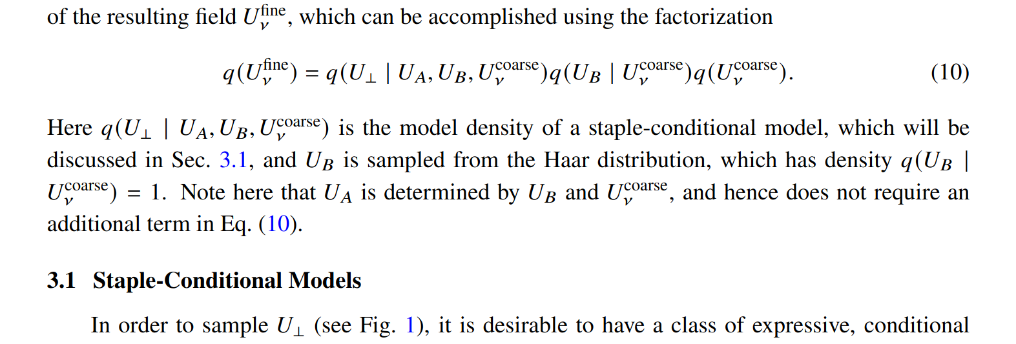
Multiscale Normalizing Flows for Gauge Theories
Ryan Abbott et al. POSLATTICE(2023)

Slide 23
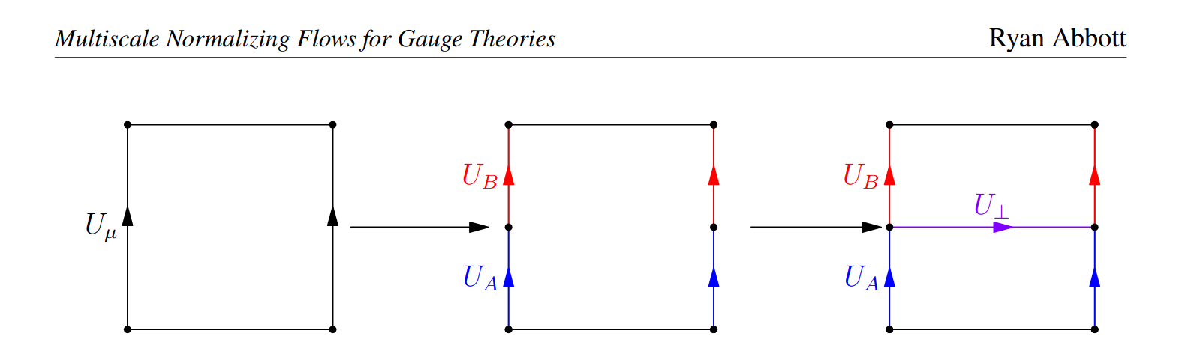
Upsampling Gauge Theory

