Slide 1
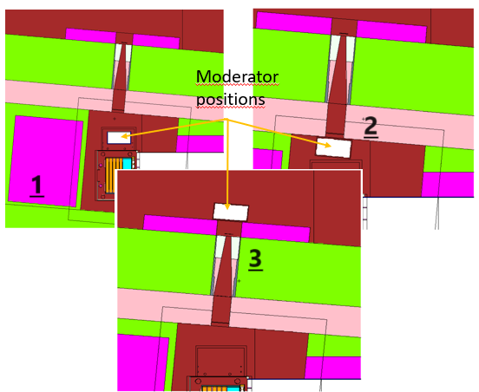

A moderator for the NEAR Station
Neutron spectra simulations
by Gediminas Stankunas
All input files (geometry, etc.)
by Vasilis Vlachoudis, Matteo Cecchetto, et al.
Results elaborated by AM
alberto.mengoni@cern.ch

Slide 2
A moderator for the NEAR Station

Slide 3
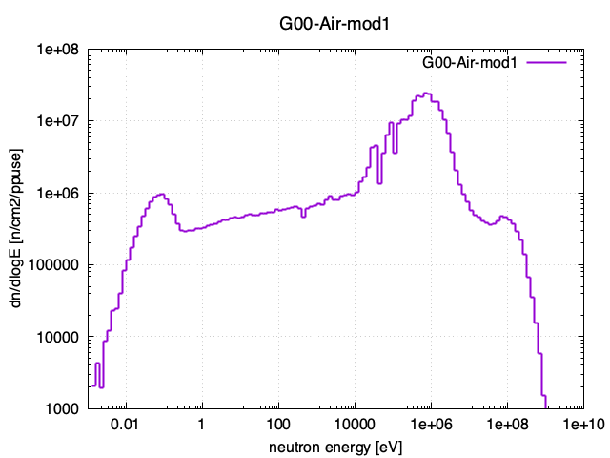
Neutron spectra
fln[ 1]="G00-Air-mod1"
fln[ 2]="G01-Al2O3.05-mod1"
fln[ 3]="G02-Al2O3.10-mod1"
fln[ 4]="G03-Al2O3.20-mod1"
fln[ 5]="G04-Al2O3-mod1"
fln[ 6]="G05-AlF3.TiF3-mod1"
fln[ 7]="G06-AlF3-mod1"
fln[ 8]="G07-Al-mod1"
fln[ 9]="G08-Be.05-mod1"
fln[10]="G09-Be.10-mod1"
fln[11]="G10-Be.20-mod1"
fln[12]="G11-CF2-mod1"
fln[13]="G12-CaF2-mod1"
fln[14]="G13-Fluental-mod1"
fln[15]="G14-LiF-mod1"
fln[16]="G15-MgF2-mod1"
fln[17]="G16-TiF3-mod1"
fln[18]="G17-Void-mod1"

Slide 4
NEAR moderator(s)
10 cm thickness for the moderators

Slide 5
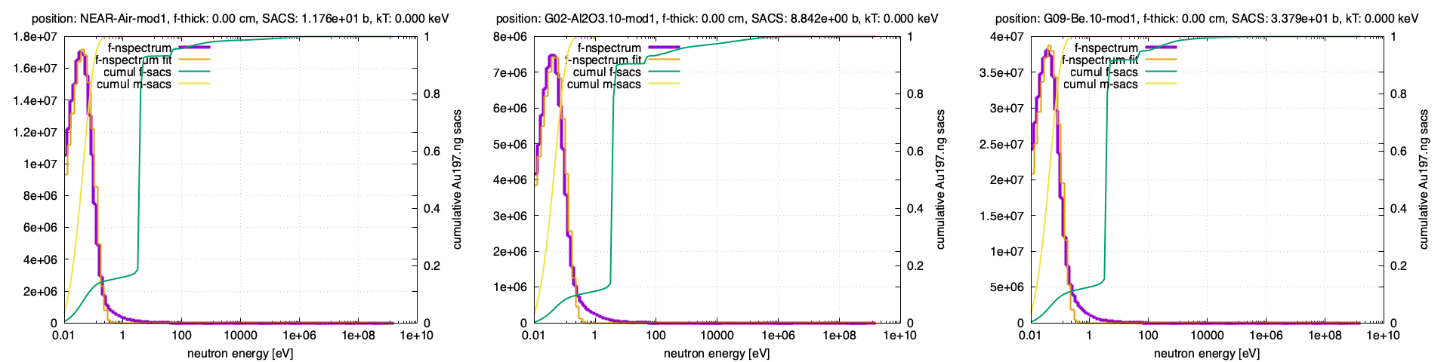
NEAR moderator(s)
No moderator
Al₂O₃ (10 cm)
Be (10 cm)
nflux [n/cm2/eV/ppulse]
no filter

Slide 6
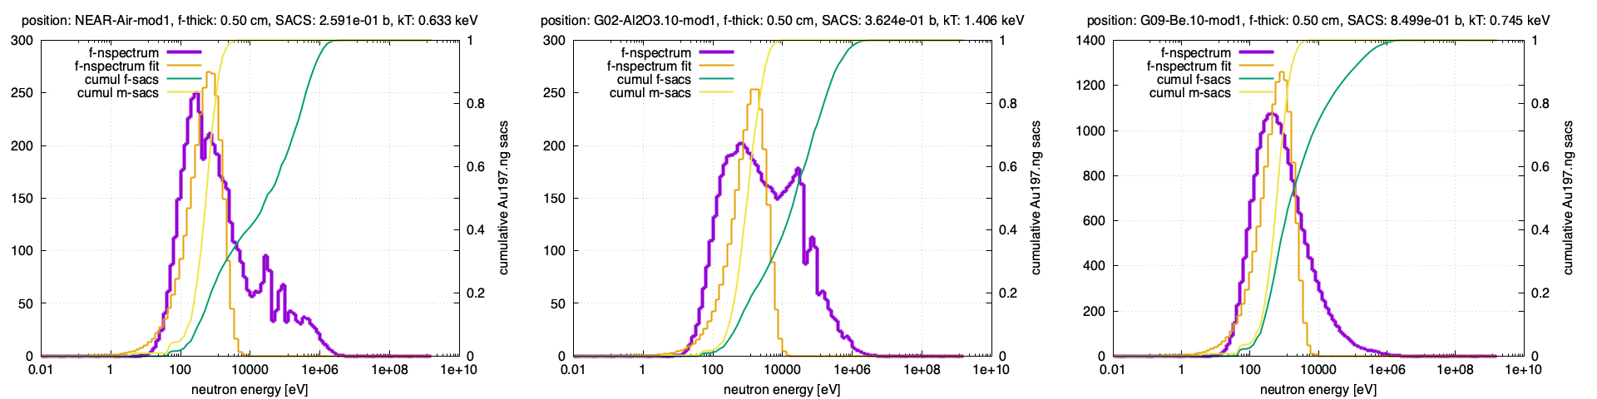
NEAR moderator(s)
No moderator
Al₂O₃ (10 cm)
Be (10 cm)
nflux [n/cm2/eV/ppulse]
filter thickness: 0.5 cm

Slide 7
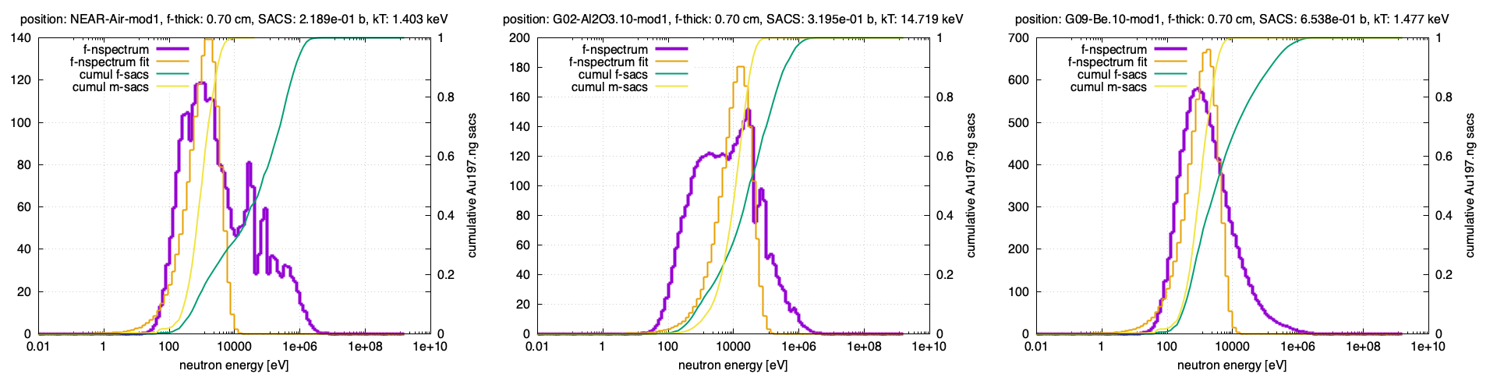
NEAR moderator(s)
No moderator
Al₂O₃ (10 cm)
Be (10 cm)
nflux [n/cm2/eV/ppulse]
filter thickness: 0.7 cm

Slide 8
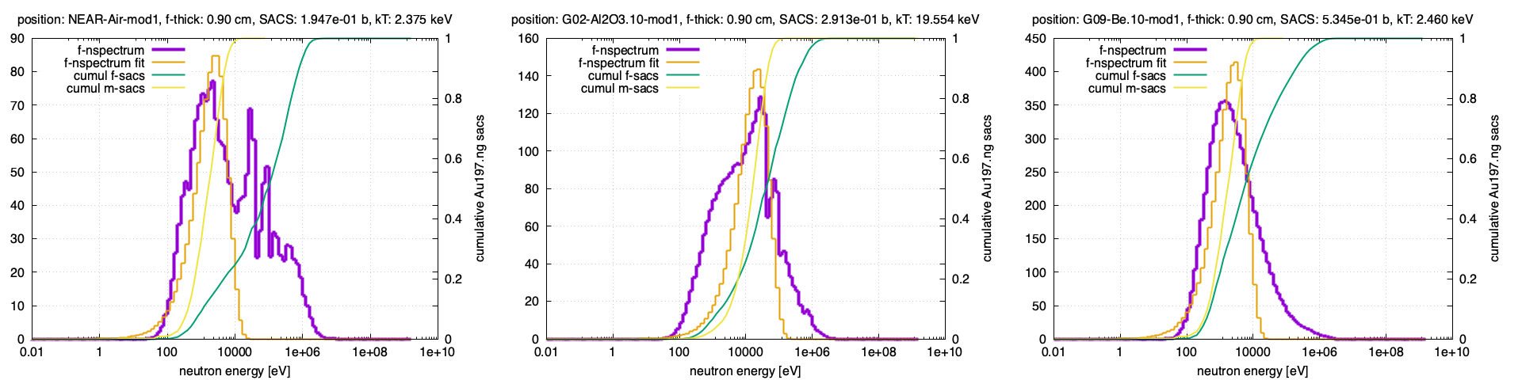
NEAR moderator(s)
No moderator
Al₂O₃ (10 cm)
Be (10 cm)
nflux [n/cm2/eV/ppulse]
filter thickness: 0.9 cm

Slide 9
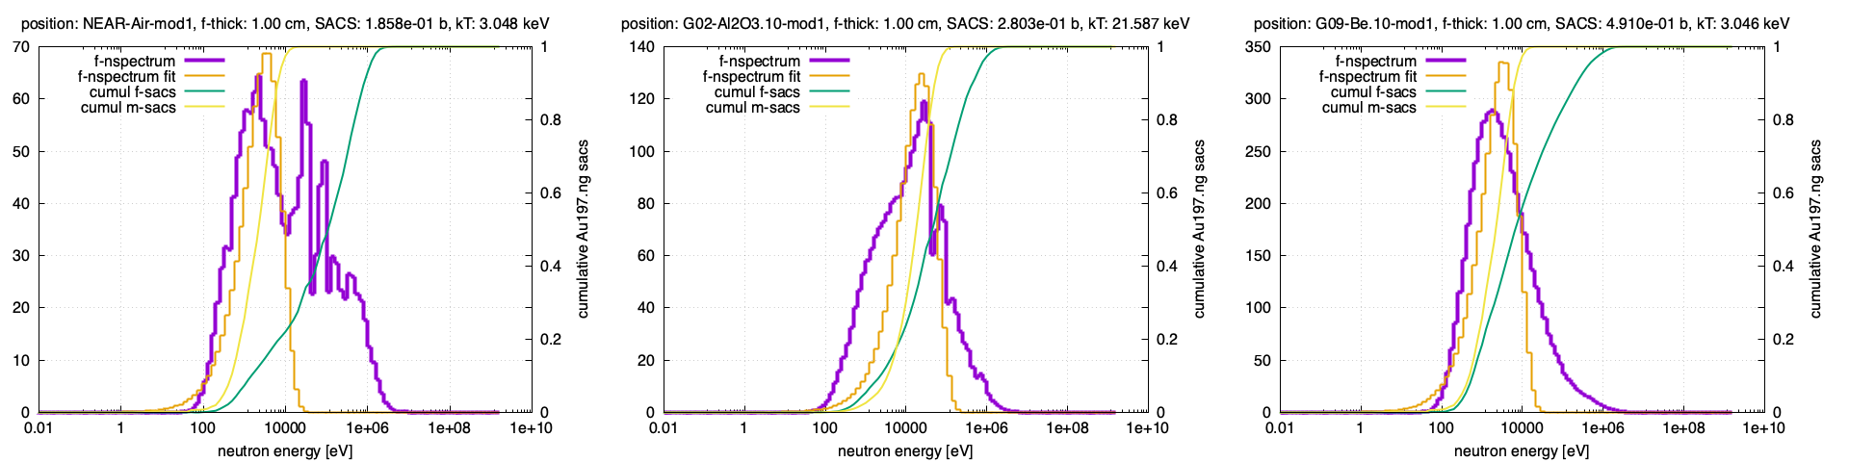
NEAR moderator(s)
No moderator
Al₂O₃ (10 cm)
Be (10 cm)
nflux [n/cm2/eV/ppulse]
filter thickness: 1.0 cm

Slide 10
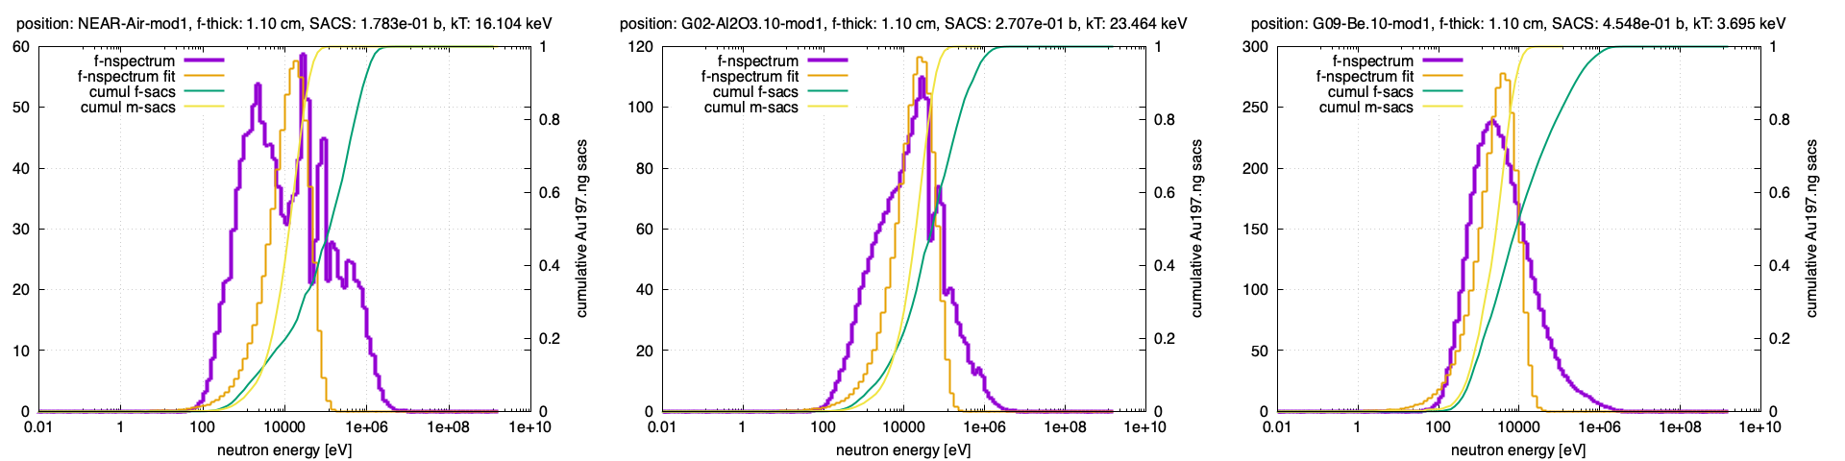
NEAR moderator(s)
No moderator
Al₂O₃ (10 cm)
Be (10 cm)
nflux [n/cm2/eV/ppulse]
filter thickness: 1.1 cm

Slide 11
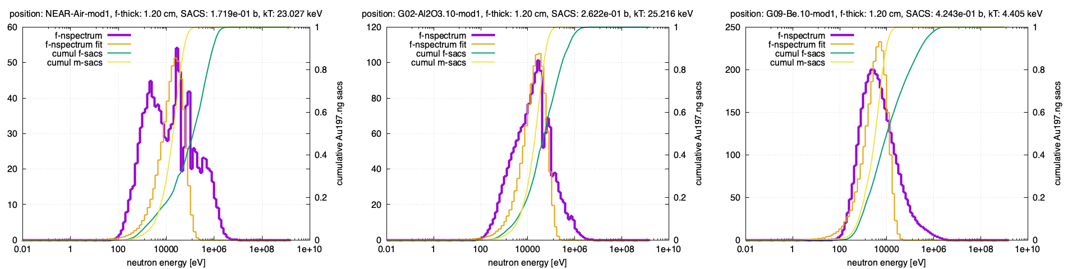
NEAR moderator(s)
No moderator
Al₂O₃ (10 cm)
Be (10 cm)
nflux [n/cm2/eV/ppulse]
filter thickness: 1.2 cm

Slide 12
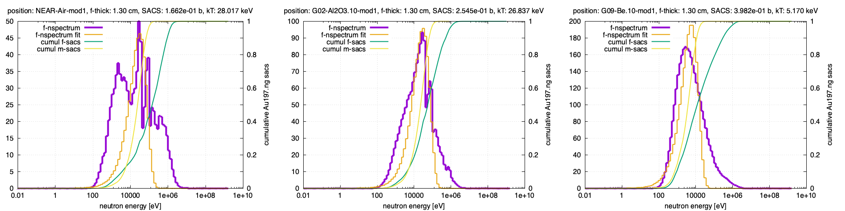
NEAR moderator(s)
No moderator
Al₂O₃ (10 cm)
Be (10 cm)
nflux [n/cm2/eV/ppulse]
filter thickness: 1.3 cm

Slide 13
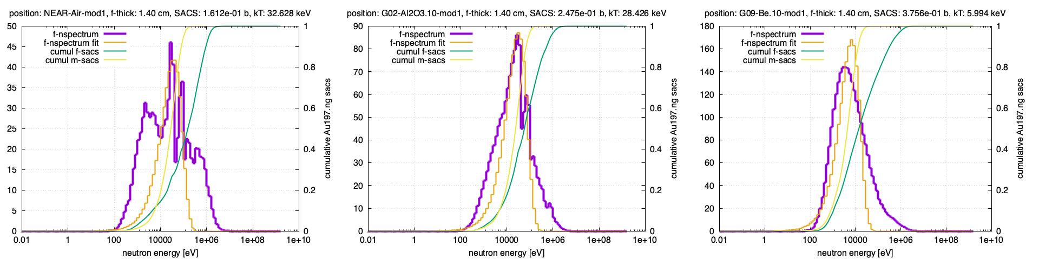
NEAR moderator(s)
No moderator
Al₂O₃ (10 cm)
Be (10 cm)
nflux [n/cm2/eV/ppulse]
filter thickness: 1.4 cm

Slide 14
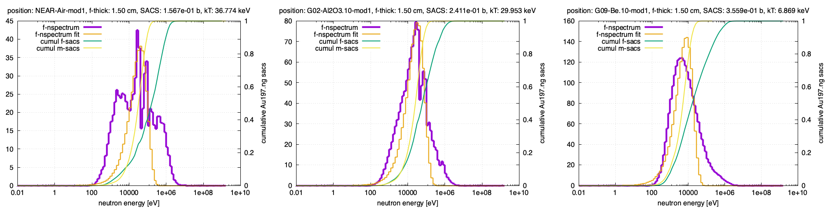
NEAR moderator(s)
No moderator
Al₂O₃ (10 cm)
Be (10 cm)
nflux [n/cm2/eV/ppulse]
filter thickness: 1.5 cm

Slide 15
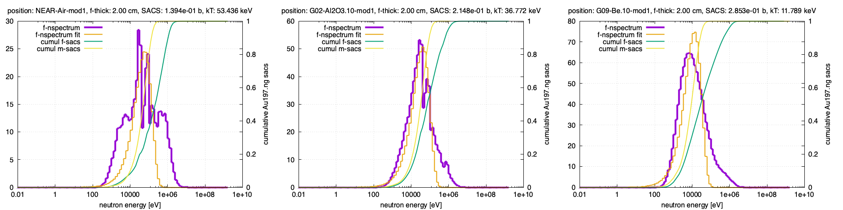
NEAR moderator(s)
No moderator
Al₂O₃ (10 cm)
Be (10 cm)
nflux [n/cm2/eV/ppulse]
filter thickness: 2.0 cm

Slide 16
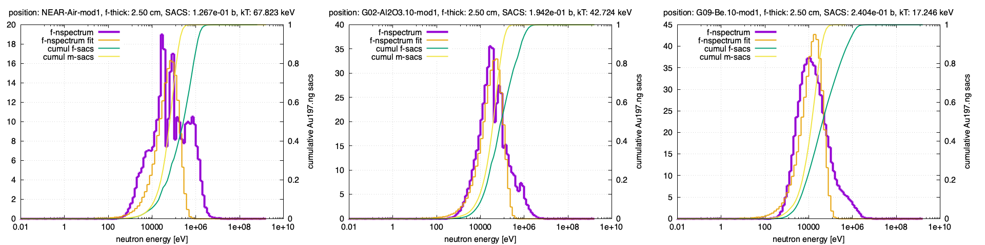
NEAR moderator(s)
No moderator
Al₂O₃ (10 cm)
Be (10 cm)
nflux [n/cm2/eV/ppulse]
filter thickness: 2.5 cm

Slide 17
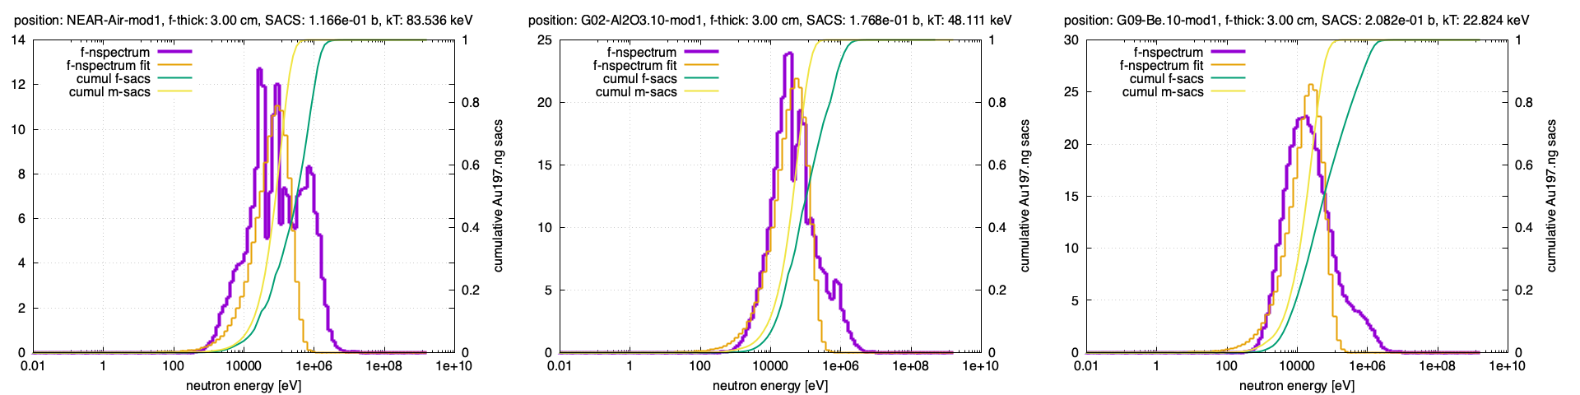
NEAR moderator(s)
No moderator
Al₂O₃ (10 cm)
Be (10 cm)
nflux [n/cm2/eV/ppulse]
filter thickness: 3.0 cm

Slide 18
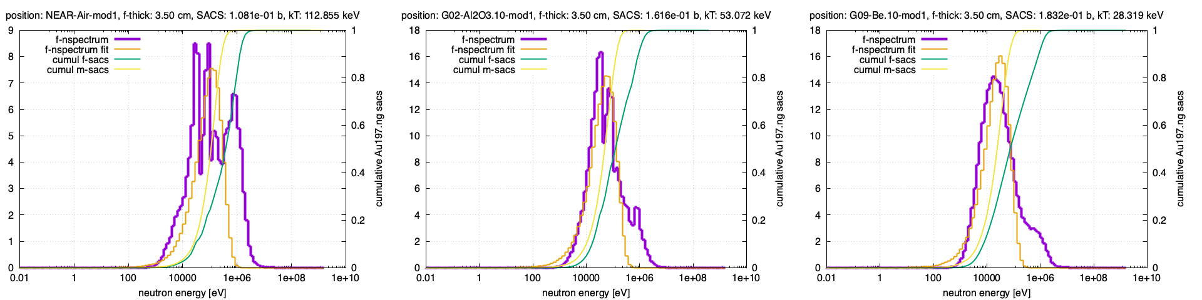
NEAR moderator(s)
No moderator
Al₂O₃ (10 cm)
Be (10 cm)
nflux [n/cm2/eV/ppulse]
filter thickness: 3.5 cm

Slide 19
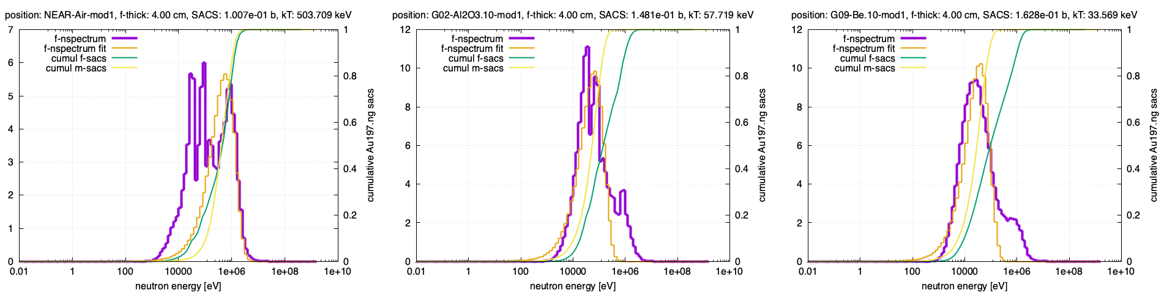
NEAR moderator(s)
No moderator
Al₂O₃ (10 cm)
Be (10 cm)
nflux [n/cm2/eV/ppulse]
filter thickness: 4.0 cm

Slide 20
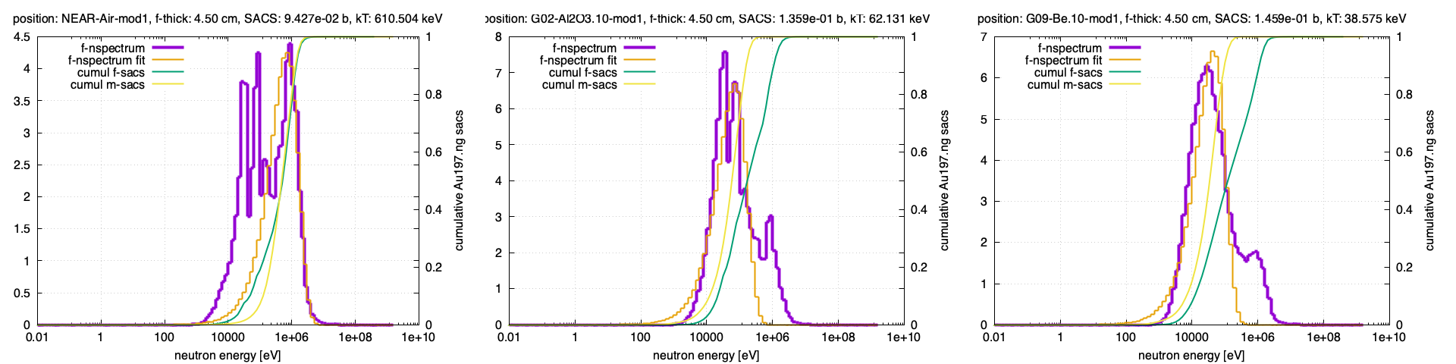
NEAR moderator(s)
No moderator
Al₂O₃ (10 cm)
Be (10 cm)
nflux [n/cm2/eV/ppulse]
filter thickness: 4.5 cm

Slide 21
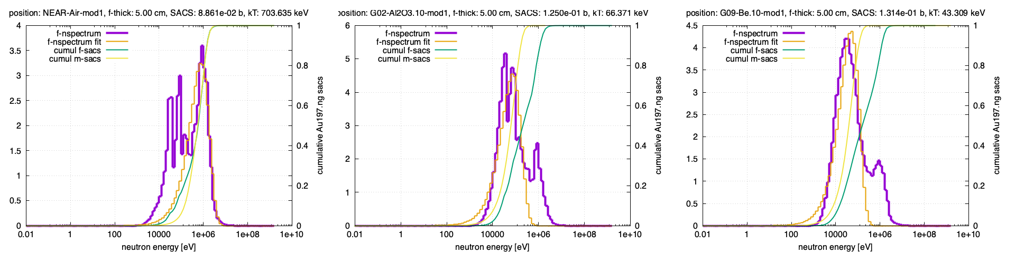
NEAR moderator(s)
No moderator
Al₂O₃ (10 cm)
Be (10 cm)
nflux [n/cm2/eV/ppulse]
filter thickness: 5.0 cm

Slide 22
NEAR moderator(s)

Slide 23
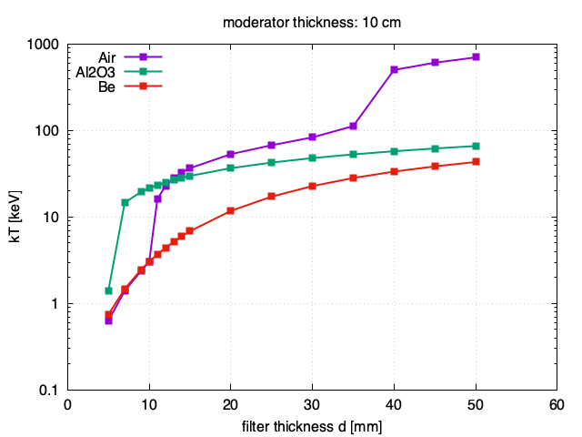
NEAR moderator(s)

Slide 24
The End

