Slide 1
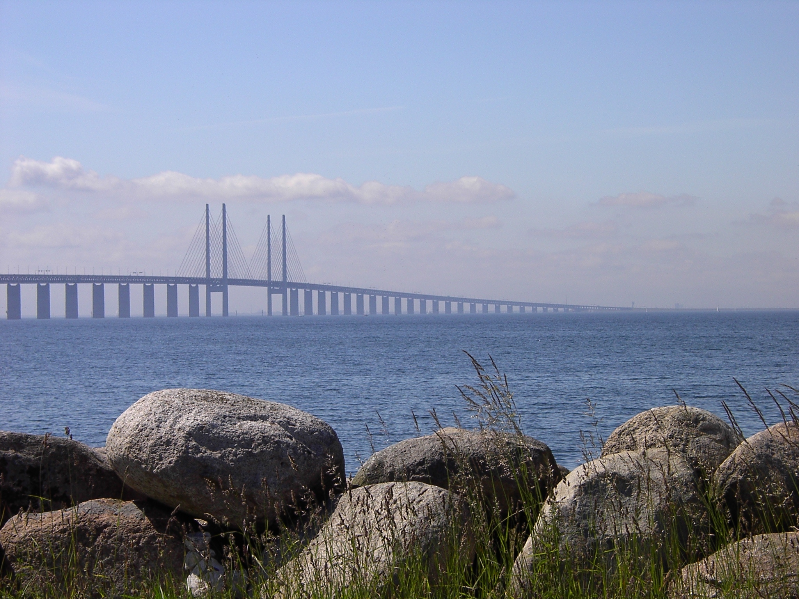
Skåne
the southernmost part of Sweden
2025-06-09
Annika Annerby Jansson
President of the Regional council

Slide 2
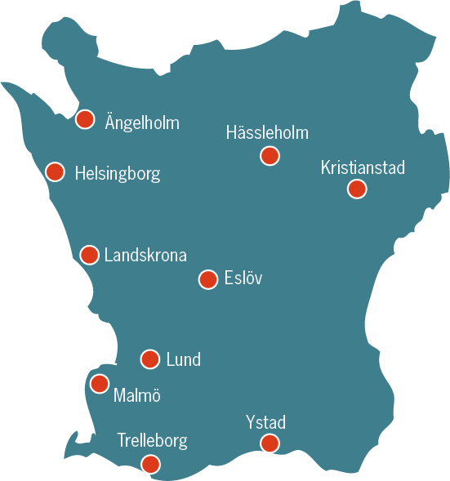
Skåne
Population 1.40 million
Largest cities and population 2021
Malmö 352,000
Helsingborg 150,000
Lund 130,000
Kristianstad 87,000
Airports
Copenhagen Airport (Denmark)
Kristianstad Österlen Airport
Malmö Airport
Ängelholm-Helsingborg Airport
Notes:
Skåne
Koncernkontoret, avdelningen för regional utveckling, Anders Bergqvist. Anders.Bergquist@skane.se
Uppdaterad: jan 2023

Slide 3
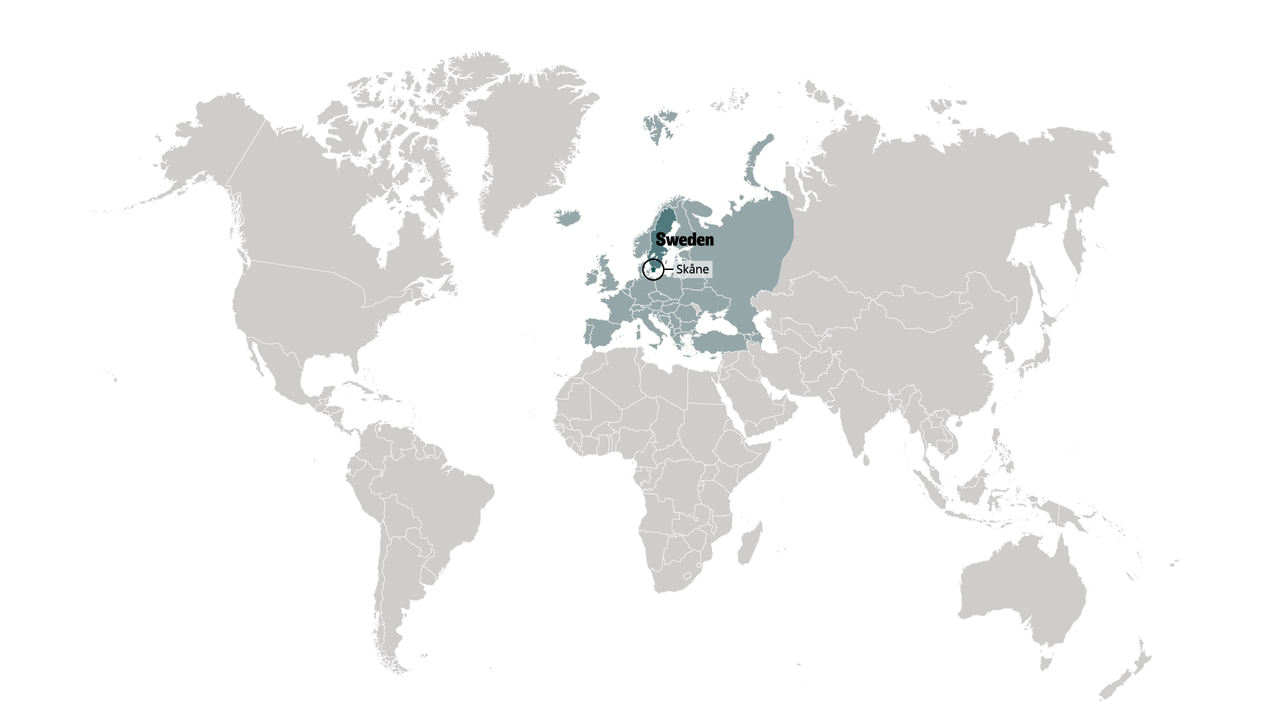
Skåne is situated at the heart of Scandinavia
The southernmost part of Sweden, Skåne is a region that’s in the centre of things with access to 4.4 million people in the Greater Copenhagen area
Its unique geography makes it a point of connection between Denmark and Sweden through the Öresund Bridge
Notes:
Skåne is the southernmost region of Sweden, located at the heart of Scandinavia.
Its unique geography as part of Scandinavia and the Greater Copenhagen region makes it a point of connection not just between Denmark and Sweden through the Öresund Bridge, but Europe and the Nordic region as well.
With 1.4 million people, Skåne is one of the largest labour markets in all of the Nordic countries.

Slide 4
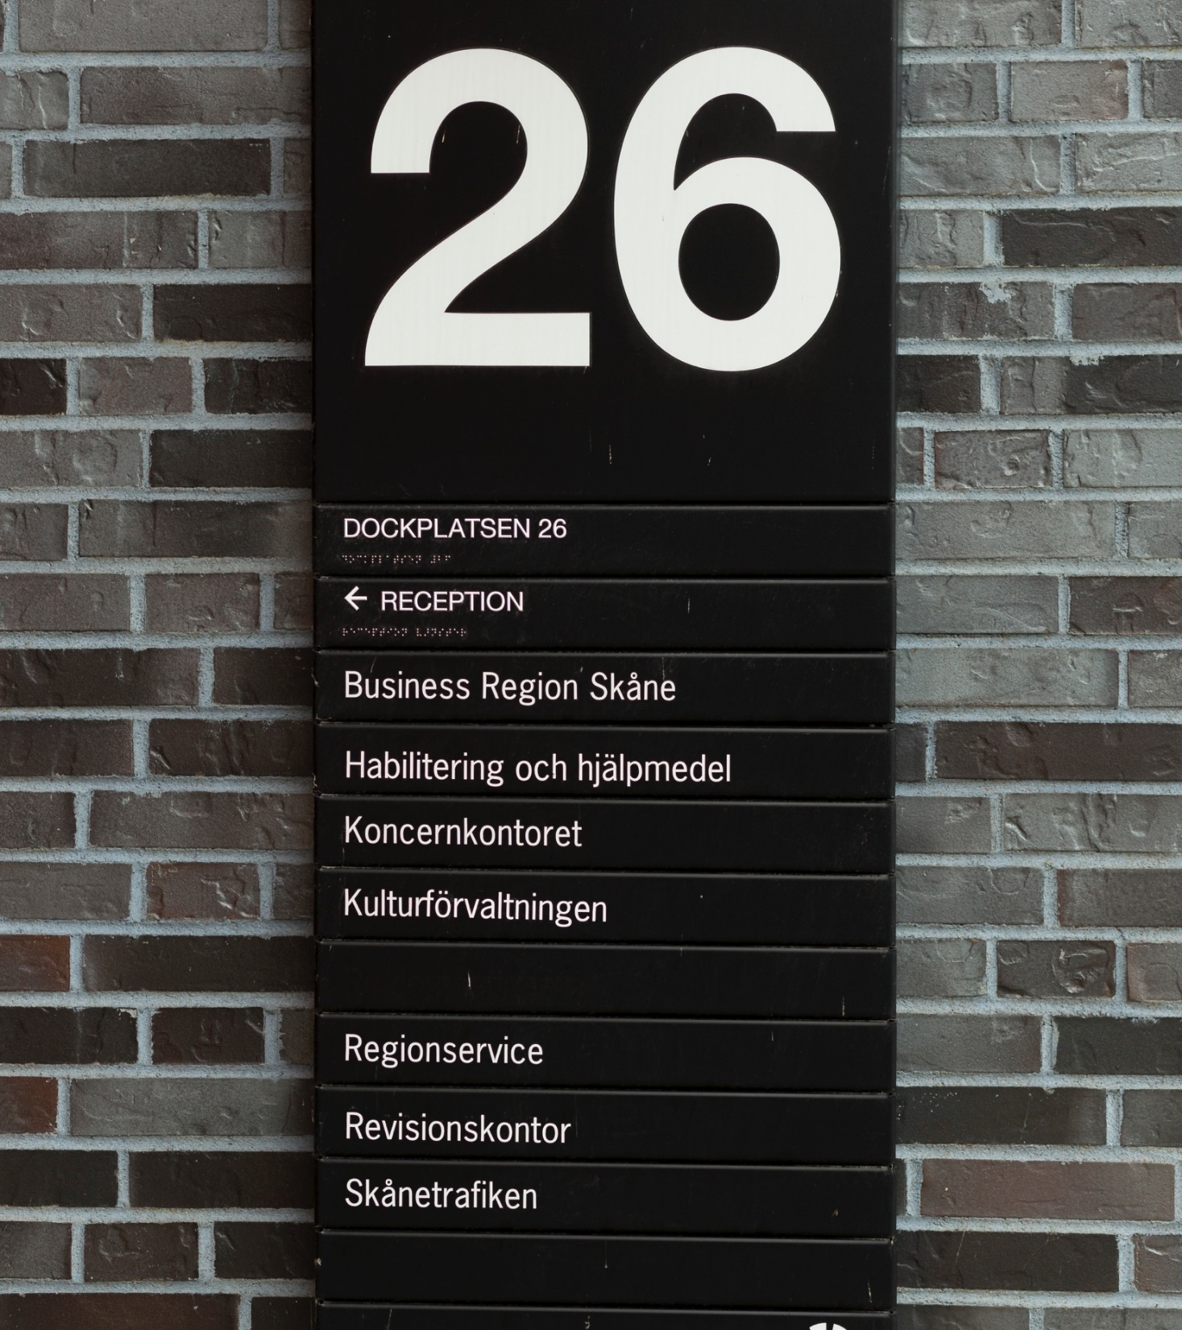
Region Skåne
Self-governing administrative region, funded by taxes
Governed by a Regional Council with 149 members elected directly by the inhabitants of Skåne
Established in 1999
Annual turnover approx. EUR 5 billion
Number of employees approx. 38 000
Responsibilities:
Healthcare
Regional development
Regional representative of Skåne towards national and interregional bodies
Photo: Region Skåne
Notes:
Some information about Region Skåne.

Slide 5


Health in a broad perspective
Nine hospitals, one of which is a university hospital
About 150 care centers and 150
child care centers, public
as well as private
160 psychiatric clinics and sections
400 dental clinics
1177 Health care guide on telephone
– councelling 24 hours a day
Local healthcare surgeries
Dental care
Healthcare advice
Ambulance
Medical science

Slide 6

Growth and sustainable development
Social planning
Trade and industry
Infrastructure
Public transport
Culture
Environment
Tourism
Photo: Apelöga

Slide 7
Expenditure
Revenues
Notes:
Source: https://www.skane.se/organisation-politik/om-region-skane/Ekonomi-och-uppfoljning/

Slide 8
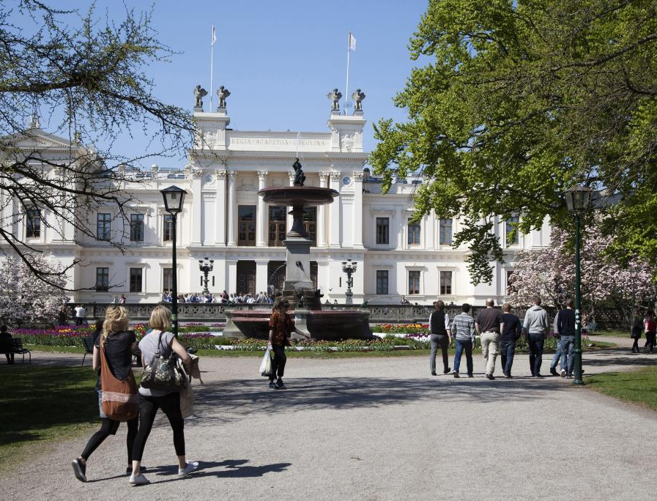
Colleges and universities
Lund University (46,000 students)
  Lund University, Helsingborg Campus
  Faculty of Engineering (LTH) at Lund University
Malmö University (24,000 students)
Kristianstad University College
(14,000 students)
Swedish University of
Agricultural Sciences Alnarp
World Maritime University (FN)
Photo: Lund University, M Riesedal
Notes:
Högskolor och universitet
Lunds universitet grundades 1666 och är det nutida Sveriges näst äldsta lärosäte efter Uppsala universitet. Lunds universitet är ett av de största universiteten i Norden. Malmö högskola blev Malmö universitet 2018.
Bild: Lunds universitet, foto: Mikael Riesedal
Fakta:
https://www.lu.se/start
https://mau.se/
https://www.hkr.se/
https://www.slu.se/om-slu/orter/alnarp/
https://wmu.se/
Källa: Regional utveckling / Fredrik Broman, fredrik.broman@skane.se
Uppdaterad: januari 2023

Slide 9
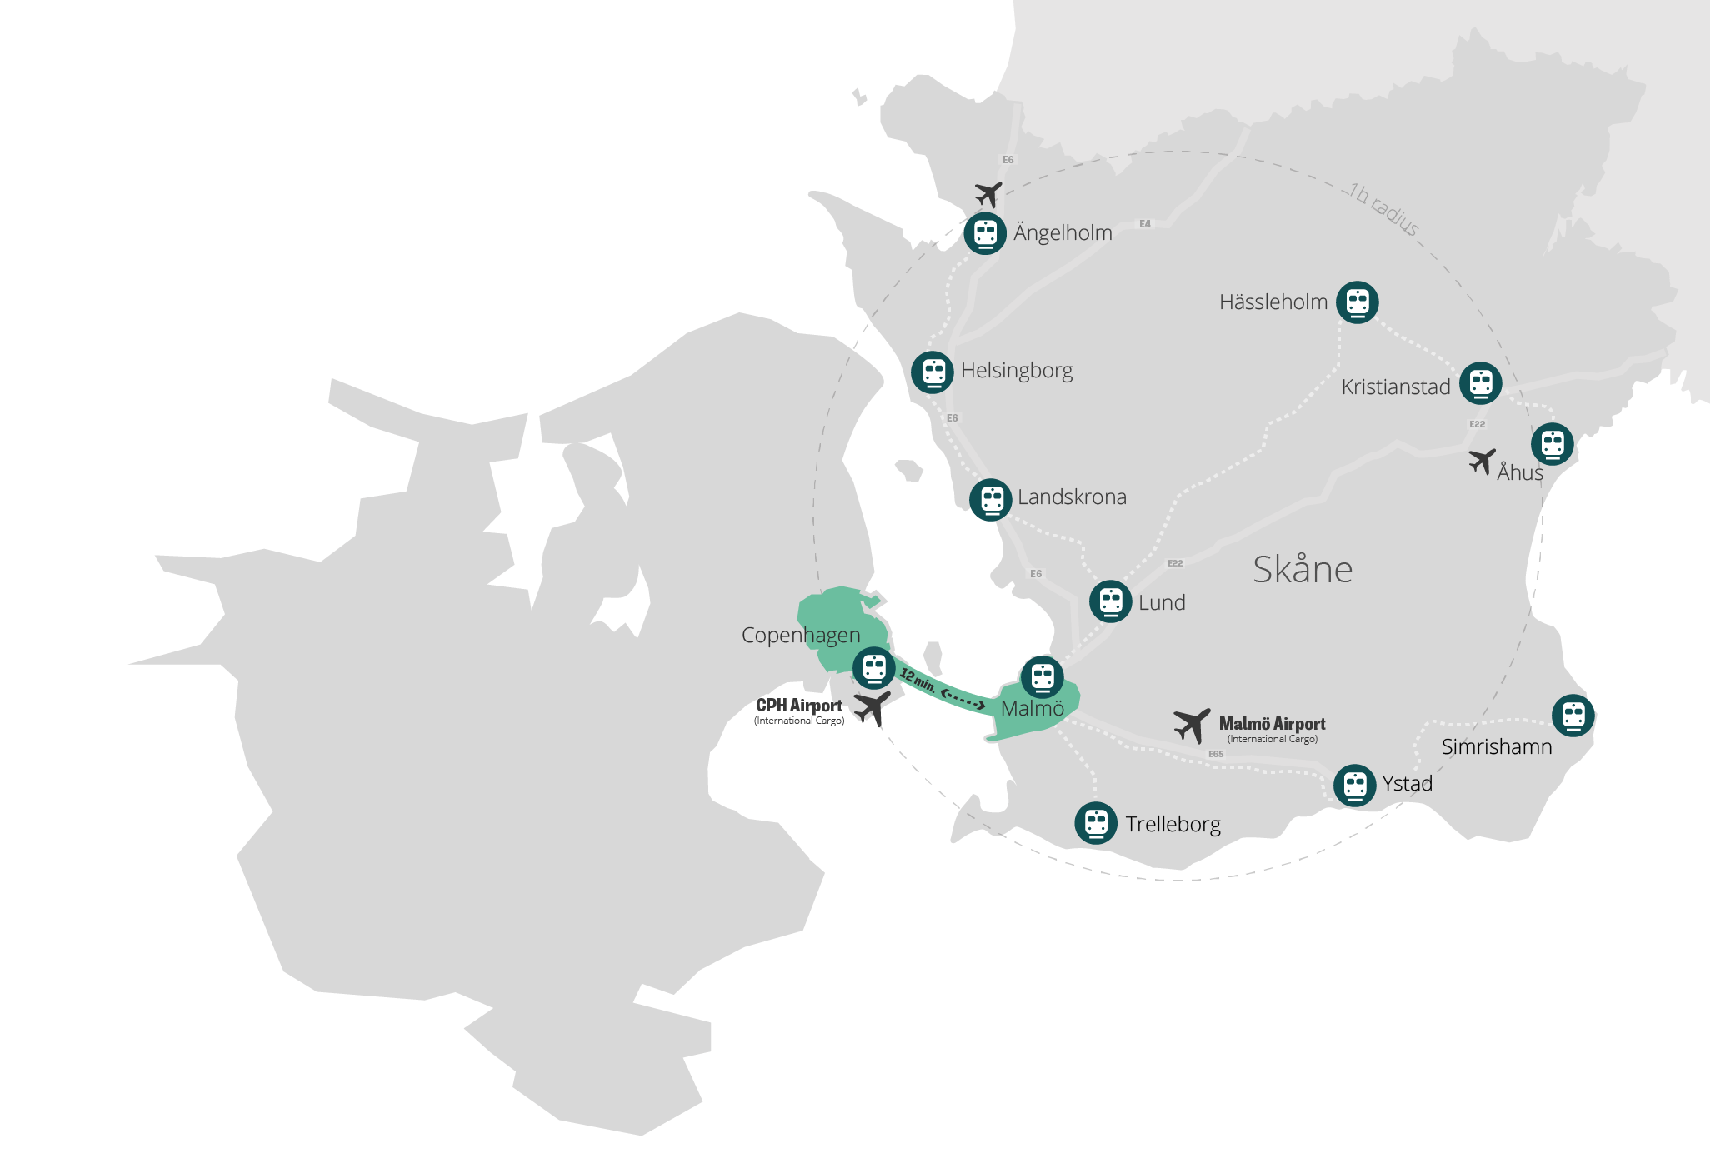

Everything you need within one hour by car or public transport
The largest international airport in the Nordics, Copenhagen International Airport (CPH) is located within 20 minutes by train or car from the city of Malmö
Most of the region is reachable within one hour by car or train
Skåne is also a key point of access to both the 25 million consumers in Scandinavia and the 125 million in Northern Europe
Notes:
Skåne is where Sweden meets Denmark and Scandinavia meets the world. The proximity to Copenhagen, with a major international airport and a potentially large labour market on the other side of the strait, presents great opportunities. Copenhagen Airport is the largest in Scandinavia and transports passengers and cargo to around 165 destinations every year.
Most of the region is reachable within one hour by car or train
On its own, the region is part of a dynamic transnational market of over 4 million consumers; but it’s also an essential link between the 25 million consumers in Scandinavia and the 125 million in Northern Europe.

Slide 10
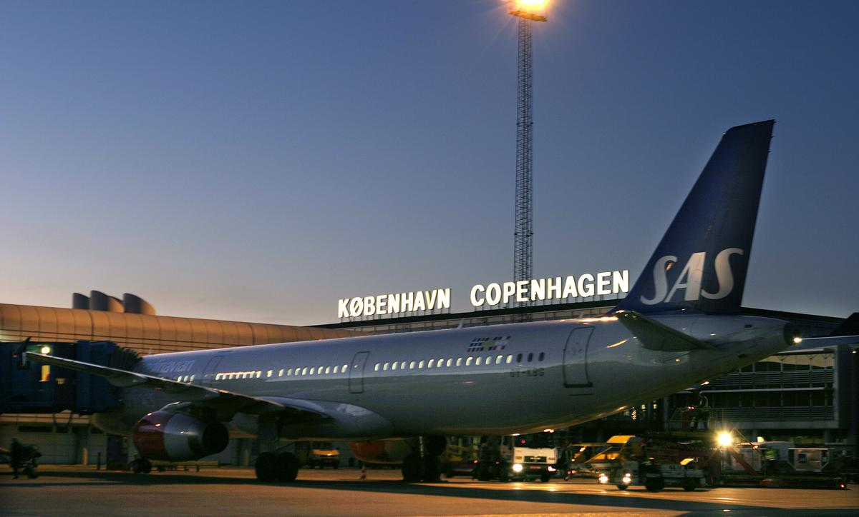
Good infrastructure
and accessibility
Photo: Copenhagen Airport
Notes:
Bra infrastruktur och tillgänglighet
I Skåne finns tre flygplatser, Malmö Airport, Kristianstad Österlen Airport och Ängelholm-Helsingborg Flygplats, med trafik såväl inom landet som till några internationella destinationer.
Københavns Lufthavn / Copenhagen Airport är Skandinaviens största internationella hub med mer än 120 internationella rutter, inklusive direkta rutter till stora affärsområden i Nordamerika och Asien. Över 30 miljoner passagerare 2019.
Från Malmö C tar det ca 20 minuter med direkttåg till Copenhagen Airport.
I Sverige omsätts nästan två tredjedelar av det sjöburna godset i de tio största hamnarna, varav tre är skånska; Helsingborg, Malmö och Trelleborg. Copenhagen Malmo Port är en av Nordens största hamn- och terminaloperatörer och har en nyckelposition i Östersjöregionen. Detta möjliggör en smidig, snabb överföring av människor och gods över hela världen.
Foto: Fly og Handling 43 / Københavns Lufthavn / bildbank press
Källa:
https://www.swedavia.se/malmo
https://www.kidairport.com/
https://www.angelholmhelsingborgairport.se/
https://www.cph.dk/
http://www.cmport.com/
https://www.lansstyrelsen.se/skane/besoksmal/kulturmiljoprogram/skanes-historia-och-utveckling/kustens-landskap/hamnar-och-varv.html
Källa: Regional utveckling / Fredrik Broman, fredrik.broman@skane.se
Uppdaterad: januari 2023

Slide 11
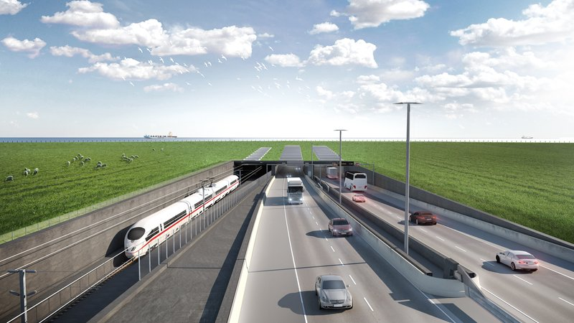
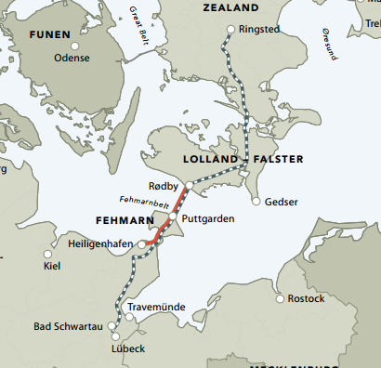
The Fehmarn Belt tunnel in 2028
The Fehmarn Belt tunnel in 2028
Photo: Femern A/S
Notes:
The Fehmarn Belt link, a tunnel between Rödby in Denmark and Puttgarten in Germany, is expected to be operational by 2028. It will provide swift access to Germany and other European markets.
Once completed, the journey between Denmark and Germany will take 7 minutes by train and 10 minutes by car.
That means you will be able to travel from Stockholm to Hamburg in just nine hours and from Malmö to Hamburg in approx. three hours.
Yet another major infrastructure investment dawning, a link that will bring Scandinavia closer to the continent, Germany and the rest of Europe: the Fehmarn Belt Link.
This will be the longest combined rail and road tunnel, consisting of a four lane motorway alongside railway, as an immersed tunnel.
Facts
A fixed link, approx. 18 km long, between Fehmarn (DE) and Lolland (DK).
The Fehmarn region includes the important commerce center, Hamburg.
Construction period (prel.): 2015-24
Total costs: 5.5 billion EUR out of which 4.1 for construction

Slide 12
Our four priorities for sustainable regional development
Improved health för more people
A competitive business sector
A connected Skåne
A strengthened competence supply

Slide 13
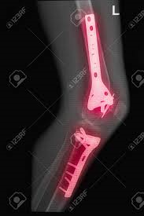
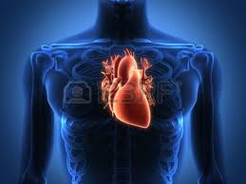
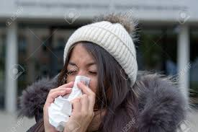
Healthcare
is linked with regional development
Eight public health objectives
1. Conditions for early life
2. Skills, expertise
and education
3. Work, working conditions and health and safety
4. Income and livelihoods
5. Housing and the local environment
6. Lifestyle
7. Control, influence and participation
8. Equal healthcare that promotes health
Source: Govt. Bill 2017/18:249
LIVING CONDITIONS
INFECTIONS
BROKEN LEG
HEART
PROBLEMS
BIGGEST COST
Notes:
Hälso- och sjukvård hänger ihop med regional utveckling II
Det avgörande för varje del av verksamheten är att den förstår hur den dockar in i helheten –
Även om det i alla aktiviteter som avdelningen ägnar sig åt – tex näringslivsutveckling – i det dagliga arbetet inte är det man som enskild tjänsteman tänker på
Triangelresonemanget:
Vad är 95% av RS verksamhet – sjukvård och hjälpa våra patienter från det vardagliga enklare till den avancerade specialistvården
Men vart går merparten av vår budget
Men 65% av dessa kroniska sjukdomar som tar så stor del av budgeten är möjliga att förebygga det handlar om livsvillkor och levnadsvanor
Regional utvecklinsarbete handlar om livsvillkor – oavsett om det handlar om infrastruktursatsningar eller insatser för ett välmående näringsliv som genererar jobb osv
Låt oss vända på trianglarna och se vad framtidens hälsosystem ger för möjligheter
OBS! Folkhälsan i Sverige visar till exempel att andelen som anger att de har ängslan, oro eller ångest ökar. Fler anger att de har fetma och det finns stora skillnader i befolkningen beroende på var man bor, kön, ålder, samt socioekonomi. Skillnaderna tycks inte minska och har i vissa fall till och med ökat. Hälsan utvecklas inte lika gynnsamt för dem som inte har eftergymnasial utbildning, sett till medellivslängd, självskattad hälsa, fetma, hjärtinfarkt och lungcancer. Levnadsvanorna utvecklas inom några områden positivt, såsom minskad daglig rökning bland unga och bland gravida samt minskad riskkonsumtion av alkohol bland unga. Men barn och vuxna är mycket stillasittande, i regel 9 timmar per dag. Vi vet också att fysiskt aktiva har 30-50% lägre risk att utveckla depression, diabetes typ 2 eller vissa cancerformer jämfört med inaktiva och idag har vi tre gånger högre andel med fetma i befolkningen idag jämfört med 80-talet.
Källa: Regional utveckling / Fredrik Broman, fredrik.broman@skane.se
Uppdaterad: jan 2023

Slide 14

Region Skåne
Climate and energy targets
Emissions of nitrous oxide and anesthetic gases will be reduced by 50 percent by the end of 2030 compared with the 2019 level.
All purchased district heating and district cooling for Region Skåne's own properties must be fossil fuel free by 2020 and renewable by 2030.
By the end of 2030, Region Skåne will have 100 percent fossil fuel-free land transport under its own and external auspices when performing transport services for Region Skåne.
In 2025, Region Skåne's energy use in owner-occupied properties will be
190 kWh / m2
Notes:
Procurement of nitrous oxide destructors for 5 hospitals is in progress.
The total share of fossil fuel free energy in owner occupied properties, internal transport and public transport in 2020 was 99.7 percent.
Energy consumption in 2013 was 236 kWh / m2 and the outcome in 2020 was 202 kWh / m2, which is an energy saving of 40.2 GWh.

Slide 15


Skåne is an innovation leader
Photo: Apelöga
The 2021 ‘Regional Innovation Scoreboard’ ranked Skåne overall as the 9th most innovative region in the EU
The region is home to world-leading technology companies, well-known start-up companies, and ground-breaking research.
Notes:
Skåne often ranks high in global indices of the world’s most innovative regions, 2021 ranked as 9th most innovative region in the EU
https://ec.europa.eu/growth/industry/policy/innovation/regional_en
Skåne is considered as the 2nd best region in EU when measuring ‘Lifelong learning’. Lifelong learning encompasses all purposeful learning activity, whether formal, non-formal or informal, undertaken on an ongoing basis with the aim of improving knowledge, skills and competence.
Skåne is also ranked as #2 region in EU when it comes to ‘PCT patent applications per billion regional GDP’. The indicator measures the number of patents applied for at the European Patent Office (EPO), by year of filing.
Skåne has a long history of innovation and the region’s prosperity is based on innovative and successful export companies that have been able to adapt as the market changes.

Slide 16
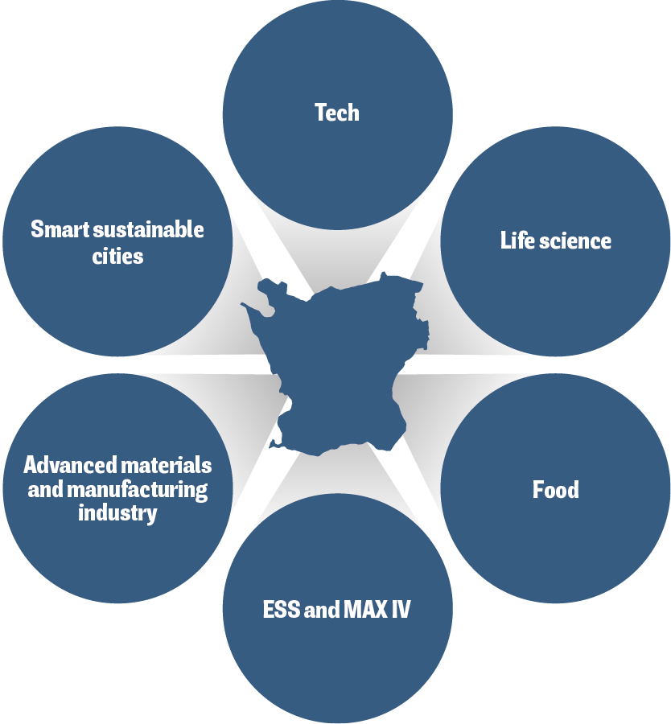
Focus areas in Skåne
Notes:
Skåne hosts a unique research environment in which the private sector, government and academia collaborate closely. An extensive network of research assets unite dynamic sector clusters, science parks, universities and public bodies in a shared ambition to drive innovation and business.
The research and innovation council of Skåne (FIRS) has prioritised six areas of specialisation with growth potential. The main selection criteria for most of the prioritised areas has been the existence of a cluster within the Skåne business environment. An additional one has been whether or not the area has a clear relationship with prominent research fields in the region.

Slide 17
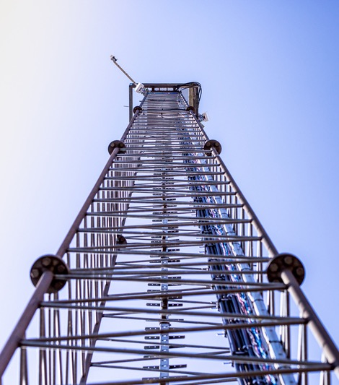
Tech
There is a wide range of tech companies in Skåne; from global leaders to well-known start-up ​
Including successful companies within hardware and network solutions, sensors and Internet of things, but also various forms of digital applications and consulting services​
The region has specifically advanced technical expertise in deep tech which includes Artificial Intelligence, Internet of Things, 5G, image recognition and big data​
A rapidly growing segment is game development​
There are several solid education platforms aimed at producing tech related competence and tech is the most common area for new innovations​
Skåne tech companies are attracting the fourth largest share of investments trailing the Nordic capital cities​
Photo: Apelöga

Slide 18
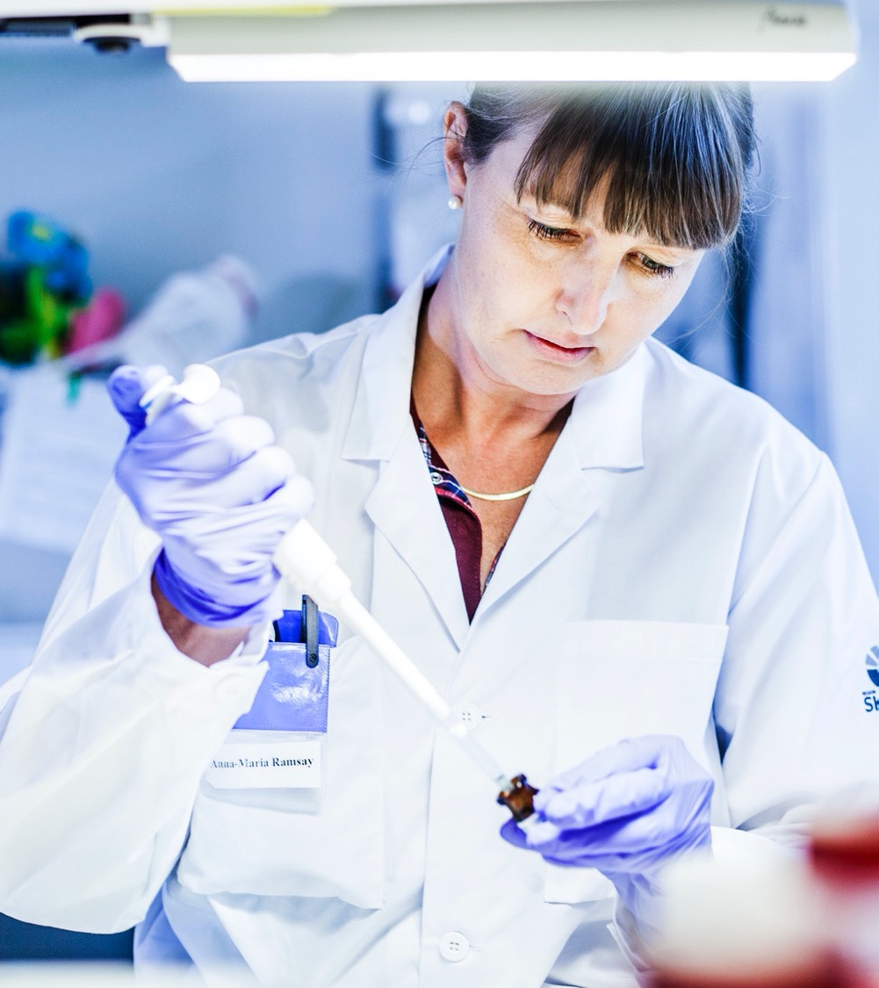
Life science​
The life science sector in Skåne is well-known internationally and accounts for 16 % of the Swedish life science industry​
Skåne is part of Medicon Valley, the strongest life science cluster in the Nordics with over 50,000 employees, making it Northern Europe´s largest labour market in life science​
The life science sector includes companies in the development, production, and distribution of medicines and medical technology, basic research, clinical research, and parts of the healthcare system​
The sector is currently undergoing a change that entails both a new approach to tech and big data, and an increased focus on prevention​
The life science sector in Skåne has a strong academic reputation, with a large number of internationally recognized scientific publications.​
Photo: Apelöga

Slide 19

Food
50% of all food produced in Sweden comes from Skåne​
The region has strong assets in the entire food system, from primary production, through processing and packaging, to the retail and consumer sector, as well as a well-developed innovation system​
A prominent strength is at the intersection of life science, agronomy, and food research, especially with regard to diabetes and metabolism​
Skåne has a significant start-up scene for new food companies covering the entire spectrum from sustainable fish farming to biodegradable products​
Sweden’s largest incubator with a food profile – Krinova – is situated in Skåne​
Photo: Apelöga

Slide 20
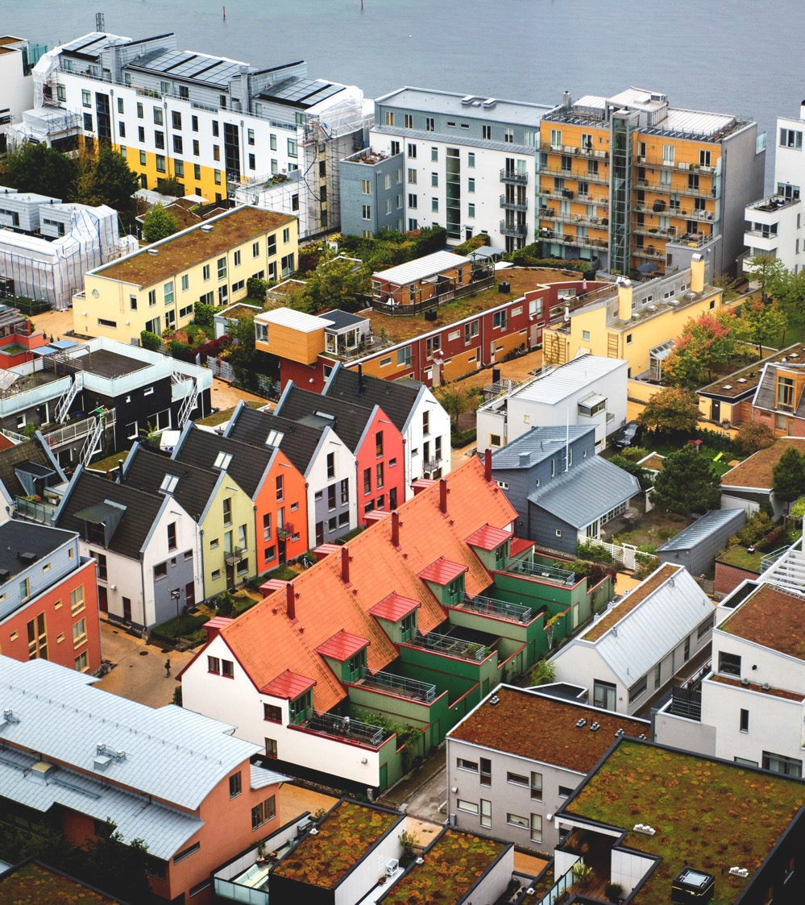
Smart sustainable cities​
In Sweden, 85 % of the population is living in cities which has led to the rapid development and implementation of smart and efficient solutions​
This is a sector in which Skåne’s larger cities have expressed a clear ambition to innovate together with businesses, academia and civil society​
Much of the potential for innovation in the urban environment requires system solutions where the public sector and the business community collaborate, test and scale up​
In Skåne, there are important research strongholds within the areas of climate environment, renewable energy and fuel, the Internet of Things as well as water and recycling​
The Skåne politicians highlight sustainable urban development as a strategically important area for further development​
Western Harbour in Malmö by Aline Lessner, Image Bank Sweden

Slide 21
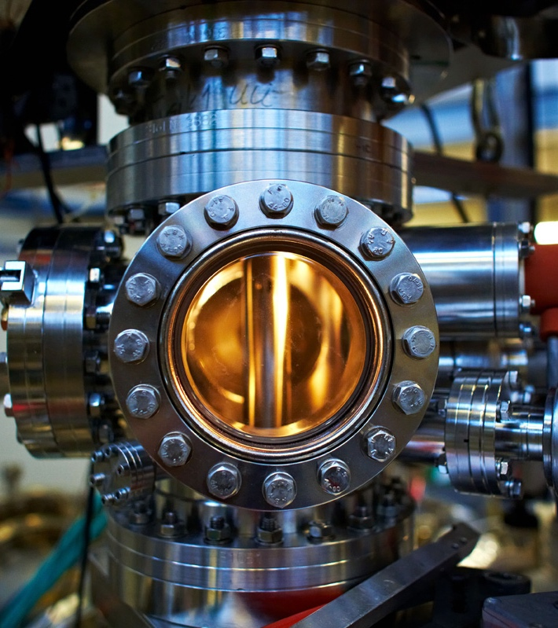
Advanced materials and manufacturing industry
(incl ESS & Max IV)​
The global demand for advanced materials is increasing due to rapid industrialisation and the market is expected to grow at a CAGR of 5.1 %
2018–2024​
Skåne’s advanced materials and manufacturing industry includes several different sub-industries such as packaging, refrigeration and ventilation technology, chemistry, plastics, and rubber​
The manufacturing industry is currently transitioning from unskilled to qualified jobs and many companies are investing in various forms of smart automation and digitalisation​
ESS and MAX IV are two globally renowned research facilities attracting international research and interest, increasing attractiveness, and leading to an influx of skills to the Skåne region​
Max Lab by Lasse Davidsson

Slide 22
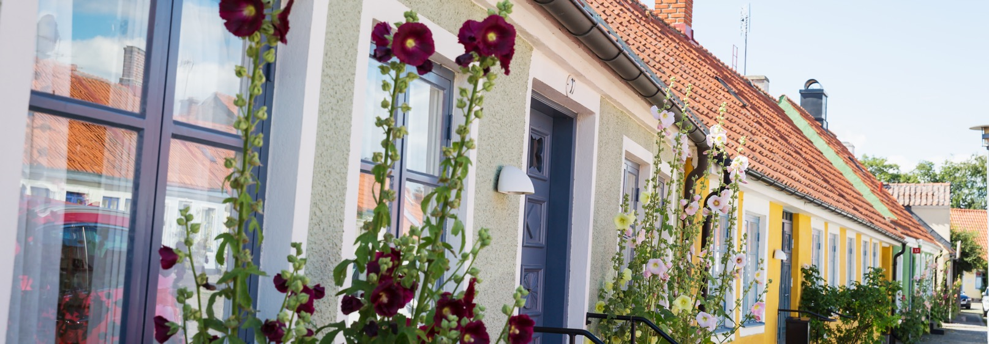
Skåne’s cities and municipalities
Photo_Apelöga
33 municipalities
Malmö, Lund, Helsingborg and Kristianstad are the four main cities
Notes:
There are 33 municipalities in Skåne
The area is approximately 11000 km²
The 3 main cities are Malmö, Lund and Helsingborg

Slide 23
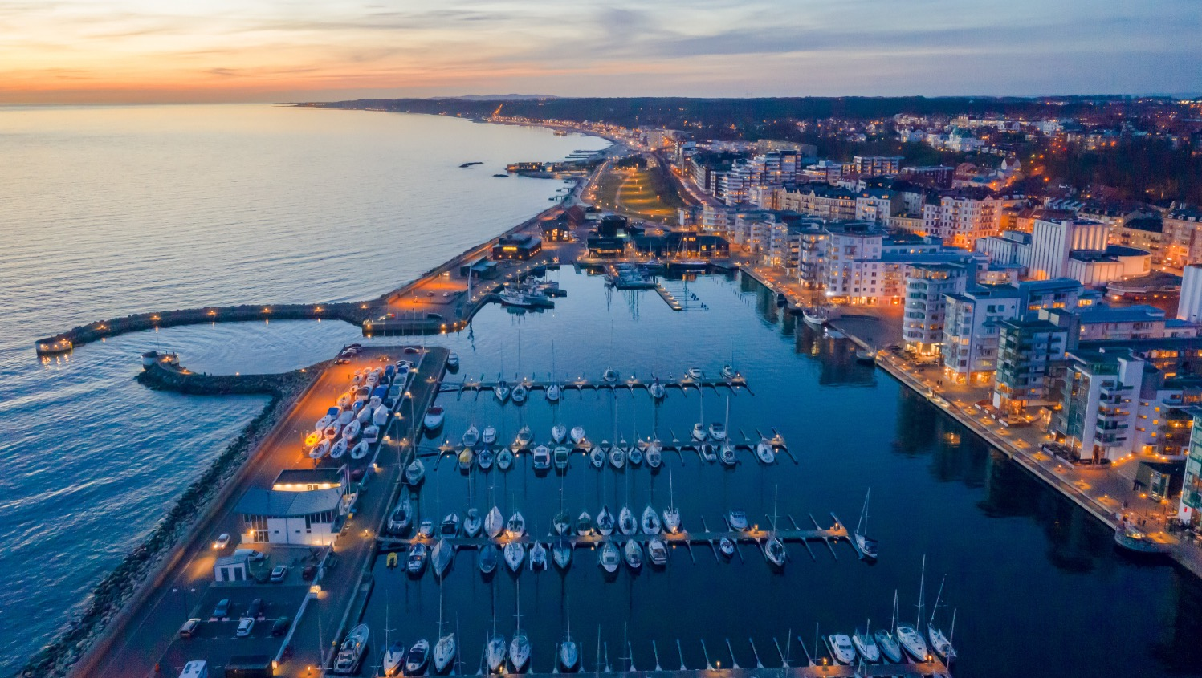
The city of Helsingborg
Photo: City of Helsingborg
Notes:
Helsingborg is the second largest city in Skåne. It also has a coastal location, facing the Danish town of Helsingör. Like Malmö, Helsingborg’s old industrial port has also undergone a transformation into an attractive office and residential area. A new project called H+ which will transform an old harbour area. The project includes the foundations for a tunnel which will eventually connect Helsingborg with Helsingör by road and rail.
Helsingborg came second in the 2020 iCapital award issued by the EU. The award goes to the European city that is best able to demonstrate its ability to harness innovation to improve the lives of its citizens

Slide 24
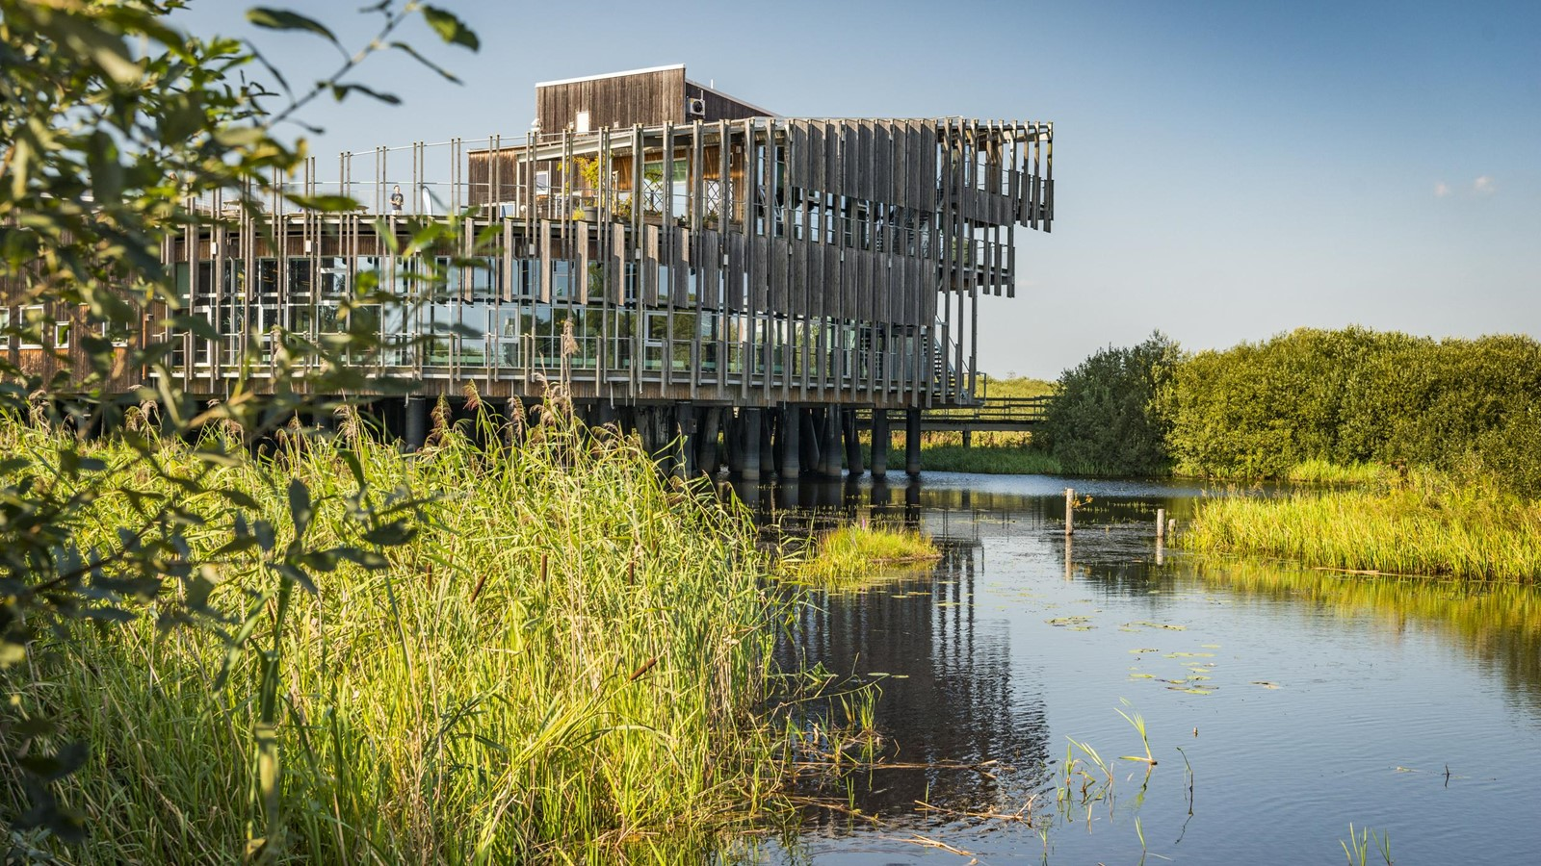
Notes:
Naturrum Vattenriket, Kristianstad

Slide 25

The city of Lund
12th largest city of Sweden with appr 130 000 inhabitants in the municipality
The European Spallation Source and MAX IV
Lund University, one of Scandinavia’s largest institutions for education and research
Ideon Science Park – home to over 400 companies
Domkyrkan ”the Dome”, one of the seven wonders of Sweden
Notes:
Lund is another important city in Skåne, mostly known for its University, but also for two of the world’s most advanced research facilities, namely MAX IV and ESS.
The city with approximately 124 935 inhabitants is believed to have been founded around 990 during the period that Skåne belonged to Denmark.
Lund University is one of Scandinavia’s largest institutions for education and research, known for it’s vibrant student life – which includes a Carnival every 4 years.
Lunds domkyrka har fått toppbetyget tre stjärnor av Guide Michelins turistguide Green Guide och har utsetts till ett av Sveriges sju underverk av Vetenskapsradions lyssnare. (Källa: https://lundsdomkyrka.se/lunds-domkyrka-2/)

Slide 26
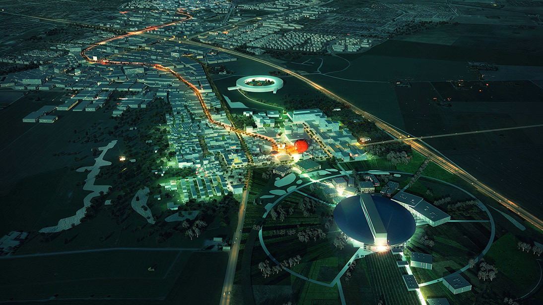
Science Village Scandinavia
Home to two of the most advanced materials science facilities in the world
MAX IV Laboratory
A national research facility
Inaugurated June 2016
Synchrotron source, ”x-ray”
Swedish and international researchers
Budget: Roughly 629m Euro
ESS, European Spallation Source
17 European countries
Sweden and Denmark as hosts
Inauguration 2019, operation 2025
Neutron source, microscope
Researchers mainly international
Budget: 1.84 billion EUR
Photo: COBE
Notes:
Linking both Max IV and ESS and currently under development is Science Village, which forms part of the new city district. The land covers 18 hectares planned for approximately 250,000 m² GFA intended businesses, research and educational facilities in the field of materials research and innovation. University and university college campuses, guest accommodation, research institutes, services, gyms, restaurants and cafés will be built on the plot. The buildings can be erected with up to seven or eight floors, in a variety of architectural styles.
It will develop into a dynamic and sustainable city district that not only accommodates world class research but also serves as a platform for society to play a role in the changes going on as a result of ESS and MAX IV.
Credit: COBE

Slide 27
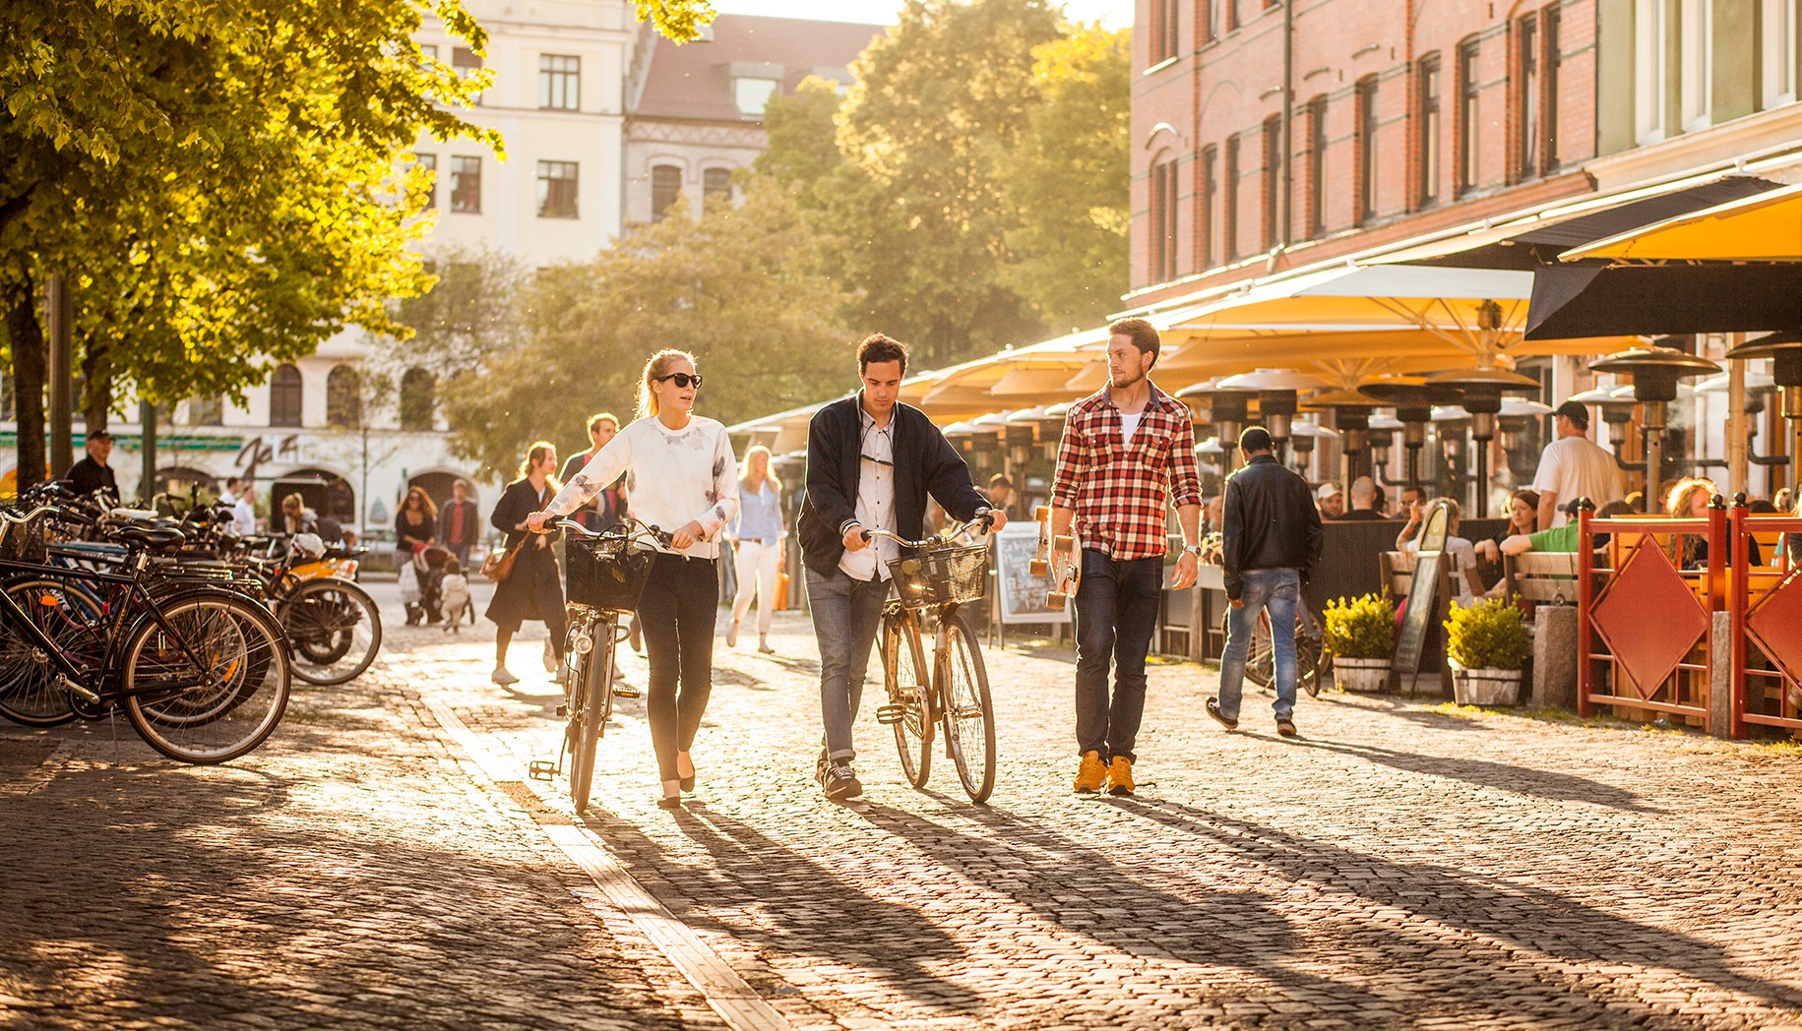
Malmö – a vibrant city
Photo: Apelöga, Malmö Town Image Bank
Notes:
The city is all about culture, exciting cuisine, innovative architecture and a vibrant social scene.
Nearly half of the population are under 35 and the city can also boast with the highest proportion of foreign born residents then any other city in Sweden, a young, talented and international hub.
The city is also home to a large number of thriving startups and innovative success story companies like Oatly and Orbital Systems, and Malmö has been listed one of Europe's biggest tech hubs in State of European Tech 2020.
Malmö University has more than 24,000 students and about 1,600 employees (academic and administrative), and it is the ninth largest institute of learning in Sweden. Source: Wikipedia
In 2021, Malmö was named the best Swedish student city of the year, an award decided upon by a student body which assessed how Malmö excelled at working with its student environment. Source: Swedish National Union of Students (SFS)
Malmö has been selected as one of the greenest city in the magazine ”Hållbarhet” .
Skåne’s capital has attracted the eye of Travel and Leisure magazine, who called it the “hippest city in Scandinavia” in 2014, Forbes, who ranked it the 4th most inventive city in the world (right behind San Francisco, San Diego, and Eindhoven), and was also considered the number one emerging tech hub in the world.

Slide 28
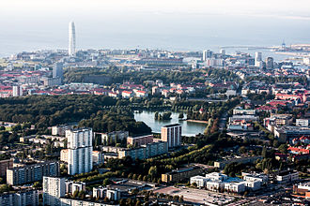

Slide 29
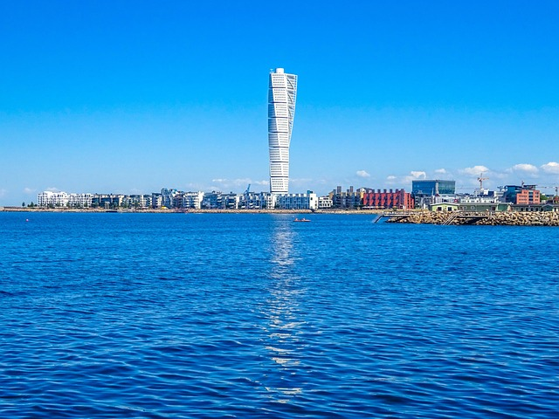

Slide 30

Work-life balance
Photo: Apelöga
Notes:
Employers and employees alike put high value on work-life balance. Generous state-funded parental allowances, subsidised childcare and high-quality state schooling all play their part in making the region a great place to bring up children.
Crime is low by international standards and a 21st century transport network provides ease of movement. From Skåne, the city attractions of Copenhagen are just a quick train or car ride across the Öresund Bridge. Copenhagen International Airport puts a wide assortment of other destinations within easy reach.
The unique combination of plurality, a stimulating business environment and high quality of life means you really can enjoy the best of all worlds in Skåne.

Slide 31


Exceptional quality of life
Photo: Image Bank Sweden
Besides having a fantastic infrastructure for international business, Skåne offers beautiful countryside and the chance to enjoy a high quality of life. It is often just a 15 minute journey from the city centres to the unspoilt countryside and some of the world’s finest sandy beaches.
Notes:
Where in Europe can you commute from a demanding job in an international city to your home in a quiet suburb in just 15 minutes by bicycle? In cities like Malmö, Lund and Helsingborg, such quality of life and convenience is normal. Skåne is fairly small and you can easily reach each corner of the region within an hour.
Source (beaches): Blå Flagg

Slide 32
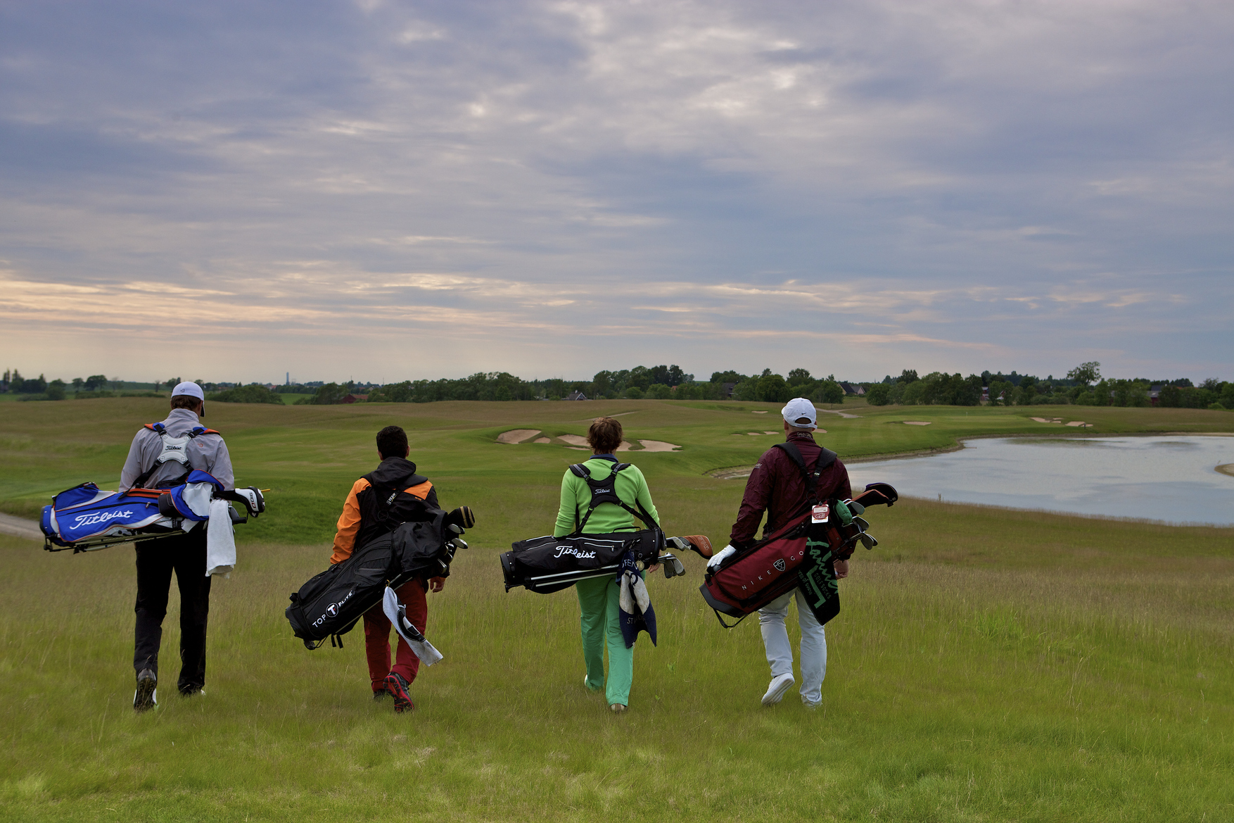
Notes:
Golf i Bara, PGA of Sweden National, golfbana, Bara
Källa: https://bildbank.skane.se, Golf_Bara.jpg

Slide 33
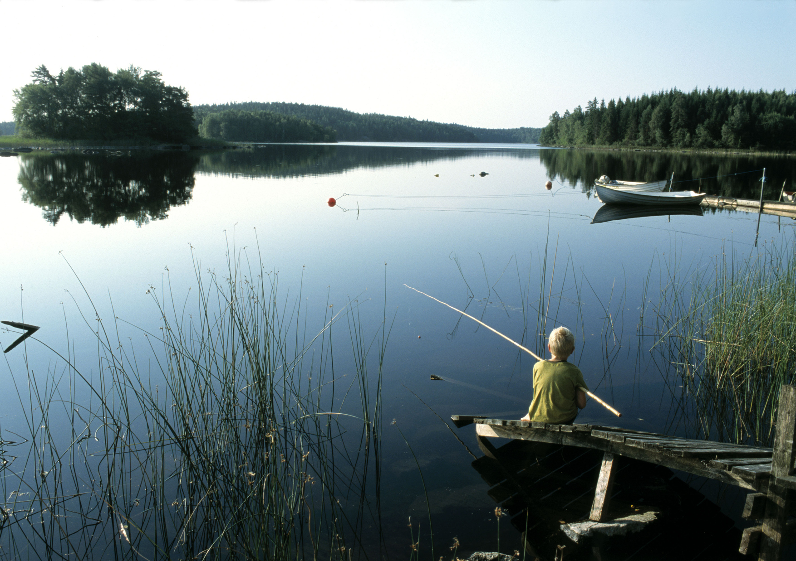
Notes:
Fiske Immeln, Skåne nordost
Källa: https://bildbank.skane.se, Fiske_Immeln.jpg

Slide 34
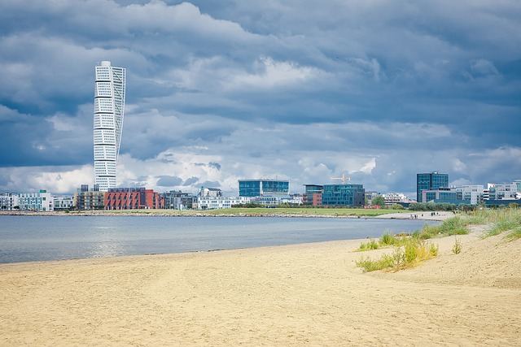

Slide 35

Thank you for your attention
Photo: Apelöga

