Slide 1
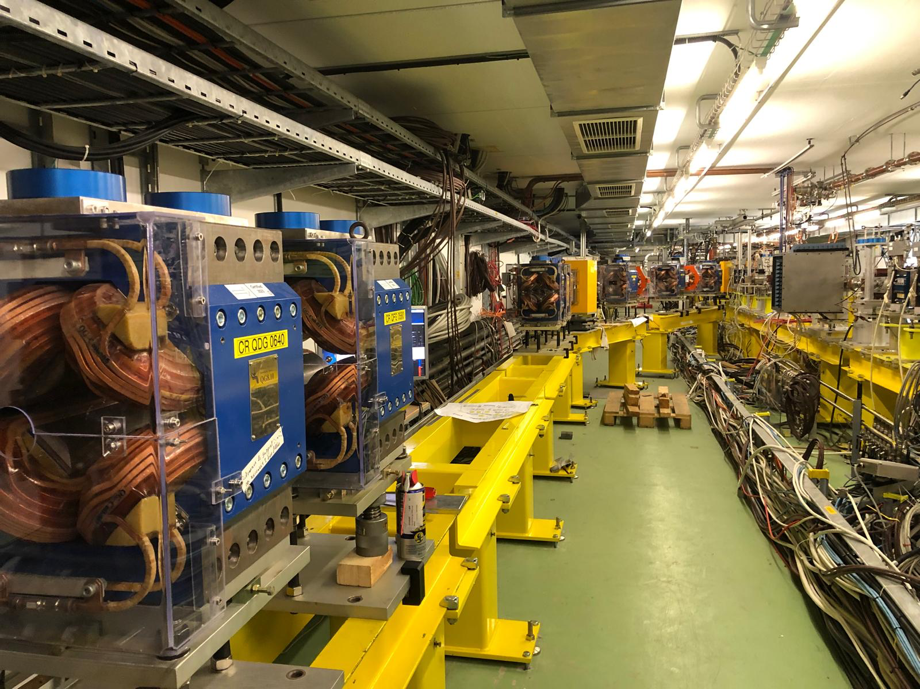
CLEAR, operational status and machine learning opportunities
Giacomo Tangari
tCSC 2025 – Malmö
giacomo.tangari@cern.ch

Slide 2

What is CLEAR?
CERN Linear Electron Accelerator for Research
Versatile linear accelerator facility, supports R&D in accelerator technologies and applications.
Provides electron bunches with energies up to ~200 MeV, flexible bunch structure and timing.
Key applications:
  Accelerator component testing (e.g., diagnostics, kickers, RF systems)
  High-gradient structure experiments
  Medical and industrial beam applications
  Plasma wakefield acceleration studies
  Machine Learning

Slide 3
What is CLEAR?
CERN Linear Electron Accelerator for Research
Versatile linear accelerator facility, supports R&D in accelerator technologies and applications.
Provides electron bunches with energies up to ~200 MeV, flexible bunch structure and timing.
Key applications:
  Accelerator component testing (e.g., diagnostics, kickers, RF systems)
  High-gradient structure experiments
  Medical and industrial beam applications
  Plasma wakefield acceleration studies
  Machine Learning

Slide 4
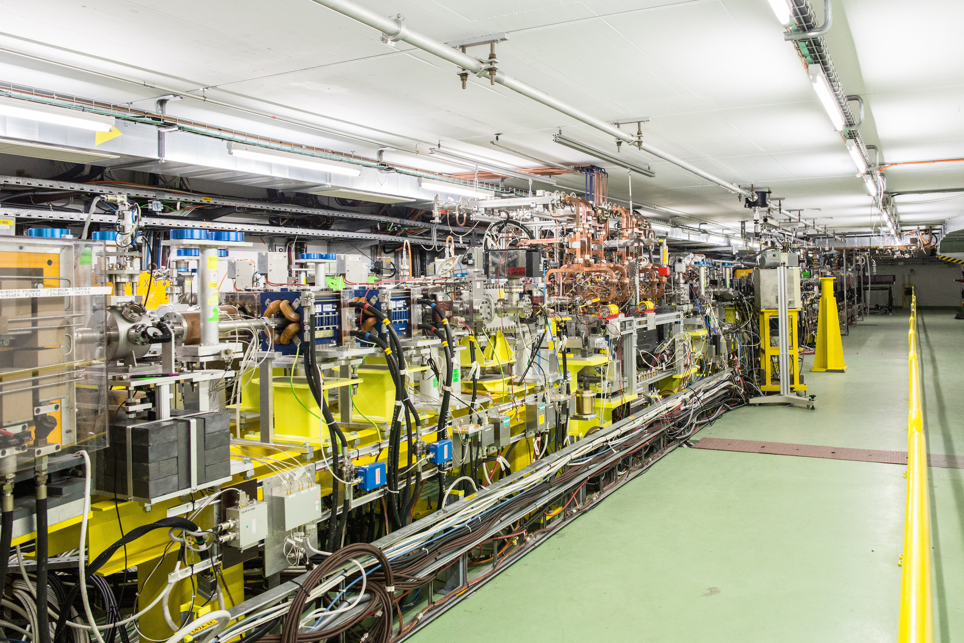
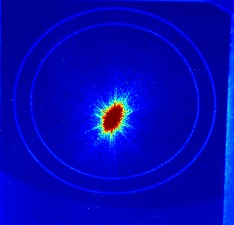
Operational Tools
CLEAR DAQ
  Data acquisition system for automated, synchronized collection of beamline measurements.
  CLEAR Data Handling - Structured data storage and access.
  CLEAR Image Handling – Management of beam images from screen monitors.
CLEAR Online Dosimetry
  Real-time dose measurement and feedback for radiation-sensitive applications.
Scan Worker
  Framework to automate multi-parameter scans (e.g., laser, RF settings) and coordinate data acquisition.
Quadrupole Scans
  Tool to perform emittance measurements and optics studies via quadrupole strength variation.
CLEAR Simulations
  Accompanying simulation framework to compare with experimental results.

Slide 5

Machine Learning opportunities
Two paths:
  Simplifying Accelerator Operation:
    Moving towards autonomous control
      Autonomous beam trajectories optimization
      Autonomous beam alignment

Slide 6

Machine Learning opportunities
Two paths:
  Simplifying Accelerator Operation:
    Moving towards autonomous control
      Autonomous beam trajectories optimization
      Autonomous beam alignment
  Enhancing Accelerator Performance:
    Beam energy evolution forecasting
    Charge evolution forecasting

Slide 7
Simplifying Accelerator Operation
Automatic Beam – based alignment studies
  For now, a steady-hand and time-consuming work for the operator
  Tried one-to-one and Dispersion Free Steering techniques, promising first results but need for 3-5 iterations to work
Reinforcement Learning for autonomous control
  Agent training to have it ready to go, as operational help
  For now, still following invasive procedures (mirrors and screens)

Slide 8

Simplifying Accelerator Operation
Automatic Beam – based alignment studies
  For now, a steady-hand and time-consuming work for the operator
  Tried one-to-one and Dispersion Free Steering techniques, promising first results but need for 3-5 iterations to work
Reinforcement Learning for autonomous control
  Agent training to have it ready to go, as operational help
  For now, still following invasive procedures (mirrors and screens)

Slide 9

Enhancing Accelerator Performance
Energy and charge forecasting studies
  Non-invasive measurements → virtual diagnostics
  Model trained with 1-step-ahead forecasting
  Linear regression model comparable to more complex ones
  Will to extend to multi-step prediction and insert into real-time feedback loops for beam stabilization

Slide 10
Enhancing Accelerator Performance
Energy and charge forecasting studies
  Non-invasive measurements → virtual diagnostics
  Model trained with 1-step-ahead forecasting
  Linear regression model comparable to more complex ones
  Will to extend to multi-step prediction and insert into real-time feedback loops for beam stabilization
Implementation of Supervised and Reinforcement Learning on simulation model of CLEAR
  Mid-to-Long term plan
  First step on experimental beamline only, to have operative simulation of the tools
  Second step to increase action region to the whole LINAC (photocathode)

Slide 11
References and Publications
Papers, used as a reference in this presentation, regarding CLEAR can be found at clear.cern/content/publications.
Some of the presented work has not been published yet.
Many thanks to the whole CLEAR team.

Slide 12
Questions?
Ideas?
Thank You!
clear.cern.ch

Slide 13
Backup Slides

Slide 14
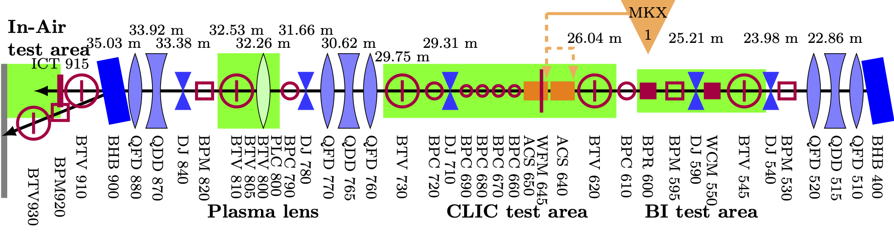
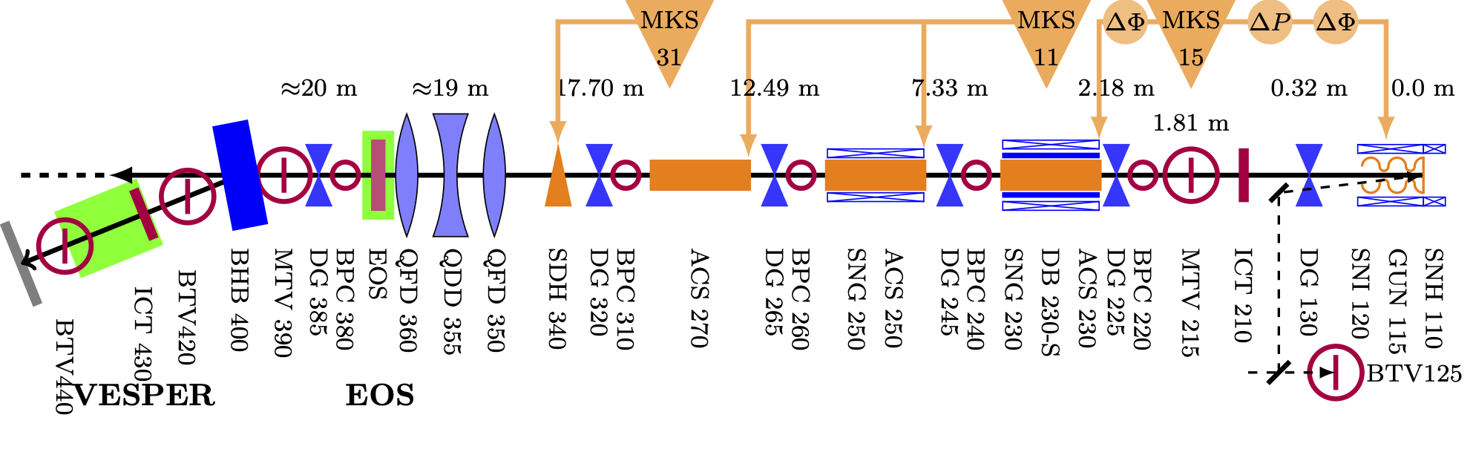
CLEAR Parameters
Beam parameter | Range
Energy | 30 – 230 MeV
Energy Spread | < 0.2 % rms (< 1 MeV FWHM)
Bunch Length | 0.1 ps – 10 ps rms
Bunch Charge | 5 pC – 3 nC
Number of bunches per pulse | 1 to ~150
Maximum total pulse charge | 80 nC
Normalized emittances | 3 μm to 30 μm (bunch charge dependent)
Repetition rate | 0.8 to 10 Hz
Bunch spacing | 1.5 GHz or 3 GHz

