Slide 1
WP5.1.6 Access control
T. Lang (EN-AA)
2025-01-15
https://indico.cern.ch/event/1496936/

Slide 2
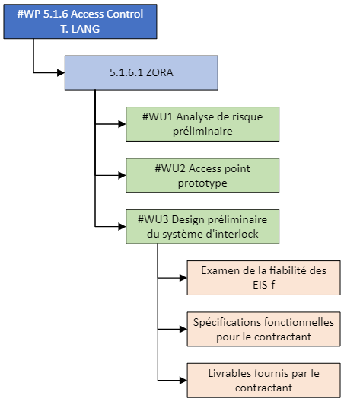


NA-CONS WP5.1.6
EHN1 (EDMS 2683693)
EHN2 (EDMS 3087026)
SAS PPE (prototype)
2e SAS PPE
Evaluation of the input signals used by the personnel protection system via the instrumented safety functions (compliance with CERN safety requirements and the cabling convention).
(EDMS 3124131)
Preliminary technical study to implement the changes and consolidate/renovate the architecture of the access system.
2

Slide 3
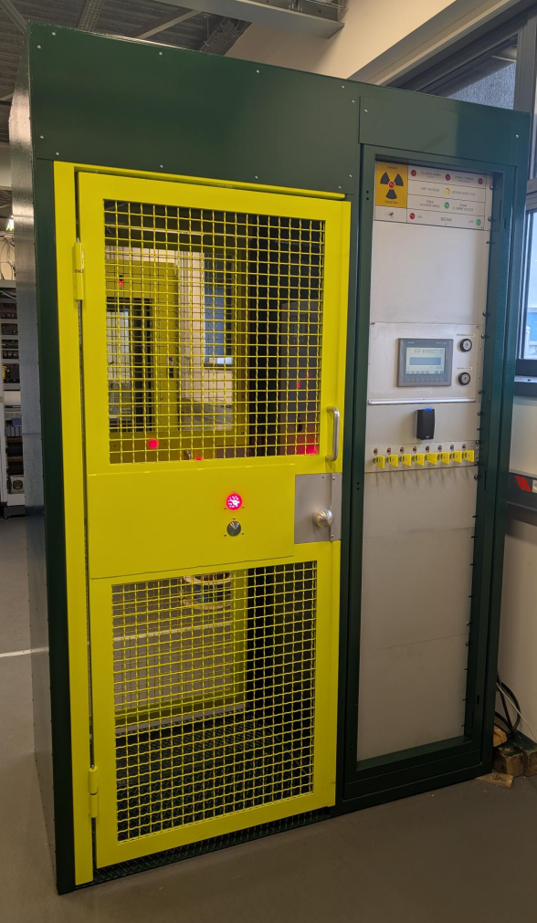
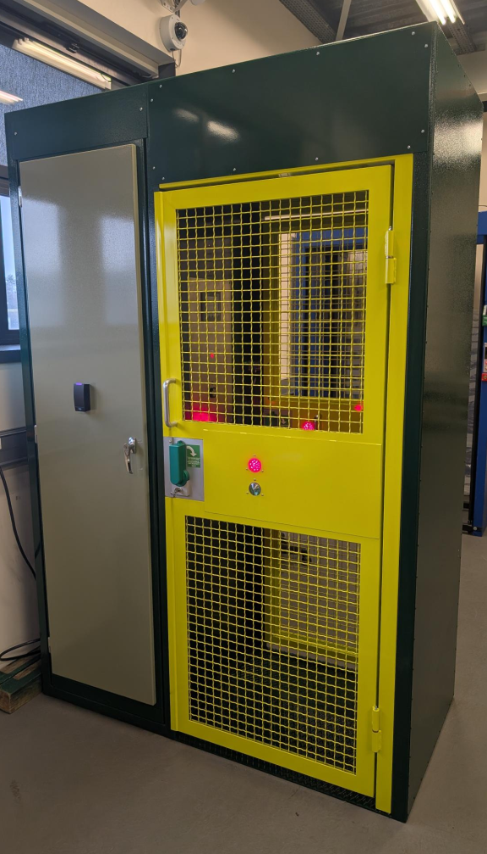
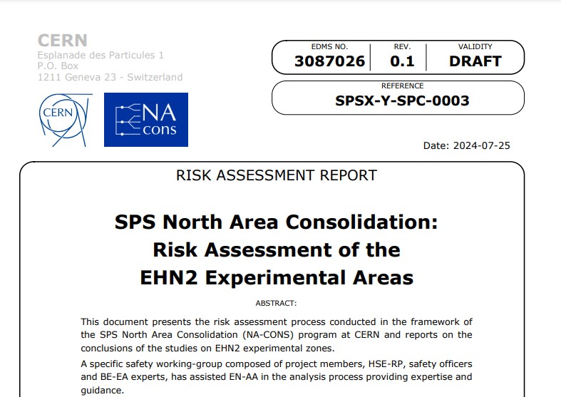
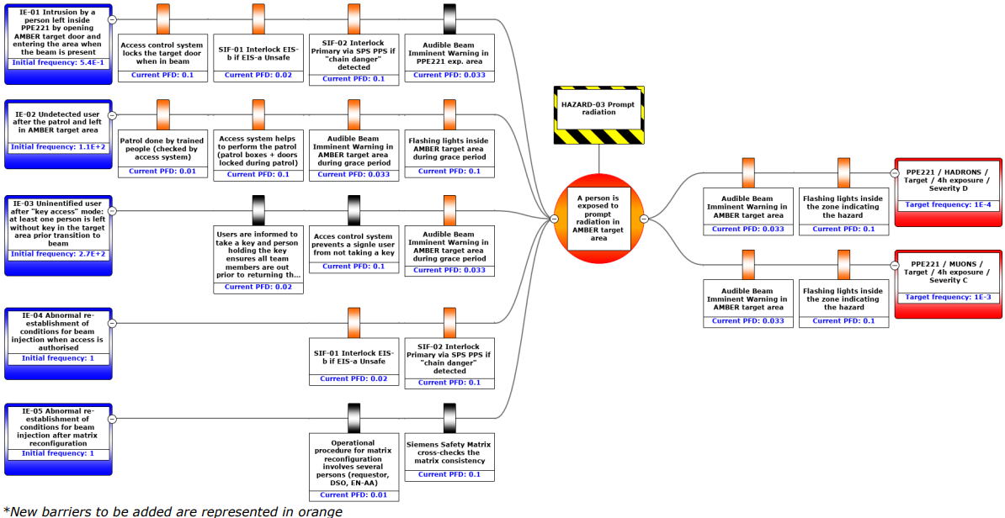
Completed activities *since WP 5.1 meeting #11 (21.08.24)
    Construction of 2nd SAS PPE is complete (@PS0 test platform: b.271)
      SAS ready for series production (Hardware part)
    EHN2 risk assessment document is under approval in EDMS (Managed by Natalya Kahn – BE/EA)
      Presented to PS-CSAP #80 on 05.12.24
      All comments have been addressed.
      EDMS 3087026

Slide 4
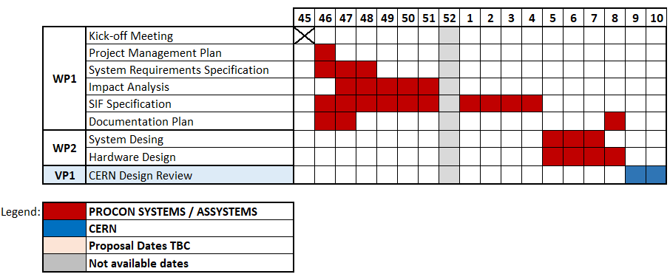
Ongoing activities
    SPS Experimental Areas Access & Safety System renovation preliminary study (Update the ageing automation infrastructure to address the obsolescence of Siemens components + implement the recommendations from the risk assessment process for EHN1 and EHN2 such as the new safety functions, integration of SAS PPE, etc…)
      Contractor quotation proposal : EDMS 3162607
      EDMS folder for the project documents : CERN-0000263333
      OSVC 10605894 is approved. Project Cost: 84,703€
      Project milestones and associated payments :
        10% at the order / w43 2024
        80 % at the validation of VP1 - CERN Design review / w07 2025
        10% at the validation by CERN of as-built documentation / w09 2025 (28.02.25)
2024 2025

