Slide 1
NA-CONS WP5.1.2
Sprinklers
F. Deperraz (EN-AA)
https://indico.cern.ch/event/1496936/
15/01/2025

Slide 2
Sprinkler System
Installation planned YETS 24/25
  TA801, GL802 & PGT802
  New subcontractor of ArceClima
    Three welders qualified
    Two pipe fitters
    Worksite supervisor
  An additional MME welder

Slide 3
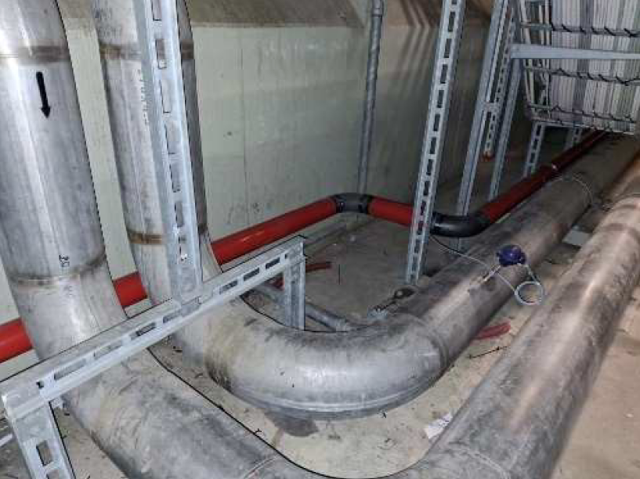
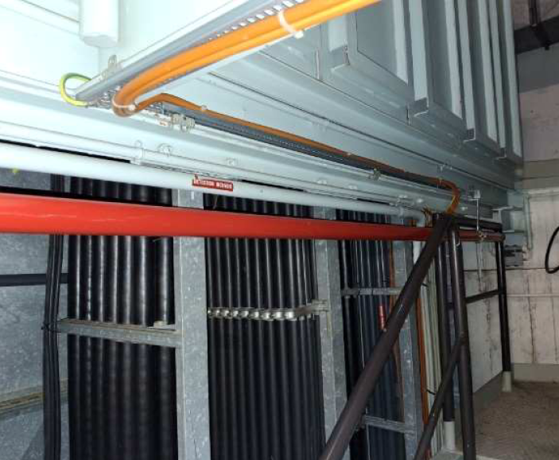
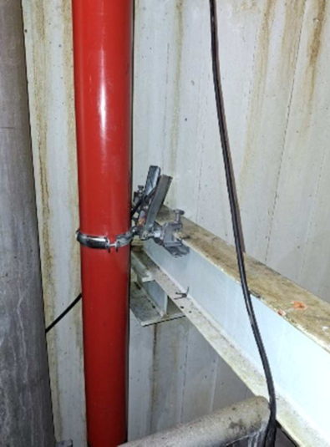
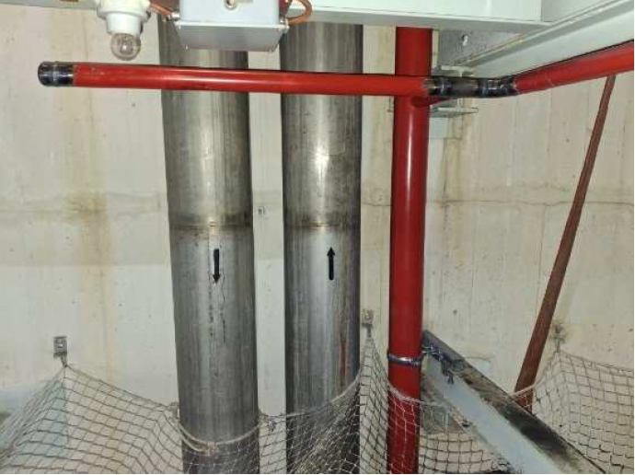
Ongoing activities
Planning
Task Name | Duration | Start | Finish | Advancement
NA CONSOLIDATION PROJECT FASE II | 44 days | Tue 10/12/24 | Fri 07/02/25
TA 802 DISMANTELLING | 3 days | Tue 10/12/24 | Thu 12/12/24 | 100%
TA802 BA80 PART DISMANTELLING | 1 day | Tue 10/12/24 | Tue 10/12/24 | 100%
TA 802 UNDERGROUND DISMANTELLING | 2 days | Wed 11/12/24 | Thu 12/12/24 | 100%
INSTALLATION TA802 | 31 days | Wed 11/12/24 | Thu 23/01/25
BA80 LINE | 3 days | Wed 11/12/24 | Fri 13/12/24 | 100%
TA802 -1 LEVEL | 7 days | Wed 11/12/24 | Thu 19/12/24 | 5%
TA802 SHAFT LEVELS | 5 days | Wed 08/01/25 | Tue 14/01/25 | 90%
TA802 STORAGE AREA | 2 days | Fri 10/01/25 | Mon 13/01/25 | 5%
TA802 TA PASSAGE FASE I | 1 day | Tue 14/01/25 | Tue 14/01/25 | 30%
TA802 TA PASSAGE FASE II | 1 day | Mon 20/01/25 | Mon 20/01/25
PRESSURE TEST TA802 LINE | 0 days | Wed 22/01/25 | Wed 22/01/25
CERN OFFICIAL COMMISSIONING TA802 | 0 days | Thu 23/01/25 | Thu 23/01/25
FINISH TA801 INSTALLATION | 9 days | Mon 20/01/25 | Fri 31/01/25
TA801 STORAGE AREA | 2 days | Mon 20/01/25 | Tue 21/01/25
TA801 TA PASSAGE | 6 days | Tue 21/01/25 | Tue 28/01/25
XRAYS TEST TA801 TA PASSAGE | 0 days | Tue 28/01/25 | Tue 28/01/25
FAILED WELDING REPAIR TA801 | 1 day | Wed 29/01/25 | Wed 29/01/25
PRESSURE TEST TA801 LINE CERN OFICIAL COMMISSIONING | 0 days | Thu 30/01/25 | Thu 30/01/25
CERN OFICIAL COMMISSIONING TA801 | 0 days | Fri 31/01/25 | Fri 31/01/25
AS BUILT DOCUMENTATION | 15 days | Mon 20/01/25 | Fri 07/02/25
AS BUILT DOCUMENTATION | 15 days | Mon 20/01/25 | Fri 07/02/25
BA80 – False Floor
Level -2
The first X-ray results aren’t conclusive. The welds must be redone and retested.
Shaft PGT802
Level -3

