Slide 1
Fire Detection underground system
NA-CONS WP5.1.1
2025-01-15
https://indico.cern.ch/event/1496936/

Slide 2
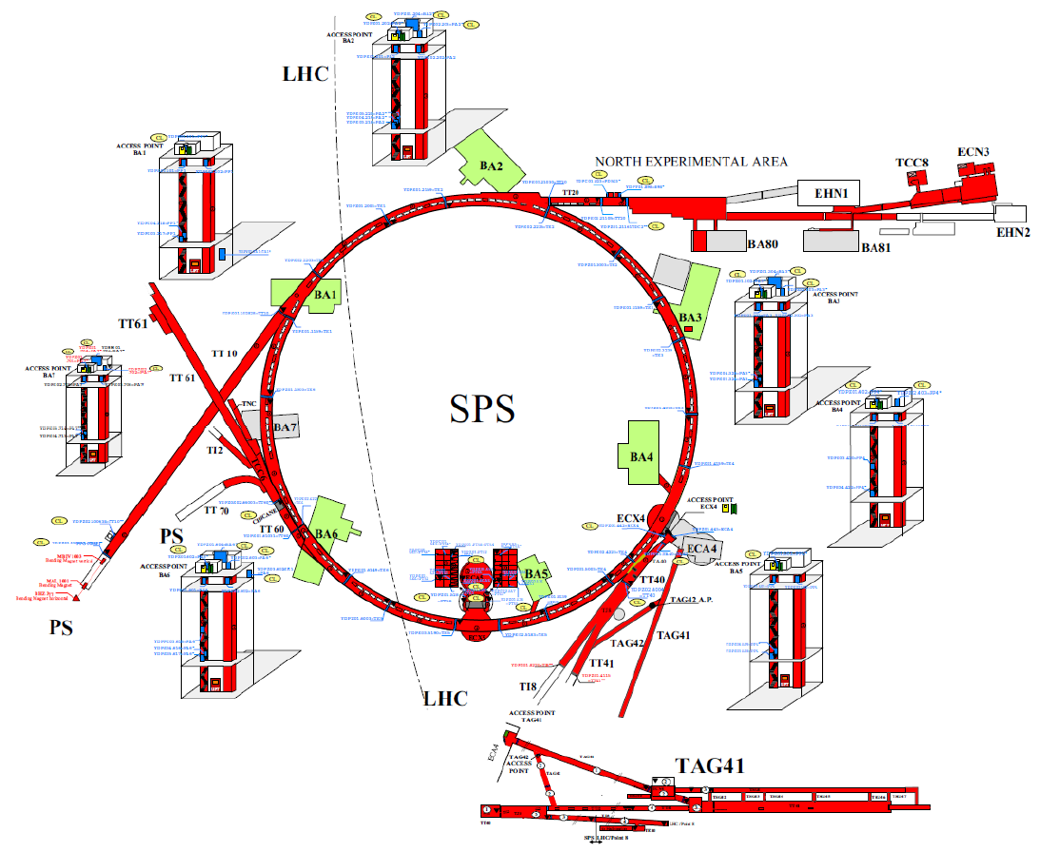
Schematic overview of the SPS complex

Slide 3
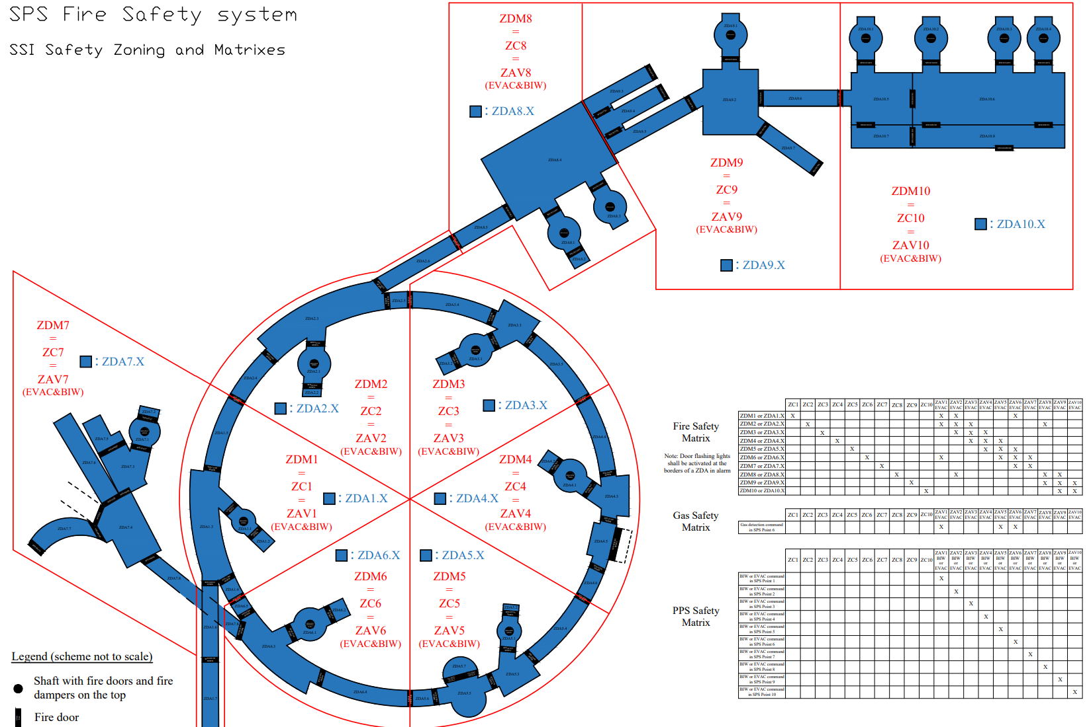
SSI safety zoning

Slide 4
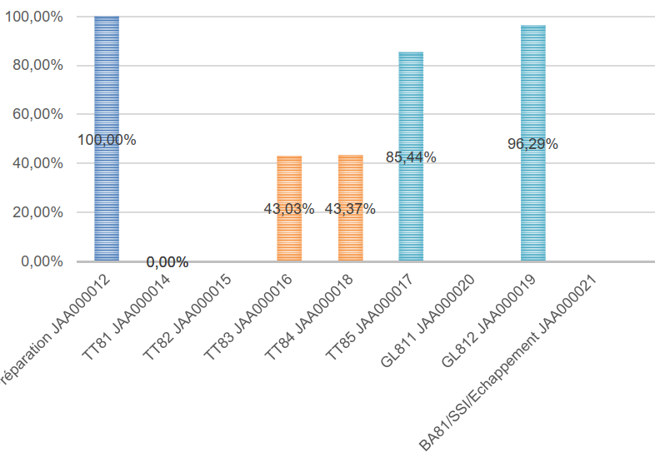
Activities at BA81 during YETS 24/25 – Piping installation

Slide 5
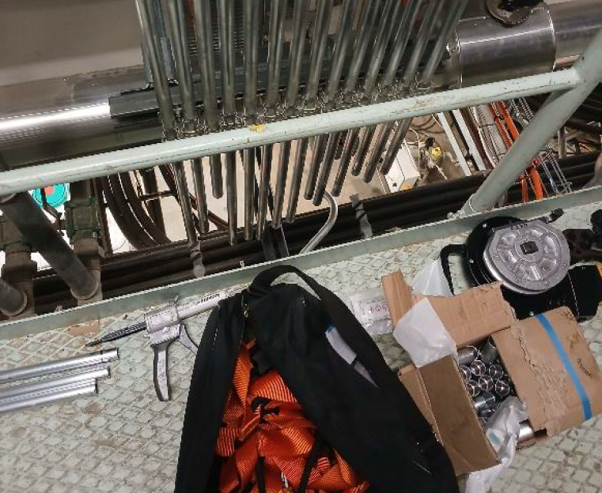
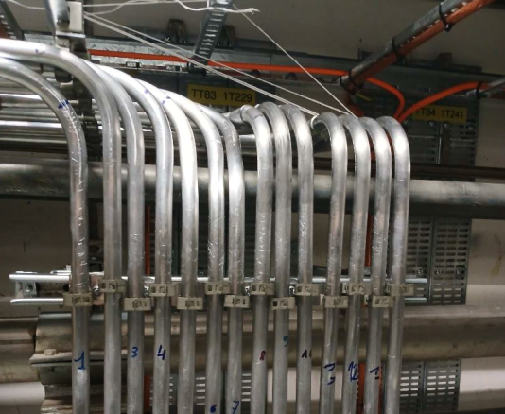
Activities at BA81 during YETS 24/25 – Piping installation

Slide 6
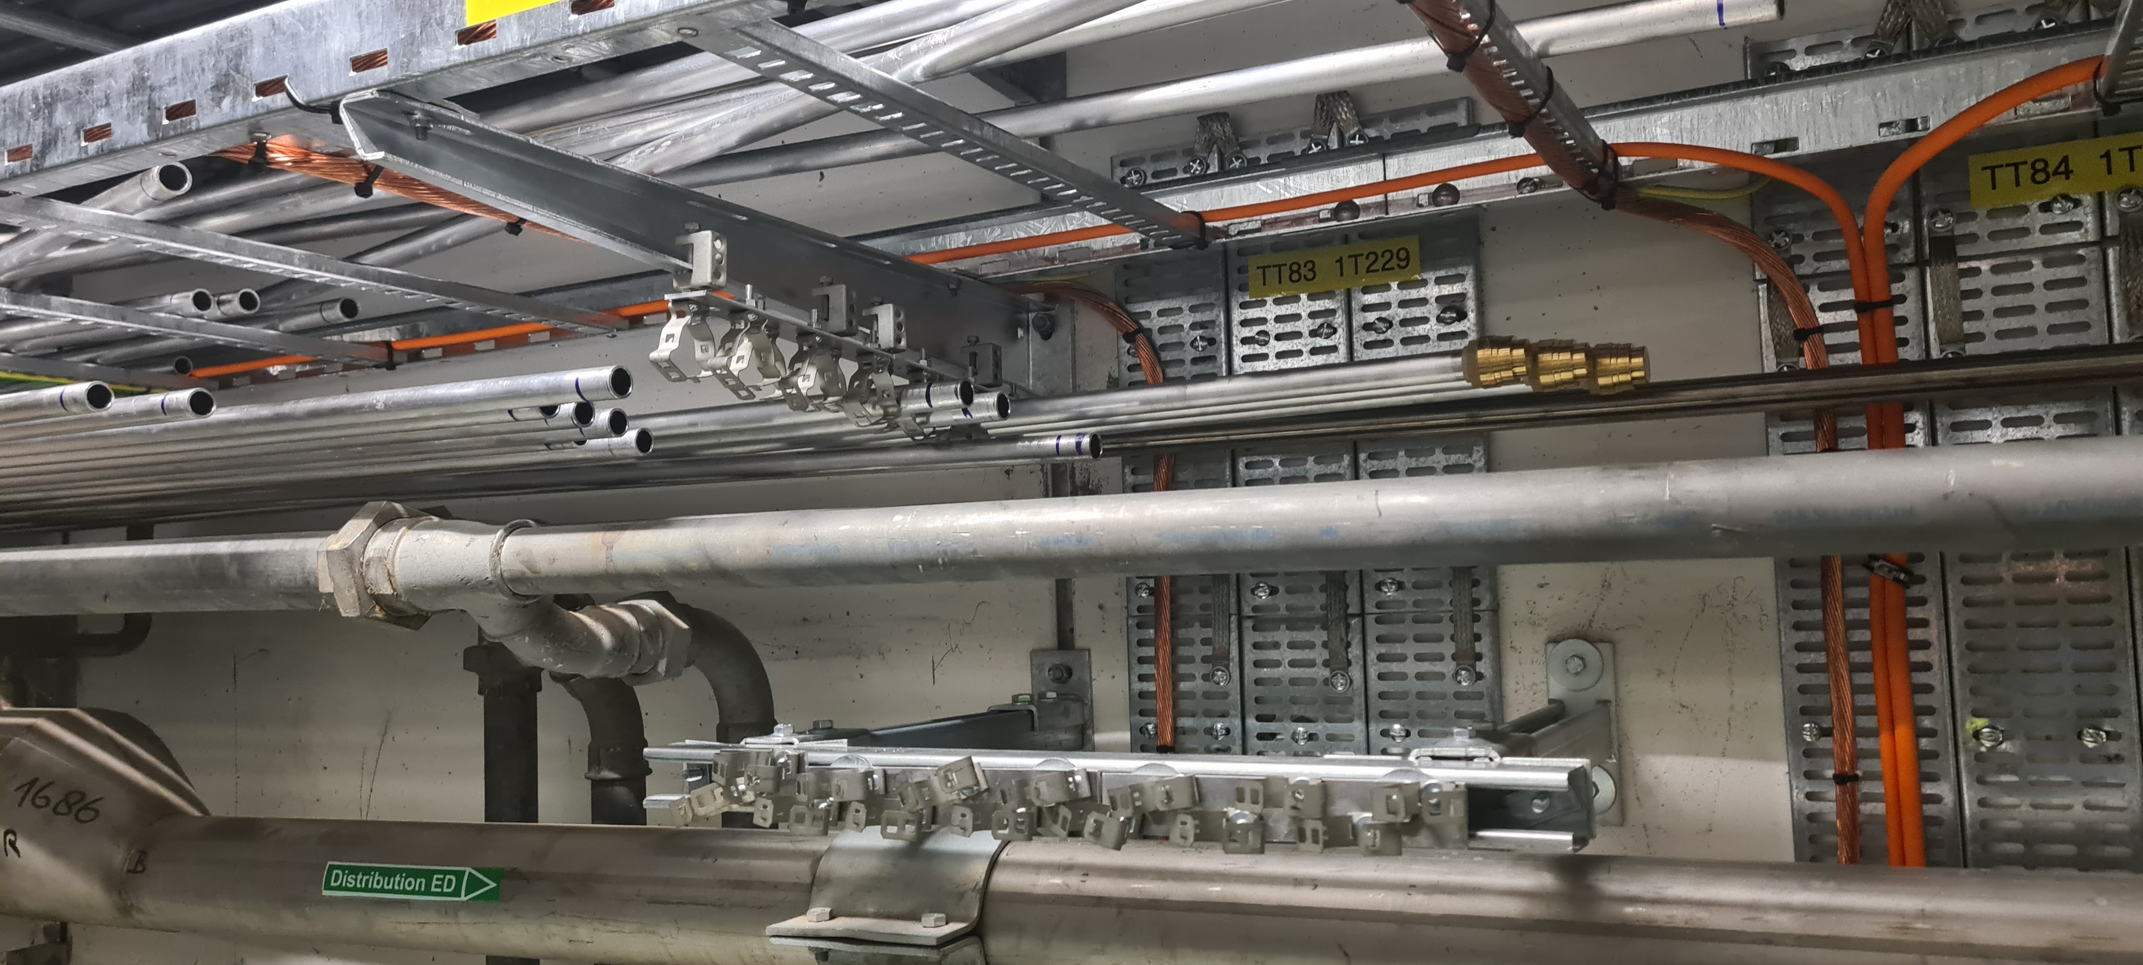
Activities at BA81 during YETS 24/25 – Piping installation

Slide 7
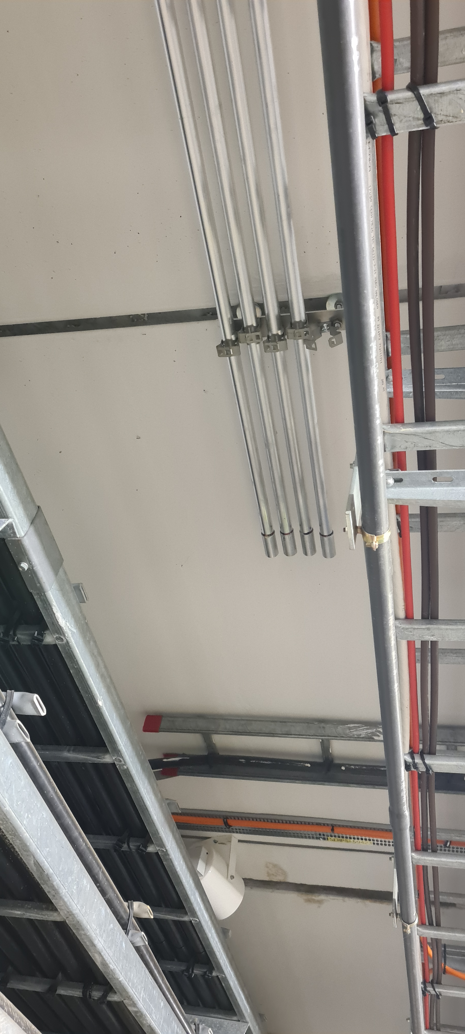
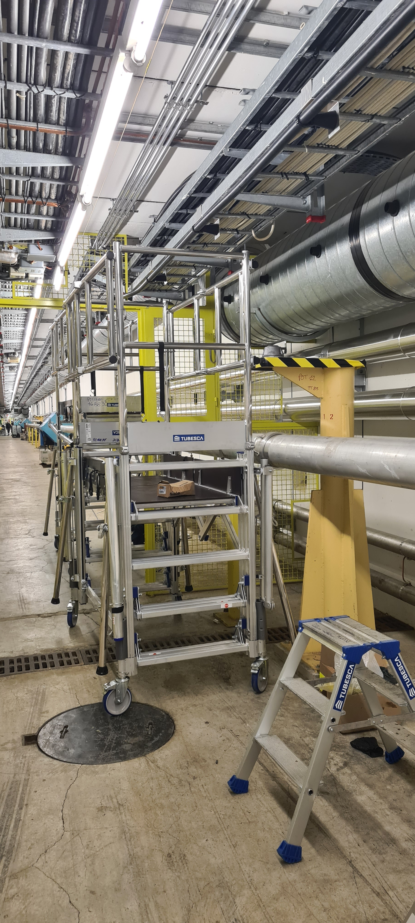
Activities at BA81 during YETS 24/25 – Piping installation

Slide 8
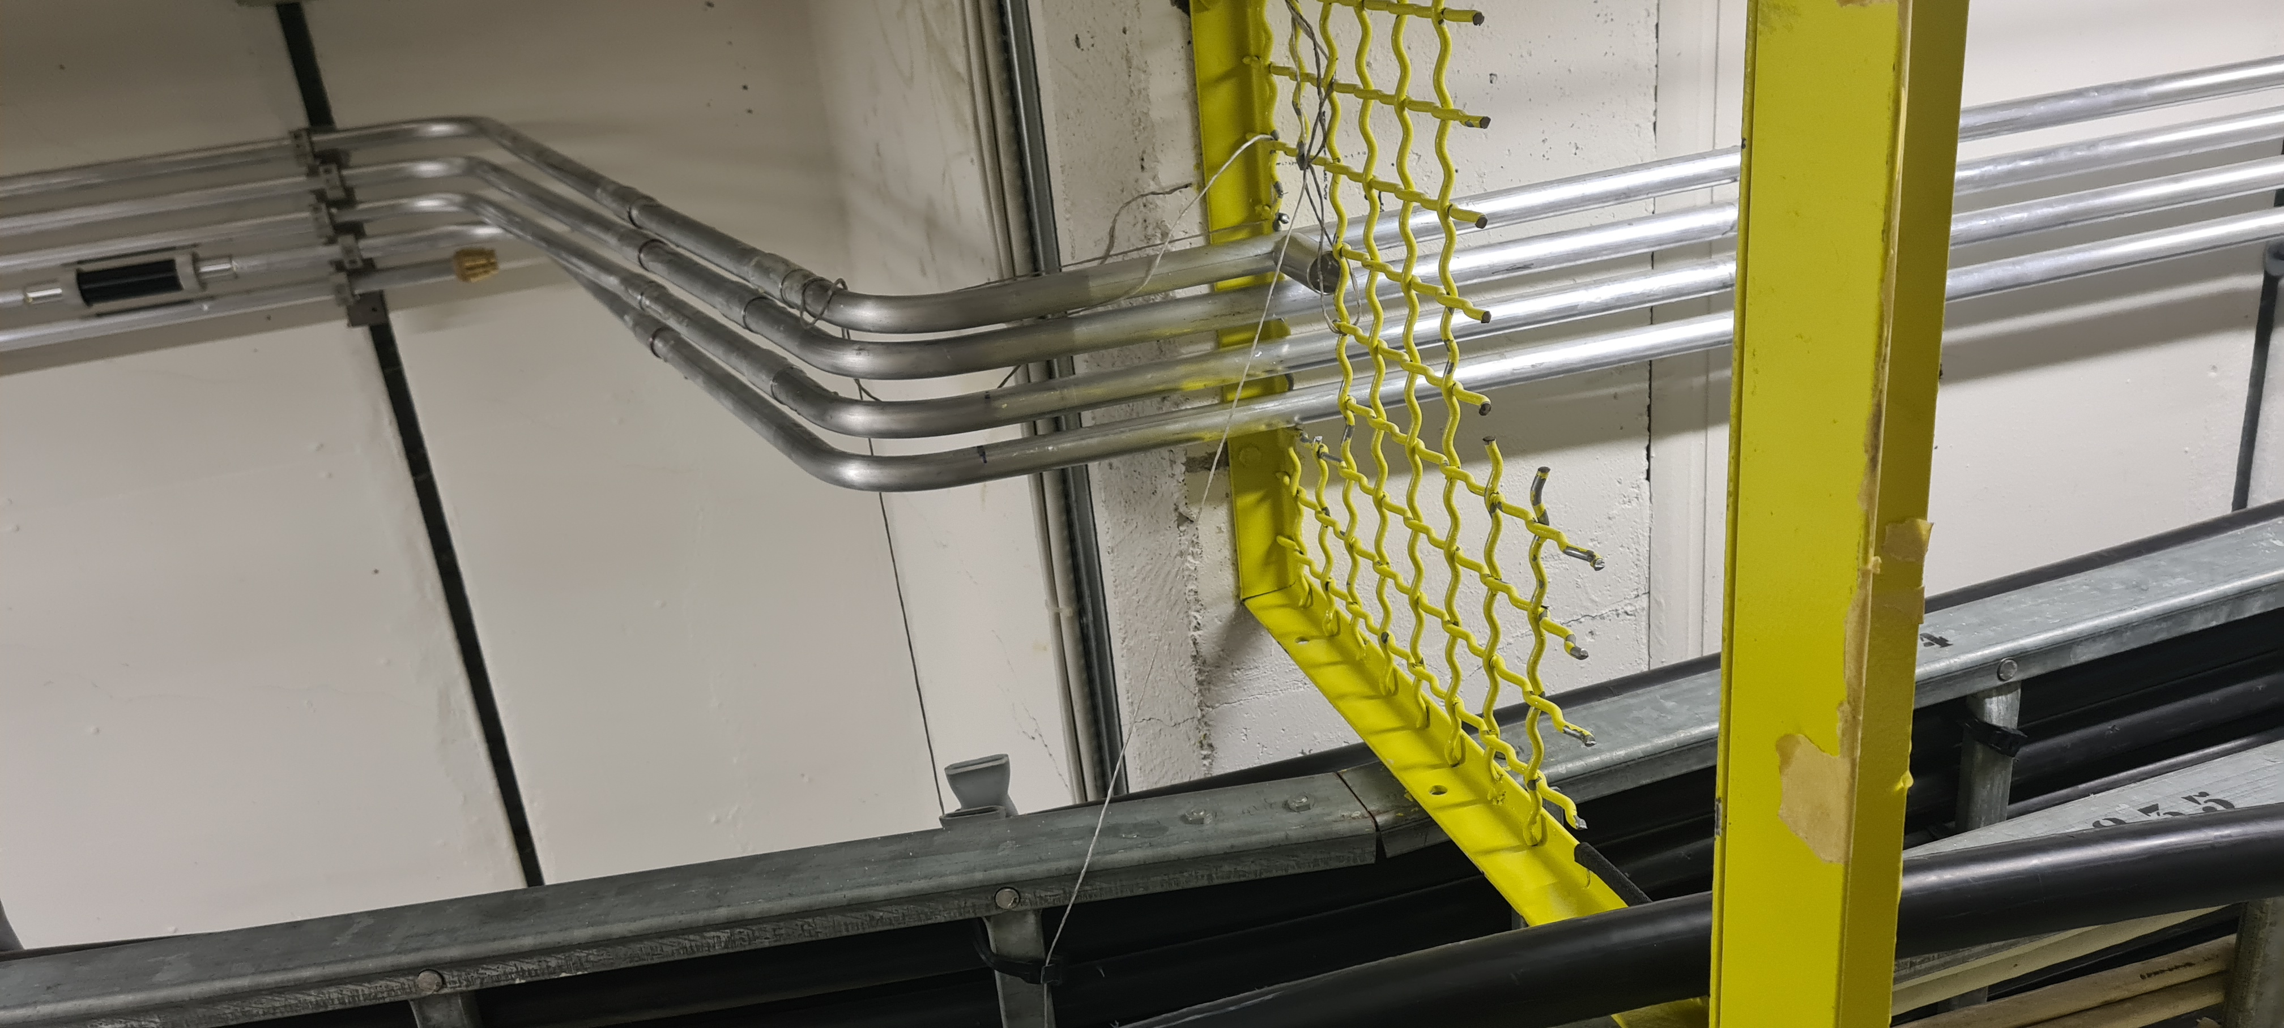
Activities at BA81 during YETS 24/25 – Piping installation

Slide 9
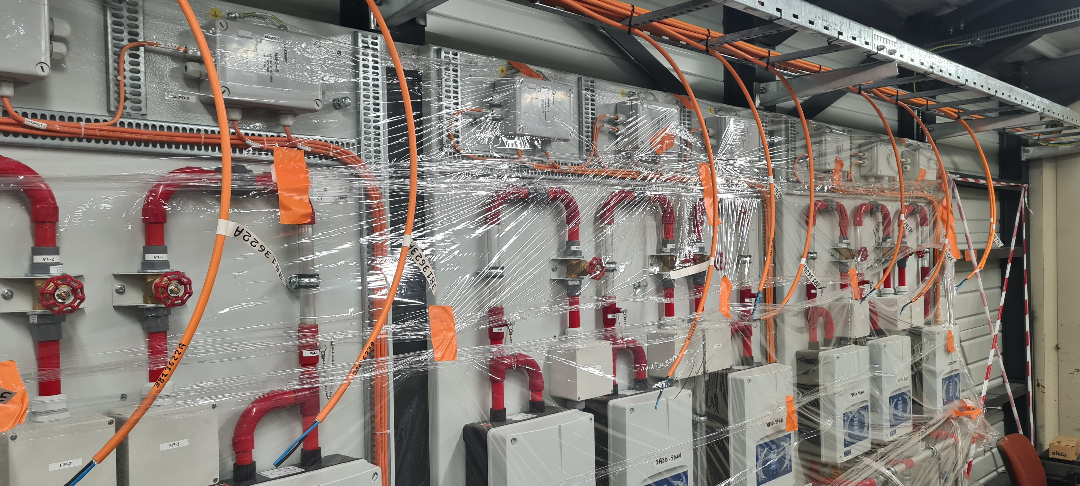
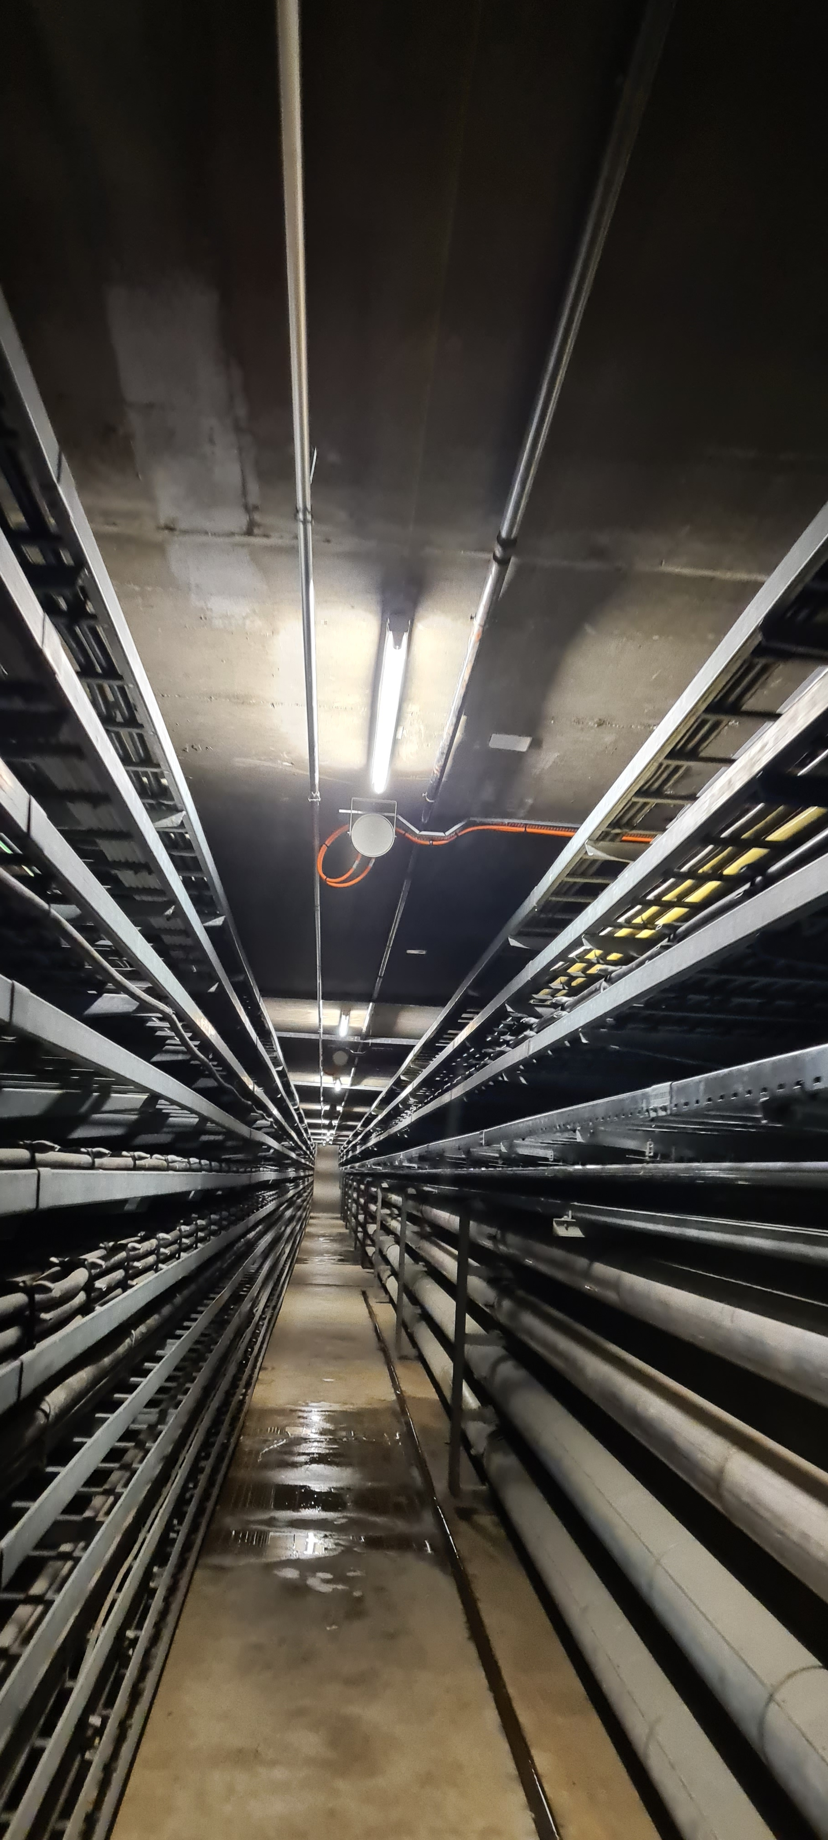
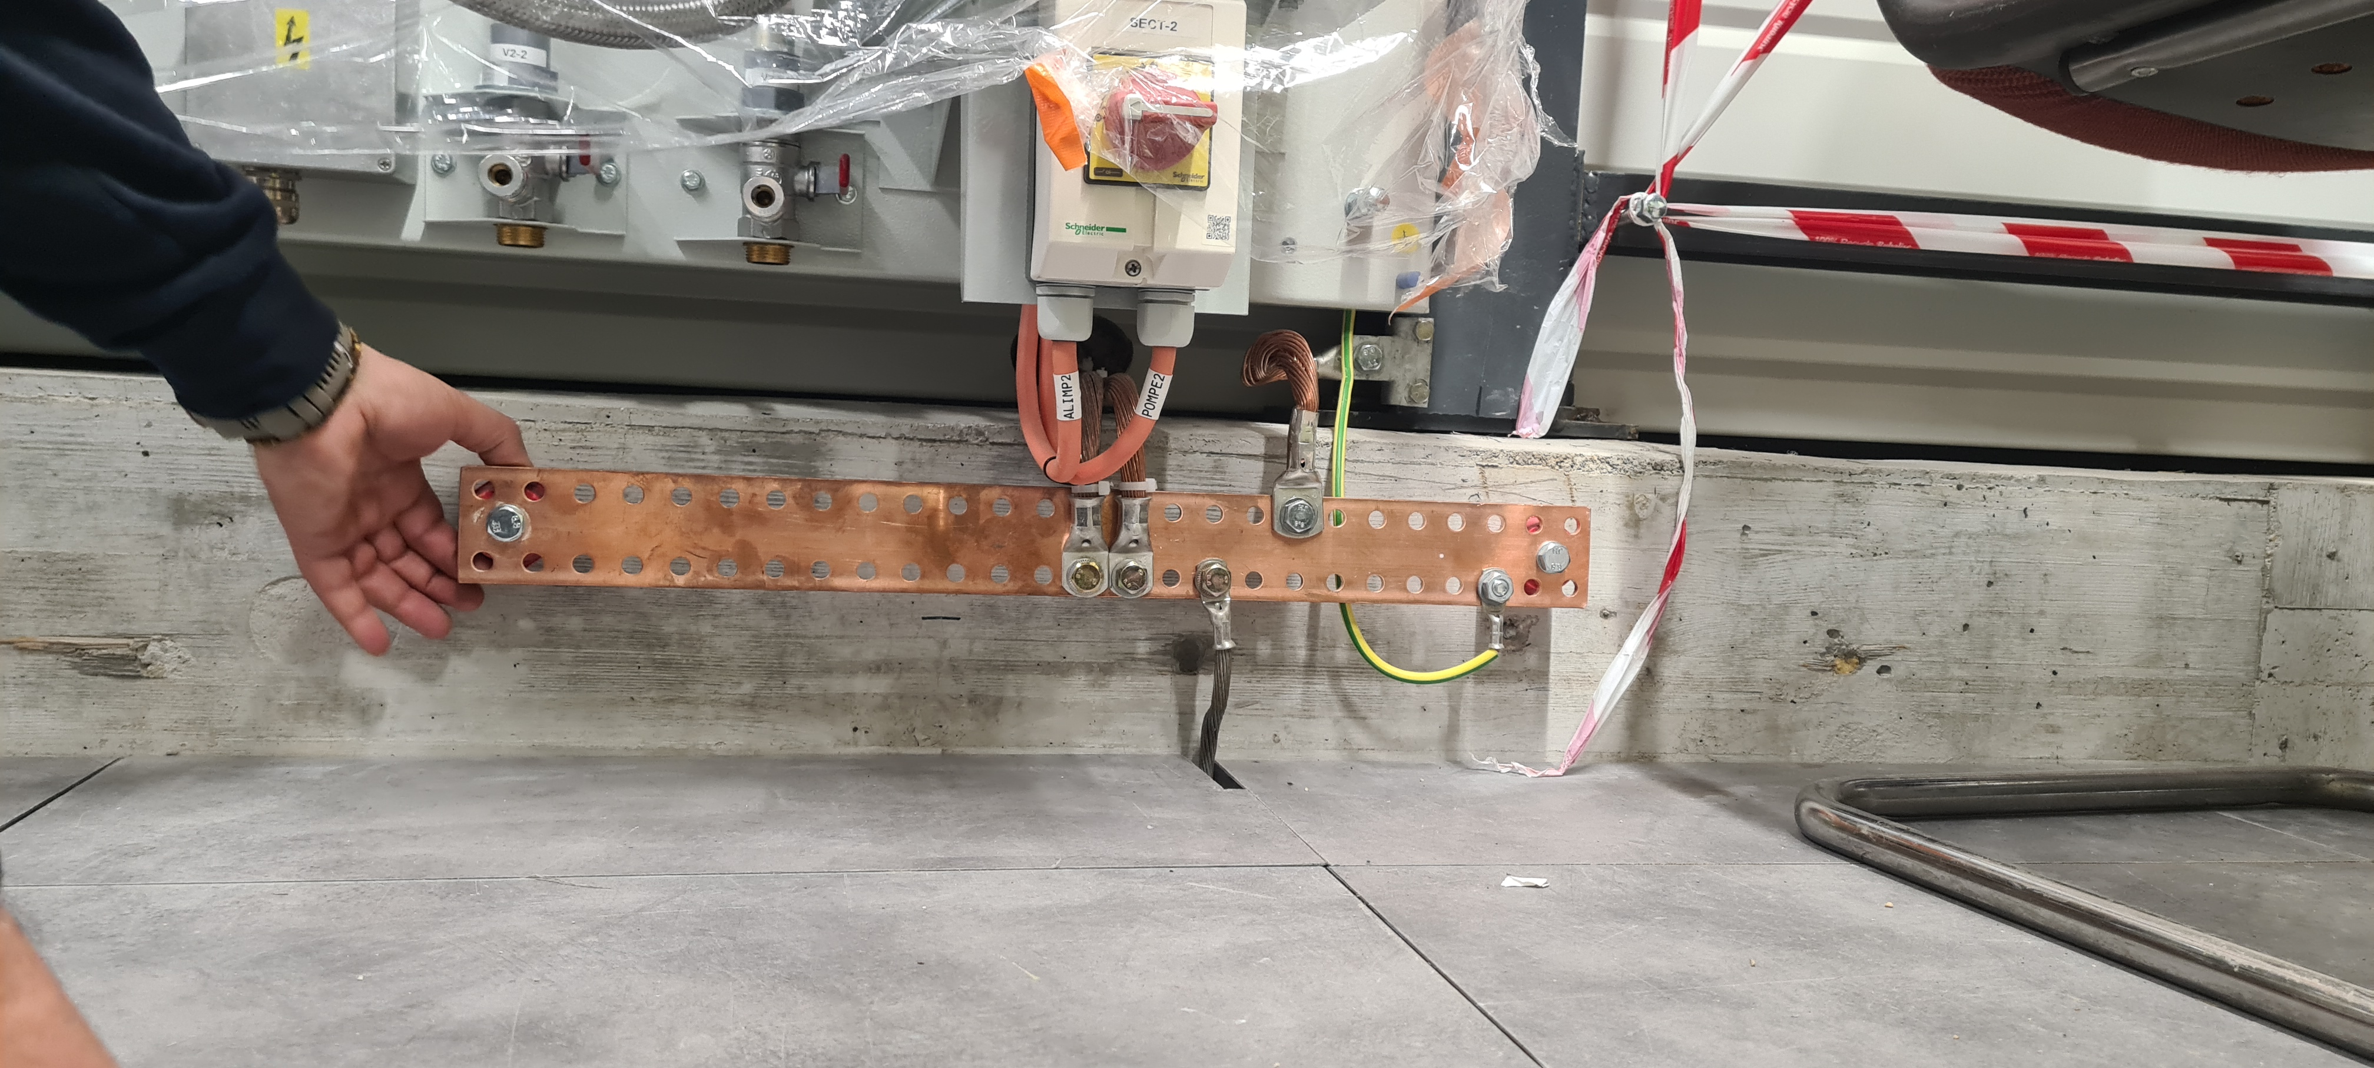
Activities at BA81 during YETS 24/25 – Electrical installation

Slide 10
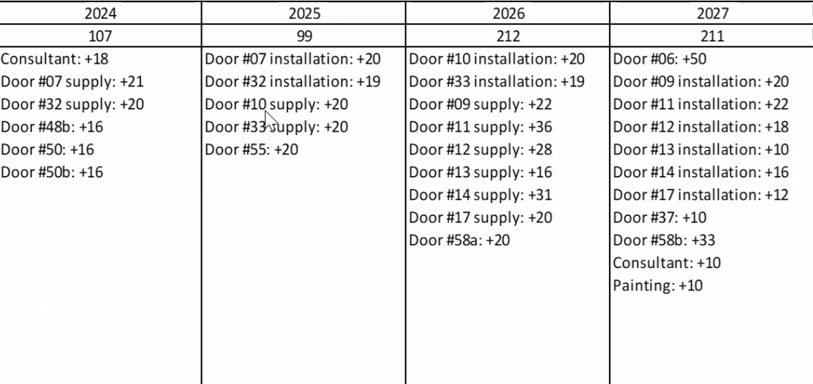
BA81
    Disengagement of the DEF contractor (B1522) for the installation of the supply after the YETS 24/25 -> Review the spending profile (Ongoing discussions with commercial team)
    An area of BA81 not covered (TDC8) -> Exhaustive control of ongoing studies
    Ongoing discussions with EN-CV for ventilation (2025-01-22)
    Electrical connection of the equipment underground (missing identification) : 100 %
    Electrical connection of the equipment surface : 50 % -> Ongoing discussions with EN-EL for power request
    Planning : EDMS 3093614
      Completion of work for the next YETS 25/26 (electrical connection, pipe drilling, pre-commissioning, etc.)
      Commissioning of detection and evacuation planned for the next YETS 25/26 (tbc)
      Instrumentation of the doors and Site Acceptance Test planned during the LS3
Courtesy by Adem K.

Slide 11
BA80 – Activities scheduled
    Disengagement of the DEF contractor for the installation of the supply
    Ongoing discussions with integration room SSI and underground for rejected pipe
    No work scheduled for the next YETS
    Ongoing discussions with SCE for integration PCF D.25 (2025-01-29)
    Ongoing discussions with EN-CV for the room SSI ventilation (2025-01-14)
    ECR BA80 Fire Detection Underground : before June 30, 2025
    Installation and Site Acceptance Test scheduled for LS3

Slide 13
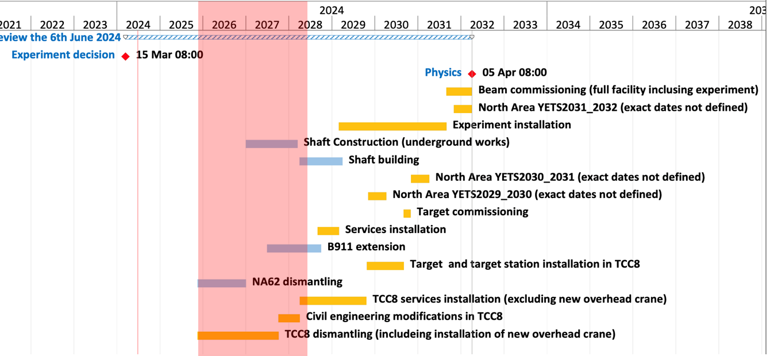
ECN3 – Latest Project Schedule

Slide 14
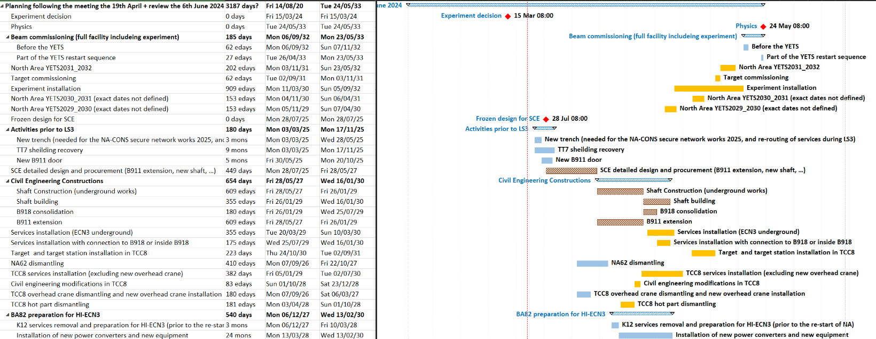
ECN3 – Latest Project Schedule

Slide 15
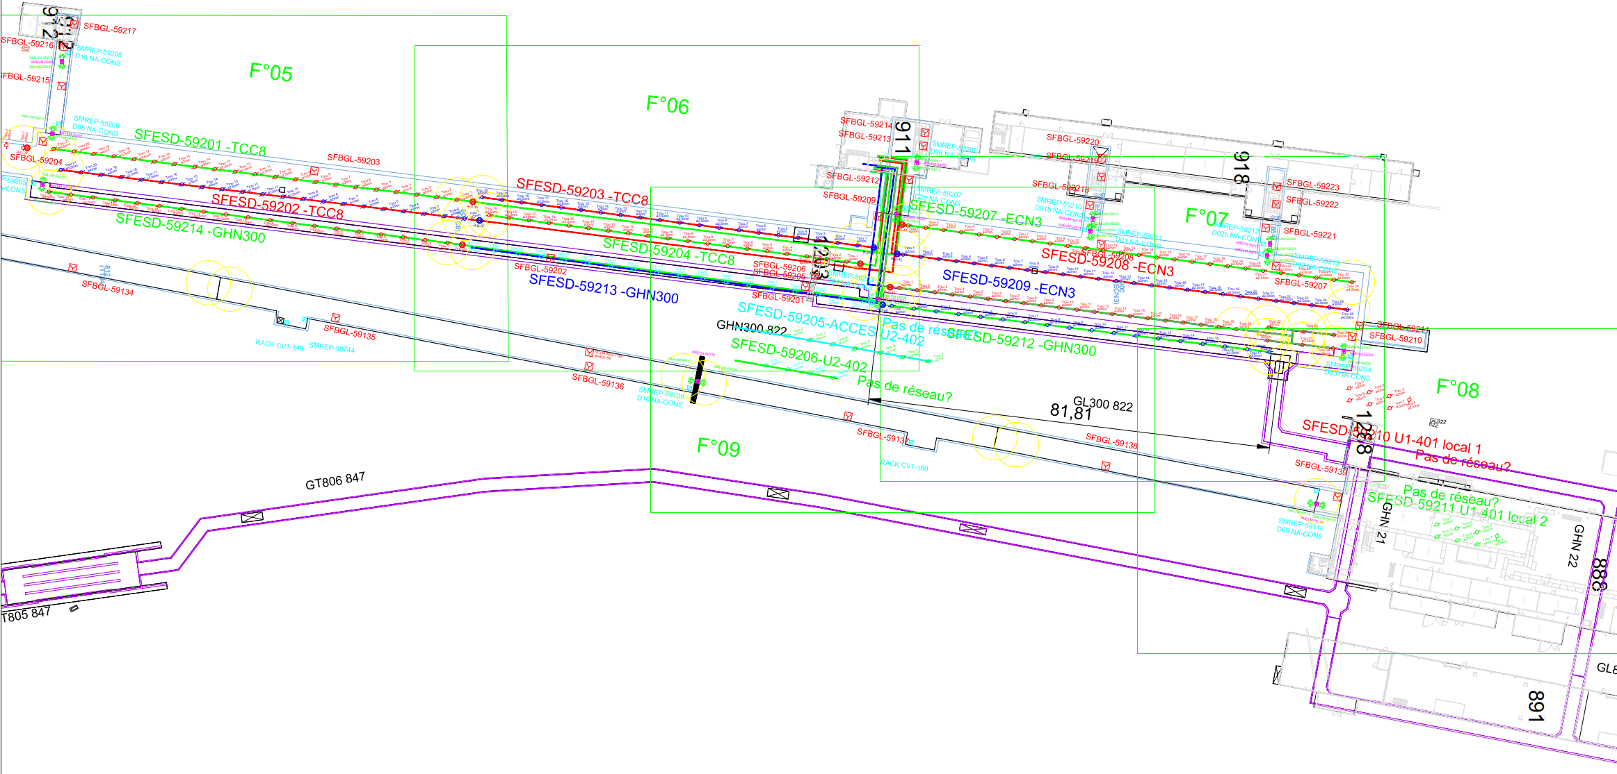
Installation equipment ECN3, TCC8, GHN300, PP851, PT851, TT851, PA852, PT852, TT852, PT853, PT854, TT854
61 Loudspeakers
23 Manual call points
33 Flashing lights
10 LASD
3 ASD

Slide 16
Power request ECN3 Fire Safety
Lieu | Designation/Utilisateur | Racks/Equipement | Type de Reseau | Type d'alimentation | Type de Depart | Diff. | Un (V) | In (A)
ECN3 PA852 | SDI CIE | SFDIN-00592 | Secour/Safety | Mono | Disj. | No | 230 | 20
ECN3 PA852 | SMSI CIE | SMSMS-00592 | Secour/Safety | Mono | Disj. | No | 230 | 20
ECN3 PA852 | SSS CIE | SESSS-00592 | Secour/Safety | Mono | Disj. | No | 230 | 32
ECN3 PA852 | SDI - LASD - Pompe 25 | SFESD-59201 | Secour/Safety | 3 Ph | Disj. | No | 400 | 6
ECN3 PA852 | SDI - LASD - Pompe 26 | SFESD-59201 | Secour/Safety | 3 Ph | Disj. | No | 400 | 6
ECN3 PA852 | SDI - LASD - Pompe 27 | SFESD-59203 | Secour/Safety | 3 Ph | Disj. | No | 400 | 6
ECN3 PA852 | SDI - LASD - Pompe 28 | SFESD-59203 | Secour/Safety | 3 Ph | Disj. | No | 400 | 6
ECN3 PA852 | SDI - LASD - Pompe 29 | SFESD-59207 | Secour/Safety | 3 Ph | Disj. | No | 400 | 6
ECN3 PA852 | SDI - LASD - Pompe 30 | SFESD-59207 | Secour/Safety | 3 Ph | Disj. | No | 400 | 6
ECN3 PA852 | SDI - LASD - Pompe 31 | SFESD-59206 | Secour/Safety | 3 Ph | Disj. | No | 400 | 6
ECN3 PA852 | SDI - LASD - Pompe 32 | SFESD-59206 | Secour/Safety | 3 Ph | Disj. | No | 400 | 6
ECN3 PA852 | SDI - LASD - Pompe 33 | SFESD-59212 | Secour/Safety | 3 Ph | Disj. | No | 400 | 6
ECN3 PA852 | SDI - LASD - Pompe 34 | SFESD-59212 | Secour/Safety | 3 Ph | Disj. | No | 400 | 6
ECN3 PA852 | SDI - LASD - Reserve | (réserve) | Secour/Safety | 3 Ph | Disj. | No | 400 | 6
ECN3 PA852 | SDI - LASD - Reserve | (réserve) | Secour/Safety | 3 Ph | Disj. | No | 400 | 6
ECN3 - PA851 | SDI - ASD | SFASD-59503-59504 | Secour/Safety | Mono | Disj. | No | 230 | 10
ECN3 - PA851 | SDI - ASD - Reserve | (réserve) | Secour/Safety | Mono | Disj. | No | 230 | 10
ECN3 - PA853 | SDI - ASD | SFASD-59505-59506 | Secour/Safety | Mono | Disj. | No | 230 | 10
ECN3 - PA853 | SDI - ASD - Reserve | (réserve) | Secour/Safety | Mono | Disj. | No | 230 | 10
ECN3 - PA854 | SDI - ASD | SFASD-59507-59508 | Secour/Safety | Mono | Disj. | No | 230 | 10
ECN3 - PA854 | SDI - ASD - Reserve | (réserve) | Secour/Safety | Mono | Disj. | No | 230 | 10

Slide 17
Interface with the CERN ventilation system
Tenant |  | Aboutissant |  | Cable |  | Fil | Utilisation | Centrale | Numéro | Localisation | Type d'interface
 | Rack CMSI |  | Rack CV | MHF2 |  | 1 | ARRET VENTILATION SPS 1 (CONTACT SEC -) | Centrale N°16 | 888 CV1 151 | TT 84 | - Commande envoyée par le CMSI - Contact sec NF - Transmission en sécurité positive
 |  |  |  |  |  | 2 | ARRET VENTILATION SPS 1 (CONTACT SEC +)
 | Rack CMSI |  | Rack CV | MHF2 |  | 1 | ARRET VENTILATION TT10 (CONTACT SEC -) | Centrale N°17 | 900 W2 85 | TCC8 | - Commande envoyée par le CMSI - Contact sec NF - Transmission en sécurité positive
 |  |  |  |  |  | 2 | ARRET VENTILATION TT10 (CONTACT SEC +)
 | Rack CMSI |  | Rack CV | MHF2 |  | 1 | ARRET VENTILATION TT10 (CONTACT SEC -) | Centrale N°18 | 900 CV1 152 | ECN3 | - Commande envoyée par le CMSI - Contact sec NF - Transmission en sécurité positive
 |  |  |  |  |  | 2 | ARRET VENTILATION TT10 (CONTACT SEC +)
 | Rack CMSI |  | Rack CV | MHF2 |  | 1 | ARRET VENTILATION TT10 (CONTACT SEC -) | Centrale N°19 | 900 CV1 153 | GHN3 | - Commande envoyée par le CMSI - Contact sec NF - Transmission en sécurité positive
 |  |  |  |  |  | 2 | ARRET VENTILATION TT10 (CONTACT SEC +)
 | Rack CMSI |  | Rack CV | MHF2 |  | 1 | ARRET VENTILATION TT10 (CONTACT SEC -) | Centrale N°20 | 900 CV1 154 | TCC8 | - Commande envoyée par le CMSI - Contact sec NF - Transmission en sécurité positive
 |  |  |  |  |  | 2 | ARRET VENTILATION TT10 (CONTACT SEC +)

