Slide 1
NA-CONS Cost, Schedule & Scope Review:
WP5.1 Fire Safety and Access System
Anna Suwalska EN-AA on behalf of WP5.1 team, NA-CONS CSSR, February 6-7 2025

Slide 2
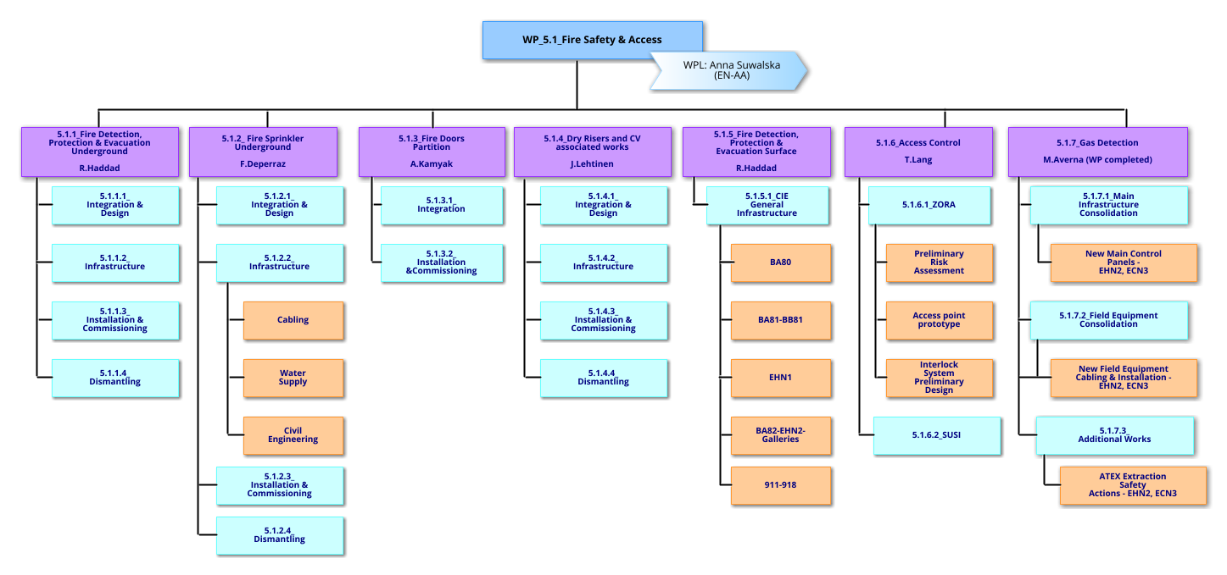
WP5.1 WBS
Since Aug 2024
Courtesy of
Deepti Kandhol

Slide 3
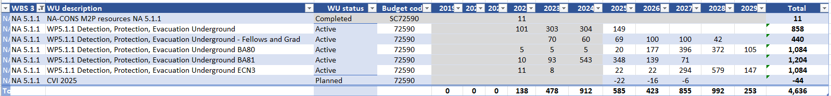
WP5.1 Scope & changes since CSR’2024
Baseline - Approved change of SCOPE - SCOPE needs to be confirmed
WP5.1.1 Installation, tests and commissioning of the fire detection, protection and evacuation systems in the underground of BA80, BA81, ECN3.
WP5.1.2 Installation, tests and commissioning of the sprinkler system in BA80 underground.

Slide 4
WP5.1 Scope & changes since CSR’2024
Baseline - Approved change of SCOPE - SCOPE needs to be confirmed
WP5.1.3 Installation of fire compartments in the underground of BA80, BA81, technical galleries, ECN3 & it’s technical galleries
WP5.1.4 Installation of dry risers in entry to underground in BA80,BA81, EHN2, EHN1, ECN3 entire underground of NA. Installation of supplementary firefighting equipment CAFs and new CAF-CUBE-S.
WBS | WBS 2 | WBS 3 | Dep | Group | Projet | WU description | WU status | Category | Budget code | 2019 | 2020 | 2021 | 2022 | 2023 | 2024 | 2025 | 2026 | 2027 | 2028 | 2029 | Total
NA 5 | NA 5.1 | NA 5.1.4 | HSE | HSE-FRS | NA-CONS-P1 | CFRS equipment | Active | GOODS | 74165 | - | - | - | - | - | 170 | - | - | - | - | - | 170
Total |  |  |  |  |  |  |  |  |  | 0 | 0 | 0 | 0 | 0 | 170 | 0 | 0 | 0 | 0 | 0 | 170

Slide 5
WP5.1 Scope & changes since CSR’2024
Baseline - Approved change of SCOPE - SCOPE needs to be confirmed
WP5.1.5 Installation, test and commissioning of the fire detection and evacuation systems in the surface buildings EHN2,BA82, BA80, BA81, EHN1, 911,918 *
WP5.1.6 Risk Assessment of EHN1 and EHN2. Prototype of an access system to NA experimental areas.

Slide 6
WP Schedule , Status, KPIs

Slide 7
Planning / Schedule

Slide 8
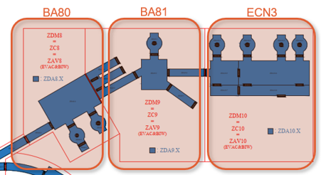
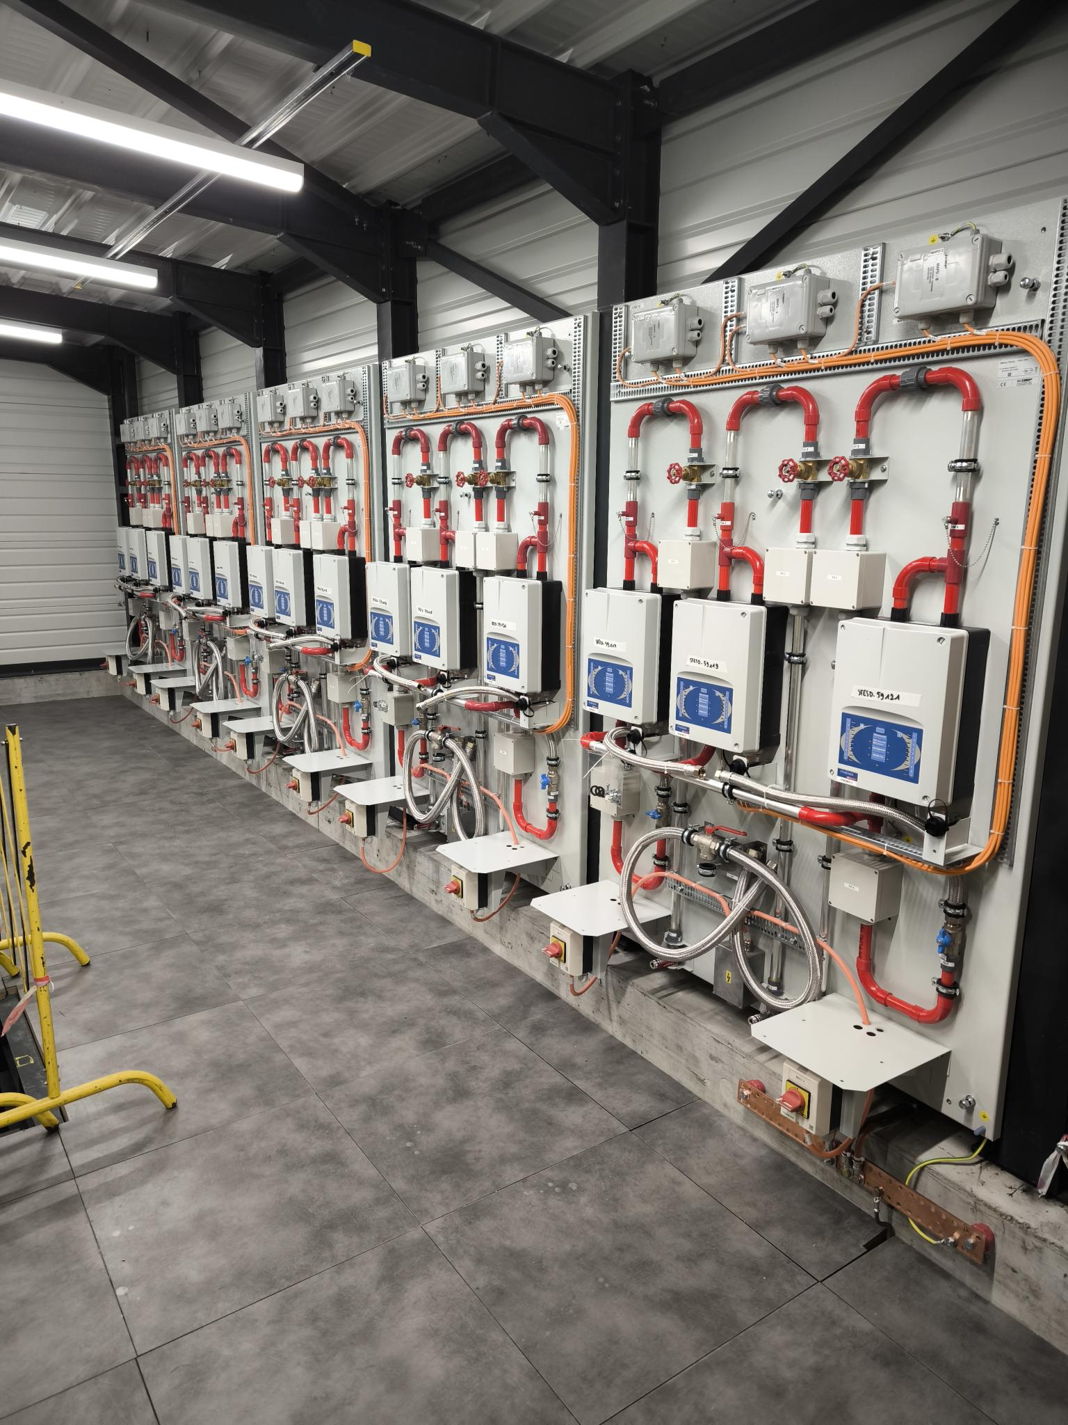
WP5.1.1 Status
UNDERGROUND FIRE DETECTION, PROTECTION, EVACUATION
Main Achievements
  BA81 Extension civil engineering works completed
  FAT of the rack and LASD platines completed, all equipment delivered to CERN
  3 racks and 7 LASD platines installed in BA81 extension, EN-EL cabling of BA81 false floor completed, internal rack cabling.
  All Manual call points & speakers in BA81 installed (YETS23/24)
  First batch of 8km of detection aluminium pipes installed (started this YETS)
  ECRs – BA81 approved , BA80 pending, ECN3 postponed
Future Milestones
  End-YETS24/25: 8km of BA81 piping installed, air-tightness tests completed.
  Q1/2025: BA81 cabling completed.
  Q1/2025: design, integration, DIC adjustments of ZONE BA80 completed.
  Mid-2025: new strategy for the future installation works approved (piping, instrumenting equipment, installation of electrical equipment).
  YETS25/26: BA81 partial commissioning (detection and evacuation). Protection function depends on the availability of all fire compartments.
  LS3: BA81 Protection completed. BA80 Detection, Protection, Evacuation completed.
  2028: detail design for systems in ECN3. Start of integration.
Zoning of the NA fire detection
BA81 Extension and fire detection equipment

Slide 9
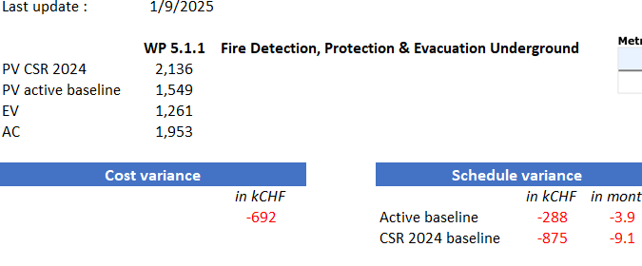
WP5.1.1 KPIs

Slide 10
WP5.1.2 Status
BA80 SPRINKLER SYSTEM
Main Achievements
  PA80 shaft and sprinkler station installed. Systems in both shafts recommissioned for RUN2024.
  Good start of works before Christmas.
  A bit slower start after Christmas – but we are monitoring very closely
  ECR – APPROVED.
Future Milestones
  The high-pressure tests and commissioning must be completed by 14.02
  Q1/2025: as-built documentation & certification
  April-2025: Project close-out
Isometric view with system completed and remaining part for YETS24/25

Slide 11
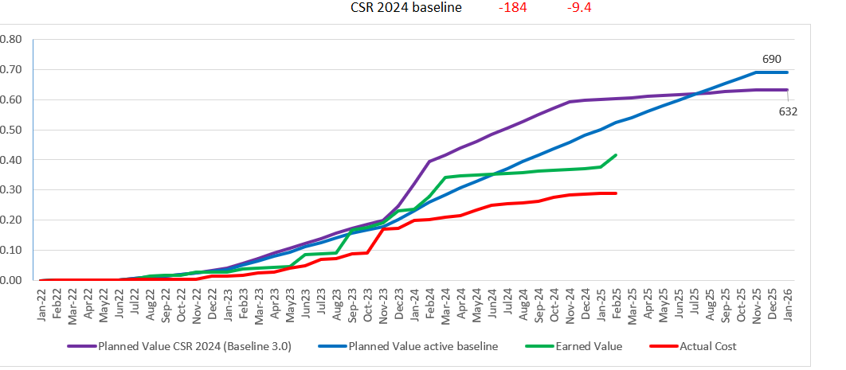
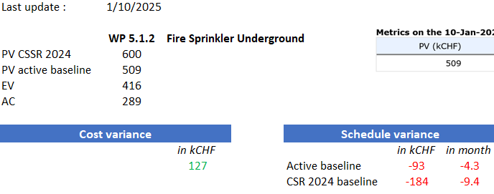

Slide 12
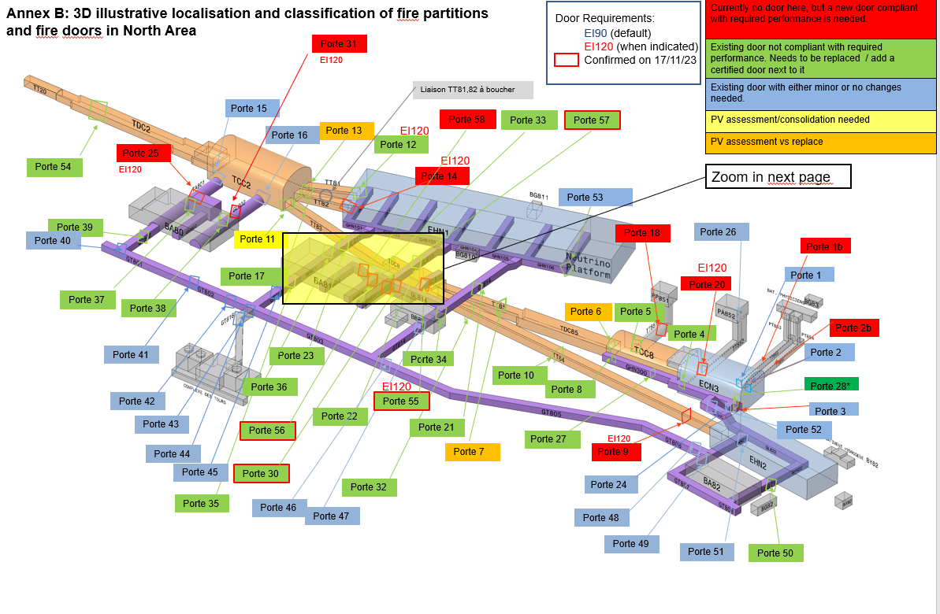
WP5.1.3 Status
North Area – fire compartments inventory
FIRE COMPARTMENTS
Main Achievements
  ECRs being approved, new ECRs in draft
  3 doors installed last YETS23/24
  6 doors being installed this YETS
  ECR – APPROVED , being prepared as the integration continue.
Future Milestones
  YETS24/25 – reception of 6 new doors
  2025: procurement of next lot of the BA81 doors
  Integration and ECRs for BA80
  YETS25/26 – installation of maximum number of doors for BA81. priority put on the doors to be instrumented by fire detection. Resource levelling with EN-ACE – to be confirmed in April 2025
  LS3: installations of remaining BA81 & all BA80 doors
  2028? : ECN3 scope to be confirmed. Integration and ECRs
  2028: design, procurement and manufacturing of fire doors for ECN3
  2029+: installation of 14 fire compartments in ECN3

Slide 13
Last update : | 1/9/2025
 | WP 5.1.3 | Fire Doors Partition
PV CSR 2024 | 23
PV active baseline | 106
EV | 106
AC | 105
Cost variance |  |  |  | Schedule variance
 |  | in kCHF |  |  |  | in kCHF | in month
 |  | 1 |  | Active baseline |  | 1 | 0.0
 |  |  |  | CSR 2024 baseline |  | 83 | 4.0

Slide 14
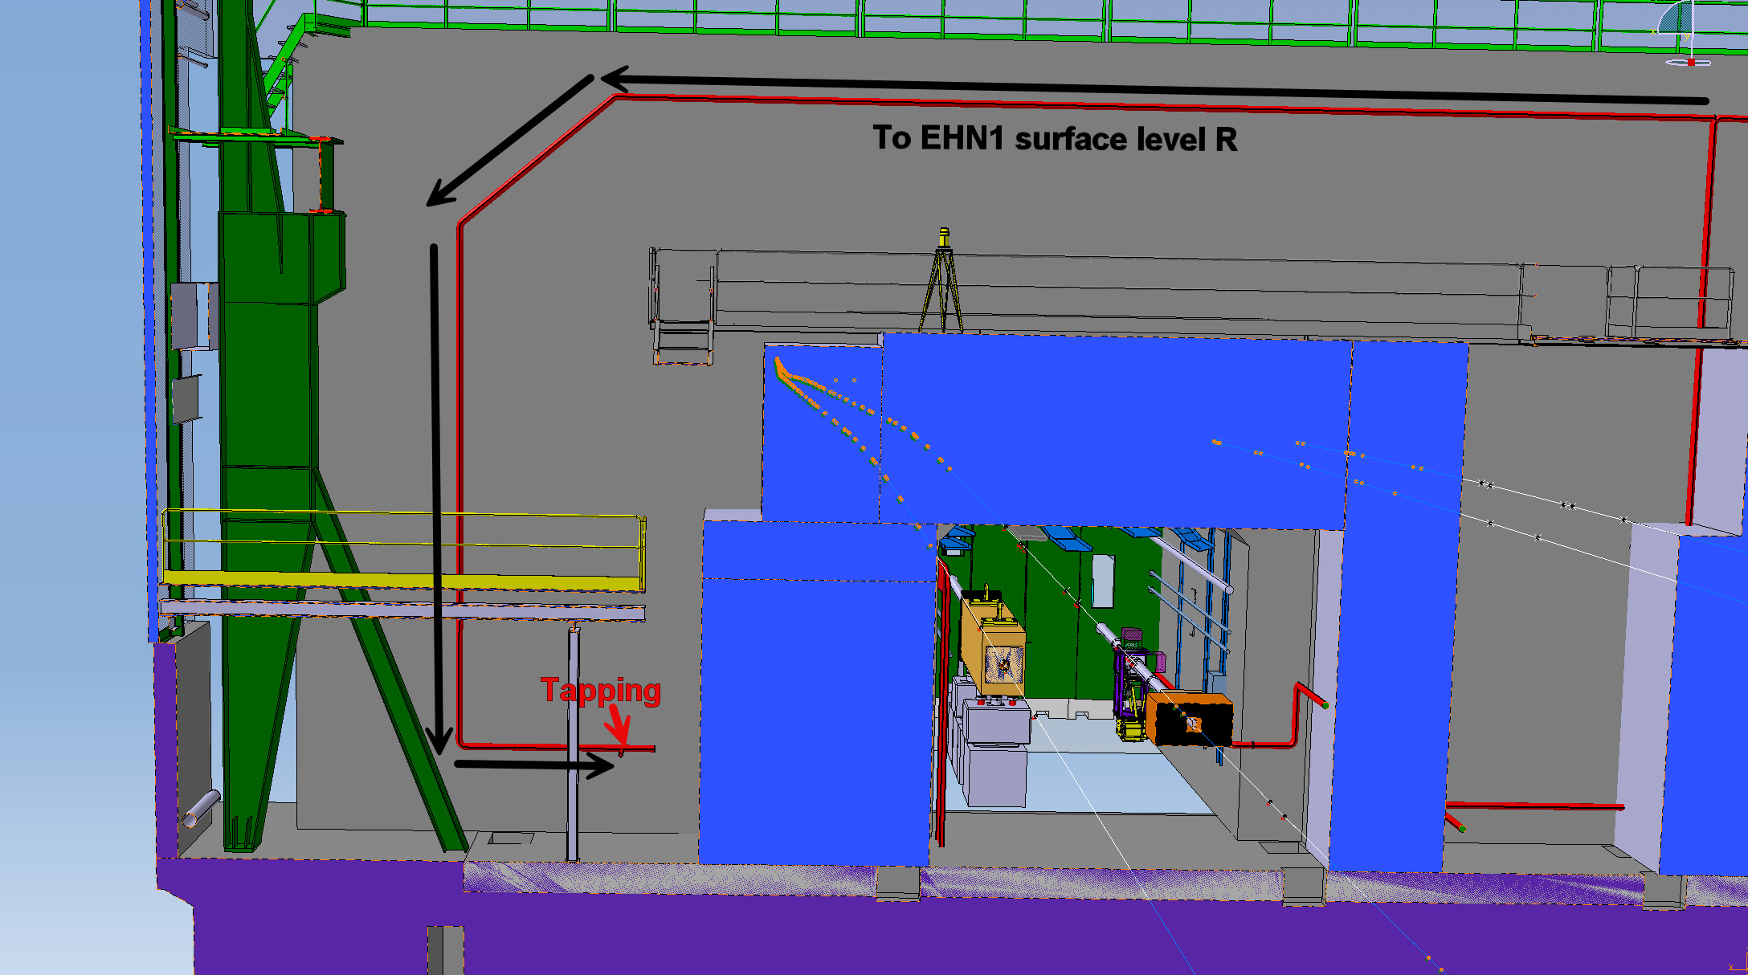
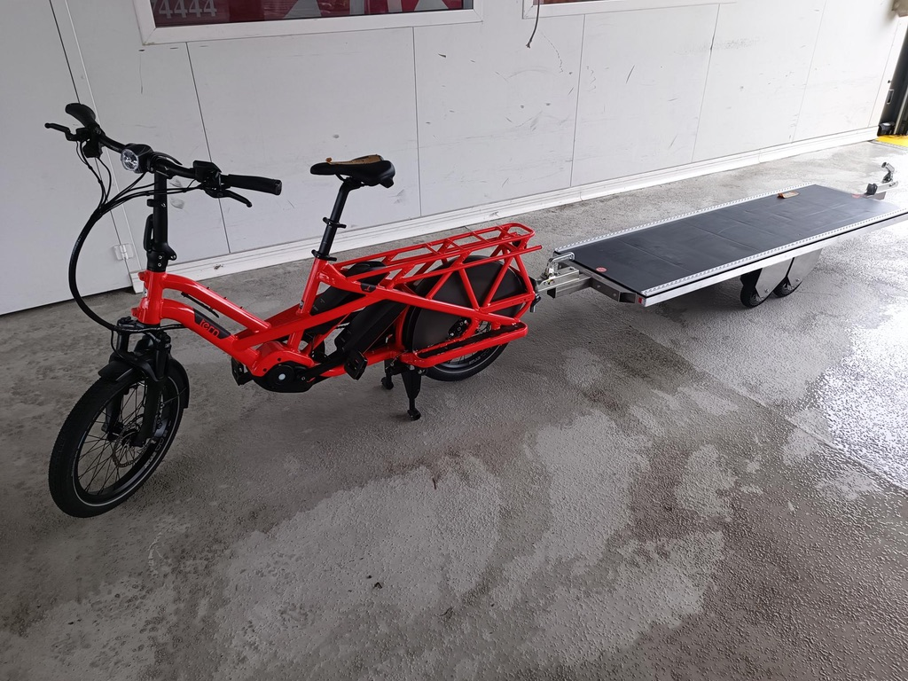
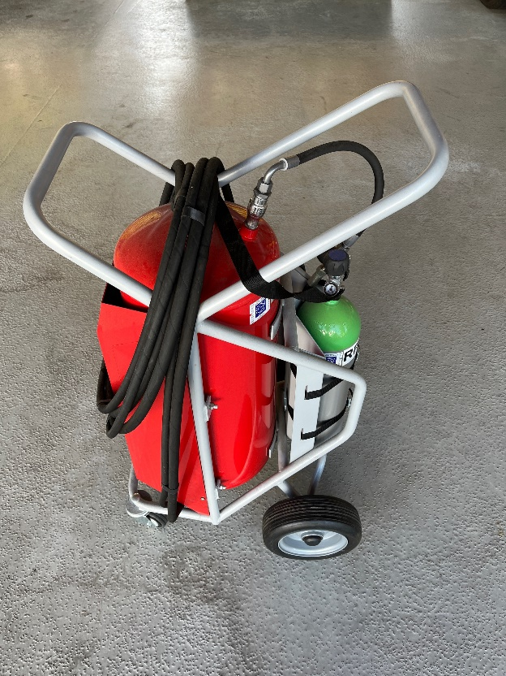
WP5.1.4 Status
DRY RISERS & ADDITIONAL FIREFIGHTING MEANS
Main Achievements
  Dry Riser working group has completed the study. The proposal was endorsed by NA-TCC and HSE TMB.
  The new technical strategy requires installation of the dry risers at the entries to the underground areas only in BA80, BA81, EHN1, EHN2, ECN3.
  Additional firefighting means portable CAFs will be placed in BA80, BA81, EHN1, EHN2, ECN3 and two CFRS tracks will be equipped with CAFS-CUBE-S.
  Integration of dry riser (?) and CAFs completed.
  CAFs procurement completed, equipment delivered on site.
Future Milestones
  YETS24/25: CAFs equipment installed/positioned in the predefined locations.
  2025? : release order for dry riser installation work completed
  LS3: progressive installation & commissioning of dry risers
  WPD for dry risers to be done URGENT + ECR to be done
EHN1 dry riser integration
Additional transport bikes for CFRS
Portable CAF

Slide 15
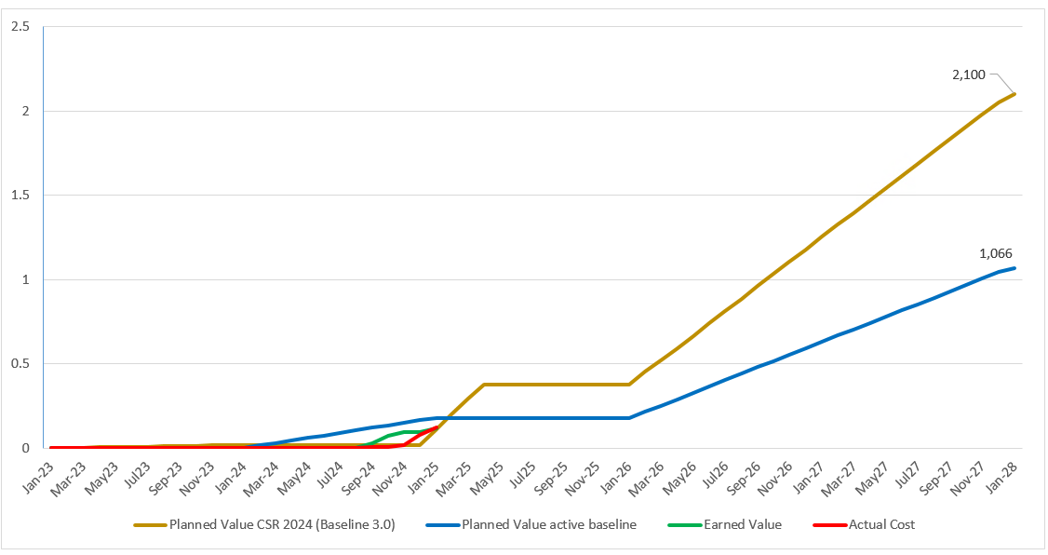
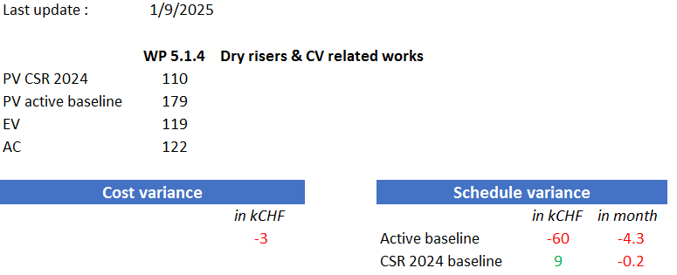

Slide 16
WP5.1.5 Status
FIRE DETECTION, PROTECTION, EVACUATION SURFACE
Main Achievements
  EHN2 doors
  EHN1 Aspirating Smoke Detection and Bris-de-Glace installed and commissioned
  4 CIE Racks for EHN1, BA81 BA80 installed on site and alarms transfeted to new racks for EHN1 and BA81.
  Removal of obsolete aspirating piping in EHN1 galleries
Future Milestones
  YETS24/25 Transfer of alarms to new rack in BA80
  YETS24/25 BA81 false floor piping and electrical equipment installation
  2025 – BDG, EVAC surface + Commissioning BA81 alarms
  ECR – EHN1 galleries APPROVED ,
  ECR - BA81 APPROVED
  ECR – BA80 , EHN1 to be done

Slide 17
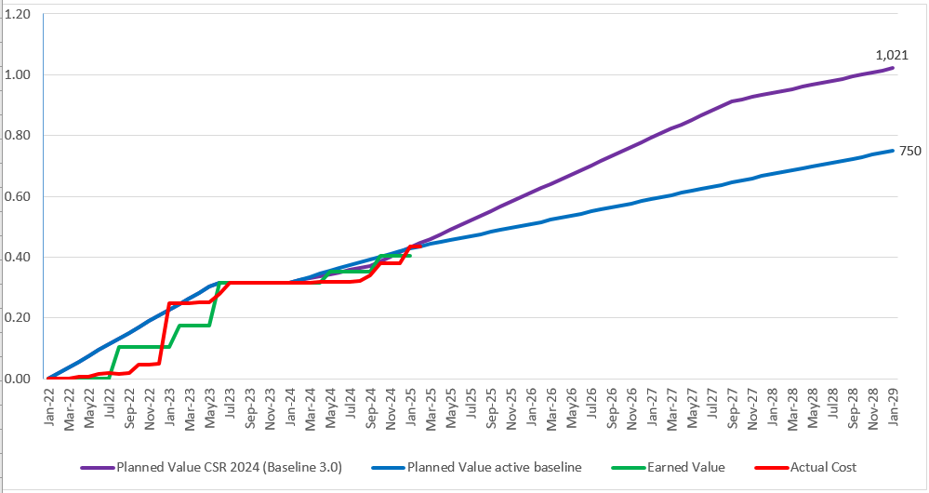
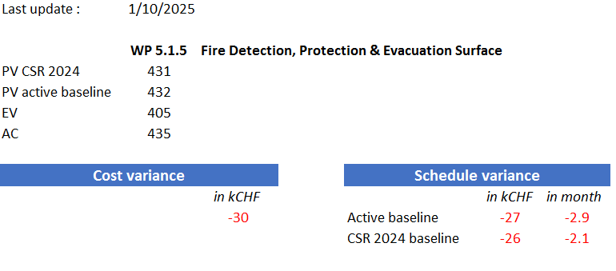

Slide 18
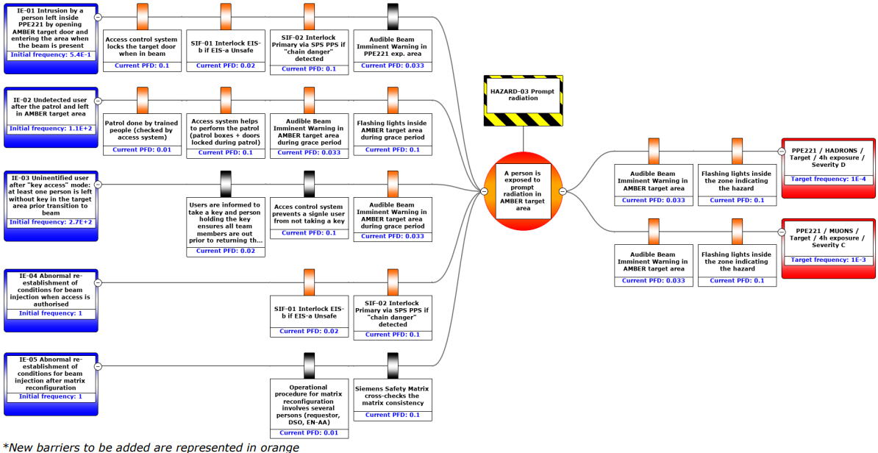
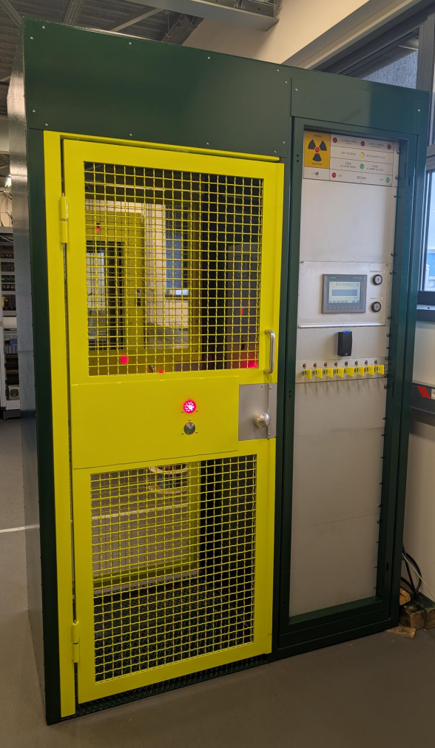
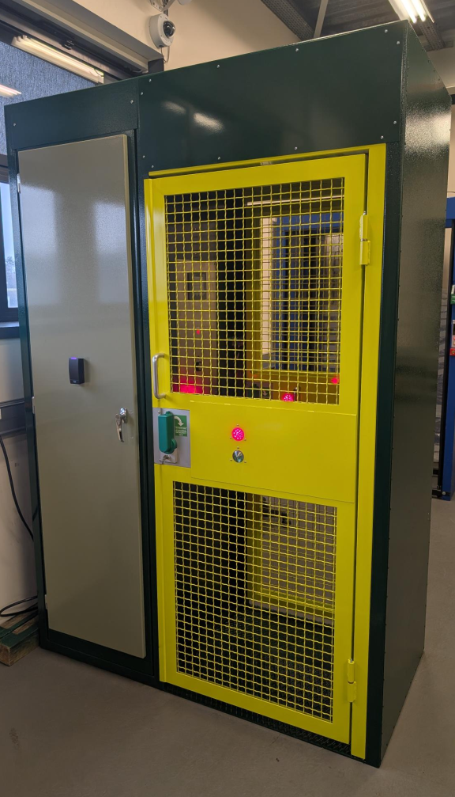
WP5.1.6 Status
PROTOTYPE OF ACCESS SYSTEMS FOR EXPERIMENTAL AREAS
Main Achievements
  EHN1 risk assessment completed (2023)
  EHN2 risk assessment in final approval. Also presented @ SPS-CSAP
  Functional specification for access doors were completed.
  Price enquiry was completed and offer was received (S289)
  Integration and displacement of existing access doors on going
Future Milestones
  March 2025: competition of the technical study to implement changes and renovate the safety systems architecture of the NA experimental areas.
  YETSs and LS3: WU displacement of existing access doors will follow installation of fire compartments
  WPD APPROVED , No ECRs –NA.

Slide 19
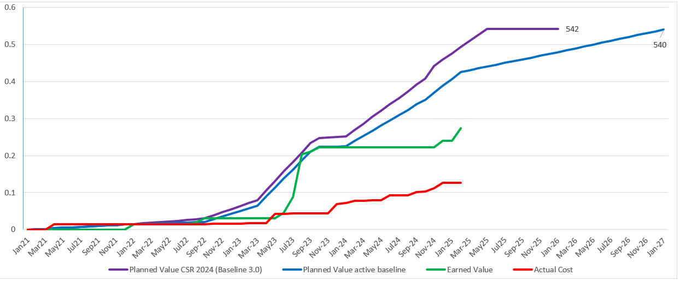
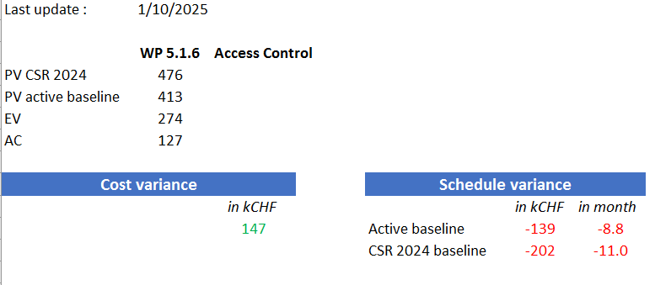

Slide 20
Procurement status
 | WP5.1.1 | WP5.1.2 | WP5.1.3 | WP5.1.4 | WP5.1.5 | WP5.1.6
Plan | B1522 (DEF) | B1523 (ArceClima) | S259, S283 Frame contracts SafeDoor (the same as SPS) | EN-CV Several frame contracts ? Still a case need of a new contract? 2)HSE-FBS – contract | B1212 | S289
Level of exposure to market volatility (list of items) | Installation will be no longer a part of the B1522. Need of a new contract –price is expected to be higher. | NA | NA | NA | NA | Prices shall not change
Strategy to cope with market volatility | Control equipment ordered already for the entire project. Electrical equipment/tubes – delivered | Prices renegotiated in 2023. The works shall be finished in 2024 | Several frame contracts | EN-CV Several frame contracts | Order of all centrals already done | Anticipated order of material. WU Prototype to be finished in 2024
+ Slides from CERN procurement (Rachid)

Slide 21
Infrastructure, Logistics, Services
 | WP5.1.1 | WP5.1.2 | WP5.1.3 | WP5.1.4 | WP5.1.5 | WP5.1.6
Have all the integration needs been requested? | Integration needs known by BE-EA. Ongoing. ECN3 waiting. | COMPLETED | Integration needs known by BE-EA. Ongoing. ECN3 waiting. | YES. Integration completed CF? | Integration needs known by BE-EA. Ongoing. | NA
De-cabling, rack and fiber installation? | YES. Modifications ongoing | COMPLETED | NA | ? | YES. Modifications ongoing | NA
Transport and logistics needs? | YES. | COMPLETED | YES. PLAN. | YES. PLAN. | YES. Contractor? | NA
Radioactive Waste disposal? | YES | COMPLETED | ? | doors | ? | NA
Storage | Sharepoint No? | COMPLETED | Sharepoint No? | Sharepoint No? | Sharepoint No?
Base-de-chantier | ? | COMPLETED | ? Sharepoint | ? Sharepoint |  | NA

Slide 22
New Budget Requests

Slide 23
Additional future requests which risk to change scope
Fire doors new requirements+ changes (HSE document)
Ventilation RP for BA80
Exhaustive piping in BA80 to TCC2
Evacuation surface after EHN1 fire risk assessment
Poigne d’urgence?/ ventilation

Slide 24
Review of likely future requests : New Scope
Title: Fire doors new requirements+ changes (HSE document
Description (BCR EDMS No.):
Motivation:
Priority/consequence of delay:

Slide 25
Review of new LS3 extension
Title: one line summary of request X
Description (BCR EDMS No.):
Motivation:
Priority/consequence of delay:

Slide 26
Review of new requests TCC2 added scope
Title: one line summary of request X
Description (BCR EDMS No.):
Motivation:
Priority/consequence of delay:

Slide 27
Summary

Slide 28
Challenges
Short YETS, many constraints related to other works in the NA
Next YETS will be even shorter
The project must cope with unknowns of HI-ECN3 , resources & contracts in a long-term
Unstable situation with the contactors (has already caused delays YETS23/24).
…………………….

Slide 29
Risks
New risks in addition to the ones collected by Filipa?

Slide 30
Summary

Slide 31
Many thanks to NA-CONS WP5.1 project and technical leaders:
F. Deperraz, R. Haddad, M. Jeckel, A. Kaymak, L. Lang, J. Lehtinen,
M. Leinonen, D. Mcfarlane, D. Raffourt, D. Vaxelaire
Special thanks to technical supporting teams:
K. Buffet, B. Debrouwere, I. Derrag, M. Lazzaroni, O. Rios

Slide 32
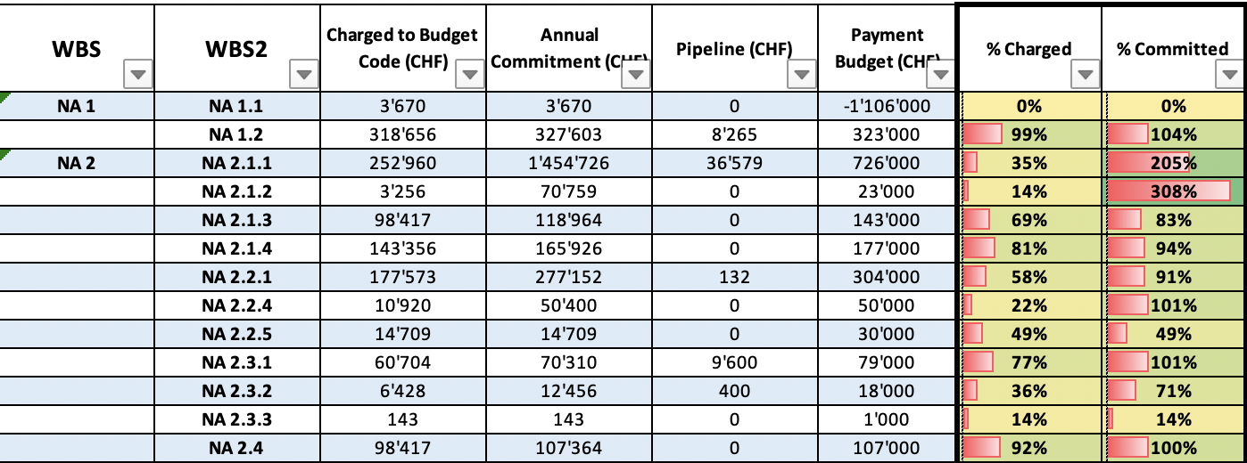
Review of Approved Activities
Click here to see the available files prepared by Emmanuelle
CET Situation to be provided by Emmanuelle on 12/2024
To be updated

Slide 33
Other points
CF – all already identified?
DICs (CV also?)
Recent change of scope for doors
Doors handle?
Installation schedles?

