Slide 1
recent CLIC accelerator changes and required updates on CLICdp work in preparation for ESPPU 2025
Summary of main parameter changes
and suggested items for work
Dominik Dannheim, Lucie Linssen, Aidan Robson, Philipp Roloff, Andre Sailer, Eva Sicking

Slide 2
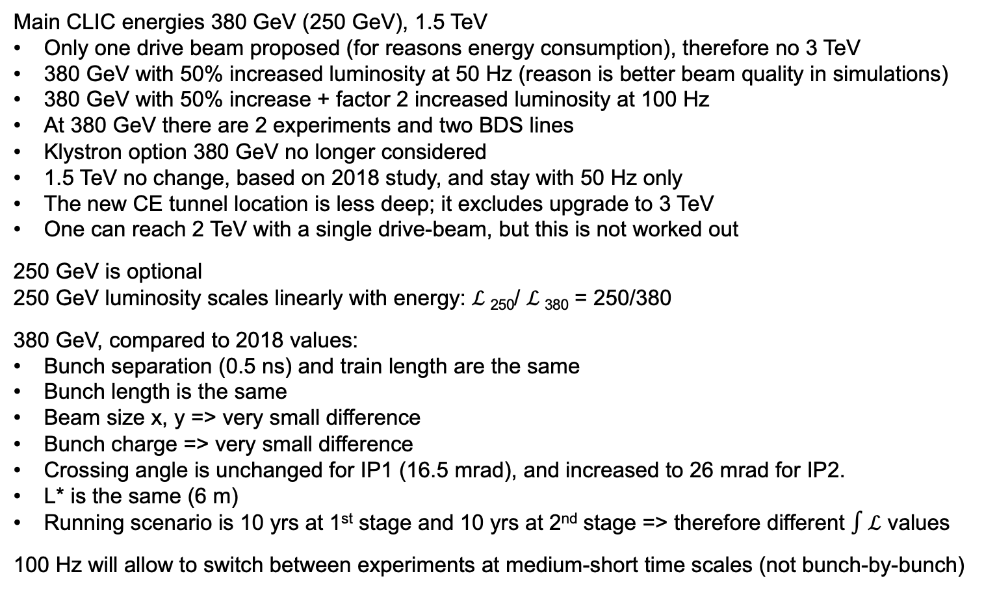
List of main changes
Main CLIC energies 380 GeV (250 GeV), 1.5 TeV
Only one drive beam proposed (for reasons energy consumption), therefore no 3 TeV
380 GeV with 50% increased luminosity at 50 Hz (reason is better beam quality in simulations)
380 GeV with 50% increase + factor 2 increased luminosity at 100 Hz
At 380 GeV there are 2 experiments and two BDS lines
Klystron option 380 GeV no longer considered
1.5 TeV no change, based on 2018 study, and stay with 50 Hz only
The new CE tunnel location is less deep; it excludes upgrade to 3 TeV
One can reach 2 TeV with a single drive-beam, but this is not worked out
250 GeV is optional
250 GeV luminosity scales linearly with energy: $ℒ$₂₅₀/ $ℒ$₃₈₀ = 250/380
380 GeV, compared to 2018 values:
Bunch separation (0.5 ns) and train length are the same
Bunch length is the same
Beam size x, y => very small difference
Bunch charge => very small difference
Crossing angle is unchanged for IP1 (16.5 mrad), and increased to 26 mrad for IP2.
L* is the same (6 m)
Running scenario is 10 yrs at 1st stage and 10 yrs at 2nd stage => therefore different $∫ℒ$ values
100 Hz will allow to switch between experiments at medium-short time scales (not bunch-by-bunch)

Slide 3
Numbers
Relevant numbers can be found in following slides by Daniel Schulte, Vera Cilento and Andre Latina, which they presented on 11/12/2024 at the CLIC project meeting.
Look at slides with
LL added on 29/1/2025:
The following 2 slides are screen shots from the PIP report: CERN-2018-010-M
Reveals further small differences between PIP report and new parameters:
emittance at the IP: 950/30 => 920/15
beam size at IP: 149/2.9 => 140/2.1

Slide 4
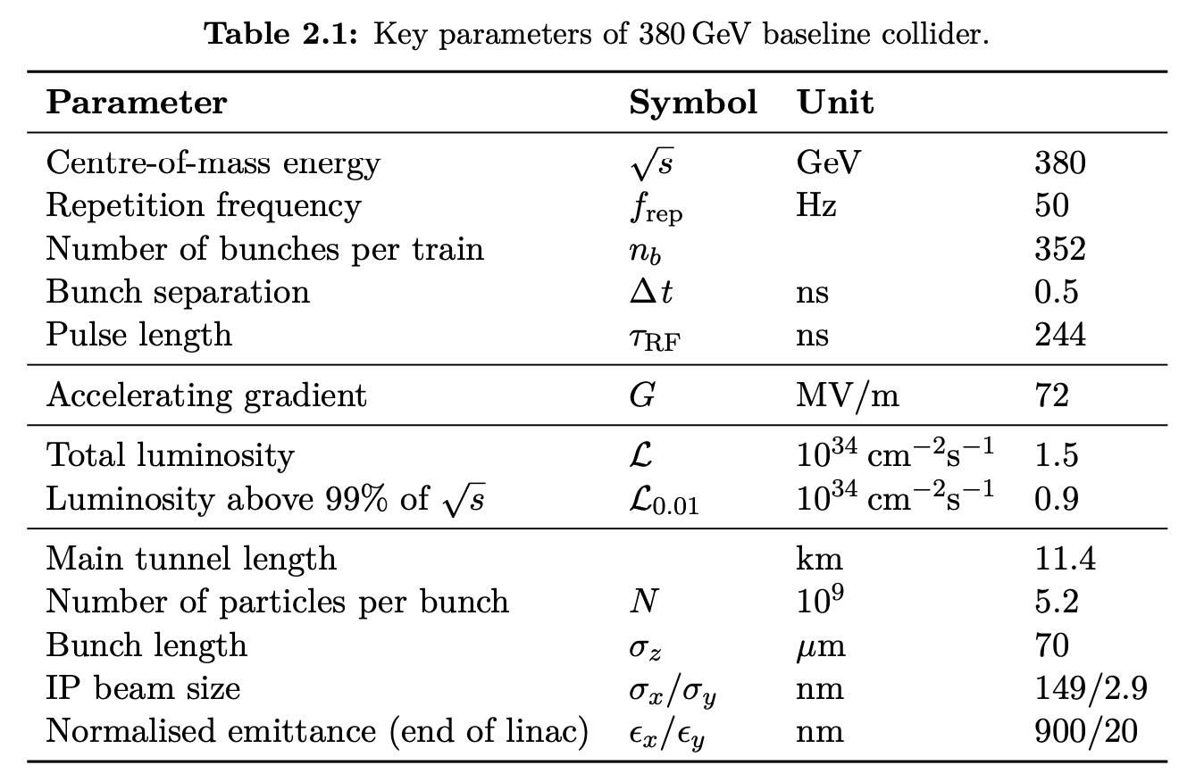
copied from PIP CERN-2018-010-M

Slide 5
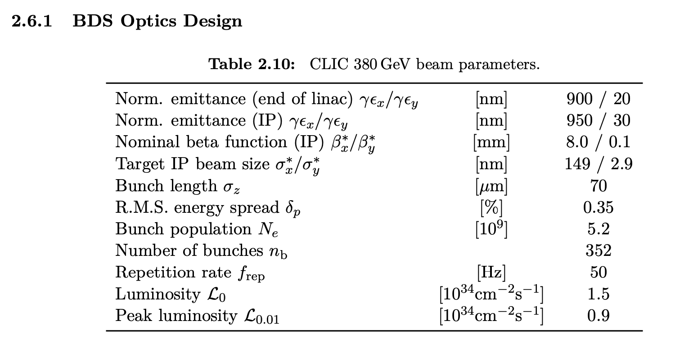
copied from PIP CERN-2018-010-M

Slide 6
Jobs for CLICdp
Table below is about to “updating” our knowledge and material. ESPPU document editing not included.
Task | Name | Comment
Simulate or scale background/occupancy numbers at 380 GeV for 100 Hz in one detector
Comment (no simulation needed) on triggerless readout at 100 Hz at 380 GeV.
Scale CLIC Higgs physics results for new integrated luminosities
New combined Higgs fit
Any action for 250 GeV?
New Higgs plots for 380 GeV + 1.5 TeV and for 380 GeV, 1.5 TeV and 3 TeV
What to do with HH without 3 TeV. How to sell it?
What is needed for top physics? Presume threshold scan stays the same. Scale some other results? ttH?
Drawing several new plots or adjusting existing plots (scripts exist still?)
Overview (bullet list?) of advances in CLIC-related detector technologies in past 5 yrs

Slide 7
Design, Parameters and Beamdynamics
CLIC Project Meeting
Wednesday December 11th, 2024
Daniel Schulte, Vera Cilento, Andrea Latina et al.

Slide 8
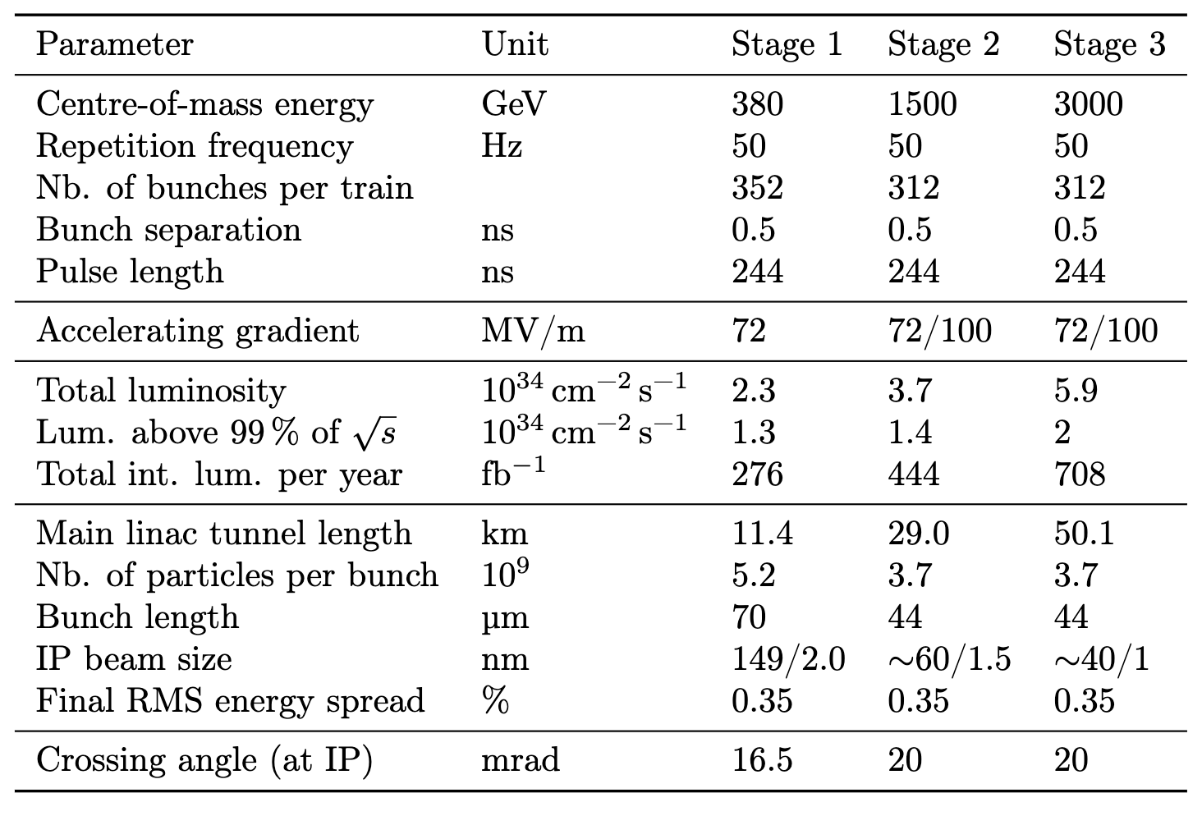
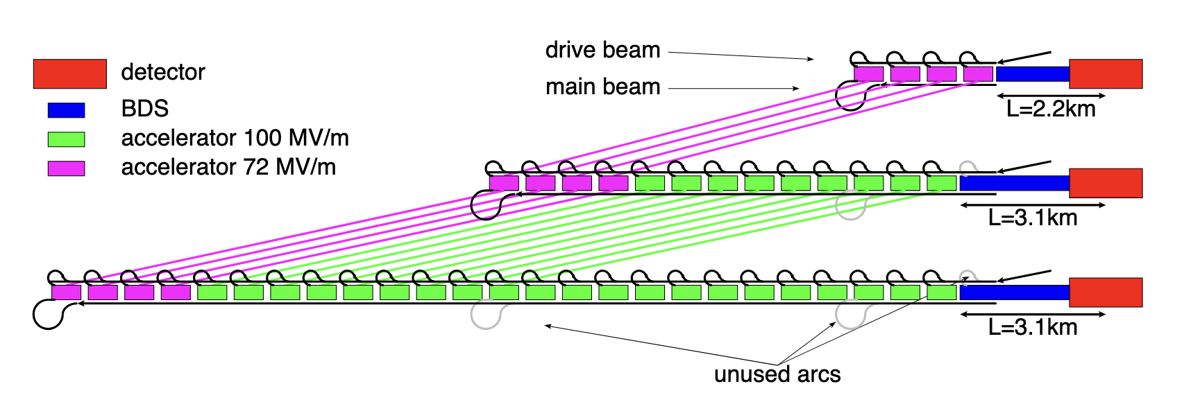
Previous Parameters
CLIC study
Snowmass submission
https://cds.cern.ch/record/2744946
Chapter 2, with adjustment
LL, in the Snowmass submission and in PIP I see 149/2.9 for 380 GeV

Slide 9
New Energy Stages
380 GeV remains baseline
250 GeV initial option
Build 380 GeV tunnel but only install about 2/3* of the accelerating structures in each drive beam sector
1.5 TeV potential upgrade
Could go to 2 TeV with single drive beam (parameters?)
*More precisely (250-9)/(380-9)
Upgrade path remains similar to previous designs

Slide 10
Luminosities
Luminosity at lower energy can be better
Same margins at all energies but need less in main linac and BDS
Required 90% likelyhood to meet static performance in each system not overall
Could increase luminosity at 380 by 50%
Can double repetition rate to 100 Hz
Needs to address two different feedback states
Can feed two detectors
As consequence L=2.25x10³⁴ cm⁻²s⁻¹ and L=4.5x10³⁴ cm⁻²s⁻¹ is possible at 380 GeV
At 1.5 TeV remain at L=3.7x10³⁴ cm⁻²s⁻¹
At 250 GeV scale with energy L=1.5(1.48)x10³⁴ cm⁻²s⁻¹ and L=3(2.96)x10³⁴ cm⁻²s⁻¹
Alexei Grudiev et al.
Need to check switching frequency (stored energy in dipoles?)

Slide 11
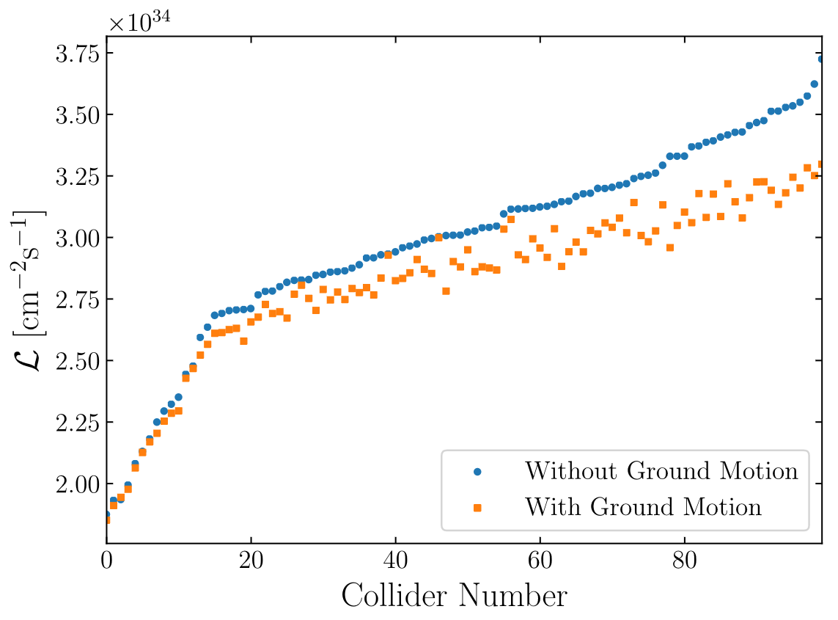
Reminder: Improved Luminosity
Could increase luminosity at 380 by 50%
Old target: L=1.5x10³⁴ cm⁻²s⁻¹
Achieved in perfect machine: L=4.3x10³⁴ cm⁻²s⁻¹
Average with static imperfections: L=3x10³⁴ cm⁻²s⁻¹
90% are better than L=2.35x10³⁴ cm⁻²s⁻¹
Average also with ground motion: L=2.8x10³⁴ cm⁻²s⁻¹
90% achieve L>2.3x10³⁴ cm⁻²s⁻¹
Adjust horizontal beam size for each case (differs from Chet’s presentation, but in published paper)
Very small impact of other imperfections
In addition, reduced emittance growth in RTML and ML
L=2.25x10³⁴ cm⁻²s⁻¹ is realistic
Documented for Snowmass, Explained in chapter 2
C. Gohil, P.N. Burrows, N. Blaskovic, A. Latina, J. Ogren, D. Schulte

Slide 12
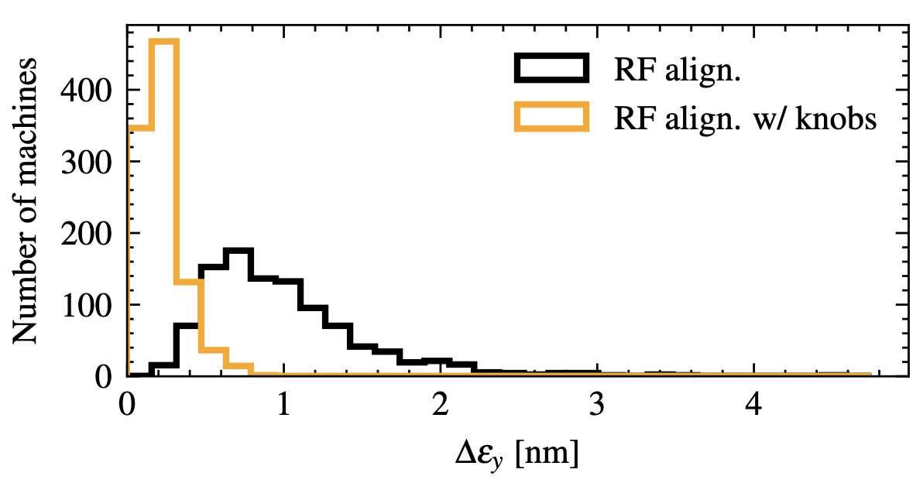
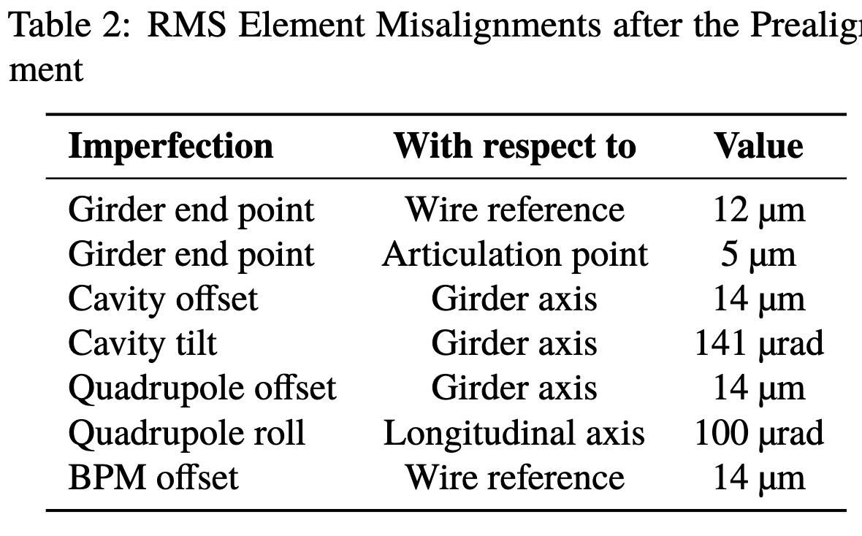
Main Linac Emittance Growth
Pastushenko, D. Schulte
Chapter 3
Use of tuning knobs in main linac reduces emittance growth
Note: full integration unfortunately not yet done

Slide 13
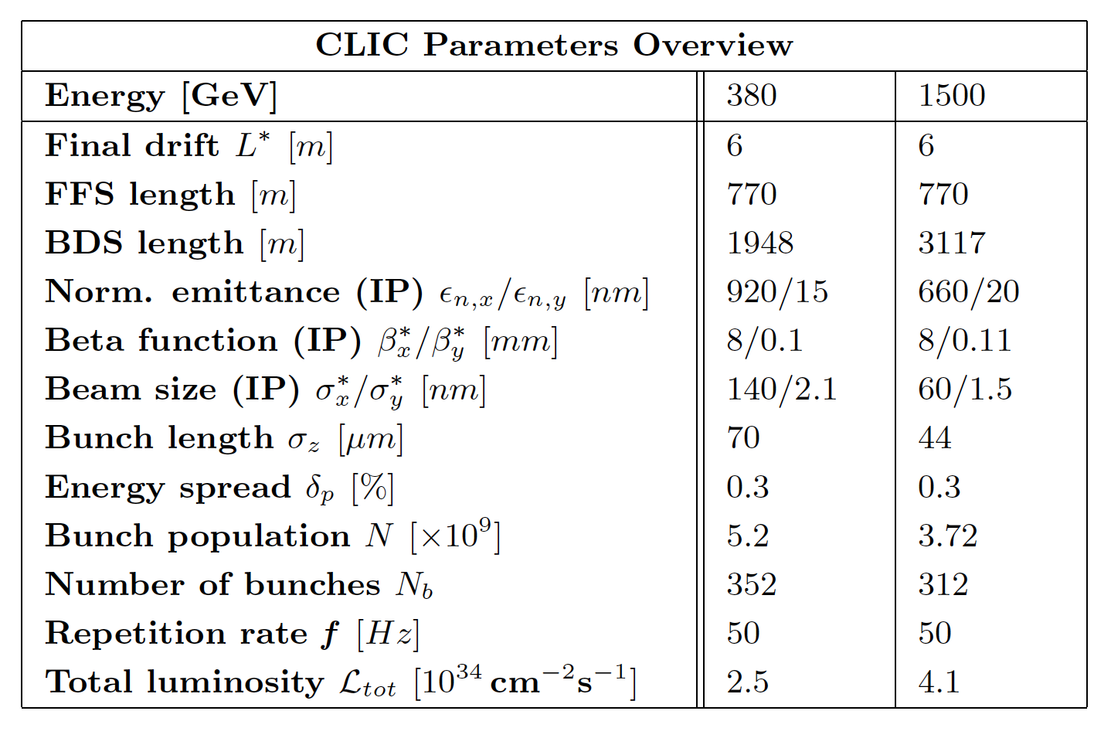
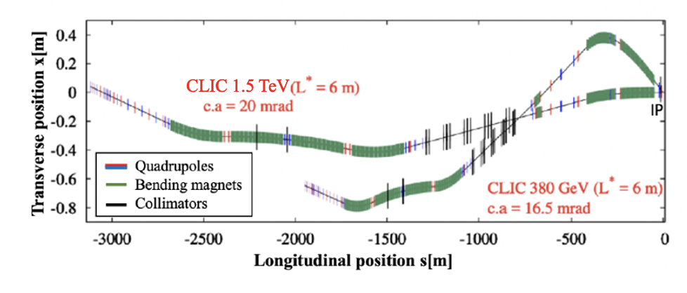
BDS Status: One IR
F. Plassard
Optimization of the 1.5 TeV design is ongoing (L. Kenendy), with a potential reduction in length of 500 to 800 meters.
Using the option with the reduced $β^{∗}$ optics (A. Pastushenko) could improve the performace by 2%.
Further optimization of the 380 GeV design length may still be possible in the future.

Slide 14
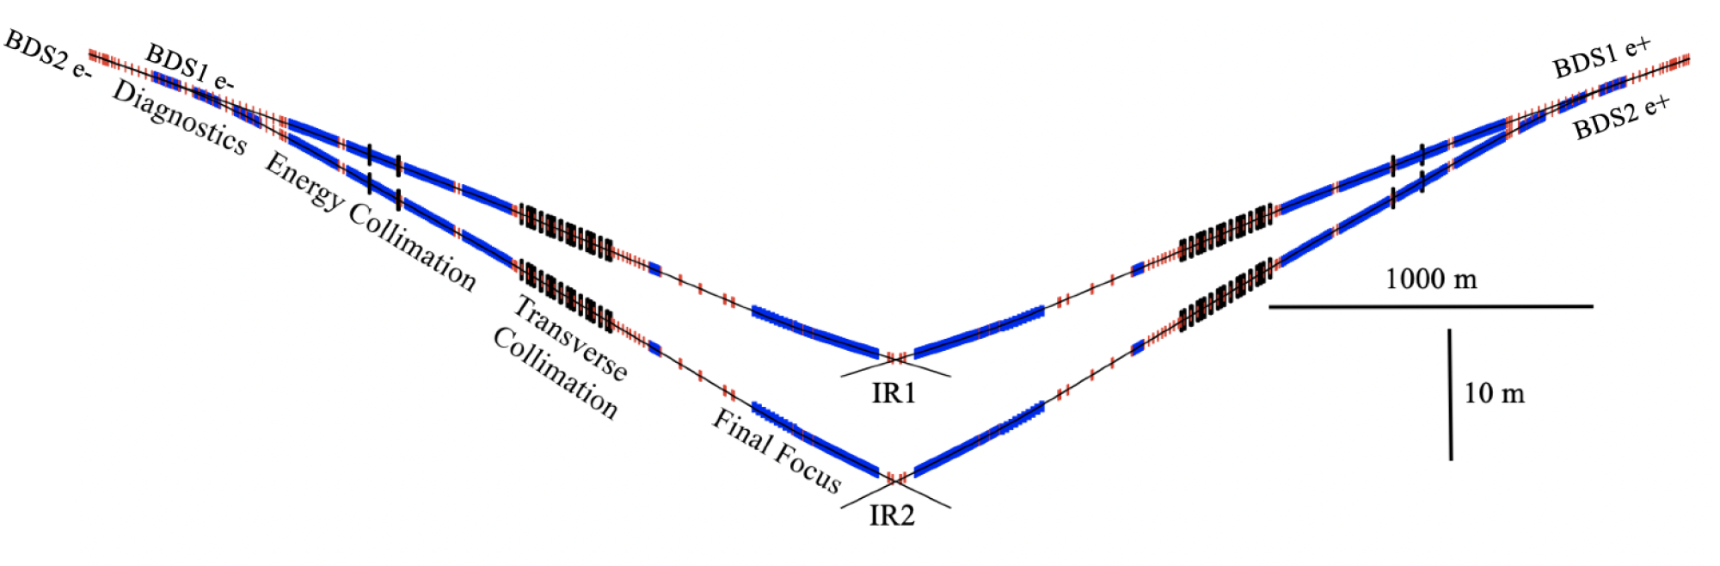
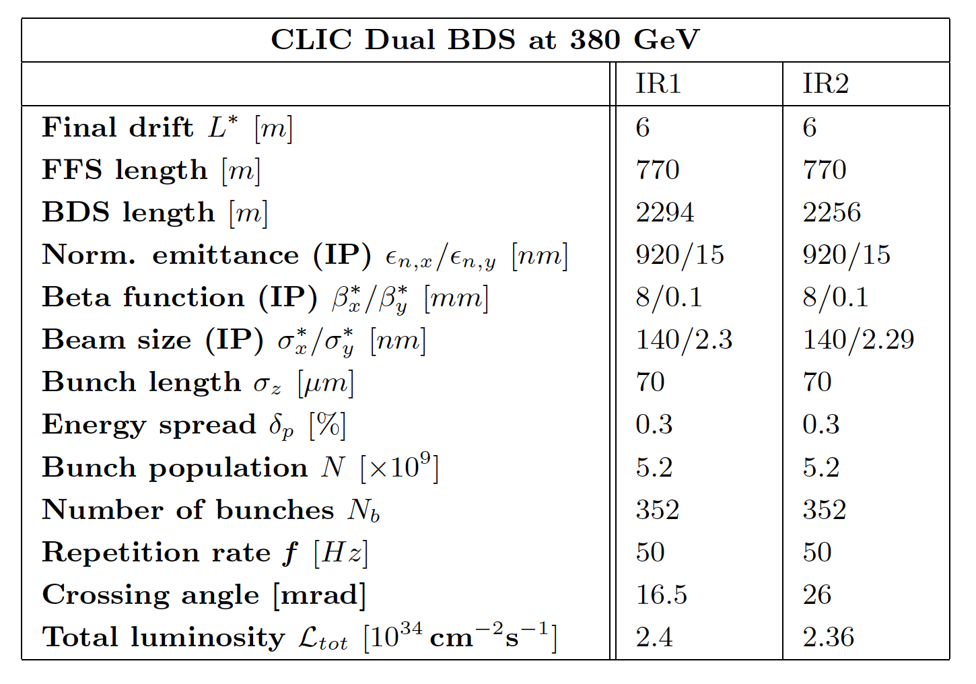
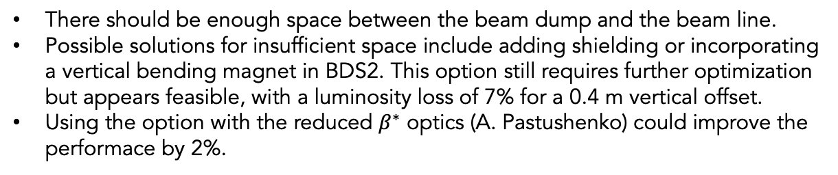
Two IR Design
Vera Cilento
There should be enough space between the beam dump and the beam line.
Possible solutions for insufficient space include adding shielding or incorporating a vertical bending magnet in BDS2. This option still requires further optimization but appears feasible, with a luminosity loss of 7% for a 0.4 m vertical offset.
Using the option with the reduced $β^{∗}$ optics (A. Pastushenko) could improve the performace by 2%.

Slide 15
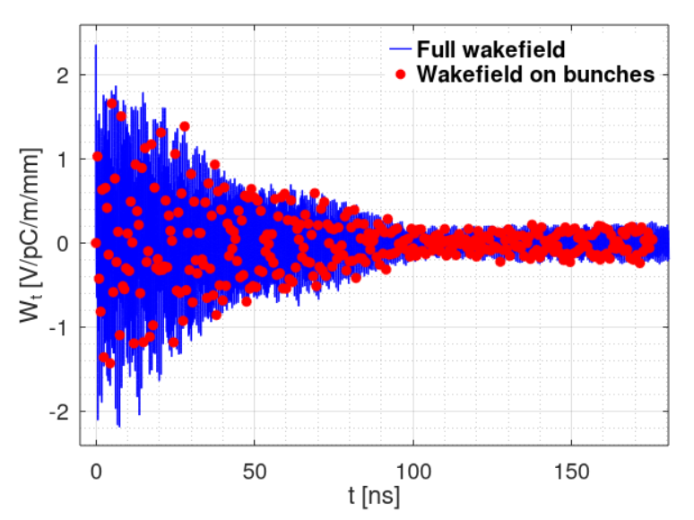
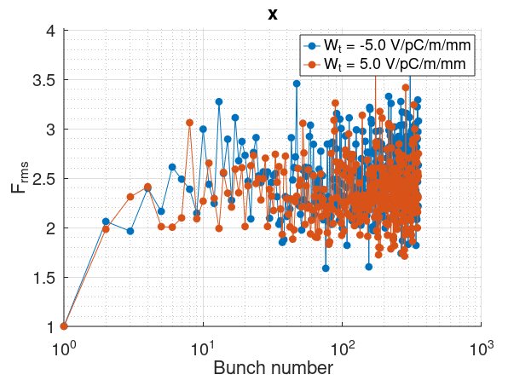
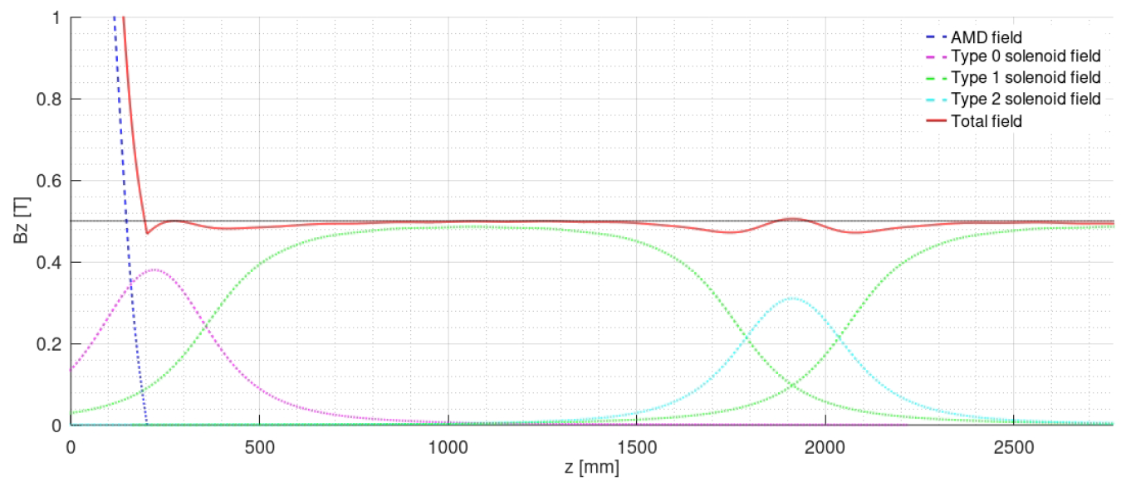
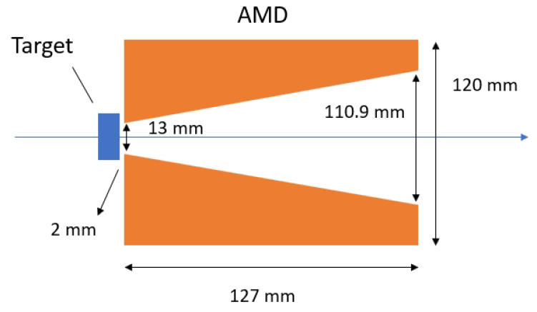
Main Beam Injectors
Y. Zhao, A. Kurtulus, A. Latina, A. Grudiev, S. Doebert
Positron source:
Start-to-end optimisation of the positron source
Electron driver energy reduced from 5 GeV to 2.3 GeV
Final positron yield: ~1.8 (380 GeV) – 2.4 (3 TeV)
Rings to Main Linac:
Bunch Compressor 2: X-band RF power consumption reduced by 50%
Booster: new RF design of the L-band structure optimised for multi-bunch operation
Beam-Based Alignment performance: improved for robustness
  Allows for tighter emittance budgets
Robust multi-bunch beam dynamics studies in collaboration with RF experts
Positron target region and optimised capture device (prototyped)
EDM
3D printed
Schematic layout
Realistic simulation fields of different components

Slide 16
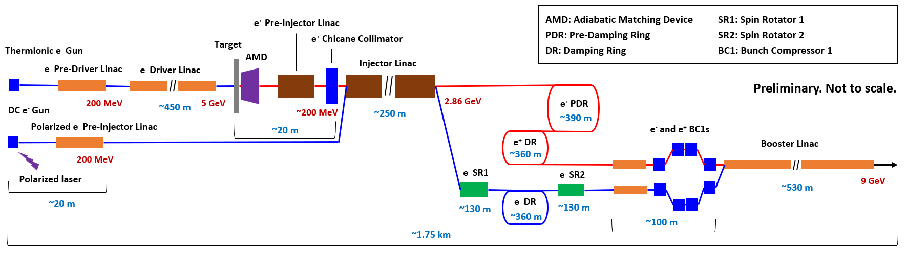
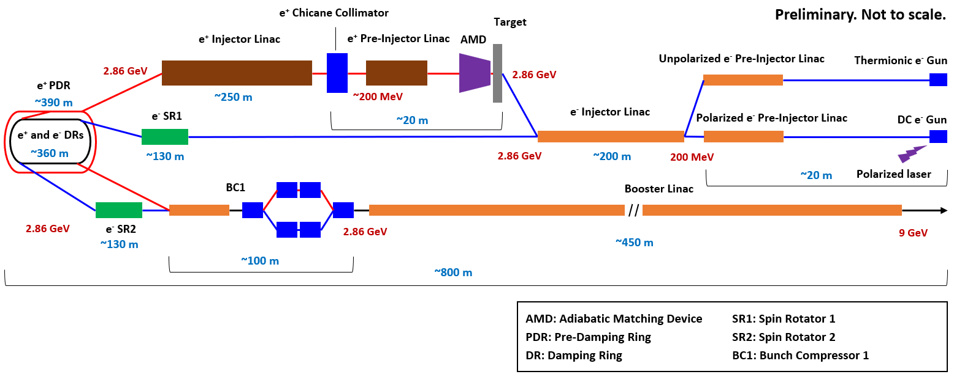
Proposal for a new Optimised Layout
Old (baseline)
New (alternative)
Y. Zhao, A. Kurtulus, A. Latina, A. Grudiev, S. Doebert

Slide 17
Operational Scenarios
Operate 10 years at each energy
Ramp-up as before
First stage first three years with 10%, 30%, 60%
Following stages ramp-up as 25% 75%
As before 1.2x10⁷ s luminosity per year
This yields:
380 GeV at 2.25x10³⁴ cm⁻²s⁻¹ yields 2.2 ab⁻¹
380 GeV at 4.5x10³⁴ cm⁻²s⁻¹ yields 4.3 ab⁻¹
250 GeV at 1.5x10³⁴ cm⁻²s⁻¹ yields 1.4 ab⁻¹
250 GeV at 3.0x10³⁴ cm⁻²s⁻¹ yields 2.8 ab⁻¹
1.5 TeV at 3.7x10³⁴ cm⁻²s⁻¹ yields 4 ab⁻¹
Ph. Lebrun, L. Linssen, D. Schulte, S. Stapnes, E: Adli et al.
Chapter 2
Distribution of beam on both experiments to be defined

