Slide 1



Electroweak and Higgs Physics CTEQ Summer School 2025
Matthew Herndon, University of Wisconsin - Madison
2025-06-21,22

Slide 2
In this talk: EW + Higgs
Measurement of SM Properties
  Introduction, Predictions, and experiments to measure the SM
Precision EW measurement
  W and Z cross sections
  Parameters: sin²θ^{l}_{eff} , m_{W}
  Digressions: Jets and “QCD analysis”
Multiboson physics
  di and tri-boson, VBS, polarization, TGC, QGC
Higgs physics
  Cross sections, decays
  Rare production and decay processes
Summary
ATLAS summary plots
CMS summary plots

Slide 3
Measurement of SM Properties
  Nearly every diagram you find like this is wrong!
  In this case the ZγWW vertex not represented
and other introductory material

Slide 4
The Standard Model of Particle Physics
Exploring the fundamental theory that explains 3 (of 4) of the forces of nature.
This talk will focus on selected measurements EW and Higgs physics performed using high transverse momentum (p_{T}) and/or massive SM particles.
Only covers a tiny fraction of the SM measurements made at the LHC (and elsewhere)
See recent reviews from: ATLAS and CMS

Slide 5
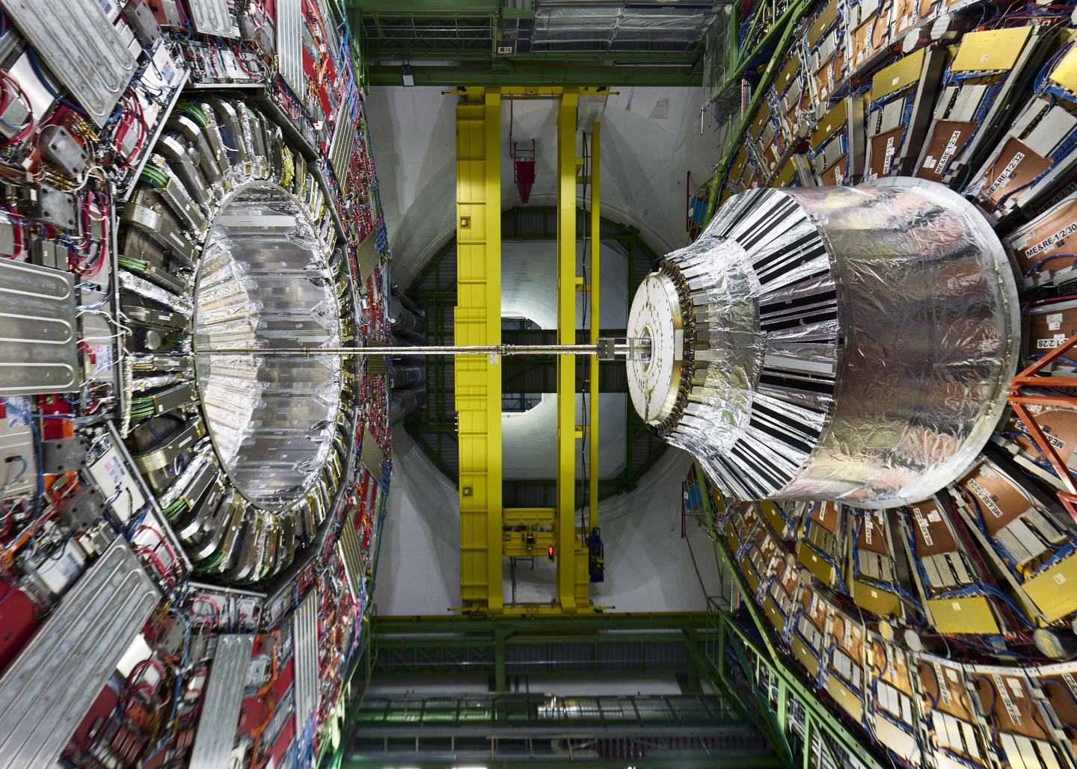
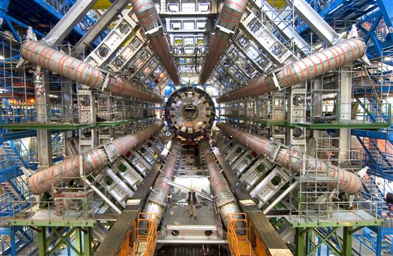
As measured by the ATLAS and CMS Experiments (+one from LHCb)
CMS
ATLAS
Choice of images is biased – I work on muon systems ☺.

Slide 6
Some qualitative remarks on the performance of these detectors
The efficiency, angular coverage, granularity, resolution and identification capabilities of the detectors are good enough that most activity from a collision can often be attributed to individual: electrons, muon, taus, photons, charged hadrons or neutral hadrons.
Electrons and muons
  Identified with low background and near 100% efficiency over large ranges of pseudo-rapidity and momentum
  Often as much as twice the pseudo-rapidity compared to previous collider detectors.
  Enables the precision measurements in single and multi-boson physics and searches for rare processes
Photons
  Identified efficiently with low background
  Enables the precise cross section measurements in modes with photons and searches for rare processes
Jets
  Particle flow jets measure and identify most of the jet constituents
  Near hadron level jets
  Excellent jet energy scale and resolution calibrations
  Corrections between reconstructed and hadron level jets fairly diagonal
  Enables an extensive program of comparison with theory, PDF and α_{S} determinations, and tuning of MC performance
Missing energy resolution is decent with reduced tails
All this in turn enables precision measurements and discovery of rare processes: m_{W}, H → μμ …
The performance of the previous generations of detectors were nothing like this!
and the accelerator and theory communities have accomplished equivalent improvements!

Slide 7
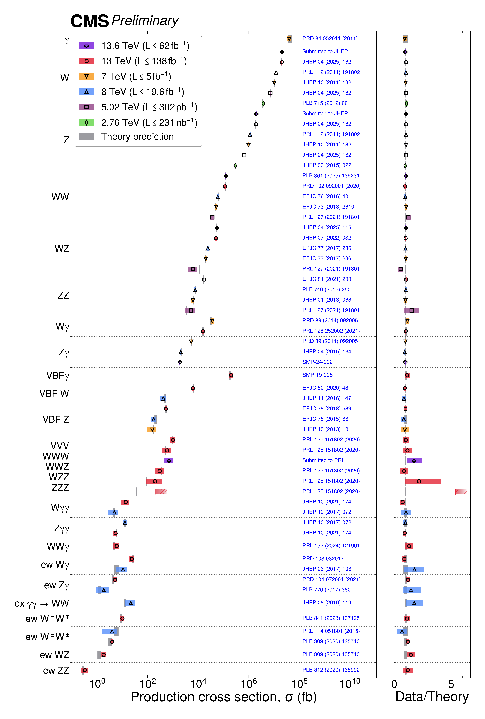
Predictions - Measurements
Scientific exploration
  build an experiment → take data → formulate a theory
  theory → make predictions
  build a new experiment → test the predictions
The theory is not really that useful if it’s not predictive!
The Standard Model is one of the ultimate predictive theories
We need a strong understanding of the SM and calculations within the SM:
  What is interesting to measure
  How precisely can we predict measurables
  How precisely can/should we measure them
  How to build our detector
Theory/Experiment - pushing each other to higher precision

Slide 8
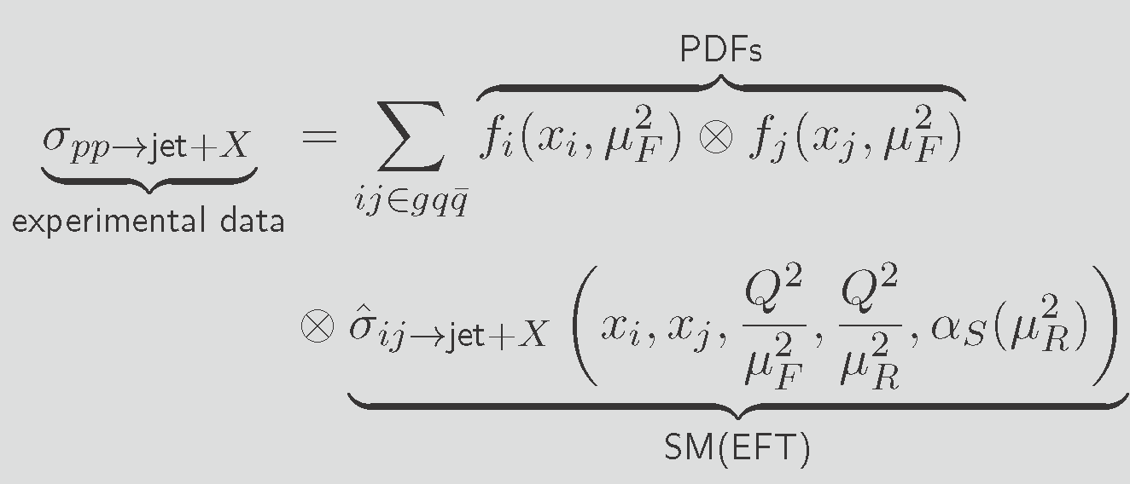
Elements of a SM Prediction: the cross section
The basic measurable prediction of the SM at a collider is a production cross section
Hadron collider: colliding partons: quarks and gluons
  QCD interactions are ubiquitous
  QCD factorization allows us to separate perturbative and non/semi- perturbative physics and make prediction –
  introduces factorization scale
Perturbative calculation hard collision
  Evaluation of Feynman diagrams – in orders of α_{s}, α
  LO: Almost useless: can be off by factors of 3 (gg→H)
  NLO QCD: large increases in cross sections: 10-100%
    New initial/final states (involving jets), loop diagrams
    Renormalization necessary - renormalization scale
    Minimum necessary for reasonable accuracy
  NNLO QCD: increases in cross section: 5%-50%
    Generally, achieves several percent accuracy
    Increase in high energy tails of distributions: 10s%
    Necessary for many analyses
  NLO EW: increase (or decrease) the high energy tails of distributions: 10s%
  Can also incorporating a logarithmic resummation calculation - helps low p_{T} or p_{T} thresholds of objects, systems
  Precision measurements may need higher order calculations: N3LO, N4LO
SM calculation of the inclusive jet cross section

Slide 9
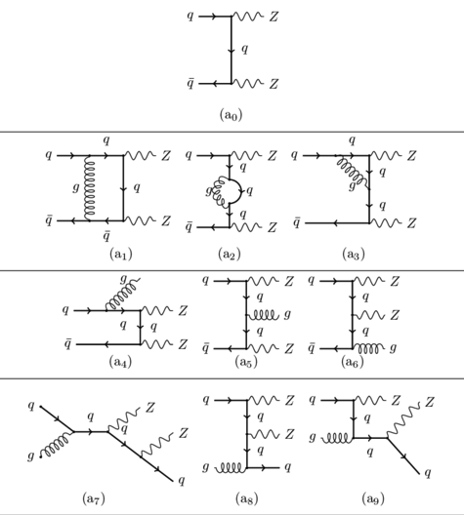
Example ZZ cross section predictions
LO QDC
Excellent data-set for cross section measurements
  Easily triggered in leptonic decays: Z→l⁺l⁻
  Almost background free in four electron or muon final state
  At LHC luminosities a precision cross section measurement is possible
  NNLO Cross section prediction necessary
    Both NLO and NNLO introduce new initial states adding to the cross section
    NNLO necessary for percent level cross section prediction.
  Due to new initial states the QCD perturbative series is almost never converged before NNLO
Interference between loop and LO diagram is an NLO contribution
Real emission. Negative contribution from loop diagram cancels infrared divergence in this NLO diagram
New NLO initial states add to cross section
New NNLO initial states add to cross section
  Alternatively, you can capture much (but not all) of the increase in cross section by generating the real emission and new initial state diagrams separately. V or VV +njets

Slide 10
Elements of a SM Prediction: the cross section
Non/semi-perturbative physics
Colliding partons
  Proton distribution functions, PDFs, structure of the proton
  Non-perturbative at lowest energies
  Evolved up to the perturbative collision scale, factorization scale, μ_{F}
QCD NXLO → Jets
  Fragmentation functions and partons showers (PS)
  Hadronization
  Introduces a matching scale, jets produced in the hard
    collision vs PS jets
Proton remnants
  Underlying events (UE)
  Multiparton interactions (MPI)
  PS, UE, MPI treated with tunes and/or transverse momentum dependent TMD-PDFs
These issues must be corrected for when measuring a cross section and represent important ancillary measurements. For precision measurements they can be limiting factors.
SM calculation of the inclusive jet cross section

Slide 11
Proceeding down the stairway to discovery!

Slide 12
QCD Measurements
CMS xs review
A digression into QCD
demonstrating that even the most basic measurements at a hadron collider needs NNLO predictions to correctly model the data.

Slide 13
Inclusive Jet Cross Section - CMS
JHEP 02 142, JHEP 12 035 (2022)
Prediction: NNLO QCD with NLO EW corrections
  Corrected for NP (non perturbative) effects to particle level jets
  NP corrections based on several MCs and tunes
Data: Unfolded to particle level using full detector simulation
Unfolding Matrix: Reconstructed to hadron level gen jets
Excellent agreement seen with NNLO QCD + NLO EW prediction

Slide 14
Inclusive Jet Cross Section, NLO vs NNLO
Predictions:
NNLO QCD with NLO EW corrections
NLO+NLL QCD with NLO EW corrections
NLO, even with NLL, is not enough to achieve agreement with the data
10-20% disagreements unsurprising.
Different predictions from NLO PDFs inconsistent
NNLO calculations necessary to demonstrate consistency with SM at the precision of the LHC data for many (most) analyses.

Slide 15
W and Z cross sections
The hadron collider precision cross section frontier

Slide 16
Precision pp collider cross sections
W and Z cross sections
  Easily triggered pure data samples (W→lν, Z→l⁺l⁻)
  Performance of lepton triggering, reconstruction, and Id calibrated using tag and probe on large data samples.
  Can define both fiducial and total cross-section measurements.
  Dominant uncertainties
    luminosity uncertainty
    Extrapolation from measurement phase space to fiducial region (small) or total cross section (larger)
    Ratios can reduce uncertainties: especially luminosity uncertainty
The SM calculations
  NNLO, NNLO+NNLL, N3L0, even approximate N4LO+N4LL (DYTurbo)
  Logarithmic re-summation of vector boson pT
  Dominant uncertainties
    PDF and scale uncertainty
    Especially when phase space limited to fiducial cross-section region
The precision frontier in hadron collider cross-section measurements and predictions
Interesting dichotomy of uncertainties fiducial vs. total/ exp vs. theory cross section measurement comparisons.

Slide 17
W and Z cross sections historical
Context
Takes a few minutes to collect a UA1 sized dataset at the LHC

Slide 18
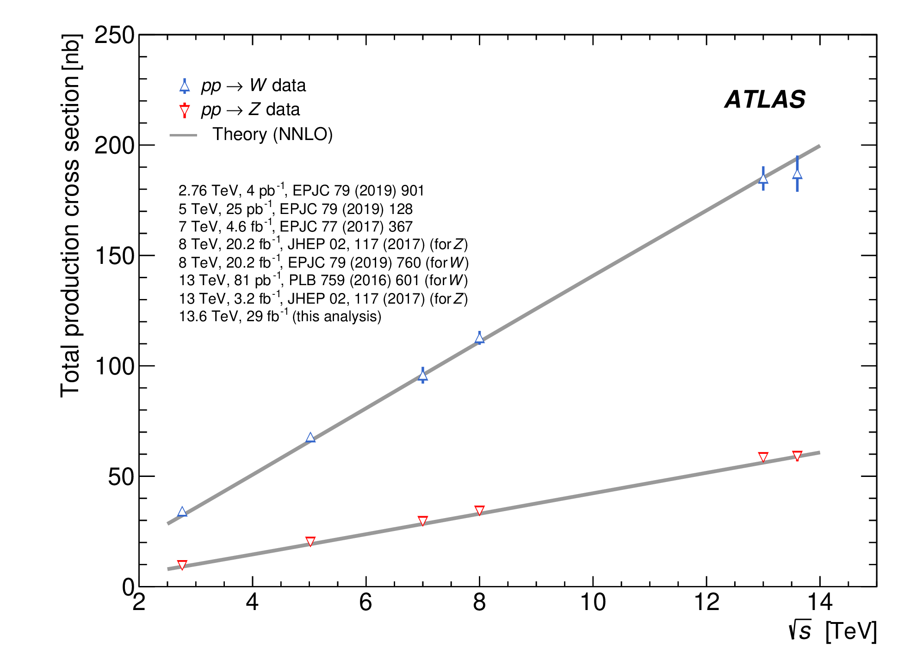
W and Z cross sections – ATLAS, CMS
Inclusive cross section comparison to N3LO QCD with approximate N3L0 PDFs and to NNLO
5,6 energies shown. 13.6 TeV CMS results complete as well (Submitted to JHEP ).

Slide 19
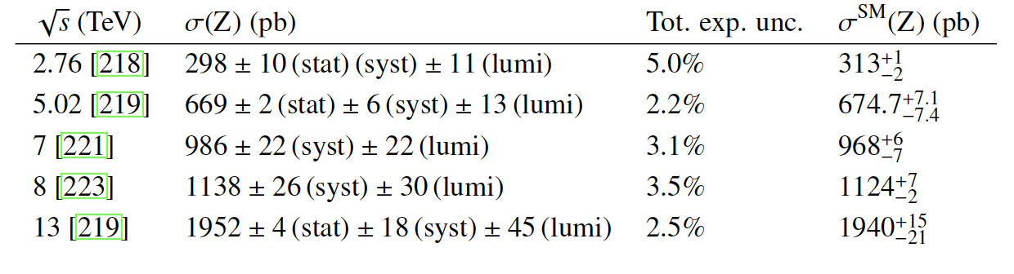
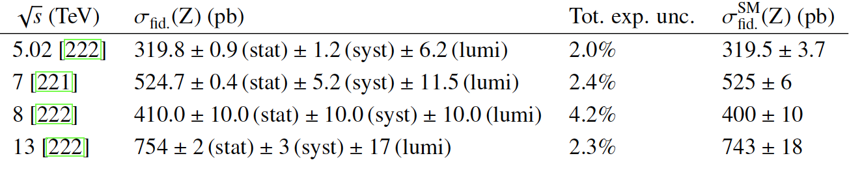

W and Z cross sections - CMS
Experimental results
Additional theory uncertainty to extrapolate to total cross-section substantial
1.5% fiducial Z result at 13.6TeV
Evolving improvements in luminosity calculation
still dominated by luminosity uncertainty
Theory Calculations
Calculations in a limited phase space generally less accurate
Exp.-theory pattern of uncertainties best seen in measurements with the same data set
New ATLAS Run 2 luminosity measurement achieves 0.83% uncertainty. Sub 1% cross section measurements possible!
Inclusive cross sections, N3LO calculation
Fiducial cross sections, NNLO(+NNLL) calculations
13.6. 2021 ± 12 (syst) ± 28(lumi) 1.6% 1994 ± 15
13.6. 764 ± 3 (syst) ± 11(lumi) 1.5% 766 ± 7

Slide 20
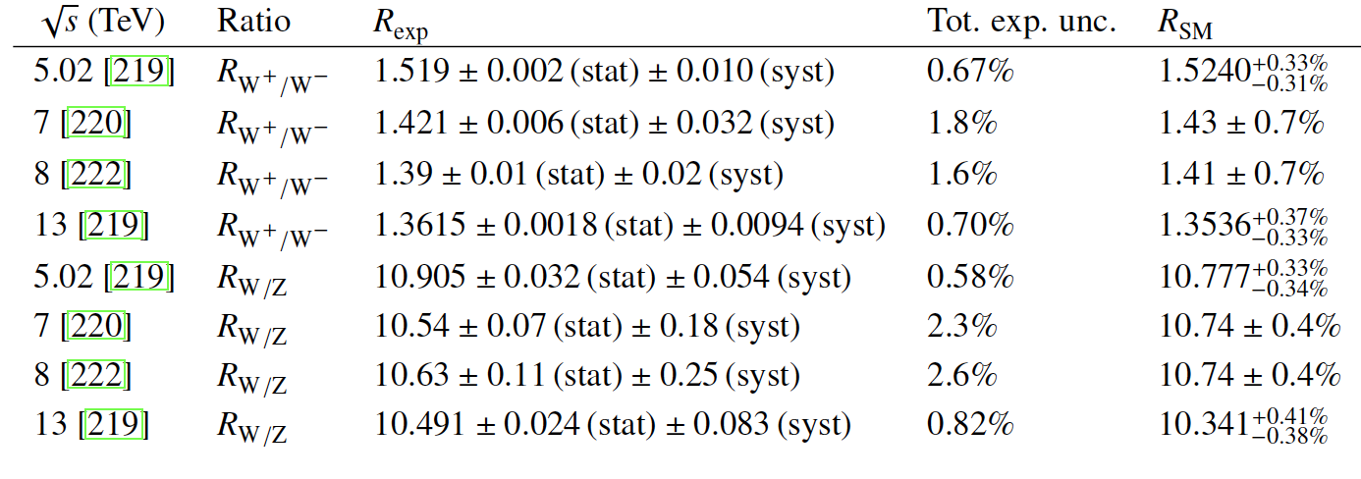
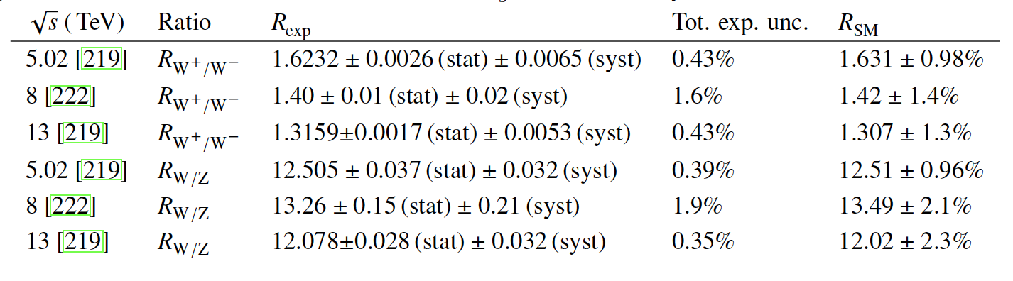
W and Z cross section ratios - CMS
Inclusive cross section ratios, NNLO calculation
Fiducial cross sections ratios, NNLO calculations
Experimental measurements
Luminosity uncertainty cancels out. Other uncertainties reduced.
Theory calculation
Scale uncertainties reduced
Both achieve sub 0.5% uncertainty in best cases!
Not the same best cases.
Fid exp best - Total theory best

Slide 21
Measurements of EW Parameters
m_{W}, sin²θ^{l}_{eff}

Slide 22
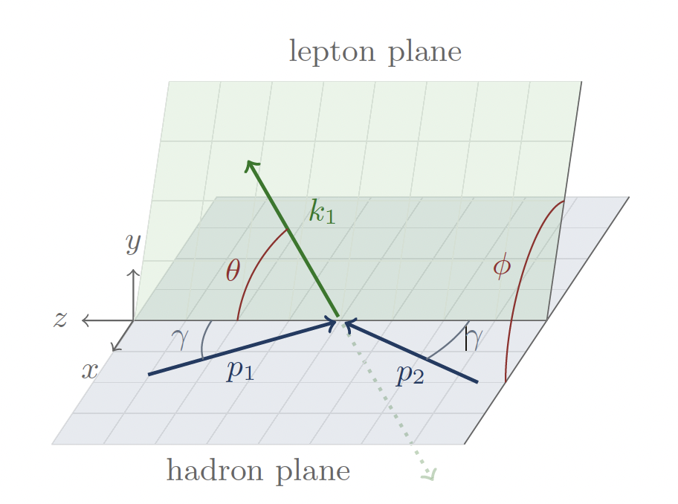
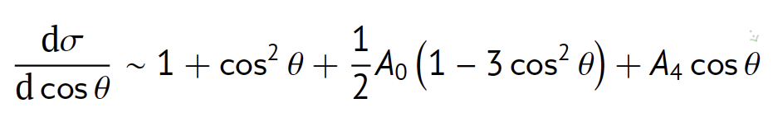
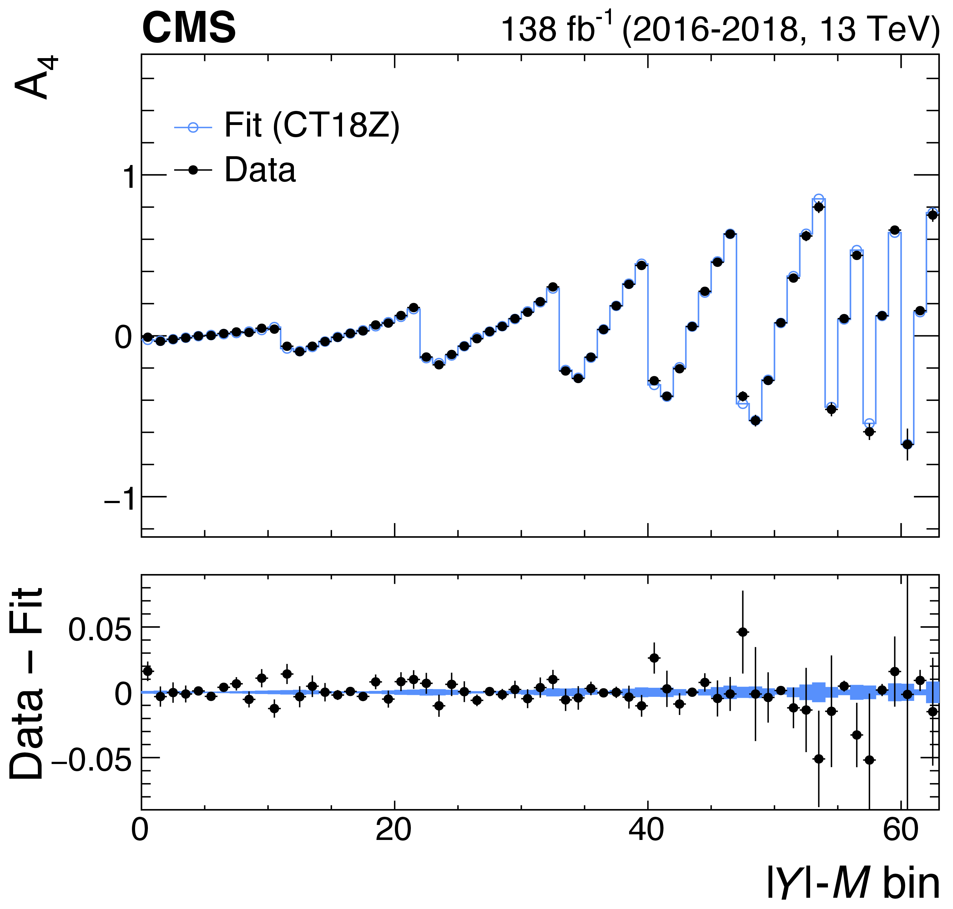
Effective weak mixing angle – CMS, LHCb
Drell Yan, pp→l⁺l⁻ forward backward asymmetry
  A_{FB} used to determine sin²θ^{l}_{eff}
  A_{FB} due to A₄ term which depends on sin²θ^{l}_{eff}
  Quark direction in the hadron plane inferred from the DY pair rapidity
  Events with forward rapidity leptons more useful for determining sin²θ^{l}_{eff}
CMS includes forward HF electrons 3.14 < |η| < 4.36
LHCb muon reconstruction 2.0 < |η| < 4.5
CMS: Phys. Lett. B 866 (2025) 139526
LHCb: JHEP 12 (2024) 026

Slide 23
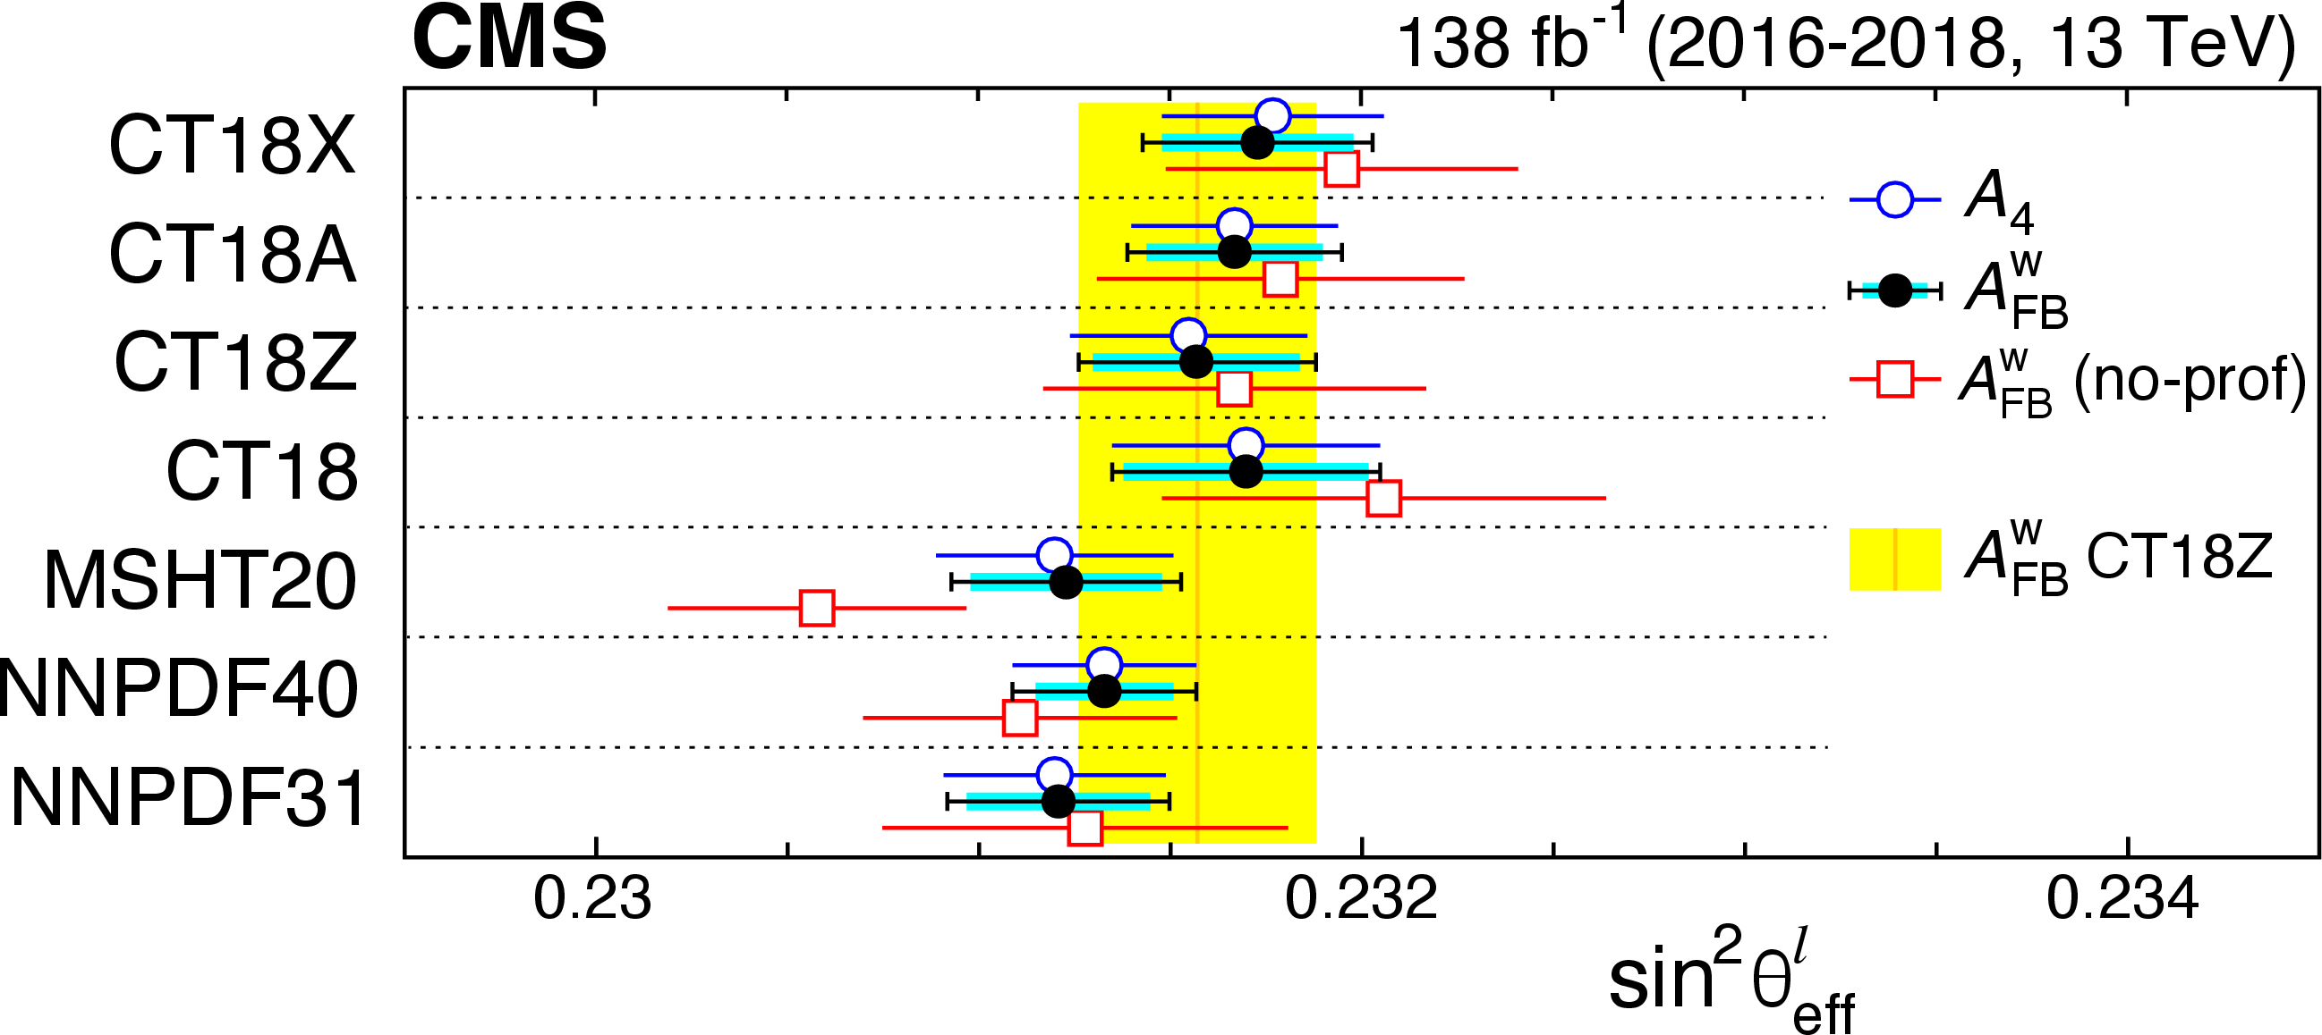
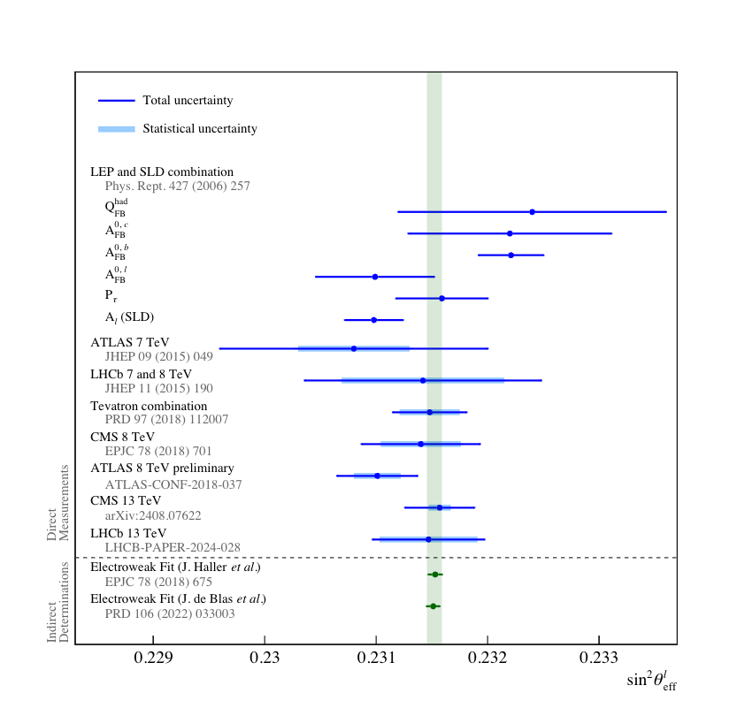
Effective weak mixing angle – CMS, LHCb
Nearing precision of SLD and LEP combination results
Hadron collider results midway between e⁺e⁻ collider results ☺
Difference in results from various global PDF sets
PDF were profiled to reduce uncertianties

Slide 24
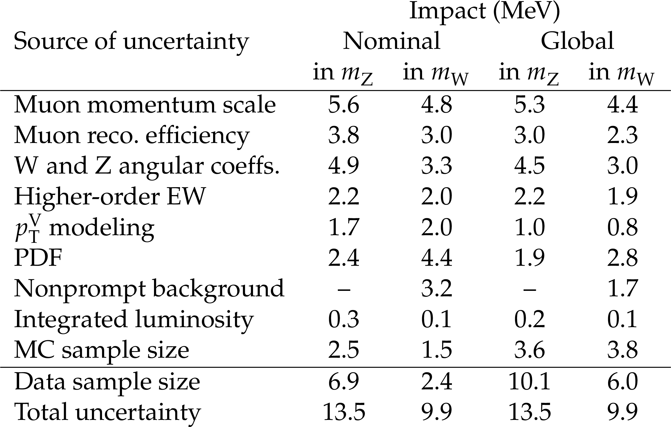
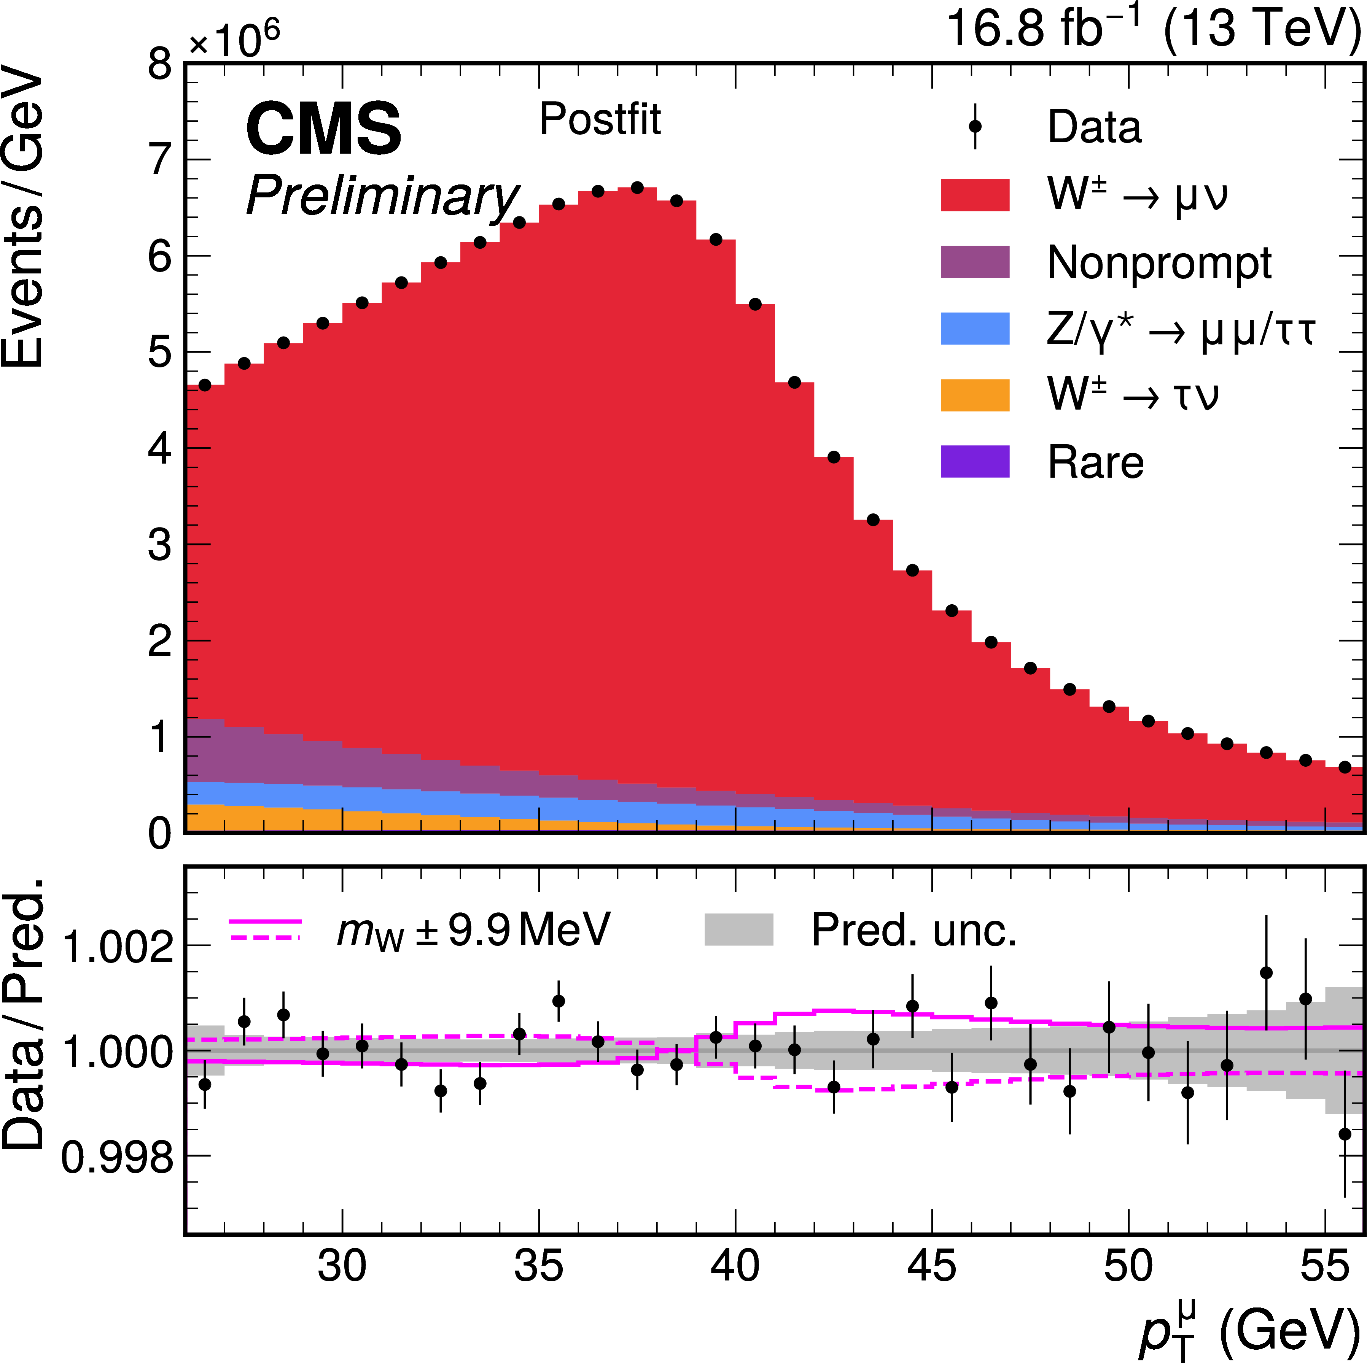

W mass - CMS
Submitted to Nature
  m_{W} extracted using a likelihood fit of p_{T}(μ)
  Excellent theory modeling and strong constraints of uncertainties from the data necessary to understand expected distribution as a function of m_{W}
  Let’s consider the systematics table to understand what has been achieved.
  Momentum scale. Improved tracker alignment, improved detector description, improved track fit, calibration using J/ψ events
  Highly granular reconstruction efficiencies using Z tag and probe
  Theory model including:
    POWHEG NNLO QDC MiNNLO with PS at NNLO accuracy
    N3LL logarithmic re-summation from DYTurbo
    PYTHIA 8 PS, Photos++ photon FSR
    CP5 Tune and further tune of intrinsic k_{T} parameters
    Full array of NNLO PDFs, Constraint of PDFs from data
    Implemented in SCETLib preserving NNLO+N3LL accuracy with matching to PS and control of all relevant uncertainties including non-perturbative model uncertainties for both Z and W cases.
  Uncertainties constrained in the likelihood fit allowing substantial reduction of PDF and other uncertainties.
Sub 10 MeV uncertainty! 0.01%
m_{W} = 80360.2 $±$ 9.9 MeV!!

Slide 25
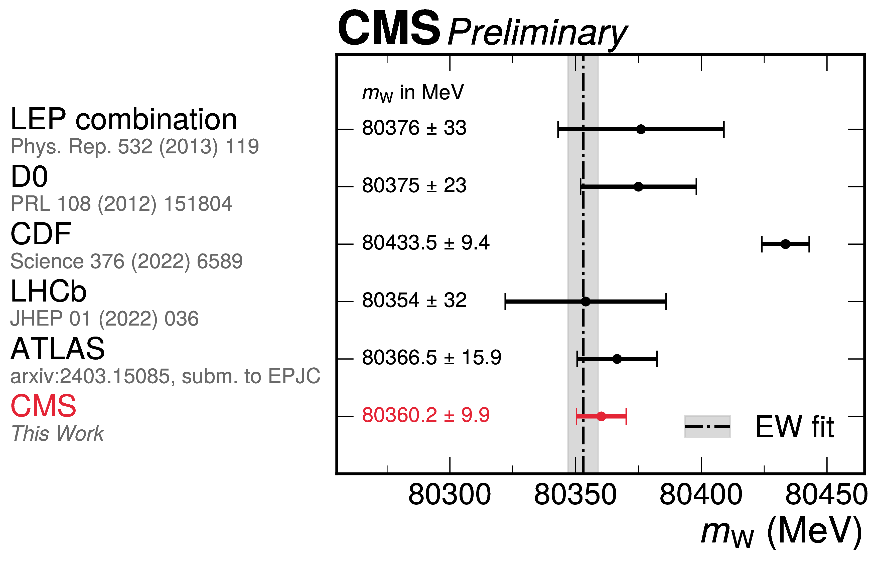
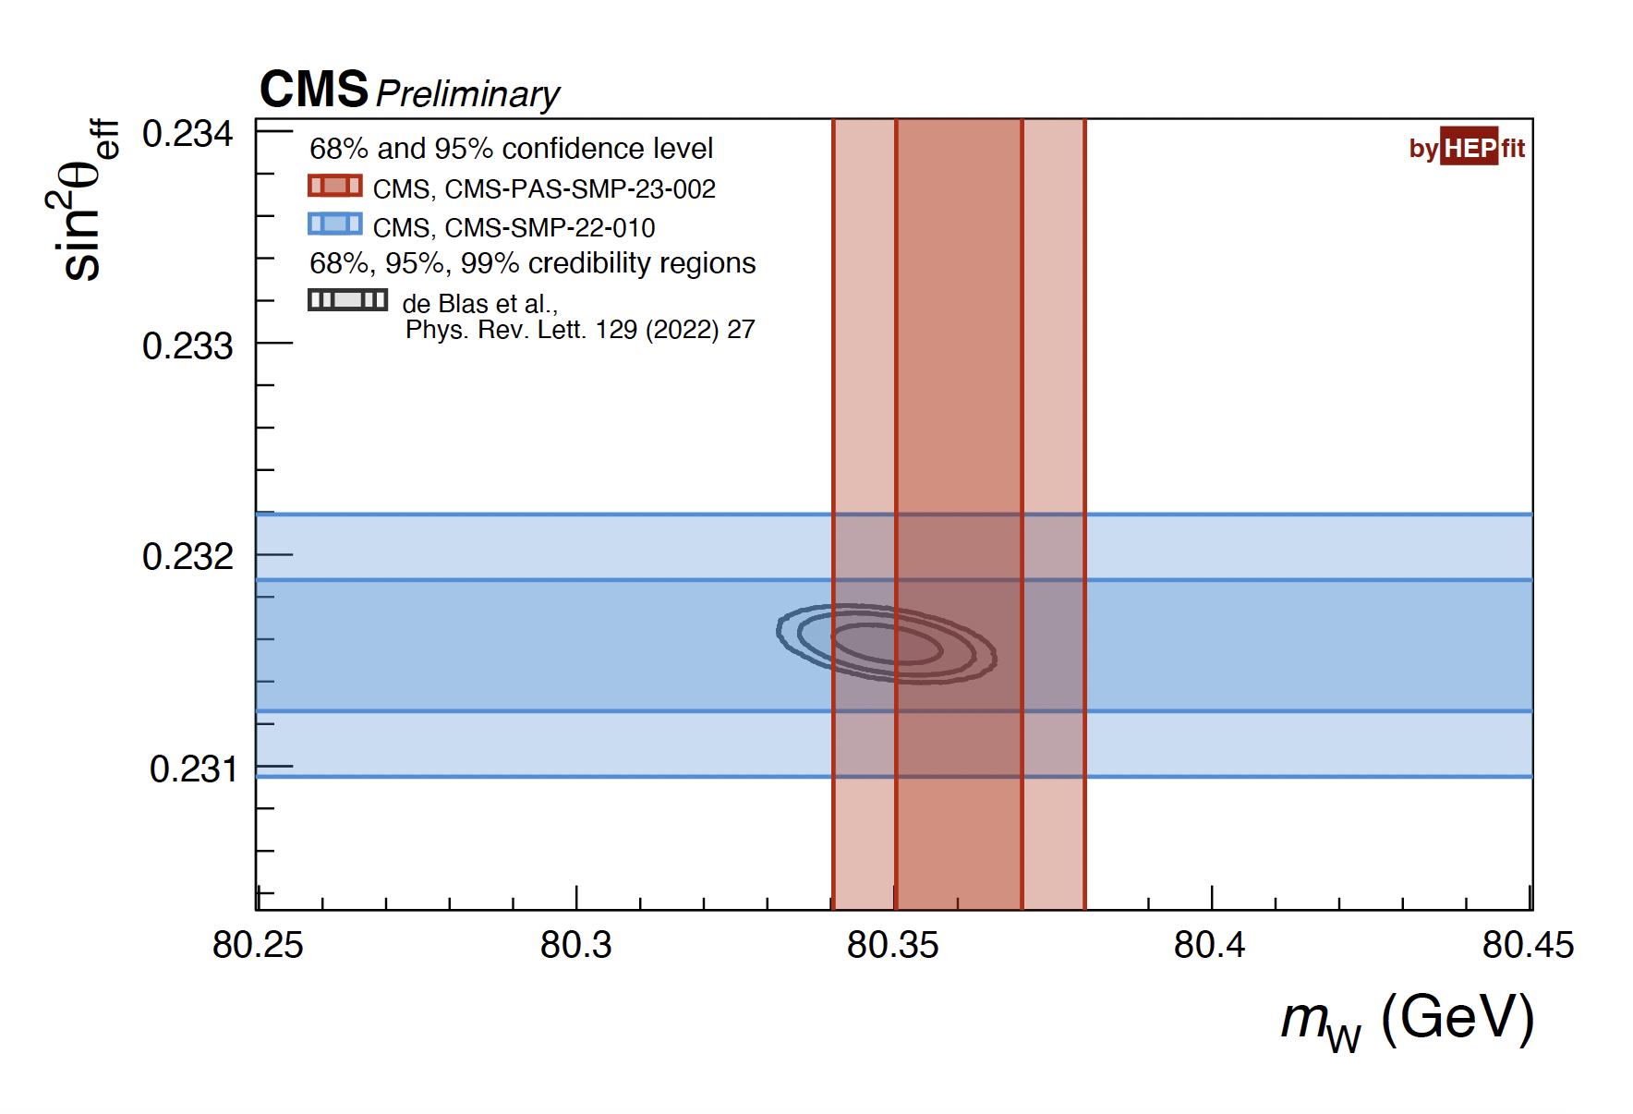
W mass
Sub 10 MeV uncertainty achieved!
Can we do better?
Global uncertainty fit indicates largest uncertainty is statistical in nature
Simultaneous QCD analysis of PDFs and m_{W}? Include multi differential W and Z kinematics and other analysis (W+c…) that could constrain PDFs. Also improves angular coefficients
10x MC statistics. Momentum scale including + vs - diff. Cosmic track-based alignment?
Low Pile up run? Better reconstruction effs. Backgrounds. Use hadronic recoil in m_{T}(W) analysis.

Slide 26
W mass
Sub 10 MeV uncertainty achieved!
Can we do better?
Global uncertainty fit indicates largest uncertainty is statistical in nature
Simultaneous QCD analysis of PDFs and m_{W}? Include multi differential W and Z kinematics and other analysis (W+c…) that could constrain PDFs. Also improves angular coefficients
10x MC statistics. Momentum scale including + vs - diff. Cosmic track-based alignment?
Low Pile up run? Better reconstruction effs. Backgrounds. Use hadronic recoil in m_{T}(W) analysis.

Slide 27
QCD Measurements
CMS xs review
Another digression into QCD
The “QCD analysis”

Slide 28
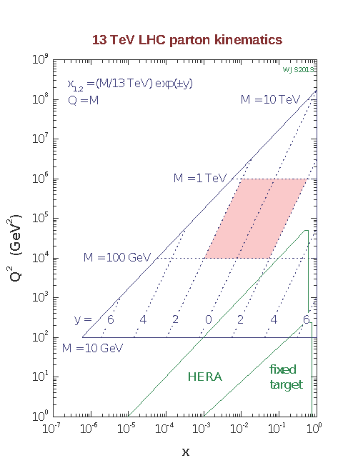
The “QCD Analysis”
Requirements for comparison of SM predictions to LHC data
  NNLO QCD calculations
  NNLO PDF determinations
  NNLO α_{S} determination
PDFs
  LHC probes Q² and x regions of PDFs not accesses by previous accelerators
  Needs HERA data, fix lower Q² and x,
  where the PDF parameterization is typically defined
One solution, to assemble these elements: “QCD Analysis”
  Analysis of LHC QCD Jets data (and often other useful data sets)
  Determination PDFs and α_{S} or other parameter of interest
  Using HERA I, II datasets with LHC Jets data
  fitting framework available as open-source software - xFitter
Plot courtesy of W.J. Sterling

Slide 29
QCD Analysis, PDFs - ATLAS
Combined PDF fit of ATLAS data
  Inclusive Jets → strongly impacts valance quark and gluon distributions
  W, Z/γ∗ → strange and anti-quark, W+Jets, Z+jets → strange and anti-quark
  ttbar → high-x gluon distribution
  Inclusive isolated photon – well fit by data (has often not been the case)
xFitter framework: ATLASpdf21
  NNLO QCD + NLO EW
  Parameterization at initial Q² evolved
    up to relevant scale using DGLAP equations
  Correlations carefully treated
    Luminosity, jet related uncertainties
Significant improvement over HERAPDF (where expected). Equivalent performance to Global PDF fits
Eur. Phys. J. C 82 (2022) 438

Slide 30
QCD Analysis, PDFs and α_{S}
- CMS
Combined PDF and α_{S} fits
  Separate analysis with sensitivity to specific PDFs and/or α_{S}
Most precise α_{S} results from NNLO QCD Analysis of 13 TeV inclusive jet and differential di-Jet data. Uncertainties order ± 0.0018
New inclusive jet measurement, 2.76, 7, 8 and 13 TeV: s = 0.1176 ±
0.0014
0.0016
Phys. Lett. B 868 (2025) 139651
In general, the ultimate measurements of SM parameters that depend on PDFs could benefit from simultaneous QCD Analysis of the PDFs using appropriately chosen datasets for the parameter(s) of interest – m_{W}, sinθ_{Weff} …

Slide 31
Multi-boson Physics
Di-boson
Weak boson polarization, TGCs

Slide 32
Di-boson production cross sections
Di-boson cross sections also near the pp precision frontier
  Same advantages as W and Z physics
    Easily triggered pure data samples (typically at least one Z→l⁺l⁻)
    Performance of lepton triggering, reconstruction, and Id calibrated using large tag and probe on large data samples.
  Good statistics due to large integrated luminosities
  Dominant uncertainties
    luminosity uncertainty
    Extrapolation from measurement phase space to fiducial region (small) or total cross section (larger)
The SM calculations
  NNLO QCD + NLO EW
  Dominant uncertainties
    PDF and scale uncertainty
    Especially when extrapolating to fiducial cross-section
ZZ, Zγ, WW and WZ measurements achieving precision near that of W and Z cross sections

Slide 33
Di-boson production cross sections
Leading precision from ATLAS Zγ, ZZ, WW and CMS WZ measurements
  ZZ: 2.6% precision: 49.3 ± 0.8(stat) ± 0.8(syst) ± 0.8(lumi) (1.3 total) fb
  Zγ: 2.9% precision: 533.7 ± 2.1(stat) ± 12.4(syst) ± 9.1(lumi) fb
  WW (new lumi) 3.1% precision: 707 ± 7(stat) ± 20(syst) ± 6(lumi) fb
  WZ 13.6 TeV: 3.4% precision: 297.6 ± 6.4 (stat) ± 6.4 (syst) ± 4.2 (lumi) ± 1.5 (theo) fb
  Luminosity precision typically the second dominant uncertainty,
  ZZ: 2.2, Zγ: 2.5% achievable with new ATLAS luminosity. (my calculation)
JHEP 03 (2020) 054
JHEP 07 (2021) 005
submitted to JHEP
JHEP 04 (2025) 115
WZ: already competitive measurements at 13.6 TeV
ATLAS should recalculate their Run 2 cross sections with updated luminosities! ☺

Slide 34
Di-boson production cross sections
Good precision achieved over a wide array of di-boson final states
Also, now 13.6 TeV WZ and WW results
13.6 TeV ZZ results

Slide 35
Di-boson differential production cross sections
Example CMS: ZZ
Disagreement in high mass tail m4l distribution
Improved by EW corrections
Disagreement in Njet distribution
Improved by nNNLO+PS MC. NNLO MC combined with PS using the MiNNLO method
QCD now extensively investigated in di-boson physics also
JHEP 10 (2024) 209
These disagreements were observed in previous analysis and were improved by advances in theory techniques.
Typical of areas of disagreement, ZZ+3 jets … Multiple heavy particles and jets

Slide 36
Di-boson production, weak boson polarization
Vector boson polarization in di-boson production
  An important step toward using polarization to establish longitudinal vector boson scattering
  Longitudinal polarization state is a basic property of the weak bosons from EW symmetry breaking
  Correlations in polarization can test quantum entanglement
  CMS: Observation of individually longitudinally polarized W and Z bosons in WZ production
  ATLAS: Observation longitudinally polarized boson pairs in WZ and evidence in ZZ production (4.3σ)
JHEP 07 (2022) 032
PLB 843 (2023) 137895
JHEP 12 (2023) 107
Single boson polarization extracted from cos(θ)
θ of the lepton relative to boson flight direction in the boson CM frame
Joint polarization required a multivariate discriminant

Slide 37
Di-boson production, WZ, polarization, RAZ, TGCs
WZ Radiation Amplitude Zero (RAZ)
  LO WZ production occurs via interfering t channel and triple gauge coupling (TGC) vertex s channel diagrams
  In the transverse-transverse polarization state there is an exact RAZ when W boson is scattered at 90º with respect to the incoming antiquark direction in the 𝑊𝑍 rest frame
  This occurs because of an exact cancelation due to interference with the TGC diagram.
  The RAZ is inexact at NLO
  Most easily observed as a dip near zero in ΔY(WZ)
  This represents one of the few ways in di-boson production to directly observe a TGC and thus a predicted effect of the gauge structure of the SM
PRL 133 (2024) 101802
TT signal only – TL, LT, LL subtracted as a background, pT(WZ) < 20 GeV (more LO like)
Approximate RAZ clearly observed!

Slide 38
Multi-boson Physics
Tri-boson

Slide 39
Tri-boson production
Tri-boson production many states only accessible at LHC
  Most interesting and most difficult to observe states, are VVVs. Three weak bosons
  Collectively observed by the CMS experiment. WWW observed at ATLAS.
  Also, evidence for WWZ (ATLAS) WWW, WWZ 13.6 Tev (CMS).
  Extensive analyses pursing all accessible leptonic and hadronic decay modes
PRL 125, 151802 (2020)
PRL 129 (2022) 061803
Evidence for WWZ at 13.6 TeV CMS.
Submited to PRL

Slide 40
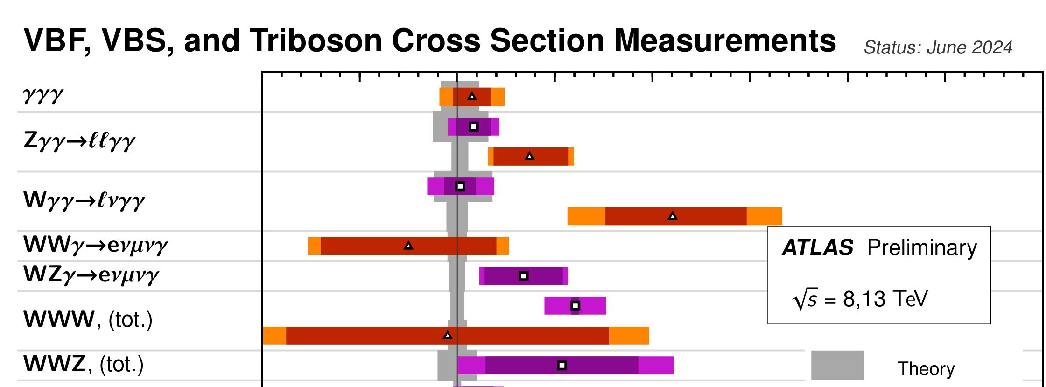
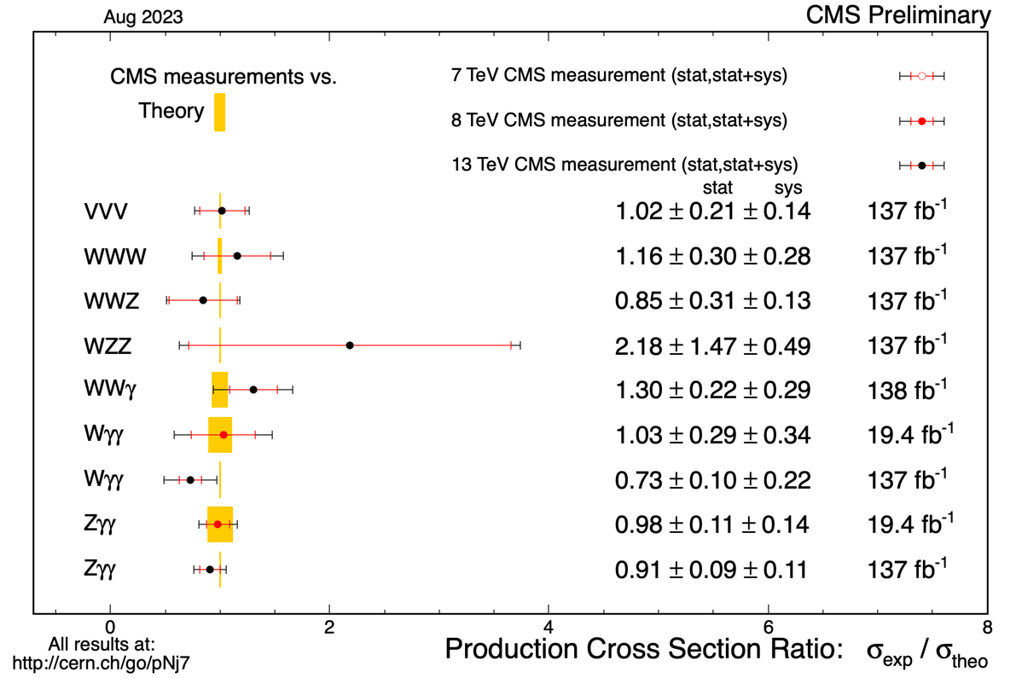
Tri-boson production
One state with two weak bosons and all but one state with three yet to be observed. All states with multiple photons seen
  CMS WWγ: 6.0 ± 0.8 (stat) ± 0.7 (syst) ± 0.6 (modeling) fb, 5.6σ
  ATLAS WZγ: 2.01 ± 0.30(stat) ± 0.16(stat) fb, 6.3σ
PRL 132 (2024) 121901
PRL 132 (2024) 021802

Slide 41
Multi-boson Physics
Vector boson Scattering
Weak boson polarization, QGCs

Slide 42
Vector boson scattering
Vector boson scattering (VBS) physics currently unique to the LHC
  Cross sections as small as fb or a fraction of a fb require LHC luminosities to produce observable signals
  VBS diagrams - purely EW interactions.
  Possible to isolate areas of phase space where interference with ”QCD” diagrams is minimal
  Production Diagrams include
    Double TGC in t (and s) channel
    Quartic gauge coupling (QGC) diagrams: possible to directly measure quartic couplings
    Higgs scattering: scattering via the Higgs necessary to unitarize the cross section of longitudinal VBS
    Interfering QCD diagrams
  Final state: forward scattered jets with a large rapidity difference and centrally produces boson pair
First observed CMS W±W± 5.5σ
PRL 120,
081801 (2018)

Slide 43
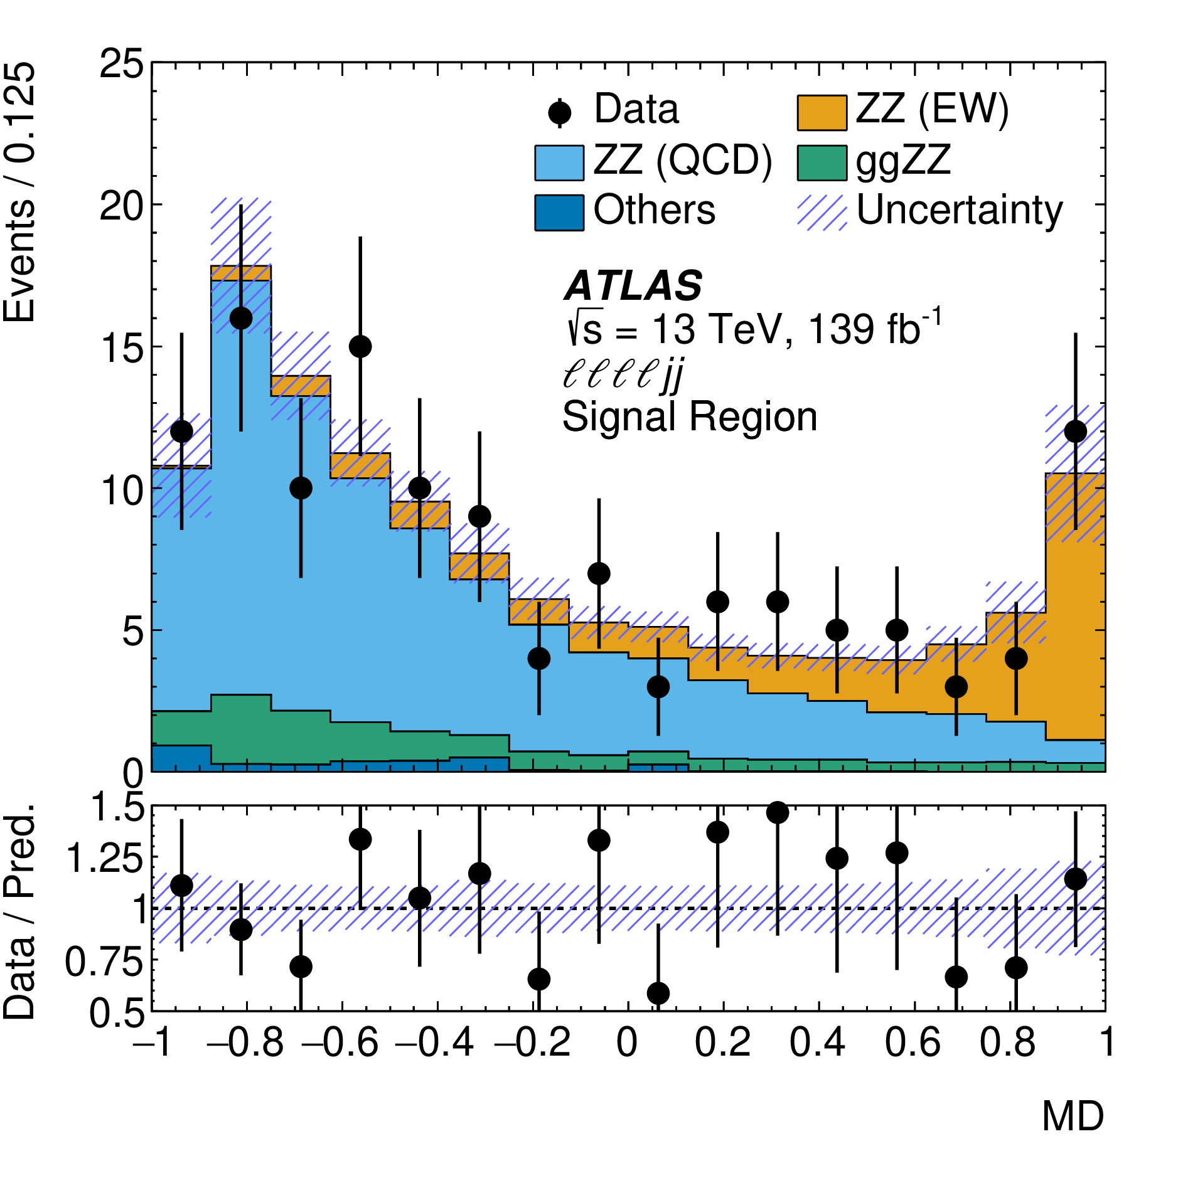
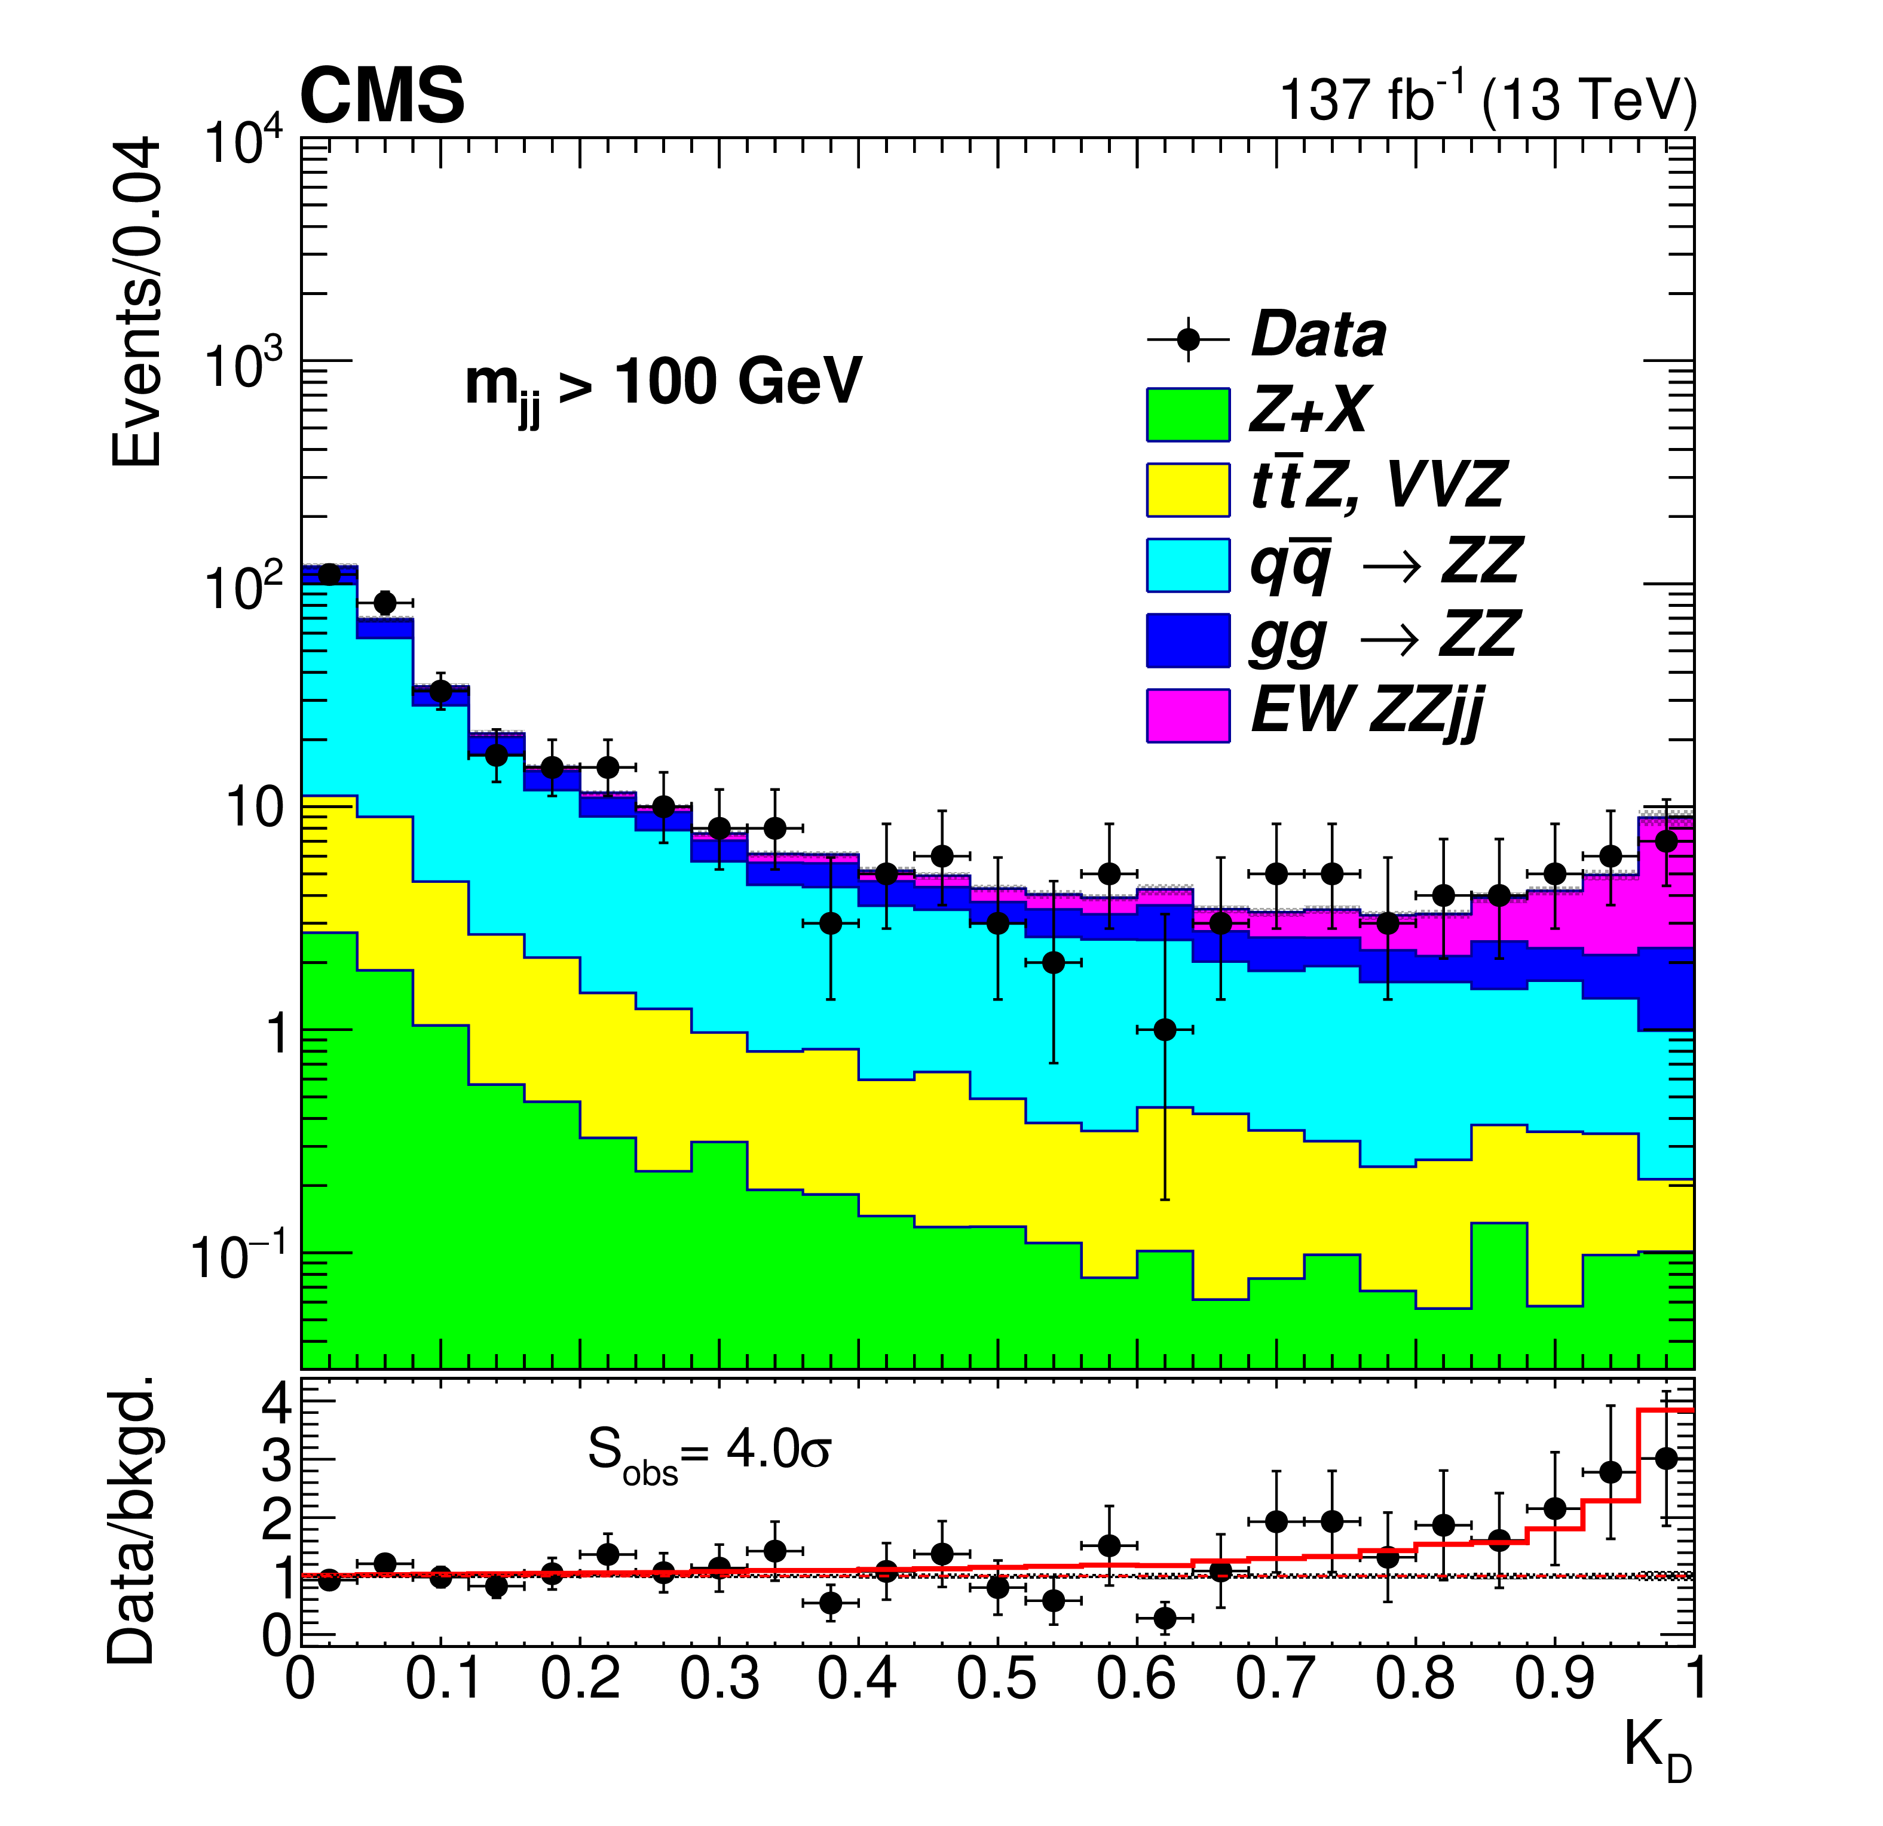
Vector boson scattering – ZZ Atlas, CMS
Some of the smallest cross section measured in the SM
  With fiducial selection, as low as 0.33-1.0 fb
    Not physically meaningful to discuss a total cross section. Interference with “QCD” production of VV + 2jets where the jets result from QCD interactions large in most of the phase space.
    Can Isolate a mostly pure VBS phase space for fiducial measurements
  ZZ: charged leptonic decays
  ATLAS analysis emphasized acceptance while CMS emphasized purity
ATLAS: 1.27 ± 0.14 fb SM 1.26 fb
CMS: 0.33 ± 0.12 fb SM 0.28 fb
Observed ATLAS, 5.6σ
Nature Physics 19, 237-253 (2023)
PLB 812 (2020) 135992

Slide 44
Vector boson scattering
With the full Run 2 data set all VBS final states observed
→ Onward to polarized VBS!

Slide 45
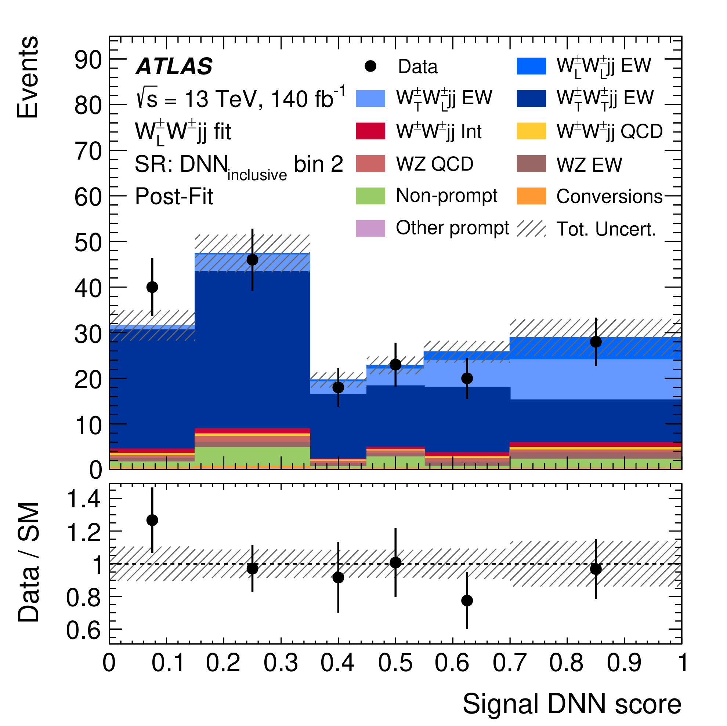
Search for polarized VBS in W±W± - ATLAS, CMS
Searches now starting for longitudinal VBS
  Use W±W±, final state used for first observation
  Distinctive same charge final state
  Smaller background of QCD induced W±W±
  Multivariate discriminant needed to maximize sensitivity
CMS Expected (observed) significance for >=1 longitudinal boson 2.3(3.1)σ
Expected σ_{LLSM} = 0.44 fb
Limit 95% C.L. σ_{LL} < 1.06 fb
CMS PLB 812 (2020) 136018
ATLAS 3.3(4.1)σ
σ(W_{L}W) = 0.88 ± 0.30 fb
Expected σ_{LLSM} = 0.29 fb
Limit 95% C.L. σ_{LL} < 0.45 fb
ATLAS Submitted to PRL

Slide 46
Higgs Production and Decay
Higgs: cross sections

Slide 47
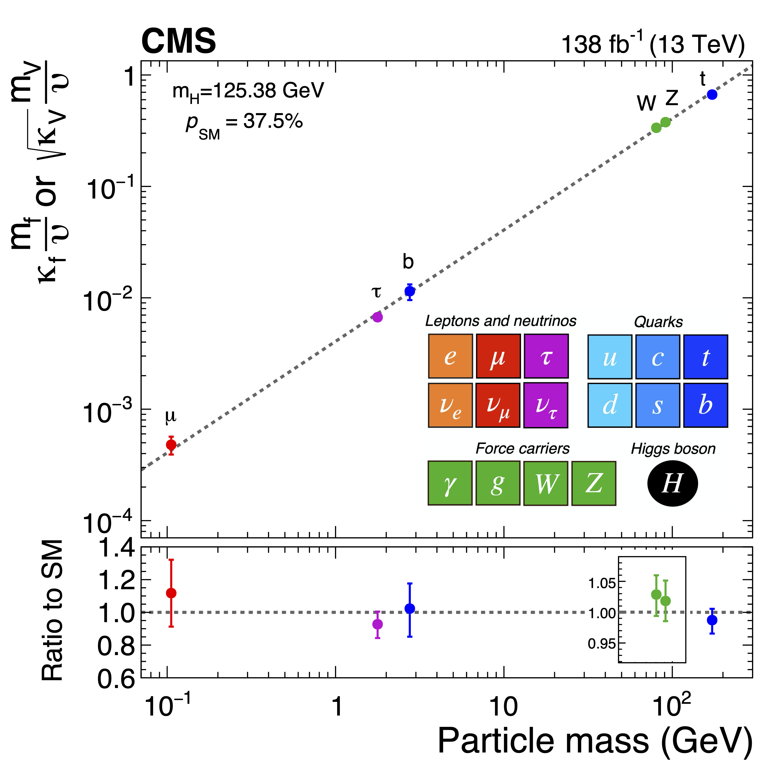
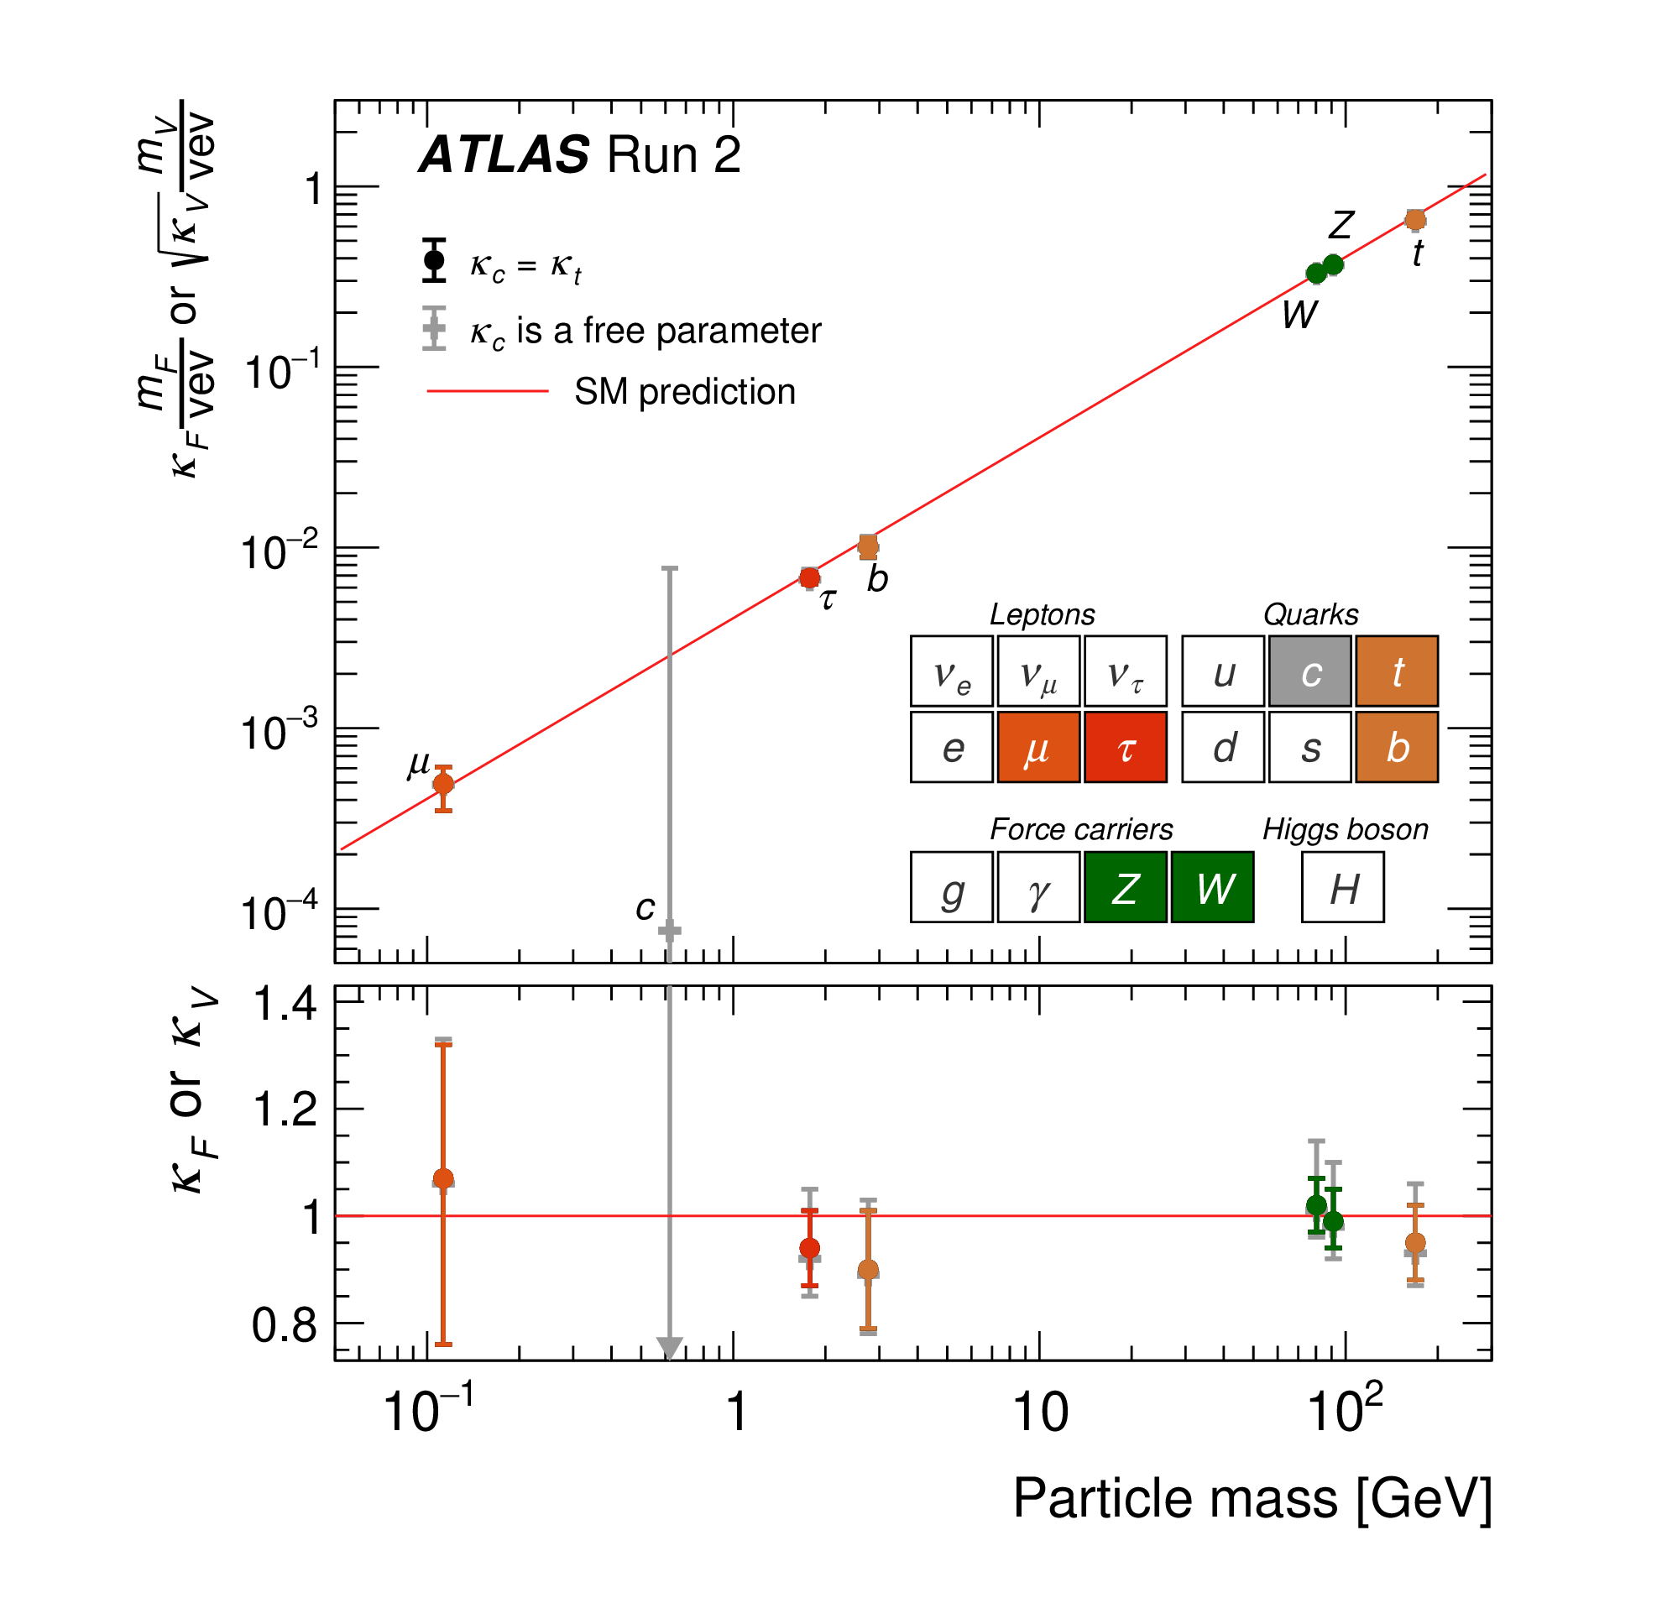
Higgs Production and decay
Many approaches, often trying to achieve a global picture and/or look for deviations.
  Highest level: Higgs boson couples to the Vector Bosons and fermions as expected
  Quantitative data behind the high level
    Total and fiducial cross sections of production processes
    Decay branching fractions
  Next level: More nuanced treatment to examine areas of interest
    Simplified template cross sections (STXS)
    Leverage to look for deviation, new physics, using Effective field theory
  Most detailed level: Fiducial differential cross sections
    Minimize uncertainty introduced by theoretical extrapolations to larger phase spaces
First observed CMS W±W± 5.5σ
Second Generation

Slide 48
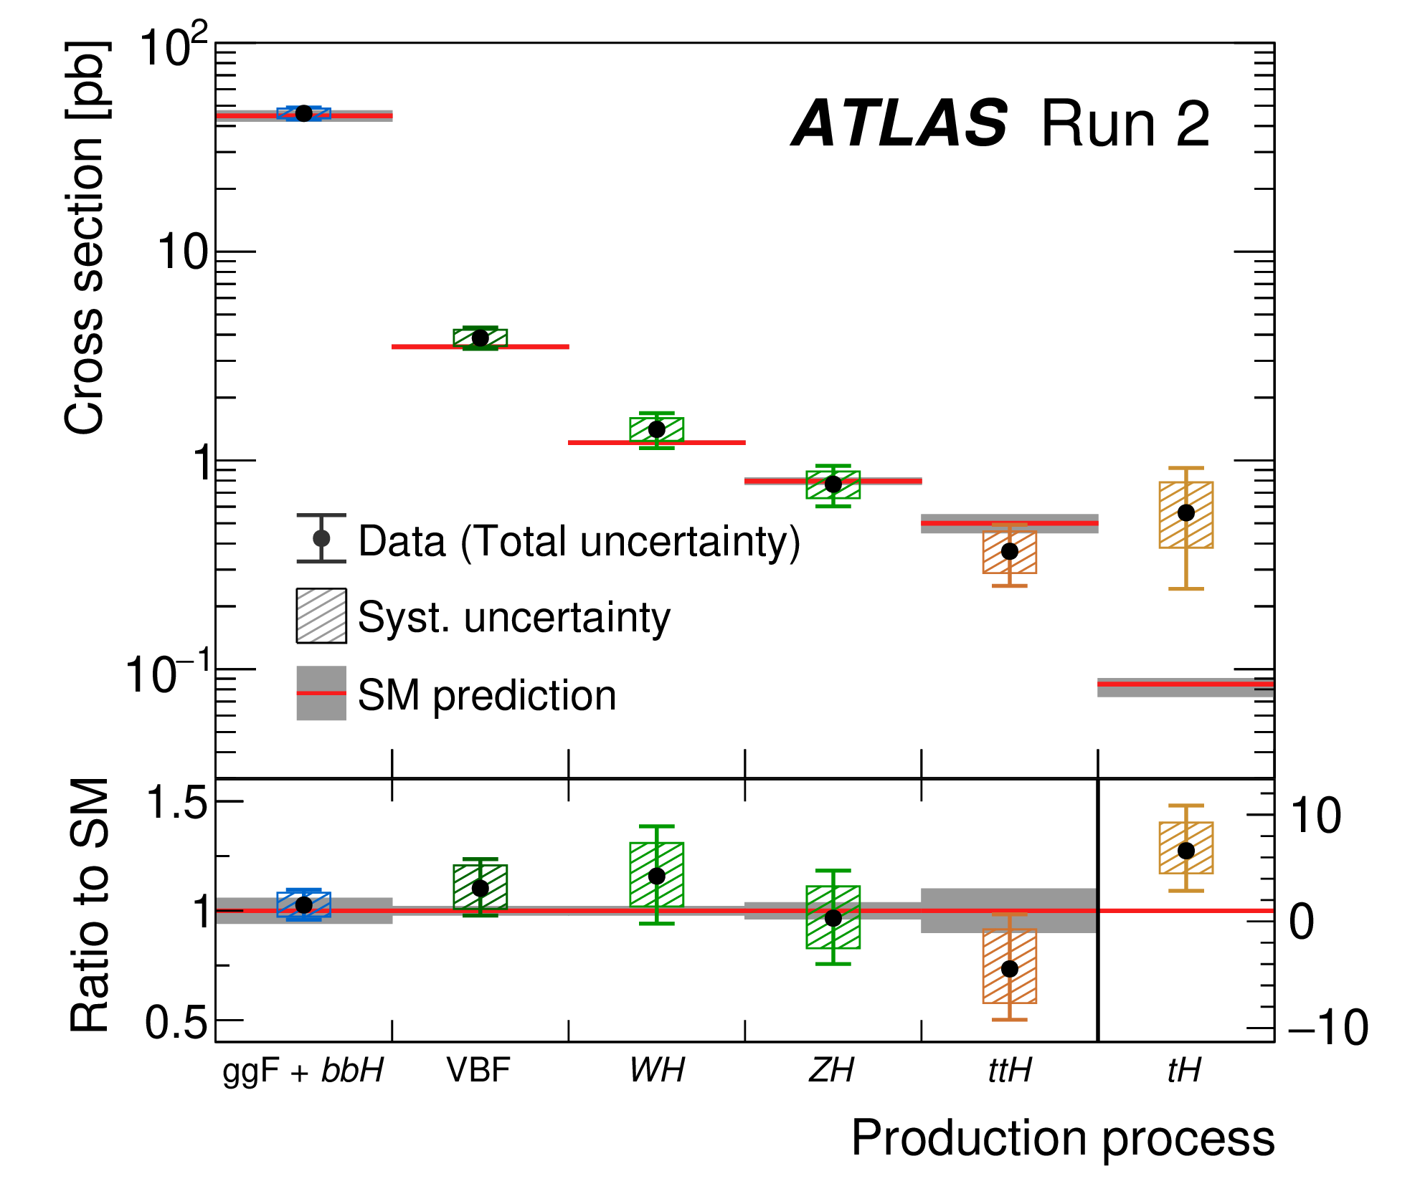
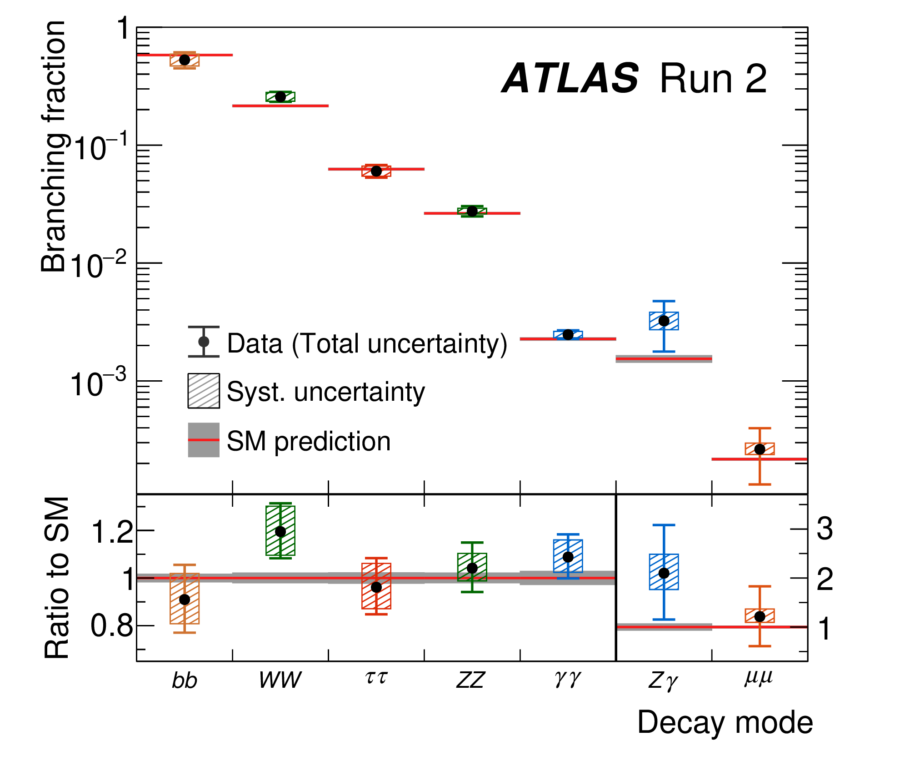
Higgs Production
Phys. Rep 1116 (2025)
Higgs Production cross sections and Decays
  Quantitative data: Total cross sections of production processes, Decay branching fractions

Slide 49
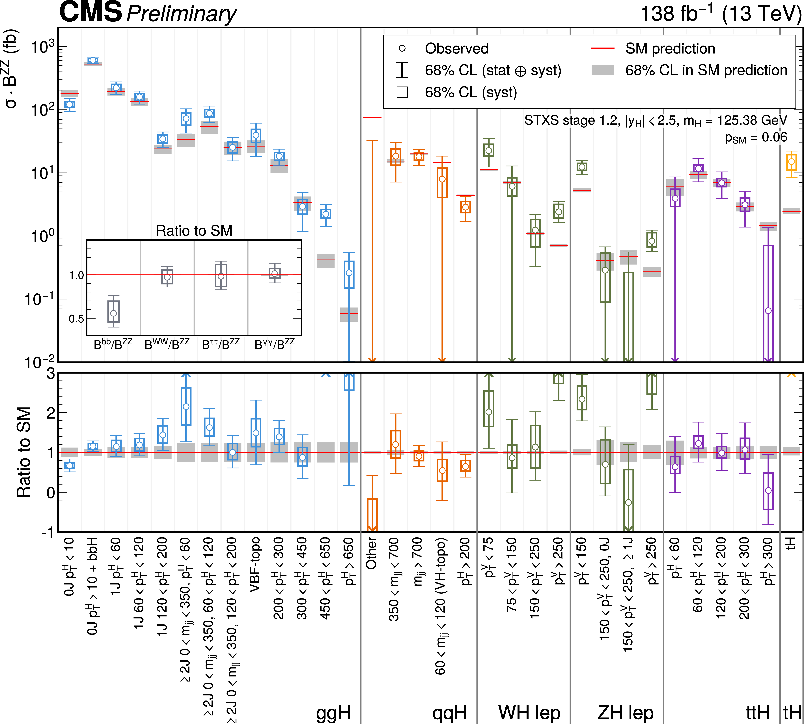
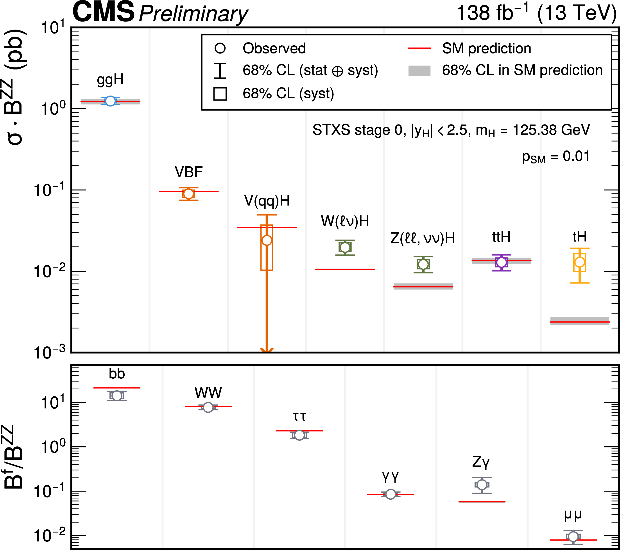
Higgs Production
CMS-PAS-HIG-21-018
ATLAS-CONF-2021-053
STXS cross sections – CMS
  Division into non overlapping phase space, production-decay-kinematic, regions
Stage 0
Stage 1.2

Slide 50
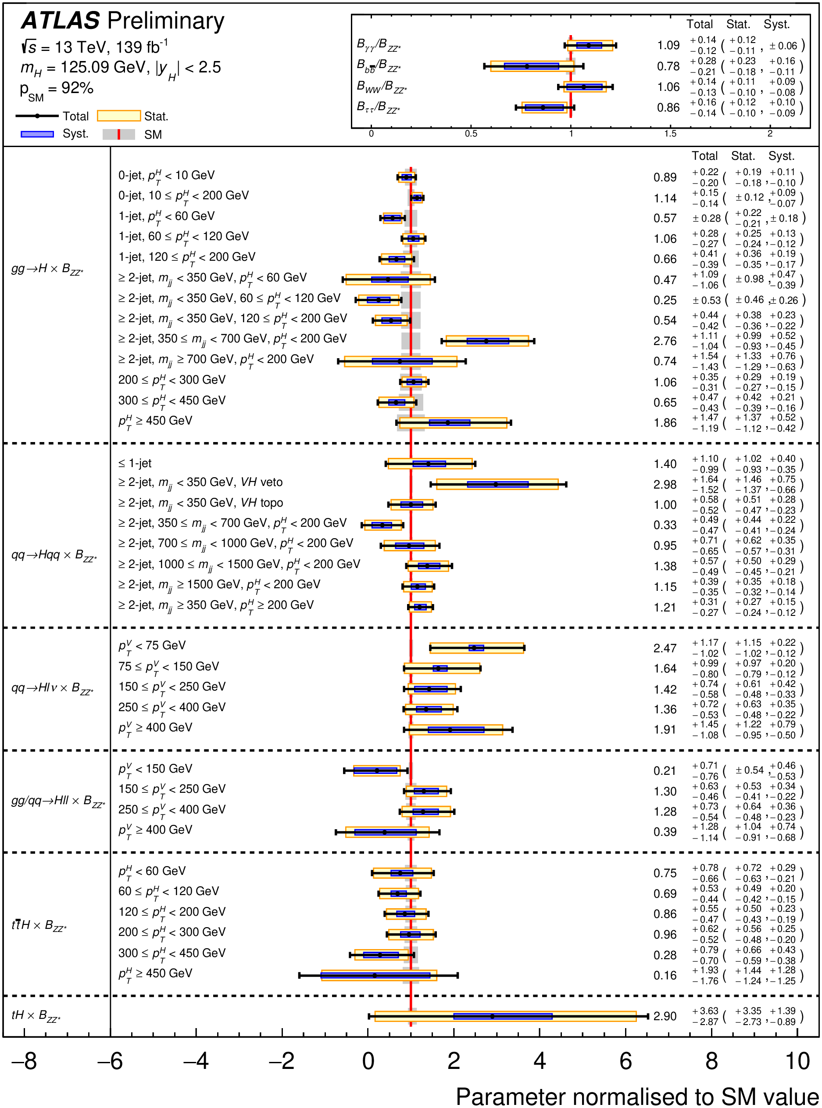
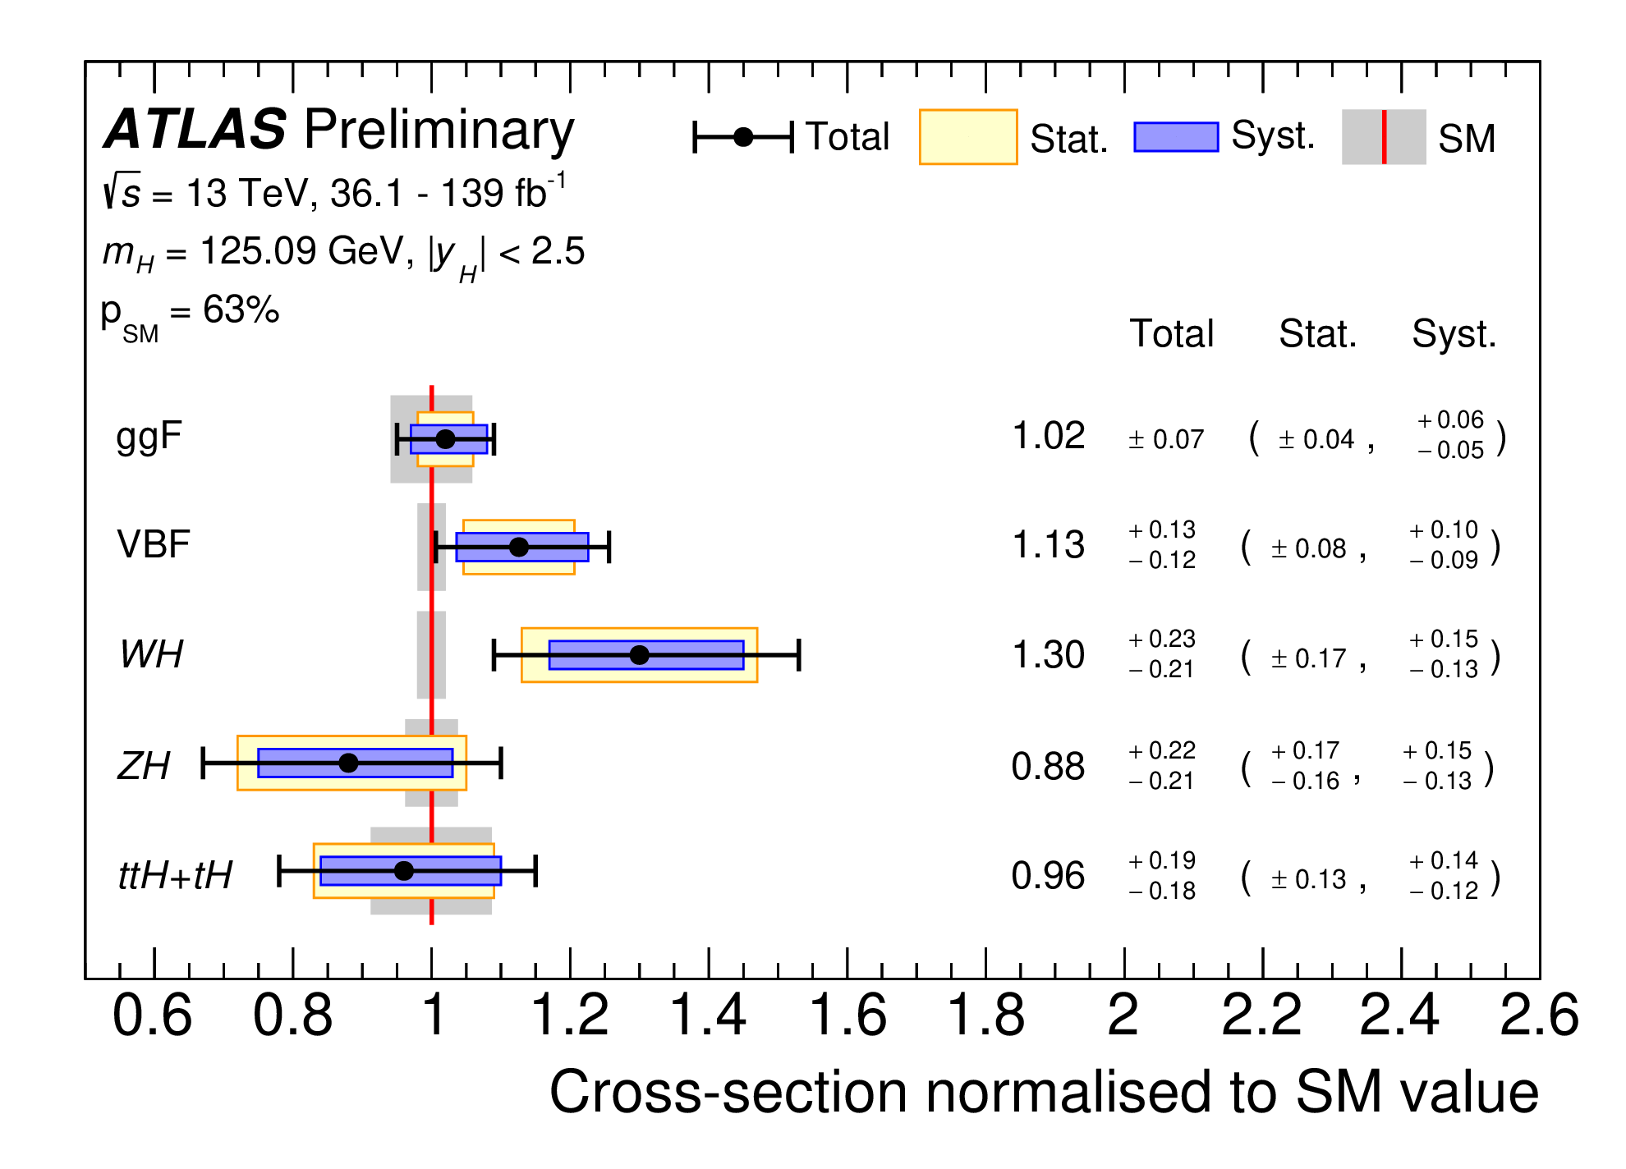
Higgs Production
CMS-PAS-HIG-21-018
ATLAS-CONF-2021-053
STXS cross sections – ATLAS
  Division into non overlapping phase space, production-decay-kinematic, regions
Stage 0
Stage 1.2

Slide 51
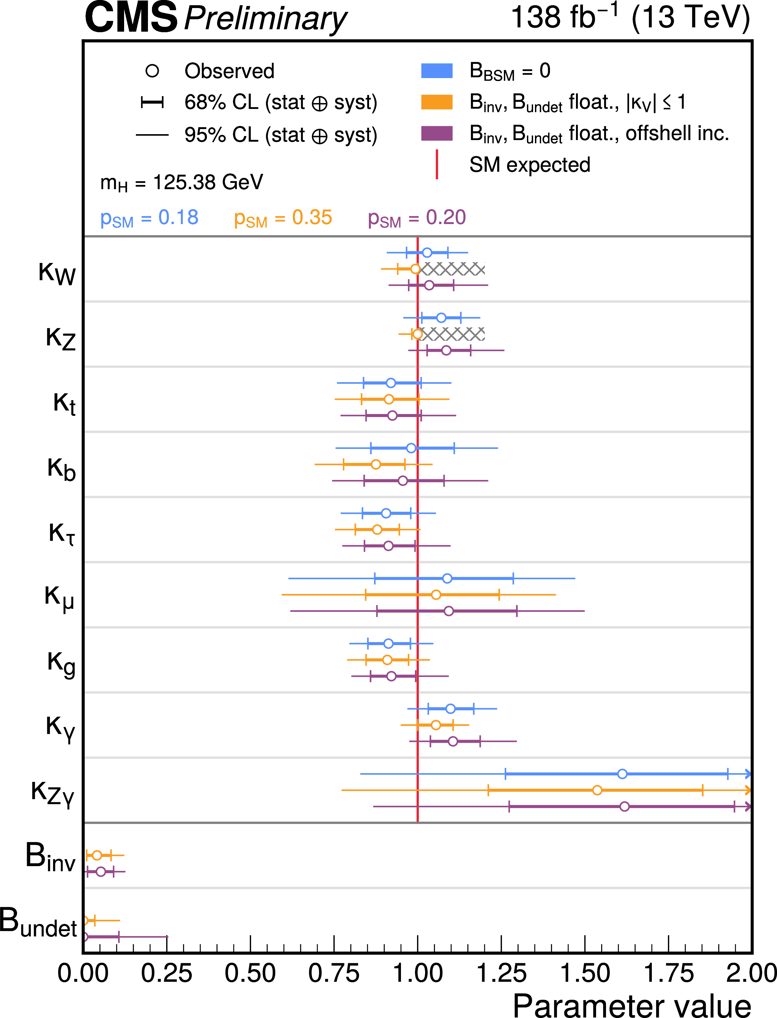
Higgs Production
CMS-PAS-HIG-21-018
STXS cross sections - CMS
  Interpretation in coupling and EFT frameworks
No Large deviations seen.
Still room for invisible NP decays
Analysis also provides plots of the impacts of representative values of each operators on the STXS cross sections.

Slide 52
Higgs Production
CMS-PAS-HIG-21-018
There are tools for automated mapping of UV complete theories onto EFTs. See for a review: Fuentes-Martin
STXS cross sections - CMS
  Impacts of EFT operators on STXS cross sections

Slide 53
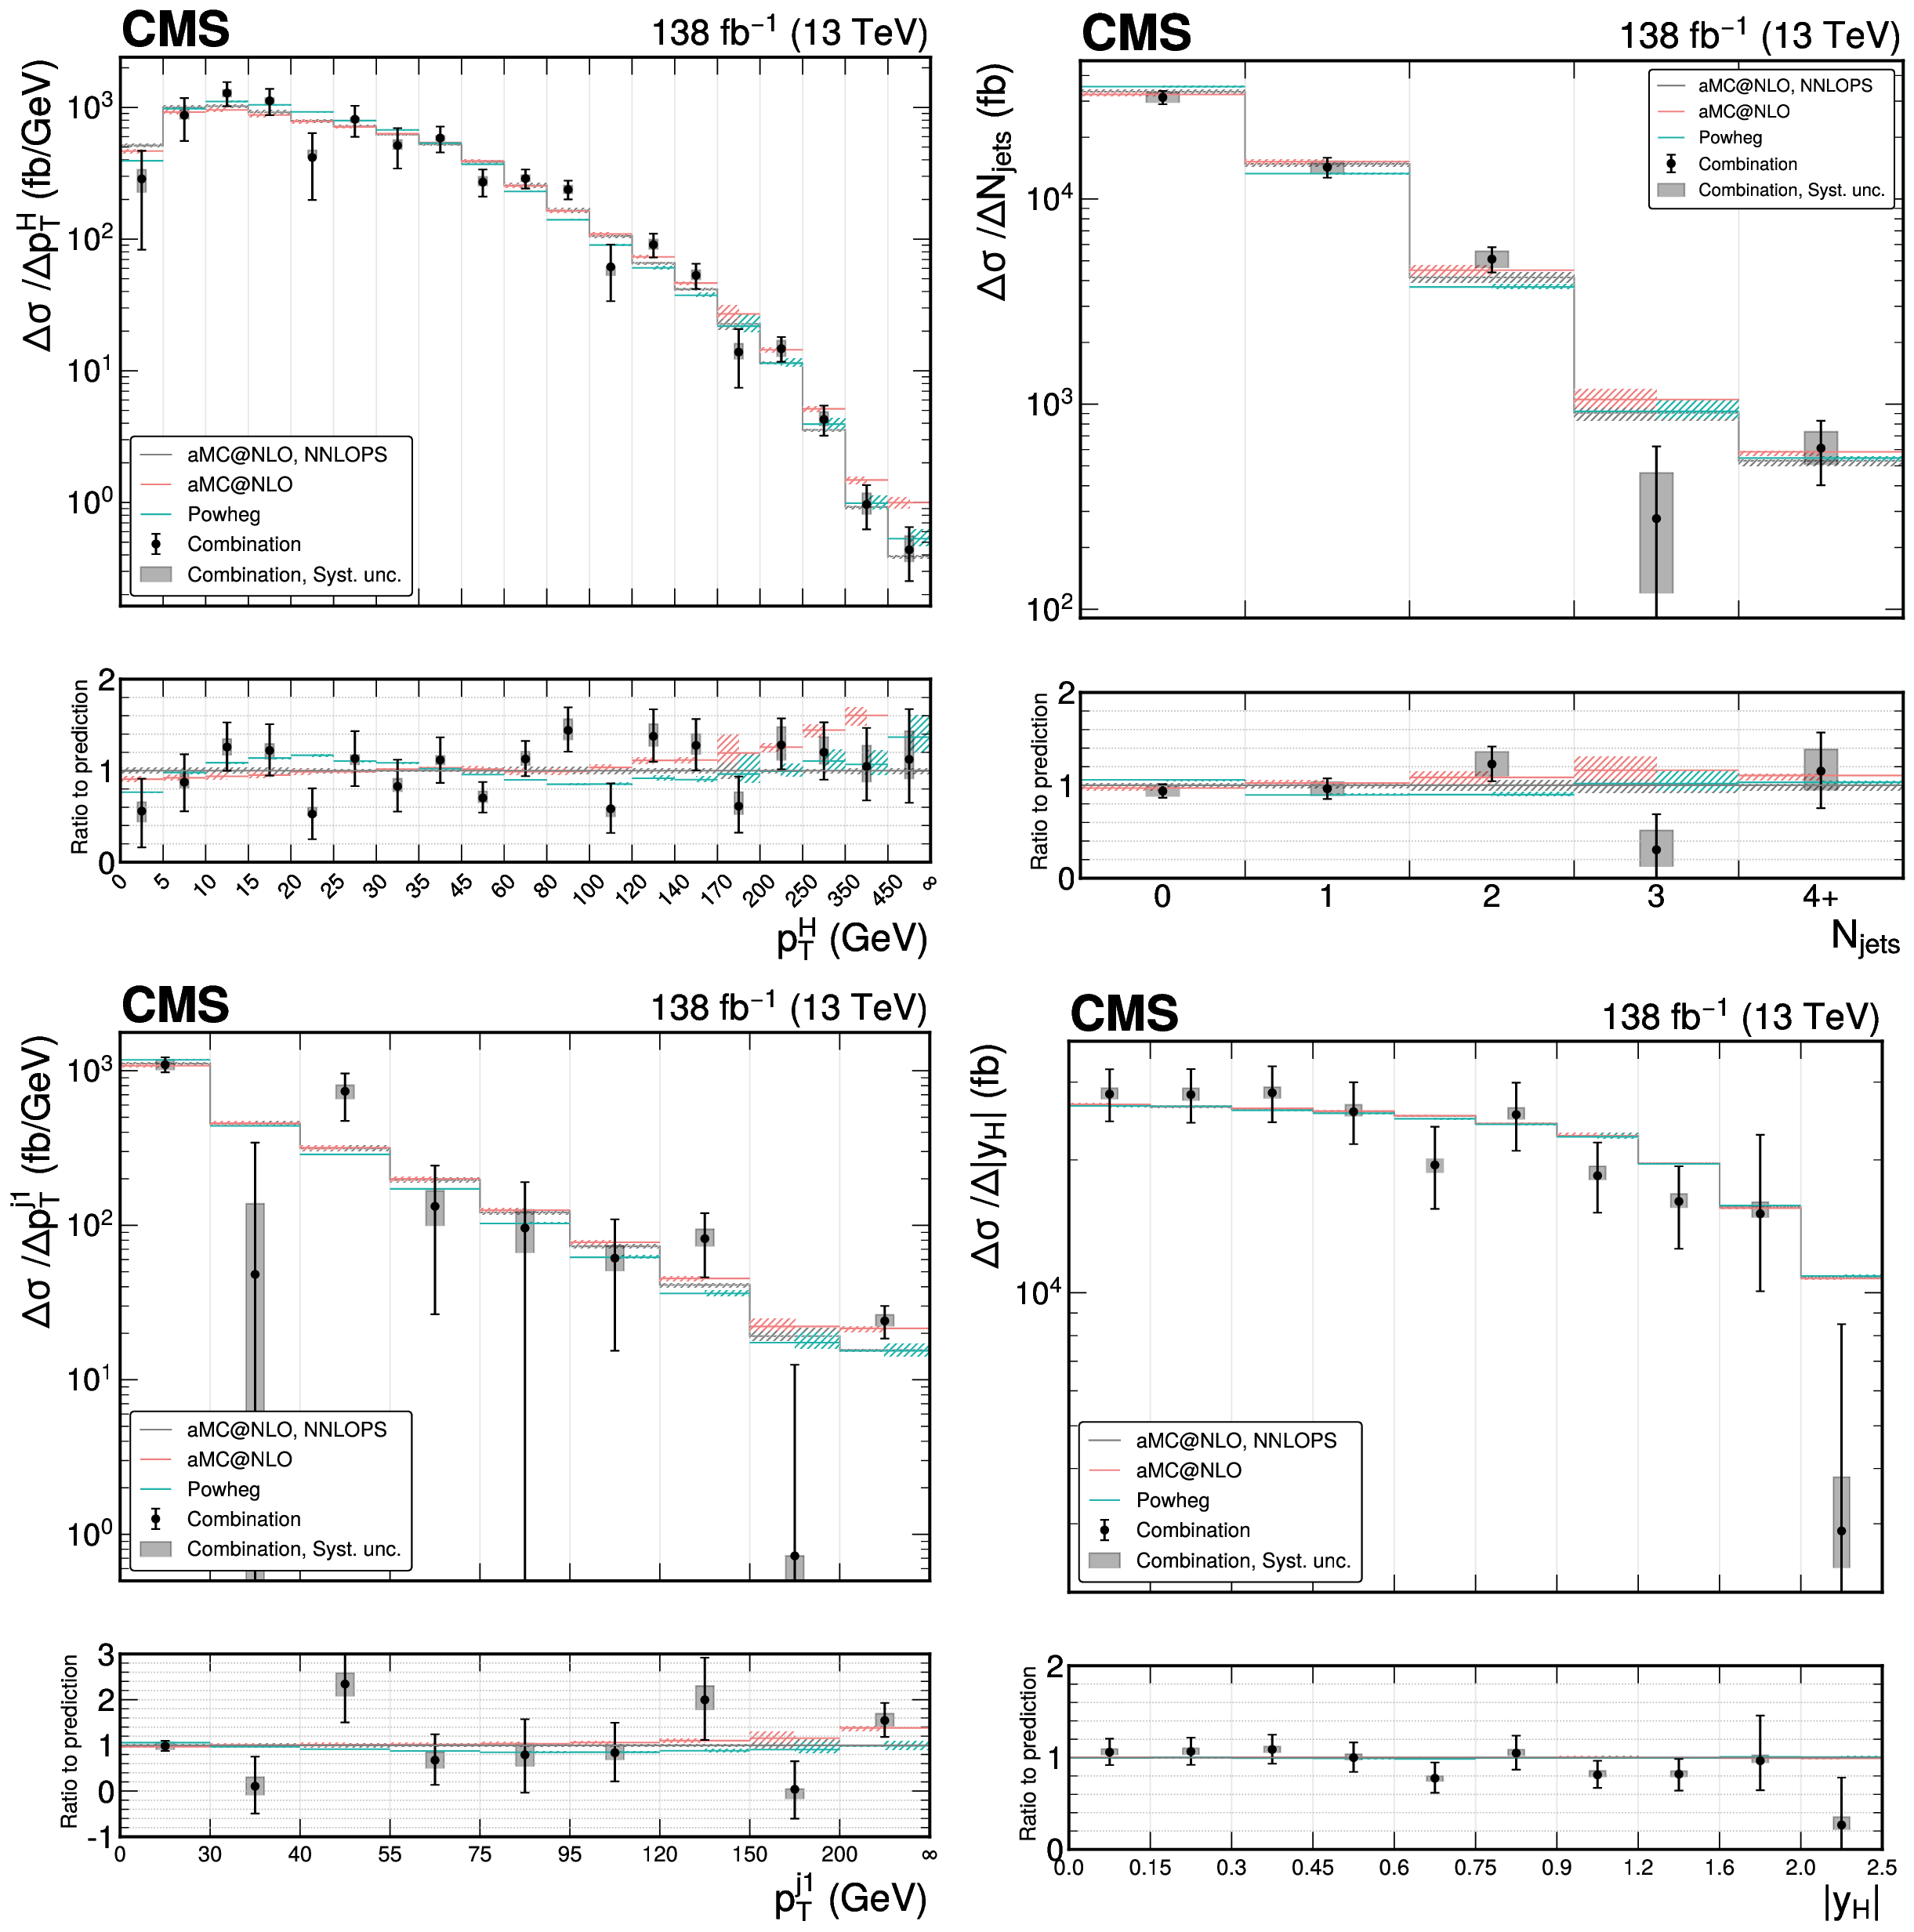
Differential Higgs Production - CMS
Precision Fiducial differential measurements combining all major production and decay modes
Also separated by final state showing consistency of the measurements
Other distributions of interest included as well: 2 jets …
Remarkable agreement seen over a large number of bins to high Higgs and jet p_{T}s and large numbers of jets
Submitted to JHEP

Slide 54
Higgs Properties
Mass, Width, Quantum numbers, Self couplings

Slide 55
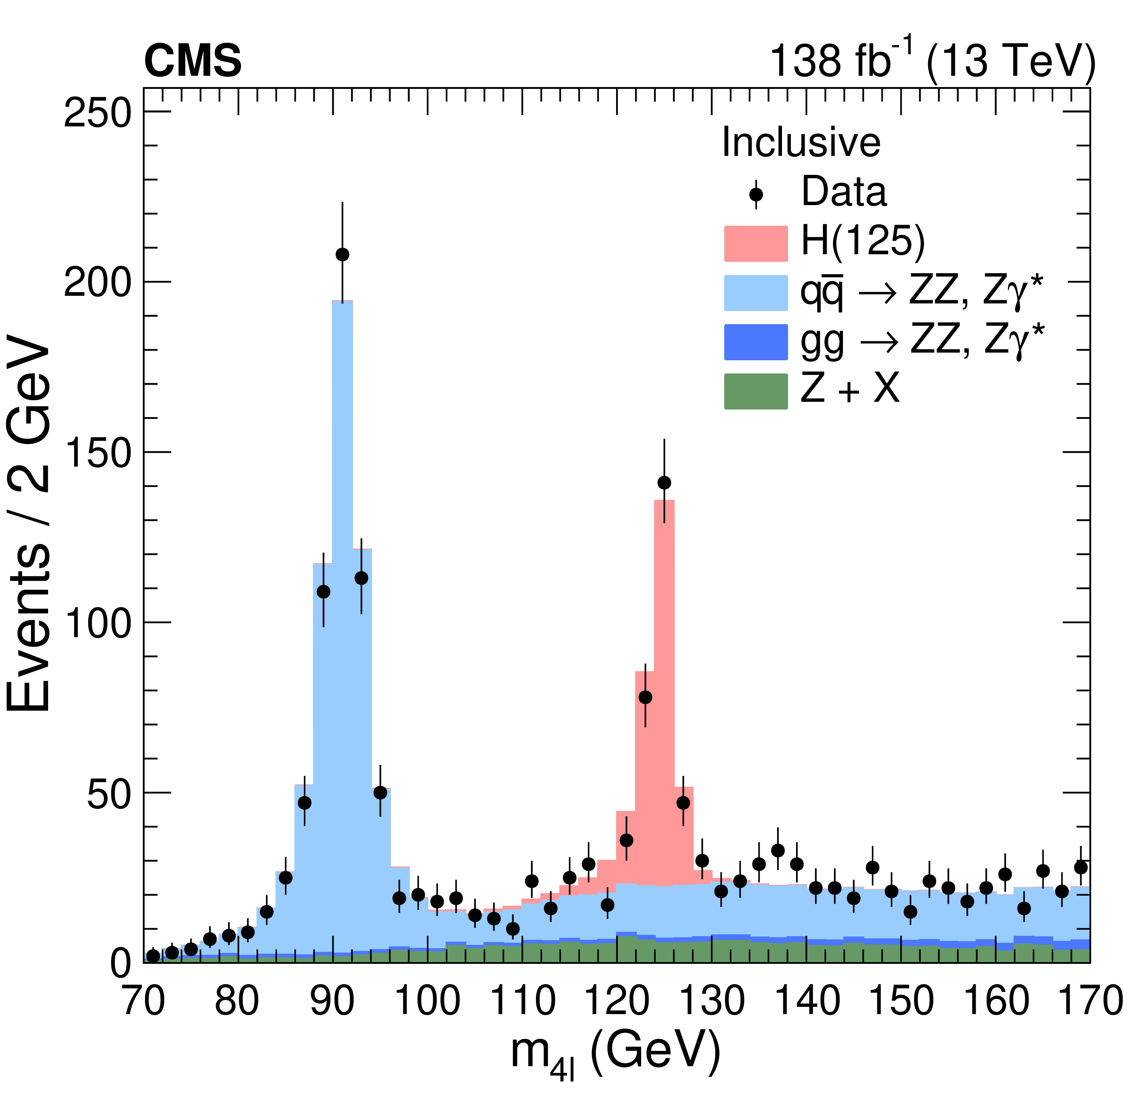
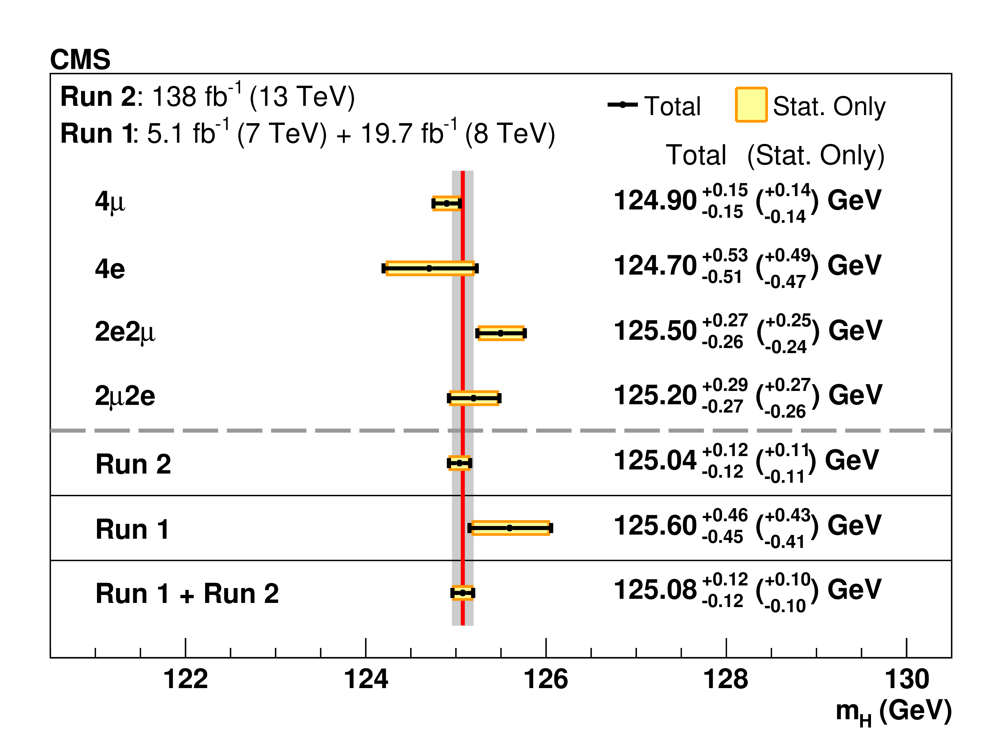
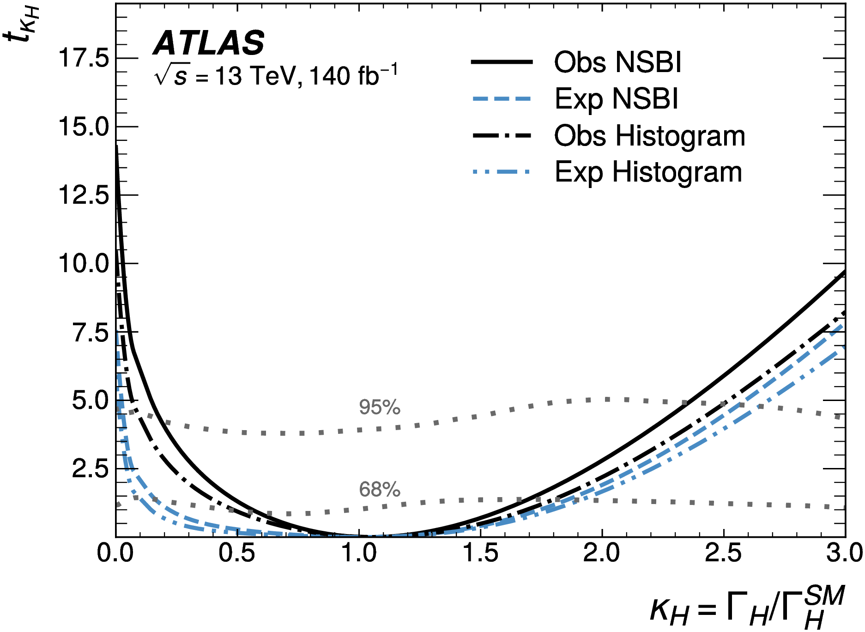
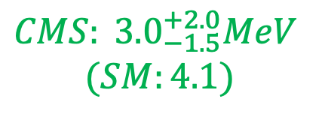

H: Mass and Width, ATLAS - CMS
PRL 131 (2023) 251802
PRD 111 (2025) 092014
Measured primarily 4l (l = e, μ) events
  Excellent momentum resolution and extensive calibration of the detectors
  Width uses an analysis of on and off shell production
PRD RPP 88 (2025) 057803
m_{H} = 125.11 ± 0.09(stat) ± 0.06(sys)
m_{H} = 125.08 ± 0.10(stat) ± 0.05(sys)
0.1% precision, statistically dominated
$${ATLAS: 4.3}_{−1.9}^{+2.7}$$
$${CMS: 3.0}_{−1.5}^{+2.0}MeV$$
$$(SM:4.1)$$

Slide 56
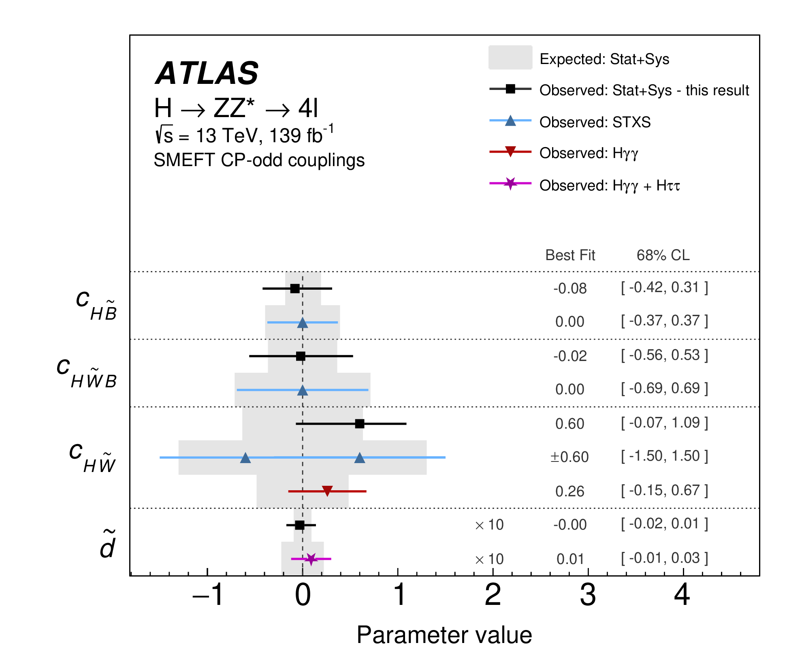
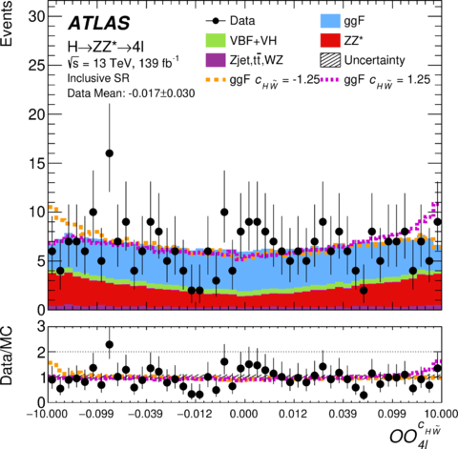
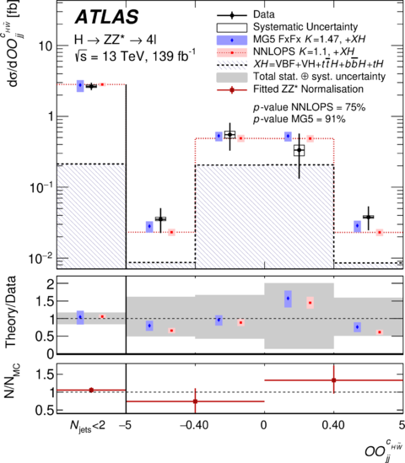
HH Quantum Numbers: ATLAS
Quantum numbers: It’s Scalar and CP Even. ☺
  Constraining the quantum numbers has moved to an EFT analysis of operators with CP odd contributions
  Use OO, optimized observables. Set limits and perform differential fiducial cross section measurements in the observable!
HEP 05 (2024) 105
Outperforms more general STXS analysis

Slide 57
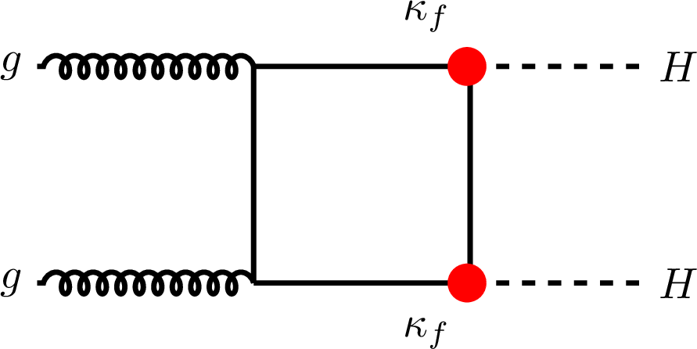
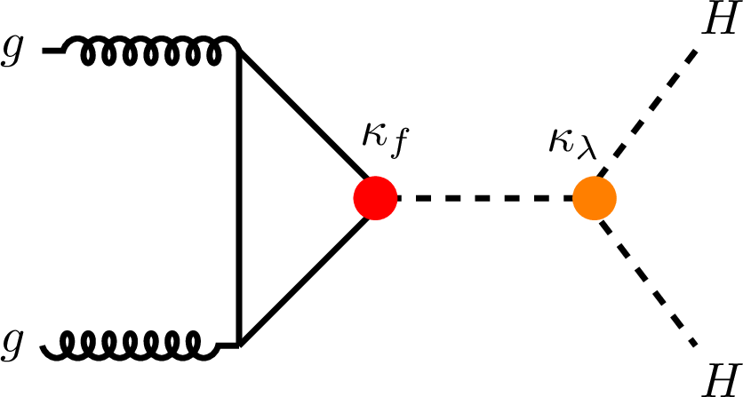
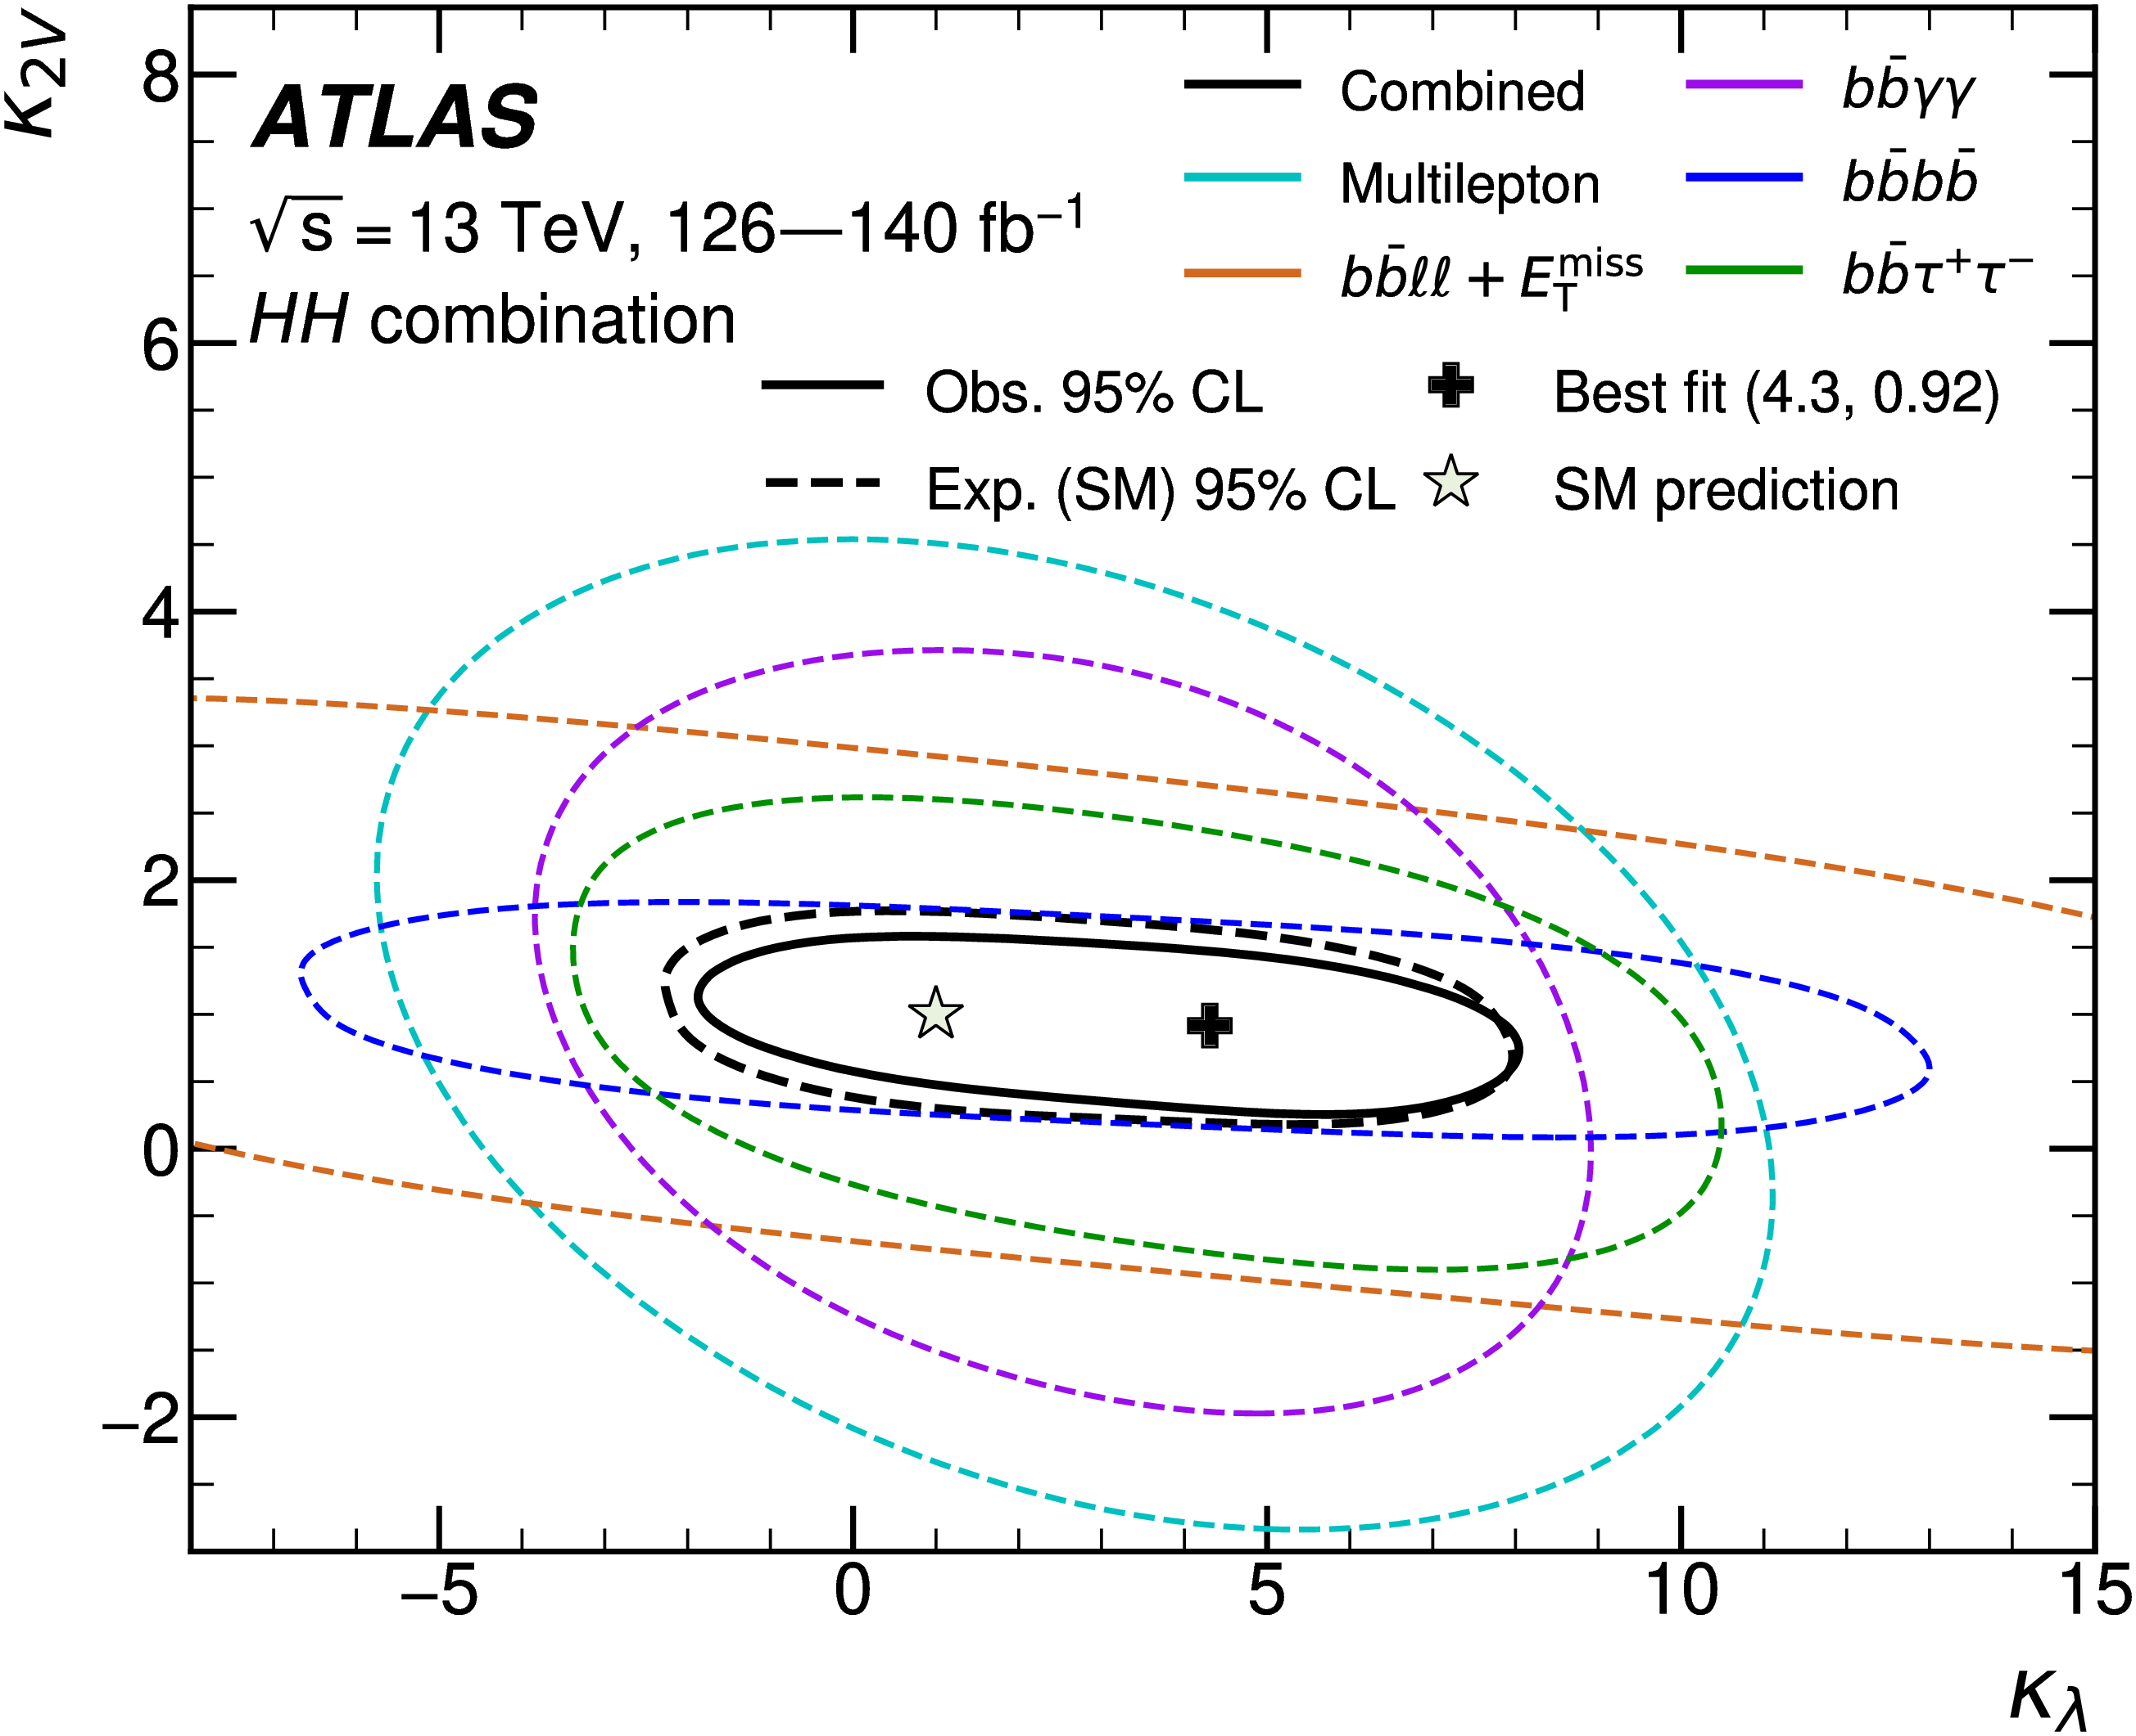
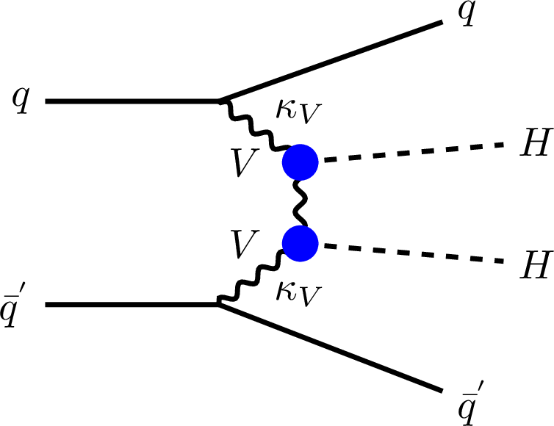
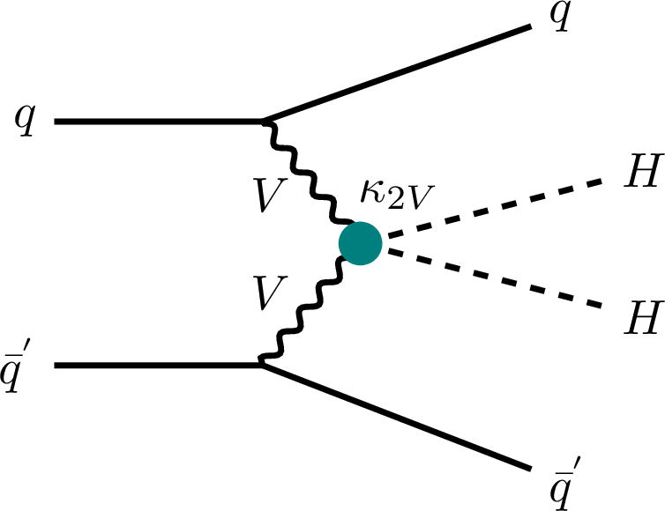
HH Self Coupling: ATLAS, CMS
Self Coupling
  Constraining coupling parameters can include both H and HH production results
  k_{λ} and k_{VV} hard to disentangle from k_{t} and k_{V} respectively. Single Higgs measurement hep
JHEP 04 (2025) 075

Slide 58
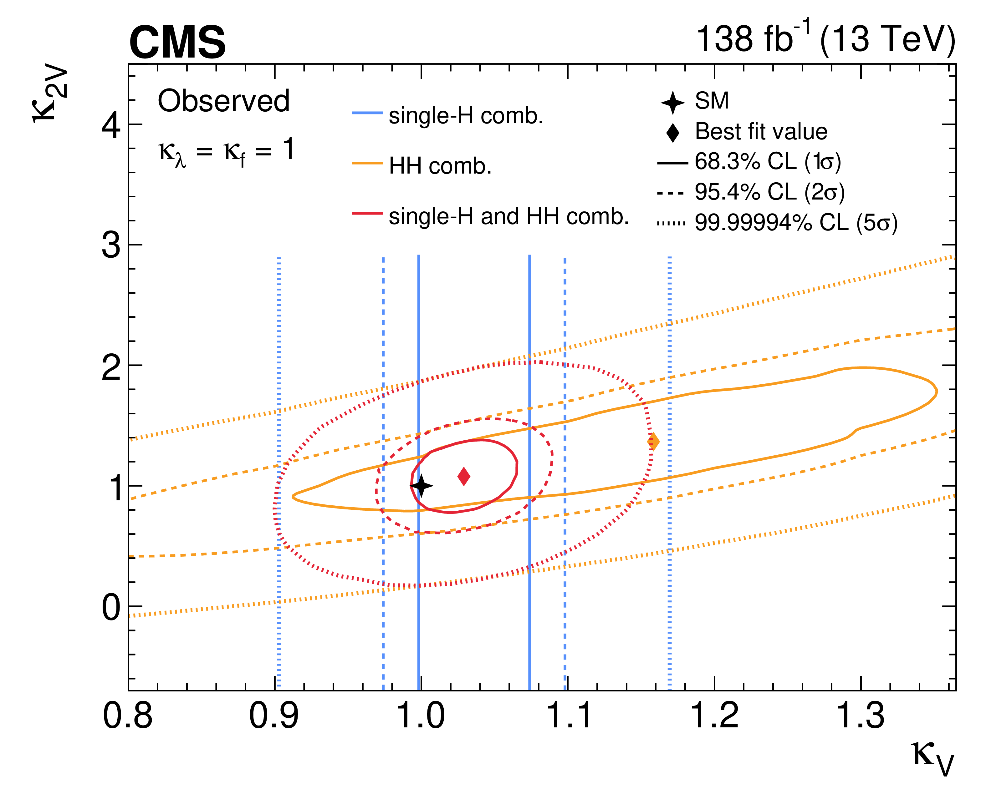
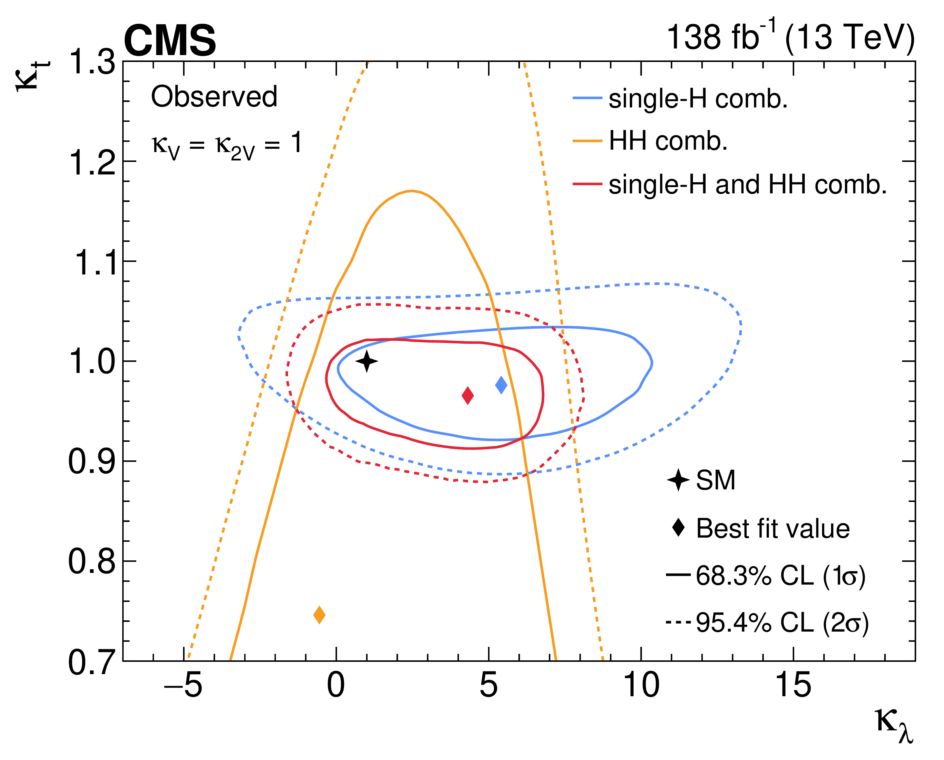
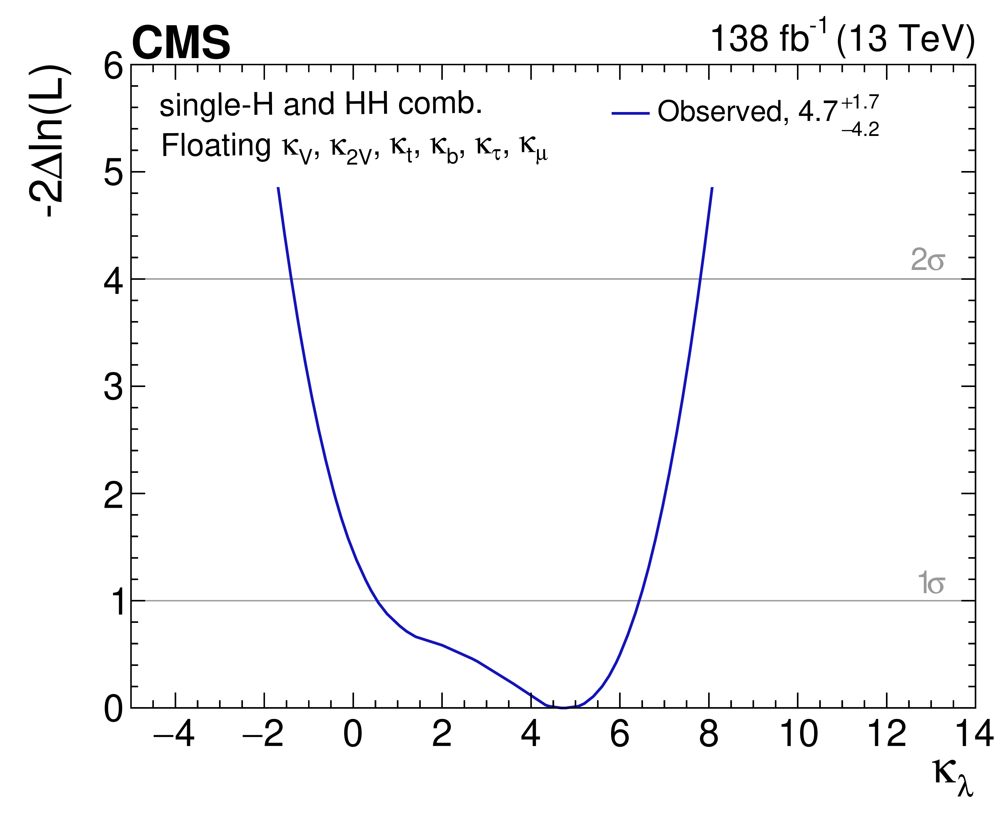
HH Self Coupling: CMS
CMS-PAS-HIG-24-018
PLB 861 (2025) 139210
Self Coupling
  Constraining coupling parameters can include both H and HH production results
  k_{λ} and k_{VV} hard to disentangle from k_{t} and k_{V} respectively. Single Higgs measurement help
k_{λ} = λ₃/λ_{3SM}
k_{λ} = measured without further constraints on relevant k parameters

Slide 59
Higgs Rare Processes
Second generation decays
HH

Slide 60

Higgs Rare processes
No significant deviations seen in the the basic Higgs production and decay processes
Where to look next
  Still fundamental Higgs physics to study
    Couplings to the second generations fermions to demonstrate the Yukawa mass mechanism for several generations of fermions
    Multiple Higgs productions to investigate Higgs self couplings and the functional form of the Higgs potential
  Rare production or decay processes in general

Slide 61



H → μμ: CMS
JHEP 01 (2021) 148
Combined search across all major production mechanisms
  Evidence for H → μμ seen using the 13 TeV data
  Combined fit performed with previous data to determine coupling strength
First evidence for coupling to a second-generation fermion. Compatible with SM expectation.

Slide 62



H →cc : ATLAS, CMS
Leveraging VH (ATLAS and CMS) and tH production with H → cc
  Driven by the outstanding performance of advanced machine learning techniques are employed for jet flavor identification and event classification.
  Typically performed simultaneously with a H → bb and/or VZ with Z → cc analysis as proof of principle
CMS-PAS-HIG-24-018
JHEP 04 (2025) 075

Slide 63





HH Production: ATLAS, CMS
CMS-PAS-HIG-24-018
JHEP 04 (2025) 075
Direct searches for HH
  Primary modes characterized by either large decay rate or low background: bbbb, bbγγ, bbττ
  Directly measure self coupling
Run 2 combinations: 3xSM

Slide 64
Summary
CMS and ATLAS have measured a wide array of EW and Higgs cross sections and parameters
  Almost every basic QCD+EW/Higgs final state you expect to produce at the LHC
  The highest precision cross section measurements have reached 1.5% uncertainty and 1% is likely achievable
  Measurements of fundamental SM parameters are becoming competitive and will soon surpass those of previous experiments
  The complex gauge structure of the SM and the parameters of EW symmetry breaking is being explored with many new measurements
  There are no substantive deviations from the SM in the current set of SM measurements
    Deviations are often seen in complex final states involving one or many bosons and multiple jets
    These are areas we expect our current calculations to be inadequate
    However, these calculations and techniques are advancing and resolving observed discrepancies
    Hopefully, when we find a statistically significant deviation from the SM that we can’t otherwise explain we should be able to state with confidence whether it is new physics

Slide 65
ATLAS SM Summary

Slide 66
CMS SM Summary

Slide 67
W mass – ATLAS Improved measurement of m_{W} and also Γ_{W}
It would be interesting to see if AZNLO does well with nJet. Focused on pT(Z)
  Profile likelihood fit of p_{T}(l) and m_{T}(W)
  Best modeling of W production kinematics and hadronic recoil
    NLO Powheg reweighed with NNLO calculations, NNLO PDFs, Pythia 8 with AZNLO tune based on Z data
    Predicts W pT distribution well at 5.02 and 13 TeV, Critical element for extracting m_{W} from p_{T}(l) and m_{T}(W)

Slide 68
W mass - ATLAS
submitted to EPJC
Uncertainties – p_{T}(l) measurement dominates
Statistical component substantial
Systematic distributed over several components
Probably difficult, but possible, to match CDF uncertainty

