Slide 1

Radiation Therapy Planning
(PTMC 2024)
Tbilisi, Georgia
04.03.2024

Slide 2
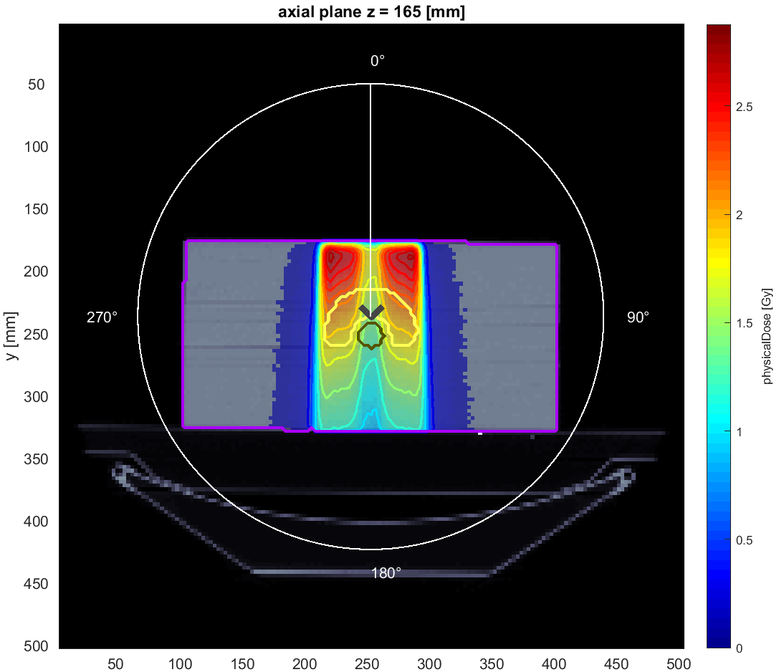
Photons, one angle
Angle = 0

Slide 3
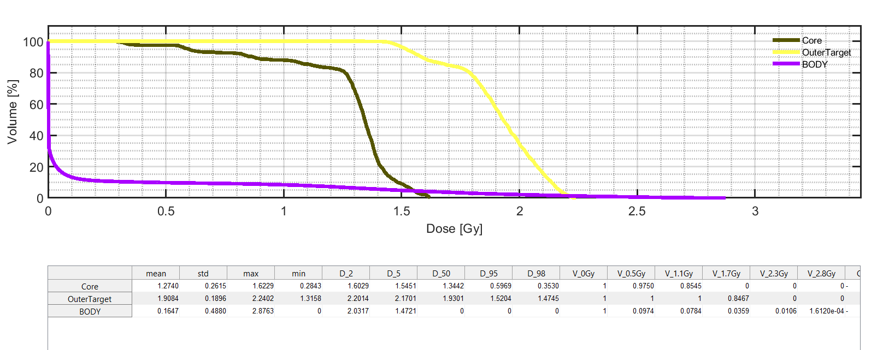
Volume dose histograms

Slide 4
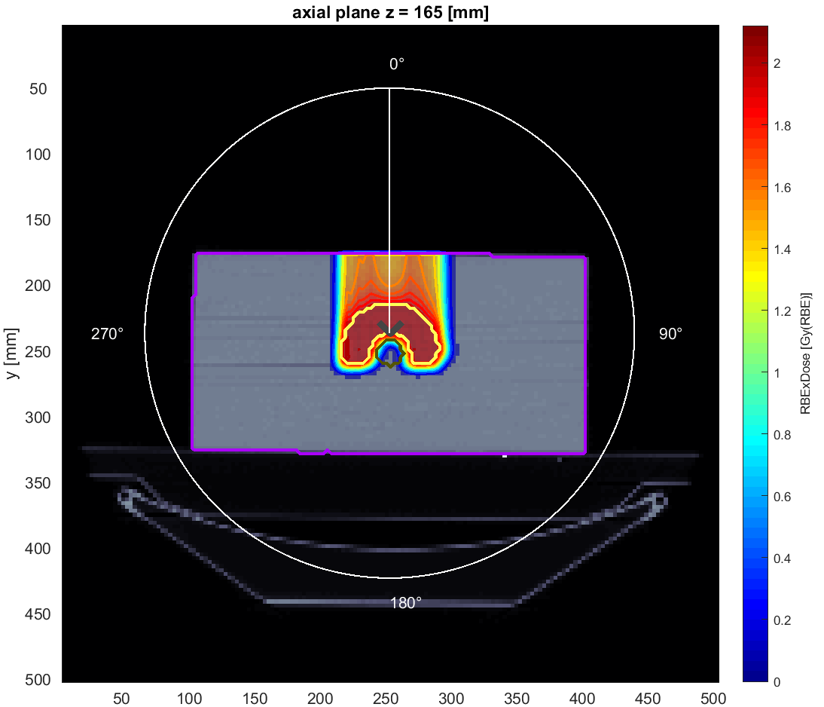
Protons, one angle
Angle = 0

Slide 5
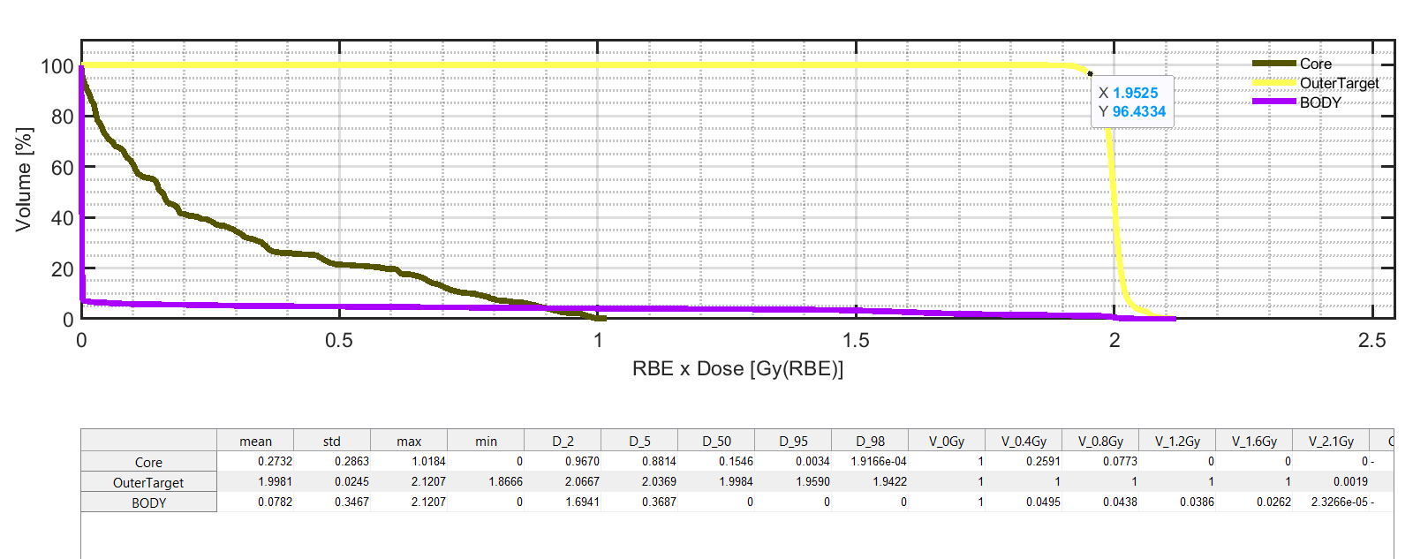
Volume dose histograms

Slide 6
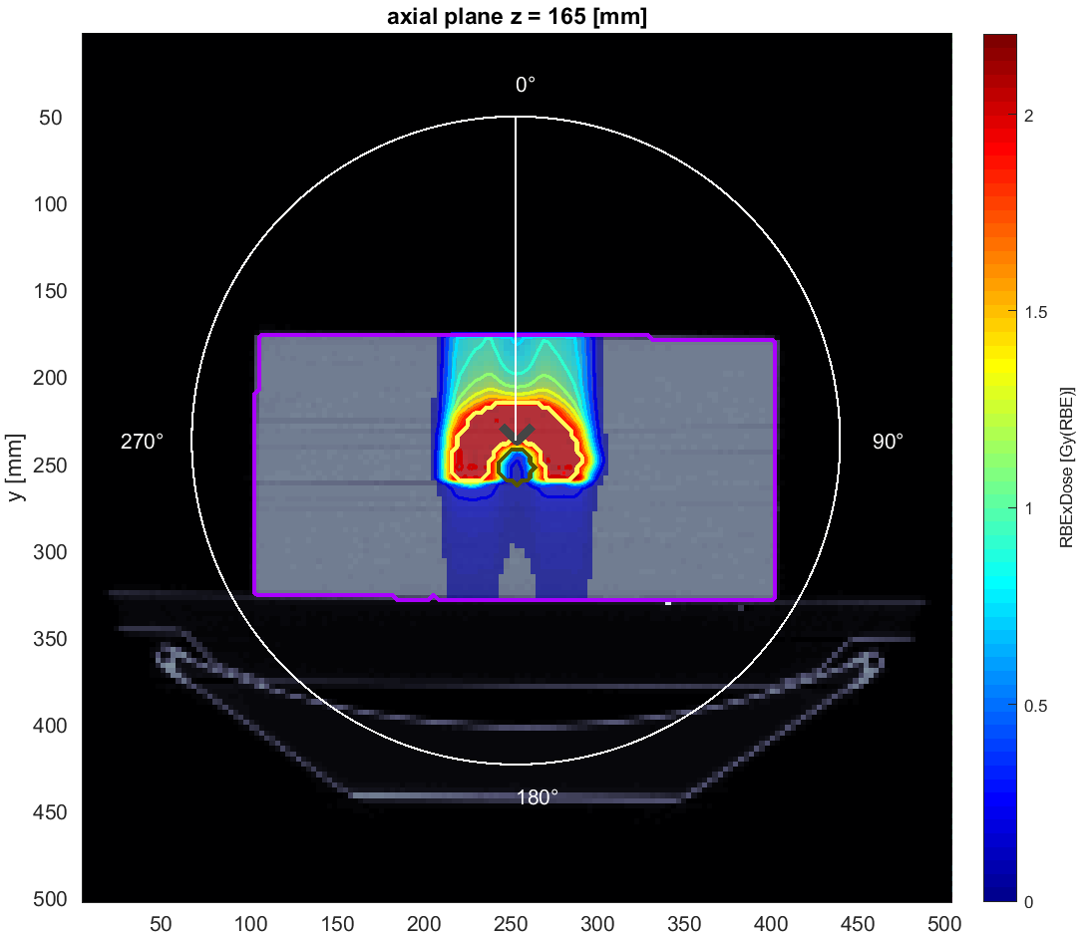
Carbons, one angle
Angle = 0

Slide 7
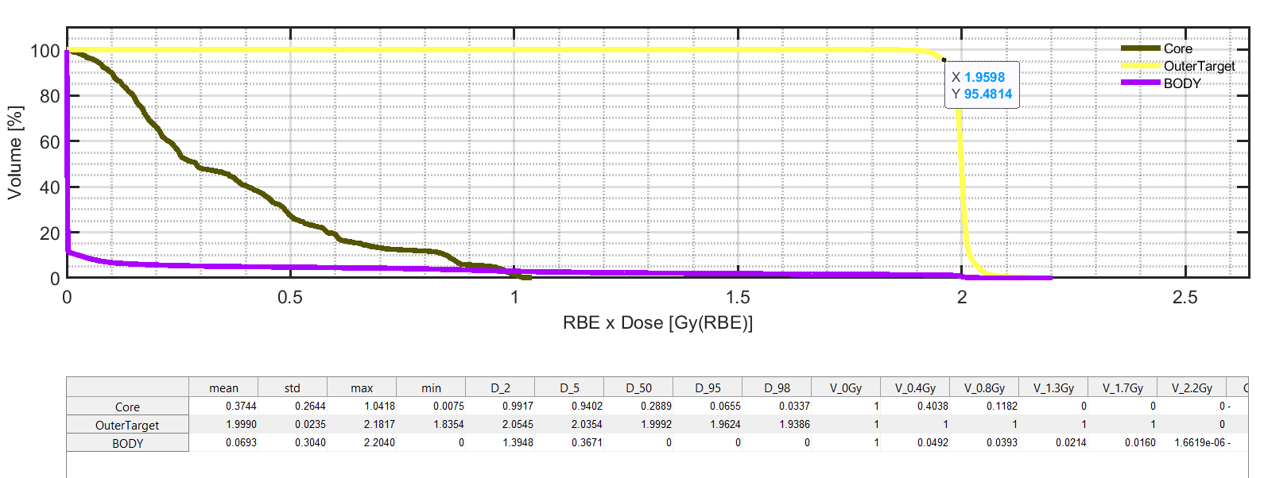
Volume dose histograms

Slide 8
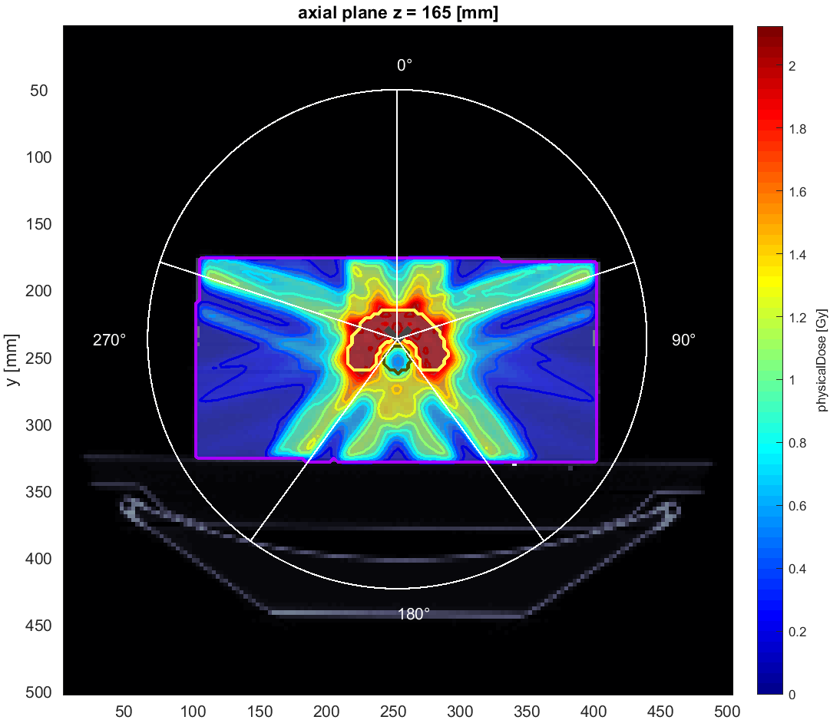
Photons, five angle
Angle = 0, 72, 144, 216, 288

Slide 9
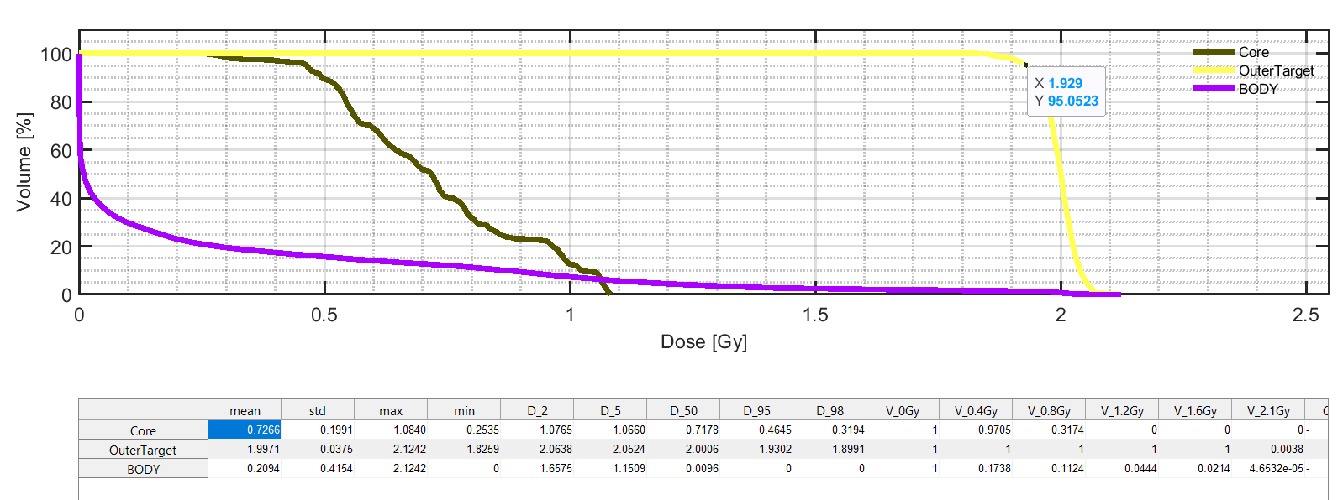

Slide 10
Thank you for your attention

