Slide 1


Radiation Therapy Planning
(PTMC 2025)
Ani kharazishvili, Ani Saria, Giorgi Menteshashvili, Nikoloz Nebieridze, Saba Shengelia
Tbilisi, Georgia
04.04.2025

Slide 2
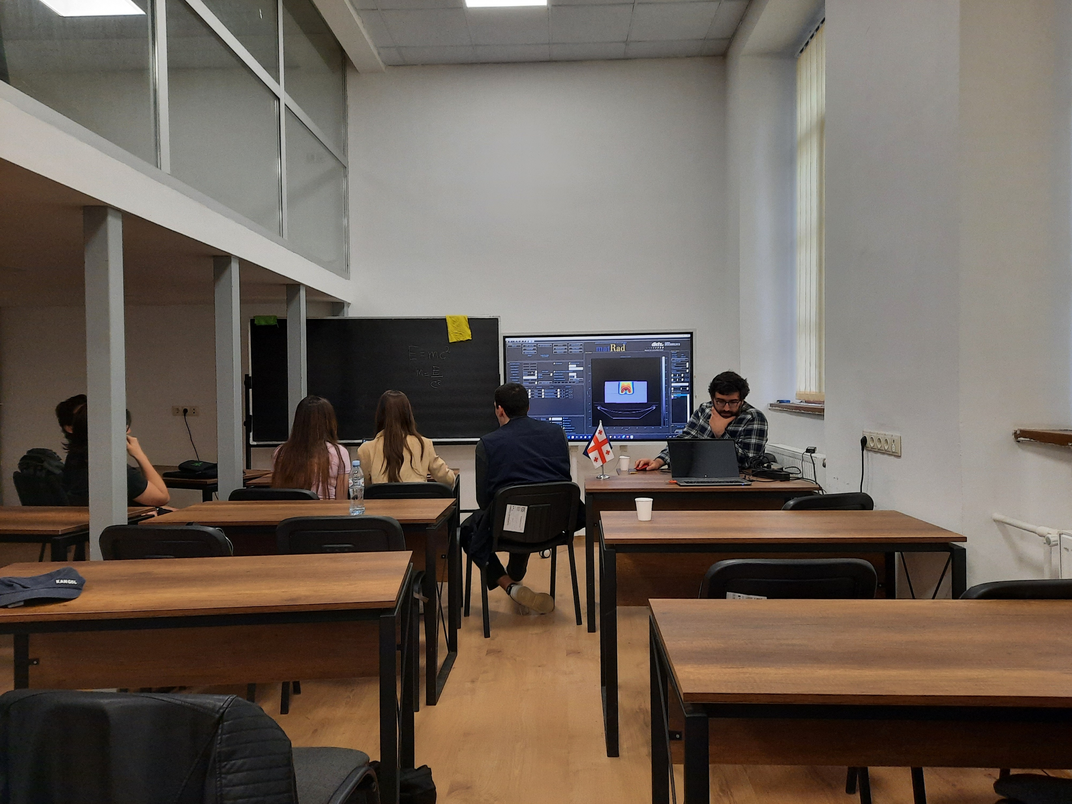
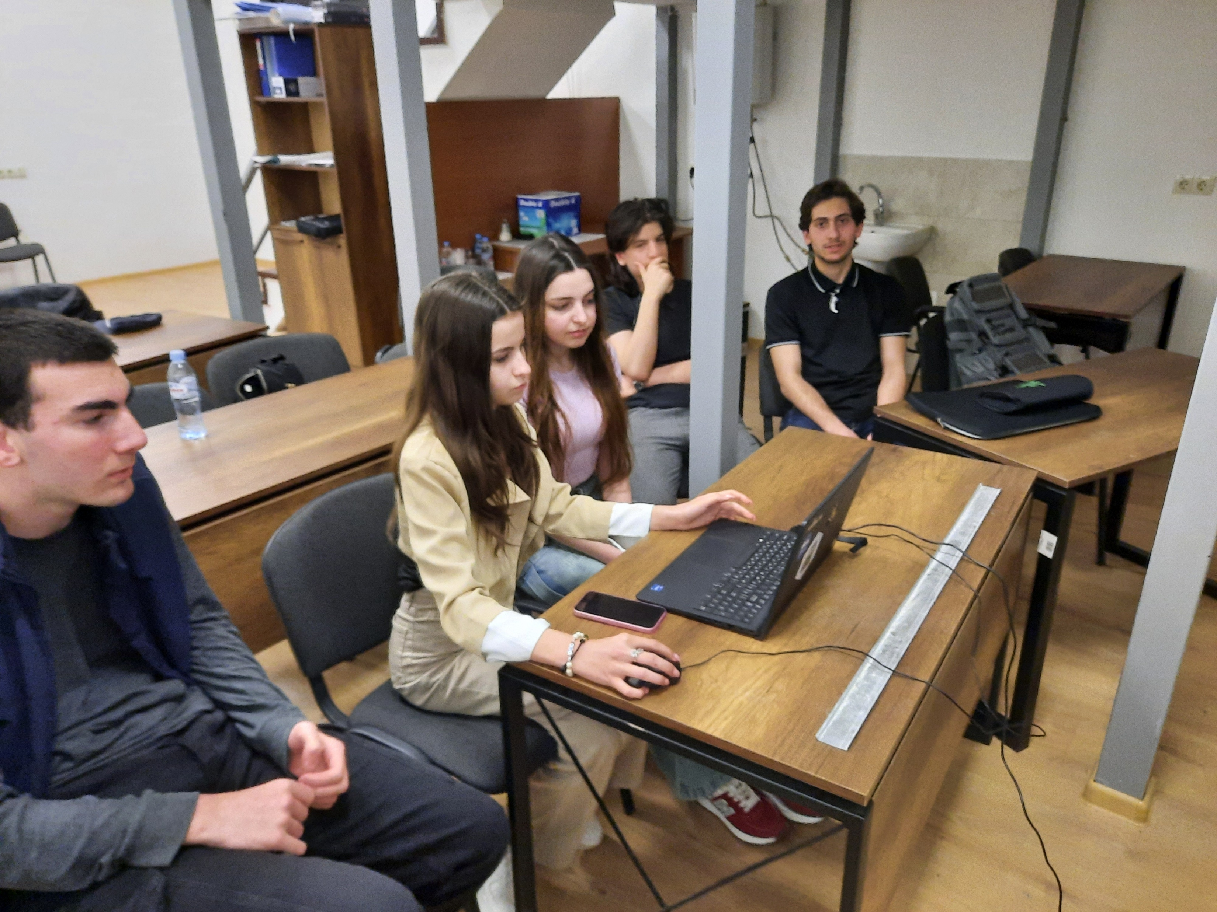
Working, Experimenting and Having fun

Slide 3
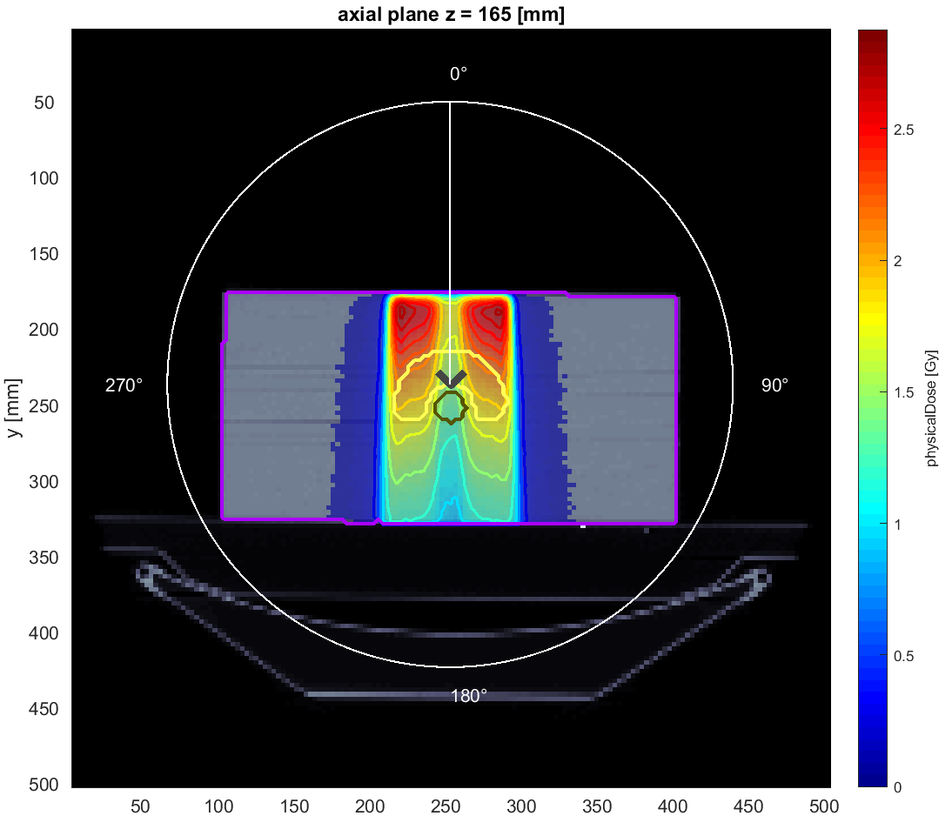
Photons, one angle
Angle = 0

Slide 4
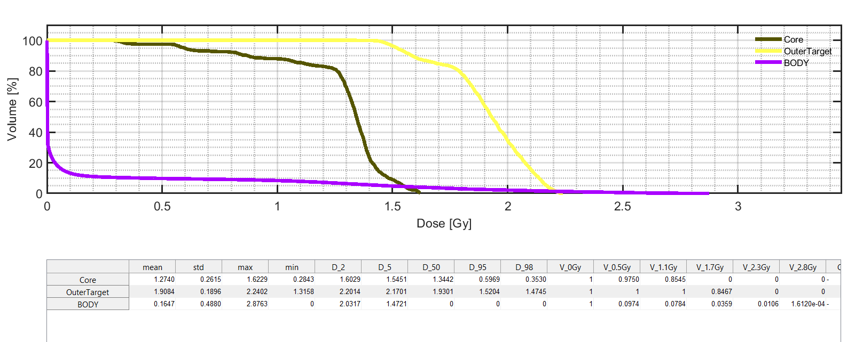
Volume dose histograms

Slide 5
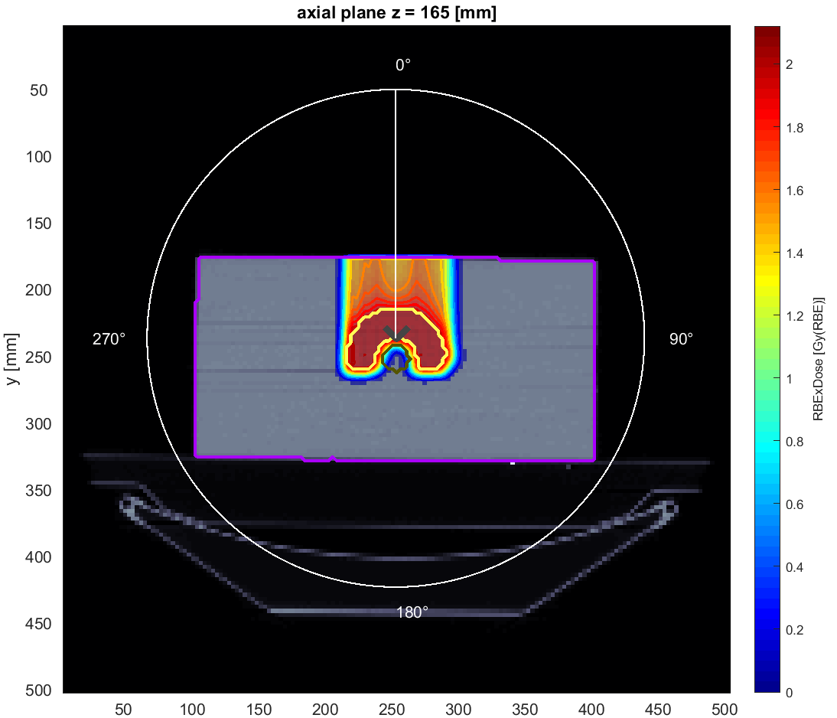
Protons, one angle
Angle = 0

Slide 6
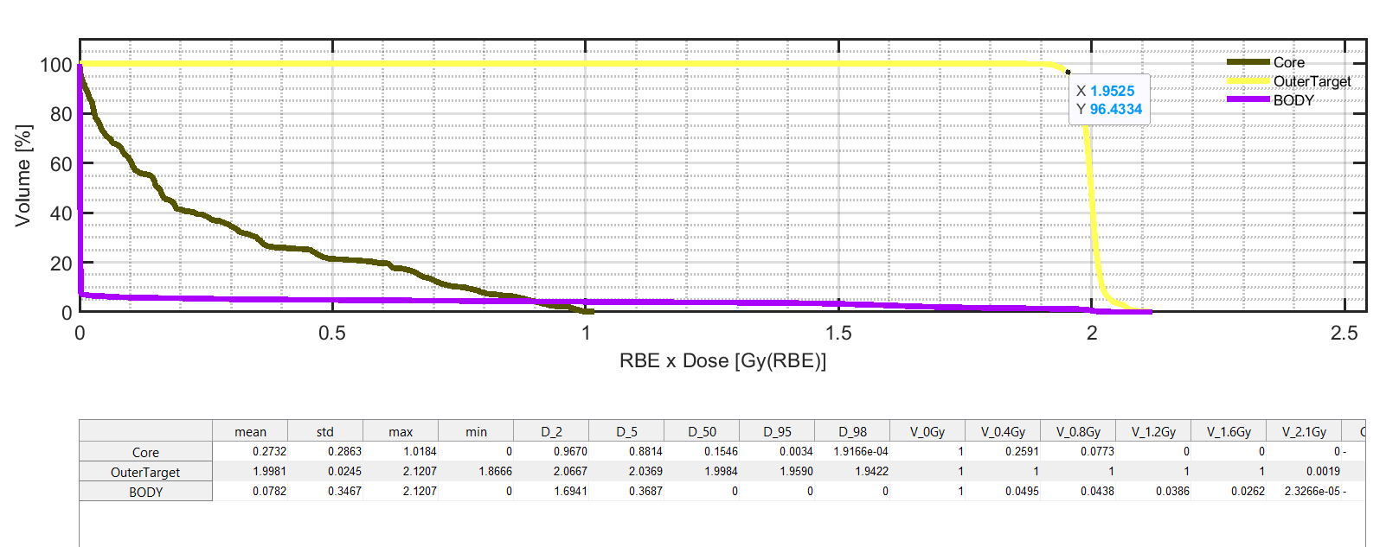
Volume dose histograms

Slide 7
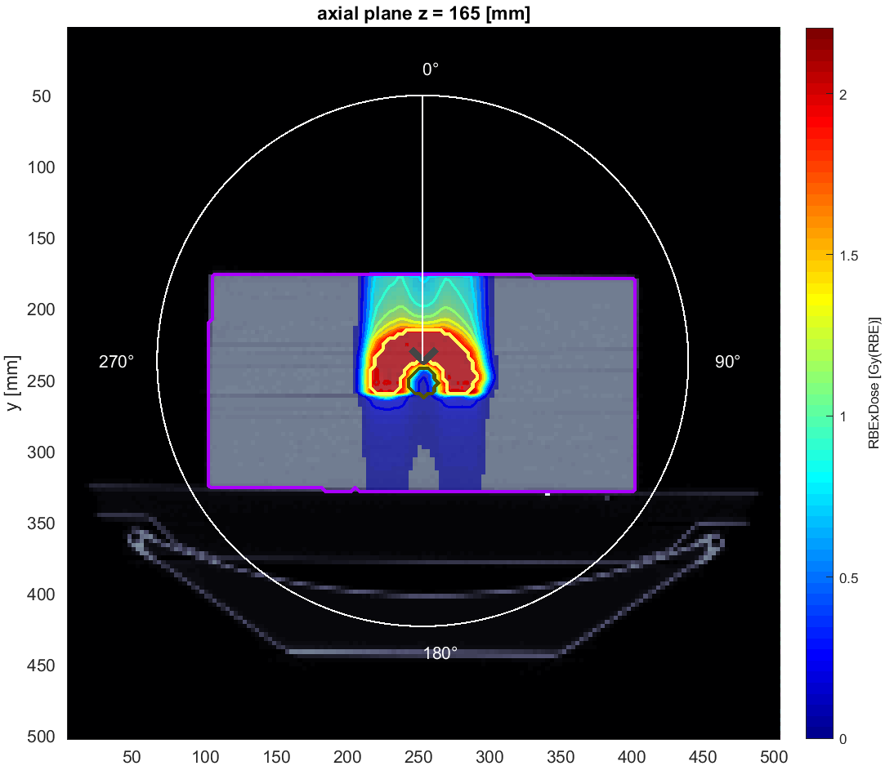
Carbons, one angle
Angle = 0

Slide 8
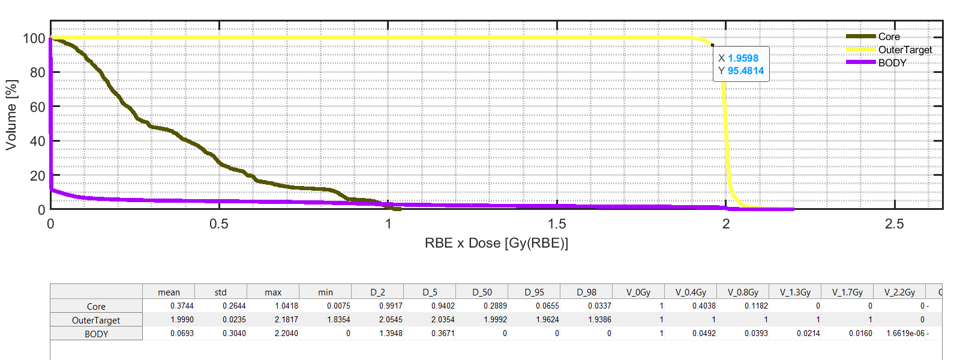
Volume dose histograms

Slide 9
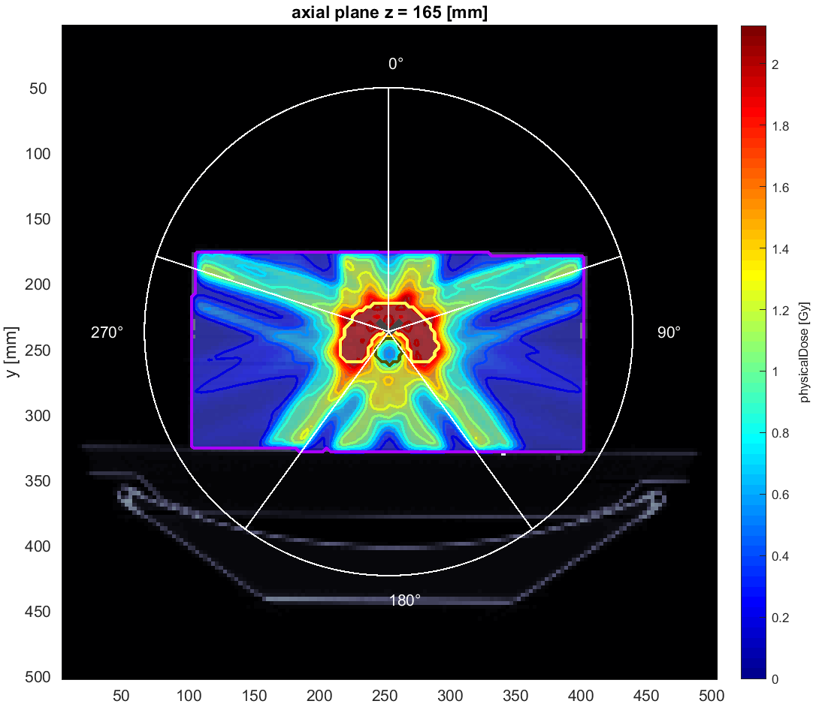
Photons, five angle
Angle = 0, 72, 144, 216, 288

Slide 10
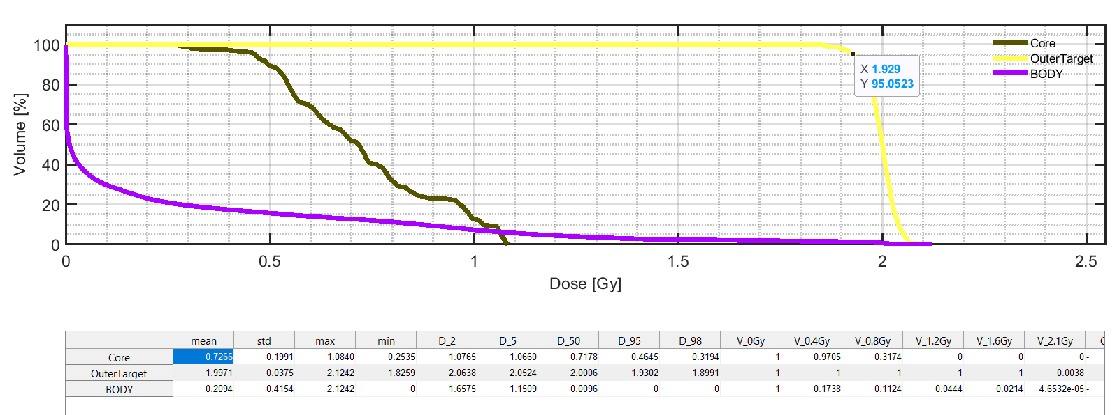

Slide 11
Thank you for your attention

