Slide 1
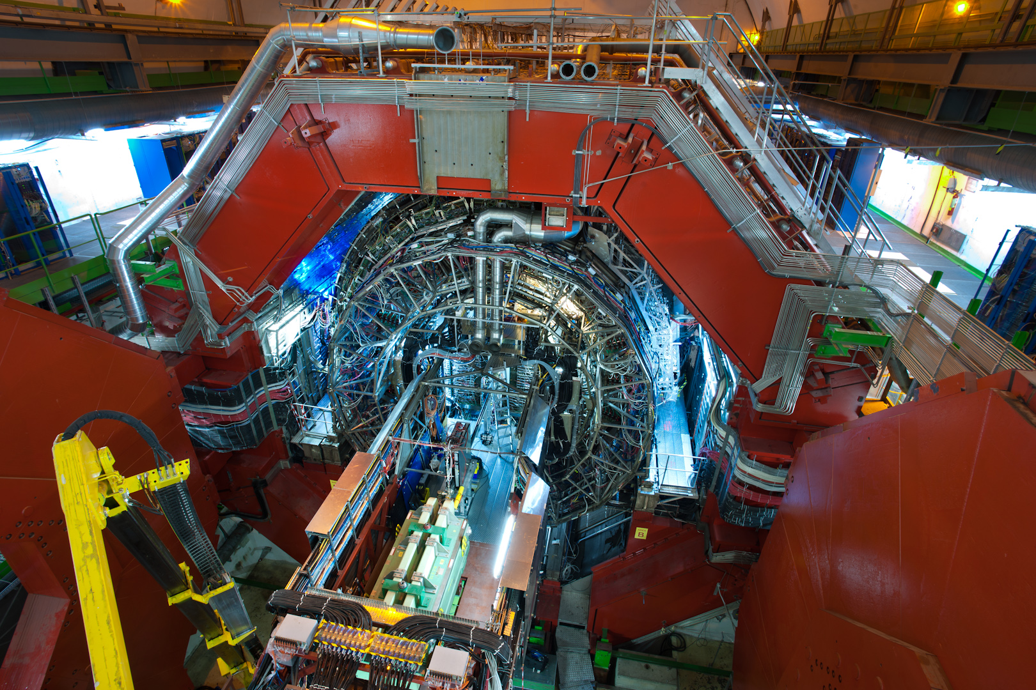
ALICE : A Large Ion Collider Experiment

Slide 2


Slide 3
Heavy ions at LHC
In addition to protons, LHC accelerates and collides lead ions isotope Pb ²⁰⁸ with 82 protons and 126 neutrons in the nucleus
Pb atom -> Pb²⁹⁺ -> Pb^{54+ ->} Pb⁸²⁺ (bare lead nucleus)
Beam energy 3.5 ΤeV x 82 = 287 TeV (574 TeV at the collision point)
6.5 ΤeV x 82 = 1066 TeV (574 TeV at the collision point)
Run 3 Energy 6.8 TeV x82 = 557.6 TeV (1115 TeV at point of collision)
Why are lead ion collisions at high energies of particular interest?

Slide 4
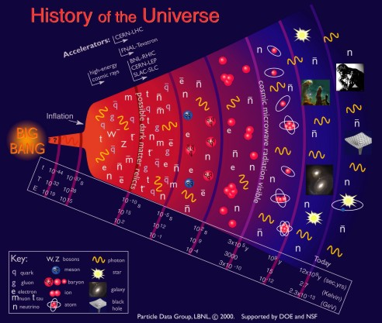
Millionths of a second after the big bang, all matter is made of free quarks and gluons,
THE QUARK GLUON PLASMA
As the universe cools and expands, the quarks and gluons are “imprisoned” for ever inside hadrons: from these, only protons and neutrons remain today
13.7 billion years ago the universe was born from a Big Bang

Slide 5
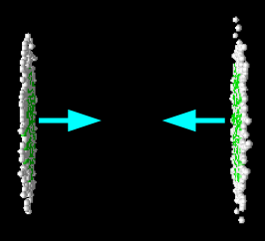
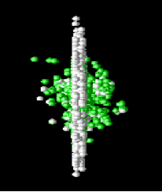
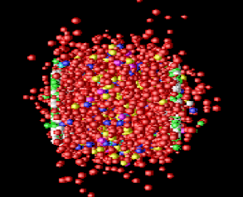
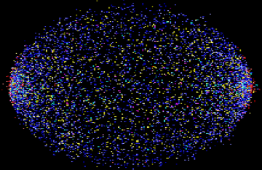
Little Bang
By colliding lead nuclei at very high energies we recreate the conditions of density and temperature which existed fractions of a second after the Big Bang
The protons and neutrons which constitute the lead nuclei melt liberating the quarks and gluons which are bound inside them
A new state of matter is created : the QUARK GLUON PLASMA
By studying its properties
We will understand better the processes which took place during the first fractions of a second in the life of the universe
We will understand better the strong interaction and how the protons and neutrons acquire their mass

Slide 6
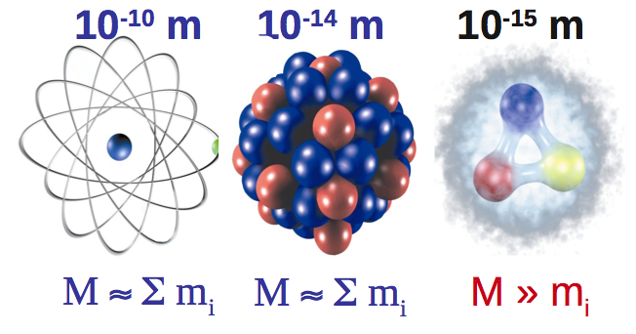
atom nucleus nucleon
In nucleons (protons and neutrons) the mass is not defined by the sum of masses of their constituents but mainly from the energy due to the movement of quarks and the energy of the gluons
Example
the proton (uud) mass : 938 MeV/c²
up quark mass : 1.7 – 3.3 Mev/c²
down quark mass : 4.1 – 5.8 MeV/c²
Sum : 7.5 -12.4 MeV/c²

Slide 7

ALICE studies stong interactions..
  Why are quarks permanently confined inside hadrons?
F=kr₁
F=kR₂
F=kR₁
F=kr₂
q
q
q
q
q
q
q
q
Notes:
Στα αδρονια τα κουαρκ συνδεονται με την ισχυρη δυναμη, που η ισχυσ της μεγαλωνει με την αποσταση και που εχει να κανει με το φορτιο του χρωματος Αν προσπαθησουμε να διαχωρισουμε τα δυο κουαρκ, δινοντας ενεργεια στο συστημα, οταν η ενεργεια κανει δυνατη τη δημιουργια ενος ζευγαριου κουαρκ-αντικουαρκ, σπαζει ο δεσμος και καταληγουμε με δυο αδρονια (αντι του αρχικου ενος)

Slide 8
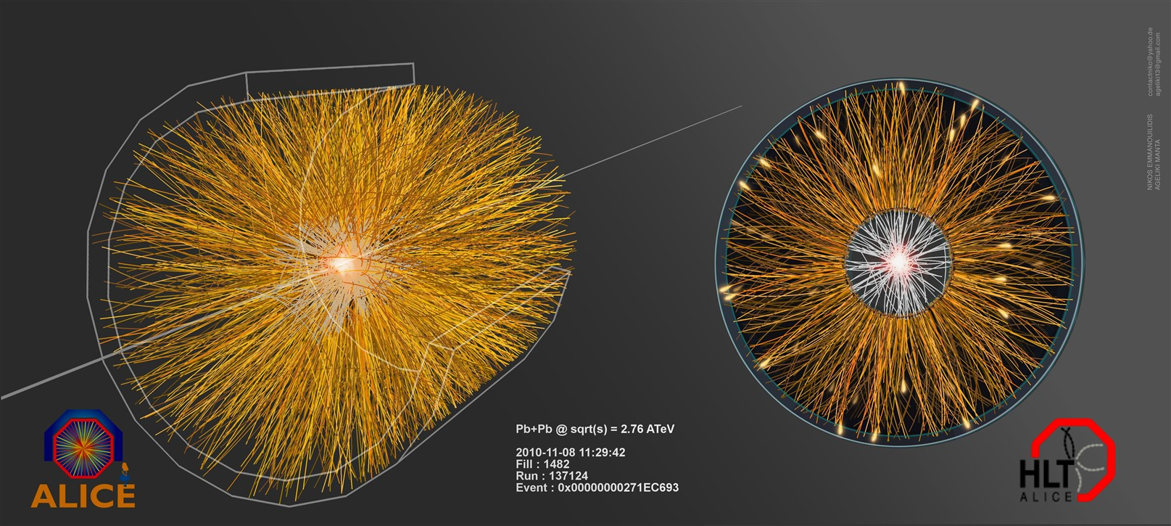
At LHC lead nuclei collide with an energy of 2.76 ΤeV/nucleon pair
13 times higher than the energy at which gold nuclei collide at RHIC (Relativistic Heavy Ion Collider) at Brookhaven, USA (near New York)
Lead ion collisions produce thousands of new particles – here we see their traces

Slide 9
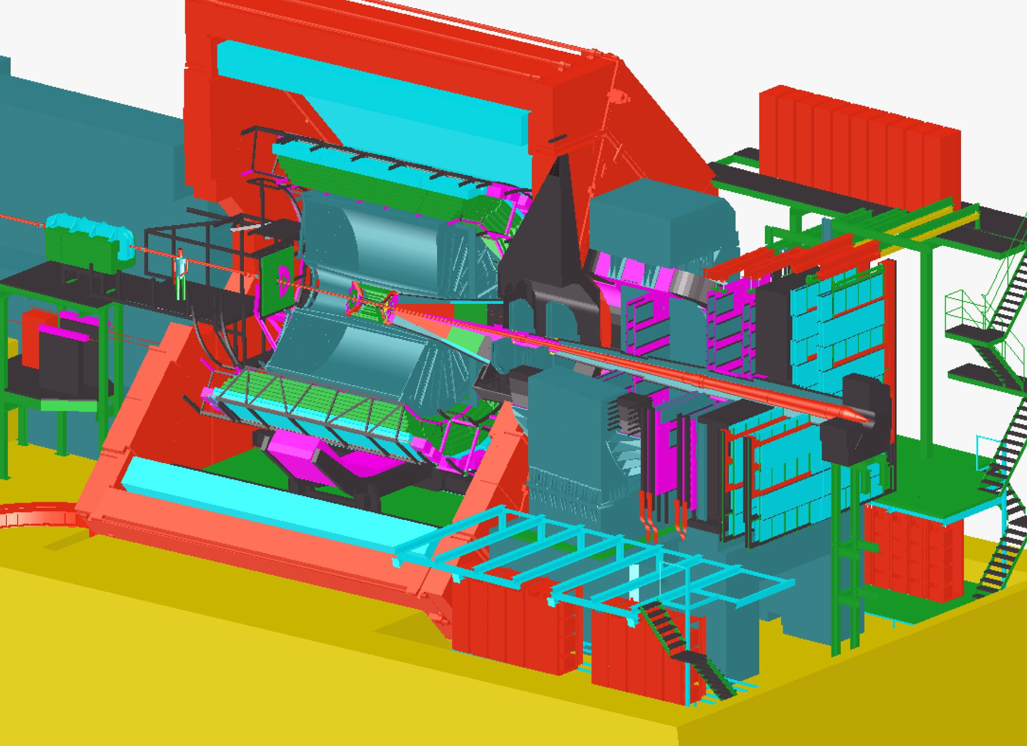
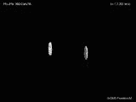
ALICE : Σχεδιασμένο για να απαντήσει στα παραπάνω ερωτήματα

Slide 10
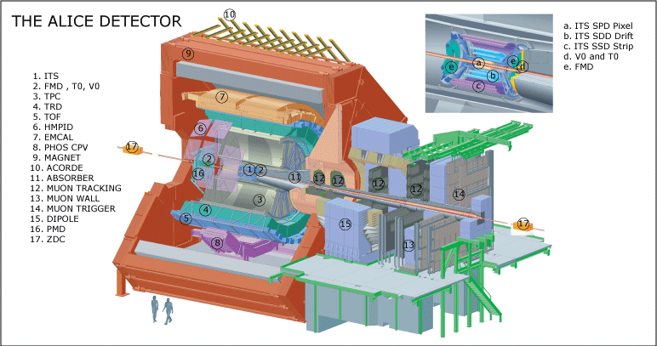
ALICE : A Large Ion Collider Experiment
16 m x 16 m x 26 m 10 0000 tons installed at point 2 of LHC, 56 m underground

Slide 11

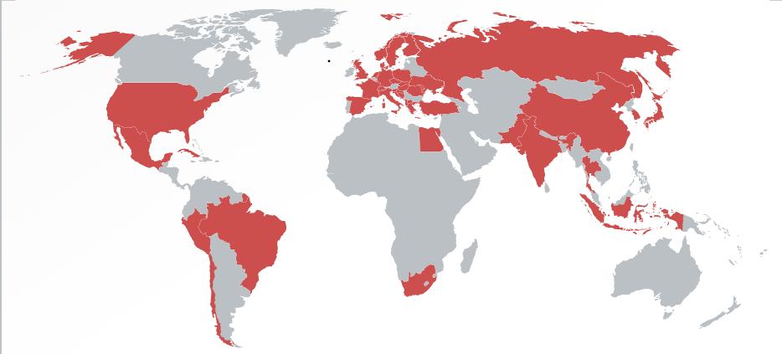
The Collaboration
37 countries, 131 Institutes, 1500 members

Slide 12
Particle Detectors
They “see” the particles produced from beam-beam or beam-target collisions
The detection is based on interaction of the particles with matter
and eventually production of an electrical signal
Various types of detectors :
Solid state detectors (semiconductors),
Gaseous detectors,
Scintillators …
They convey information about :
The particle energy (calorimeteres)
The particle type (particle identification)
Particle trajectory (tracking devices)

Slide 13
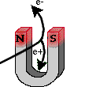
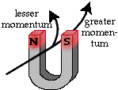
The magnetic field
Identifies the charge
Lower momentum
p = momentum
R = radius of curvature
B = magnetic field
q = charge
Higher momentum
Measures momentum
R=p/qB

Slide 14
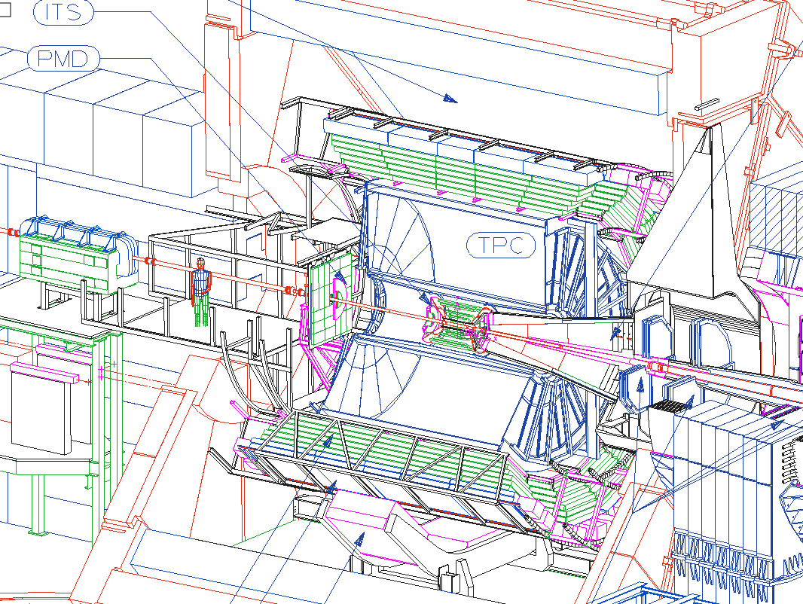
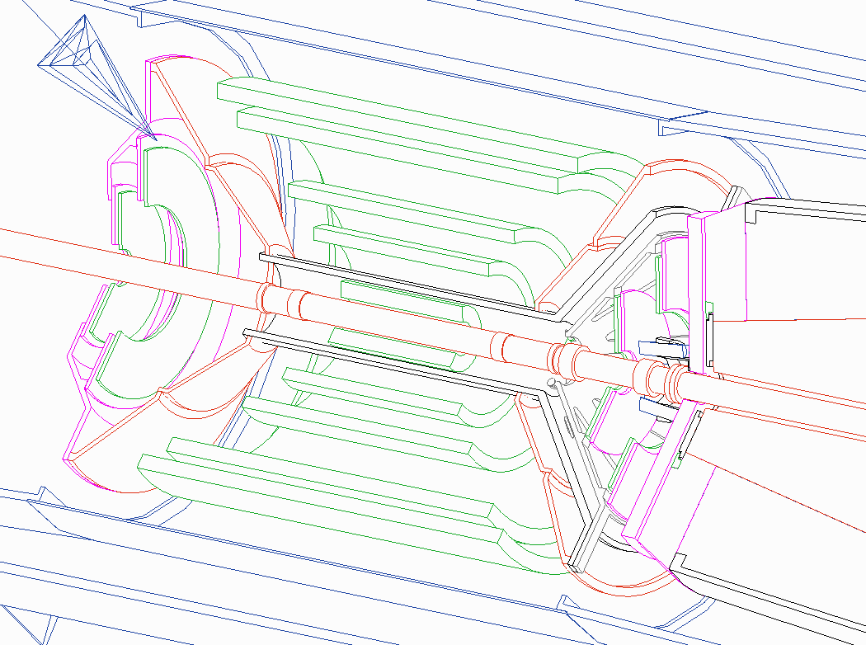
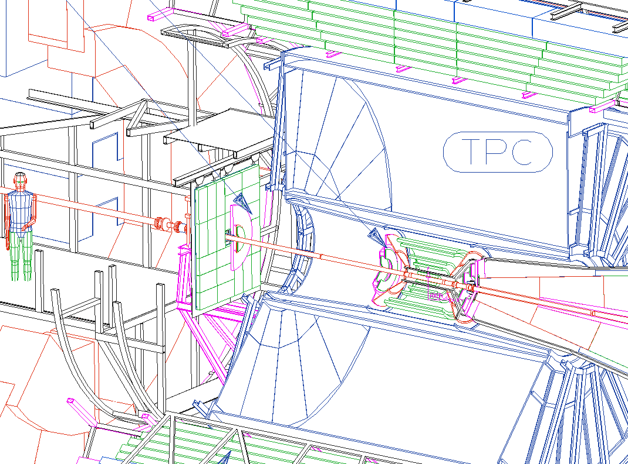
ALICE : 18 different detection systems
Around the interaction point, we have installed detectors such as ...
Inner Tracking System (ITS): p, pid
Time projection chamber (TPC) : p, pid
Transition radiation detector (TRD) : e⁻
Time Of Flight (TOF): pid

Slide 15
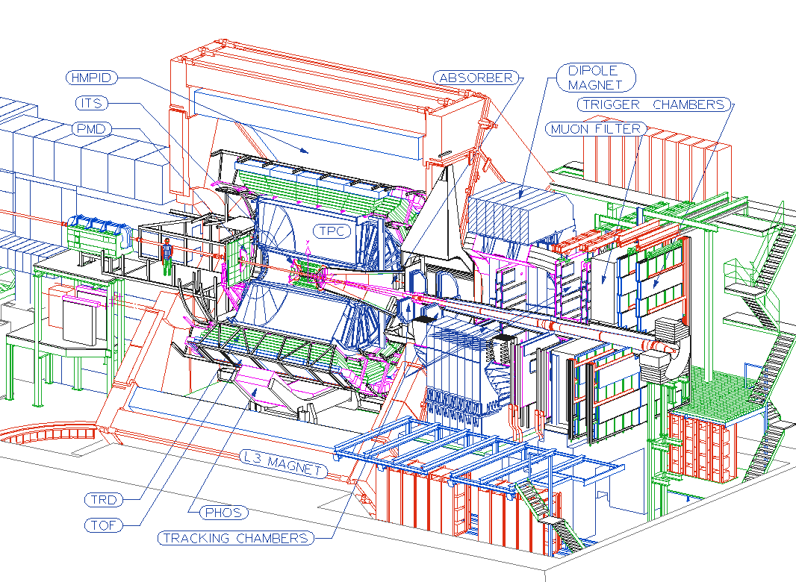
… and some more specialised detectors
Muon spectrometer:
Absorber
Dipole magnet
μ tracking chambers
Filter
Trigger
Photon detectors

Slide 16
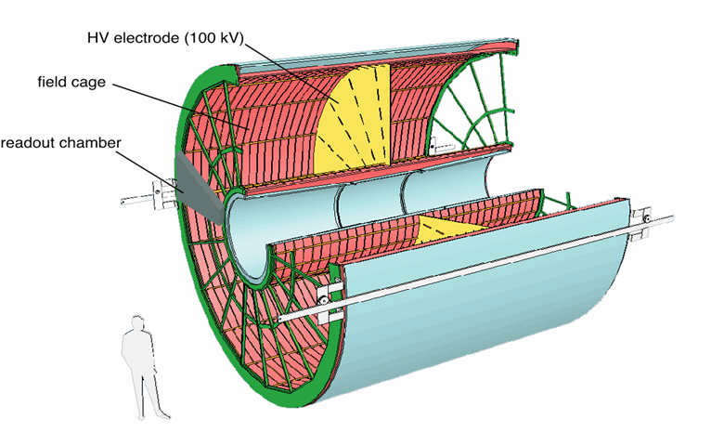
Τime Projection Chamber (TPC)
GAS VOLUME
88 m³
DRIFT GAS
90% Ne - 10%CO₂
E
E
Co₂ insulation
E
E
Drift volume
88ms
E
400 V / cm
1.6
P
b
P
5.6 m
NE / CO₂
88ms
510 cm
E
Central electrode
Readout plane segmentation
18 trapezoidal sectors
each covering 20 degrees in azimuth
End plate
5 m

Slide 17
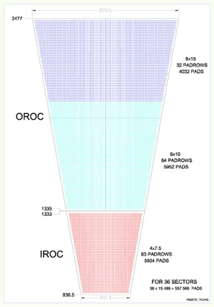
Τime Projection Chamber (TPC)
E
-HV
E
-
-
-
-
Run 3 Energy 6.8 TeV x82 = 557.6 TeV (1115 TeV at point of collision)
-
-
θ,φ
-
-
-
-
-
-
-
-
-
Arrival time

Slide 18
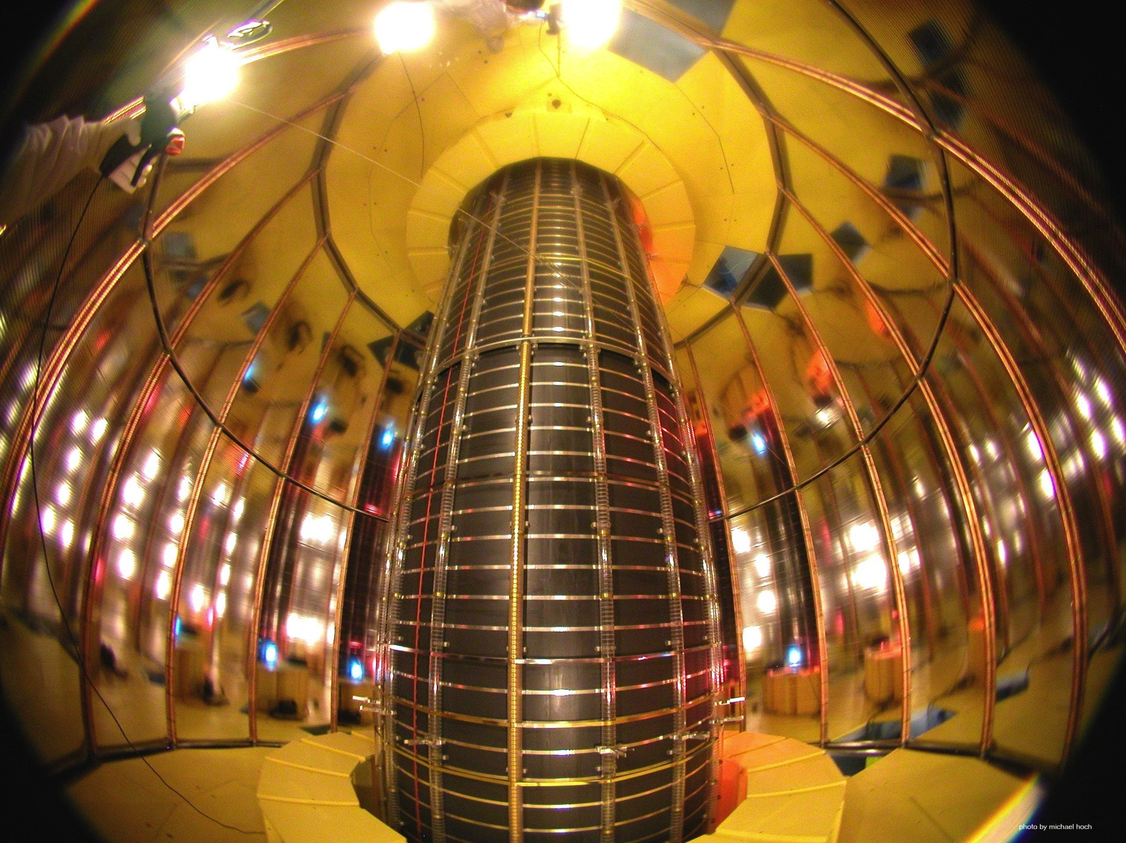

Slide 19
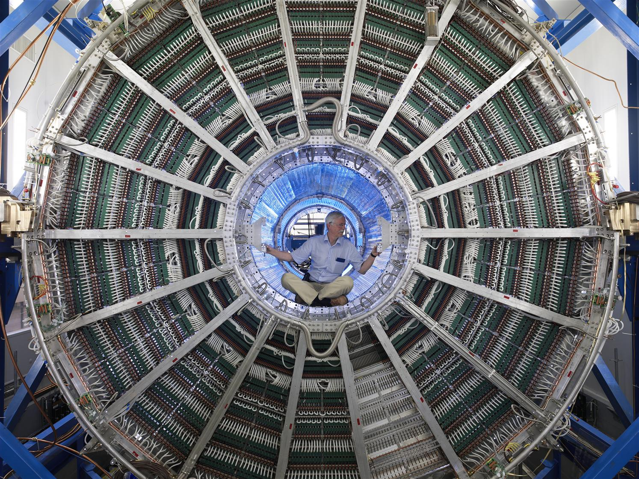

Slide 20
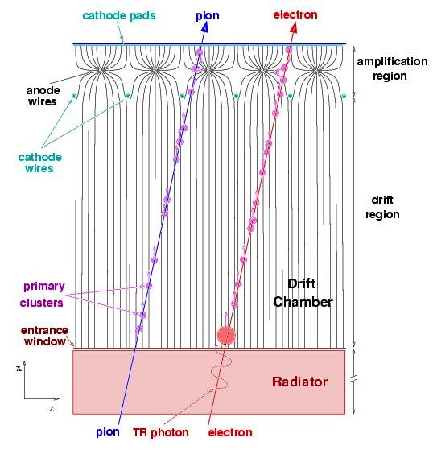
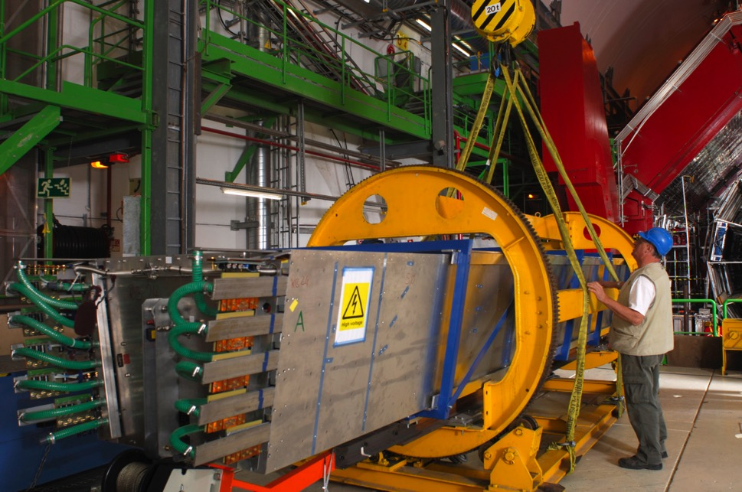
Transition Radiation Detector
A relativistic particle going through an inhomogeneous medium emits transition radiation (X rays)
The medium is chosen so that electrons only emit X-rays
We detect both charged particles and X-rays
The TRD separates electrons from pions

Slide 21
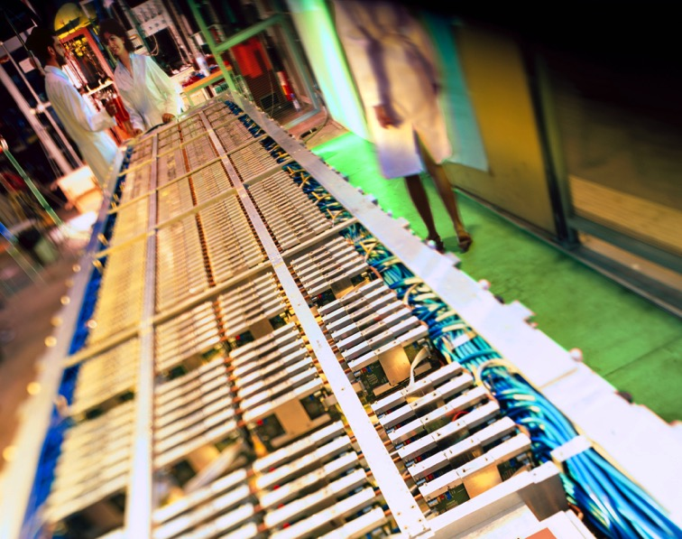
Time of Flight
HV
cathode
resistive
plate
anode
HV
Readout pads
Multigap Resistive Plate Chamber
It measures the time of flight of charged particles with a precision of 70 ps
Time and trajectory length give the particle velocity
From the curvature of the track we find the momentum
Momentum and velocity give us the mass, which identifies a particle uniquely

Slide 22
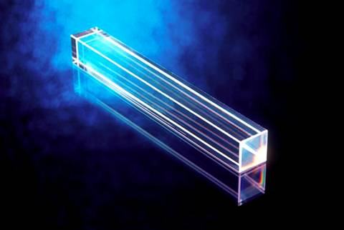
PHOS : PHOton Spectrometer
PbWO₄ : heavy and transparent
Photons are converted into electron-positron pairs
Electrons excite the atoms of the crystal
Excitation is followed by de-excitation -> emission of light (UV photons)
UV photons are detected by a photodiode at the end of the crystal, which converts phtons to electrons
Electromagnetic calorimeter
Electric signal

Slide 23
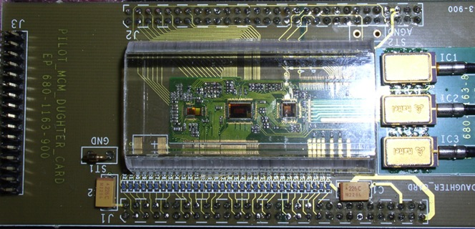
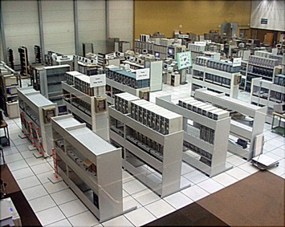
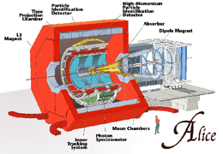
Signal processing
The signal from each detection is first processed by specialised electronics (front end electronics)
These electrical signals are digitised (readout electronics) and read out by computers
The information is transferred by optical fibers and recorded.

Slide 24


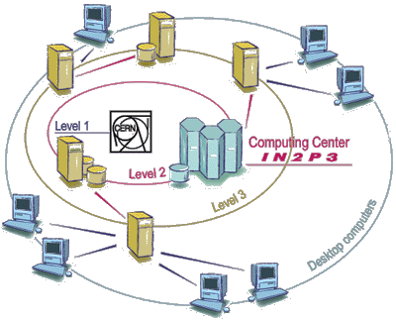
Data analysis
Thousands of computers in computer centres all over the world are connected to the GRID. They share their storage capacity and processing power.
LBL/NERSC
OSU/OSC
Birmingham
NIKHEF
Dubna
Nantes
Saclay
GSI
Merida
CERN
Padova
IRB
Lyon
Torino
Bologna
Bari
Cagliari
Yerevan
Catania
Kolkata, India
Capetown, ZA
The GRID

Slide 25
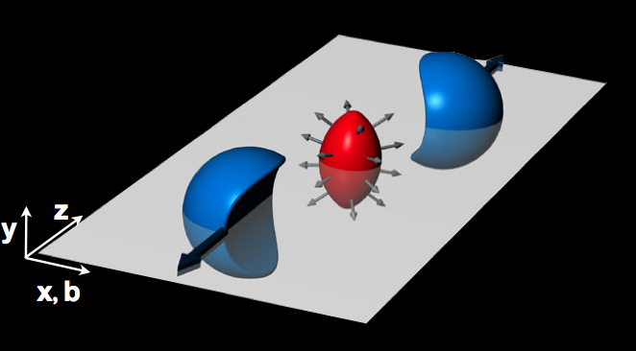
A perfect liquid at LHC
The primordial matter recreated by high energy lead ion collisons at the LHC was initially expected to behave like a gaseous plasma; instead, it appears to behave like a perfect liquid, with coordinated collective motion (“flow”) among the constituent particles.
This had already been announced by experiments at RHIC
The dense matter created by lead collisions flows almost with no friction (like water, which has low viscosity) and not like honey (which has high viscosity)
Almond shape
More hadrons are observed parallel to the interaction plane then in the plane perpedicular to it
One of the most spectacular results of heavy-ion experiments

Slide 26
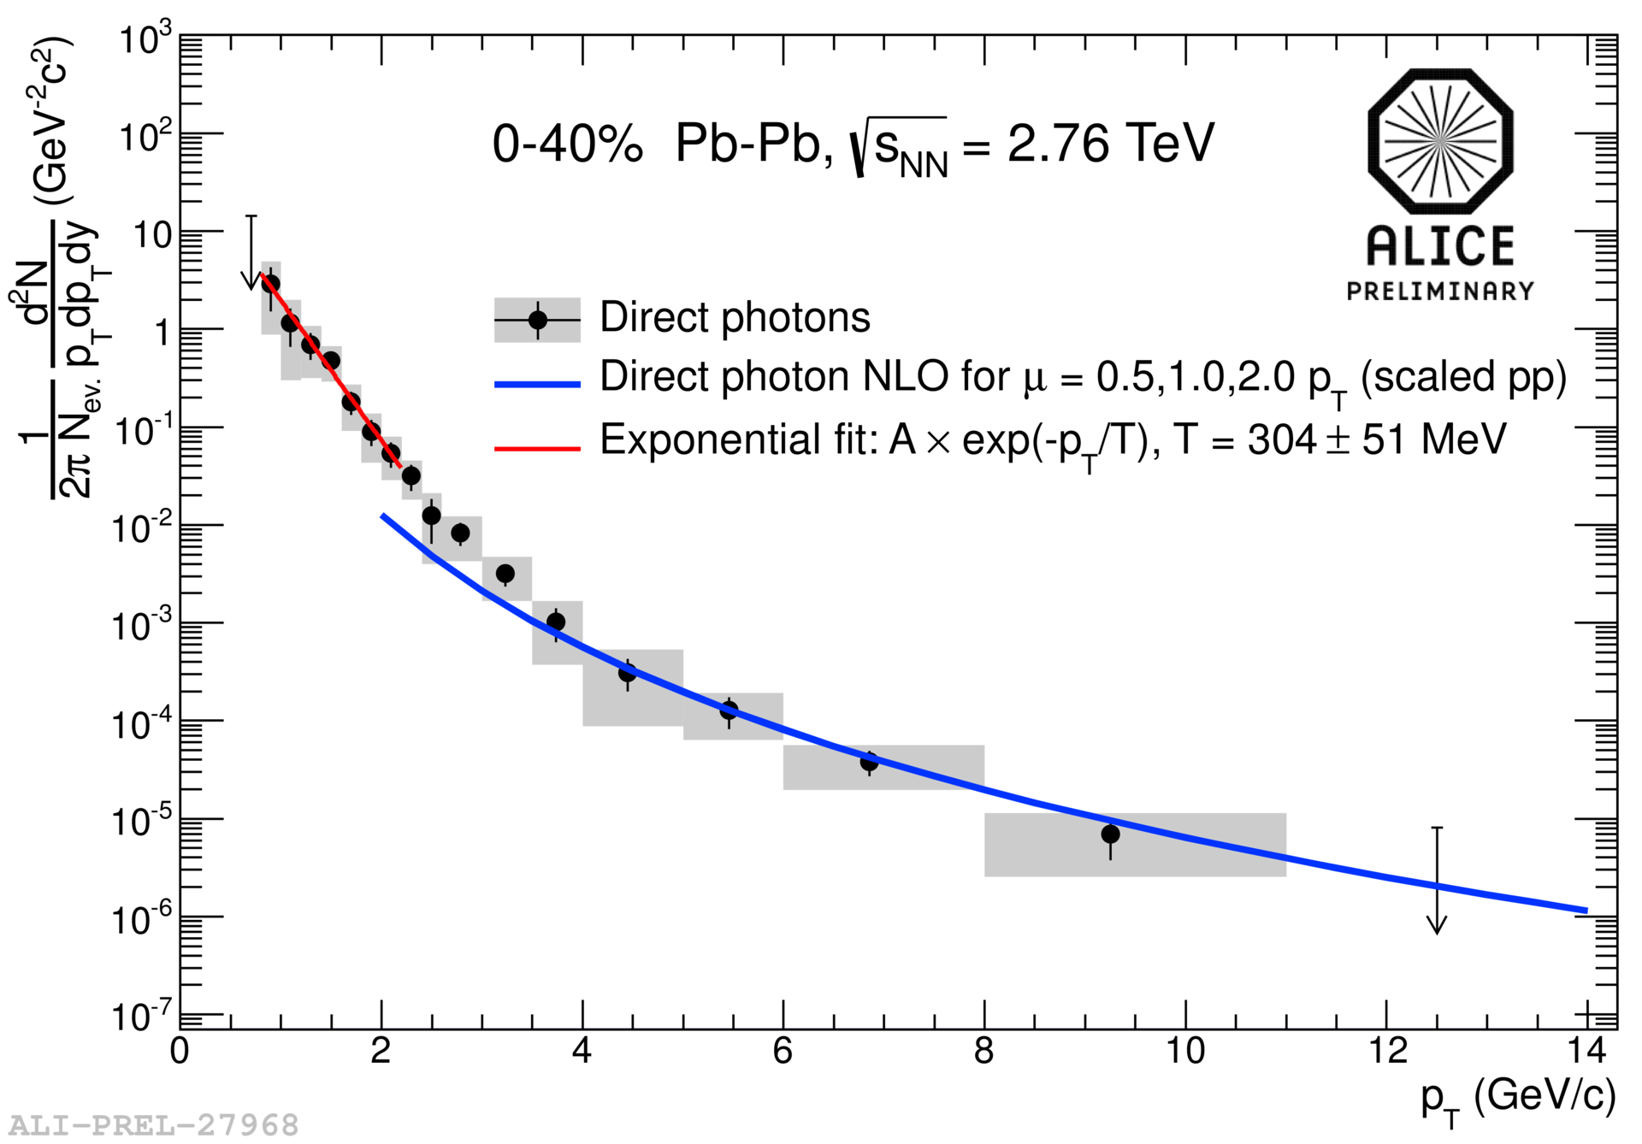

Highest man-made temperature
Thermal photons, radiated by the quark gluon plasma (“direct” photons, not coming from decays of hadrons) reflect the temperature of the system.
The inverse slope of the distribution of these photons suggests that the initial temperature of the system created by lead collisions is some trillion of degrees Kelvin.
This temperature is 250 000 times higher than the temperature in the core of the sun
The hottest piece of matter ever formed
Before heavy ion collisions at LHC

Slide 27
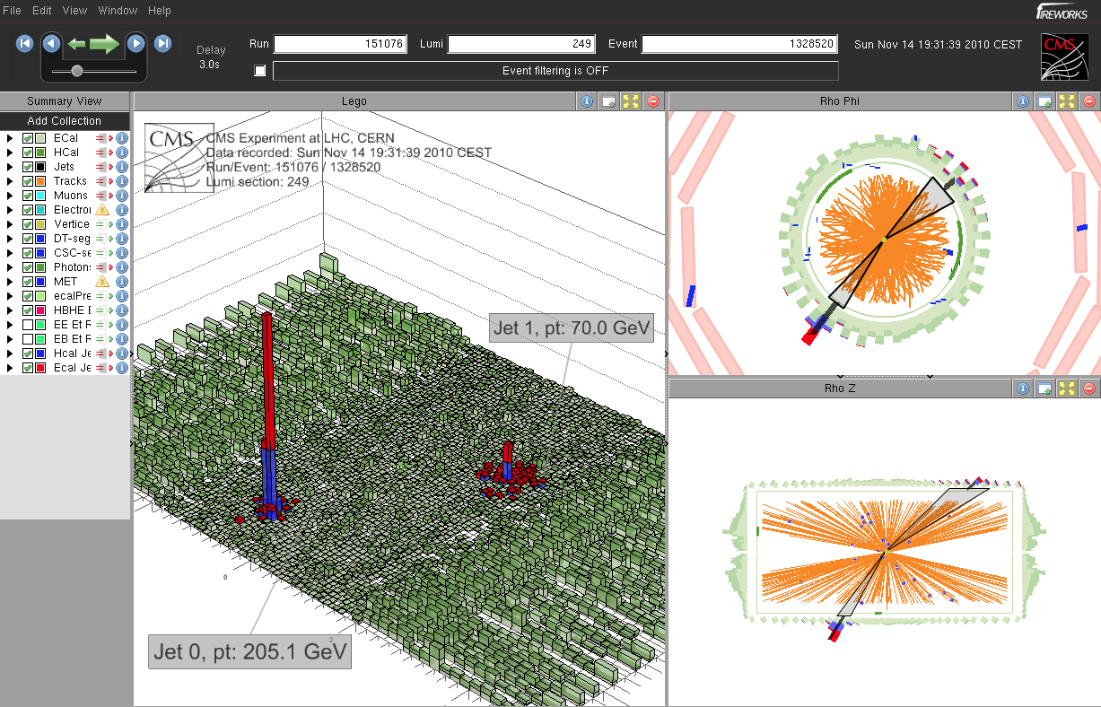
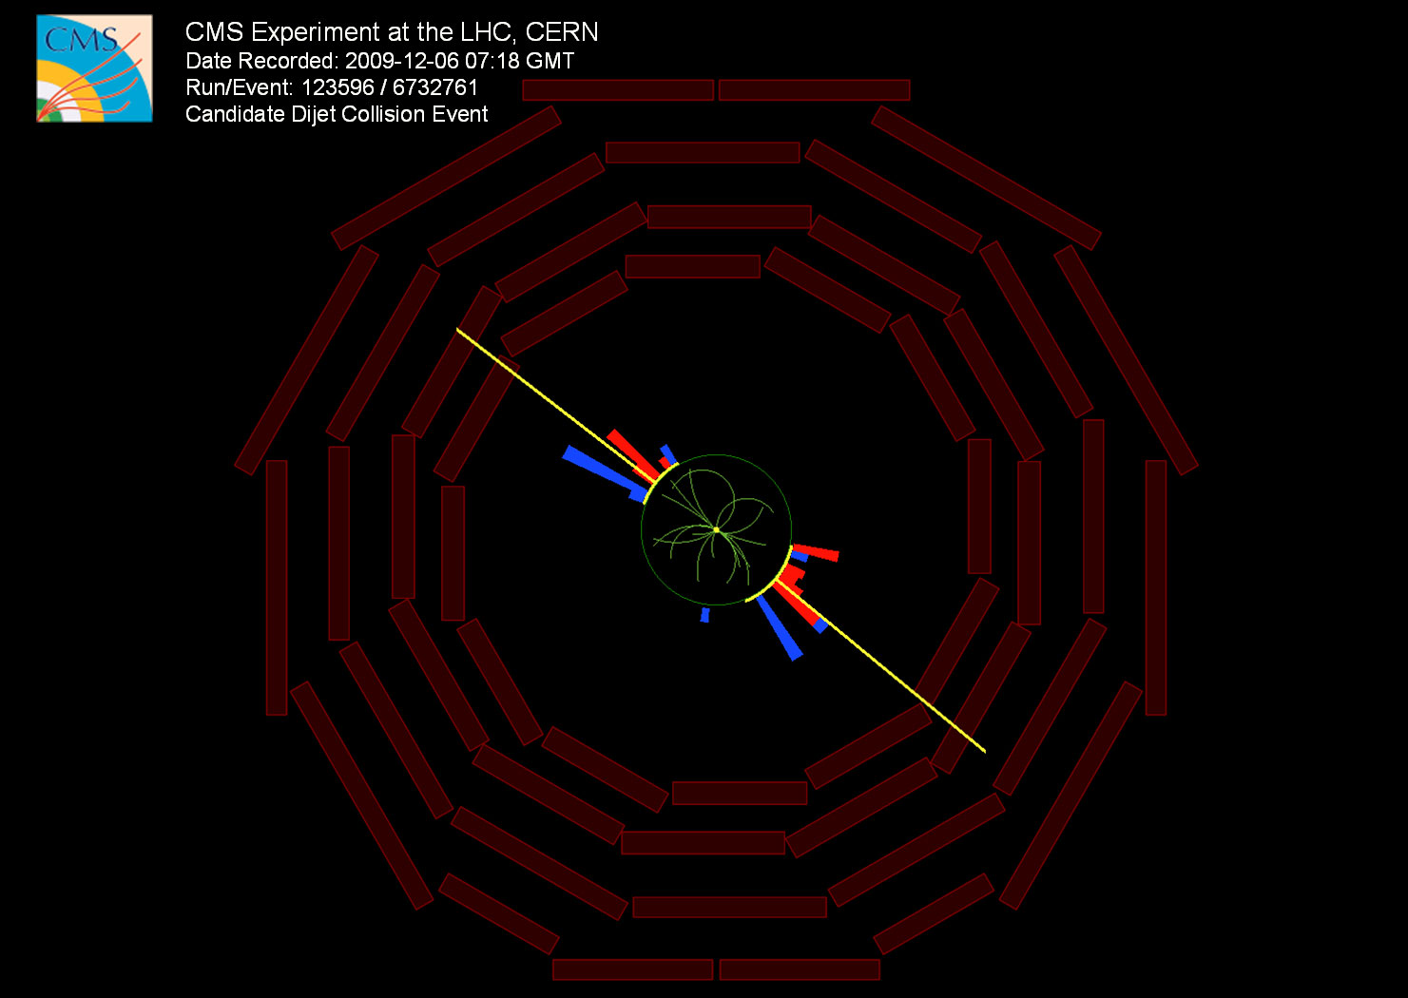
Energy loss
One of the first announcements from the first lead ion run at LHC, December 2010)
Jets going in opposite directions
have ~ equal energies
Lead ion collision event
One jet has much less energy than the other.
The jet produced near the QGP surface has high energy whereas the one that traverses the QGP is absorbed and scattered by the dense medium losing big part of its energy
Proton collision event – two jets with energy of ~20 GeV

Slide 28
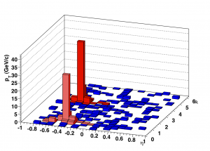
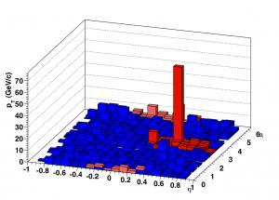
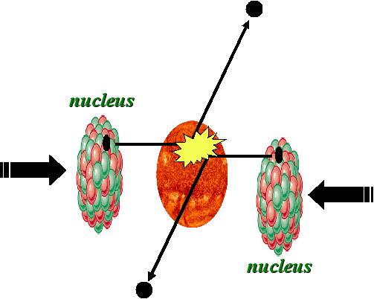
Jet Quenching
ALICE – peripheral lead ion collisions- two jets
ALICE – central lead ion collisions
1 jet is visible, the other has been absorbed while travelling through the QGP and does not come out

Slide 29
The J/Ψ mystery
J/Ψ Discovered in 1974, almost simultaneously, at Brookhaven (proton-nuclei collisions) and at SLAC (collisions e⁺e⁻)
Bound state of a c quark and a c anti-quark (mass 3 GeV)
The two “object” that make the J/Ψ are bound due to strong interaction
Inside the quark gluon plasma, due to the high number of free colour charges, the binding between c-quark and c-antiquark becomes weaker, the pair disintegrates and the J/Ψ disappears
Suppression of the observed J/Ψ signal
(J/Ψ -> μμ and J/Ψ -> e⁺e⁻)
Suppression depends on QGP temperature

Slide 30
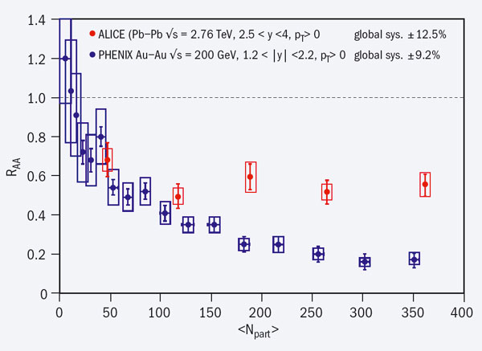
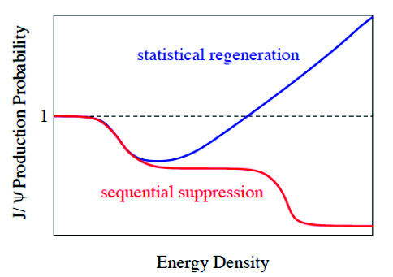
The J/Ψ mystery
Regeneration of J/Ψ at very central collisions
Two competing phenomena
Suppression of J/Ψ due to interaction with the quark gluon plasma
Creation of many J/Ψ due to the high number of c – anti-c pairs created from the huge collision energy
Nuclear modification factor R_{AA}
number of J/Ψ observed in lead ion collisions
_____________________________________________________________
number of J/Ψ observed in proton collisions

Slide 31
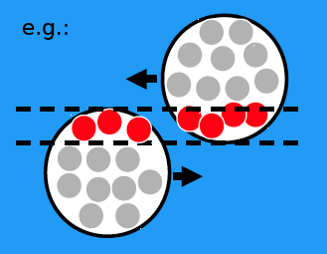
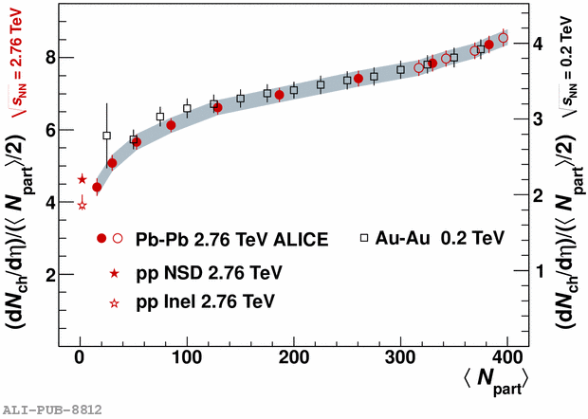
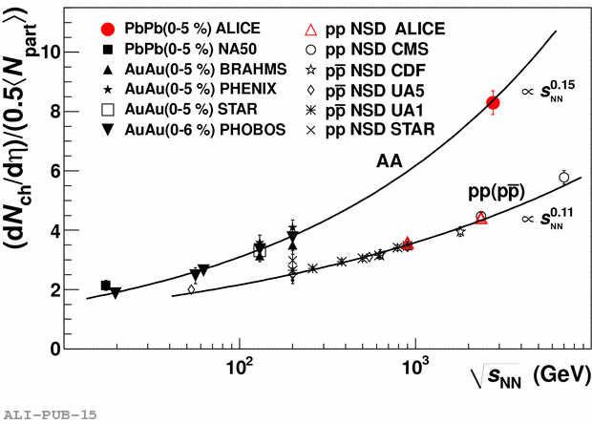
When lead nuclei collide all nucleons (protons and neutrons) can take part in the collision (central) or only some (peripheral)
N_{part}: number of nucleons participating in the interaction
The number of charged particles produced depends on the centrality of the collision.
It gives information on how the quarks and gluons are transformed into the particles (pions, Kaons,..) which we detect.
From the number of charged particles we deduce the energy density : it is 3 times higher than at RHIC.

