Slide 1

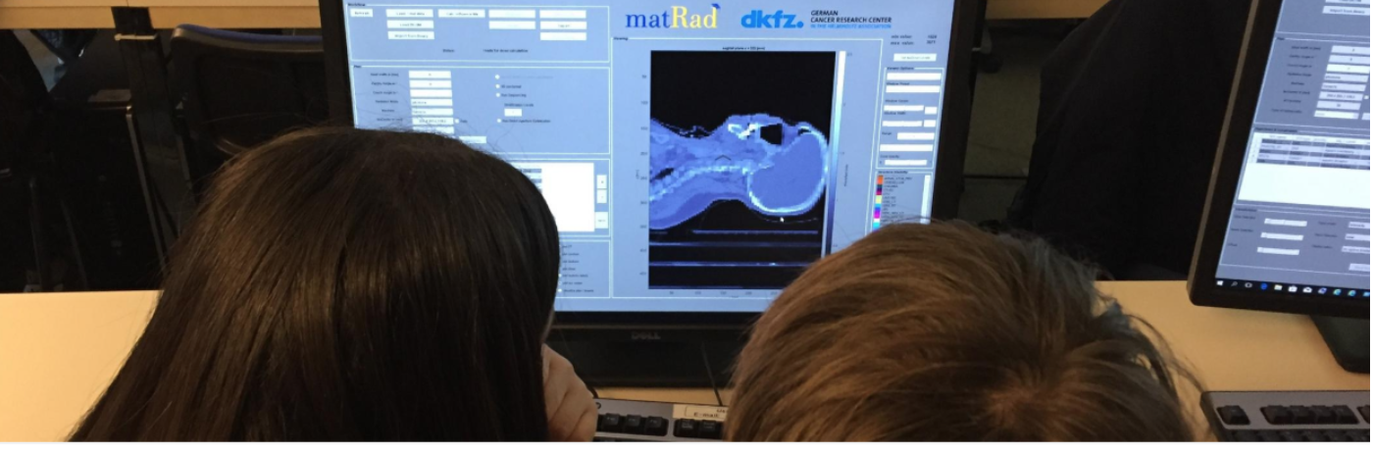




Particle Therapy MasterClass
https://indico.cern.ch/event/840212/
Yiota Foka (GSI/CERN)
on behalf of
IPPOG and IMC Steering Group

Slide 2
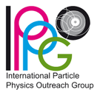

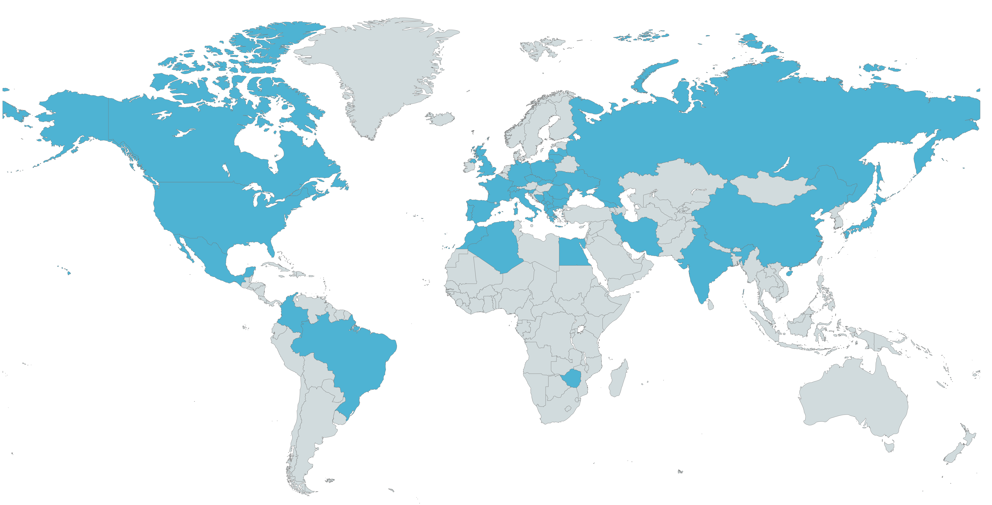
Participants of hybrid PTMC 2020-2025
https://indico.cern.ch/e/PTMC
Total: 37 countries , 70 institutes
From Japan to Latinoamerica
web pages with agendas of every institute with material
in different languages, publicly available for future events
Interest of students, motivation of tutors (voluntary work), potential impact

Slide 3
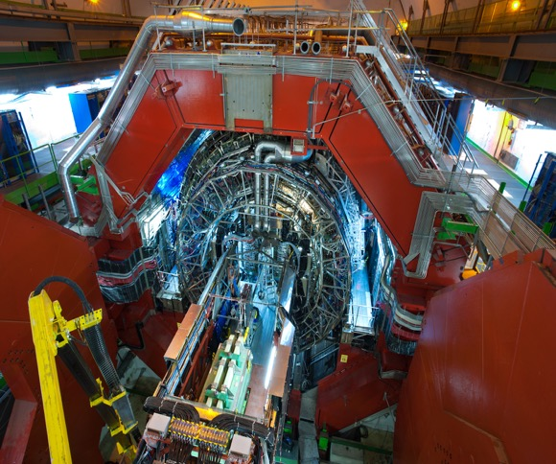
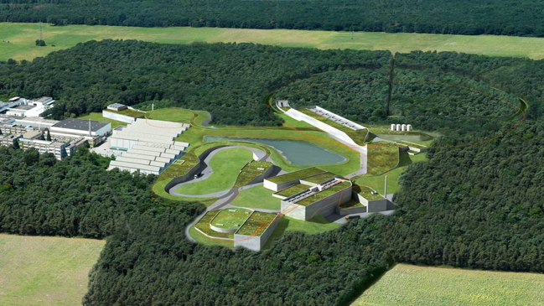
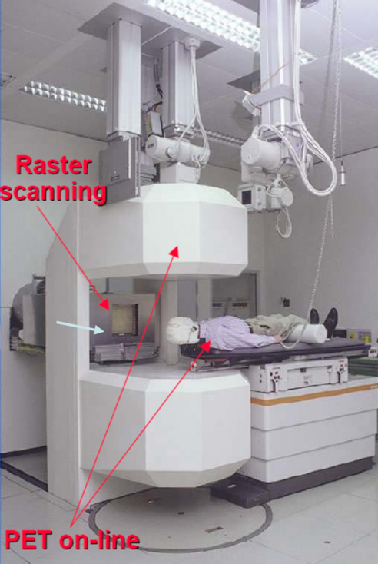
Heavy-ion research and heavy-ion therapy
Heavy-ion Physicist, involved with medical applications of heavy-ions for cancer therapy
ALICE heavy-ion experiment at CERN
GSI, pioneering heavy-ion cancer therapy
  From GSI research laboratory
  Implemented in the Heidelberg and Marburg Ion Treatment centers in Germany

Slide 4
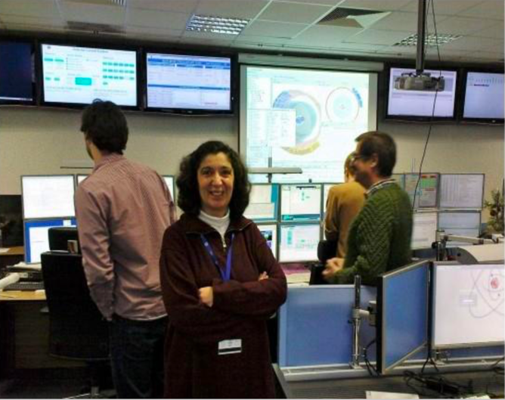
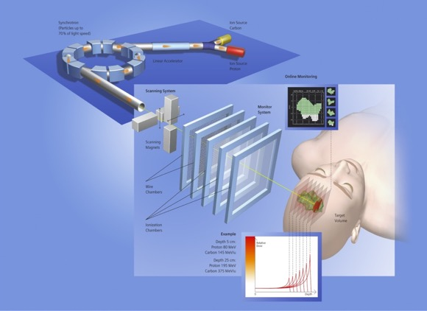
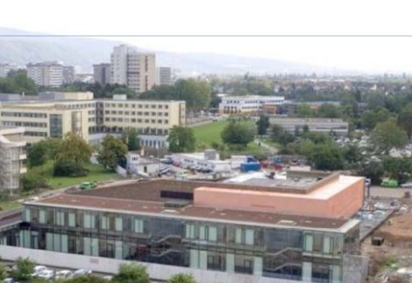
Heavy-ion research and heavy-ion therapy
Heavy-ion Physicist, involved with medical applications of heavy-ions for cancer therapy
ALICE heavy-ion experiment at CERN
GSI, pioneering heavy-ion cancer therapy in the 90s
Heidelberg Ion Therapy HIT centre
ALICE Control Room
ALICE at the CERN LHC
Implemented in Heidelberg, Marburg ion therapy centres
GSI and future FAIR
ALICE at the CERN LHC

Slide 5
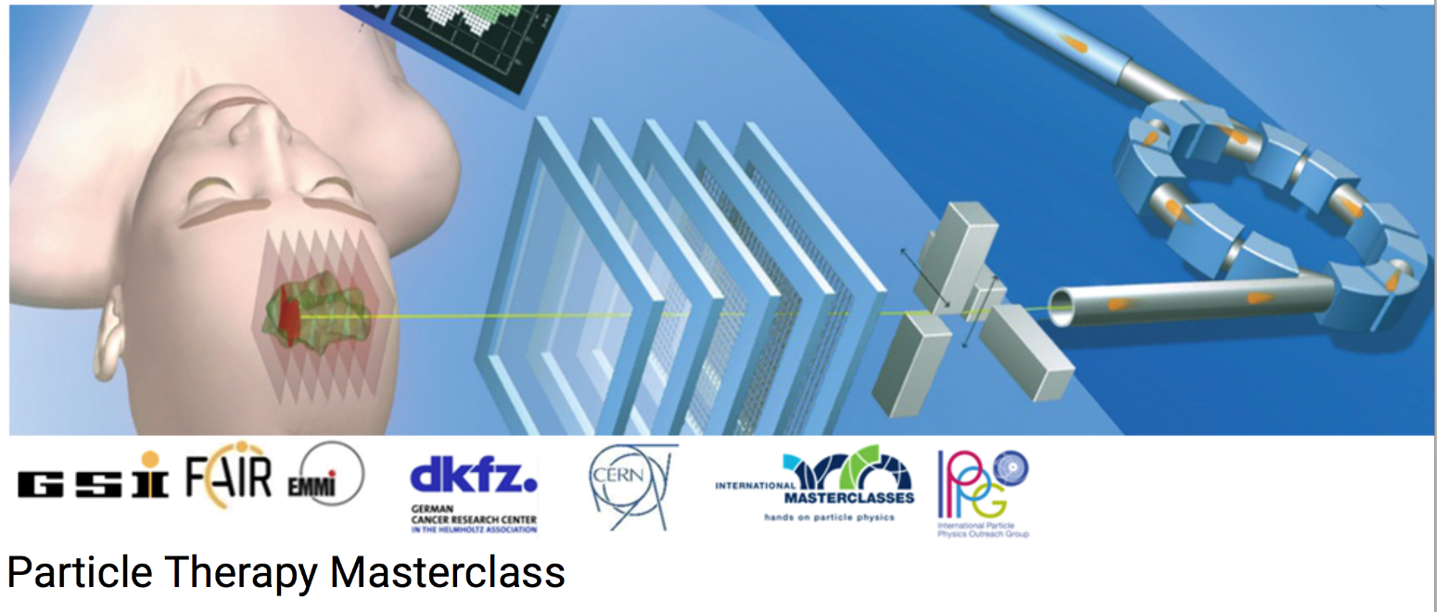

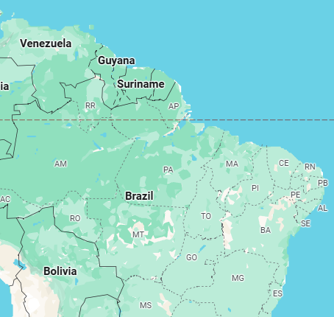
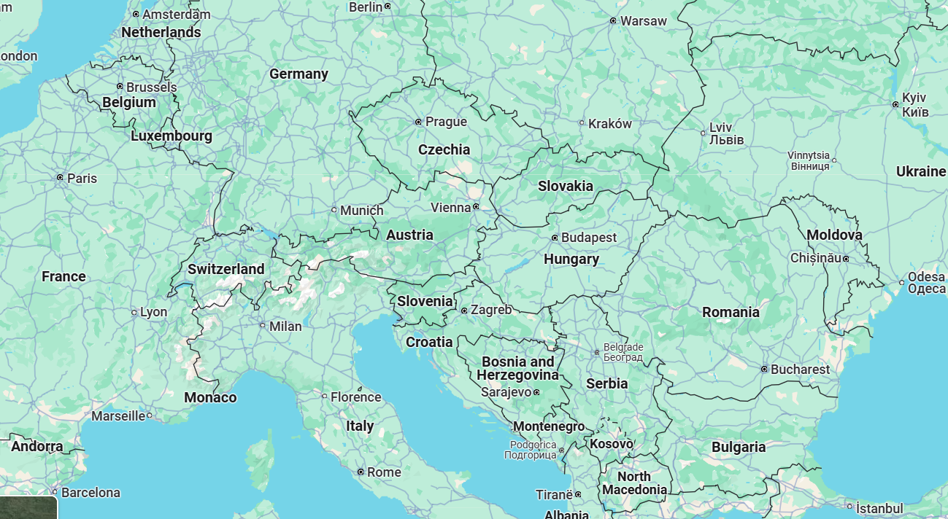
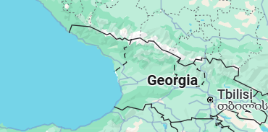

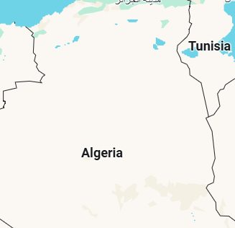
PTMC Video Conference 4 April 2025
PARTICLE THERAPY MASTERCLASS

Slide 6
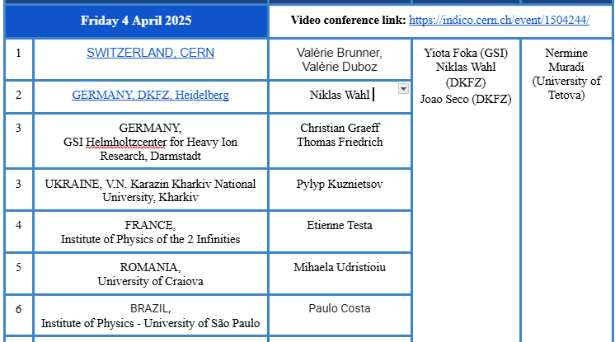
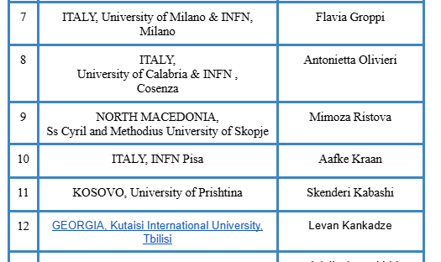
PTMC Video Conference 4 April 2025
PARTICLE THERAPY MASTERCLASS

Slide 7
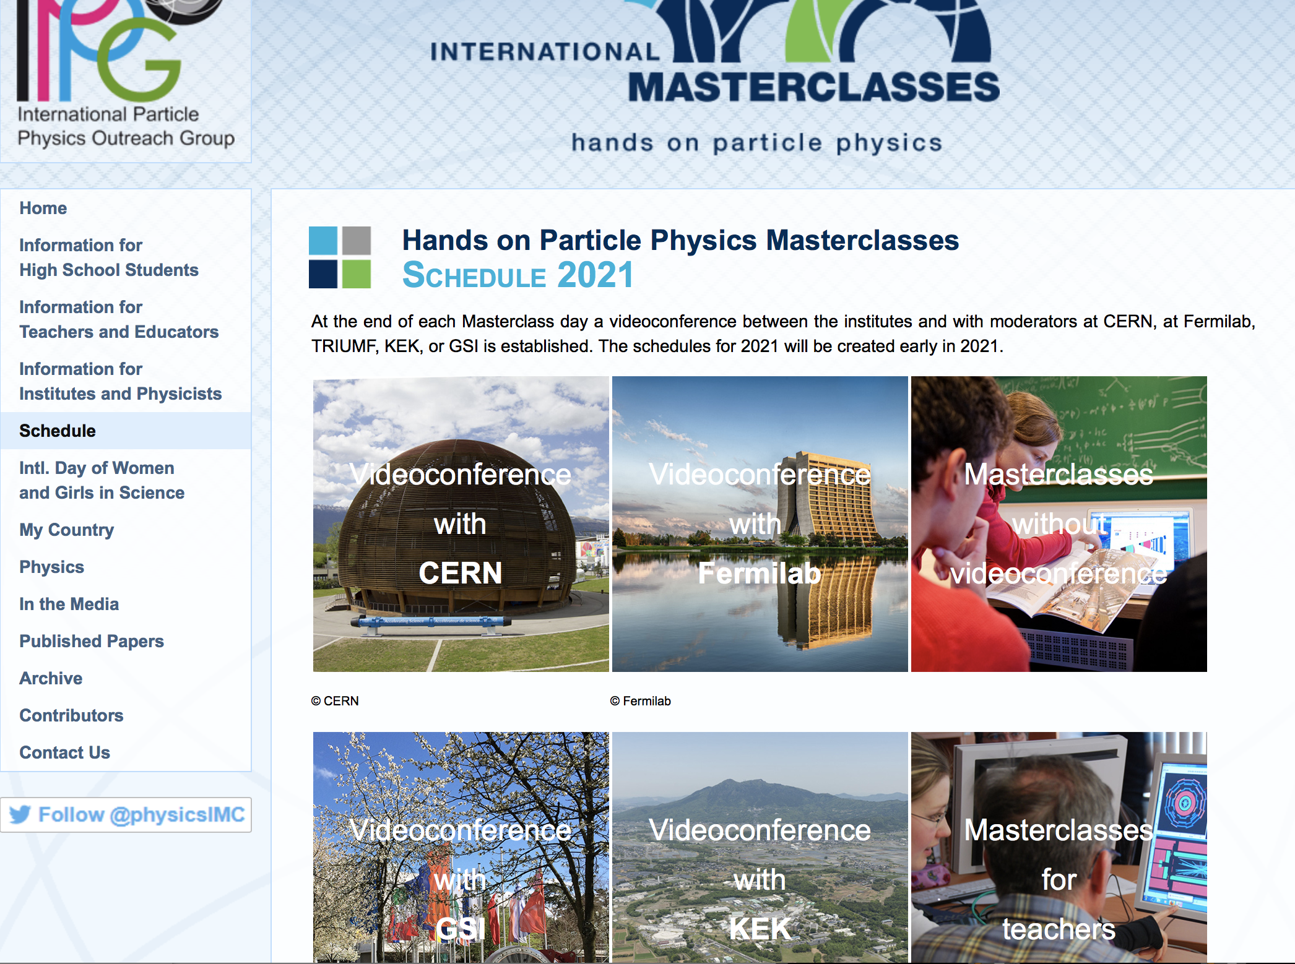
https://physicsmasterclasses.org/

Slide 8

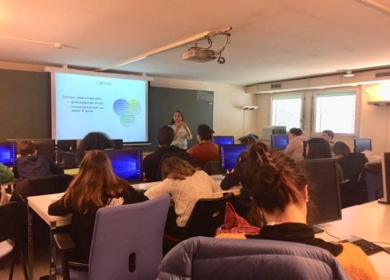
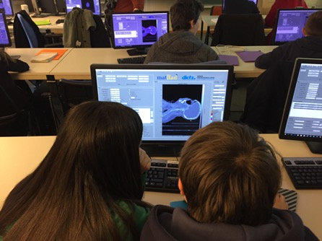
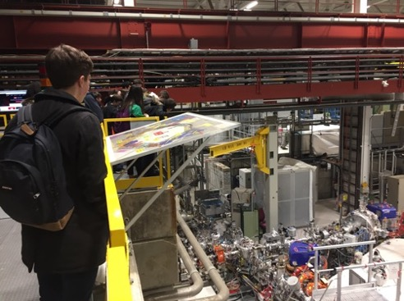
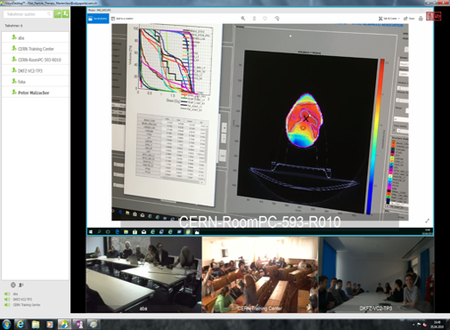
Concept and programme of a PTMC day
Poster: ARIS MAMARAS on PTMC
Scientists for a day !!
Local: Morning Presentations
Local: Afternoon Hands-on
Adapted online/zoom due to covid
Every year, mid-February to mid-April
school-children (15-19 year old)
are invited at/by an institute of their area.
2-5 institutes per day performing
the same programme
Local: Morning Visits
Common: Afternoon at 16:00
Video-Conference
LOCAL TIME: ACTIVITY
8:30 - 9:00 Registration and Welcome
9:00 - 10:00 Introductory lectures
10:30 - 11:30 Visit of a lab or experiment
12:00 - 13:00 Lunch
13:00 - 15:00 Hands-on session
15:00 - 16:00 Discuss results locally
16:00 - 17:00 Common Video Conference
IAEA-CN301-059
Slide 11
Panagiota Foka

Slide 9
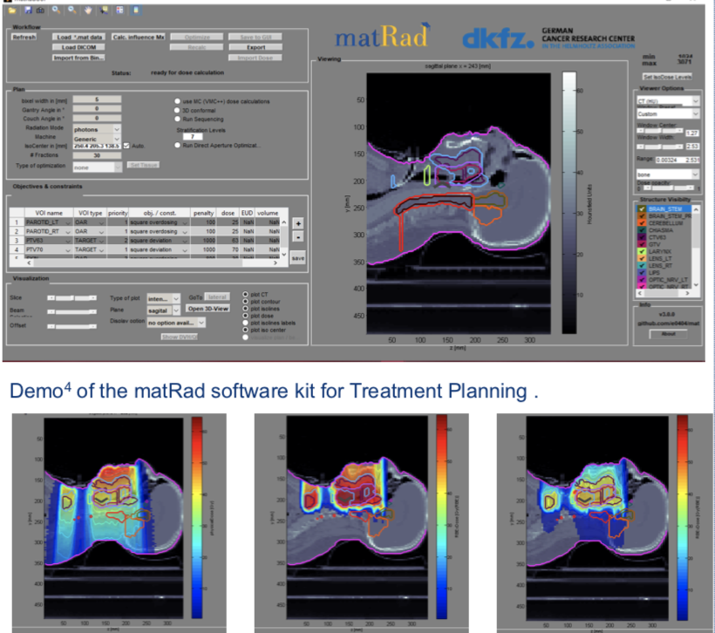
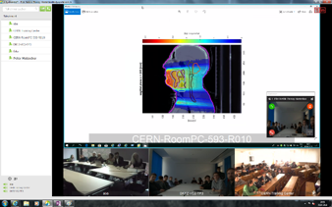
New PTMC and Treatment Planning
Based on professional open source treatment planning: matRad
developed by Heidelberg DKFZ www.matrad.org
Simplified version for PTMC
Using photons, protons and carbon ions

Slide 10
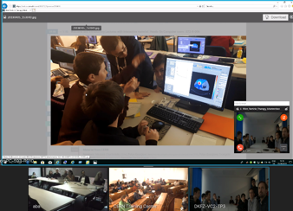
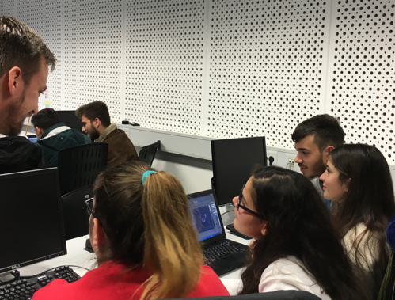

PTMC pilots in 2019
First local test: GSI, 7th February 2019
First international test: CERN, DKFZ, GSI, 5th April 2019
Participation of CURIEosity Team from Crete, Greece
CERN, DKFZ, GSI
Survey: positive results from students
Hope and motivation to contribute
to the fight against cancer

Slide 11
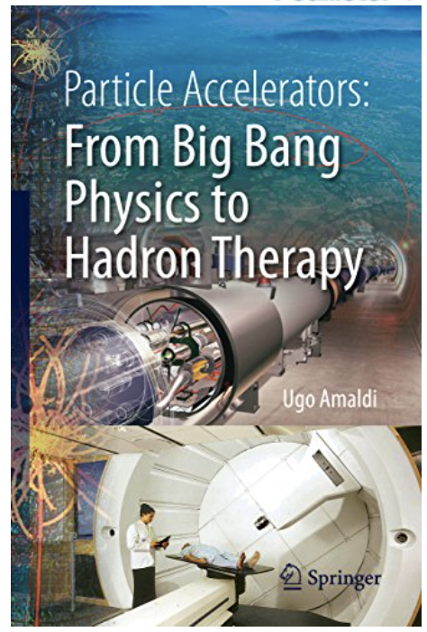
How is physics related to medicine?
What is particle therapy?
How one can use particles for
cancer treatment?
Accelerators for research
and accelerators for
cancer treatment
One of the aims of PTMC:
address such questions

Slide 12
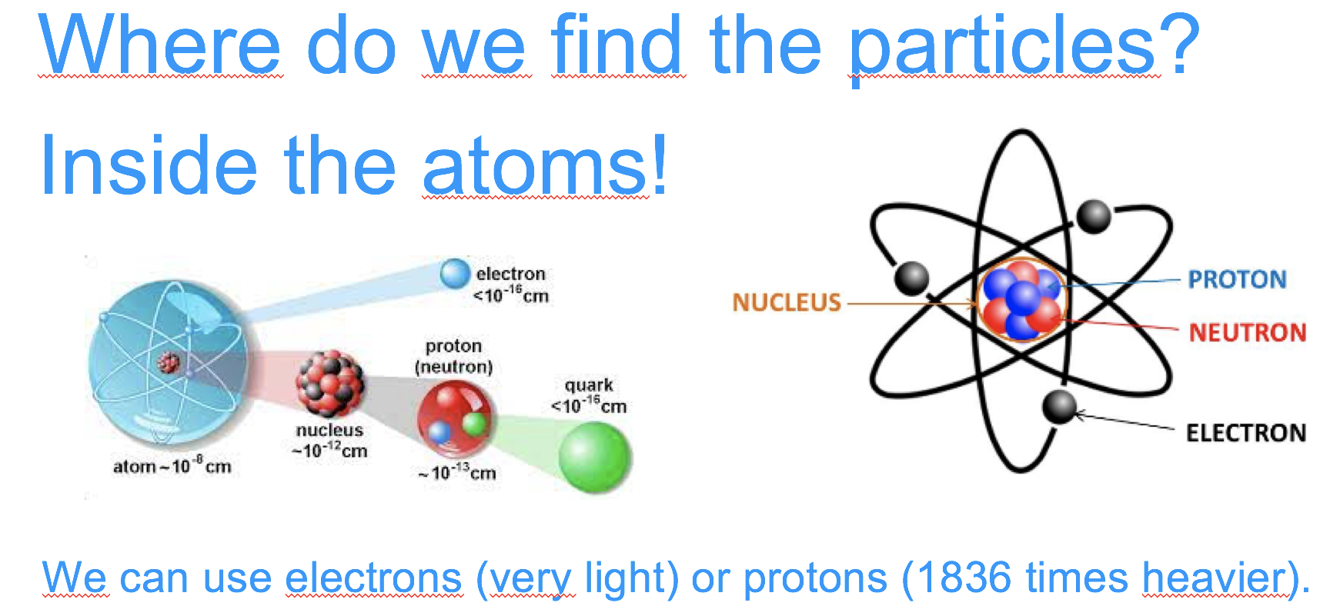

Accelerators: our key to the subatomic world
Particle accelerators are our door to access the subatomic dimension… and exploit the atom and its components

Slide 13
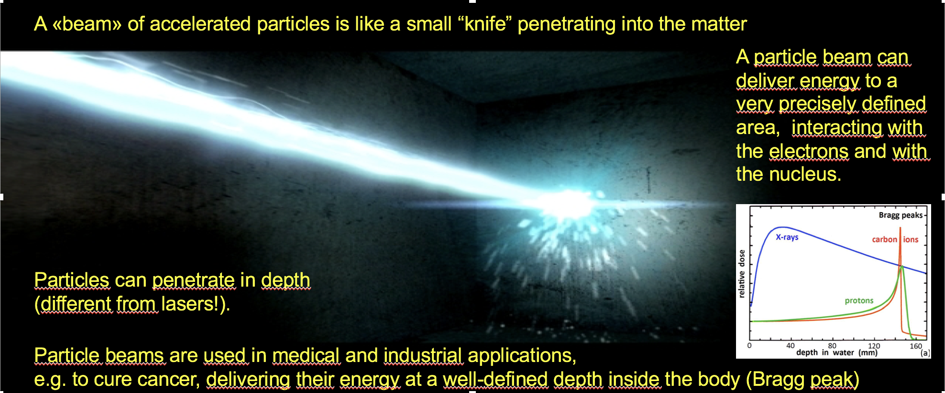
Accelerators: can precisely deliver energy

Slide 14
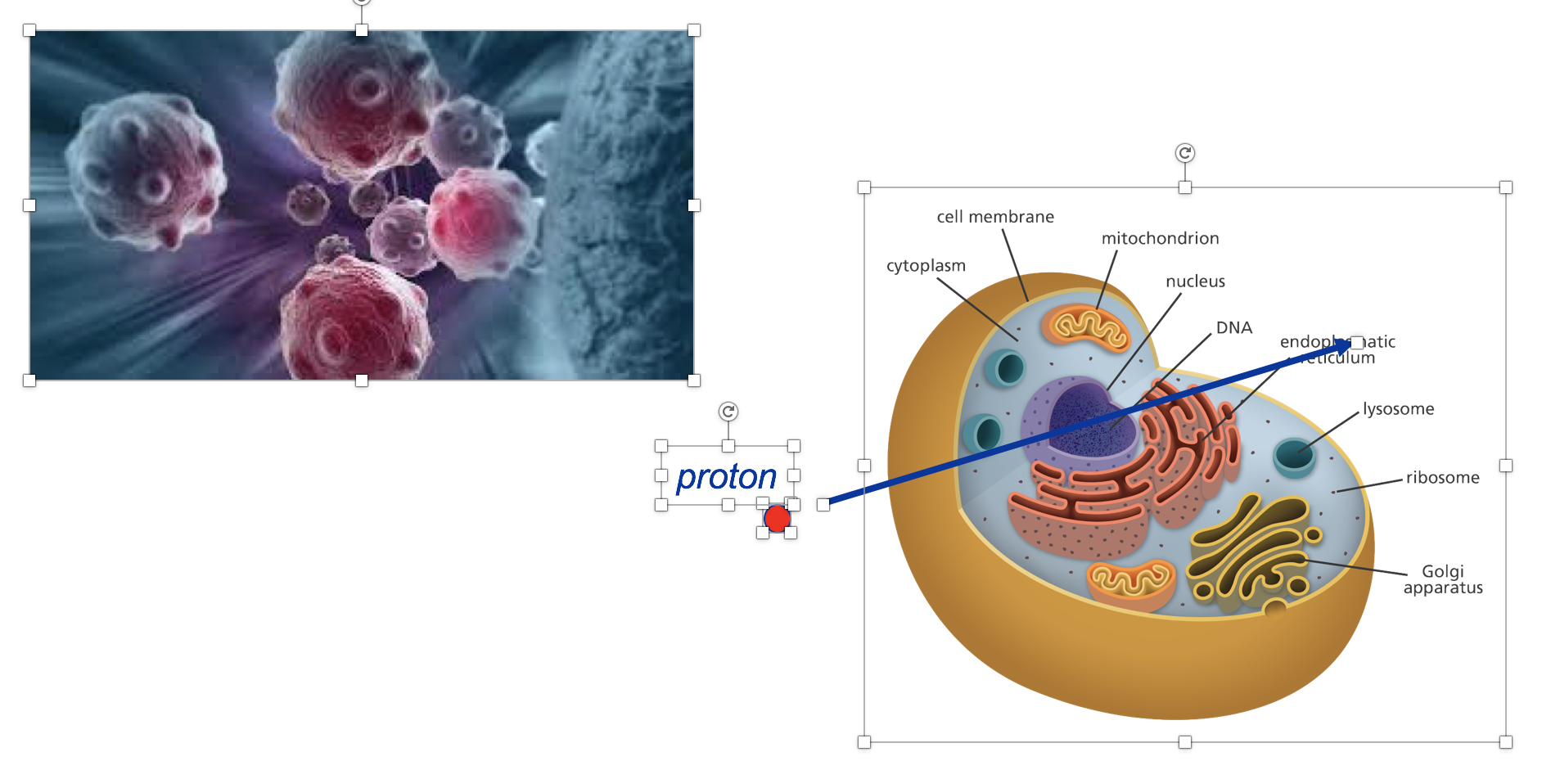
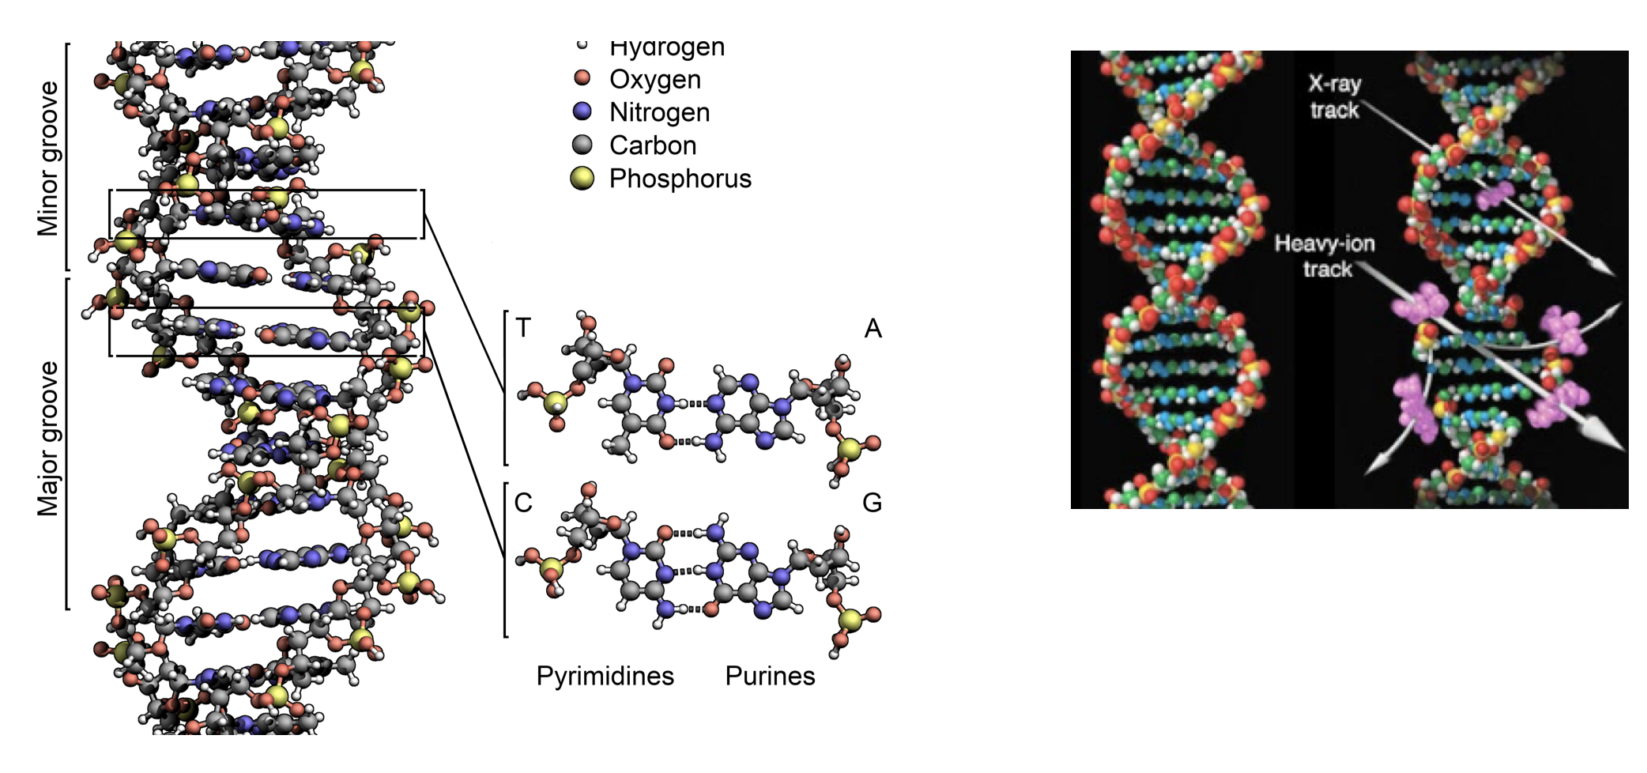
A particle beam can break the DNA and kill a cell

Slide 15
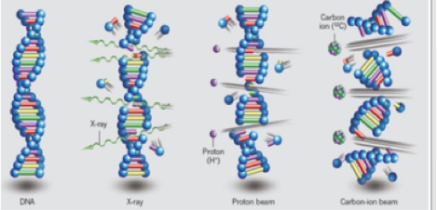
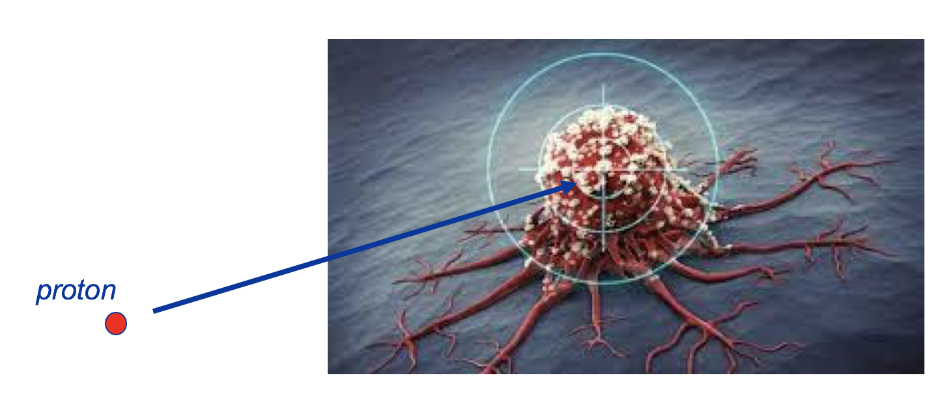
And if the cells has the cancer?
Killed !
A particle beam can break the DNA and kill a cell

Slide 16
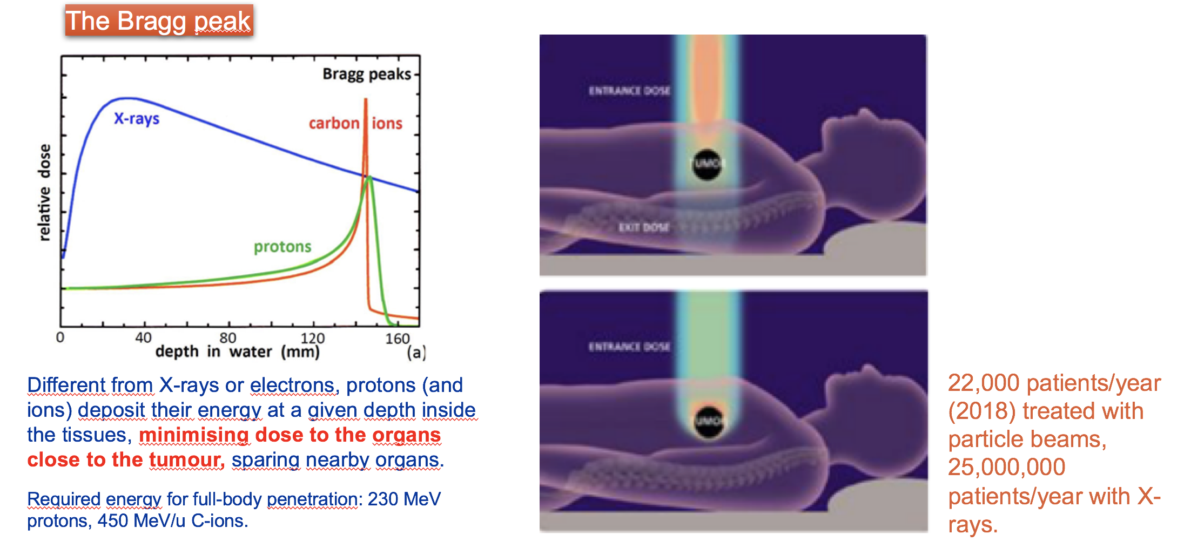
Hadron therapy with protons or ions

Slide 17
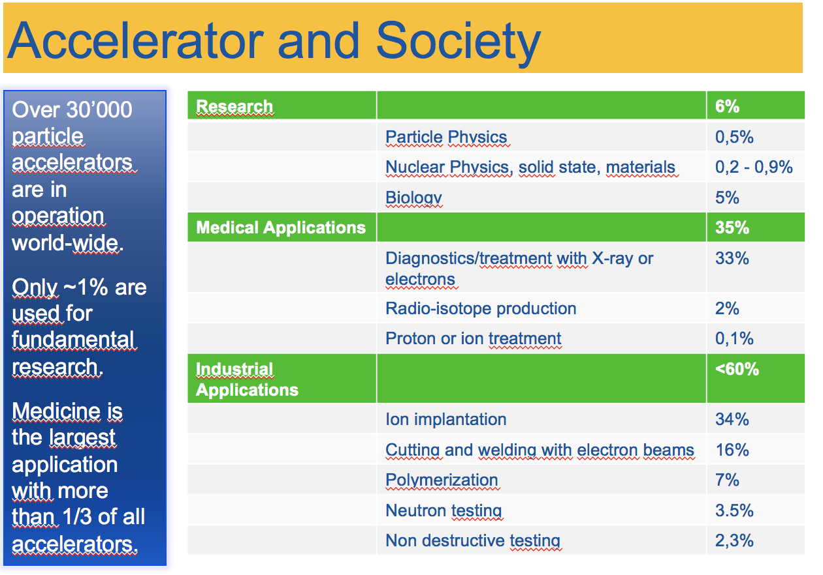

Slide 18
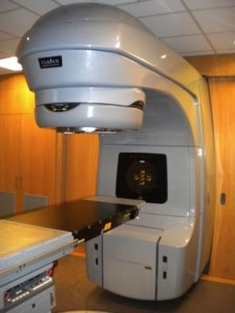
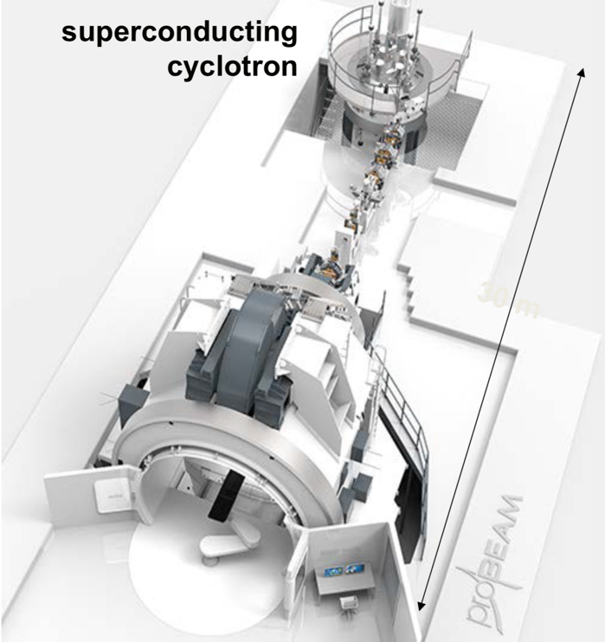
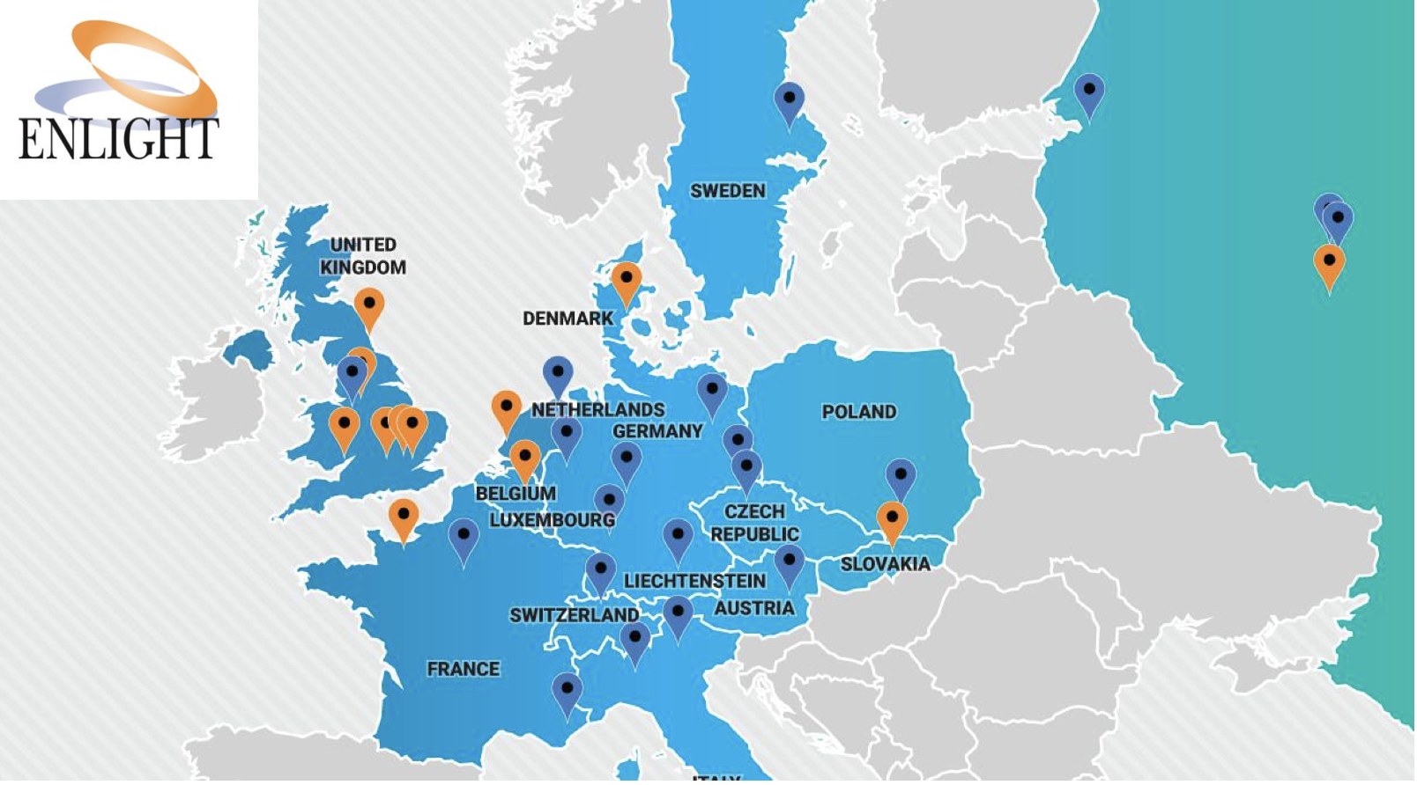
Accelerators for health
Conventional x-ray
Radiotherapy
Particle/Hadron Therapy with protons
Hadron Therapy centers in Europe (2018)

Slide 19
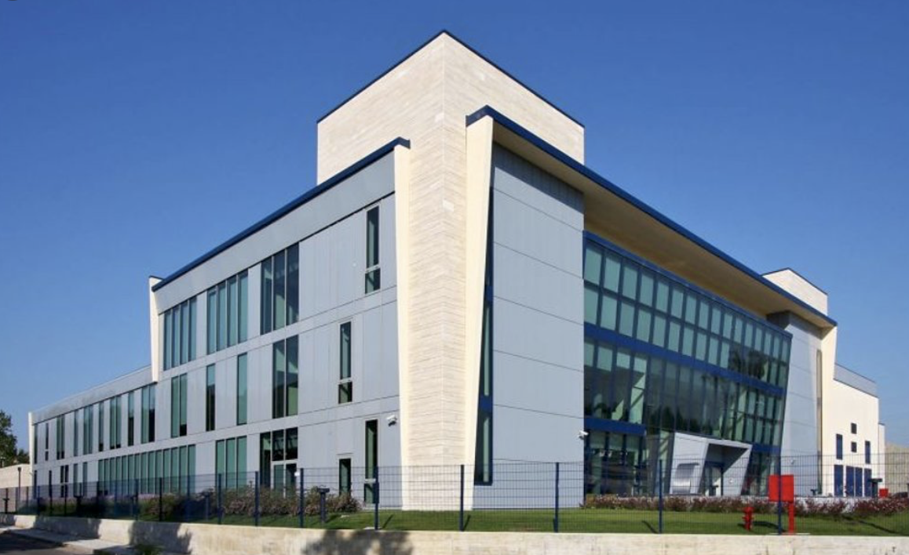
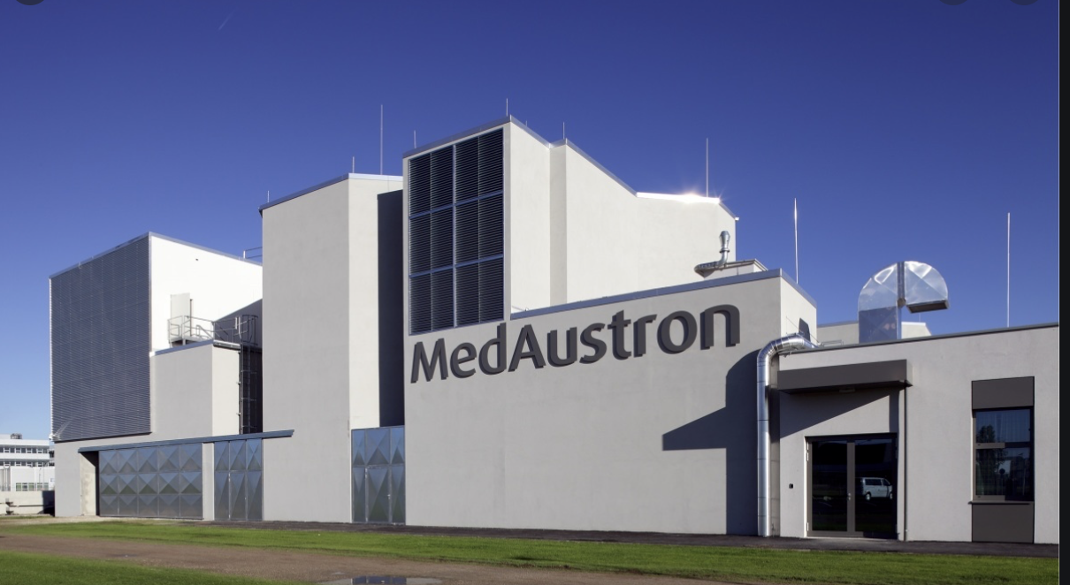
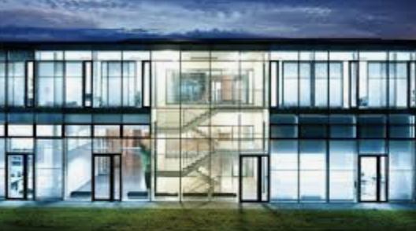
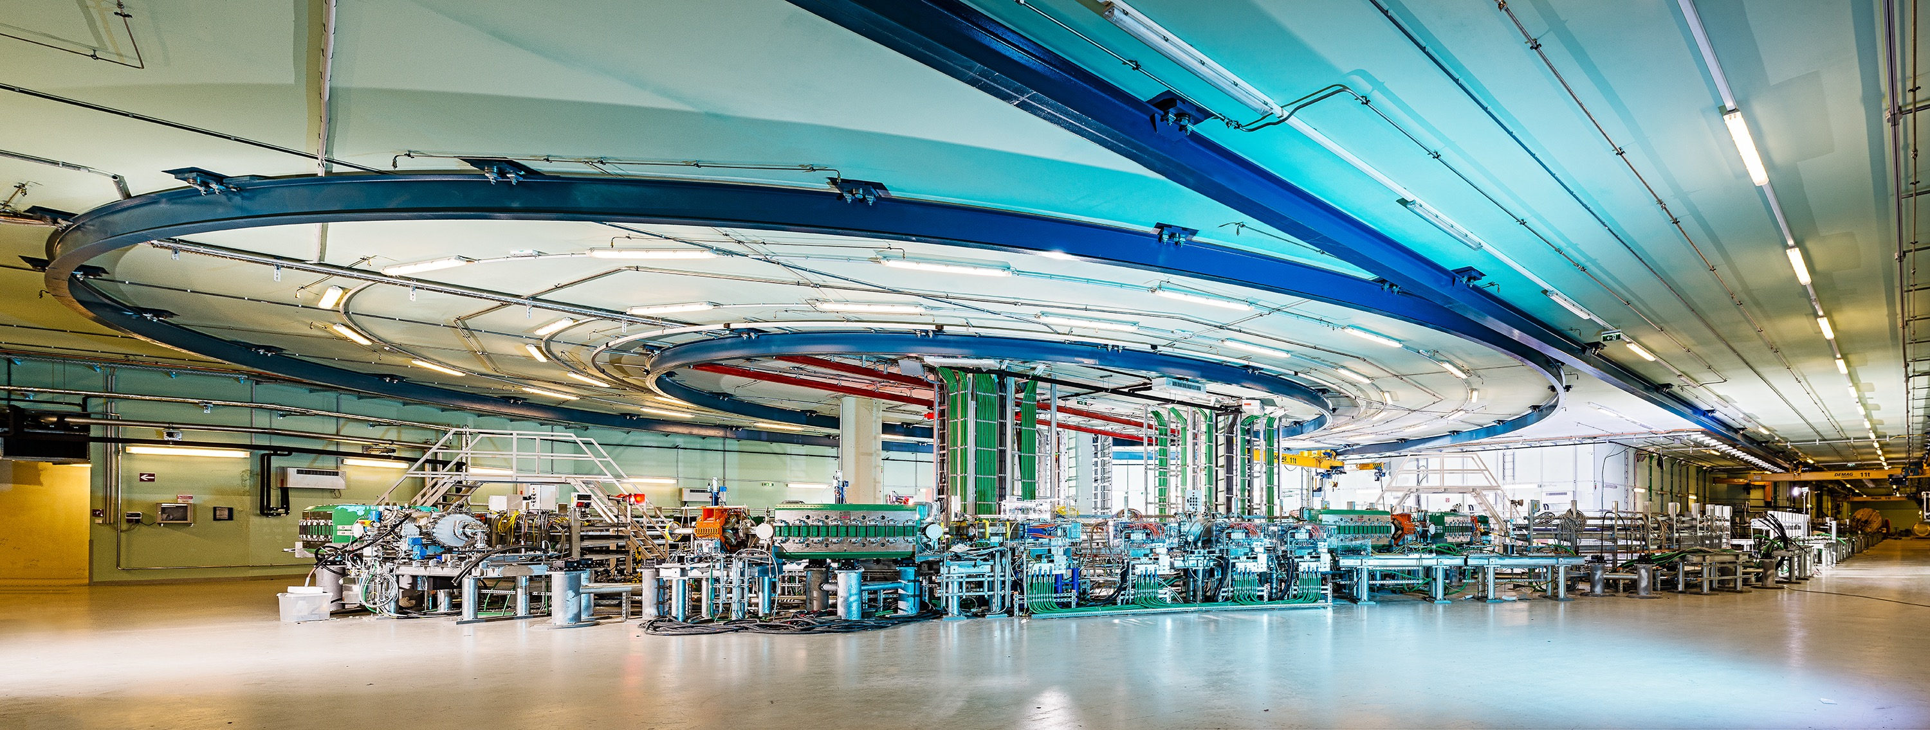
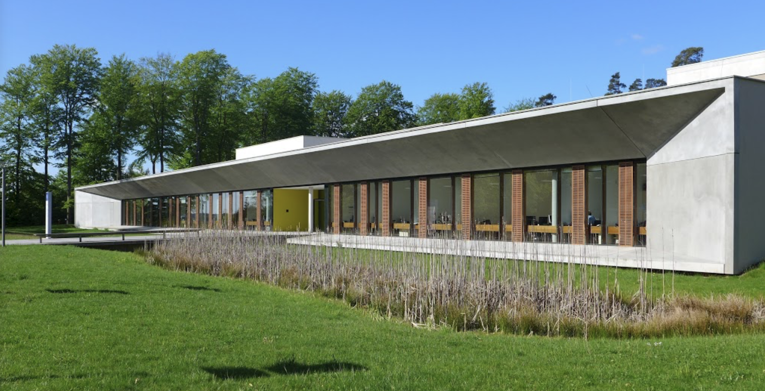
Four carbon-ion cancer therapy centers in Europe
MedAustron, Αustria
CNAO, Ιtaly
HIT, Germany
MIT, Germany

Slide 20

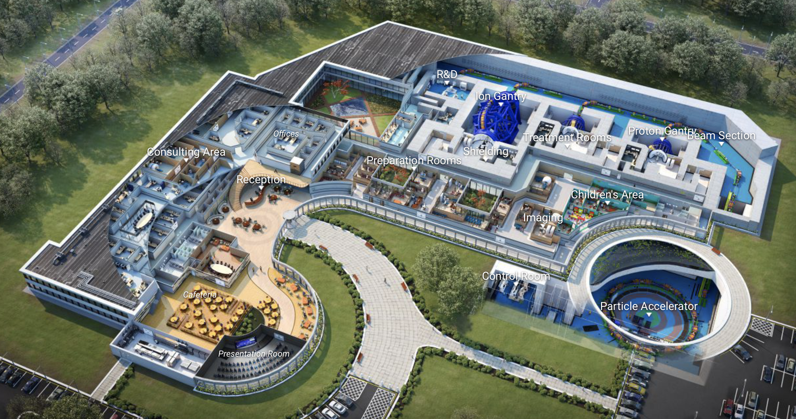
Virtual Hadron Therapy Center

Slide 21
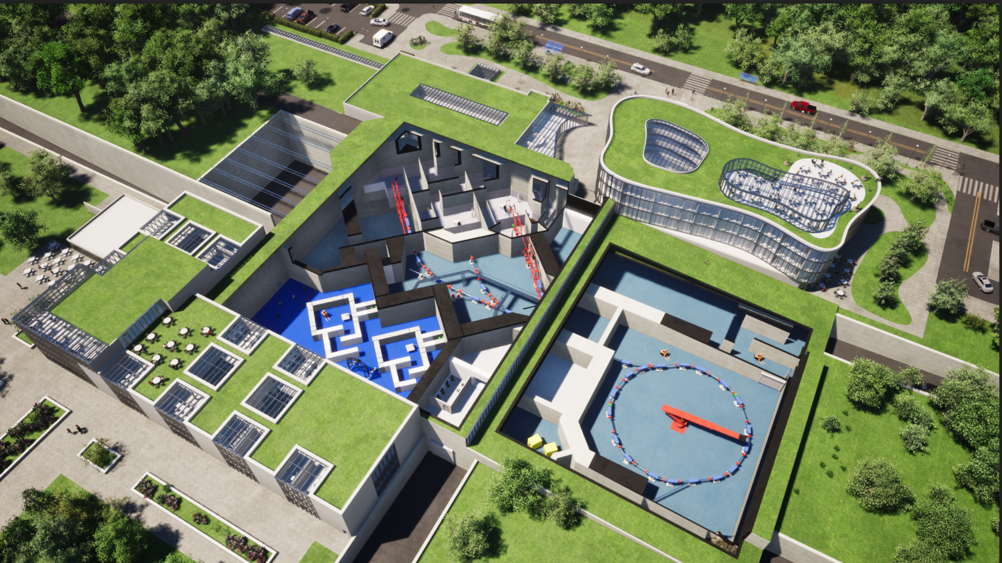
SEEIIST
South East European International Institute
for
Sustainable Technologies
Proposal for a facility in South East Europe: SEEIIST
50% research and 50% therapy
with multiple ions
Architectural design, Kaprinis Architects

Slide 22
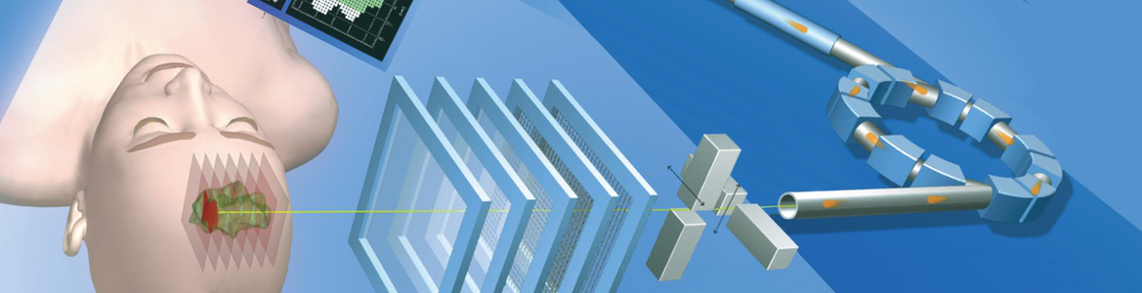
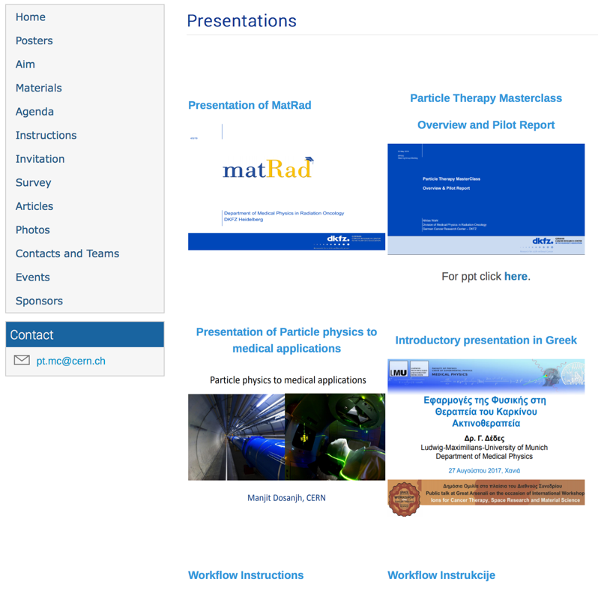
Particle Therapy MasterClass
https://indico.cern.ch/event/840212/
Material in different languages
Animations

Slide 23
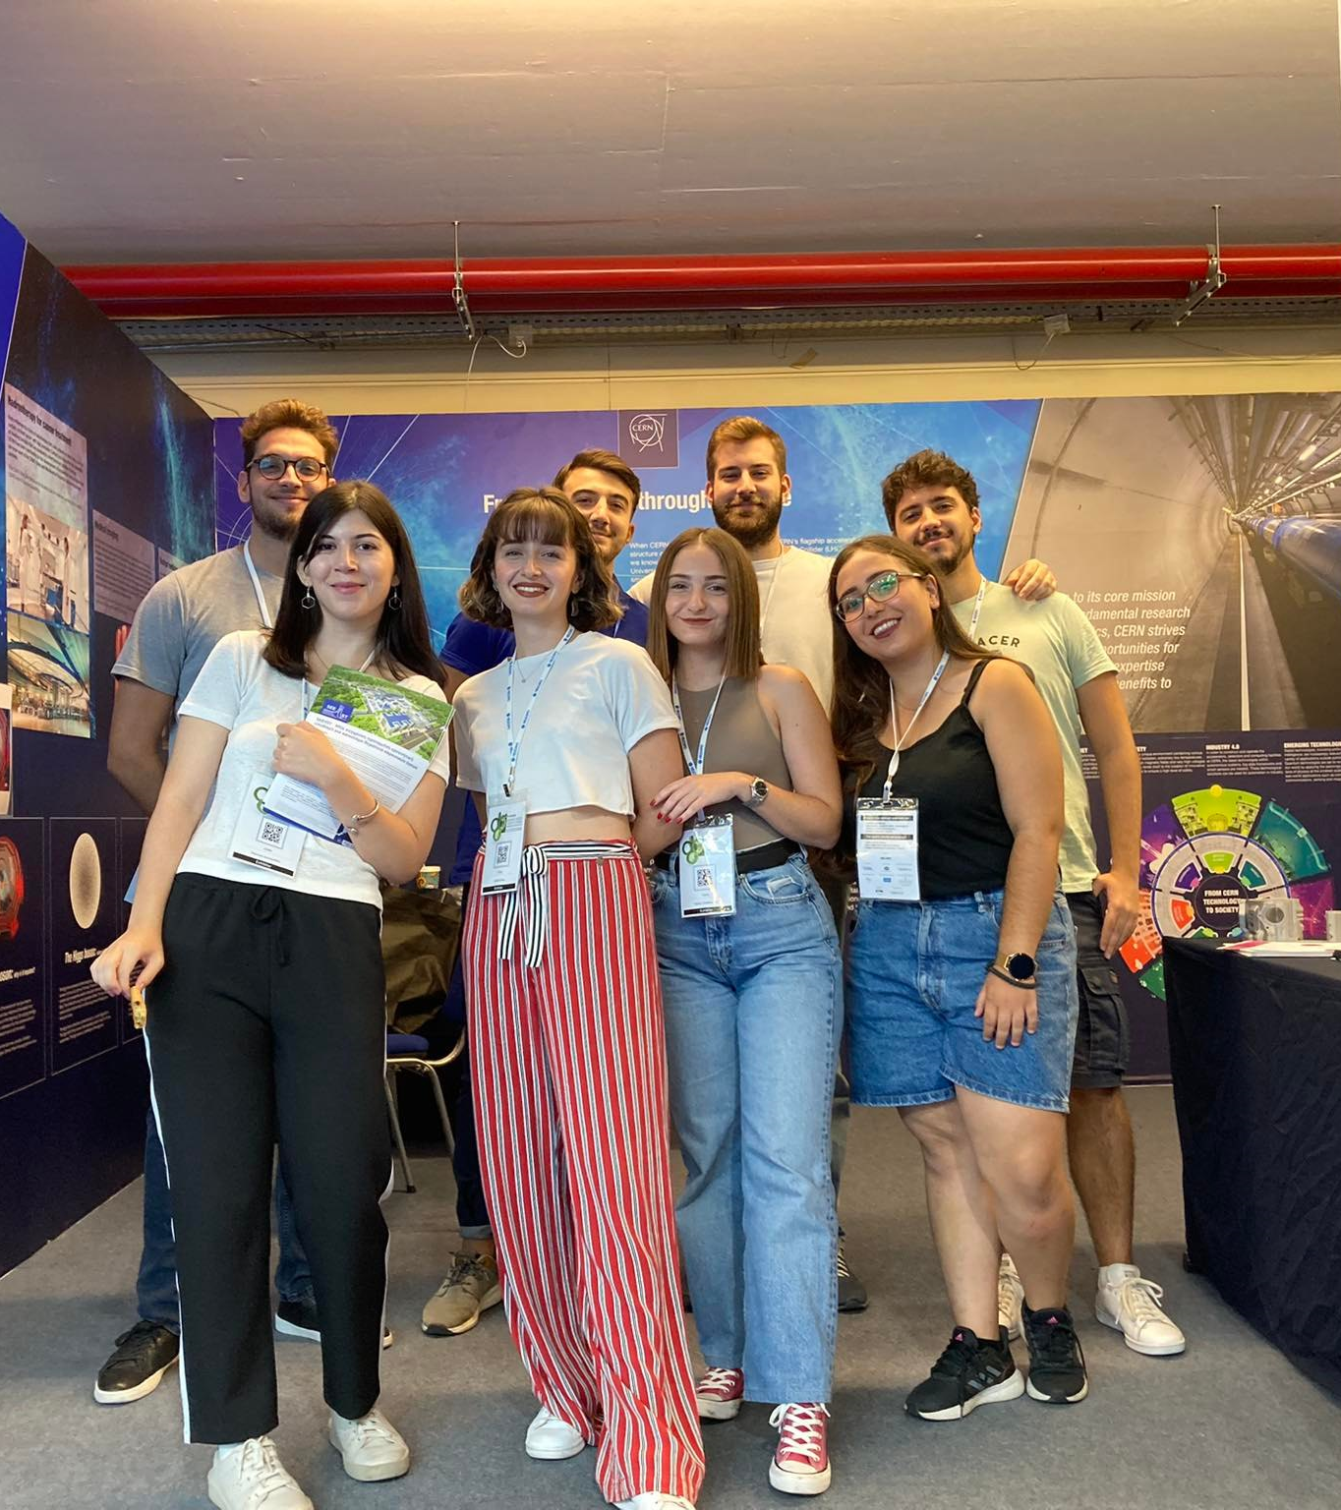
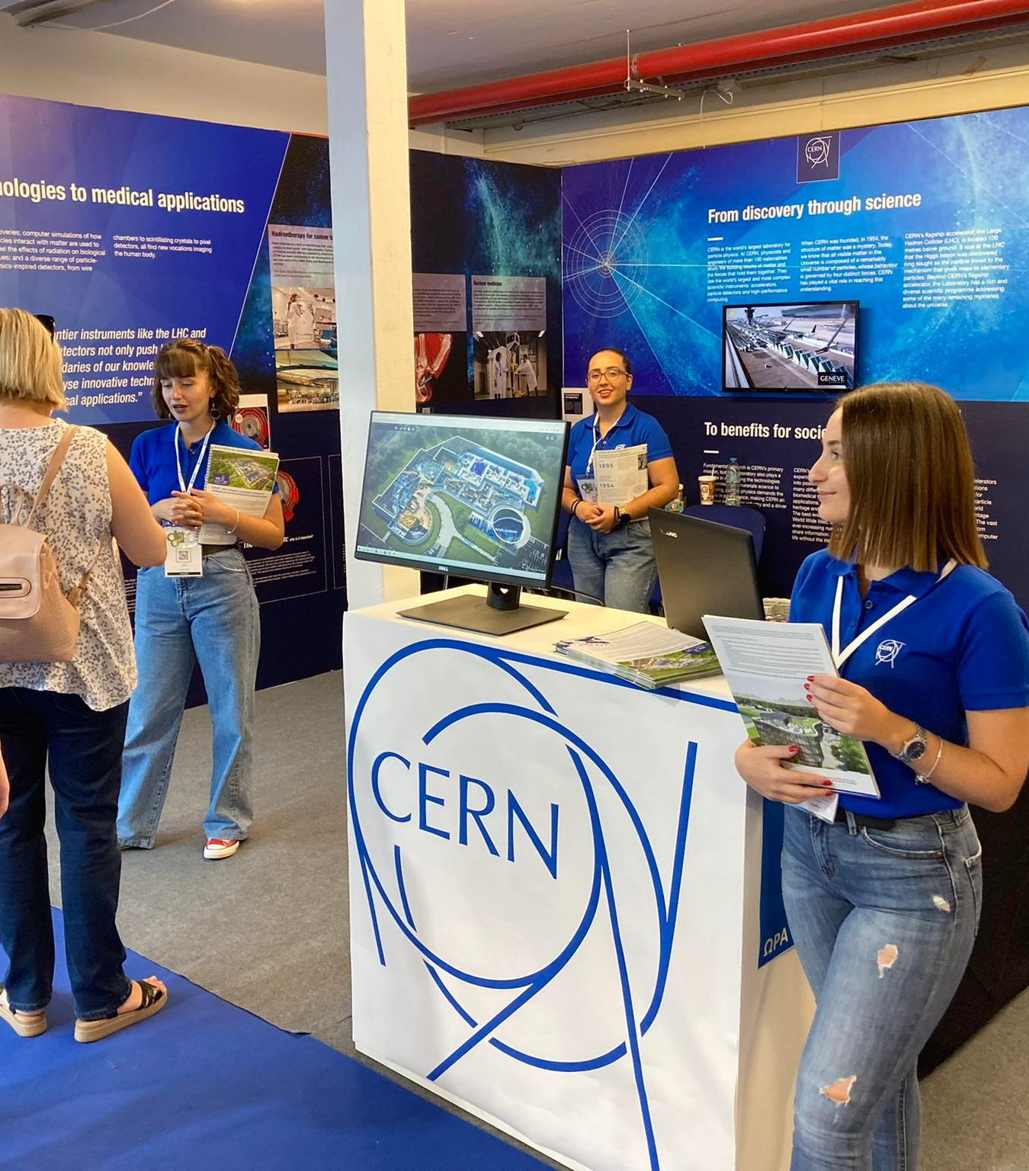
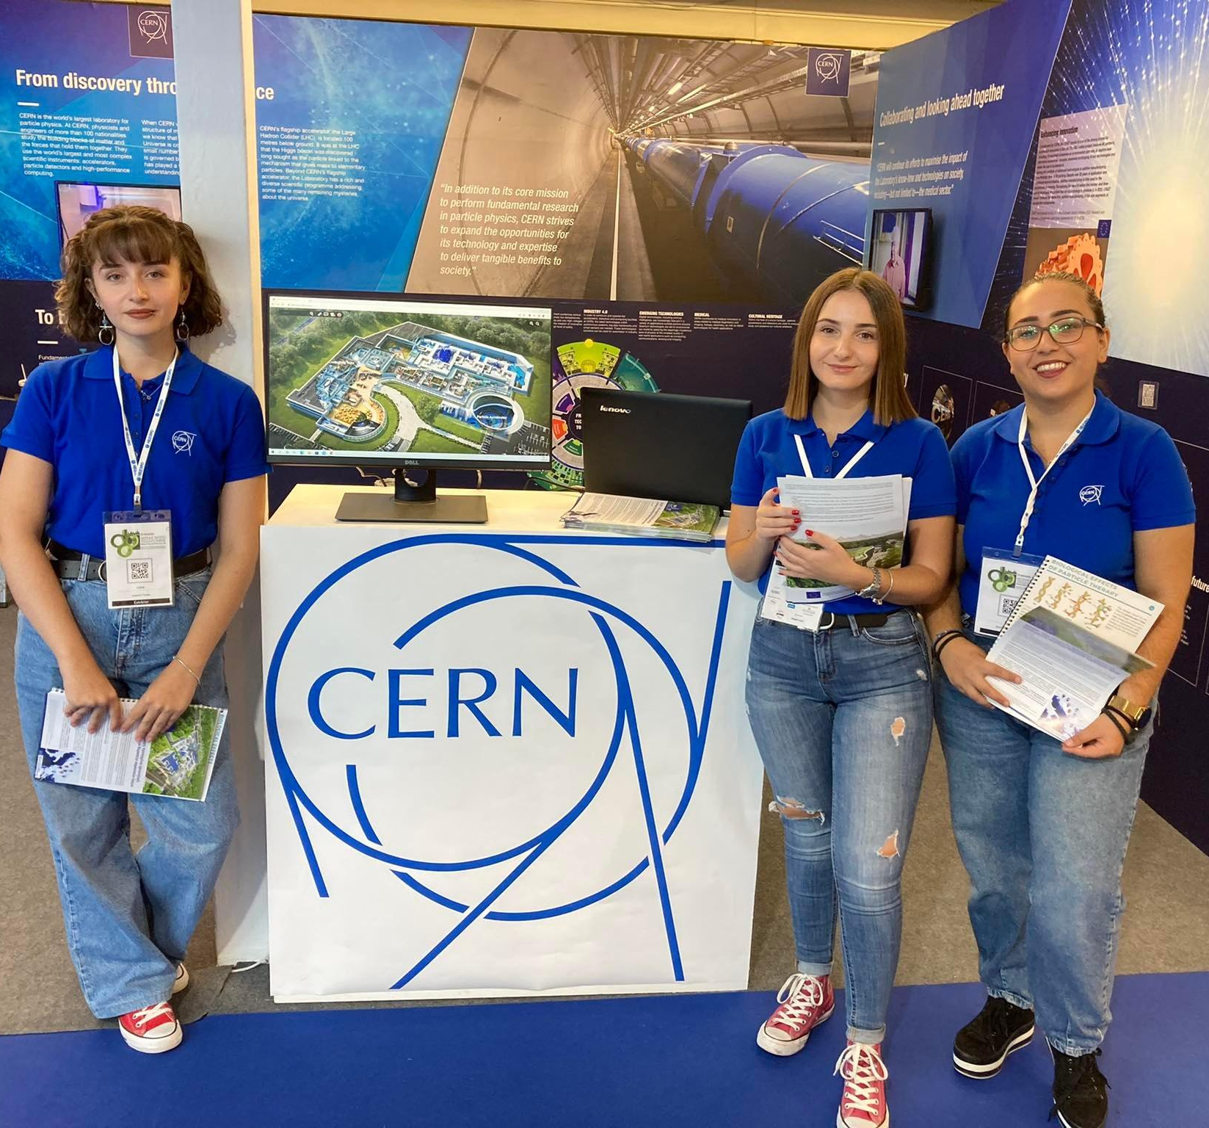
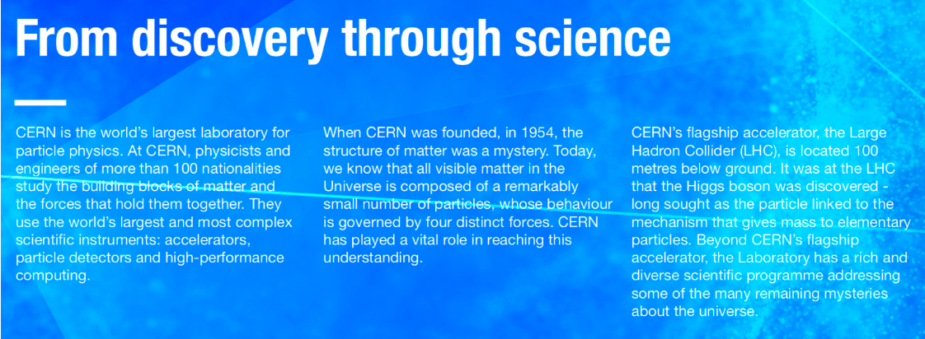
Panel 2: From discovery through science...To benefits for society

Slide 24


Slide 25


HITRIplus Aims
Main aims:
transnational access,
new developments for the future SEEIIST facility
and upgrades of the existing ones
networking, training and education (capacity building)
HITRIplus EU-funded project
  Large consortium of research infrastructures including CERN and GSI,
  plus universities, industry, all four existing European heavy-ion therapy centres,
  and the future research infrastructure SEEIIST (South-East Europe International Institute for Sustainable Technologies)
IAEA-CN301-059
Slide 6
Panagiota Foka

Slide 26



HITRIplus Open Access: Transnational Access TNA
TNA: https://www.hitriplus.eu/transnational-access-what-is-ta/
FORMS for TNA Access
CLINICAL: https://www.hitriplus.eu/transnational-access-ca/
RESEARCH: https://www.hitriplus.eu/transnational-access-ra/

Slide 27

HITRIplus Educational Material in YouTube Channel

Slide 28

Heavy-ion research and heavy-ion therapy
Pb-Pb at 5.5 TeV
pp at 14 TeV
88-430 MeV/u carbon
50-221 MeV/u protons

Slide 29

https://indico.cern.ch/event/840212/

