Slide 1
1
GeneraL information
Frank Zimmermann
200th FCC-ee Accelerator Design Meeting & 71st FCCIS WP2.2 Meeting

Slide 2
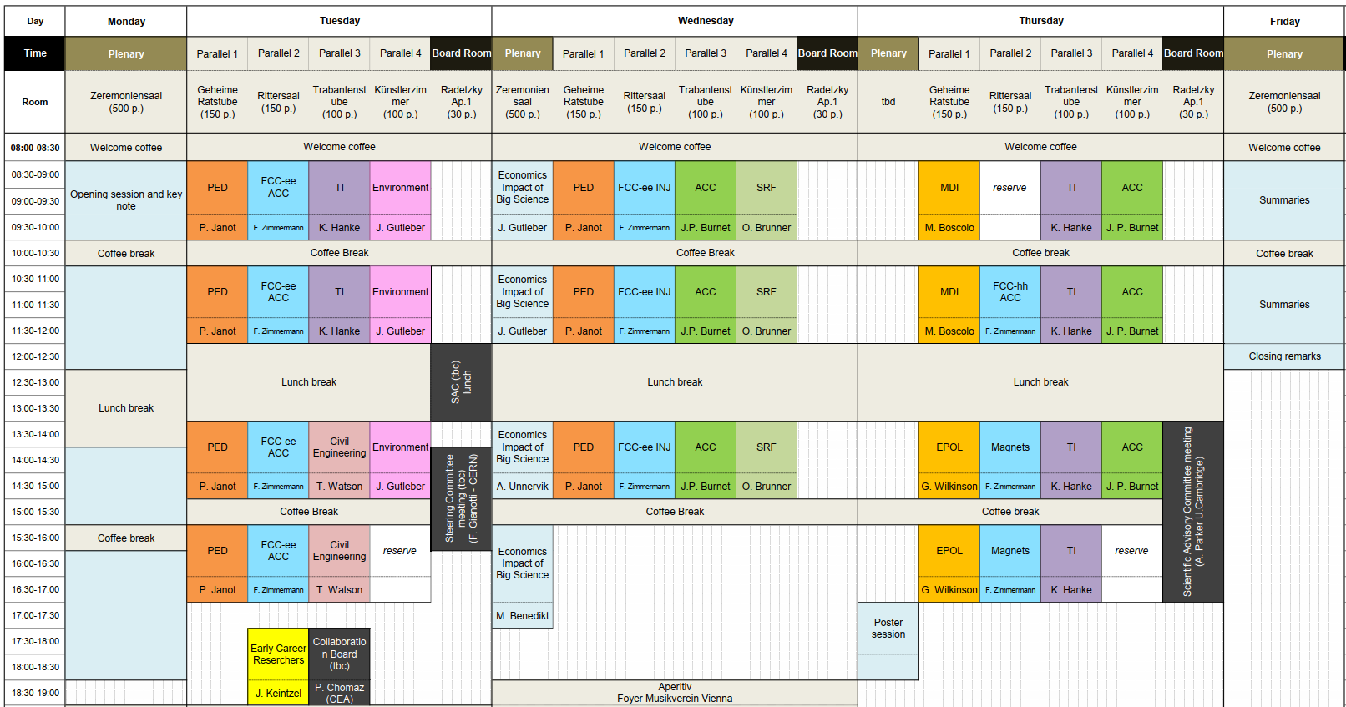
FCC Week 2025 draft program overview
Programme overview V0.7

Slide 3
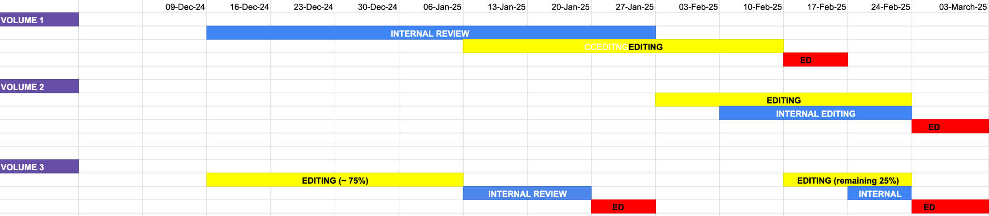
FCC FSR vol 2 status & schedule
Volume 2
Submission for copy editing: Monday, 3rd February 2025
Edit by JP/PC: Tuesday, 25th February 2025
Submission to ED: Wednesday, 26th February 2025
Receive comments from ED: Friday, 7th March 2025
Current Progress: Safety and Dismantling chapters have been edited. The remaining sections are not yet available for editing and are expected around early February.

Slide 4
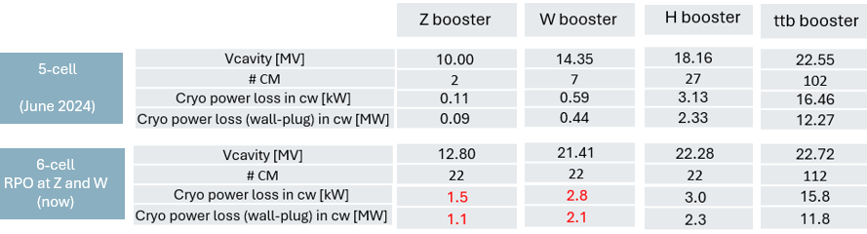
open question - FCC-ee booster
RF mode of operation and cavity voltages at injection and ramp
→ impact on duty factor cryo power, beam dynamics
“For sure there is an impact on the cryogenic consumption. Below a quick evaluation and comparison with the previous scheme at the maximum energy.
The cryo power is increased (in red). This is the value in continuous wave (CW) operation and it has to be multiplied by the RF duty cycle.”
Franck Peauger

Slide 5
collaboration with SuperKEKB
eeFACT’25 workshop early March incl. visits to KEK
monthly beam-beam meeting KEK-CERN-IHEP
KEK secondments to CERN
Further CERN secondments to KEK

