Slide 1
Beam Damage Experiments on Superconducting Coils
David Gancarcik (MPE-CB)
with contributions of many and many others (see acknowledgements)
TE-MPE Annual Meeting 2025, 21 January 2025

Slide 2
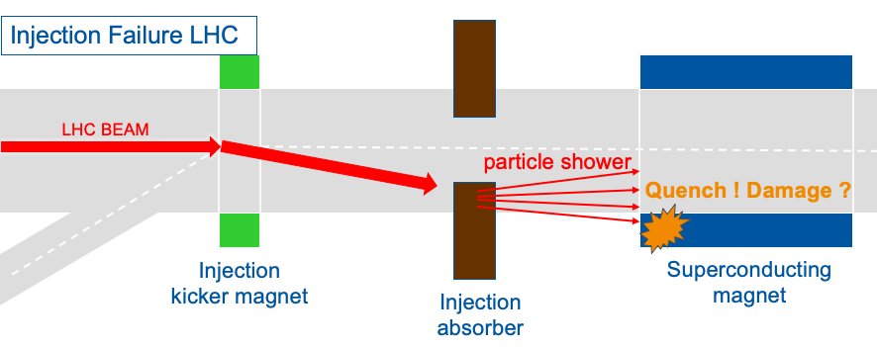
Motivation of the studies on sc. magnet components
Ultra-fast failures in HL-LHC: Injection kicker failure case
Courtesy of V. Raginel
What are the damage mechanisms and limits of superconducting magnets due to high-intensity beam impact? Will the magnets be permanently damaged?
TE-MPE Annual Meeting 2025, 21 January 2025

Slide 3
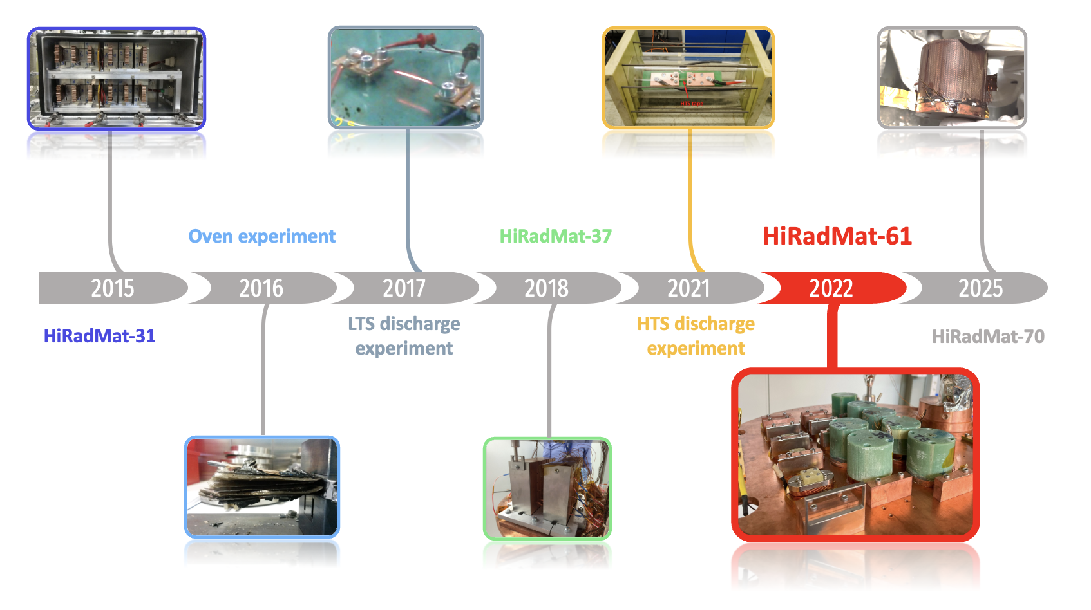
Timeline of the studies on sc. magnet components
Courtesy of
D. Domange
From studying damage in strands, insulation, and cables across different temperature ranges and timescales → impact of racetrack sc. coils at 4K with 440 GeV beam
TE-MPE Annual Meeting 2025, 21 January 2025

Slide 4
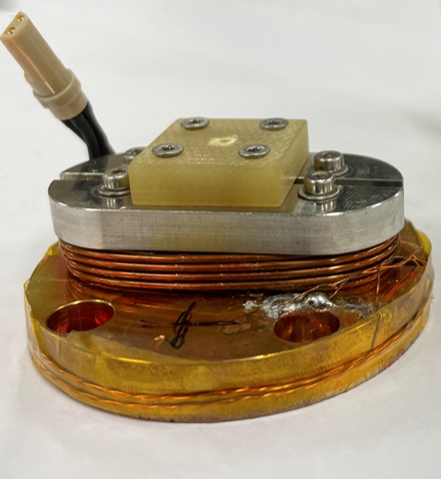
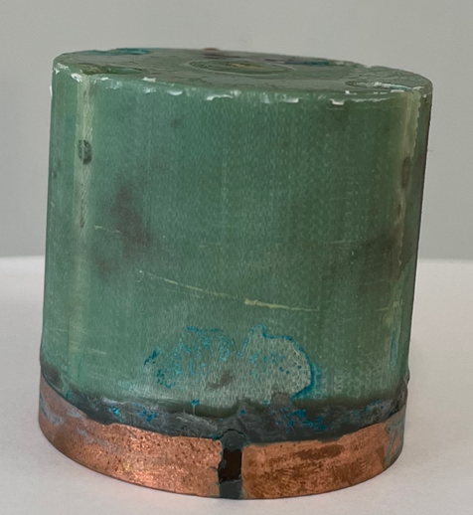
Sample racetrack coils impacted by the beam
Copper base Ø = 48mm
Nb-Ti sample coil:
  Ø 0.825mm LHC dipole inner layer strand
Nb₃Sn sample coil:
  Ø 0.85mm RRP HL-LHC triplet strand
  Heat-treated with HL-LHC temperature profile and impregnated with CTD101K epoxy (same as MQXF)
Pre-irradiation qualification was performed at University of Geneva (critical transport current measurement)
48 mm
48 mm
TE-MPE Annual Meeting 2025, 21 January 2025

Slide 5
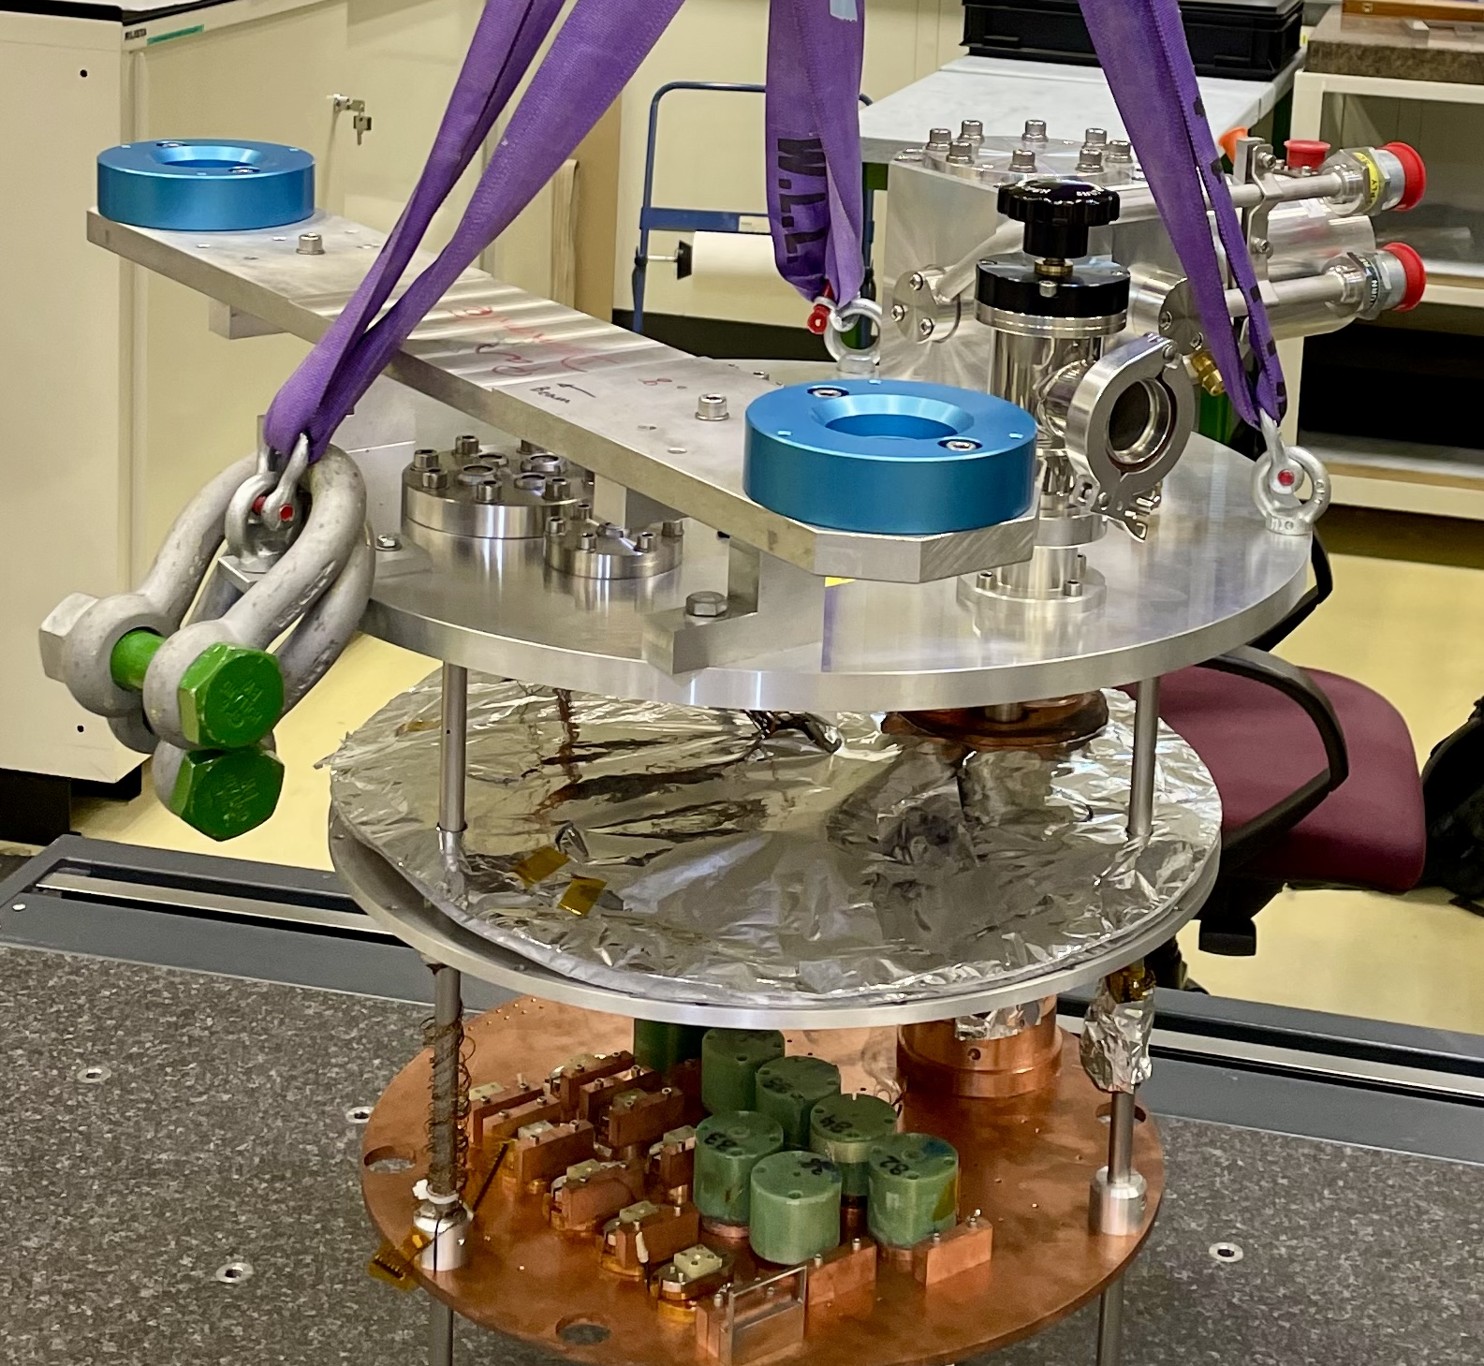
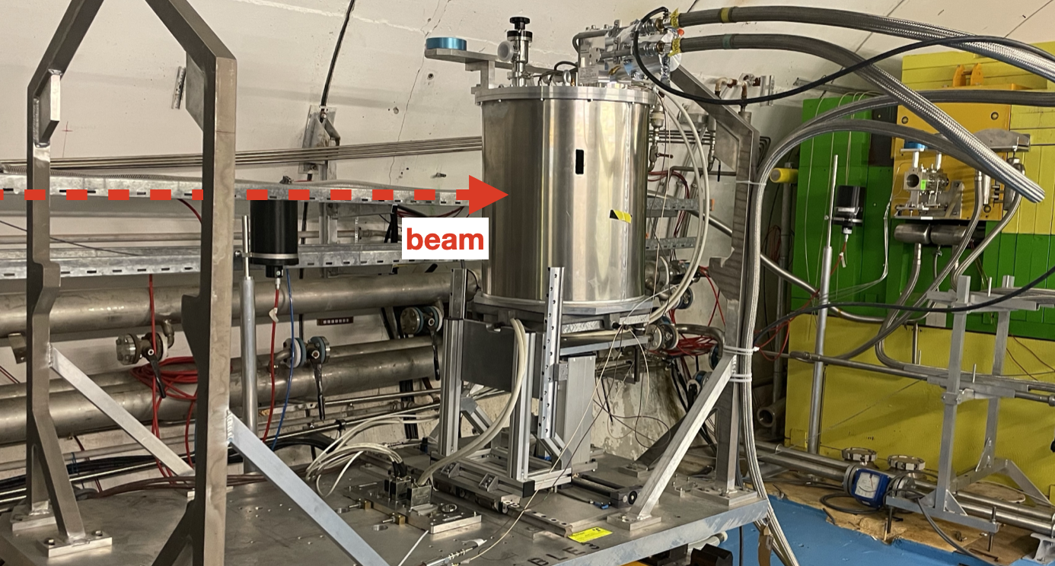
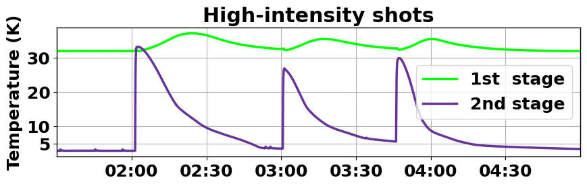
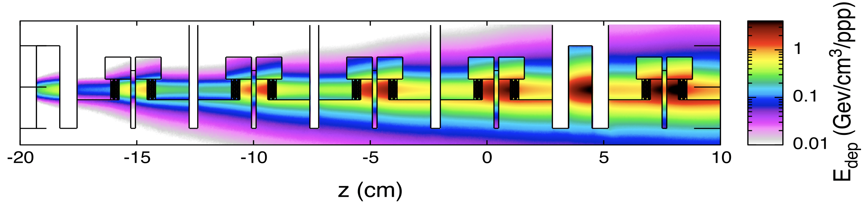
Experimental setup in HRMT facility
Samples arranged in vacuum vessel
Vacuum vessel cooled to 4K impacted by beam in HRMT tunnel
TE-MPE Annual Meeting 2025, 21 January 2025

Slide 6
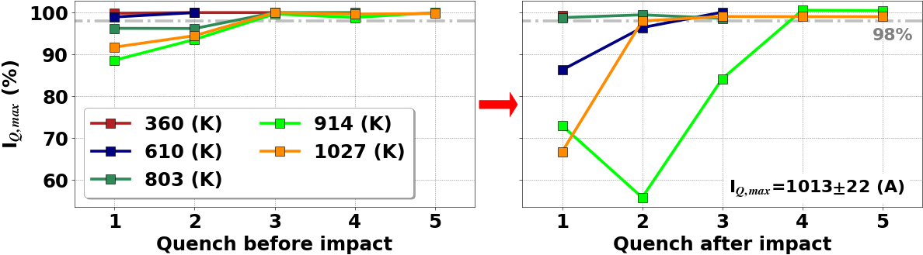
Post-irradiation I_{c} measurement (Nb-Ti coils)
All samples reached more than 98% of pre-irradiation current → No permanent degradation was observed in Nb-Ti coils
Temporary memory loss for samples at or above 610K
  Strong de-training observed after irradiation compared to the effect of a thermal cycle
  Likely caused by tension in the winding due to beam heating => tension is released during a few first training quenches (up to 3, usually 1)
TE-MPE Annual Meeting 2025, 21 January 2025

Slide 7
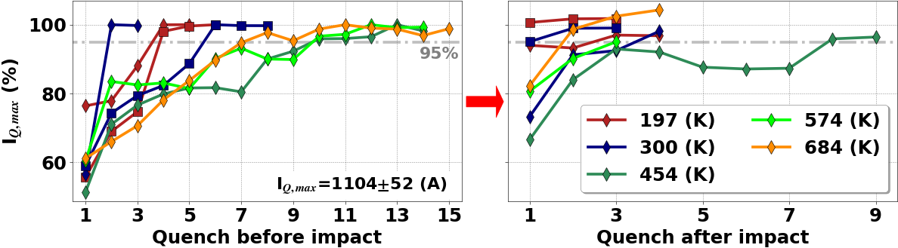
Post-irradiation I_{c} measurement (Nb₃Sn coils)
All samples reached more than 95% of pre-irradiation current → No permanent degradation was observed in Nb₃Sn coils
Temporary memory loss was also observed, but at the level of a thermal cycle. Due to the small statistics, this cannot be reliably attributed to the beam impact
TE-MPE Annual Meeting 2025, 21 January 2025

Slide 8
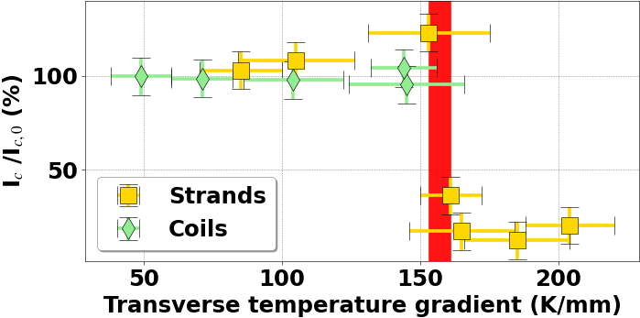
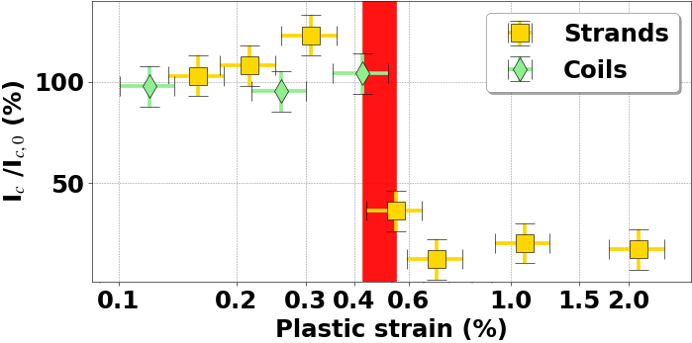
The main damage mechanism due to beam impact
Filament breakage: not observed in coils as the transverse gradient (and the plastic strain, simulated with dedicated ANSYS simulations) did not reach the critical value of 153 K/mm (or plastic strain of 0.51%)
TE-MPE Annual Meeting 2025, 21 January 2025

Slide 9
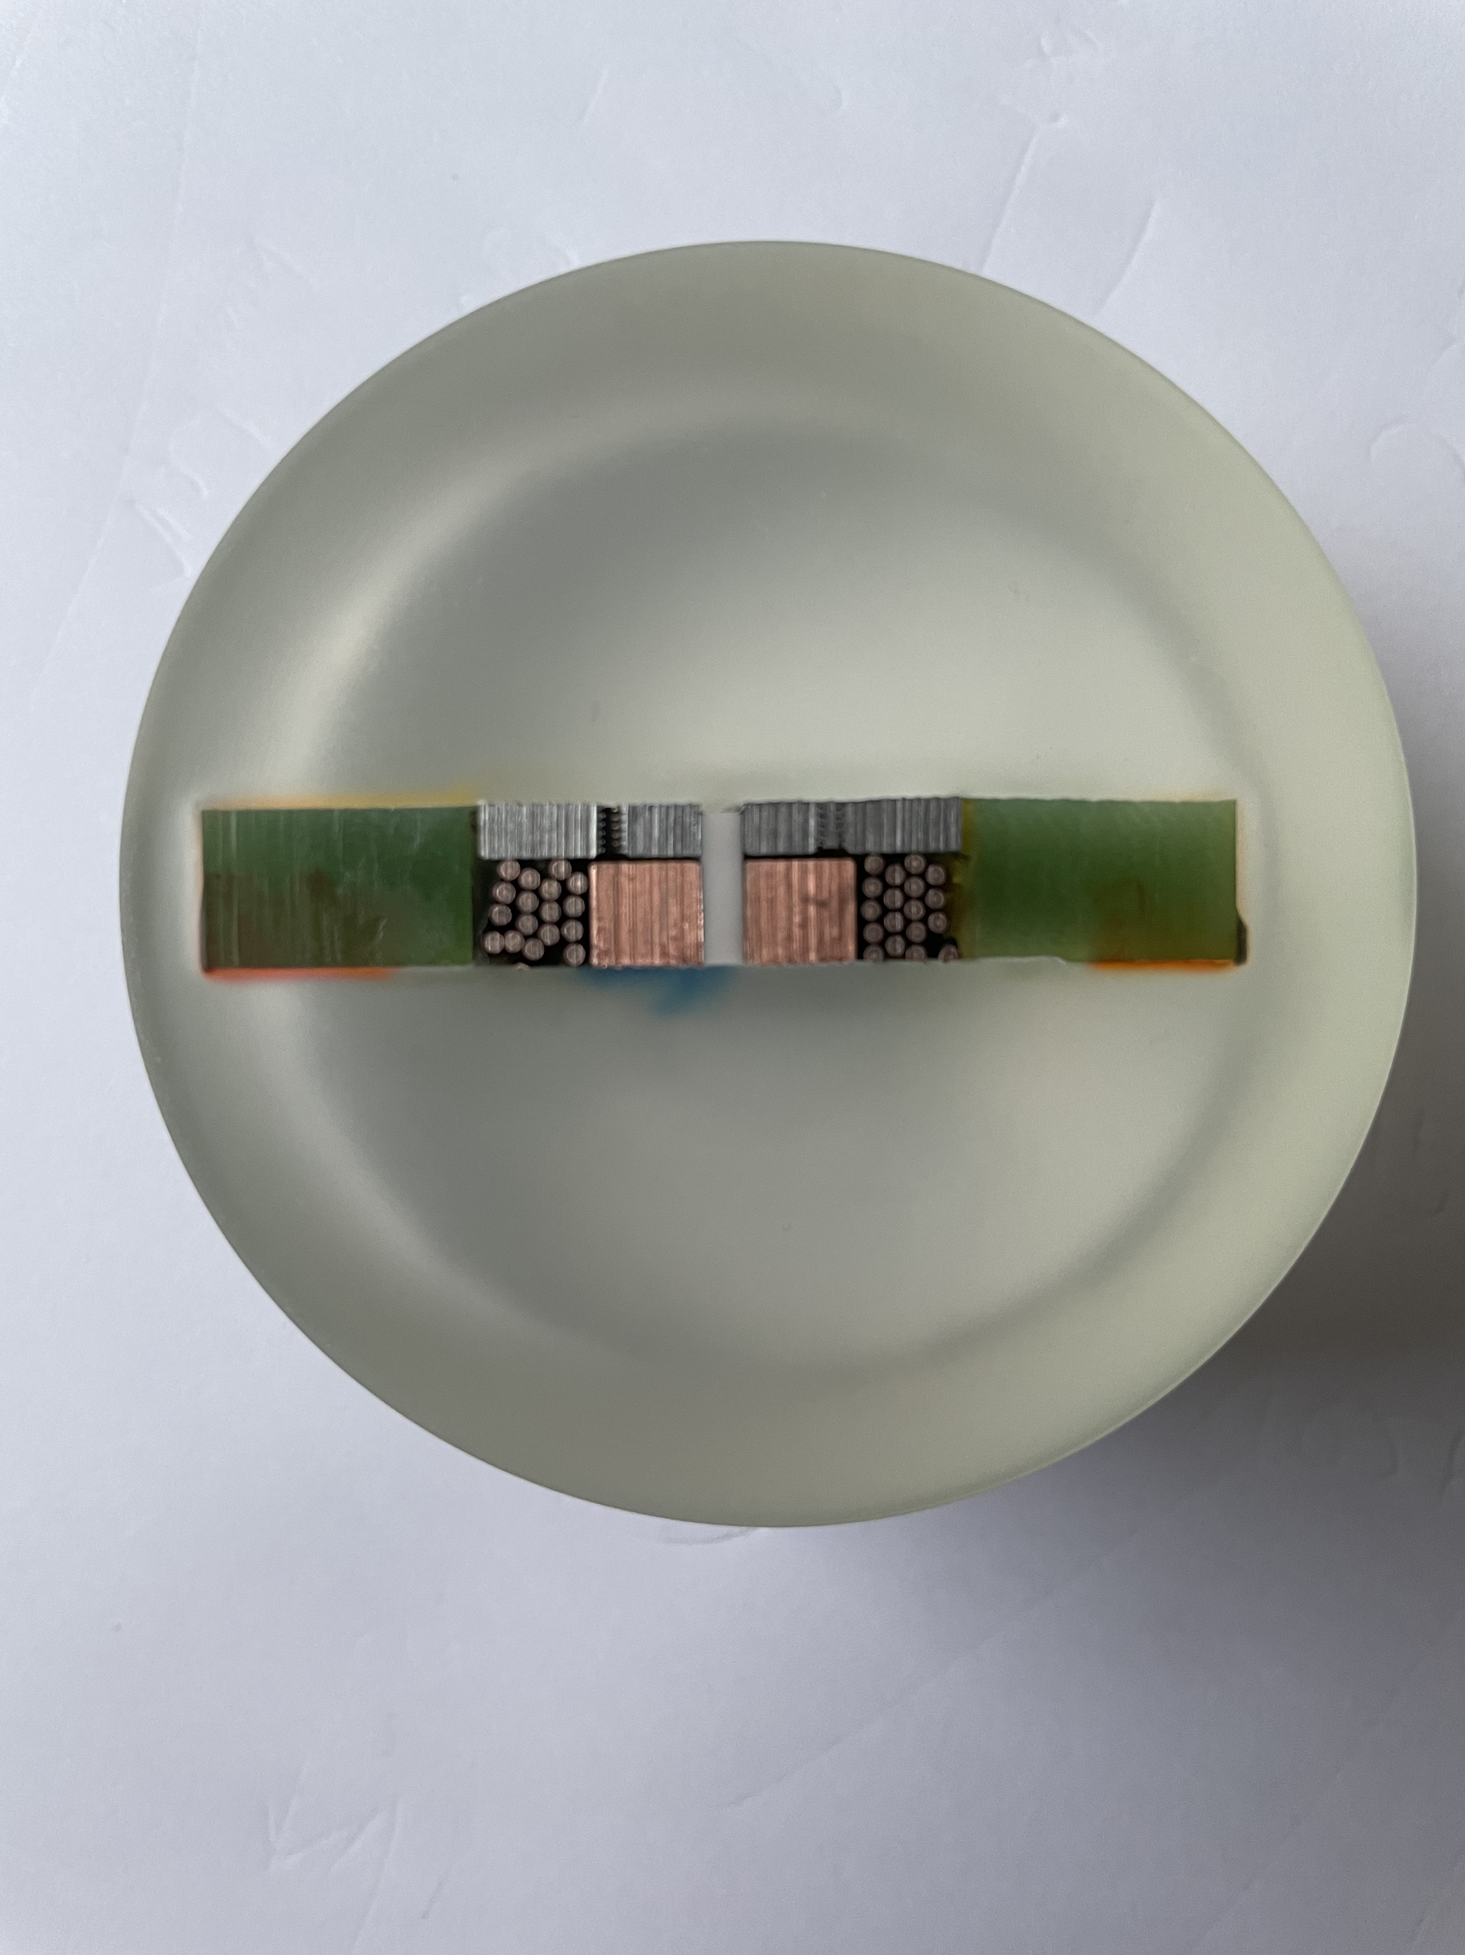
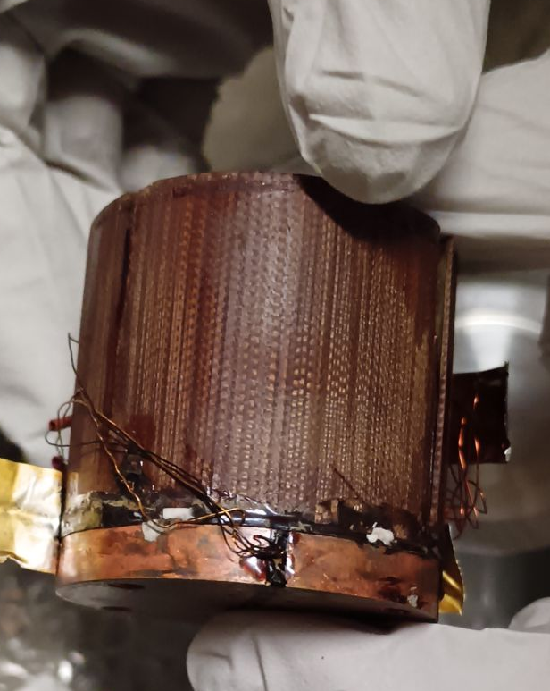
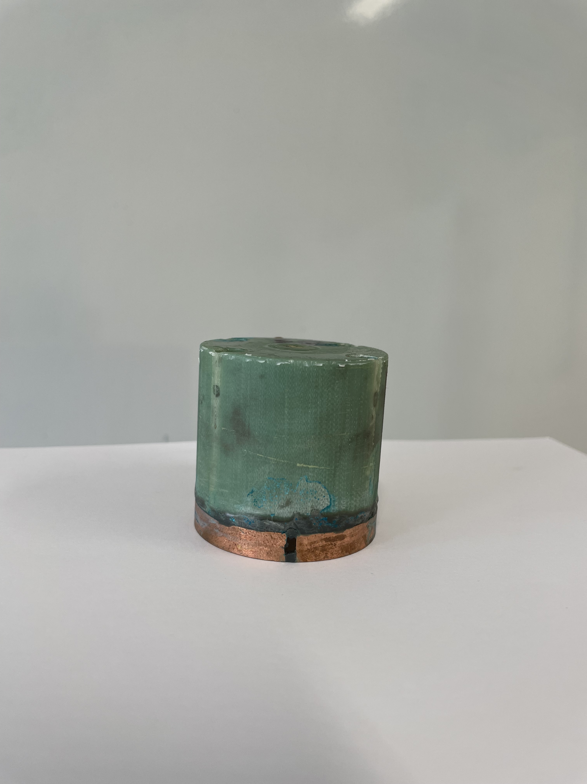
Conclusion and outlook
No additional damage mechanism has been identified
Destructive testing in progress
The upcoming experiment (October 2025) will investigate:
  additional damage mechanisms in coils irradiated with gamma-rays to 25 and 30 MGray (integral dose levels expected in HL-LHC inner triplets) and subsequentially impacted by the proton beam
  region of higher transverse gradients (plastic strain)
cross section of Nb₃Sn coil after cut
Nb₃Sn coil
Nb₃Sn coil at 25MGray
TE-MPE Annual Meeting 2025, 21 January 2025

Slide 10
Acknowledgments
A. Bernhard, S. Bolton, M. Bonura, B. Bordini, B. Bulat, E. Calvo, N. Charitonidis, A. Cherif, S. Clement, B. Descargues, D. Domange, E. Effinger, M. Favre, N. Glamann, A. Goillot, A. Grau, C. Hernalsteens, D. Jauregui, D. Kleiven, T. Koettig, K. Kulesz, A. Liakopoulou, B. Lindstrom, F. Rodriguez Mateos, M. Mentink, M. Meyer, A. Monteuuis, A.-S. Mueller, Y. Nie, A. Oslandsbotn, V. Raginel, T. Raska, C. Scheuerlein, R. Schmidt, D. Schoerling, J. Schubert, C. Senatore, J. Sestak, A. Siemko, P. Simon, K. Stachon, S. Thomsen, D. Tommasini, C. Urscheler, J. Uythoven, M. P. Vaananen, A. Verweij, A. Will and mainly D. Wollmann
Presented results of strand experiment are part of A. Will’s PhD thesis
Measurements of I_{c} were performed by the University of Geneva
The sample coils were wound in KIT campus north
The Nb₃Sn sample coils have been impregnated at CERN’s polymer lab
This work is supported by the High Luminosity LHC Project
TE-MPE Annual Meeting 2025, 21 January 2025

